Slide 1
Week 9,
Encoder, decoder, transformer
Notes:
Bishop, “Deep Learning”, Chapter 19.

Slide 2


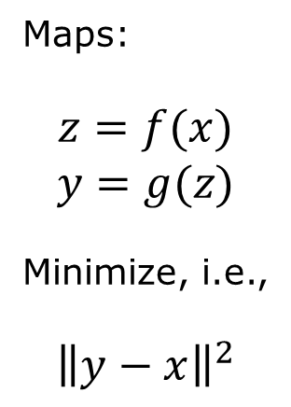





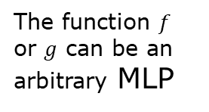









Autoencoder
Maps:
$$z=f(x)$$
$$y=g(z)$$
Minimize, i.e.,
$${\left\|y−x\right\|}^{2}$$
$$x \underset{→}{encode} z \underset{→}{decode} y$$
$${ x}_{1}$$
$${ y}_{1}$$
$${ x}_{2}$$
$${ z}_{1}$$
$${ y}_{2}$$
$${ x}_{3}$$
$${ z}_{2}$$
$${ y}_{3}$$
$$⋮$$
$$⋮$$
$${ z}_{M}$$
$$⋮$$
$${ x}_{D}$$
$${ y}_{D}$$
The function $f$ or $g$ can be an arbitrary MLP
$$D≫M$$
Notes:
The use: z = f(x) as a dimension reduction method.

Slide 3
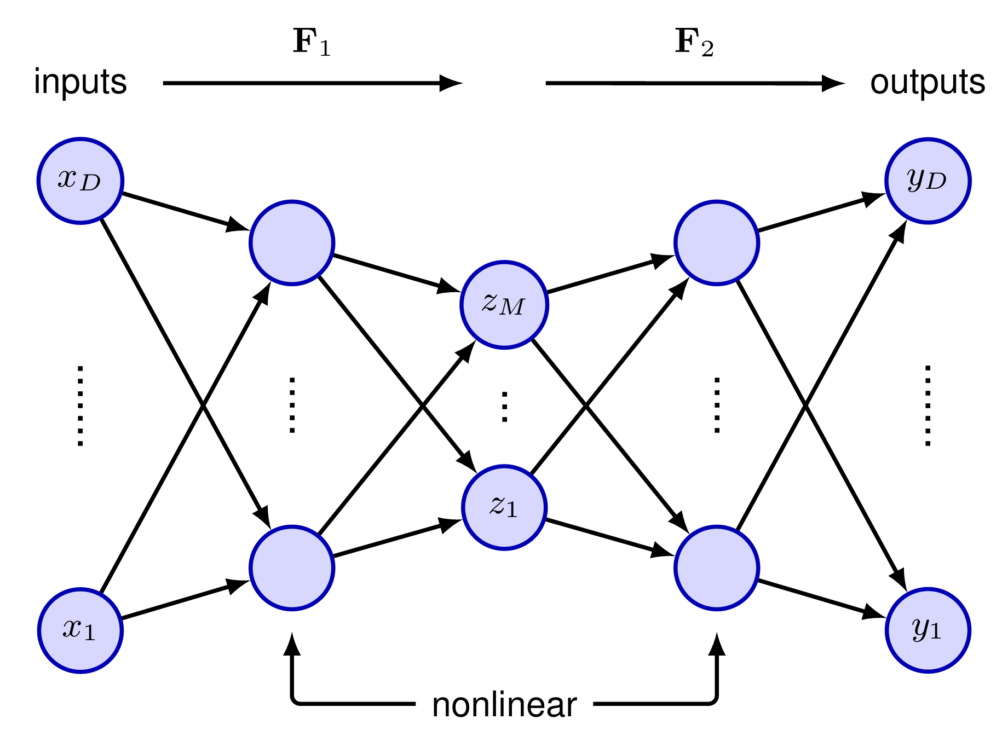
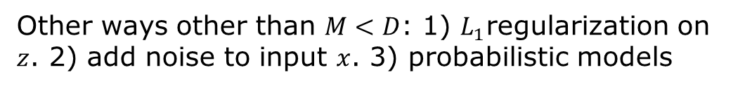
General autoencoder
Bishop, Figure 19.2 Adding extra hidden layers of nonlinear units produces an auto associative (autoencoder) network, which can perform a nonlinear dimensionality reduction.
Other ways other than $M<D$: 1) $L_{1}$regularization on $z$. 2) add noise to input $x$. 3) probabilistic models

Slide 4
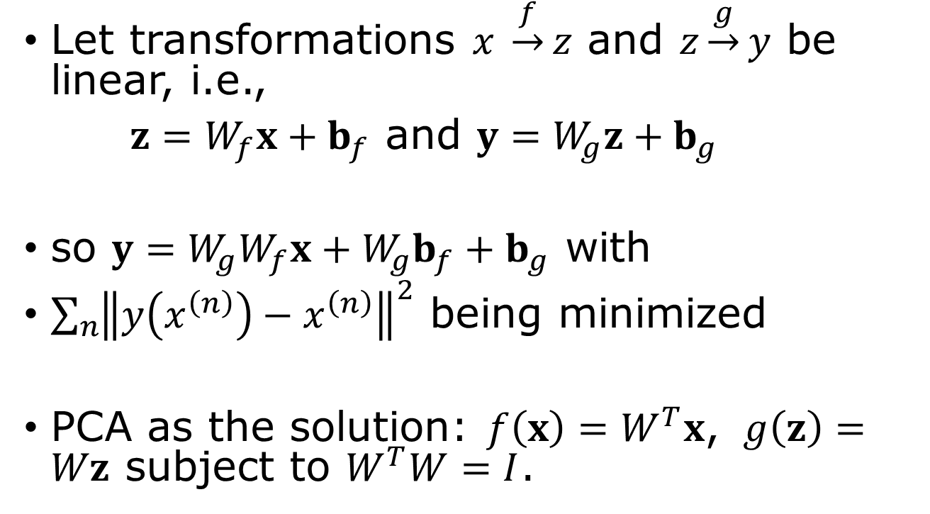
Encoder as principal component analysis
Let transformations $x$ $\underset{→}{f}z$ and $z\underset{→}{g}y$ be linear, i.e.,
$z=W_{f}x+b_{f}$ and $y=W_{g}z+b_{g}$
so $y=W_{g}W_{f}x+W_{g}b_{f}+b_{g}$ with
$\sum_{n}{{\left\|y\left(x^{\left(n\right)}\right)−x^{\left(n\right)}\right\|}^{2}}$ being minimized
PCA as the solution: $f\left(x\right)=W^{T}x$, $g\left(z\right)=Wz$ subject to $W^{T}W=I$.
Notes:
We require W_f = W_g^T, where W is an orthogonal matrix.

Slide 5
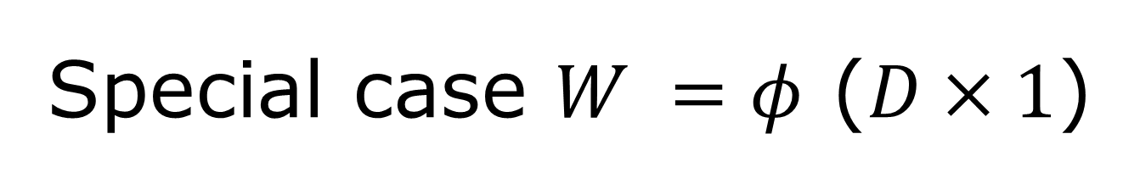
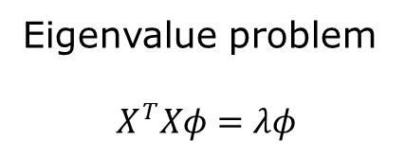
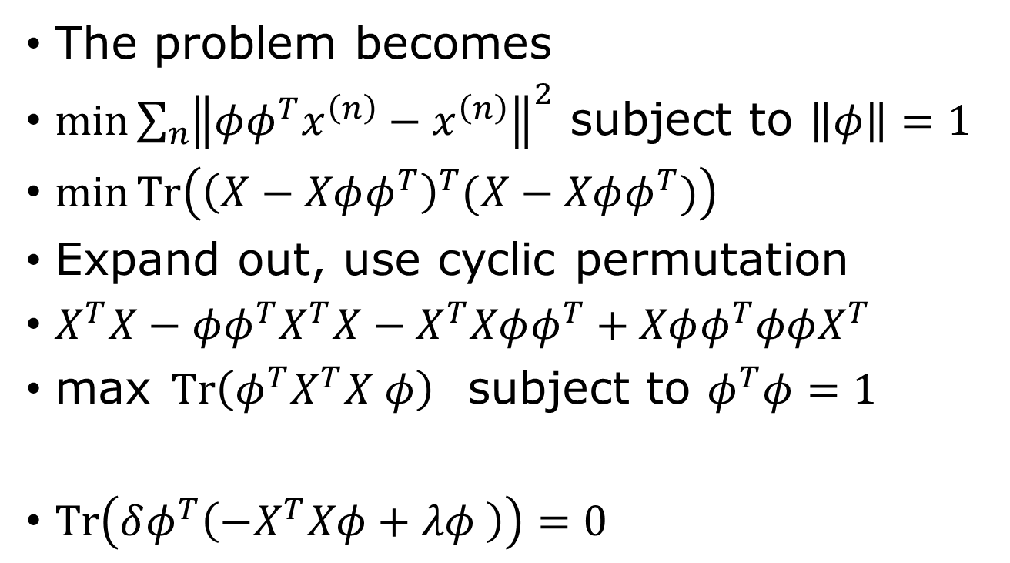
Special case $W =φ$ ($D×1$)
The problem becomes
$\min{\sum_{n}{{\left\|φφ^{T}x^{\left(n\right)}−x^{\left(n\right)}\right\|}^{2}}}$ subject to $\left\|φ\right\|=1$
$\min{Tr\left({\left(X−Xφφ^{T}\right)}^{T}(X−Xφφ^{T})\right)}$
Expand out, use cyclic permutation
$X^{T}X−φφ^{T}X^{T}X−X^{T}Xφφ^{T}+Xφφ^{T}φφX^{T}$
max$Tr\left(φ^{T}X^{T}X φ\right)$ subject to $φ^{T}φ=1$
$Tr\left(δφ^{T}\left(−X^{T}Xφ+λφ \right)\right)=0$
Eigenvalue problem
$$X^{T}Xφ=λφ$$
Notes:
See page 50 in Bengio. Here we assume the value is centered, i.e., sum_n x^(n) = 0.

Slide 6
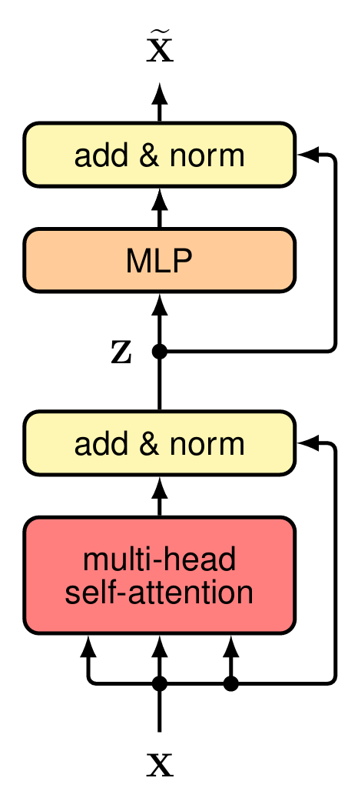
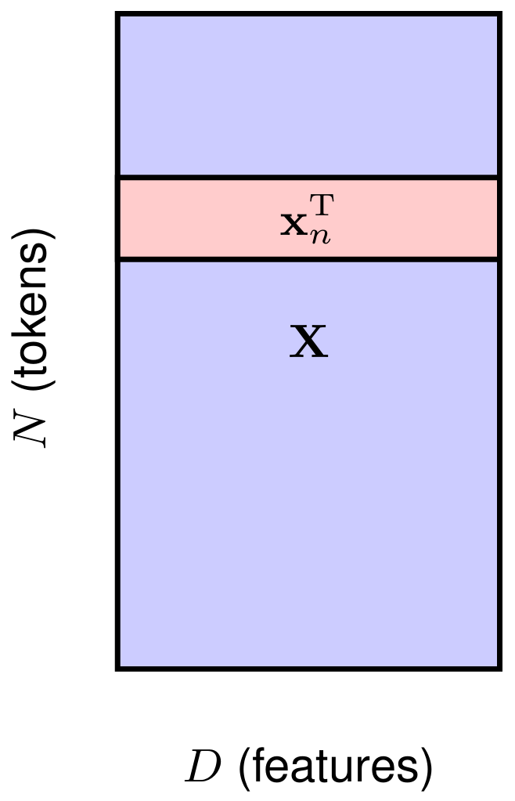
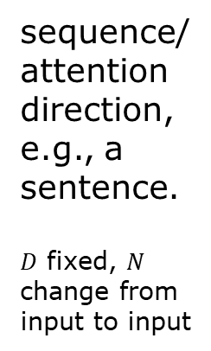
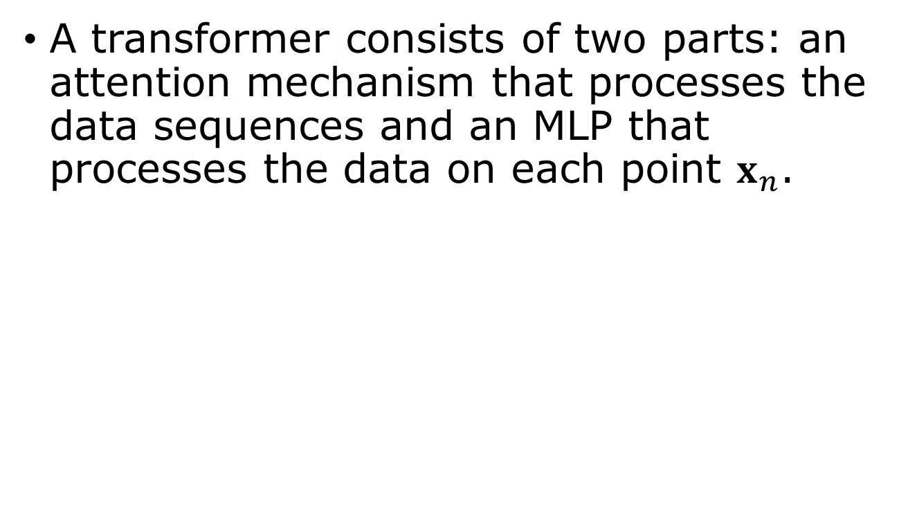
Transformer
A transformer consists of two parts: an attention mechanism that processes the data sequences and an MLP that processes the data on each point $x_{n}$.
sequence/attention
direction, e.g., a sentence.
$D$ fixed, $N$ change from input to input
Notes:
Chapter 12 of Bishop, “Deep Learning”.

Slide 7
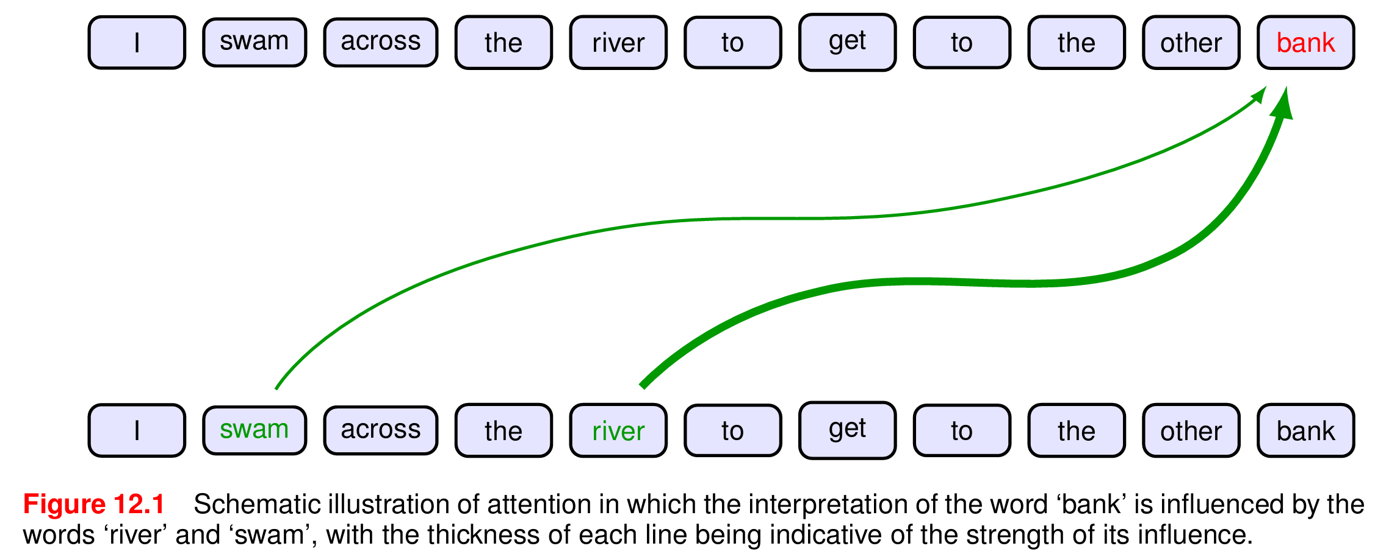
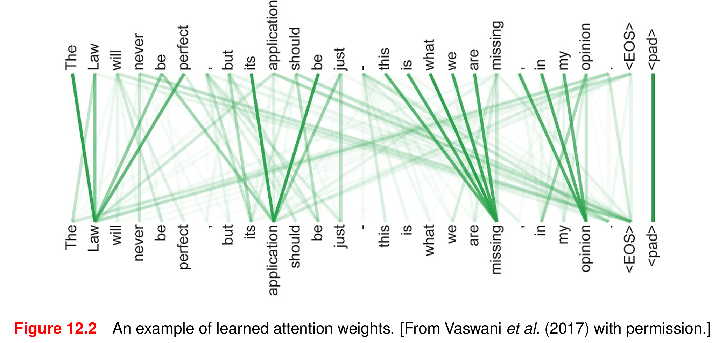
Attention
Compare: I walked across the road to get cash from the bank.

Slide 8
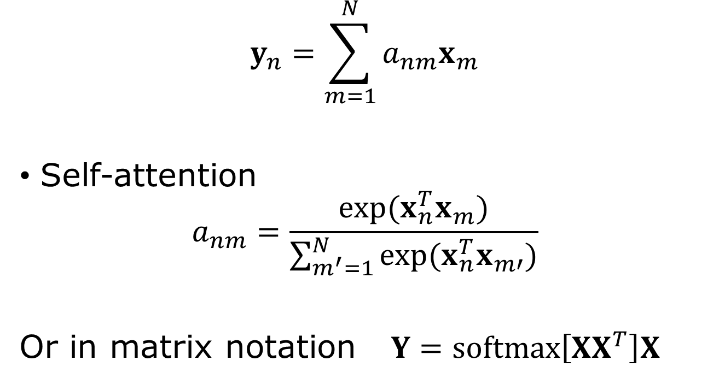
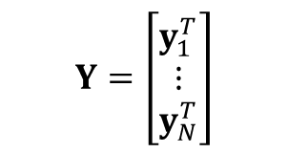
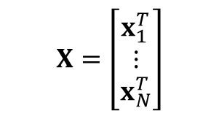
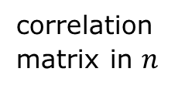
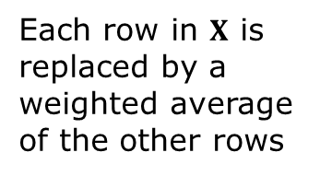
Attention
$$Y=\left[\begin{matrix}y_{1}^{T} \\ ⋮ \\ y_{N}^{T}\end{matrix}\right]$$
$$y_{n}=\sum_{m=1}^{N}{a_{nm}x_{m}}$$
Self-attention
$$a_{nm}=\frac{\exp{(x_{n}^{T}x_{m})}}{\sum_{m^{′}=1}^{N}{\exp{(x_{n}^{T}x_{m′}})}}$$
Or in matrix notation $Y=softmax\left[XX^{T}\right]X$
Each row in $X$ is replaced by a weighted average of the other rows
$$X=\left[\begin{matrix}x_{1}^{T} \\ ⋮ \\ x_{N}^{T}\end{matrix}\right]$$
correlation matrix in $n$
Notes:
The softmax is in the direction of m, or row on x_n^T x_m. The weights a_nm >= 0, sum_m a_nm = 1.

Slide 9
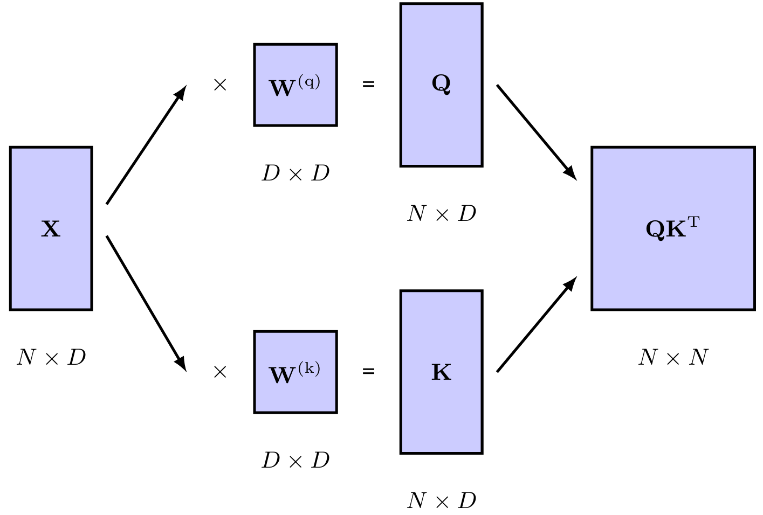
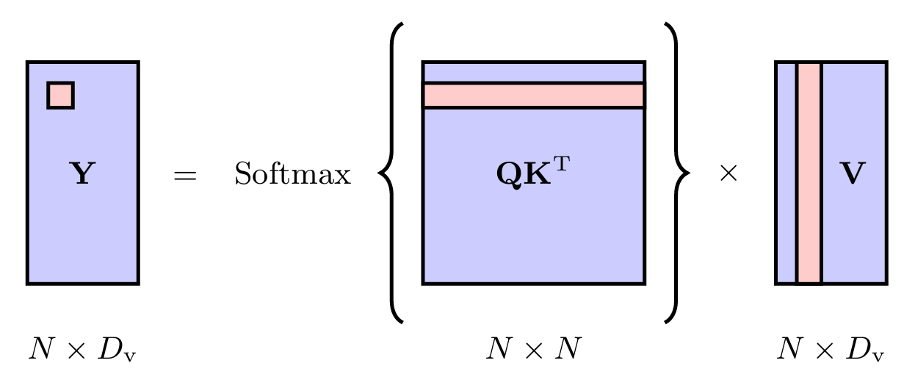
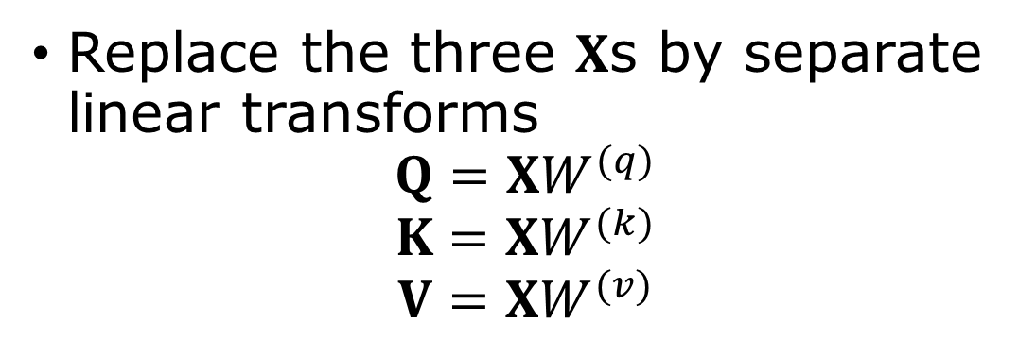
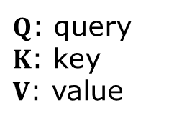
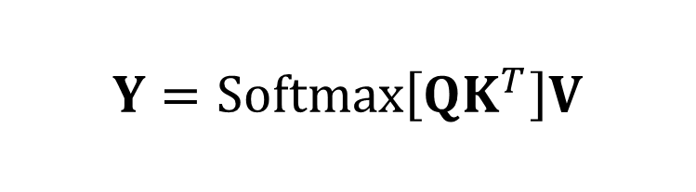
Learning
$Q$: query
$K$: key
$V$: value
Replace the three $X$s by separate linear transforms
$$Q=XW^{(q)}$$
$$K=XW^{(k)}$$
$$V=XW^{(v)}$$
Softmax along row
$$Y=Softmax\left[QK^{T}\right]V$$
Figs 12.4, 12.5 from Bishop, “Deep Learning”
Notes:
Querry: Which other words in the sentence should I pay attention to? Key: Think of this as a label or index for every word in the sentence: value: actual informational content of the word

Slide 10
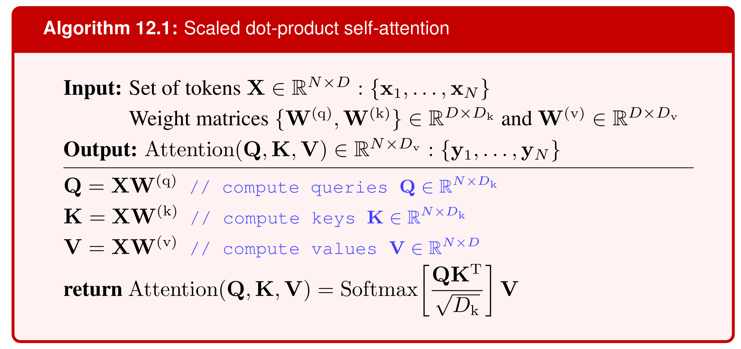
Scaled dot-product self-attention
Bishop, page 367.
Why do we need to scale by $\sqrt{D_{K}}$ ?

Slide 11
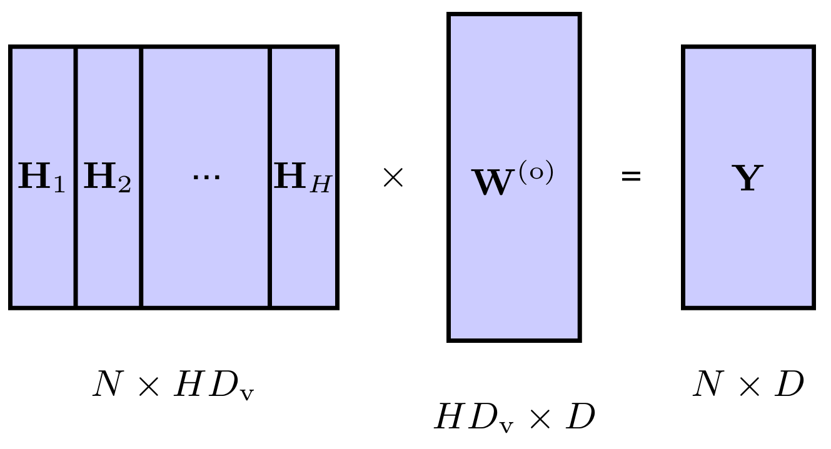
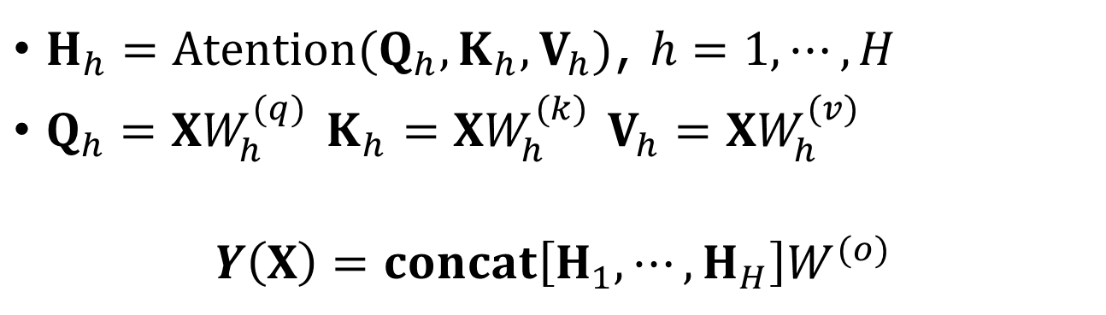
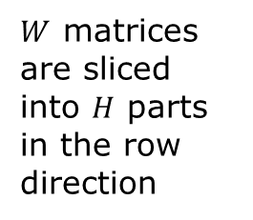

Multi-head attention
$H_{h}=Atention(Q_{h},K_{h},V_{h})$, $h=1,⋯,H$
$Q_{h}=XW_{h}^{(q)}$ $K_{h}=XW_{h}^{(k)}$ $V_{h}=XW_{h}^{(v)}$
$$Y\left(X\right)=concat\left[H_{1},⋯, H_{H}\right]W^{(o)}$$
$W$ matrices are sliced into $H$ parts in the row direction
$$D_{v}=D/H$$

Slide 12

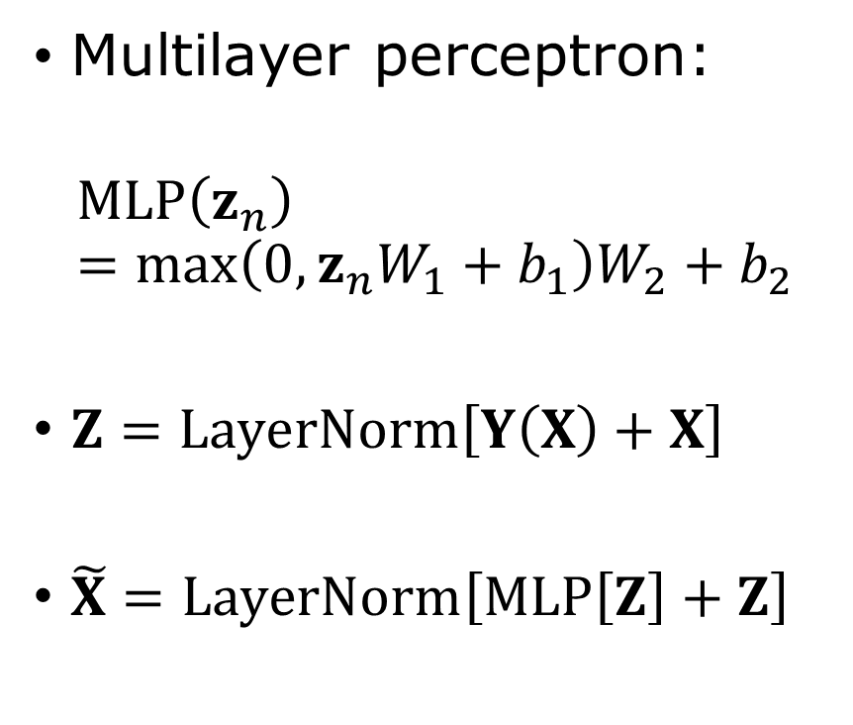

Add & norm
Multilayer perceptron:
$$MLP\left(z_{n}\right)=\max\left(0,{z_{n}W}_{1}+b_{1}\right)W_{2}+b_{2}$$
$Z=LayerNorm\left[Y\left(X\right)+X\right]$
$\tilde{X}=LayerNorm\left[MLP\left[Z\right]+Z\right]$
$$Y$$
What is LayerNorm?
Notes:
See slide 18 for the CNN week 8.

Slide 13
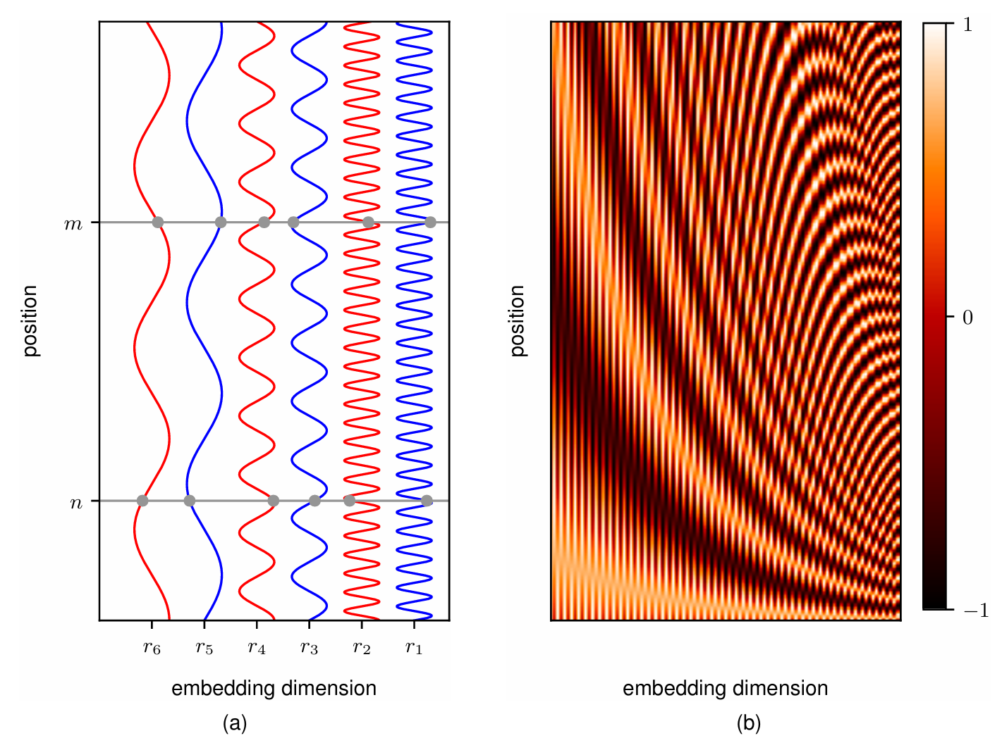
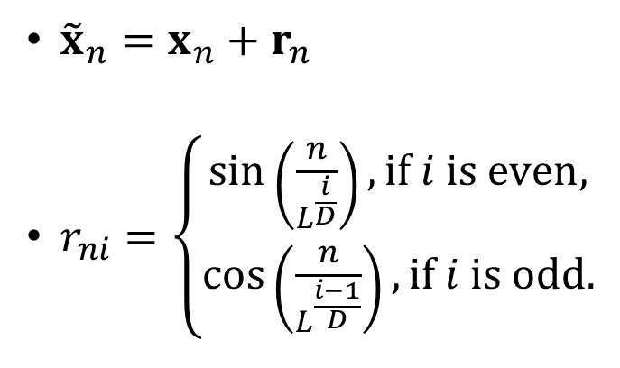


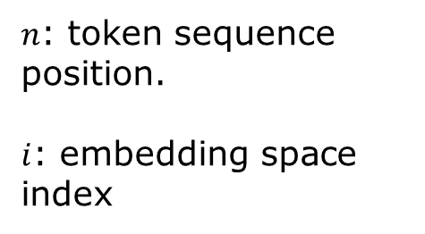
Position encoding
From Fig.12.10, page 373 of Bishop, “Deeping learning.”
${\tilde{x}}_{n}=x_{n}+r_{n}$
$r_{ni}=\left\{\begin{matrix}\sin\left(\frac{n}{L^{\frac{i}{D}}}\right), if i is even, \\ \cos\left(\frac{n}{L^{\frac{i−1}{D}}}\right), if i is odd.\end{matrix}\right.$
$$n$$
$n$: token sequence position.
$i$: embedding space index
$$i$$

Slide 14
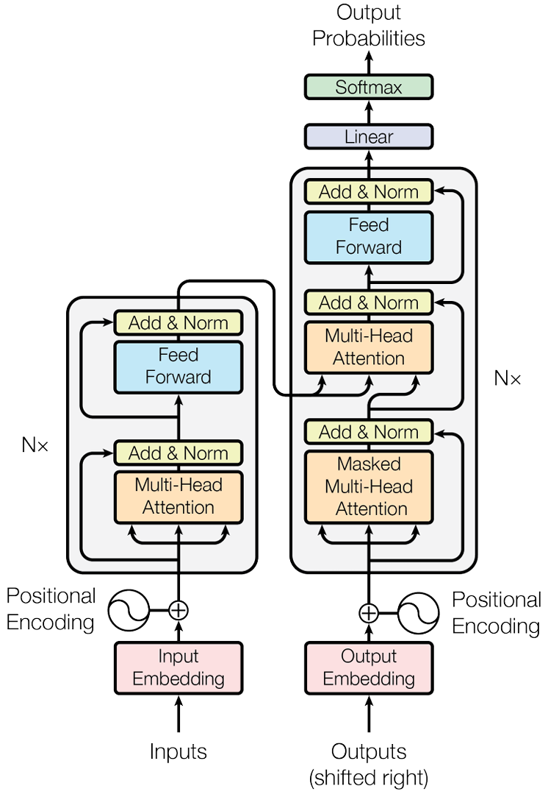
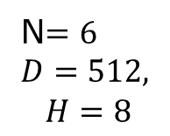



Machine translation
arXiv:1706.03762,
Vaswani, et al.
Masked attention
$$z$$
Ich
gene
gerne
Joggen
<end>
N$=6$
$$D=512,$$
$$H=8$$
outputs
$$K V$$
$$Q$$
<start> Ich gehe gerne joggen
inputs
“<start> Ich gehe gerne joggen <end>”
“<start> I like to run <end>”

Slide 15
Pytorch transformer
Torch.nn.Transformer – “Attention is All You Need.” version
class torch.nn.Transformer(d_model=512, nhead=8, num_encoder_layers=6, num_decoder_layers=6, dim_feedforward=2048, dropout=0.1, activation=<function relu>, custom_encoder=None, custom_decoder=None, layer_norm_eps=1e-05, batch_first=False, norm_first=False, bias=True, device=None, dtype=None)

Slide 16
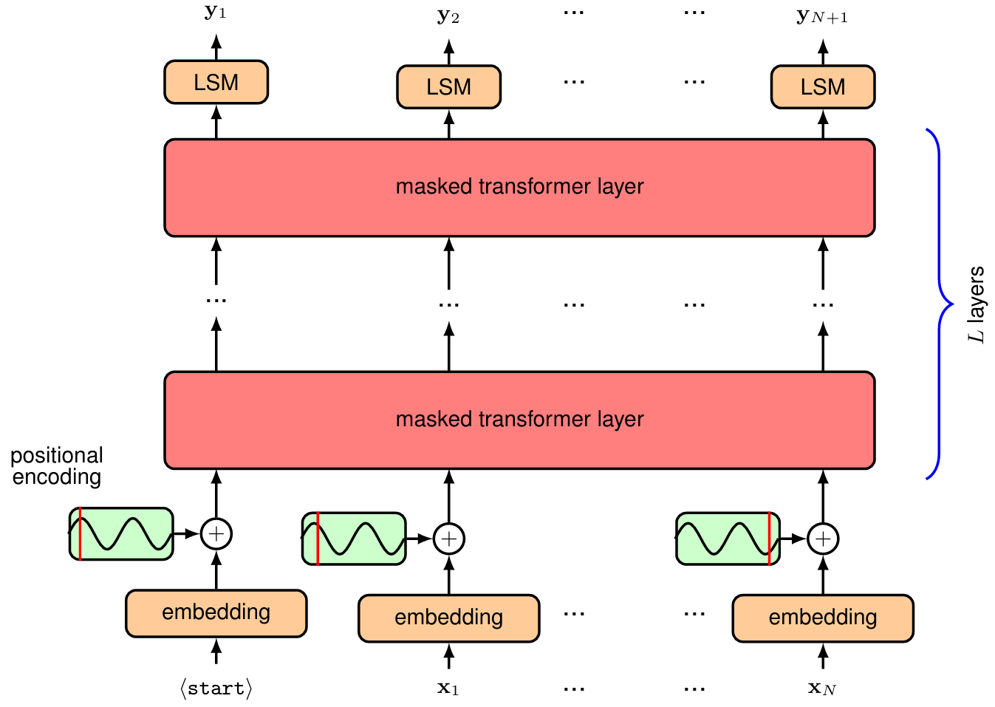
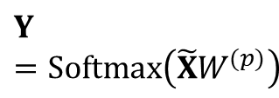
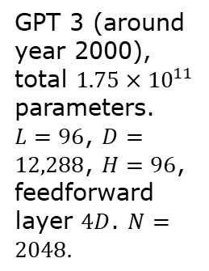
GPT (generative pretrained transformer)
$$Y=Softmax\left(\tilde{X}W^{(p)}\right)$$
GPT 3 (around year 2000), total $1.75×{10}^{11}$ parameters. $L=96$, $D=12,288$, $H=96$, feedforward layer $4D$. $N=2048.$
Fig. 12.15, Bishop

Slide 17
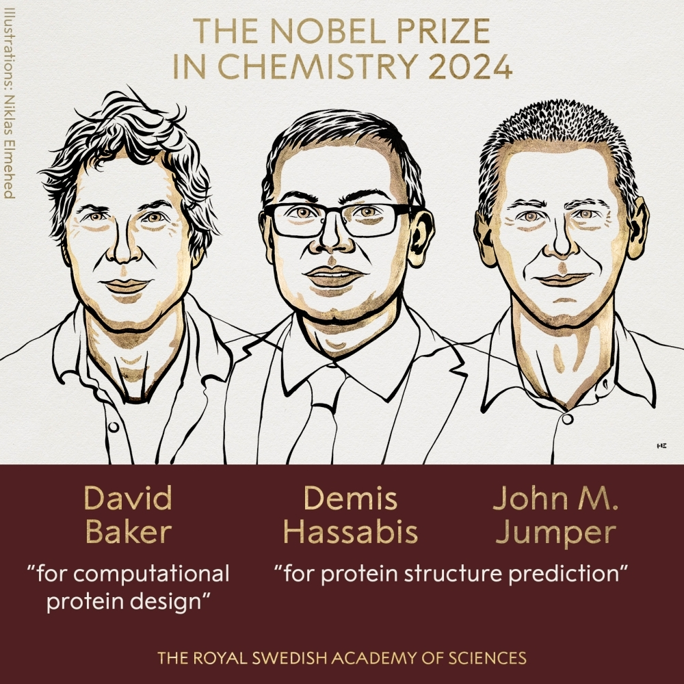
Alpha-Fold
AlphaFold is an artificial intelligence (AI) software developed by Demis Hassabis and John Jumper at Google DeepMind, who were awarded the Nobel Prize in Chemistry in 2024 for their work on protein structure prediction.

Slide 18
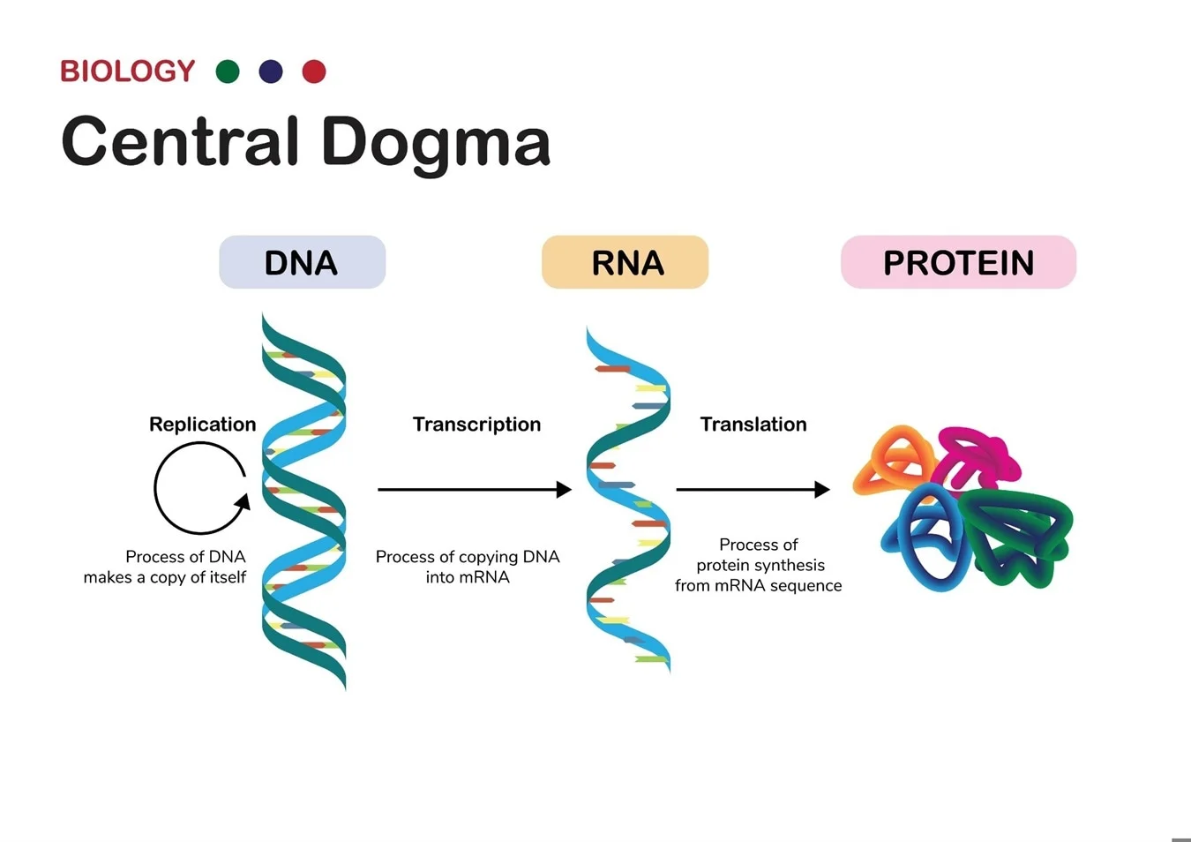
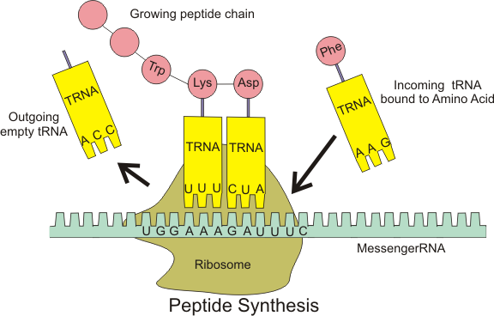
DNA, mRNA, and protein
DNA: A,C,G,T
mRNA: A,C,G,U
https://www.azolifesciences.com/article/A-Guide-to-Protein-Creation-From-DNA-to-Function.aspx
20 types of amino acids build proteins

Slide 19
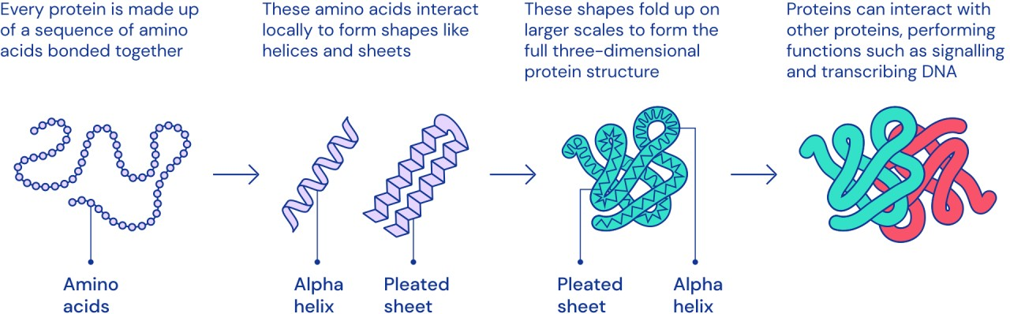
Protein folding
https://www.linkedin.com/pulse/why-protein-folding-big-deal-balasundararaman-sundar-

Slide 20
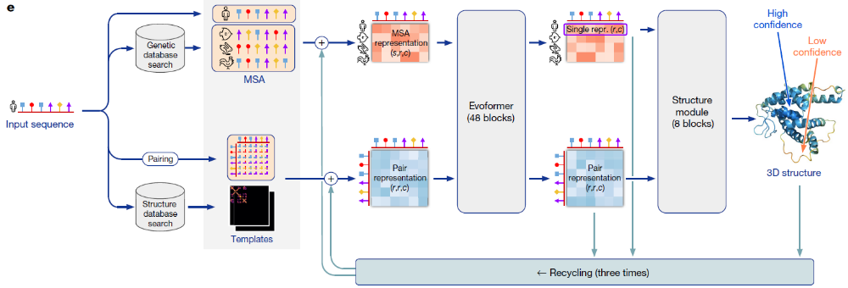
Alphafold architecture
10⁸ protein structures predicted
Mutiple sequence alignment
amino acid sequence
Key concepts: token, self-attention, transformer, gate, layernorm, representation learning, diffusion, …
Output is recycled to input (recurrent)
https://elanapearl.github.io/blog/2024/the-illustrated-alphafold/

