Slide 1
Numerical Recipes
The Art of Scientific Computing
(with applications in computational physics)
Notes:
A level 5000 module based on “Numerical Recipes in C, the art of scientific computing”, 2nd edition, by W H Press, S A Teukolsky, W T Vetterling, and B P Flannery. A soft copies of the slides are available at https://phyweb.physics.nus.edu.sg/~phywjs/CZ5101/cz5101.html

Slide 2
Computer Architecture
CPU
Memory
von Neumann architecture: both data and instructions are stored in memory.
External Storage
Notes:
For a more extensive discussion, see standard textbooks, e.g., D A Patterson & J L Hennessy, “Computer Organization & Design”.

Slide 3
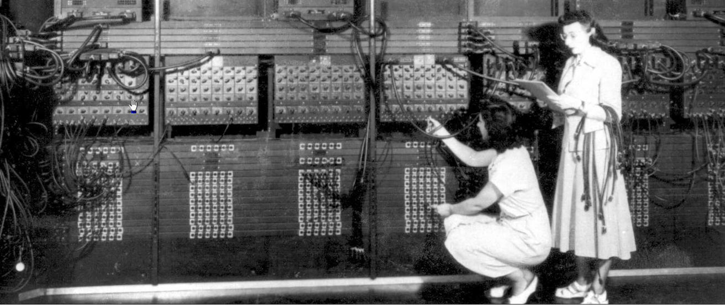
Programming a computer
~ 1950s

Slide 4
Compiled vs Interpreted programming languages
Compiled
Interpreted
Fortran, C, C++, …
Advantage: fast execution, efficient, detailed control
Disadvantage: slow/difficult code development
MATLAB, Mathematica, Python, …
Advantage: ease of use, immediate feedback
Disadvantage: typically slow, catches some errors only at run time
Notes:
There are many books on C, e.g., B W Kernighan and D M Ritchie, “the C Programming Language”, 2nd. edition. Or S. P. Harbison and G. L. Steele, Jr. “C: A Reference Manual” 5th ed.

Slide 5
Install Python
https://www.anaconda.com/download/success
Choose your OS (Windows, Mac, or Linux)
Download the distribution graphical installer
Advantage: you get jupyter notebook, numpy, as well as many other packages

Slide 6
First Python Example
# This program prints hello
#
print("hello, world!")
x = 1
y = 2
z = x + y
print(x, "+", y, "=", z)
How to run the script?
Press shift-enter on jupyter notebook cell.
Notes:
For Python, see for example, E. Matthes, “Python crash course”, 2nd edition. Or B. Lubanovic, “Introducing Python”. IDLE: integrated development and learning environment.

Slide 7
Data Types
booleans (True or False)
integers: 42, 1000, 2**100
floats: pi = 3.14159
complex: z = 1.0 + 2.5j
string, four ways: single quote, 'like', double quote, "open or close", or triple quotes, """this""", or '''this and that is in "a" la'''
Notes:
j is used as the complex units, you can type 1j for sqrt(-1), but not j alone.

Slide 8
Name of a Variable
The name serves as a handle to refer to the data (boolean, integer, etc)
The name is case sensitive, cannot start with a digit. Special character underscore can be used:
a, a1, A, x_result

Slide 9
Reserved words cannot be used as ordinary variables
False
None
True
and
as
assert
break
class
continue
def
del
elif
else
except
finally
for
from
global
if
import
in
is
lambda
nonlocal
not
or
pass
raise
return
try
while
with
yield
Notes:
Reserved words are also known as keywords.

Slide 10
Equal is not equal
x = 10 is not 10 = x
x = x + 1 make no sense if it is math
x = a + b OK if a and b have been defined earlier, but a+b = x is not.
In general, left side of ‘=’ refers to memory location, right side expression can be evaluated to numerical values

Slide 11
Expressions
Expressions can be formed with +, -, *, / with the usual meaning
Use parentheses ( …) for evaluation order, e.g., (a+b)*c
Special operators: // integer division, % modulus (remainder), ** exponentiation
a += b, is the same as a = a+b, etc.
Logical operators, ==, !=, <, <=, >, >= and, or, not, in

Slide 12
Bitwise operations
|, &, ^, ~ : bitwise or, and, exclusive or, and not. <<, >>: left shift and right shift.
Examples:
5 | 1 -> 5 5 -> 101₂
5 & 1 -> 1 1 -> 001₂
5 ^ 1 -> 4
~5 -> -6
5 << 1 -> 10
5 >> 1 -> 2

Slide 13
Control Structures - loop
for j in range(0,10,1):
print(j)
n = 1
while n < 10:
print(n)
n *= 2
0, 1, 2, …, 9 are printed.
The colon ‘:’ start of the structure
Important: indentation serves the purpose of grouping, like the { … } pair in C, or begin/end in Pascal.
Notes:
The range(…) is an “range” object.

Slide 14
Control Structure - conditional
if b > 3:
a = 1
n =1
if n < 1000:
n *= 2
else:
n = 0
The colon : are needed after structure control key words, such as for, while, if, else, def etc.
Correct indentation important here.

Slide 15
Control Structure – break, continue, else
while True:
...
if … :
break
...
else:
...
Opposite of break is continue.

Slide 16
Structured Data Type - List
a=[1,2,3]
defines elements a[0],a[1],a[2] to be 1, 2, and 3.
y=[a,”we”,3.14]
The member of elements does not have to be of the same type. A list can contain a list. So y[0] is a, and y[0][0] is 1.
Index in [ ] starts from 0, just like in C.
Notes:
The C compiler cannot check if the array is out-of-bound. Fortran is much better in array processing. Python is “foolproof”.

Slide 17
List “processing” method
Slice of the list using [start:stop:step]
append() : add an item at the end
+= : combine two lists.
insert(i,item) : insert at offset i
pop() : get then delete (the last) entry
index() : find an item offset
sort() : sort the items
copy() : make a copy of the list
Use list method with the dot notation, e.g.,
a.pop( )

Slide 18
Tuples and Dictionaries
t=(1,2,3)
defines tuple with elements 1, 2, and 3. It is the same as list except the values cannot be changed. It behaves like a constant list.
d={"A":1, "B":2, "C":3}
Dictionary consists of list of key:value pair. The value is referred to by the key, e.g., d["A"] gives 1.
Notes:
There is also data structure called set. It is a dictionary without value. See next slide. Tuple [tjupl]

Slide 19
Set: dictionaries without value
s={"A","B","C"}
Set operations: & set and, | set or, <=, <, subset of (proper subset of)
Using in to test membership of set.
Notes:
What is the difference between a set and list in mathematical sense?

Slide 20
Use Packages
import math
theta = 0.5*math.pi
x = math.sin(theta)
y = math.sqrt(x)
z = math.log(y)
print(theta,x,y,z)
Other standard packages or modules in Python includes cmath, os, datetime, etc.
Notes:
The import key word loads a module, it is just another file contains python script.

Slide 21
Define Functions
def my_print():
'''Just say hello'''
print("Hello from my print!")
def square(x):
return (x*x)
def sum(a,b):
c = a+b
return c
x = 1.0
y = 2.0
my_print()
print(square(y))
z=sum(x,y)
print(x,y,z)
Docstring: Use ''' …''' to document the function, and help(name) to view the documentation.

Slide 22
Function argument types
Set default value by arg = value
Call with key words
Variable number of parameters with *arg
Variable number of keyword arguments with **arg
E.g.:
def func(a,b=“0”)
def func(*a)
def func(arg_a=1,arg_b=2)
Notes:
*arg passes a tuple to the function, while **arg passes a dictionary to the function.

Slide 23
Class
class particle():
def __init__(self, m, v):
self.mass=m
self.speed=v
def energy(self):
return (0.5*self.mass* \
self.speed**2)
P1 = particle(m=1.0,v=0.5)
P1.mass
P1.energy()
define variables or attributes
define methods
Notes:
Backslash \ continues the line.

Slide 24
Inheritance
class spherical_particle(particle):
def __init__(self,m,v,r):
super().__init__(m,v)
self.radius = r
def print_info(self):
print(“mass =“, self.mass, “ speed = “, \
self.speed, “ radius =“, self.radius)
ball = spherical_particle(1.0, 0.5, 0.01)
ball.print_info()
ball.mass
Use the parent initialization method
Notes:
Backslash \ is line continuation.

Slide 25
Use Files
import math
filepath = "oscillator.eps"
log ="test"
fp = open(filepath, "w")
fp.write("%!PS Adobe 2.0\n")
# we trace of the shape of ellipse
b = 100
a = math.sqrt(2.0)*b
x = a
y = 0.0
fp.write("%f %f moveto\n" % (x,y))
fp.write("0.0 120.0 lineto stroke\n")
fp.write("closepath")
fp.close()
open(…) function returns a file object.
write(…) method is used to write to a file. Or use print(…,file=fp)
Finally, file is closed with the close(…) method.

Slide 26
Call by Value vs Call by Reference
a copy of the value is passed to a function argument for number. But reference is passed for a list.
def passnumber(a):
a = a + 1
print("in passnumber function, a=", a)
b = 1
passnumber(b)
print(b)
b is still 1 outside function
def listfun(mylist):
mylist[0] = 10
print("in listfunc, list=", mylist)
List = [1,2,3]
listfun(list)
print(list)
list is updated to [10,2,3]
Notes:
Ans: i is still 1, unaffected by the function call. A[0] becomes 2, because address associated with A[0] is passed to the function.

Slide 27
Computer Representation of Numbers
Unsigned or two’s complement integers (e.g., char in C)
0000 0000 = 0
0000 0001 = 1
0000 0010 = 2
0000 0011 = 3
0000 0100 = 4
0000 0101 = 5
0000 0110 = 6
. . .
0111 1111 = 127
1000 0000 = 128 or -128
1000 0001 = 129 or -127
1000 0010 = 130 or -126
1000 0011 = 131 or -125
. . .
1111 1100 = 252 or -4
1111 1101 = 253 or -3
1111 1110 = 254 or -2
1111 1111 = 255 or -1
Notes:
Two’s complement is completely equivalent to arithmetic modulo M, so i and i-M are equivalent, e.g., M=2^8=256 in the above.

Slide 28
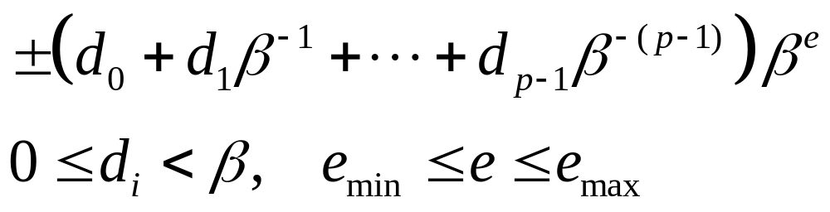
Real Numbers on Computer
Example for β=2, p=3, e_{min}= -1, e_{max}=2
ε
0 0.5 1 2 3 4 5 6 7
ε is called machine epsilon.
Notes:
Normalized number is d₀ > 0. (some books defines machine epsilon as half of the above).

Slide 29
IEEE 754 Standard (32-bit)
The bit pattern
represents
If e = 0: (-1)^{s}× f ×2⁻¹²⁶
If 0<e<255: (-1)^{s} ×(1+f) ×2^{e-127}
If e = 255 and f = 0: +∞ or -∞
or f ≠ 0: NaN (not a number)
s
b₋₁
b₋₂
… …
b₋₂₃
e
f = b₋₁2⁻¹ + b₋₂2⁻² + … + b₋₂₃2⁻²³
Notes:
See also the code testieee.c at http://www.physics.nus.edu.sg/~phywjs/CZ5101/cz5101.html The latest standard is IEEE 754-2008.

Slide 30
10.1 in single precision float
Write 10.1 = b₃2³+b₂2²+b₁2¹+b₀2⁰+b₋₁2⁻¹+b₋₂2⁻²+…+b₋₂₄2⁻²⁴
10 = 1*8 + 0*4 + 1*2+0*1 => 1010₂
0.1 = b₋₁1/2 + b₋₂1/4+ … find b₋₁ by multiplying 2 (repeatedly) and take the digit before the decimal point.
0.1 = 0.00011001100110011001100110…
Normalized form 10.1 = 1.01000011001100…× 2³
biased exponent e = 127 + 3 = 130 = 10000010
fractional part f = 0.01000011001100110011010
10.1₁₀ => 0 100,0001,0 010,0001,1001,1001,1001,1010
In hexadecimal notation: 4121999A
Note the rounding in the last bit
Notes:
To find 130 in binary, divide by 2 repeatedly, and take the remainder. Rounding to the nearest, when ties, to even (last bit is 0).

Slide 31
Error in Numerical Computation
Integer overflow (not happening in Python)
Round off error
  E.g., adding a big number with a small number, subtracting two nearby numbers, etc
  How does round off error accumulate?
Truncation error (i.e., discretization error)
  The field of numerical analysis is to control truncation error
Notes:
Catastrophic vs benign cancellation.

Slide 32
(Machine) Accuracy
Limited precision in floating point. We define machine ε as such that the next representable floating-point number larger than 1 is (1 + ε).
  ε ≈ 10⁻¹⁶ in Python (IEEE double precision)
Notes:
When a real number is rounded to the closest floating-point number, the relative error is always bounded by ε. Size of integers: char 1 byte, int, long int 4 bytes, long long it 8 bytes. 1 byte = 8 bits.

Slide 33
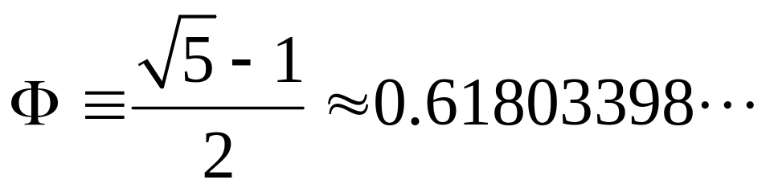
Stability
An example of computing Φ^{n}, where
We can compute either by
Φ^{n+1} = Φ^{n} Φ
or Φ^{n+1} = Φ^{n-1} – Φ^{n}
Results are shown in stability.py program
Notes:
The code is in stability.c Or stability.py in Python.

Slide 34
Reading Materials
“Numerical Recipes”, Chap 1.
“What every computer scientist should know about floating-point arithmetic”. Can be downloaded from http://perso.ens-lyon.fr/jean-michel.muller/goldberg.pdf
“Introducing Python’’, Lubanovic. See also https://docs.python.org/3/tutorial/index.html

Slide 35
Problems for Lecture 1 (Python programming, representation of numbers in computer, error, accuracy, and stability.)
1. Define a Python function to generate and print the first n Fibonacci numbers, based on the recursion, F₀=0, F₁=1, F_{n+1} = F_{n} + F_{n-1} (n=1, 2, 3, …). Also, print out the ratio F_{n-1}/F_{n}. Let n be a user input to the function!
2. (a) Study the IEEE 754 standard floating-point representation for 32-bit single precision numbers (float in C) and write out the bit-patterns for the float numbers 0.0, 1.0, 0.1, and 1/3. No need for programming.
(b) For the double-precision floating point representation (64-bit number), what is the exact value of the machine epsilon? What is the largest representable positive floating point number? Test your claim in Python.
3. From the recursion relation:
F _{n+1} = F_{n-1} – F_{n}
with F₀ and F₁ arbitrary, find the general solution F_{n}. Based on its solution, discuss why it is unstable for computing the power of golden mean Φ? (Hint: consider the trial solution of the form F_{n} = Ar^{n}. There are two solutions!).
Notes:
For bit patterns, instead of writing as 0 and 1, use hex notation, i.e., 0 to 9 uses decimal, 10 to 15 uses A, B, C, D, E, F.

