Slide 1
Chapter 16
Integration of Ordinary Differential Equations
Notes:
The chapter number refers to the book by Press at al, “Numerical Recipes”.

Slide 2
Examples of Differential Equations
ODE:
  Chemical reaction dynamics, dC/dt = -C
  Pressure change with height, dp/dy = -mgp/kT
  Newton’s equation of motion, F = m d²r/dt²
PDE:
  Maxwell’s equations for electricity and magnetism
  Elastic and fluid mechanics
  Schrödinger equation in quantum mechanics

Slide 3
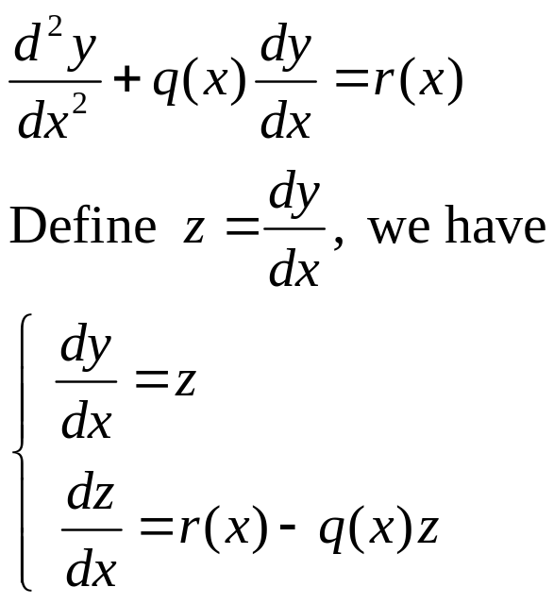
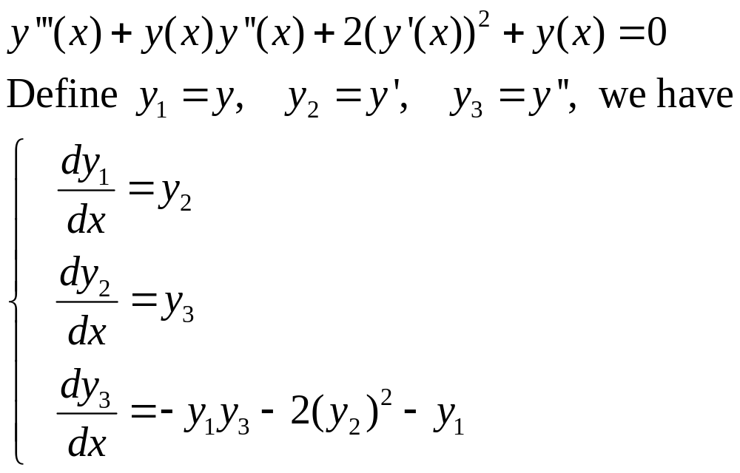
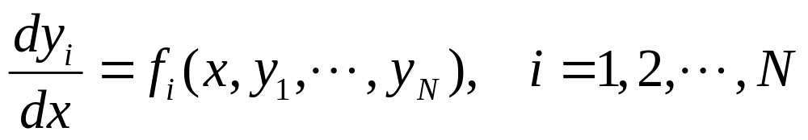
Reduce Higher order ODE to 1st Order
In general, it is sufficient to solve coupled first-order ordinary differential equations of the form
Notes:
Because higher derivatives can be eliminated by introducing new variables.

Slide 4

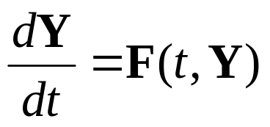
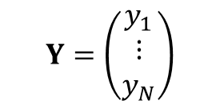
Initial Value Problem
It is convenient to consider the independent variable x as time t. The solution to the equations
is uniquely determined if the initial value at t=0, y_{i}(0), is given.
The equation can be written in vector form
$$Y=\left(\begin{matrix}y_{1} \\ ⋮ \\ y_{N}\end{matrix}\right)$$
Notes:
The solution exists and is unique provided the F function is smooth enough (continuous and their derivative are continuous). A more precise statement is the function f should be Lipschitz continuous, which means | f(x) – f(x’) | < K | x – x’|, where K >= 0 is finite. The Lipschitz condition apply to the variable y.

Slide 5
General Properties of Autonomous Systems
F(t,Y) = F(Y), independent of time t
The space spanned by Y (a set of all possible Y) is called phase space
F forms a vector field (a vector at each point Y)
y₂
Solution of dY/dt = F(Y) produces a parametric curve Y(t) in phase space.
Intersection of trajectories cannot happen, why?
F
y₁

Slide 6
Fixed Points
A location in phase space such that F(Y)=0.
Attractor, repellor
Saddle point or hyperbolic fixed point

Slide 7
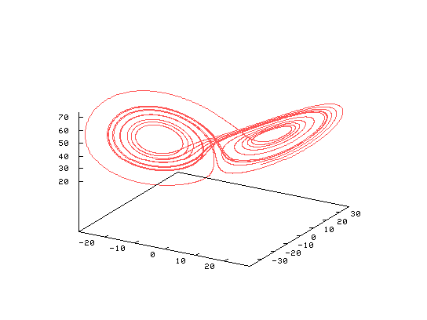
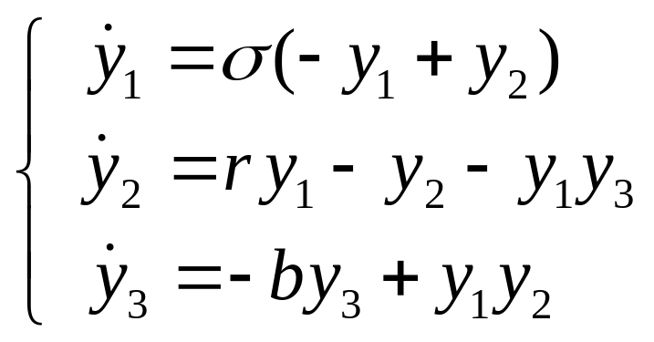
Chaos
Extremely sensitive to initial conditions [dY(t) = exp(λt)dY(0)]. E.g., Lorenz’s weather model:
y₃
y₂
y₁
Notes:
Lambda is called the Lyapunov exponent.

Slide 8
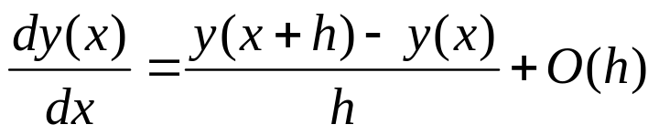
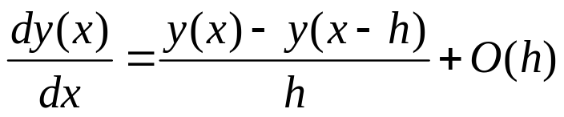
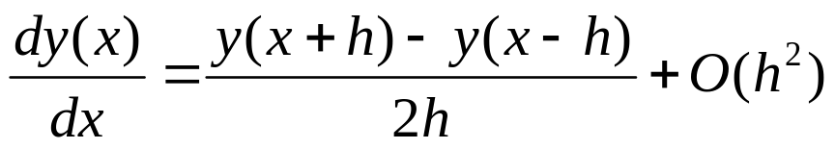
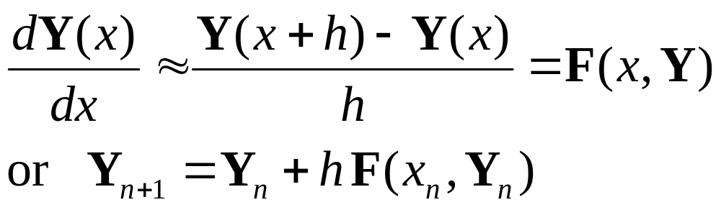
Finite difference
Forward difference:
Backward difference:
Central difference:
Euler Method:
Notes:
We set Y(nh) = Y_{n}, x_{n}=nh. See NR Chapter 5.7 for finite difference method for derivative.

Slide 9
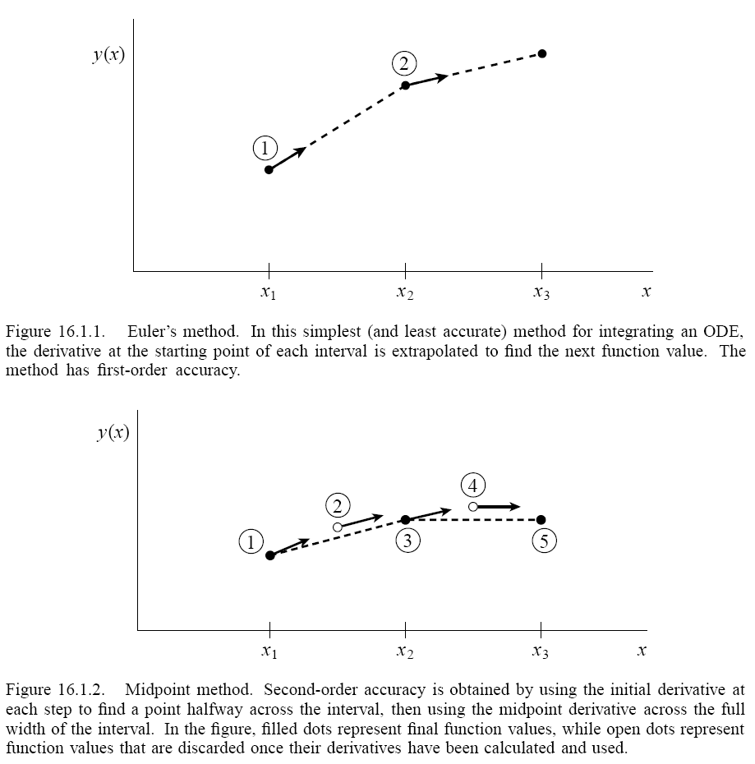
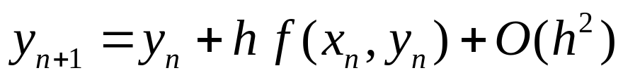
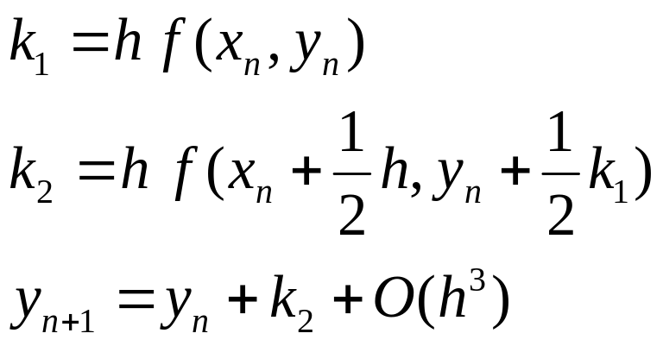
Euler and Midpoint
h

Slide 10
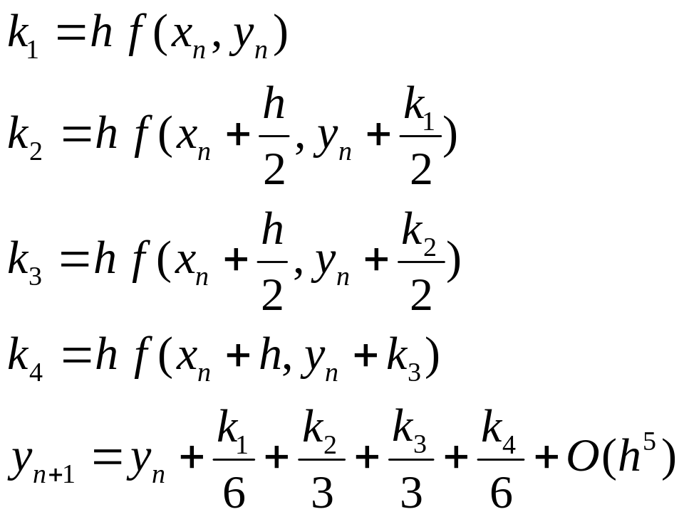
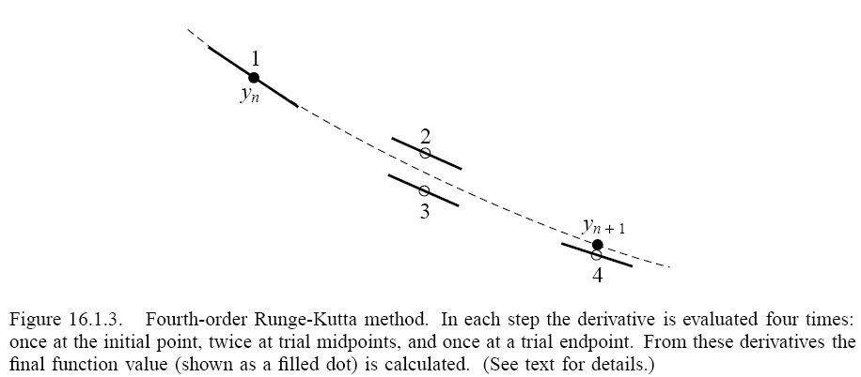
4-th Order Runge-Kutta Method

Slide 11
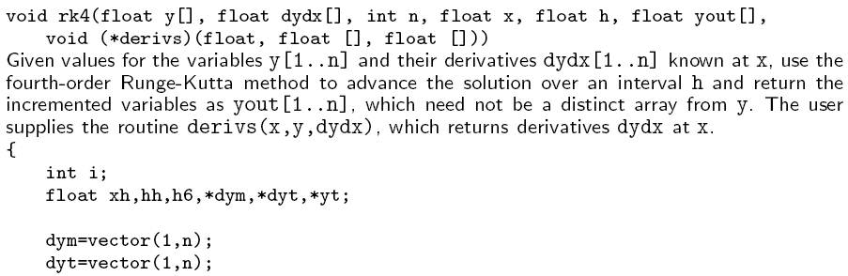
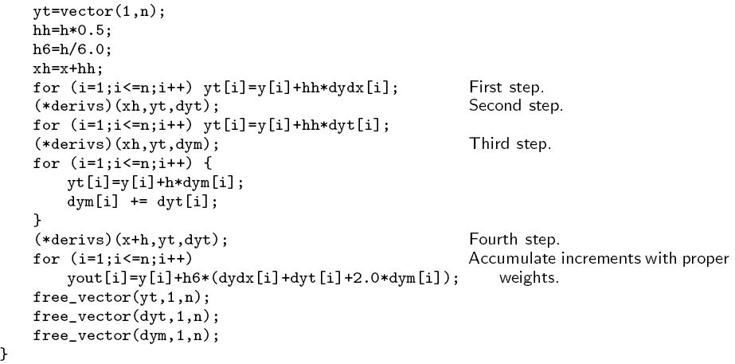
rk4( )
Python code for ODE
from scipy.integrate import ode
solver = ode(f).set_integrator(‘dopri5’)
solver.set_initial_value(y0,t0)
solver.integrate(t+dt)

Slide 12
Some General Concepts
Discretized equation, such as y_{n+1}=y_{n}+hf(x_{n},y_{n}), is consistent, if as h -> 0, it approaches the original differential equation
The error |y(x_{n+1})-y_{n+1}| =O(h^{k}) in one step from x_{n} to x_{n+1} is called local truncation error
The error |y(x)-y_{n}| for some finite x and initial condition y(0) = y₀ is the global error
The method is convergent if the global error goes to zero as h -> 0 and n -> ∞.

Slide 13
Adaptive Stepsize Control
Estimate local truncation error from the difference between one h step and two steps of h/2
Or difference of 4 and 5-th order Runge-Kutta
Increase h if the error is smaller than the tolerance, decrease h if the error is bigger than the tolerance. See NR p.721, odeint() for details.

Slide 14
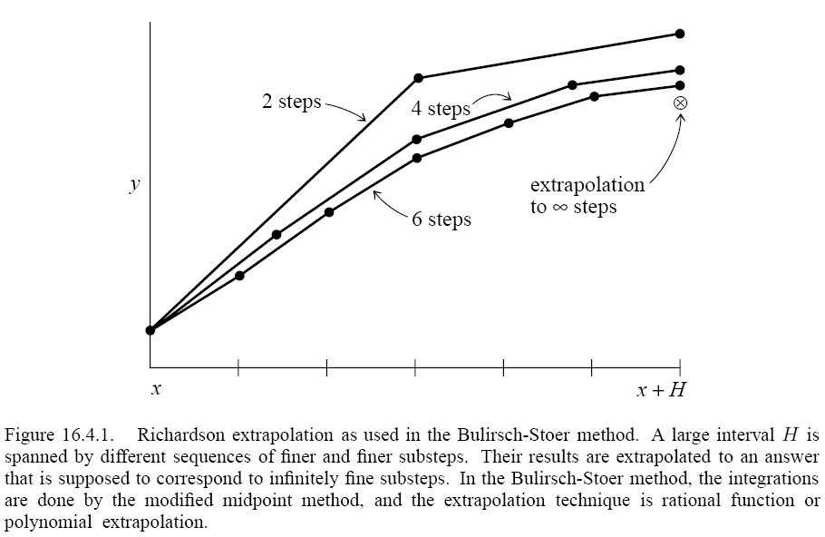
Richardson Extrapolation and Bulirsch-Stoer Method
Take a “large” step size H, consider the answer as an analytic function f(h) of h=H/n. Fit the function by polynomial or rational function interpolation. Choose a method (e.g., midpoint) such that f(h) is even in h. And finally extrapolate to h=0.

Slide 15
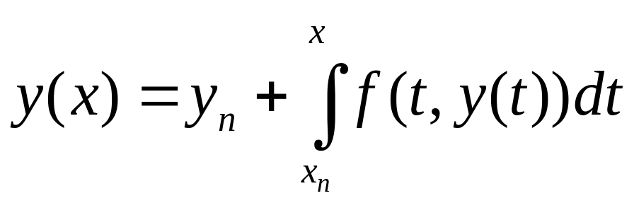
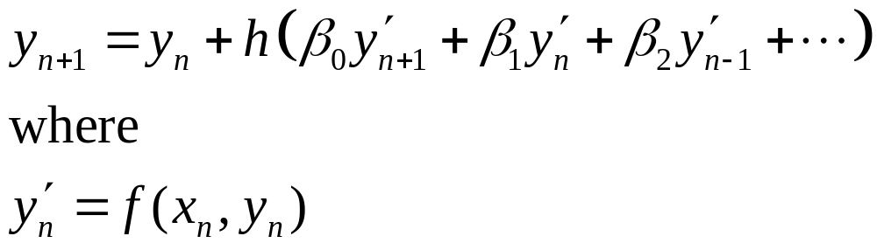
Multi-step, Explicit, Implicit, etc
Solving equation y’=f(x,y) is to compute
In general, this results in
Notes:
The integration can be discretized by, e.g., trapzoidal rule. Implicit means that the right-hand side also contain y_{n+1}. Multi-step means that y_{n+1} depends not only y_{n}, but also earlier steps.

Slide 16
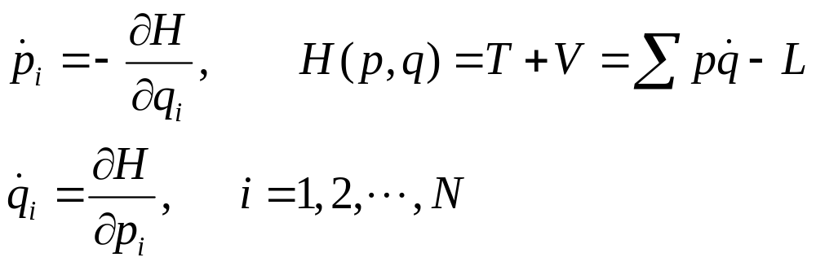
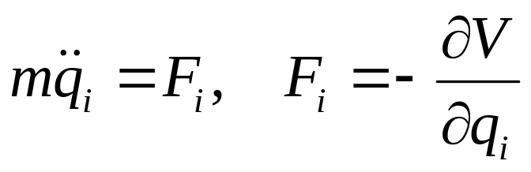
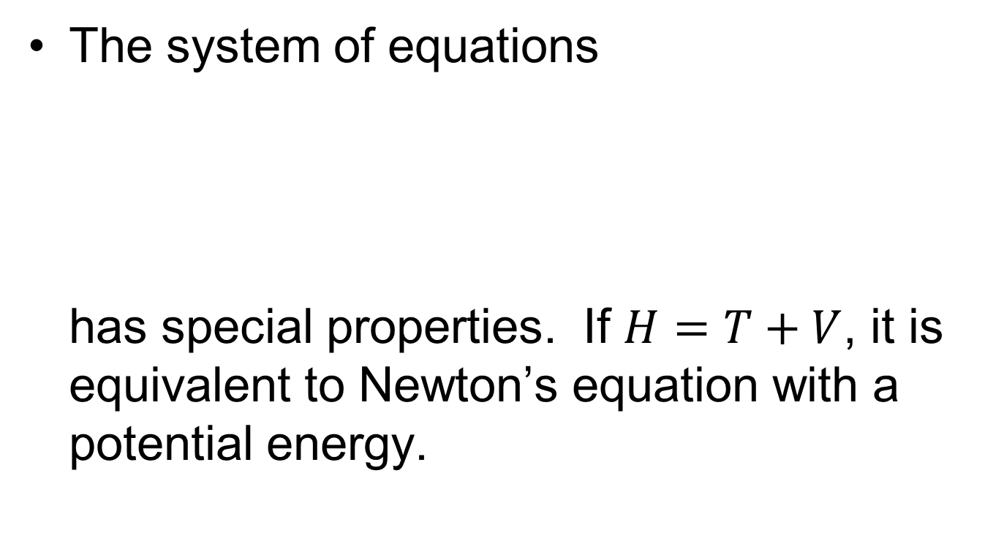
Hamiltonian System
The system of equations
has special properties. If $H=T+V$, it is equivalent to Newton’s equation with a potential energy.
Notes:
H is the Hamiltonian, T is kinetic energy, V is potential energy, L is the Lagrangian, and (p,q) are canonical conjugate pairs.

Slide 17
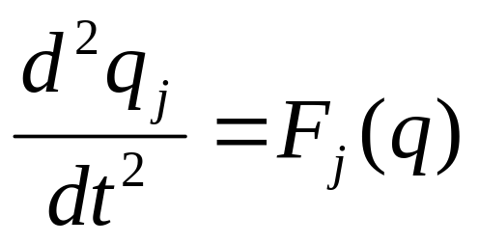
Verlet or Störmer Algorithm
Solve
by central difference
Show the error is O(h⁴)
Notes:
Verlet 1960s, but it has a long history.

Slide 18
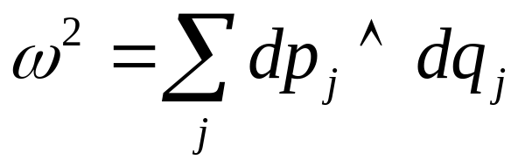
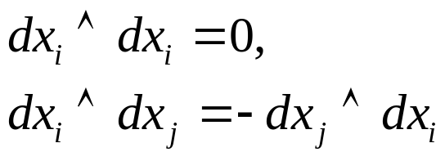
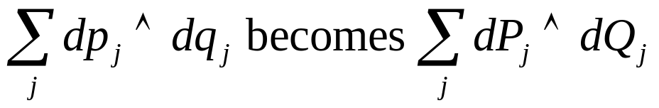
2-Form and Symplectics
The Hamiltonian dynamics, beside having a conserved energy, also has additional conserved quantities (ω²)^{n},n=1,2,..,N:
A canonical transform is a mapping from (p,q) to (P,Q) such that the form of ω² is the same. I.e.
wedge product:
Notes:
See, e.g., V.I. Arnold, “Mathematical Methods of Classical Mechanics”, 2nd Edition, Springer 1989.

Slide 19
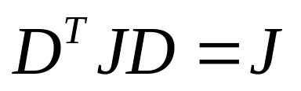
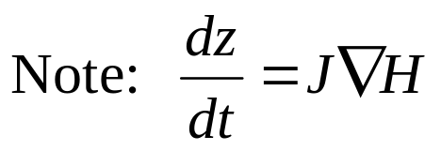
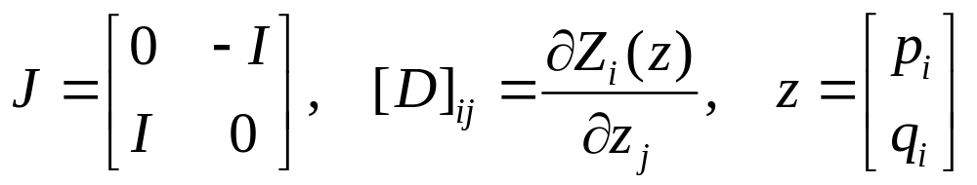
Canonical Transformation
Equivalent condition for canonical transform z to Z is
where
ω^{2N} means volume element in phase space – Hamiltonian dynamics preserves the volume – Liouville’s theorem.
Notes:
The canonical transform can be defined in several equivalent ways:
(0) The form of the Hamilton’s equation is the same z = J∂H/∂z -> Z = J ∂K/∂Z, where K = H + … and the map z -> Z(z,t) can be parametrically also a function of time t. And the transformation satisfies pdq – H = PdQ – K + dF/dt.
(1) The two form ω² = Σ dq ˄ dp is an invariant (see V.I. Arnold Chap 9 ).
DJ D^{T} = J where D is the Jacobian matrix, it is also true that D^{T}J D = J and det(D) = 1.
the Poisson brackets are invariant, i.e., [A,B] = (∂A/∂z)^{T} J (∂B/∂z) is the same using z or Z.
As an example for canonical transform, we take Z = exp(t [. , G]) z, where t is an arbitrary real parameter. See, e.g., “Classical Mechanics,” Chap 9 of Goldstein et al, 3rd.

Slide 20
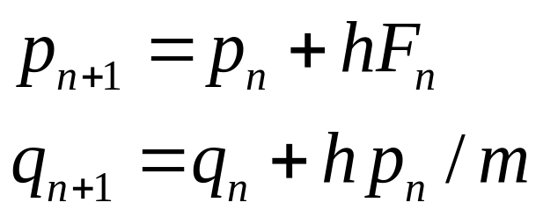
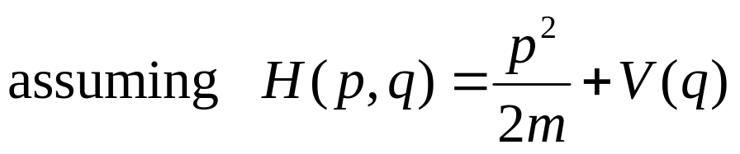
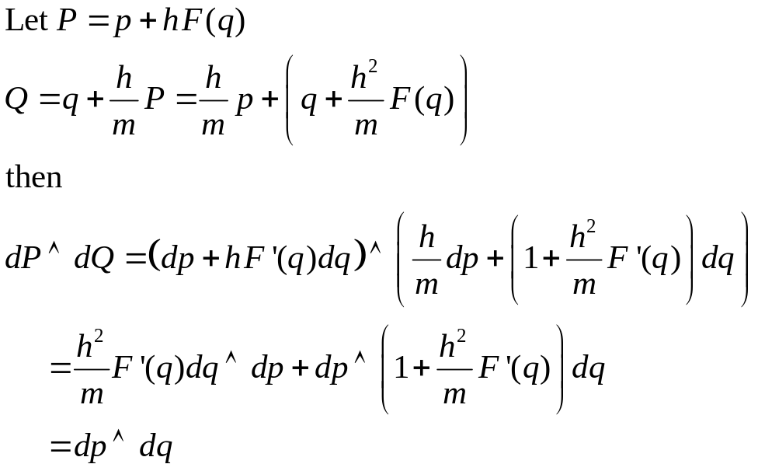
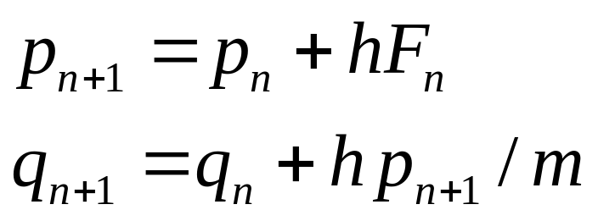
Example of Symplectic Algorithm
Euler method is not symplectic
But the following is

Slide 21
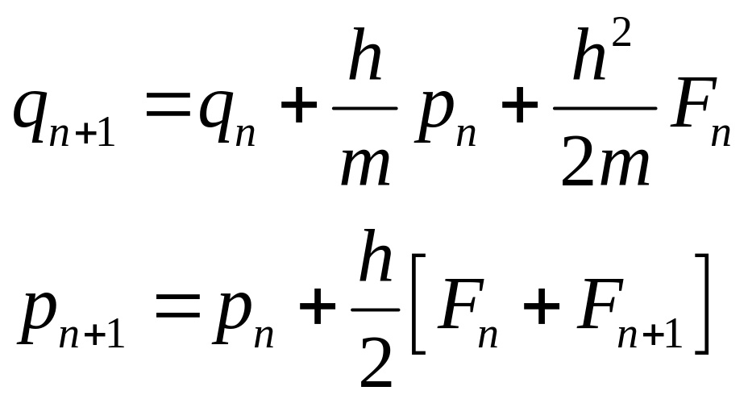
Second-Order Symplectic or Velocity Verlet
Combine two half-step size first-order symplectic algorithms, one can obtain:
Symplectic algorithm preserves the symplectic properties of the Hamiltonian system exactly.
Notes:
Show that the second-order symplectic algorithm is equivalent to the simple Verlet method after the variable p is eliminated. General symplectic algorithm can be derived using Poisson brackets for Hamiltonian dynamics and operator splitting methods. See next slide.

Slide 22
Deriving Symplectic Algorithm
The equation of motion of any dynamic variable A=A(p,q) is dA/dt = - {H,A}. The formal solution is A(t) = exp(-t{H,.})A.
Since H=T+V, we can perform Trotter-Suzuki operator splitting, A(t) ≈ exp(-t{T,.}) exp(-t{V,.}) A.
Since exp(-{G,.}) is symplectic, the operator splitting is symplectic provided each factor is computed exactly.
Notes:
The Poisson bracket { , } is defined by {A,B} = sum dA/dq dB/dp – dB/dq dA/dp. We define {H, .} A = {H, A}. How to obtain higher order symplectic algorithms, e.g., 4-th order?

Slide 23
Problem set 10
Show that the 2nd order symplectic algorithm (on slide 21) is indeed symplectic!
Show that the 4-th order Runge-Kutta is equivalent to Simpson rule if y’=f(x,y)=f(x) independent of y.
Verify that the 4-th order Runge-Kutta formula is indeed accurate to 4-th order [Taylor expanding both side of equation (Fig. 16.1.3)]. Do this with Mathematica.

