Slide 1
Chapter 17
Boundary Value Problems

Slide 2
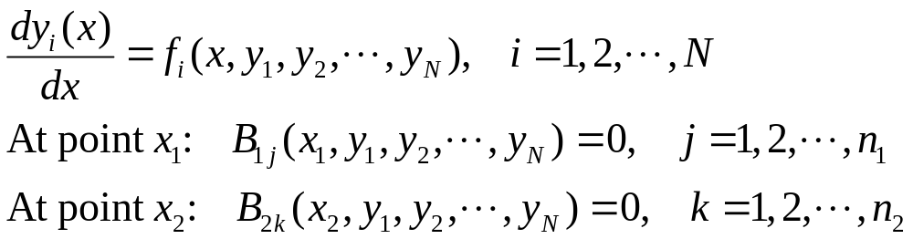
Standard Form of Two-Point Boundary Value Problem
In total, there are n₁+n₂= N boundary conditions.

Slide 3
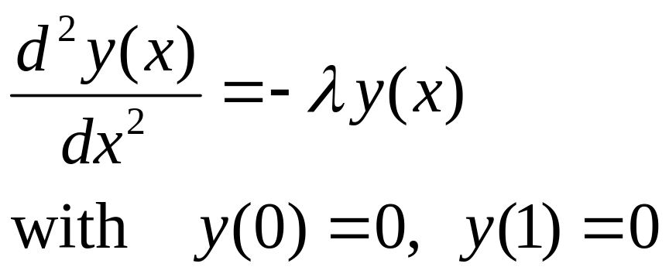
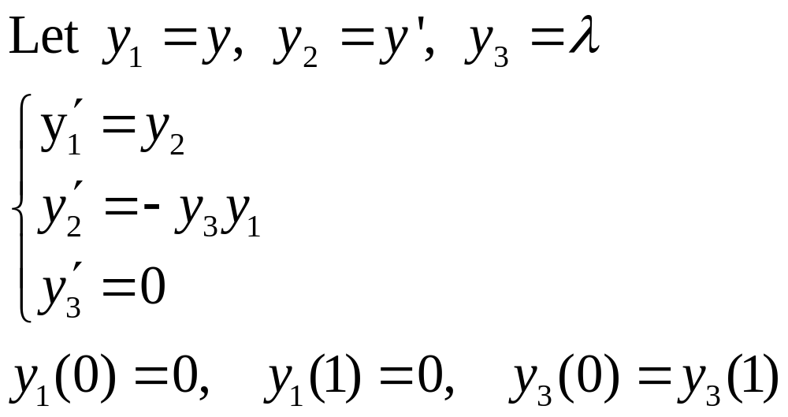
Example, Eigenvalue Problem
λ is also unknown.
Notes:
The answers to the eigenvalue problem is y(x) = A sin(n pi x), with eigenvalue lambda = (n pi)^2. Does the numerical solution to y1, y2, y3 as a boundary value problem gives the correct answers?

Slide 4
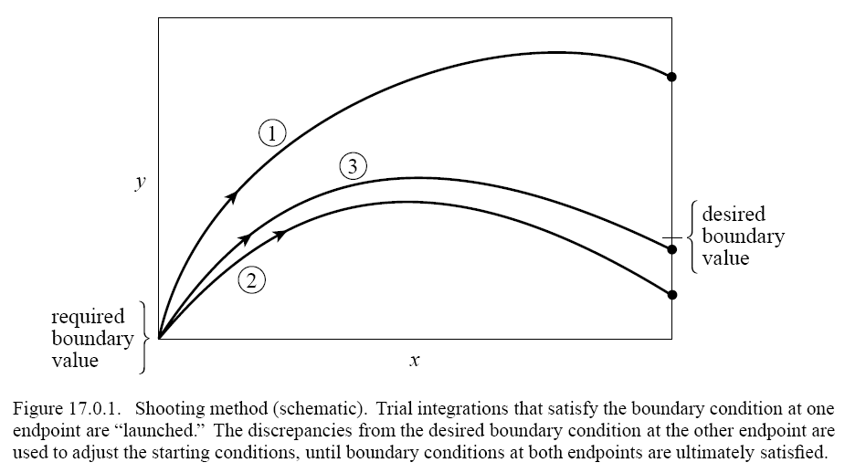
Shooting Method
Use Newton-Raphson to get the target

Slide 5
The Shooting Method (start)
At the starting point x₁ we have n₁ conditions to satisfy, thus we have n₂=N-n₁ freely variable starting parameters
Let
be the initial values of y which is parametrized by n₂ V-values without constraint.

Slide 6
The Shooting Method (discrepancy)
Using any standard ODE solver to find the solution at x₂. Compute a difference between the required boundary condition and actual value:
Our objective is to search the root of F with respect to V.

Slide 7
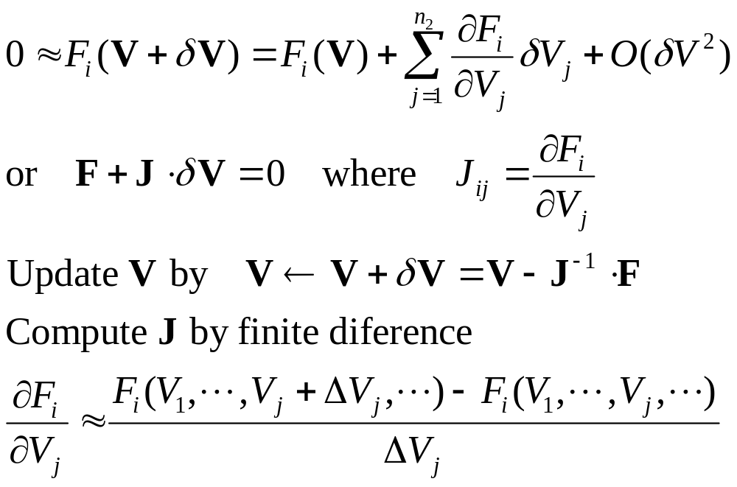
Newton-Raphson for Root

Slide 8
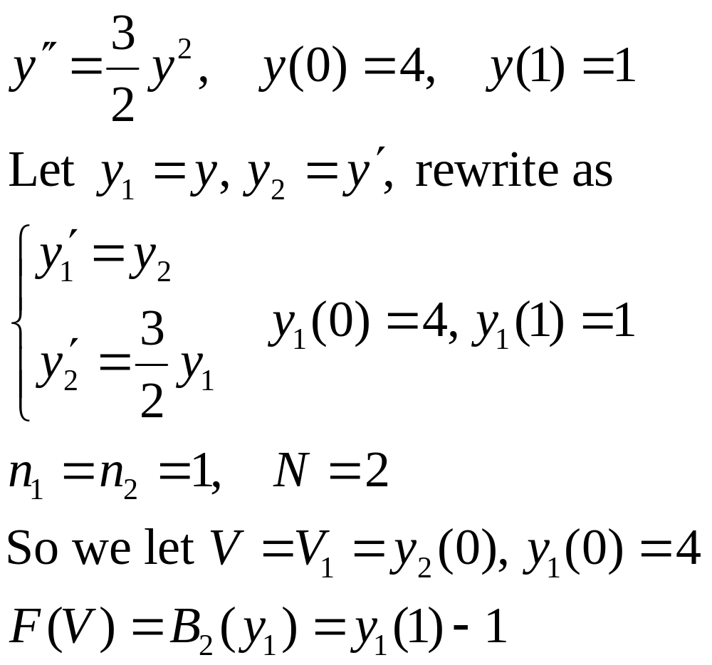
An Example

Slide 9
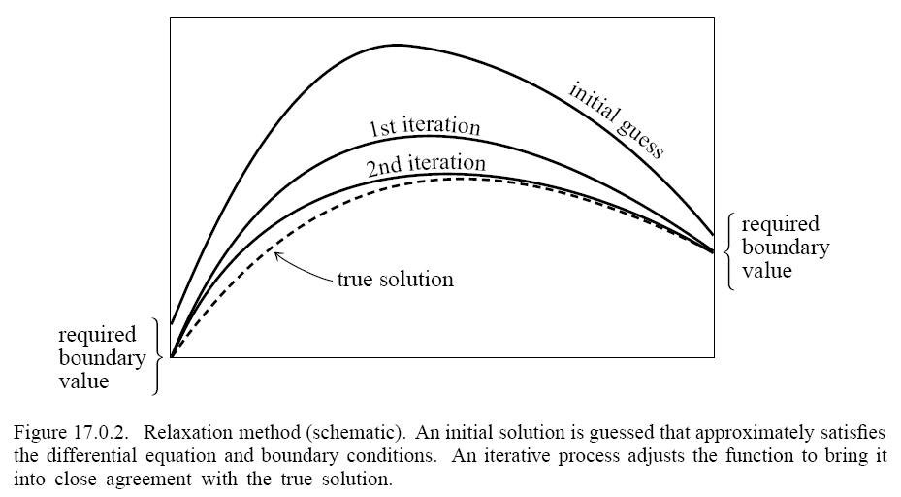
Relaxation Methods
Work with finite differences

Slide 10
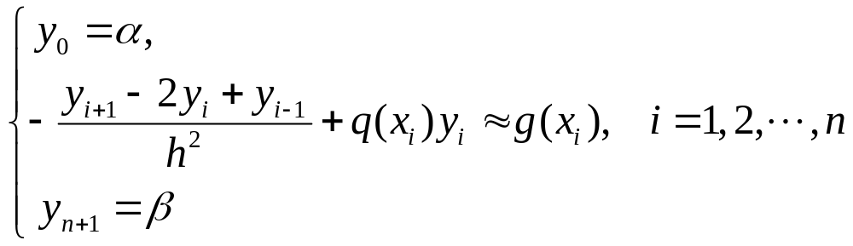
Difference Method
Consider
Discretize the interval x_{j}=a+jh and equation
The difference equations form a linear system Ay = b if the equation is linear.
Notes:
More advanced method known as multi-grid method converges faster.

Slide 11
Reviews
Python programming, float IEEE representations
Errors in numerical calculations
Linear systems
Interpolations
Integrations of definite integrals and differential equations
Random number and Monte Carlo
Neural networks
Least squares, fitting
Optimization, root finding

Slide 12
Topics not Covered
Eigenvalue problems, Ax=λx
Evaluation of special functions
Integral equations
Partial differential equations (PDE)
…

Slide 13
Review Problem 1
Mix and Match
Methods
Crout’s Newton-Raphson Relax
Gaussian quadrature Trapzoidal rule
Romberg method LU SVD
Lagrange formula Neville’s shooting
Gauss-Jordan elimination Euler
Back/forward substitution Bulirsch-Stoer
Splines Steepest descent Symplectic
Conjugate gradient Secant Metropolis
Golden section Simulated annealing
Variance Normal equation
Levenberg-Marquardt Runge-Kutta
Stochastic velocity scaling
Problems
Solve Ax = b
Det(A)
Approximate f(x) by polynomial
Integrate
Fit a straight line
Find minima
Solve ODE or PDE
Estimate error of fit
Compute condition number
Traveling salesman
Nonlinear equation

Slide 14
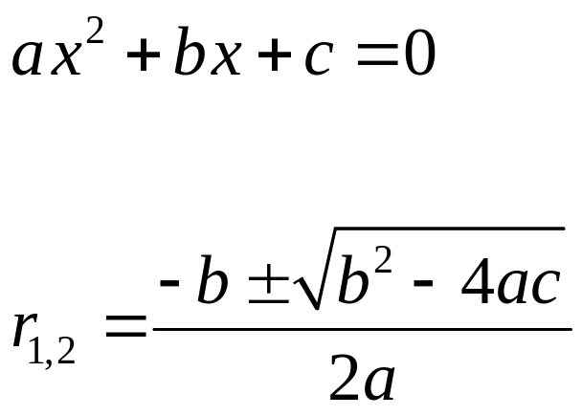
Review Problem 2
Error in numerical calculation, catastrophic cancellation
Discuss the pitfalls of solving the quadratic equation by the standard formula
Read the IEEE 754 webpage article “What every computer scientist should know about floating-point arithmetic”.

Slide 15
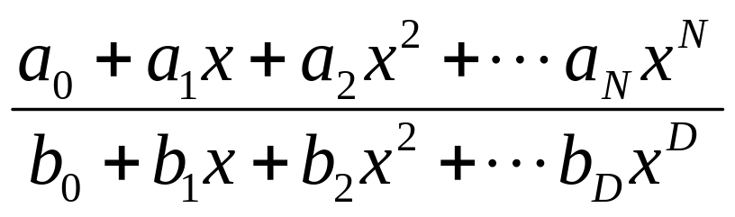
Review Problem 3
To interpolate or extrapolate with polynomials, we do Neville’s algorithm with Lagrange interpolation formula. Discuss what is required (computationally) if we consider rational functions (This is known as Padé approximation).

Slide 16
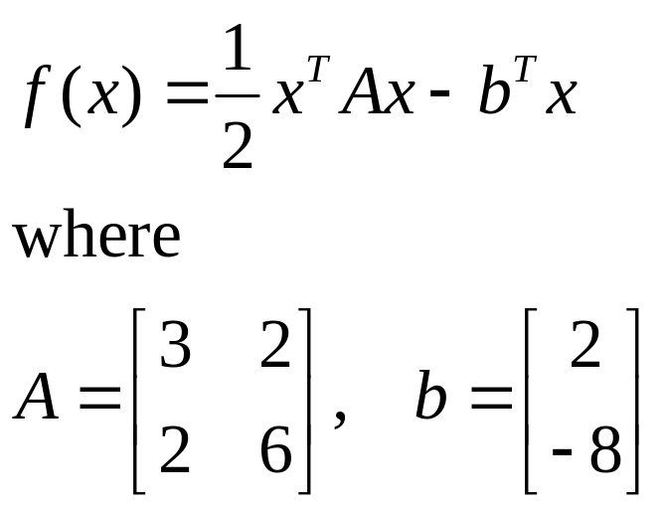
Review Problem 4
Work out the steps for Conjugate Gradient and Steepest Descent for minimum of the following function
The minimum is at (2,2).

Slide 17
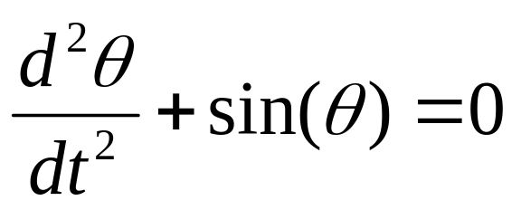
Review Problem 5
Discuss the general features (trajectories in phase space) of the ordinary differential equation of a pendulum. What method should be best used to solve it numerically?

Slide 18
Other Routine Problems
Gauss elimination
Solve LU decomposition with Crout’s
Do interpolation with Neville’s
The errors in well-known integration rules
Newton Raphson iteration formula
Normal equation for least-square
Euler/midpoint methods for ODE

Slide 19
Conceptual Type of Problems
Existence of solutions
O(N?) of an algorithm, why fast or slow
Accuracy of methods O(h?)
Basic analysis techniques (e.g. Taylor series expansion)
Key idea in an algorithm or a method (e.g., conjugate gradient, gaussian quadrature, Romberg, etc)

