Slide 1
Chapter 2, Linear Systems, Mainly LU Decomposition
Notes:
Chapter number refers to “Numerical Recipes” chapters.

Slide 2
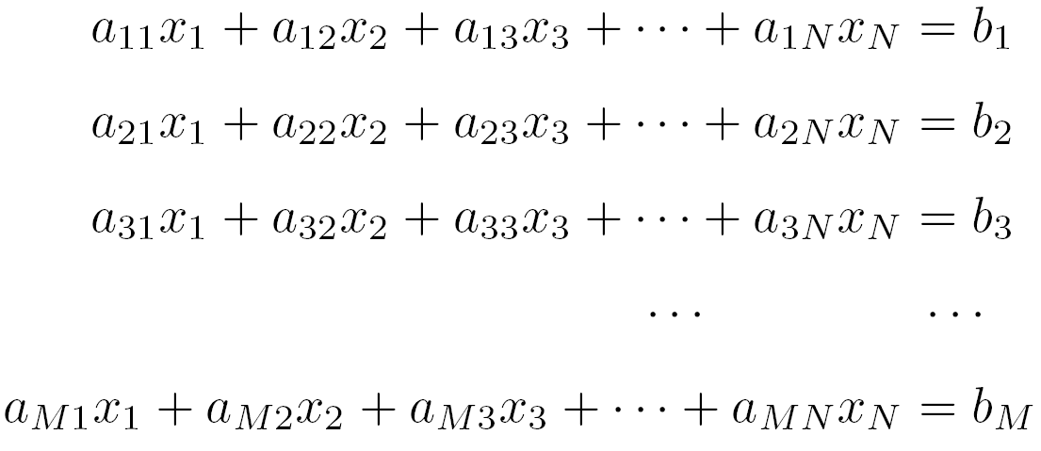
Linear Systems
In matrix notation: A x = b
See, e.g., “Matrix Analysis”, Horn & Johnson, or “Matrix Computations”, Golub and van Loan.
Notes:
When do we need to solve a linear equation? E.g., resistor network, eigenvectors of an eigenvalue problem, discretized Maxwell equations in frequency domain, update steps in minimalization of multi-variable functions, linearized Boltzmann equation, phonon modes, finite element method, etc.

Slide 3
Existence and Solutions
M = N, for nonsingular square matrix, a unique solution exists
M < N, more variables than equations – infinitely many solutions
M > N, may not have solution; one can ask for a least-square solution, e.g., from the normal equation (A^{T}A) x = (A^{T} b)
Notes:
M is the number of equations. What is nonsingular? Answer: det(A) ≠ 0. Note in M > N, A^T( Ax – b) = 0, i.e., all columns of A is normal to the residue r = Ax – b.

Slide 4
Some Concepts in Linear Algebra
Vector space, linear independence, and dimension
Null space of a matrix A: the set of all x such that Ax = 0
Range of A: the set of all Ax
Rank of A: max number of linearly independent columns (= rows)
Rank of A + Null space Dim of A = number of columns of A
Notes:
Vector space: if x and y is in the space, we can add x+y, and multiply by a number c*x. Linearly independent, c1*x1 + c2*x2 + … cn *xn = 0 implies c1=c2=..cn =0. dimension is the max number of linearly independent vectors. Rank of A is the dimension of the range of A.

Slide 5
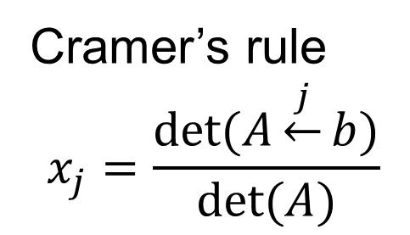
Computation Tasks and Pitfalls
Solve A x = b
Find A⁻¹
Compute det(A)
Round-off error makes the system singular or with larger errors
Cramer’s rule
$$x_{j}=\frac{\det{(A\underset{←}{j}b)}}{\det{(A)}}$$
Notes:
The matrix A_j is obtained by replacing the j-th column by the b vector.

Slide 6
Gauss Elimination
Basic facts about linear equations
  Interchanging any two rows of A and b does not change the solution x
  Replace a row by a linear combination of itself and any other row does not change x
  Interchange column permutes the solution
Pivoting
LU is equivalent to Gauss elimination
Notes:
Gauss elimination makes reduced echelon form, which is helpful to find null space or determine if the linear system is consistent. LU decomposition and Gauss elimination to an upper triangular form is in fact the same.

Slide 7

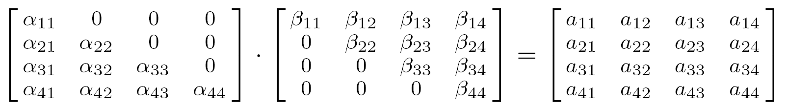
LU Decomposition
L . U = A
Thus A x = (LU) x = L (U x) = b
Let y = U x, then solve y in L y = b by forward substitution
Solve x in U x = y by backward substitution
Notes:
L: lower triangular, diagonals are set to 1 by convention (Doolittle form). U: upper triangular, product of the diagonals beta_i gives the determinant.

Slide 8
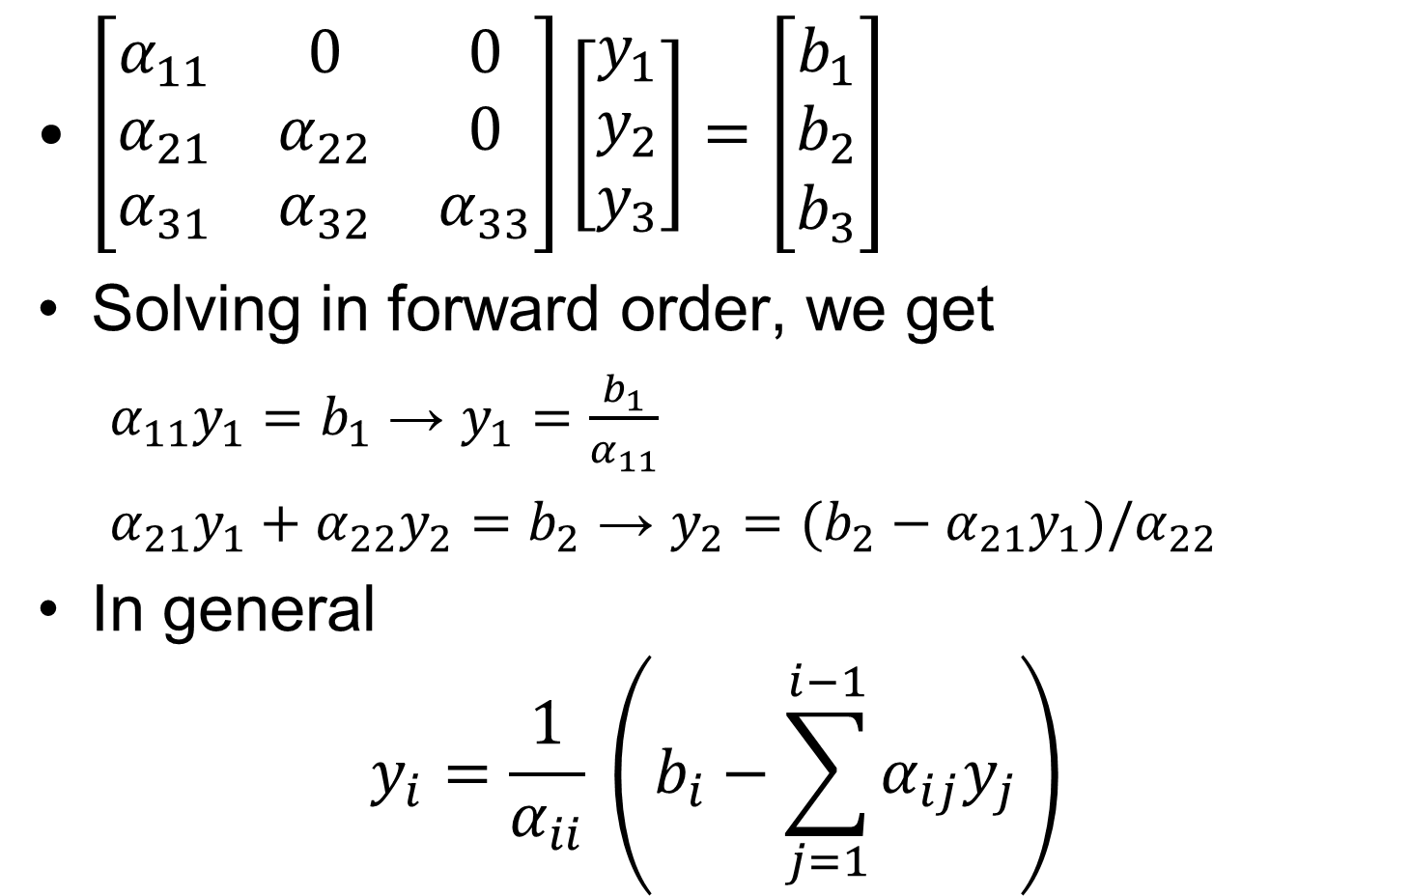
Forward substitution
$\left[\begin{matrix}α_{11} & 0 & 0 \\ α_{21} & α_{22} & 0 \\ α_{31} & α_{32} & α_{33}\end{matrix}\right]\left[\begin{matrix}y_{1} \\ y_{2} \\ y_{3}\end{matrix}\right]=\left[\begin{matrix}b_{1} \\ b_{2} \\ b_{3}\end{matrix}\right]$
Solving in forward order, we get
  $α_{11}y_{1}=b_{1}$ → $y_{1}=\frac{b_{1}}{α_{11}}$
  $α_{21}y_{1}+α_{22}y_{2}=b_{2}$ → $y_{2}=(b_{2}−α_{21}y_{1})/α_{22}$
In general
$$y_{i}=\frac{1}{α_{ii}} \left(b_{i}−\sum_{j=1}^{i−1}{α_{ij}y_{j}}\right)$$

Slide 9
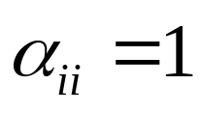
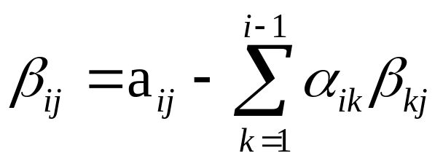
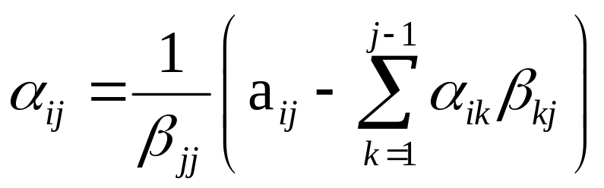
Crout’s Algorithm
Set for all i
For each j = 1, 2, 3, …, N
  (a) for i = 1, 2, …, j
  (b) for i = j +1, j +2, …, N
a_{ij} for A
for L
for U
A = LU
L y = b
U x = y
Ax = LUx = b
Notes:
This should probably be called the Dolittle algorithm, but we follow NR book’s terminology. For more details on the derivation of LU decomposition algorithms, see (1) Press et al, “Numerical Recipes in C,” 2nd edition, chapter 2, pages 32-49. (2) Golub & van Loan, “Matrix Computations,” Chapter 3, pages 87-103. (3) Stoer & Bulirsch, “Introduction to Numerical Analysis,” Chapter 4, pages167-176.

Slide 10
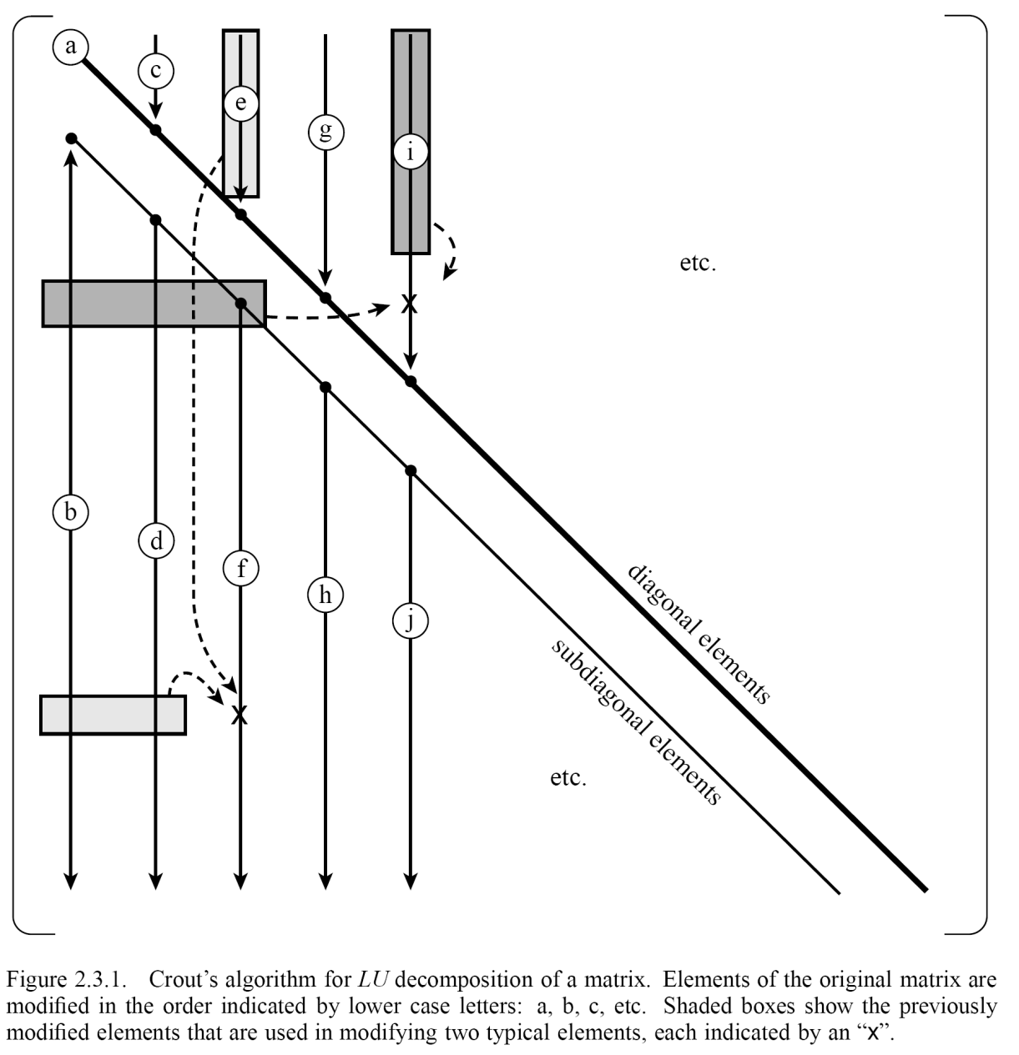

Order of Update in Crout’s Algorithm
β
$$α_{ii}=1$$
α

Slide 11
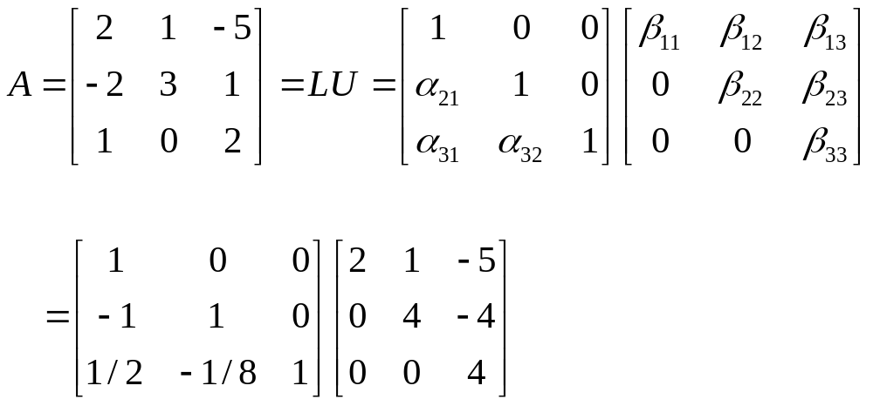
LU Decomposition (without pivoting)
Determining the entries in an order scanning the column from top to bottom and left to right. L and U are stored in the same place as the original A.
Notes:
The LAPACK routine is dgetrf( ).

Slide 12
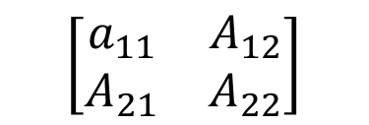
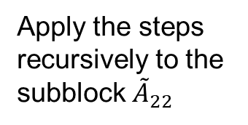
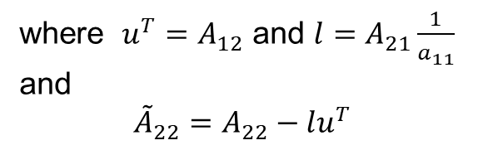
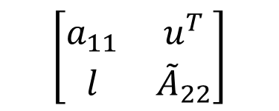
Right-looking recursive algorithm
partition the matrix with sizes 1 and N-1
$$\left[\begin{matrix}a_{11} & A_{12} \\ A_{21} & A_{22}\end{matrix}\right]$$
$$\left[\begin{matrix}a_{11} & u^{T} \\ l & {\tilde{A}}_{22}\end{matrix}\right]$$
where $u^{T}=A_{12}$ and $l=A_{21}\frac{1}{a_{11}}$ and
$${\tilde{A}}_{22}=A_{22}−lu^{T}$$
Apply the steps recursively to the subblock ${\tilde{A}}_{22}$
Notes:
The expression with two vectors by l u^T is called outer product, while l^T u is dot or inner product.

Slide 13
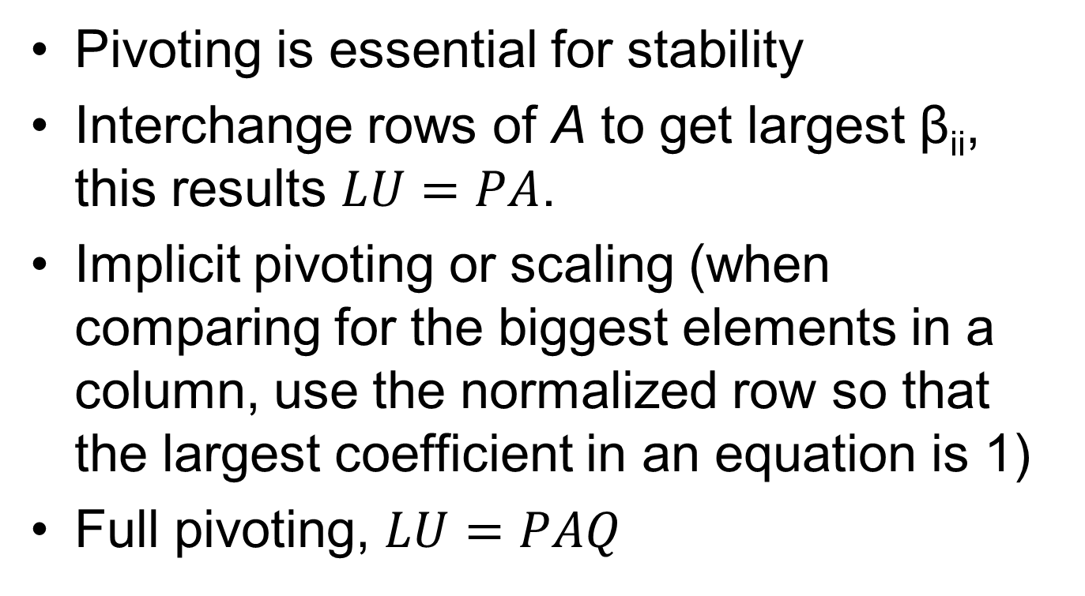
Pivoting
Pivoting is essential for stability
Interchange rows of A to get largest β_{ii}, this results $LU=PA$.
Implicit pivoting or scaling (when comparing for the biggest elements in a column, use the normalized row so that the largest coefficient in an equation is 1)
Full pivoting, $LU=PAQ$
Notes:
P or Q is permutation matrix, which is obtained by permutation of rows of an identity matrix. In code, it is represented as indx[j] which represents that in j-th step, the row j is permuted with row indx[j]. The order matters.

Slide 14
ludcmp(…)
import math
def ludcmp(a, n, indx, d):
d[0] = 1.0
vv=indx.copy()
for i in range(0,n):
big = 0.0
for j in range(0,n):
temp = math.fabs(a[i][j])
if (temp > big):
big = temp
vv[i]=1.0/big
Indentations are important in Python

Slide 15
Run Crout’s algorithm
for j in range(0,n):
big = 0.0
for i in range(0,n):
if(i<j):
l = i
else:
l = j
sum = a[i][j]
for k in range(0,l):
sum -= a[i][k]*a[k][j]
a[i][j] = sum

Slide 16
if(i>=j):
dum = vv[i]*math.fabs(sum)
if (dum >= big):
big = dum
imax = i
if (j != imax):
dum = a[imax]
a[imax] = a[j]
a[j] = dum
d[0] = - d[0]
vv[imax] = vv[j]
indx[j] = imax
dum = 1.0/a[j][j]
for i in range(j+1,n):
a[i][j] *= dum
Need very carefully pay attention to indentation!

Slide 17
Computational Complexity
How many basic steps does the LU decomposition program take?
Big O( … ) notation & asymptotic performance
O(N³) for LU decomposition
Memory access traffic impacts running time
Notes:
More precisely, how many additions and multiplications one need to perform? We have time complexity as well as space (memory usage) complexity.

Slide 18
Compute A⁻¹
Let B = A⁻¹
then AB = I (I is identity matrix)
or A [b₁, b₂, …,b_{N}] = [e₁, e₂, …,e_{N}]
or A b_{j} = e_{j} for j = 1, 2, …, N
where b_{j} is the j-th column of B.
I.e., to compute A⁻¹, we solve a linear system N times, each with a unit vector e_{j}.
Notes:
In the notation [b₁, b₂, …, b_{N}], each b_{i} is a column vector, so the whole [ …] is the matrix B.

Slide 19
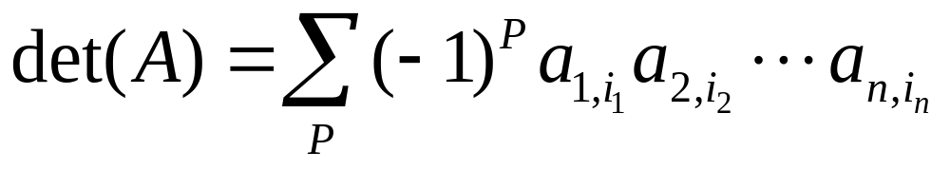
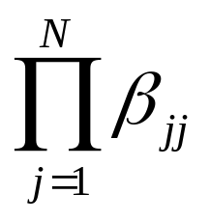
Compute det(A)
Definition of determinant
Properties of determinant (anti-symmetry, Laplace expansion, etc)
Since det(LU) = det(L) det(U), thus
det(A) = det(U) =
Notes:
Chapter 6 of CD Meyer’s book for linear algebra is very good on determinants. Use of determinant in physics/math: fermion wavefunctions, coordinate transform (Jacobian), etc.

Slide 20
Use numpy and scipy
numpy: define N-dimensional arrays of various types
scipy: efficient numerical routines such as integration, interpolation, linear algebra, and statistics. scipy needs numpy in most cases.

Slide 21
Solve Ax =b in scipy
import numpy as np
from scipy import linalg
# A is 2x2 matrix
A = np.array([[1.03,2.0],[3.5,4.1]])
# b is the right-side vector
b = np.array([[5.0],[6.1]])
# x is solution
x = np.linalg.solve(A,b)
Notes:
The numpy.linalg.solve( ) uses LAPACK routine *gesv( ).

Slide 22
Use LAPACK
Lapack is a free, high quality linear algebra solver package (downloadable at www.netlib.org/lapack/). Much more sophisticated than NR routines.
Written in Fortran 90
Calling inside Python made possible through scipy
Notes:
Wrapper in python for these fortran routines are implemented in scipy.

Slide 23
What Lapack can do?
Solution of linear systems, Ax = b
Least-square problem, min ||Ax-b||²
Singular value decomposition, A = UsV ^{T}
Eigenvalue problems, Ax = λx

Slide 24
Other matrix decompositions
Cholesky: A = LL^{T}, A is real symmetric, positive definite.
QR factorization: A=QR, Q is orthogonal Q^{T}Q=I, R is upper triangular.
Schur: U†AU= upper triangular with eigenvalues λ on the diagonals.
Singular value decomposition: A=UΣV †, U and V are unitary U†U=I, V†V=I , Σ is nonnegative diagonal.
Notes:
See also: R. A. Horn and C. R. Johnson, “Matrix Analysis”, Cambridge Univ Press (2013).

Slide 25
Reading, Reference
Read NR, Chap. 2
For a more thorough treatment on numerical linear algebra computation problems, see G H Golub & C F van Loan, “Matrix Computations”, as well as Horn & Johnson, “Matrix Analysis.”
Notes:
See also J. Stoer & R. Bulirsch, “Introduction to Numerical Analysis”, but a very theoretical book.

Slide 26
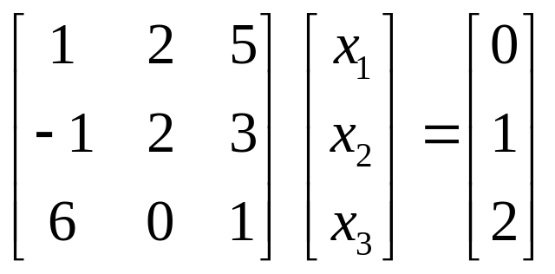
Problems for week 3/chapter 2
1. Consider the following linear equation
(a) Solve the system (by hand) with LU decomposition, following Crout’s algorithm (slide 8, NR p.44) exactly, without pivoting.
(b) Find the inverse of the 3×3 matrix, using LU decomposition.
(c) Find the determinant of the 3×3 matrix, using LU decomposition.
2. Can we do LU decomposition for all square, real matrices? What is the condition for the existence of an LU decomposition? The answers depend on whether pivoting is applied or not. Partial or full pivoting.
Notes:
Most math books will call the algorithm Dolittle instead of Crout’s. But we follow the usage of NR.

