Slide 1
Chapter 3, Interpolation and Extrapolation

Slide 2
Interpolation & Extrapolation
(x_{i},y_{i})
Fit by an analytic function f(x) that passes through the given N data points exactly.

Slide 3
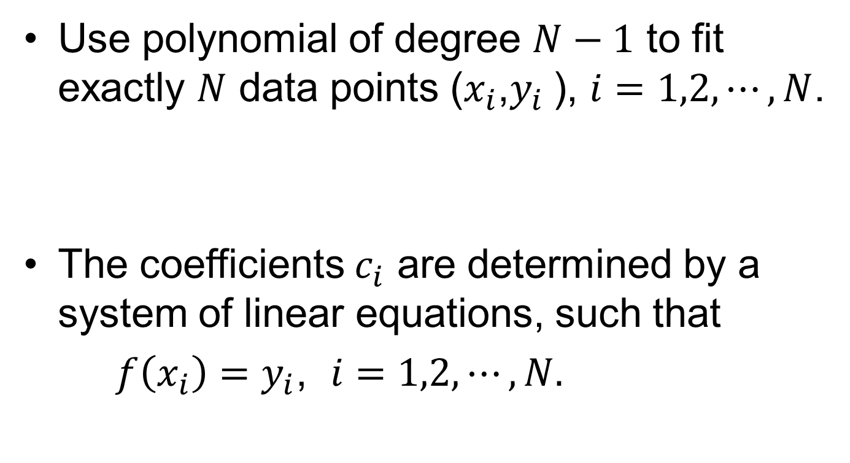
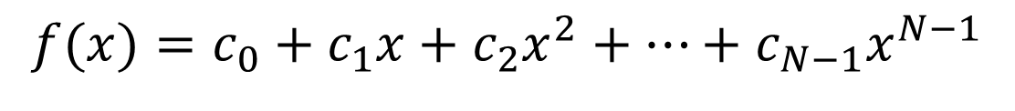
Polynomial Interpolation
Use polynomial of degree $N−1$ to fit exactly $N$ data points ($x_{i}$,$y_{i}$), $i=1,2,⋯,N$.
The coefficients $c_{i}$ are determined by a system of linear equations, such that
$f\left(x_{i}\right)=y_{i}$, $i=1,2,⋯, N.$
$$f(x)=c_{0}+c_{1}x+c_{2}x^{2}+⋯+c_{N−1}x^{N−1}$$
Notes:
Polynomial degree: the highest power of x. Use ratio of polynomials (Pade’ approximation) is another way.

Slide 4
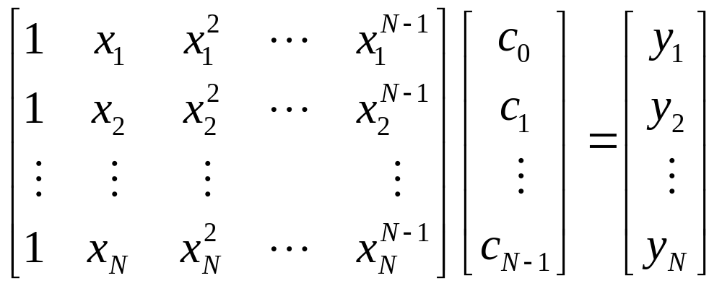
Vandermonde Matrix Equation
It is not advisable to solve this system numerically because of possible ill-conditioning.
Notes:
The ill-conditioning means the x values are close or coincident.

Slide 5
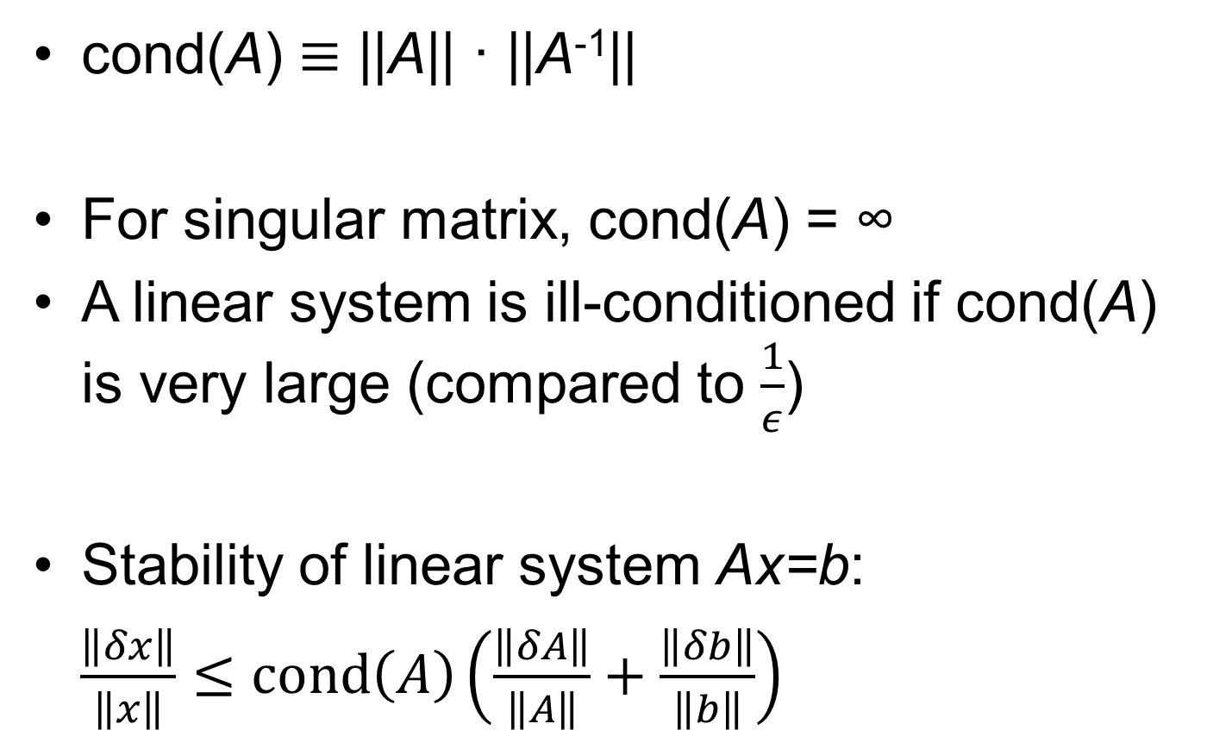

Condition Number
cond(A) $≡$ ||A|| · ||A⁻¹||
For singular matrix, cond(A) = ∞
A linear system is ill-conditioned if cond(A) is very large (compared to $\frac{1}{ε}$)
Stability of linear system Ax=b:
$\frac{\left\|δx\right\|}{\left\|x\right\|}≤cond\left(A\right)\left(\frac{\left\|δA\right\|}{\left\|A\right\|}+\frac{\left\|δb\right\|}{\left\|b\right\|}\right)$
: norm
Notes:
For cond(A), A must be a square matrix; for norm ||A||, A can be vector or matrix (of any size). For a discussion on norms, see, e.g., Golub & van Loan, “Matrix Computations”, 3rd, page 52 – 57. The significance of the condition number is that the relative error of a linear system can be bounded by the condition number, as well as for error in det(A).

Slide 6
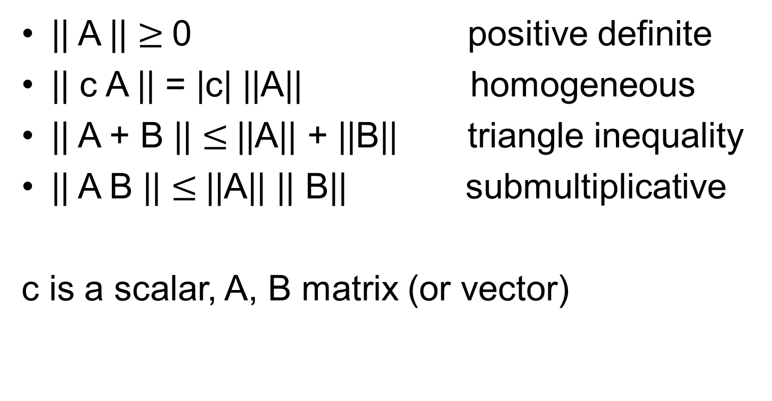
Properties of norm || .. ||
|| A || $≥$0 positive definite
|| c A || = |c| ||A|| homogeneous
|| A + B || $≤$||A|| + ||B|| triangle inequality
|| A B || $≤$||A|| || B|| submultiplicative
c is a scalar, A, B matrix (or vector)

Slide 7
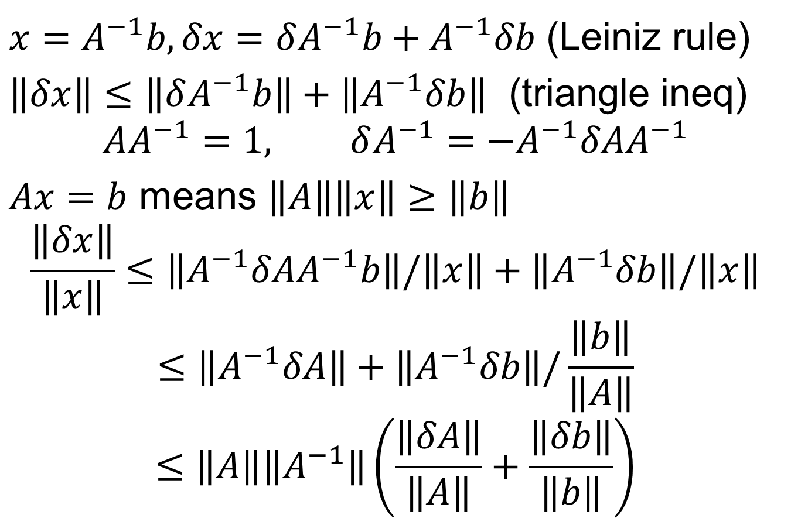
Prove:
$x=A^{−1}b, δx=δA^{−1}b+A^{−1}δb$ (Leiniz rule)
$\left\|δx\right\|≤\left\|δA^{−1}b\right\|+\left\|A^{−1}δb\right\|$ (triangle ineq)
$$AA^{−1}=1, δA^{−1}={−A}^{−1}δAA^{−1}$$
$Ax=b$ means $\left\|A\right\|\left\|x\right\|≥\left\|b\right\|$
$$\frac{\left\|δx\right\|}{\left\|x\right\|}≤\left\|A^{−1}δAA^{−1}b\right\|/\left\|x\right\|+\left\|A^{−1}δb\right\|/\left\|x\right\|$$
$$≤\left\|A^{−1}δA\right\|+\left\|A^{−1}δb\right\|/\frac{\left\|b\right\|}{\left\|A\right\|}$$
$$≤\left\|A\right\|\left\|A^{−1}\right\|\left(\frac{\left\|δA\right\|}{\left\|A\right\|}+\frac{\left\|δb\right\|}{\left\|b\right\|}\right)$$

Slide 8
Definition of norm
Norm || . ||: a real function that satisfies (1) f(A) > 0, if A ≠ 0,
(2) f(A+B) ≤ f(A) + f(B),
(3) f(αA) = |α| f(A).
With norm, we can talk about error, limit, convergence, continuity, etc, in vector space or matrices.
Notes:
The norm ||x|| is (1) positive definite, (2) satisfies triangle inequality, (3) and is linearly scale.

Slide 9
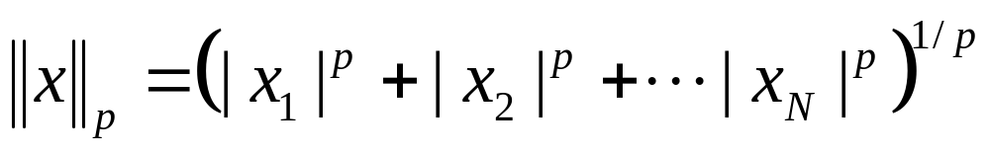
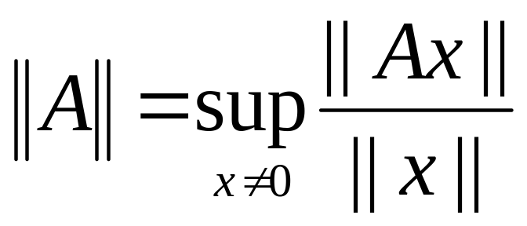
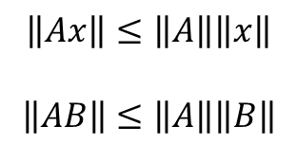
Norms
Vector p-norm (p ≥ 1)
Induced matrix norm
$$\left\|Ax\right\|≤\left\|A\right\|\left\|x\right\|$$
$$\left\|AB\right\|≤\left\|A\right\|\left\|B\right\|$$
sup: supremum (or least upper bound)
Notes:
Frobenius norm is like a 2-norm applied to the matrix elements. Opposite of supremum is infimum (inf). What happen if p<1?

Slide 10
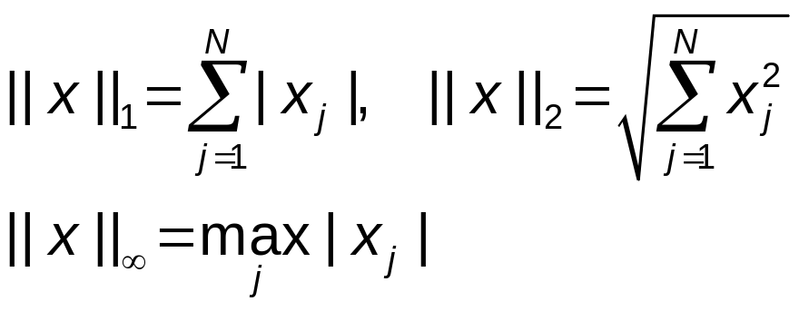
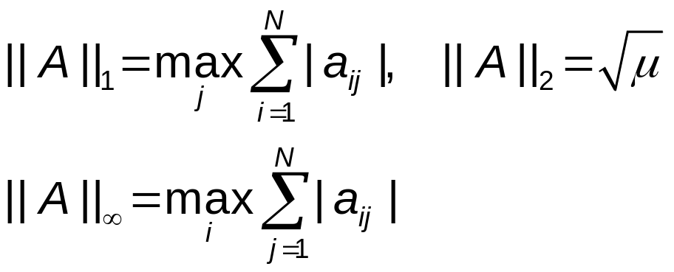
Commonly Used Norms
Vector norm
Matrix norm
Where μ is the maximum eigenvalue of matrix A^{T}A.
Notes:
The Frobenius norm, defined as ||A||_F^2 = Tr(AA^+) = sum_{i,j} |a_{ij}|^2 is not an induced norm.

Slide 11
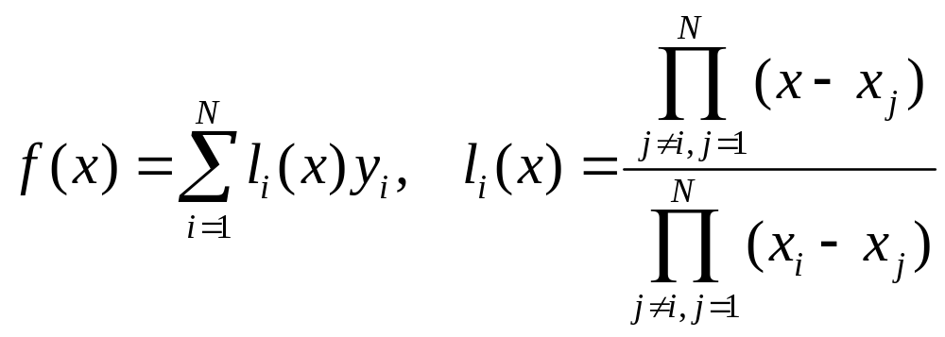
Lagrange’s Formula
It can be verified that the solution to the Vandermonde equation is given by the formula below:
l_{i}(x) has the property l_{i}(x_{j}) = δ_{ij}.
Notes:
Delta_{ij} is Kronecker delta. It is 1 if i=j, and 0 otherwise.

Slide 12
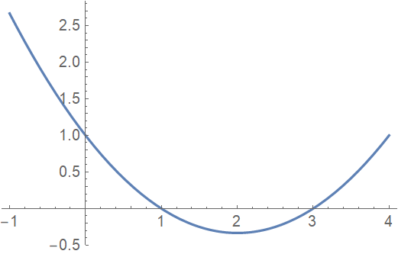
l₁(x) for x_{i} = 0, 1, 3
The Lagrange basis polynomial l_{i}(x) is defined by the property: l_{i}(x_{j}) = δ_{ij}

Slide 13
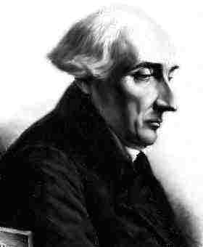
Joseph-Louis Lagrange (1736-1813)
Italian-French mathematician associated with many classic mathematics and physics – Lagrange multipliers in minimization of a function, Lagrange’s interpolation formula, Lagrange’s theorem in group theory and number theory, and the Lagrangian (L=T-V) in mechanics and Euler-Lagrange equations.

Slide 14
Neville’s Algorithm
Evaluate Lagrange’s interpolation formula f(x) at a given point x, from the data points (x_{i},y_{i}).
Interpolation tableau P
x₁: y₁ = P₁
P₁₂
x₂: y₂ = P₂ P₁₂₃
P₂₃ P₁₂₃₄
x₃: y₃ = P₃ P₂₃₄
P₃₄
x₄: y₄ = P₄
P_{i,i+1,i+2,…,i+n} is a polynomial of degree n in x that passes through the points (x_{i},y_{i}), (x_{i+1},y_{i+1}), …, (x_{i+n},y_{i+n}) exactly.
Notes:
Eric Harold Neville 1889-1961.

Slide 15
Determine P₁₂ from P₁ & P₂
Given the value P₁ and P₂ at x=x₁ and x₂, we find linear interpolation
P₁₂(x) = λ(x) P₁+[1-λ(x)] P₂
Since P₁₂(x₁) = P₁ and P₁₂(x₂) = P₂, we must have
λ(x₁) = 1, λ(x₂) = 0
so
λ(x) = λ₁₂= (x-x₂)/(x₁-x₂)

Slide 16
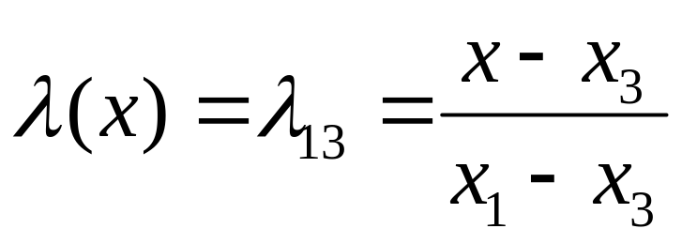
Determine P₁₂₃ from P₁₂ & P₂₃
We write
  P₁₂₃(x) = λ(x) P₁₂(x) + [1-λ(x)] P₂₃(x)
  P₁₂₃(x₂) = P₂ already for any choice of λ(x). We require that P₁₂₃(x₁)=P₁₂(x₁) =P₁ and P₁₂₃(x₃)=P₂₃(x₃) =P₃, thus λ(x₁) = 1, λ(x₃) = 0
  or

Slide 17
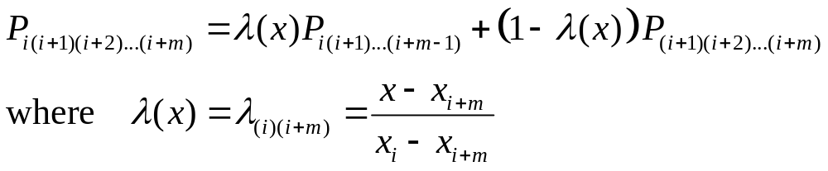
Recursion Relation for P
Given two m-point interpolated value P constructed from point i,i+1,i+2,…,i+m-1, and i+1,i+2,…,i+m, the next level m+1 point interpolation from i to i+m is a linear combination:

Slide 18
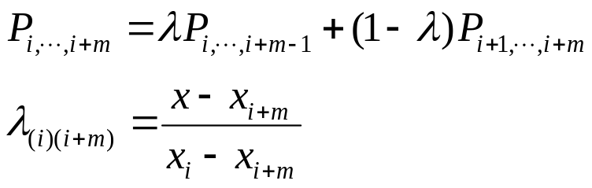
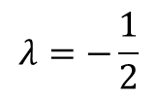
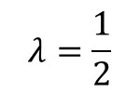


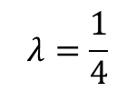
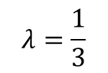
Evaluate f(3) given 4-points (0,1), (1,2), (2,3),(4,0), us P table.
x₁=0, y₁=1 =P₁
$$λ=−2$$
P_{1,2} = 4
$$λ=−\frac{1}{2}$$
P_{1,2,3} = 4
x₂=1, y₂=2 =P₂
P_{2,3} = 4
$$λ=−1$$
$$λ=\frac{1}{4}$$
P_{1,2,3,4}= 11/4
x₃=2, y₃=3 =P₃
$$λ=\frac{1}{3}$$
P_{2,3,4} = 7/3
$$λ=\frac{1}{2}$$
P_{3,4} = 3/2
x₄=4, y₄=0 =P₄

Slide 19
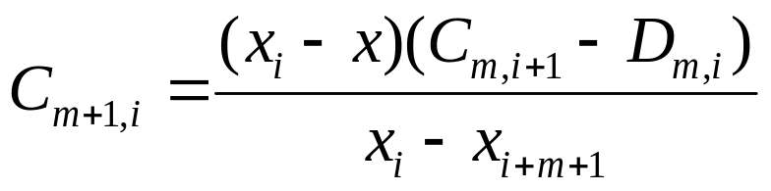
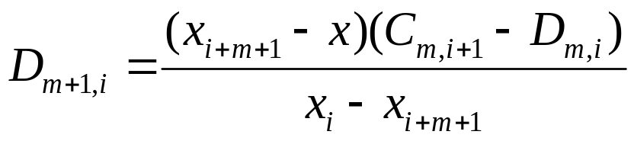
Use Small Difference C & D
P₁
C_{1,1} = P₁₂-P₁
P₁₂
D_{1,1}
C_{2,1=}P₁₂₃-P₁₂
P₁₂₃
P₂
D_{2,1}
C_{1,2}
C_{3,1}=P₁₂₃₄-P₁₂₃
P₂₃
D_{1,2}
P₁₂₃₄
C_{2,2}
P₃
P₂₃₄
D_{3,1}=P₁₂₃₄-P₂₃₄
C_{1,3}
P₃₄
D_{2,2}=P₂₃₄-P₃₄
D_{1,3}
P₄

Slide 20
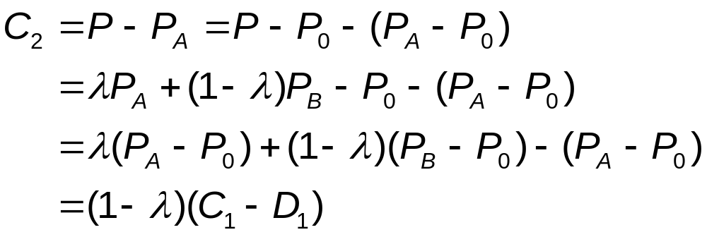

Deriving the Relation among C & D
P_{A}
D₁=P_{A} –P₀
C₂=P-P_{A}
P₀
P =λ P_{A} + (1-λ)P_{B}
C₁=P_{B} –P₀
D₂=P-P_{B}
P_{B}
Notes:
To get required λ, extend the lines (in a straight way) at P back to the starting points.

Slide 21
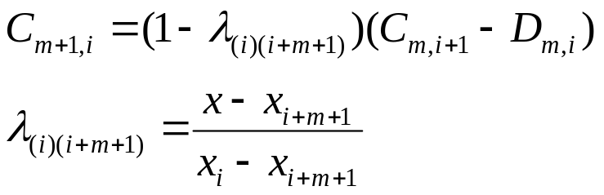

Evaluate f(3) given 4-points (0,1), (1,2), (2,3),(4,0).
C_{0,1}=1
x₁=0, y₁=1 =P₁
C_{1,1} = 3
D_{0,1}=1
C_{2,1}= 0
C_{0,2}=2
D_{1,1}= 2
x₂=1, y₂=2 =P₂
C_{1,2}= 2
D_{2,1}= 0
C_{3,1}= - 5/4
D_{0,2}=2
P₁₂₃₄= 11/4
C_{0,3}=3
D_{1,2}= 1
C_{2,2}= -5/3
D_{3,1}= 5/12
x₃=2, y₃=3 =P₃
C_{1,3}= -3/2
D_{0,3}=3
D_{2,2}=5/6
C_{0,4}=0
D_{1,3} = 3/2
x₄=4, y₄=0 =P₄
D_{0,4}=0

Slide 22
polint( ) Program
import math
def polint(xa, ya, n, x, y, dy):
c = ya.copy()
d = ya.copy()
ns = 0
dif = math.fabs(x-xa[0])
for i in range(1,n):
dift = math.fabs(x-xa[i])
if (dift < dif):
ns = i
dif = dift
y[0] = ya[ns]
ns -= 1
Notes:
What is the computational complexity of Neville’s algorithm?

Slide 23
polint(), continued
for m in range(1,n):
for i in range(0,n-m):
ho = xa[i]-x
hp = xa[i+m]-x
w = c[i+1]-d[i]
den = ho – hp
den = w/den
d[i] = hp*den
c[i] = ho*den
if(2*(ns+1) < (n-m)):
dy[0] = c[ns+1]
else:
dy[0] = d[ns]
ns -= 1
y[0] += dy[0]

Slide 24
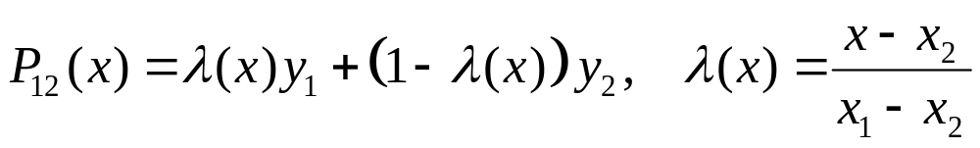
Piecewise Linear Interpolation
y
P₂₃(x)
P₁₂(x)
(x₂,y₂)
(x₃,y₃)
P₃₄(x)
(x₁,y₁)
(x₄,y₄)
P₄₅(x)
(x₅,y₅)
x

Slide 25
Piecewise Polynomial Interpolation
y
Discontinuous derivatives across segment
P₁₂₃₄(x)
P₁₂₃₄(x)
(x₂,y₂)
(x₃,y₃)
P₂₃₄₅(x)
(x₁,y₁)
(x₄,y₄)
P₂₃₄₅(x)
(x₅,y₅)
x

Slide 26
Cubic Spline, P_{i}(x) is cubic
Same 1st and 2nd derivatives at the connection point.
y
P₂(x)
P₁(x)
(x₂,y₂)
(x₃,y₃)
P₃(x)
(x₁,y₁)
P₄(x)
(x₄,y₄)
(x₅,y₅)
x
$$P_{i}\left(x\right)=a_{i}x^{3}+b_{i}x^{2}+c_{i}x+d_{i}, i=1,2,3,4$$

Slide 27
Cubic Spline
Given N points (x_{i},y_{i}), i=1,2,…,N, for each interval between points i to i+1, fit to cubic polynomials such that P_{i}(x_{i})=y_{i} and P_{i}(x_{i+1})=y_{i+1}.
Make 1st and 2nd derivatives continuous across intervals, i.e., P_{i}^{(n)}(x_{i+1}) = P^{(n)}_{i+1}(x_{i+1}), n = 1 and 2.
Fix boundary condition to P⁽²⁾(x_{1 or N})=0, to completely specify.
Notes:
Superscript (1) denotes first derivative, (2) denote second derivative.

Slide 28
Reading
NR, Chapter 3
See also J. Stoer and R. Bulirsch, “Introduction to Numerical Analysis,” Chapter 2.
Notes:
NR: Numerical Recipes in C, 2nd edition.

Slide 29
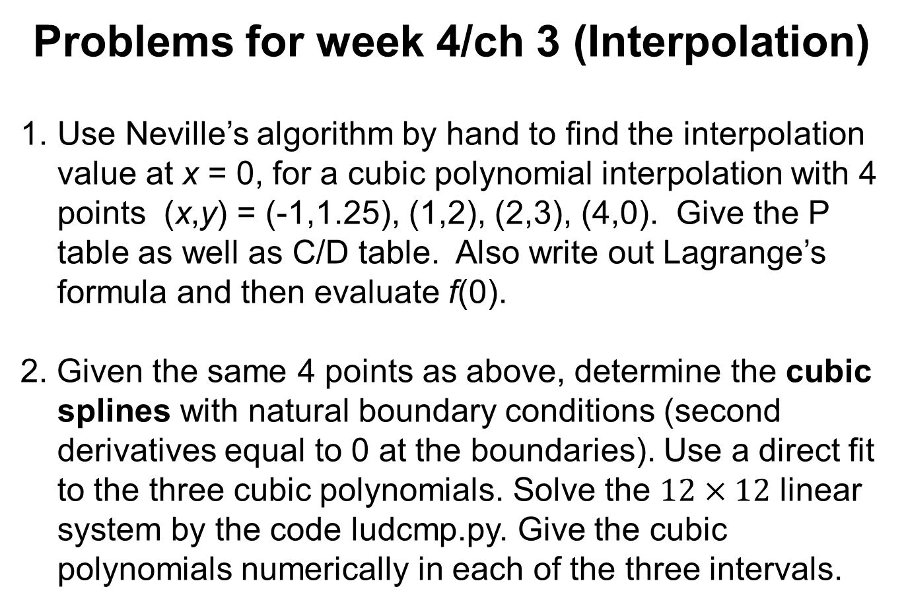
Problems for week 4/ch 3 (Interpolation)
Use Neville’s algorithm by hand to find the interpolation value at x = 0, for a cubic polynomial interpolation with 4 points (x,y) = (-1,1.25), (1,2), (2,3), (4,0). Give the P table as well as C/D table. Also write out Lagrange’s formula and then evaluate f(0).
2. Given the same 4 points as above, determine the cubic splines with natural boundary conditions (second derivatives equal to 0 at the boundaries). Use a direct fit to the three cubic polynomials. Solve the $12×12$ linear system by the code ludcmp.py. Give the cubic polynomials numerically in each of the three intervals.

