Slide 1
Chapter 4,
Integration of Functions

Slide 2

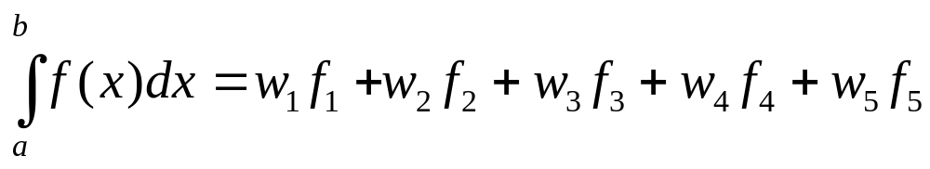
Open and Closed Formulas
Open formulas - use interior points only.
Extended formulas – piecewise sum of integration formula.
x₁=a x₂ x₃ x₄ x₅=b
Closed formula uses end points, e.g.,

Slide 3
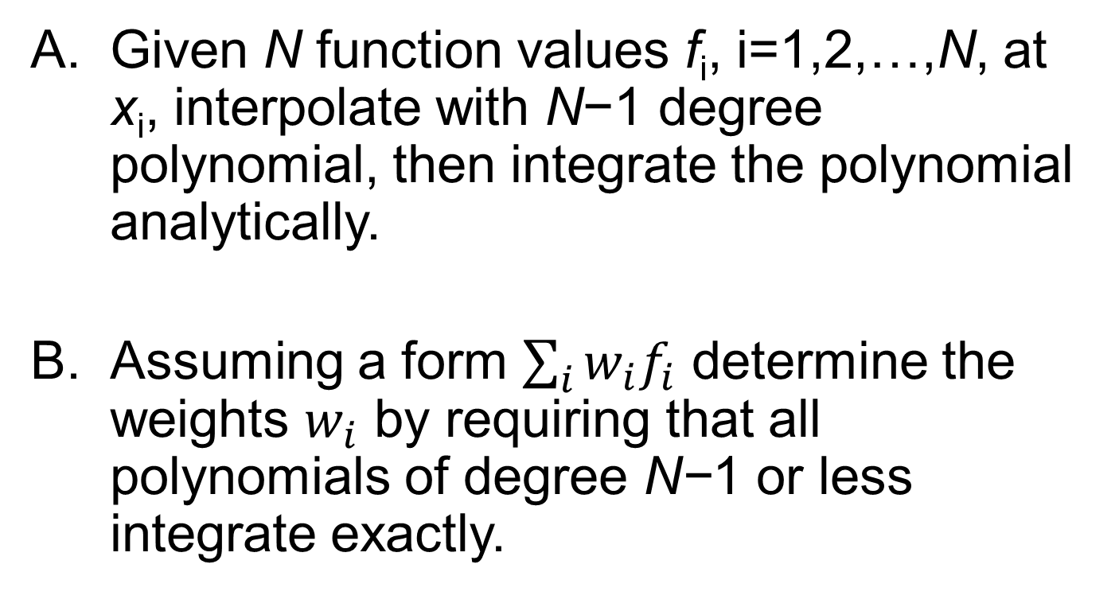
Deriving Integration Formulas
Given N function values f_{i}, i=1,2,…,N, at x_{i}, interpolate with N−1 degree polynomial, then integrate the polynomial analytically.
Assuming a form $\sum_{i}{w_{i}f_{i}}$ determine the weights $w_{i}$ by requiring that all polynomials of degree N−1 or less integrate exactly.
Notes:
The methods A and B give identical result.

Slide 4
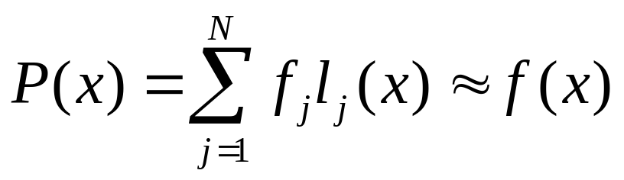
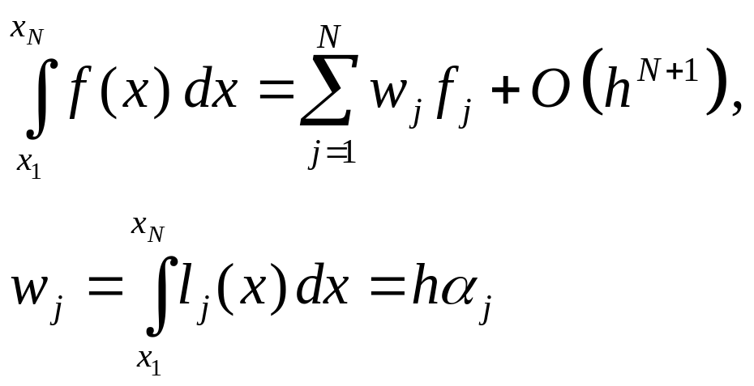
Closed Newton-Cotes Formulas
Equally spaced abscissas, x_{j}=x₁+(j-1)h
Lagrange’s interpolation formula
Integrating, gives
Where l_{j}(x) is a polynomial of degree N-1 such that l_{j}(x_{j}) = 1 and else l_{j}(x_{k}) = 0 if k ≠ j.
Notes:
Why error is O(h^{N+1})? abscissa = x value = coordinate, ordinate = y value.

Slide 5
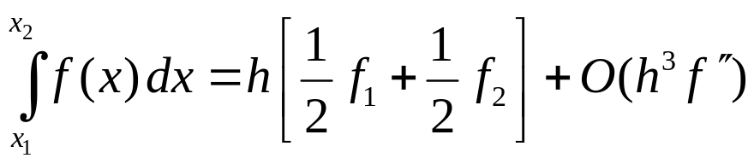
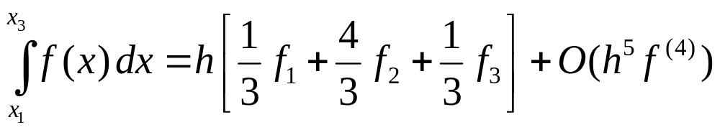
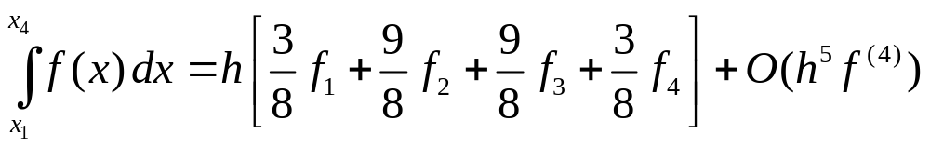
Special Cases, N=2,3,4 : the Integration Rules
linear interpolation
Trapezoidal rule
Simpson’s rule
3/8 rule
parabola
cubic
Notes:
We also have the simpler case of N=1, which is the rectangular rule. Trapezoidal [trœpizəidl]. Simpson’rule rule is also called Kepler’s rule.

Slide 6
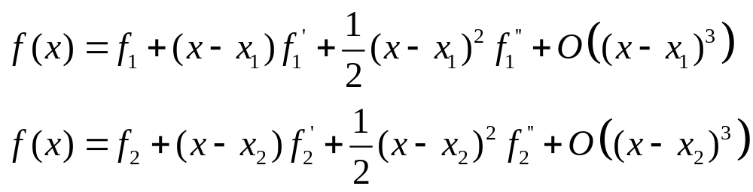
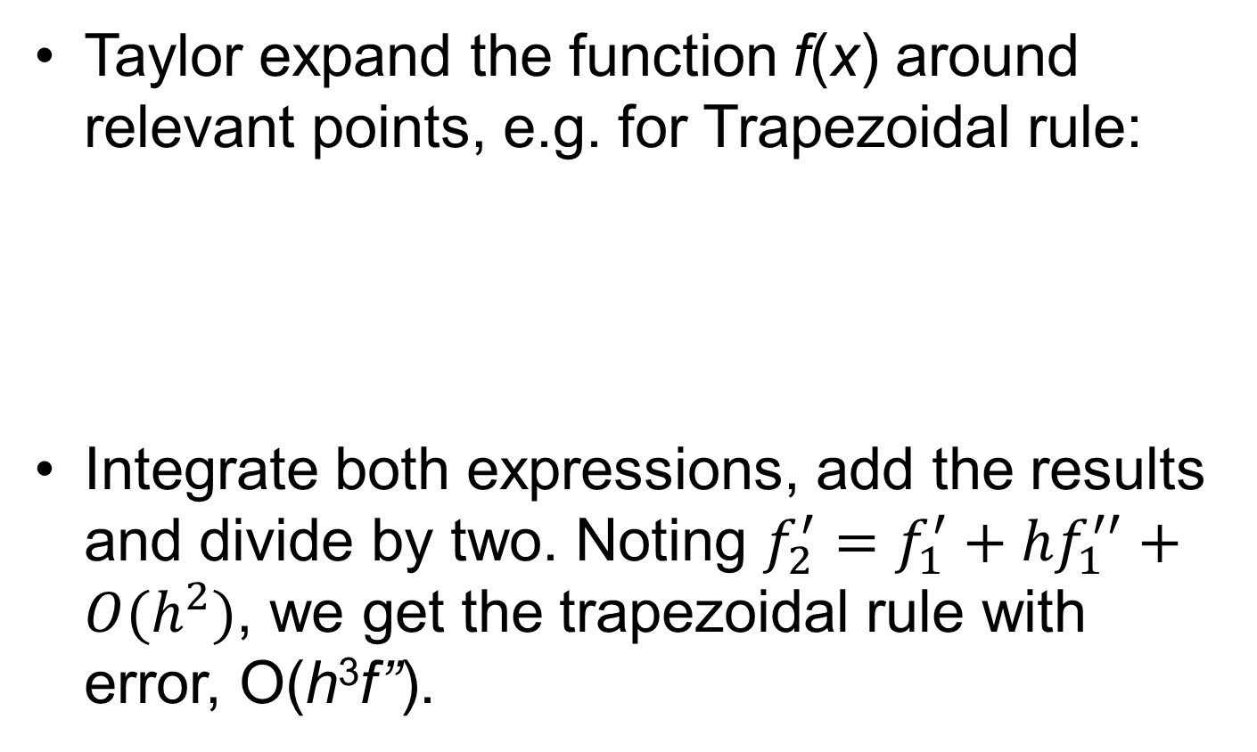
Estimate the Error
Taylor expand the function f(x) around relevant points, e.g. for Trapezoidal rule:
Integrate both expressions, add the results and divide by two. Noting $f_{2}^{′}=f_{1}^{′}+hf_{1}^{′′}+O(h^{2})$, we get the trapezoidal rule with error, O(h³f’’).
Notes:
Why no O(h^2) term?

Slide 7
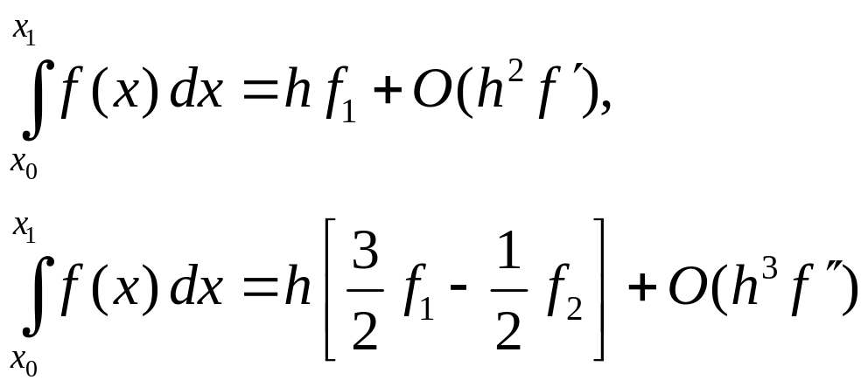
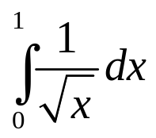
Open Formula in a Single Interval
These formulas are useful to construct extended formulas with open interval
x₀ x₁ x₂
Open formulas are useful for integrals where the end-point is singular, e.g.,

Slide 8
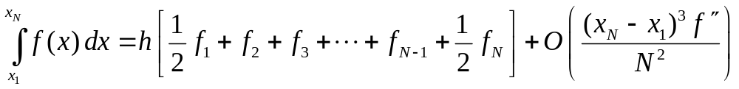
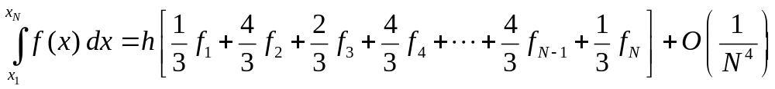
Extended Formulas
x₁ x₂ x₃ x₄ … x_{N}
Using trapezoidal rule in intervals [x₁,x₂], [x₂,x₃], [x₃,x₄], …, and [x_{N-1},x_{N} ], we get
Using Simpson’s rule in intervals [x₁,x₃], [x₃,x₅], etc, we get
Notes:
For trapezoidal rule, any N is fine. For Simpson’s rule, N must be an odd number.

Slide 9
Trapezoidal Routine
Sequence of points for each iteration n
n = 1
n = 2
n = 3
n = 4
2h_{n}
n = …
Subdivide the intervals and compute f_{i} only at points that have not been computed before.

Slide 10
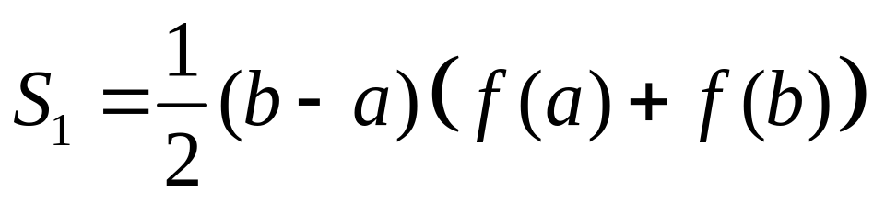
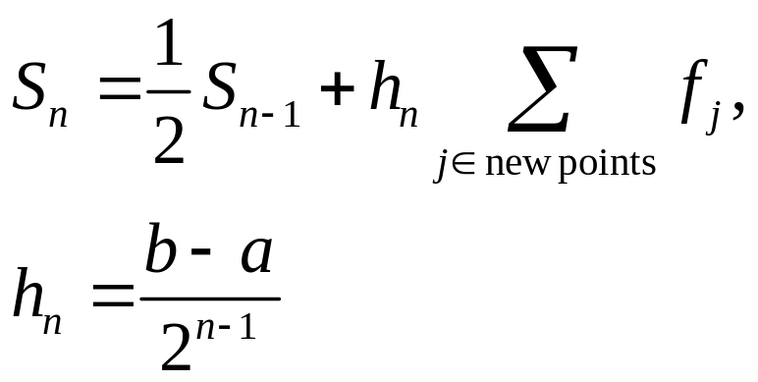
Recursive Computation of Trapezoidal Sum
If n = 1 (two points, one interval)
else if (n > 1)

Slide 11
trapzd( )
def FUNC(x):
return (x*x)
def trapzd(FUNC, a, b, n, s):
if n==1:
s = 0.5*(b-a)*(FUNC(a)+FUNC(b))
return s
else:
it = 2**(n-2)
d = (b-a)/it
x = a + 0.5*d
sum = 0.0
for j in range(0,it):
sum += FUNC(x)
x += d
s = 0.5*(s + (b-a)*sum/it)
return s
Note: d = 2 h_{n}

Slide 12
qtrap(..) call trapzd(..) until convergence
def qtrap(FUNC, a, b):
EPS = 1.0e-8
JMAX = 20
olds = -1.0e300
s = 0.0
for j in range(1, JMAX):
s = trapzd(FUNC,a,b,j,s)
if (math.fabs(s-olds) < EPS*math.fabs(olds)):
return s
if(s == 0.0 and olds == 0.0 and j > 6):
return s
olds = s
res = qtrap(FUNC,0.0,1.0)
print(res)

Slide 13
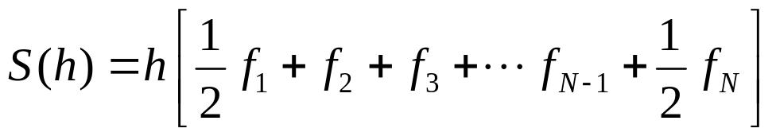
Romberg Integration
Compute trapezoidal sum
for different values of h, e.g., h₀, h₀/2, h₀/4, h₀/8, etc.
Extrapolate S(h) in polynomial of h² to h → 0. The justification for this is due to the Euler-Maclaurin formula.

Slide 14
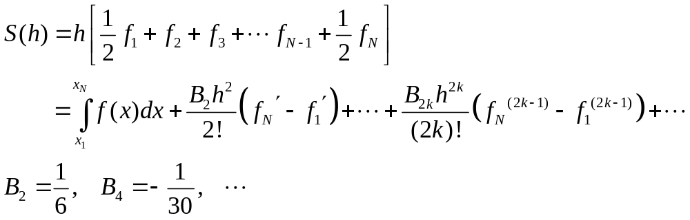
Euler-Maclaurin Summation Formula
The important point is that S(h) is in powers of h².
Notes:
B is called Bernoulli number.

Slide 15
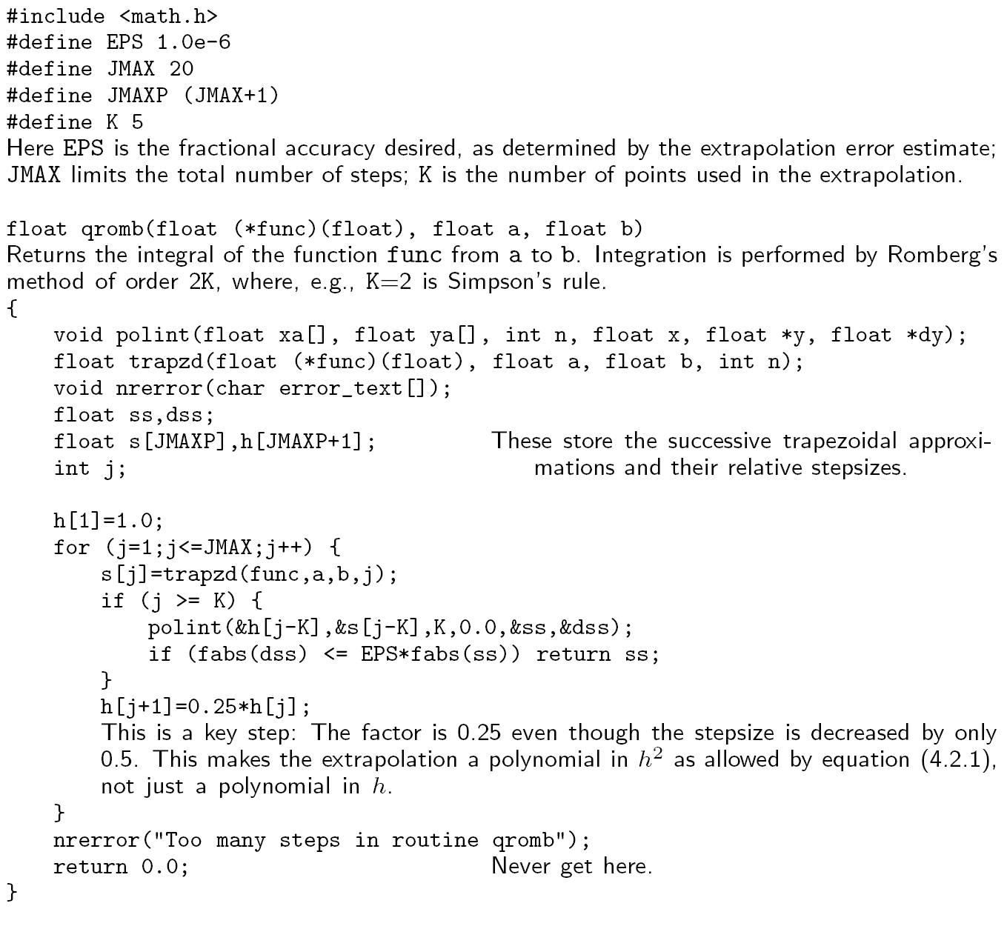
qromb( ) still in C
Notes:
See “Numerical Recipes in C”, chapter 4.3, page 140.

Slide 16
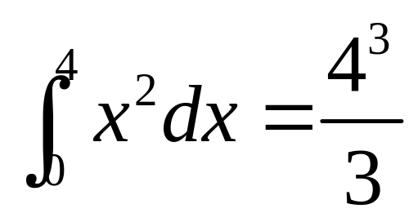
Integration Use Scipy
from scipy import integrate
x2 = lambda x: x**2
integrate.quad(x2,0,4)
Notes:
The Scipy quad() is actually calling Fortran QUADPACK. Lambda introduces a nameless one-line (pure) function.

Slide 17
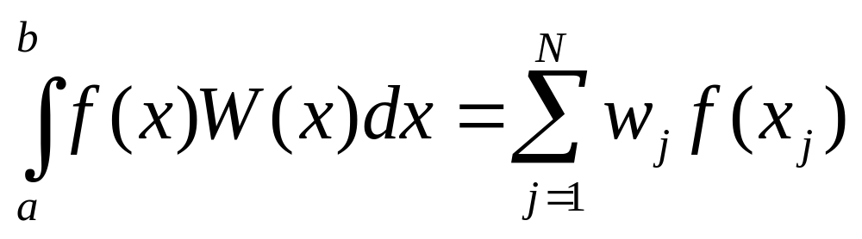
Theory of Gaussian Quadrature
Find w_{j} and abscissas x_{j} arbitrarily spaced that integrate exactly for all polynomials f(x) up to degree 2N-1:
where the weight function W(x) is assumed positive and continuous.
Notes:
Note that the right-hand side of the formula does not have the weight function W(x).

Slide 18
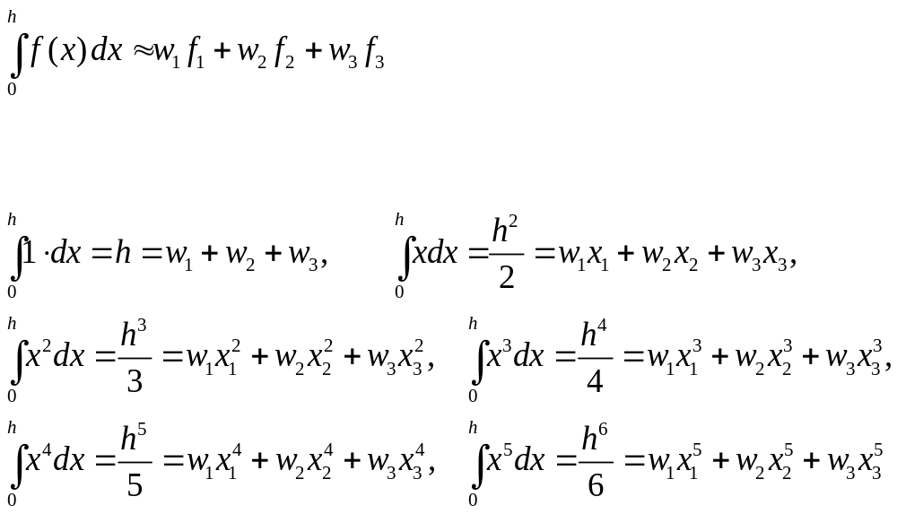
Example, 3 points, weight W(x)=1, exact for polynomials up to x⁵
set f(x) =1, x, x², …, x⁵.
How to find the solution of 6 coupled nonlinear equations?

Slide 19
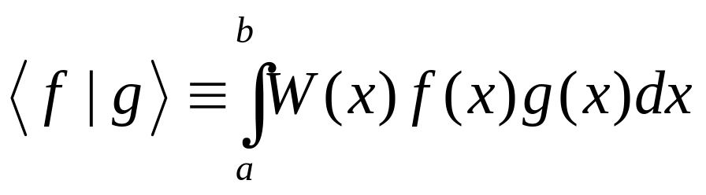
Orthogonal Polynomials
Two polynomials are said orthogonal with respect to a fixed weight function W(x) and fixed interval [a,b], if
is zero.
One can construct the orthogonal polynomial set {p_{j}(x), j=0,1, 2, …} recursively.
Notes:
Index j indicate the degree of polynomial.

Slide 20
Constructing Orthogonal Polynomials
Start with the zeroth order P₀(x)=1
Let P₁(x)=c₀+c₁x, determine the coefficients by requiring <P₀|P₁>=0, For weight W(x)=1 in interval [-1,1], this gives P₁(x)=x
Determine P₂(x)= c₀+c₁x+c₂x² by requiring <P₀|P₂>=0, <P₁|P₂>=0
In general
P_{j+1}(x) = (x-a_{j}) P_{j}(x) – b_{j} P_{j-1}(x)
Notes:
This process is known as Gram-Schmidt orthogonalization (in linear vector spaces). Why P_{j+1} does not depends on P_{j-2} and small index P?

Slide 21
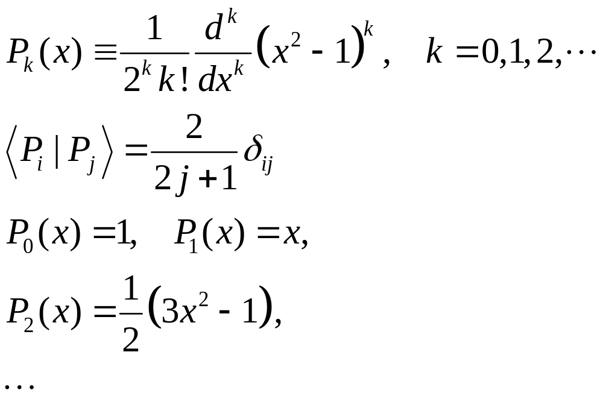
Example of Orthogonal Polynomials
With weight W(x) = 1 in interval [-1,1], the corresponding orthogonal polynomials are the Legendre polynomials:

Slide 22
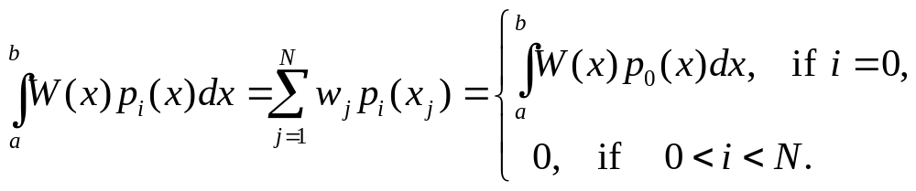
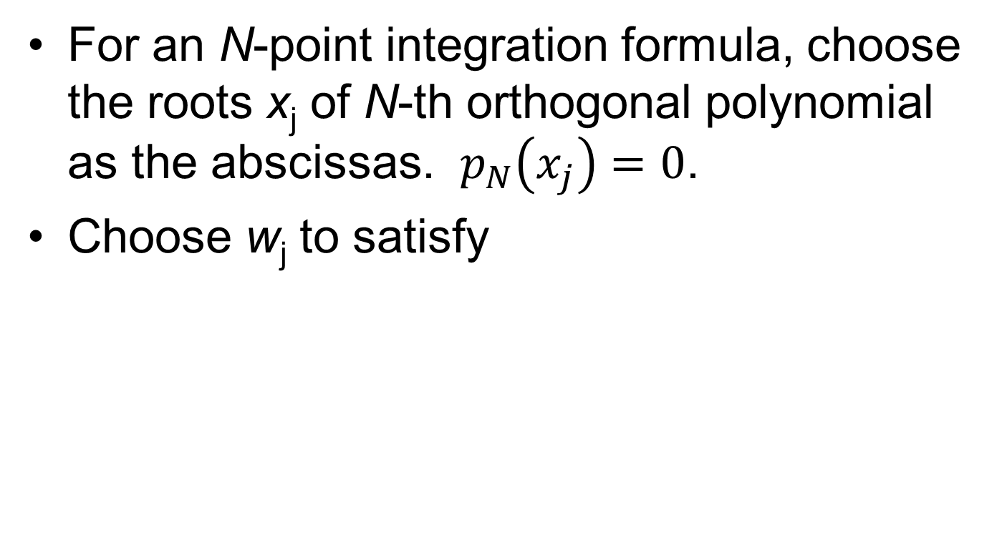
Abscissas in Gaussian Quadrature
For an N-point integration formula, choose the roots x_{j} of N-th orthogonal polynomial as the abscissas. $p_{N}\left(x_{j}\right)=0$.
Choose w_{j} to satisfy
It turns out that the ‘integration equal to 0’ is true also for i up to 2N-1.

Slide 23
Gaussian integration formula is exact for all polynomials of degree 2N-1
Let f(x) be any polynomial of degree 2N-1, we can write
f(x) = q(x) P_{N}(x) + r(x)
where r(x) and q(x) are degree N-1.
Considering the left- and right-hand side of the integration formula with function f(x), show that they are equal.
Notes:
How to divide in polynomials so that f = qP+r?

Slide 24
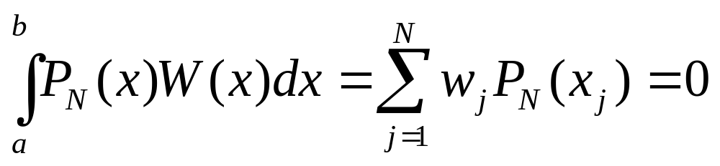
It is sufficient to show validity for f(x) = P₀=1,P₁, …,P_{N}, ..,P_{2N-1}. For 1 to N-1, it is equal to 0 by assumption.
For P_{N}, since x_{j} is the roots of P_{N},
For i = N+1,N+2, …,2N-1, we write P_{i}=qP_{N}+r, the first term qP_{N} is 0. Expand r in terms of P₀, P₁, …, P_{N-1}. We need to show coefficient for P₀ is the same on both sides of the equation.
Equality breaks down for P_{2N}
Notes:
For i=2N, the integral on the left side by definition is 0 (since it is orthogonal to P0), but right-side sum w P in general is not 0. The exactness of the integral breaks down.

Slide 25
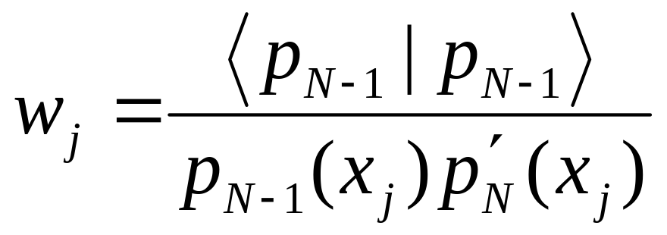
Solution for the Weight w_{j}
This formula assumes that the polynomials are normalized according to Eqs.(4.5.6) & (4.57), page 149 of NR.
Notes:
NR refers to “Numerical Recipes in C”, 2nd edition.

Slide 26
Reading, References
Read Chapter 4 of NR.
For an in-depth treatment of numerical methods, see, e.g., J. Stoer and R. Bulirsch, “Introduction to Numerical Analysis”.
See also M. T. Heath, “Scientific Computing, an introductory survey”, 2nd ed.

Slide 27
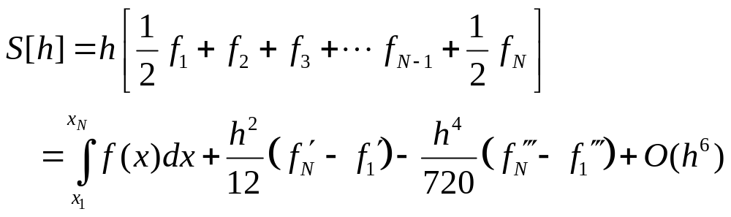
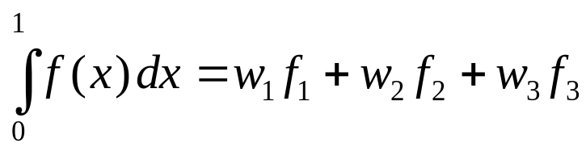
Problems for Lecture 4
1. Compute the Euler-Maclaurin summation formula for the first three terms, i.e.,
where h = (x_{N}-x₁)/(N-1). (Hint: Taylor expand & compute recursively.)
2. Use the theory of Gaussian quadrature to find a 3-point integration formula for the weight W(x) = 1 and interval [0, 1]. That is, find the abscissas x_{j} and weights w_{j} such that the formula below is exact for all polynomials of degree 5 or less.

