Slide 1
Chapter 10
Minimization or Maximization of Functions
Notes:
This week we study the method of find minimum or maximum of a function with many variables. You are asked to read the article on the conjugate gradient method. There is a link to the paper in the last page of this slide file.

Slide 2
Optimization Problems
Solution of a problem can be formulated as an optimization, e.g., light travel in a medium by Fermat’s principle, density functional theory (DFT) for electronic structure, Lagrangian mechanics with Hamilton’s least action, determining the weights in a neural network, etc.
Or even to solve Ax = b
Notes:
Finding minimum or maximum is closely related to find the solution of linear equations. The most important example is to find a minimum of a quadratic form, ½ x^T A x – b^T x. Finding minimum is to take the derivative, and let it equals to zero, which give a linear problem Ax = b. This is discussed in the conjugate gradient notes, which you are asked to read. In the conjugate gradient case, we turn the problem around, instead of solving a linear equation directly, e.g., by LU decomposition, we try to find minimum of the corresponding quadratic form. This method is efficient and fast if the matrix A is sparse, and Ax can be computed quickly. However, this works only when A is a symmetric matrix (why?).
The minimization problem is extremely important in physics because many problems (such as the solution of schrödinger equation for a ground state in quantum mechanics) can be formulated by a variational principle. The solution is found by minimization. The density functional theory can also be formulated as a minimization problem.

Slide 3
General Consideration
Use function values only, or use function values and its derivatives
Storage of O(N) or O(N²)
With constraints or no constraints
Choice of methods
  Steepest Descent
  Conjugate Gradient
  BFGS
Notes:
See NR on discuss of this. Broyden–Fletcher–Goldfarb–Shanno (BFGS) algorithm is an iterative method for solving unconstrained nonlinear optimization problems

Slide 4
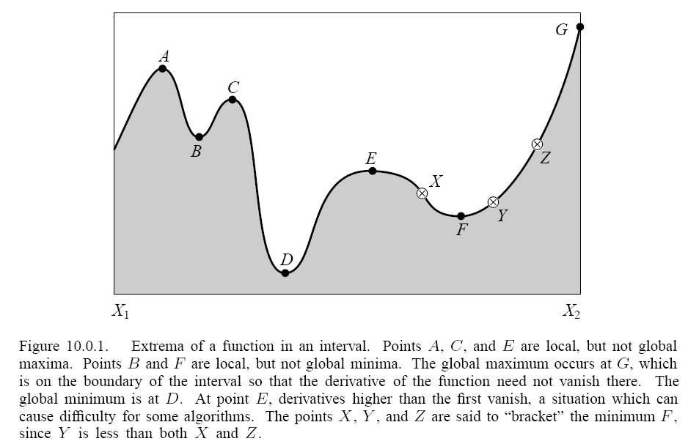
Local & Global Extremum
Notes:
We distinguish global and local minima.

Slide 5




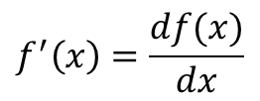

Gradient Descent
$ε$ is small
$$x→x−εf′(x)$$
$$f(x)$$
$$f^{′}\left(x\right)=\frac{df(x)}{dx}$$
$$x$$
$$f\left(x+h\right)=f\left(x\right)+f^{′}\left(x\right)h+O(h^{2})$$
Notes:
Show that moving x according to h = - eps f’ always decreases f value locally.

Slide 6
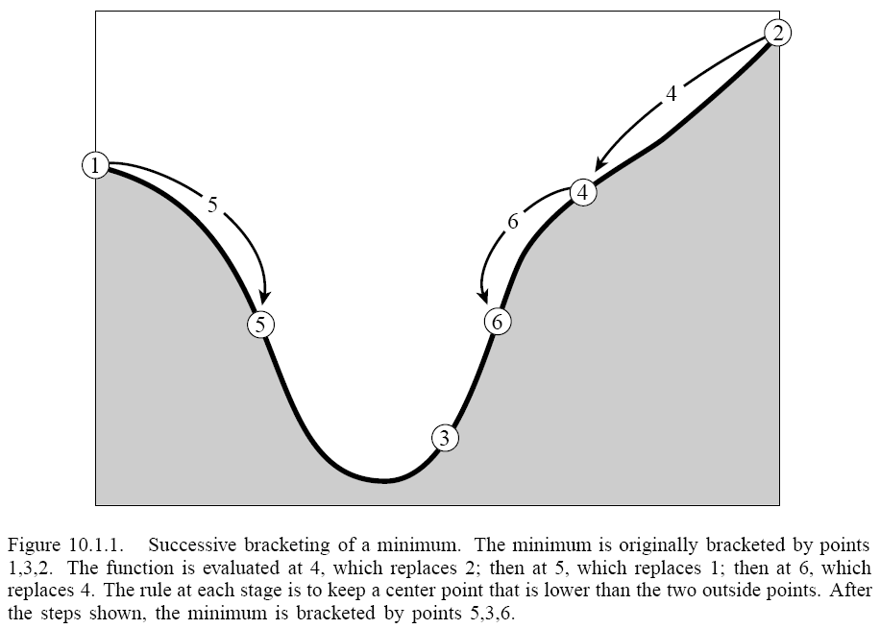
Bracketing and Search in 1D
Bracket a minimum means that for given a < b < c, we have f(b) < f(a), and f(b) < f(c). There is a minimum in the interval (a,c).
c
a
b
Notes:
Given three points, if we find the middle point is lower that the two boundary points, the we know there is a minimum between the two boundary points. To locate the minimum, we insert a 4th point between either [a,b], or [b, c] to eliminate one of the two end-points. The method is discussed in the next slides known as golden section search.

Slide 7
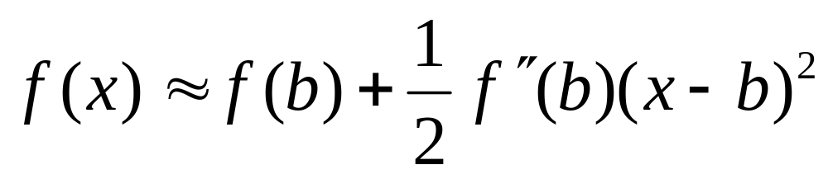
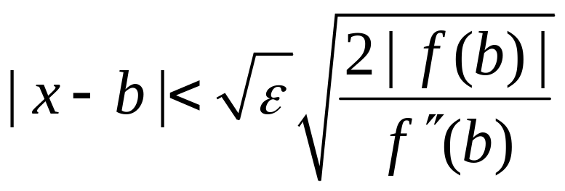

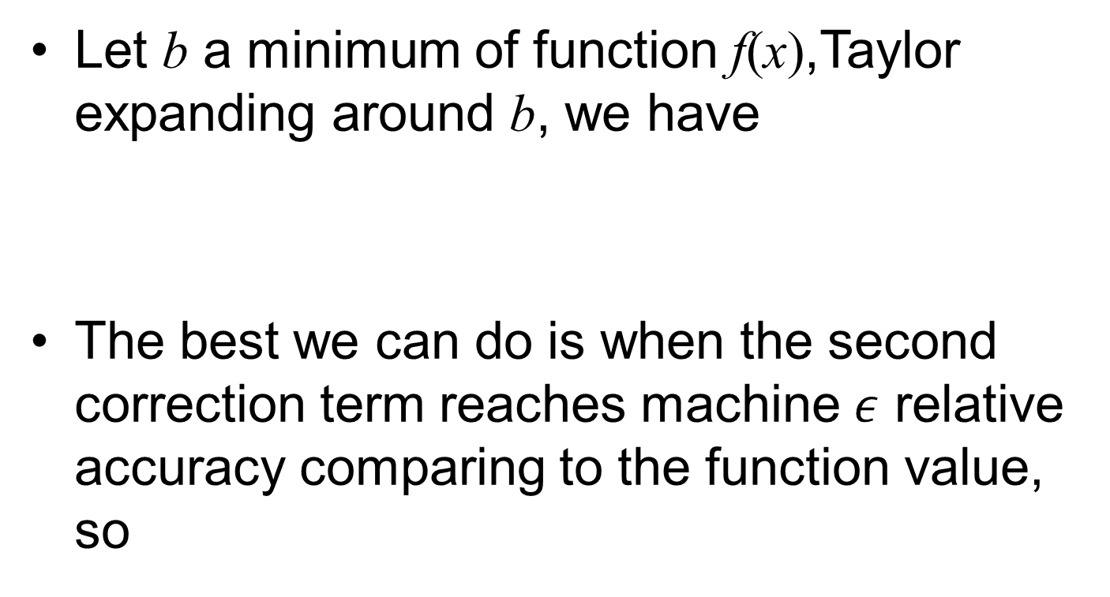
How accurately can we locate a minimum using $f$?
Let b a minimum of function f(x),Taylor expanding around b, we have
The best we can do is when the second correction term reaches machine $ε$ relative accuracy comparing to the function value, so
Notes:
As a rule of thumb, if we compute in double precision, relative error eps = 10^{-15}, then we can locate x value only at most 10^{-7} in relative accuracy. Its justification is given by the bottom formula above.

Slide 8
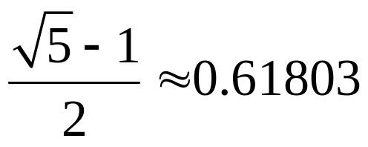
Golden Section Search
x
a
b
c
Choose x such that the ratio of intervals [a,b] to [b,c] is the same as [a,x] to [x,b]. Remove [a,x] if f[x] > f[b], or remove [b,c] if f[x] < f[b].
The asymptotic limit of the ratio is the Golden mean
Notes:
Starting with a golden ratio, removal of either [a,x] or [b,c], the segments are still in golden ratio. However, even if we start with arbitrary locations for a, b, c. It will approach the golden ratio in the end, as discussed in NR.

Slide 9
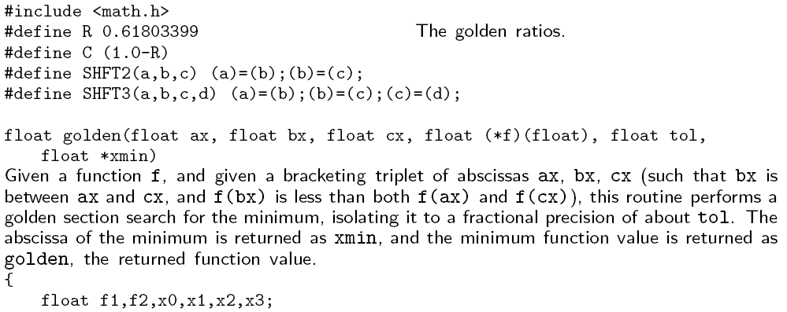
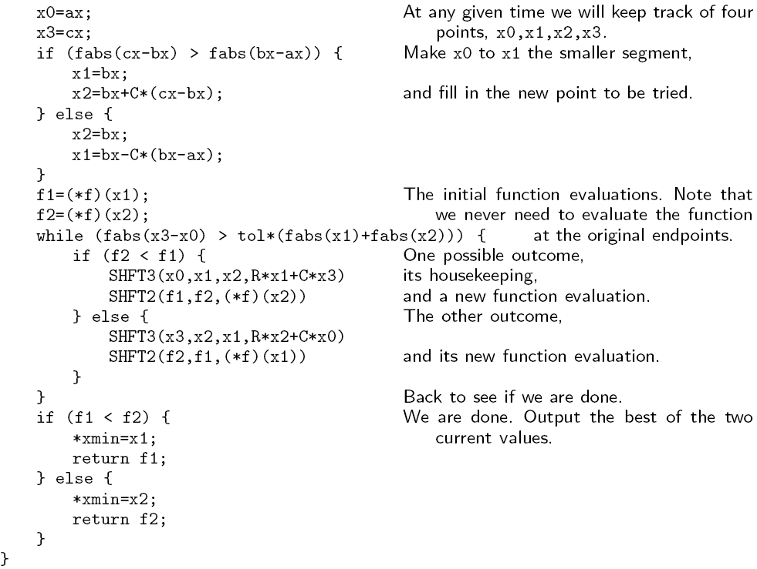
Notes:
Take a close look the code here.

Slide 10
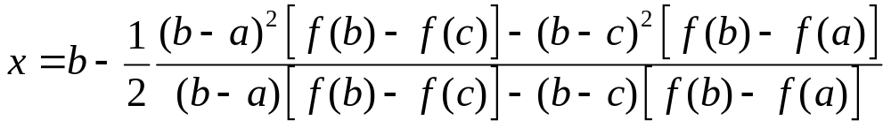
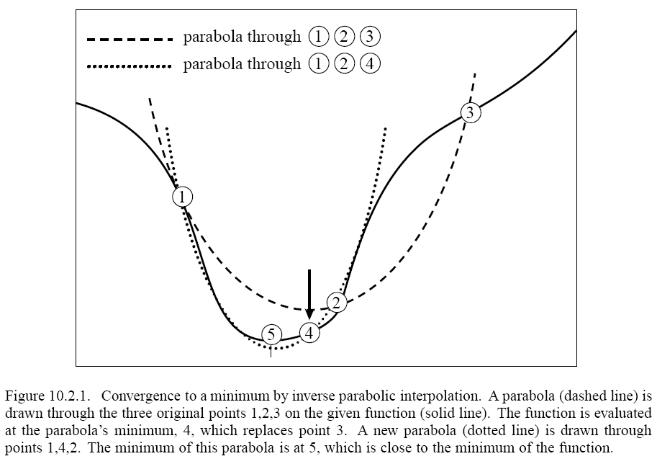
Parabolic Interpolation &
Brent’s Method
Brent’s method combines parabolic interpolation with Golden section search, with some complicated bookkeeping. See NR, page 404-405 for details.
Notes:
This is a more elaborate method comparing to the golden mean search.

Slide 11
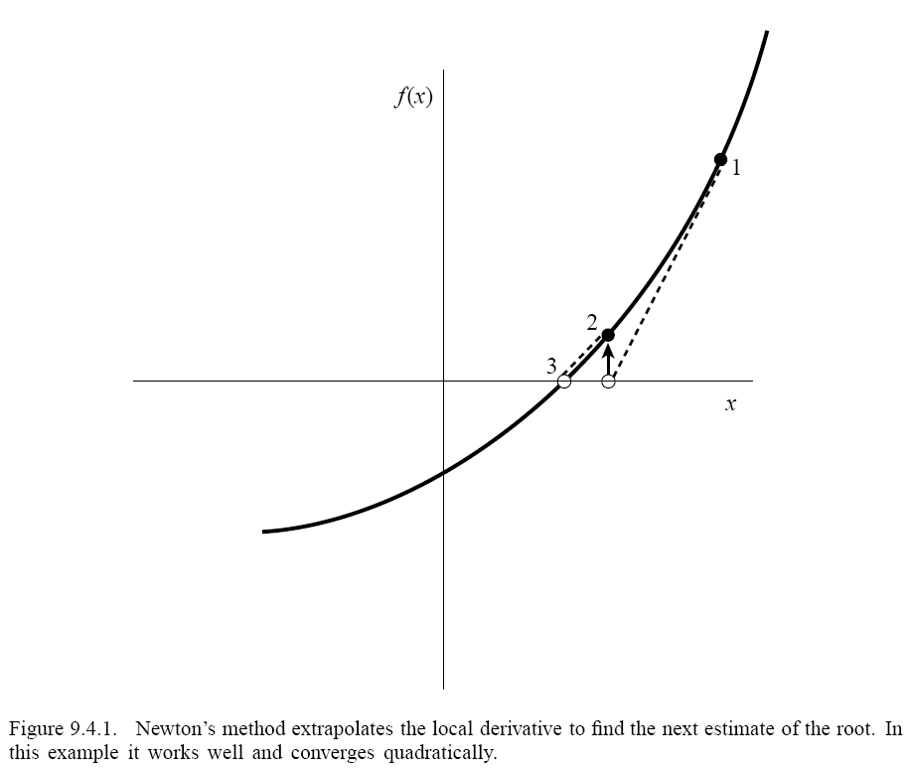
Minimization as a root-finding problem
Let’s the derivative dF(x)/dx = f(x), then minimizing (or maximizing) F is the same as finding zero of f, i.e., f(x) = 0.
Newton method:
approximate curve
as a straight line.
Notes:
See numerical recipes, chapter 9. With Newton iteration, you can locate the minimum to machine precision, why?

Slide 12
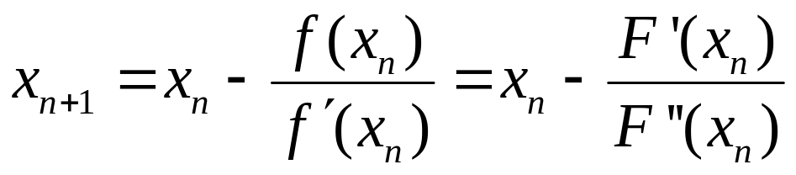
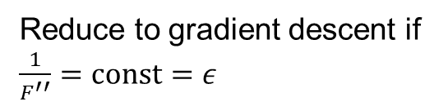
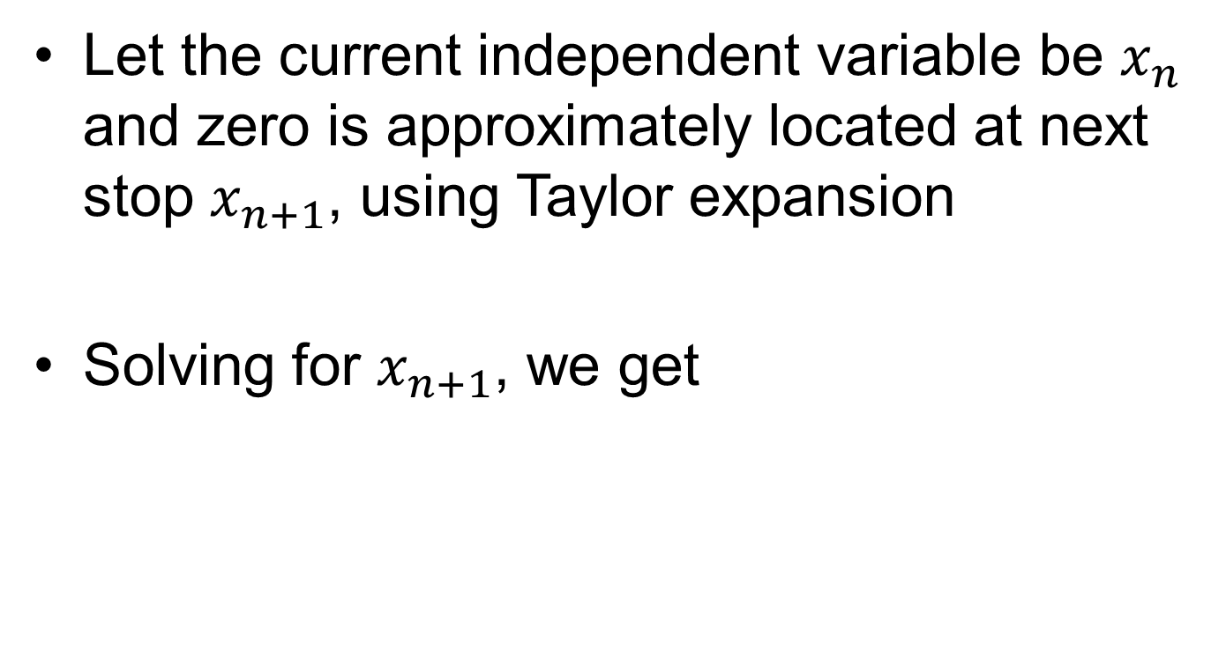
Deriving Newton Iteration
Let the current independent variable be $x_{n}$ and zero is approximately located at next stop $x_{n+1}$, using Taylor expansion
Solving for $x_{n+1}$, we get
Reduce to gradient descent if $\frac{1}{F^{′′}}=const=ε$
Notes:
Conditions for convergence (1) close enough to solution, (2) f’(x) ≠ 0, (3) Lipschitz condition for the derivative |f’(x) – f’(y) | < L | x –y|. If we assume we have a minimum, then F’’ > 0 when x is close to the minimum. Thus the update, x -> x – F’(x)/F’’(x) is closely related the descent method with eta 1/F’’ as the optimal choice.

Slide 13
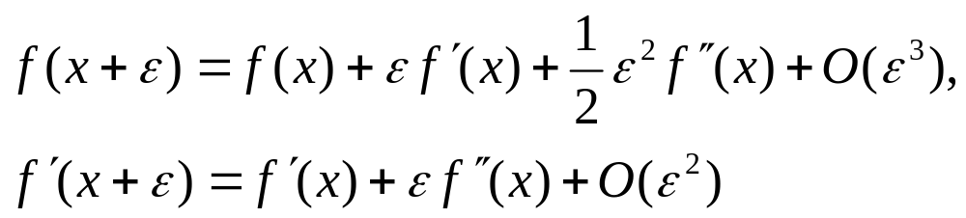
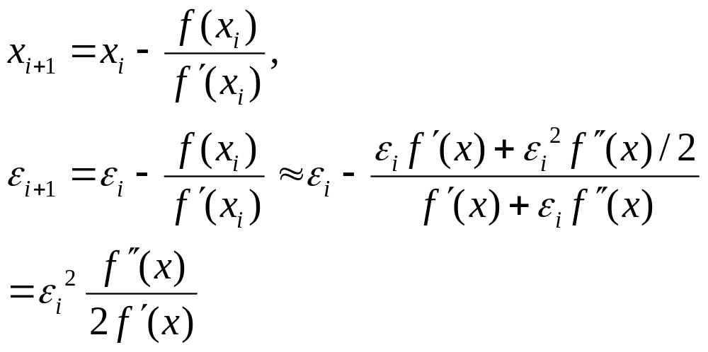
Convergence in Newton Iteration
Let x be the exact root, x_{i} is the value at i-th iteration, and ε_{i} =x_{i}-x is the error, then
Rate of convergence:
(Quadratic convergence)

Slide 14
Strategy in Higher Dimensions
Starting from a point P and a direction n, find the minimum on the line P + λn, i.e., do a 1D minimization of y(λ)=f(P+λn)
Replace P by P + λ_{min} n, choose another direction n’ and repeat step 1.
The trick and variation of the algorithms are on chosen n.
Notes:
The line search, moving in a one-dimensional subspace of high dimensional space, reduces high dimensions back to one dimension, so it is important to know how to do 1D minimum as discussed earlier. A line can be represented by a set of linear equations. If P and n are two vectors, convince your self that P + lambda * n, represent a line if the scalar lambda is varied. This is general in any dimension N.

Slide 15
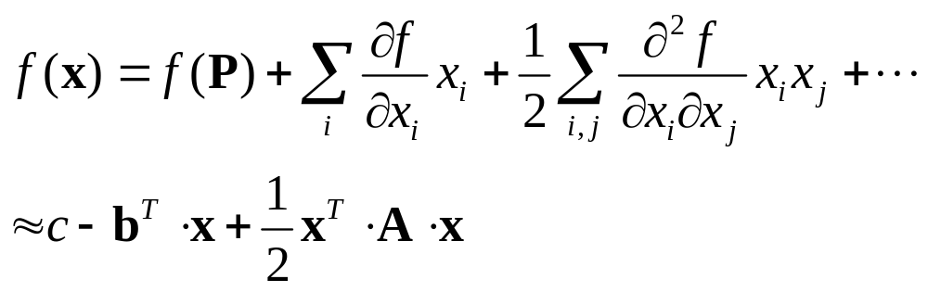

Local Properties near Minimum
Let P be some point of interest which is chosen to be the origin x=0. Taylor expansion gives
Minimizing f is the same as solving the equation
^{T} for transpose of a matrix
Notes:
The algorithm discussed in the next few slides assume that the function is smooth and already closed to its minimum so that Taylor expansion makes sense. The word “point” means a point in N dimensions, not necessarily three dimensions. Thus matrix A is N x N.

Slide 16
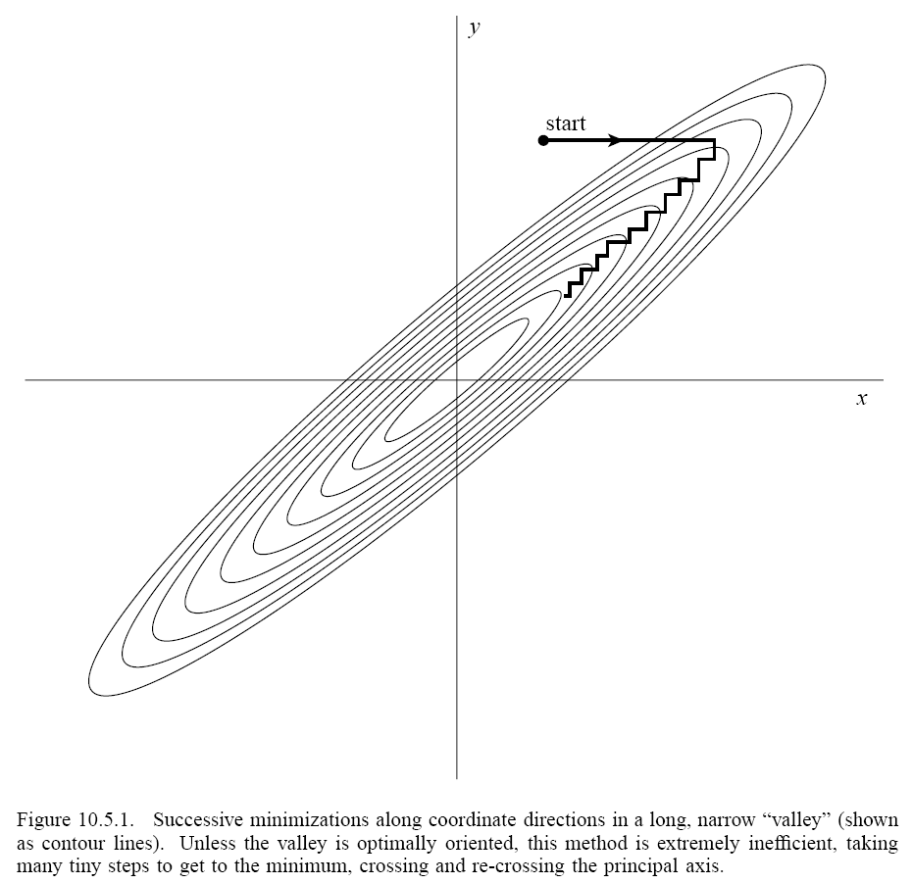
Search along Coordinate Directions
Search minimum along x direction, followed by search minimum along y direction, and so on. Such a method takes a very large number of steps to converge.
The curved loops represent f(x,y) = const.

Slide 17
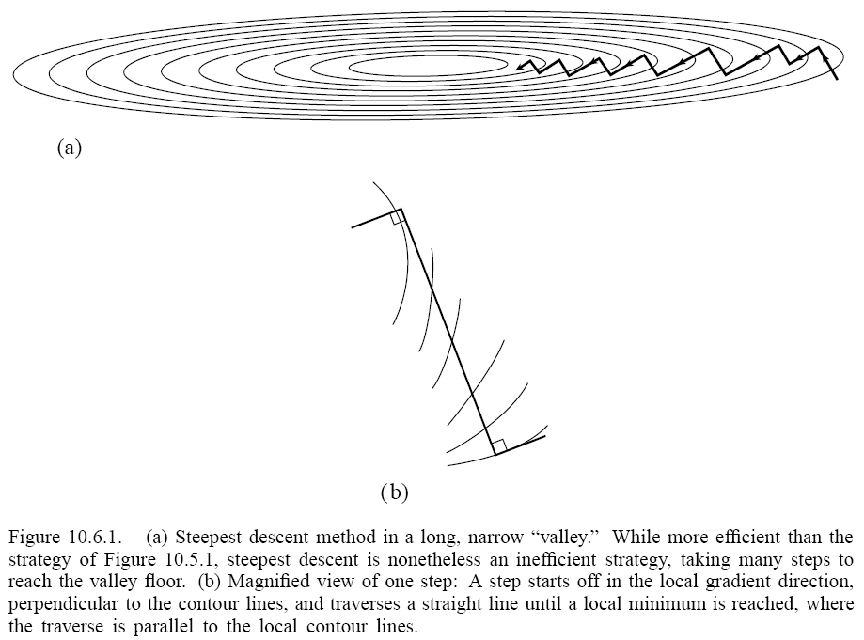
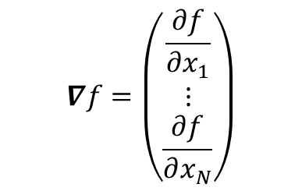
Steepest Descent
Search in the direction with the largest decrease, i.e., n = -∇f
Constant f contour line (surface) is perpendicular to n, because df = dx⋅∇f = 0.
The current search direction n and next search direction are orthogonal, because for minimum λ we have
y’(λ) = df(P+λn)/dλ = n^{T} ⋅ ∇f|_{P+λn} = 0
n’
n^{T} ⋅ n’ = 0
n
$$∇f=\left(\begin{matrix}\frac{∂f}{∂x_{1}} \\ ⋮ \\ \frac{∂f}{∂x_{N}}\end{matrix}\right)$$
Notes:
Steepest descent means we go in a direction given by the gradient of the current location, go as far as we can in that straight-line direction until we find minimum along that direction. The condition to stop turns out to be that the new gradient and old gradient are perpendicular to each other. The direction of gradient is always perpendicular to the constant f surface, that is, the gradient is in the direction of norm.

Slide 18
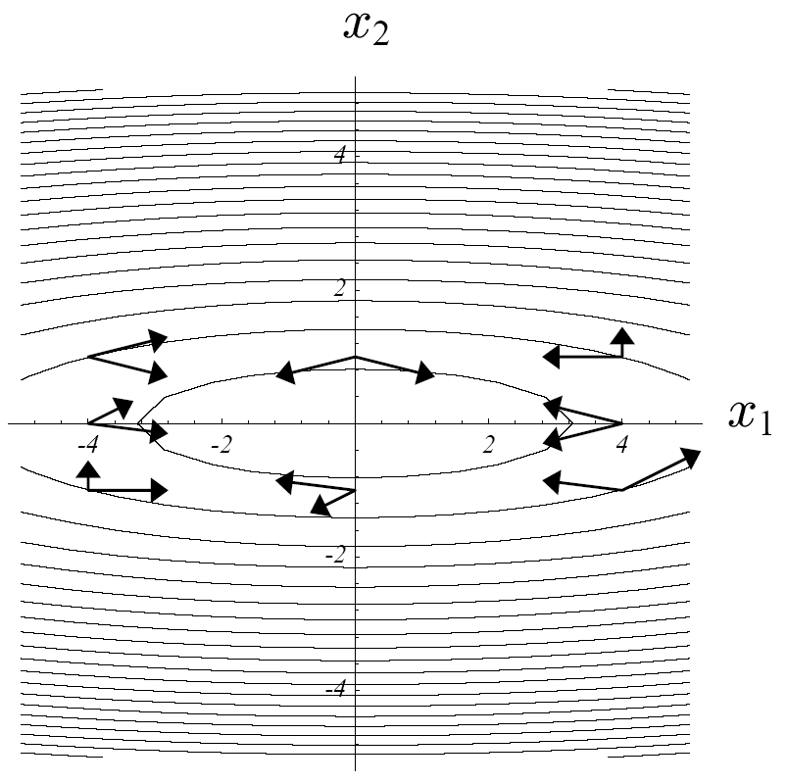
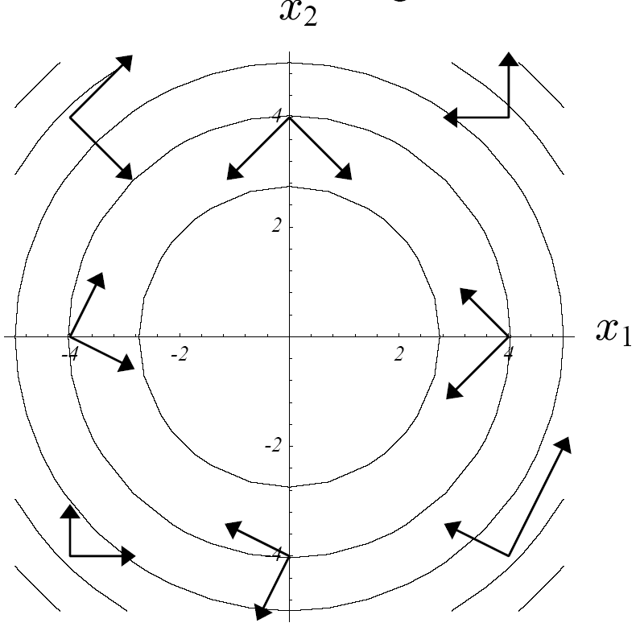
Conjugate Condition
Make a linear coordinate transformation, such that contour is circular and (search) vectors are orthogonal
n₁^{T} ⋅ A ⋅ n₂ = 0
Notes:
Figures from http://www-2.cs.cmu.edu/~quake-papers/ The idea of conjugate gradient is that we consider transforming the problem in a new coordinate system so that the constant value contour is circular (2D) or spherical (3D). If this is the case, we only need to do two searches in a perpendicular directions (in 2D) as indicated by the arrows on the left plot. It takes two steps no matter where we start with. However, the trick is that we don’t want to do this transformation explicitly. The perpendicular condition turns out to be n_1^T A n_2 = 0 in the original coordinate system, which is called conjugate condition. (The 1st tutorial problem of this week is about this.) So in the original setup, we need to determine the directions so that they are conjugate with each other.

Slide 19
Conjugate Gradient Method
Start with negative gradient n₀ = g₀ = -∇f(x₀), find new minimum x₁
Build the next search direction n₁ from g₀ and g₁ = -∇f(x₁), such that n₀⋅A⋅n₁ = 0
Repeat step 2 iteratively to find n_{j} (a Gram-Schmidt orthogonalization process). The result is a set of N vectors (in N dimensions) n_{i}^{T}⋅A⋅n_{j} = 0
Notes:
This is the idea, but actually CG method do things more smartly than listed here. It is actually done by the slides of next one. Because the dimensionality is N, you can at most construct N mutually perpendicular directions. So this means the conjugate gradient method converge exactly in N steps, if the function f is exactly a quadratic form.

Slide 20
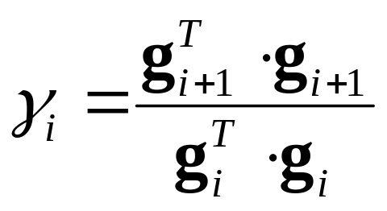
Conjugate Gradient Algorithm
Initialize n₀ = g₀ = -∇f(x₀), i = 0
Find λ that minimizes f(x_{i}+λn_{i}), let x_{i+1} =x_{i}+λn_{i}
Compute new negative gradient g_{i+1} = -∇f(x_{i+1})
Compute
Update new search direction as n_{i+1} = g_{i+1} + γ_{i}n_{i}; ++i, go to 2
(Fletcher-Reeves)
Notes:
Here is the final algorithm. We can not go into the derivation of the algorithm. But if you read the posted CG paper, we’ll learn a lot about linear algebra, and get a good understanding why the method above actually works. To better understand the procedure, you should do with a concrete example, for example, the f function in 2D as given in the CG paper. That is, use the quadratic function defined there. Starting with any initial (x,y), and follow the steps above, see if you reach the solution. NR discussed variation of step 4. This particular one is known as Fletcher-Reeves.

Slide 21
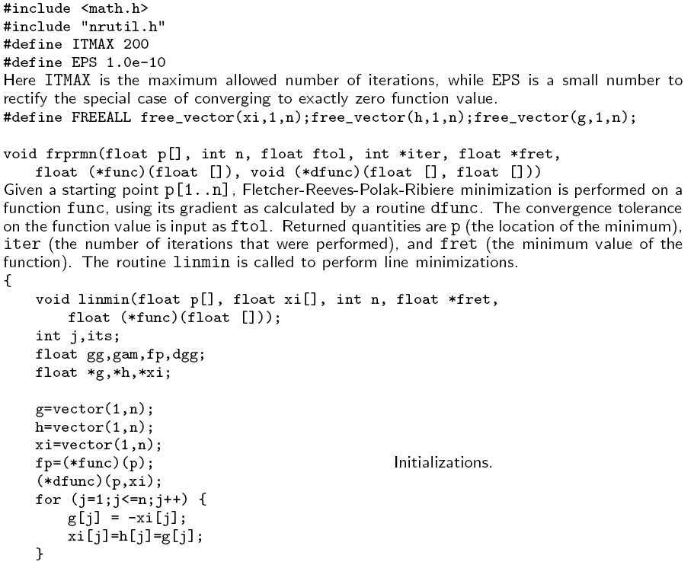
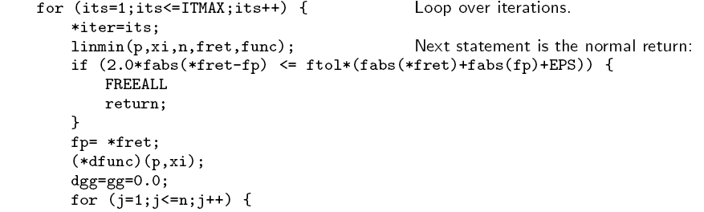
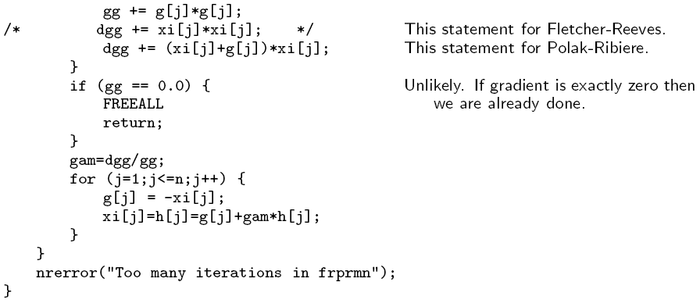
The Conjugate Gradient C Program
Notes:
Skip the code if it is difficult. See python code: https://phyweb.physics.nus.edu.sg/~phywjs/CZ5101/CG.py

Slide 22
CG, a Python implementation
import numpy as np
def conjugate_gradient(A, b, x=None, max_iter=512, reltol=1e-2):
if x is None:
x=np.zeros_like(b)
r=b-A(x)
d=r
rsnew=np.sum(r.conj()*r).real
rs0=rsnew
ii=0
while ((ii<max_iter) and (rsnew>(reltol**2*rs0))):
ii=ii+1
Ad=A(d)
alpha=rsnew/(np.sum(d.conj()*Ad))
x=x+alpha*d
if ii%50==0:
#every now and then compute exact residual to mitigate
# round-off errors
r=b-A(x)
d=r
else:
r=r-alpha*Ad
rsold=rsnew
rsnew=np.sum(r.conj()*r).real
d=r+rsnew/rsold*d
return x
Notes:
From https://researchsfinest.com/2020/04/15/conjugate-gradient-in-python/

Slide 23
TensorFlow implementation of CG
tf.linalg.experimental.conjugate_gradient(operator, rhs, preconditioner=None, x=None, tol=1e-05, max_iterater=20,name=‘conjugate_gradient’)
Solves a linear system of equations Ax = rhs for Hermitian, positive definite matrix A, the matrix A is presented by operator.

Slide 24
Simulated Annealing
To minimize f(x), we make random change to x by the following rule:
Set “temperature” T a large value, decrease as we go
Metropolis algorithm: make local change from x to x’. If f decreases, accept the change, otherwise, accept only with a small probability r = exp[-(f(x’)-f(x))/T]. This is done by comparing r with a random number 0 < ξ < 1.
Notes:
Simulated annealing is a sort of Monte Carlo method, but with a gradual decrease of the temperature.

Slide 25
Traveling Salesman Problem
Beijing
Tokyo
Shanghai
Taipei
Hong Kong
Kuala Lumpur
Find shortest path that cycles through each city exactly once.
Singapore

Slide 26
Reading Materials
Chapter 10 of NR
Read:
http://www.cs.cmu.edu/~quake-papers/painless-conjugate-gradient.pdf

Slide 27
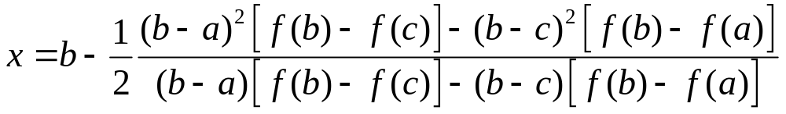
Problem set 7
Derive the formula of Brent method (minimum x determined by three points):
Suppose that the function is given by the quadratic form f=(1/2)x^{T}⋅A⋅x, where A is a symmetric and positive definite matrix. Find a linear transform to x so that in the new coordinate system, the function becomes f = (1/2)|y|², y = Ux [i.e., the contour is exactly circular or spherical]. More precisely, give a computational procedure for U. If two vectors in the new system are orthogonal, y₁^{T}⋅y₂=0, what does it mean in the original system?
Notes:
For Q2, the Cholesky decomposition is the best.

