Slide 1
Chapter 15
Modeling of Data
Notes:
Three things to provide (i) estimate of the fitting parameters, (ii) errors on them, (iii) a statistical measure of goodness-of-fit.

Slide 2
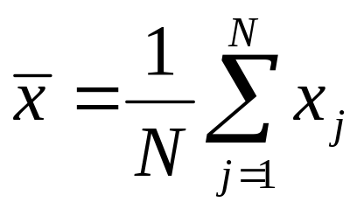
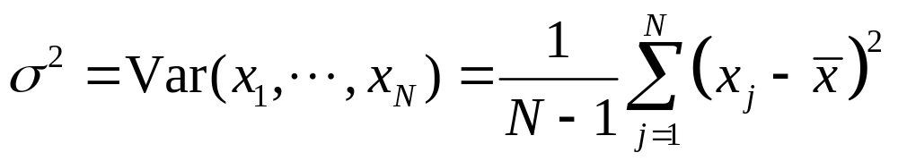
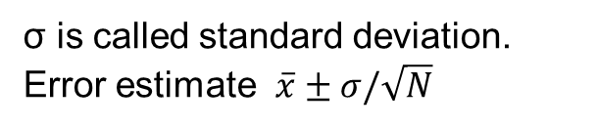
Statistics of Data
Mean (or average):
Variance:
Median: a value x_{j} such that half of the data are bigger and half of the data are smaller than it.
σ is called standard deviation. Error estimate $\overline{x}±σ/\sqrt{N}$
Notes:
Dividing by N-1 rather than N is called “unbiased” estimate, why?

Slide 3
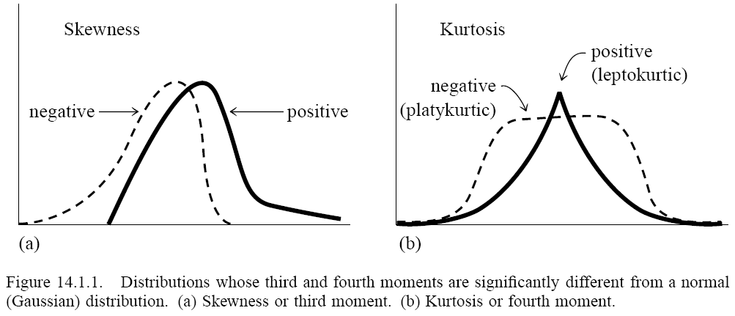
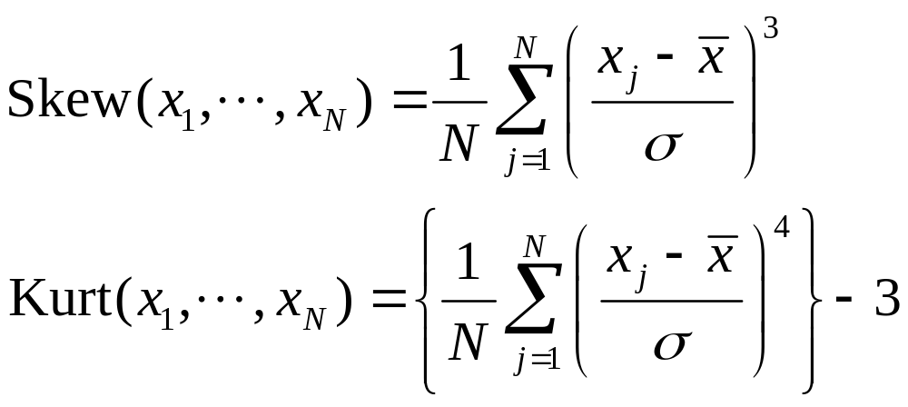
Higher Moments

Slide 4
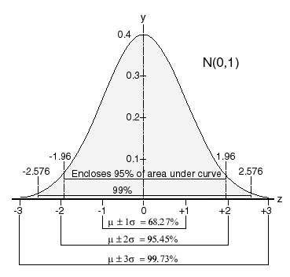
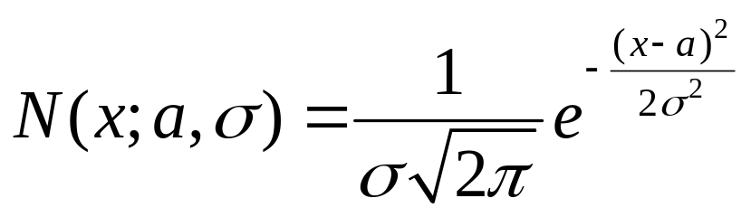
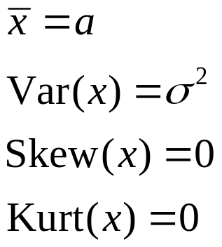
Gaussian Distribution
Confidence intervals

Slide 5
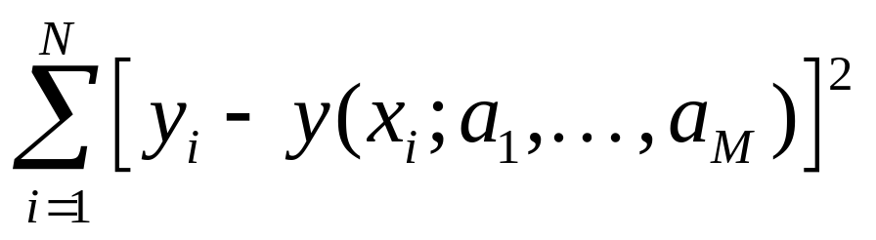
Least Squares
Given N data points (x_{i},y_{i}), i = 1, …, N, find the fitting parameters a_{j}, j = 1, 2, …, M of a function
f(x) = y(x; a₁,a₂,…,a_{M})
such that
is minimized over the parameters a_{j}.

Slide 6
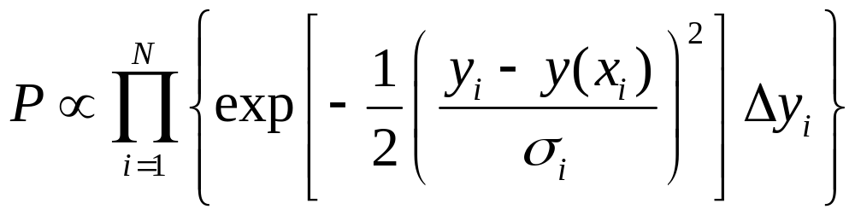
Why Least Squares
Given the parameters, what is the probability that the observed data occurred?
Assuming an independent, Gaussian distribution, this is:
Notes:
There is the more elaborate Baysian analysis which we will not go into. This is the maximum-likelihood estimate.

Slide 7
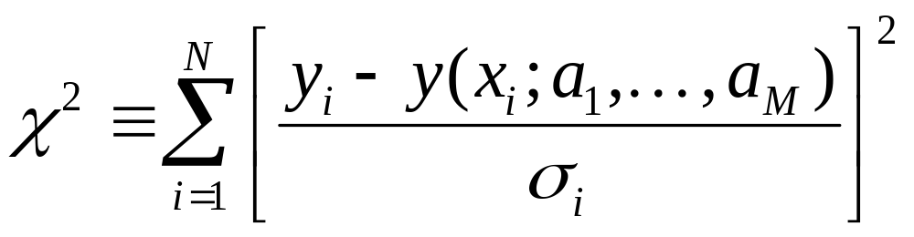
Chi-Square Fitting
Minimize the quantity:
If each term is an independent Gaussian, χ² follows the so-called χ² distribution. Given the value χ² above, we can compute Q = Prob(random variable chi² > χ²)
If Q < 0.001 or Q > .999, the model may be rejected.

Slide 8
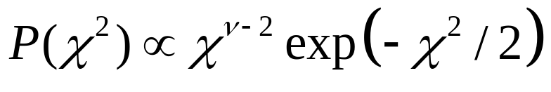
Meaning of Goodness-of-Fit Q
If the statistic χ² indeed follows this distribution, the probability that the chi-square value is the currently computed value χ², or greater, equals the hashed area Q.
It is quite unlikely if Q is very small or very close to 1. If so, we reject the model.
Number of degrees of freedom ν = N – M.
Observed value of χ²
Area = Q
0
χ²
Notes:
v is the number of sum of gaussian random variables. χ2 is the sum of gaussian squared. Q value is also called P value?? in other statistic literature. R2 or coefficient of determination is sometimes used.

Slide 9
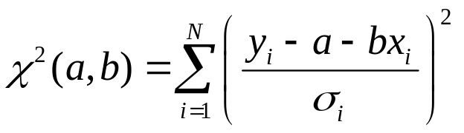
Fitting to Straight Line
(with known errors)
Given (x_{i}, y_{i}±σ_{i})
Find interception a and slope b such that
the chi-square merit function is minimized.
Goodness-of-fit is Q=gammq((N-2)/2, χ²/2). If Q > 0.1, the fitting is good; if Q ≈ 0.001, may be OK, but if Q < 0.001, the fitting is questionable.
If Q > 0.999, the fitting is too good to be true.
y
fitting to y=a+bx
x

Slide 10
Linear Regression Model
y
Error in y, but no error in x.
Data do not follow exactly the straight line. The basic assumption in linear regression (least squares fit) is that the deviations ε are independent gaussian random noise.
ε
fitting to y=a+bx
x

Slide 11
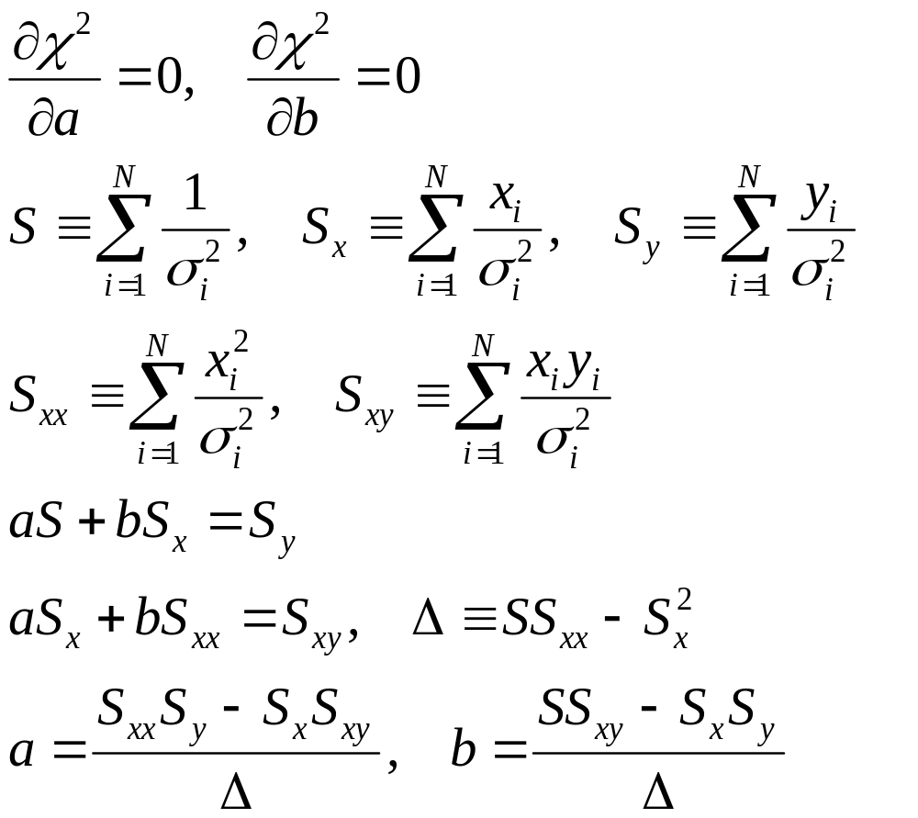
Solution of Straight Line Fit

Slide 12
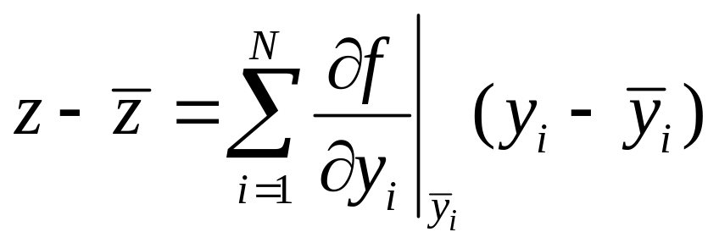
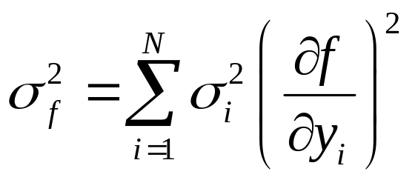
Error Propagation
Let z = f(y₁,y₂,…,y_{N}) be a function of independent random variables y_{i}. Assuming the variances are small, we have
Variance of z is related to variances of y_{i} by

Slide 13
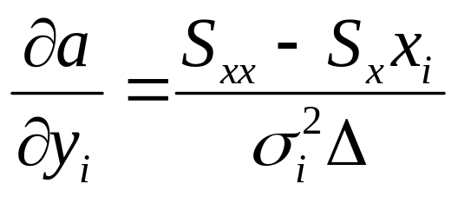
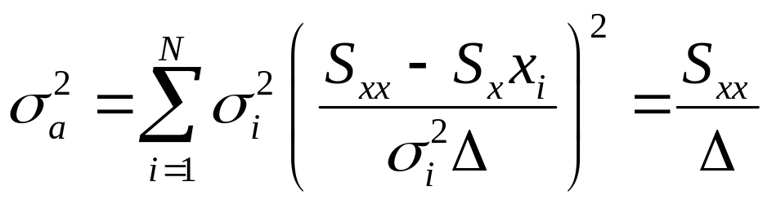
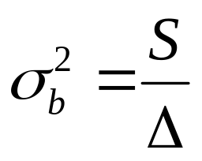
Error Estimates on a and b
Using error propagation formula, viewing a as a function of y_{i}, we have
Thus
Similarly

Slide 14
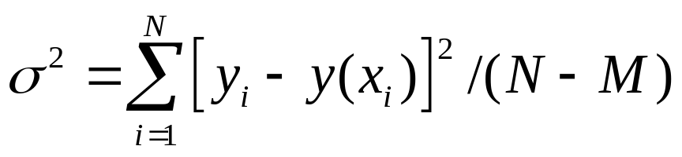
What if error in y_{i} is unknown?
The goodness-of-fit Q can no longer be computed
Assuming all data have same σ:
Error in a and b can still be estimated, using σ_{i}=σ (but less reliably)
M is number of basis functions, M=2 for straight line fit.

Slide 15
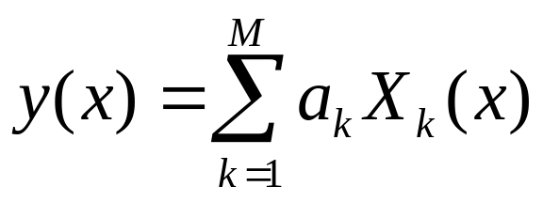
General Linear Least-Squares
Fit to a linear combination of arbitrary functions:
E.g., polynomial fit X_{k}(x)=x^{k-1}, or harmonic series X_{k}(x)=sin(kx), etc
The basis functions X_{k}(x) can be nonlinear

Slide 16
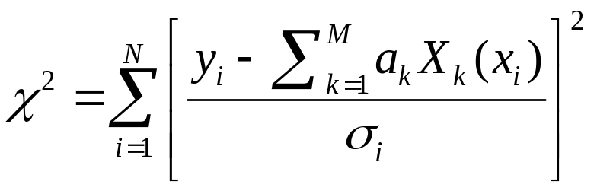
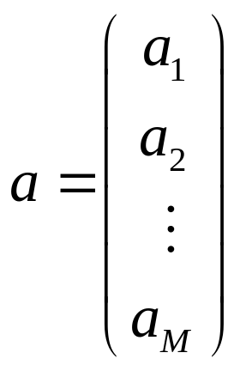
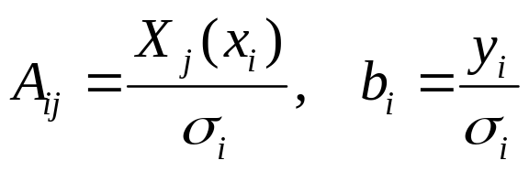
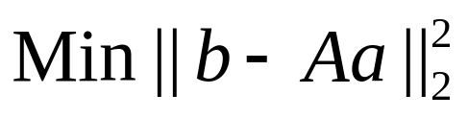

Merit Function & Design Matrix
Find a_{k} that minimize
Define
The problem can be stated as
Let a be a column vector:
$\left\|⋅\right\|$ is 2-norm
Notes:
Recall the LASSO method add extra 1-norm term.

Slide 17
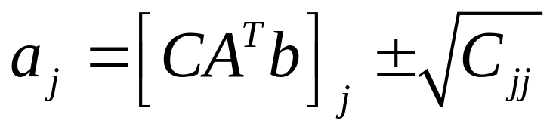
Normal Equation & Covariance
The solution to min ||b-Aa||² is A^{T}Aa=A^{T}b
Let C = (A^{T}A)⁻¹, then a = CA^{T}b
We can view data y_{i} as a random variable due to random error, y_{i}=y(x)+ε_{i}. <ε_{i}>=0, <ε_{i}ε_{j}>=σ_{i}² δ_{ij}. Thus, a is also a random variable. Covariance of a is precisely C
<aa^{T}>-<a><a^{T}> = C
Estimate of the fitting coefficient is

Slide 18
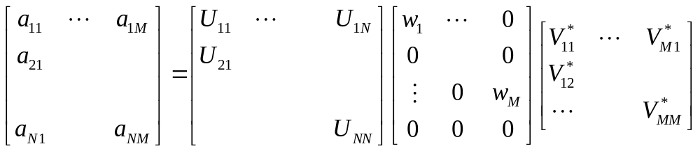
Singular Value Decomposition
We can factor arbitrary complex matrix as
A = UΣV†
N×M
N×M
N×N
M×M
U and V are unitary, i.e., UU†=1, VV†=1
Σ is diagonal (but need not square), real and positive, w_{j} ≥ 0.
Notes:
The singular values are the square root of the eigenvalues of AA† or A†A. Dagger † denotes conjugate transpose. For real matrix A, † becomes transpose ^{T}.

Slide 19
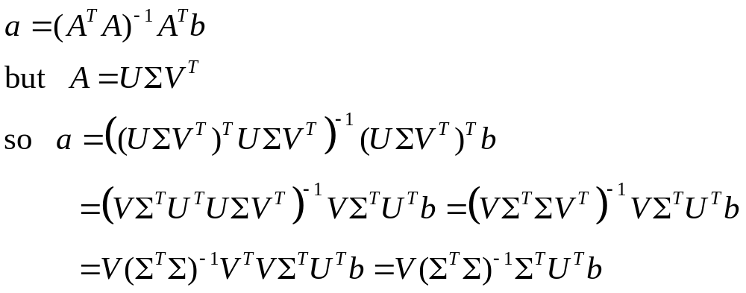
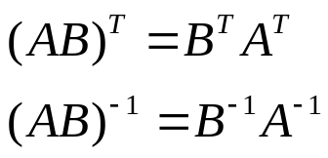
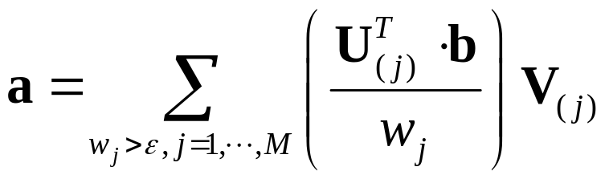
Solve Least-Squares by SVD
From normal equation, we have
Omitting terms with very small w gives a robust method.
Or
Notes:
U(j), V(j) are j-th column of U and V.

Slide 20
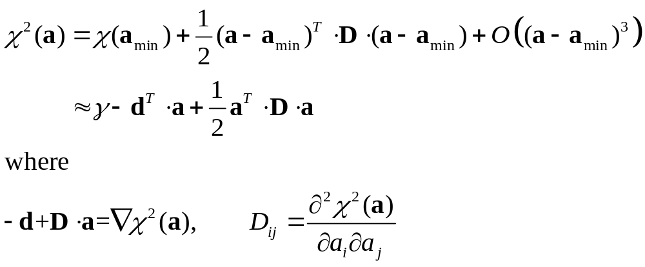
Nonlinear Model y=y(x; a)
χ² is a nonlinear function of a. Close to a minimum, we have (Taylor expansion)
²

Slide 21
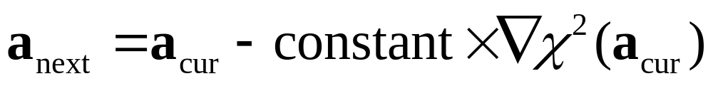
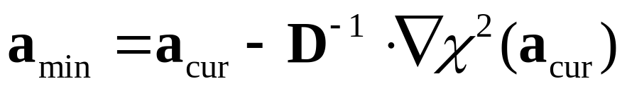
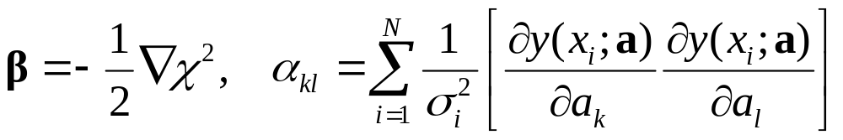
Solution Methods
Know gradient only, Steepest descent:
Know both gradient and Hessian matrix:
Define
Notes:
y(x,a) is the fitting function. Alpha_kl is always the Hessian D, but omitted terms.

Slide 22
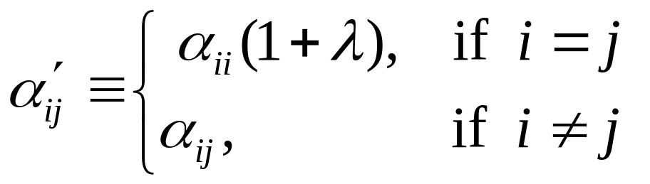
Levenberg-Marquardt Method
Smoothly interpolate between the two methods by a control parameter λ. λ=0, use more precise Hessian; λ very large, use steepest descent.
Define new matrix A' with elements:

Slide 23
Levenberg-Marquardt Algorithm
Start with an initial guess of a
Compute χ²(a)
Pick a modest value for λ, say λ=0.001
(†) Solve A'δa=β, evaluate χ²(a+δa)
If χ² increase, increase λ by a factor of 10 and go back to (†)
If χ² decrease, decrease λ by a factor of 10, update a ← a+ δa, and go back to (†)

Slide 24
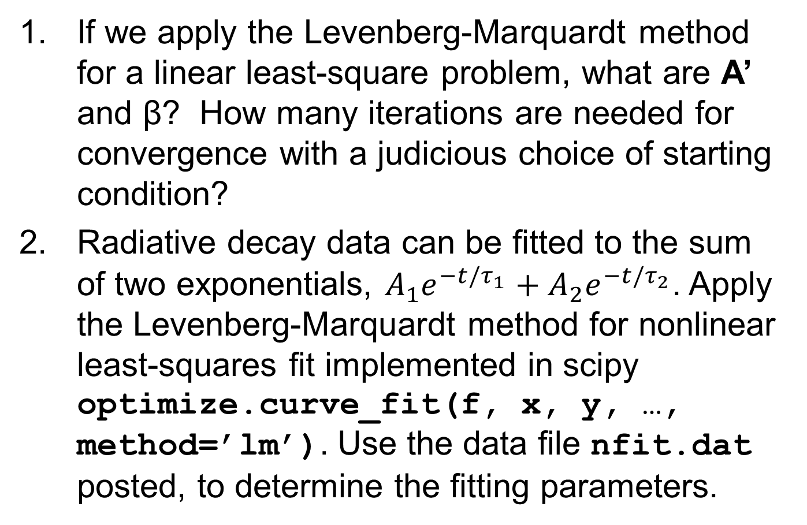
Problem Set 9
If we apply the Levenberg-Marquardt method for a linear least-square problem, what are A’ and β? How many iterations are needed for convergence with a judicious choice of starting condition?
Radiative decay data can be fitted to the sum of two exponentials, $A_{1}e^{−t/τ_{1}}+A_{2}e^{−t/τ_{2}}$. Apply the Levenberg-Marquardt method for nonlinear least-squares fit implemented in scipy optimize.curve_fit(f, x, y, …, method=’lm’). Use the data file nfit.dat posted, to determine the fitting parameters.
Notes:
The fitting data is here: https://phyweb.physics.nus.edu.sg/~phywjs/CZ5101/nfit.dat

