Slide 1
PC2135
Thermodynamics and Statistical Mechanics
Prof. Wang Jian-Sheng

Slide 2
Format/assessment, etc
Lectures on Mon/Fri 4:00-6:00 pm, LT29/26
Use Canvas to submit assignments, etc
6 homework (30%) submitting PDF on odd week Friday 11:59 pm, midterm (30%), final (40%), closed book
Course webpage: https://phyweb.physics.nus.edu.sg/~phywjs/PC2230/pc2230.html

Slide 3
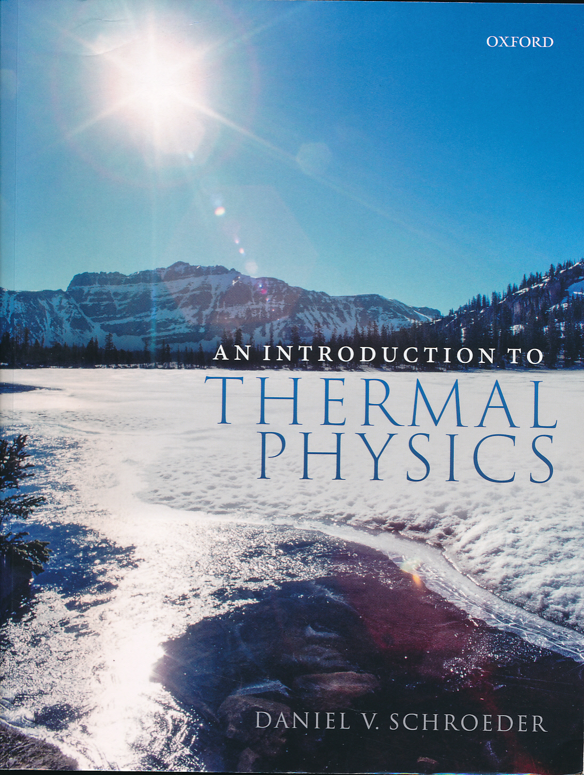
Textbook
D. V. Schroeder
“an introduction to thermal physics”, Oxford, (2021)

Slide 4
Week 1
Concept of temperature, ideal gas

Slide 5
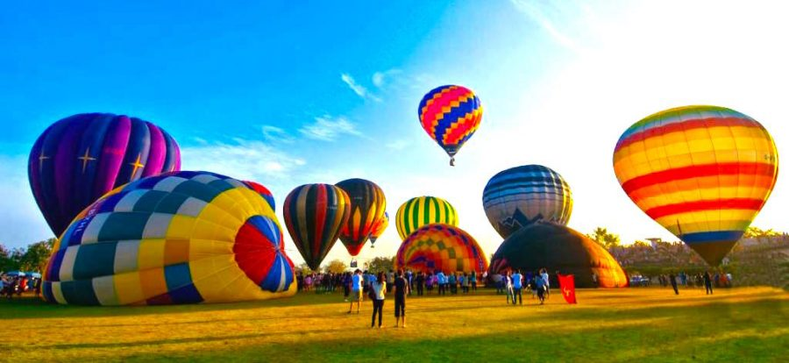
Thermal equilibrium
Exchanged quantity | Type of equilibrium
energy | thermal
volume | mechanical
particle | chemical
“a hot-air balloon interacts thermally, mechanically, and diffusively with its environment – exchange energy, volume, and particles.” Schroeder p.3.
https://en.blog.kkday.com/794/best-hot-air-balloon-worldwide

Slide 6
Definition of temperature
Temperature is what you measure with a thermometer. [operational definition]
Temperature is the thing that’s the same for two objects, after they’ve been in contact long enough. [theoretical definition]

Slide 7
Definition of temperature
Temperature is a measure of the tendency of an object to spontaneously give up energy to its surroundings. When two objects are in thermal contact, the one that tends to spontaneously lose energy is at the higher temperature.
[A more elaborate version of theoretical definition]
A rigorous definition based on entropy will be given in week 3.

Slide 8
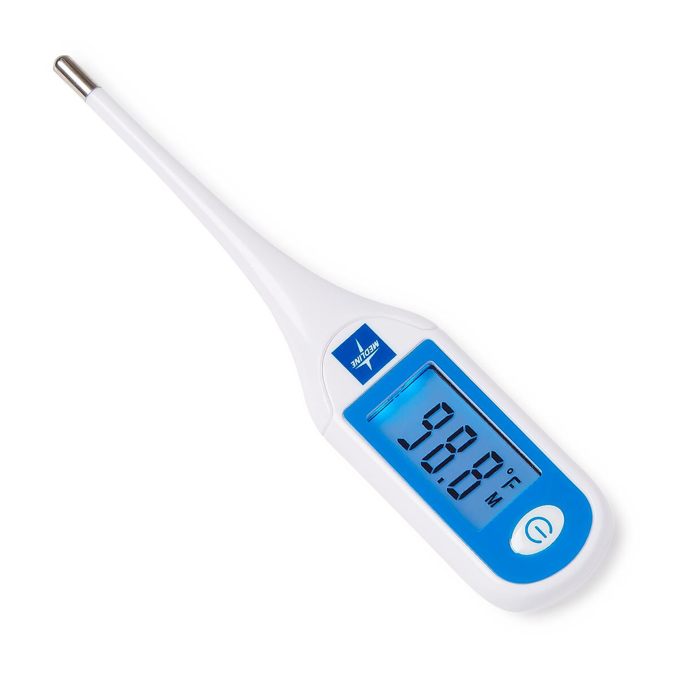
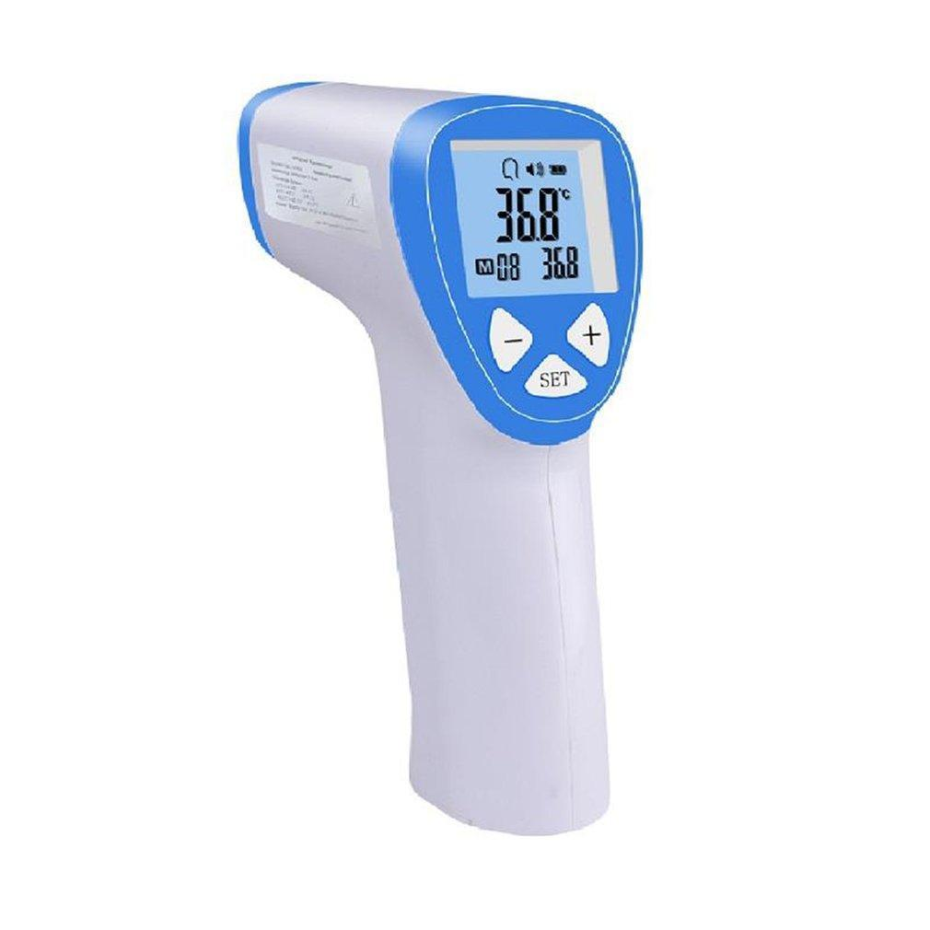
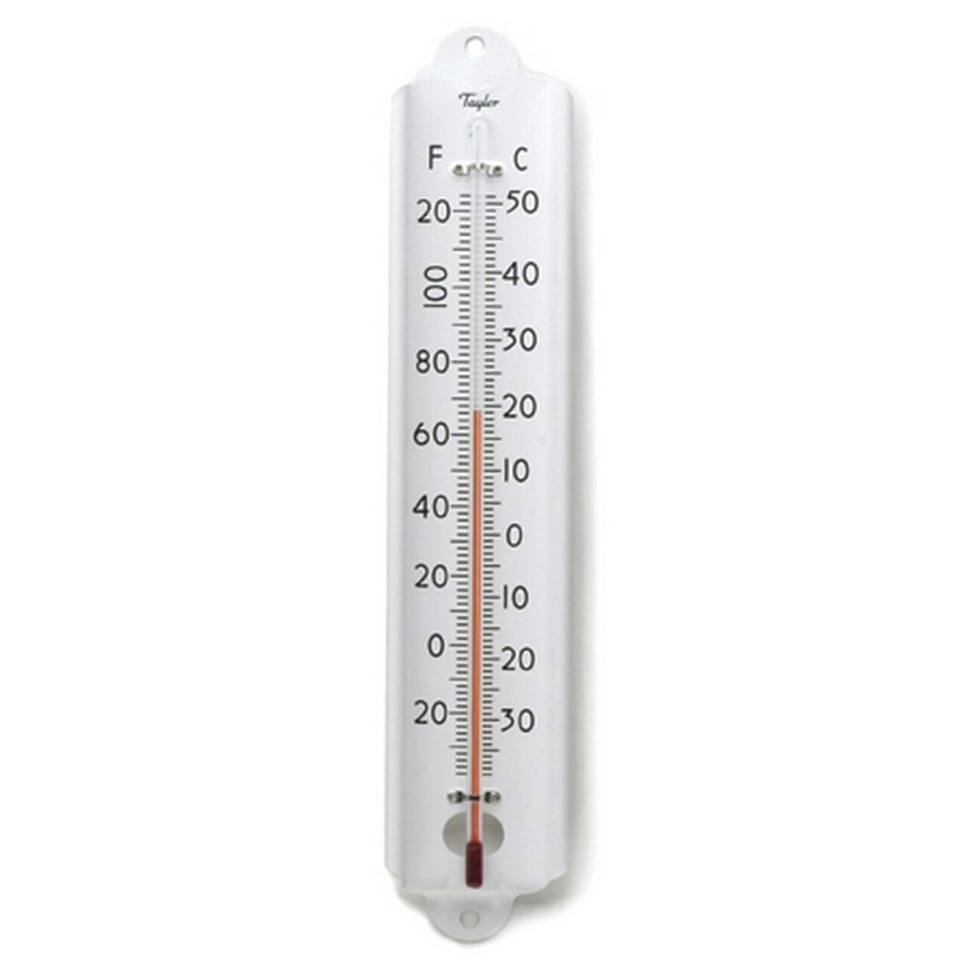
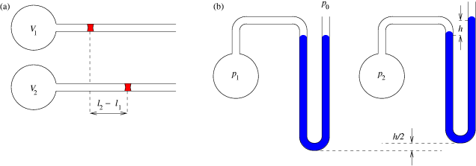
Different types of thermometers
Thermocouple based on Seebeck effect
All bodies radiate electromagnetic waves
Volume expands when heated
Gas thermometers based on volume

Slide 9


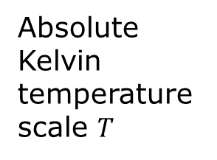
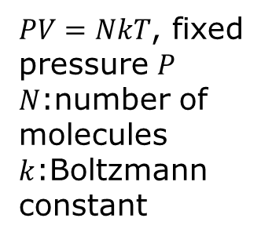
(Ideal) Gas thermometer
volume $V$
$PV=NkT$, fixed pressure $P$
$N$:number of molecules
$k$:Boltzmann constant
-273
0
t (degree Celsius)
Absolute Kelvin temperature scale $T$
$$T \left(K\right)=t\left(℃\right)+273.15$$

Slide 10
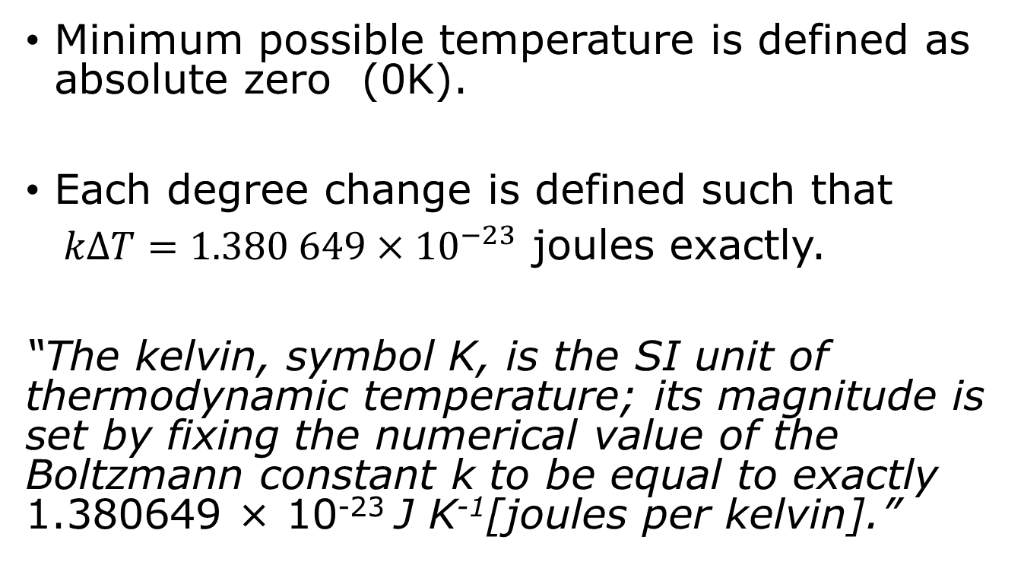
Kelvin scale, what is a degree?
Minimum possible temperature is defined as absolute zero (0K).
Each degree change is defined such that
$kΔT=1.380 649×{10}^{−23}$ joules exactly.
“The kelvin, symbol K, is the SI unit of thermodynamic temperature; its magnitude is set by fixing the numerical value of the Boltzmann constant k to be equal to exactly 1.380649 × 10⁻²³ J K⁻¹[joules per kelvin].”

Slide 11
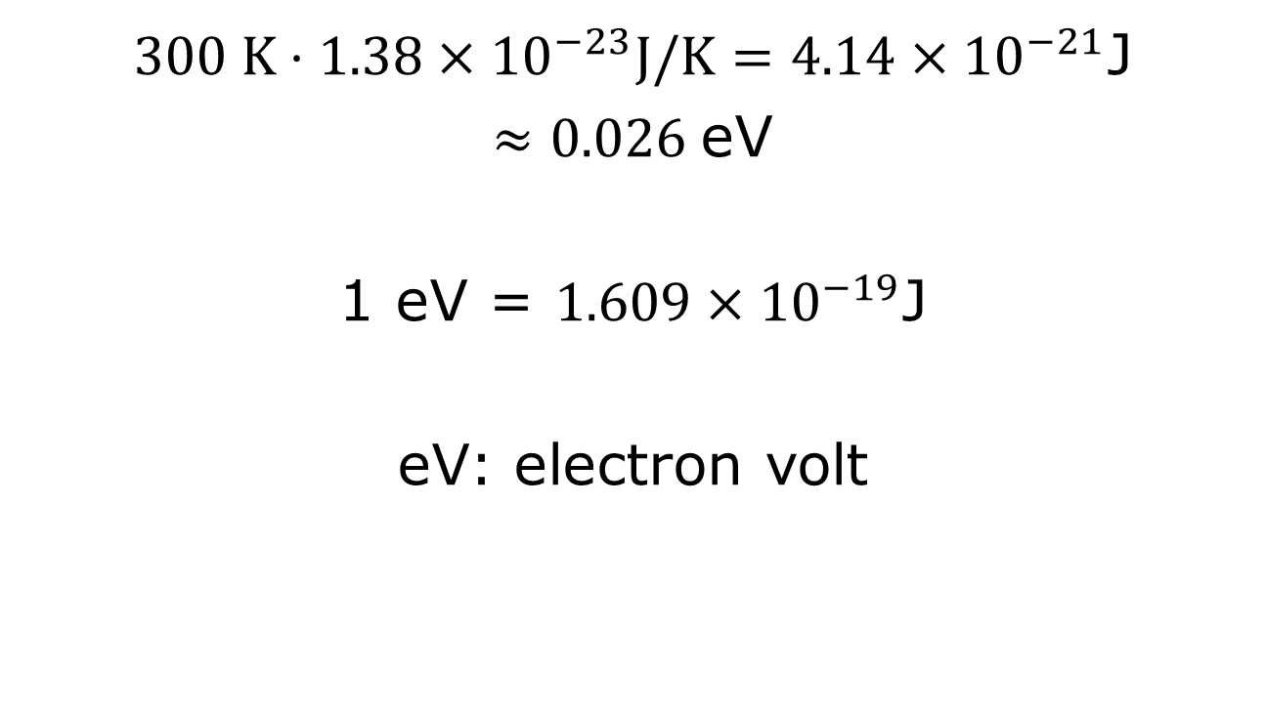
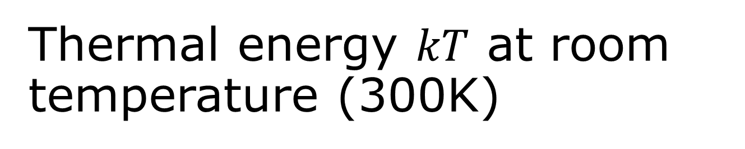

Thermal energy $kT$ at room temperature (300K)
$300 K⋅1.38×{10}^{−23}J/K=4.14×{10}^{−21}$J
$≈0.026$eV
1 eV = $1.609×{10}^{−19}$J
eV: electron volt
Boltzmann constant $k$: the unit conversion factor from kelvin to joule.

Slide 12
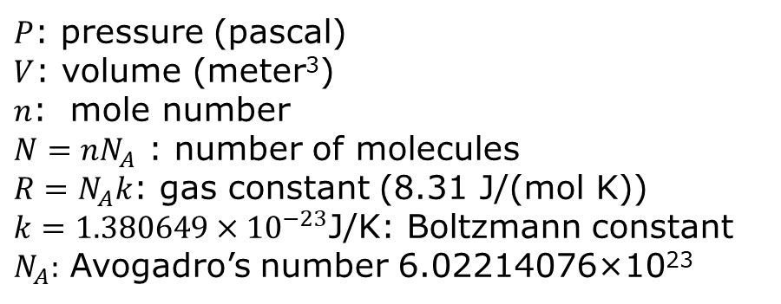
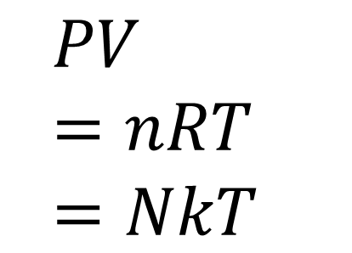
Ideal gas law
$$PV=nRT =NkT$$
$P$: pressure (pascal)
$V$: volume (meter³)
$n$: mole number
$N=nN_{A}$ : number of molecules
$R=N_{A}k$: gas constant (8.31 J/(mol K))
$k=1.380649×{10}^{−23}$J/K: Boltzmann constant
$N_{A}:$ Avogadro’s number 6.02214076×10²³
https://phet.colorado.edu/sims/html/gas-properties/latest/gas-properties_en.html

Slide 13
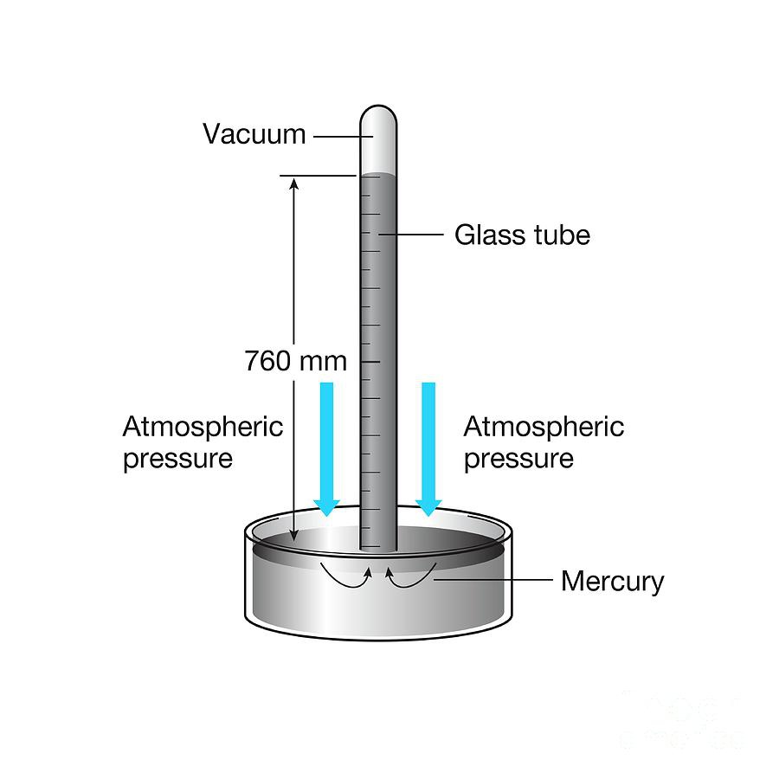
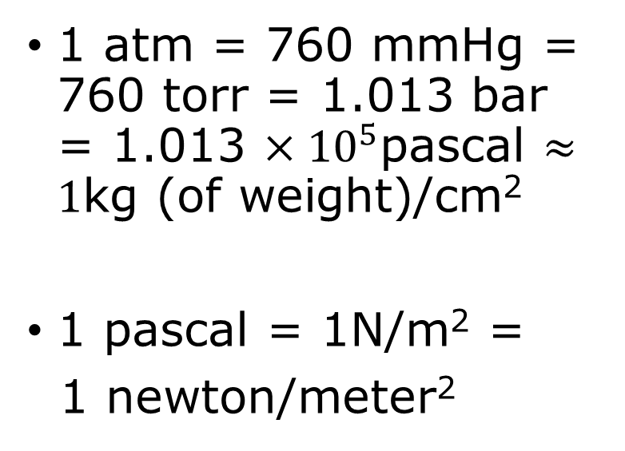
Measure atmospheric pressure, units for pressure
1 atm = 760 mmHg = 760 torr = 1.013 bar = 1.013 $×{10}^{5}$pascal $≈1$kg (of weight)/cm²
1 pascal = 1N/m² =
1 newton/meter²

Slide 14

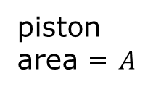




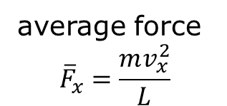


A microscopic model of an ideal gas
$$PV=NkT$$
piston area = $A$
force $F_{x}$
$$v_{x}$$
$$m$$
volume = $V=LA$
$$\vec{v}$$
average force
$${\overline{F}}_{x}=\frac{mv_{x}^{2}}{L}$$
length = $L$

Slide 15

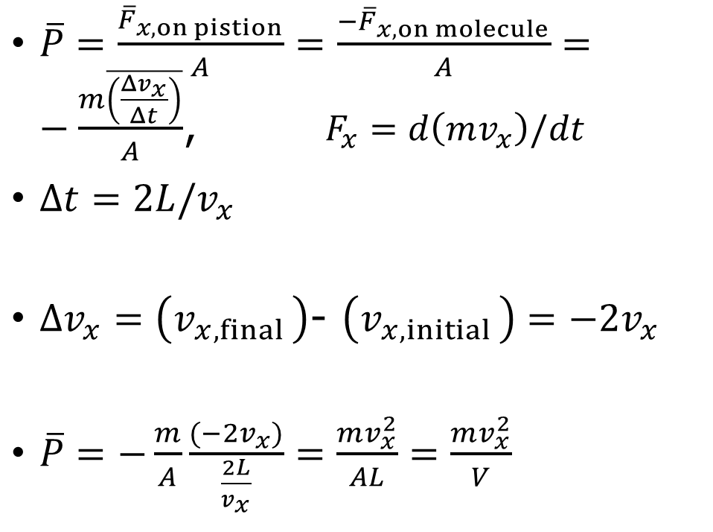

Relate pressure to kinetic energy
bar for time average
$\overline{P}=\frac{{\overline{F}}_{x,on pistion}}{A}=\frac{{−\overline{F}}_{x,on molecule}}{A}=−\frac{m\overline{\left(\frac{Δv_{x}}{Δt}\right)}}{A}$, $F_{x}=d\left(mv_{x}\right)/dt$
$Δt=2L/v_{x}$
$Δv_{x}=\left(v_{x,final }\right)$- $\left(v_{x,initial }\right)=−2v_{x}$
$\overline{P}=−\frac{m}{A}\frac{(−2v_{x})}{\frac{2L}{v_{x}}}=\frac{mv_{x}^{2}}{AL}=\frac{mv_{x}^{2}}{V}$
One molecule in a box
round trip time
$$v_{x}$$
$$L$$

Slide 16
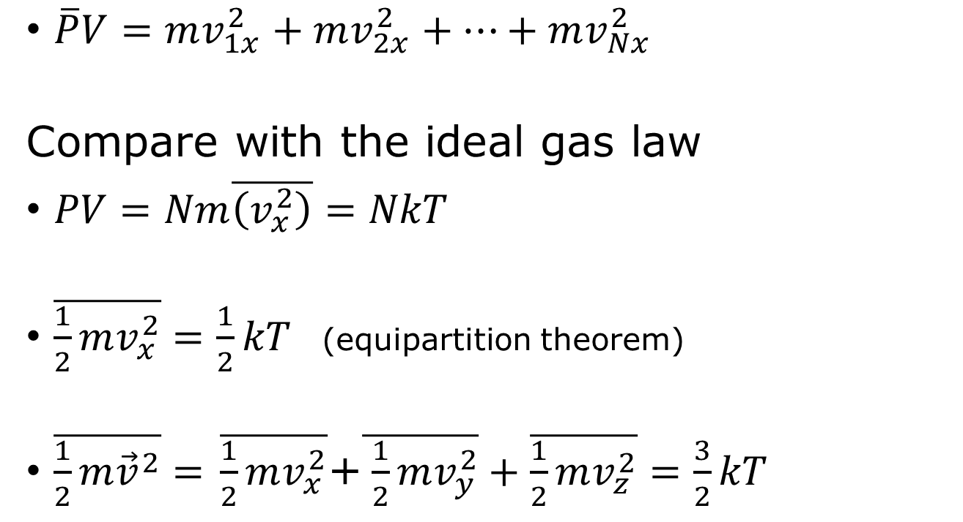
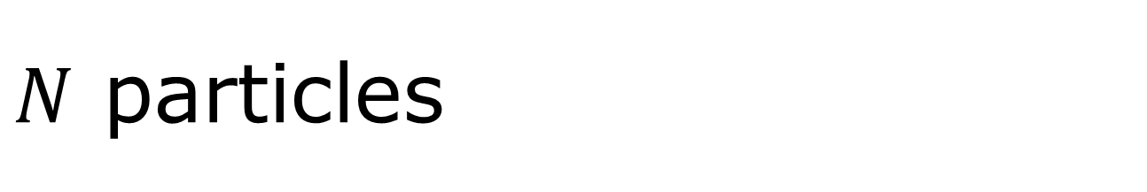
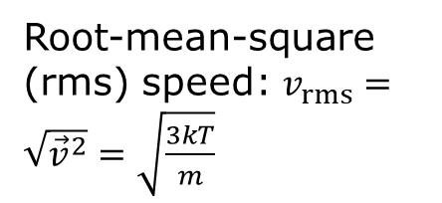
$N$ particles
replacing time average by particle average
$\overline{P}V=mv_{1x}^{2}+mv_{2x}^{2}+⋯+mv_{Nx}^{2}$
Compare with the ideal gas law
$PV=Nm\overline{\left(v_{x}^{2}\right)}=NkT$
$\overline{\frac{1}{2}mv_{x}^{2}}=\frac{1}{2}kT$ (equipartition theorem)
$\overline{\frac{1}{2}m{\vec{v}}^{2}}=$ $\overline{\frac{1}{2}mv_{x}^{2}}$+$\overline{ \frac{1}{2}mv_{y}^{2}}+\overline{\frac{1}{2}mv_{z}^{2}}=\frac{3}{2}kT$
Root-mean-square (rms) speed: $v_{rms}=\sqrt{{\vec{v}}^{2}}=\sqrt{\frac{3kT}{m}}$

Slide 17
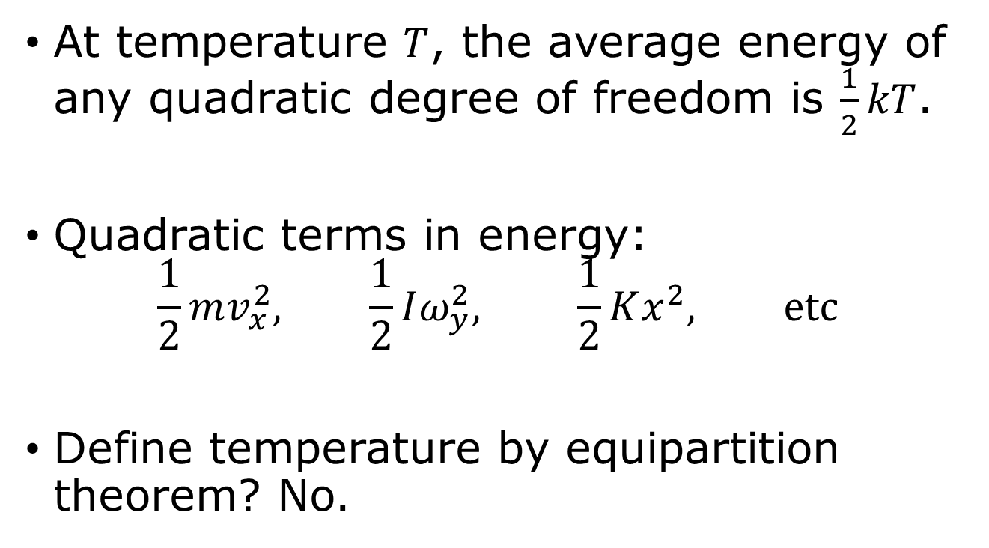
Equipartition theorem
At temperature $T$, the average energy of any quadratic degree of freedom is $\frac{1}{2}kT$.
Quadratic terms in energy:
$$\frac{1}{2}mv_{x}^{2}, \frac{1}{2}Iω_{y}^{2}, \frac{1}{2}Kx^{2}, etc$$
Define temperature by equipartition theorem? No.

Slide 18


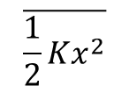
Quantum correction to equipartition
$$\overline{\frac{1}{2}Kx^{2}}$$
$$\frac{kT}{2}$$
zero-point motion
0
$$T$$

Slide 19
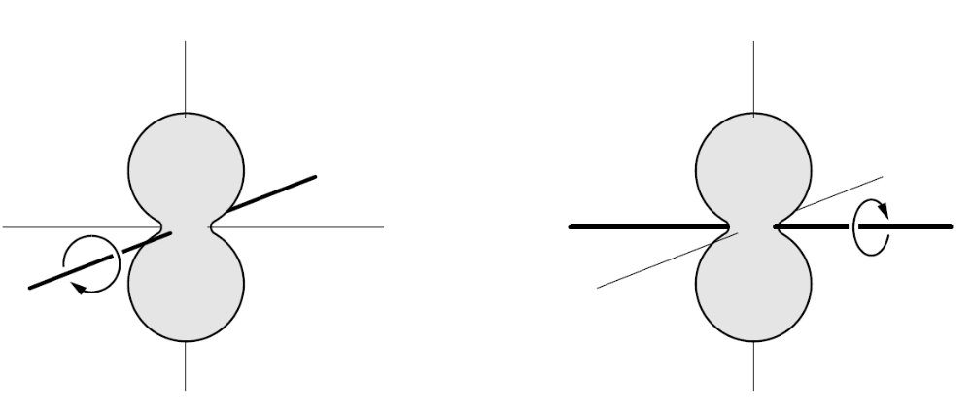
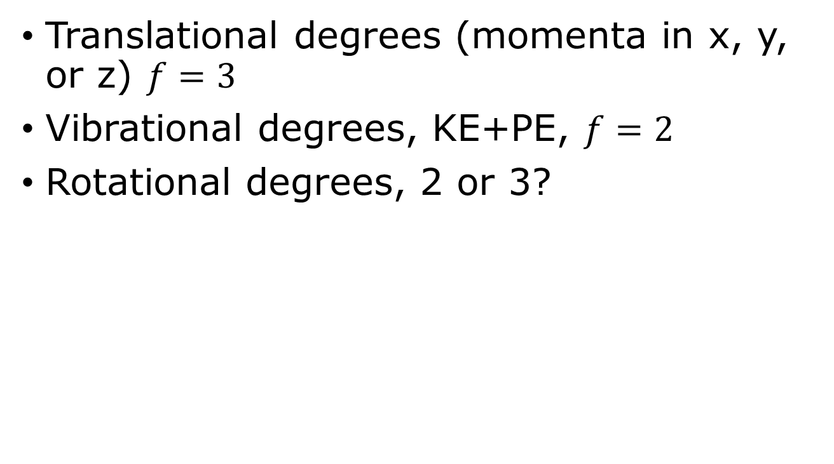
Counting the number of quadratic terms f
Translational degrees (momenta in x, y, or z) $f=3$
Vibrational degrees, KE+PE, $f=2$
Rotational degrees, 2 or 3?
A linear molecule such as O₂ can rotate about two independent axes. Rotation about the symmetry axis, down the length of the molecule, does not count, as the moment of inertia is 0.

Slide 20
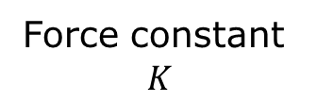
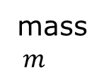
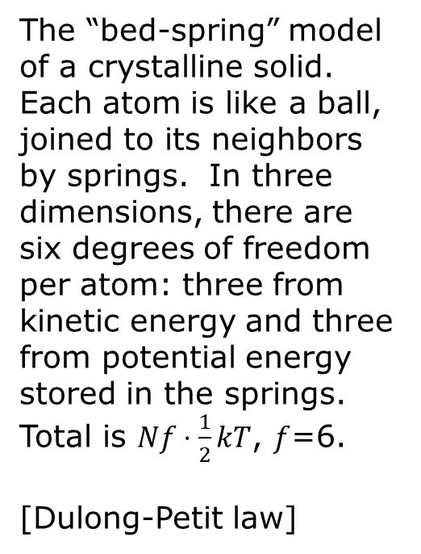
Lattice vibrations
Force constant
$$K$$
The “bed-spring” model of a crystalline solid. Each atom is like a ball, joined to its neighbors by springs. In three dimensions, there are six degrees of freedom per atom: three from kinetic energy and three from potential energy stored in the springs. Total is $Nf⋅\frac{1}{2}kT$, $f$=6.
[Dulong-Petit law]
mass$m$

Slide 21
Tutorial problems,
1.7, 1.22, 1.25
Do the problem before the class

Slide 22
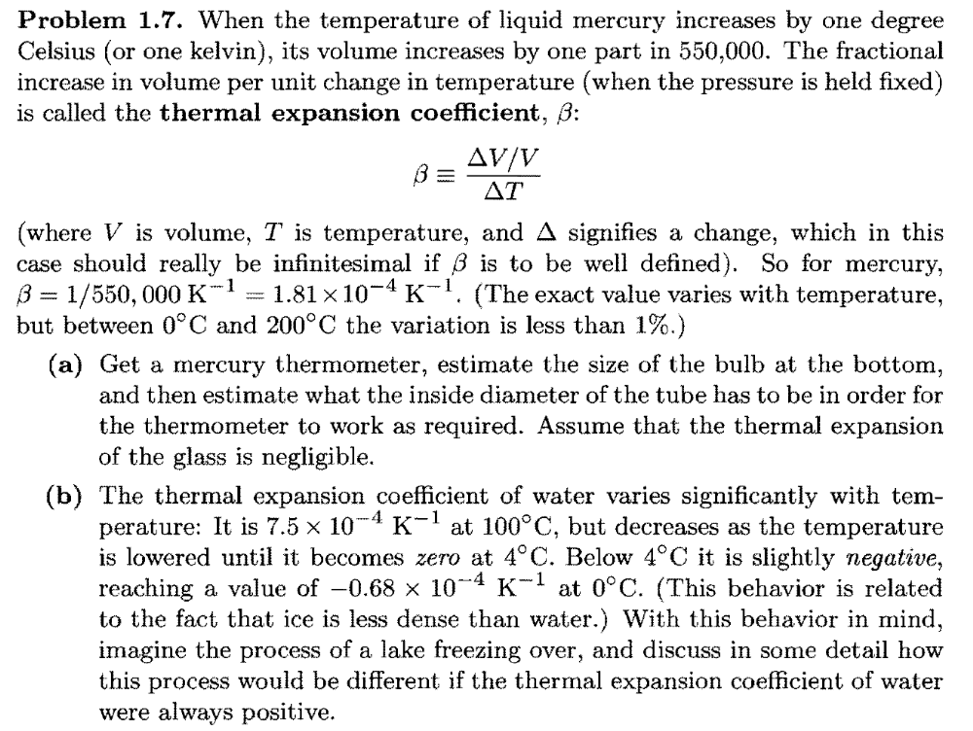

Slide 23
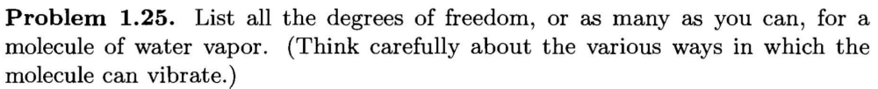
Problem 1.25, page 17
Total degrees of freedom: 3 x 3 = 9
Translation of center of mass: 3
Rigid rotation: 3 (three Euler angles)
Vibrations: 9 – 3 – 3 = 3

Slide 24
