Slide 1
Week 12
Quantum statistics, applications

Slide 2
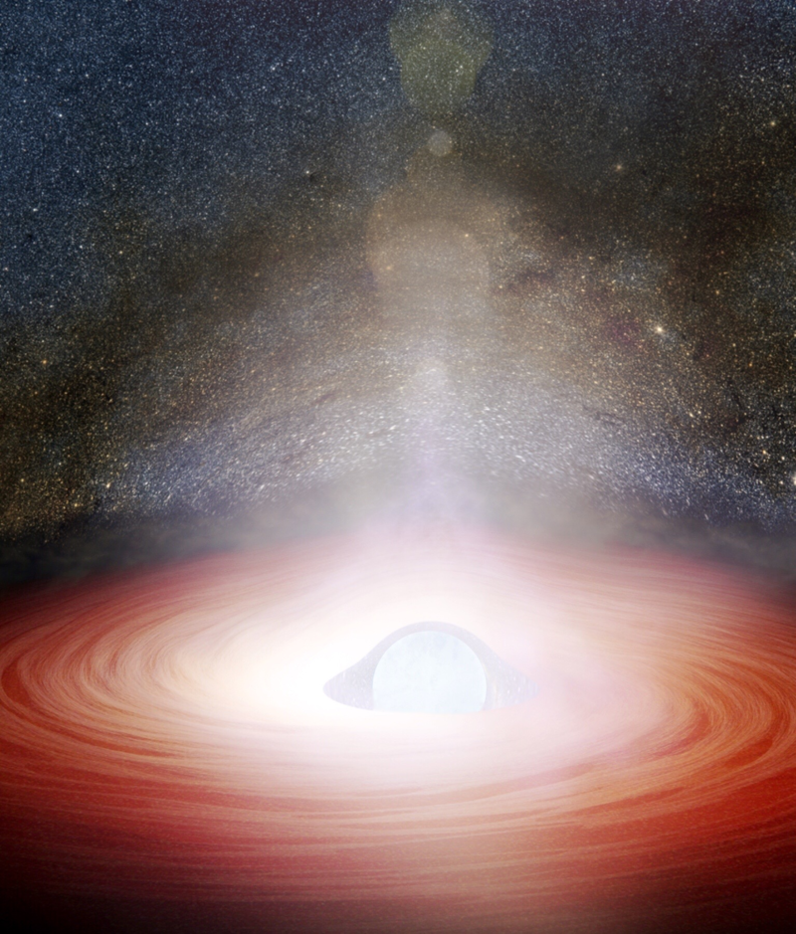
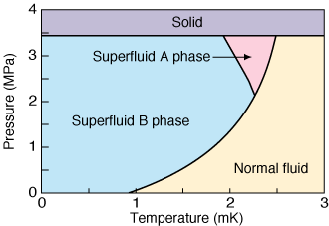

Degenerate Fermi gas
Electrons in metal
Neutron star
³He
$$p+e→n+ν_{e}$$
From Wikipedia

Slide 3
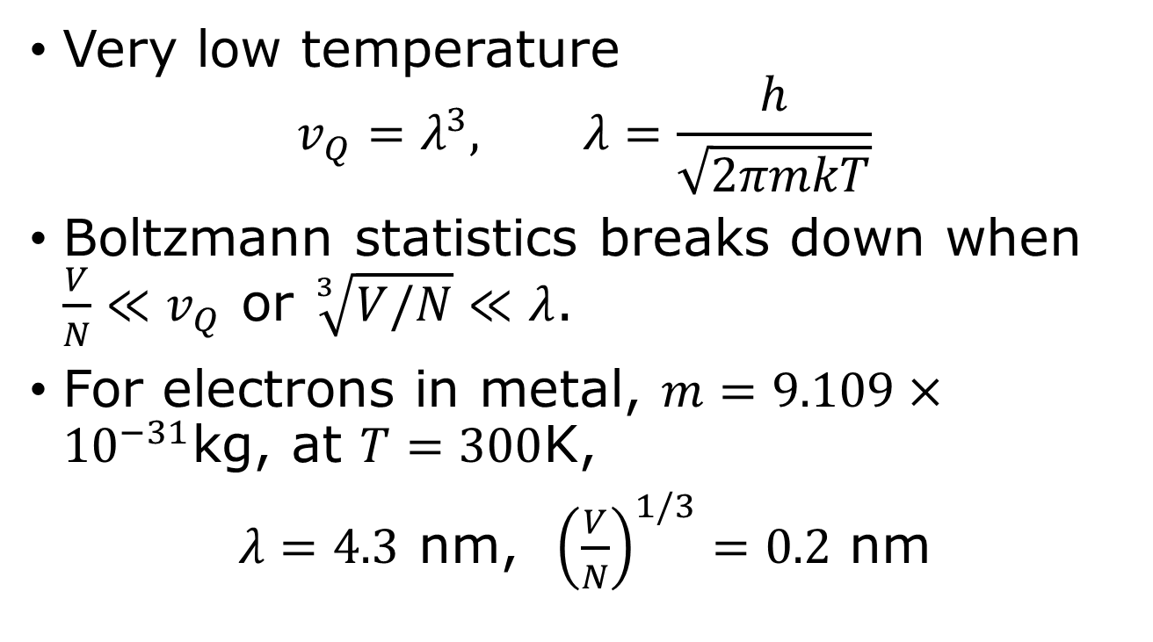
Degenerate Fermi gases
Very low temperature
$$v_{Q}=λ^{3}, λ=\frac{h}{\sqrt{2πmkT}}$$
Boltzmann statistics breaks down when $\frac{V}{N}≪v_{Q}$ or $\sqrt[3]{V/N}≪λ$.
For electrons in metal, $m=9.109×{10}^{−31}$kg, at $T=300$K,
$λ=4.3$ nm, ${\left(\frac{V}{N}\right)}^{1/3}=0.2$ nm

Slide 4
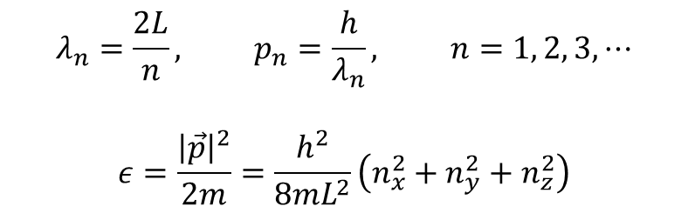

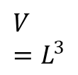
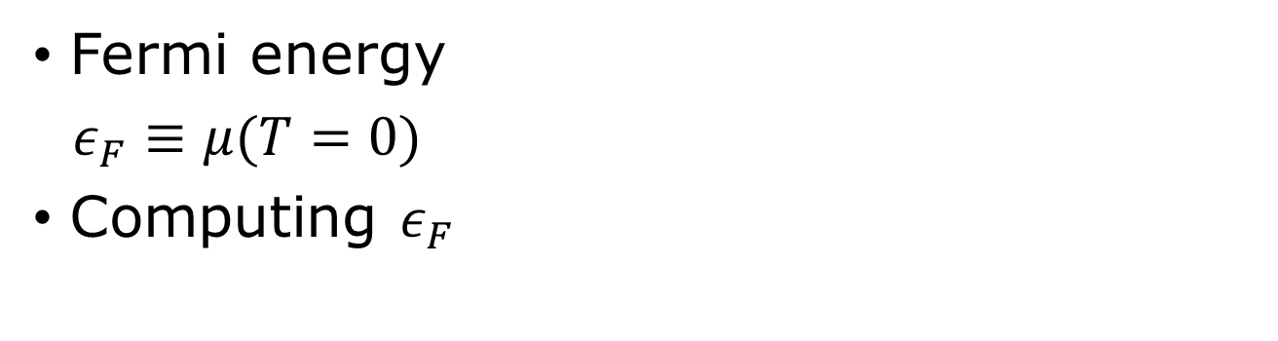



Zero temperature, Fermi particles in a box
$${\overline{n}}_{FD}$$
Fermi energy
$ε_{F}≡μ(T=0)$
Computing $ε_{F}$
1
0
$$ε$$
$$μ=ε_{F}$$
$$λ_{n}=\frac{2L}{n}, p_{n}=\frac{h}{λ_{n}}, n=1, 2, 3, ⋯$$
$$ε=\frac{{\left|\vec{p}\right|}^{2}}{2m}=\frac{h^{2}}{8mL^{2}}\left(n_{x}^{2}+n_{y}^{2}+n_{z}^{2}\right)$$
$$V=L^{3}$$
$$L$$

Slide 5



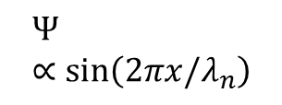



Particle in a box, fixed boundary condition vs periodic boundary condition
$$Ψ∝\sin\left(2πx/λ_{n}\right)$$
standing wave
$$Ψ∝e^{i2πnx/L}$$
travelling wave
$$n=1$$
$$n=1$$
$$n=0$$
0 $L$
0 $L$

Slide 6
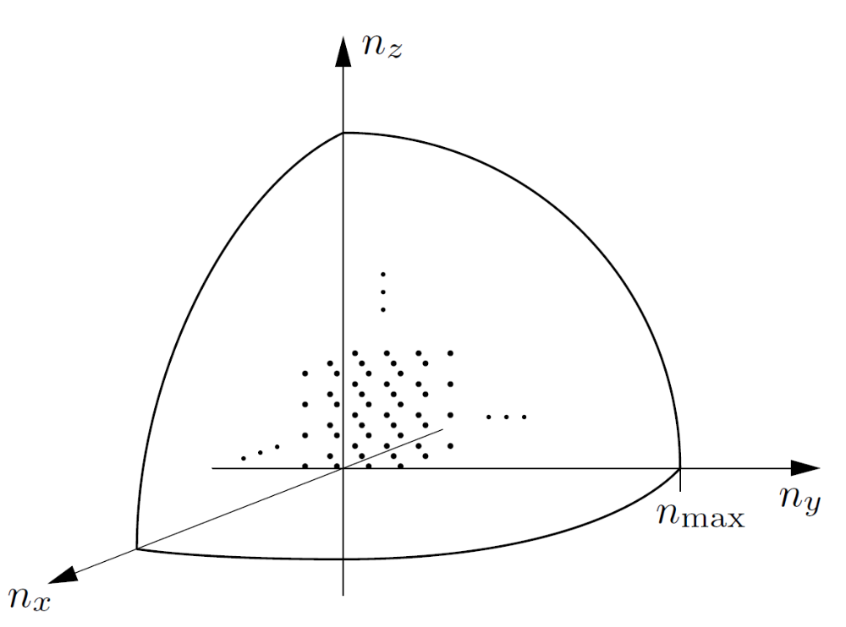
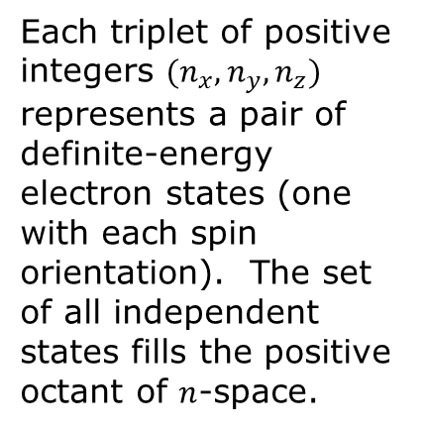
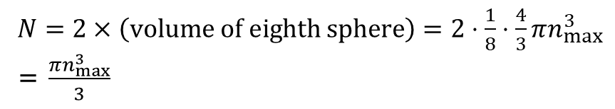
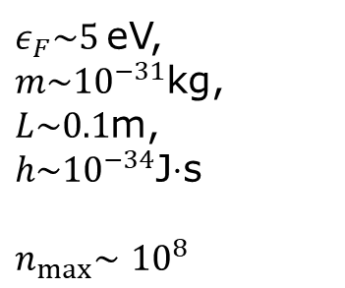

Counting the number of states
$$ε_{F}=\frac{h^{2}n_{max}^{2}}{8mL^{2}}$$
Each triplet of positive integers $(n_{x}, n_{y},n_{z})$ represents a pair of definite-energy electron states (one with each spin orientation). The set of all independent states fills the positive octant of $n$-space.
$ε_{F}\sim 5$eV, $m\sim {10}^{−31}$kg, $L\sim 0.1$m, $h\sim {10}^{−34}$J$⋅$s
$n_{max}\sim$ ${10}^{8}$
$N=2×\left(volume of eighth sphere\right)=2⋅\frac{1}{8}⋅\frac{4}{3}πn_{max}^{3}$ = $\frac{πn_{max}^{3}}{3}$

Slide 7
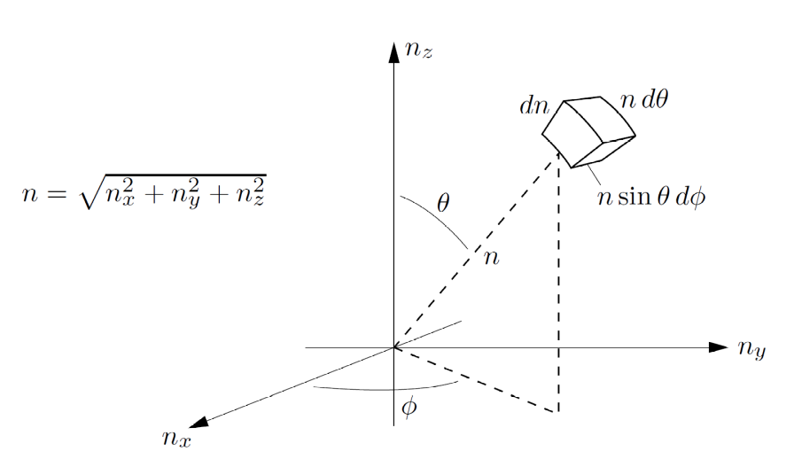
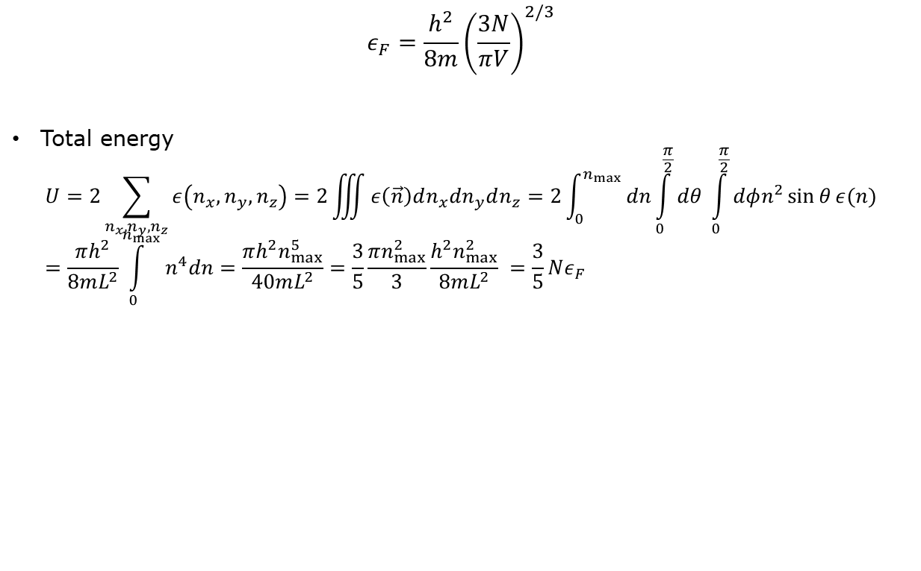
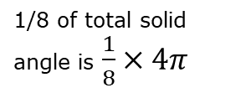
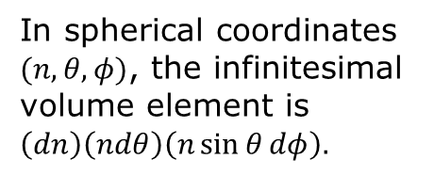
Fermi energy, total energy
$$ε_{F}=\frac{h^{2}}{8m}{\left(\frac{3N}{πV}\right)}^{2/3}$$
Total energy
$$U=2\sum_{n_{x},n_{y},n_{z}}{ε\left(n_{x}, n_{y}, n_{z}\right)=2\iiint{ε\left(\vec{n}\right)dn_{x}dn_{y}dn_{z}=2\int_{0}^{n_{max}}{dn\int_{0}^{\frac{π}{2}}{dθ \int_{0}^{\frac{π}{2}}{dφn^{2}\sin{θ}ε(n)}}}}}=\frac{πh^{2}}{8mL^{2}}\int_{0}^{n_{max}}{n^{4}dn=\frac{πh^{2}n_{max}^{5}}{40mL^{2}}=\frac{3}{5}\frac{πn_{max}^{2}}{3}\frac{h^{2}n_{max}^{2}}{8mL^{2}} =\frac{3}{5}Nε_{F}}$$
1/8 of total solid angle is $\frac{1}{8}×4π$
In spherical coordinates $(n,θ, φ)$, the infinitesimal volume element is $\left(dn\right)\left(ndθ\right)\left(n\sin{θ}dφ\right).$

Slide 8
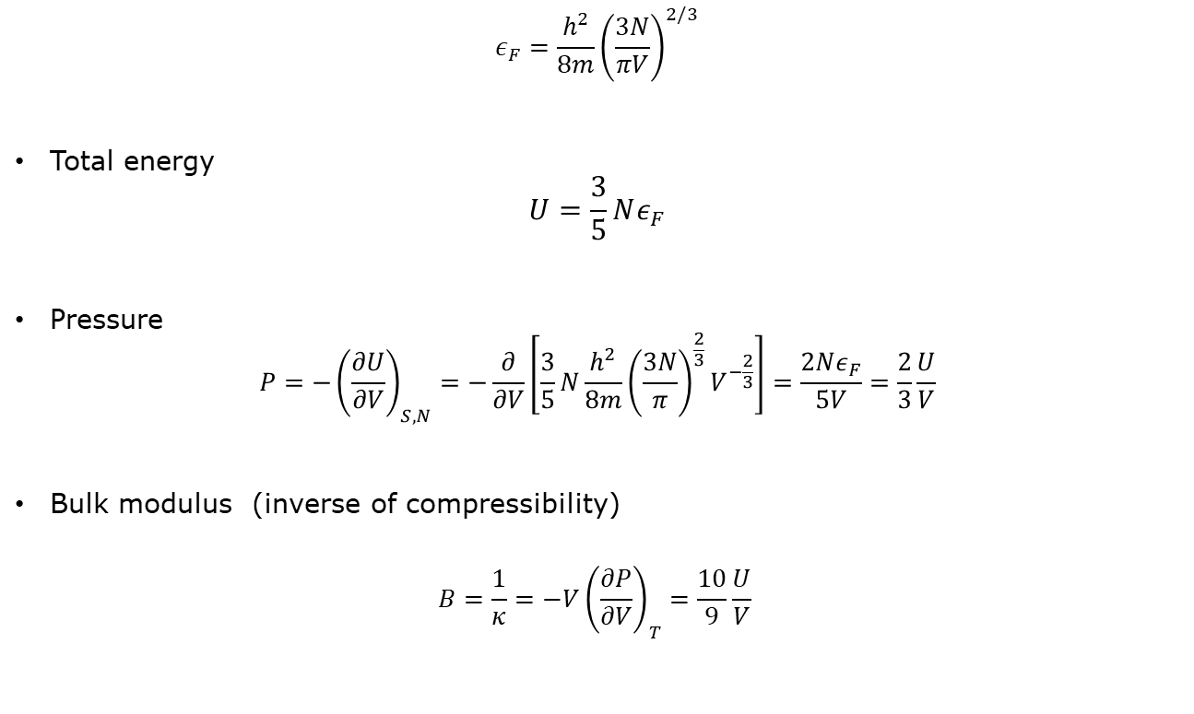

Fermi gas at $T=0$, pressure, bulk modulus
$$ε_{F}=\frac{h^{2}}{8m}{\left(\frac{3N}{πV}\right)}^{2/3}$$
Total energy
$$U=\frac{3}{5}Nε_{F}$$
Pressure
$$P=−{\left(\frac{∂U}{∂V}\right)}_{S,N}=−\frac{∂}{∂V}\left[\frac{3}{5}N\frac{h^{2}}{8m}{\left(\frac{3N}{π}\right)}^{\frac{2}{3}}V^{−\frac{2}{3}}\right]=\frac{2Nε_{F}}{5V}=\frac{2}{3}\frac{U}{V}$$
Bulk modulus (inverse of compressibility)
$$B=\frac{1}{κ}=−V{\left(\frac{∂P}{∂V}\right)}_{T}=\frac{10}{9}\frac{U}{V}$$

Slide 9
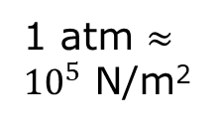
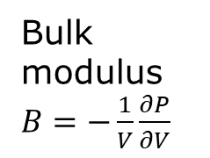
Compare free electron model with experiments
Metal | Free electron B | Measured B
Li | 23.9 | 11.5
Na | 9.23 | 6.42
K | 3.19 | 2.81
Rb | 2.28 | 1.92
Cs | 1.54 | 1.43
Cu | 63.8 | 134.3
Ag | 34.5 | 99.9
Al | 228 | 76.0
Bulk modulus $B=−\frac{1}{V}\frac{∂P}{∂V}$
From Table 2.2, Ashcroft/Mermin, “Solid State Physics”, page 39. Units for B is in 10⁹ N/m^{2.}
1 atm $≈{10}^{5}$ N/m²

Slide 10


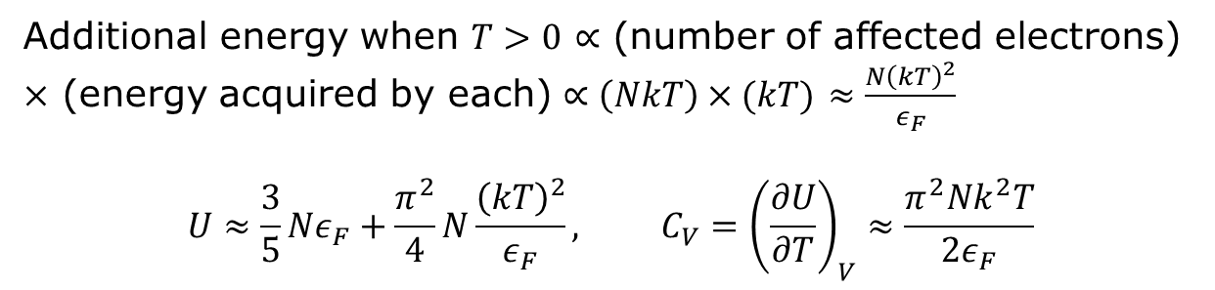

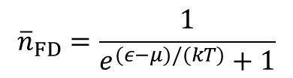
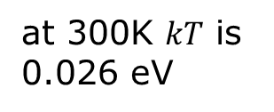
Fermi distribution, small T
$${\overline{n}}_{FD}$$
$${\overline{n}}_{FD}=\frac{1}{e^{(ε−μ)/(kT)}+1}$$
at 300K $kT$ is 0.026 eV
1
$$T→0$$
$$kT$$
$$μ$$
$$ε$$
Additional energy when $T>0$ $∝$ (number of affected electrons) $×$ (energy acquired by each) $∝\left(NkT\right)×(kT)$ $≈\frac{N{\left(kT\right)}^{2}}{ε_{F}}$
$$U≈\frac{3}{5}Nε_{F}+\frac{π^{2}}{4}N\frac{{\left(kT\right)}^{2}}{ε_{F}}, C_{V}={\left(\frac{∂U}{∂T}\right)}_{V}≈\frac{π^{2}Nk^{2}T}{2ε_{F}}$$
Notes:
meV = 0.001 eV. 1 eV = 1.602 x 10^(-19) joule.

Slide 11
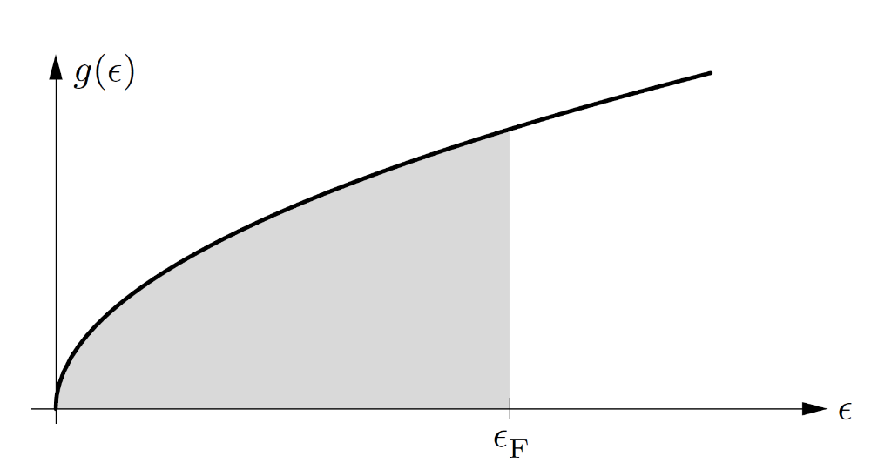
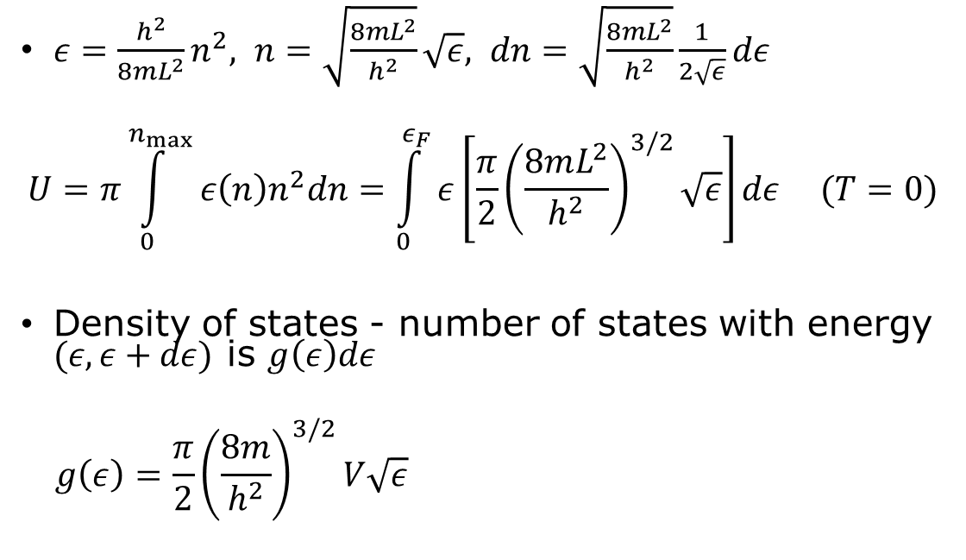

Density of states
$ε=\frac{h^{2}}{8mL^{2}}n^{2}, n=\sqrt{\frac{8mL^{2}}{h^{2}}}\sqrt{ε}, dn=\sqrt{\frac{8mL^{2}}{h^{2}}}\frac{1}{2\sqrt{ε}}dε$
$$U=π\int_{0}^{n_{max}}{ε\left(n\right)n^{2}dn=\int_{0}^{ε_{F}}{ε\left[\frac{π}{2}{\left(\frac{8mL^{2}}{h^{2}}\right)}^{3/2}\sqrt{ε}\right]dε (T=0})}$$
Density of states - number of states with energy $(ε, ε+dε)$ is $g\left(ε\right)dε$
$$g\left(ε\right)=\frac{π}{2}{\left(\frac{8m}{h^{2}}\right)}^{3/2}V\sqrt{ε}$$
$$g\left(ε\right)=g_{0}\sqrt{ε}$$

Slide 12
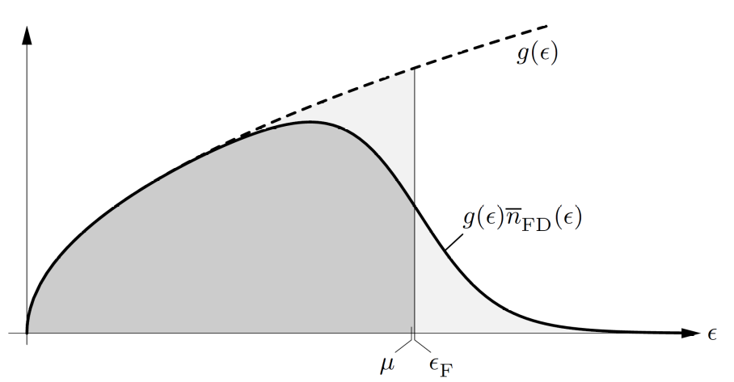
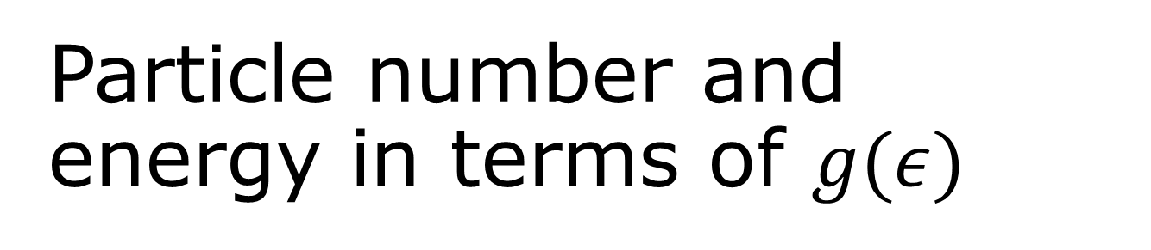

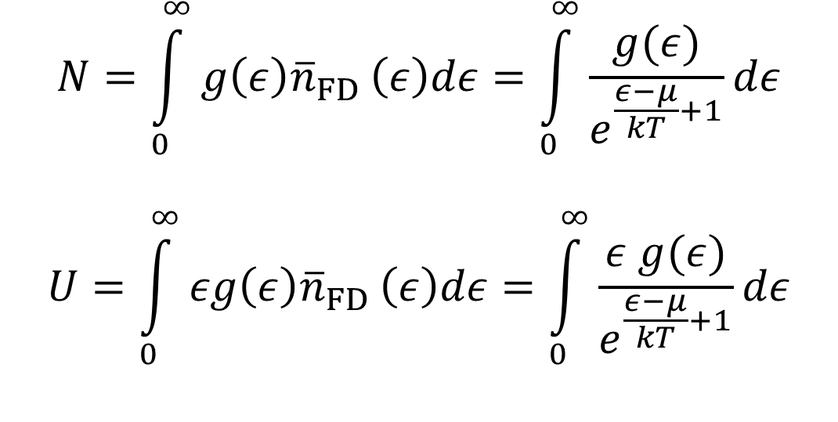
Particle number and energy in terms of $g(ε)$
$$N=\int_{0}^{∞}{g\left(ε\right){\overline{n}}_{FD}}\left(ε\right)dε=\int_{0}^{∞}{\frac{g(ε)}{e^{\frac{ε−μ}{kT}+1}}dε}$$
$$U=\int_{0}^{∞}{εg\left(ε\right){\overline{n}}_{FD}}\left(ε\right)dε=\int_{0}^{∞}{\frac{ε g(ε)}{e^{\frac{ε−μ}{kT}+1}}dε}$$
$$μ\left(T\right)≤ε_{F}$$

Slide 13
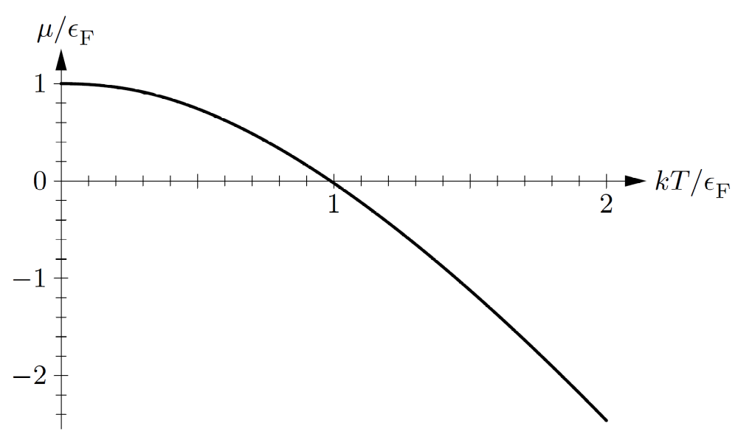
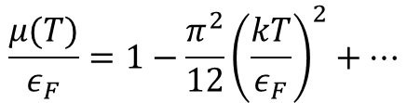
Chemical potential
$$\frac{μ(T)}{ε_{F}}=1−\frac{π^{2}}{12}{\left(\frac{kT}{ε_{F}}\right)}^{2}+⋯$$

Slide 14
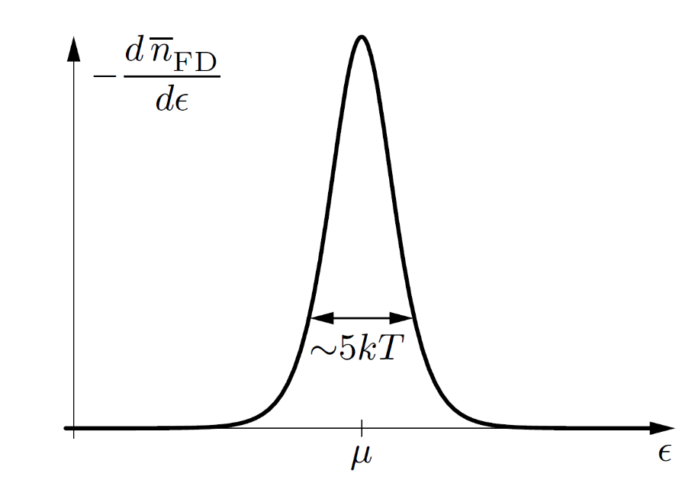
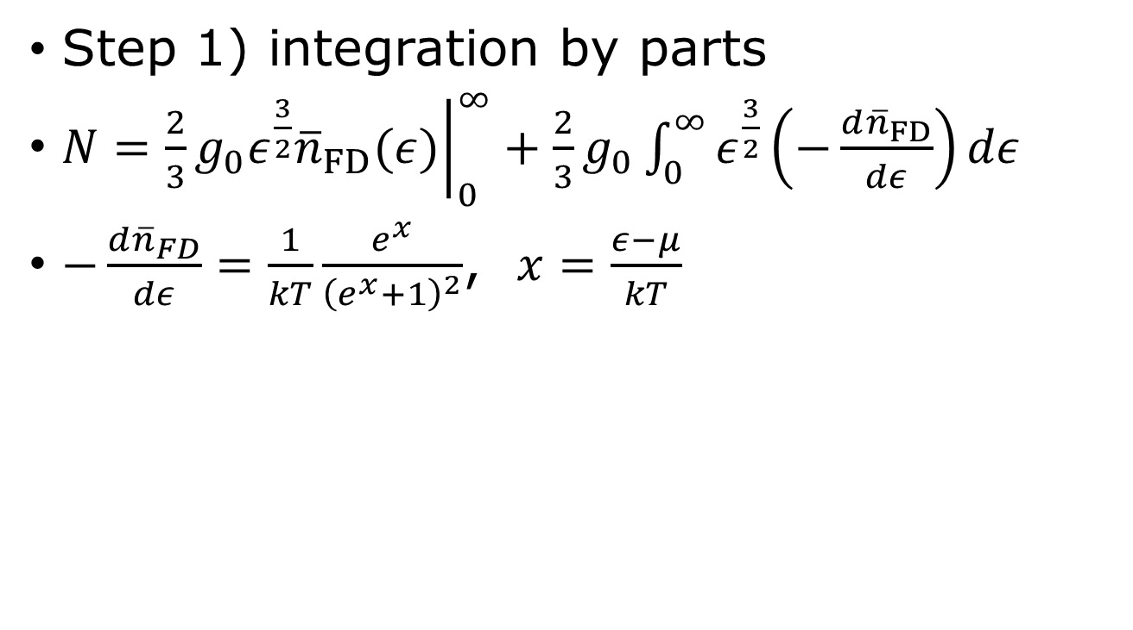
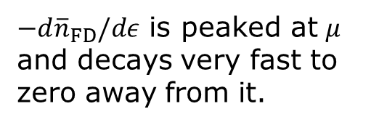
Sommerfeld expansion
Step 1) integration by parts
$N={\left.\frac{2}{3}g_{0}ε^{\frac{3}{2}}{\overline{n}}_{FD}(ε)\right|}_{0}^{∞}+\frac{2}{3}g_{0}\int_{0}^{∞}{ε^{\frac{3}{2}}\left(−\frac{d{\overline{n}}_{FD}}{dε}\right)dε}$
$−\frac{d{\overline{n}}_{FD}}{dε}=\frac{1}{kT}\frac{e^{x}}{{\left(e^{x}+1\right)}^{2}}$, $x=\frac{ε−μ}{kT}$
$−d{\overline{n}}_{FD}/dε$ is peaked at $μ$ and decays very fast to zero away from it.

Slide 15
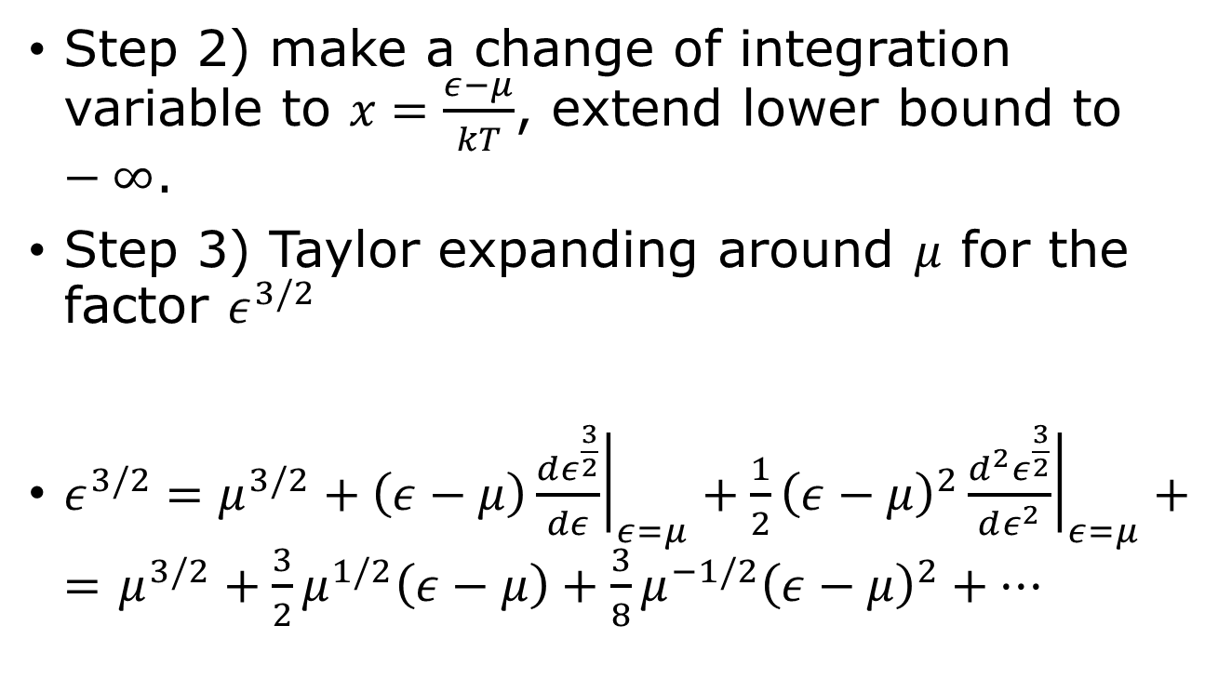
Sommerfeld expansion
Step 2) make a change of integration variable to $x=\frac{ε−μ}{kT}$, extend lower bound to $−∞$.
Step 3) Taylor expanding around $μ$ for the factor $ε^{3/2}$
$ε^{3/2}=μ^{3/2}+\left(ε−μ\right){\left.\frac{dε^{\frac{3}{2}}}{dε}\right|}_{ε=μ}+{\frac{1}{2}\left(ε−μ\right)}^{2}{\left.\frac{d^{2}ε^{\frac{3}{2}}}{dε^{2}}\right|}_{ε=μ}+=$ $μ^{3/2}+\frac{3}{2}μ^{1/2}\left(ε−μ\right)+{\frac{3}{8}μ^{−1/2}\left(ε−μ\right)}^{2}+⋯$

Slide 16
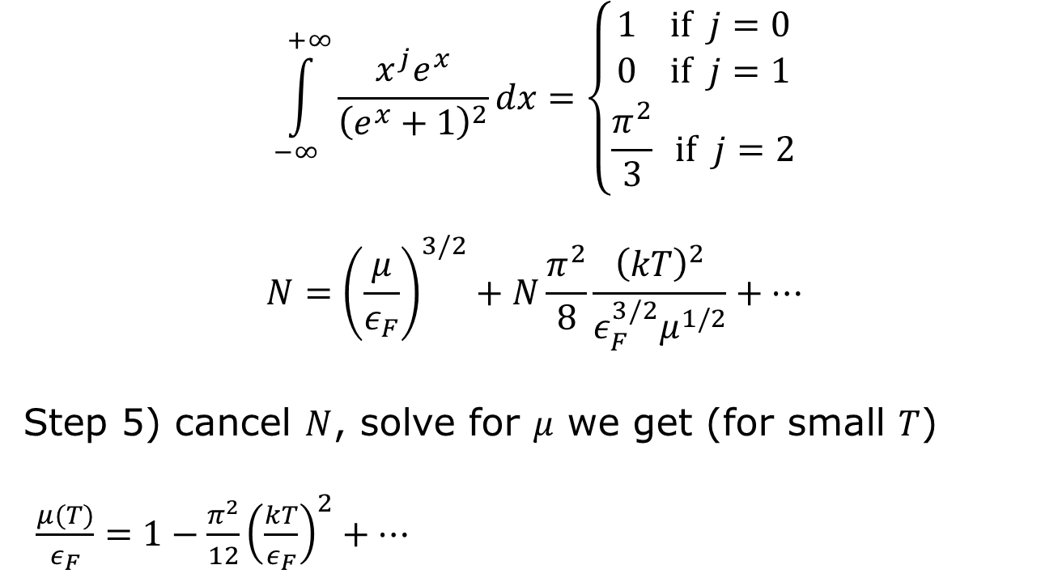
Step 4) using integrals
$$\int_{−∞}^{+∞}{\frac{x^{j}e^{x}}{{\left(e^{x}+1\right)}^{2}}}dx=\left\{\begin{matrix}1 if j=0 \\ 0 if j=1 \\ \frac{π^{2}}{3} if j=2\end{matrix}\right.$$
$$N={\left(\frac{μ}{ε_{F}}\right)}^{3/2}+N\frac{π^{2}}{8}\frac{{\left(kT\right)}^{2}}{ε_{F}^{3/2}μ^{1/2}}+⋯$$
Step 5) cancel $N$, solve for $μ$ we get (for small $T$)
$\frac{μ(T)}{ε_{F}}=1−\frac{π^{2}}{12}{\left(\frac{kT}{ε_{F}}\right)}^{2}+⋯$

Slide 17
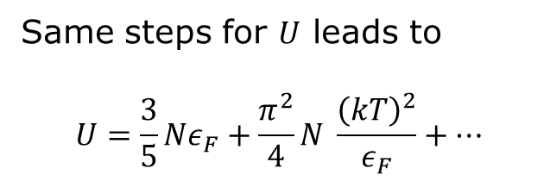
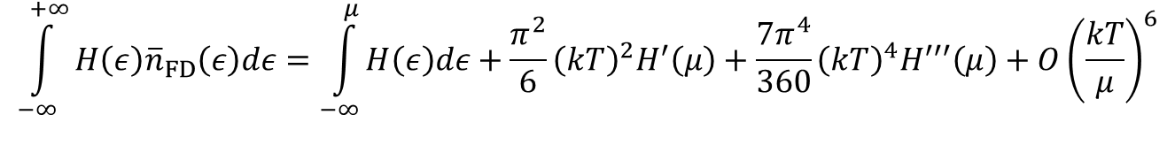
Sommerfeld expansion formula
$$\int_{−∞}^{+∞}{H\left(ε\right){\overline{n}}_{FD}\left(ε\right)dε=\int_{−∞}^{μ}{H\left(ε\right)dε}+\frac{π^{2}}{6}{\left(kT\right)}^{2}H^{′}\left(μ\right)+\frac{7π^{4}}{360}{\left(kT\right)}^{4}H^{′′′}\left(μ\right)+O{\left(\frac{kT}{μ}\right)}^{6}}$$
Same steps for $U$ leads to
$$U=\frac{3}{5}Nε_{F}+\frac{π^{2}}{4}N \frac{{\left(kT\right)}^{2}}{ε_{F}}+⋯$$

Slide 18
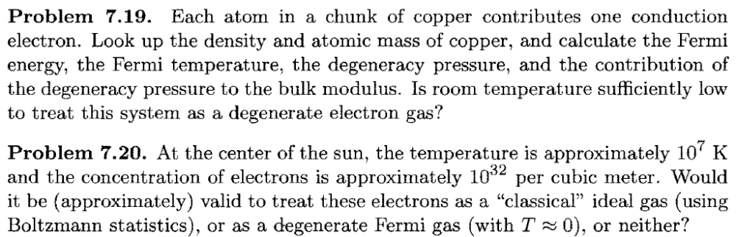
Tutorial problems

Slide 19
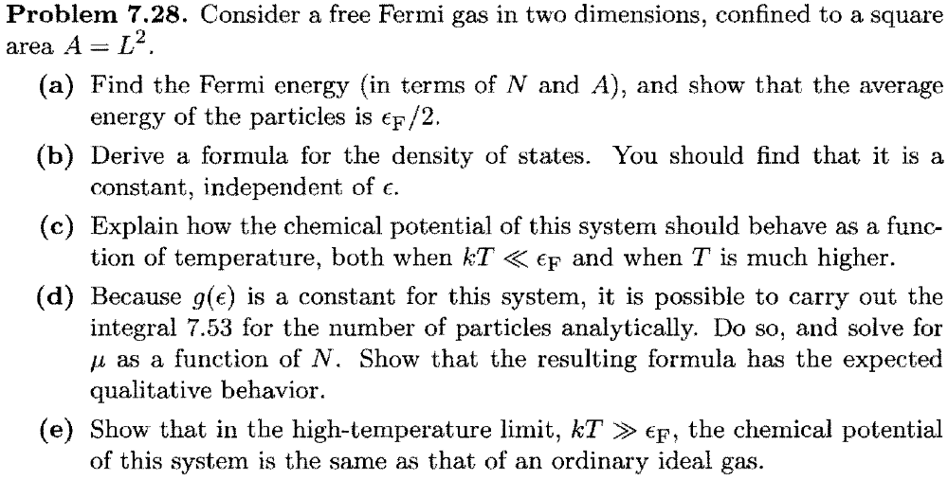
Tutorial problem 7.28

