Slide 1
Week 13
Blackbody radiation

Slide 2

Blackbody radiation
light or photon
Temperature $T$

Slide 3
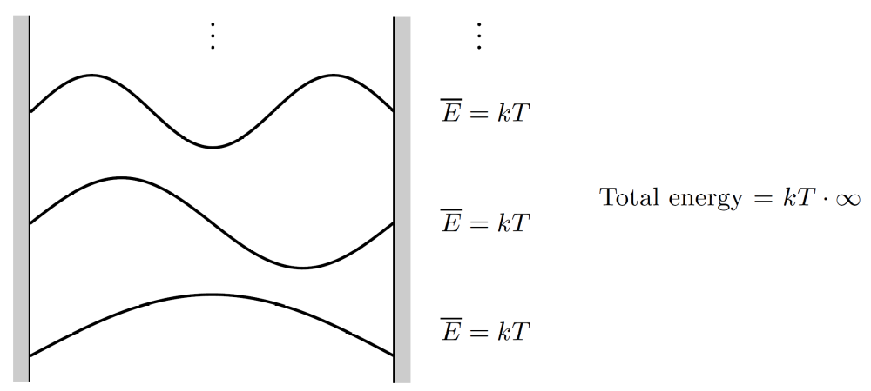
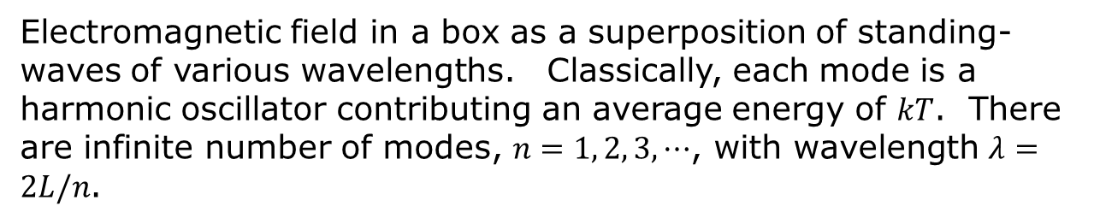
The ultraviolet catastrophe
Classical physics – equipartition theorem
Electromagnetic field in a box as a superposition of standing-waves of various wavelengths. Classically, each mode is a harmonic oscillator contributing an average energy of $kT$. There are infinite number of modes, $n=1, 2, 3, ⋯$, with wavelength $λ=2L/n$.

Slide 4
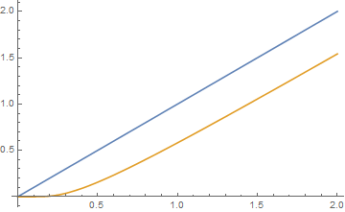
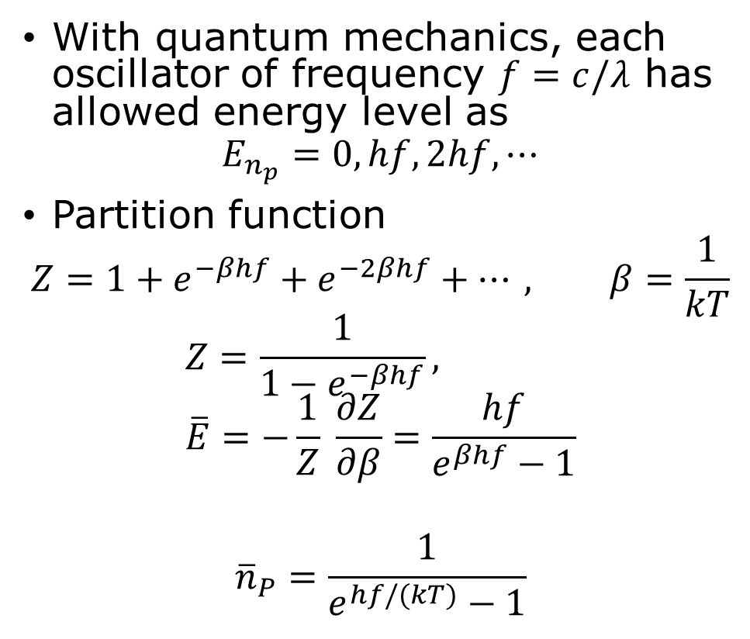


Planck distribution
With quantum mechanics, each oscillator of frequency $f=c/λ$ has allowed energy level as
$$E_{n_{p}}=0,hf,2hf,⋯$$
Partition function
$$Z=1+e^{−βhf}+e^{−2βhf}+⋯, β=\frac{1}{kT}$$
$$Z=\frac{1}{1−e^{−βhf}}, \overline{E}=−\frac{1}{Z} \frac{∂Z}{∂β}=\frac{hf}{e^{βhf}−1}$$
$${\overline{n}}_{P}=\frac{1}{e^{hf/(kT)}−1}$$
$$\frac{\overline{E}}{hf}$$
classical
quantum
$$\frac{kT}{hf}$$

Slide 5
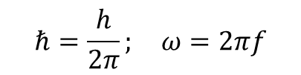
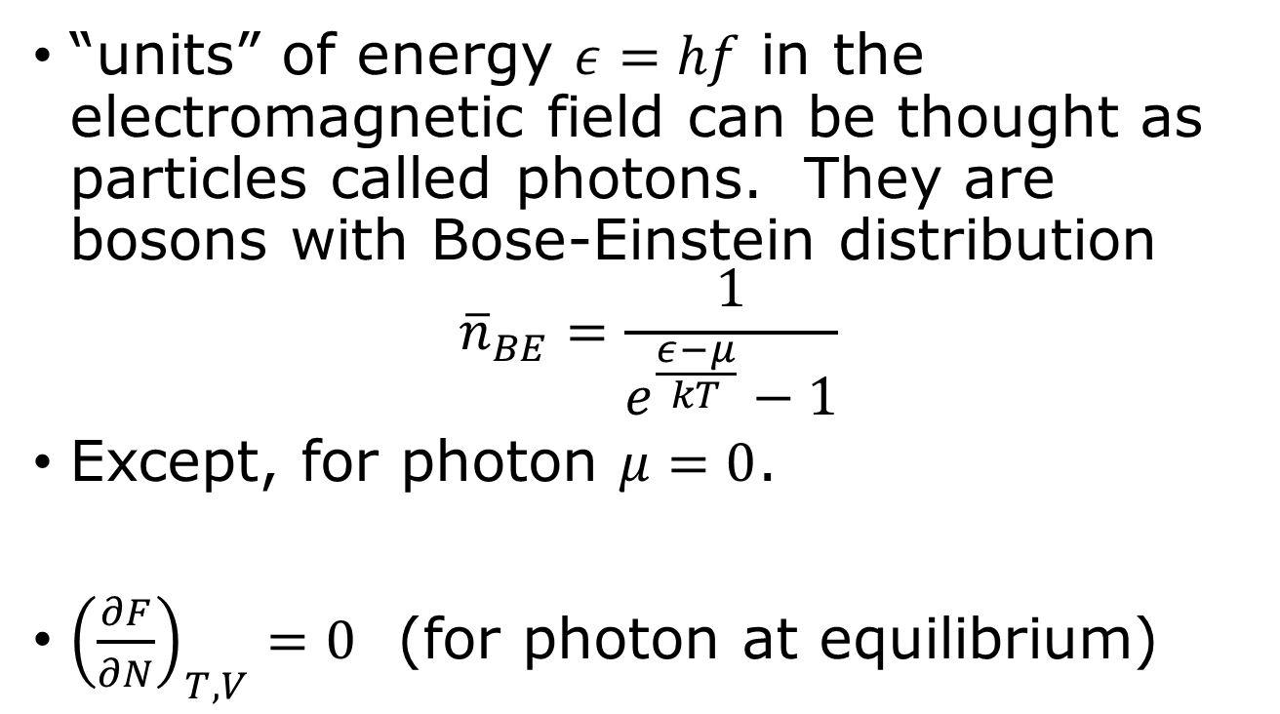
Photons
$$ℏ=\frac{h}{2π}; ω=2πf$$
“units” of energy $ε=hf$ in the electromagnetic field can be thought as particles called photons. They are bosons with Bose-Einstein distribution
$${\overline{n}}_{BE}=\frac{1}{e^{\frac{ε−μ}{kT}}−1}$$
Except, for photon $μ=0$.
${\left(\frac{∂F}{∂N}\right)}_{T,V}=0$ (for photon at equilibrium)

Slide 6

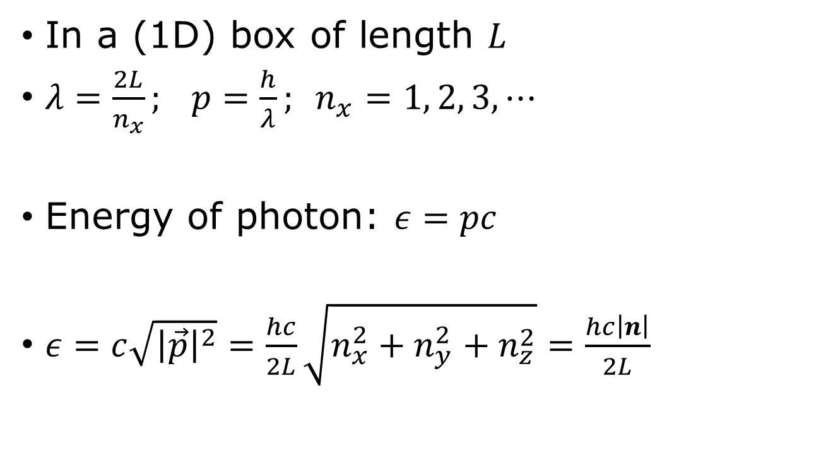

Photon dispersion relation
$$ε=hf=c|p|$$
In a (1D) box of length $L$
$λ=\frac{2L}{n_{x}}; p=\frac{h}{λ}; n_{x}=1, 2, 3, ⋯$
Energy of photon: $ε=pc$
$ε=c\sqrt{{\left|\vec{p}\right|}^{2}}=\frac{hc}{2L}\sqrt{n_{x}^{2}+n_{y}^{2}+n_{z}^{2}}=\frac{hc\left|n\right|}{2L}$
0
$$p$$

Slide 7
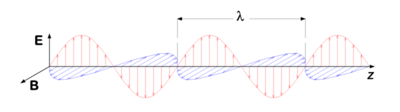
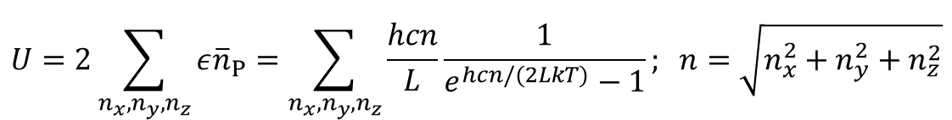
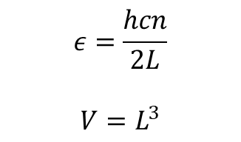
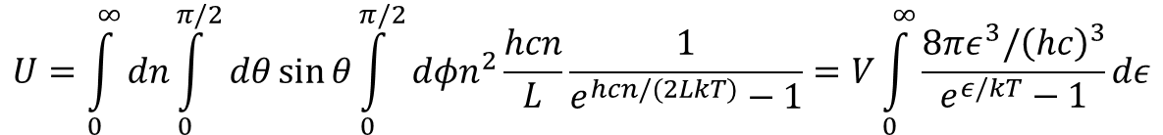
Summing over modes
$$ε=\frac{hcn}{2L}$$
$$V=L^{3}$$
$$U=2\sum_{n_{x}, n_{y},n_{z}}{ε{\overline{n}}_{P}}=\sum_{n_{x},n_{y},n_{z}}{\frac{hcn}{L}\frac{1}{e^{hcn/(2LkT)}−1}}; n=\sqrt{n_{x}^{2}+n_{y}^{2}+n_{z}^{2}}$$
$$U=\int_{0}^{∞}{dn}\int_{0}^{π/2}{dθ}\sin{θ}\int_{0}^{π/2}{dφn^{2}\frac{hcn}{L}\frac{1}{e^{hcn/(2LkT)}−1}}=V\int_{0}^{∞}{\frac{8πε^{3}/{\left(hc\right)}^{3}}{e^{ε/kT}−1}dε}$$

Slide 8
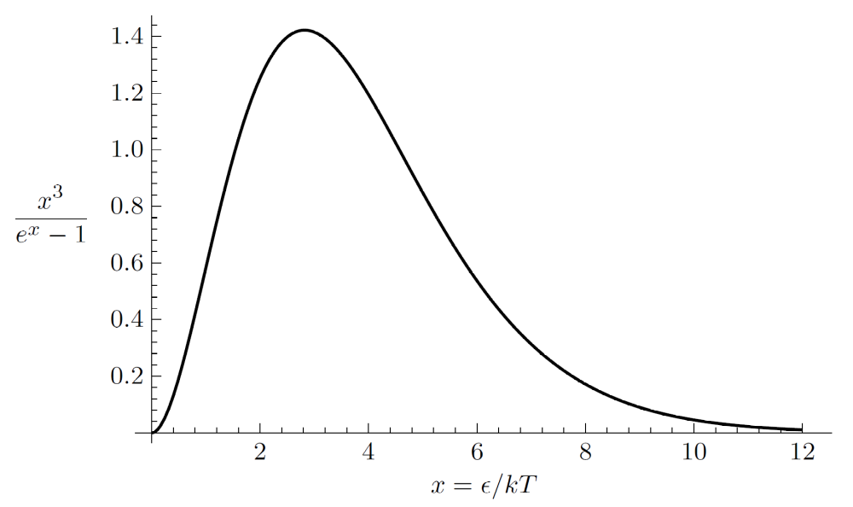
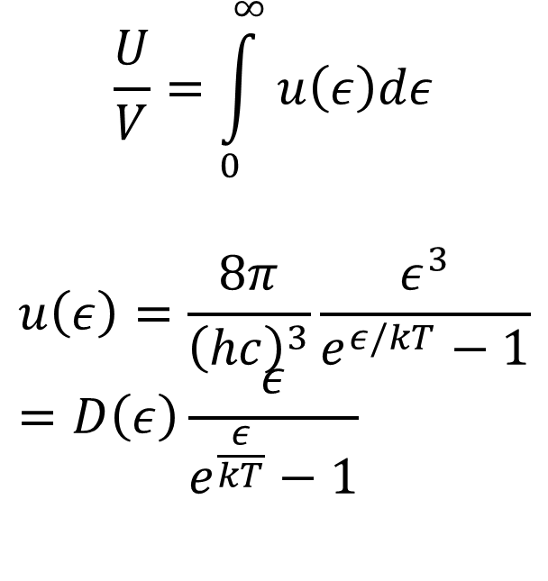

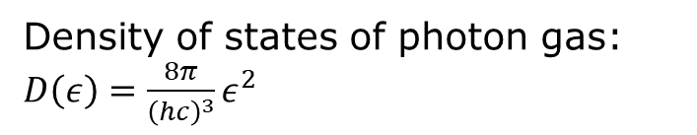
Planck spectrum
$$u(x)$$
$$\frac{U}{V}=\int_{0}^{∞}{u\left(ε\right)dε}$$
$$u\left(ε\right)=\frac{8π}{{\left(hc\right)}^{3}}\frac{ε^{3}}{e^{ε/kT}−1}=D\left(ε\right)\frac{ε}{e^{\frac{ε}{kT}}−1}$$
Density of states of photon gas: $D\left(ε\right)=\frac{8π}{{\left(hc\right)}^{3}}ε^{2}$

Slide 9

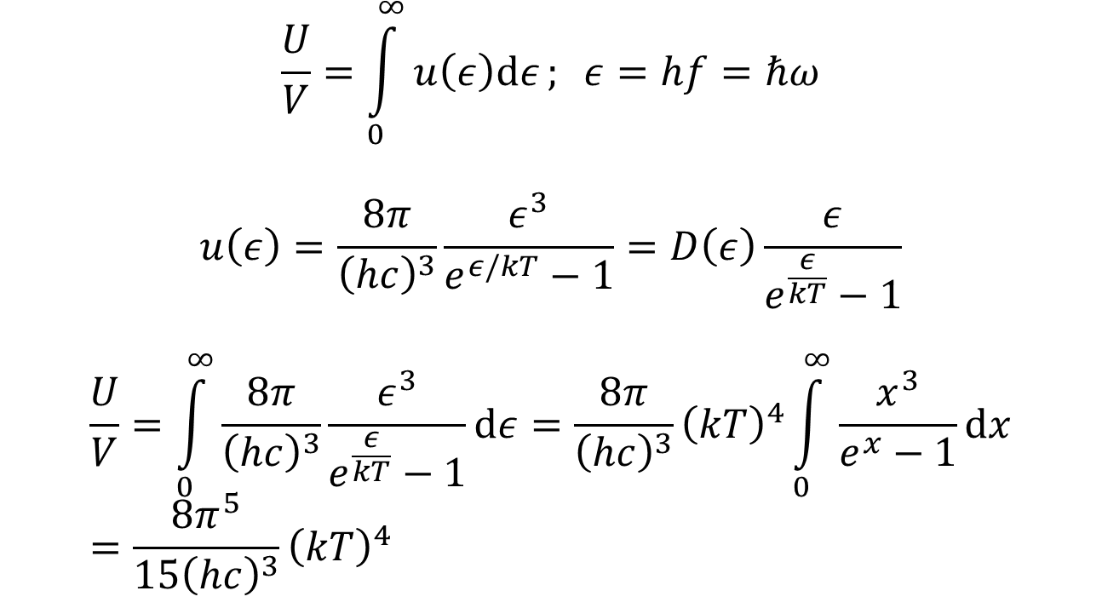
Planck spectrum, total energy
$$\frac{U}{V}=\int_{0}^{∞}{u\left(ε\right)dε}; ε=hf=ℏω$$
$$u\left(ε\right)=\frac{8π}{{\left(hc\right)}^{3}}\frac{ε^{3}}{e^{ε/kT}−1}=D\left(ε\right)\frac{ε}{e^{\frac{ε}{kT}}−1}$$
$$\frac{U}{V}=\int_{0}^{∞}{\frac{8π}{{\left(hc\right)}^{3}}\frac{ε^{3}}{e^{\frac{ε}{kT}}−1}dε}={\frac{8π}{{\left(hc\right)}^{3}}\left(kT\right)}^{4}\int_{0}^{∞}{\frac{x^{3}}{e^{x}−1}dx}={\frac{8π^{5}}{{15\left(hc\right)}^{3}}\left(kT\right)}^{4}$$
$$x=\frac{ε}{kT}$$

Slide 10
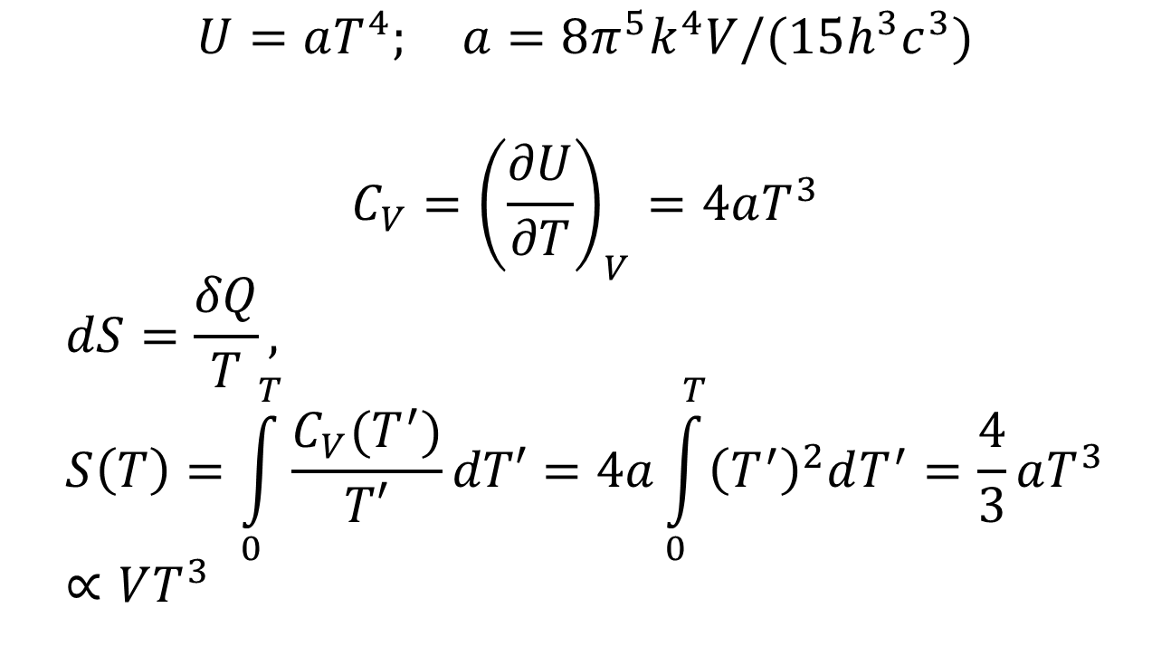
Entropy of photon gas
$$U=aT^{4}; a=8π^{5}k^{4}V/(15h^{3}c^{3})$$
$$C_{V}={\left(\frac{∂U}{∂T}\right)}_{V}=4aT^{3}$$
$$dS=\frac{δQ}{T}, S\left(T\right)=\int_{0}^{T}{\frac{C_{V}(T^{′})}{T′}dT′}=4a\int_{0}^{T}{{\left(T^{′}\right)}^{2}dT^{′}}=\frac{4}{3}aT^{3}∝VT^{3}$$

Slide 11
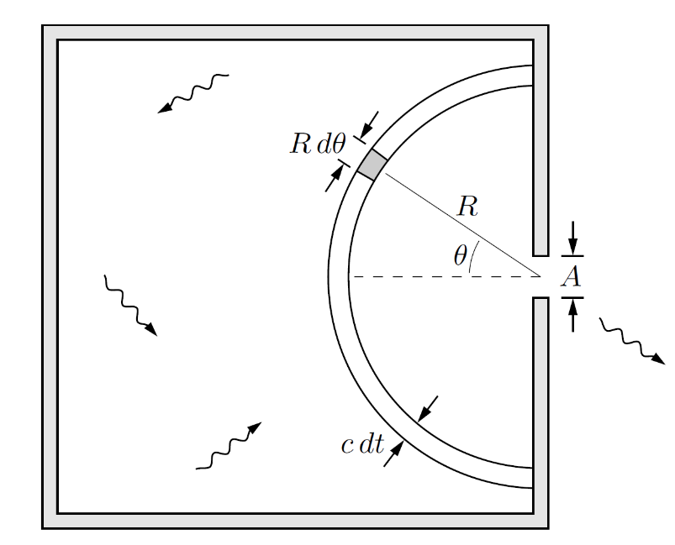
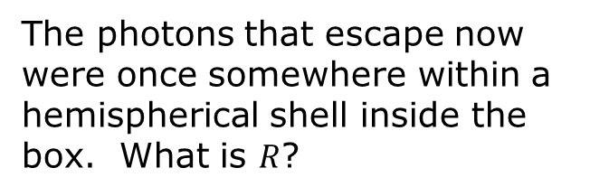
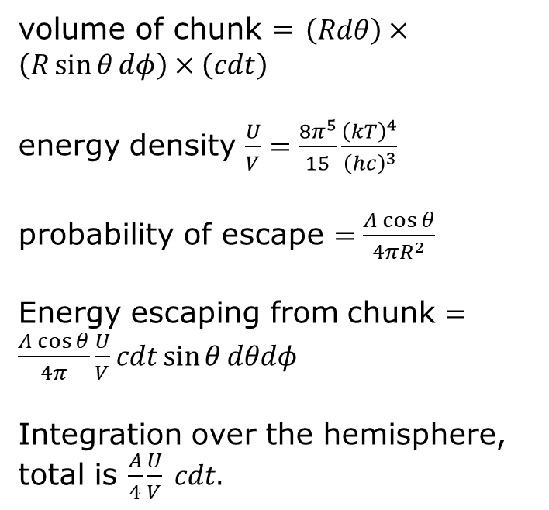
Photons escaping through a hole, Stefan’s law
volume of chunk = $\left(Rdθ\right)×\left(R\sin{θ}dφ\right)×\left(cdt\right)$
energy density $\frac{U}{V}=\frac{8π^{5}}{15}\frac{{\left(kT\right)}^{4}}{{\left(hc\right)}^{3}}$
probability of escape $=\frac{A\cos{θ}}{4πR^{2}}$
Energy escaping from chunk $=\frac{A\cos{θ}}{4π}\frac{U}{V}cdt\sin{θ}dθdφ$
Integration over the hemisphere, total is $\frac{A}{4}\frac{U}{V} cdt.$
The photons that escape now were once somewhere within a hemispherical shell inside the box. What is $R$?

Slide 12
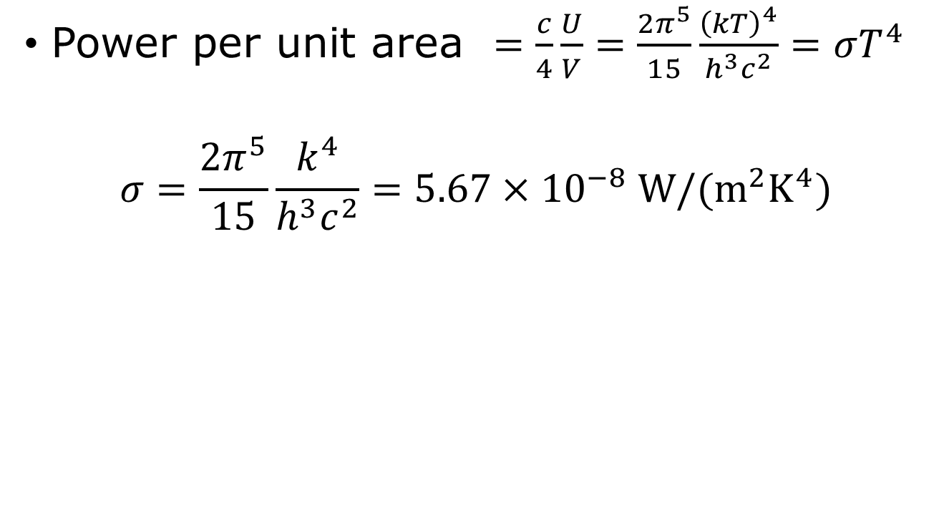
Stefan-Boltzmann law
Power per unit area $=\frac{c}{4}\frac{U}{V}=\frac{2π^{5}}{15}\frac{{\left(kT\right)}^{4}}{h^{3}c^{2}}=σT^{4}$
$$σ=\frac{2π^{5}}{15}\frac{k^{4}}{h^{3}c^{2}}=5.67×{10}^{−8} W/(m^{2}K^{4})$$

Slide 13
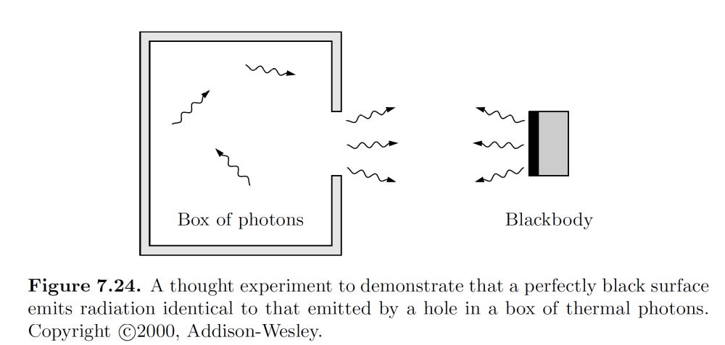
Why a hole is the same as a blackbody for radiation?

Slide 14
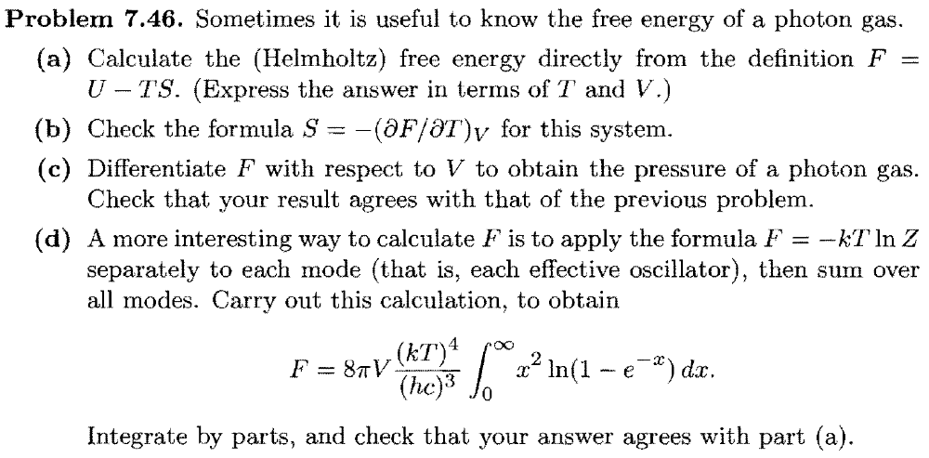
Tutorial problem 7.46

