Slide 1
Week 2
First law, heat and work

Slide 2
Energy, conservation of
In a closed and isolated system, energy is conserved.
Noether’s theorem: every continuous symmetry of a physical theory has an associated conserved quantity; if the symmetry is time invariance, then the conserved quantity is called “energy”. The energy conservation law is a consequence of the shift symmetry of time.

Slide 3
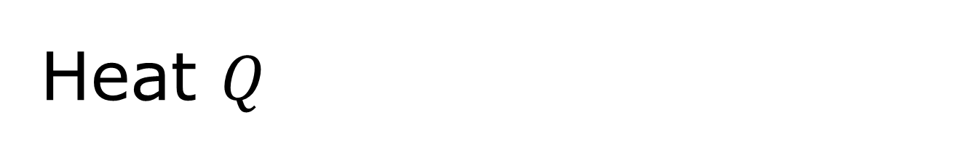
Heat $Q$
Heat is defined as any spontaneous flow of energy from one object to another caused by a difference in temperature between the objects.
Redistributions of microscopic states without macroscopic geometric change.

Slide 4

Work $W$
Work, in thermodynamics, is defined as any other transfer of energy (other than heat) into or out of a system, which is macroscopic/mechanical/electrical, etc., in origin.
Volume change leads to work, but this is not the only one possible.

Slide 5
Before the first law, i.e., the zeroth law of thermodynamics
If body C is in thermal equilibrium with two other bodies, A and B, then A and B are in thermal equilibrium with one another. [I.e., thermometer makes sense.]
C
A
B
Minus one (-1) law?

Slide 6
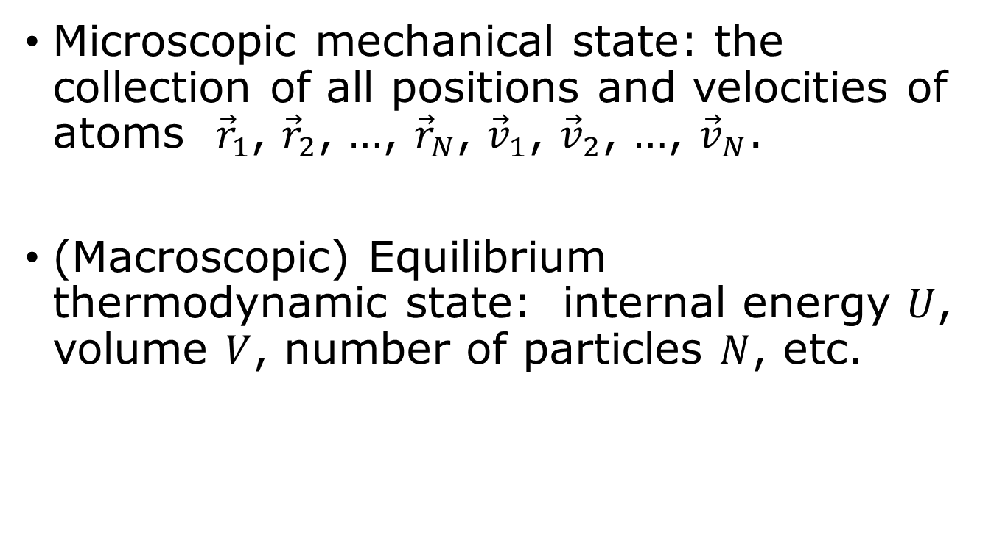
States
Microscopic mechanical state: the collection of all positions and velocities of atoms ${\vec{r}}_{1}$, ${\vec{r}}_{2}$, …, ${\vec{r}}_{N}$, ${\vec{v}}_{1}$, ${\vec{v}}_{2}$, …, ${\vec{v}}_{N}$.
(Macroscopic) Equilibrium thermodynamic state: internal energy $U$, volume $V$, number of particles $N$, etc.

Slide 7


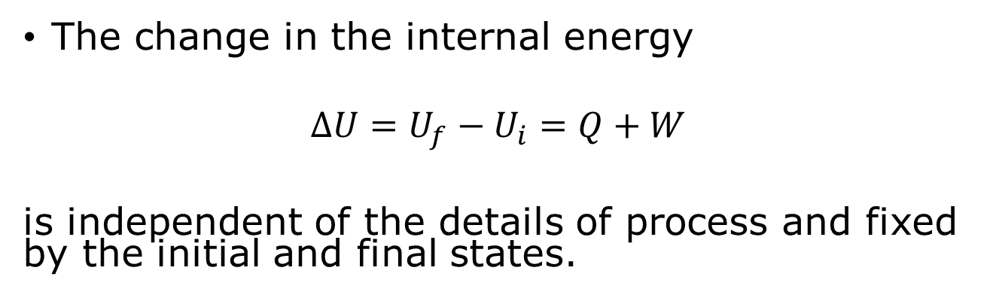



The first law of thermodynamics
The change in the internal energy
$$ΔU=U_{f}−U_{i}=Q+W$$
is independent of the details of process and fixed by the initial and final states.
$$W=−PdV$$
$$U_{i}$$
$$U_{f}$$
$$Q+W$$
$$Q$$

Slide 8
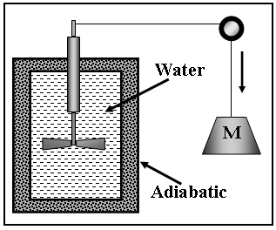


Joule’s experiment
$$ΔU=Q+W$$
Whether use wheel to stir the water to warm up by 1 degree or use candle to heat it up, the amount of energy needed is the same. 3rd way, use resistor & battery.

Slide 9
Three modes of heat transfer
Conduction is the transfer of heat by molecular contact, fast-moving molecules bump into slow-moving molecules, giving up some of their energy in the process.
Convection is the bulk motion of a gas or liquid, driven, e.g., by a gravitational field.
Radiation is the emission of electromagnetic waves.

Slide 10
Units for heat
Old units: calories
Modern units: joule (1 joule = 1 kg m²/s²), the same as work.
1 calorie = 4.184 J is the energy needed to raise the temperature of 1 gram of water by 1 degree.

Slide 11

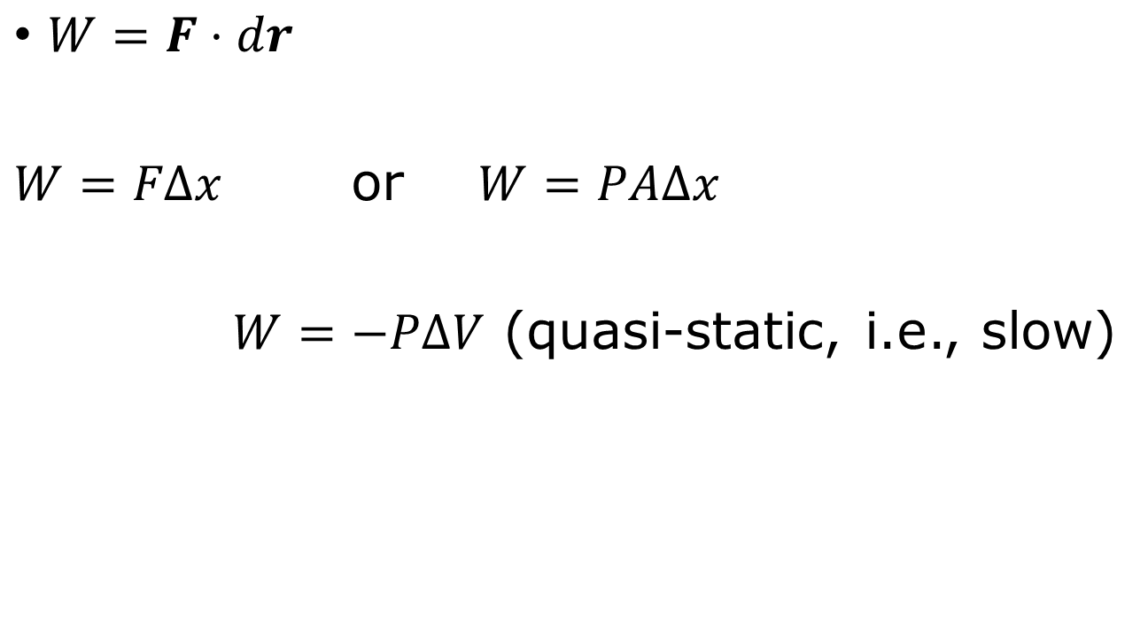

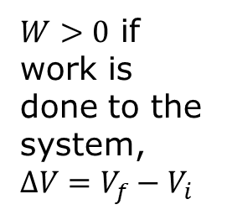

Compression work
$W=F⋅dr$
$W=FΔx$ or $W=PAΔx$
$W=−PΔV$ (quasi-static, i.e., slow)
Pressure $P=\frac{F}{A}$
$W>0$ if work is done to the system,$ΔV=V_{f}−V_{i}$
$$ΔV$$
$$P$$

Slide 12







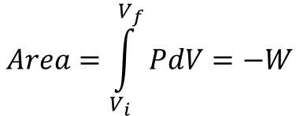
Quasistatic work (slow)
pressure $P$
pressure $P$
$$Area=\int_{V_{i}}^{V_{f}}{PdV}=−W$$
$$P$$
$$V_{i} V_{f}$$
$$V_{i} V_{f}$$
volume $V$
volume $V$
Recall the definition of definite integral: Riemann sum

Slide 13

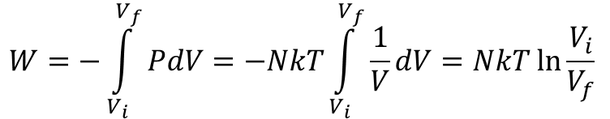
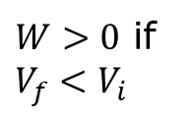

Compression of an ideal gas, isothermal process, T fixed
$$W=−\int_{V_{i}}^{V_{f}}{PdV=−NkT\int_{V_{i}}^{V_{f}}{\frac{1}{V}}dV}=NkT ln\frac{V_{i}}{V_{f}}$$
$$P∝1/V$$
pressure
$W>0$ if $V_{f}<V_{i}$
$V_{f}$ $V_{i}$ volume

Slide 14
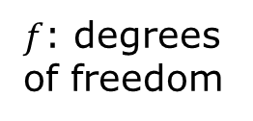
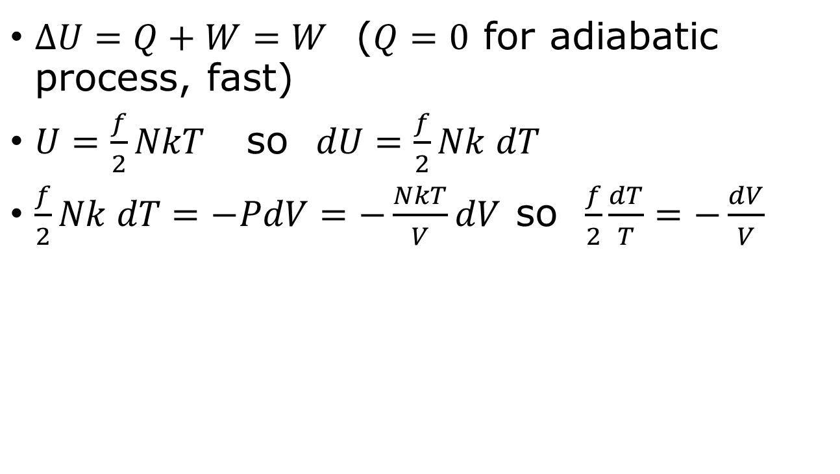

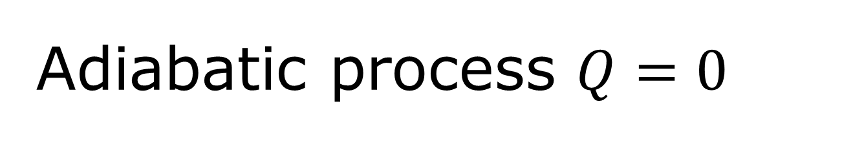

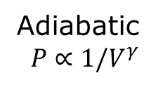


Adiabatic process $Q=0$
$ΔU=Q+W=W$ ($Q=0$ for adiabatic process, fast)
$U=\frac{f}{2}NkT$ so $dU=\frac{f}{2}Nk dT$
$\frac{f}{2}Nk dT=−PdV=−\frac{NkT}{V}dV$ so $\frac{f}{2}\frac{dT}{T}=−\frac{dV}{V}$
Adiabatic
$$P∝1/V^{γ}$$
$f$: degrees of freedom
pressure
$$T_{f}$$
Isothermal $P∝\frac{1}{V}$
$$T_{i}$$
$V_{f}$ $V_{i}$ volume

Slide 15
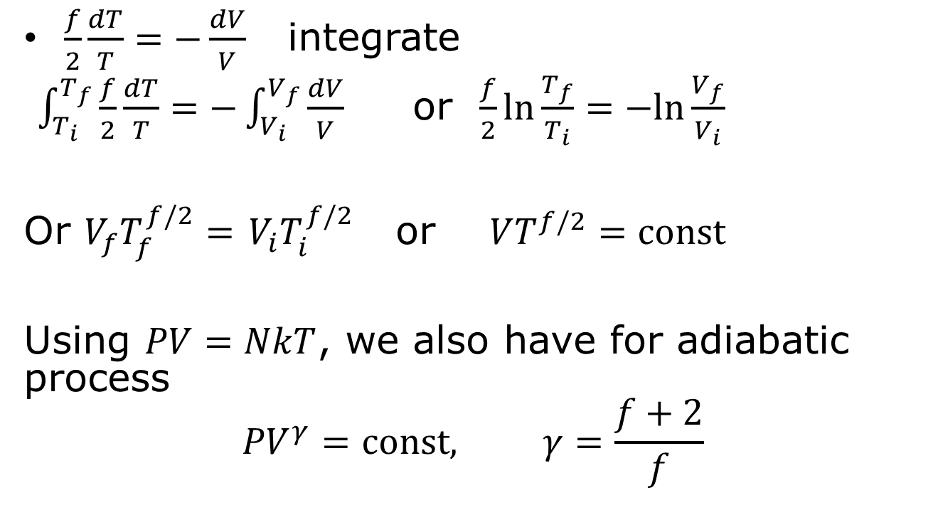
Adiabatic compression
$\frac{f}{2}\frac{dT}{T}=−\frac{dV}{V}$ integrate
$\int_{T_{i}}^{T_{f}}{\frac{f}{2}\frac{dT}{T}=−\int_{V_{i}}^{V_{f}}{\frac{dV}{V}}}$ or $\frac{f}{2}ln\frac{T_{f}}{T_{i}}=−ln\frac{V_{f}}{V_{i}}$
Or $V_{f}T_{f}^{f/2}=$ $V_{i}T_{i}^{f/2}$ or $VT^{f/2}=const$
Using $PV=NkT$, we also have for adiabatic process
$${PV}^{γ}=const, γ=\frac{f+2}{f}$$

Slide 16

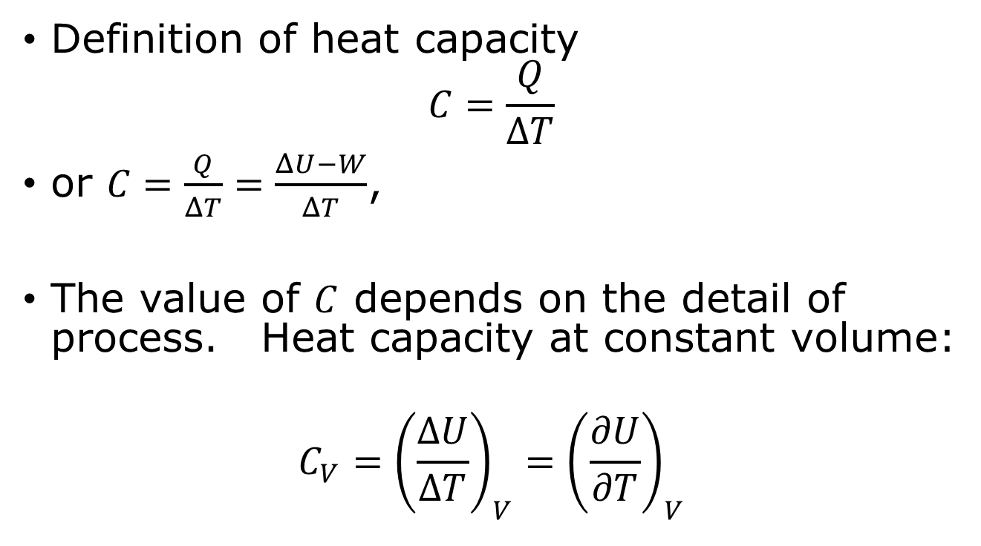
Heat capacities
Definition of heat capacity
$$C=\frac{Q}{ΔT}$$
or $C=\frac{Q}{ΔT}=\frac{ΔU−W}{ΔT}$,
The value of $C$ depends on the detail of process. Heat capacity at constant volume:
$$C_{V}={\left(\frac{ΔU}{ΔT}\right)}_{V}={\left(\frac{∂U}{∂T}\right)}_{V}$$
$$ΔT→0$$

Slide 17

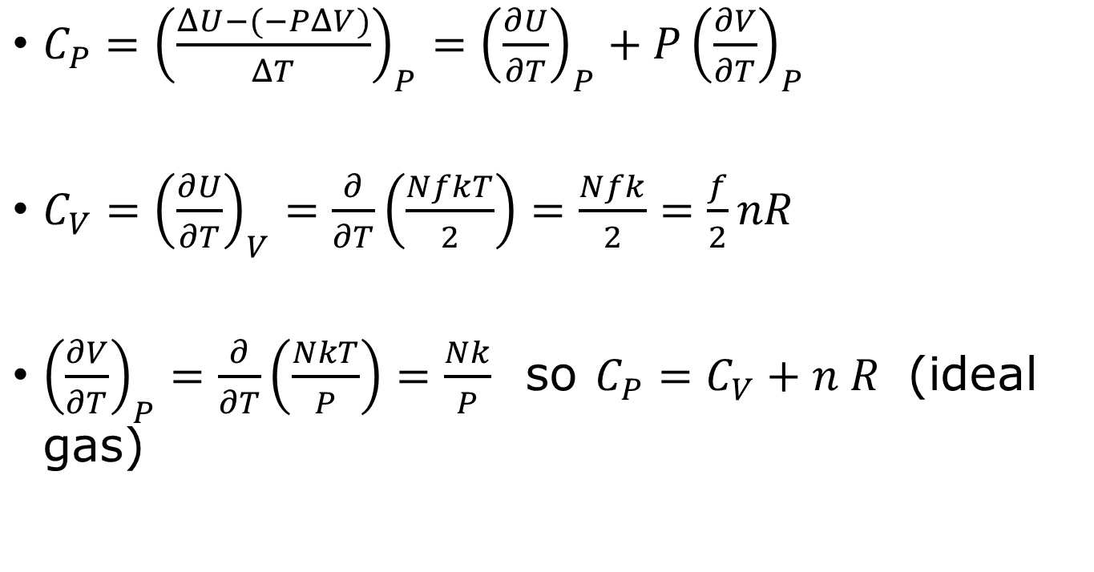
Heat capacity at constant pressure
$C_{P}={\left(\frac{ΔU−(−PΔV)}{ΔT}\right)}_{P}={\left(\frac{∂U}{∂T}\right)}_{P}+P{\left(\frac{∂V}{∂T}\right)}_{P}$
$C_{V}={\left(\frac{∂U}{∂T}\right)}_{V}=\frac{∂}{∂T}\left(\frac{NfkT}{2}\right)=\frac{Nfk}{2}=\frac{f}{2}nR$
${\left(\frac{∂V}{∂T}\right)}_{P}=\frac{∂}{∂T}\left(\frac{NkT}{P}\right)=\frac{Nk}{P}$ so $C_{P}=C_{V}+n R$ (ideal gas)
Recall the concept of partial derivatives.
Show that $γ=C_{p}/C_{V}$

Slide 18
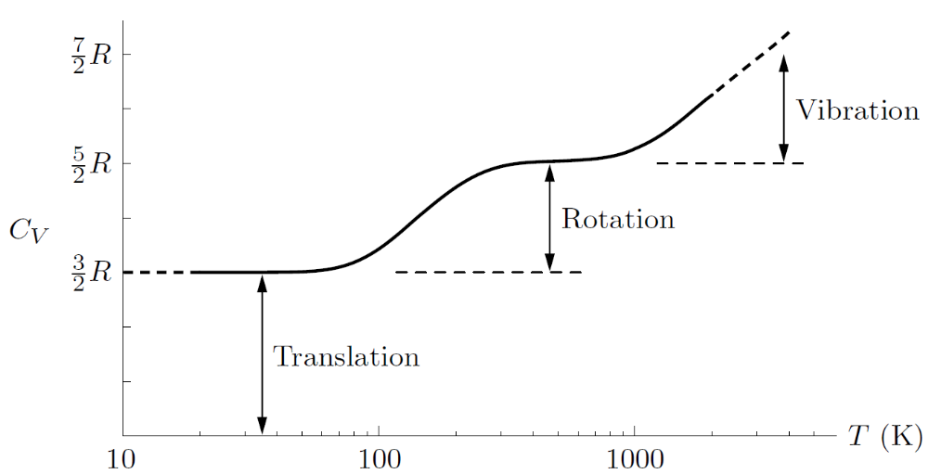
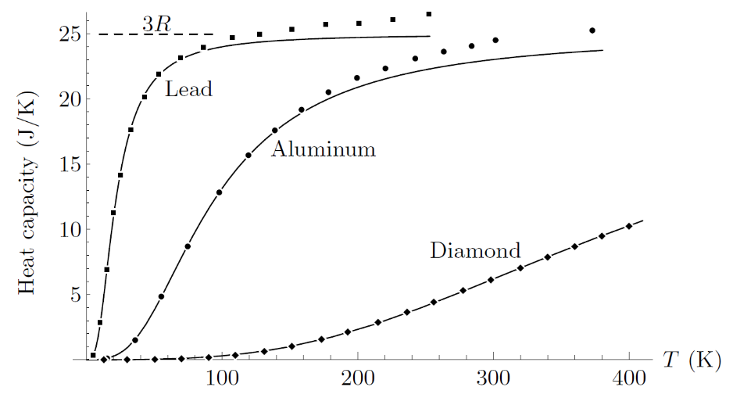
Heat capacities
← Heat capacity at constant volume of one mole of hydrogen (H₂) gas - temperature dependent.
Fig. 1.13 & 1.14 from Schroeder, copyright Addison-Wesley
→ Measured heat capacities of one mole solid at constant pressure (symbols) vs model prediction (at constant volume).

Slide 19
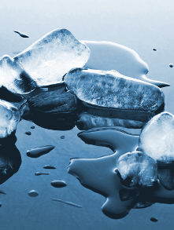
Latent heat
The amount of heat required to make a phase transformation, i.e., ice melt.
Latent heat for melting ice is 334 J/g.

Slide 20
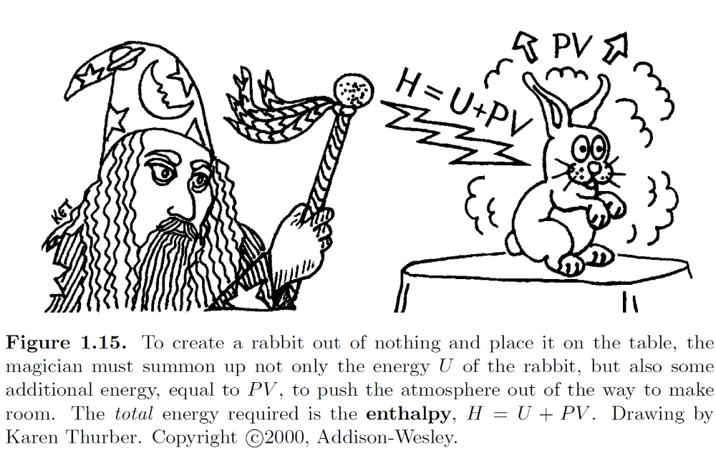
Enthalpy

Slide 21
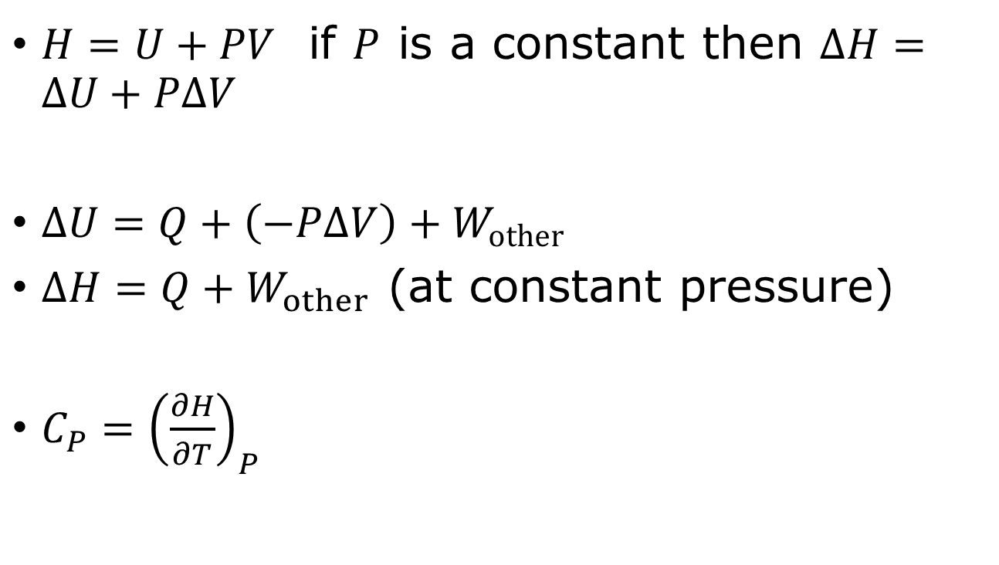
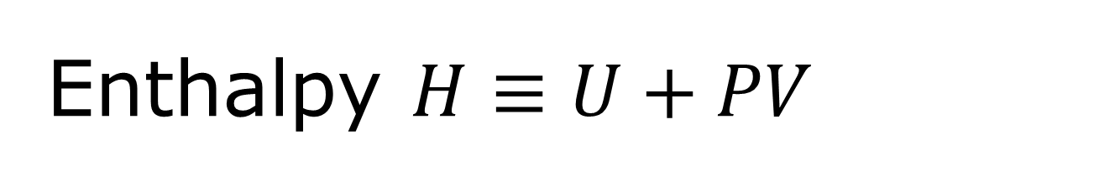
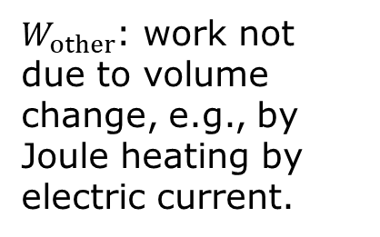
Enthalpy $H≡U+PV$
$H=U+PV$ if $P$ is a constant then $ΔH=ΔU+PΔV$
$ΔU=Q+\left(−PΔV\right)+W_{other}$
$ΔH=Q+W_{other}$ (at constant pressure)
$C_{P}={\left(\frac{∂H}{∂T}\right)}_{P}$
$W_{other}$: work not due to volume change, e.g., by Joule heating by electric current.

Slide 22

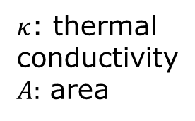




Rate processes, heat conduction, Fourier’s law
material | Thermal conductivity κ [W/(mK)]
air | 0.026
wood | 0.08
water | 0.6
glass | 0.8
ion | 80
copper | 400
$$\frac{Q}{Δt}=−κA\frac{dT}{dx}$$
$$Q$$
Inside $T_{2}$
Outside $T_{1}$
$κ$: thermal conductivity
$A:$ area
$$Δx$$

Slide 23






Viscosity
$$z$$
$$F_{x}$$
$$Δz$$
fluid
$$u_{x}$$
Area = $A$
substance | Viscosity (mPa⋅s) | Temperature (Celsius)
benzene | 0.604 | 25
water | 1.0016 | 20
mercury | 1.526 | 25
Whole milk | 2.12 | 20
Oliver oil | 56.2 | 26
honey | 2000 - 10000 | 20
peanut better | ≈ 10⁵
$$\frac{F_{x}}{A}=η\frac{du_{x}}{dz}$$

Slide 24


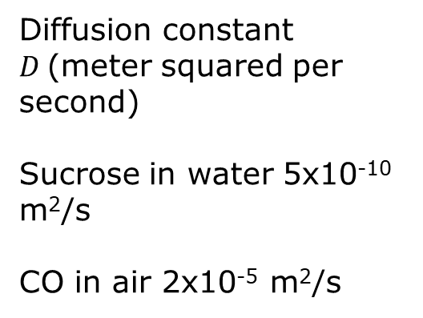
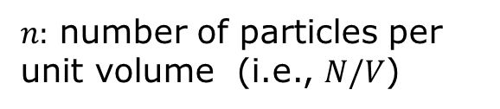

Diffusion, Fick’s law
$$J_{x}=−D\frac{dn}{dx}$$
$n:$ number of particles per unit volume (i.e., $N/V$)
Diffusion constant $D$(meter squared per second)
Sucrose in water 5x10⁻¹⁰ m²/s
CO in air 2x10⁻⁵ m²/s
$$\vec{J}$$
$$x$$

Slide 25
Define thermal equilibrium again
There should be no transport of any kinds, i.e., no temperature gradient for heat transfer, no velocity gradient for momentum transport, and no concentrate gradient for particle transport.

Slide 26
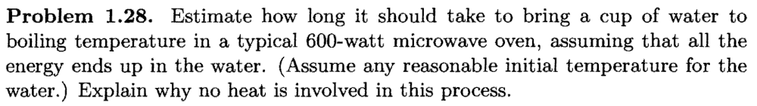
Tutorial problems 1.28 (page 20), 1.39 (page 27)

Slide 27
