Slide 1
Week 3
The second law, entropy

Slide 2
Second law
Basic fact about heat: heat flows from hot to cold (naturally).
You cannot convert all heat to work. You cannot build a heat engine more efficient than the ideal Carnot engine.
Entropy cannot decrease for an isolated system.

Slide 3
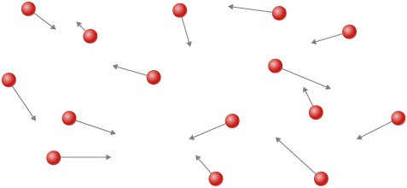
Macro vs Micro
Macro: large, coarse – thermodynamics
Micro: small, atomic, detailed – statistical mechanics
U,V,N
r_{1,} v_{1,} r_{2,} v_{2, …}

Slide 4
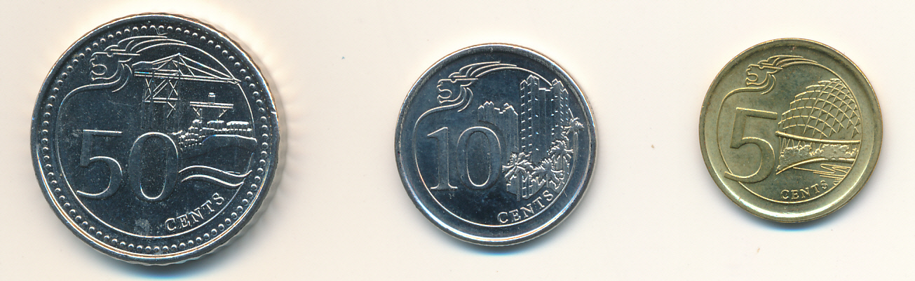
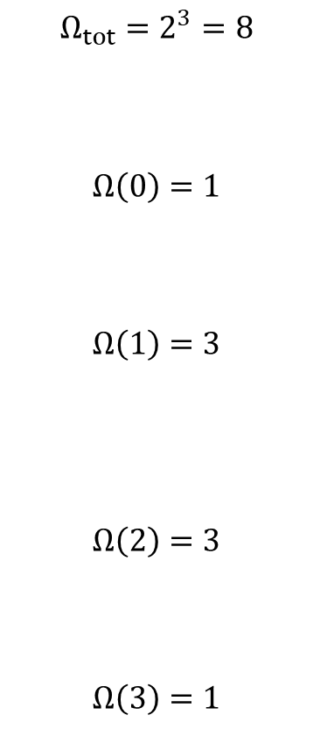
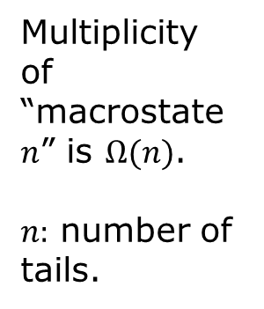
All possible “microstates” of three coins
$$Ω_{tot}=2^{3}=8$$
$$Ω\left(0\right)=1$$
$$Ω\left(1\right)=3$$
$$Ω\left(2\right)=3$$
$$Ω\left(3\right)=1$$
Multiplicity of “macrostate $n$” is $Ω(n)$.
$n:$ number of tails.
H H H
H H T
H T H
T H H
H T T
T H T
T T H
T T T

Slide 5
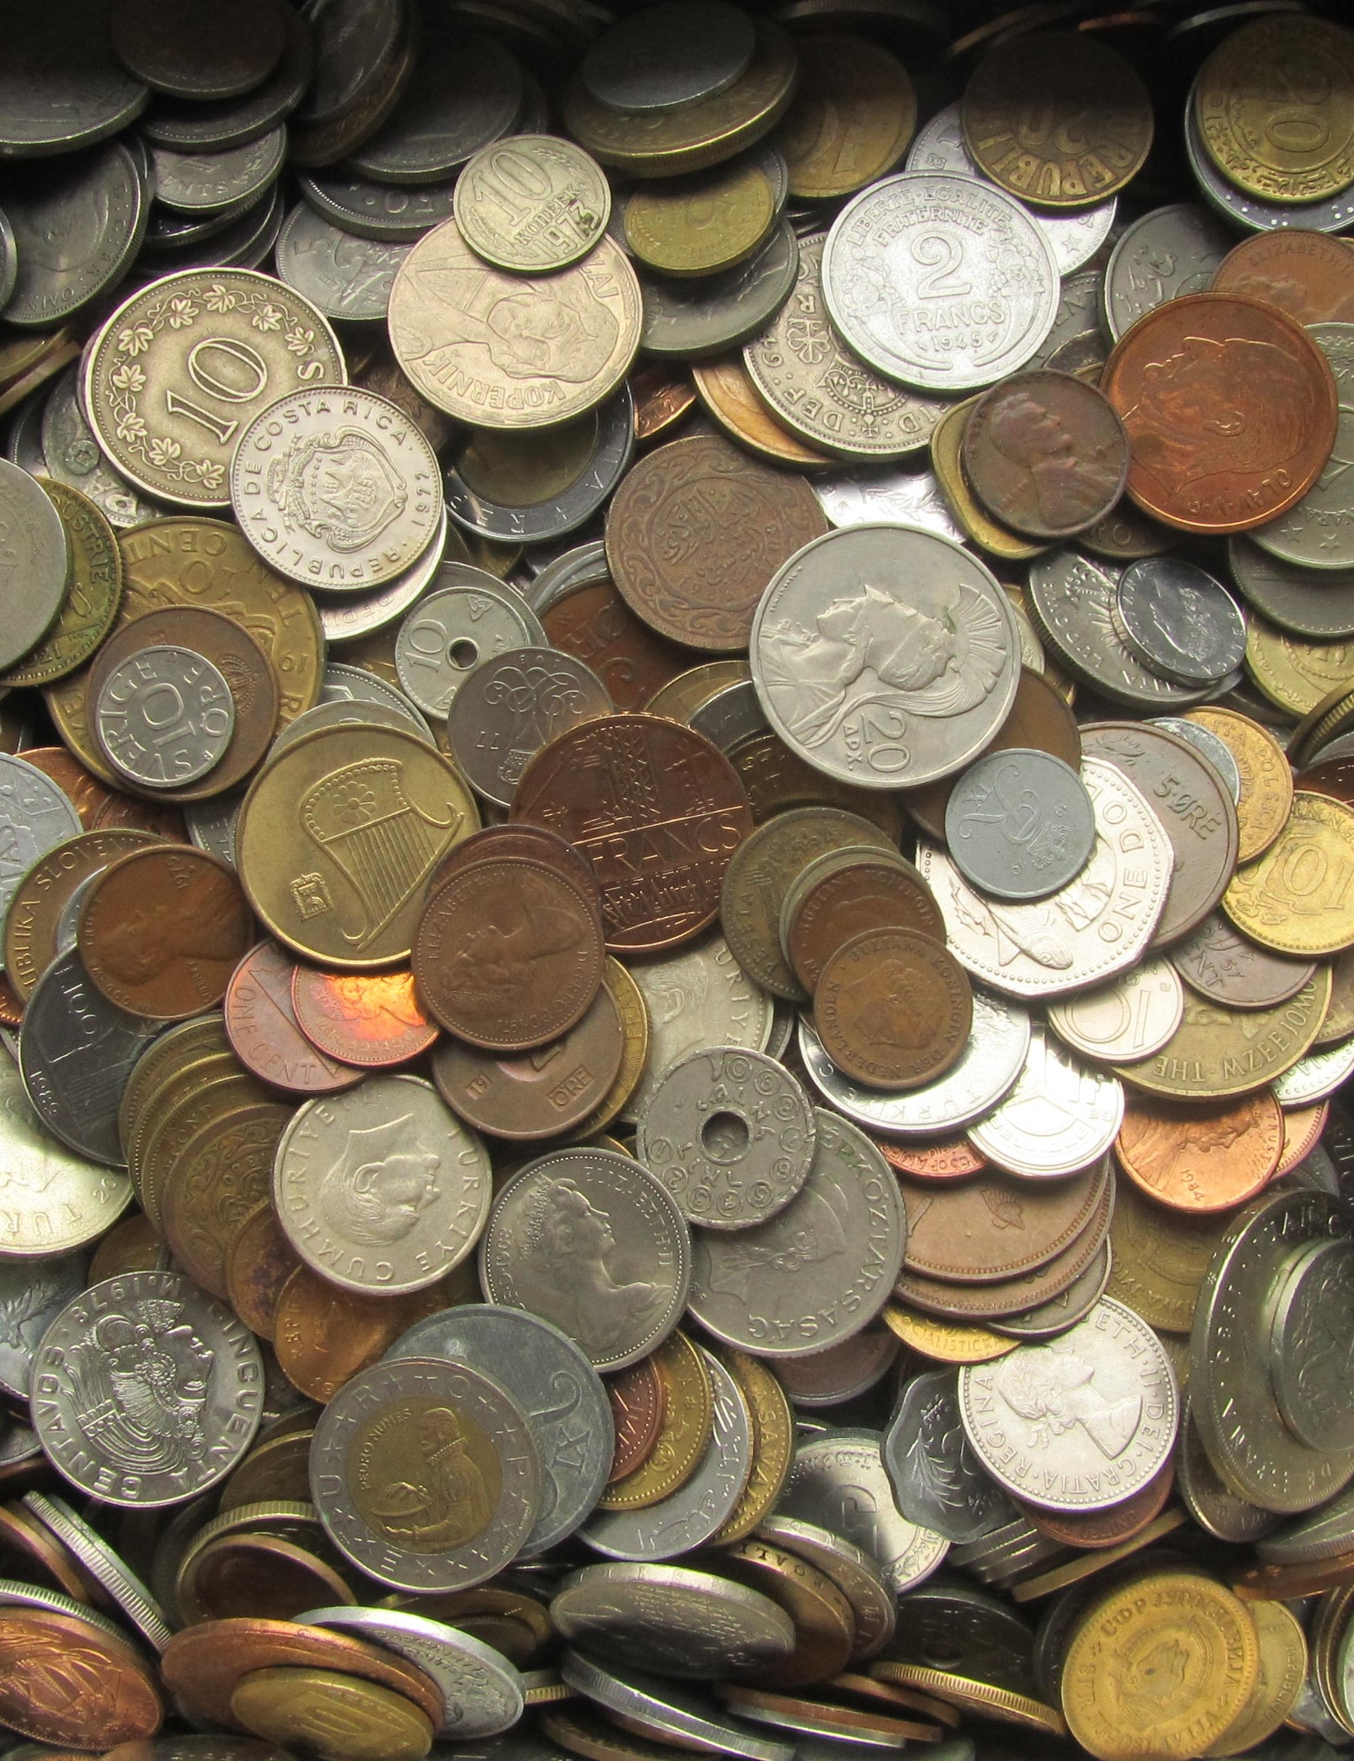
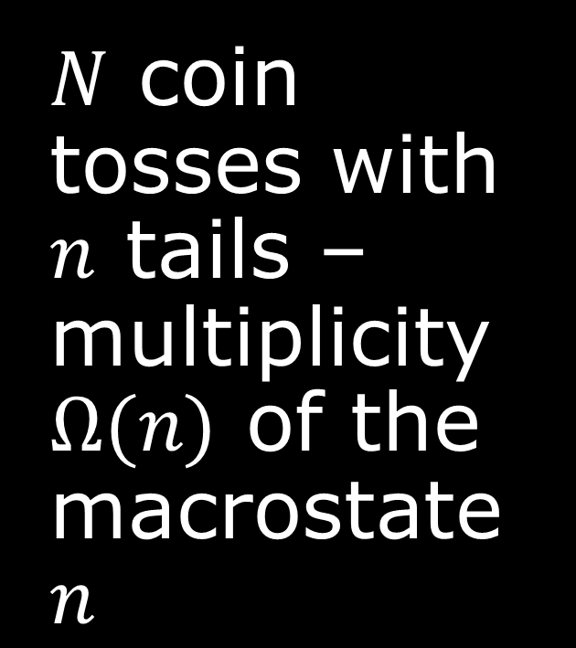
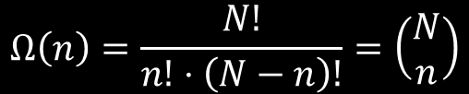
$N$ coin tosses with $n$ tails – multiplicity $Ω(n)$ of the macrostate $n$
$$Ω\left(n\right)=\frac{N!}{n!⋅\left(N−n\right)!}=\left(\begin{matrix}N \\ n\end{matrix}\right)$$

Slide 6
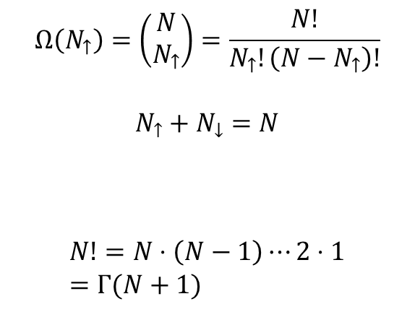
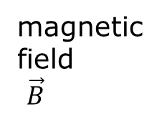

Two-state paramagnet
magnetic field
$\vec{B}$
Spins up or down
$$Ω\left(N_{↑}\right)=\left(\begin{matrix}N \\ N_{↑}\end{matrix}\right)=\frac{N!}{N_{↑}!\left(N−N_{↑}\right)!}$$
$$N_{↑}+N_{↓}=N$$
$$N!=N⋅\left(N−1\right)⋯2⋅1=Γ(N+1)$$
$$x!=Γ(x+1)=\int_{0}^{∞}{t^{x}e^{−t}dt}$$

Slide 7


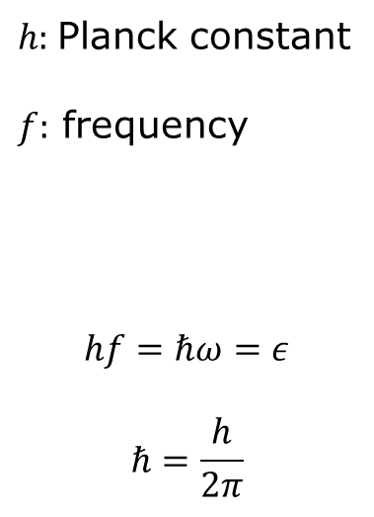
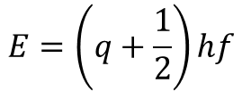

A quantum oscillator
$$E=\left(q+\frac{1}{2}\right)hf$$
$h:$Planck constant
$f:$ frequency
$$hf=ℏω=ε$$
$$ℏ=\frac{h}{2π}$$
$$\frac{5}{2}hf$$
E
$$\frac{3}{2}hf$$
$$\frac{1}{2}hf$$
x

Slide 8
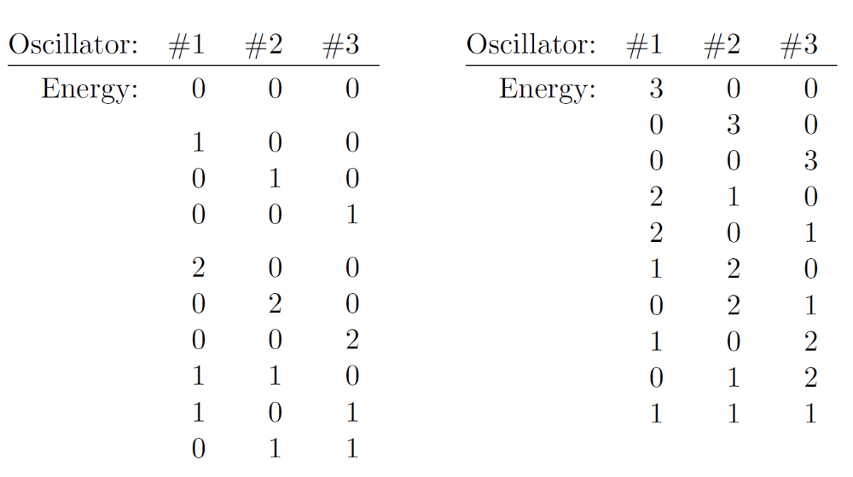
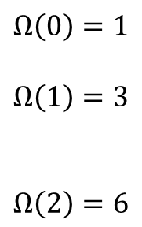





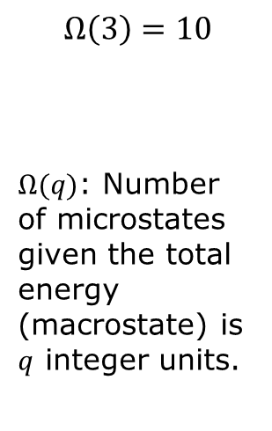
Einstein model of a solid
$$⋮$$
$$⋮$$
$$⋮$$
$$⋮$$
$$…$$
energy
1 2 3 … N
$$Ω\left(0\right)=1$$
$$Ω\left(1\right)=3$$
$$Ω\left(2\right)=6$$
$$Ω\left(3\right)=10$$
$Ω(q)$: Number of microstates given the total energy (macrostate) is $q$ integer units.

Slide 9
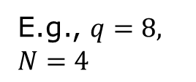
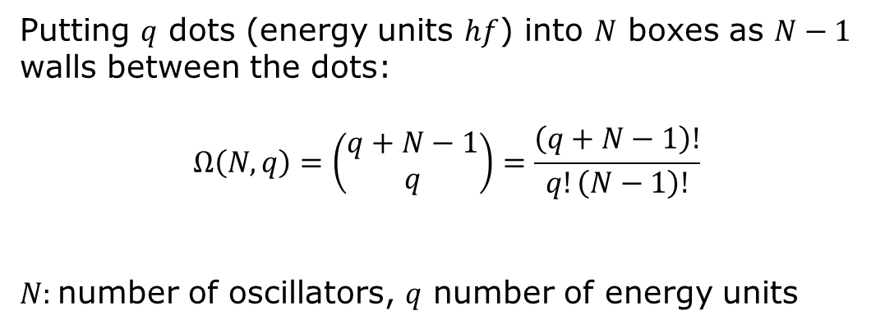
Counting microstates in Einstein model of solid
E.g., $q=8,$ $N=4$
Putting $q$ dots (energy units $hf$) into $N$ boxes as $N−1$ walls between the dots:
$$Ω\left(N,q\right)=\left(\begin{matrix}q+N−1 \\ q\end{matrix}\right)=\frac{\left(q+N−1\right)!}{q!\left(N−1\right)!}$$
$N:$number of oscillators, $q$ number of energy units

Slide 10
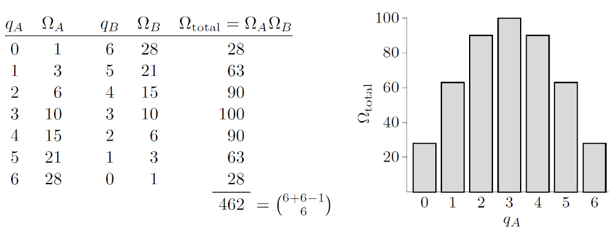
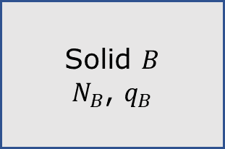
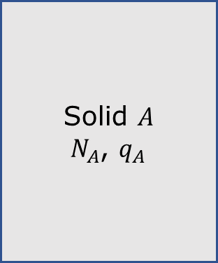
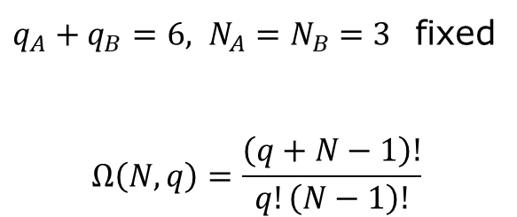

Two Einstein solids
Solid $A$
$N_{A}$, $q_{A}$
energy transfer
$$Δq$$
$q_{A}+q_{B}=6, N_{A}=N_{B}=3$ fixed
$$Ω\left(N,q\right)=\frac{\left(q+N−1\right)!}{q!\left(N−1\right)!}$$
Solid $B$
$N_{B}$, $q_{B}$

Slide 11
Fundamental assumption of statistical mechanics
In an isolated system in thermal equilibrium, all accessible microstates are equally probable.
“Isolated system” : micro-canonical, fixing energy U

Slide 12

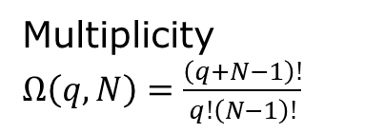
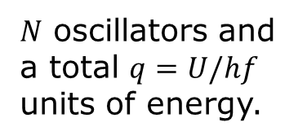
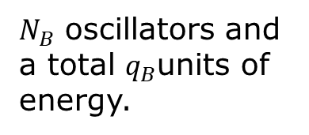
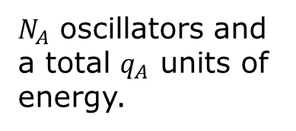
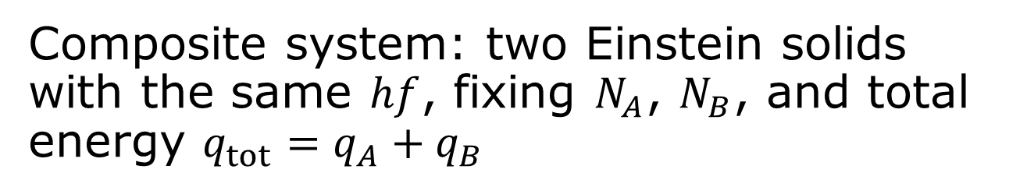
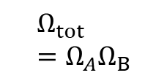
Single system
$N$ oscillators and a total $q=U/hf$ units of energy.
Multiplicity $Ω\left(q,N\right)=\frac{\left(q+N−1\right)!}{q!\left(N−1\right)!}$
Composite system: two Einstein solids with the same $hf$, fixing $N_{A}$, $N_{B}$, and total energy $q_{tot}=q_{A}+q_{B}$
$N_{A}$ oscillators and a total $q_{A}$ units of energy.
$$Δq$$
$N_{B}$ oscillators and a total $q_{B}$units of energy.
$$Ω_{tot}=Ω_{A}Ω_{B}$$
Macrostate of the composite system: $q_{A}=U_{A}/hf$

Slide 13
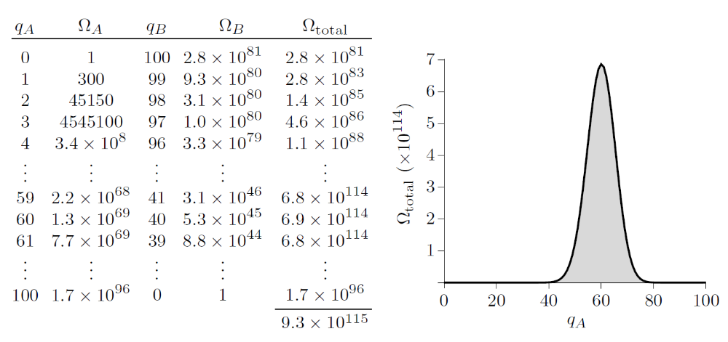
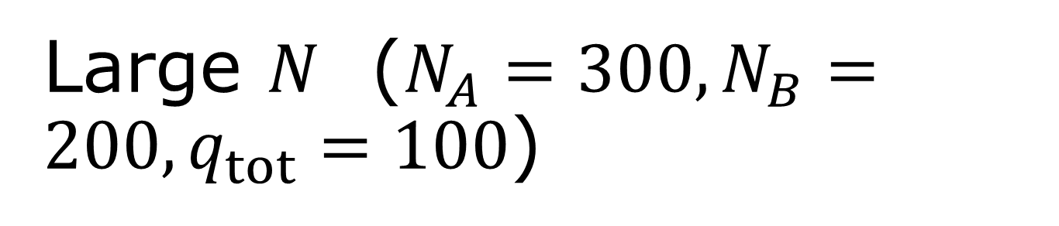
Large $N$ ($N_{A}=300, N_{B}=200, q_{tot}=100$)
Second law of thermodynamics: the spontaneous flow of energy stops when a system is at, or very near, its most likely mascrostate.

Slide 14
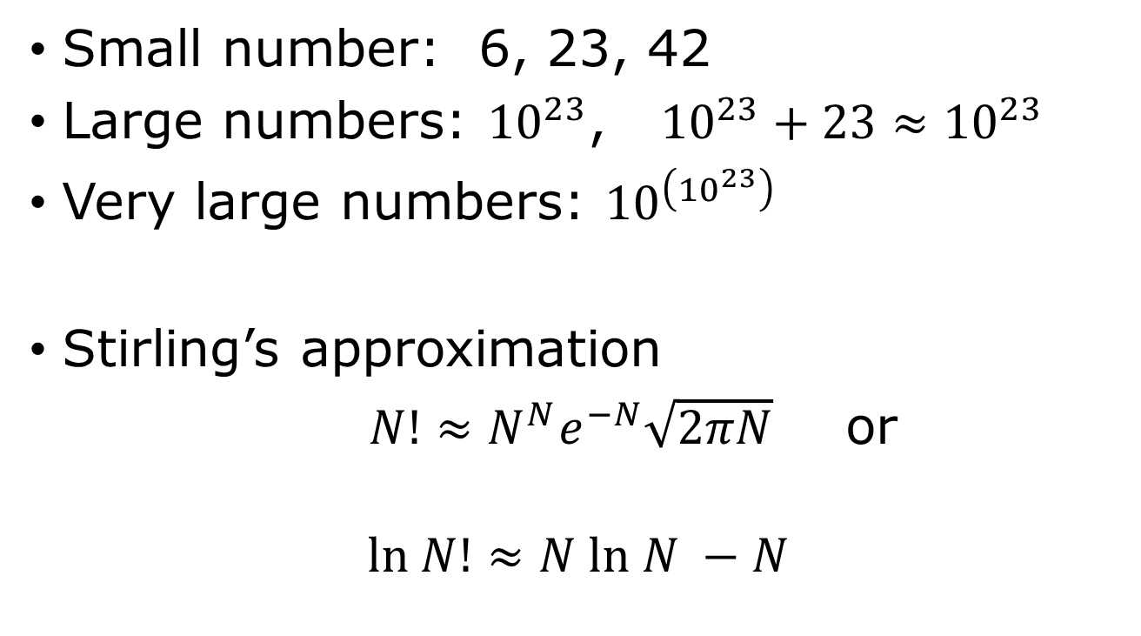
Small, large, and very large numbers
Small number: 6, 23, 42
Large numbers: ${10}^{23}$, ${10}^{23}+23≈{10}^{23}$
Very large numbers: ${10}^{\left({10}^{23}\right)}$
Stirling’s approximation
$N!≈N^{N}e^{−N}\sqrt{2πN}$ or
$$ln N!≈N ln N −N$$

Slide 15

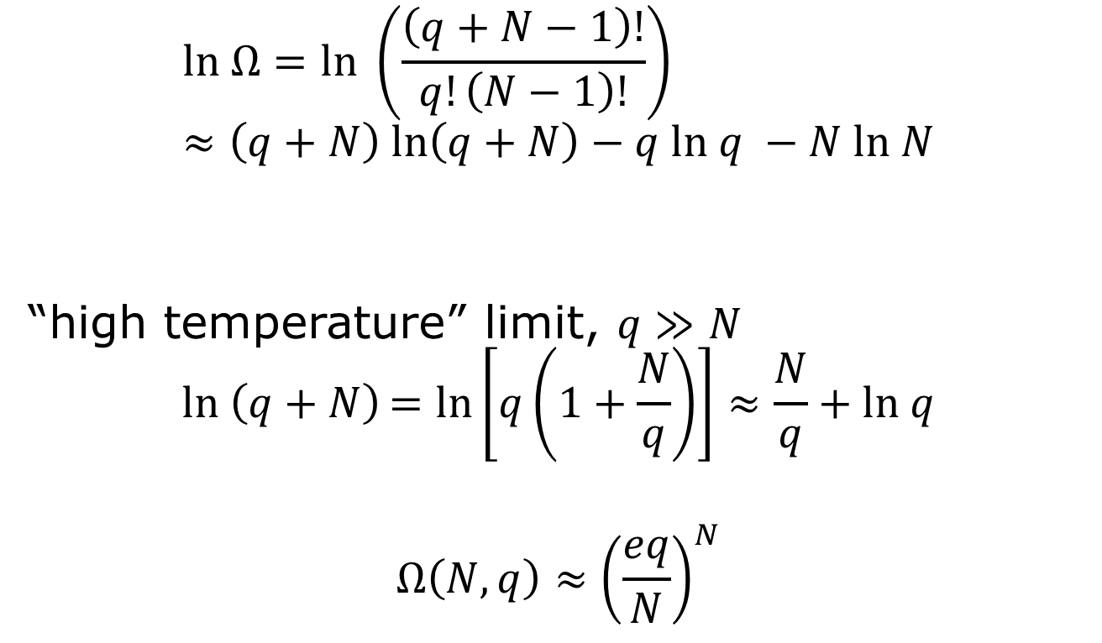
Multiplicity of a large Einstein solid
$$ln Ω=ln \left(\frac{\left(q+N−1\right)!}{q!\left(N−1\right)!}\right)≈\left(q+N\right) ln\left(q+N\right)−q ln q −N ln N$$
“high temperature” limit, $q≫N$
$$ln \left(q+N\right)=ln\left[q\left(1+\frac{N}{q}\right)\right]≈\frac{N}{q}+ln q$$
$$Ω\left(N,q\right)≈{\left(\frac{eq}{N}\right)}^{N}$$
$\ln\left(1+x\right)≈x$ if $x$ small

Slide 16
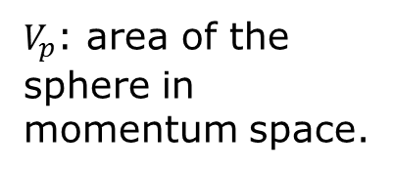
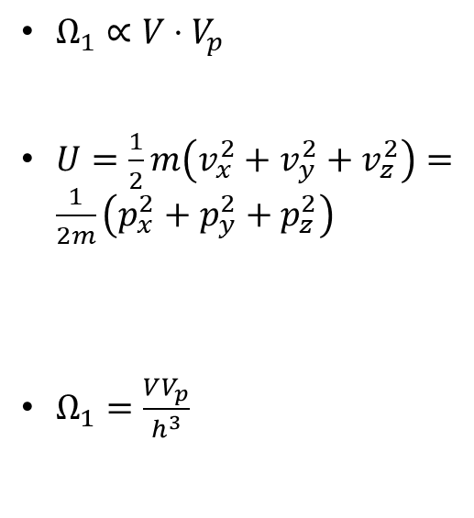

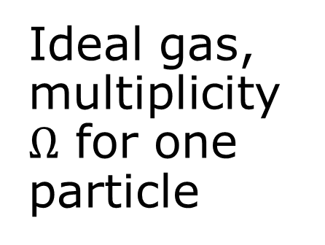



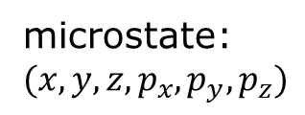
Ideal gas, multiplicity $Ω$ for one particle
How to count continuous variables?
microstate: $(x,y,z,p_{x},p_{y},p_{z})$
$$p_{z}$$
radius $R=\sqrt{2mU}$
$Ω_{1}∝V⋅V_{p}$
$U=\frac{1}{2}m\left(v_{x}^{2}+v_{y}^{2}+v_{z}^{2}\right)=\frac{1}{2m}\left(p_{x}^{2}+p_{y}^{2}+p_{z}^{2}\right)$
$Ω_{1}=\frac{VV_{p}}{h^{3}}$
$$p_{y}$$
$$p_{x}$$
$V_{p}$: area of the sphere in momentum space.

Slide 17
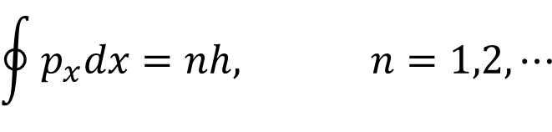
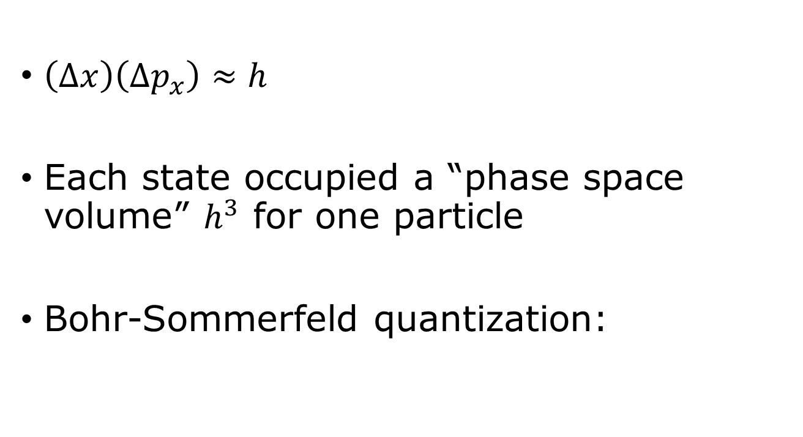
Counting states, Heisenberg uncertainty principle
$\left(Δx\right)\left(Δp_{x}\right)≈h$
Each state occupied a “phase space volume” $h^{3}$ for one particle
Bohr-Sommerfeld quantization:
$$\oint{p_{x}dx=nh, n=1,2,⋯}$$

Slide 18
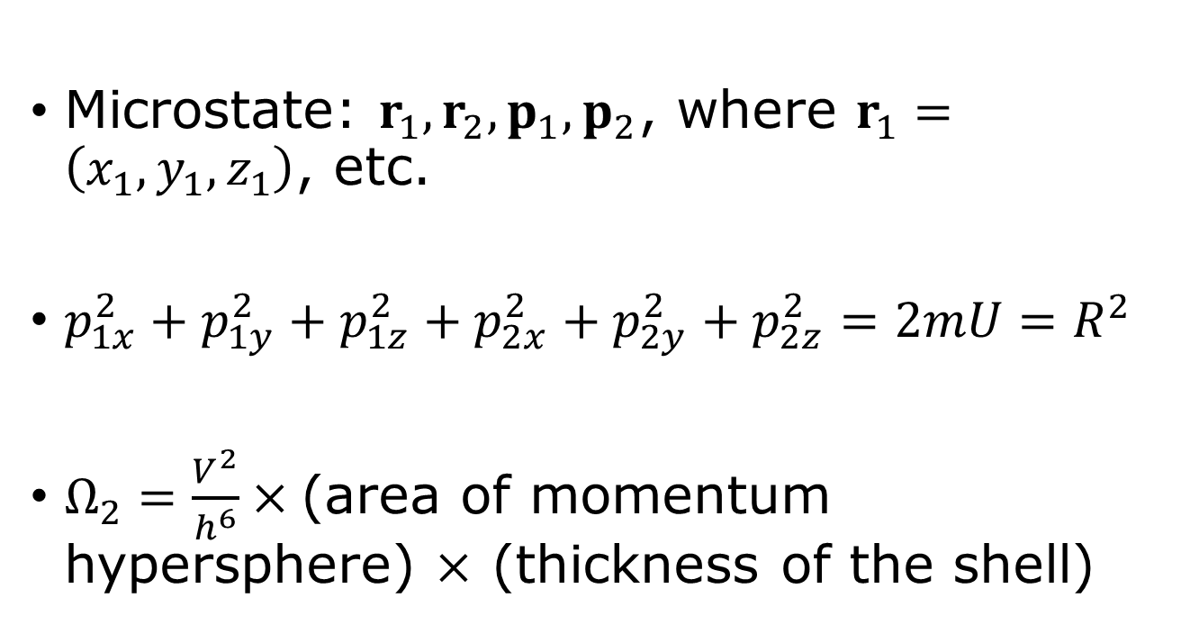
Ideal gas with two particles
Microstate: $r_{1},r_{2},p_{1},p_{2}$, where $r_{1}=\left(x_{1},y_{1},z_{1}\right)$, etc.
$p_{1x}^{2}+p_{1y}^{2}+p_{1z}^{2}+p_{2x}^{2}+p_{2y}^{2}+p_{2z}^{2}=2mU=R^{2}$
$Ω_{2}=\frac{V^{2}}{h^{6}}×$(area of momentum hypersphere) $×$ (thickness of the shell)

Slide 19
Identical particles
Exchange particles
1
2
2
1
$Ω_{2}=\frac{1}{2}\frac{V^{2}}{h^{6}}×$(shell volume of momentum hypersphere)

Slide 20
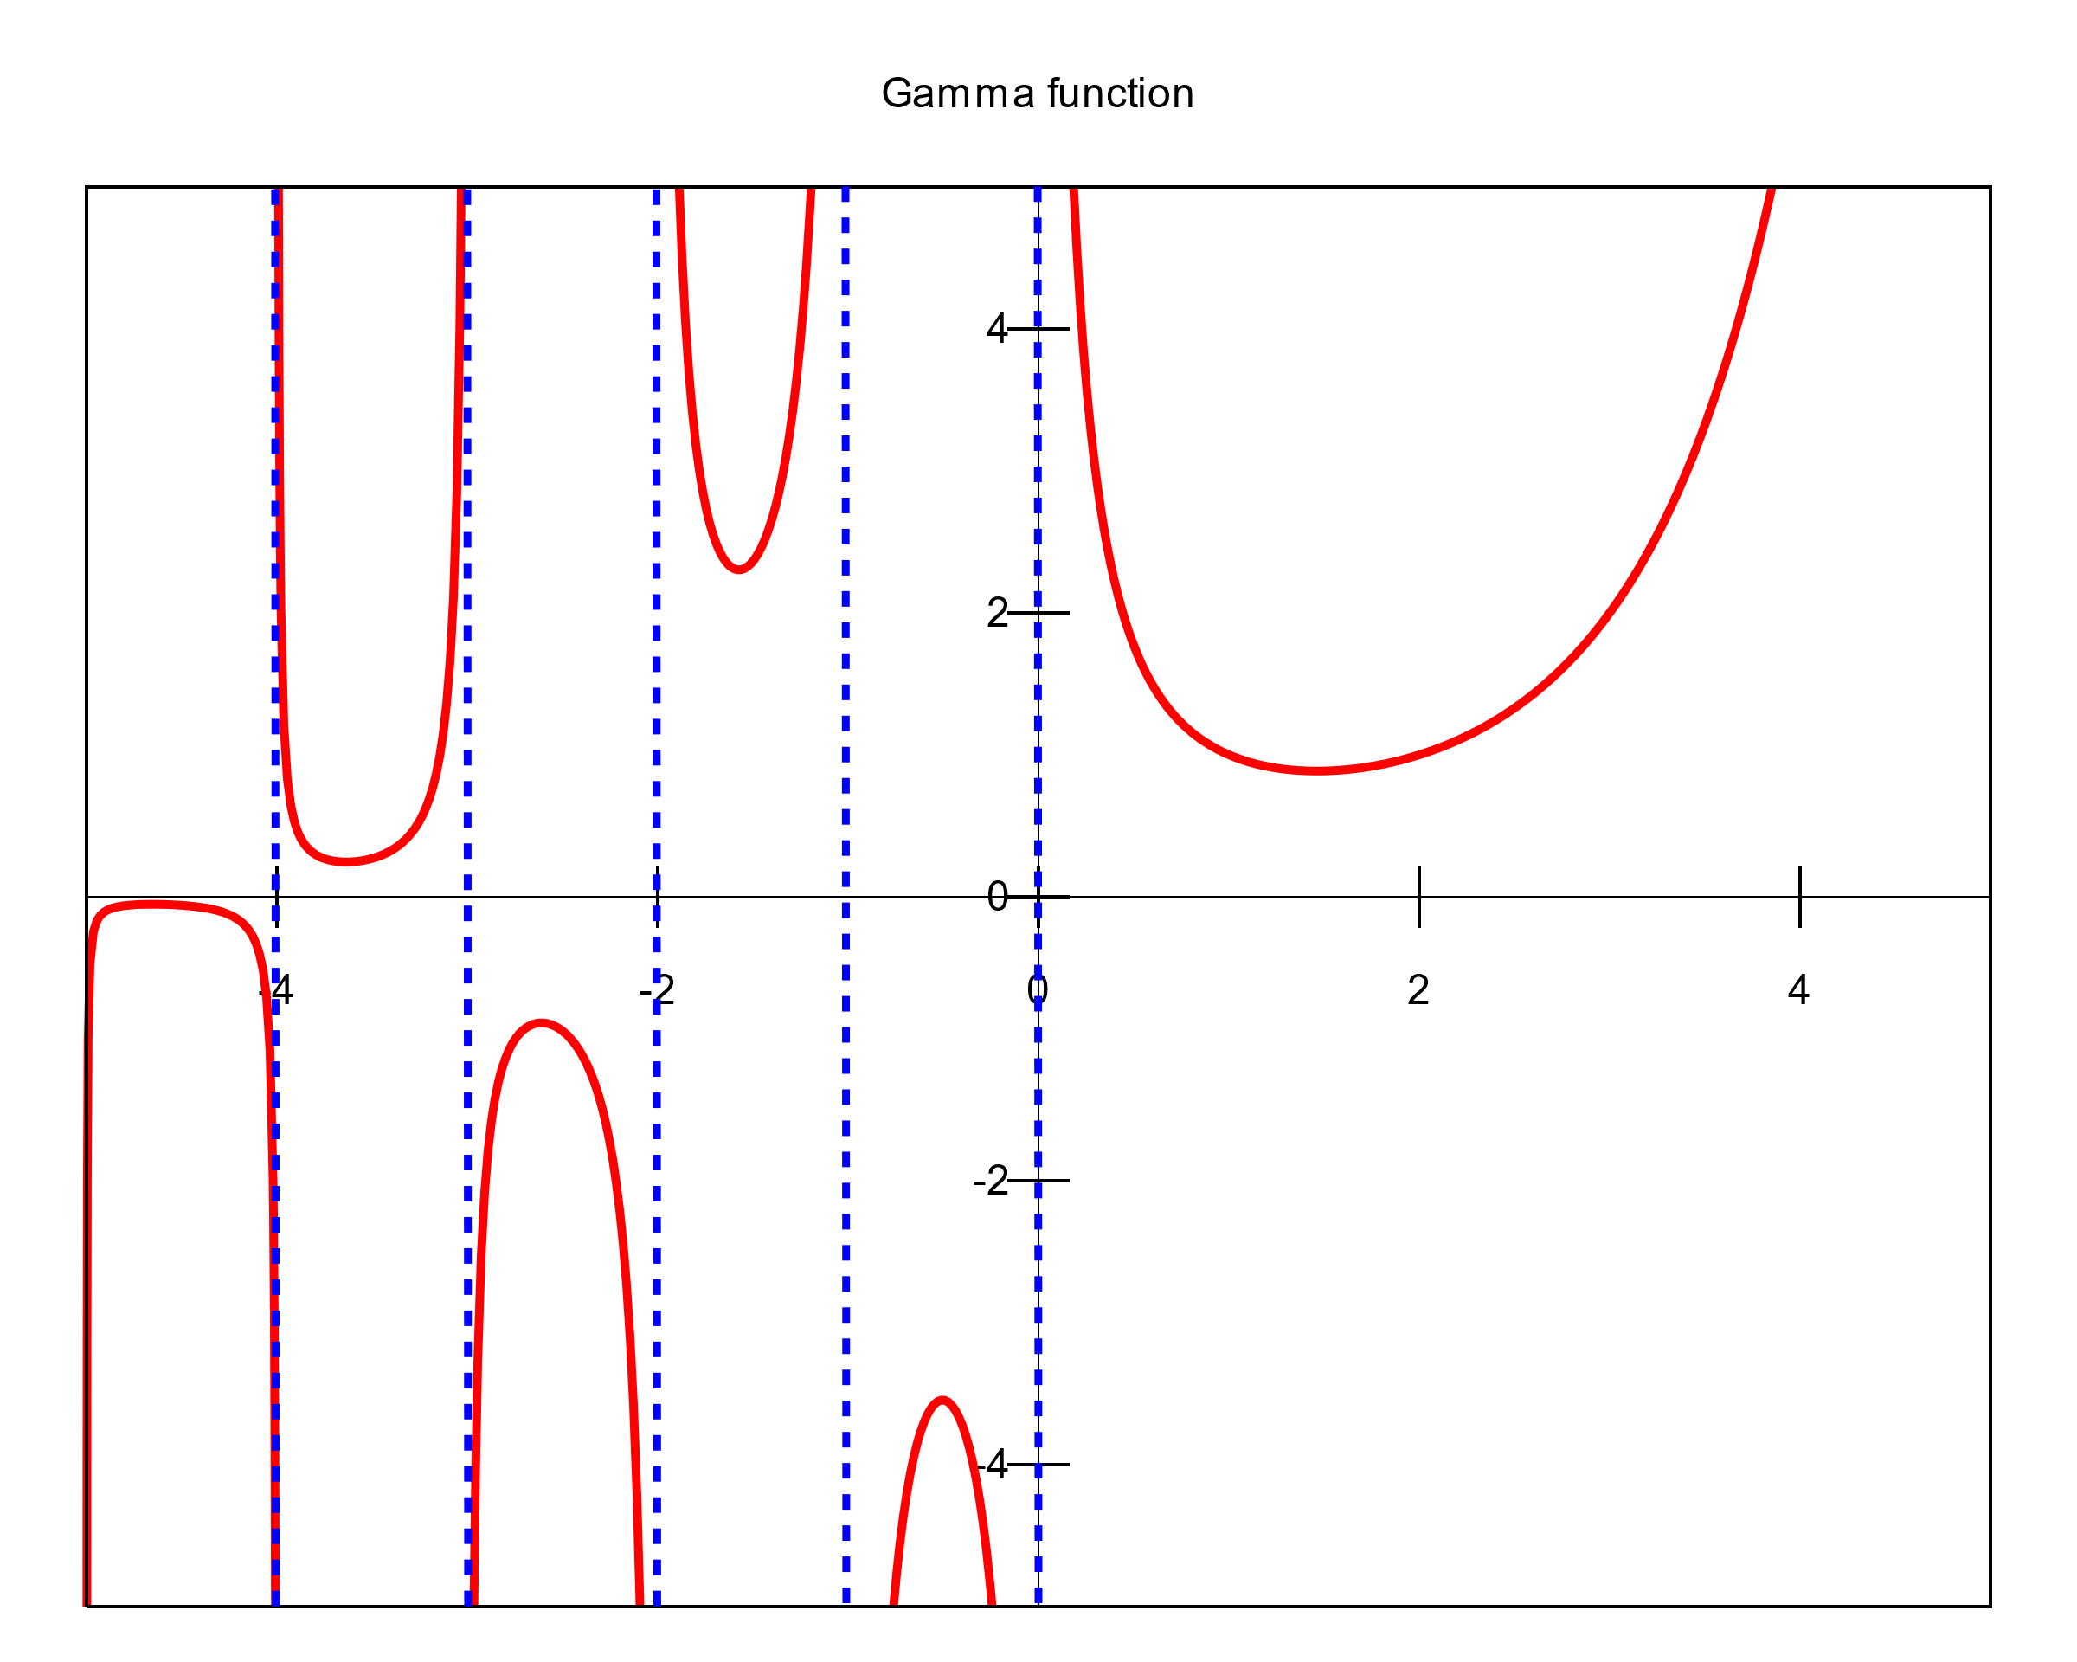
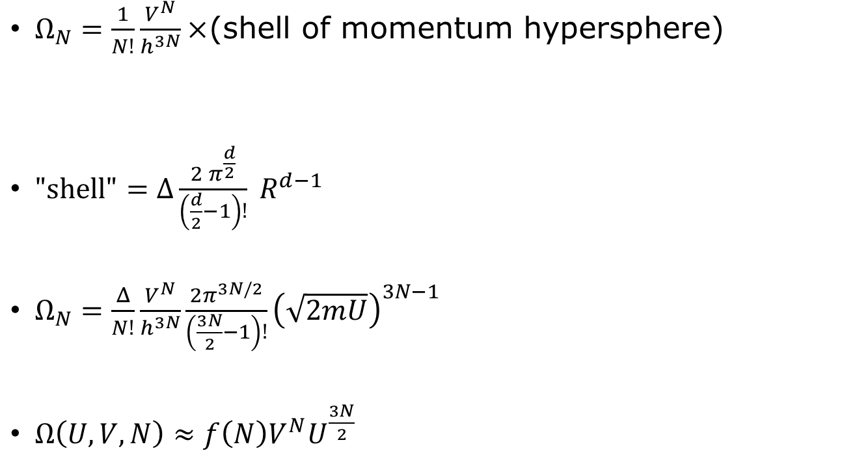
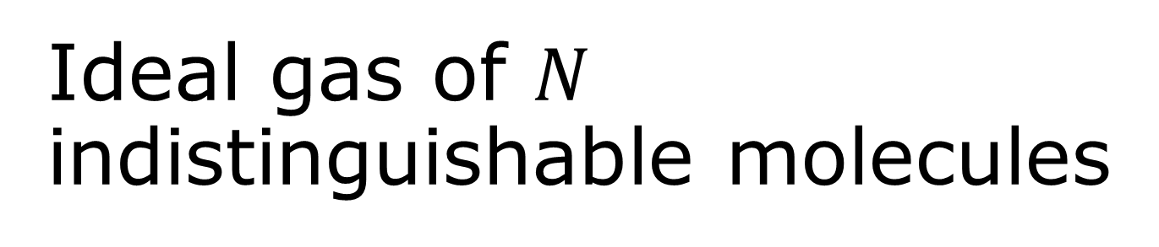

Ideal gas of $N$ indistinguishable molecules
$Ω_{N}=\frac{1}{N!}\frac{V^{N}}{h^{3N}}×$(shell of momentum hypersphere)
$\text{"}\text{shell}\text{"}=Δ\frac{2 π^{\frac{d}{2}}}{\left(\frac{d}{2}−1\right)!} R^{d−1}$
$Ω_{N}=\frac{Δ}{N!}\frac{V^{N}}{h^{3N}}\frac{2π^{3N/2}}{\left(\frac{3N}{2}−1\right)!}{\left(\sqrt{2mU}\right)}^{3N−1}$
$Ω\left(U,V,N\right)≈f\left(N\right)V^{N}U^{\frac{3N}{2}}$
$$x!=Γ(x+1)$$

Slide 21
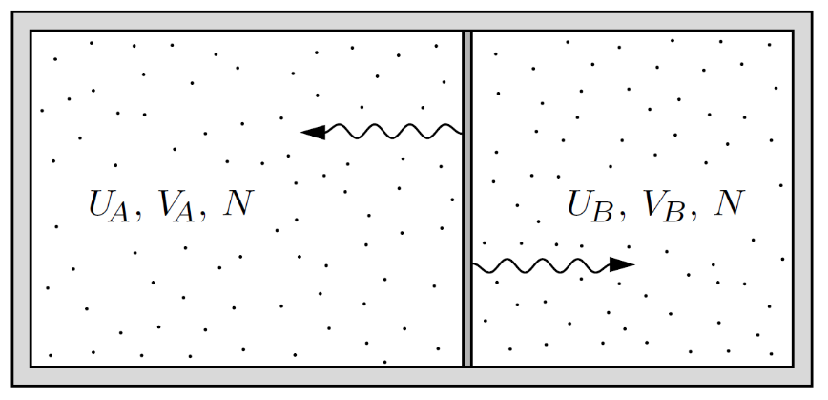
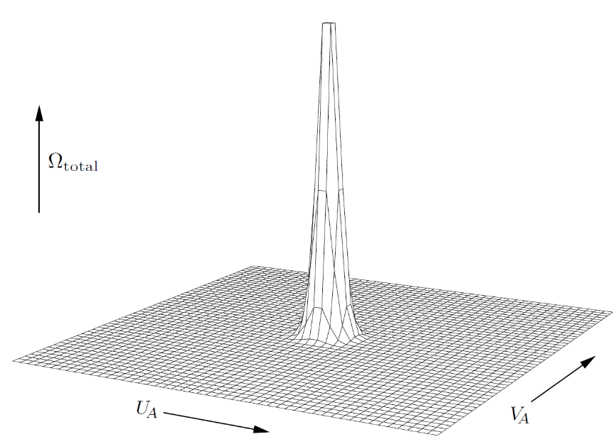
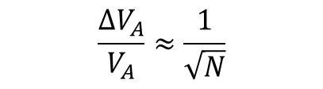
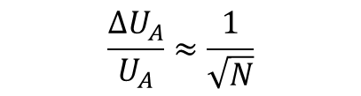
Interacting ideal gas
Figures 2.11 & 2.12 from D V Schroeder, “An introduction to thermal physics”, copyright, Addison-Wesley.
$$\frac{ΔU_{A}}{U_{A}}≈\frac{1}{\sqrt{N}}$$
$$\frac{ΔV_{A}}{V_{A}}≈\frac{1}{\sqrt{N}}$$

Slide 22
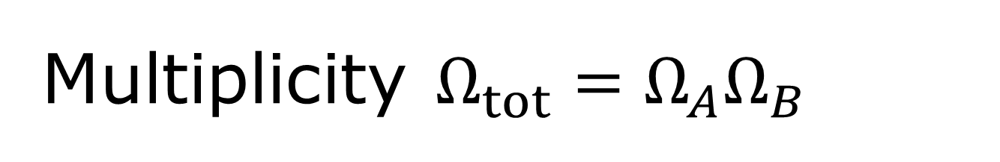
Multiplicity $Ω_{tot}=Ω_{A}Ω_{B}$
Any large system in equilibrium will be found in the macrostate with the greatest multiplicity (aside from fluctuations that are normally too small to measure).
Second law of thermodynamics: Multiplicity (of a composite system) tends to increase.

Slide 23
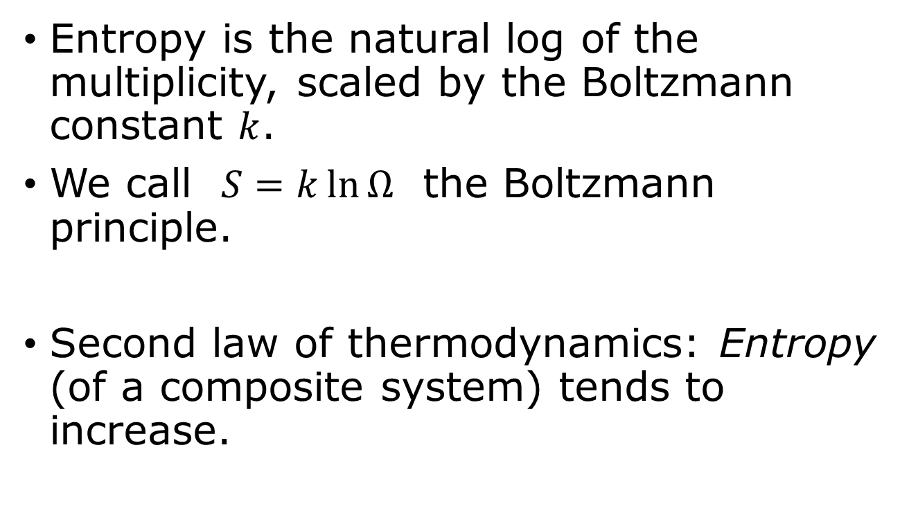
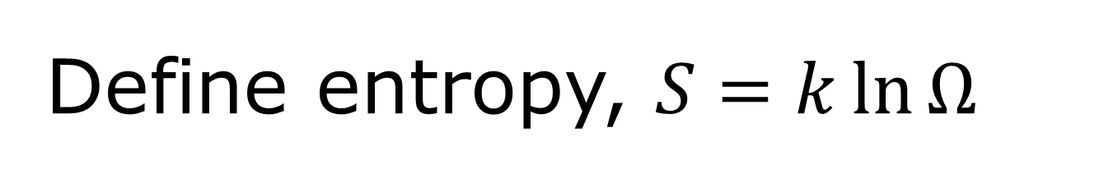
Define entropy, $S=k\ln{Ω}$
Entropy is the natural log of the multiplicity, scaled by the Boltzmann constant $k$.
We call $S=k\ln{Ω}$ the Boltzmann principle.
Second law of thermodynamics: Entropy (of a composite system) tends to increase.

Slide 24
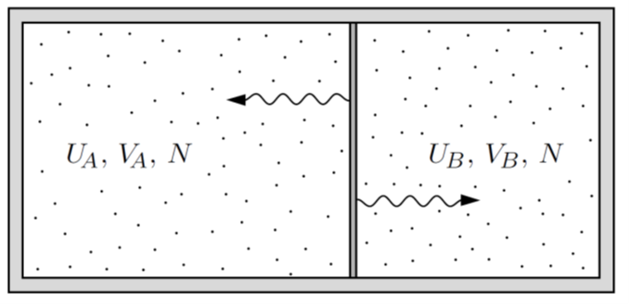
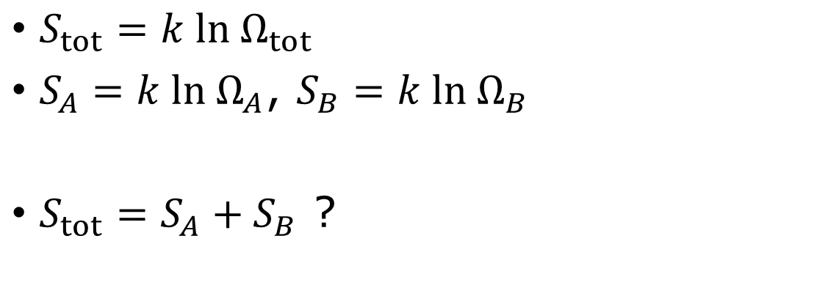
Additivity of entropy
$S_{tot}=k ln Ω_{tot}$
$S_{A}=k ln Ω_{A}$, $S_{B}=k ln Ω_{B}$
$S_{tot}=S_{A}+S_{B}$ ?

Slide 25
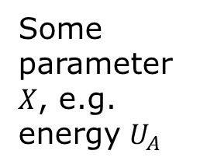


Entropy reaches a maximum when composition system is in overall equilibrium
$$S_{tot}=S_{A}+S_{B}$$
Some parameter $X$, e.g. energy $U_{A}$
$$X_{eq}$$
Callen postulates of thermodynamics

Slide 26

Entropy of an ideal gas – Sackur-Tetrode formula
$S=Nk \left[ln \left(\frac{V}{N}{\left(\frac{4πmU}{3Nh^{2}}\right)}^{3/2}\right)+\frac{5}{2}\right]$
Entropy increases in free expansion
Mixing of two different particles increases entropy

Slide 27
Entropy increases
Free expansion and mixing

Slide 28


Tutorial problem 2.5
Problem 2.5 (page 55).
For an Einstein solid with each of the following values of $N$ and $q$,
list all of the possible microstates, count them, and verify formula 2.9.
(a) N = 3, q = 4
(b) N = 3, q = 5
(c) N = 3, q = 6
(d) N = 4, q = 2
(e) N = 4, q = 3
(f) N = 1, q = anything
(g) N = anything, q = 1
$Ω\left(N,q\right)=\left(\begin{matrix}q+N−1 \\ q\end{matrix}\right)=\frac{\left(q+N−1\right)!}{q!\left(N−1\right)!}$ (2.9)

Slide 29

Tutorial problem, 2.8 (page 59)

Slide 30

Tutorial problem 2.31, 2.35 (fill the missing steps for Sackur-Tetrode formula, Eq.(2.49), discuss which terms can be omitted, which term needs keep, in the Stirling’s approx., …)

