Slide 1
Week 4
Interactions and Implications

Slide 2
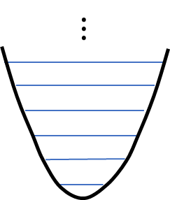







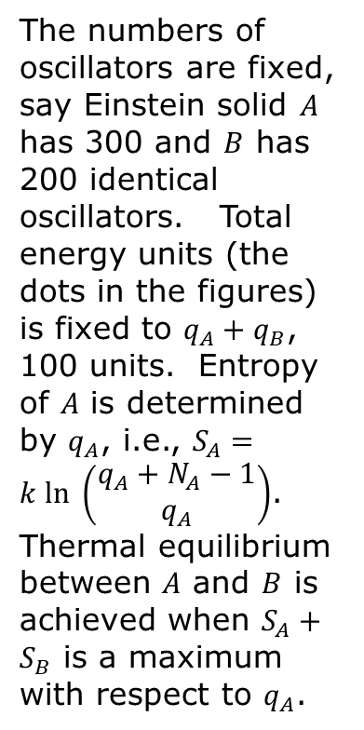
Equilibrium
$$N_{A},q_{A},Ω_{A}, S_{A}=k ln Ω_{A}$$
The numbers of oscillators are fixed, say Einstein solid $A$ has 300 and $B$ has 200 identical oscillators. Total energy units (the dots in the figures) is fixed to $q_{A}+q_{B}$, 100 units. Entropy of $A$ is determined by $q_{A}$, i.e., $S_{A}=k ln \left(\begin{matrix}q_{A}+N_{A}−1 \\ q_{A}\end{matrix}\right)$. Thermal equilibrium between $A$ and $B$ is achieved when $S_{A}+S_{B}$ is a maximum with respect to $q_{A}$.
$$A$$
move dots
$$⋯$$
1 2 … $N_{A}$
$$Δq$$
Move the “dots”
$$B$$
$$⋯$$
$N_{A}+1$ $N_{A}+2$ … ${N_{A}+N}_{B}$
$$N_{B},q_{B},Ω_{B}, S_{B}=k ln Ω_{B}$$

Slide 3
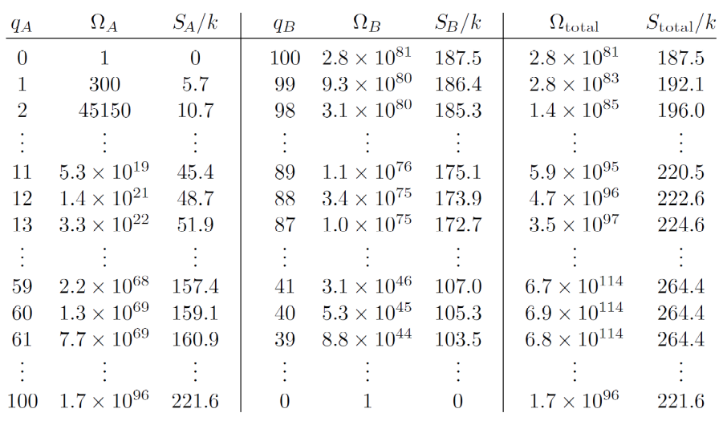
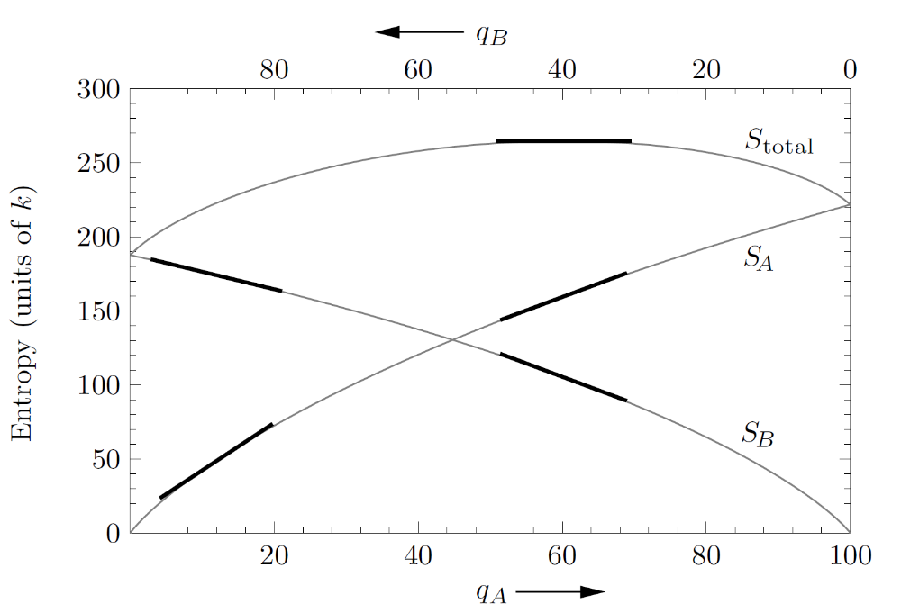



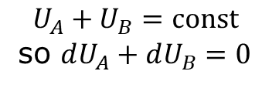

Entropies $S_{A},S_{B}$ and the sum $S_{total}$
$$S_{total}=S_{A}+S_{B}$$
$$\frac{∂S_{A}}{∂U_{A}}+\frac{∂S_{B}}{∂U_{A}}=0 ⇒ \frac{∂S_{A}}{∂U_{A}}=\frac{∂S_{B}}{∂U_{B}}$$
$$\frac{∂S_{total}}{∂q_{A}}=0 or \frac{∂S_{total}}{∂U_{A}}=0, {U_{A}=εq}_{A}$$
$$U_{A}+U_{B}=const$$
so $dU_{A}+dU_{B}=0$

Slide 4






Entropy, single system vs composite system
$$U_{A}+U_{B}=const$$
$$S$$
$S_{A}+S_{B}$ combined A+B
$S_{A}$ single system $A$
$S_{B}$ single system $B$
$$U_{A}$$

Slide 5

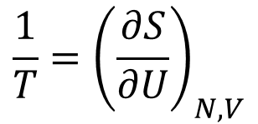
“official” definition of temperature
money ↔ energy
happiness ↔ entropy
generosity ↔ temperature
$$\frac{1}{T}={\left(\frac{∂S}{∂U}\right)}_{N,V}$$
$$\frac{∂S_{A}}{∂U_{A}}=\frac{∂S_{B}}{∂U_{B}} ⇒ \frac{1}{T_{A}}=\frac{1}{T_{B}}$$
“normal”
“miserly”
“enlightened”
entropy
entropy
entropy
energy
energy
energy

Slide 6
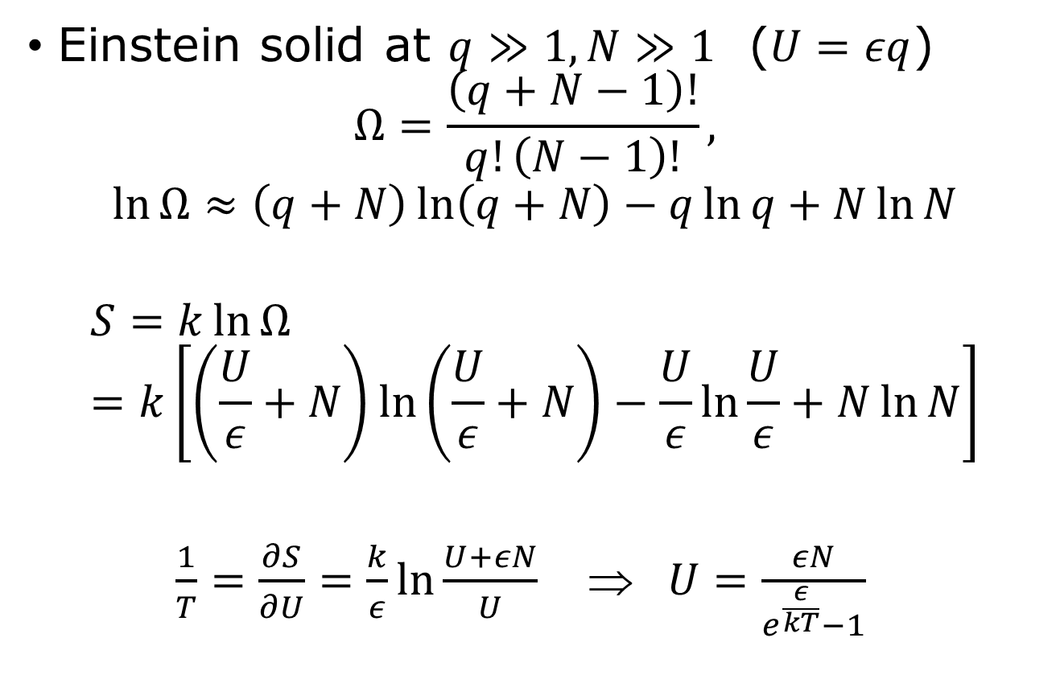
Temperature, examples
Einstein solid at $q≫1, N≫1$ ($U=εq$)
$$Ω=\frac{\left(q+N−1\right)!}{q!\left(N−1\right)!},$$
$$\ln{Ω}≈\left(q+N\right)\ln\left(q+N\right)−q\ln{q}+N\ln{N}$$
$$S=k\ln{Ω}=k\left[\left(\frac{U}{ε}+N\right)\ln\left(\frac{U}{ε}+N\right)−\frac{U}{ε}\ln{\frac{U}{ε}}+N\ln{N}\right]$$
$\frac{1}{T}=\frac{∂S}{∂U}=\frac{k}{ε}\ln{\frac{U+εN}{U}}$ ⇒ $U=\frac{εN}{e^{\frac{ε}{kT}}−1}$
Bose function

Slide 7
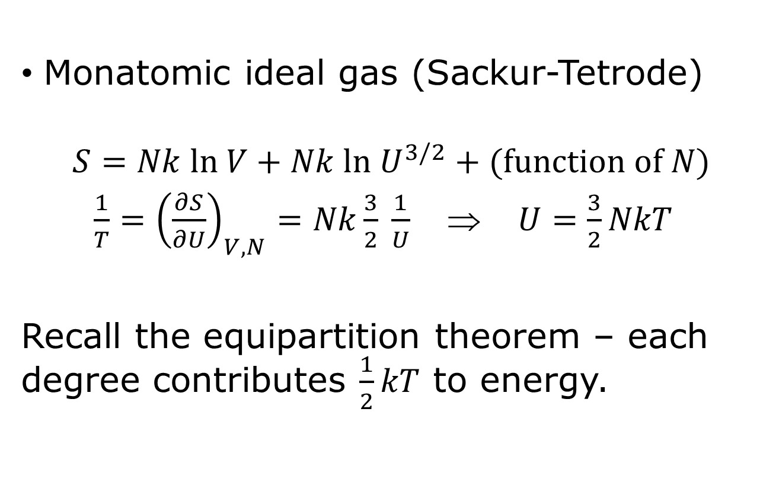
Temperature, more examples
Monatomic ideal gas (Sackur-Tetrode)
$$S=Nk ln V+Nk ln U^{3/2}+(function of N)$$
$\frac{1}{T}={\left(\frac{∂S}{∂U}\right)}_{V,N}=Nk\frac{3}{2} \frac{1}{U}$ ⇒ $U=\frac{3}{2}NkT$
Recall the equipartition theorem – each degree contributes $\frac{1}{2}kT$ to energy.

Slide 8
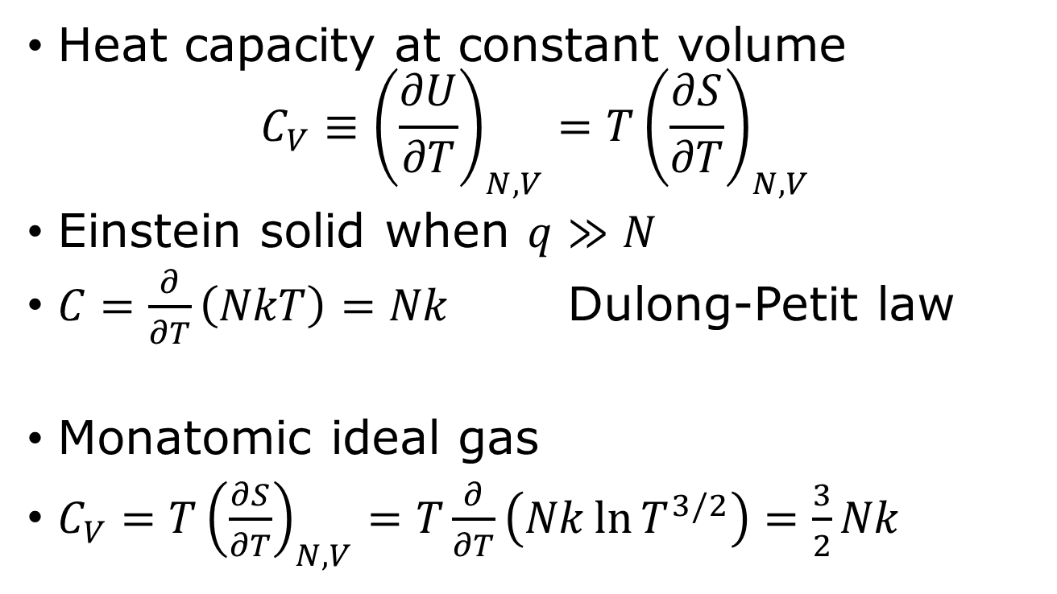
Entropy and heat capacity
Heat capacity at constant volume
$$C_{V}≡{\left(\frac{∂U}{∂T}\right)}_{N,V}=T{\left(\frac{∂S}{∂T}\right)}_{N,V}$$
Einstein solid when $q≫N$
$C=\frac{∂}{∂T}\left(NkT\right)=Nk$ Dulong-Petit law
Monatomic ideal gas
$C_{V}={T\left(\frac{∂S}{∂T}\right)}_{N,V}=T\frac{∂}{∂T}\left(Nk\ln{T^{3/2}}\right)=\frac{3}{2}Nk$

Slide 9
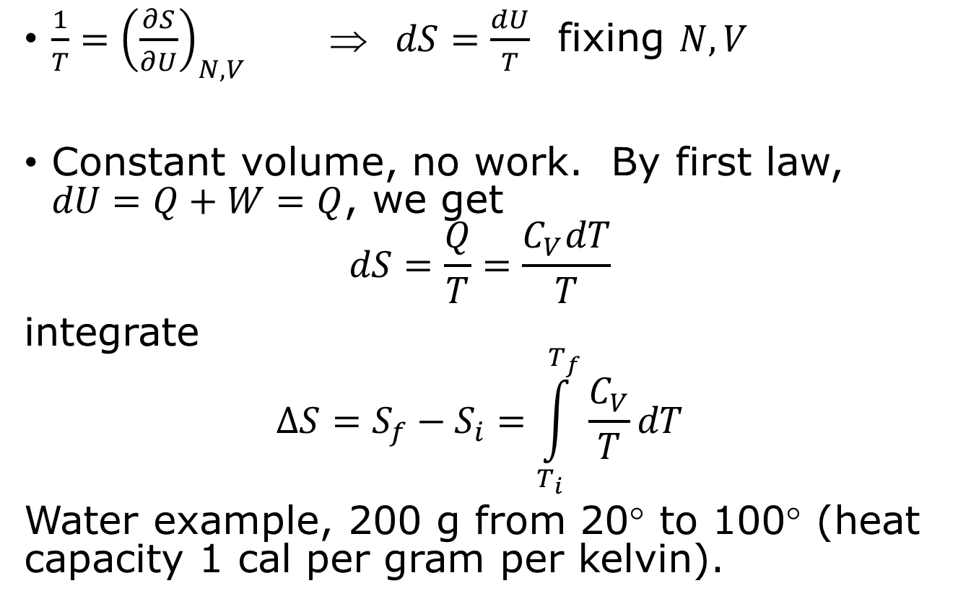
Measuring entropies
$\frac{1}{T}={\left(\frac{∂S}{∂U}\right)}_{N,V}$ ⇒ $dS=\frac{dU}{T}$ fixing $N,V$
Constant volume, no work. By first law, $dU=Q+W=Q$, we get
$$dS=\frac{Q}{T}=\frac{C_{V}dT}{T}$$
integrate
$$ΔS=S_{f}−S_{i}=\int_{T_{i}}^{T_{f}}{\frac{C_{V}}{T}dT}$$
Water example, 200 g from 20° to 100° (heat capacity 1 cal per gram per kelvin).

Slide 10
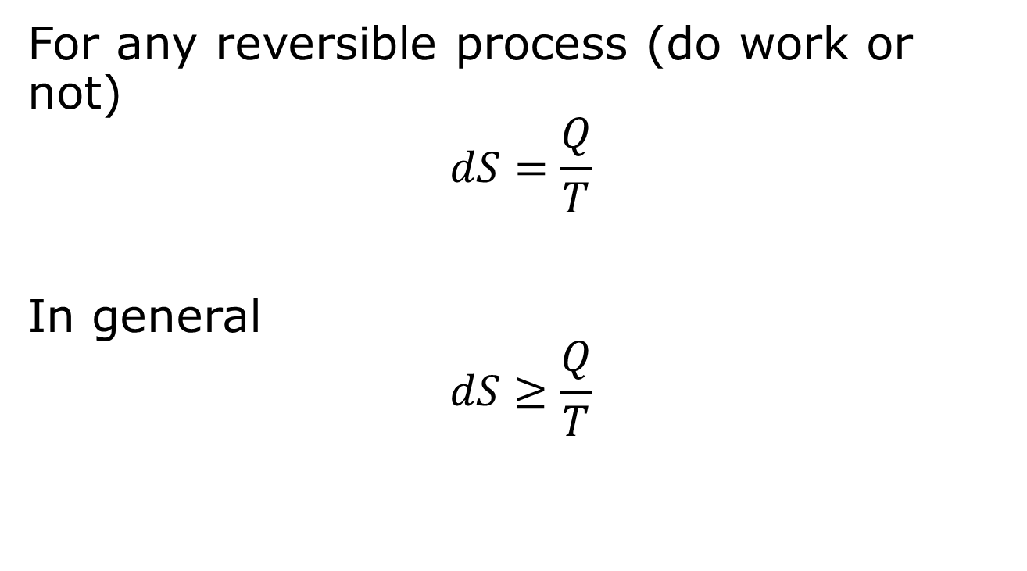
Macroscopic view of entropy (Clausius)
For any reversible process (do work or not)
$$dS=\frac{Q}{T}$$
In general
$$dS≥\frac{Q}{T}$$
These equations are generally true, fixing volume or not.

Slide 11


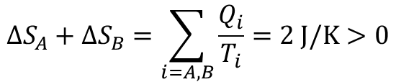
Entropy increases in irreversible processes
Q=1500 J
A
T_{A}=500 K
B
T_{B}=300 K
heat transfer
$$ΔS_{A}=\frac{−Q}{T_{A}}=\frac{−1500 J}{500 K}=−3 J/K$$
$$ΔS_{B}=\frac{+Q}{T_{B}}=\frac{1500 J}{300 K}=5 J/K$$
$$ΔS_{A}+ΔS_{B}=\sum_{i=A,B}{\frac{Q_{i}}{T_{i}}=2 J/K>0}$$

Slide 12
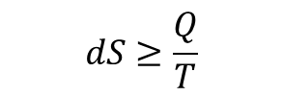

Clausius inequality, changes over a cycle
P
$$dS≥\frac{Q}{T}$$
V
$$\sum_{j}{\frac{Q_{j}}{T_{j}}≤0}$$

Slide 13



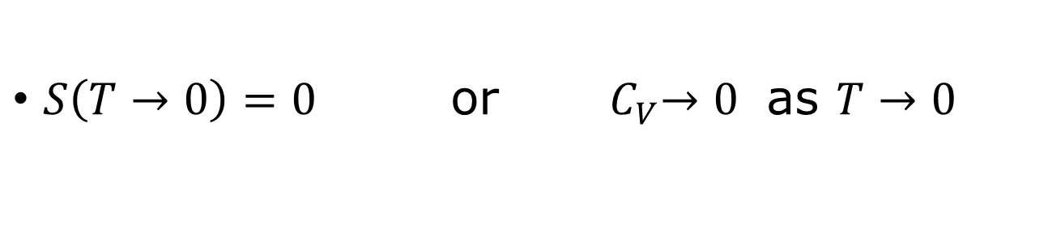




Third law of thermodynamics
$$S$$
$$C_{V}$$
infinite slope =1/T
$$S=0$$
$$C_{V}=0$$
$$U$$
$$0$$
$$T$$
$S\left(T→0\right)=0$ or ${ C}_{V}→0$ as $T→0$

Slide 14

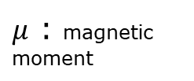
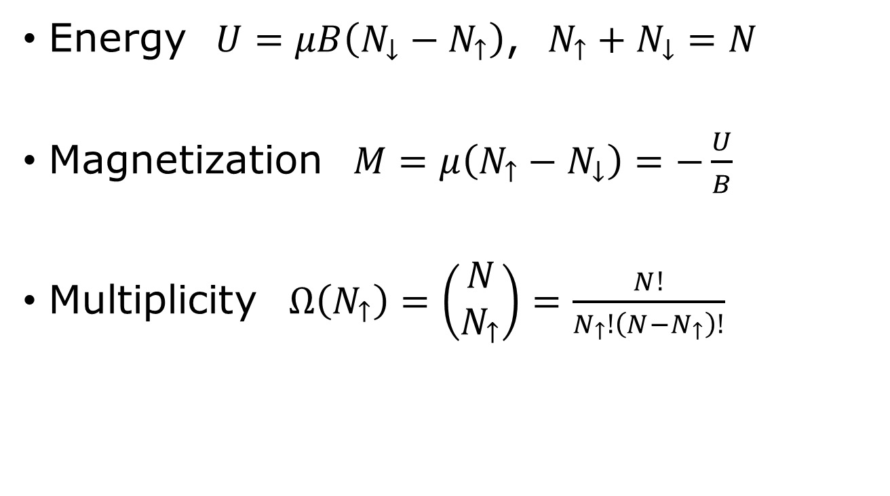



Paramagnets
$$+μB$$
“down”
$$0$$
$$\vec{B}$$
$$−μB$$
“up”
Magnetic induction
$μ$ : magnetic moment
Energy $U=μB\left(N_{↓}−N_{↑}\right)$, $N_{↑}+N_{↓}=N$
Magnetization $M=μ\left(N_{↑}−N_{↓}\right)=−\frac{U}{B}$
Multiplicity $Ω\left(N_{↑}\right)=\left(\begin{matrix}N \\ N_{↑}\end{matrix}\right)=\frac{N!}{N_{↑}!\left(N−N_{↑}\right)!}$

Slide 15
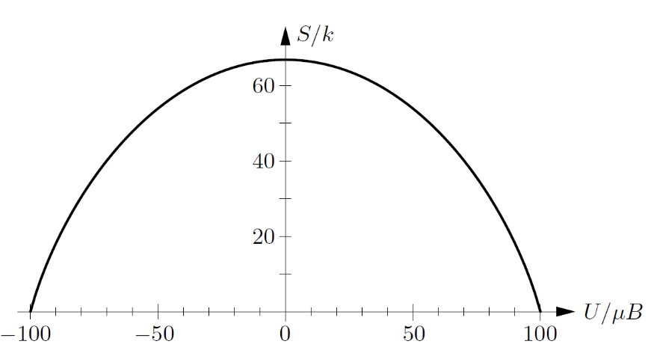
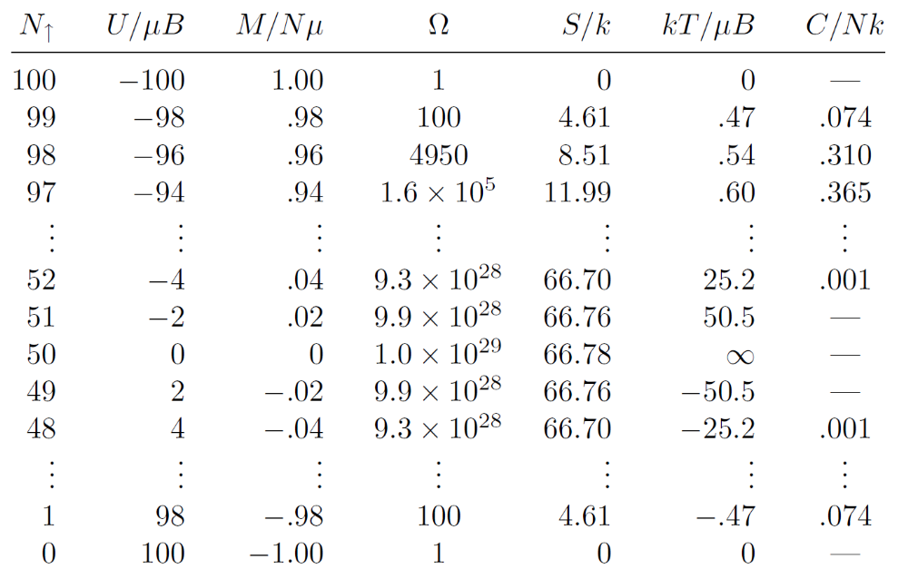
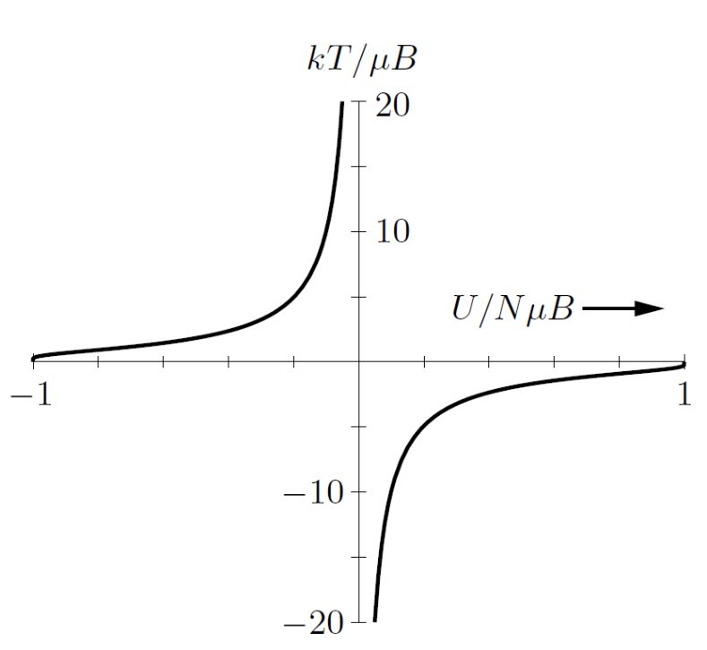
Numerical solution
Table 3.2, figures 3.8, 3.9 of D. V. Schroeder, copyright Addison-Wesley.

Slide 16
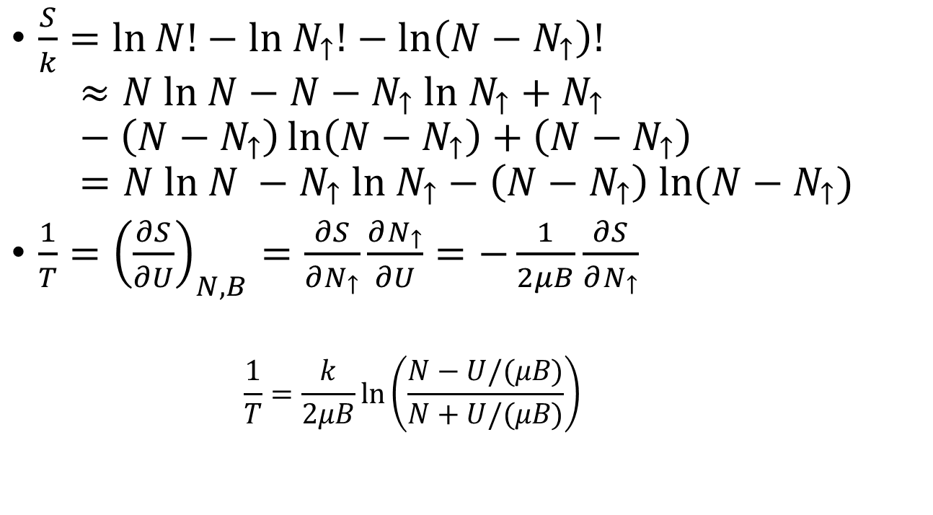
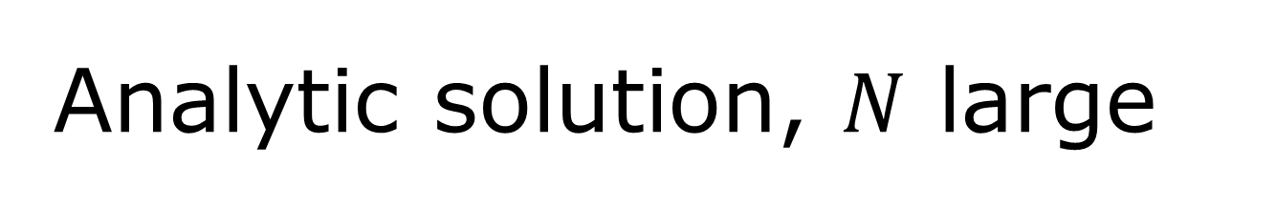
Analytic solution, $N$ large
$\frac{S}{k}=\ln{N!}−ln N_{↑}!−ln\left(N−N_{↑}\right)!$
$$≈N ln N−N−N_{↑} ln N_{↑}+N_{↑}−\left(N−N_{↑}\right)\ln\left(N−N_{↑}\right)+\left(N−N_{↑}\right)=N ln N −N_{↑} ln N_{↑}−\left(N−N_{↑}\right) ln(N−N_{↑})$$
$\frac{1}{T}={\left(\frac{∂S}{∂U}\right)}_{N,B}=\frac{∂S}{∂N_{↑}}\frac{∂N_{↑}}{∂U}=−\frac{1}{2μB}\frac{∂S}{∂N_{↑}}$
    $$\frac{1}{T}=\frac{k}{2μB}\ln\left(\frac{N−U/(μB)}{N+U/(μB)}\right)$$

Slide 17
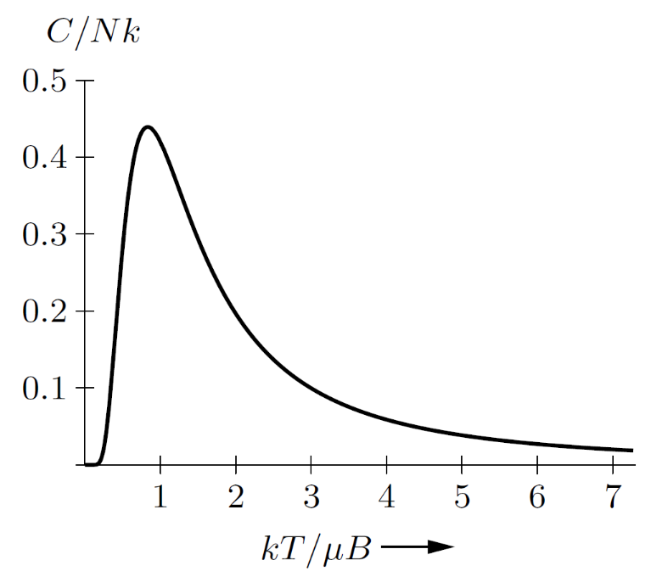
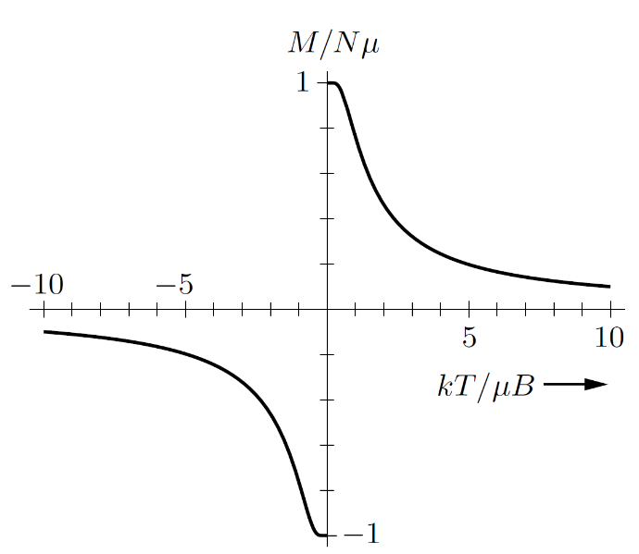
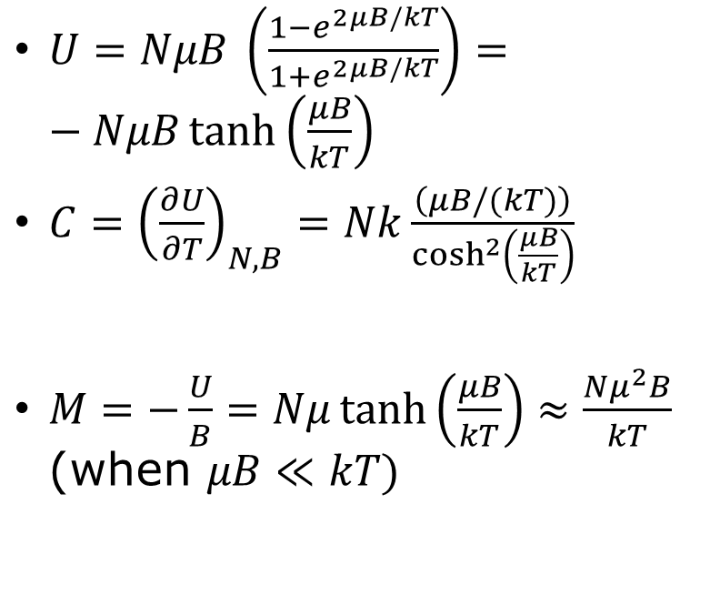
Heat capacity and magnetization
$U=NμB \left(\frac{1−e^{2μB/kT}}{1+e^{2μB/kT}}\right)=−NμB\tanh\left(\frac{μB}{kT}\right)$
$C={\left(\frac{∂U}{∂T}\right)}_{N,B}=Nk\frac{\left(μB/(kT)\right)}{\cosh^{2}\left(\frac{μB}{kT}\right)}$
$M=−\frac{U}{B}=Nμ\tanh\left(\frac{μB}{kT}\right)≈\frac{Nμ^{2}B}{kT}$ (when $μB≪kT)$

Slide 18
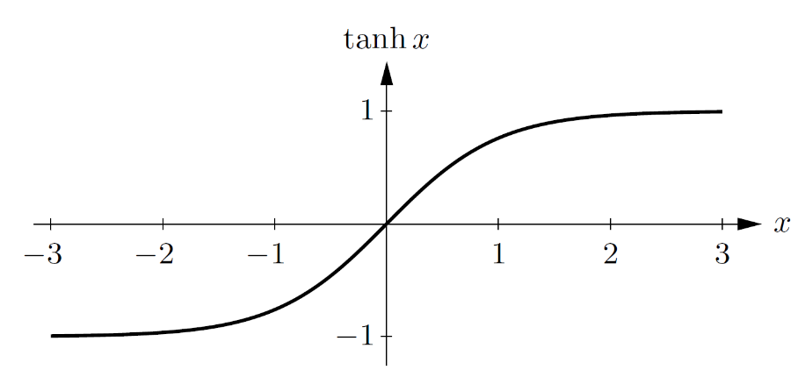
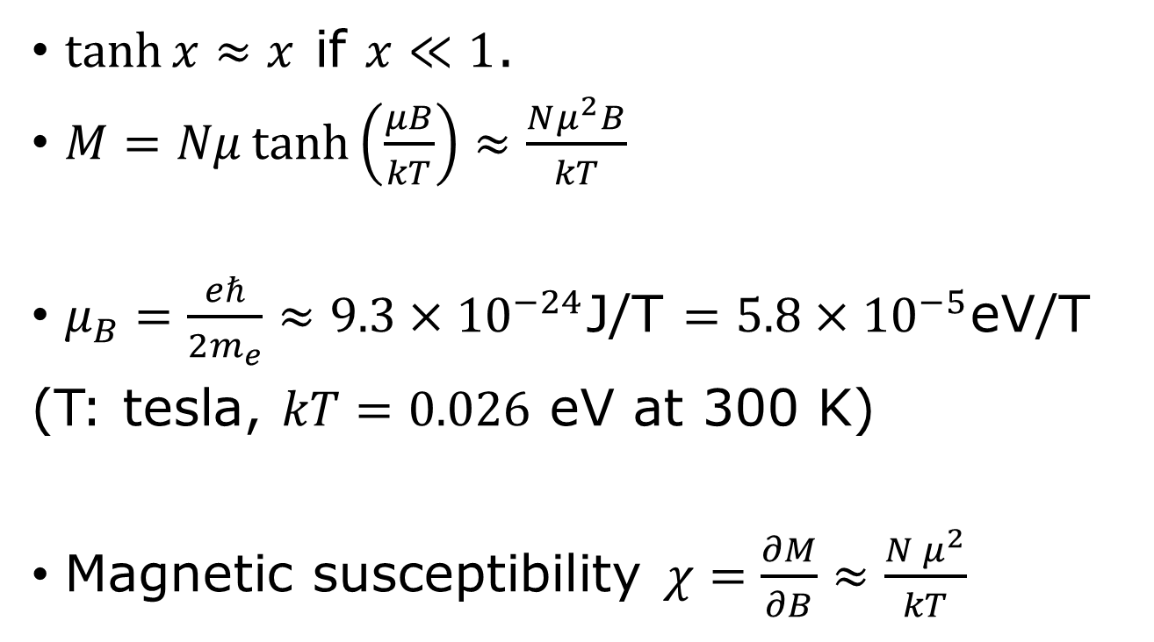
Magnetization, Bohr magneton, Curie’s law
$\tanh{x≈x}$ if $x≪1$.
$M=Nμ\tanh\left(\frac{μB}{kT}\right)≈\frac{Nμ^{2}B}{kT}$
$μ_{B}=\frac{eℏ}{2m_{e}}≈9.3×{10}^{−24}$J/T $=5.8×{10}^{−5}$eV/T
(T: tesla, $kT=0.026$ eV at 300 K)
Magnetic susceptibility $χ=\frac{∂M}{∂B}≈\frac{N μ^{2}}{kT}$

Slide 19
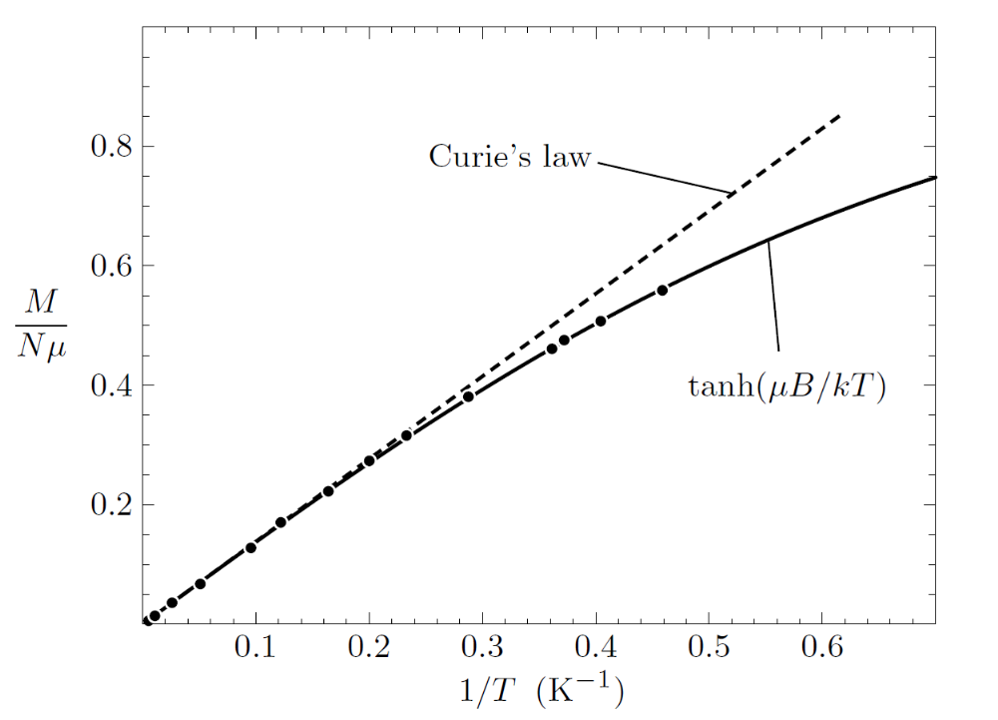
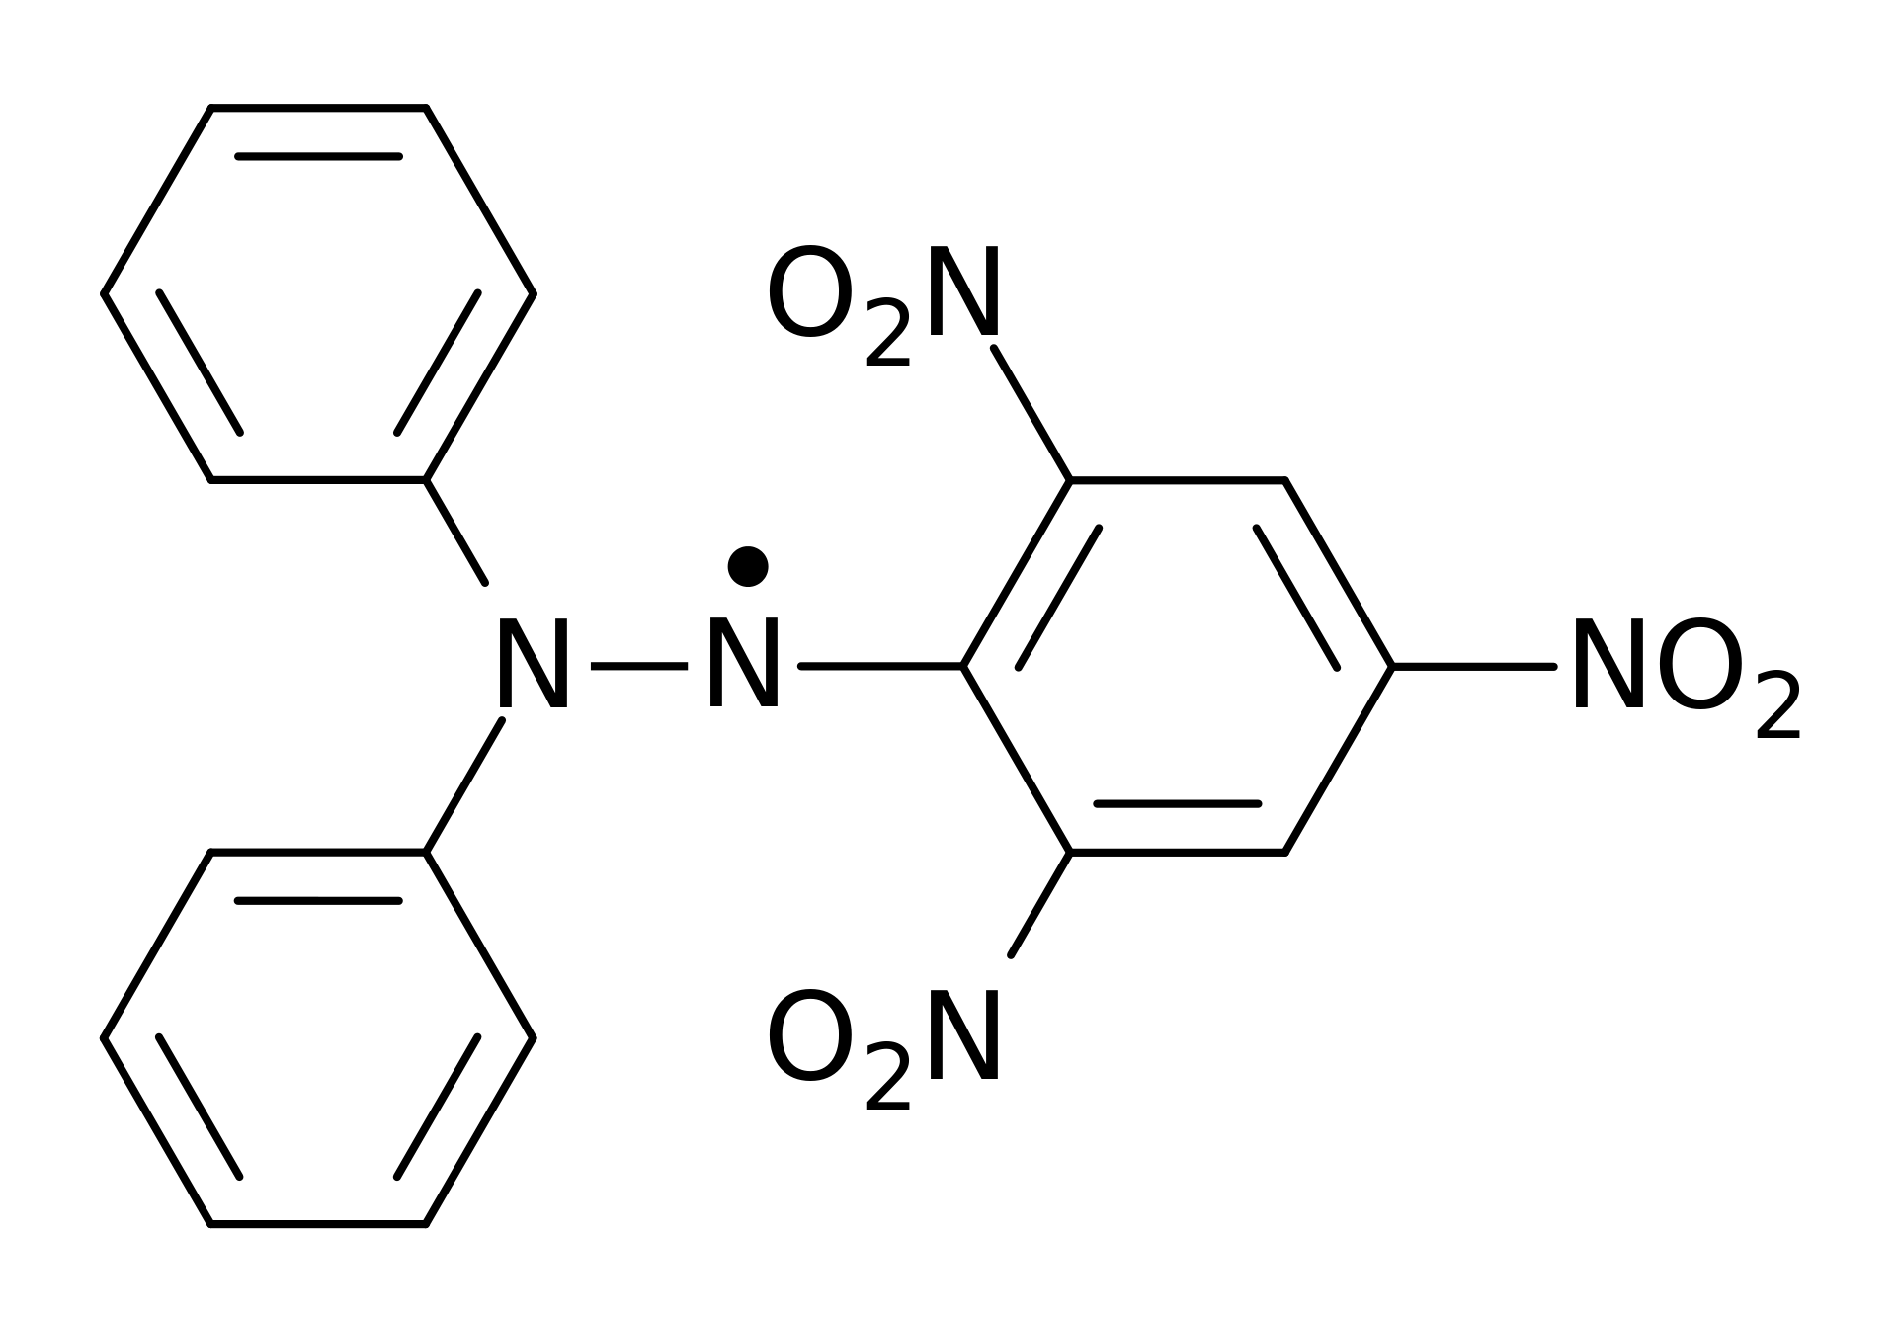
Verify Curie’s law
Experimental measurements of the magnetization of the organic free radical “DPPH”, taken at B = 2.06 T. Figure 3.12 of Schroeder.

