Slide 1
Week 5
Mechanical & chemical equilibrium

Slide 2
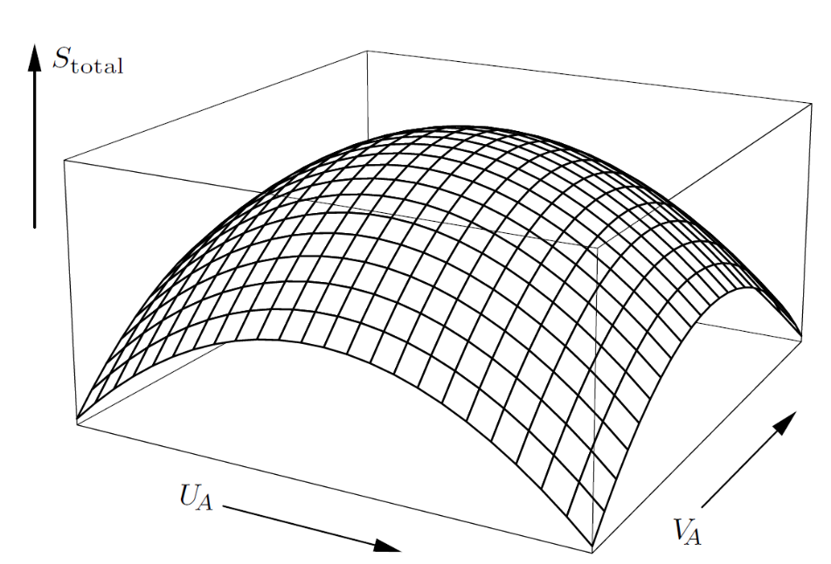








Mechanical equilibrium and pressure
$V_{A}+V_{B}=const$, $∂V_{A}=−∂V_{B}$
$$ΔU$$
$\frac{∂S_{A}}{∂V_{A}}=\frac{∂S_{B}}{∂V_{B}}$at equilibrium
$$U_{A},V_{A},S_{A}$$
$$ΔV$$
$$U_{B},V_{B},S_{B}$$
$$\frac{∂S_{total}}{∂U_{A}}=0, \frac{∂S_{total}}{∂V_{A}}=0$$
$$0=\frac{∂S_{total}}{∂V_{A}}=\frac{∂S_{A}}{∂V_{A}}+\frac{∂S_{B}}{∂V_{A}}=\frac{∂S_{A}}{∂V_{A}}−\frac{∂S_{B}}{∂V_{B}}$$

Slide 3
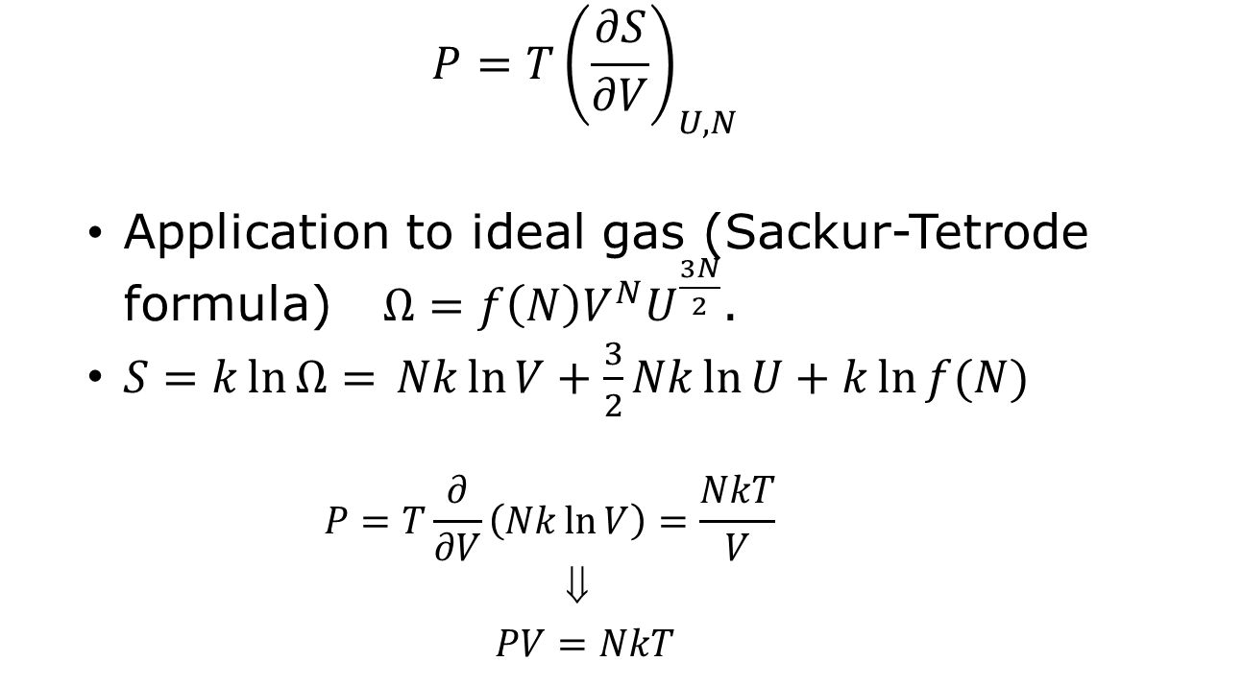
“Definition” of pressure
  $$P=T{\left(\frac{∂S}{∂V}\right)}_{U,N}$$
  Application to ideal gas (Sackur-Tetrode formula) $Ω=f\left(N\right)V^{N}U^{\frac{3N}{2}}$.
  $S=k\ln{Ω=} Nk\ln{V+\frac{3}{2}Nk\ln{U+k\ln{f(N)}}}$
    $$P=T\frac{∂}{∂V}\left(Nk\ln{V}\right)=\frac{NkT}{V}$$
    ⇓
    $PV=NkT$

Slide 4

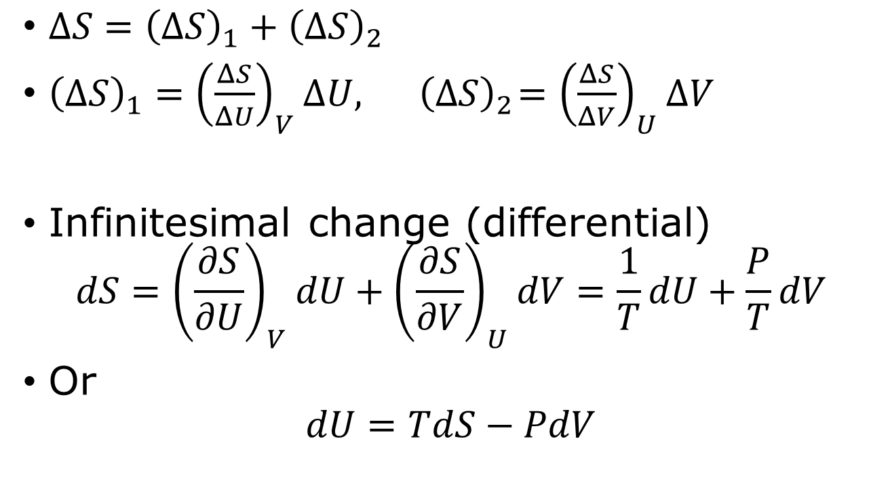



The thermodynamic identity
$$V$$
$$ΔV$$
step 2
step 1
$$U$$
$ΔS={\left(ΔS\right)}_{1}+{\left(ΔS\right)}_{2}$
${\left(ΔS\right)}_{1}={\left(\frac{ΔS}{ΔU}\right)}_{V}ΔU,{ \left(ΔS\right)}_{2}={\left(\frac{ΔS}{ΔV}\right)}_{U}ΔV$
Infinitesimal change (differential)
$$dS={\left(\frac{∂S}{∂U}\right)}_{V}dU+{\left(\frac{∂S}{∂V}\right)}_{U}dV=\frac{1}{T}dU+\frac{P}{T}dV$$
Or
$$dU=TdS−PdV$$
$$ΔU$$

Slide 5
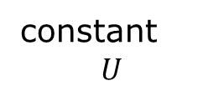
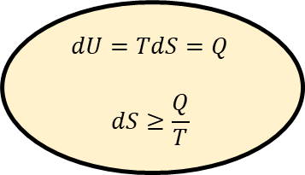
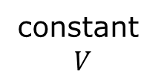
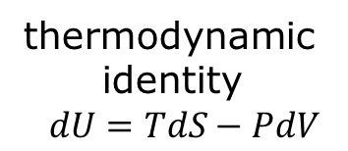

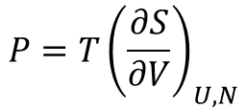

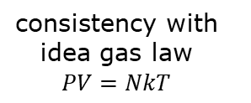
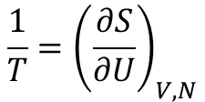
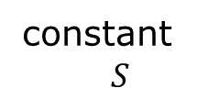
$U:$internal energy, $S:$ entropy, $V$: volume, $T$: temperature, $P$: pressure
thermodynamic
identity
$$dU=TdS−PdV$$
constant
$$V$$
$$dU=TdS=Q$$
$$dS≥\frac{Q}{T}$$
$$dU=Q+W$$
constant
$$U$$
first law of thermodynamics
constant
$$S$$
macroscopic
entropy,
second law
of thermodynamics
$$P={T\left(\frac{∂S}{∂V}\right)}_{U,N}$$
$$dU=−PdV$$
$$\frac{1}{T}={\left(\frac{∂S}{∂U}\right)}_{V,N}$$
adiabatic
process
definition of temperature
consistency with idea gas law
$$PV=NkT$$

Slide 6
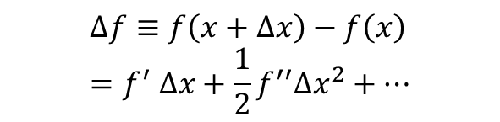

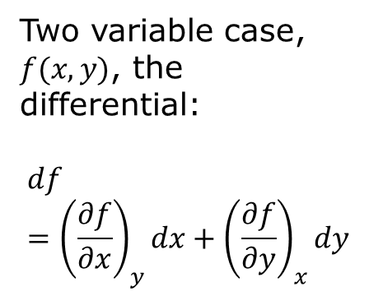





The meaning of the differential $d$
$$f$$
Two variable case, $f(x,y)$, the differential:
$$df={\left(\frac{∂f}{∂x}\right)}_{y}dx+{\left(\frac{∂f}{∂y}\right)}_{x}dy$$
slope = $f′$ at $x$
$$df=f^{′}dx$$
$$dx$$
$$x$$
Finite difference:
$$Δf≡f\left(x+Δx\right)−f\left(x\right)=f^{′} Δx+\frac{1}{2}f^{′′}Δx^{2}+⋯$$

Slide 7


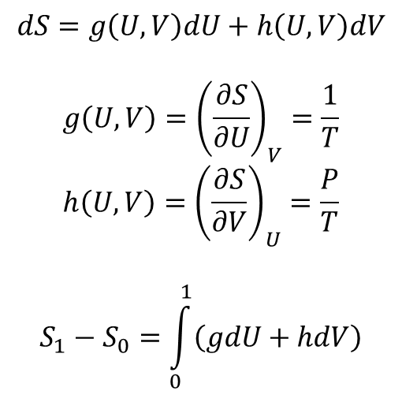
Recover entropy difference from the differential
$$V$$
$$dS=g\left(U,V\right)dU+h\left(U,V\right)dV$$
$$g\left(U,V\right)={\left(\frac{∂S}{∂U}\right)}_{V}=\frac{1}{T}$$
$$h\left(U,V\right)={\left(\frac{∂S}{∂V}\right)}_{U}=\frac{P}{T}$$
$$S_{1}−S_{0}=\int_{0}^{1}{\left(gdU+hdV\right)}$$
1
0
$$U$$
line integral
A state-function change like the entropy does not depend on how the path is taking.

Slide 8
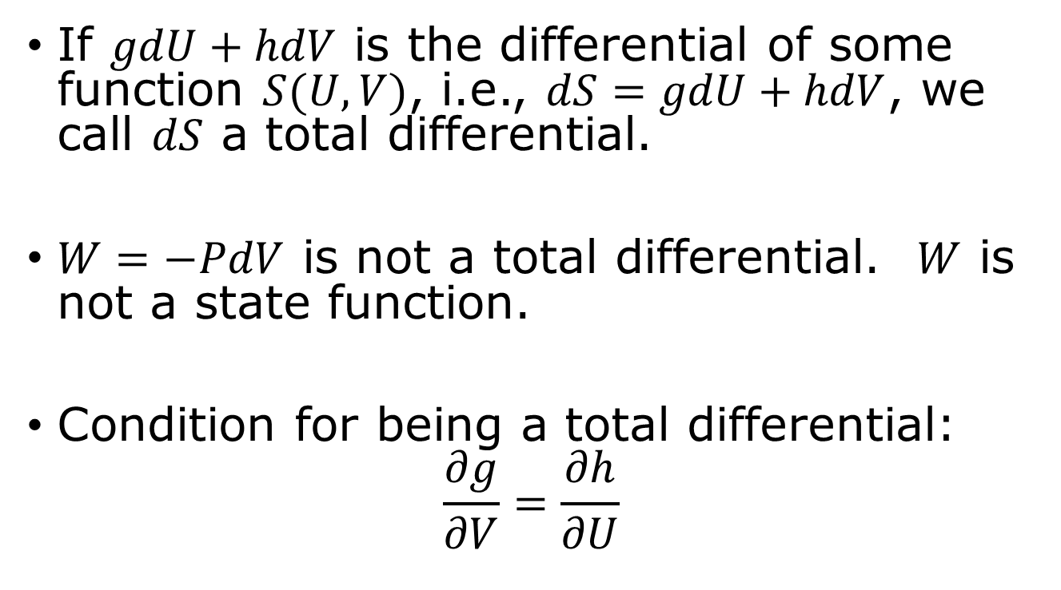
Total differential/Maxwell’s relation
If $gdU+hdV$ is the differential of some function $S(U,V)$, i.e., $dS=gdU+hdV$, we call $dS$ a total differential.
$W=−PdV$ is not a total differential. $W$ is not a state function.
Condition for being a total differential:
$$\frac{∂g}{∂V}=\frac{∂h}{∂U}$$
This is a Maxwell’s relation.

Slide 9
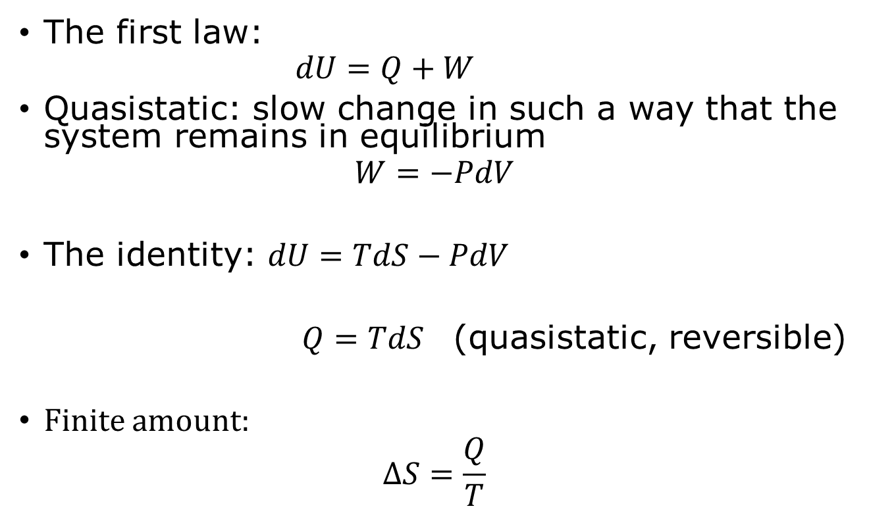
Entropy and heat revisited
The first law:
    $$dU=Q+W$$
Quasistatic: slow change in such a way that the system remains in equilibrium
$$W=−PdV$$
The identity: $dU=TdS−PdV$
$Q=TdS$ (quasistatic, reversible)
Finite amount:
$$ΔS=\frac{Q}{T}$$

Slide 10
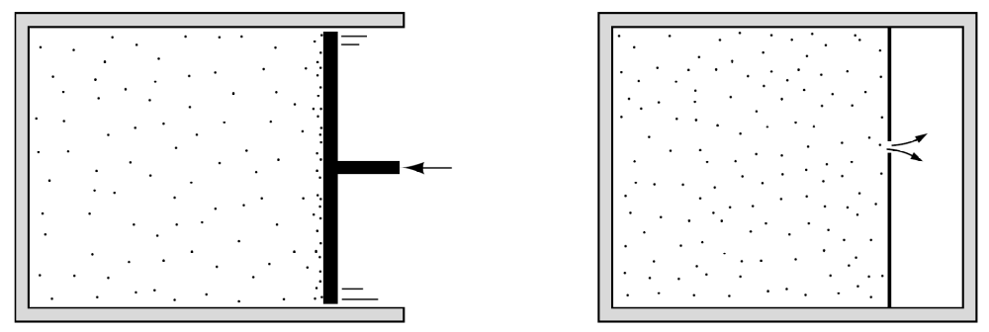

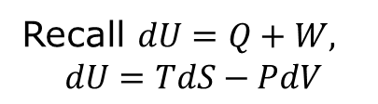
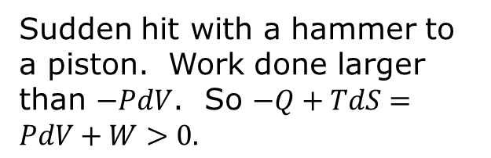
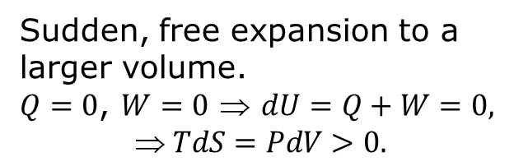
Non-quasistatic processes
Sudden hit with a hammer to a piston. Work done larger than $−PdV$. So $−Q+TdS=PdV+W>0.$
Sudden, free expansion to a larger volume.
$Q=0$, $W=0$ ⇒ $dU=Q+W=0,$
$$ TdS=PdV>0.$$
$$dS>\frac{Q}{T}$$
Recall $dU=Q+W,$
$$dU=TdS−PdV$$

Slide 11
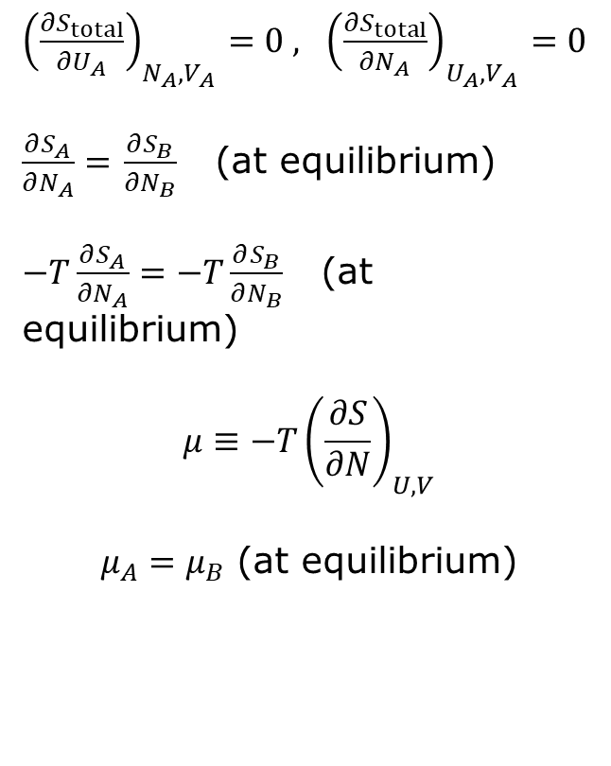

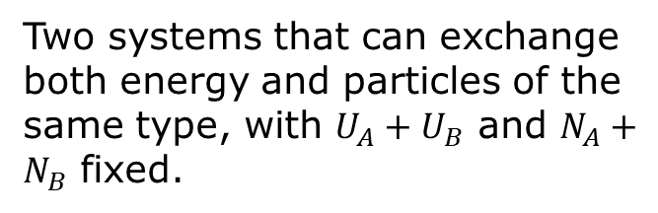
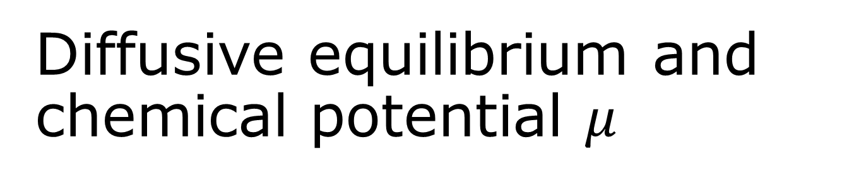



Diffusive equilibrium and chemical potential $μ$
A B
${\left(\frac{∂S_{total}}{∂U_{A}}\right)}_{N_{A},V_{A}}=0 , {\left(\frac{∂S_{total}}{∂N_{A}}\right)}_{U_{A},V_{A}}=0$
$\frac{∂S_{A}}{∂N_{A}}=$ $\frac{∂S_{B}}{∂N_{B}}$ (at equilibrium)
$−T\frac{∂S_{A}}{∂N_{A}}=−T\frac{∂S_{B}}{∂N_{B}}$ (at equilibrium)
$$μ≡−T{\left(\frac{∂S}{∂N}\right)}_{U,V}$$
$μ_{A}=μ_{B}$ (at equilibrium)
$$ΔU$$
$$ΔN$$
$$U_{A},N_{A},S_{A}$$
$$U_{B},N_{B},S_{B}$$
Two systems that can exchange both energy and particles of the same type, with $U_{A}+U_{B}$ and $N_{A}+N_{B}$ fixed.

Slide 12
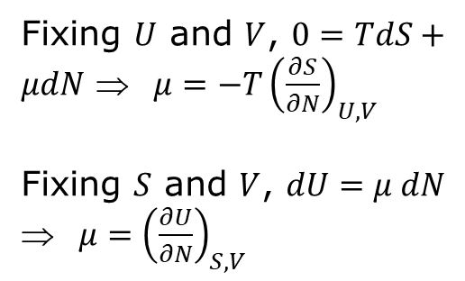

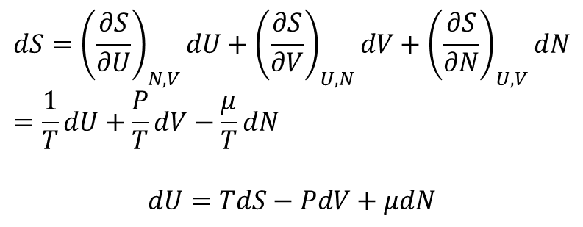

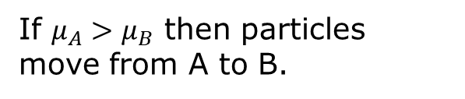


Meaning of chemical potential $μ$
$$dS={\left(\frac{∂S}{∂U}\right)}_{N,V}dU+{\left(\frac{∂S}{∂V}\right)}_{U,N}dV+{\left(\frac{∂S}{∂N}\right)}_{U,V}dN=\frac{1}{T}dU+\frac{P}{T}dV−\frac{μ}{T}dN$$
$$dU=TdS−PdV+μdN$$
If $μ_{A}>μ_{B}$ then particles move from A to B.
Fixing $U$ and $V$, $0=TdS+μdN$ ⇒ $μ=−T{\left(\frac{∂S}{∂N}\right)}_{U,V}$
Fixing $S$ and $V$, $dU=μ dN$ ⇒ $μ={\left(\frac{∂U}{∂N}\right)}_{S,V}$
$$ΔN$$
$$U_{A},N_{A},S_{A}$$
$$U_{B},N_{B},S_{B}$$

Slide 13
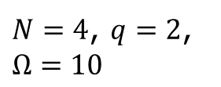
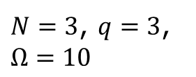


Chemical potential, Einstein oscillator example
$$Ω=\left(\begin{matrix}N+q−1 \\ q\end{matrix}\right)$$
$N=3$, $q=3$, $Ω=10$
$N=4$, $q=2$, $Ω=10$
Change of energy when the number of oscillators is creased by 1, fixing entropy.
$$μ≈\frac{ΔU}{ΔN}=\frac{−ε}{1}=−ε$$

Slide 14
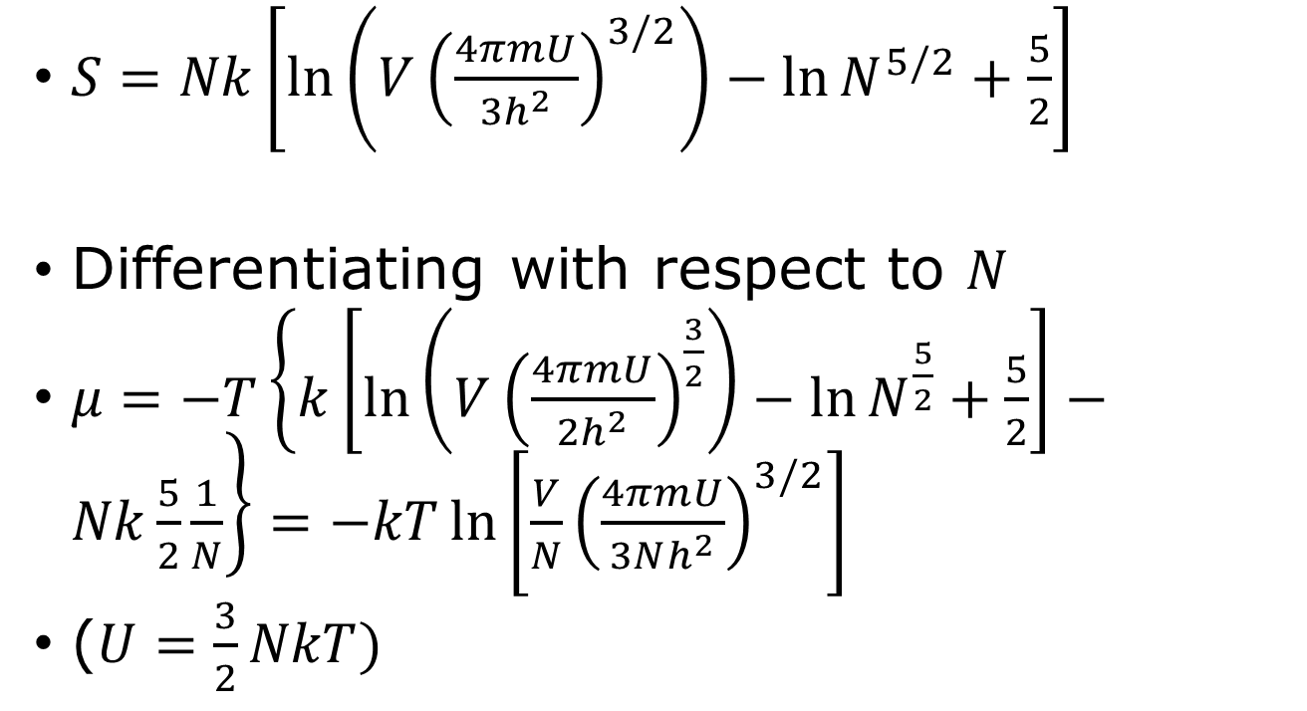
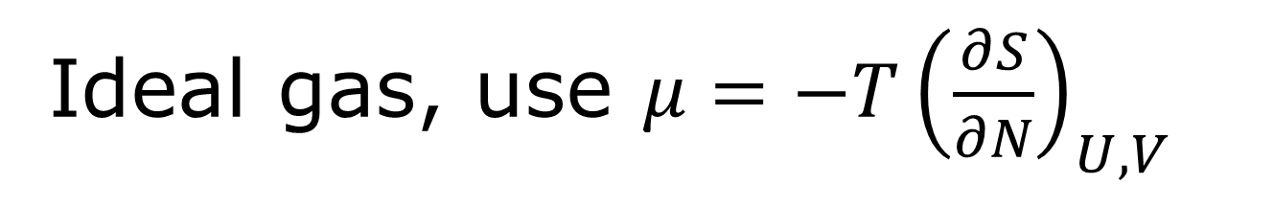
Ideal gas, use $μ=−T{\left(\frac{∂S}{∂N}\right)}_{U,V}$
$S=Nk\left[\ln\left(V{\left(\frac{4πmU}{3h^{2}}\right)}^{3/2}\right)−\ln{N^{5/2}+\frac{5}{2}}\right]$
Differentiating with respect to $N$
$μ=−T\left\{k\left[\ln\left(V{\left(\frac{4πmU}{2h^{2}}\right)}^{\frac{3}{2}}\right)−\ln{N^{\frac{5}{2}}+\frac{5}{2}}\right]−Nk\frac{5}{2}\frac{1}{N}\right\}=−kT\ln\left[\frac{V}{N}{\left(\frac{4πmU}{3Nh^{2}}\right)}^{3/2}\right]$
($U=\frac{3}{2}NkT)$

Slide 15



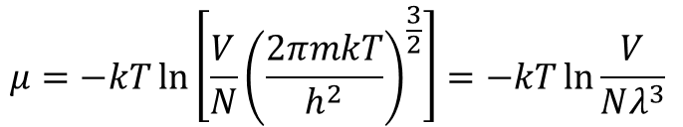
Chemical potentials of ideal classical, Bose, Fermi gases
$$μ$$
Fermi
classical
0
$$T$$
Bose
$$μ=−kT\ln\left[\frac{V}{N}{\left(\frac{2πmkT}{h^{2}}\right)}^{\frac{3}{2}}\right]=−kT\ln{\frac{V}{Nλ^{3}}}$$
$$λ≡\frac{h}{\sqrt{2πmkT}}$$

Slide 16
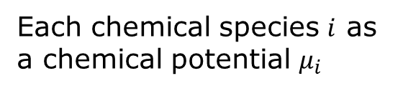
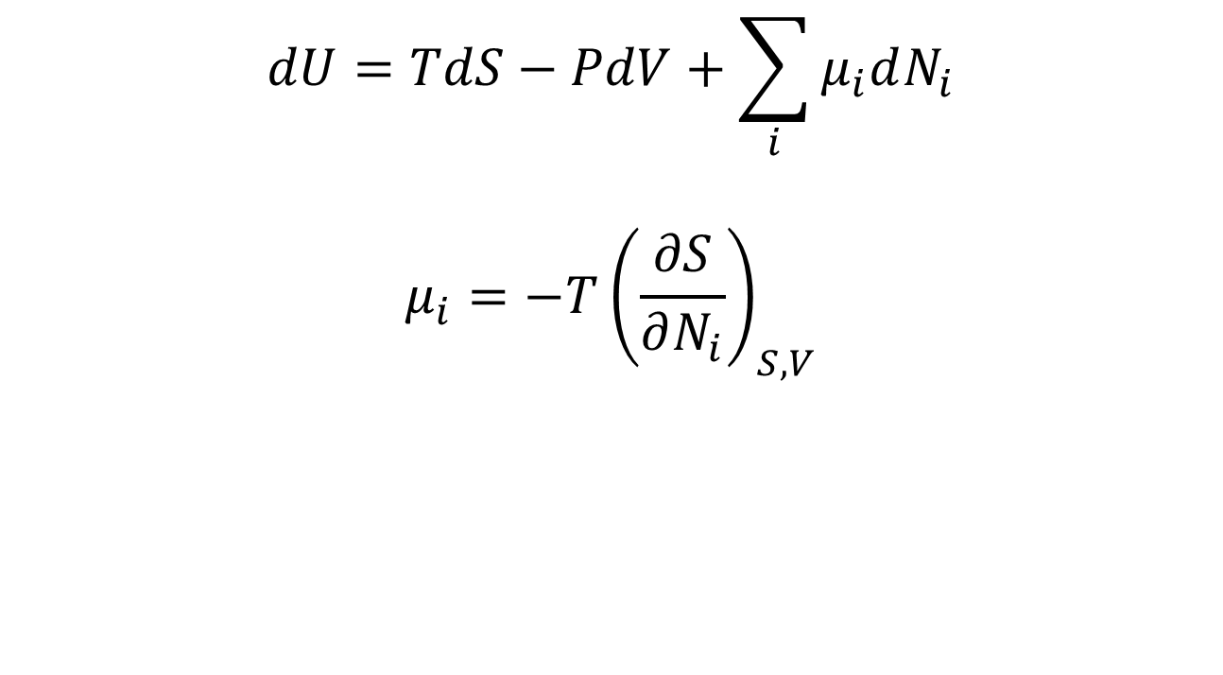
Generalized thermodynamic identity
$$dU=TdS−PdV+\sum_{i}{μ_{i}dN_{i}}$$
$$μ_{i}=−T{\left(\frac{∂S}{∂N_{i}}\right)}_{S,V}$$
Each chemical species $i$ as a chemical potential $μ_{i}$

Slide 17
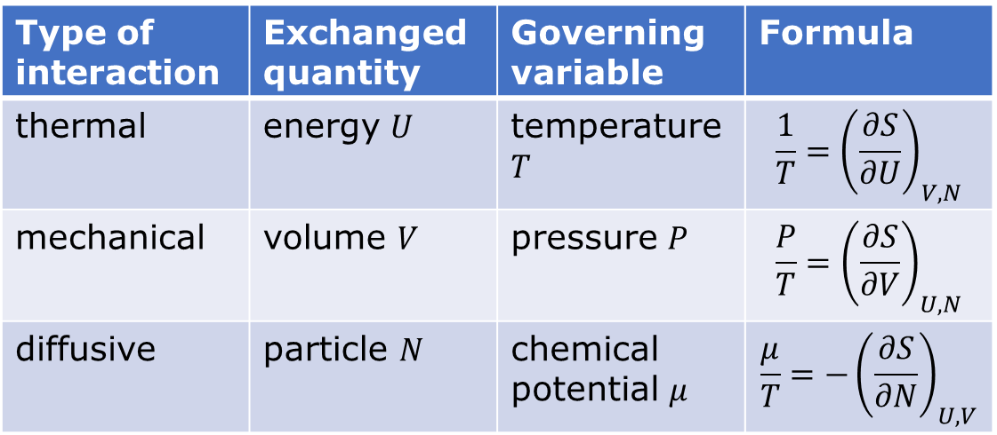
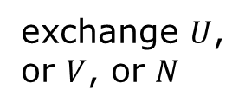
Summary
exchange $U$, or $V$, or $N$
A
B
Type of interaction | Exchanged quantity | Governing variable | Formula
thermal | energy $U$ | temperature $T$ | $$\frac{1}{T}={\left(\frac{∂S}{∂U}\right)}_{V,N}$$
mechanical | volume $V$ | pressure $P$ | $$\frac{P}{T}={\left(\frac{∂S}{∂V}\right)}_{U,N}$$
diffusive | particle $N$ | chemical potential $μ$ | $$\frac{μ}{T}=−{\left(\frac{∂S}{∂N}\right)}_{U,V}$$
Thermodynamic identity: $dU=TdS−PdV+μdN$

Slide 18
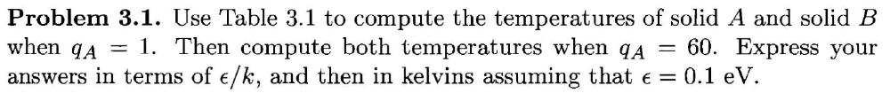
Tutorial problem 3.1

Slide 19
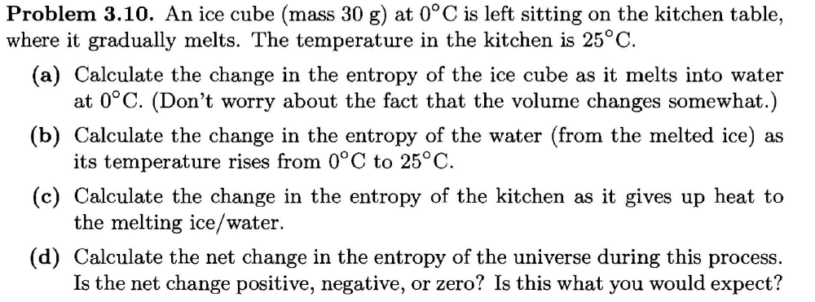
Problem 3.10

Slide 20
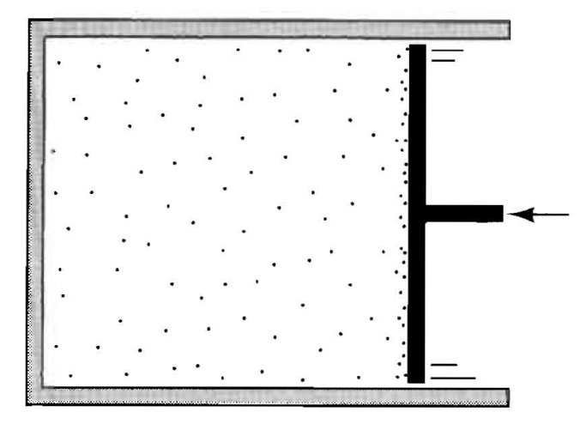
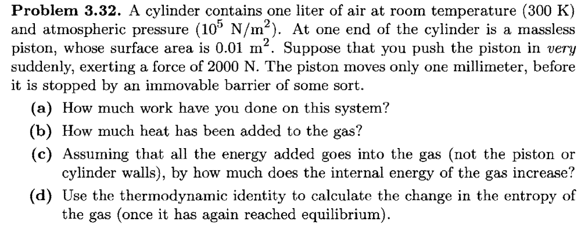
Problem 3.32

