Slide 1
Week 6
Engines and Refrigerators

Slide 2
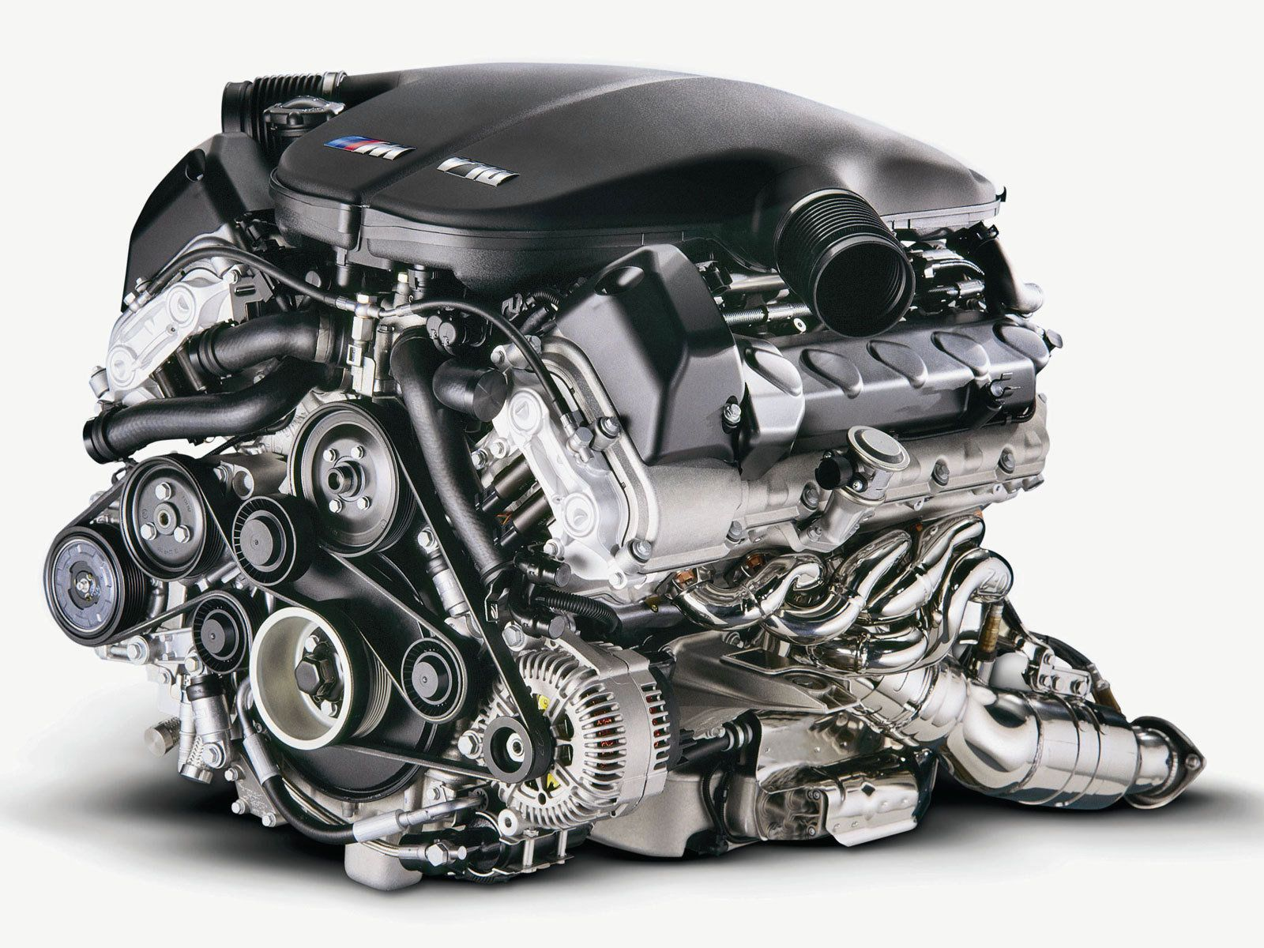
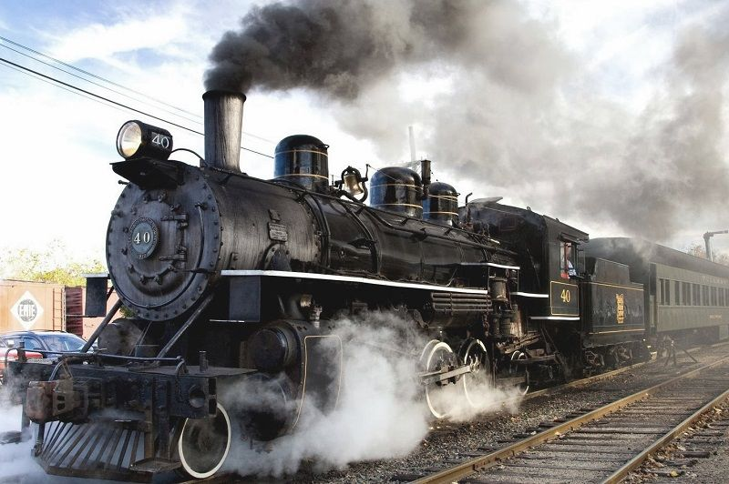
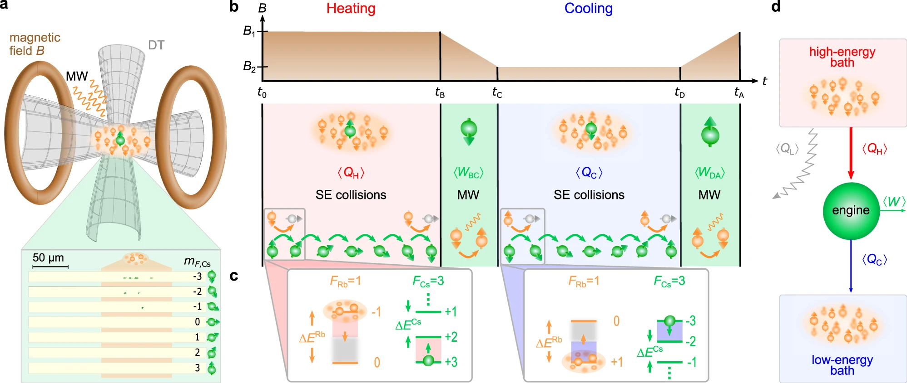
Heat engines
A modern car engine BMW V10.
https://isaacscienceblog.com/2017/04/28/heat-engine-theory/
⇒ Quantum heat engine made of a single Cesium atom with spin in an ultracold Rubidium bath. From Nature Comm 12, 2063 (2021).

Slide 3
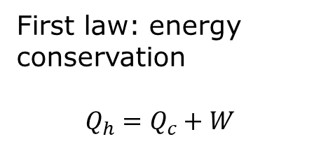

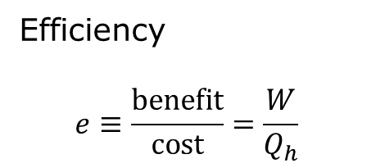




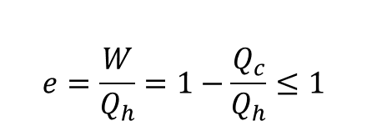
Energy-flow in heat engine
Hot reservoir, $T_{h}$
Efficiency
$$e≡\frac{benefit}{cost}=\frac{W}{Q_{h}}$$
$$Q_{h}$$
First law: energy conservation
$$Q_{h}=Q_{c}+W$$
Engine
$$W$$
$$Q_{c}$$
$$e=\frac{W}{Q_{h}}=1−\frac{Q_{c}}{Q_{h}}≤1$$
Cold reservoir, $T_{c}$
Sign convention: arrow direction is positive.

Slide 4
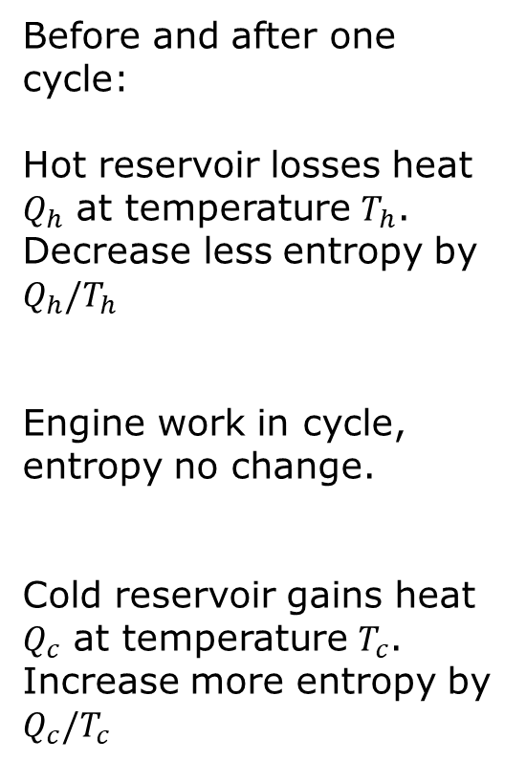


Entropy “flow”, $ΔS≥ \frac{Q}{T}$
Hot reservoir, $T_{h}$
Before and after one cycle:
Hot reservoir losses heat $Q_{h}$ at temperature $T_{h}$. Decrease less entropy by $Q_{h}/T_{h}$
Engine work in cycle, entropy no change.
Cold reservoir gains heat $Q_{c}$ at temperature $T_{c}$. Increase more entropy by $Q_{c}/T_{c}$
$$Q_{h}$$
Engine
$$Q_{c}$$
Cold reservoir, $T_{c}$

Slide 5
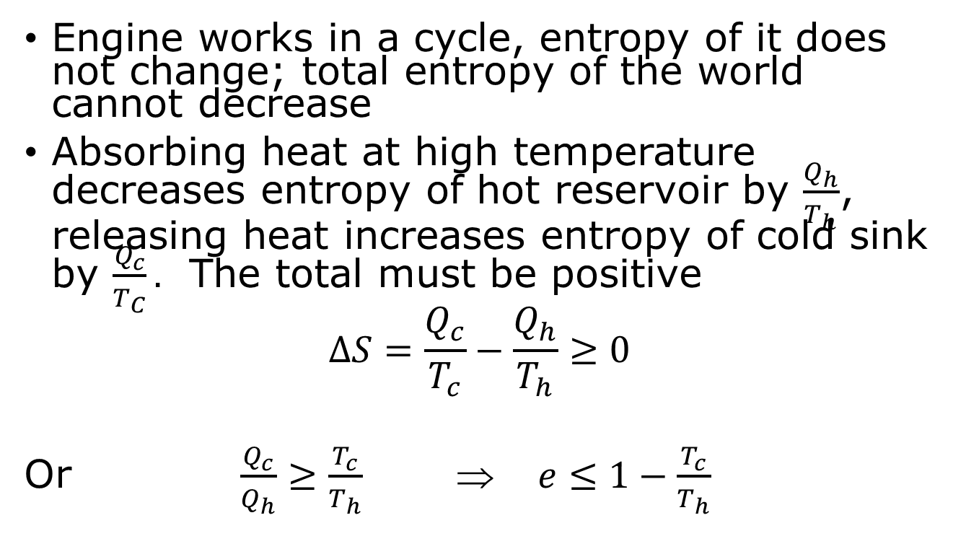
2nd law, maximum efficiency
Engine works in a cycle, entropy of it does not change; total entropy of the world cannot decrease
Absorbing heat at high temperature decreases entropy of hot reservoir by $\frac{Q_{h}}{T_{h}}$, releasing heat increases entropy of cold sink by $\frac{Q_{c}}{T_{C}}.$ The total must be positive
$$ΔS=\frac{Q_{c}}{T_{c}}−\frac{Q_{h}}{T_{h}}≥0$$
Or $\frac{Q_{c}}{Q_{h}}≥\frac{T_{c}}{T_{h}} ⇒ e≤1−\frac{T_{c}}{T_{h}}$

Slide 6
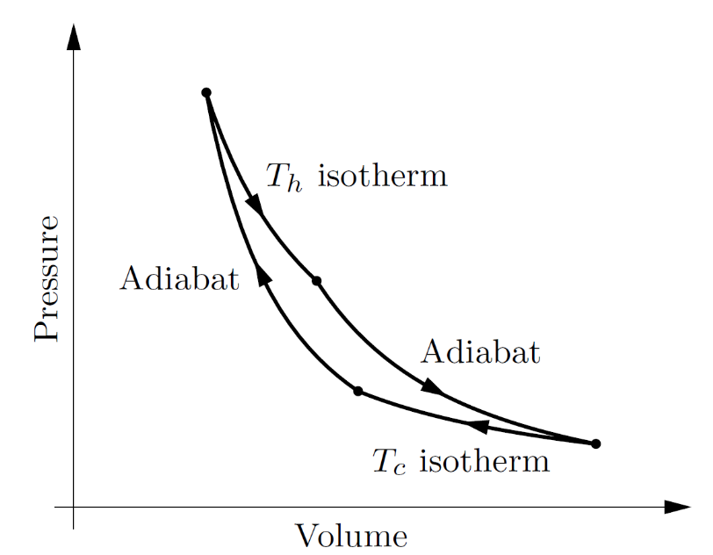
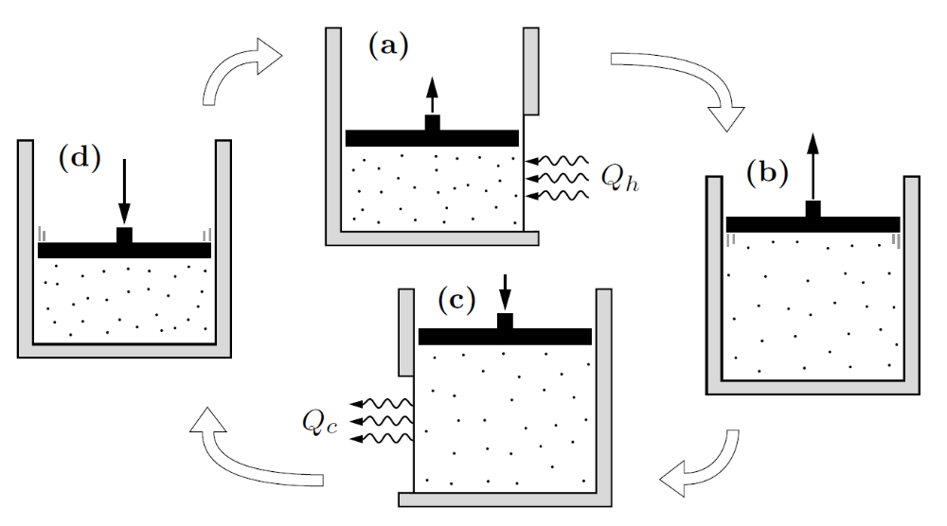


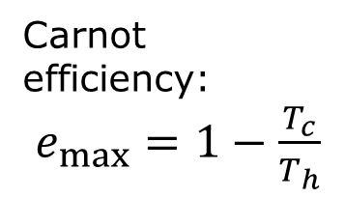
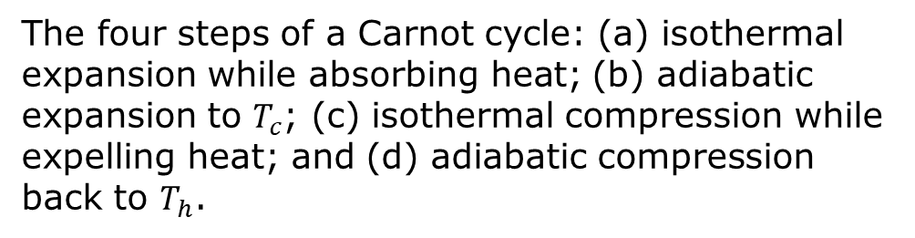
Carnot cycle
(a)
(d)
(b)
$$T_{h}$$
(c)
$$T_{c}$$
Carnot efficiency:
$e_{max}=1−\frac{T_{c}}{T_{h}}$
The four steps of a Carnot cycle: (a) isothermal expansion while absorbing heat; (b) adiabatic expansion to $T_{c}$; (c) isothermal compression while expelling heat; and (d) adiabatic compression back to $T_{h}$.

Slide 7





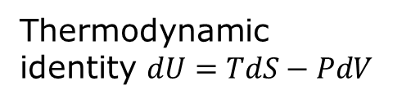

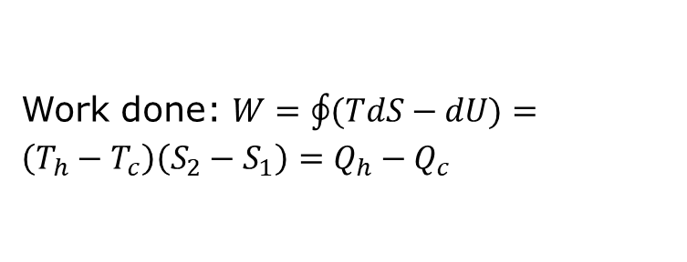

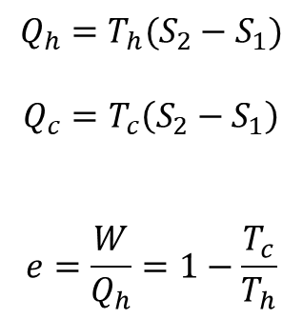
Carnot cycle in $S$-$T$ space
Entropy $S$ of working
substance
$$Q_{h}=T_{h}(S_{2}−S_{1})$$
$$Q_{c}=T_{c}\left(S_{2}−S_{1}\right)$$
$$e=\frac{W}{Q_{h}}=1−\frac{T_{c}}{T_{h}}$$
(b)
$$S_{2}$$
(c)
(a)
$$S_{1}$$
(d)
$$T_{c}$$
$$T_{h}$$
Temperature $T$
Work done: $W=\oint{(TdS−dU)}=\left(T_{h}−T_{c}\right)\left(S_{2}−S_{1}\right)=Q_{h}−Q_{c}$
Thermodynamic identity $dU=TdS−PdV$

Slide 8

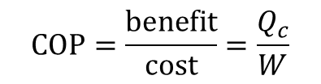

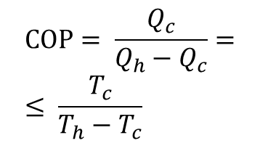

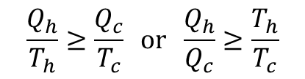
Refrigerator
Coefficient of Performance (COP)
$$COP=\frac{benefit}{cost}=\frac{Q_{c}}{W}$$
Hot reservoir, $T_{h}$
$$Q_{h}$$
$$W=Q_{h}−Q_{c}$$
Engine of refrigerator
$$\frac{Q_{h}}{T_{h}}≥\frac{Q_{c}}{T_{c}} or \frac{Q_{h}}{Q_{c}}≥\frac{T_{h}}{T_{c}}$$
$$W$$
$$Q_{c}$$
$$COP= \frac{Q_{c}}{Q_{h}−Q_{c}}=≤ \frac{T_{c}}{T_{h}−T_{c}}$$
Cold reservoir, $T_{c}$

Slide 9
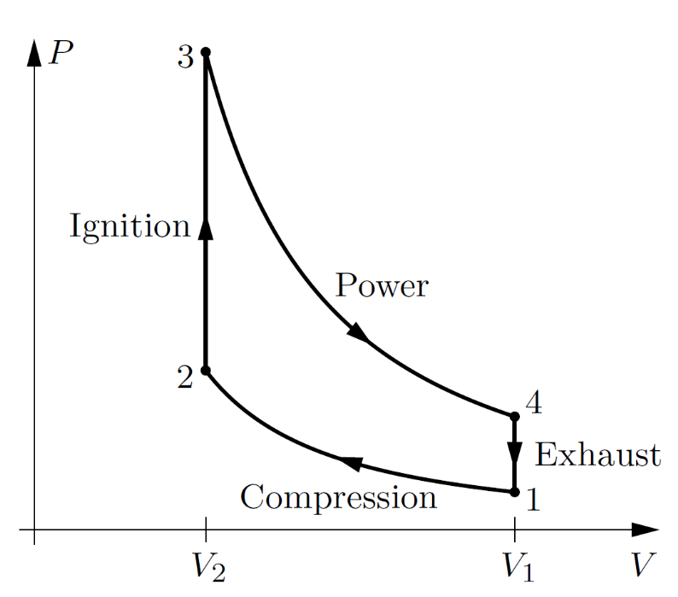
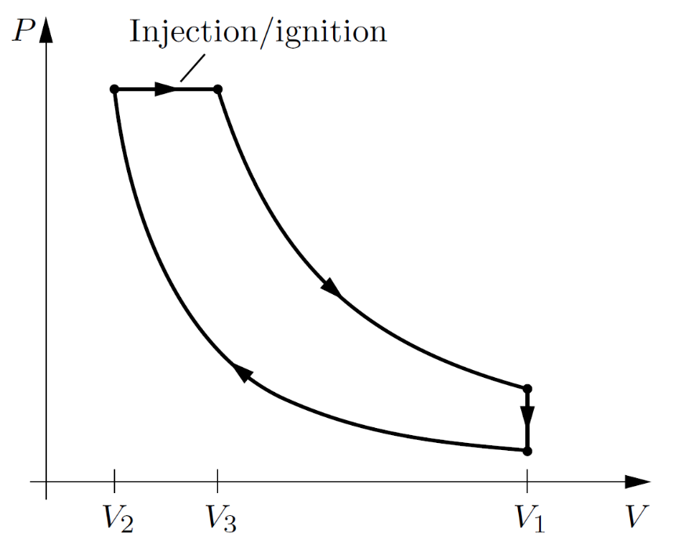
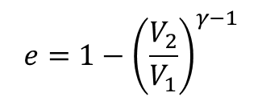
Real heat engines – internal combustion engines
Idealized Otto cycle
Diesel cycle
$$e=1−{\left(\frac{V_{2}}{V_{1}}\right)}^{γ−1}$$
(adiabatic)
(adiabatic)
(adiabatic)
(adiabatic)

Slide 10
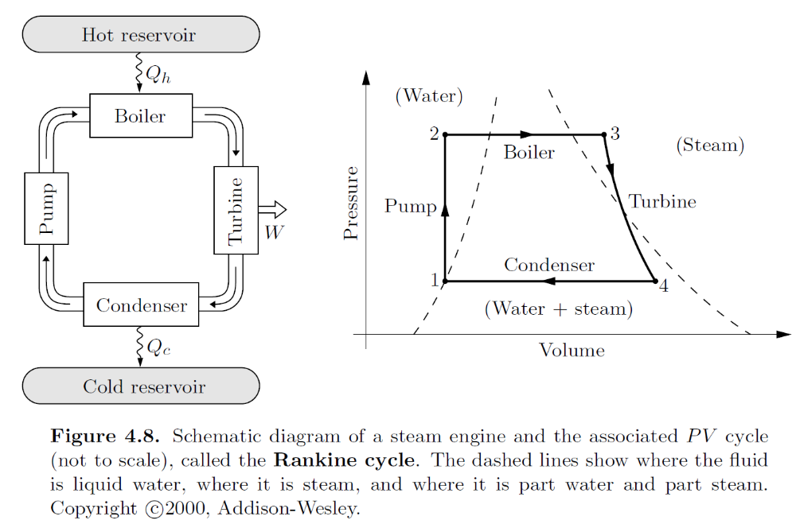
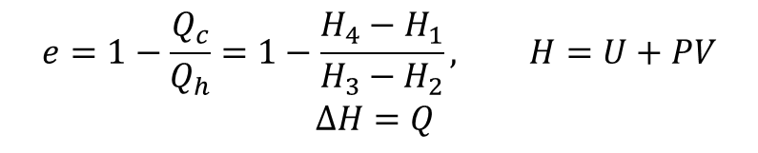
Stream engine – Rankine cycle
$$e=1−\frac{Q_{c}}{Q_{h}}=1−\frac{H_{4}−H_{1}}{H_{3}−H_{2}}, H=U+PV$$
$$ΔH=Q$$

Slide 11
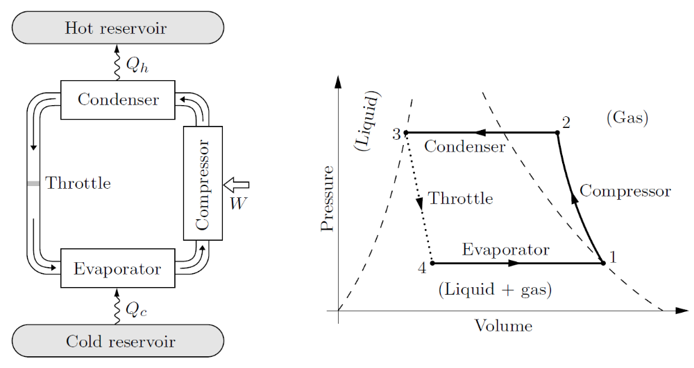
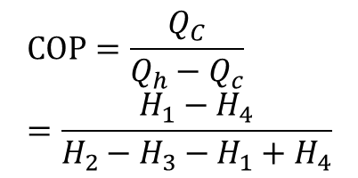
Real Refrigerators
$$COP=\frac{Q_{C}}{Q_{h}−Q_{c}}=\frac{H_{1}−H_{4}}{H_{2}−H_{3}−H_{1}+H_{4}}$$

Slide 12
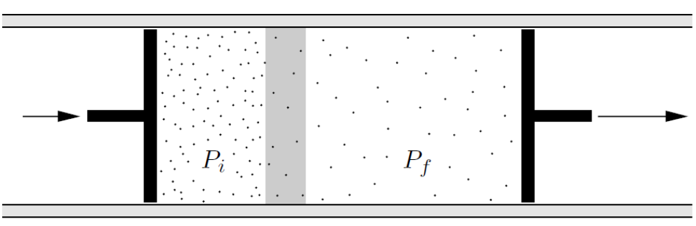

The throttling process (Joule-Thomson)
A fluid is pushed through a porous plug and then expands into a region of lower pressure, decreasing temperature. This cooling works only for non-ideal gas.
$$U_{f}−U_{i}=Q+W=W_{left}+W_{right}$$
$U_{f}−U_{i}=P_{i}V_{i}−P_{f}V_{f}$ $→$ $H_{f}=H_{i}$
$$H=U_{potential}+U_{kinetic}+PV$$

Slide 13
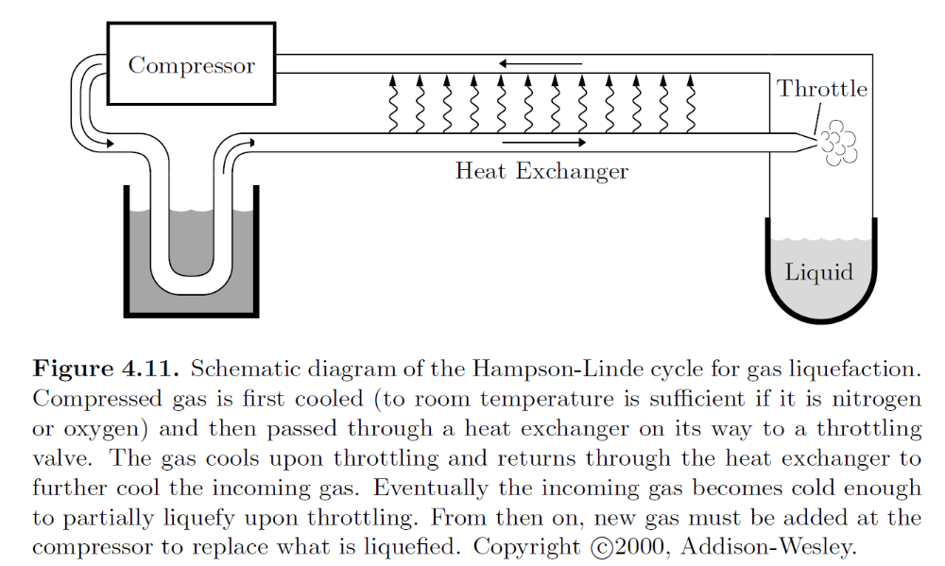
Liquefaction of gases

Slide 14
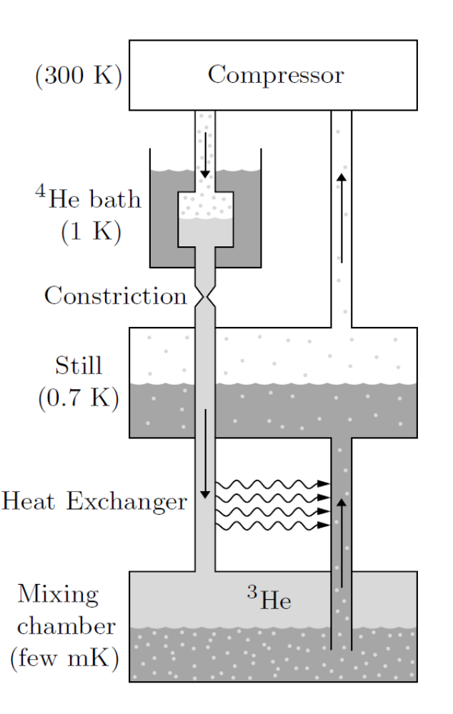
Towards absolute zero
³He gas partial pressure much higher than that of ⁴He.
Helium dilution refrigerator. The working substance is ³He circulating contour-clockwise.
Evaporating of top pure ³He to diluted one at the bottom absorb heat, cooling temperatures down to few mK.
Top: pure ³He liquid
bottom: 6% ³He solution in ⁴He

Slide 15
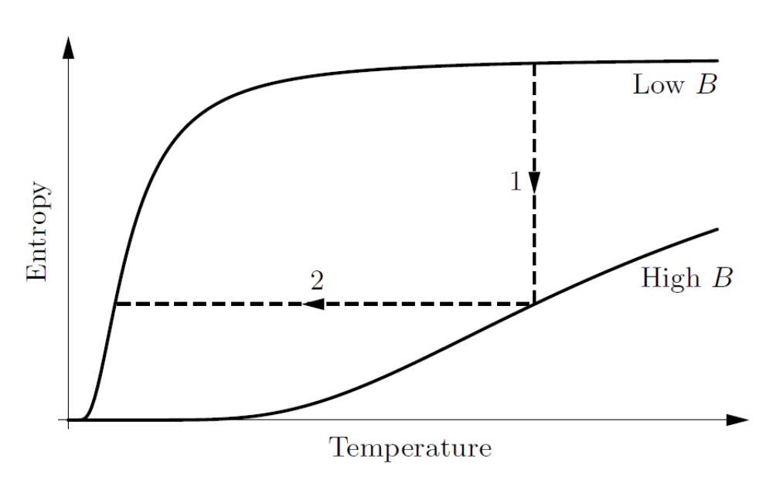
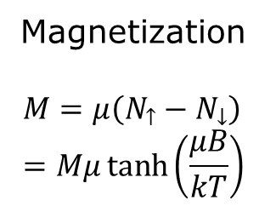
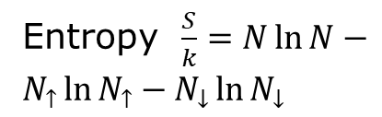
Magnetic cooling
Magnetization
$$M=μ\left(N_{↑}−N_{↓}\right)=Mμ\tanh\left(\frac{μB}{kT}\right)$$
Entropy $\frac{S}{k}=N\ln{N}−N_{↑}\ln{N_{↑}}−N_{↓}\ln{N_{↓}}$
The magnetic cooling process consists of an isothermal increase in the field strength (step 1), followed by an adiabatic decrease of B (step 2).
Can go down to 10⁻⁹ K with nuclear spin.

Slide 16
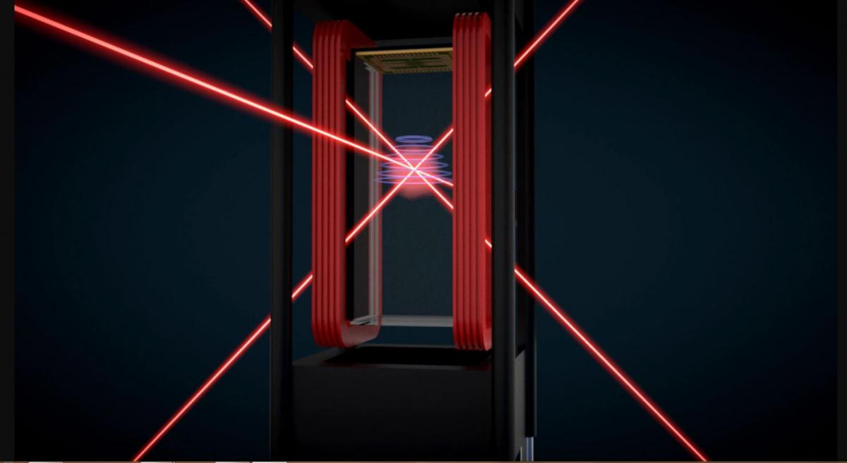
Laser cooling & magnetic field trapping
Down to micro kelvin

Slide 17
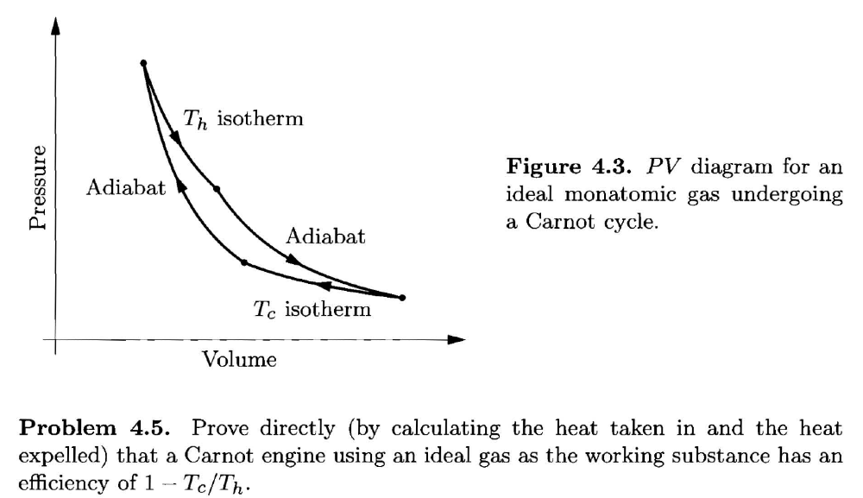
Tutorial problem 4.5

Slide 18
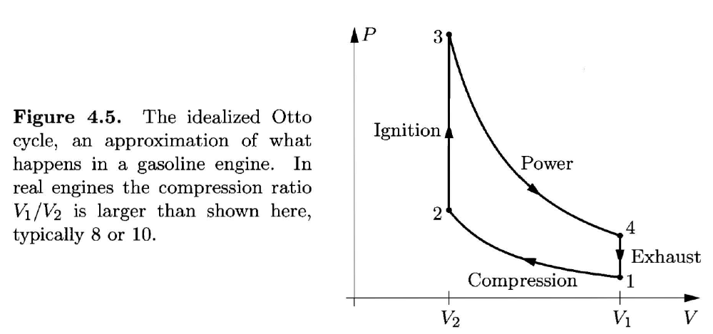
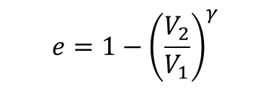
Problem 4.18
$$e=1−{\left(\frac{V_{2}}{V_{1}}\right)}^{γ}$$

Slide 19
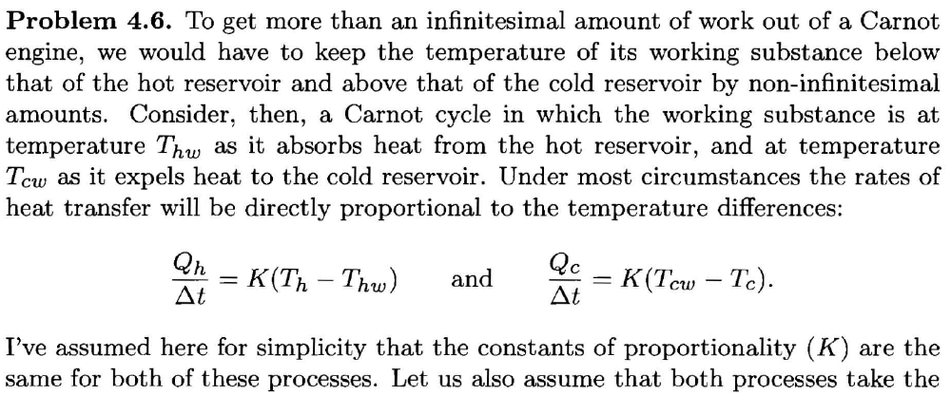
Problem 4.6

Slide 20
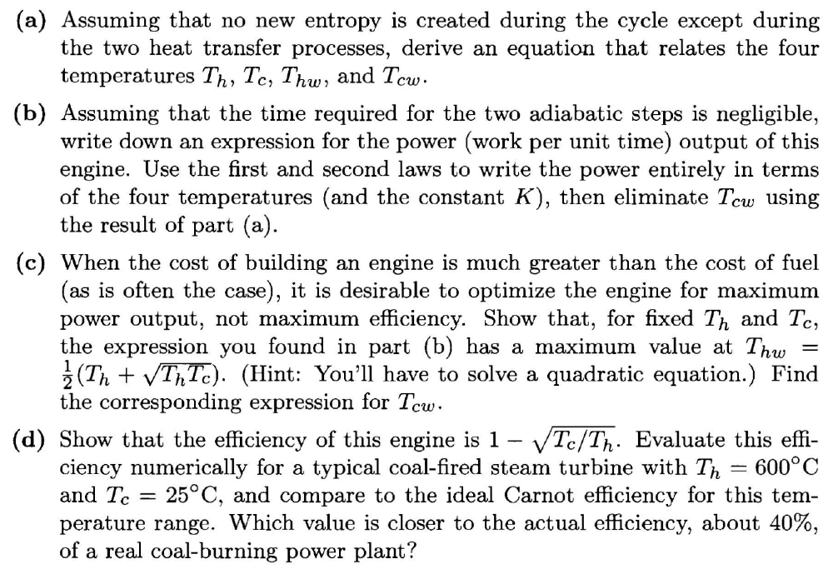
Prob 4.6 continued

