Slide 1
Week 7
Free energy & other thermodynamic functions

Slide 2
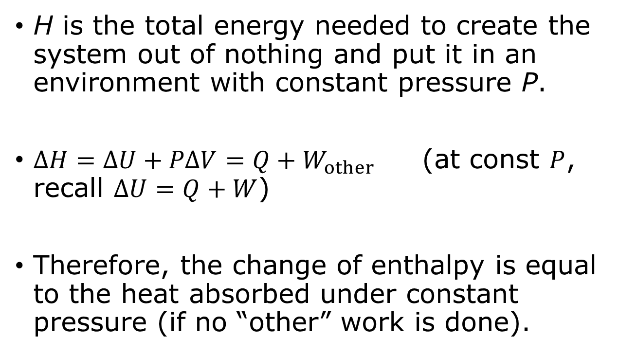

Enthalpy $H≡U+PV$
H is the total energy needed to create the system out of nothing and put it in an environment with constant pressure P.
$ΔH=ΔU+PΔV=Q+W_{other}$ (at const $P$, recall $ΔU=Q+W$)
Therefore, the change of enthalpy is equal to the heat absorbed under constant pressure (if no “other” work is done).

Slide 3
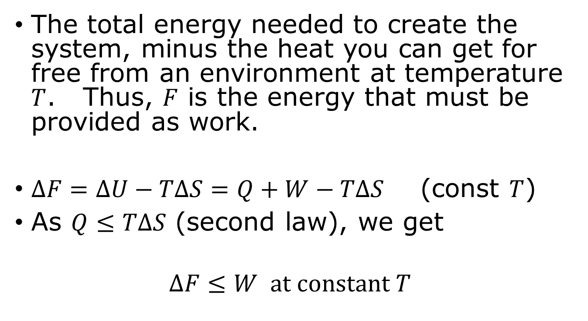
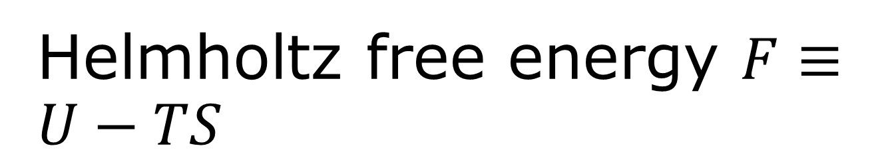
Helmholtz free energy $F≡U−TS$
The total energy needed to create the system, minus the heat you can get for free from an environment at temperature $T$. Thus, $F$ is the energy that must be provided as work.
$ΔF=ΔU−TΔS=Q+W−TΔS$ (const $T$)
As $Q≤TΔS$ (second law), we get
$$ΔF≤W at constant T$$

Slide 4
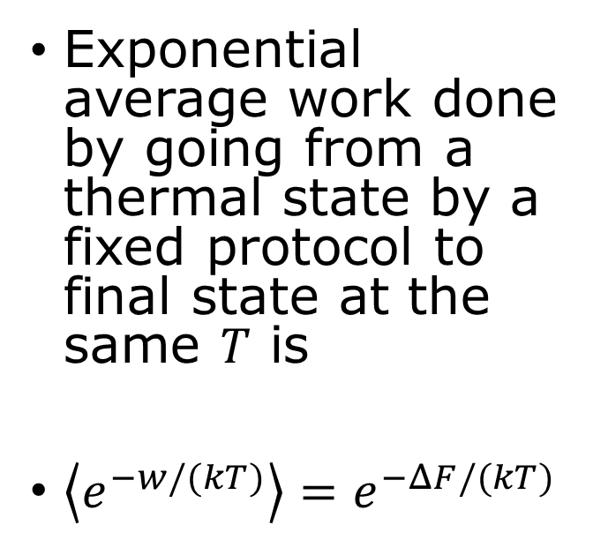
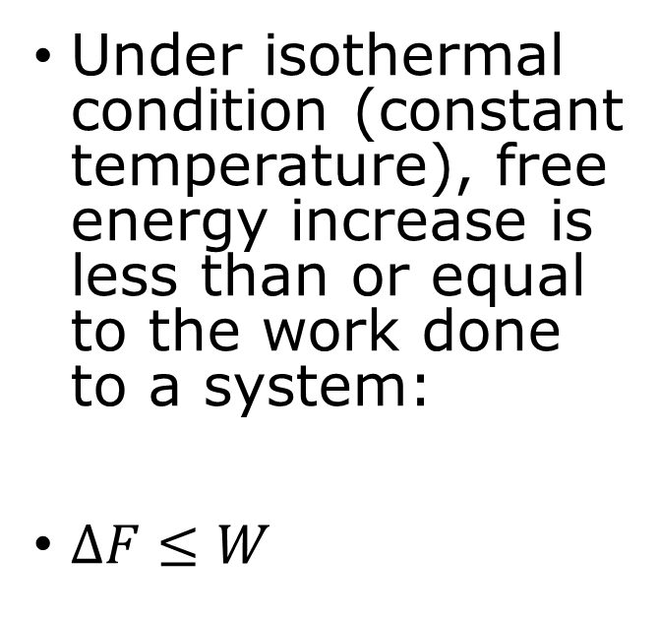
Thermodynamic inequality vs statistical-mechanic equality
Free energy Inequality
Jarzynski equality
Under isothermal condition (constant temperature), free energy increase is less than or equal to the work done to a system:
$ΔF≤W$
Exponential average work done by going from a thermal state by a fixed protocol to final state at the same $T$ is
$\left\langle e^{−w/(kT)}\right\rangle =e^{−ΔF/(kT)}$

Slide 5
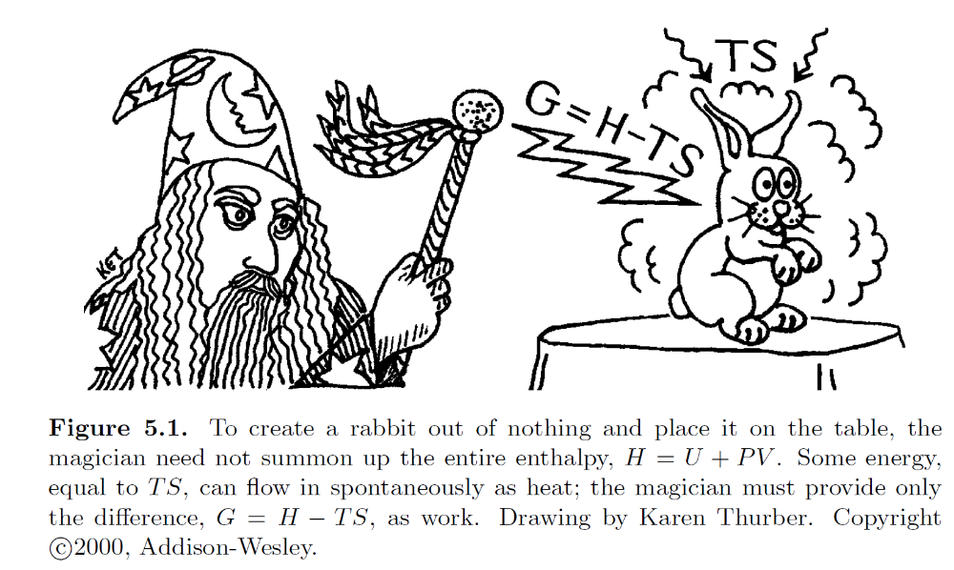
Gibbs free energy $G$

Slide 6
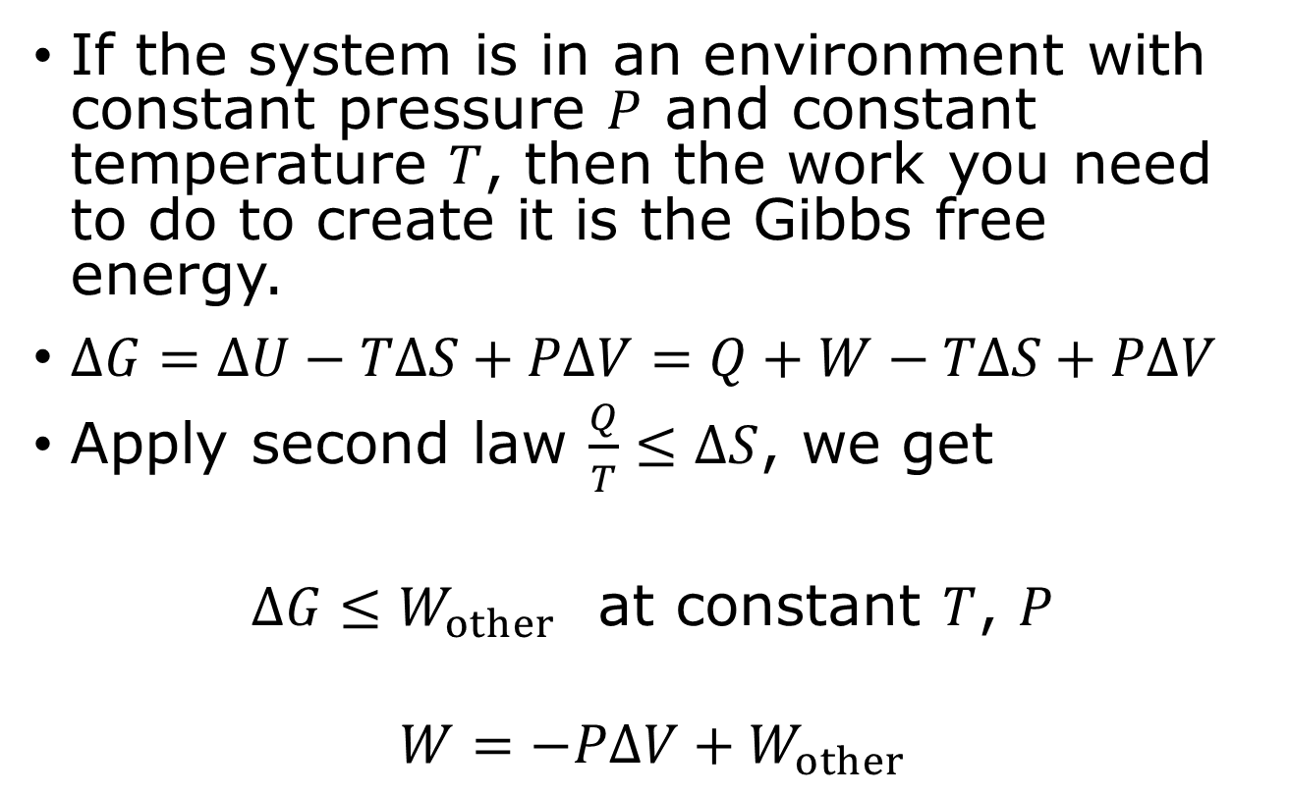

$$G≡U−TS+PV$$
If the system is in an environment with constant pressure $P$ and constant temperature $T$, then the work you need to do to create it is the Gibbs free energy.
$ΔG=ΔU−TΔS+PΔV=Q+W−TΔS+PΔV$
Apply second law $\frac{Q}{T}≤ΔS$, we get
$ΔG≤W_{other}$ at constant $T$, $P$
$$W=−PΔV+W_{other}$$

Slide 7
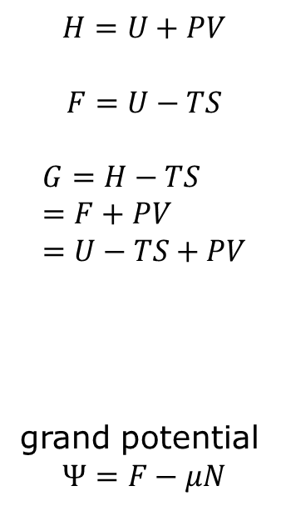






Four thermodynamic potentials
$$−TS$$
$$H=U+PV$$
$$F=U−TS$$
$$G=H−TS=F+PV=U−TS+PV$$
grand potential
$$Ψ=F−μN$$
$$U$$
$$F$$
energy
Helmholtz free energy
$$+PV$$
$$H$$
$$G$$
enthalpy
Gibbs free energy

Slide 8
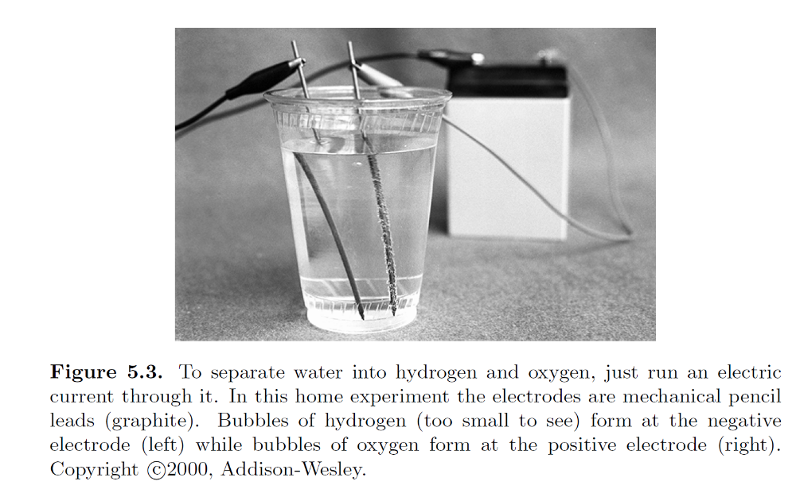
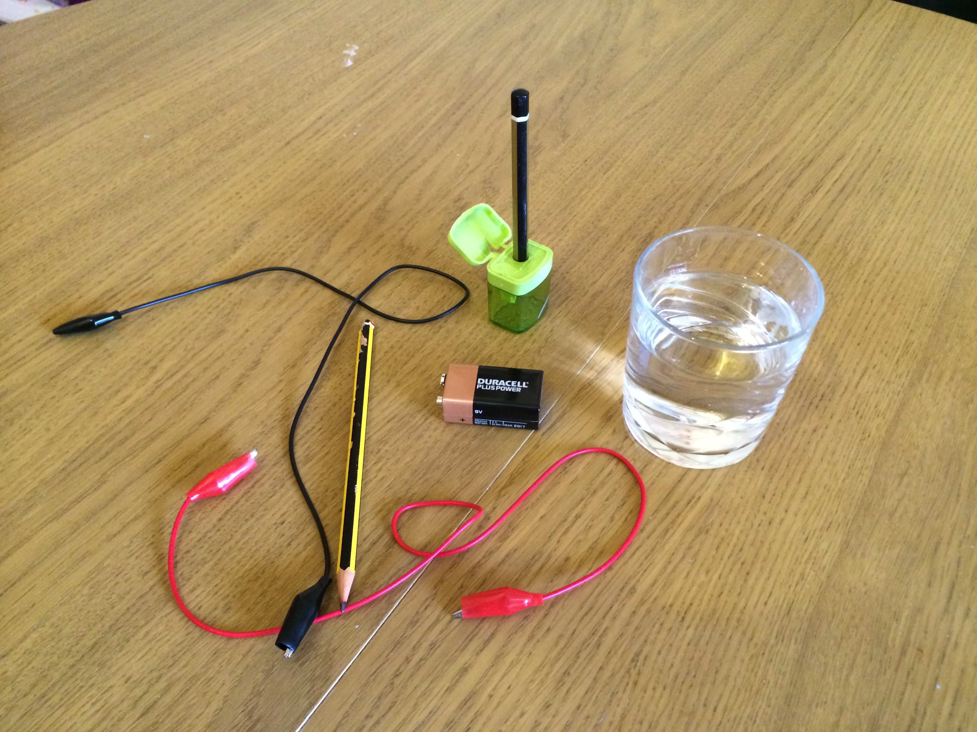
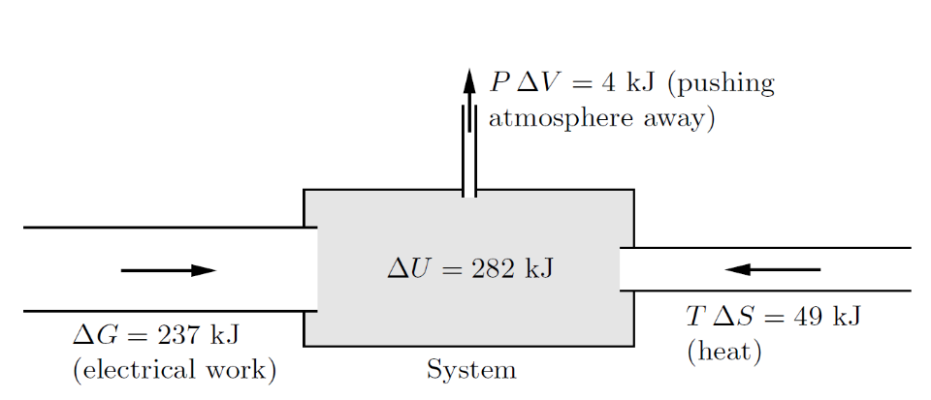
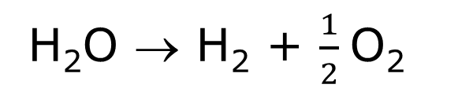
Electrolysis
H₂O → H₂ + $\frac{1}{2}$O₂

Slide 9
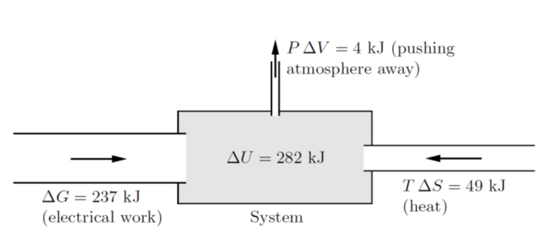
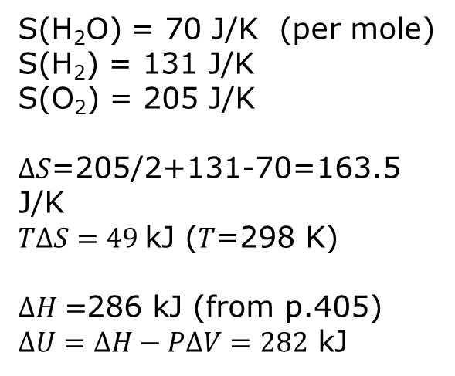
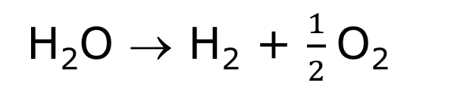
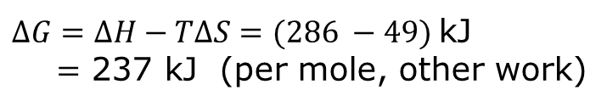
Electrical energy needed
S(H₂O) = 70 J/K (per mole)
S(H₂) = 131 J/K
S(O₂) = 205 J/K
$ΔS$=205/2+131-70=163.5 J/K
$TΔS=49$kJ (𝑇=298 K)
$ΔH=$286 kJ (from p.405)
$ΔU=ΔH−PΔV=282$ kJ
H₂O → H₂ + $\frac{1}{2}$O₂
$ΔG=ΔH−TΔS=(286 −49)$kJ
$=$ 237 kJ (per mole, other work)

Slide 10
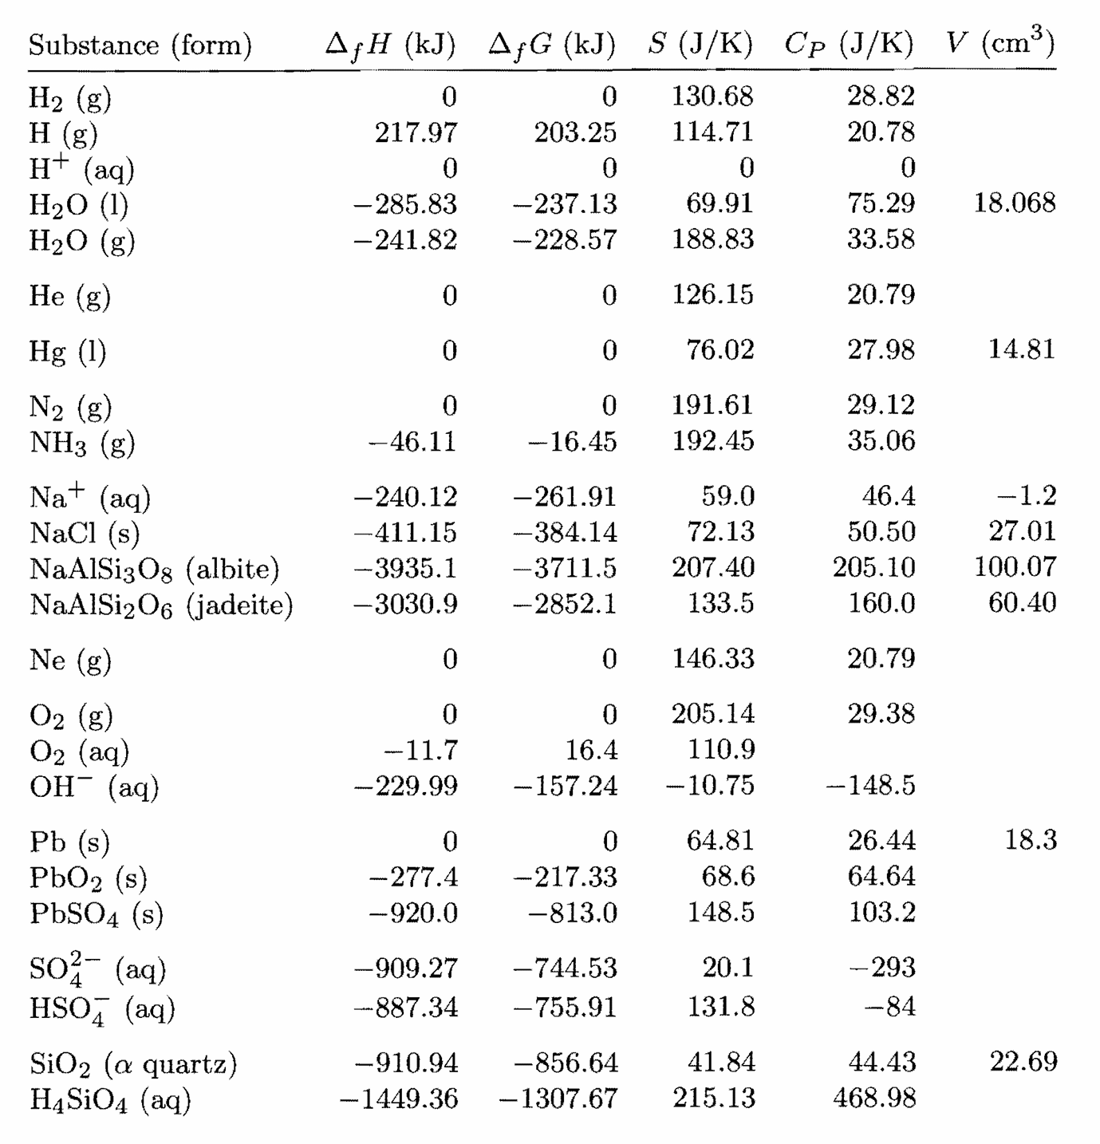
Thermodynamic properties of selected substances (1 mole at 298 K and 1 bar) p.405

Slide 11
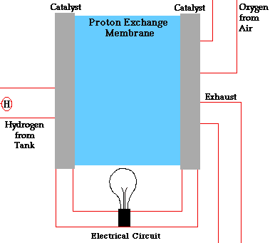
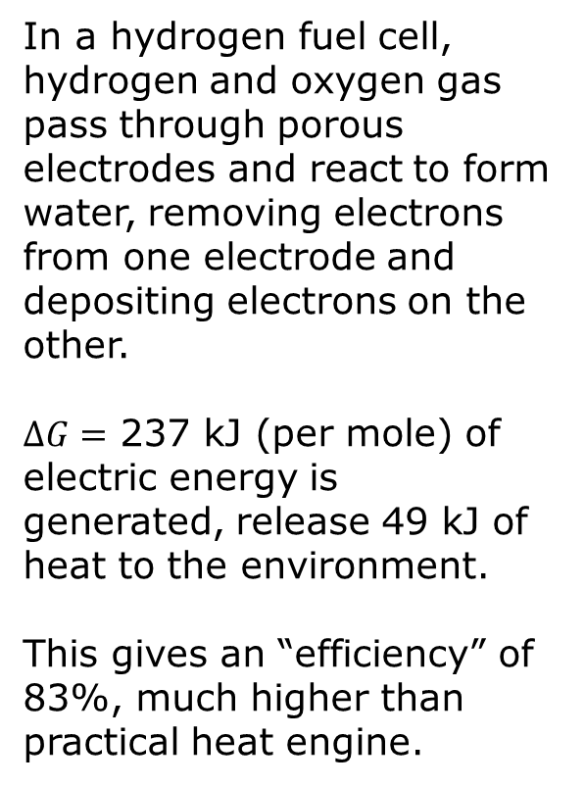
Fuel cell
In a hydrogen fuel cell, hydrogen and oxygen gas pass through porous electrodes and react to form water, removing electrons from one electrode and depositing electrons on the other.
$ΔG=$ 237 kJ (per mole) of electric energy is generated, release 49 kJ of heat to the environment.
This gives an “efficiency” of 83%, much higher than practical heat engine.
From https://americanhistory.si.edu/fuelcells/basics.htm

Slide 12
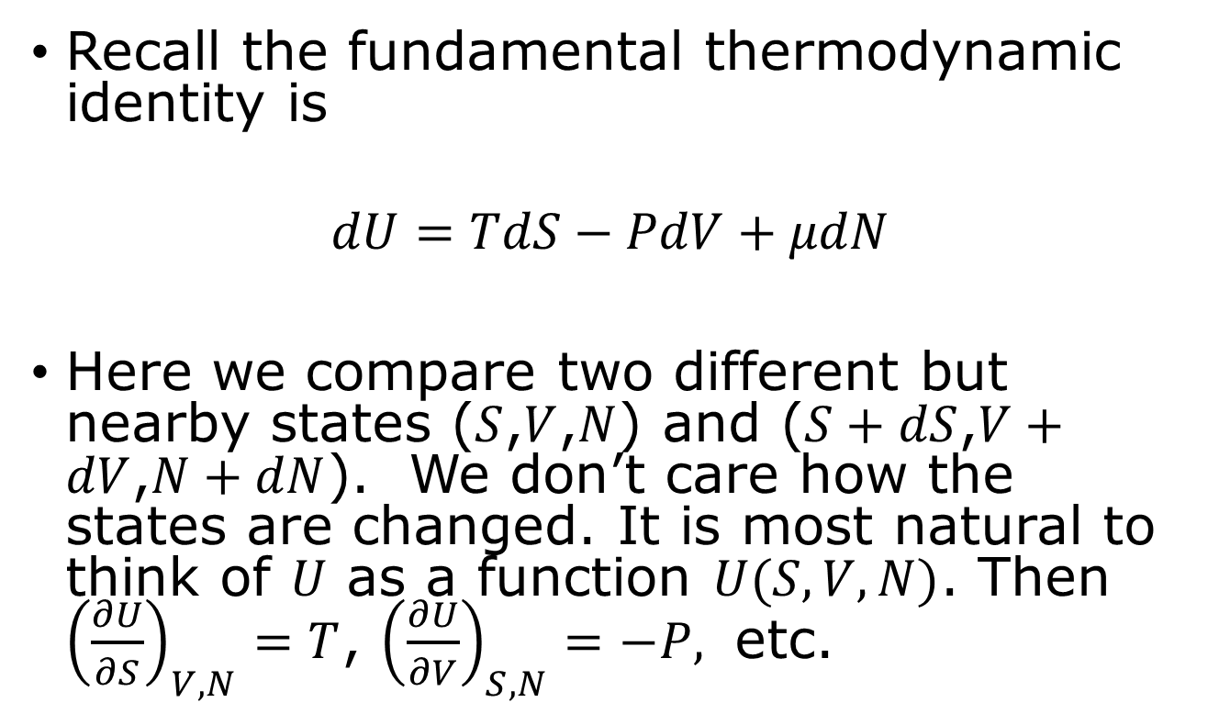
Thermodynamic identities
Recall the fundamental thermodynamic identity is
$$dU=TdS−PdV+μdN$$
Here we compare two different but nearby states ($S$,$V$,$N$) and ($S+dS$,$V+dV$,$N+dN$). We don’t care how the states are changed. It is most natural to think of $U$ as a function $U(S,V,N)$. Then ${\left(\frac{∂U}{∂S}\right)}_{V,N}=T$, ${\left(\frac{∂U}{∂V}\right)}_{S,N}=−P,$ etc.

Slide 13
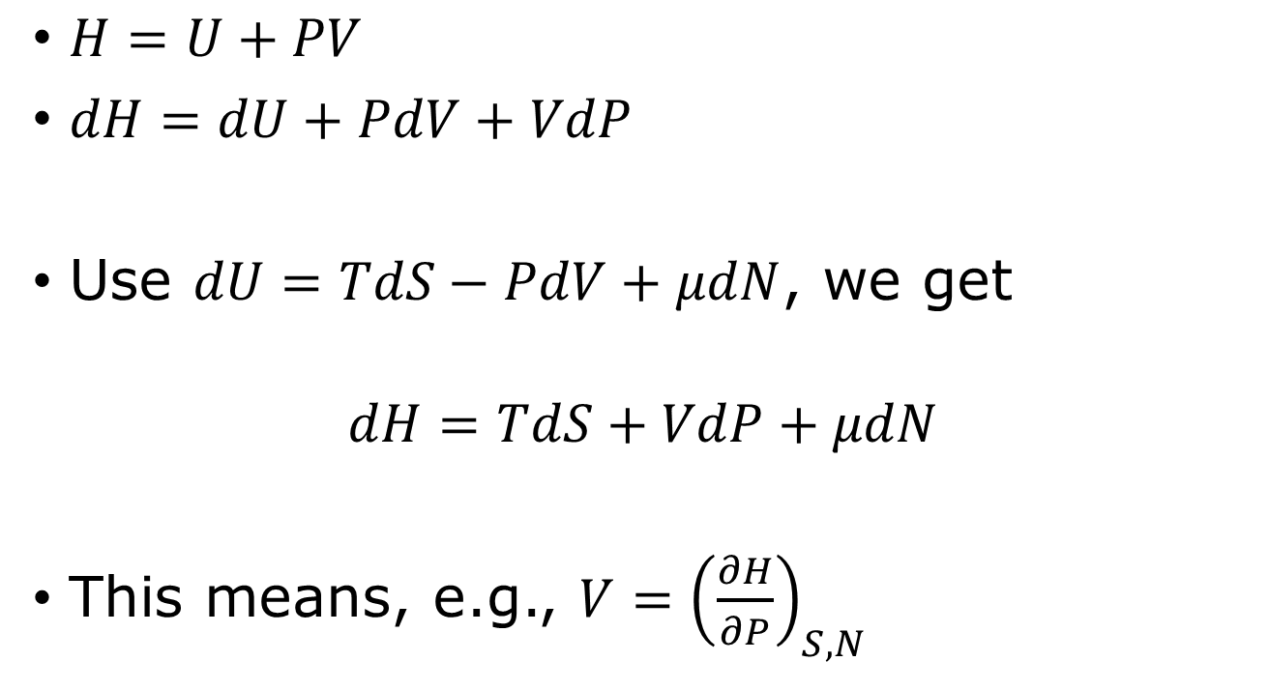
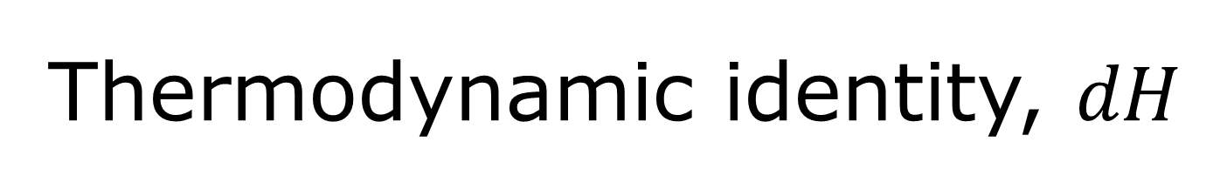
Thermodynamic identity, $dH$
$H=U+PV$
$dH=dU+PdV+VdP$
Use $dU=TdS−PdV+μdN$, we get
$$dH=TdS+VdP+μdN$$
This means, e.g., $V={\left(\frac{∂H}{∂P}\right)}_{S,N}$

Slide 14
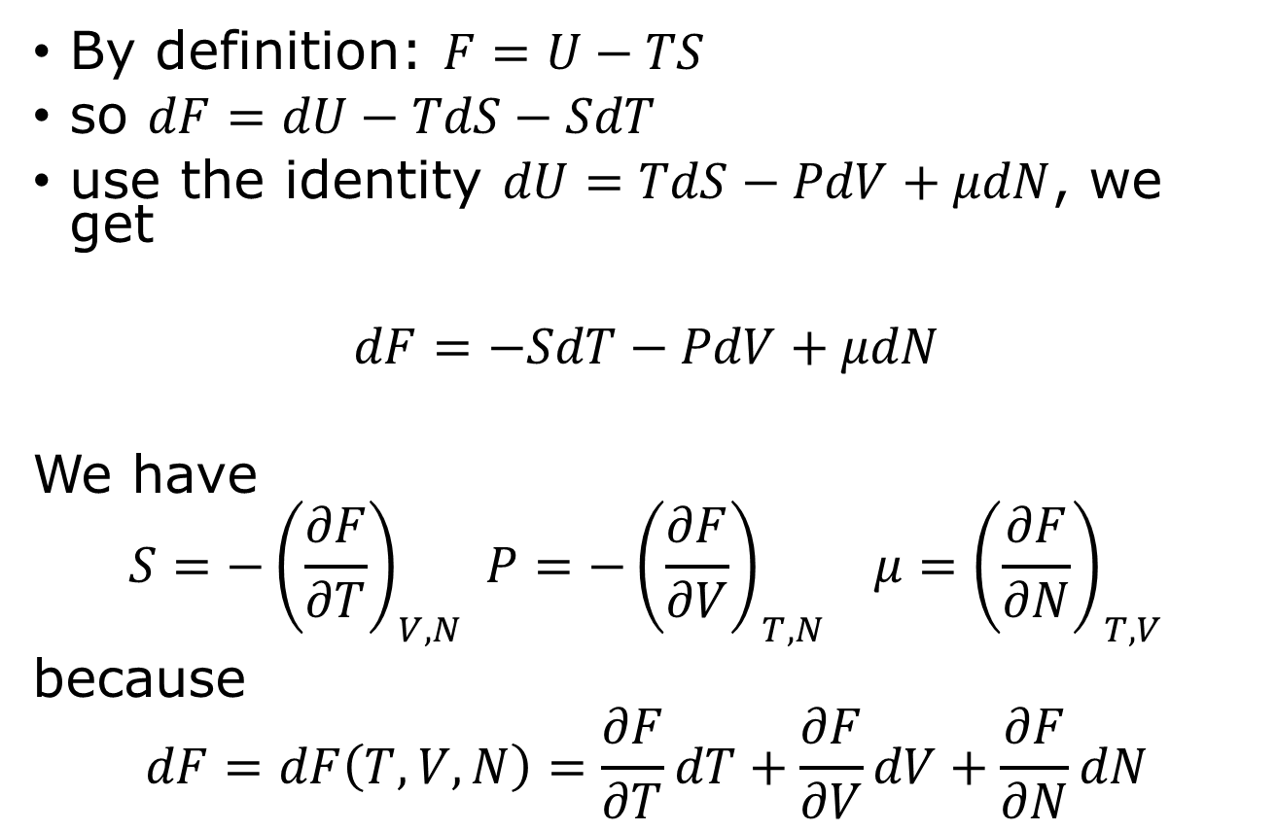
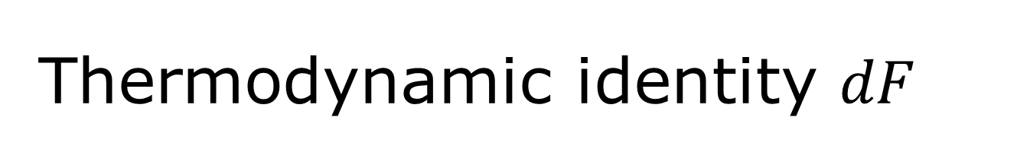
Thermodynamic identity $dF$
By definition: $F=U−TS$
so $dF=dU−TdS−SdT$
use the identity $dU=TdS−PdV+μdN$, we get
$$dF=−SdT−PdV+μdN$$
We have
$$S=−{\left(\frac{∂F}{∂T}\right)}_{V,N} P={−\left(\frac{∂F}{∂V}\right)}_{T,N} μ={\left(\frac{∂F}{∂N}\right)}_{T,V}$$
because
$$dF=dF\left(T,V,N\right)=\frac{∂F}{∂T}dT+\frac{∂F}{∂V}dV+\frac{∂F}{∂N}dN$$

Slide 15
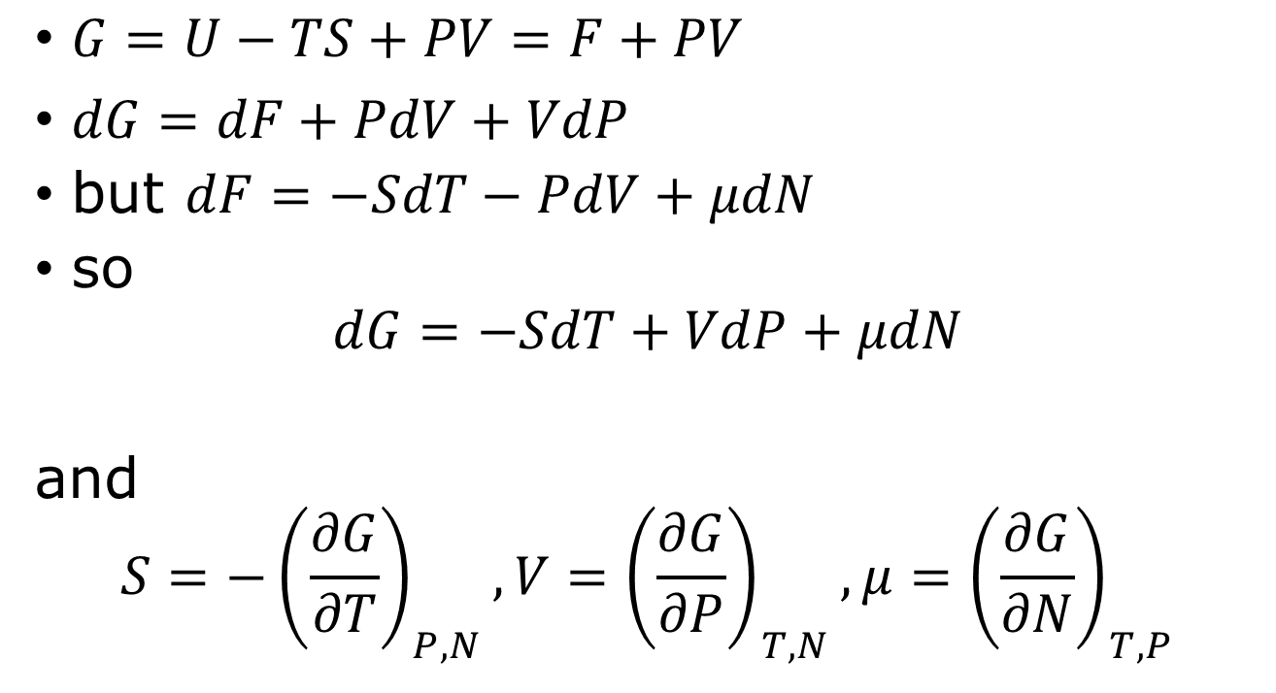

Thermodynamic identity for $G$
$G=U−TS+PV=F+PV$
$dG=dF+PdV+VdP$
but $dF=−SdT−PdV+μdN$
so
$$dG=−SdT+VdP+μdN$$
and
$$S=−{\left(\frac{∂G}{∂T}\right)}_{P,N}, V={\left(\frac{∂G}{∂P}\right)}_{T,N}, μ={\left(\frac{∂G}{∂N}\right)}_{T,P}$$

Slide 16
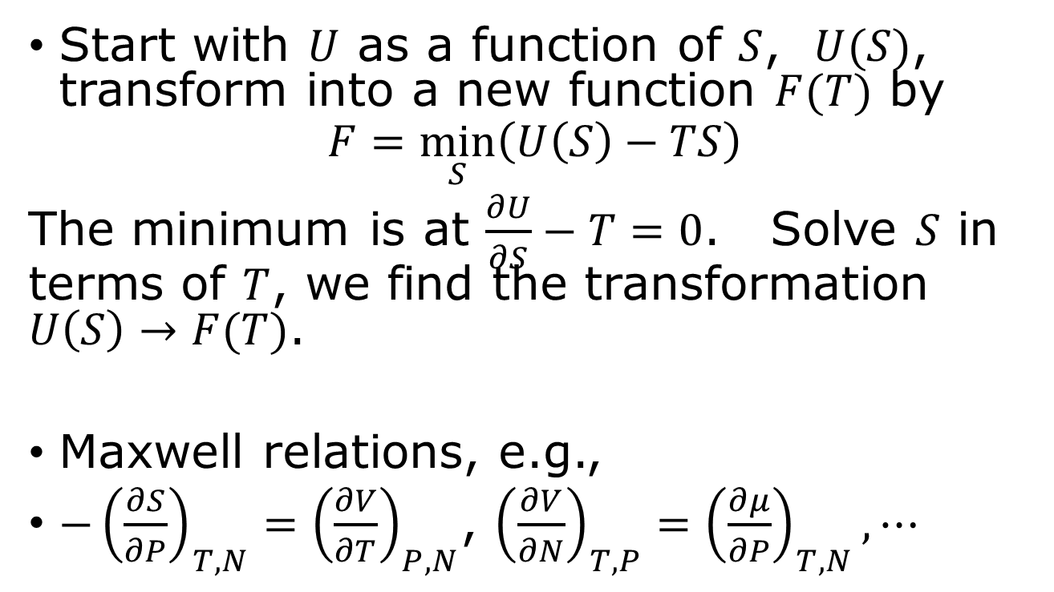
Legendre transform/Maxwell’s relation
Start with $U$ as a function of $S$, $U(S)$, transform into a new function $F(T)$ by
$$F=\min_{S}\left(U\left(S\right)−TS\right)$$
The minimum is at $\frac{∂U}{∂S}−T=0$. Solve $S$ in terms of $T$, we find the transformation $U\left(S\right)→F(T)$.
Maxwell relations, e.g.,
$−{\left(\frac{∂S}{∂P}\right)}_{T,N}={\left(\frac{∂V}{∂T}\right)}_{P,N}$, ${\left(\frac{∂V}{∂N}\right)}_{T,P}={\left(\frac{∂μ}{∂P}\right)}_{T,N},⋯$

Slide 17

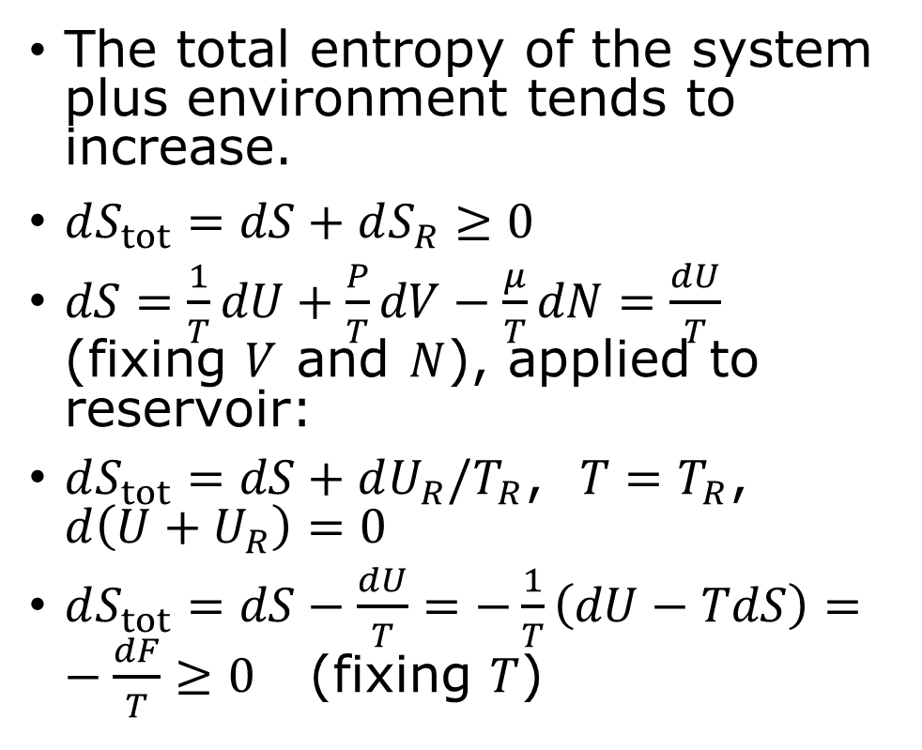
Free energy as a force toward equilibrium
The total entropy of the system plus environment tends to increase.
$dS_{tot}=dS+dS_{R}≥0$
$dS=\frac{1}{T}dU+\frac{P}{T}dV−\frac{μ}{T}dN=\frac{dU}{T}$ (fixing $V$ and $N$), applied to reservoir:
$dS_{tot}=dS+dU_{R}/T_{R}$, $T=T_{R}$, $d\left(U+U_{R}\right)=0$
$dS_{tot}=dS−\frac{dU}{T}=−\frac{1}{T}\left(dU−TdS\right)=−\frac{dF}{T}≥0$ (fixing $T$)
System
Environment (reservoir) at T
i.e., $dF≤0$

Slide 18
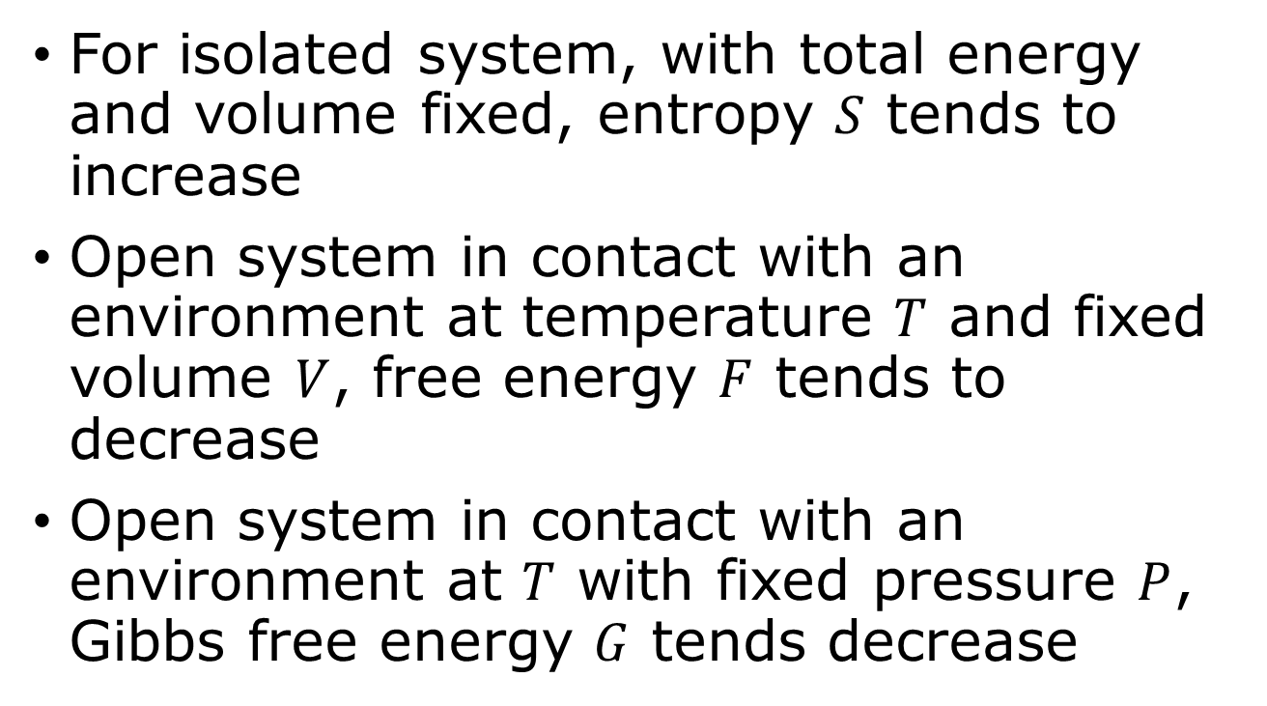
Towards equilibrium
For isolated system, with total energy and volume fixed, entropy $S$ tends to increase
Open system in contact with an environment at temperature $T$ and fixed volume $V$, free energy $F$ tends to decrease
Open system in contact with an environment at $T$ with fixed pressure $P$, Gibbs free energy $G$ tends decrease
$$F≡U−TS, G≡U+PV−TS$$

Slide 19
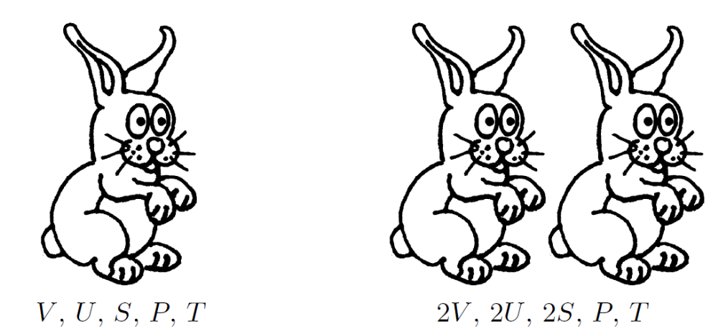
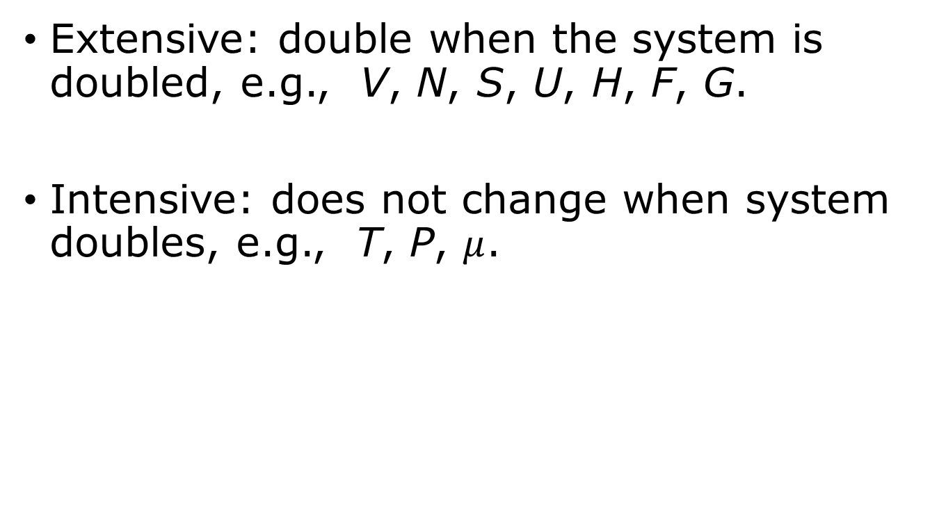
Extensive and intensive quantities
Extensive: double when the system is doubled, e.g., V, N, S, U, H, F, G.
Intensive: does not change when system doubles, e.g., T, P, $μ$.
Two rabbits have twice as much volume, energy, and entropy as one rabbit, but not twice as much pressure or temperature. From page 163.

Slide 20
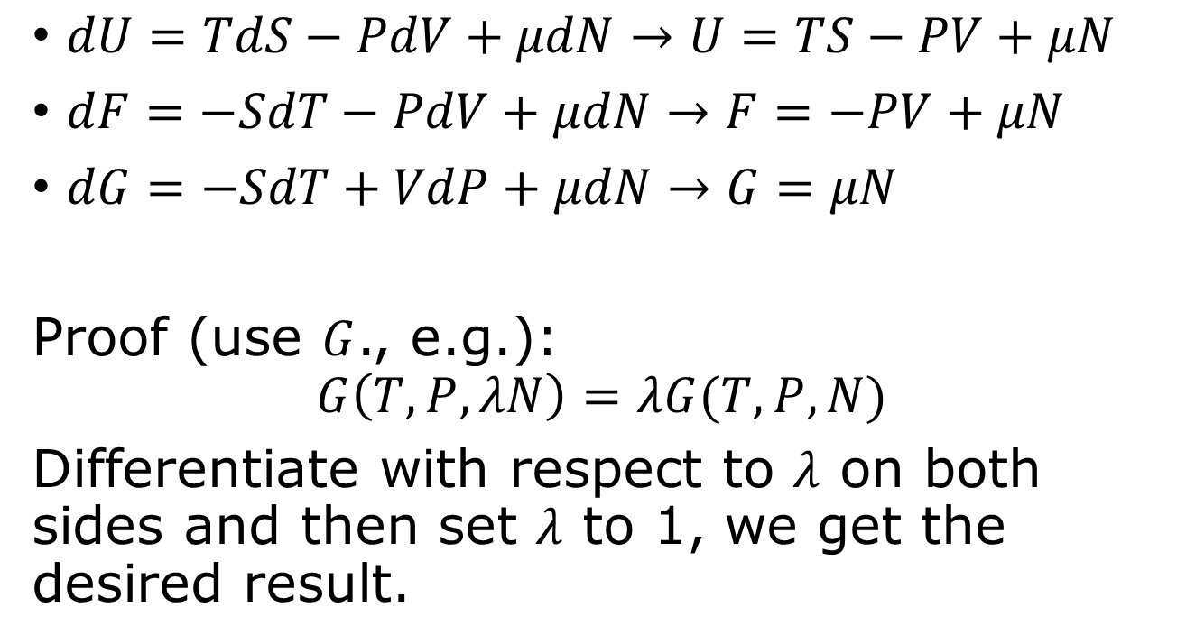
Euler equations
$dU=TdS−PdV+μdN→U=TS−PV+μN$
$dF=−SdT−PdV+μdN→F=−PV+μN$
$dG=−SdT+VdP+μdN→G=μN$
Proof (use $G$., e.g.):
$$G\left(T,P,λN\right)=λG(T,P,N)$$
Differentiate with respect to $λ$ on both sides and then set $λ$ to 1, we get the desired result.

Slide 21

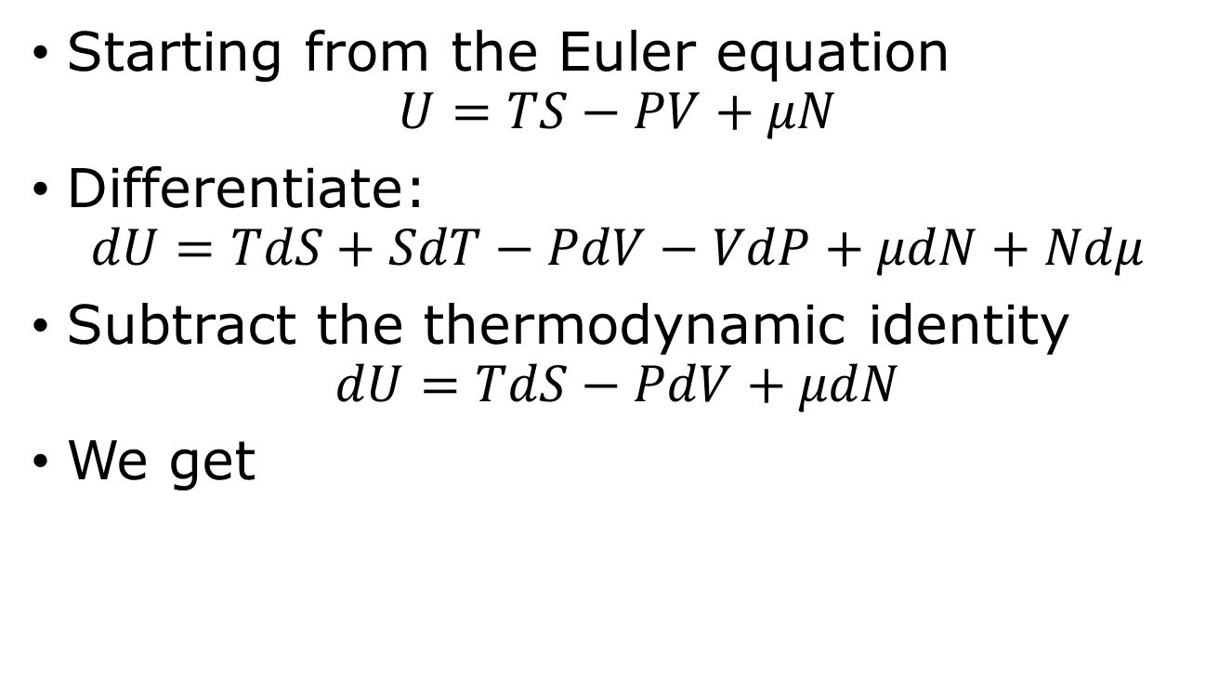
Gibbs-Duhem relation
Starting from the Euler equation
$$U=TS−PV+μN$$
Differentiate:
$$dU=TdS+SdT−PdV−VdP+μdN+Ndμ$$
Subtract the thermodynamic identity
$$dU=TdS−PdV+μdN$$
We get
$$SdT−VdP+Ndμ=0$$

Slide 22
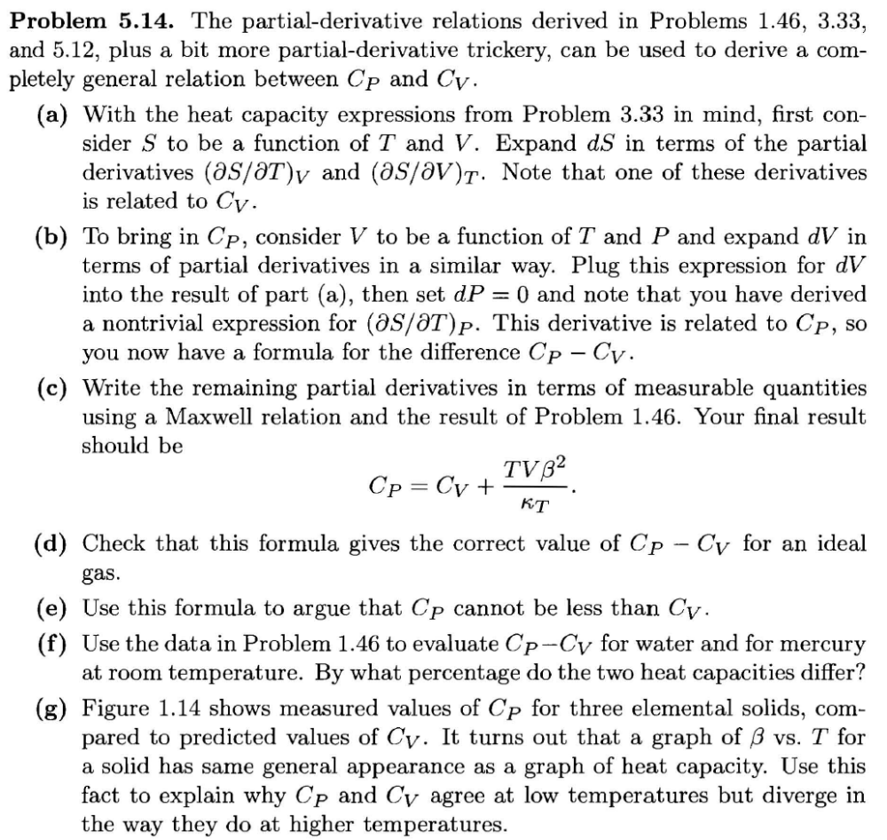
Tutorial problem 1.46, 3.33, 5.12, 5.14

