Slide 1
Week 8
Phase transformations

Slide 2
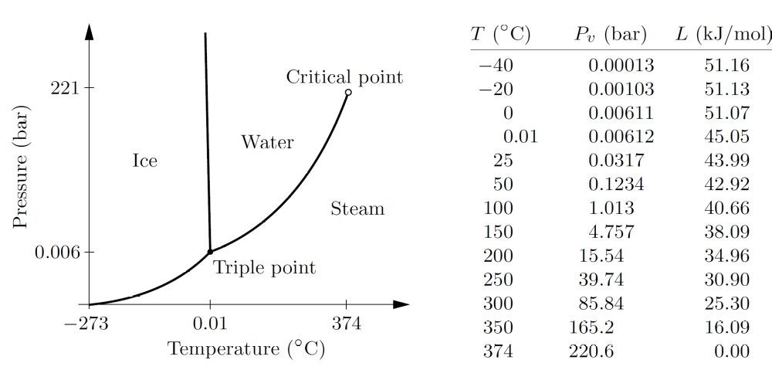
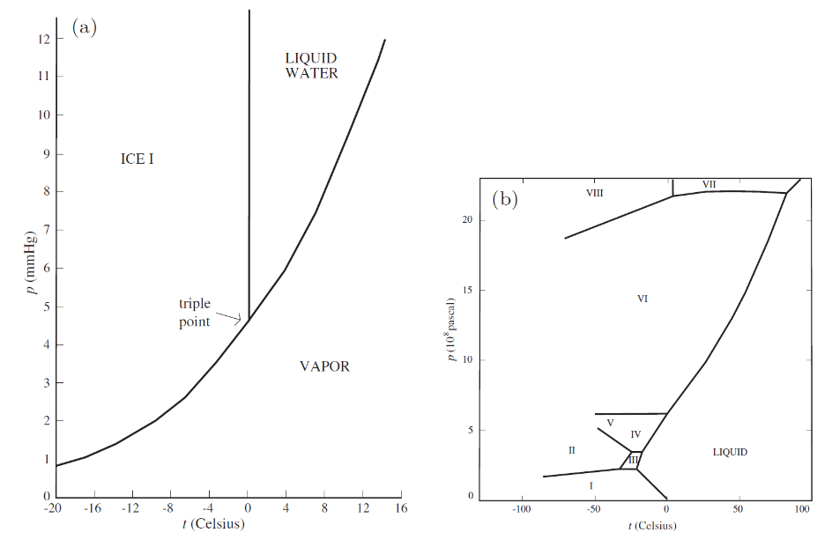
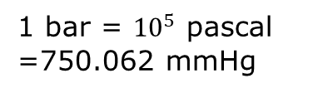
Phase diagrams for pure water (H₂O)
1 bar = ${10}^{5}$ pascal
=750.062 mmHg
ice I: hexagonal
Ice II: rhombohedral
Ice III: tetragonal
Ice IV: rhombohedral
Ice V: monoclinic
Ice VII: cubic
…

Slide 3
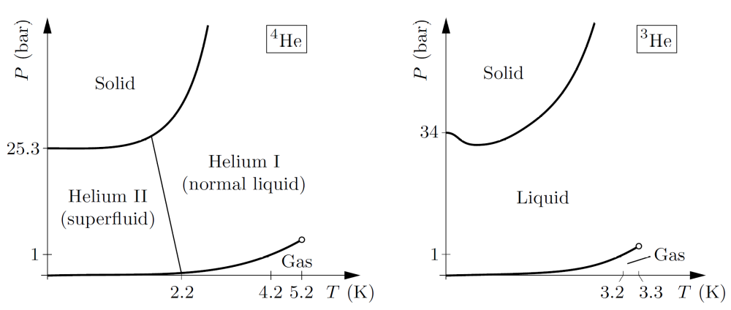
Phase diagrams of He
Figure 5.13. Neither diagram is to scale, but qualitative relations between the diagrams are shown correctly.

Slide 4
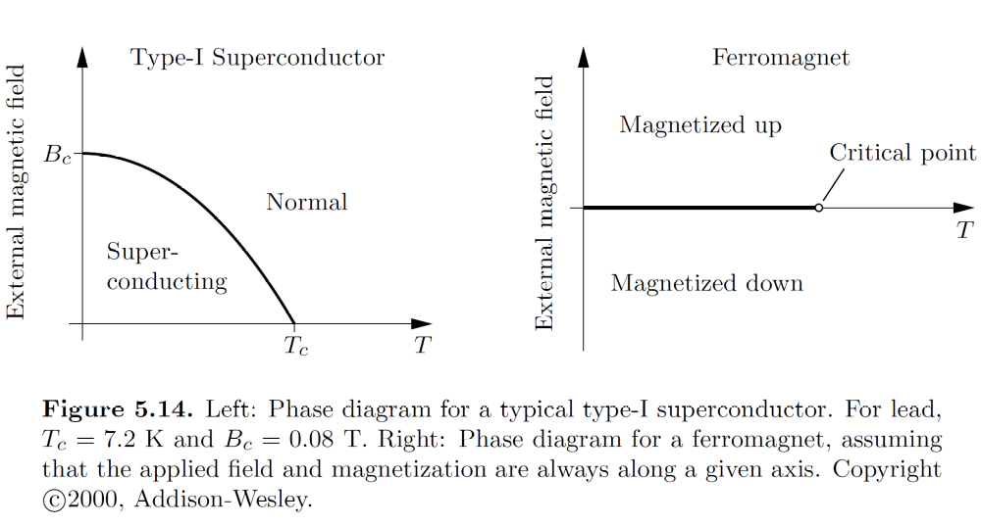
Superconductor & Ferromagnet

Slide 5
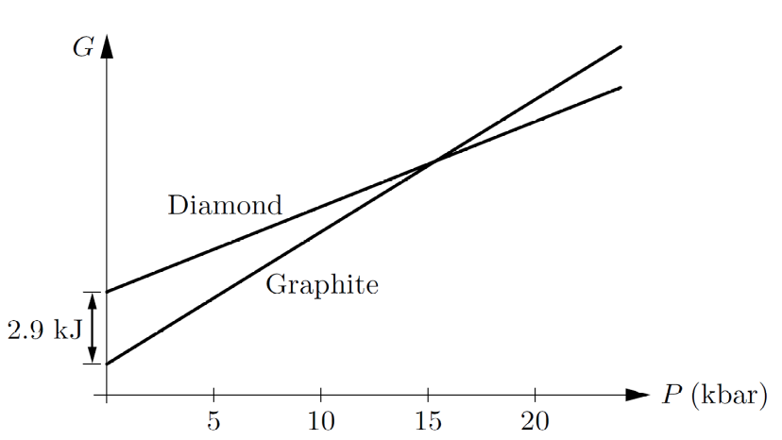
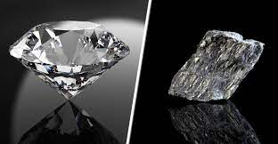
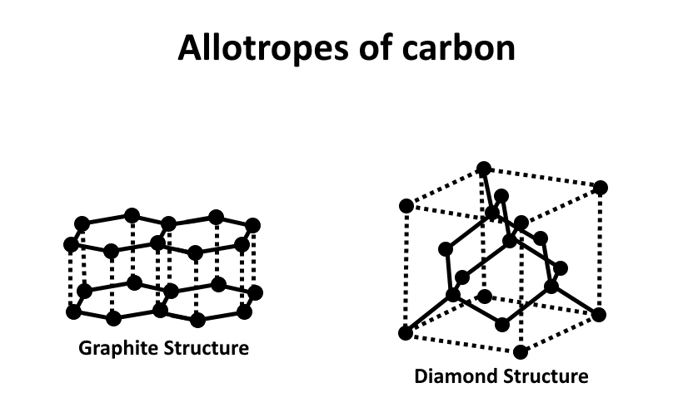
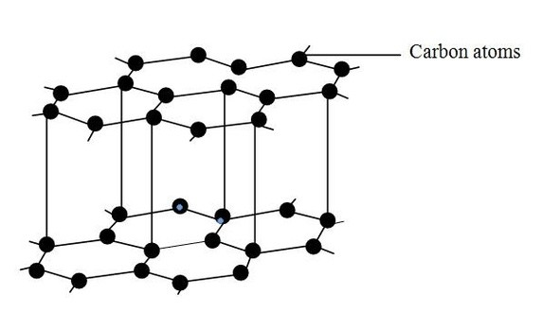
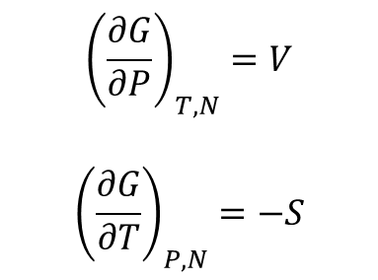
Diamond and graphite
$${\left(\frac{∂G}{∂P}\right)}_{T,N}=V$$
$${\left(\frac{∂G}{∂T}\right)}_{P,N}=−S$$
graphite, AB stacking
two-fcc lattice

Slide 6
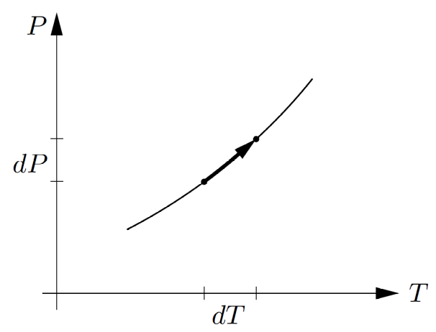
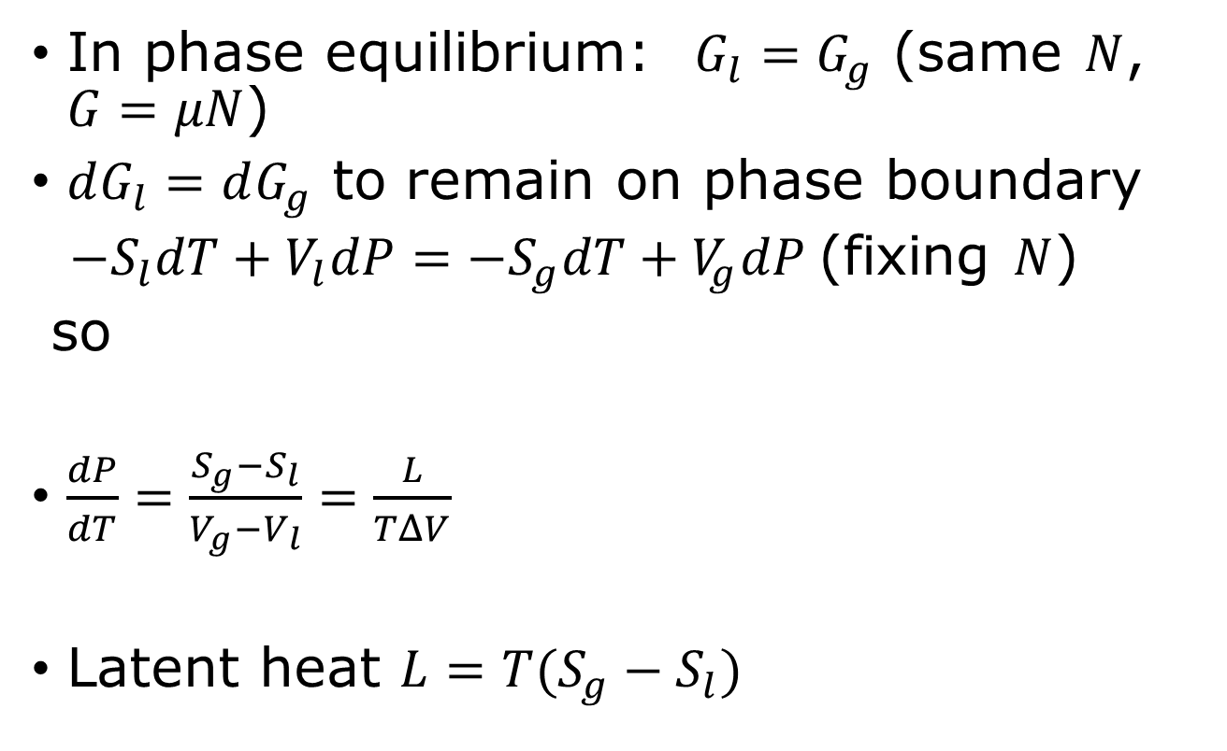
The Clausius-Clapeyron equation
In phase equilibrium: $G_{l}=G_{g}$ (same $N$, $G=μN$)
$dG_{l}=dG_{g}$ to remain on phase boundary
$−S_{l}dT+V_{l}dP=−S_{g}dT+V_{g}dP$(fixing $N$)
so
$\frac{dP}{dT}=\frac{S_{g}−S_{l}}{V_{g}−V_{l}}=\frac{L}{TΔV}$
Latent heat $L=T(S_{g}−S_{l})$
liquid
gas

Slide 7
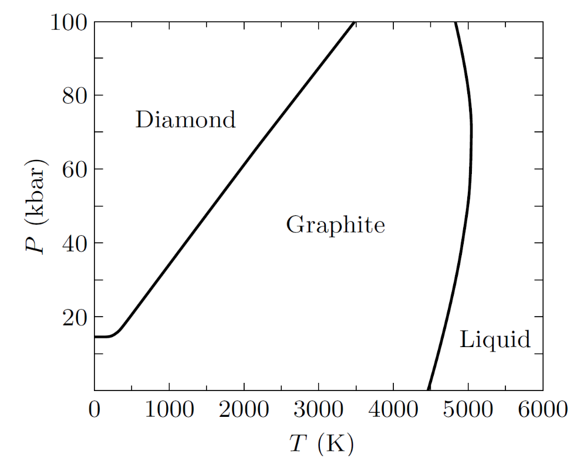
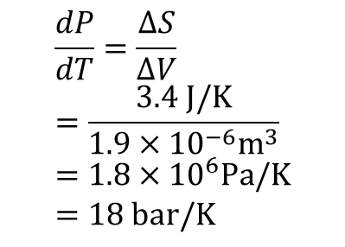
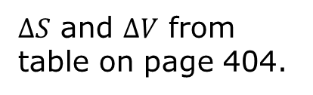
Diamond-graphite phase boundary
Experimental phase diagram of carbon
$$\frac{dP}{dT}=\frac{ΔS}{ΔV}=\frac{3.4 J/K}{1.9×{10}^{−6}m^{3}}=1.8×{10}^{6}Pa/K=18 bar/K$$
$ΔS$ and $ΔV$ from table on page 404.

Slide 8
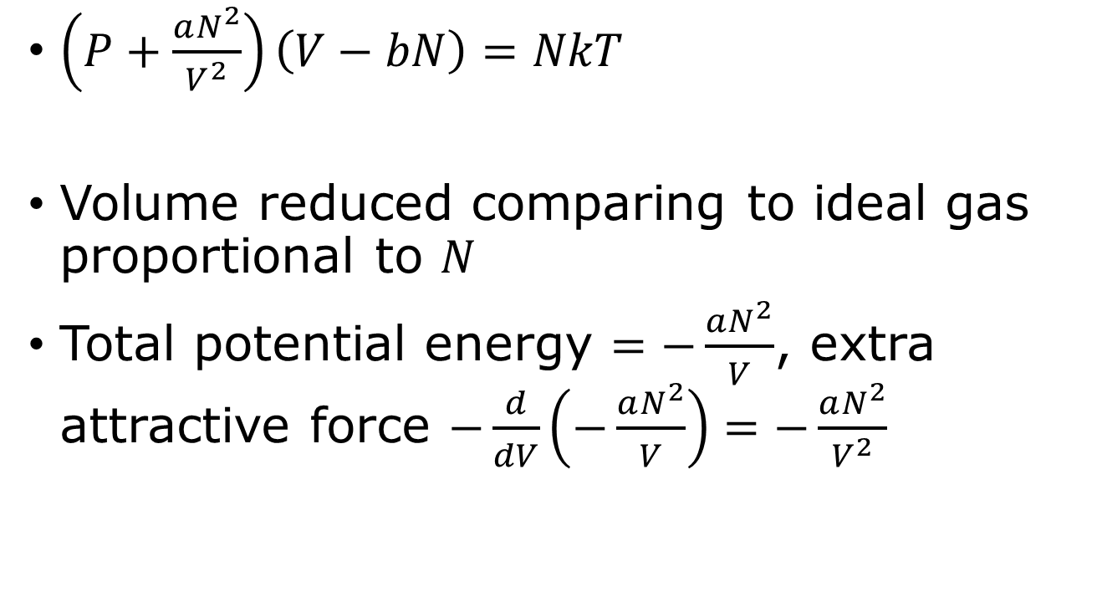
van der Waals equation
$\left(P+\frac{aN^{2}}{V^{2}}\right)\left(V−bN\right)=NkT$
Volume reduced comparing to ideal gas proportional to $N$
Total potential energy $=−\frac{aN^{2}}{V}$, extra attractive force $−\frac{d}{dV}\left(−\frac{aN^{2}}{V}\right)=−\frac{aN^{2}}{V^{2}}$

Slide 9
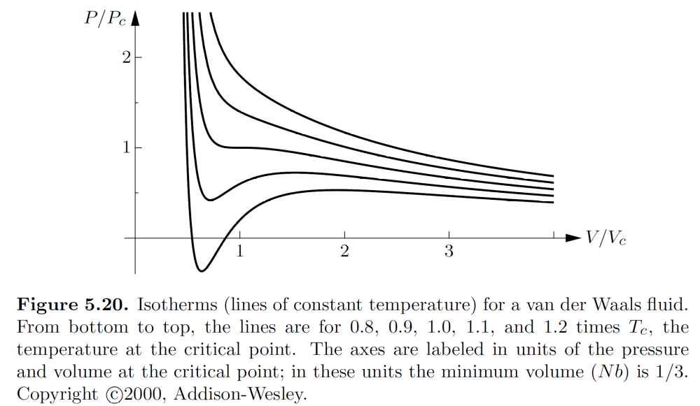

van der Waals equation of states
$$P=\frac{NkT}{V−bN}−\frac{aN^{2}}{V^{2}}$$

Slide 10
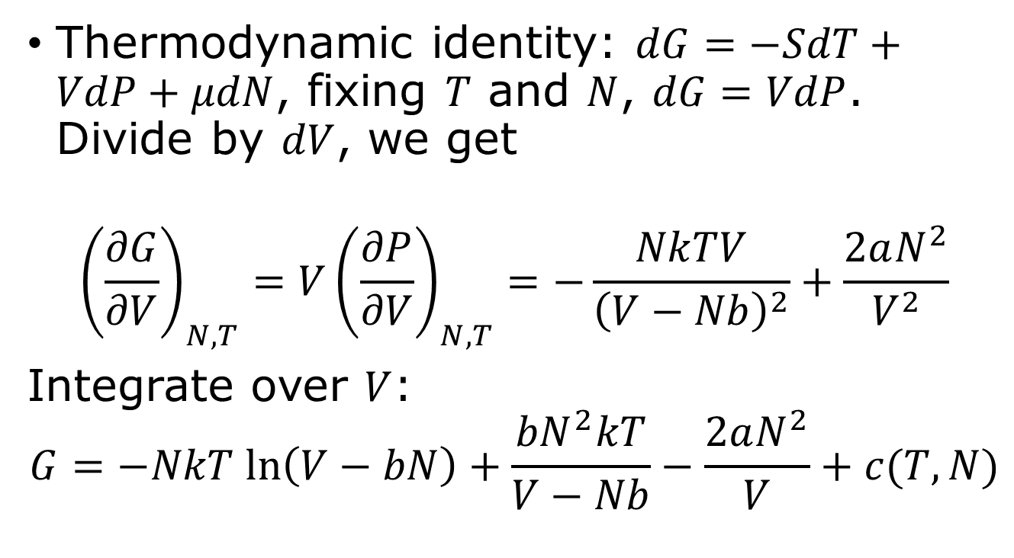
Gibbs free energy of van der Waals gas
Thermodynamic identity: $dG=−SdT+VdP+μdN$, fixing $T$ and $N$, $dG=VdP$. Divide by $dV$, we get
$${\left(\frac{∂G}{∂V}\right)}_{N,T}=V{\left(\frac{∂P}{∂V}\right)}_{N,T}=−\frac{NkTV}{{\left(V−Nb\right)}^{2}}+\frac{2aN^{2}}{V^{2}}$$
Integrate over $V$:
$$G=−NkT ln\left(V−bN\right)+\frac{{bN}^{2}kT}{V−Nb}−\frac{2aN^{2}}{V}+c(T,N)$$

Slide 11
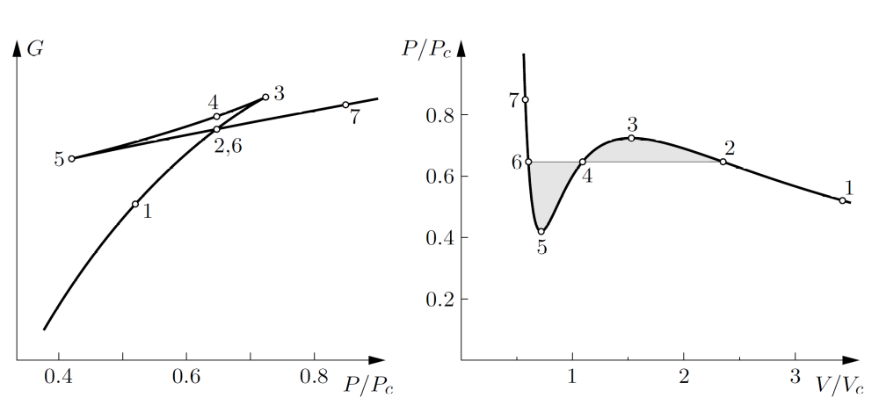
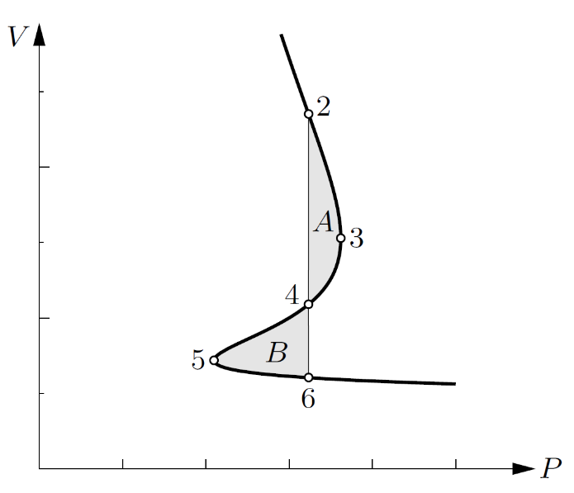



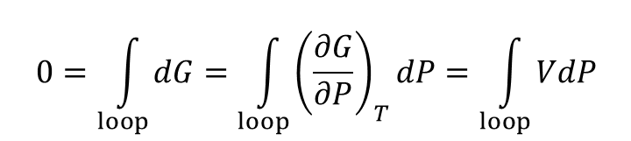

Maxwell’s construction
Flip $P↔V$
$G\left(V\right)$ vs $P(V$) fixing $T$
$$T=0.9 T_{c}$$
$$0=\int_{loop}{dG=\int_{loop}{{\left(\frac{∂G}{∂P}\right)}_{T}dP=\int_{loop}{VdP}}}$$
loop = $(2→3→4→5→6)$
Area A (2,3,4) = Area B (4,5,6)

Slide 12
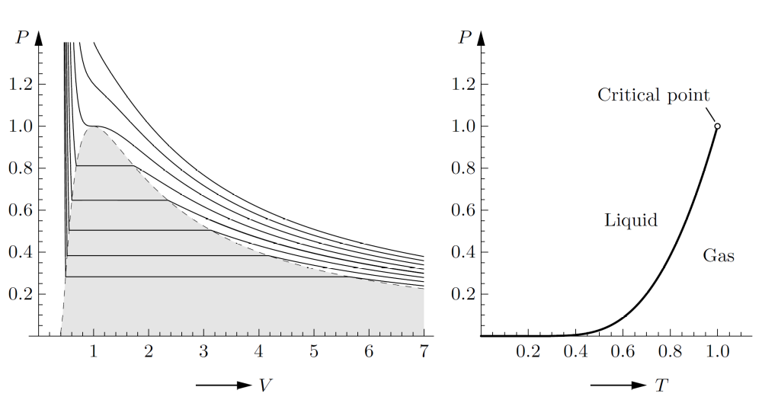

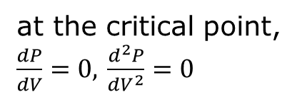
The critical point
$$V_{c}=3Nb, { P}_{c}=\frac{a}{27b^{2}}, kT_{c}=\frac{8a}{27b}$$
at the critical point, $\frac{dP}{dV}=0,$ $\frac{d^{2}P}{dV^{2}}=0$

Slide 13
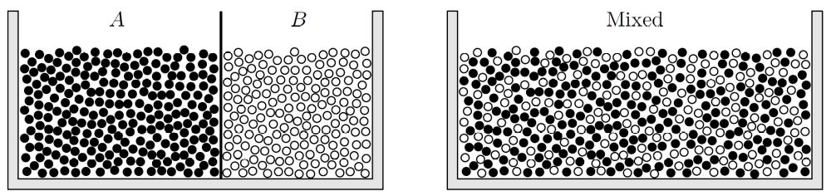
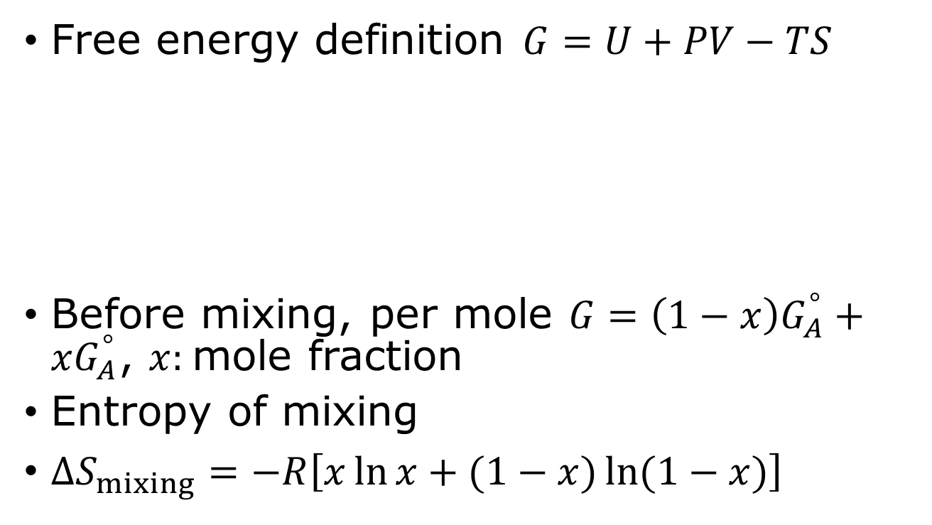

Phase transformation of mixtures
Free energy definition $G=U+PV−TS$
Before mixing, per mole $G=\left(1−x\right)G_{A}^{°}+xG_{A}^{°}$, $x:$mole fraction
Entropy of mixing
$ΔS_{mixing}=−R\left[x\ln{x+(1−x)}\ln{(1−x)}\right]$
$$R=N_{A}k$$

Slide 14
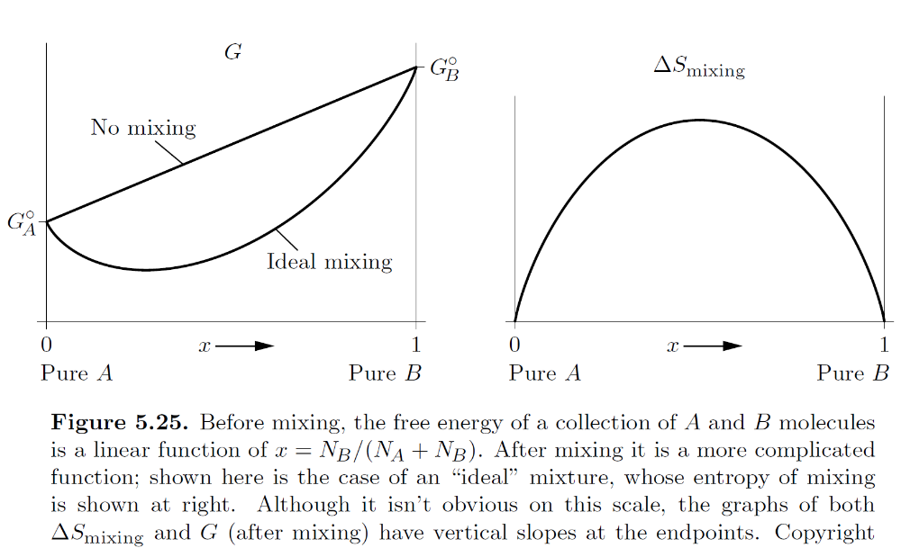
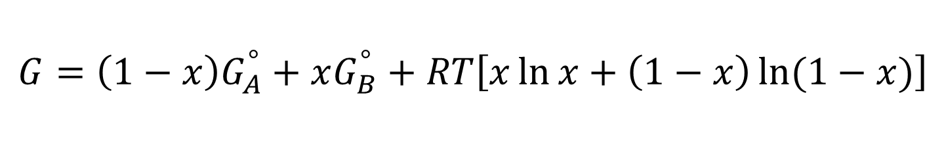
$$G=\left(1−x\right)G_{A}^{°}+xG_{B}^{°}+RT\left[x\ln{x+\left(1−x\right)\ln{(1−x)}}\right]$$
(ideal mixture)

Slide 15
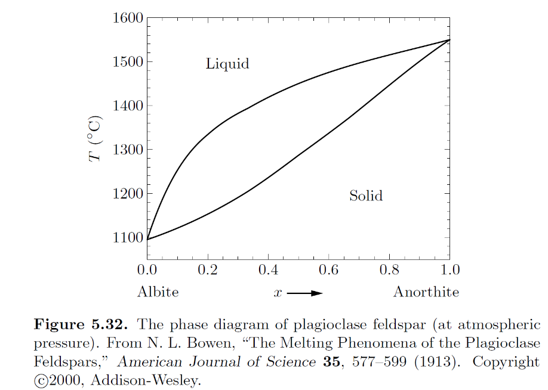
Phase changes of miscible mixture

Slide 16
Eutectic system
tin
lead

Slide 17
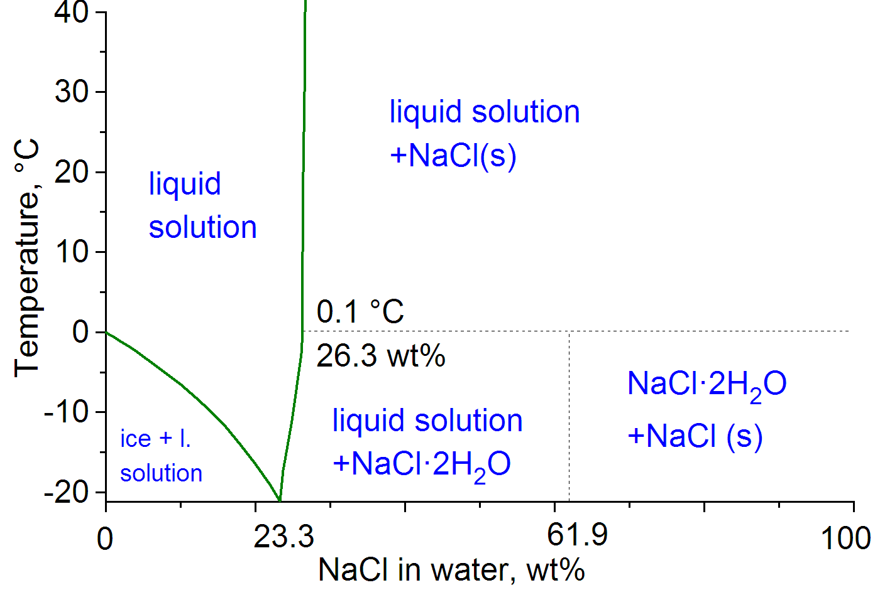
H₂O-NaCl phase diagram
https://en.wikipedia.org/wiki/Saline_water

Slide 18
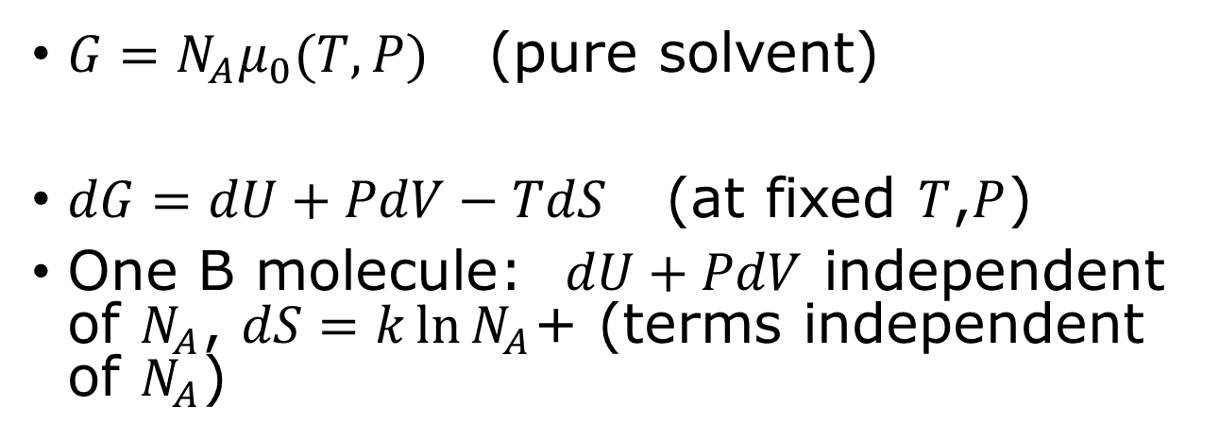

Dilute solution
B: solute
$N_{A}$: solvent, $N_{B}$: solute (small)
$G=N_{A}μ_{0}(T,P)$ (pure solvent)
$dG=dU+PdV−TdS$ (at fixed $T$,$P$)
One B molecule: $dU+PdV$ independent of $N_{A}$, $dS=k\ln{N_{A}}$+ (terms independent of $N_{A}$)

Slide 19
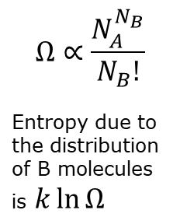
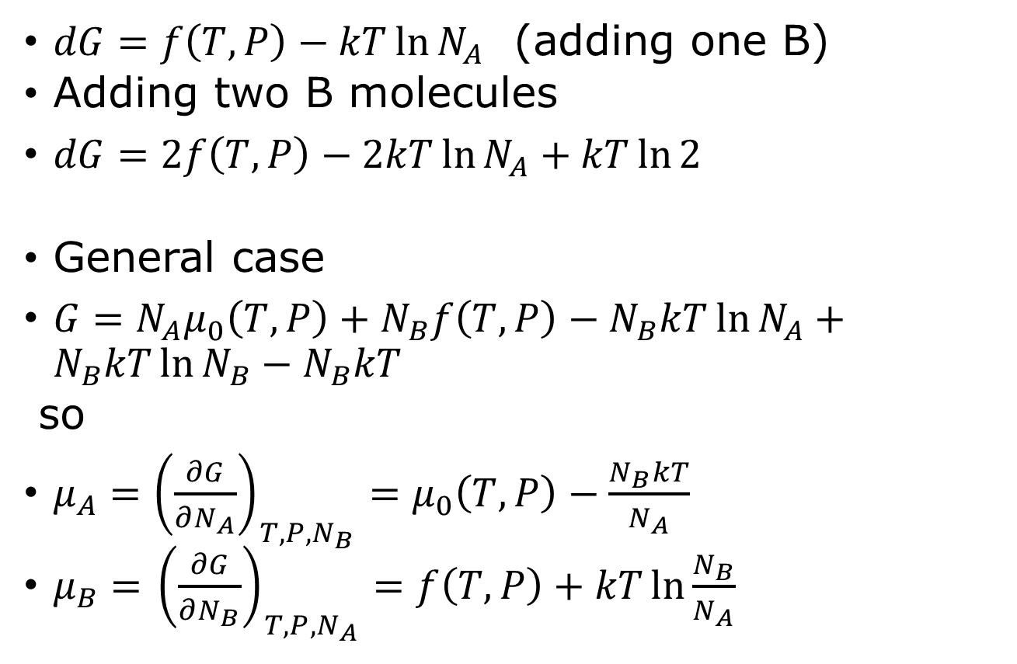
Gibbs free energy of dilute solution
$dG=f\left(T,P\right)−kT\ln{N_{A}}$ (adding one B)
Adding two B molecules
$dG=2f\left(T,P\right)−2kT\ln{N_{A}}+kT\ln{2}$
General case
$G=N_{A}μ_{0}\left(T,P\right)+N_{B}f\left(T,P\right)−N_{B}kT\ln{N_{A}}+N_{B}kT\ln{N_{B}}−N_{B}kT$
so
$μ_{A}={\left(\frac{∂G}{∂N_{A}}\right)}_{T,P,N_{B}}=μ_{0}\left(T,P\right)−\frac{N_{B}kT}{N_{A}}$
$μ_{B}=$ ${\left(\frac{∂G}{∂N_{B}}\right)}_{T,P,N_{A}}=f\left(T,P\right)+kT\ln{\frac{N_{B}}{N_{A}}}$
$$Ω∝\frac{N_{A}^{N_{B}}}{N_{B}!}$$
Entropy due to the distribution of B molecules is $k\ln{Ω}$

Slide 20
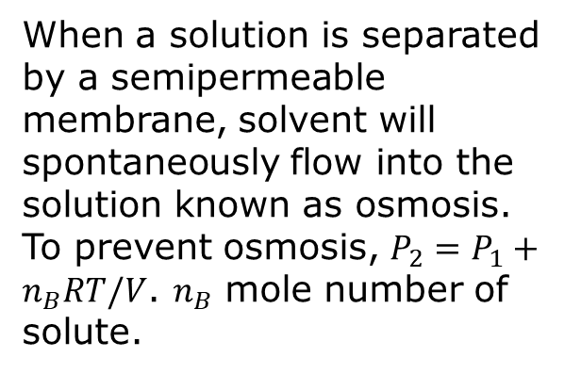
Osmotic pressure
When a solution is separated by a semipermeable membrane, solvent will spontaneously flow into the solution known as osmosis. To prevent osmosis, $P_{2}=P_{1}+n_{B}RT/V$. $n_{B}$ mole number of solute.

Slide 21
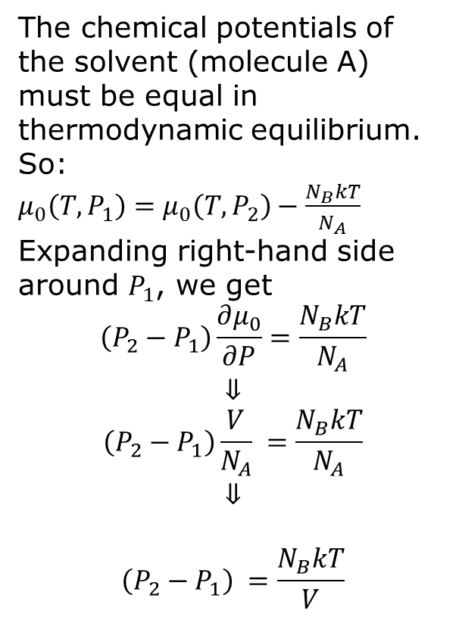
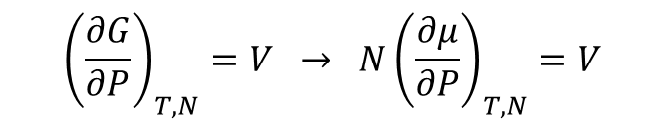

Osmotic pressure
The chemical potentials of the solvent (molecule A) must be equal in thermodynamic equilibrium. So:
$μ_{0}\left(T,P_{1}\right)=μ_{0}\left(T,P_{2}\right)−\frac{N_{B}kT}{N_{A}}$
Expanding right-hand side around $P_{1}$, we get
$$\left(P_{2}−P_{1}\right)\frac{∂μ_{0}}{∂P}=\frac{N_{B}kT}{N_{A}}$$
$$⇓$$
$$\left(P_{2}−P_{1}\right)\frac{V}{N_{A}} =\frac{N_{B}kT}{N_{A}}$$
$$⇓$$
$$\left(P_{2}−P_{1}\right) =\frac{N_{B}kT}{V}$$
$P_{1}$ $P_{2}$
$${\left(\frac{∂G}{∂P}\right)}_{T,N}=V → N{\left(\frac{∂μ}{∂P}\right)}_{T,N}=V$$

Slide 22
Tutorial problems 5.48, 5.49

Slide 23
Problem 5.77

