Slide 1
Week 9
Boltzmann Statistics

Slide 2


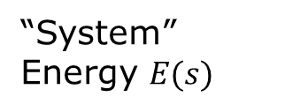

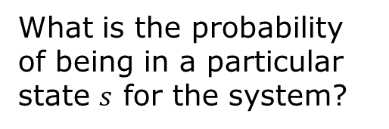

Boltzmann factor e^{-βE}
i.e., canonical ensemble
Energy level of a hydrogen atom
“System”
Energy $E(s)$
“Reservoir”
Energy U_{R}
Temperature T
3s 3p and 3d
-1.5 eV
2s 2p_{x} 2p_{y} 2p_{z}
-3.4 eV
Exchange energy, fix $T$, $V$, and particle number
$$s_{2}$$
$U_{R}+E(s)=$const
$$s_{1}$$
What is the probability of being in a particular state $s$ for the system?
1s
-13.6 eV

Slide 3
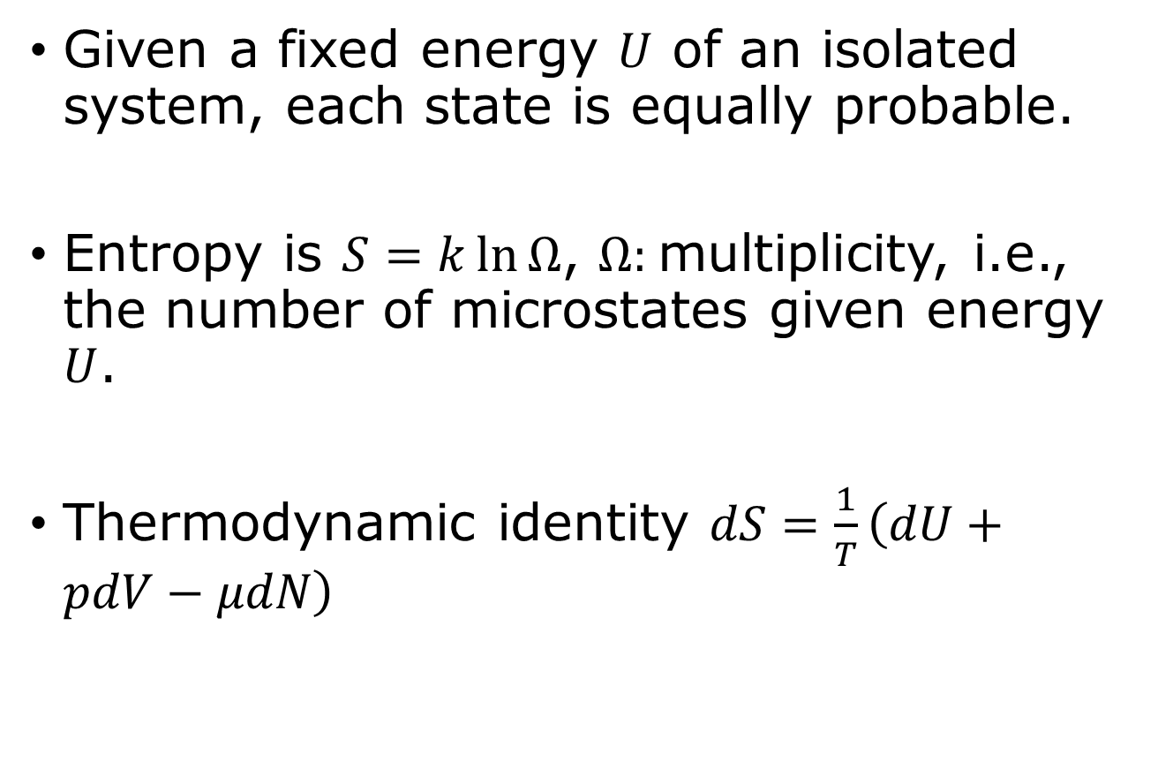
Micro-canonical ensemble
Given a fixed energy $U$ of an isolated system, each state is equally probable.
Entropy is $S=k\ln{Ω}$, $Ω:$multiplicity, i.e., the number of microstates given energy $U$.
Thermodynamic identity $dS=\frac{1}{T}\left(dU+pdV−μdN\right)$

Slide 4
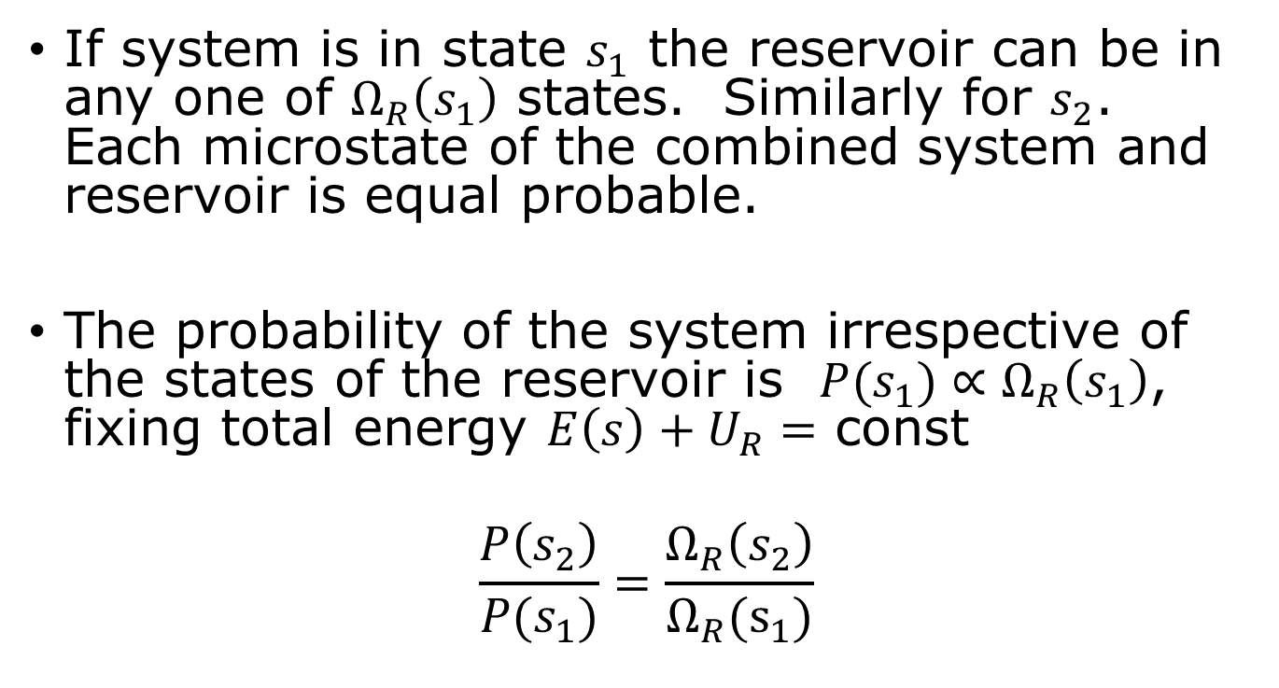
Probability of system state attached to a reservoir
If system is in state $s_{1}$ the reservoir can be in any one of $Ω_{R}\left(s_{1}\right)$ states. Similarly for $s_{2}$. Each microstate of the combined system and reservoir is equal probable.
The probability of the system irrespective of the states of the reservoir is $P(s_{1})∝Ω_{R}\left(s_{1}\right)$, fixing total energy $E\left(s\right)+U_{R}=$ const
$$\frac{P\left(s_{2}\right)}{P(s_{1})}=\frac{Ω_{R}\left(s_{2}\right)}{Ω_{R}(s_{1})}$$

Slide 5
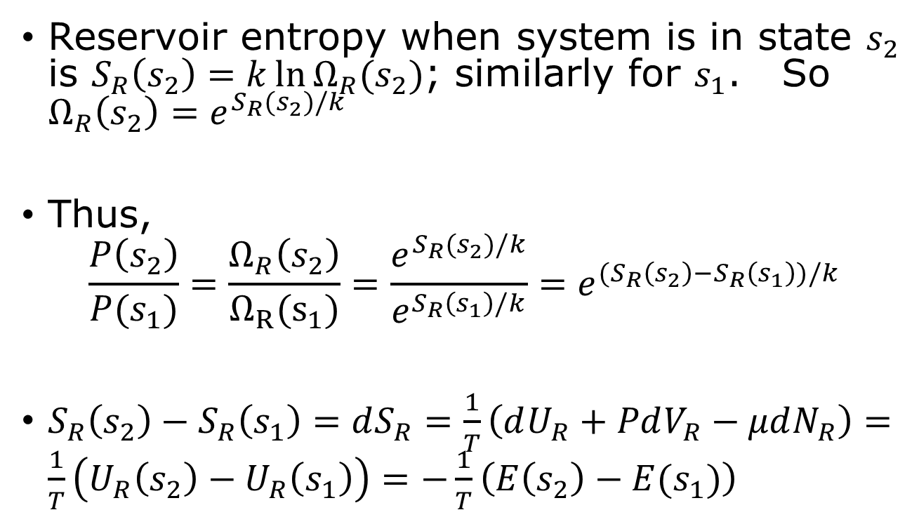
Deriving the Boltzmann factor
Reservoir entropy when system is in state $s_{2}$ is $S_{R}\left(s_{2}\right)=k\ln{Ω_{R}(s_{2})}$; similarly for $s_{1}$. So $Ω_{R}\left(s_{2}\right)=e^{S_{R}(s_{2})/k}$
Thus,
$$\frac{P\left(s_{2}\right)}{P(s_{1})}=\frac{Ω_{R}\left(s_{2}\right)}{Ω_{R}(s_{1})}=\frac{e^{S_{R}(s_{2})/k}}{e^{S_{R}\left(s_{1}\right)/k}}=e^{(S_{R}\left(s_{2}\right)−S_{R}\left(s_{1}\right))/k}$$
$S_{R}\left(s_{2}\right)−S_{R}\left(s_{1}\right)=dS_{R}=\frac{1}{T}\left(dU_{R}+PdV_{R}−μdN_{R}\right)=\frac{1}{T}\left(U_{R}\left(s_{2}\right)−U_{R}\left(s_{1}\right)\right)=−\frac{1}{T}\left(E\left(s_{2}\right)−E(s_{1})\right)$
0
0

Slide 6
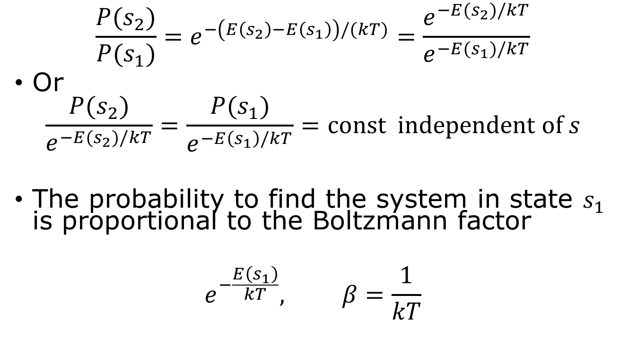
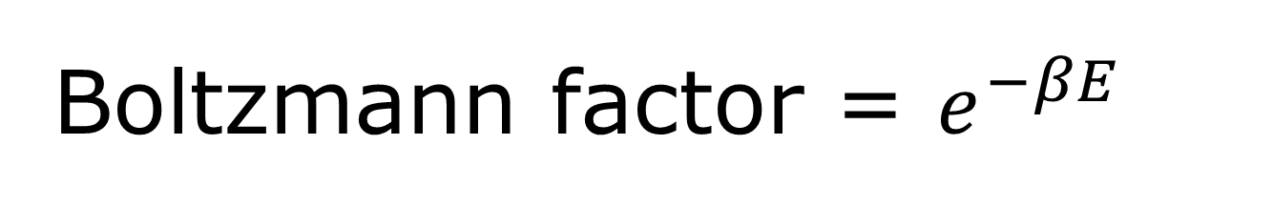
Boltzmann factor = $e^{−βE}$
$$\frac{P(s_{2})}{P(s_{1})}=e^{−\left(E\left(s_{2}\right)−E\left(s_{1}\right)\right)/(kT)}=\frac{e^{−E(s_{2})/kT}}{e^{−E(s_{1})/kT}}$$
Or
$$\frac{P(s_{2})}{e^{−E(s_{2})/kT}}=\frac{P(s_{1})}{e^{−E\left(s_{1}\right)/kT}}=const independent of s$$
The probability to find the system in state $s_{1}$ is proportional to the Boltzmann factor
$$e^{−\frac{E\left(s_{1}\right)}{kT}}, β=\frac{1}{kT}$$

Slide 7
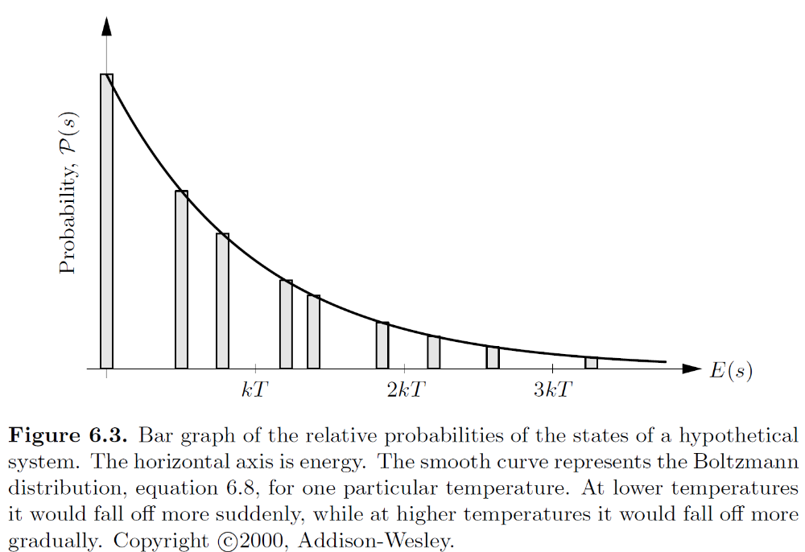
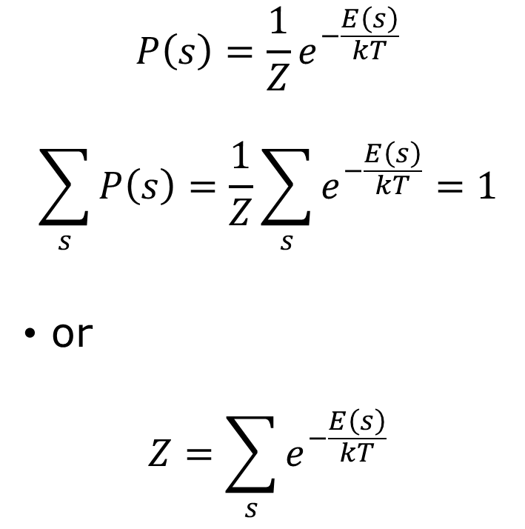
Fixing constant by normalization, partition function Z
$$P\left(s\right)=\frac{1}{Z}e^{−\frac{E\left(s\right)}{kT}}$$
$$\sum_{s}{P\left(s\right)=\frac{1}{Z}\sum_{s}{e^{−\frac{E\left(s\right)}{kT}}=1}}$$
or
$$Z=\sum_{s}{e^{−\frac{E\left(s\right)}{kT}}}$$

Slide 8
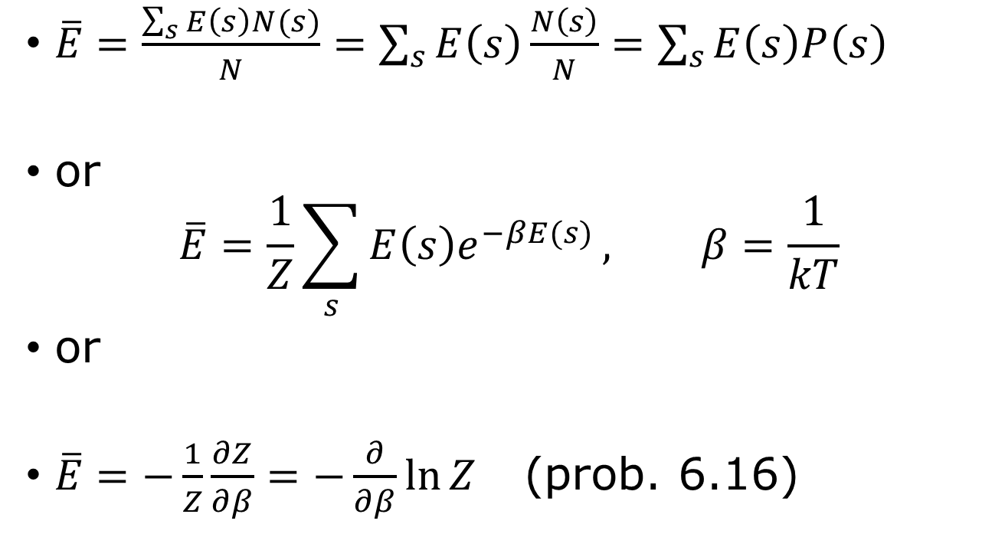
Average values
$\overline{E}=\frac{\sum_{s}{E\left(s\right)N(s)}}{N}=\sum_{s}{E\left(s\right)\frac{N\left(s\right)}{N}}=\sum_{s}{E\left(s\right)P\left(s\right)}$
or
$$\overline{E}=\frac{1}{Z}\sum_{s}{E\left(s\right)e^{−βE(s)}}, β=\frac{1}{kT}$$
or
$\overline{E}=−\frac{1}{Z}\frac{∂Z}{∂β}=−\frac{∂}{∂β}\ln{Z}$ (prob. 6.16)

Slide 9
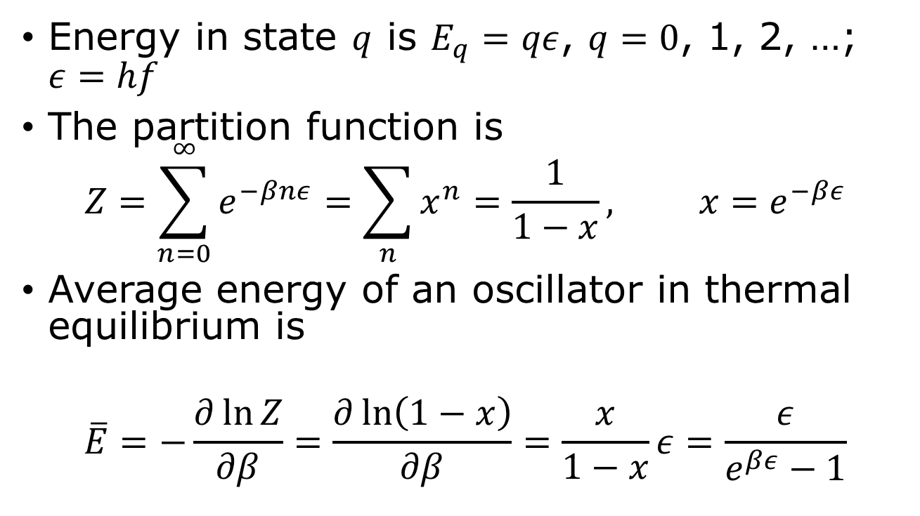
Harmonic oscillator
Energy in state $q$ is $E_{q}=qε$, $q=0$, 1, 2, …; $ε=hf$
The partition function is
$$Z=\sum_{n=0}^{∞}{e^{−βnε}=\sum_{n}{x^{n}=\frac{1}{1−x}}, x=e^{−βε}}$$
Average energy of an oscillator in thermal equilibrium is
$$\overline{E}=−\frac{∂\ln{Z}}{∂β}=\frac{∂\ln\left(1−x\right)}{∂β}=\frac{x}{1−x}ε=\frac{ε}{e^{βε}−1}$$

Slide 10
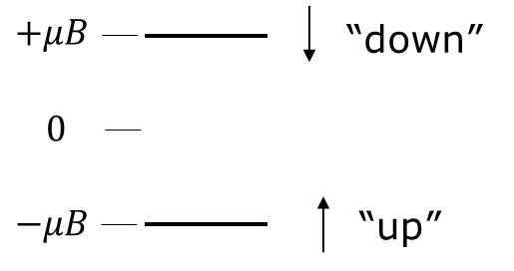
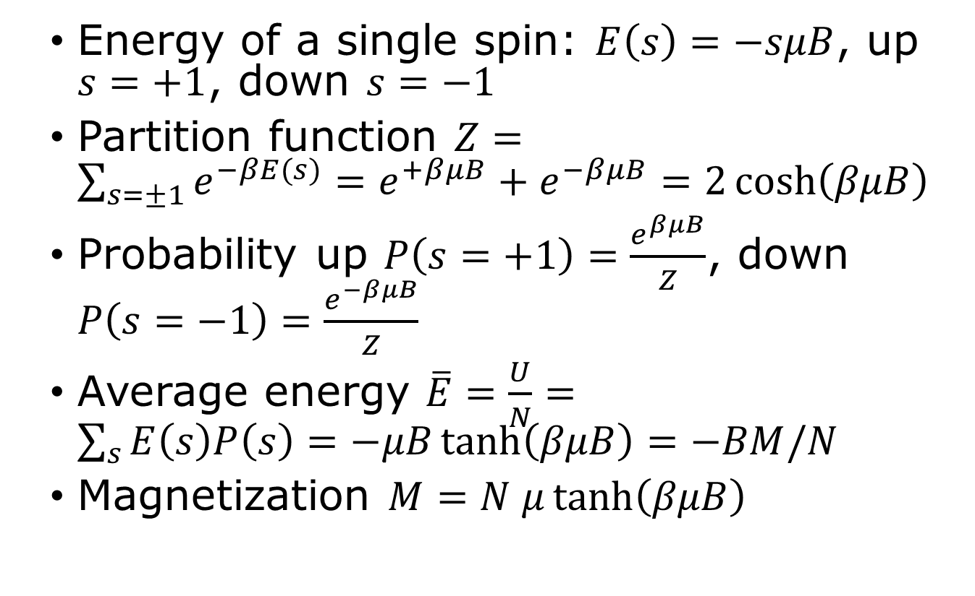
Paramagnet, canonical ensemble
Energy of a single spin: $E\left(s\right)=−sμB$, up $s=+1$, down $s=−1$
Partition function $Z=\sum_{s=±1}{e^{−βE(s)}=e^{+βμB}+e^{−βμB}=2\cosh\left(βμB\right)}$
Probability up $P\left(s=+1\right)=\frac{e^{βμB}}{Z}$, down $P\left(s=−1\right)=\frac{e^{−βμB}}{Z}$
Average energy $\overline{E}=\frac{U}{N}=\sum_{s}{E\left(s\right)P\left(s\right)=−μB\tanh\left(βμB\right)=−BM/N}$
Magnetization $M=N μ\tanh\left(βμB\right)$

Slide 11
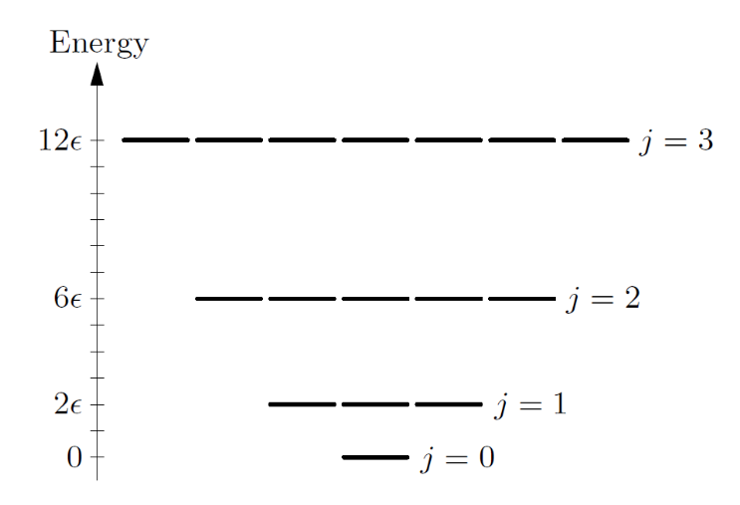
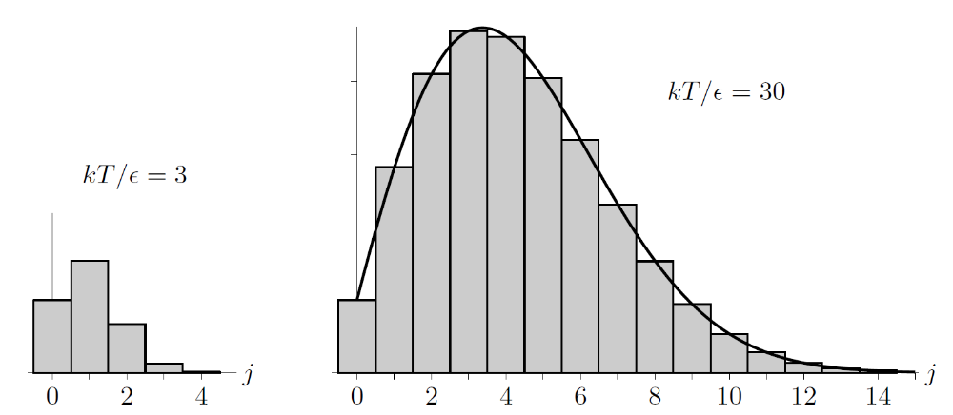
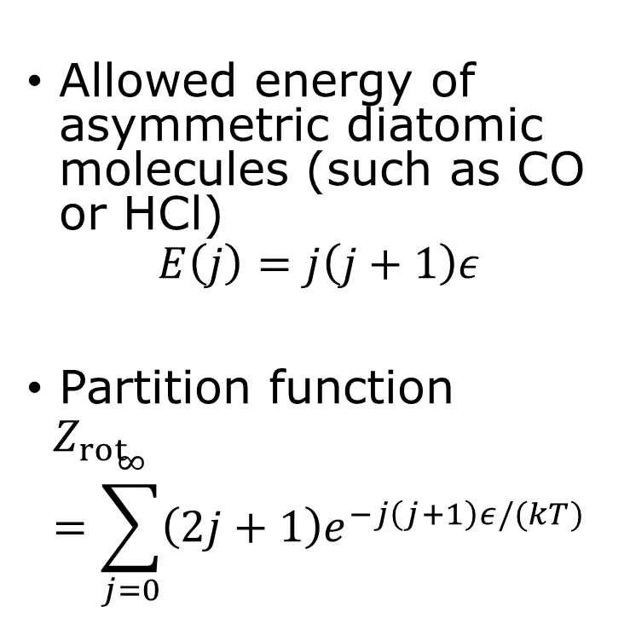
Rotation of diatomic molecule
Allowed energy of asymmetric diatomic molecules (such as CO or HCl)
$$E\left(j\right)=j\left(j+1\right)ε$$
Partition function
$$Z_{rot}=\sum_{j=0}^{∞}{\left(2j+1\right)e^{−j\left(j+1\right)ε/(kT)}}$$

Slide 12
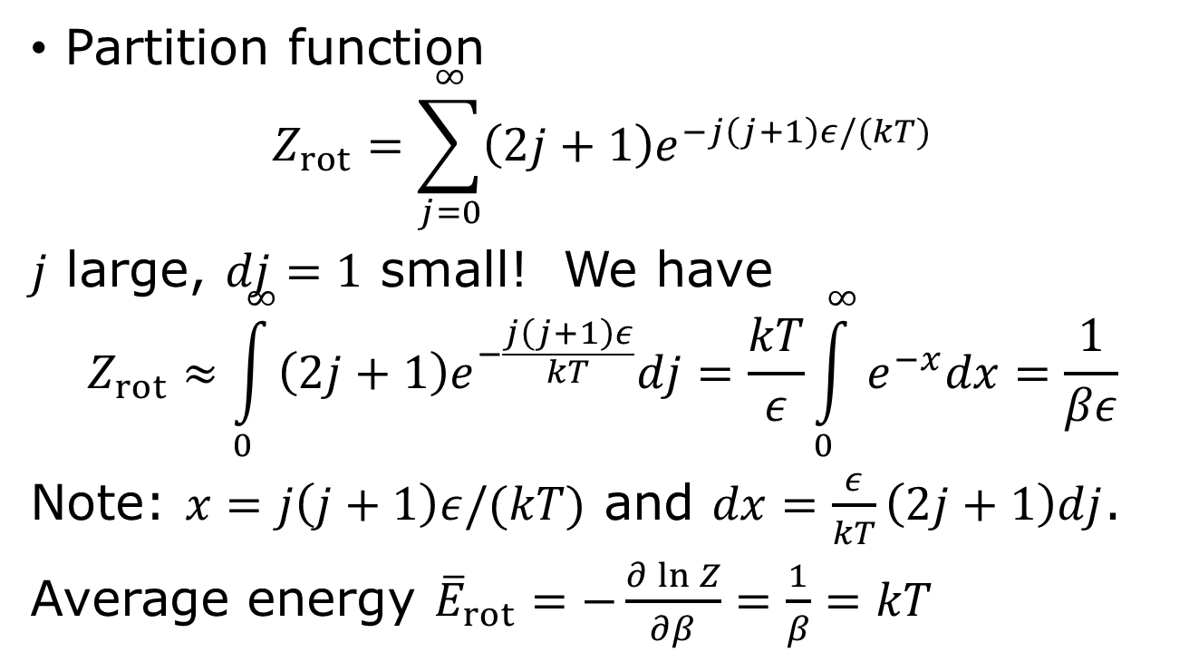
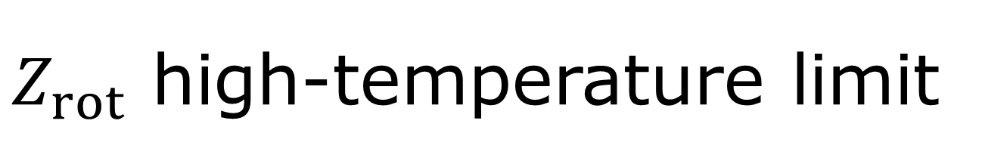
$Z_{rot}$ high-temperature limit
Partition function
$$Z_{rot}=\sum_{j=0}^{∞}{\left(2j+1\right)e^{−j\left(j+1\right)ε/(kT)}}$$
$j$ large, $dj=1$ small! We have
$$Z_{rot}≈\int_{0}^{∞}{\left(2j+1\right)e^{−\frac{j\left(j+1\right)ε}{kT}}dj=\frac{kT}{ε}\int_{0}^{∞}{e^{−x}dx}}=\frac{1}{βε}$$
Note: $x=j\left(j+1\right)ε/(kT)$ and $dx=\frac{ε}{kT}\left(2j+1\right)dj$.
Average energy ${\overline{E}}_{rot}=−\frac{∂\ln{Z}}{∂β}=\frac{1}{β}=kT$

Slide 13
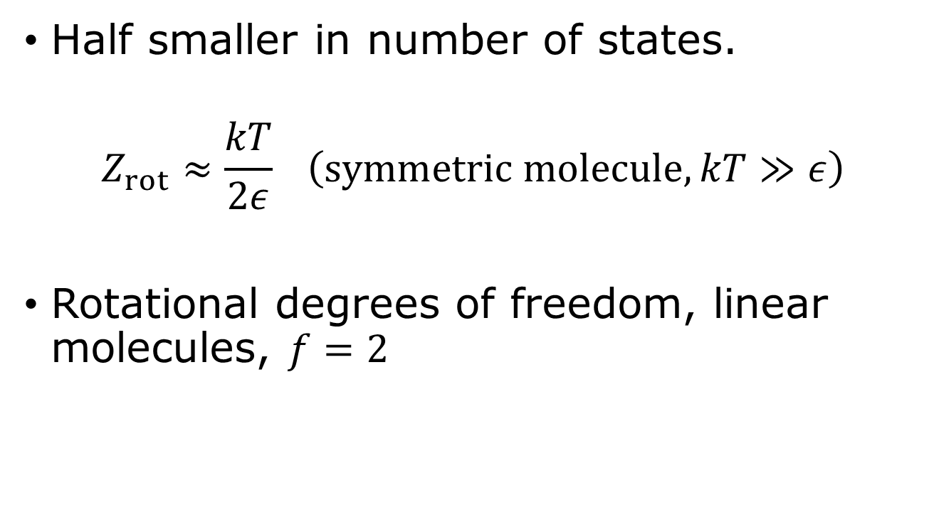
Identical atoms, such as N₂ or O₂?
Half smaller in number of states.
$$Z_{rot}≈\frac{kT}{2ε} \left(symmetric molecule, kT≫ε\right)$$
Rotational degrees of freedom, linear molecules, $f=2$

Slide 14
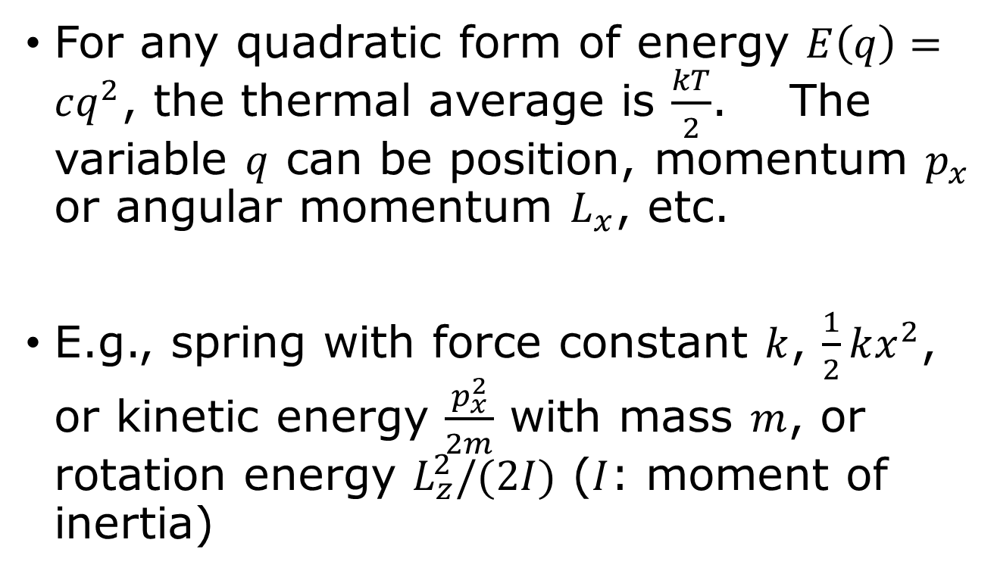
The equipartition theorem
For any quadratic form of energy $E\left(q\right)=cq^{2}$, the thermal average is $\frac{kT}{2}$. The variable $q$ can be position, momentum $p_{x}$ or angular momentum $L_{x}$, etc.
E.g., spring with force constant $k$, $\frac{1}{2}kx^{2}$, or kinetic energy $\frac{p_{x}^{2}}{2m}$ with mass $m$, or rotation energy $L_{z}^{2}/(2I)$ ($I$: moment of inertia)

Slide 15
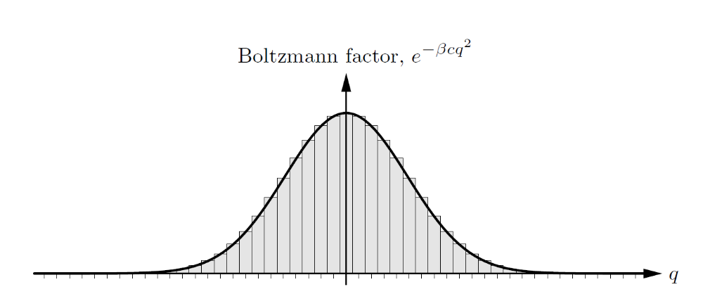




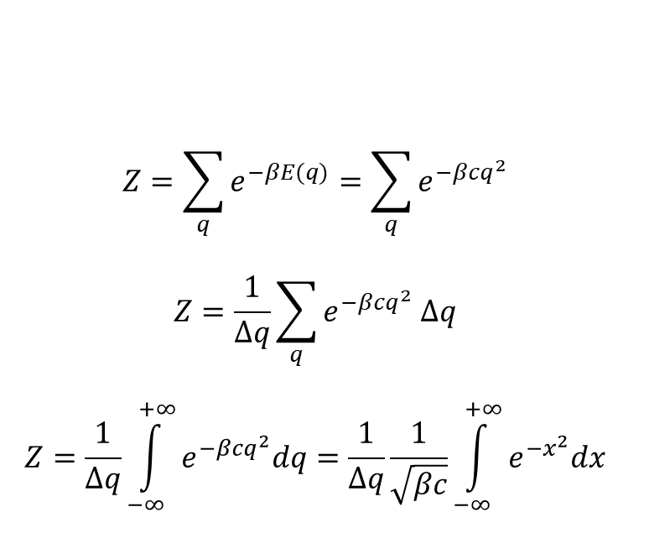
“Counting states” over a continuous variable $q$
$$q$$
$$Δq$$
$$Z=\sum_{q}{e^{−βE(q)}=\sum_{q}{e^{−βcq^{2}}}}$$
$$Z=\frac{1}{Δq}\sum_{q}{e^{−βcq^{2}} Δq}$$
$$Z=\frac{1}{Δq}\int_{−∞}^{+∞}{e^{−βcq^{2}}dq}=\frac{1}{Δq}\frac{1}{\sqrt{βc}}\int_{−∞}^{+∞}{e^{{−x}^{2}}dx}$$
$$Δq→0$$

Slide 16
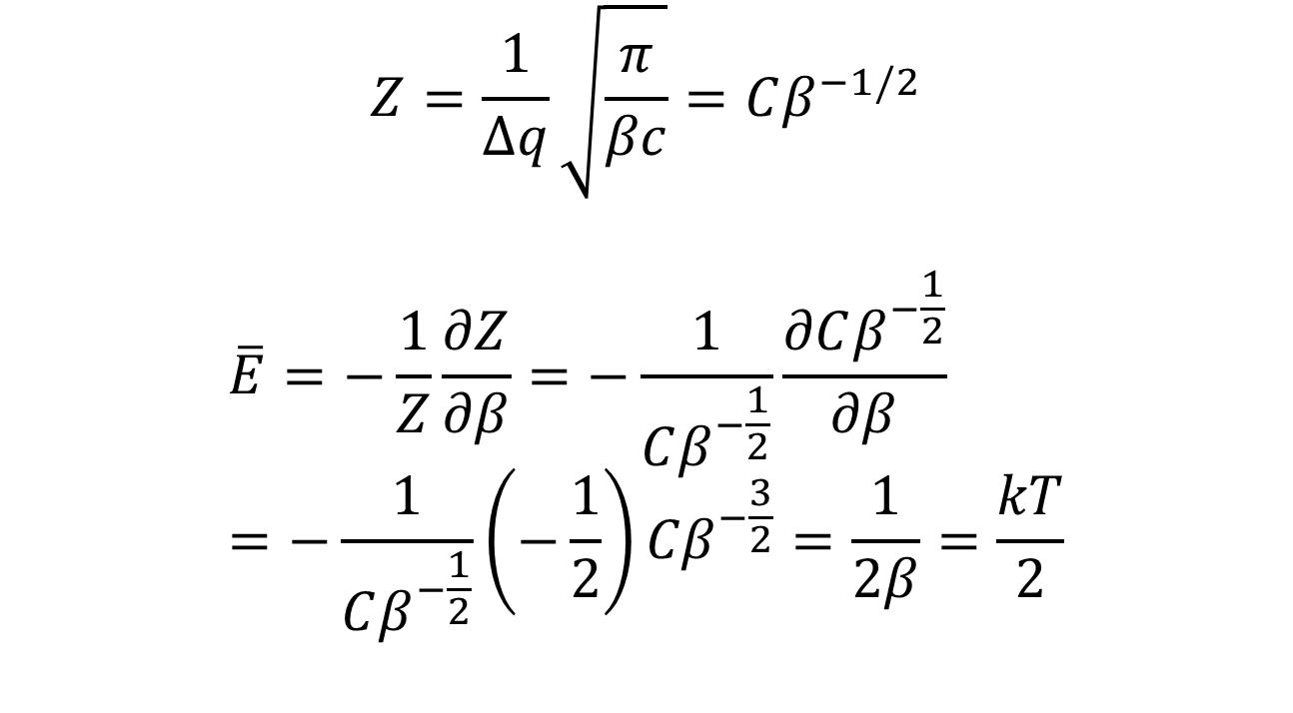
Equipartition theorem
$$Z=\frac{1}{Δq}\sqrt{\frac{π}{βc}}=Cβ^{−1/2}$$
$$\overline{E}=−\frac{1}{Z}\frac{∂Z}{∂β}=−\frac{1}{Cβ^{−\frac{1}{2}}}\frac{∂Cβ^{−\frac{1}{2}}}{∂β}=−\frac{1}{Cβ^{−\frac{1}{2}}}\left(−\frac{1}{2}\right){Cβ}^{−\frac{3}{2}}=\frac{1}{2β}=\frac{kT}{2}$$

Slide 17
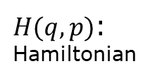
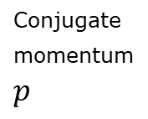

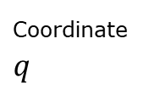
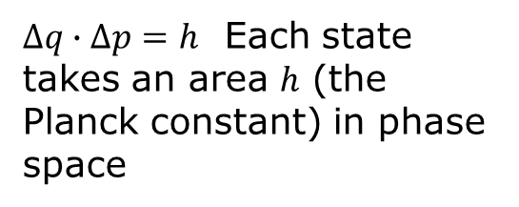


How to “count” states in classical physics in general?
Conjugate momentum $p$
$Δq∙Δp=h$ Each state takes an area $h$ (the Planck constant) in phase space
$$Δp$$
Coordinate $q$
$$Δq$$
$$Z=\sum_{s}{e^{−βE(s)}} → \int{\frac{dqdp}{h} e^{−βH(q,p)}}$$
$H(q,p)$: Hamiltonian
discrete continuous

Slide 18

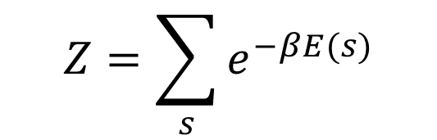


Breakdown of equipartition at low temperature, why and how?
$$q$$
$$Δq$$
$$Z=\sum_{s}{e^{−βE(s)}}$$
$$Δq→0$$
$$\overline{E}$$
$$\frac{kT}{2}$$
$$T$$

Slide 19
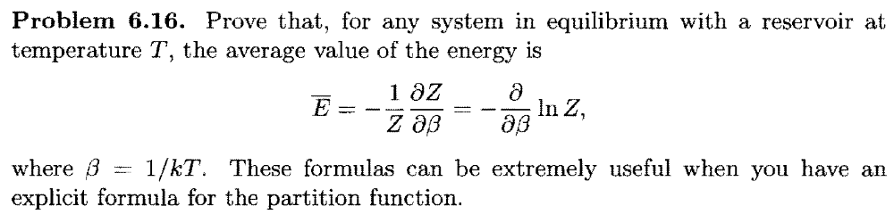
Tutorial problems 6.16, 6.17

Slide 20
