Slide 1
Week 1,
Lattice Symmetries
Bravais lattice, real lattice vector R, reciprocal lattice vector K, point group, space group, group representations, Bloch theorem
Notes:
Bravais pronounced [braivei]. For this week contents, students are encouraged to read Chap.4-7, Ashcroft/Mermin, “Solid State Physics”.

Slide 2
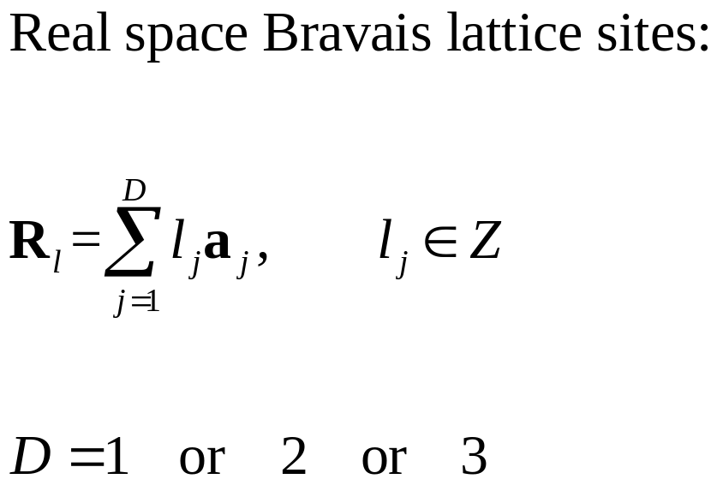
Discrete lattices
1D
2D
3D
a
Notes:
The vectors a_j is called the primitive vectors.

Slide 3
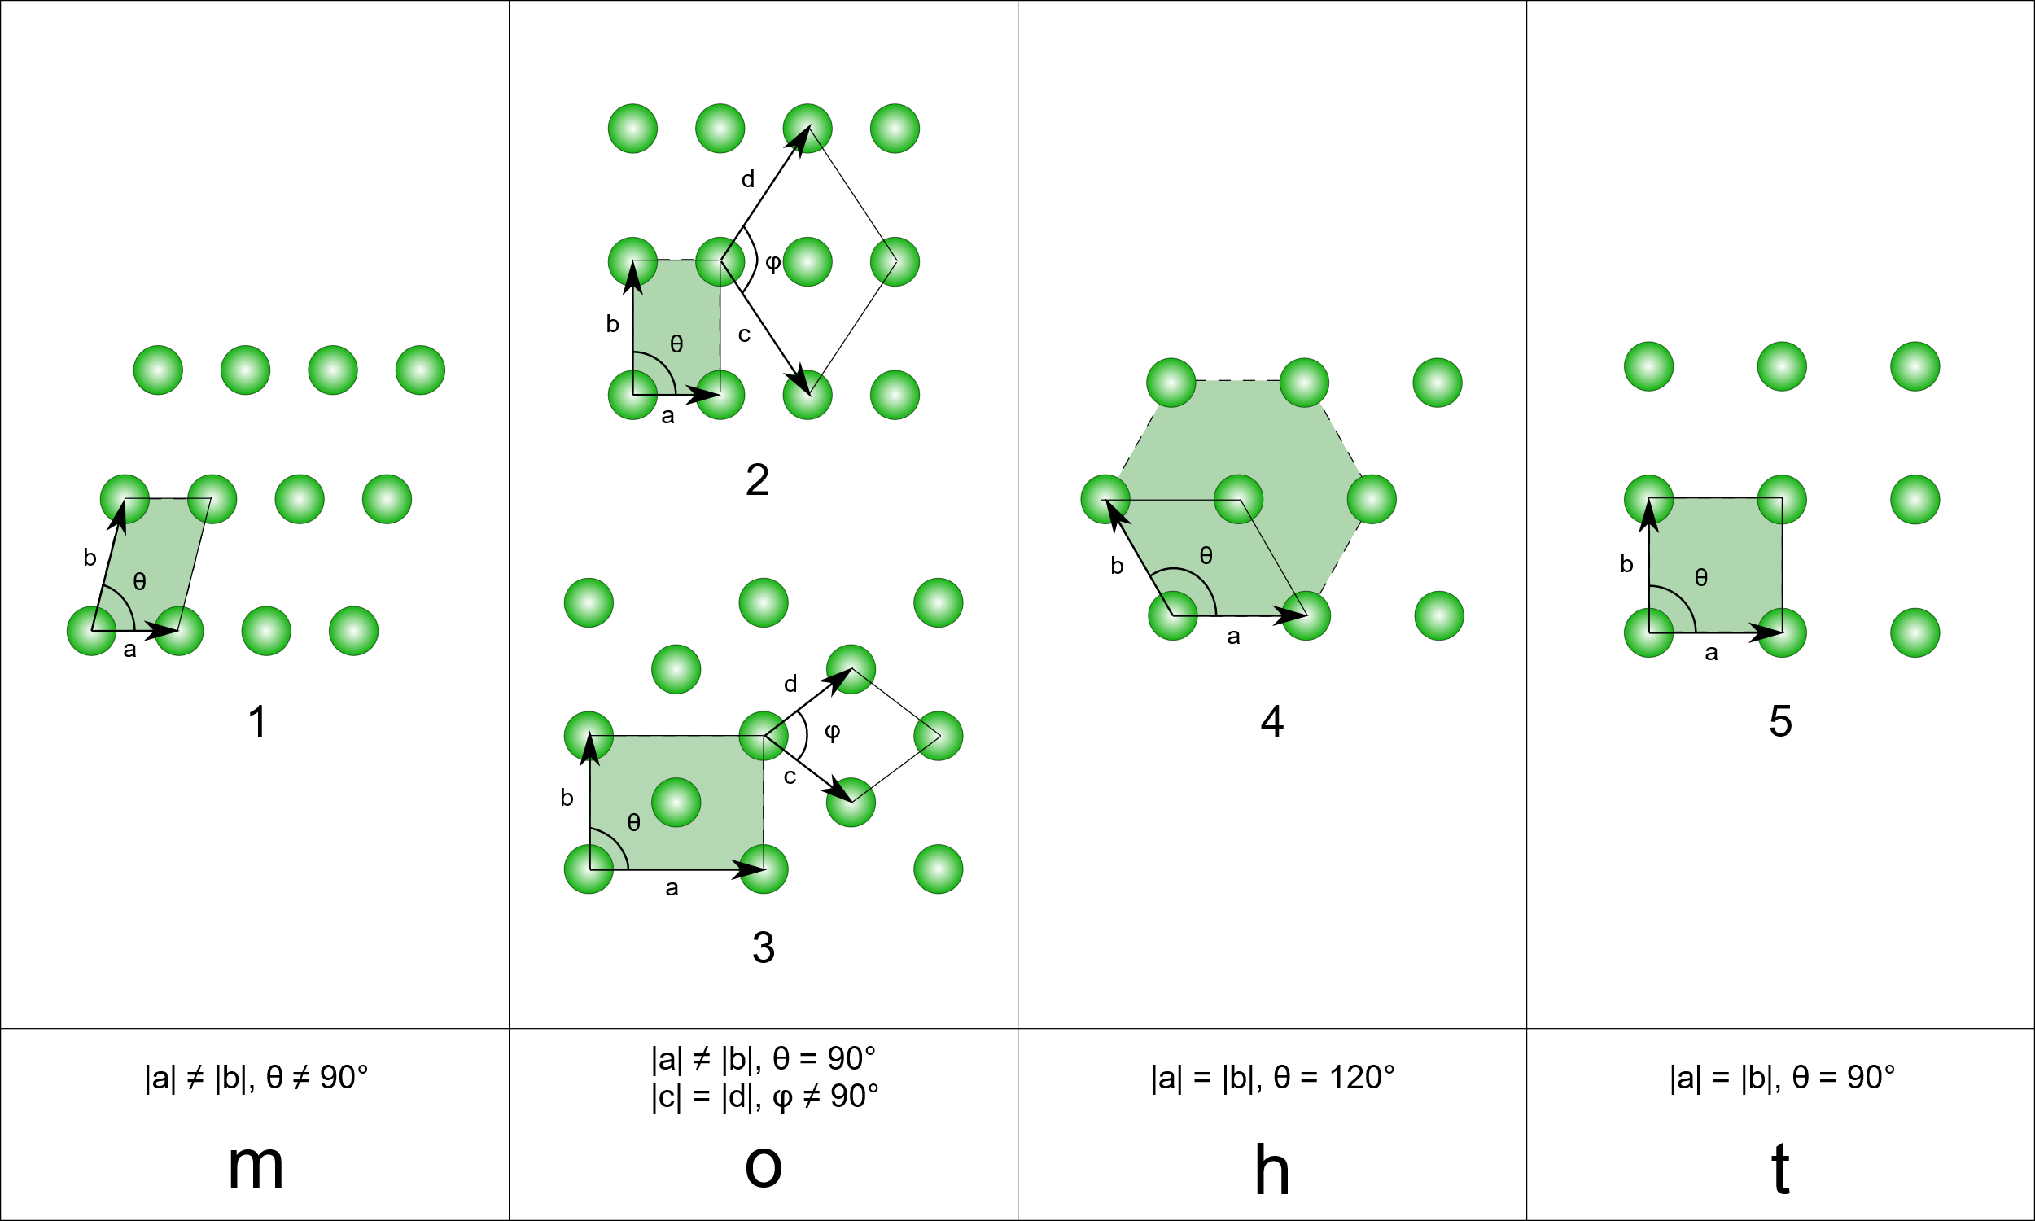
Bravais lattice: each unit cell has only one atom (5 types in 2D)
https://en.wikipedia.org/wiki/Bravais_lattice#/media/File:2d-bravais.svg
Notes:
In two dimensions, there are 5 Bravais lattice with 4 point groups (systems), and 17 crystallographic space group.

Slide 4
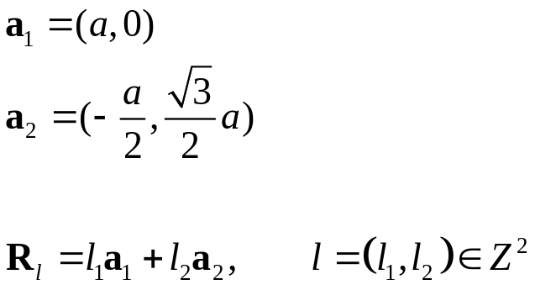
Graphene lattice
a₂
a₁
y
x
Notes:
Note, the set of sites denoted by R_l only fills the red dots, missing the yellow sites.

Slide 5
Point and space groups of 3D Bravais lattices and crystal structures
No. \ types | Bravais Lattice (Basis of spherical symmetry) | Crystal Structure (Basis of arbitrary symmetry)
Number of point groups | 7 (seven crystal systems: cubic, tetragonal, orthorhombic, monoclinic, triclinic, trigonal, and hexagonal) | 32 (the 32-crystallographic point groups)
Number of space groups | 14 (fourteen Bravais lattices) | 230 (the 230 crystal space groups)
Notes:
Chapter 7 of Ashcroft/Mermin, “Solid State Physics”.

Slide 6
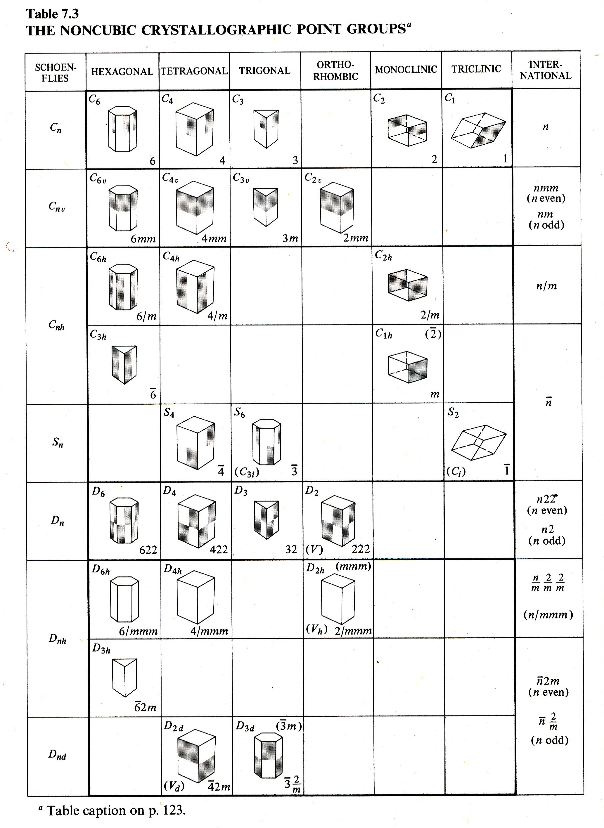
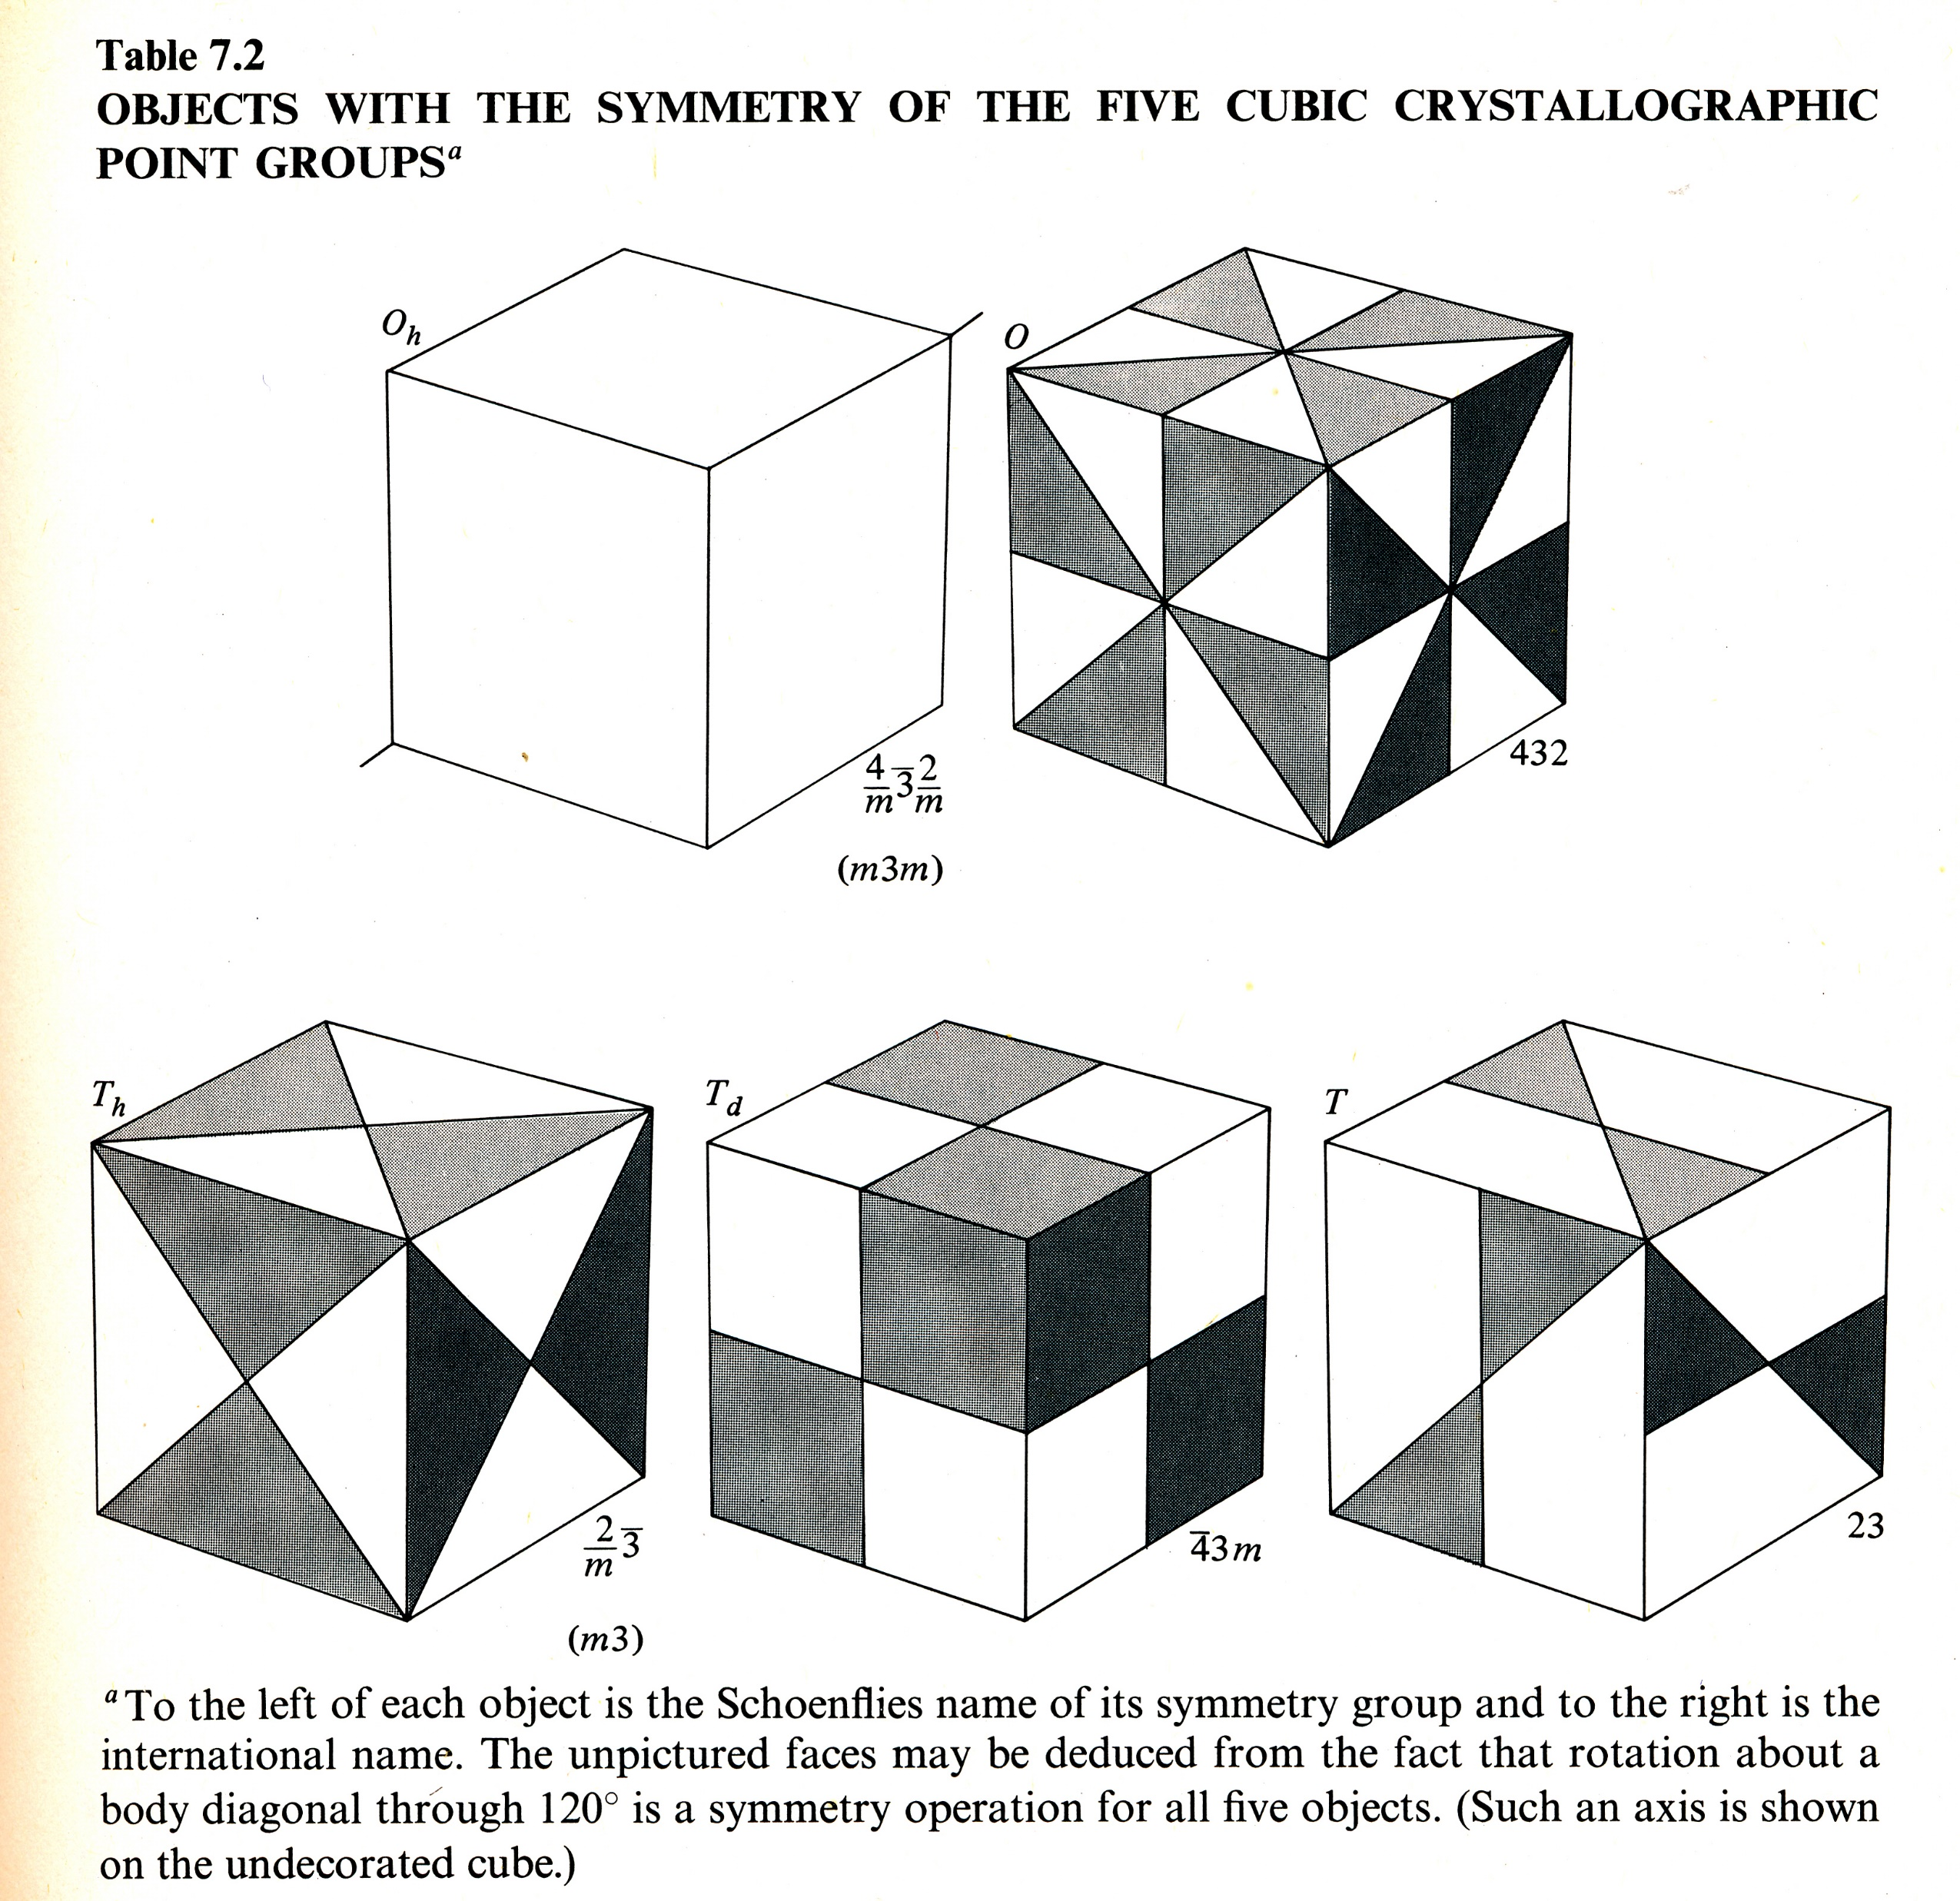
32 crystallographic point groups
Ashcroft/Mermin, Chap 7
Notes:
C_n, rotation by 2pi/n, C_nv, rotation and vertical mirror reflection, C_nh rotation and horizontal reflection (perpendicular to rotation axis). S_n = C_n*sigma_h, D_n, rotation and two-fold axis perpendicular to the main axis, S_2 = i is inversion (r -> -r), Dnh, D_n + horizonal mirror reflection, Dnd = Dn + mirror planes bisect the 2-fold axes.

Slide 7
Definition of a group
A set G that are
Closed under operation ∗, i.e., if A and B ∈ G, so is A∗B.
There exits an identity E, such that E∗A=A∗E=A.
For each element A there is a unique inverse B=A⁻¹, such that A∗B=B∗A=E.
The operation is associative, i.e., A∗(B∗C) = (A∗B)∗C.
Notes:
A.W. Joshi, “Elements of Group Theory for Physicists”, 4th edition, New Age International (1997). For a first course elementary introduction to group theory, I recommend Charles C. Pinter, “A Book of Abstract Algebra”, 2nd ed, McGraw-Hill (1990). For application in quantum mechanics, M. Tinkham, “Group theory and quantum mechanics”, Dover. For application in solid state physics, see M. S. Dresselhaus, et al, “Group theory, application to the physics of condensed matter.” Springer (2008). I also highly encourage a first reading be the book by A. Zee, “Group theory in a nutshell for physicists”, Princeton, 2016.

Slide 8
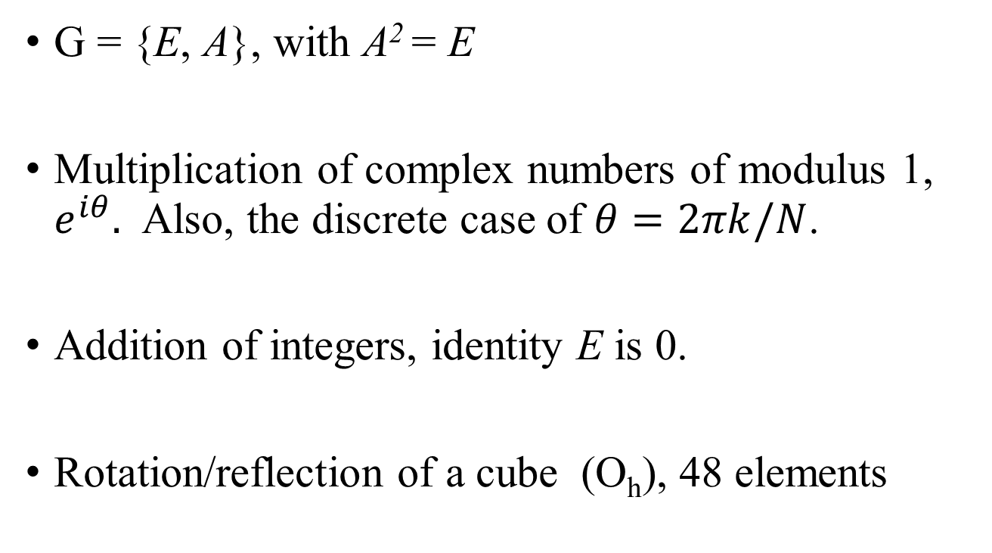
Examples of groups
G = {E, A}, with A² = E
Multiplication of complex numbers of modulus 1, $e^{iθ}.$ Also, the discrete case of $θ=2πk/N$.
Addition of integers, identity E is 0.
Rotation/reflection of a cube (O_{h}), 48 elements

Slide 9
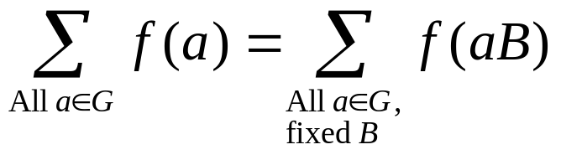
Multiplication table & rearrangement theorem
y
Group C_{3v} | E | A = σ₃ | B = σ₂ | C = σ₁ | D = C₃² | F = C₃
E | E | A | B | C | D | F
A | A | E | D | F | B | C
B | B | F | E | D | C | A
C | C | D | F | E | A | B
D | D | C | A | B | F | E
F | F | B | C | A | E | D
2
x
1
3
A²=B²=C²=E, D³ = F³ =E, F² = D, FA=B, AF=C, etc
Notes:
We define the meaning of group operations as follows: E nothing changes, sigma_1 permutes 2 and 3, fixing 1. Similarly, sigma_2 fixing site 2, permutes 1 and 3. F rotates the sites 2pi/3 clockwise. D rotates the sites counter clockwise.
Order of group: number of elements of the group – C3v has order 6. Order of elements, smallest n such that A^n = E.

Slide 10
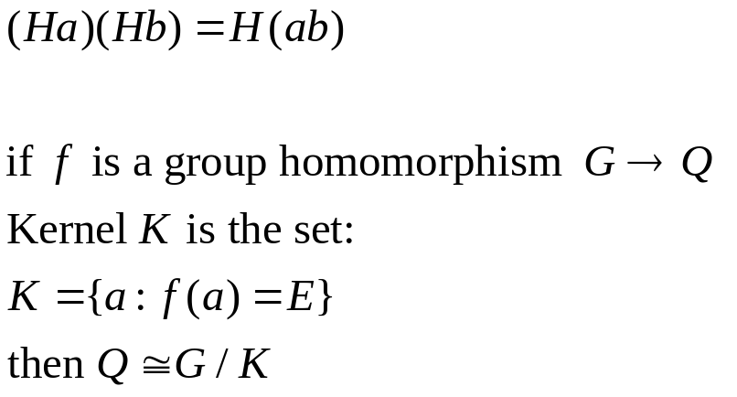
Coset & quotient group G/H
H is a subgroup of G. The set Ha is called right coset. If Ha = aH, for all a, H is a normal (invariant) subgroup. The multiplication of cosets are then well defined and is the quotient group G/H.
H
Ha
Hb
H⋅⋅⋅
Lagrange theorem: order of G must be a multiple of the order of subgroup H.
Notes:
Homomorphism: if a, b belongs to G, and f map a, b, c, .., to Q. Then f(ab) = f(a)f(b). The multiplication ab is in G, and that f(a)f(b) is in Q. Order of G: number of elements of G.

Slide 11
Point group of graphene (any rotation/reflection fixing the origin)
C_{6v}
Notes:
Which point should the origin fixed with respect to rotation, inversion, reflection?

Slide 12
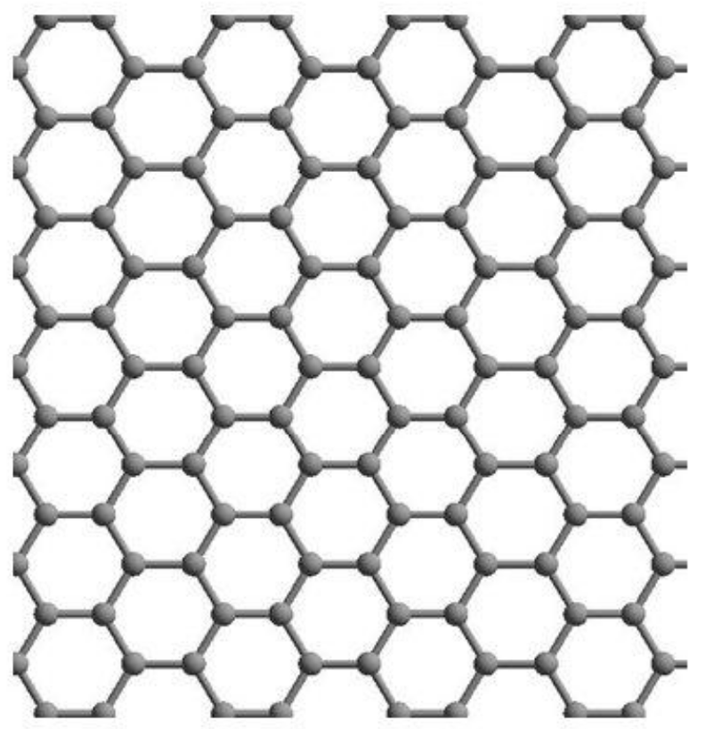



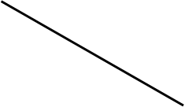
Space group of graphene (rotation, mirror reflection + translation including glide reflection)
P6mm: blue dotted line is glide line, solid line mirror reflection, hexagon 6-fold axis (perpendicular to the 2D plane), triangle 3-fold axis, cone 2-fold axis.
Notes:
These slides discuss 2D space groups: http://n.ethz.ch/~nielssi/download/4.%20Semester/AC%20II/Unterlagen/symmetry_2D_3.pdf

Slide 13
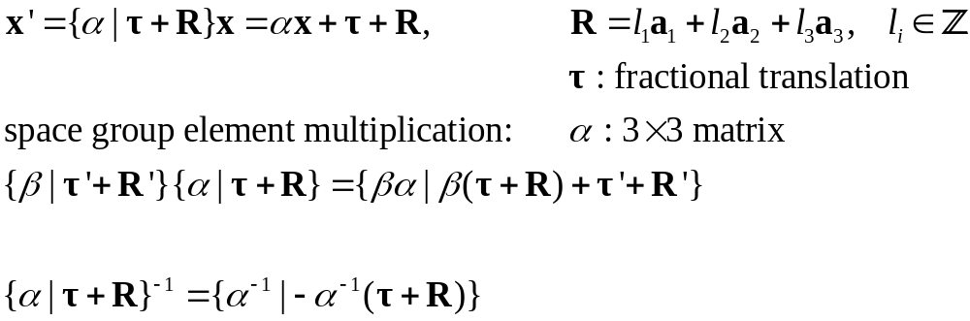
Space groups, symmorphic vs nonsymmorphic
If, with a suitable choice of origin, the space group elements can be written as {α |R}, i.e., with τ = 0, then the space group is called symmorphic, otherwise if not possible, nonsymmorphic.
Notes:
See Chapter 9, Dresselhaus, “group theory…” Based on the rule of group multiplication, show that R of all lattice translations is an invariant subgroup.

Slide 14
Representation of a group
If group elements satisfy AB=C, there are square matrices D(A), for each element A of the group, that mirror the group multiplication, i.e.,
D(AB) = D(A)D(B).
Irreducible representation – not possible to find a common S such that all SDS⁻¹s are block diagonals. There is no invariant subspaces that D acts on.
Character χ of the representation is an invariant given by the matrix trace Tr(D).
Notes:
By representation we mean a group homomorphism from G to the general linear group of invertible matrices of Ds. It is the mapping f : A -> D(A) which should be emphasized.

Slide 15
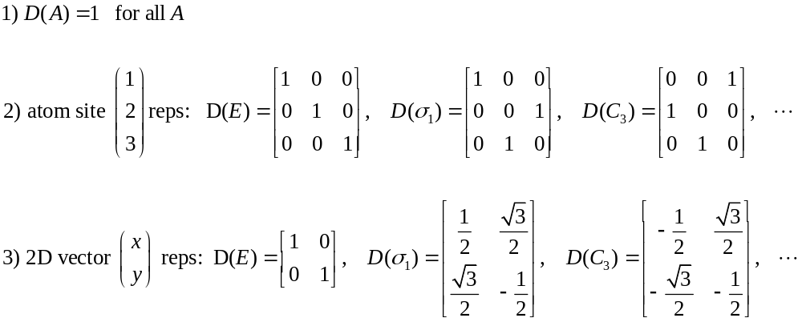
Example of representations for C_{3v}
y
2
x
1
3
Notes:
We use passive point of view, i.e., for C_3 the triangle remains, and the coordinate axes is rotated by 2pi/3, counter-clockwise.

Slide 16
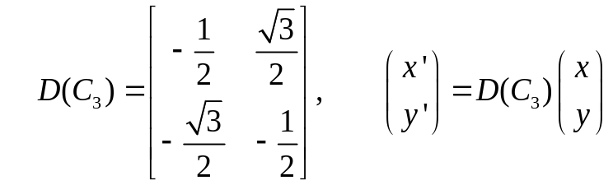
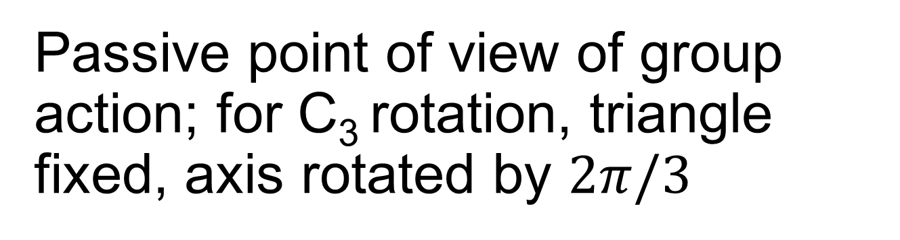
Passive point of view of group action; for C₃ rotation, triangle fixed, axis rotated by $2π/3$
y
x’
2
x
y’
1
3
Notes:
We use passive point of view, i.e., for C_3 the triangle remains, and the coordinate axes is rotated by 2pi/3, counter-clockwise.

Slide 17
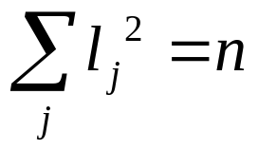
Four theorems regarding irreducible representation
1) The representation can be made unitary. 2) Schur’s lemmas: If a matrix C commutes with all the irreducible matrices D(A) of a group, C must be cI, i.e., identity matrix times a constant. 3) If MD⁽¹⁾=D⁽²⁾M, then M = 0. Or if not, two irreducible D⁽¹⁾ and D⁽²⁾ are equivalent representations. 4) different components of D are orthogonal (wonderful orthogonality theorem).
number of classes = number of different irreducible representations
n: order of group, l_{j}: dimension of D^{(j)}
Notes:
A and B are in the same class if SAS^-1 = B, for some S. That is, member in the same class are “similar”. Two representations are equivalent if there is a non-singular S, such D^(2)(A) = S^-1 D^(1)(A) S, for all A.

Slide 18
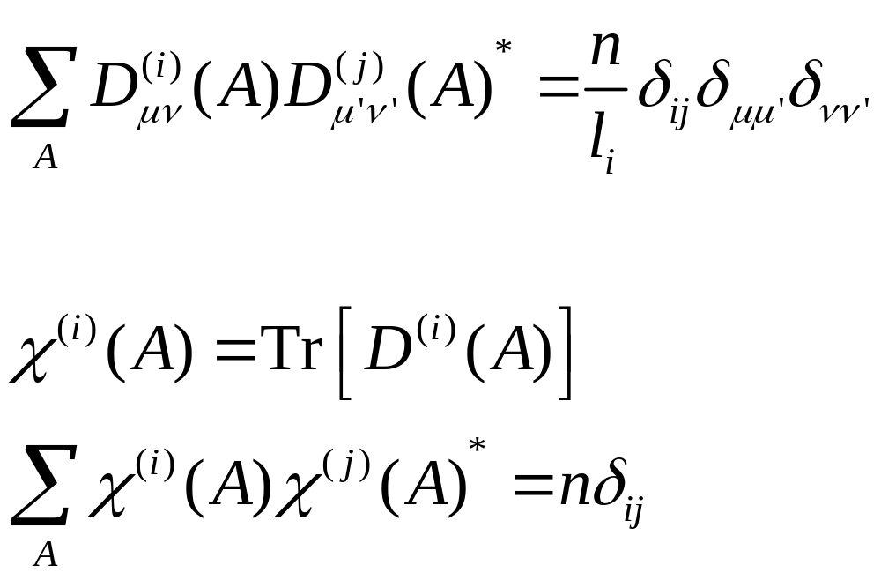
Wonderful orthogonality theorem
χ^{(i)} (A) : character of i-th irreducible representation of the group element A.
n: order of the group.
D^{(i)} is l_{i} × l_{i} matrix.

Slide 19
Class
If A=X⁻¹BX, we say A and B are in the same class (or similar), or in notation A ≅ B
Class is an equivalence relation: 1) reflective, A ≅ A; 2) symmetric, A ≅ B implies B ≅ A; 3) transitive, A ≅ B and B ≅ A implies A ≅ C
The classes partition the group G
Notes:
equal = is an equivalence relation.

Slide 20
Character table χ for group C_{3v}
C_{3v} (3m) |  |  | E | 2C₃ | 3σ_{v}
x²+y², z² | z | A₁ | 1 | 1 | 1
 | R_{z} | A₂ | 1 | 1 | −1
(x²-y², xy) (xz, yz) | (x, y) (R_{x}, R_{y}) | E | 2 | −1 | 0
χ(E) gives the dimension of the representation l_{i}.
Classes: {E}, 2C₃ = {C₃, C₃²}, 3σ_{v}= {σ₁,σ₂,σ₃}.
Left two columns show the quadratic (Raman) and linear (IR) basis of the representation. R_{α} : rotation about α axis/angular momentum or pseudo-vector.
Notes:
Mulliken naming conventions for the irreducible representations: A -- one dimensional, symmetric with respect to the principle rotation axis. B – one dimensional antisymmetric with respect to principle rotation axis. E – two fold degenerate, T – three-fold degenerate. Subscript 1 symmetric with respect to sigma_v (or C_2 pendicular to principle C_n), 2 – antisymmetric with respect to sigma_v, Subscript g – symmetric with respect to inversion, subscript u – antisymmetric with respect to inversion. Prime, symmetric with respect to sigma_h, double prime antisymmetric with respect to sigma_h. See also:
http://www.huntresearchgroup.org.uk/teaching/teaching_MOs_year2/L2_Addn_Symm_Labels.pdf

Slide 21
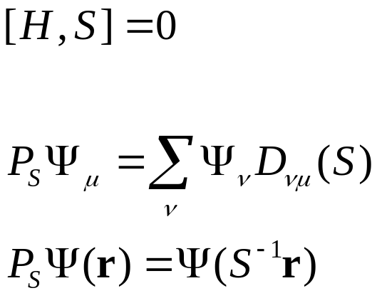
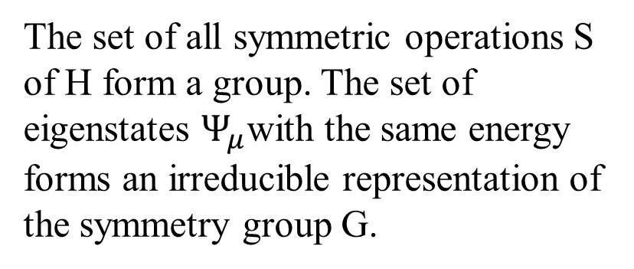
Symmetries in quantum mechanics, [S,H]=0
When a wavefunction |Ψ> is transformed by S, to |Ψ′> = S|Ψ>, the Hamiltonian will be transformed from H to H′, such that
<Ψ′|H′|Ψ′> = <Ψ|H|Ψ>. This means the operator transforms according to H′=SHS⁻¹. If the system is symmetric with respect to the transformation S, then
The set of all symmetric operations S of H form a group. The set of eigenstates $Ψ_{μ}$with the same energy forms an irreducible representation of the symmetry group G.
Notes:
The relation between the operator in wave function space, P_S, and S, is an isomorphism. Show the definition of P_S fulfills the group property, i.e., ST is associated with operator P_{ST). It is important to note that the wave function is summed in D from the left with the first index v.

Slide 22
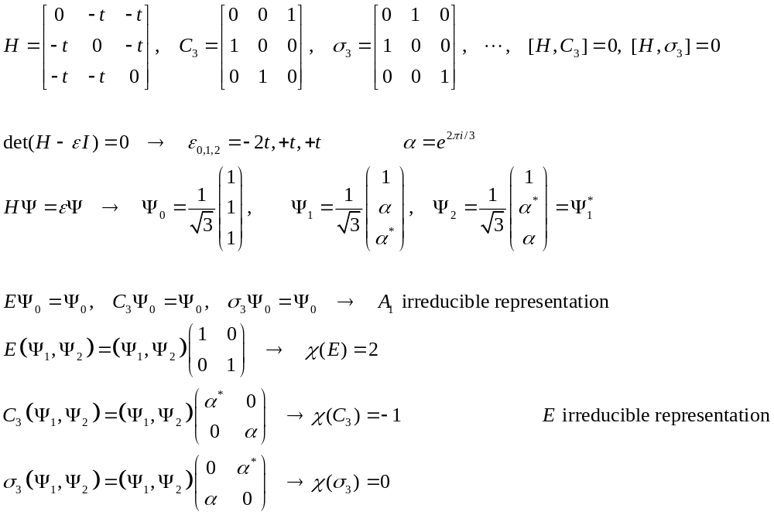
Classify Ψ of a three-site molecule with C_{3v} symmetry
2
1
3
Notes:
The site representation acts on the site label as column vector from the left, e.g., C3 (1,2,3)^T = (3,1,2)^T. A general site representation, Psi = (a, b, c)^T, with the 3x3 matrices as our D, is clearly a reducible presentation, check its characters, we find it is
A_1 + E.

Slide 23
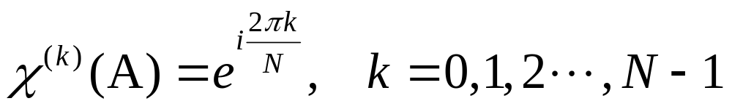
Cyclic group of order N
Let group G = {A, A², A³, …, A^{N-1}, A^{N}=E}
D(A) can be represented as a unitary matrix, which can be diagonalized with eigenvalues satisfying |λ|=1, λ^{N}=1.
If S diagonalizes D(A), it diagonalizes all elements of the group, with D(A^{k})=diag{λ^{k}}.
This means the irreducible representations of the cyclic group can only be one-dimensional, with
Notes:
Each element by itself form a class in an Abelian group, thus number of classes equal number of elements. If so by sum l_i^2 = n, l_i can only to 1, i.e. one dimensional. Here in the representation theory we work with matrices in the complex domain C, if we restrict it to be in Q, for example, the number of irreducible representations are much reduced and more difficult to deal with.

Slide 24
Translational symmetry
Consider a 1D system with [H,T(a)]=0. T(a) is a discrete translation by a lattice constant. Using periodic boundary condition, we have T(Na) = T(a)^{N}=E.
Let H|Ψ>=ε|Ψ>,
but T(a) (H|Ψ>)=H(T(a)|Ψ>)=ε(T(a)|Ψ>)
This means T(a)|Ψ> is also an eigenstate of H with the same energy. However, the cyclic group can only have 1D representation so
T(a)|Ψ>=λ|Ψ>, λ^{N} = 1
Notes:
The wave function of same energy is unique to a phase factor.

Slide 25
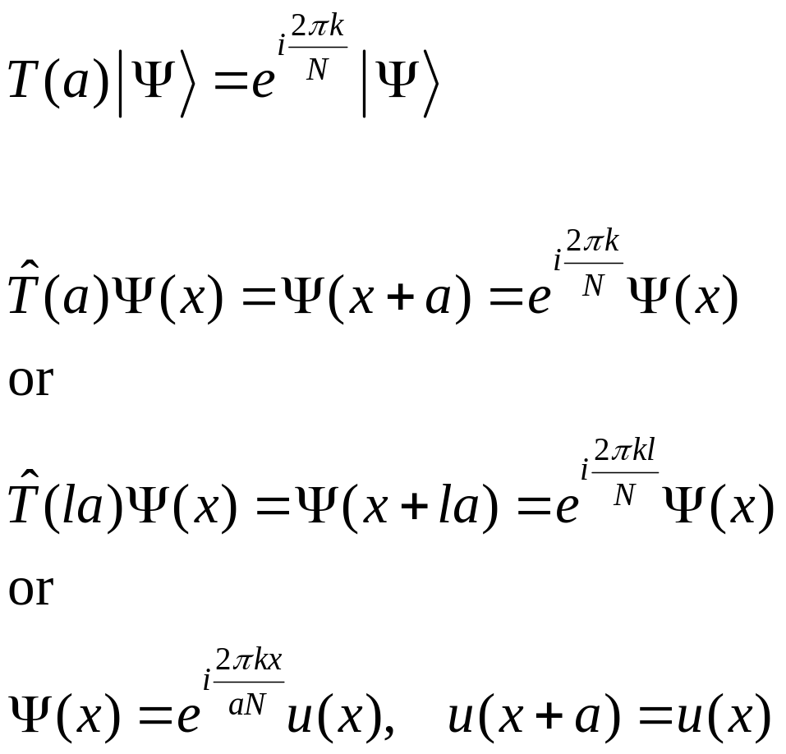
Bloch’s theorem
The integer index k = 0, 1, 2, …, N-1 label the N different irreducible representations of the translation cyclic group of order N.
Each energy eigenstate of H must fall into one of the translation group representations labelled by k or the wavevector 2πk/(aN).
Notes:
What is exactly hat{T} in 1D? It is exp( a d/dx) by Taylor expansion of Psi(x+a) at x. Here translation by a is in the passive sense – it is the new coordinate x’ that is translated by positive a with respect to old coordinate x.

Slide 26
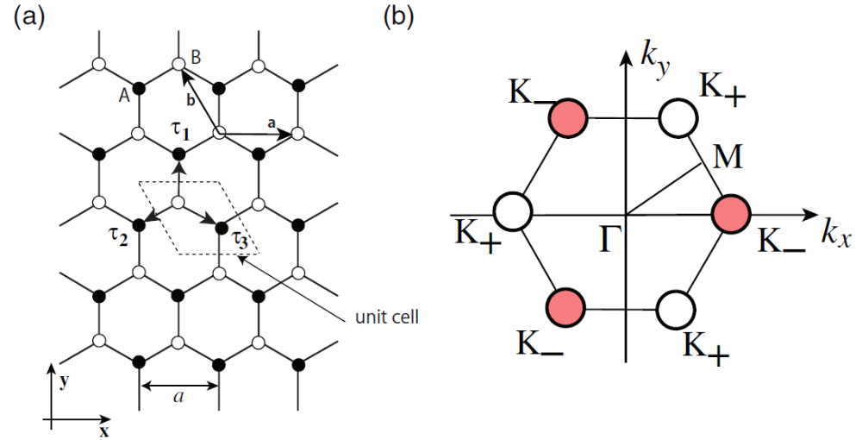
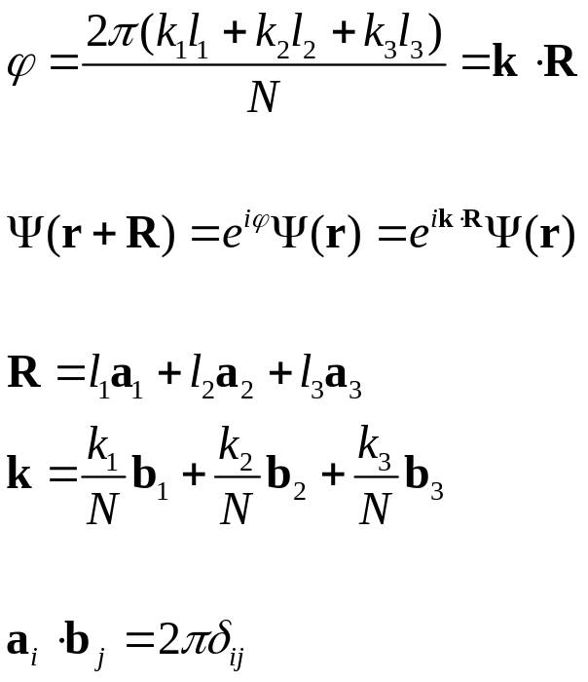
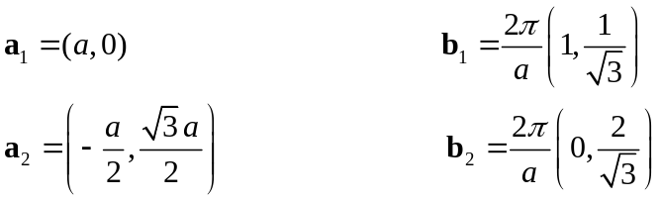
Brillouin zone, reciprocal space or k space
In 3D, the real space translation symmetry is indicated by the real space lattice vector R, the phase factor is
Notes:
The 3D translational group is a direct product (Cartesian product) of the 3 one-dimension translational groups (in three dimensions 1, 2, 3).

Slide 27
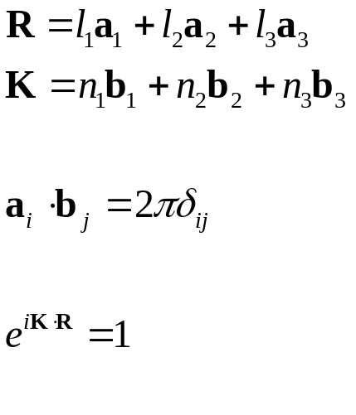
Reciprocal lattice, X-ray diffraction by crystal
Laue condition: constructive interference will occur provided the change in wave vector is a vector of the reciprocal lattice.
k’
K = k’-k
k
Notes:
See Chap 6 of Ashcroft/Mermin.

