Slide 1
Week 10,
Berry phases, SSH Model
Surface states, definition of Berry phase, Berry phase in SSH model, bulk-edge correspondence, Chern number, phonon Hall effect, etc

Slide 2
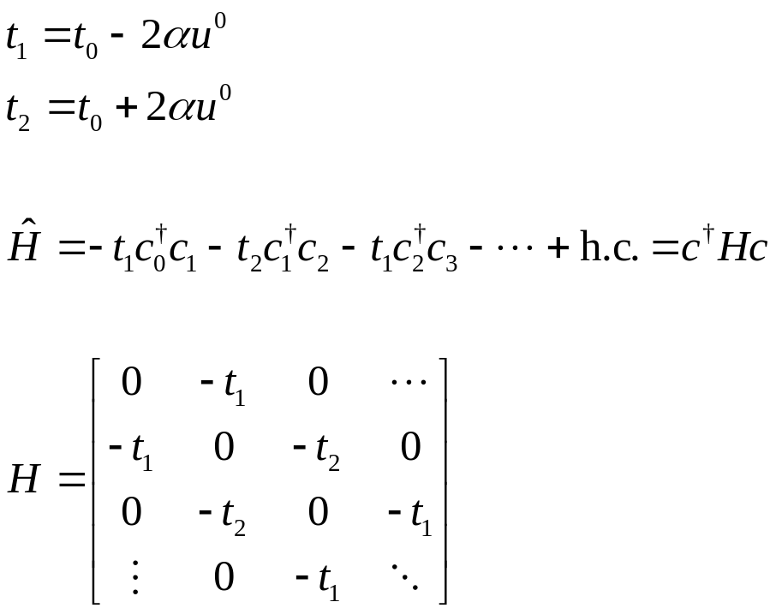
SSH model as a “topological insulator”
$t_{1}$ $t_{2}$ $t_{1}$ $t_{2}$ …
…
0 1 2 3 4 …. n …

Slide 3
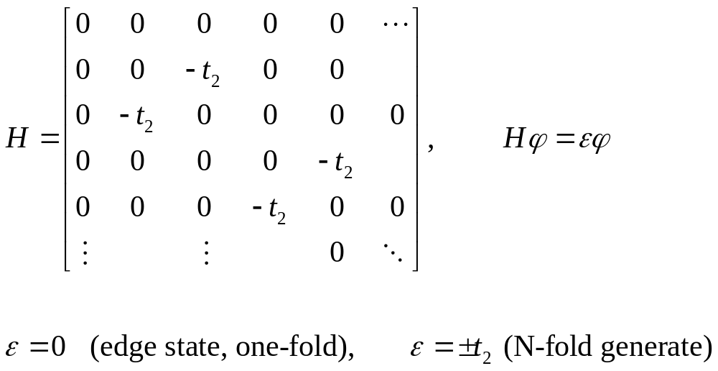




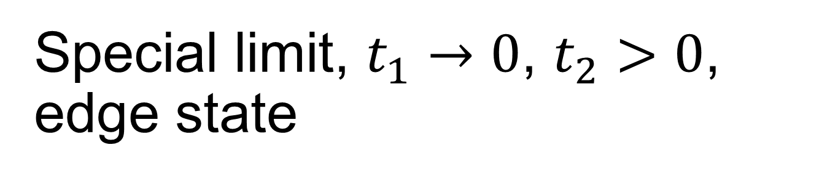
Special limit, $t_{1}→0$, $t_{2}>0$, edge state
$t_{1}=0$ $t_{2}$ $t_{2}$ …
0 1 2 3 4 …. n …
$$+t_{2}$$
$$0$$
$$−t_{2}$$
Notes:
Work out the eigenstate phi.

Slide 4
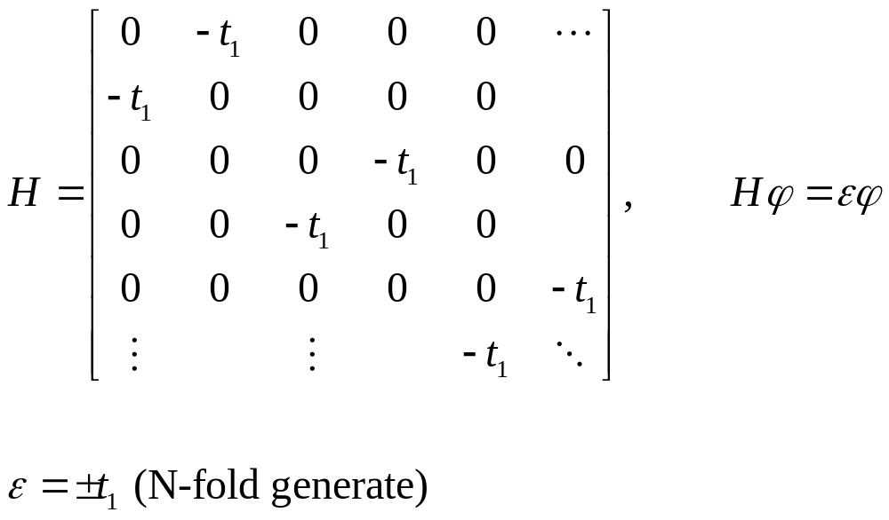
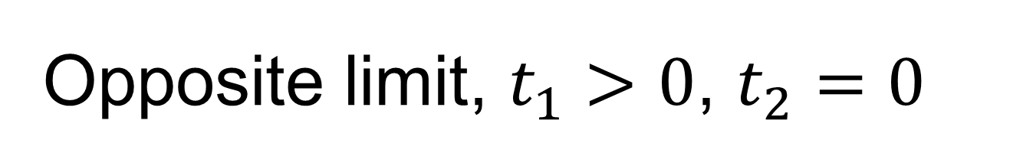


Opposite limit, $t_{1}>0$, $t_{2}=0$
$t_{1}$ $t_{2}=0$ $t_{1}$ …
0 1 2 3 4 …. n …
$$+t_{1}$$
$$−t_{1}$$
no edge state

Slide 5
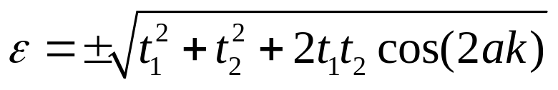




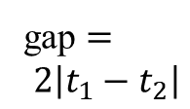
General cases
$$t_{1}<t_{2}$$
$$t_{1}>t_{2}$$
$$k$$
gap $=$
$$2\left|t_{1}−t_{2}\right|$$
$$t_{1}=t_{2}$$

Slide 6
Scattering states vs edge state near the end of SSH chain

Slide 7
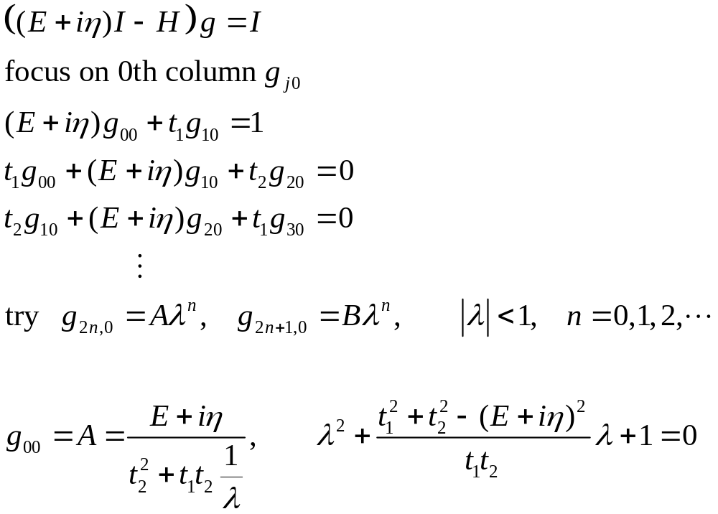
Surface Green’s function g₀₀

Slide 8
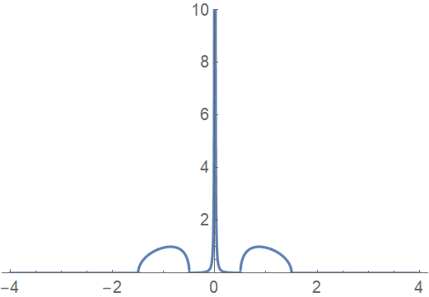
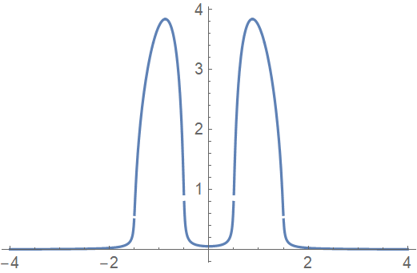
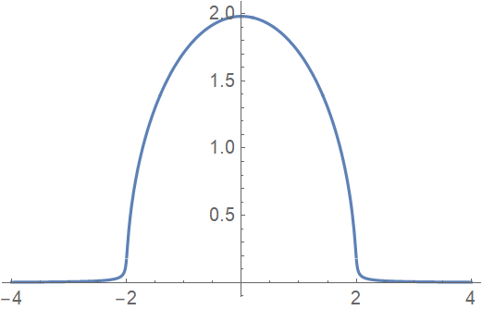
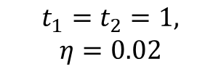
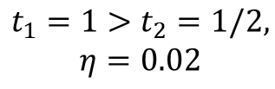
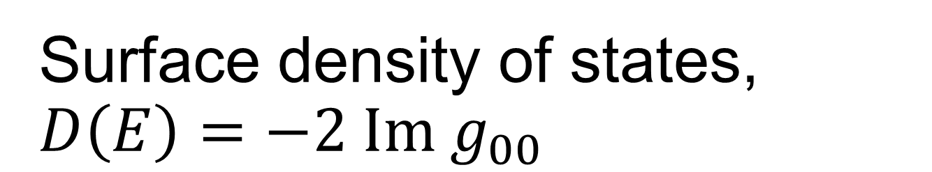
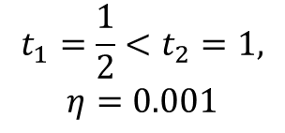


Surface density of states, $D\left(E\right)=−2 Im g_{00}$
$$t_{1}=\frac{1}{2}<t_{2}=1,$$
$$η=0.001$$
$$t_{1}=1>t_{2}=1/2,$$
$$η=0.02$$
$$D(E)$$
$$t_{1}=t_{2}=1,$$
$$η=0.02$$
$$E$$

Slide 9
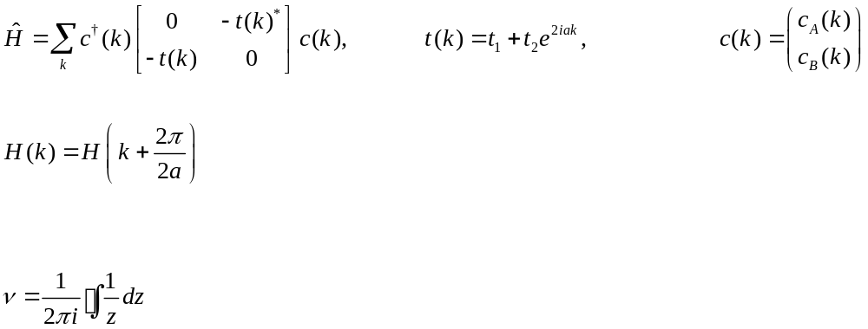




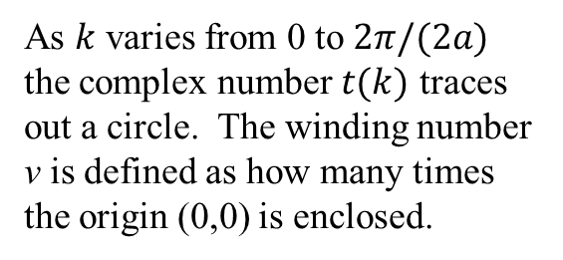

SSH model in k space
$$Im t\left(k\right)$$
$$t_{2}$$
angle = $2ak$
As $k$ varies from 0 to $2π/(2a)$ the complex number $t(k)$ traces out a circle. The winding number ν is defined as how many times the origin (0,0) is enclosed.
$$t_{1}$$
$$Re t\left(k\right)$$

Slide 10
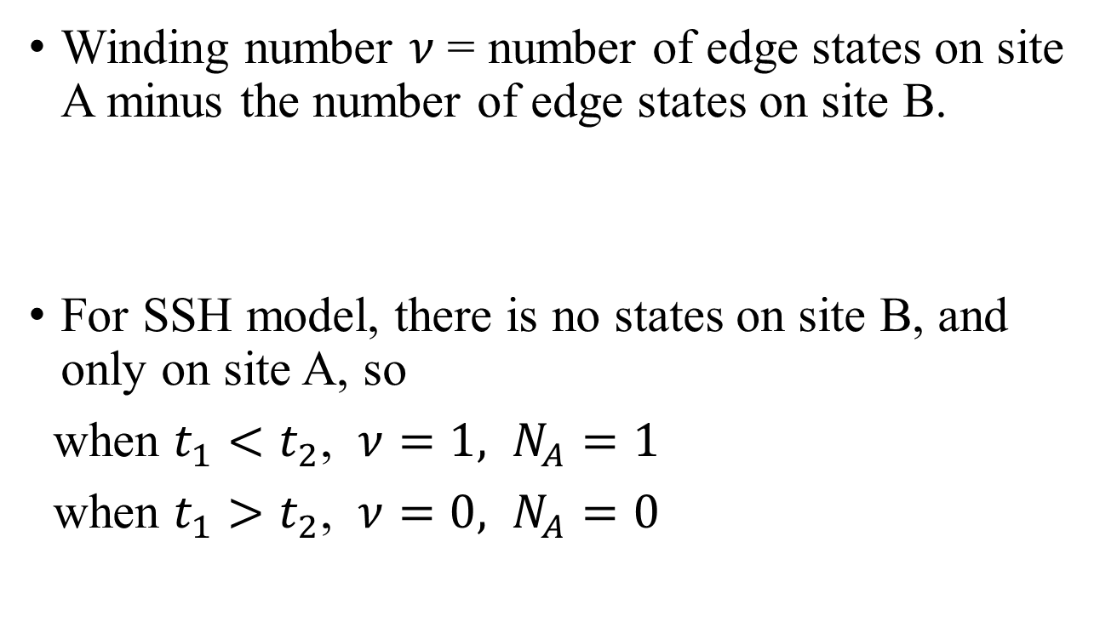
Bulk-edge correspondence
Winding number $ν$ = number of edge states on site A minus the number of edge states on site B.
For SSH model, there is no states on site B, and only on site A, so
when $t_{1}<t_{2}$, $ν=1,$ $N_{A}=1$
when $t_{1}>t_{2}$, $ν=0,$ $N_{A}=0$
$t_{1}$ $t_{2}$ $t_{1}$ $t_{2}$ …
A B A B A ….

Slide 11
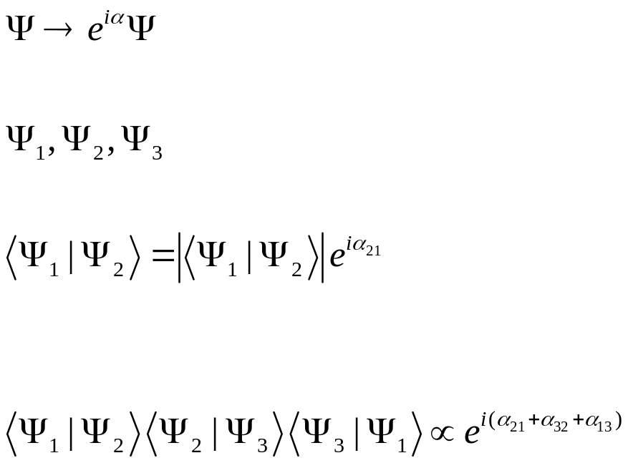



Overall phase and relative phases in quantum mechanics
$${|Ψ}_{2}>$$
$${|Ψ}_{1}>$$
$${|Ψ}_{3}>$$
The relative phase in a loop is invariant and has physical consequences.
Notes:
See “Berry phases in electronic structure theory”, David Vanderbilt, Cambridge (2018). What does “invariant” mean?

Slide 12
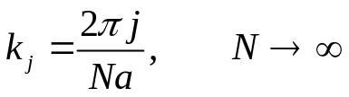
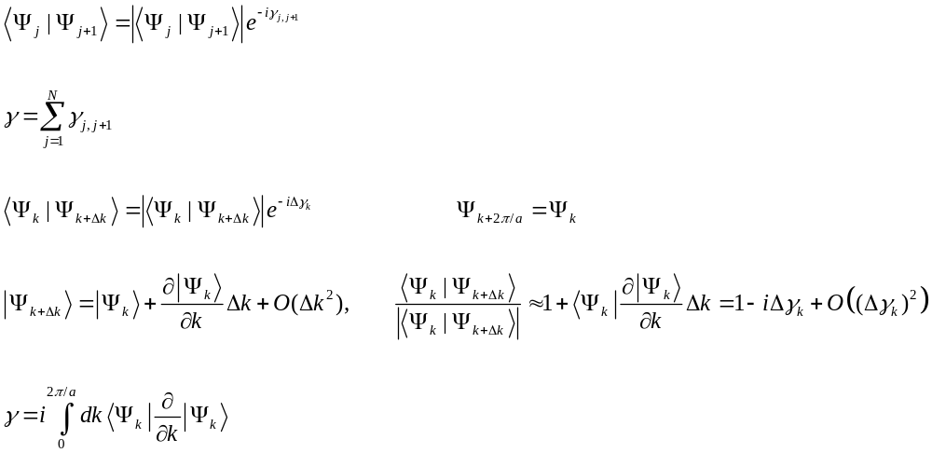
Berry phase in a loop of k space
j+1
j
…
3
2
1
N
N-1
Notes:
Gamma is also known as Zak phase. Show that gamma is real, or <Psi | d |Psi>/dk is purely imaginary. Show that |<Psi(k) | Psi(k +dk)>| =1 + O(dk^2), and there is no linear term in dk.

Slide 13
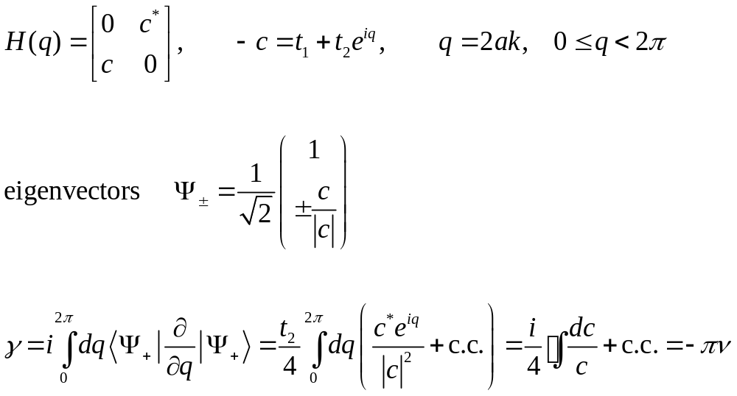
Compute the Zak phase for SSH model
winding number
Notes:
Note that –pi and pi are considered equivalent since Berry phase can be defined only modulo 2pi.

Slide 14
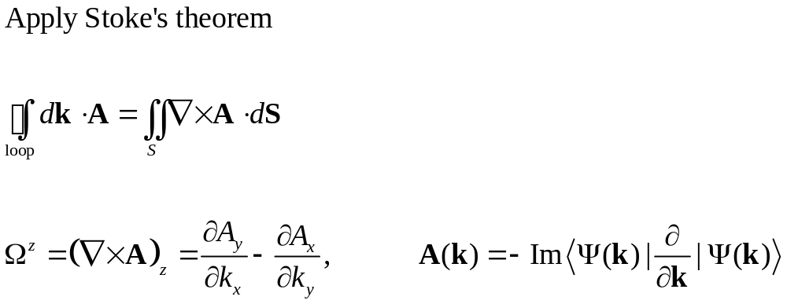


Berry curvature (need 2D parameter k space)
S
$$k_{y}$$
$$k_{x}$$
Notes:
The vector A (or one-form A . dk) is called Berry connection. The curl of A gives the Berry curvature. One can express Omega^z in terms of the eigenvector and eigenvector
Of H(k), getting rid of the derivatives on the wave functions.

Slide 15
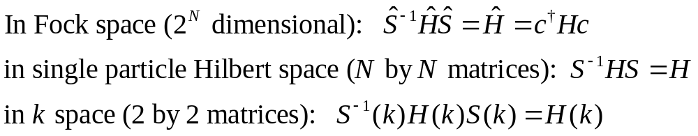
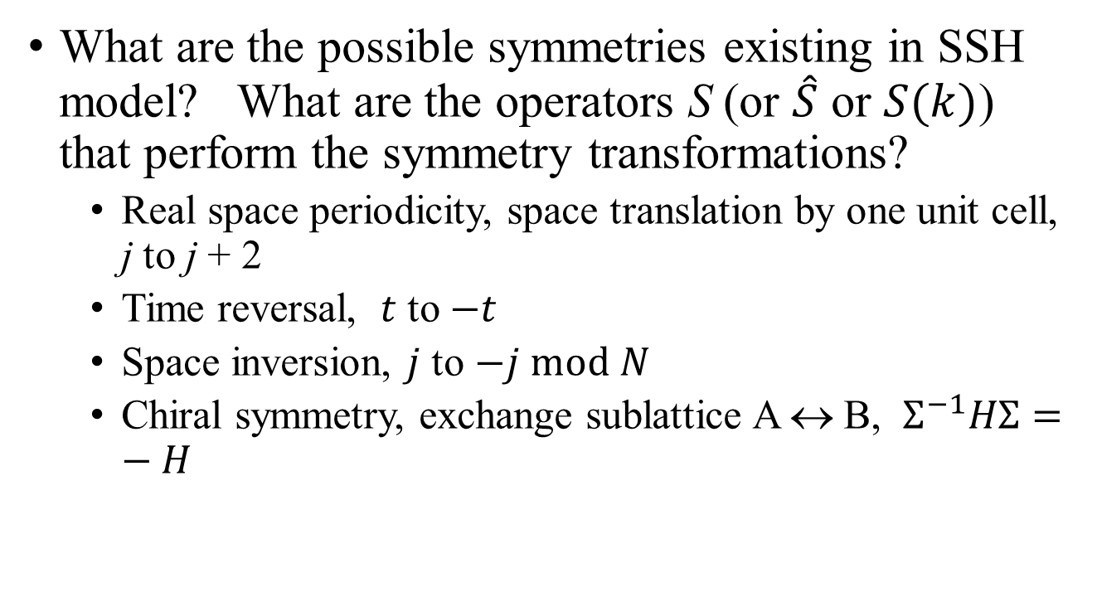
Symmetries in SSH model
What are the possible symmetries existing in SSH model? What are the operators S (or $\hat{S}$ or $S(k)$) that perform the symmetry transformations?
  Real space periodicity, space translation by one unit cell, j to j + 2
  Time reversal, $t$ to $−t$
  Space inversion, $j$ to $−j mod N$
  Chiral symmetry, exchange sublattice A ↔ B, $Σ^{−1}HΣ=−H$

Slide 16
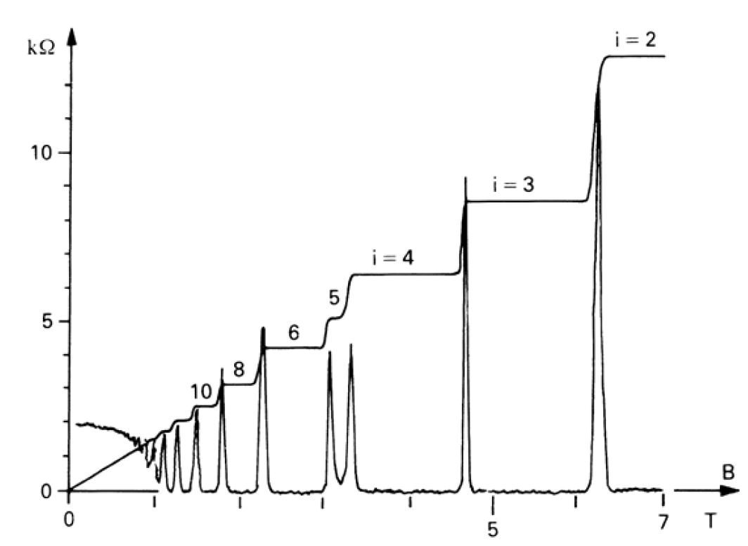
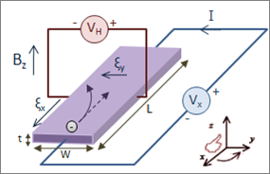

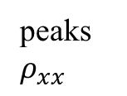
Hall effect
steps $ρ_{yx}$
peaks $ρ_{xx}$
Derive the Drude model result in magnetic field for the Hall effect (following Ashcroft/Mermin)
Notes:
Hall geometry figure from https://en.wikipedia.org/wiki/Hall_effect

Slide 17
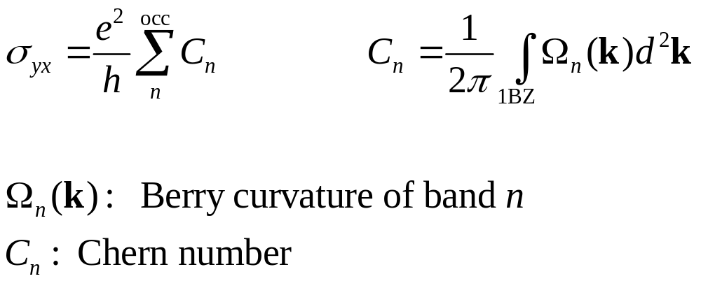
Quantum Hall effect, TKNN formula
Thouless, Kohmoto, Nightingale, den Nijs (1982)
Notes:
C_n of band n is called the Chern number, a topological invariant.

Slide 18
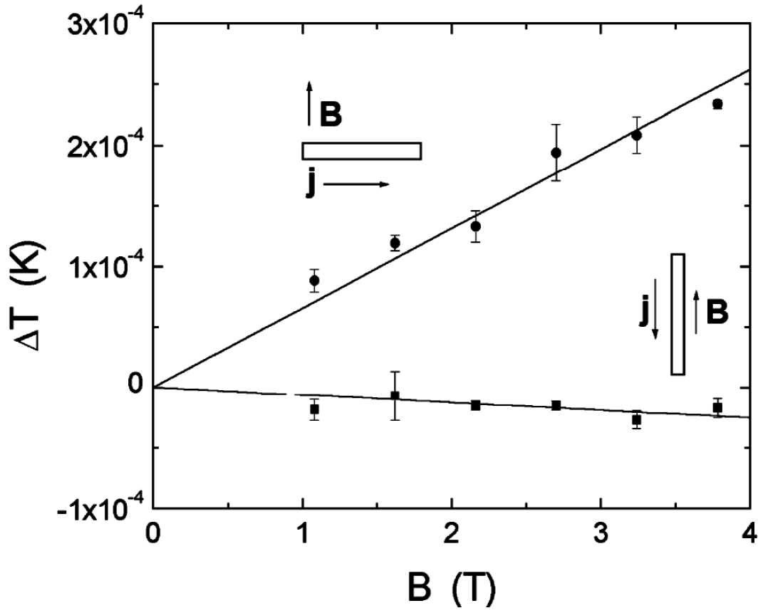
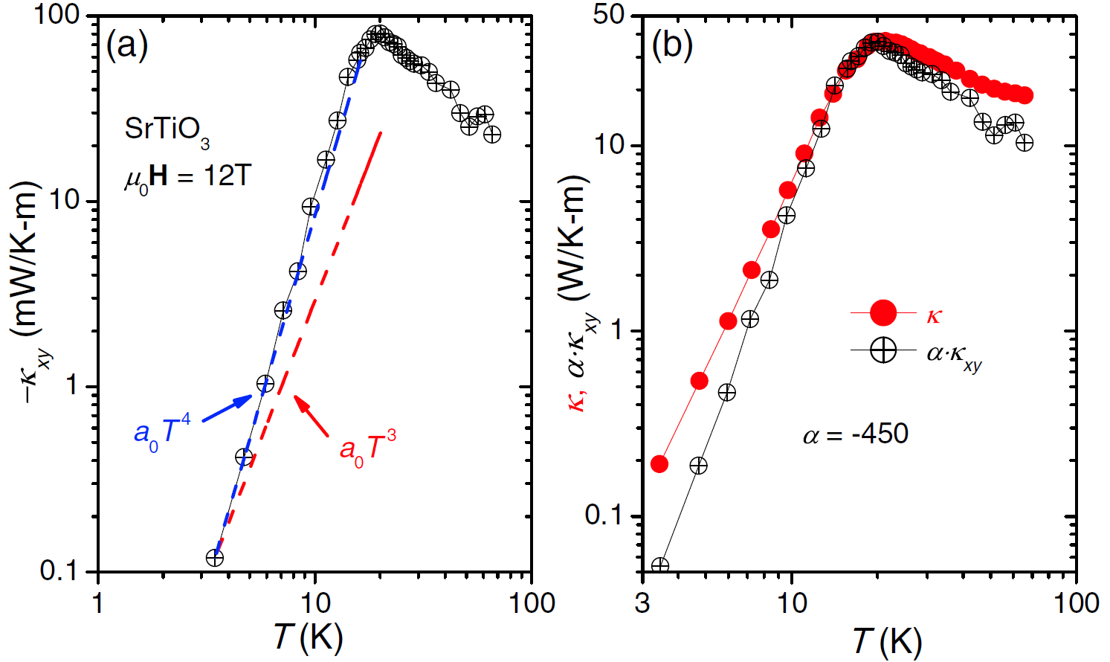
Phonon Hall effect
First phonon Hall experiment on Tb₃Ga₅O₁₂ at T=5.45 K, with k_{xy} estimated to be 0.45 (mW/K-m) at B = 10 T. C. Strohm, G.L.J.A. Rikken, and P. Wyder, PRL 95, 155901 (2005).
SrTiO₃ Hall experimental result, X. Li, B. Fauqué, Z. Zhu, and K. Behnia, PRL 124, 105901 (2020).

Slide 19
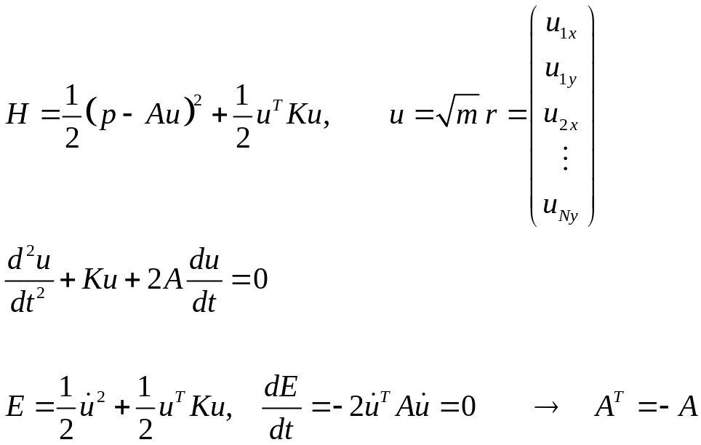
Phonon Hall model
Positive definite
Velocity dependent force
but non-dissipative
What is the physical original of A?
Notes:
A Hamiltonian system cannot be dissipative – equation of motion need only A^T - A, here what I mean is that if the equation of motion contains A du/dt, non-dissipative mean A must be antisymmetric.

Slide 20
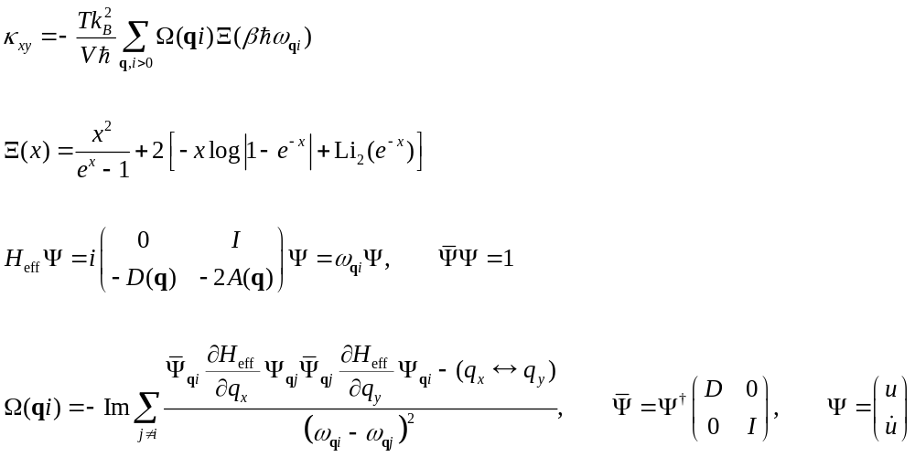

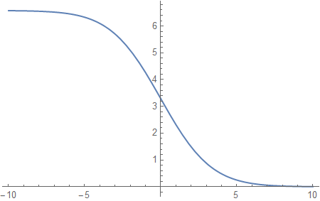

T. Qin et al formula
Notes:
Kxy is Hall thermal conductivity, i.e., when a temperature gradient is applied in y direction, a heat current appears in x direction. Such that Jx = - k_xy dT/dy. For more detail, see Sun, et al, https://arxiv.org/abs/2005.10578 as well as Sun Kangtai’s PhD thesis.

