Slide 1
Week 11,
Magnetic field, Haldane Model, Chern number
Gauge invariance, Peierls substitution, linear response, Kubo formula, integer quantum Hall effect, Berry curvature, Chern number, TKNN formula
Notes:
See also this online notes: https://phyx.readthedocs.io/en/latest/index.html

Slide 2
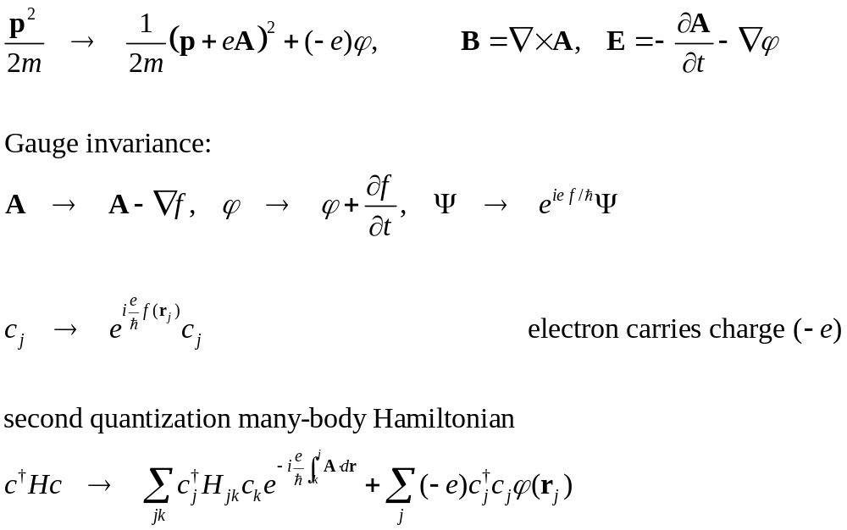
Electron Hamiltonian in electromagnetic field
Notes:
Show both the first quantization and second quantization Hamiltonians are gauge invariant. What does this really mean is that the corresponding time-dependent Schrodinger equation is gauge invariant, and the E and B fields are gauge invariant.

Slide 3
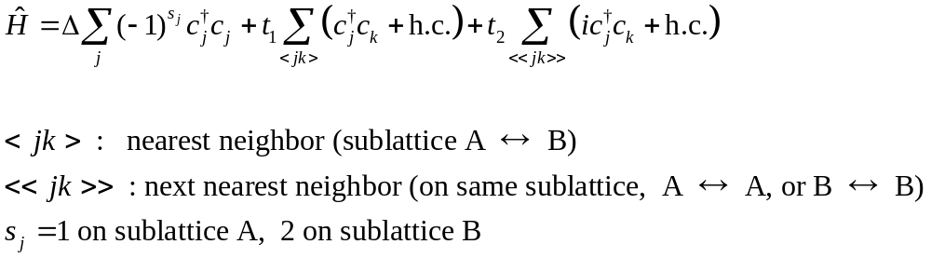


Haldane model (1988)
A
$$t_{1}$$
$${it}_{2}=t_{2}e^{\frac{iπ}{2}}$$
B
Notes:
See D Vanderbilt, “Berry phases in electronic structure theory,” Cambridge (2018).

Slide 4
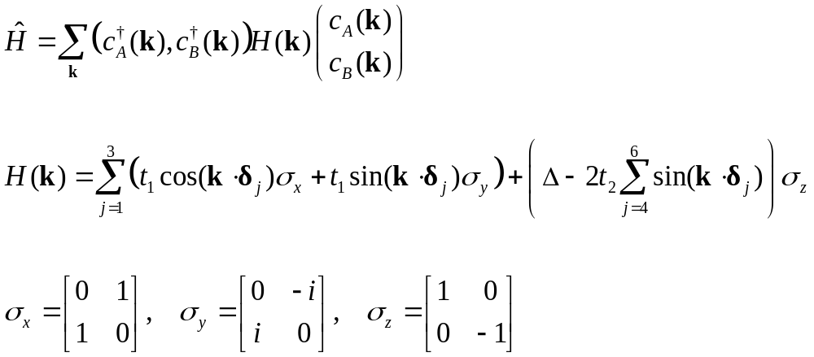





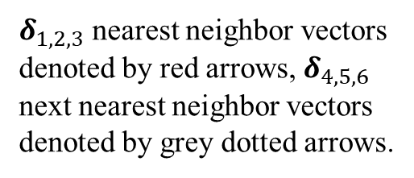
The Haldane model in k space
$$t_{1}$$
$$δ_{4}$$
$$t_{1}$$
$${−it}_{2}$$
$δ_{1,2,3}$ nearest neighbor vectors denoted by red arrows, $δ_{4,5,6}$ next nearest neighbor vectors denoted by grey dotted arrows.
$$δ_{1}$$

Slide 5
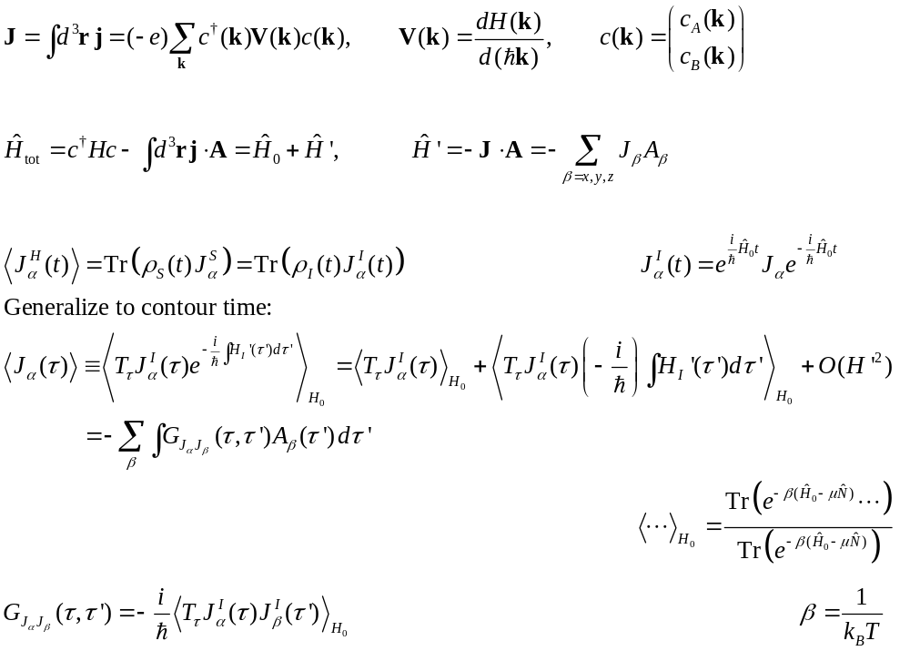
Linear response theory for conductivity
0
Notes:
Where does the interaction term –j.A comes from? We can obtain it from expanding the A term (assuming small) from the Peierls substitution Hamiltonian.

Slide 6
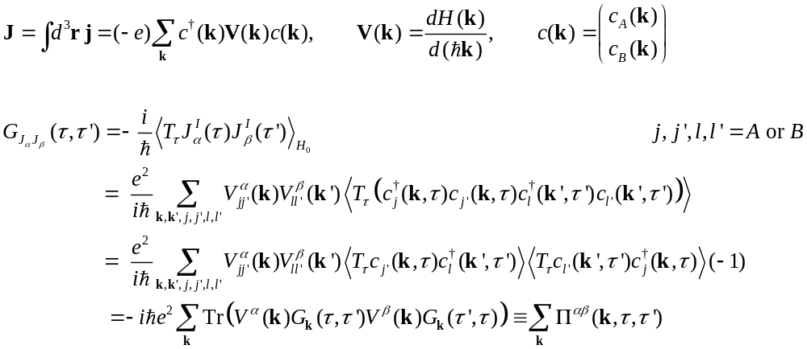


Apply Wick’s theorem to compute G_{JJ}
$$τ, α$$
$$τ′, β$$

Slide 7
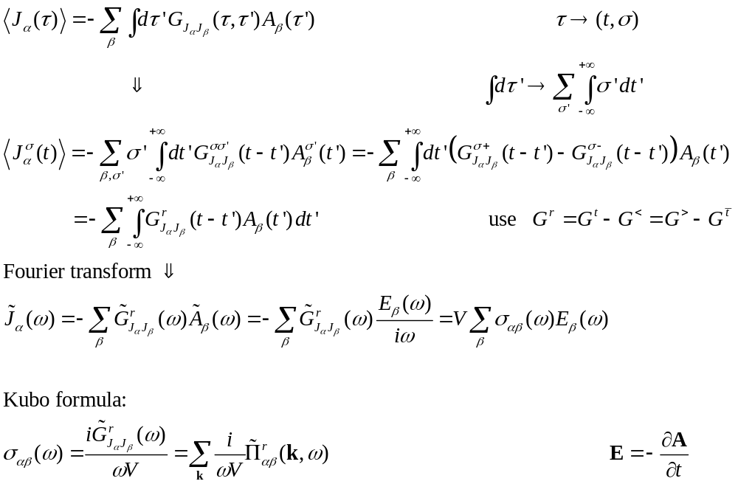
Back to real time t and then ω
Notes:
See also G. D. Mahan, “Many-particle physics, 3rd ed, Chapter 3.8

Slide 8
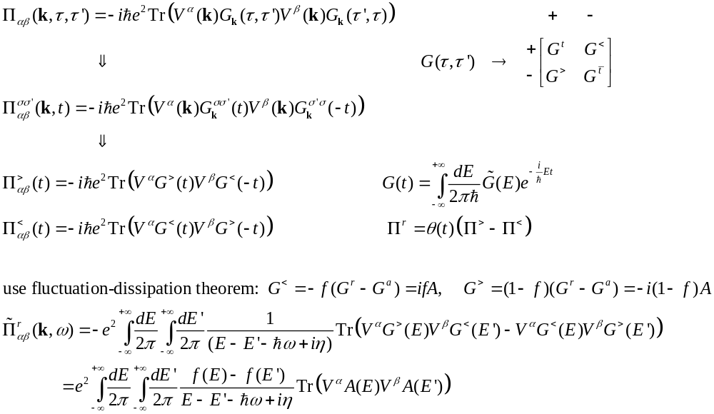
From contour Π to retarded Π
Notes:
The trace means sum over sublattice space, fixing k.

Slide 9
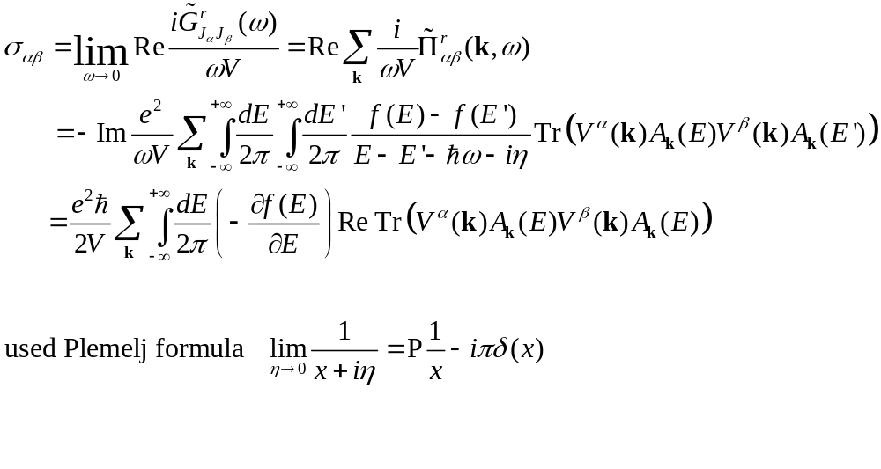
DC conductivity, ω → 0
Notes:
DC: direct current (w-dependent, AC) P stands for Cauchy principle value. It is meaningful only under an integral sign.

Slide 10
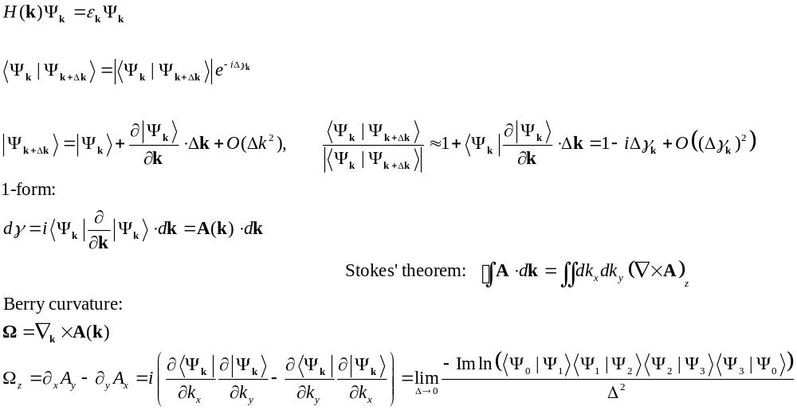

Berry phase/Berry curvature
2
0 1
$$Δ$$
Notes:
Show that the two definitions (by partial derivative and by running over a small square) for \Omega_z are equivalent.

Slide 11
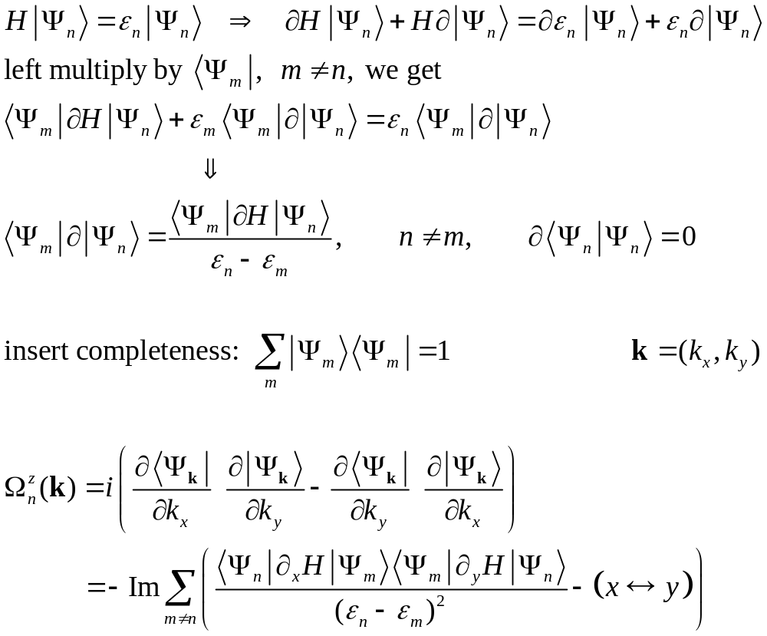
Computing Berry curvature from eigenstates

Slide 12
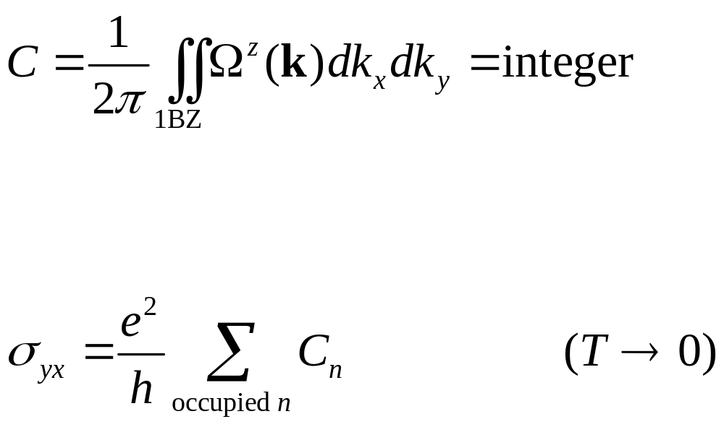
Chern number, TKNN formula (1982)
Notes:
TKNN: D. J. Thouless, M. Kohmoto, M. P/ Nightingale, and. M. den Nijs. See this article for a derivation. https://www.damtp.cam.ac.uk/user/tong/qhe/two.pdf and https://www.nobelprize.org/uploads/2018/06/haldane-lecture-slides.pdf

Slide 13
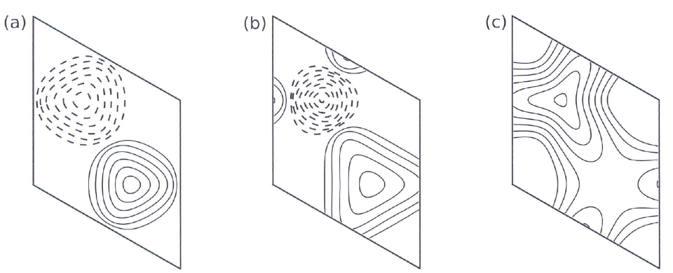
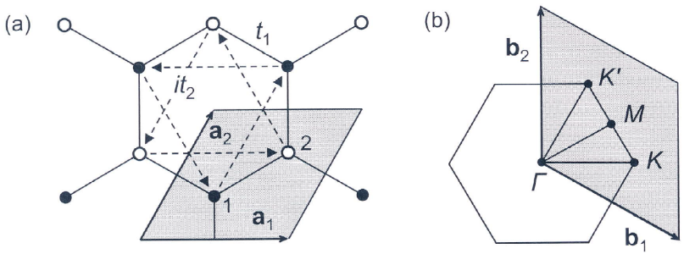
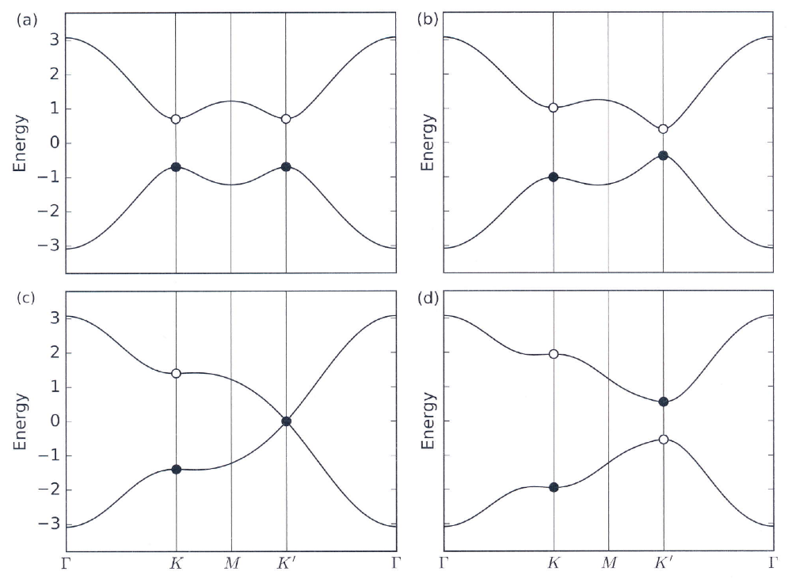
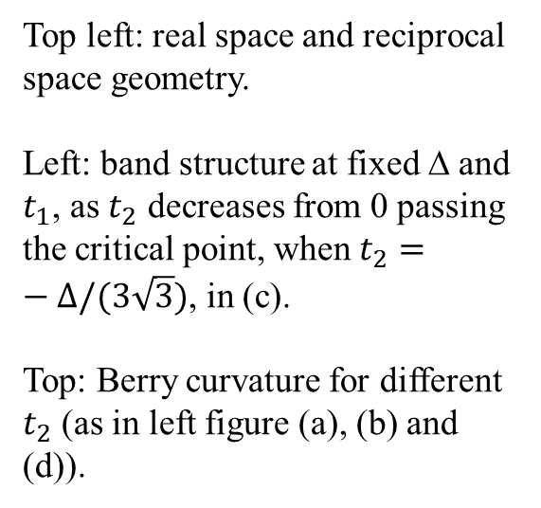
Haldane model
$$C=0 C=0 C=1$$
Top left: real space and reciprocal space geometry.
Left: band structure at fixed Δ and $t_{1}$, as $t_{2}$ decreases from 0 passing the critical point, when $t_{2}=−Δ/(3\sqrt{3})$, in (c).
Top: Berry curvature for different $t_{2}$ (as in left figure (a), (b) and (d)).
Notes:
The figures are from D. Vanderbilt, “Berry phases in electronic structure theory”, Chap 5, pages 203-206.

Slide 14
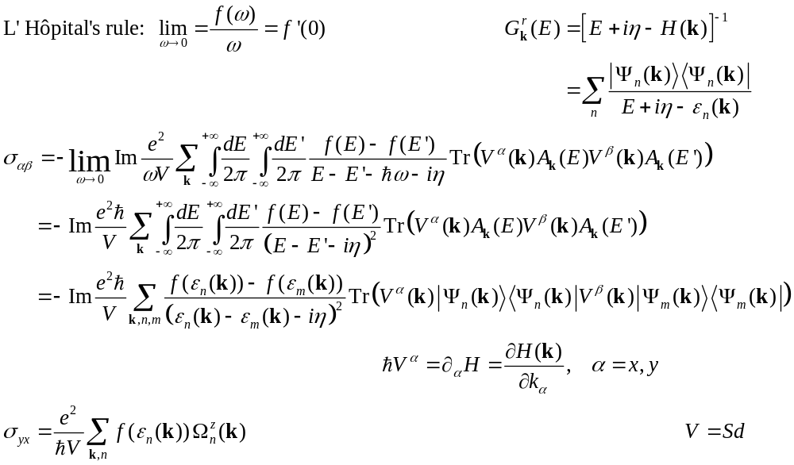
DC conductivity, taking the ω→0 limit differently
Notes:
For 2D materials, the volume V should be interpreted as the area A instead. n is band index. Note that berry curvature formula makes sense only when we have a minimum of two bands.

Slide 15
Other aspects of Berry phase physics
Interpretation/calculation of electro-polarization of ferroelectric materials
Electron-phonon interaction in Born-Oppenheimer approximation
Electron transport in adiabatic driven systems
Berry phases in periodic driven systems, Floquet theory, etc
Notes:
This web site covers a good deal of modern topology physics: https://topocondmat.org/index.html

