Slide 1
Week 12,
Superconductivity,
BCS theory
Superconductivity phenomenology, London equation, BCS Hamiltonian, Bogoliubov-de Gennes Hamiltonian, BCS ground state, gap equation
Notes:
See books by M. Tinkham, “Introduction to superconductivity”, 2nd edition, or P. G. de Gennes, “Superconductivity of Metals and Alloys”, or this lecture notes https://portal.ifi.unicamp.br/images/files/graduacao/aulas-on-line/fen-emerg/lecture_notes_BCS.pdf

Slide 2
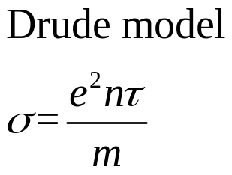



Resistivity goes to 0 abruptly at temperature T_{c}
$$ρ=1/σ$$
0
$$T_{c}$$
$$T$$
Notes:
Note: Ohm’s law, current I = GV, conductance G = sigma*A/L, V: voltage difference, A: cross section area, L transport length.

Slide 3
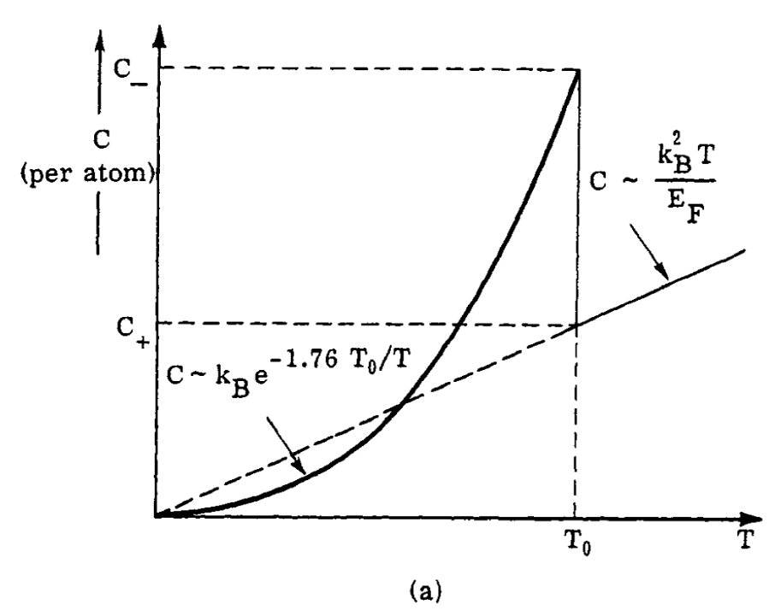
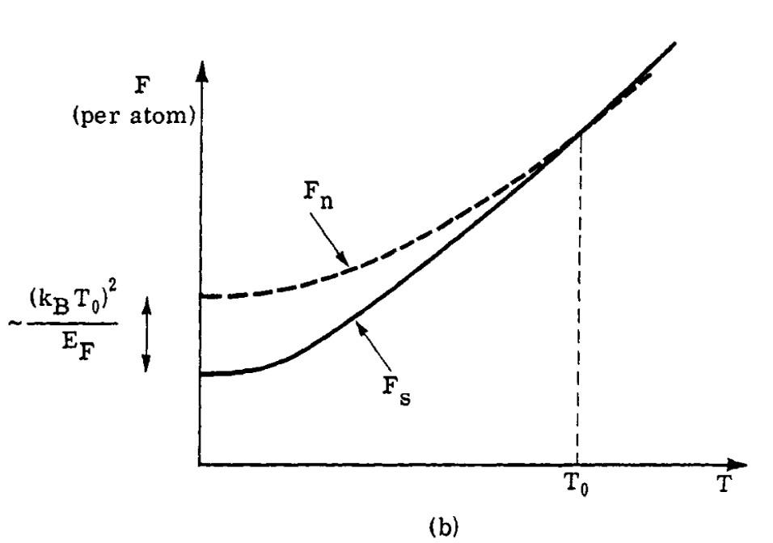
Thermodynamic properties
heat capacity
free energy
Notes:
Figures from P. G. de Gennes, “Superconductivity of metals and allows”, page 2.

Slide 4





Meissner effect
$$H=\frac{1}{μ_{0}}B−M$$
normal
Super-conducting
$$T_{c}$$
$$T$$
$$B$$
$$B$$
normal metal
superconductor
Notes:
Type I vs Type II superconductor.

Slide 5
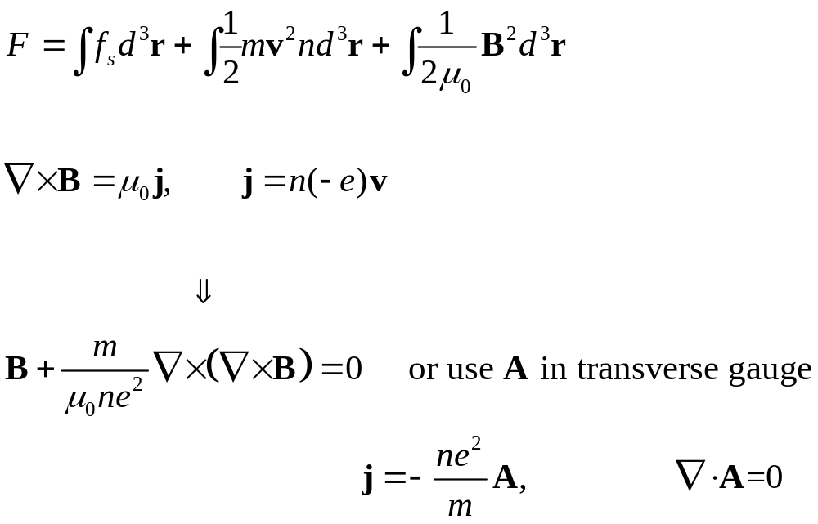
Electromagnetic property – London equation
Notes:
The vector potential must be in Landon gauge or also called Coulomb gauge in order for the equation j proportional to A to be valid.

Slide 6

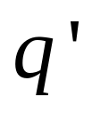

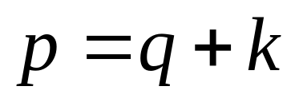
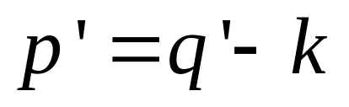
Origin of conventional superconductivity – exchange of phonons
Notes:
The phonon wave spans large distance of order, say, 100 nm, so the interactions are mean-field like.

Slide 7
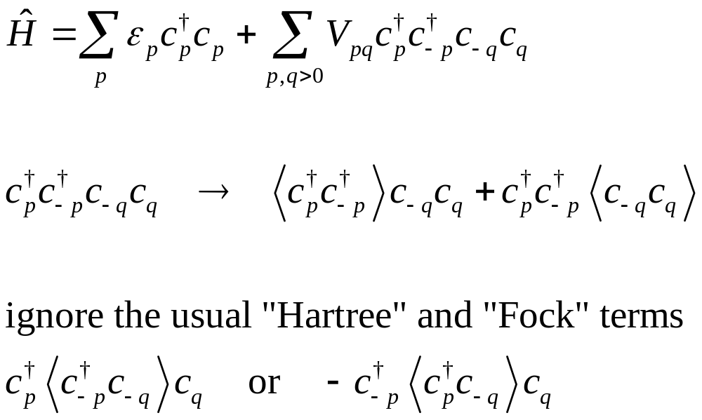
Mean-field approximation for “Coulomb” interaction (1D)
Notes:
The original BCS theory is based on the Cooper pair which is c_{p,+} c_{-p,-}, that is opposite momentum and opposition spin. In our spinless model, we have opposite momentum only. This is equivalent to so-called p-wave theory where the spins are in parallel.

Slide 8
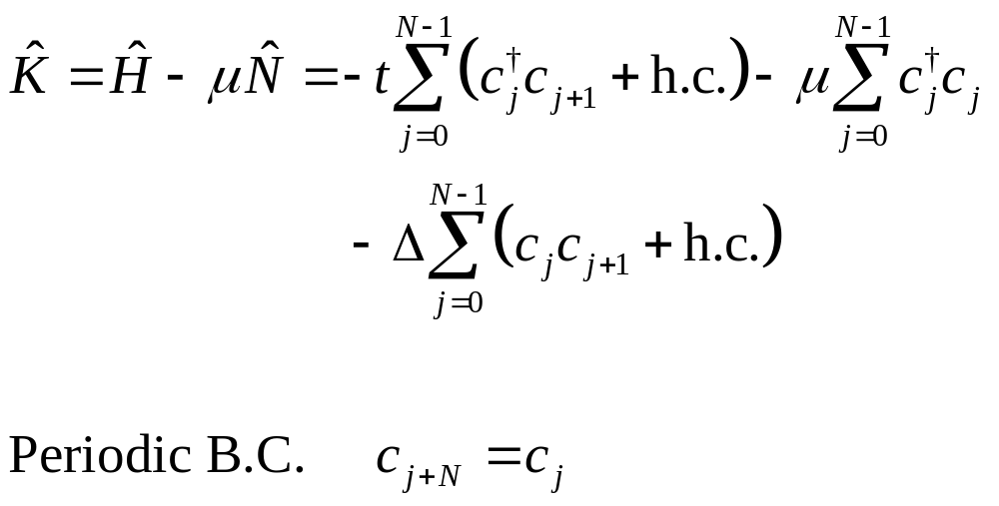
A microscopic model for superconductivity (1D, spinless or p-wave)
Notes:
Delta is gap parameter, or order parameter, for superconductivity.

Slide 9

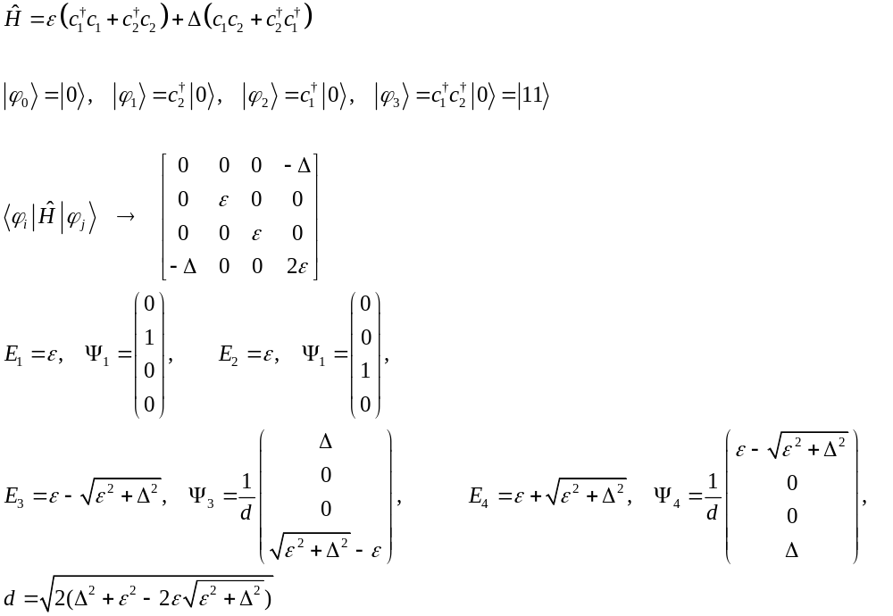


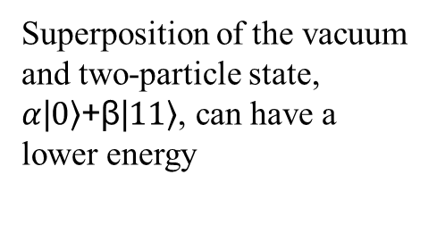


A toy model for (Cooper) pairing
$$E_{i}$$
$$Δ$$
Superposition of the vacuum and two-particle state, $α$|$\left.0\right\rangle$+β|$\left.11\right\rangle$, can have a lower energy

Slide 10
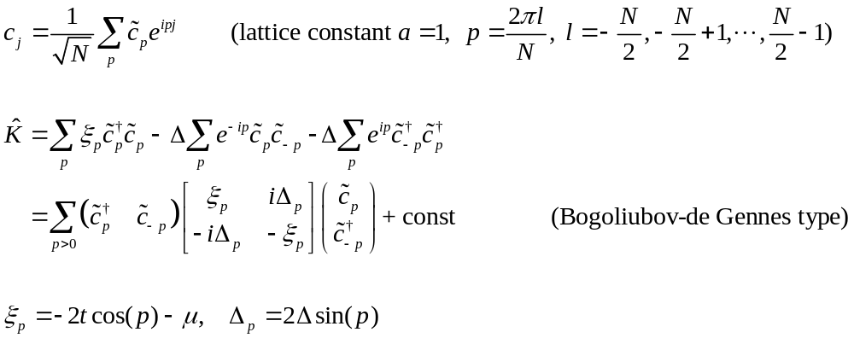
1D chain model in momentum p-space

Slide 11
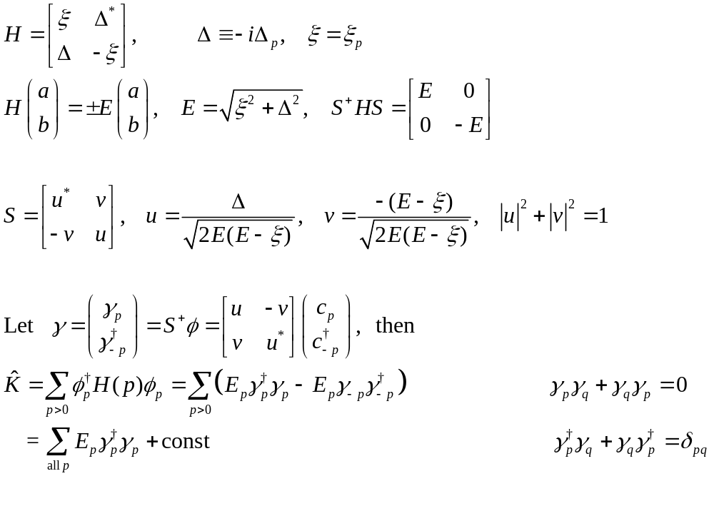



Diagonalise BdG Hamiltonian
$$E$$
$$Δ$$
$$p$$
Notes:
Gamma are the fermionic quasi-particles, in BCS theory. Note here v is real, but u is purely imaginary.

Slide 12
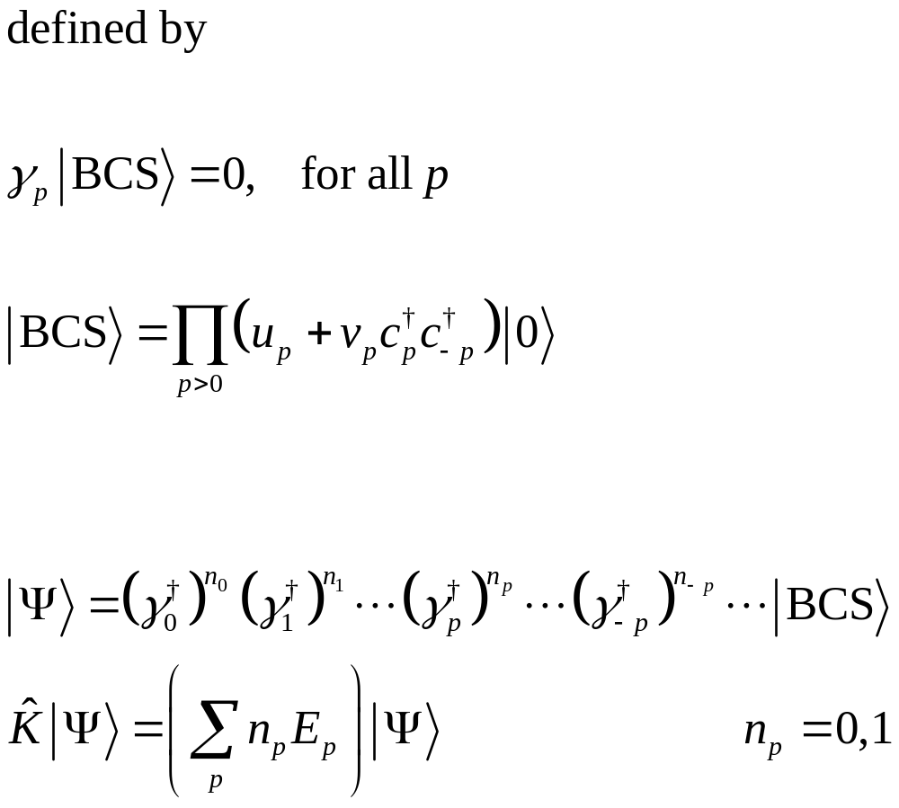
The BCS ground state
Notes:
We remind again K = H – mu N is the Kamiltonian.

Slide 13
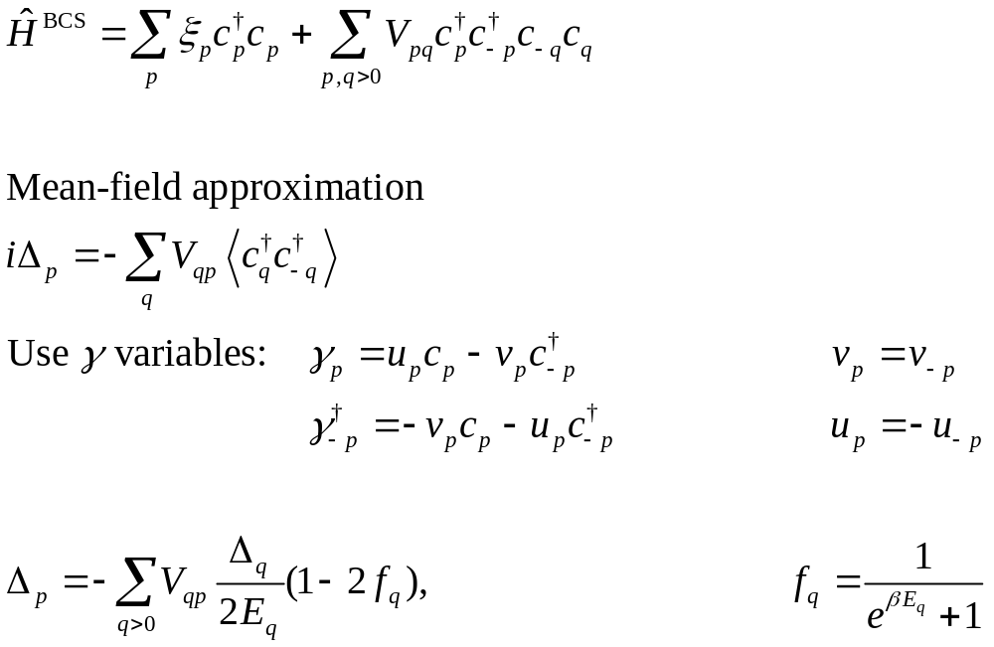


Gap equation
$$Δ$$
$$T_{c}$$
Notes:
No chemical potential here in f because mu is already contained in xi, or in the K = H- mu N at the beginning.

