Slide 1
Week 2,
Lattice Vibration, Phonons
Quantum harmonic oscillator, vibration of molecules, normal modes, lattice phonon waves, second quantization, lattice dynamics, phonon dispersion from DFT first principles

Slide 2
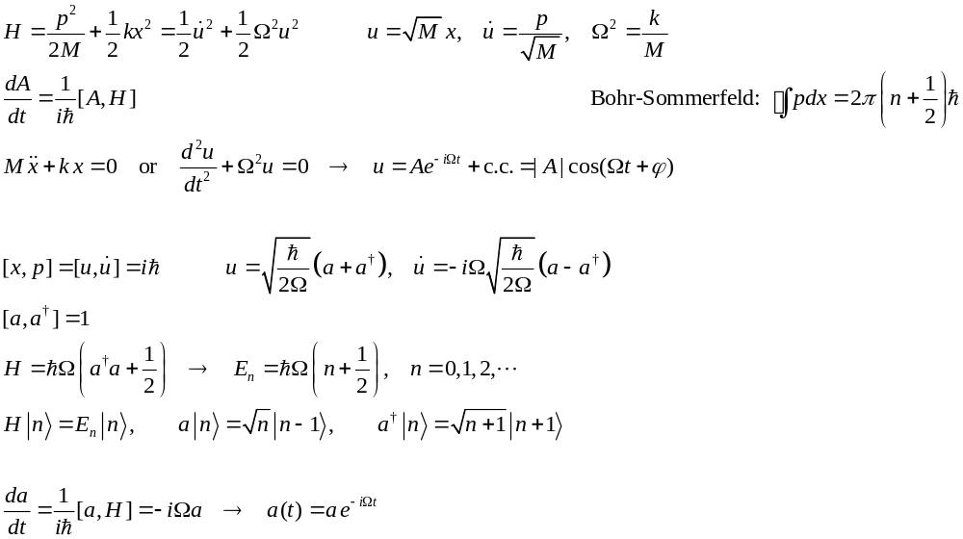



Harmonic oscillator
x
$$\frac{5}{2}ℏΩ$$
E
$$\frac{3}{2}ℏΩ$$
$$\frac{1}{2}ℏΩ$$
x
Notes:
Review the quantum-mechanics books, such as J. J. Sakurai.

Slide 3
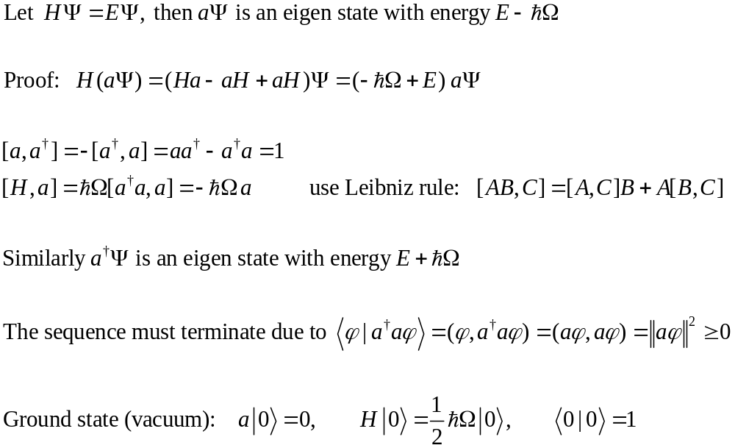

Annihilation and creation operators
Energy E
E
$$E−ℏΩ$$
Notes:
Note, we follow the usual convention of Dirac <f | g> = (g, f), i.e., linear in g, antilinear in f, and adjunct (Hermitian) is defined by ( a g, f) = (g, a^+ f).

Slide 4
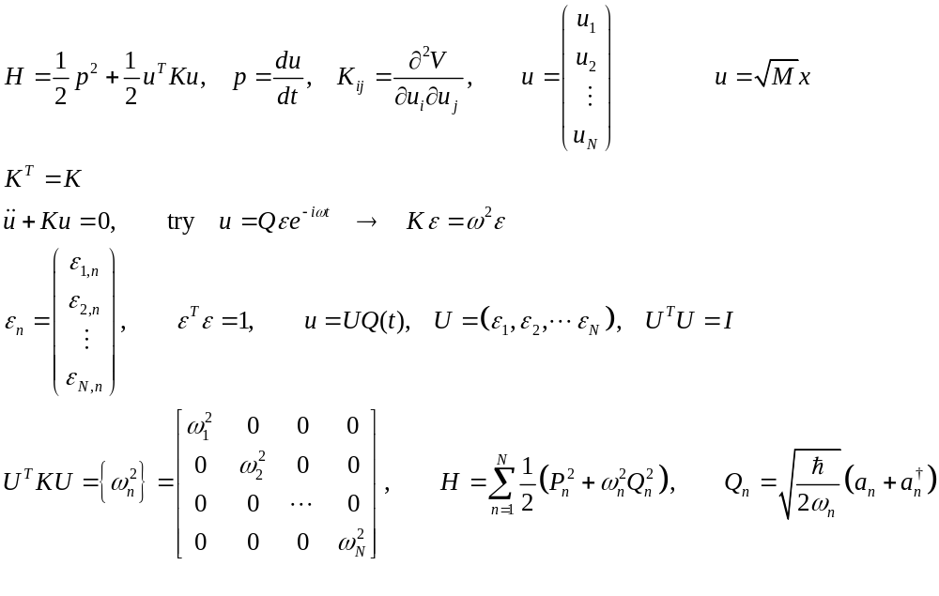
Molecular vibration, normal mode
Notes:
Q_n(t) = Q_n exp(-I w_n t) is called the normal mode coordinate for the mode n.

Slide 5
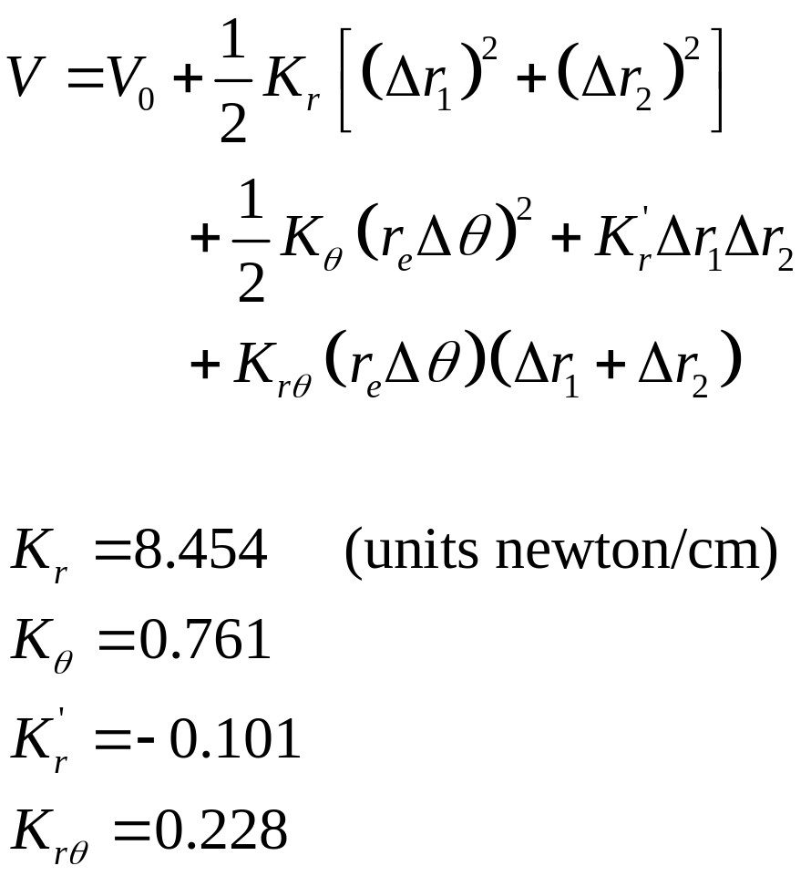
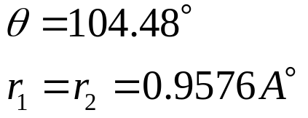



Water molecule
H
$$r_{1}$$
O
$$θ$$
$$r_{2}$$
H
Notes:
From page 10 in https://www.princeton.edu/~fhs/fhspapers/fhspaper79.pdf

Slide 6
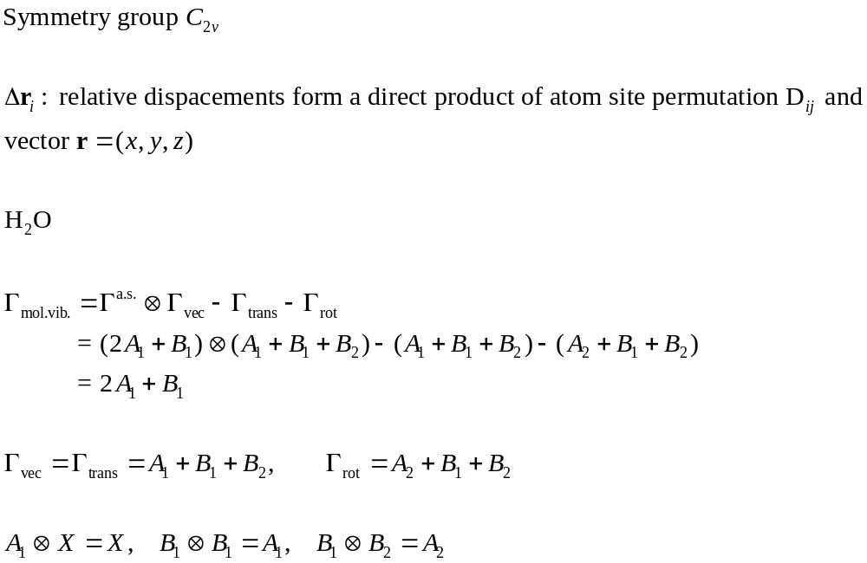
Molecular vibration, group theory, H₂O
A₁ A₁
z
x
B₁
C_{2v} |  | E | C₂ | σ_{v} | σ’_{v}
z | A₁ | 1 | 1 | 1 | 1
R_{z} | A₂ | 1 | 1 | -1 | -1
x, R_{y} | B₁ | 1 | -1 | 1 | -1
y, R_{x} | B₂ | 1 | -1 | -1 | 1
 | _{Γ}^{a.s} | 3 | 1 | 3 | 1
Notes:
See chap 8 of Dresselhaus et al, “Group theory, application to physics of condensed matter” sigma_v, in the plane of molecule, sigma_v’ is perpendicular to the plane of molecule. C2 (z axis) passes through O, in the plane of molecule, in the direction of two Hs.

Slide 7
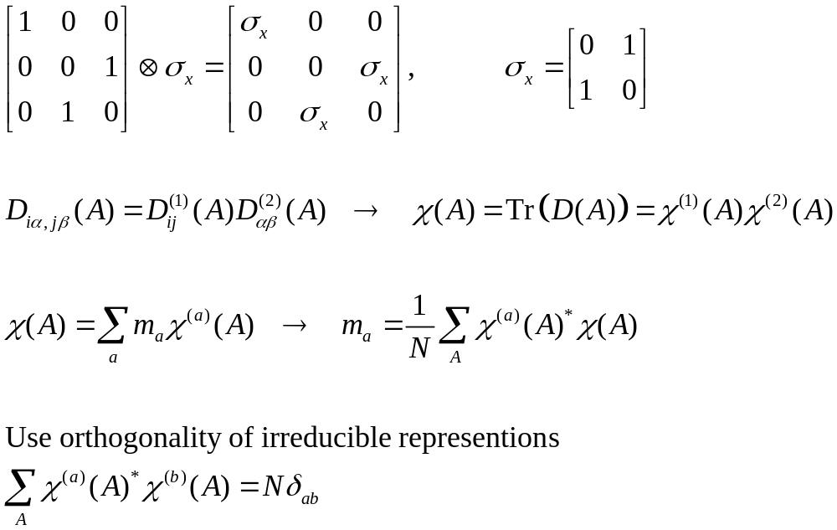
Direct product representation
Notes:
N here is the order of the group.

Slide 8
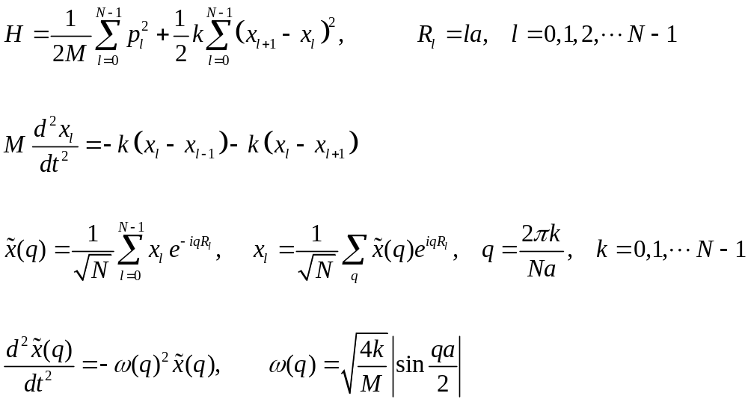
Lattice vibration, 1D chain
k k
x₀
a: lattice constant
x_{l-1} x_{l} x_{l+1}
x_{N-1} x_{N} =x₀
ω
0
2π/a
q

Slide 9
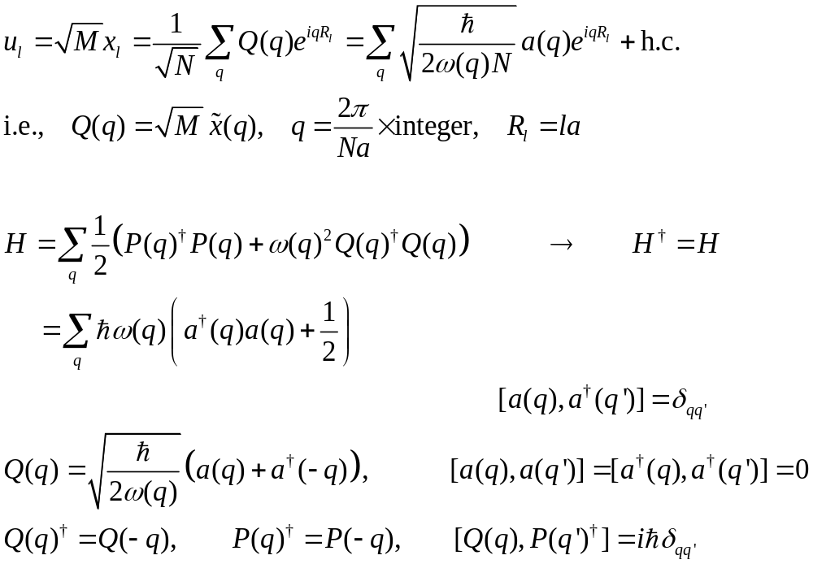
Normal mode coordinates, second quantization of 1D chain
Notes:
Lattice vibration differs from small molecules in that here we deal with travelling wave instead of standing wave.

Slide 10
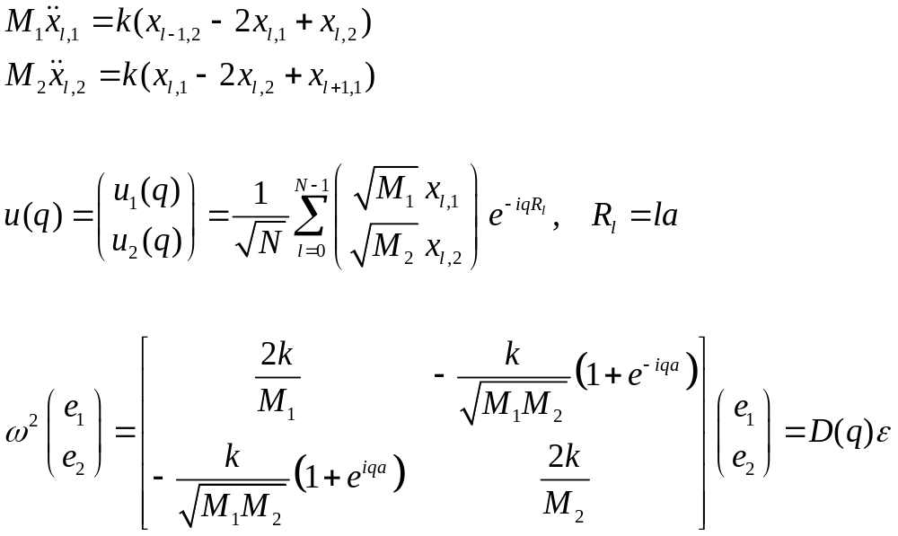
1D chain with two kinds of atoms
l-1 l l+1
k k k
M₁ M₂
ω
a
LO
LA
q
π/a
Notes:
(u1,u2) is (e1, e2) except e is normalized to 1, i.e., e^+ e = 1.

Slide 11
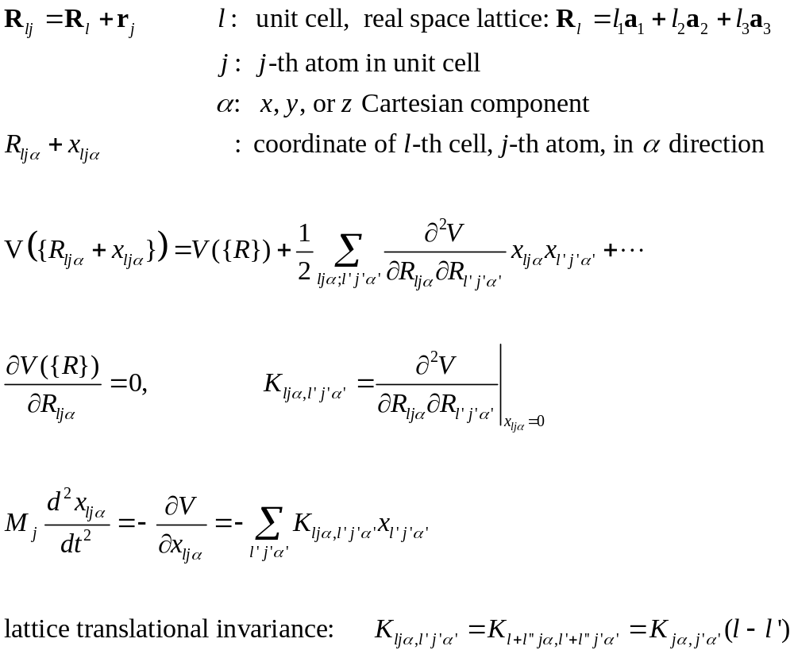
General lattice, forces, eqn
a₂
r_{j}
x_{lj}
R_{l}
a₁
Notes:
For general discussion of phonon physics, see e.g., J Callaway, “Quantum theory of solid state”.

Slide 12
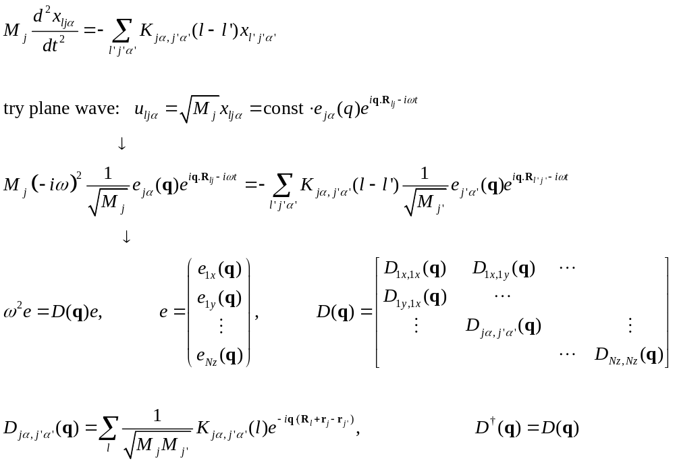
Dynamic matrix
Notes:
See M Born and K. Huang, “Dynamical Theory of Crystal Lattices”, Clarendon (1954), pages 67-69, 173-175.

Slide 13
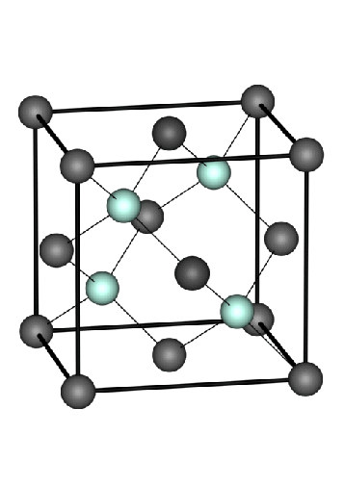
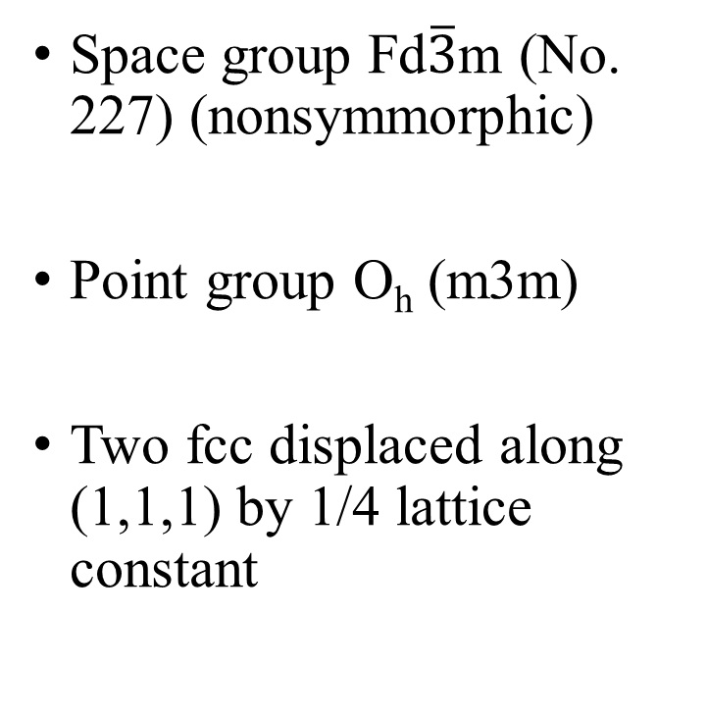
Diamond lattice, structure
Space group Fd$\overline{3}$m (No. 227) (nonsymmorphic)
Point group O_{h} (m3m)
Two fcc displaced along (1,1,1) by 1/4 lattice constant
Notes:
This page at the bottom give a table of all the 192 space group symmetry operations.
http://lampx.tugraz.at/~hadley/ss1/crystalstructure/structures/diamond/diamond.php
Figure from https://www.researchgate.net/figure/Conventional-cubic-cell-of-the-diamond-lattice-Element-Lattice-Constant-a-A_fig2_285014517

Slide 14
Character χ table for O_{h}
 | E | 8C₃ | 6C₂ | 6C₄ | 3C₂ =(C₄)² | i | 6S₄ | 8S₆ | 3σ_{h} | 6σ_{d} | linear, rotations | quadratic
A_{1g} (Γ₁) | 1 | 1 | 1 | 1 | 1 | 1 | 1 | 1 | 1 | 1 |  | x²+y²+z²
A_{2g} (Γ₂) | 1 | 1 | -1 | -1 | 1 | 1 | -1 | 1 | 1 | -1
E_{g} (Γ₁₂) | 2 | -1 | 0 | 0 | 2 | 2 | 0 | -1 | 2 | 0 |  | (2z²-x²-y², x²-y²)
T_{1g} (Γ₁₅′) | 3 | 0 | -1 | 1 | -1 | 3 | 1 | 0 | -1 | -1 | (R_{x}, R_{y}, R_{z})
T_{2g} (Γ₂₅′) | 3 | 0 | 1 | -1 | -1 | 3 | -1 | 0 | -1 | 1 |  | (xz, yz, xy)
A_{1u} (Γ₁′) | 1 | 1 | 1 | 1 | 1 | -1 | -1 | -1 | -1 | -1
A_{2u} (Γ₂′) | 1 | 1 | -1 | -1 | 1 | -1 | 1 | -1 | -1 | 1
E_{u} (Γ₁₂′) | 2 | -1 | 0 | 0 | 2 | -2 | 0 | 1 | -2 | 0
T_{1u} (Γ₁₅) | 3 | 0 | -1 | 1 | -1 | -3 | -1 | 0 | 1 | 1 | (x, y, z)
T_{2u} (Γ₂₅) | 3 | 0 | 1 | -1 | -1 | -3 | 1 | 0 | 1 | -1
Notes:
See this page for the point group O_h:
http://gernot-katzers-spice-pages.com/character_tables/Oh.html
See also the Wikipedia page for a complete list: https://en.wikipedia.org/wiki/List_of_character_tables_for_chemically_important_3D_point_groups

Slide 15
Run QE at HPC (e.g., atlas9.nus.edu.sg)
Setup the proper running environment for QE by issuing two linux commands:
source /etc/profile.d/rec_modules.sh
module load espresso6.5-Centos6_Intel
The QE binary is then available as pw.x (for DFT plane wave self consistency) and ph.x (DFT perturbative phonon calculation)
Notes:
See HPC site at https://nusit.nus.edu.sg/services/getting-started/introductory-guide-for-new-hpc-users/
Software in general https://nusit.nus.edu.sg/services/hpc/application-software/
and Quantum Espresso in particular https://nusit.nus.edu.sg/services/hpc/application-software/quantum-espresso/

Slide 16
Quantum Espresso (QE) for phonon mode at Γ point
Step 1: run pw.x at the equilibrium structure
mpirun –np 8 pw.x –in scf.in > out
Step 2: run ph.x to obtain frequencies and eigenmodes.
mpirun –np 8 ph.x –in ph.in > phout
See also https://www.quantum-espresso.org/resources/tutorials/shanghai-2013/hands-on-phonons/phonons_tutorial_shanghai1.pdf
Notes:
See also:
https://www.quantum-espresso.org/resources/tutorials/shanghai-2013/hands-on-phonons/phonons_tutorial_shanghai1.pdf

Slide 17
Input file scf.in for pw.x
&control
prefix = 'diamond'
calculation = 'vc-relax'
restart_mode = 'from_scratch'
pseudo_dir = './'
/
&system
ibrav = 0
celldm(1)=6.75870348
nat = 2
ntyp = 1
ecutwfc = 60.0
/
&electrons
conv_thr = 1.0d-10
/
&IONS
ion_dynamics = 'bfgs'
/
&CELL
cell_dynamics = 'bfgs'
cell_dofree = 'ibrav'
/
CELL_PARAMETERS alat
0.0000000 0.5000000 0.5000000
0.5000000 0.0000000 0.5000000
0.5000000 0.5000000 0.0000000
ATOMIC_SPECIES
C 12.011 C.UPF
ATOMIC_POSITIONS alat
C 0.0000000 0.0000000 0.000000
C 0.250000 0.25000000 0.250000
K_POINTS automatic
10 10 10 0 0 0

Slide 18
Input file ph.in for ph.x
phonons at Gamma point
&INPUTPH
prefix = 'diamond'
epsil = .true.
fildyn = 'dyn.G'
tr2_ph = 1.0d-14
/
0.0 0.0 0.0
The normal mode displacements are reported in the dyn.G file.

Slide 19
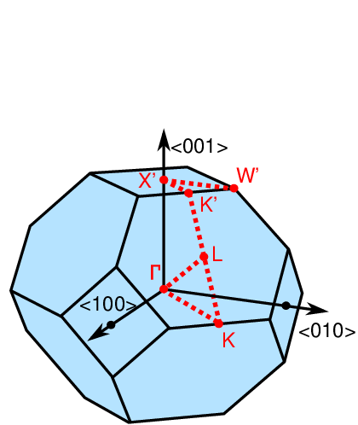
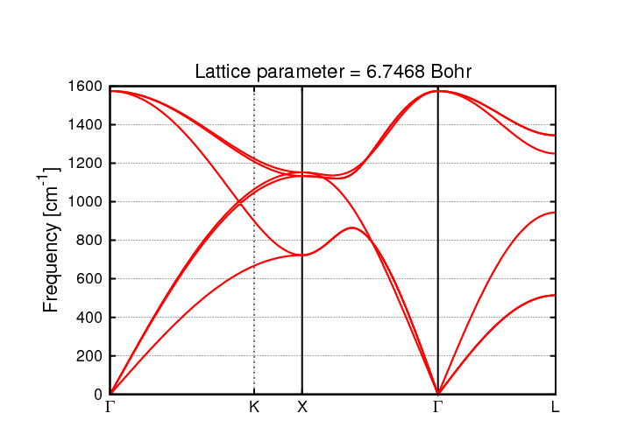
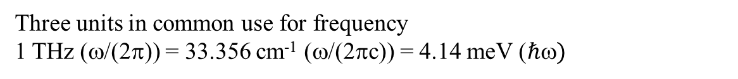
Phonon dispersion for diamond
Three units in common use for frequency
1 THz (ω/(2π)) = 33.356 cm⁻¹ (ω/(2πc)) = 4.14 meV ($ℏ)$
Notes:
Figure from http://exciting-code.org/lithium-phonon-and-thermal-properties-diamond
https://www.researchgate.net/figure/The-Brillouin-zone-of-a-FCC-lattice-Fig-13-The-truncated-octahedron-is-formed-buy_fig3_264872465

