Slide 1
Week 3,
Electrons, tight-binding models
Electron orbitals, tight-binding models, creation/annihilation operators, second quantization, graphene band structures, density of states
Notes:
Read chapters 1-3, H Bruus & K. Flensberg, “Many-body quantum theory in condensed matter physics”.

Slide 2
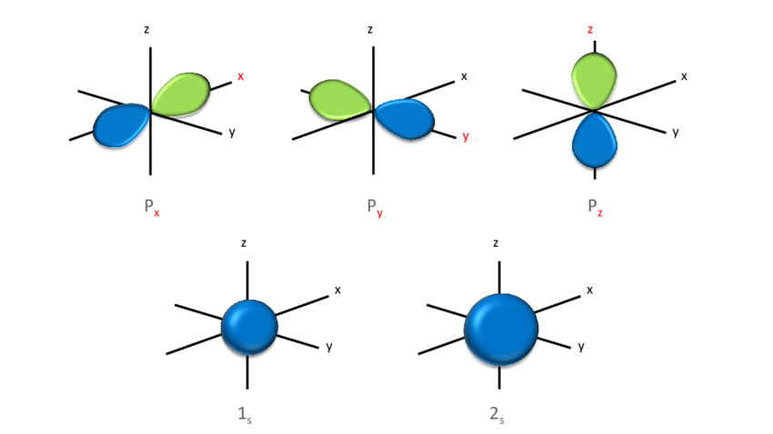
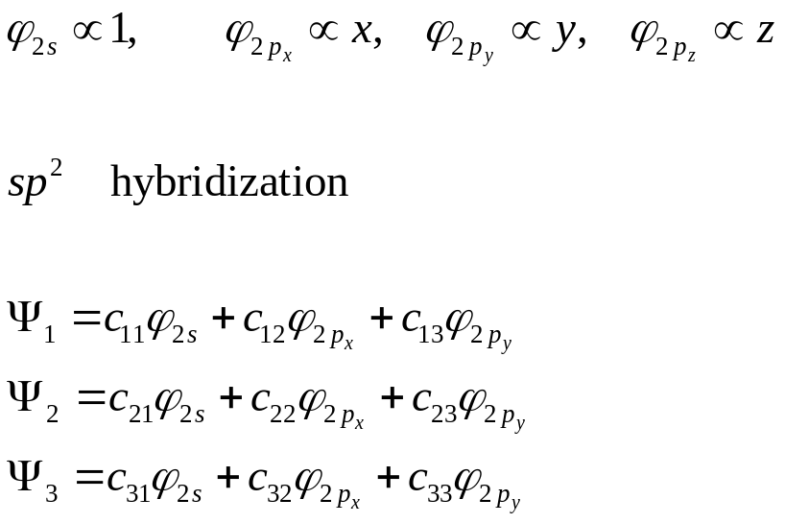
Atomic orbitals of carbon atom
Density (gm cm⁻³)
Lattice constant (Å)
Melting temperature
carbon 12.011
3.52 6
1s²2s²2p²
3.57 diamond
(4300) 1860
Mass
Atomic number
Debye temperature (K)
C
Notes:
Figure from https://www.researchgate.net/figure/3D-representation-of-s-and-p-atomic-orbitals-of-the-hydrogen-atom_fig1_328225193. The choice for sp^2 is
c11^2 + c21^2 + c31^2 = 1. The three states should be orthonormal, and the three states should be related by 2pi/3 rotation, see R. Saito, G. Dresselhaus and M. S. Dresselhaus, “Physical properties of carbon nanotubes’, World Scientific (1998), page 8.

Slide 3
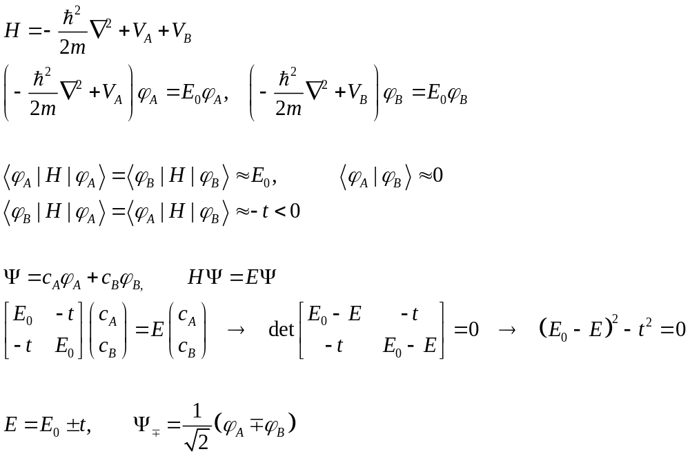


Bonding
Potential
V_{A} V_{B}
$${σ^{∗}: φ}_{A}−φ_{B}$$
E₀+t
E₀
E₀-t
$σ: φ_{A}+φ_{B}$
Notes:
What is the general feature if we put N of these potentials V in a line? Ans: The N-fold generate E_0 will split into N levels forming band when N -> inf. The smaller the hopping t, the narrower the band. So 1s band is very narrow, i.e., almost localized at the site.

Slide 4
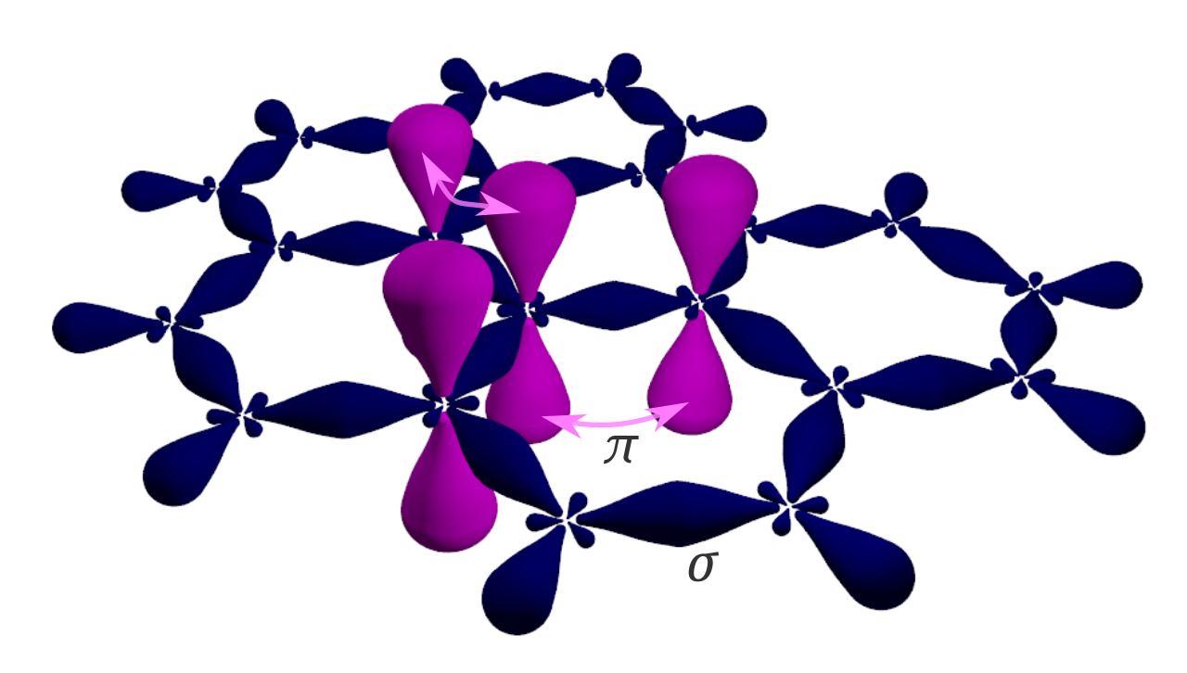
p_{z} (or π) orbital in graphene
Each atomic orbital can be occupied by two electrons with spin up and down.
1 s -> 2 electrons
3 sp² -> 3 electrons from each atom (shared occupation of the σ bond)
p_{z} -> 1 electron each atom (half filling)
Notes:
Figure by Ponor - Own work, CC BY-SA 4.0, https://commons.wikimedia.org/w/index.php?curid=92461297

Slide 5
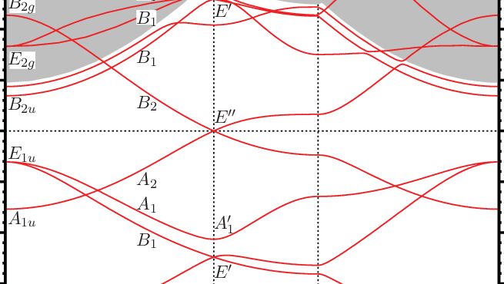



Graphene band structure
$$k_{y}$$
M
$$Γ$$
K
$$k_{x}$$
D_{6h}
D_{3h}
Γ K M Γ
Notes:
Figure from https://www.researchgate.net/figure/Color-online-Graphene-band-structure-evaluated-with-use-of-the-FP-LAPW-method-The_fig1_258695492/download
Since each unit cell of graphene has two atoms, we have altogether 12 electrons, the 4 electrons are in 1s orbitals (in pseupotential as core electrons not has a band here). The remain 8 electrons are by the dispersion below the fermi level which is the horizontal dotted line.

Slide 6
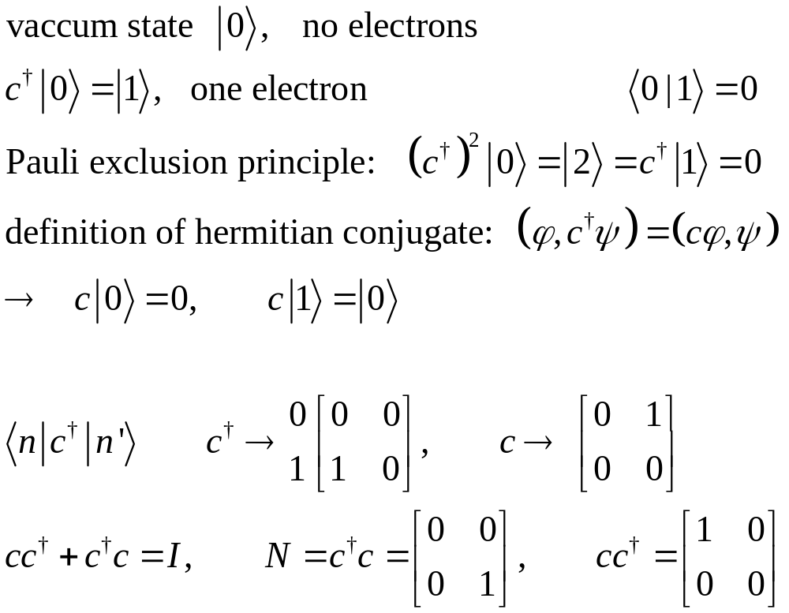
Focus on one site (spinless)
0 1
Notes:
See also NEGF-quantum-dot.pdf 23 March 2017

Slide 7
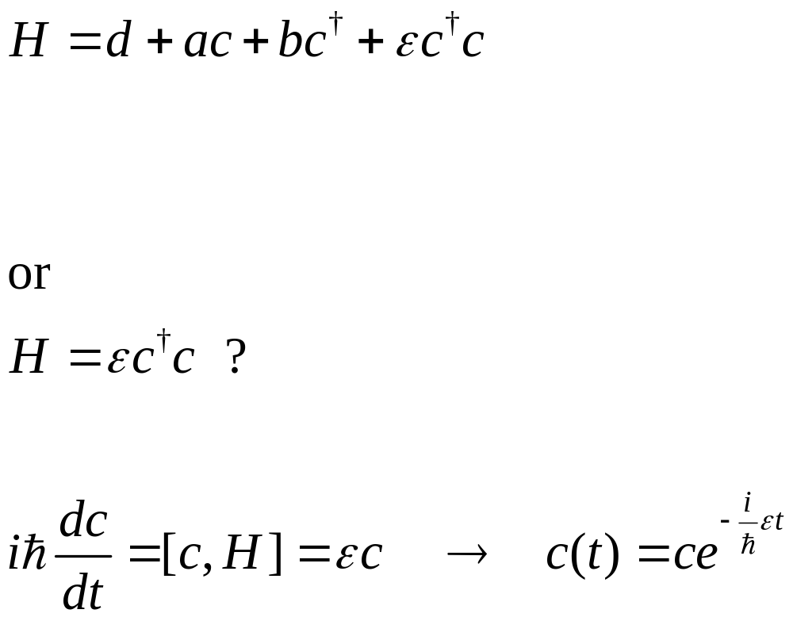
Quantum dot Hamiltonian
energy
ε
Notes:
At least H need to be Hermitian, so we must have b = a*, and d and eps real. However, we may have the PT-symmetric quantum mechanics, where H is not required to be Hermitian. See M. Bender. https://arxiv.org/abs/quant-ph/0501052

Slide 8
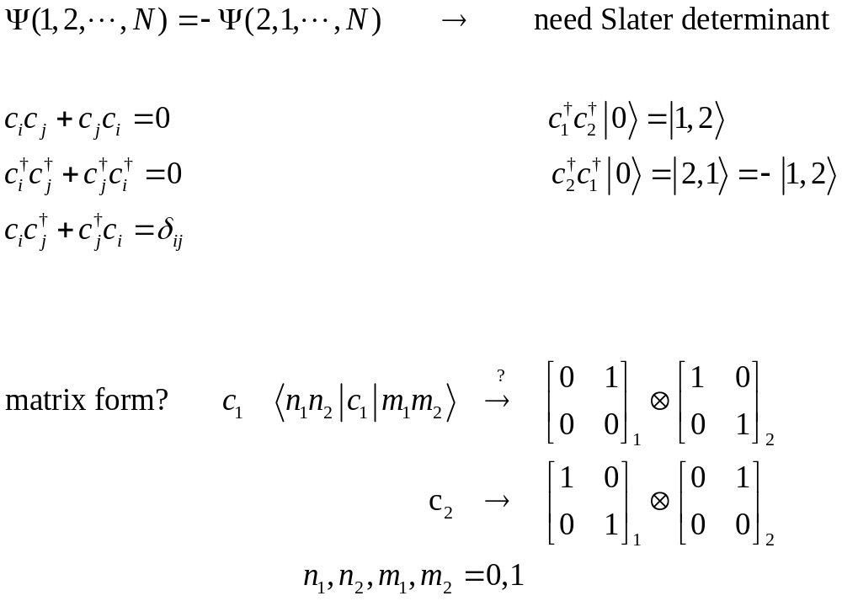
Many electrons, property of identical fermions
Notes:
Work out the correct matrix representation for a set of N fermion operators. delta_ij is Kronecker delta equal 1 if i = j, and 0 otherwise.

Slide 9
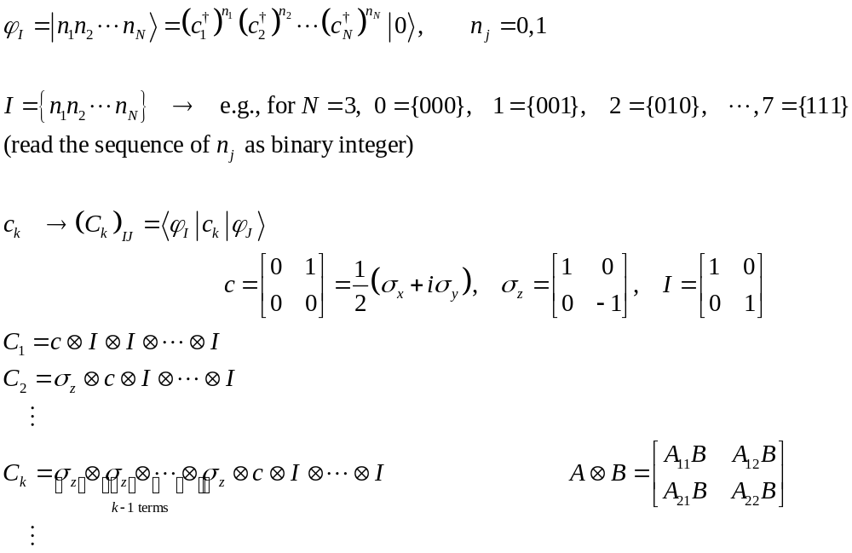
Matrix representation of fermionic operators : Jordan-Wigner
Notes:
The set of 2^N all phi_I spans the “Fock” space, while the N one particle states is usually called Hilbert space, Fock space = vacuum + C^N_1 one particle states + C^N_2 two-particle states + ….+ C^N_k of k-particle states + 1 N particle states. Here + means direct sum of linear spaces. C^N_k = N!/(k!(N-k)!) is the combinatorial number of choice k out of N (sites). We note c sigma_z + sigma_z c = 0; this is the reason why C_i C_j + C_j C_i = 0, as required of the fermion operators.

Slide 10
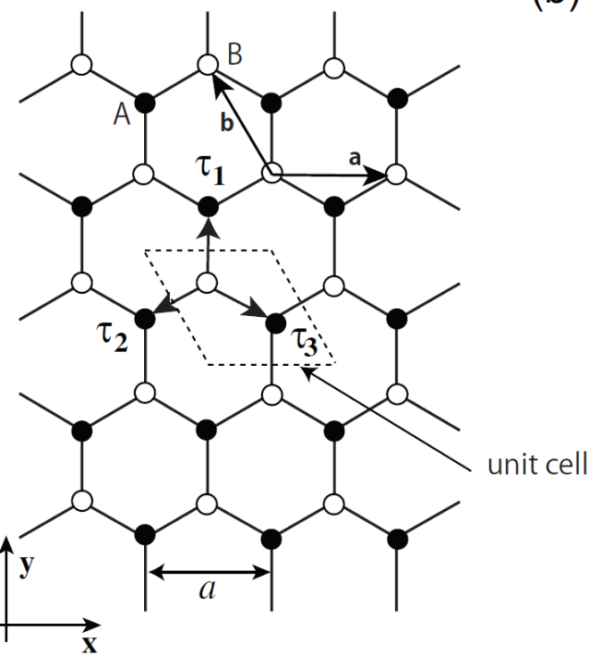
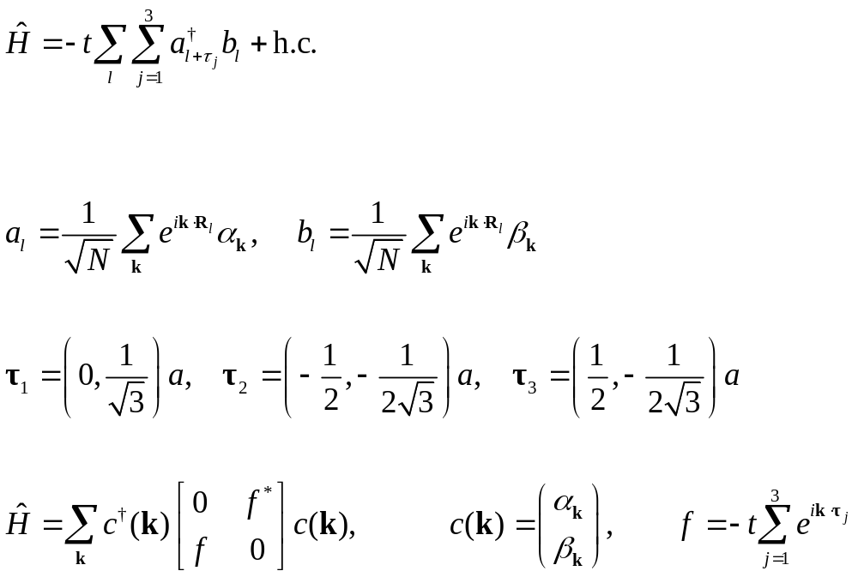
Tight-binding model for graphene
Notes:
Hopping t = 2.8 eV. Go through the math from real space l to Fourier space (wave-vector space) k, to show the formula for H(k) is correct. If sublattice b is at the Bravais lattice sites denoted by R_l, the sublattice a is always shifted by tau_j, so for both a and b, the Fourier transform is based on the actual location exp( i k. r), where r is the location of the atom.

Slide 11
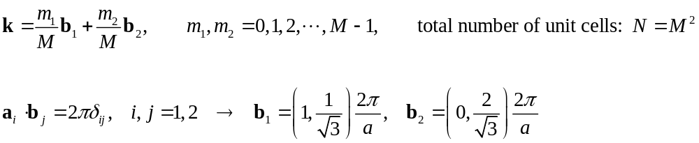
Choice of k values
k_{y}
b₂
M
K’
b₁
K
Γ
k_{x}
Notes:
Prove that the rhombus (equilateral quadrilateral) and the hexagon has the same area, 2) How to move the pieces of the rhombus back to the Wigner-Seitz cell by displacing of the reciprocal lattice vectors n1 b1 + n2 b2, where n1 and n2 are integers? The Wigner-Seitz cell obtained by a Voronoi construction.

Slide 12
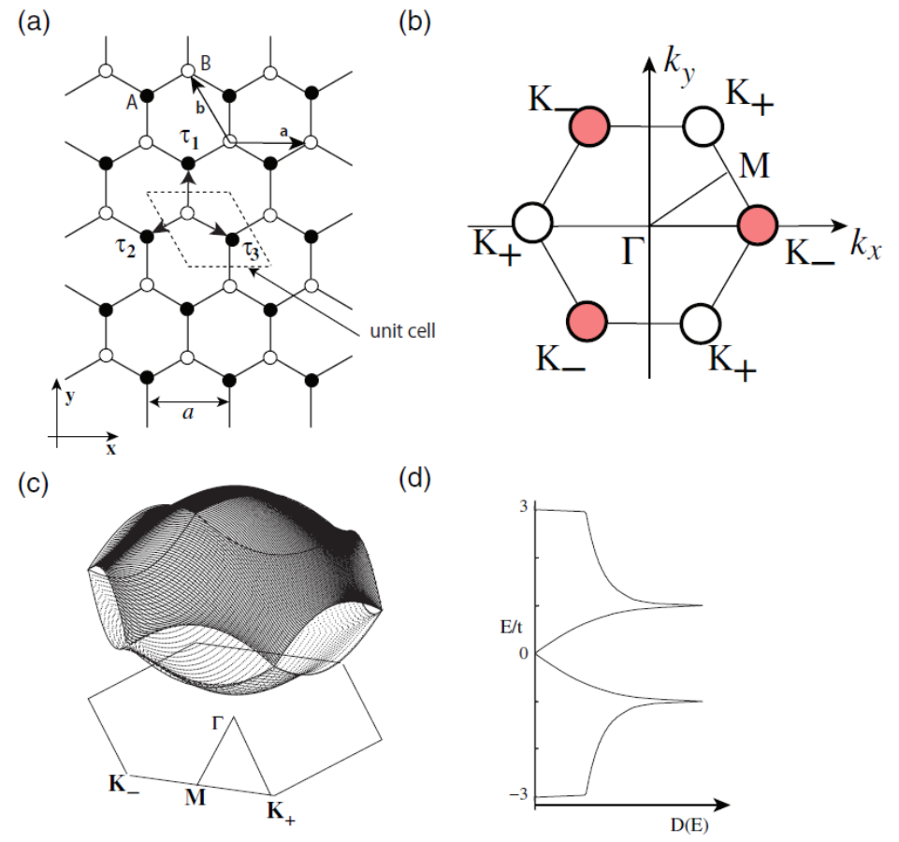
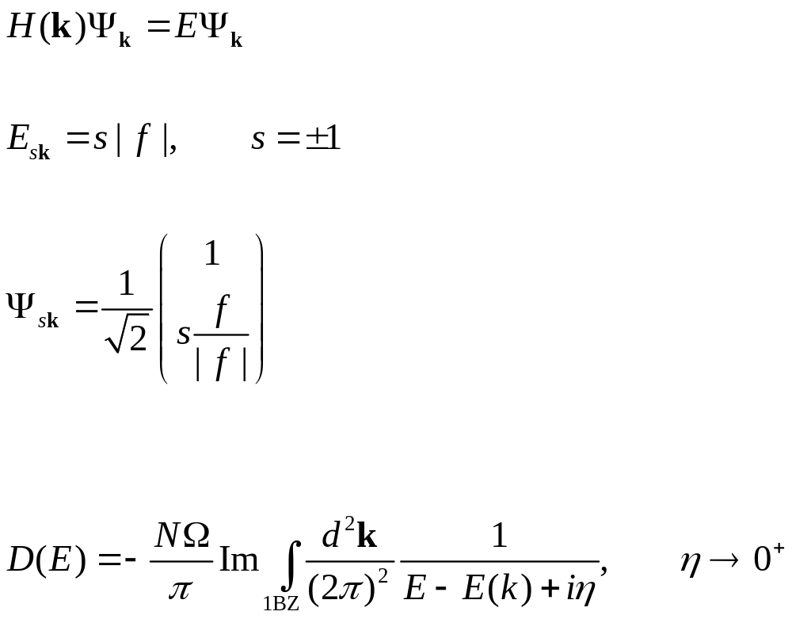
Solution of graphene model
Notes:
Figure from Wakabayashi, et atl, Science and Tech of adv Materials, https://doi.org/10.1088/1468-6996/11/5/054504. Omega is the volume of the unit cell. Such that int dE D(E) = N. N is the number of unit cell. The definition of the density of state is based on the fact that 1/(x + i eta) = P 1/x - i pi delta(x), P stands for the principle value, and eta -> 0+, delta(x) is Dirac delta function.

Slide 13
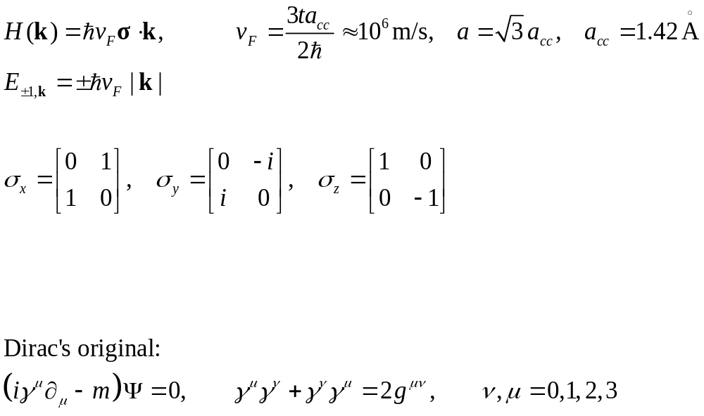
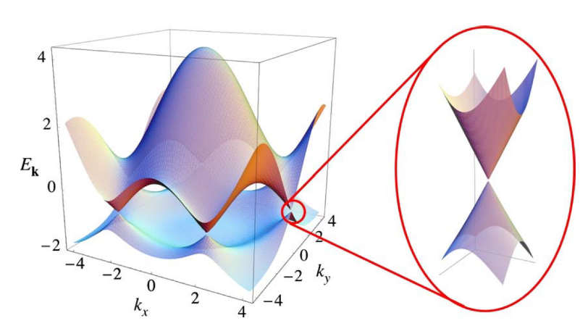
Dirac model near K points
Notes:
Here k is measured from K, i.e., deviations from the K point. Show the f function, when expanded at K point, to linear order in k, produce the Dirac model. Figure from A H Castro Neto, et al, “The electronic properties of graphene”, Rev Mod Phys. 81, 109 (2009).

Slide 14
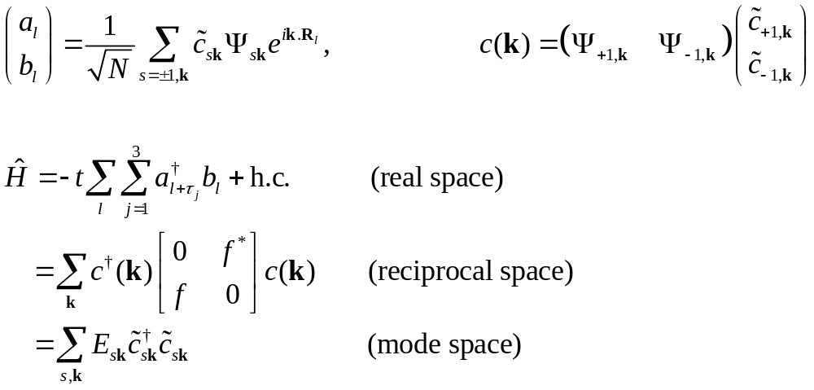
Quantum field

Slide 15
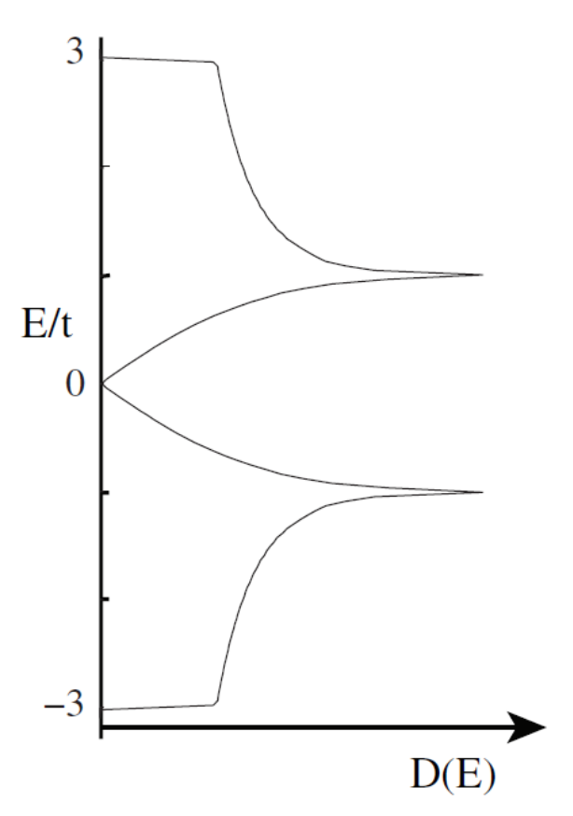
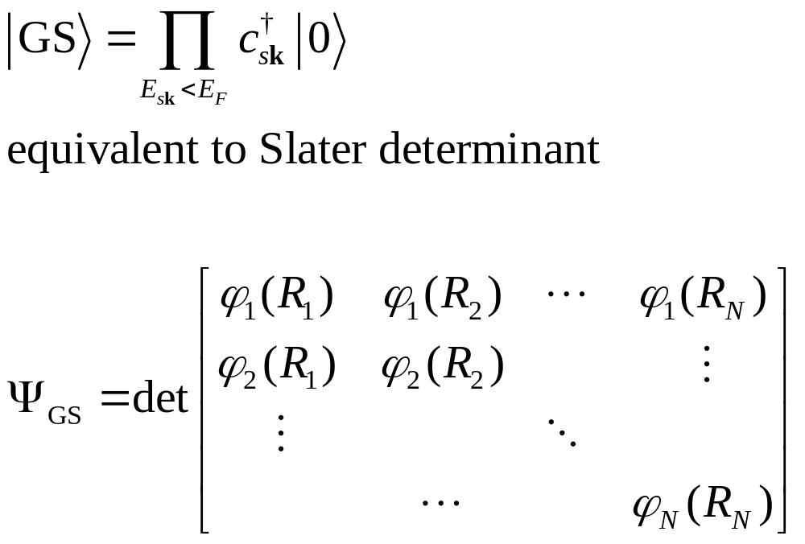
Many-body ground state
E_{F}=0
Notes:
Exactly what is the single electron wave function phi_i(R_j) here?

Slide 16
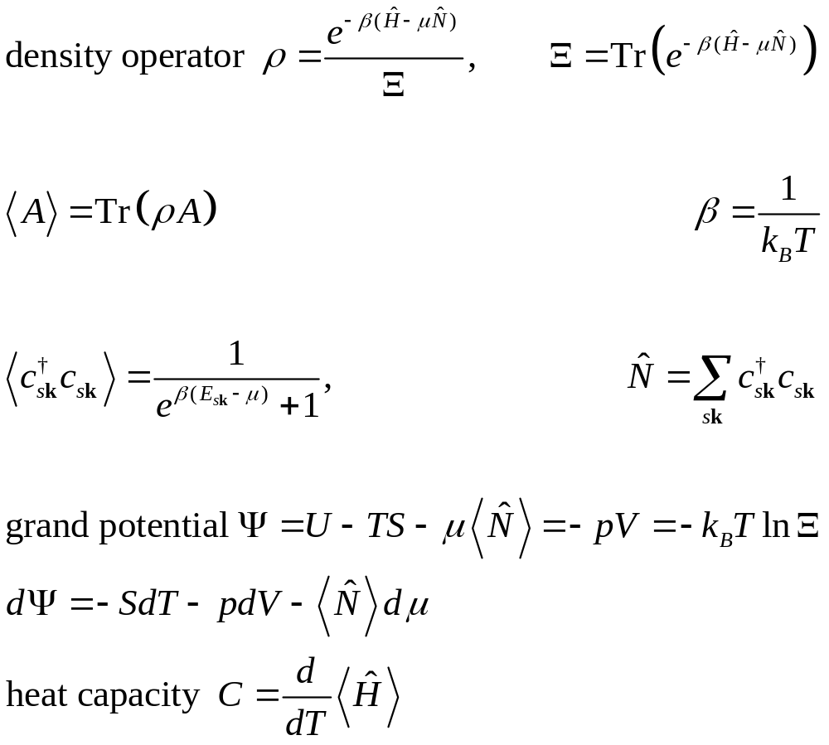
Statistical mechanics
Problem:
Compute the internal energy and heat capacity at constant volume for graphene at low temperature when chemical potential is at the Dirac point (μ=0).
Notes:
Note that photon (black-body radiation) is C \propto T^3, so is lattice vibration (phonons) in 3D. In 3D electron heat capacity for normal metal is proportional to T.

Slide 17
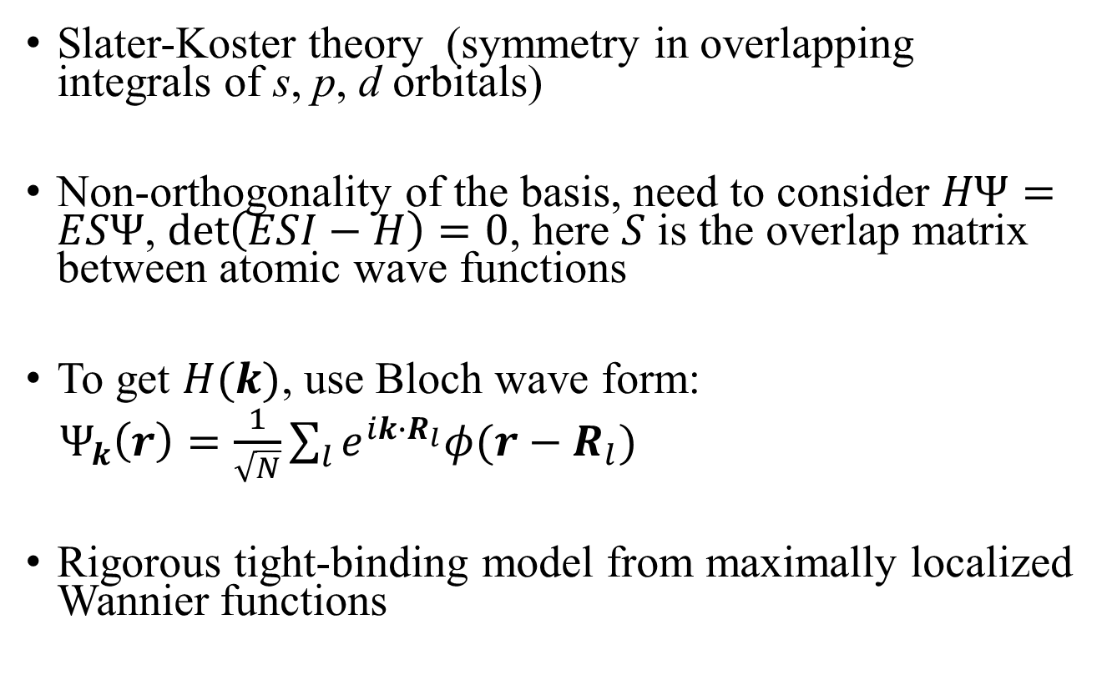
More general tight-binding models
Slater-Koster theory (symmetry in overlapping integrals of s, p, d orbitals)
Non-orthogonality of the basis, need to consider $HΨ=ESΨ$, $\det\left(ESI−H\right)=0$, here $S$ is the overlap matrix between atomic wave functions
To get $H(k)$, use Bloch wave form:
$Ψ_{k}\left(r\right)=\frac{1}{\sqrt{N}}\sum_{l}{e^{ik∙R_{l}}φ(r−R_{l})}$
Rigorous tight-binding model from maximally localized Wannier functions
Notes:
Show that Psi_k( r ) indeed satisfy the Bloch theorem. For Wannier function, see http://www.wannier.org/ See arxiv://1309.5429 by Jung and McDonald, for bilayer graphene using Wannier method.

Slide 18
Calculating band structure of graphene, steps 1 to 3, run pw.x
Step 1, use calculation='vc-relax’, in the &CONTROL namelist to find the optimal lattice parameters, if it is not yet optimal (e.g., 0 stress). You need an ion_dynamics in this case. You can skip this if lattice parameter is already optimal
Step 2, do a self-consistent calculation='scf’
Step 3, do a non-self-consistent, band structure calculation with calculation='bands’, other parameters remain the same as in step 2. Specify the k-point path now with a data card as
K_POINTS crystal_b
4
0.0000000000 0.000000000 0.000000000 50 ! G
-0.333333333 0.666666667 0.000000000 50 ! K
0.000000000 0.500000000 0.000000000 50 ! M
0.0000000000 0.000000000 0.000000000 50 ! G
Notes:
Check up this webpage if you don’t understand the input format: https://www.quantum-espresso.org/Doc/INPUT_PW.html

Slide 19
Calculating band structure of graphene, step 4, run band.x to get data for plotting
Step 4, run
mpirun -np 8 bands.x<bands.in >bands.out
to generate from the raw data for plotting in the data file band.dat with an input of a single namelist:
&bands
prefix = 'graphene’ (as used in other input files)
filband = 'bands.dat’
/
Notes:
see https://www.quantum-espresso.org/Doc/INPUT_BANDS.html#idm13

