Slide 1
Week 4
Electron-electron, electron-phonon interactions, nonequilibrium Green’s functions, Hartree-Fock method

Slide 2
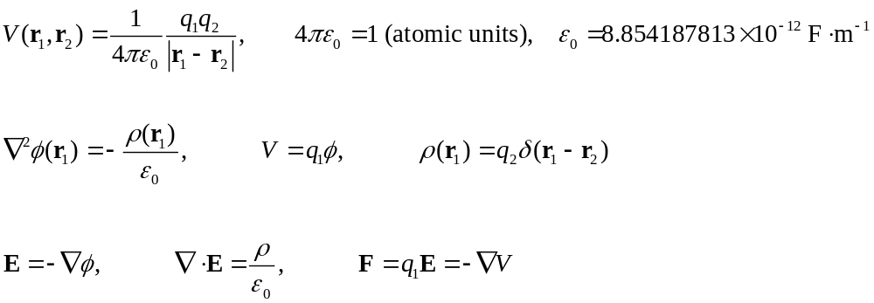
Coulomb’s law between charges
q_{1,} r₁
q_{2,} r₂
Notes:
phi electric potential (volt), V potential energy (joule), epsilon_0 is dielectric constant of vacuum or vacuum permittivity. E: electric field strength, F force acting on particle 1. Note, infinite appears here if r1 approaches r2. This is Maxwell’s equations when c -> inf. Note that c = 299792458 m/s exactly, and mu_0 = 4pi x 10^-7 approximately, and epsilon_0 * mu_0 = 1/c^2.

Slide 3
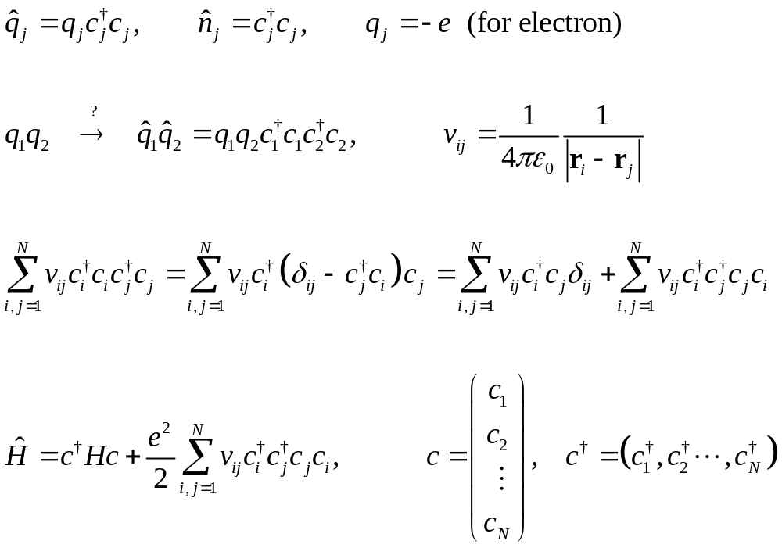
Coulomb interaction in quantum operator form
Notes:
e = 1.602176621 x 10^-19 coulombs. The factor ½ in front of the sum to remove double counting. We have used the anti-commutator of c operators. What is the correct value to take when i=j even in the c+_i c+_j c_j c_i form? This question seems ill-defined on lattice. It goes away if electrons are on the continuum as in DFT.

Slide 4
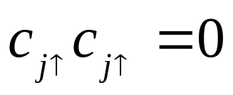
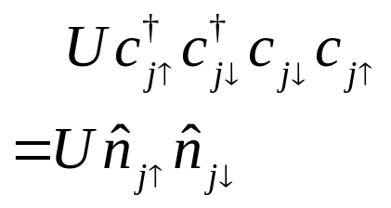
Hubbard interaction
Onsite interaction: putting two electrons of the same spin on the same location is not possible due to Pauli exclusion principle. Putting two electrons on the same site must have opposite spins.
Notes:
Read this introductory note on creation/annihilation operators and the Hubbard model: https://www.cond-mat.de/events/correl16/manuscripts/scalettar.pdf

Slide 5
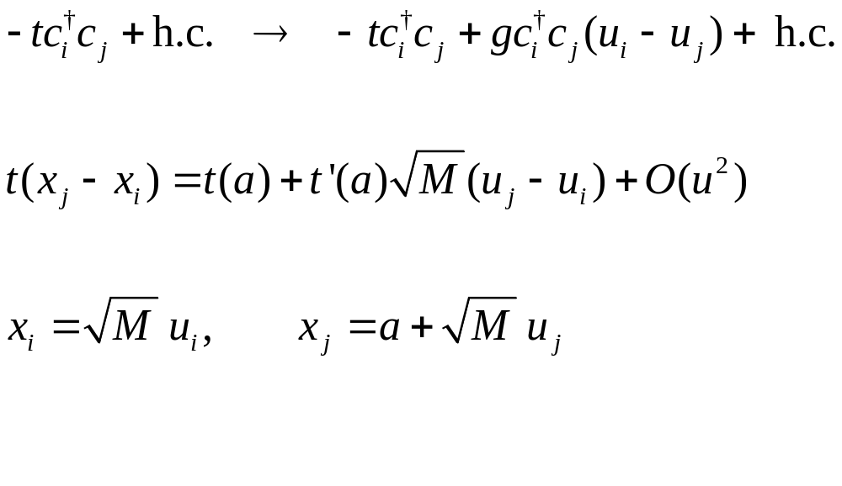
Electron phonon interaction, a simple consideration (SSH type)
hopping t
distance
Notes:
SSH: Su-Schrieffer-Heeger.

Slide 6
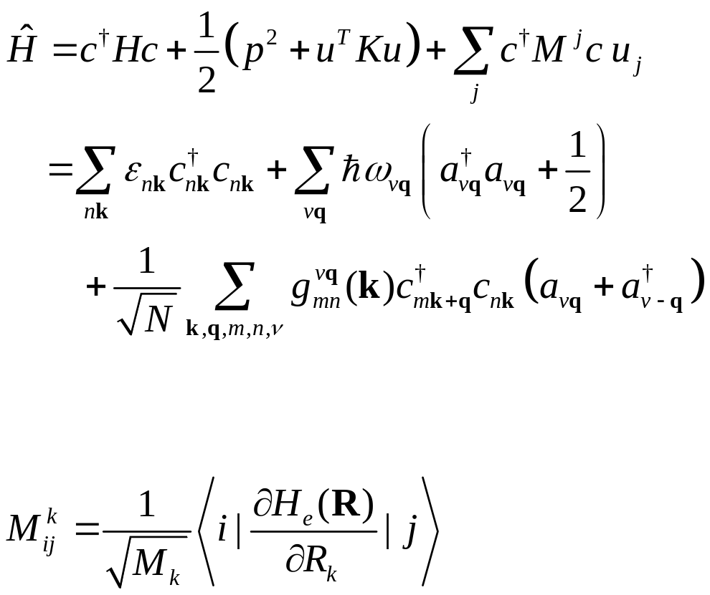
Electron-phonon interaction, first principles
Problem: work out the explicit relationship between real space and mode space representations of the Hamiltonian.
n,k
ν,q
g
m,k+q
Notes:
See, e.g., F. Giustino, Rev. Mod. Phys. 89, 015003 (2017).

Slide 7
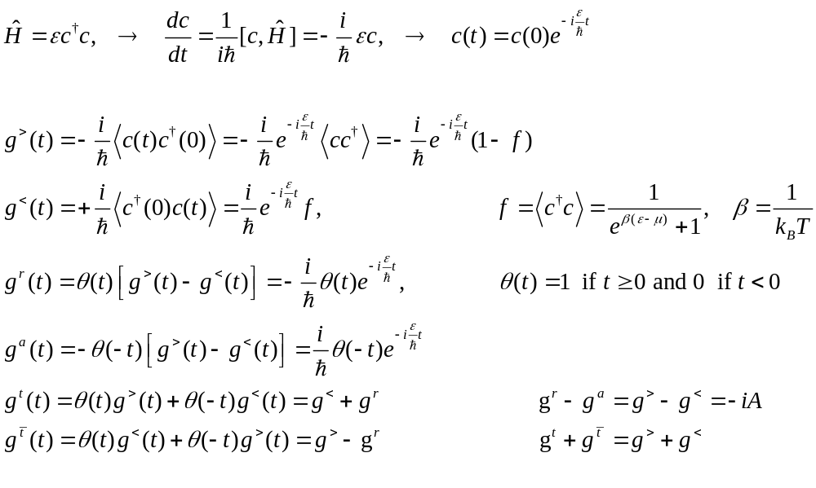
Electron Green’s function of a single mode
Notes:
See also note NEGF-quantum-dot.pdf The theta(t) is known as Heaviside step function. The derivative d theta(t)/dt = delta(t) is the Dirac delta function. My definition of electron Green’s function disagree with Mahan, Bruus and Flensberg, because they used K = H – mu*N. Use of K is good for Matsubara approach but obscure in real time NEGF. My definition agrees with Kadanoff-Baym, or Haug and Jauho (Quantum kinetics in transport and optics of semiconductors).

Slide 8
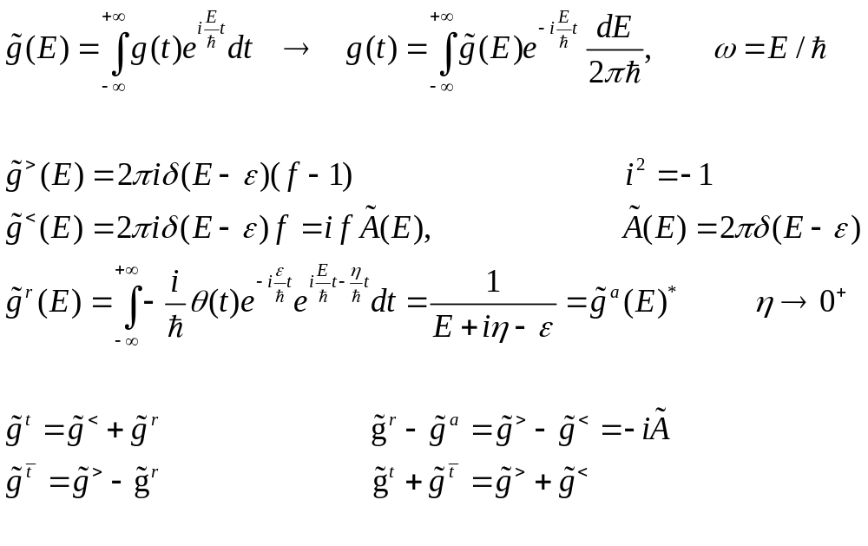
Electron Green’s function of a single mode, go into E space
Notes:
See also note NEGF-quantum-dot.pdf We note tilde A divided by 2pi gives then density of state normalized to 1 (after integration over E).

Slide 9
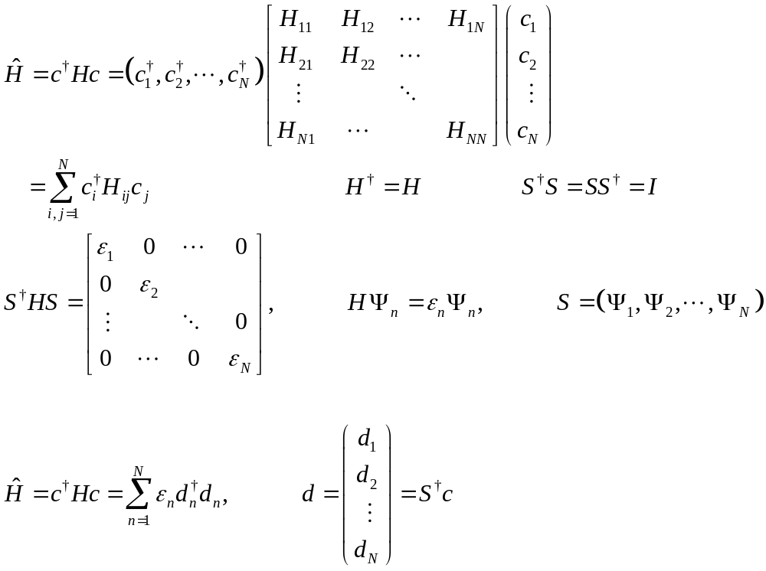
Green’s functions of many degrees, diagonalize H
Notes:
S is unitary. Show if S^\dagger S = I, then it must be S S^\dagger = I. Note, I used i, j, k for real space index, and n, m designating the mode.

Slide 10
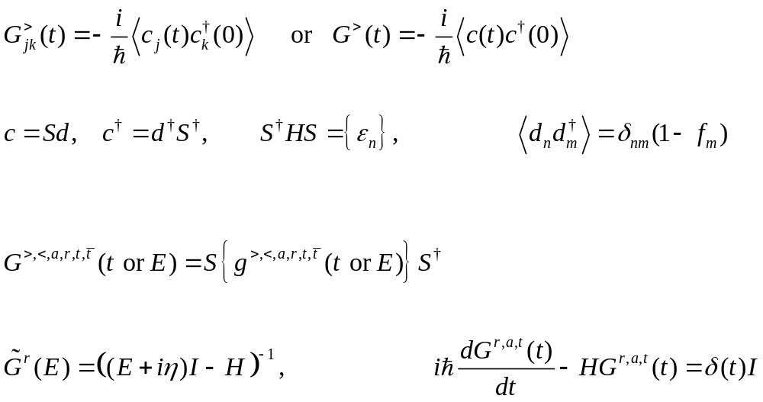
Many degree Green’s function
as N×N matrix
Notes:
If it is a matrix, A, the inverse matrix is rewritten as A^{-1}. Only for a number a, we write inverse as 1/a. c(t) is a column vector, while c^\dagger(t) is a row vector.

Slide 11
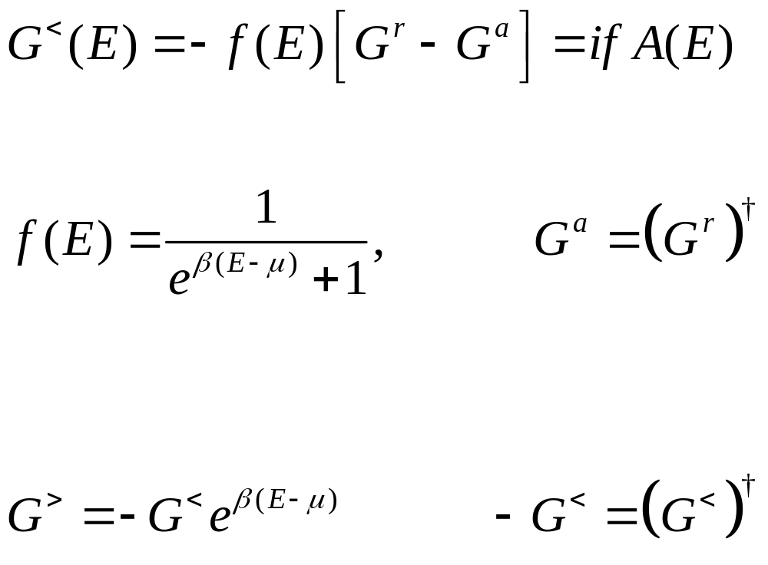
Fluctuation-dissipation theorem in thermal equilibrium
Prove this important result using the Lehmann representation.
Notes:
Lehmann representation means we evaluate the trace in which the total Hamiltonian \hat H is diagonal. See electron NEGF notes, also Bruus and Flensberg, or Haug and Jauho for the Lehmann representation and proof.

Slide 12
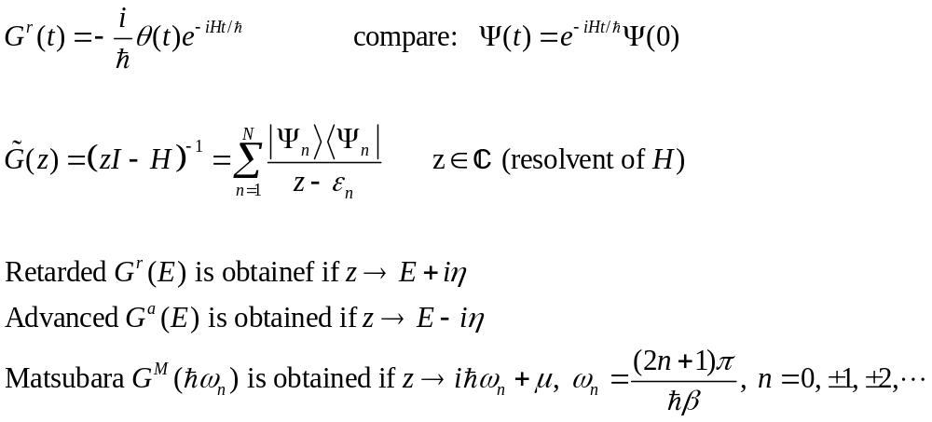
Green’s function, complex z
Notes:
For Bose particle the Matsubara frequency is integer multiply of 2pi/beta. For fermion, it is shift by pi.

Slide 13
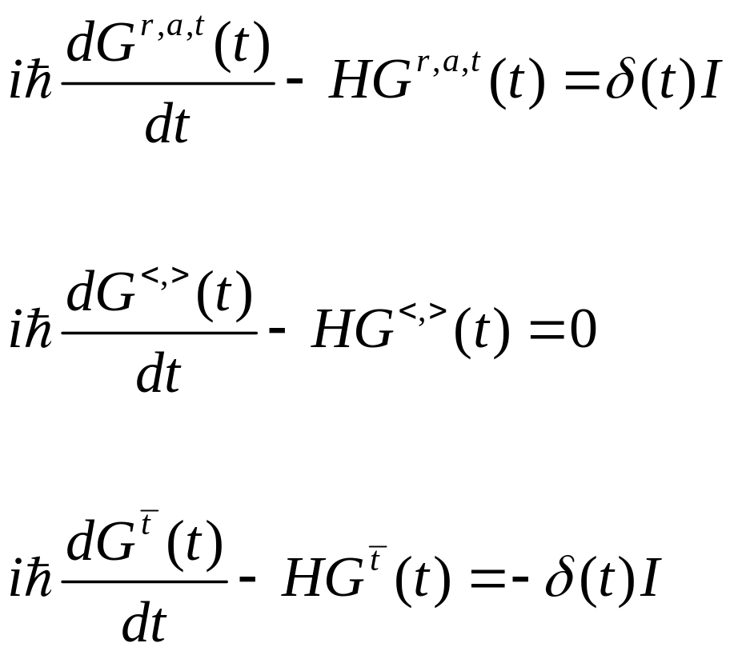
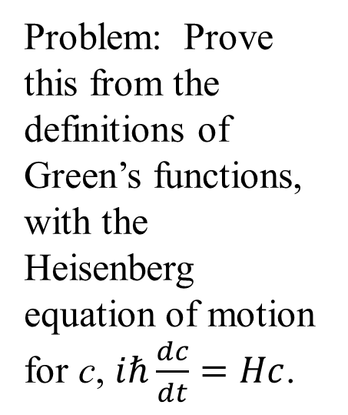
Equation of motion of (free) Green’s functions
Problem: Prove this from the definitions of Green’s functions, with the Heisenberg equation of motion for c, $iℏ\frac{dc}{dt}=Hc$.
Notes:
By free we mean there is no interaction terms in the Hamiltonian, i.e., we assume \hat H = c^\dagger H c. What do we get if we Fourier transform the equations into Fourier E space?

Slide 14
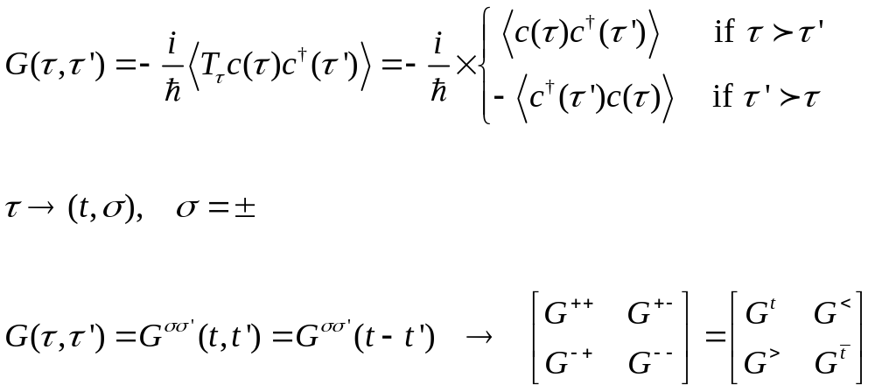
Contour ordered Green’s function
+
τ’
-
τ
+ −
+
−
Notes:
a > b means b is earlier on contour, a is late on contour. The contour runs from –inf (earliest) to +inf for the + branch and then turn back from +inf to –inf (latest) on the lower – branch.
Switch of a fermion operator incurs a minus sign, which is part of the definition of the contour order operator T_tau.

Slide 15
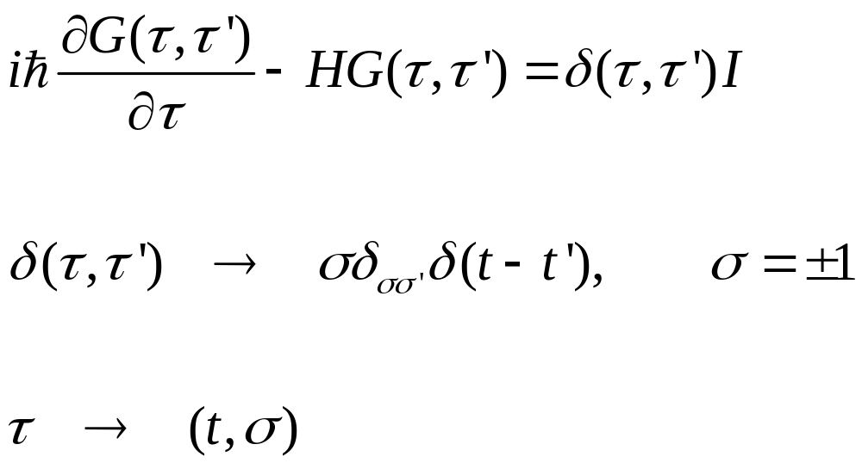




Equation of motion on contour
$$+$$
$$τ$$
$$t→+∞$$
$$−$$
Notes:
Here I is NxN identity matrix. We cannot make Fourier transform on tau, we must transform tau according to the rule tau -> (t, sigma), and then make Fourier transform to real time t. See example, https://arxiv.org/abs/1303.7317

Slide 16
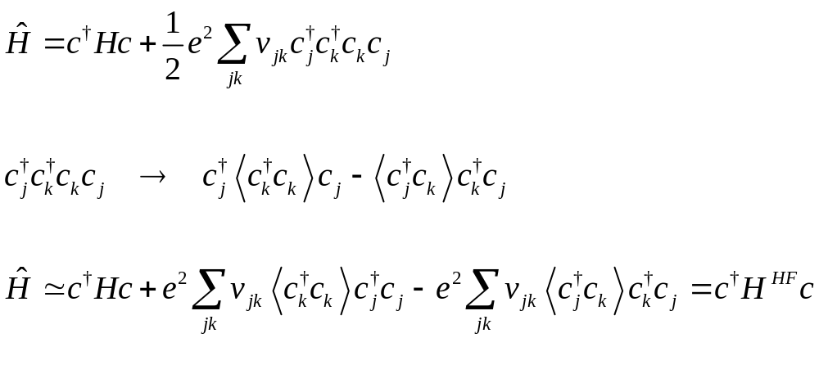
Handle Coulomb interaction, the simplest way, mean-field theory
Hartree tern
Fock term
Notes:
Why need a minus sign here? I dropped 1/2 in the last line. This is correct as we are interested in the equation of motion which H generated, not the total energy. The total energy is double counted in the mean-field approximation using the current formula in the last line.

Slide 17
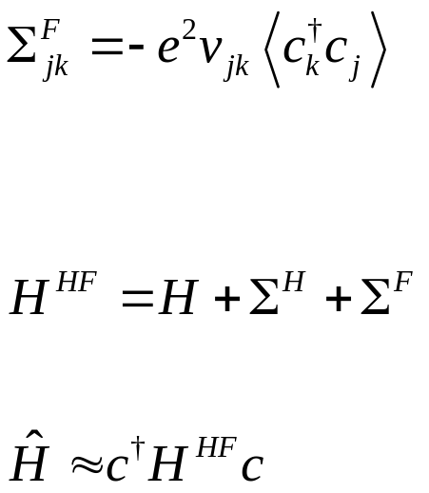
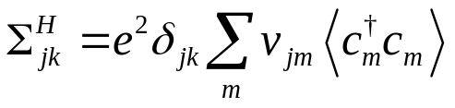
Hartree and Fock self energies
m
j
k
j
Notes:
The dotted line is for v, the solid line is for <c+ c>. We see later that the quantity <c+j c_k> is essentially a single particle density matrix.

Slide 18
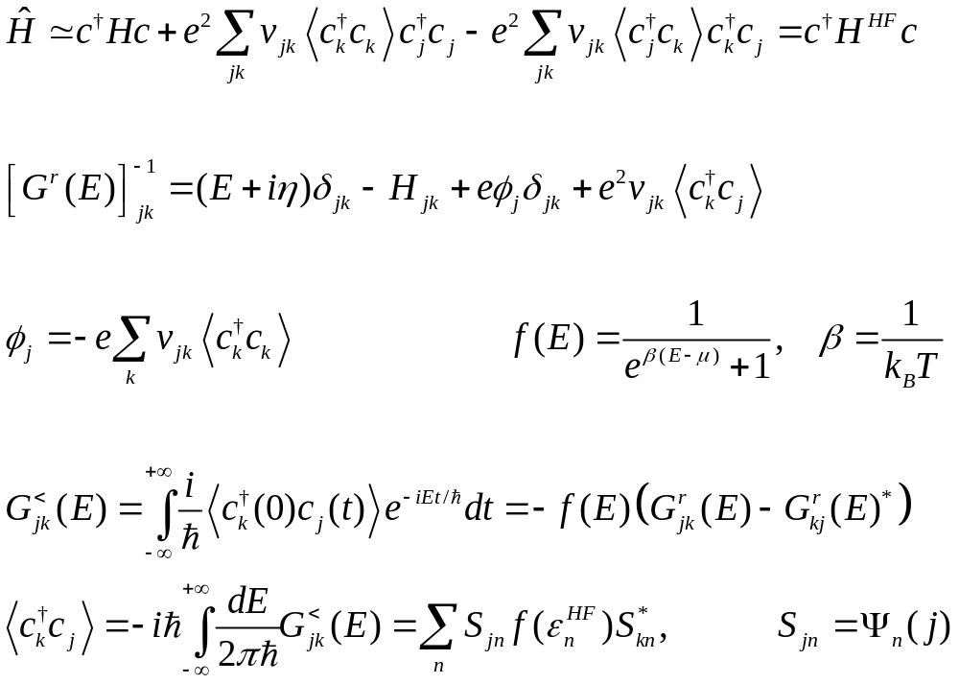
Green’s function in Hartree-Fock approximation
Notes:
Note that the label k is a site not labelling the eigen states so we don’t have Fermi function expression. Check that H^{HK} Psi_n = eps_n Psi_n, is equivalent to the usual Hartree-Fock equation.

Slide 19
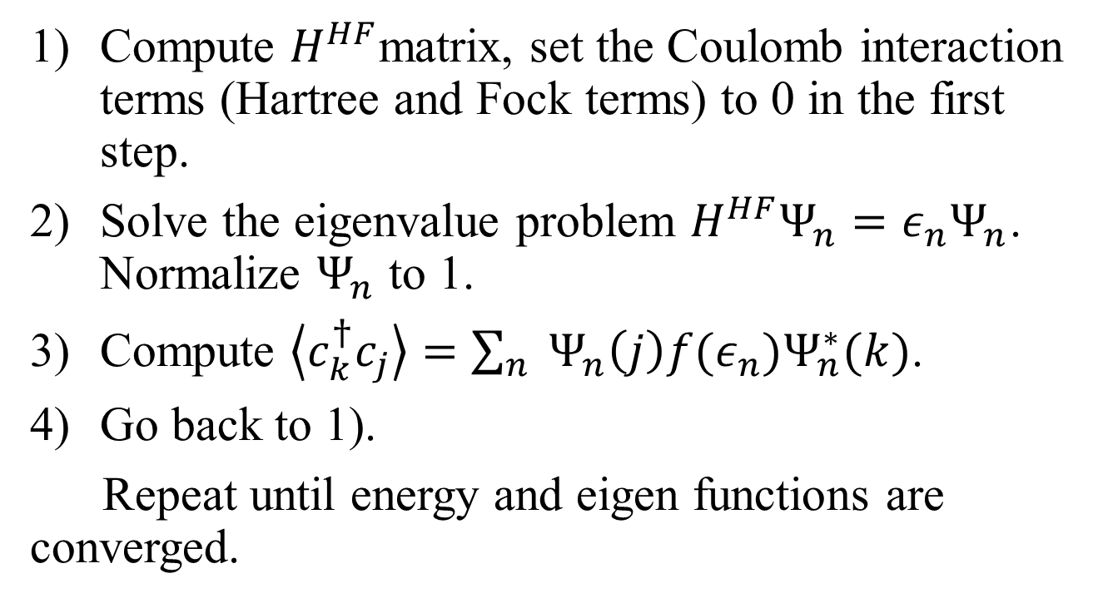
A computational procedure for Hartree-Fock self-consistency
Compute $H^{HF}$matrix, set the Coulomb interaction terms (Hartree and Fock terms) to 0 in the first step.
Solve the eigenvalue problem $H^{HF}Ψ_{n}=ε_{n}Ψ_{n}$. Normalize $Ψ_{n}$ to 1.
Compute $\left\langle c_{k}^{†}c_{j}\right\rangle =\sum_{n}{{ Ψ}_{n}\left(j\right){f(ε}_{n})Ψ_{n}^{∗}(k)}$.
Go back to 1).
Repeat until energy and eigen functions are converged.
Notes:
This is equivalently to the usual Hartree-Fock in quantum chemistry, except that here I formulate on discrete sites. The convergence of the Hartree-Fock iteration can be tricky. Pulay method can be used to better convergence control.

Slide 20
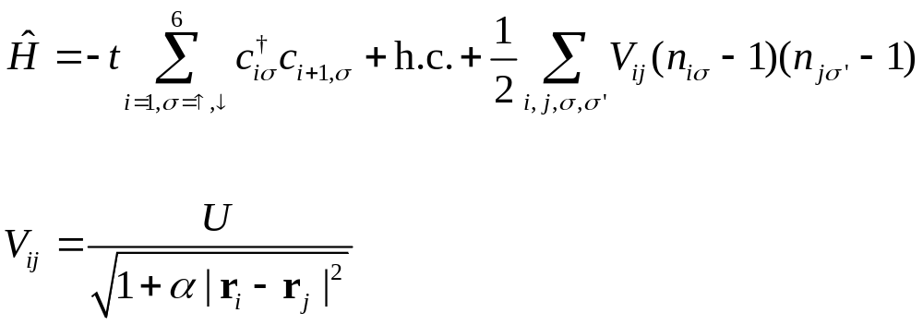
Solve the benzene ring with PPP model using Hartree-Fock?
Need spin!
Notes:
PPP: Pariser-Parr-Pople model. See https://arxiv.org/pdf/1812.04962.pdf

