Slide 1
Week 5,
Green’s functions, Dyson expansion
Contour ordered Green’s function, Wick’s theorem, Feynman diagrams, Dyson equations, “analytic continuation”, Keldysh equation
Notes:
For NEGF, see Haug and Jauho, “Quantum Kinetics in transport …” or Rammer, “Quantum field theory of non-equilibrium states”, etc.

Slide 2
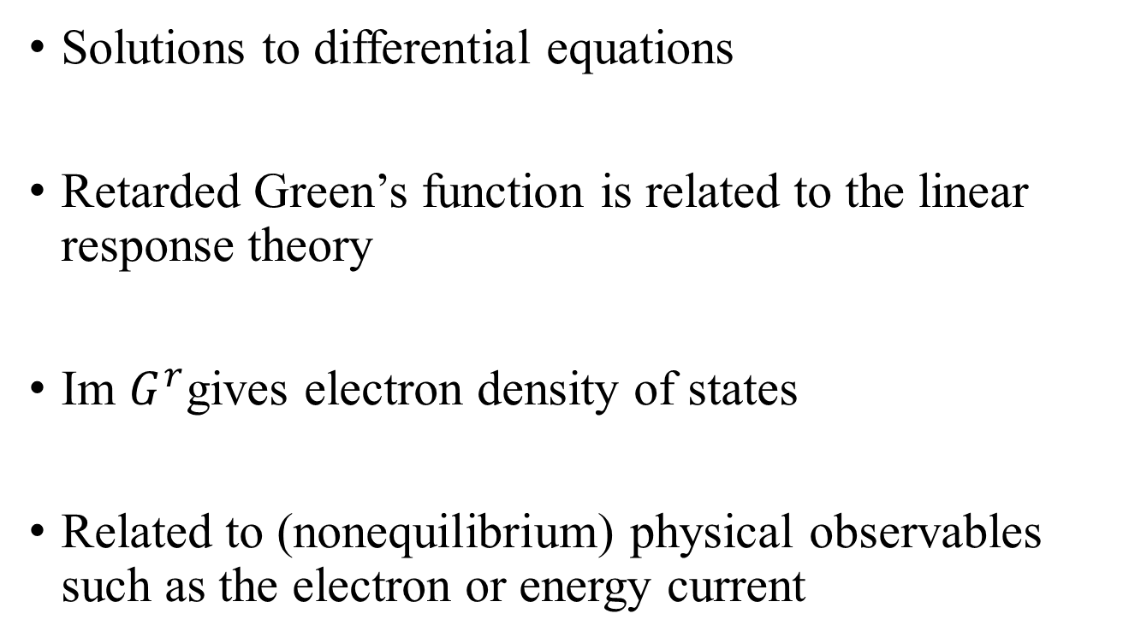
Why Green’s functions?
Solutions to differential equations
Retarded Green’s function is related to the linear response theory
Im $G^{r}$gives electron density of states
Related to (nonequilibrium) physical observables such as the electron or energy current

Slide 3
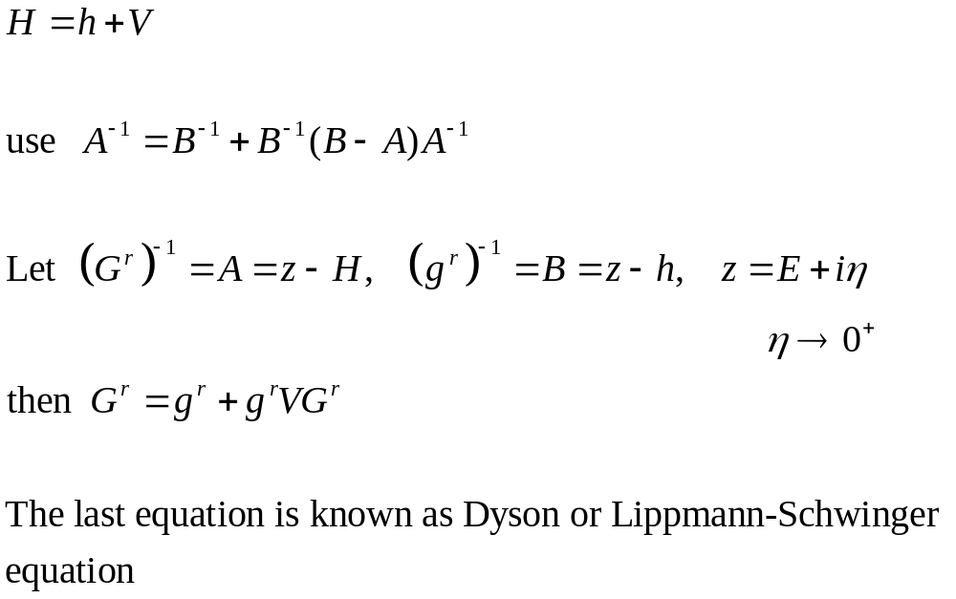
Perturbation theory, single electron

Slide 4
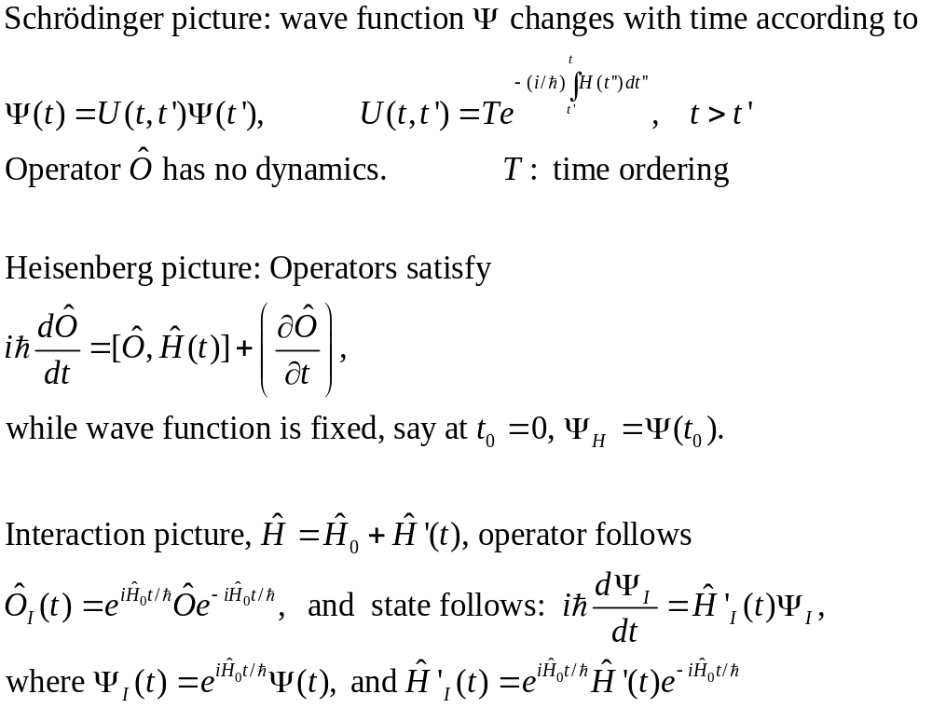
Interaction picture
1)
2)
3)
Notes:
In our definition of the interaction picture, we synchronize the three pictures at time t = 0, i.e., Psi_H = Psi_I = Psi, following Fetter and Walecka, “Quantum Theory of Many-particle systems”. Another choice is to synchronize to t0, and let t0 goes to –inf. The extra partial O/partial t exist if O is explicitly time dependent, such as time-varying applied external field interaction.

Slide 5
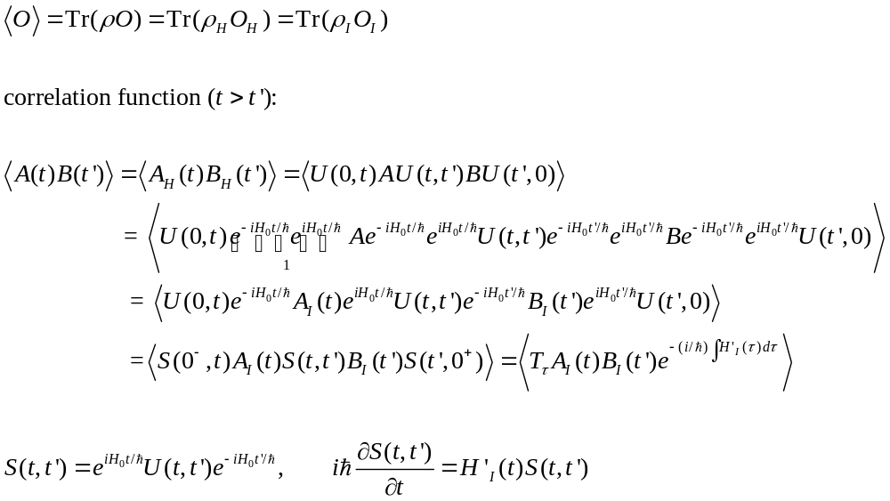
Expectation values
B
0+
t′
A
t
0−
Notes:
< ….> means Tr(rho at time t = 0), but at time t = 0, rho_H = rho_S = rho_I because the three pictures are synchronized at t = 0.

Slide 6
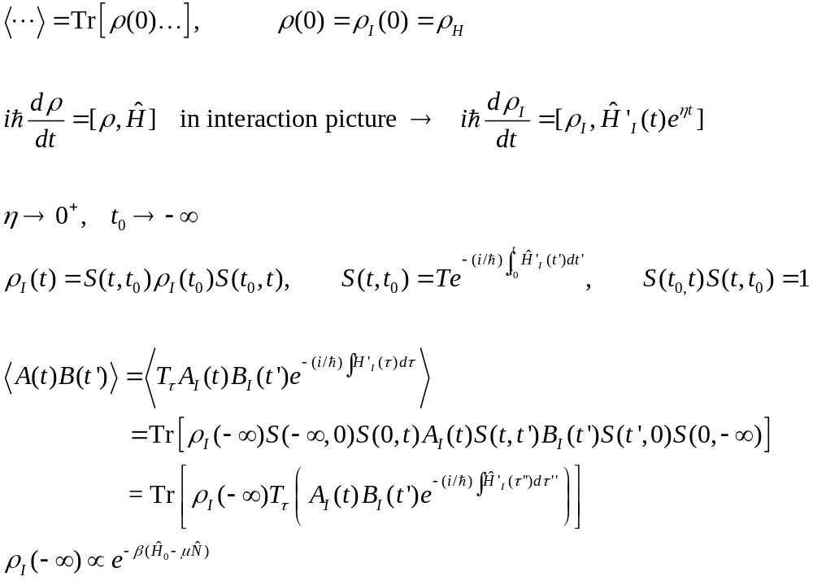
Adiabatic switch-on of interaction
Notes:
Alternatively, we can also use product of equilibrium states for rho_I(-inf) when dealing with nonequilibrium problem.

Slide 7

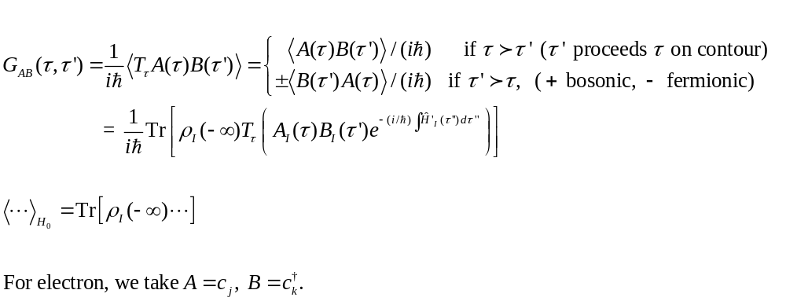
Contour ordered Green’s function
-∞, +
τ′
+∞
-∞, −
τ
Notes:
The density matrix is set between –inf +, and –inf -, in the sense of contour time. At +infinity, the two branches, +, and - are, in some sense, connected. See page 14, Eq(2.19) Alex Kamenev, “Field theory of non-equilibrium systems”, for discussion, using path integral formulation.

Slide 8
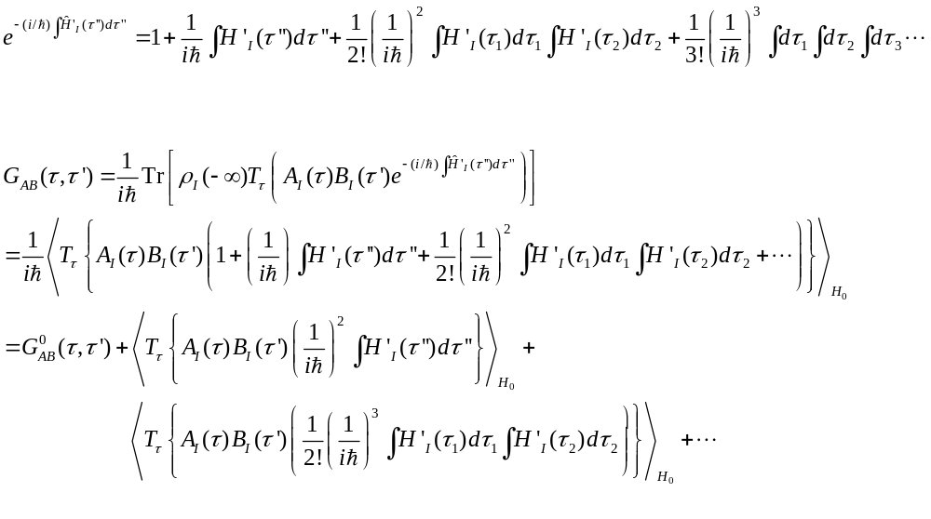
Dyson expansion
Notes:
We use the expansion for the exponential exp(x) = 1 + x + x^2/2 + x^3/3! + …

Slide 9
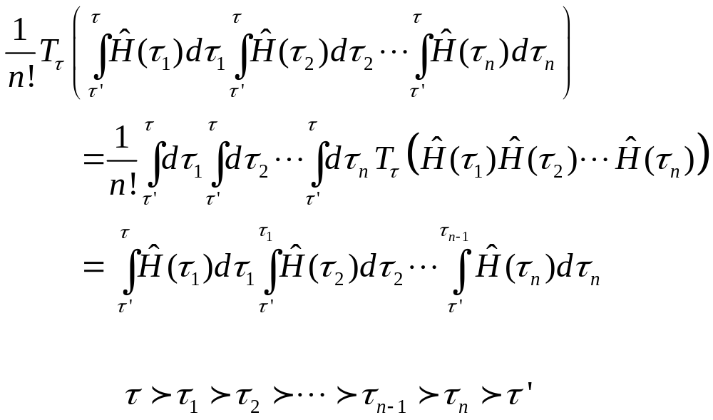
Contour order operator T_{τ}
Notes:
Why this is true? Prove this. Note H at different time does not compute, but under the sign of T_tau, they compute. Remove T_tau must order them according increasing of tau.

Slide 10
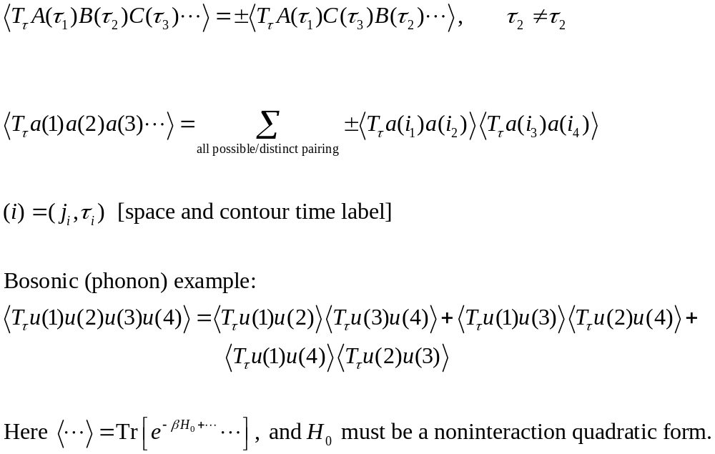
Wick’s theorem
Notes:
The operators under the sign of contour order T_tau commute between bosonic operators or bosonic with ferminonic one, and anti-commute between fermonic operators. This rule works only if tau values are different (not permanently equal). When tau’s are the same, one has to use the appropriate commutation relations valid at equal time. All possible/distinct pairing means that the order does not matter, (1,2) and (2,1) are considered the same pairing. For a proof of Wick’s see J Rammer, “Quantum field theory of non-equilibrium states”. The original Wick’s theorem applied at T=0 is given & proved in Fetter-Walecka.

Slide 11
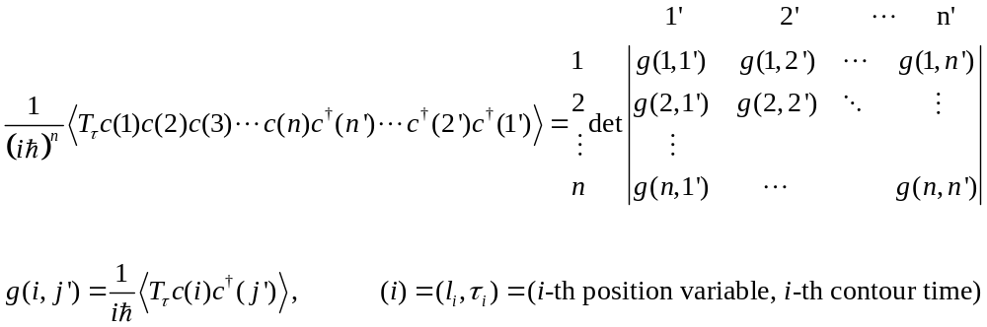
Wick’s theorem as a determinant for fermions
Notes:
For a prove of this formula, see Bruus and Flensberg, “Many-body quantum …”, Chap 11.6, page 198-200. Or Stefanucci and van Leeuwen, “Nonequilibrium many-body theory of quantum systems”, Chap 5, page 125-135.
For boson with creation/annihilation operators, we just replace determinant by a permanent (no sign changes), but it is not valid if it is the operator u (gaussian).

Slide 12
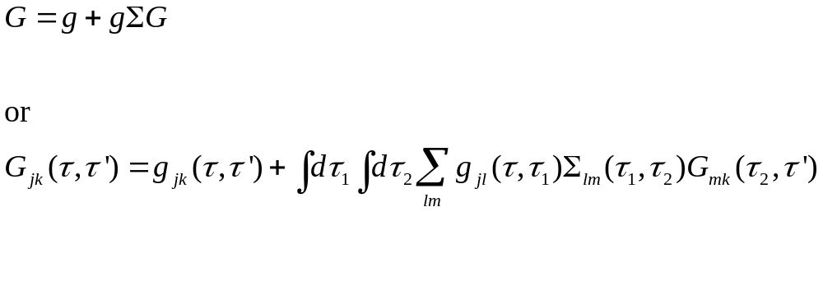
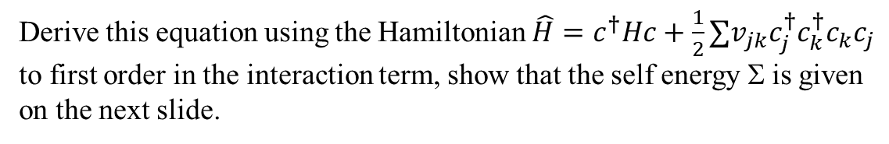
Derivation of the Dyson equation (electron case)
Derive this equation using the Hamiltonian $\hat{H}=c^{†}Hc+\frac{1}{2}∑v_{jk}c_{j}^{†}c_{k}^{†}c_{k}c_{j}$ to first order in the interaction term, show that the self energy Σ is given on the next slide.
Notes:
In the interaction term, the four operators c+j c+k c_k c_j are at equal time. At equal time, the contour order fails to be well defined (the order makes sense only when tau is different). As a result, we make keep the order as it is, if tau are all the same. The consequence of the original normal order in H’ is that some of the Green’s function is to put a tau^+ in the second argument of the green’s functions. See next slide.

Slide 13
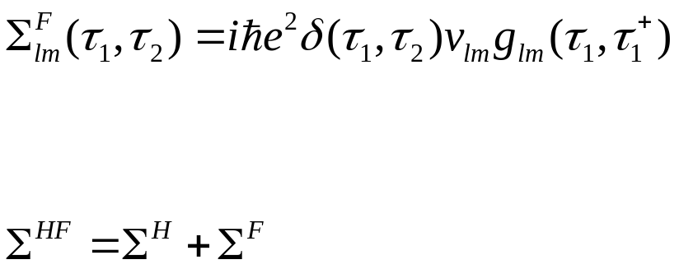
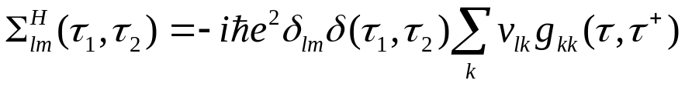
Hartree and Fock self energies
g
v
−1 for each loop
k
l
m
g
v
l
Notes:
The dotted line is for v, the solid line is for <c+ c>. Tau+ is infinitely late than tau, so it is in fact g<. The small g is the green’s function defined by the noninteracting c^\dagger H c. For Feynman-diagrammatic expansion, see Fetter and Walecka, or ADG (Abrikosov, Dzyaloshinski, Gorkov), “Method of quantum field theory in statistical physics”. When the Green’s function take tau at equal contour time, the contour order loss its meaning. In order to be consistent with the original Hamiltonian, which is normal ordered, it is consistent if we take the second argument to be later than the first, producing a unique order. So it seems good rule of thumb to say, g(tau, tau) means g(tau, tau+), the plus + means the second tau is late than the first tau.

Slide 14
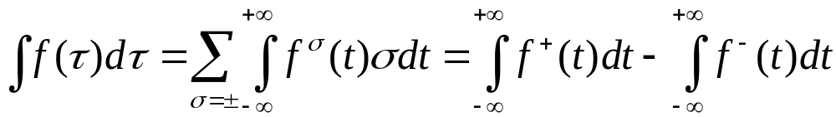
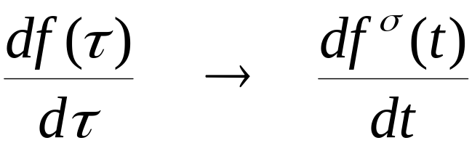
Calculus on the contour
Integration on (Keldysh) contour
Differentiation on contour
Notes:
dτ is σdt for integration, but just dt in differentiation. σ is either just the sign + or -, or +1, -1.
14

Slide 15
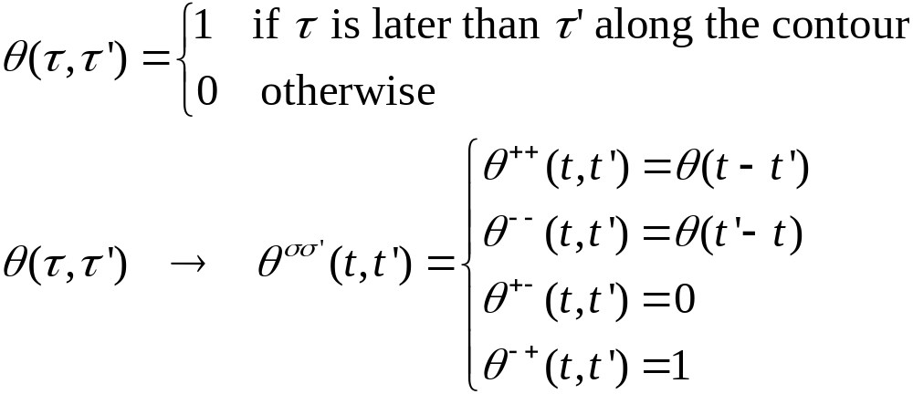

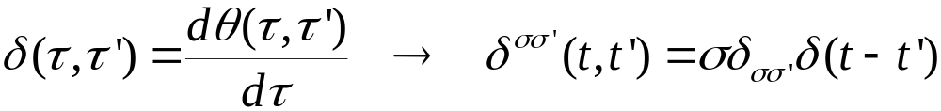
Theta function and delta function
Theta function
Delta function on contour
where θ(t) and δ(t) are the ordinary Heaviside theta and Dirac delta functions
Notes:
15

Slide 16
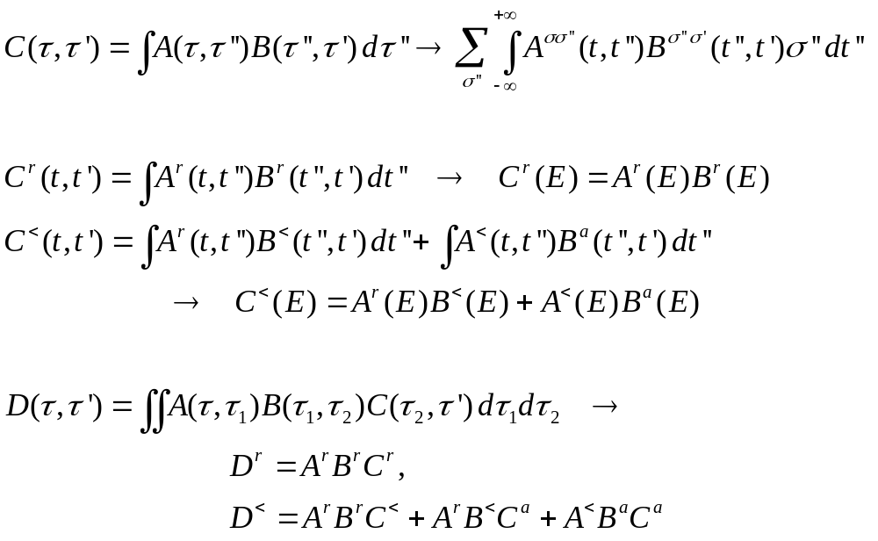
The Langreth theorem
Notes:
Need to use the relation between G⁺⁺, G⁻ ⁻, G⁺⁻, and G⁺⁻ with G^{r} and G<. See Haug & Jauho, page 66.
16

Slide 17
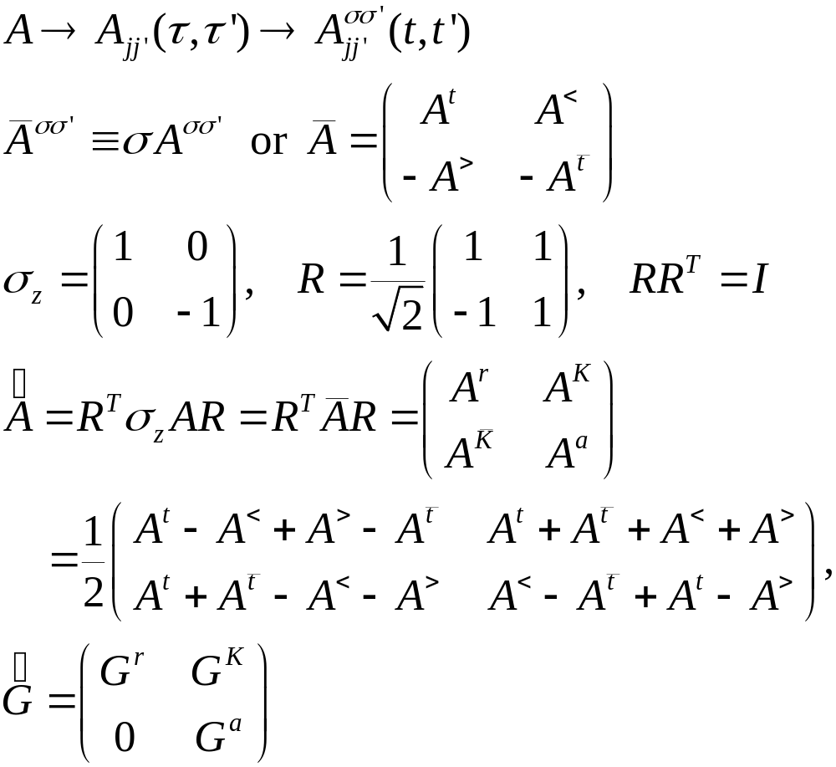
Transformation/Keldysh Rotation
Notes:
Also properly known as Larkin-Ovchinikov transform, JETP 41, 960 (1975).

Slide 18
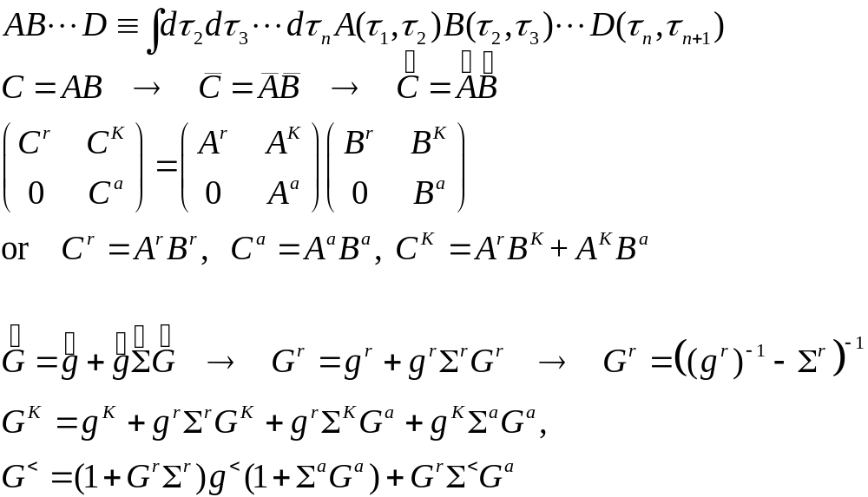
Convolution, Langreth Rule
Notes:
The last two equations are known as Keldysh equations.

