Slide 1
Week 9,
Electron transport, Landauer approach
Ballistic transport, Landauer formula, Landauer-Büttiker multiple-lead formalism, Meir-Wingreen formula, NEGF derivation of Caroli formula, surface Green’s function, Seebeck effect
Notes:
We need first recall the basics of Ohm’s law, I = V/R, and the definition of conductivity, Drude model (see Aschroft/Mermin Chapter 1), then the case of ballistic transport which is the material of this week. The main point is when ballistic transport is the correct picture (when mean free path is much larger than sample sizes).

Slide 2












1D chain transport
$$ε_{k}$$
$$ε_{k}$$
open boundary condition
$$μ_{R}$$
$$2t$$
k
k
$$−\frac{π}{a}$$
$$μ_{L}$$
$$\frac{π}{a}$$
$$−2t$$
$$t$$
…
…
…
… -2 -1 0 1 2 3 … N-1 N N+1 ….
…
$$ε_{k}$$
3
j
2
$$μ_{R}$$
periodic boundary condition
k
1
$$μ_{L}$$
N
N-1
Notes:
For a modern introduction to the electronic transport in nano-structures, see, e.g., M. Di Ventra, “Electrical transport in nanoscale systems”, Cambridge, 2008.

Slide 3
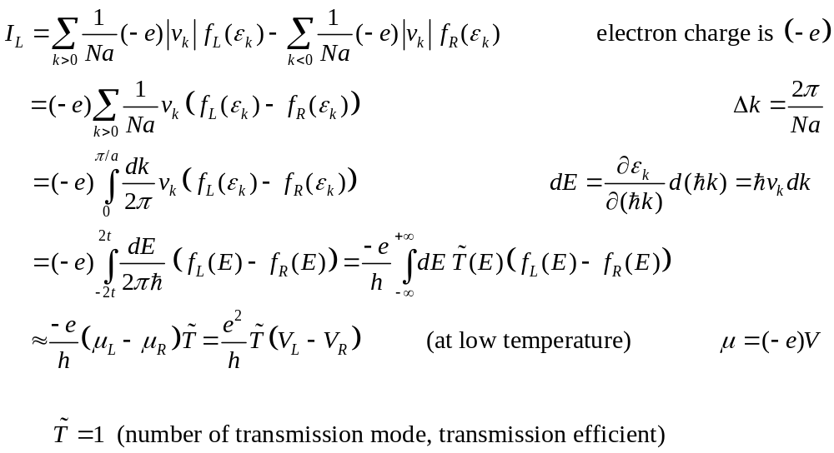
1D ballistic charge transport
Notes:
We need a factor of 2 if we take into account the spin degeneracy. Here I use “spinless” electrons. See also S Datta, “Electronic transport in mesoscopic system”, Cambridge Univ, (1995). The universal constant h/e^2 = 25.8 kilo-ohm as a standard resistance is known as the von Klitzing constant.

Slide 4
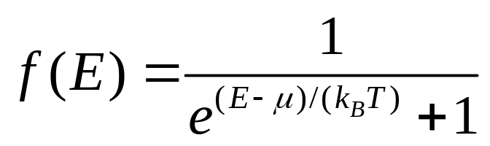




Fermi distribution
f
at 300 K k_{B}T is 26 meV
1
$$T→0$$
$$k_{B}T$$
$$μ$$
$$E$$
Notes:
meV = 0.001 eV. 1 eV = 1.602 x 10^(-19) joule.

Slide 5

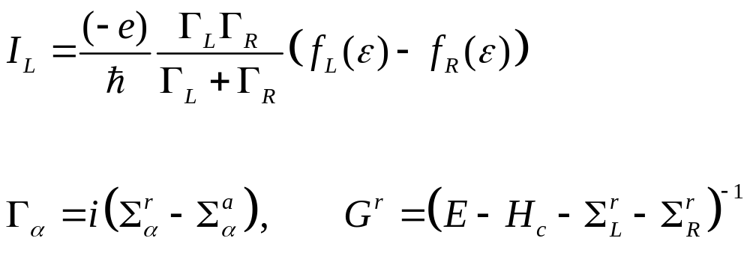
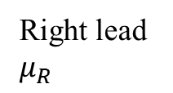
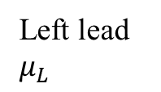


Resonant tunneling in quantum dot
$$Γ_{L}$$
$$Γ_{R}$$
Left lead $μ_{L}$
Right lead $μ_{R}$
Notes:
If we have a two-level system with energy very close to each other, then we will have the more interesting Coulomb blockade problem. I_L is defined such that going out from the left lead is positive. See H. J. W. Haug and A-P Jauho, “Quantum kinetics in transport and optics of semiconductors”, Springer, for a derivation of this formula.

Slide 6
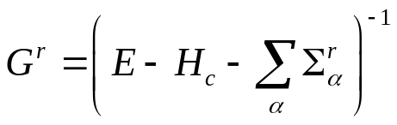
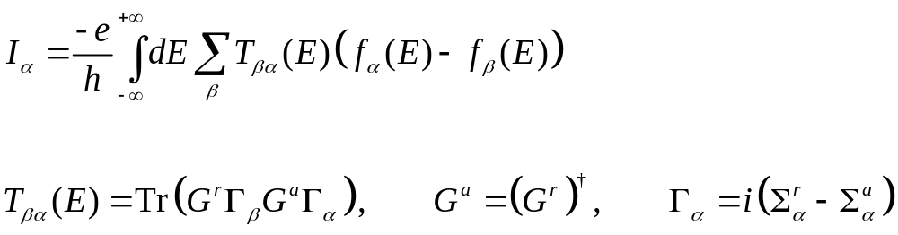

Multiple-leads, Landauer-Büttiker/Caroli formulas
lead …
lead α
Scattering region
$$I_{α}$$
lead β
Notes:
I_alpha is defined as the electric current going out of the lead alpha.

Slide 7
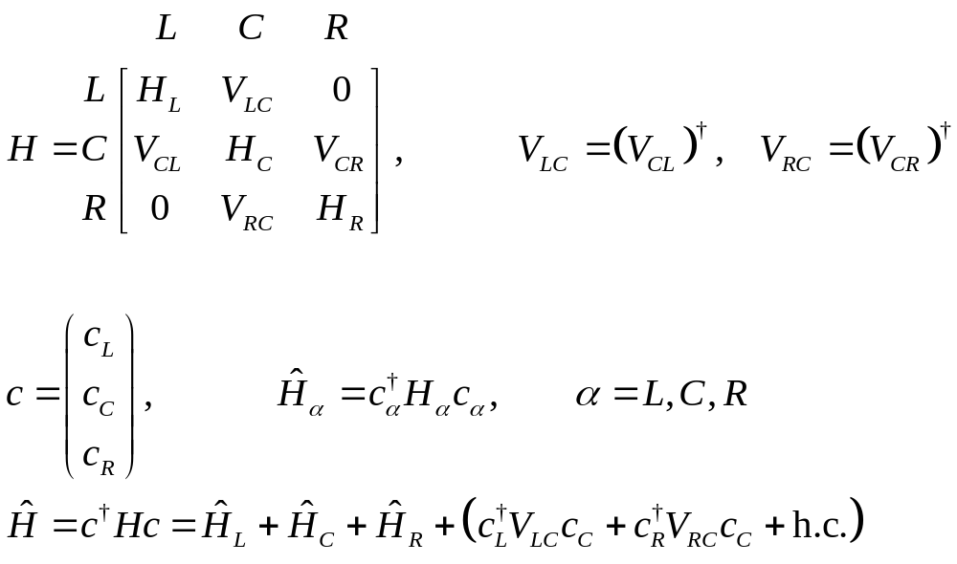
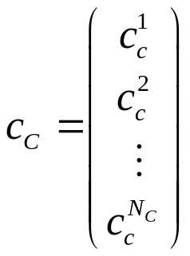

Ballistic transport – model setup
$$V_{LC}$$
L
C
R
Notes:
alpha is an index designating left (L), or right (R), or center (C).

Slide 8
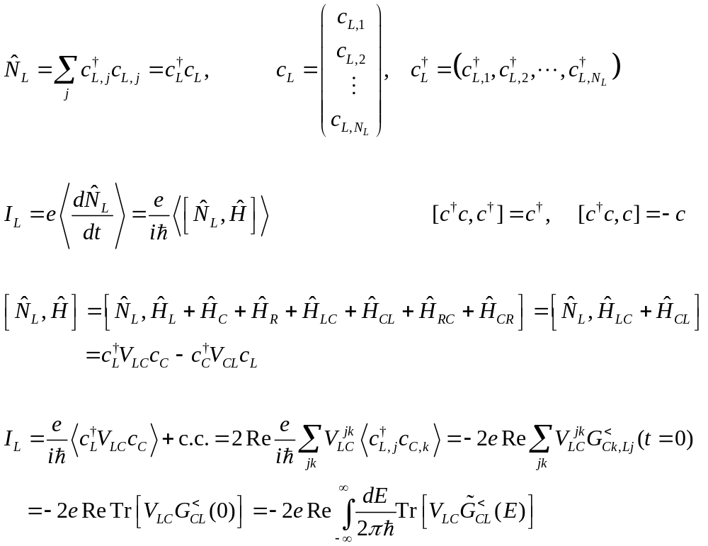
Definition of electric current out of left lead
Notes:
Because our electrons are spinless, I don’t have a factor of 2 here in defining I_L. Note the following useful identity involving commutators [ , ] and anti-commutators { , }:
[AB,C] = A[B,C] + [A,C]B (Leibniz rule) and [AB, C] = A{B,C} – {A,C}B (anti-Leibniz rule?). The original Leibniz rule of differentiation is (fg)’ = f g’ + f’ g, so commuting with C is like differentiation with respect to C. This commutator algebra has to do with Lie algebra and Lie derivatives in differential geometry.

Slide 9
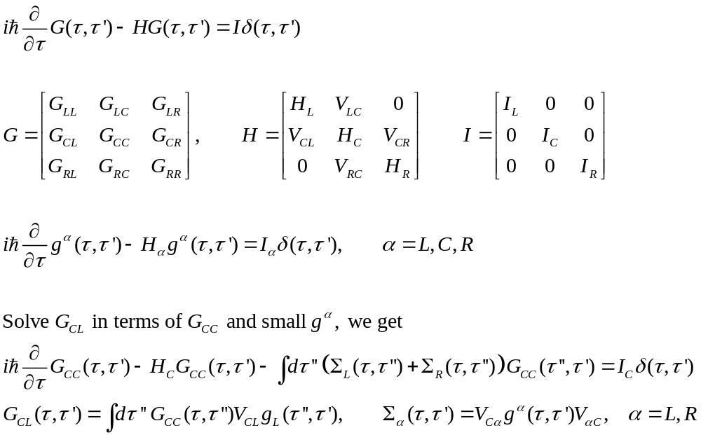
Determine the G_{CL} Green’s function on contour time
Notes:
See two of my reviews on NEGF: J.-S. Wang, J. Wang, and J. T. Lü, ``Quantum thermal transport in nanostructures,'' Eur. Phys. J. B {62}, 381 (2008). J.-S. Wang, B. K. Agarwalla, H. Li, and J. Thingna, ``Nonequilibrium Green's function method for quantum thermal transport,'' Front. Phys. {9}, 673 (2014). See also http://phyweb.physics.nus.edu.sg/~phywjs/NEGF/negf.html

Slide 10
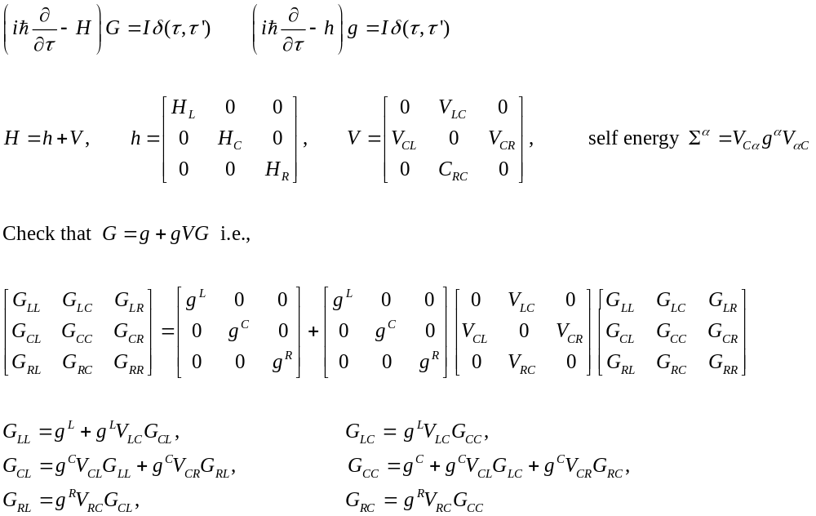
From differential equation to integral equation – the Dyson equation
Notes:
Try to express G_CL in terms of GCC and g^L.

Slide 11
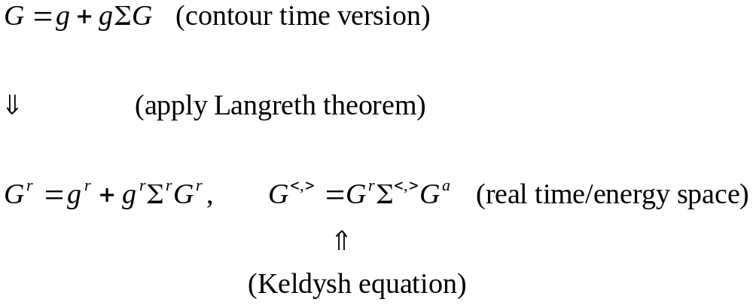
Recall the consequence of Dyson equation on contour
Notes:
To get the second Keldysh equation, one need a condition, that is (g^r)^(-1) g< = 0, this is certainly true for ballistic system, not so in general. See the last slide on week 5. The omitted term is present in a transient problem.

Slide 12
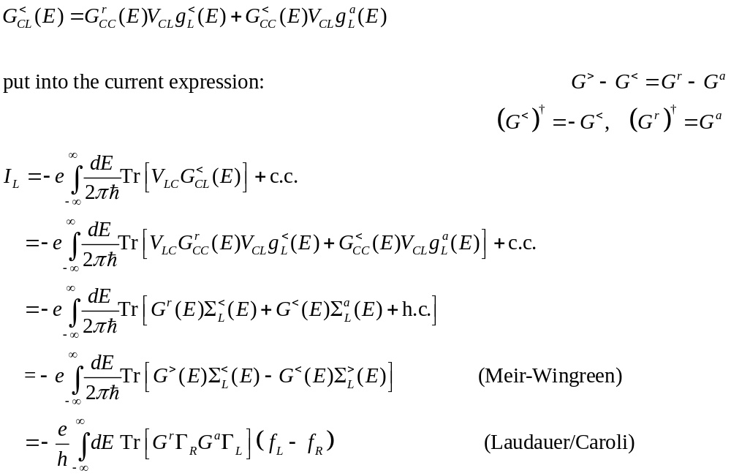
Apply Langreth rule in E space
Notes:
2*pi*hbar = h. For NEGF, see also H. J. W. Haug and A-P Jauho, “Quantum kinetics in transport and optics of semiconductors”, Springer, as standard reference.

Slide 13
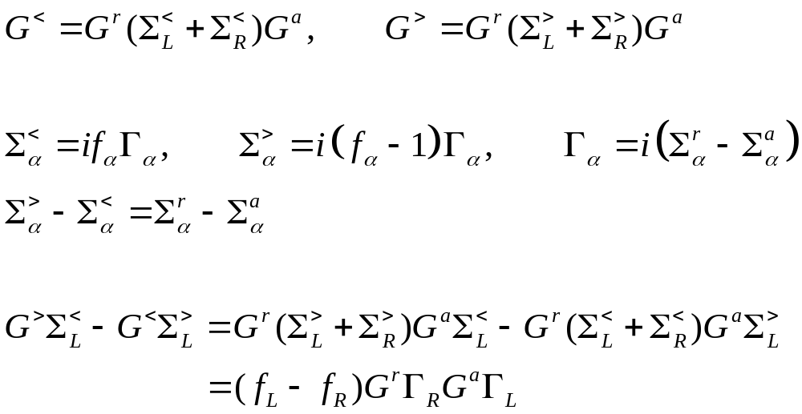
From Meir-Wingreen to Landauer
Notes:
Here we apply the fluctuation-dissipation theorem to the bath self energy < and >.

Slide 14
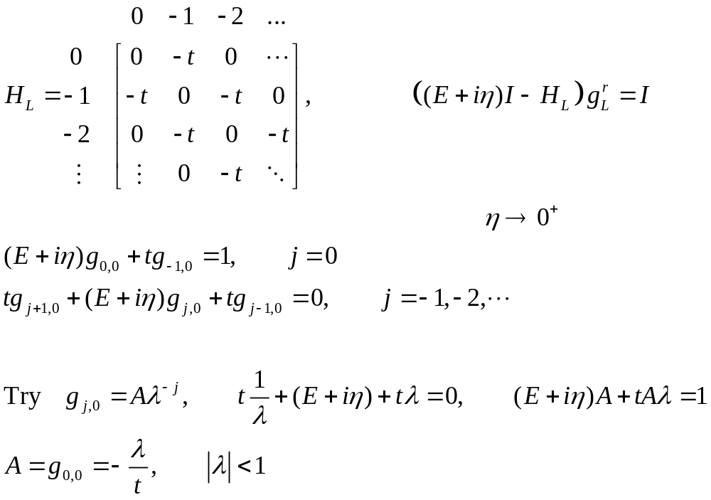
Example, 1D chain with a single site in center; step 1, determine “surface” Green’s function g_{L}

Slide 15
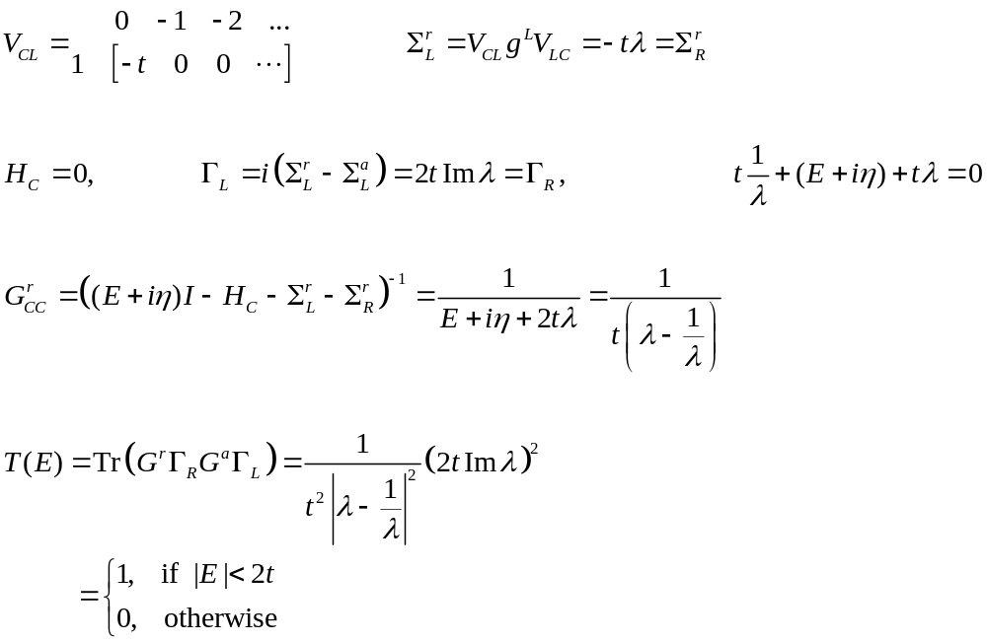



Example, 1D chain with a single site in center, step 2, determine lead self energy and G_{cc}
$$T(E)$$
1
$$−2t$$
$$+2t$$
E
Notes:
This is the same result as that on slide 3, by a “handwaving” derivation. Now we obtain the same result by rigorous NEGF.

Slide 16
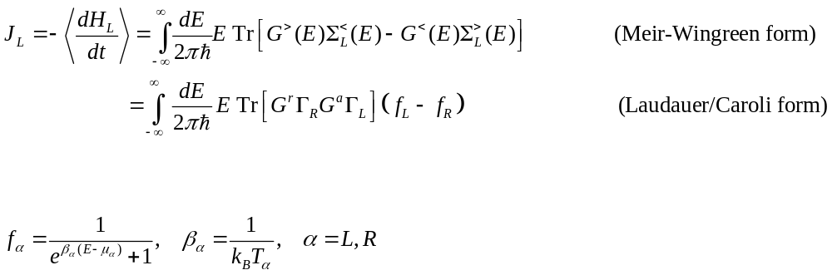
Energy transmitted by electron

Slide 17
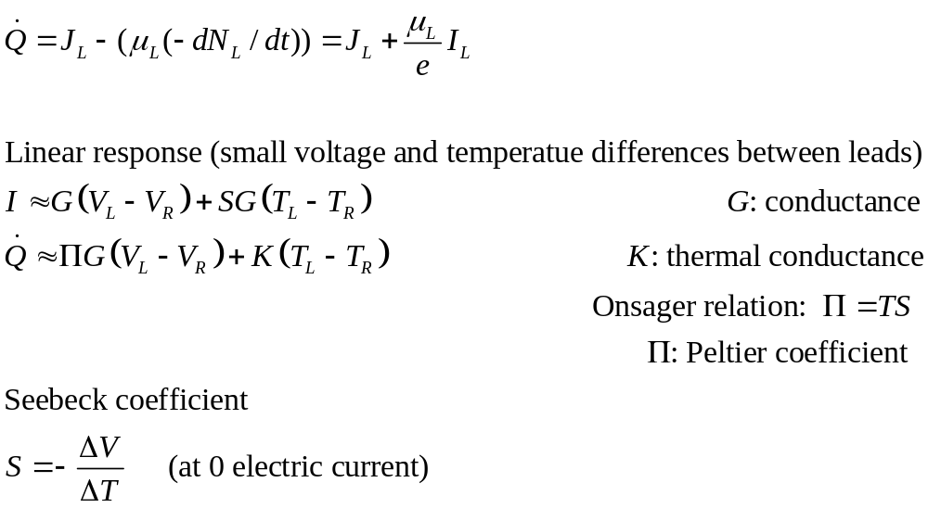
Coupled charge & heat transport by electron and Seebeck effect
Notes:
The 2x2 coefficients are also called Onsager coefficients. See https://arxiv.org/abs/1608.05595 for a long review.

