Slide 1
Week 9,
Boltzmann equation
Fermi-golden rule, derivation of the Boltzmann equations for electron-phonon system, conservation laws, H-theorem, linearized Boltzmann equation, Kubo linear response
Notes:
The book “Electrons and phonons,” by J. M. Ziman, Oxford 1960, is a classic on Boltzmann transport theory. See also “Transport phenomena,” H. Smith and H. H. Jensen.

Slide 2
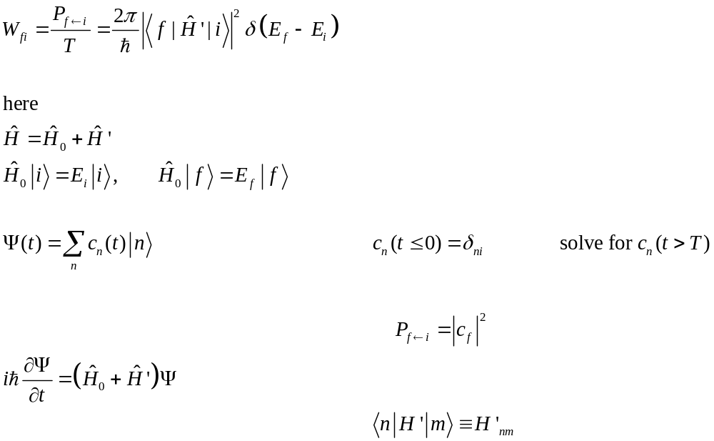




Fermi golden rule
0 T t
Notes:
For a derivation, see e.g., R. C. Tolman, “The principles of statistical mechanics”, Chap. XI.

Slide 3
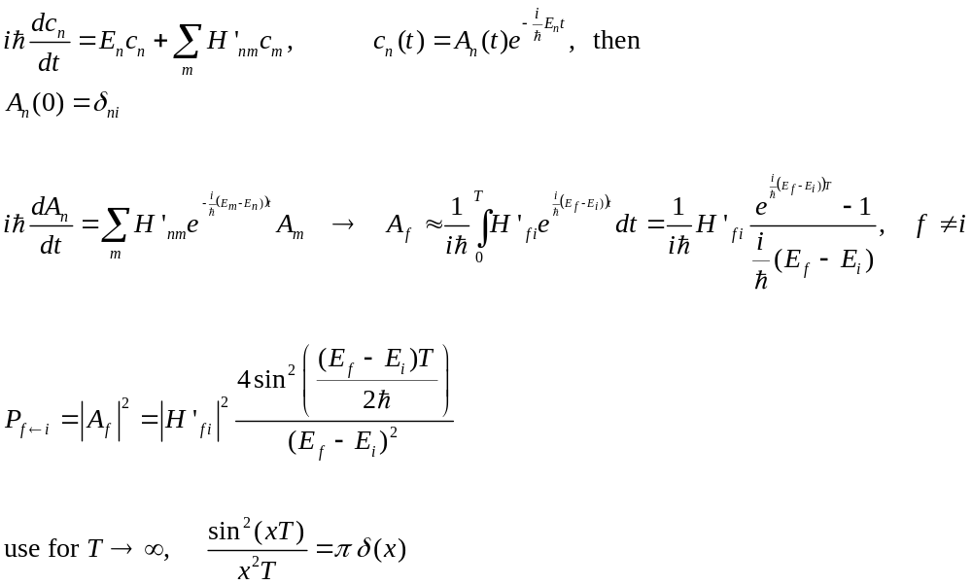
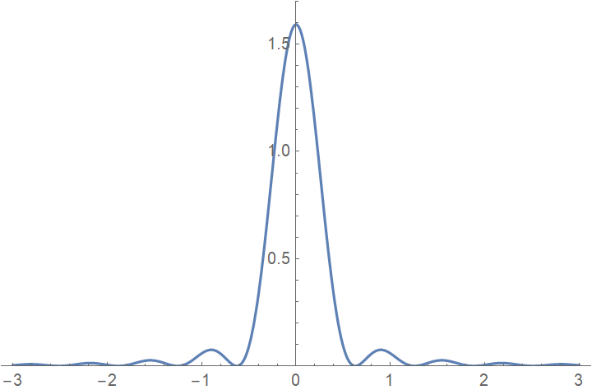

Derive the Fermi-golden rule
$$E_{f}−E_{i}$$
Notes:
The solution would be a series in H’, here we assume H’ is small and keep only the first order in H’ when solving for A_n.

Slide 4
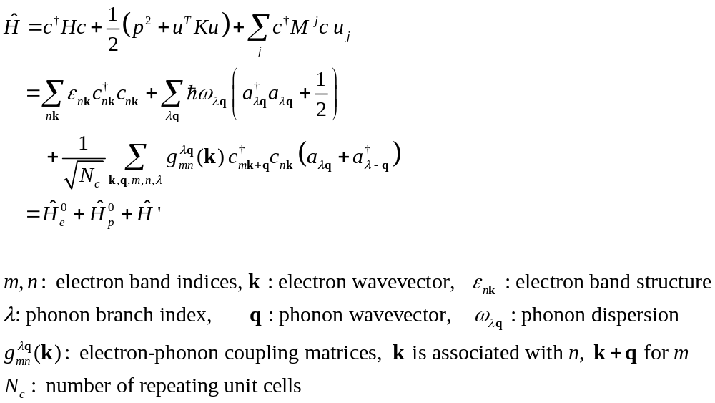
Problem setup : electron-phonon interaction
λ,q
n,k
g
m,k+q
Notes:
See, e.g., F. Giustino, Rev. Mod. Phys. 89, 015003 (2017).

Slide 5
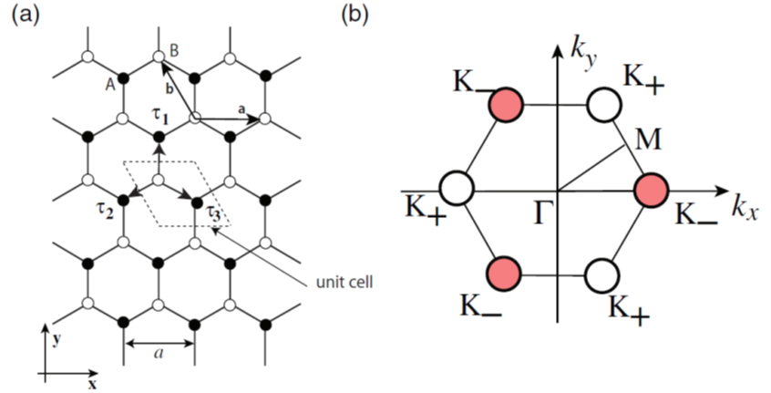
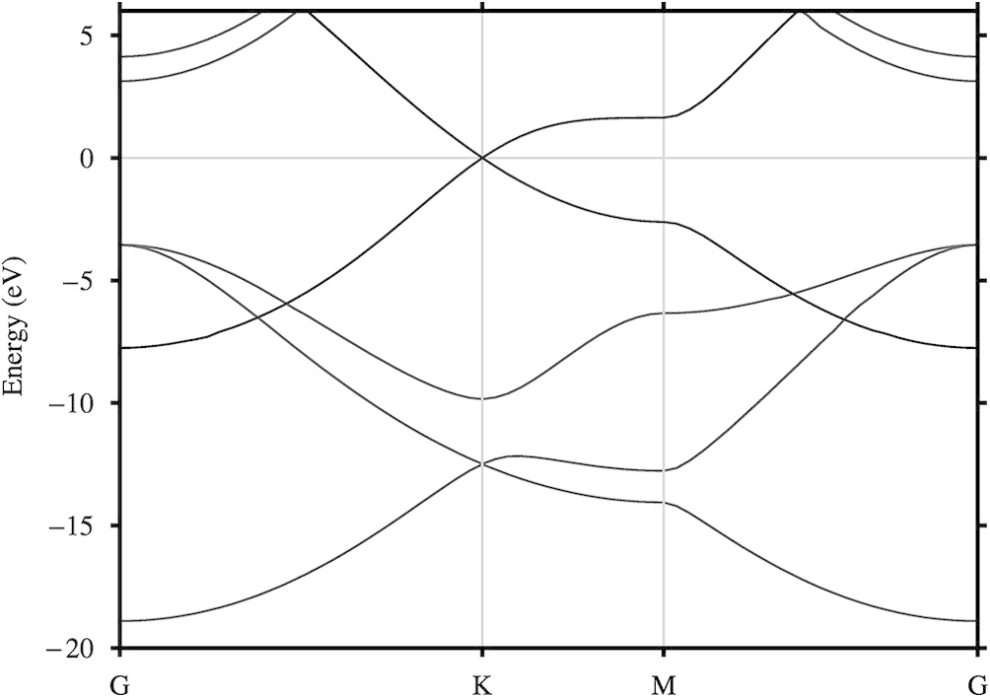
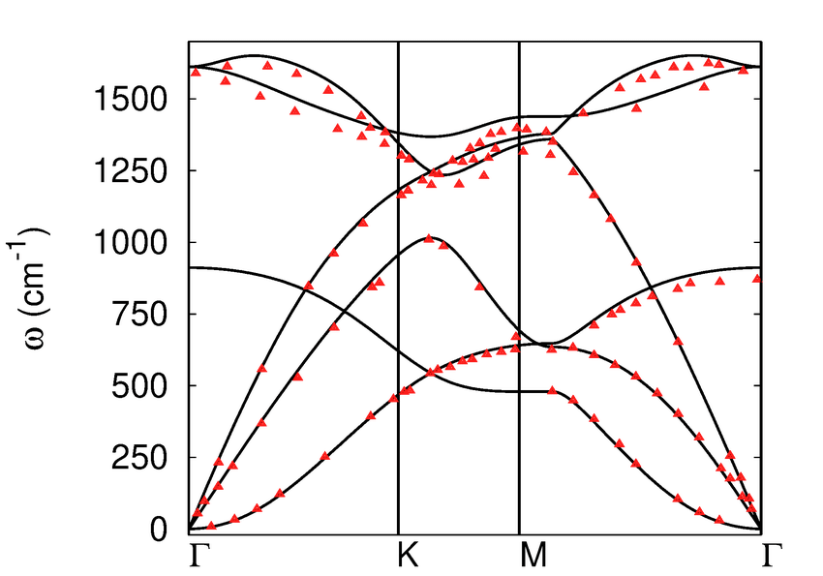
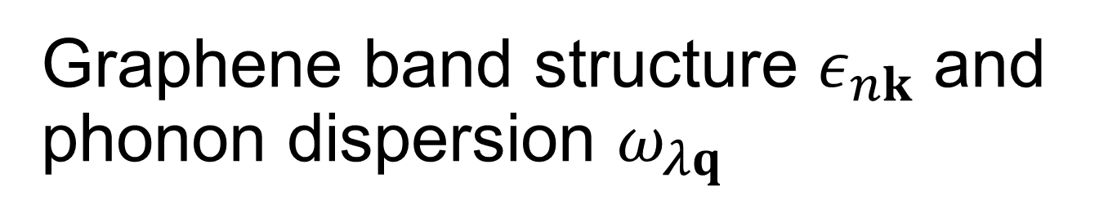
Graphene band structure $ε_{nk}$ and phonon dispersion $ω_{λq}$

Slide 6
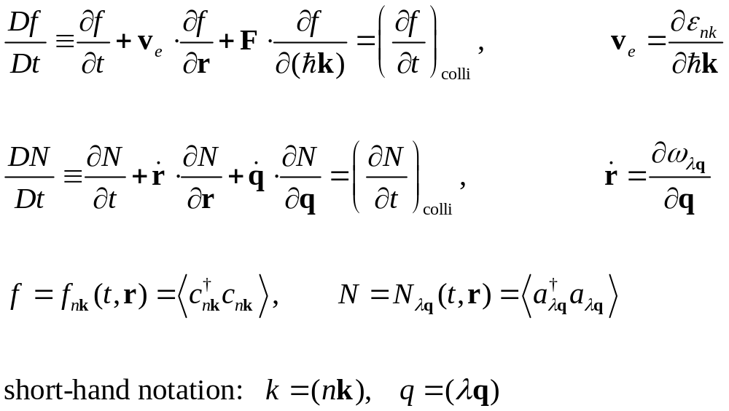
Boltzmann equations
Notes:
F and dot{q} are associated with external force and stress.

Slide 7
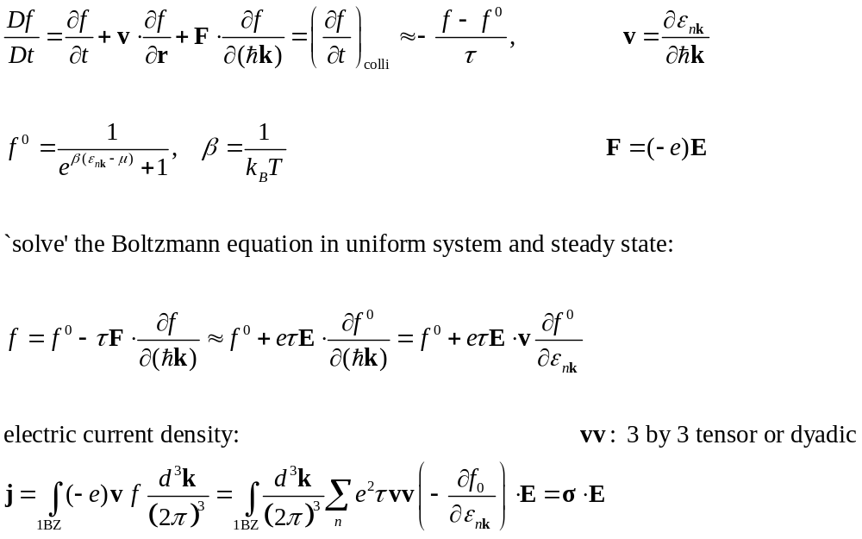
Single-mode relaxation time approximation
Notes:
Note that the relaxation time tau can be a function of the electron mode (nk) as well. I have omitted a factor of 2, since my electrons are spinless. sigma is 3x3 conductivity tensor. This is just the Ohm’s law.

Slide 8
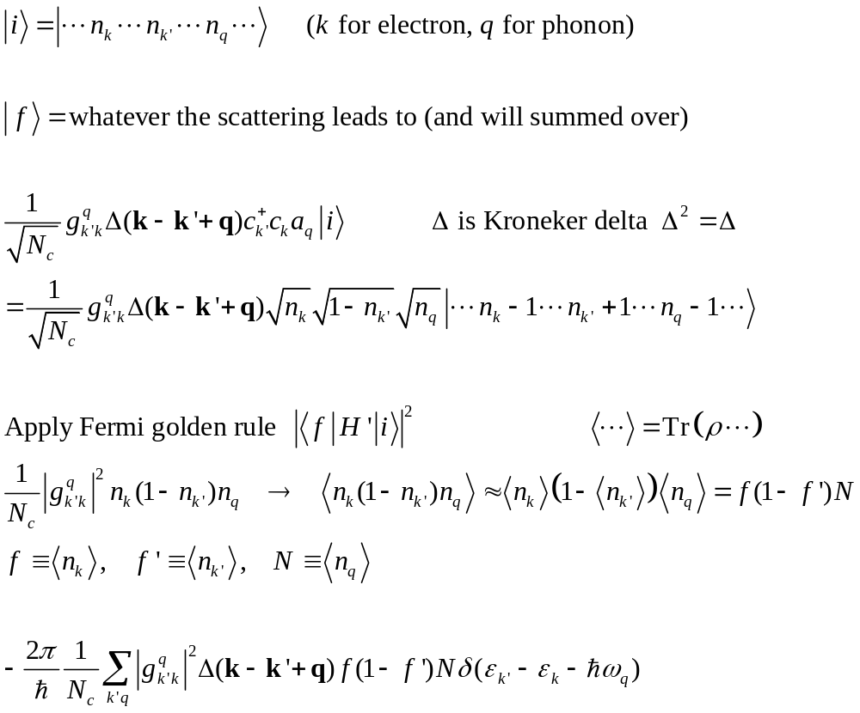
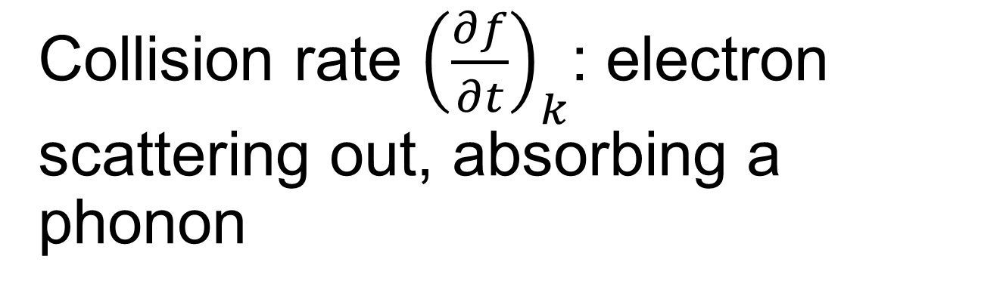
Collision rate ${\left(\frac{∂f}{∂t}\right)}_{k}$: electron scattering out, absorbing a phonon
k
q
k′
Notes:
Sorry for the bad notation, the 1/Sqrt(N), or 1/N in front is the number of units cells (an integer), while N =<a+a> = <N_q> is the phonon distribution function. In f(1-f’) N.

Slide 9
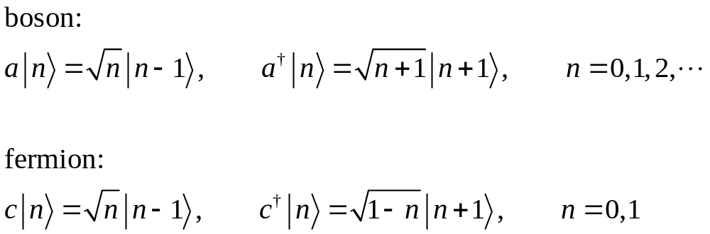
Recall the properties of creation/annihilation operators
Notes:
The square root for the fermion case seems arbitrary as sqrt(1) = 1, sqrt(0) = 0. Any justification?

Slide 10
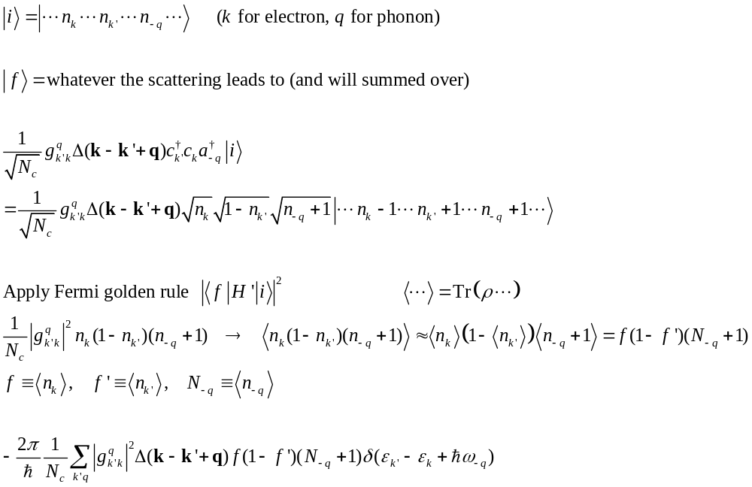
Collision rate – electron scattering out, emitting a phonon
k
q
k′

Slide 11
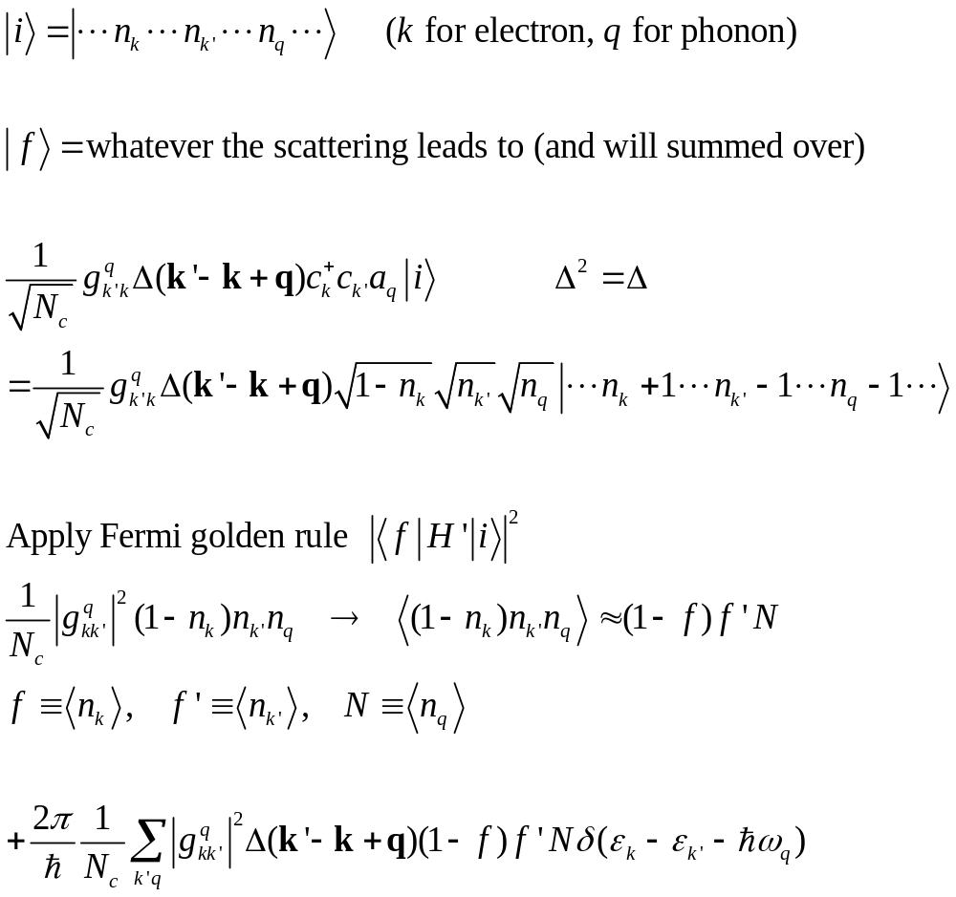
electron scattering in, absorbing a phonon
k′
q
k

Slide 12
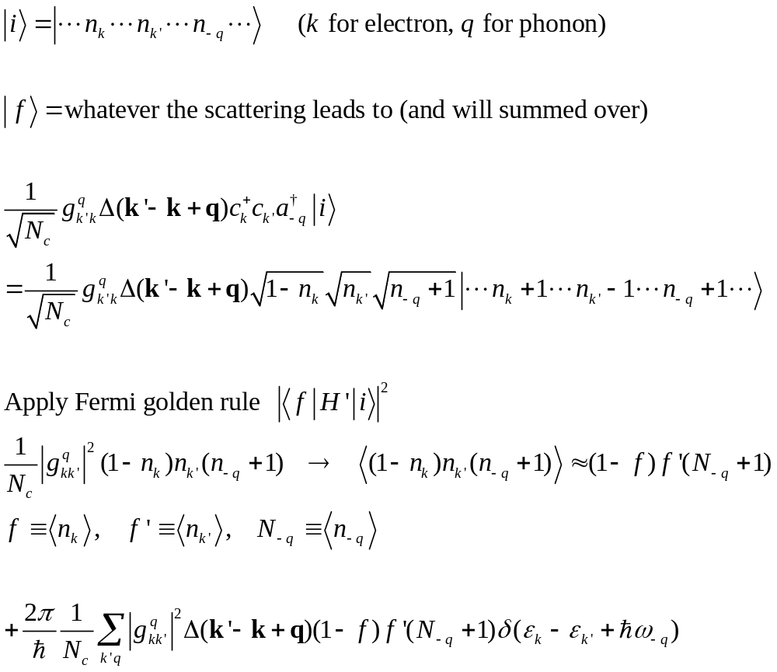
electron scattering in, emitting a phonon
k′
q
k

Slide 13
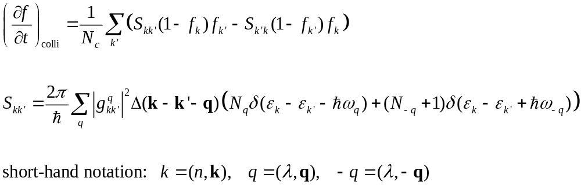
Electron collision rate, add four terms
Notes:
Note that the state k is the fixed one appear on the left hand side of the Boltzmann equation. k’ is the one that need to be summed.

Slide 14
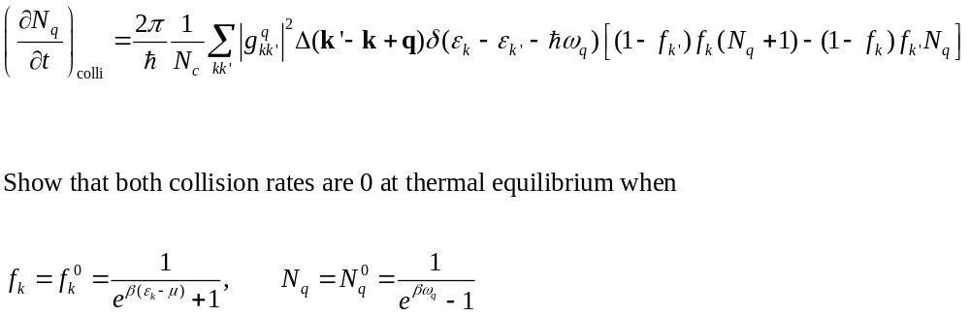
Collision rate for phonon
k, f
k′
q
q
k′, 1− f′
k

Slide 15
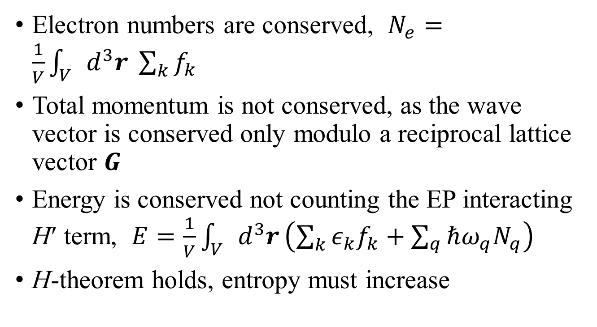
Conservation laws
Electron numbers are conserved, $N_{e}=\frac{1}{V}\int_{V}{d^{3}r \sum_{k}{f_{k}}}$
Total momentum is not conserved, as the wave vector is conserved only modulo a reciprocal lattice vector $G$
Energy is conserved not counting the EP interacting H′ term, $E=\frac{1}{V}\int_{V}{d^{3}r}\left(\sum_{k}{ε_{k}f_{k}+\sum_{q}{ℏω_{q}N_{q}}}\right)$
H-theorem holds, entropy must increase

Slide 16
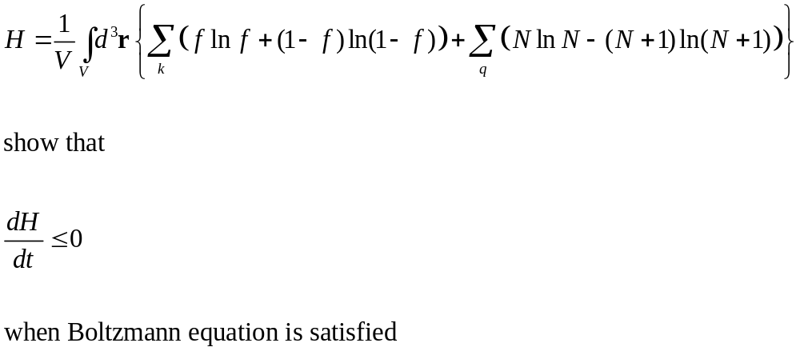
Prove the H-theorem

Slide 17
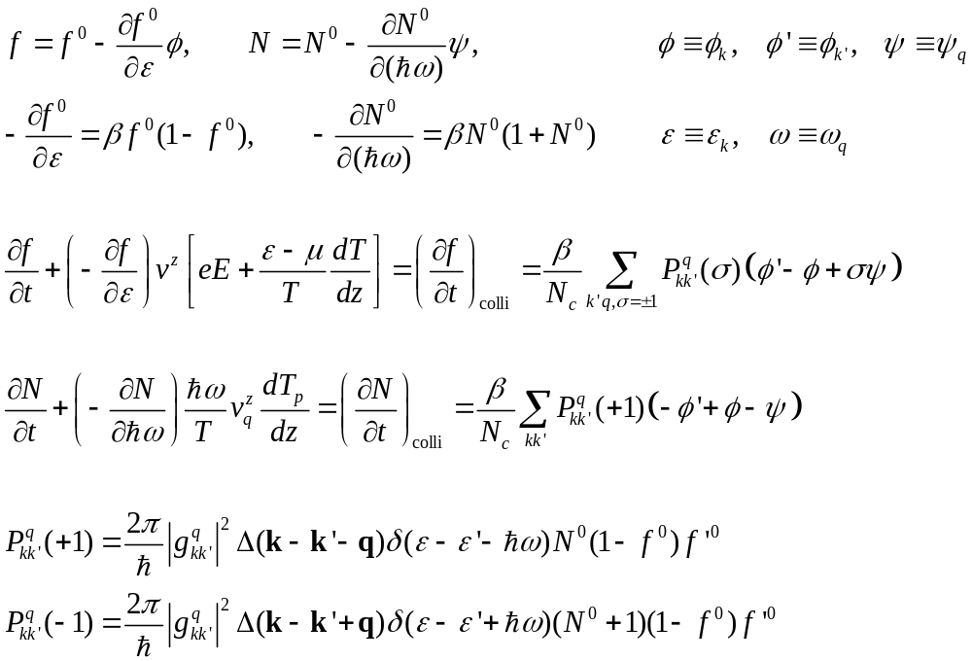
Linearized Boltzmann equation
Notes:
I think local equilibrium approximation is needed to get to the left-hand side (i.e. We can use f^0 and N^0 but beta and mu are slow varying function of the position r).

Slide 18
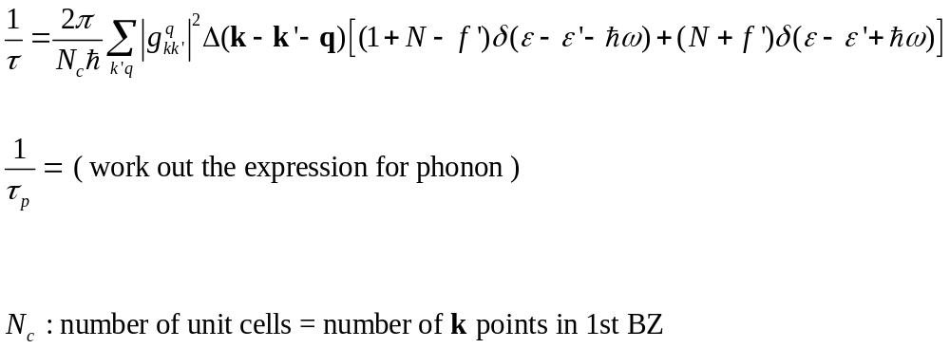
Relaxation time approximation (ignore off-diagonal terms in the linearized collision rates)
Notes:
See, e.g., Eq.(170) in F. Giustino, “Electron-phonon interactions from first principles”, Rev. Mod. Phys. 89, 015003 (2017). Sorry about the notation N here. The N inside the sum is Bose function, while the prefactor of 2pi/Nc, this Nc is the number of units cell.

Slide 19
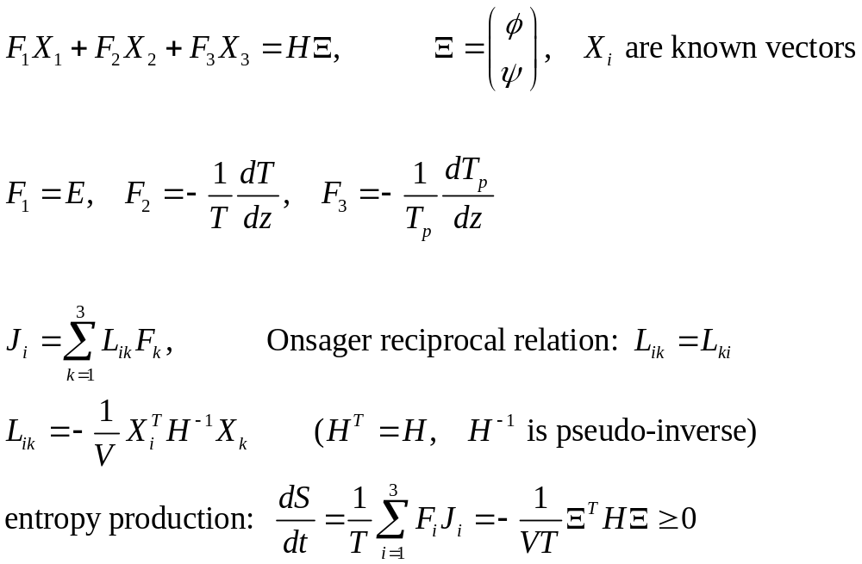
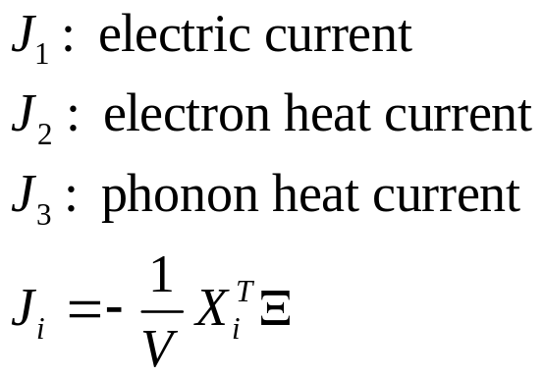
Linearized Boltzmann equation, linear nonequilibrium thermodynamics
Notes:
The idea here is from H. Smit and H.H. Jensen, “Transport phenomena”, 1989. See also R. E. Peierls, “Quantum theory of solids”.

Slide 20
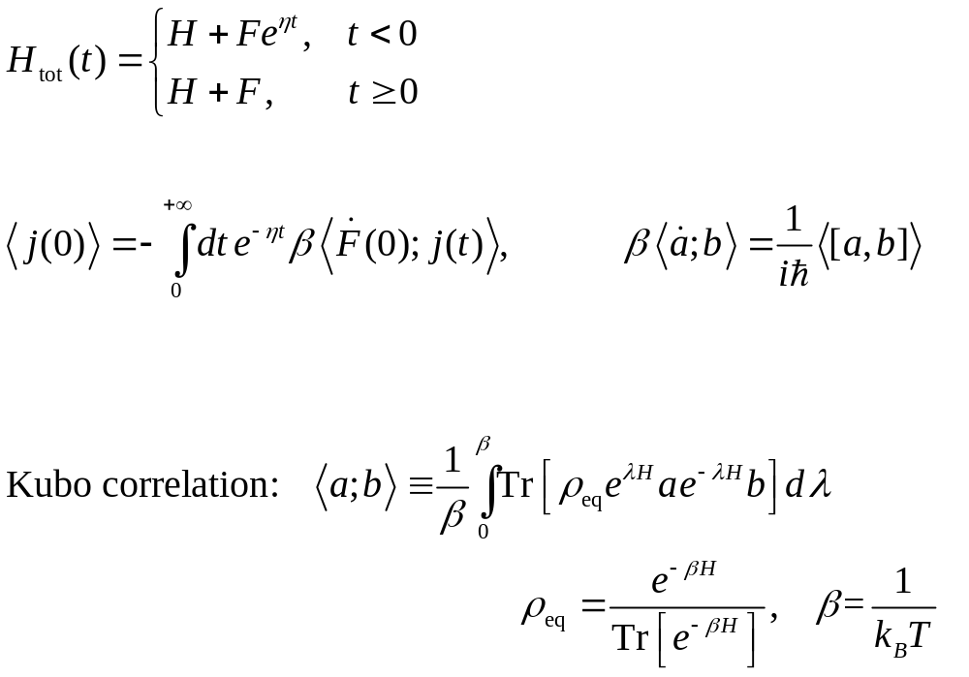
Kubo linear response theory
H+F
H
t
0
Notes:
We solve the von Neumann equation for the density matrix perturbatively to 1st order in F. <A; B> =<B; A> means Kubo canonical correlation.

