Slide 1
Photon Transport out of Non-equilibrium Systems
Jian-Sheng Wang
Department of Physics, National University of Singapore

Slide 2
Outline
Remark on fluctuation-dissipation theorem
Tight-binding model for electrons
NEGF theory of energy, momentum, and angular momentum transfer, Meir-Wingreen formulas
Applications
  Heat transfer of current-carrying systems
  Angular momentum emission from graphene edges
  Van der Waals force, fullerene system
  Co-planar super-Planckian radiation in 2D metals
  Floquet drive of a square lattice

Slide 3
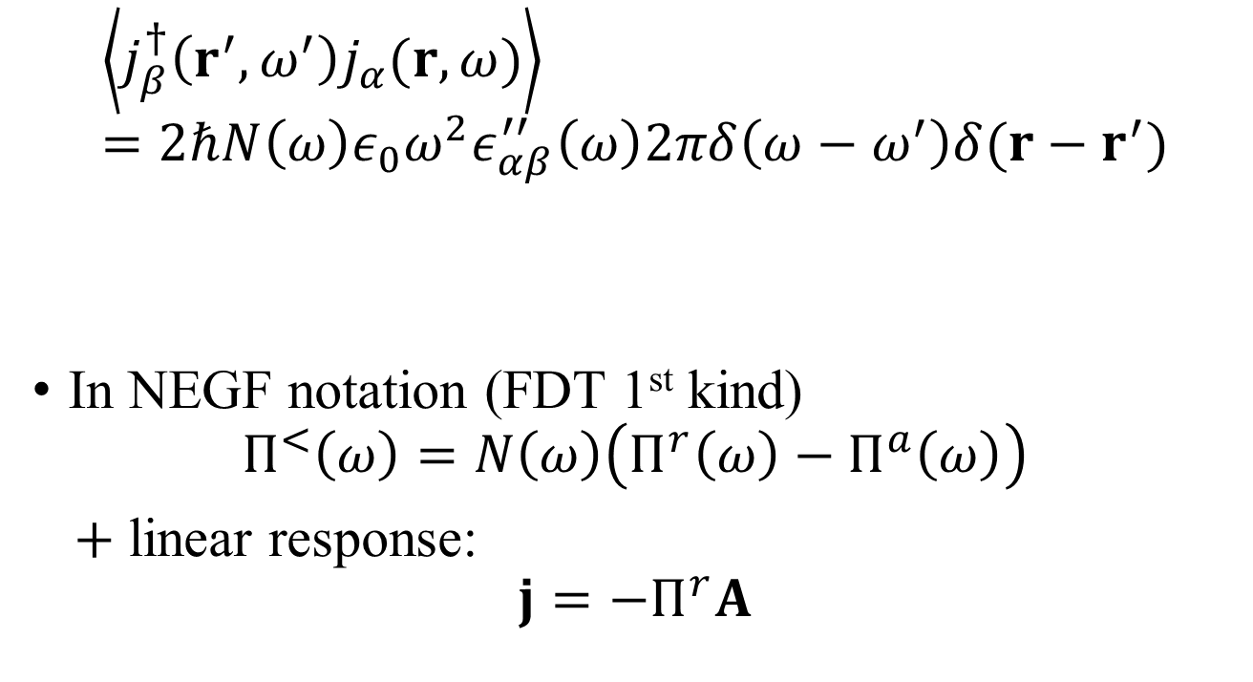
Fluctuation-dissipation theorem (of 2nd kind)
$$\left\langle j_{β}^{†}\left(r^{′},ω^{′}\right)j_{α}(r,ω)\right\rangle =2ℏN\left(ω\right)ε_{0}ω^{2}ε_{αβ}^{′′}\left(ω\right)2πδ\left(ω−ω^{′}\right)δ(r−r^{′})$$
In NEGF notation (FDT 1st kind)
$$Π^{<}\left(ω\right)=N\left(ω\right)\left(Π^{r}\left(ω\right)−Π^{a}\left(ω\right)\right)$$
$+$ linear response:
$$j=−Π^{r}A$$
Callen and Welton 1951,
Kubo 1966,
Eckhardt 1984
What to do when FDT breaks down?

Slide 4
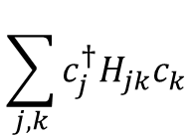
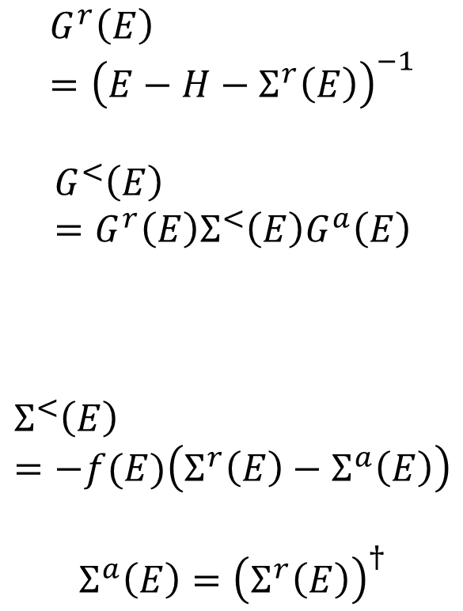
Electron tight-binding model with baths
$$G^{r}\left(E\right)={\left(E−H−Σ^{r}\left(E\right)\right)}^{−1}$$
$$G^{<}\left(E\right)=G^{r}\left(E\right)Σ^{<}\left(E\right)G^{a}\left(E\right)$$
$$Σ^{<}\left(E\right)=−f(E)\left(Σ^{r}\left(E\right)−Σ^{a}\left(E\right)\right)$$
$$Σ^{a}\left(E\right)={\left(Σ^{r}\left(E\right)\right)}^{†}$$
system
bath
$$\sum_{j,k}{c_{j}^{†}H_{jk}c_{k}}$$

Slide 5
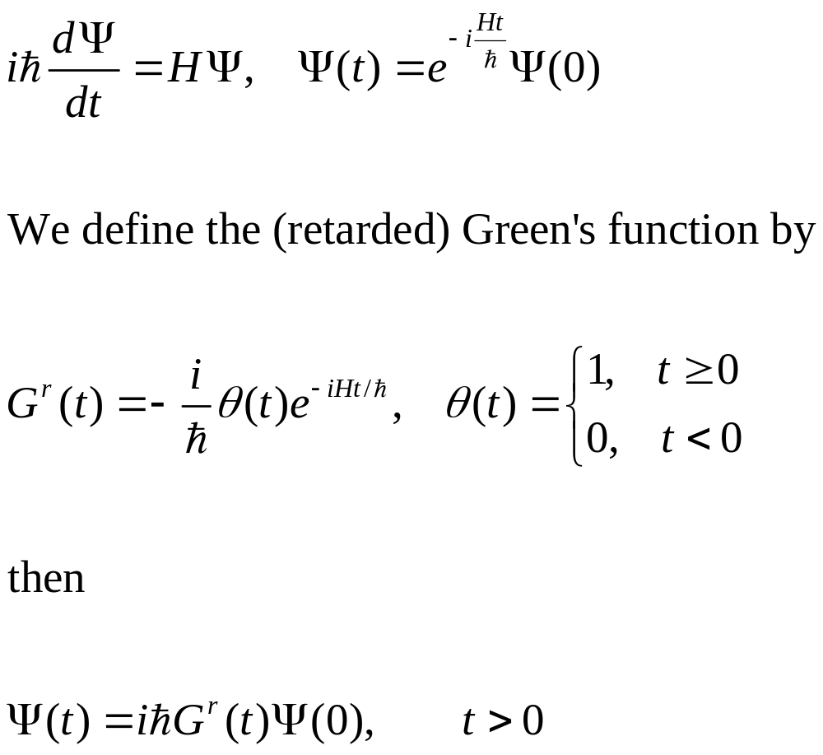
Single electron quantum mechanics
Notes:
In a particular representation, since H is 2x2 matrix, Psi a column vector, so the Green’s function G is also 2x2 matrix.

Slide 6
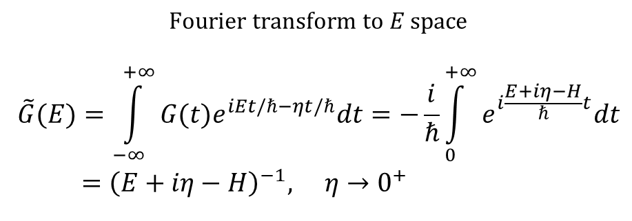
Green’s function in energy space
$$\text{Fourier} \text{transform} \text{to} E \text{space}$$
$$\tilde{G}(E)=\int_{−∞}^{+∞}{G(t)e^{iEt/ℏ−ηt/ℏ}dt=−\frac{i}{ℏ}}\int_{0}^{+∞}{e^{i\frac{E+iη−H}{ℏ}t}dt} \\ ={\left(E+iη−H\right)}^{−1}, η→0^{+}$$
${\left(z−H\right)}^{−1}$ is called resolvent of the operator $H$.
Notes:
Here z or E or i*eta really means the constant type the identity matrix I. The small eta 1) makes the integral converge, 2) makes the inverse Fourier transform well defined (which produce the theta(t) in the retarded Green’s function).

Slide 7
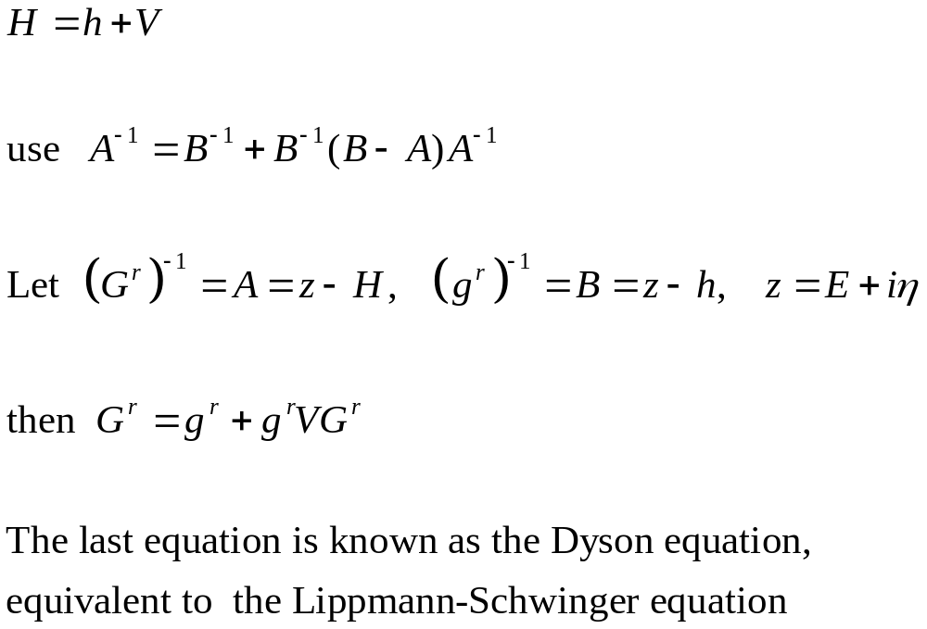
Perturbation theory, single electron

Slide 8
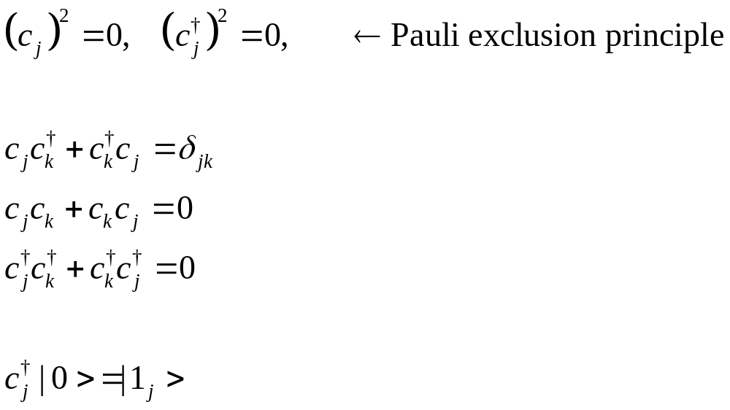
Annihilation/creation operators
defining property of fermion

Slide 9
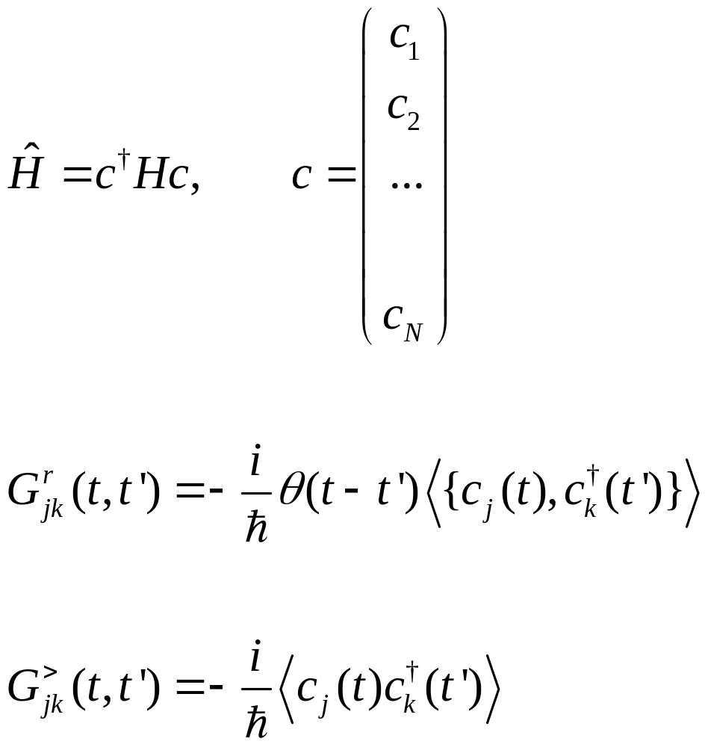
Many-electron Hamiltonian and Green’s functions
Annihilation operator c is a column vector, H is N by N matrix. {A, B} =AB+BA
Notes:
Various other Green’s functions (G<, G>, G^r, G^a, G^t, G^tbar) will be defined later for phonon. The form and relation among Greens are such so that phonon and electrons are the same. See slide 54, 55.

Slide 10
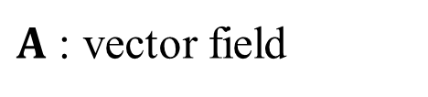
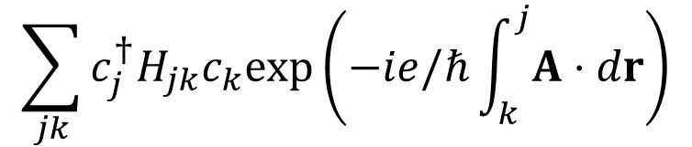
Electron-field interaction, Peierls substitution
system
$$\sum_{jk}{c_{j}^{†}H_{jk}c_{k}exp\left(−ie/ℏ\int_{k}^{j}{A⋅dr}\right)}$$
bath
$A$ : vector field

Slide 11
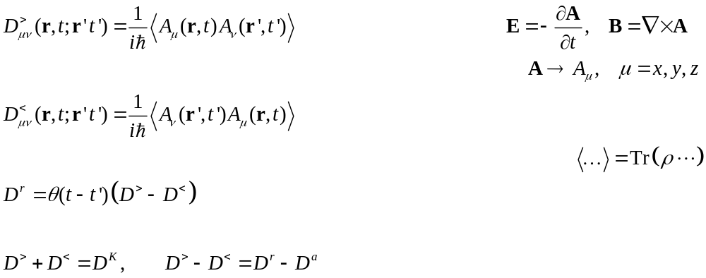

NEGF, definitions
See AGD chapter 6
$φ=0$ gauge
Heisenberg-Pauli 1930;
B. S. Kay 2021.

Slide 12
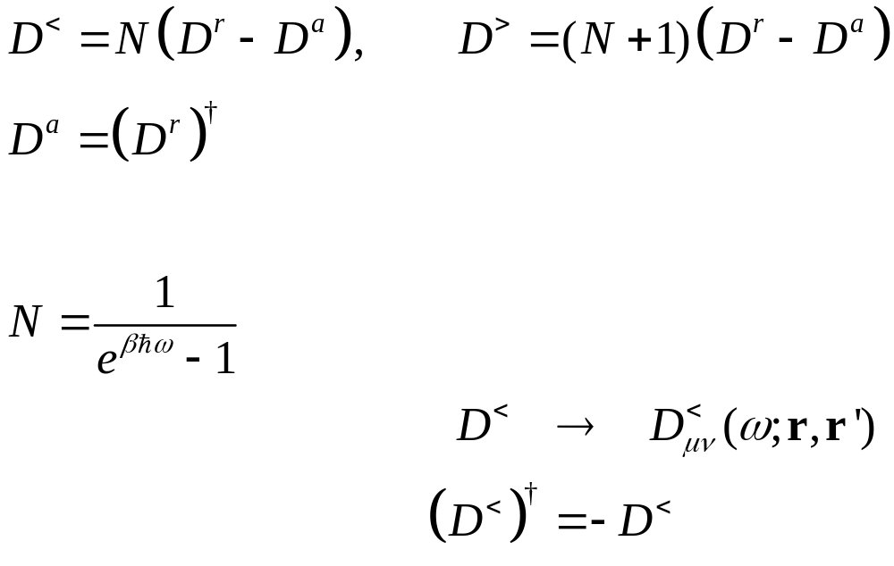
Fluctuation-dissipation theorem in thermal equilibrium
Eckhardt 1984
Agarwal 1975

Slide 13
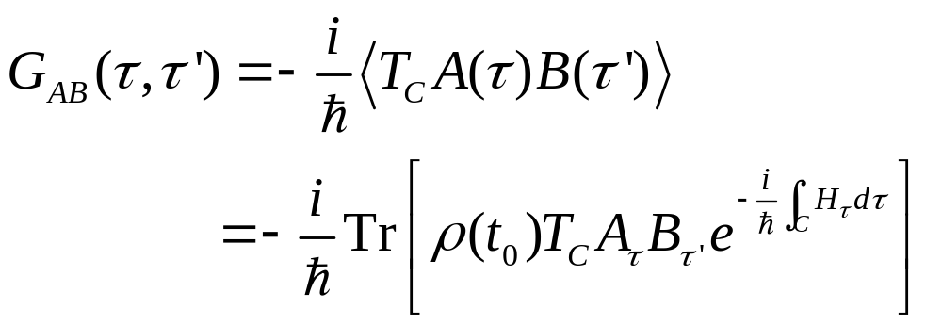
Contour-ordered Green’s function
Contour order: the operators earlier on the contour are to the right. See, e.g., H. Haug & A.-P. Jauho.
τ’
τ
t₀
Notes:
A B in the second line is in Schrodinger picture.
13

Slide 14
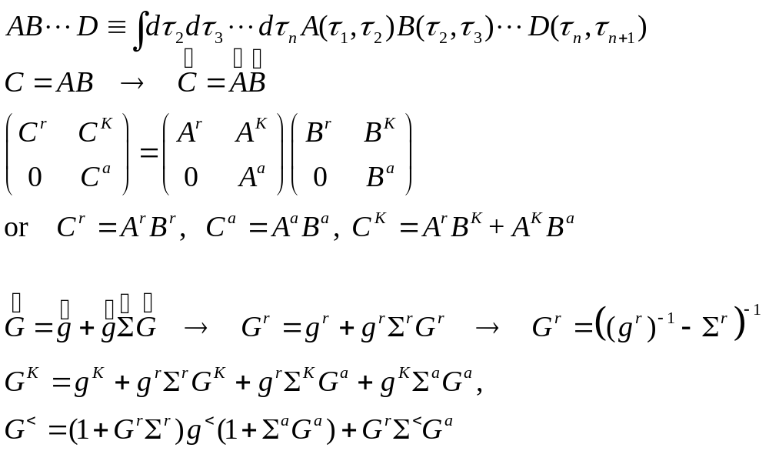
Convolution, Langreth rule
Keldysh rotation
Notes:
The last two equations are known as Keldysh equations.

Slide 15
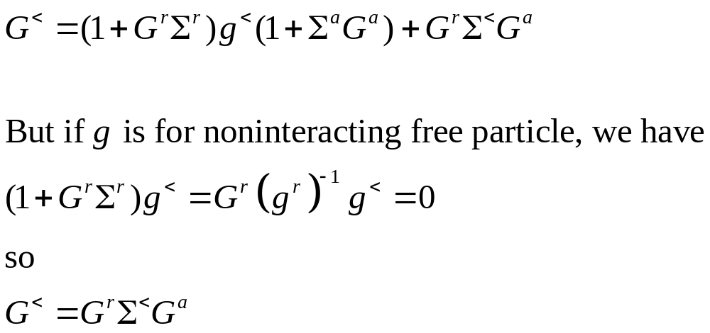
Keldysh equation

Slide 16
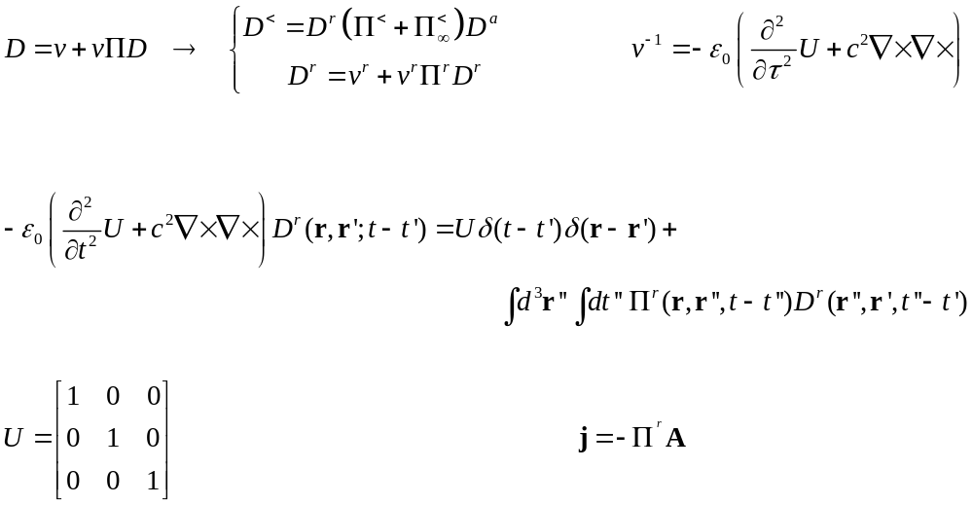

Dyson equation
contour ordered
Two-linear responses:
$$A=−Dj_{ex}$$

Slide 17
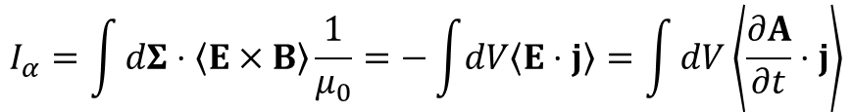
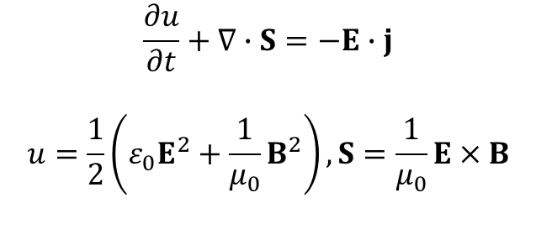
Poynting theorem and heat transfer
$$\frac{∂u}{∂t}+∇∙S=−E∙j$$
$$u=\frac{1}{2}\left(ε_{0}E^{2}+\frac{1}{μ_{0}}B^{2}\right), S=\frac{1}{μ_{0}}E×B$$
α
$$I_{α}=\int{dΣ⋅\left\langle E×B\right\rangle \frac{1}{μ_{0}}=−\int{dV\left\langle E⋅j\right\rangle }}=\int{dV\left\langle \frac{∂A}{∂t}⋅j\right\rangle }$$

Slide 18
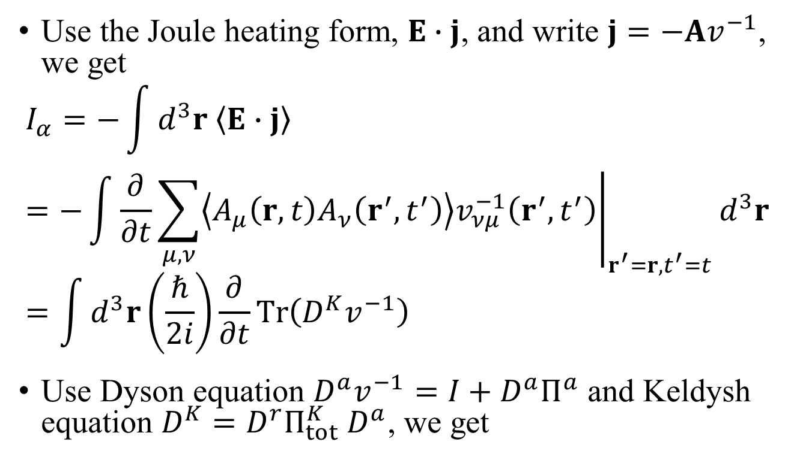
Deriving the Meir-Wingreen formula
Use the Joule heating form, $E∙j$, and write $j=−Av^{−1}$, we get
$$I_{α}=−\int{d^{3}r \left\langle E∙j\right\rangle }=−\int{{\left.\frac{∂}{∂t}\sum_{μ,ν}{\left\langle A_{μ}\left(r,t\right)A_{ν}\left(r^{′},t^{′}\right)\right\rangle v_{νμ}^{−1}\left(r^{′},t^{′}\right)}\right|}_{r^{′}=r,t^{′}=t}}d^{3}r=\int{d^{3}r\left(\frac{ℏ}{2i}\right)\frac{∂}{∂t}Tr\left(D^{K}v^{−1}\right)}$$
Use Dyson equation $D^{a}v^{−1}=I+D^{a}Π^{a}$ and Keldysh equation $D^{K}=D^{r}Π_{tot}^{K}{ D}^{a}$, we get

Slide 19
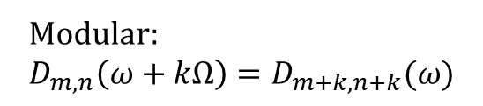
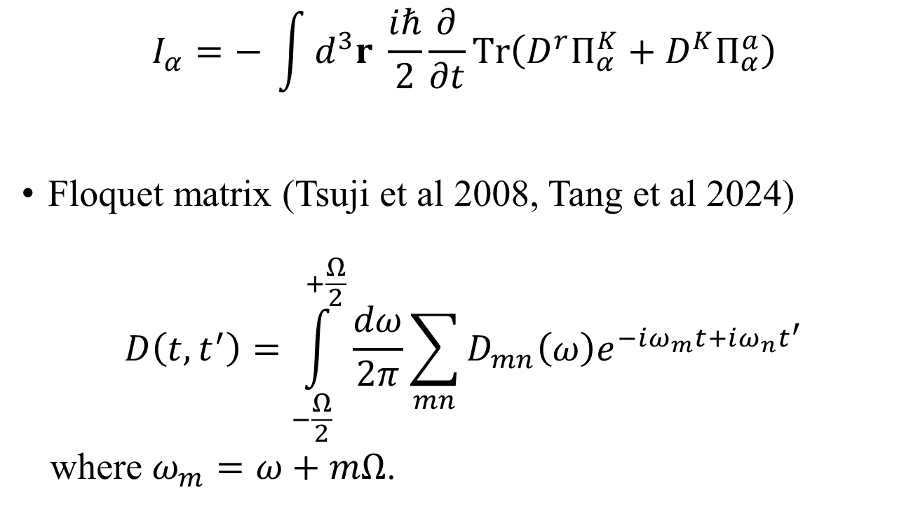
Meir-Wingreen formula
$$I_{α}=− \int{d^{3}r \frac{iℏ}{2}}\frac{∂}{∂t}Tr\left(D^{r}Π_{α}^{K}+D^{K}Π_{α}^{a}\right)$$
Floquet matrix (Tsuji et al 2008, Tang et al 2024)
$$D\left(t,t^{′}\right)=\int_{−\frac{Ω}{2}}^{+\frac{Ω}{2}}{\frac{dω}{2π}\sum_{mn}{D_{mn}\left(ω\right)e^{−iω_{m}t+iω_{n}t^{′}}}}$$
where $ω_{m}=ω+mΩ$.
Modular:
$$D_{m,n}\left(ω+kΩ\right)=D_{m+k,n+k}(ω)$$

Slide 20
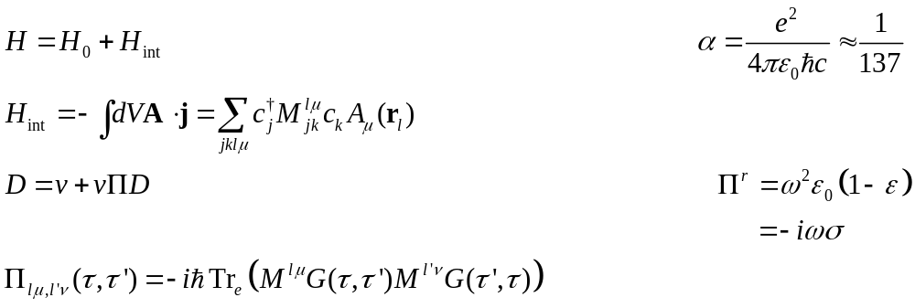

Self-energy $Π$
diamagnetic
RPA

Slide 21
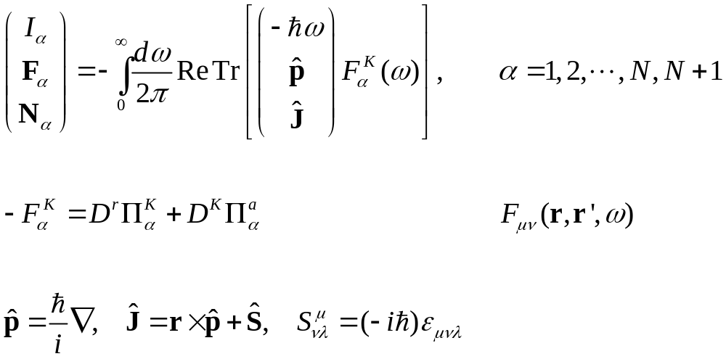
Steady-state Meir-Wingreen formula
Krüger, et al (2012); Strekha, et al (2022);
Wang, et al, Front. Phys. (2023).
Notes:
Levi Civita symbol

Slide 22

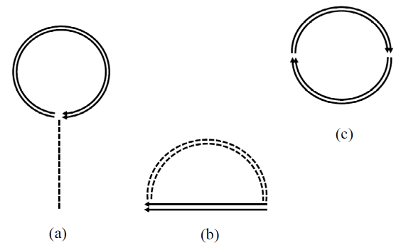
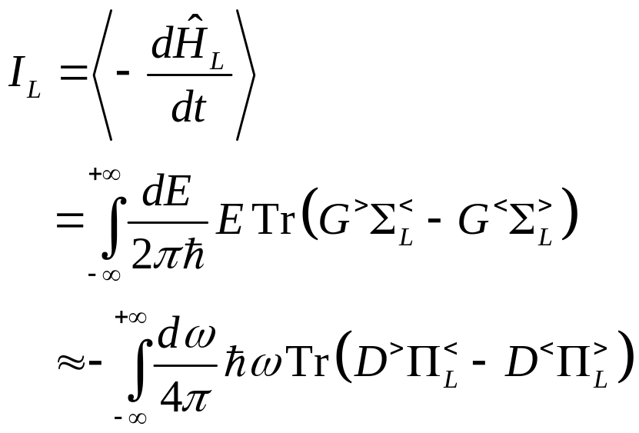
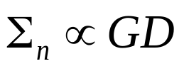
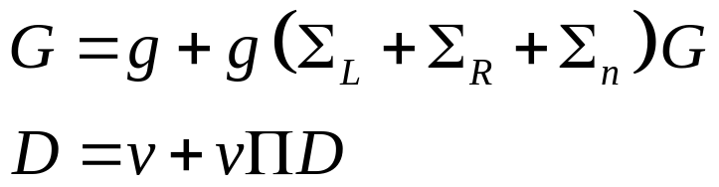
From electron to photon (scalar field theory)

Slide 23
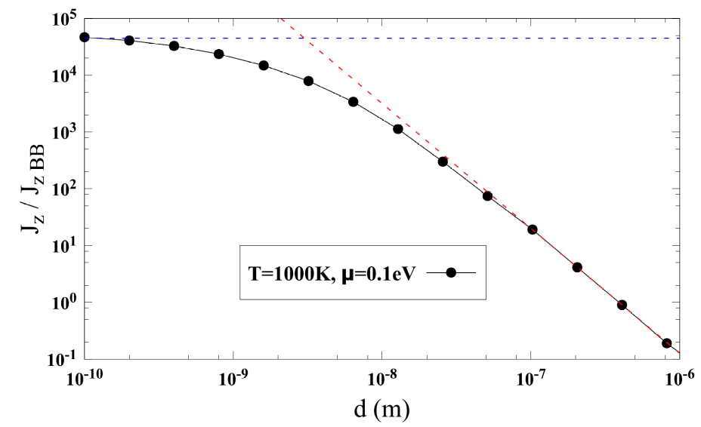
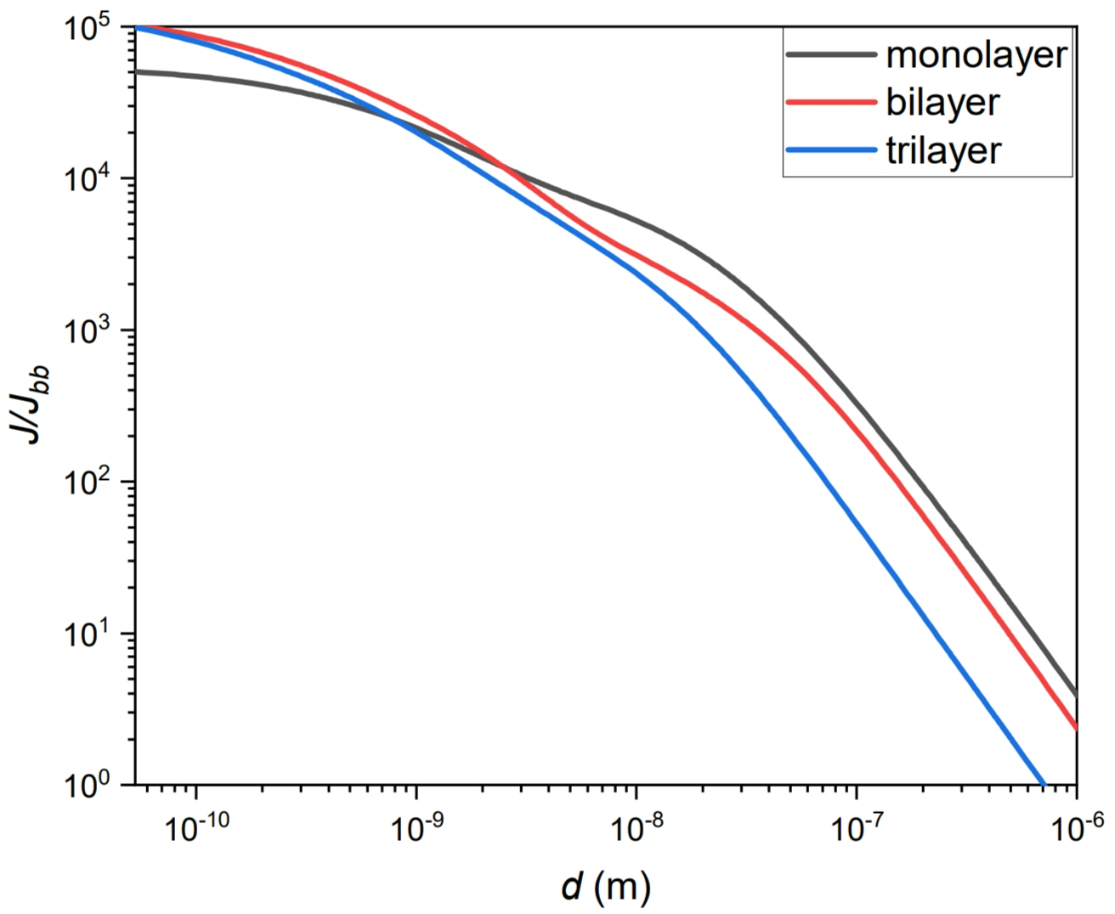
Heat transfer between two graphene sheets
↓ First principles QE/BerkeleyGW calculation for the ratio of energy transfer to blackbody value between two multilayer graphene sheets at temperatures 300 K and 1000 K. Wang, et al, Frontiers of Physics, 18, 43602 (2023).
↑ Heat transfer ratio based on electron tight-binding model with nearest neighbor hopping t = 2.8 eV, between 300 K and 1000 K sheets at chemical potential μ = 0.1 eV. Jiang & Wang, PRB 96, 155437 (2017).

Slide 24
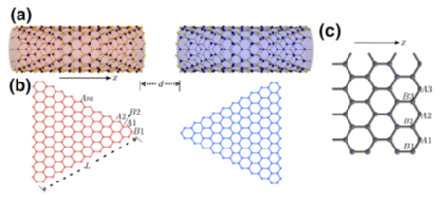
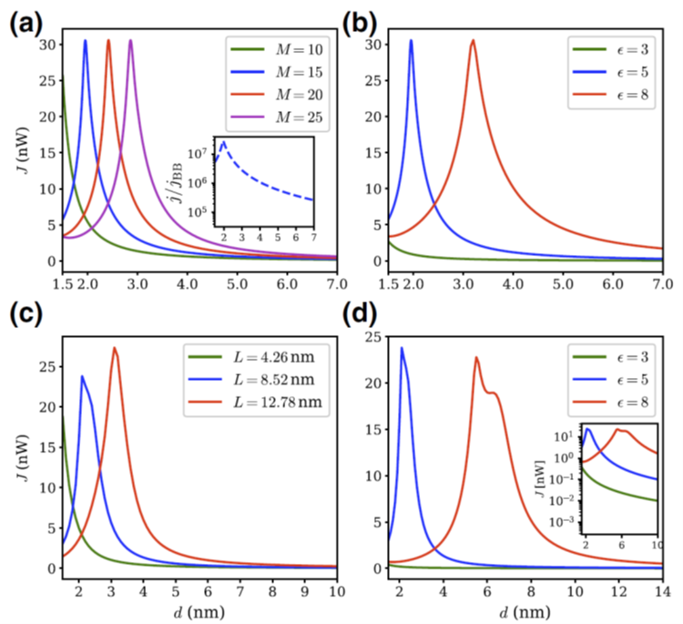
Heat transfer between zigzag nanotubes or triangles
Heat transfer from 400K to 300K objects. (a), (b) zigzag carbon nanotubes. (c), (d) nano-triangles. d: gap distance, M: nanotube circumference, L: triangle length. ε: dielectric constant. From Tang, et al, Phys. Rev. Appl. 11, 031004 (2019).

Slide 25
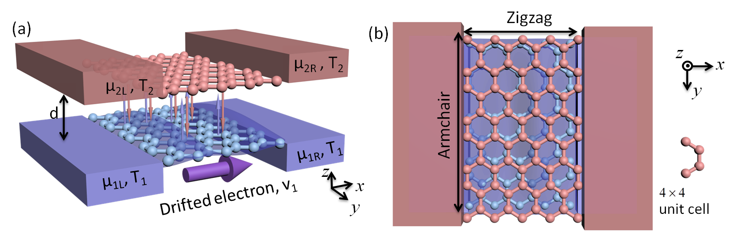
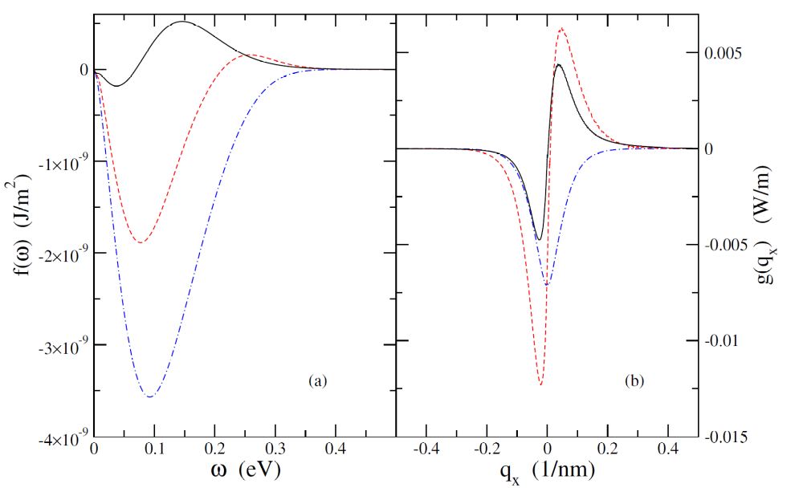
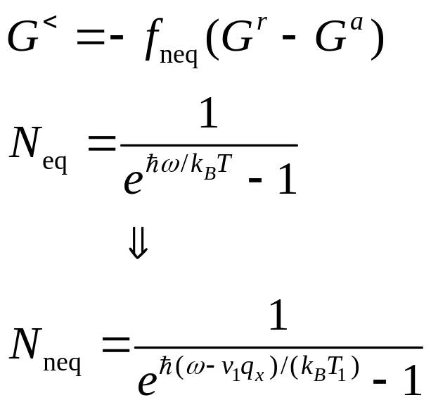
Heat transfer driven by current
Partial integrand for the total current with different driven velocities (blue dash 0, red 5, black 9, units 10⁵ m/s). From Peng arXiv:1805.09493.

Slide 26
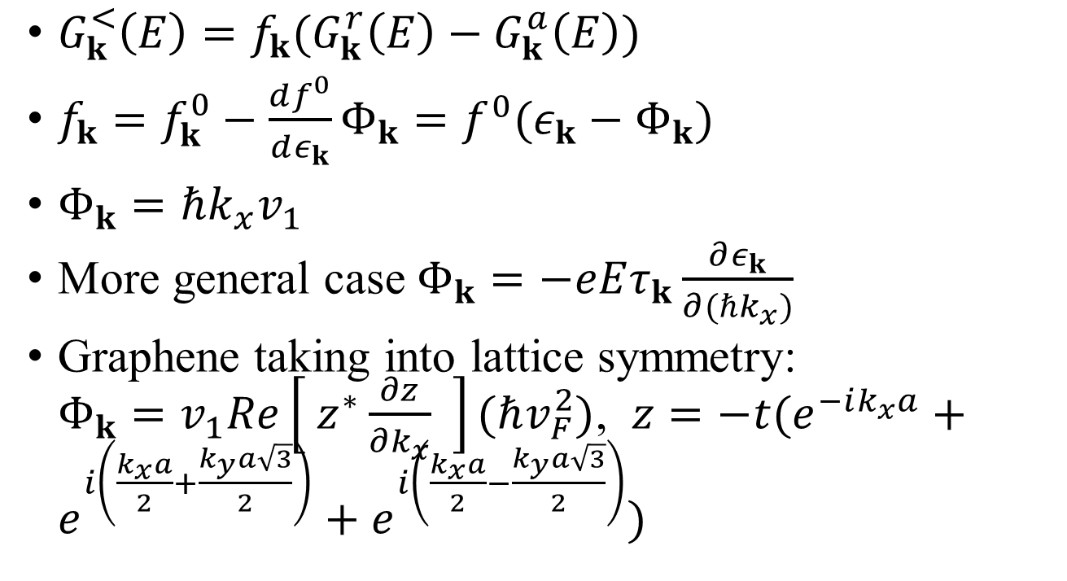
Boltzmann equation for nonequilibrium distribution
$G_{k}^{<}\left(E\right)=f_{k}(G_{k}^{r}\left(E\right)−G_{k}^{a}\left(E\right))$
$f_{k}=f_{k}^{0}−\frac{df^{0}}{dε_{k}}Φ_{k}=f^{0}(ε_{k}−Φ_{k})$
$Φ_{k}=ℏk_{x}v_{1}$
More general case $Φ_{k}=−eEτ_{k}\frac{∂ε_{k}}{∂(ℏk_{x})}$
Graphene taking into lattice symmetry: $Φ_{k}=v_{1}Re\left[ z^{∗}\frac{∂z}{∂k_{x}} \right](ℏv_{F}^{2})$, $z=−t(e^{−ik_{x}a}+e^{i\left(\frac{k_{x}a}{2}+\frac{k_{y}a\sqrt{3}}{2}\right)}+e^{i\left(\frac{k_{x}a}{2}−\frac{k_{y}a\sqrt{3}}{2}\right)})$

Slide 27
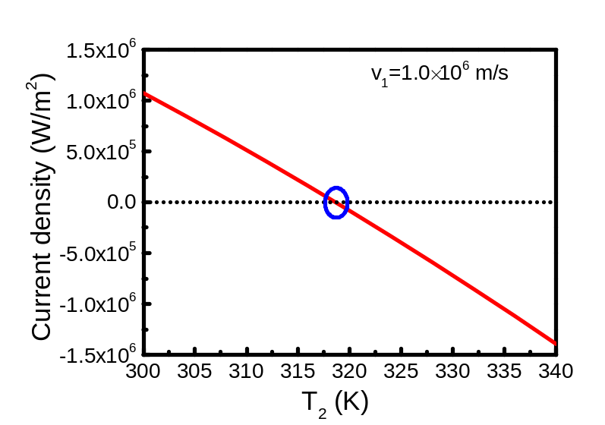
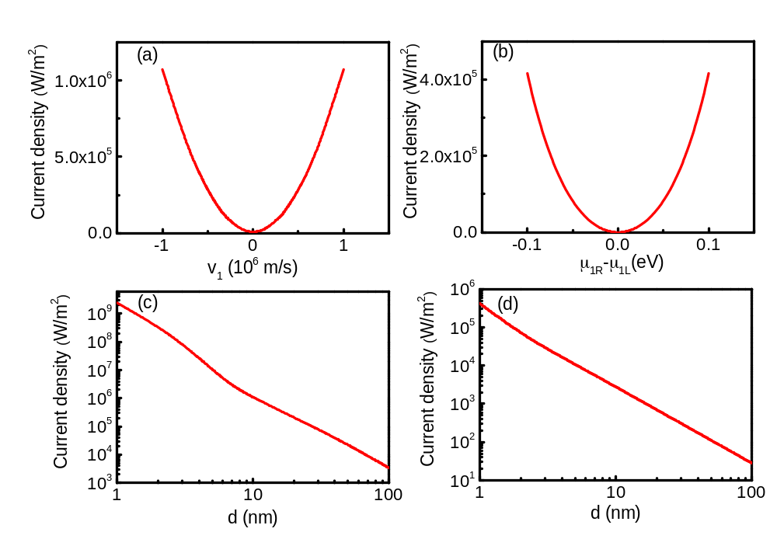
Current-induced heat transfer
: T₁=T₂=300 K. (a) and (c) infinite system (fluctuational electrodynamics), (b) and (d) 4×4 cell finite system with four leads (NEGF).
: Double-layer graphene. T₁=300K, varying T₂ at distance d = 10 nm, chemical potential at 0.1 eV.
From Peng & Wang, arXiv:1805.09493.

Slide 28
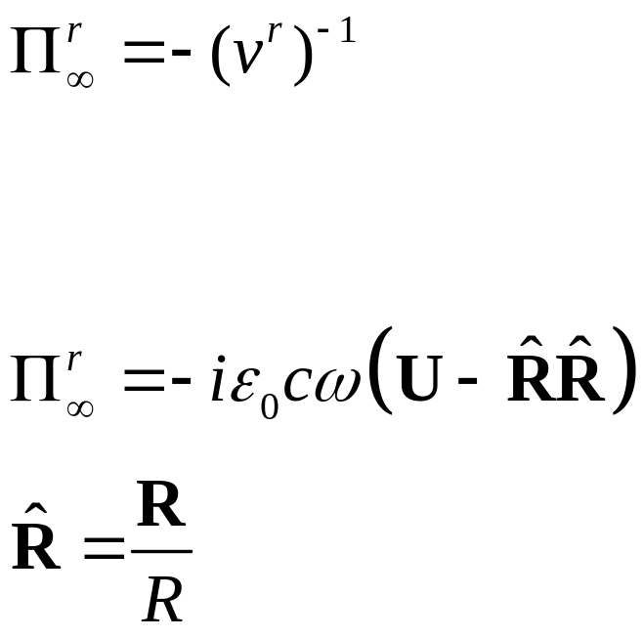

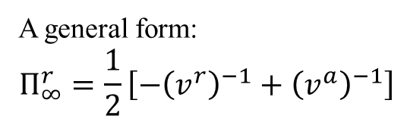

Bath at infinity
Eckhardt, PRA 29, 1991 (1984)
Krüger, et al, PRB 86, 115423 (2012)
$$∞$$
A general form:
$$Π_{∞}^{r}=\frac{1}{2}\left[−{\left(v^{r}\right)}^{−1}+{\left(v^{a}\right)}^{−1}\right]$$

Slide 29
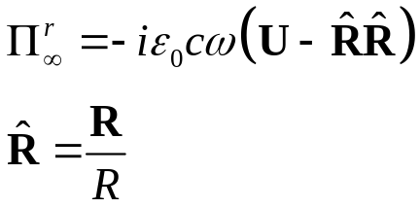
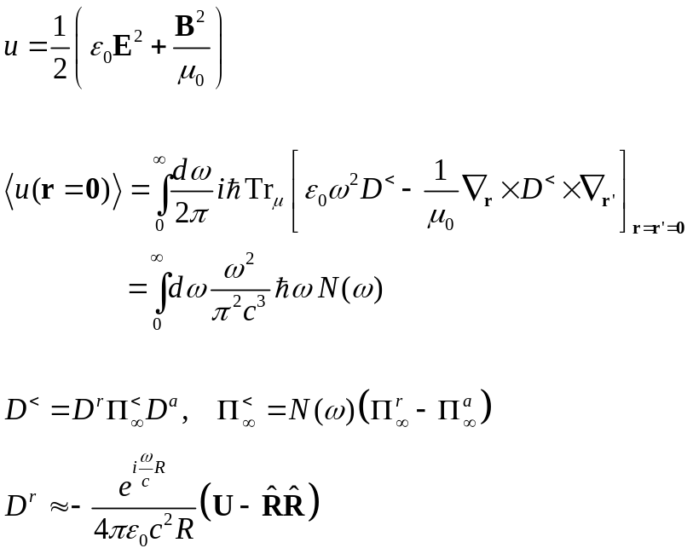
Recover Planck result
R
0

Slide 30
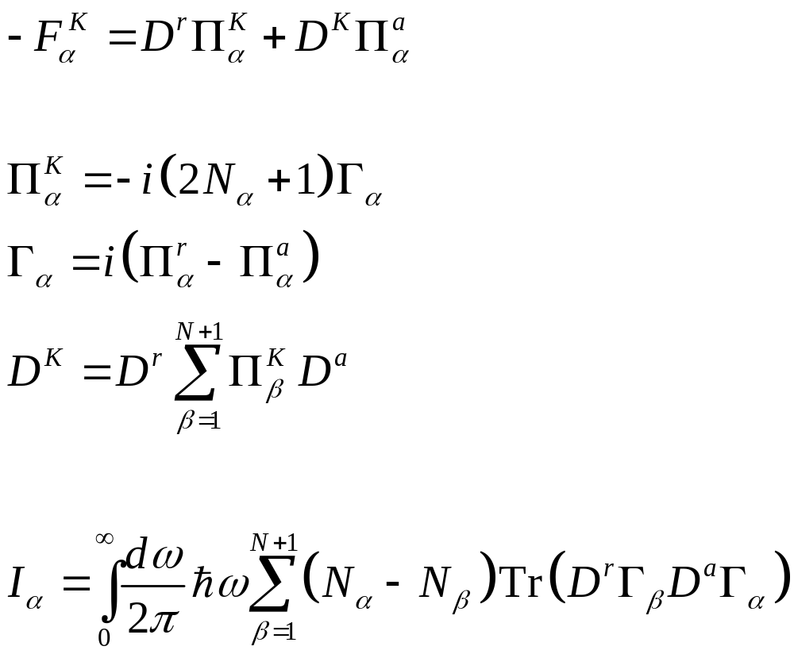
From Meir-Wingreen to Landauer: local equilibrium approximation
No Landauer form for force and torque!

Slide 31
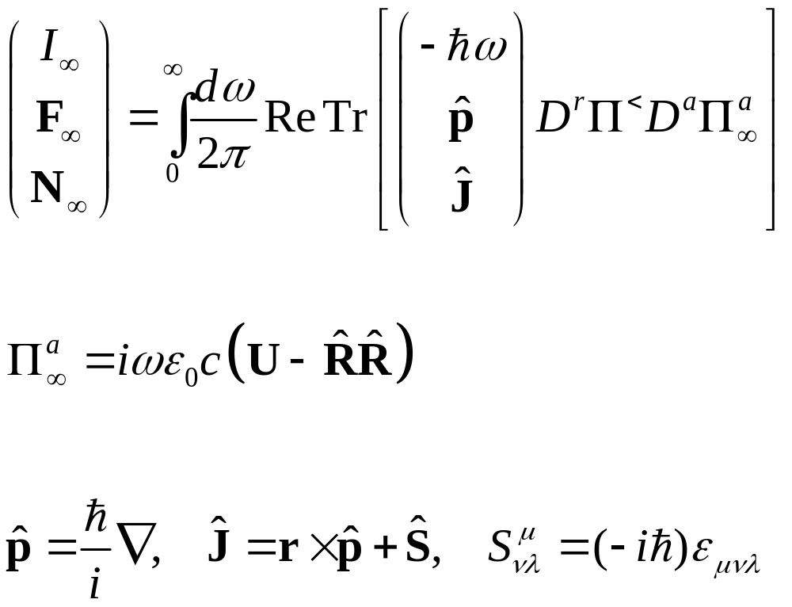
Emission to infinity

Slide 32
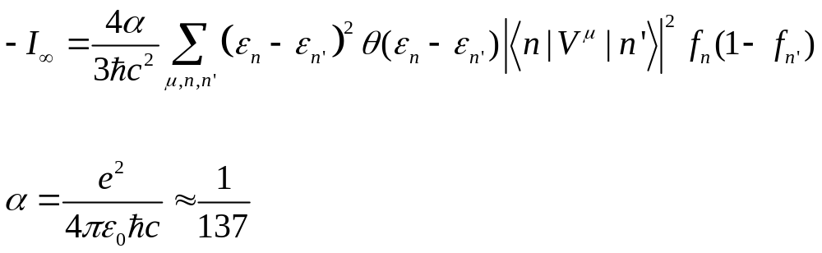
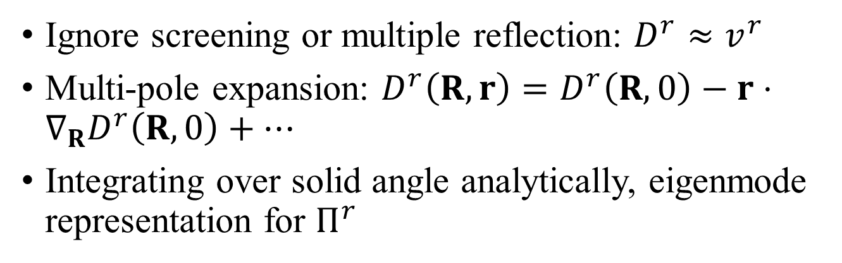
Far field approximations
Ignore screening or multiple reflection: $D^{r}≈v^{r}$
Multi-pole expansion: $D^{r}\left(R,r\right)=D^{r}\left(R,0\right)−r⋅∇_{R}D^{r}\left(R,0\right)+⋯$
Integrating over solid angle analytically, eigenmode representation for $Π^{r}$
Fermi golden rule

Slide 33
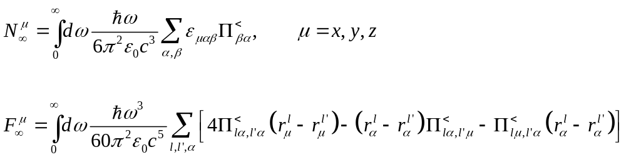
Torque and force on object
Force is zero if system is reciprocal, i.e., if ${\left(Π^{<}\right)}^{T}=Π^{<}$

Slide 34
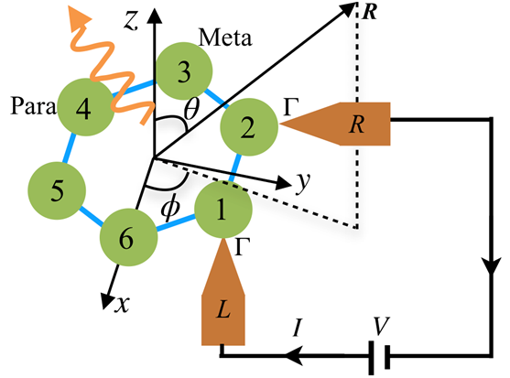
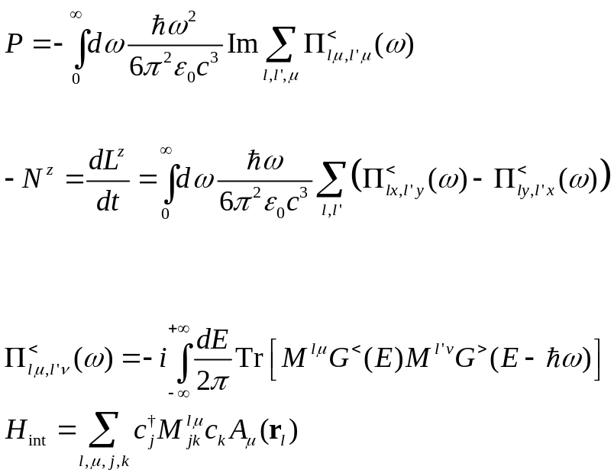
Angular momentum emission from a benzene molecule

Slide 35
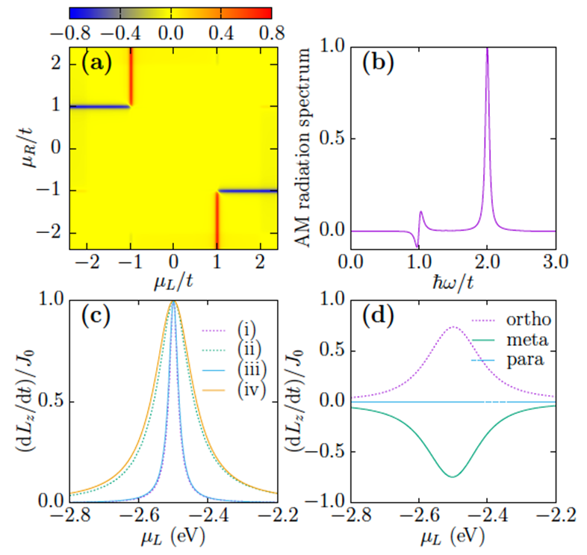


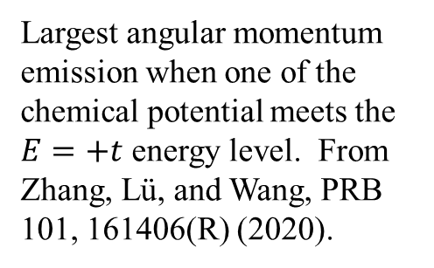
Angular momentum emission resonance effect
E
$E=t$, $\left|l\right|=2$
$$E=−2t, l=0$$
Largest angular momentum emission when one of the chemical potential meets the $E=+t$ energy level. From Zhang, Lü, and Wang, PRB 101, 161406(R) (2020).

Slide 36

Force and torque from the nonequilibrium edge
$$J$$
$$p$$
$$μ_{L}$$
$$μ_{R}$$
Zhang, et al, PRB 105, 205421 (2022).

Slide 37



Current-state, Landauer way
Express the electron Green’s function in eigen-modes
$$G^{<}\left(E\right)=i2π\sum_{n}{f_{n}}δ\left(E−ε_{n}\right)\left|n\right\rangle ⟨n|$$
Left-moving electrons follow
$f_{n}^{L}=\frac{1}{e^{β_{L}(ε_{n}−μ_{L})}+1}$
Right-moving electrons follow $f_{n}^{R}$.
Moving direction based on group velocity.
$$μ_{L}$$
$$μ_{R}$$

Slide 38



Emission from graphene edge
(a) Emission power as a function of temperature, (b) P, N, F as a function of $μ_{L}$ fixing $\frac{μ_{R}}{t}=−0.8$. Y.-M. Zhang, etc.

Slide 39

I, N, F scan $μ_{R}$vs $μ_{L}$. System size width 700 unit cells, k-point 401. From Zhang, et al, PRB 105, 205421 (2022).

Slide 40


C₆₀ and graphene
Wang and Antezza, Phys. Rev. B 109, 125105 (2024)

Slide 41



Results
↑ two strips with a rotation angle. Black: both unbiased, red: biased on top, green: both biased.
↑ power and force between the arm-chair strip and C60, symmetric bias.
→ Total emission to infinity.

Slide 42
Heat transfer of 2D metals, co-planar geometry
1000 K
300 K
y
x
z
640 × 640
d

Slide 43




Drude model approximation to photon self-energy $Π$
$$Π_{lμ,l^{′}ν}^{r}\left(ω\right)=\frac{a^{2}e^{2}ω\left(\frac{n}{m}\right)}{2iη+ω}δ_{l,l^{′}}δ_{μ,ν}$$
$n$: electron surface density
$m:$ electron effective mass
$2η=1/τ:$ inverse relation time
$a:$ lattice constant (4 a.u.)
a

Slide 44


← The distance dependence of radiative heat flux density between two coplanar metal sheets with temperatures
T₁ = 1000 K and T₂ = 300 K.
The black solid lines depict the heat flux density of black-body radiation calculated by the Stefan-Boltzmann law with view factor.
→ The spectrum of transmission function T(q,ω) between two coplanar metal sheets with a gap size of 1 µm. The red dashed lines represent the light line q² = ω²/c², the boundary between evanescent and propagating modes.
Both figures from Zhu et al, arXiv:2403.15036

Slide 45





Floquet drive of a single square lattice metal
$a=1.4$Å, $t=1$ eV
$$ε_{k}$$
$${μ(t)}_{}$$
k
$$μ\left(t\right)=2μ\cos{(Ωt)}$$
$ℏΩ=1$ eV
Wang, et al, unpublished.

Slide 46
Conclusion
NEGF formulation for photon transport between condensed matter objects at the nanoscale
Energy, momentum, and angular momentum transfer in a unified framework with the Meir-Wingreen formula
Applications in nonequilibrium settings

Slide 47
Acknowledgments
Gaoming Tang, Graduate School of China Academy of Engineering Physics, Beijing
Tao Zhu, Tiangong University, Tianjin, China
Yong-Mei Zhang, Nanjing Univ of Aeronautics and Astronautics
Jiebin Peng, Guangdong University of Technology
Zu-Quan Zhang, Zhejiang Normal university
Mauro Antezza, Univ Montpellier, CNRS, France
MOE FRC tier 1 support

