Slide 1
Enhancing thermoelectric efficiency for nanostructures and quantum dots
Jian-Sheng Wang
Department of Physics, National University of Singapore

Slide 2
Outline
Seebeck effect & thermoelectric efficiency
Disordered graphene/graphane
Quantum master equation: electron-phonon interaction to thermoelectric efficiency in quantum dots
Enhancing thermoelectric efficiency by time-dependent driven
Conclusion
1st Conference on condensed matter physics, 15-17 July 2015

Slide 3
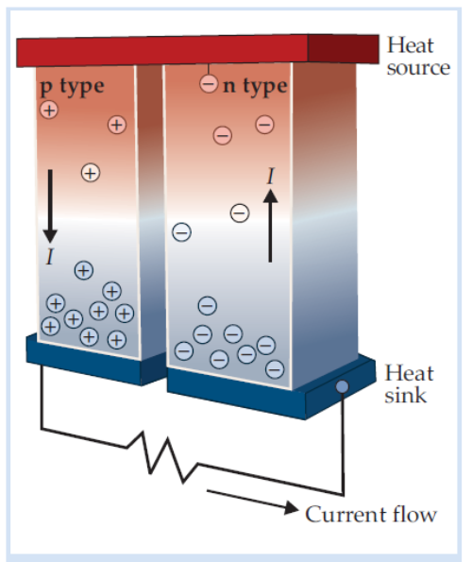
Seebeck effect
Seebeck coefficient: how much voltage difference can one generate per temperature difference? S = − dV/dT
How efficient is it comparing to Carnot engine, W/Q = 1 – T_{c}/T_{h}?
Ans: Determined by a material parameter called
ZT = S²σT/λ
σ : electric conductivity, λ : thermal conductivity, T: absolute temperature
From “Physics Today,” June 2014, p.14

Slide 4
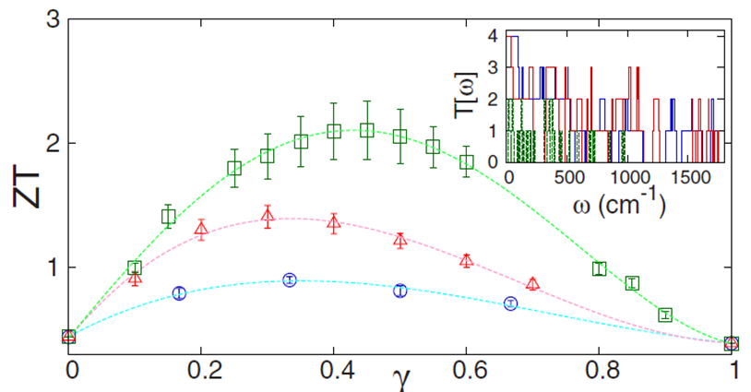
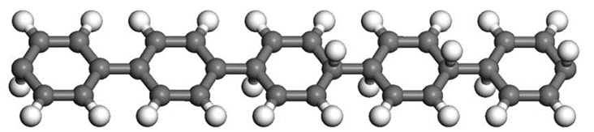
Enhancing ZT by disordering
ZT at 300K for graphene/graphane calculated using ballistic NEGF formulation for the armchair ribbons with fraction of H-bond disorder, with DFT structure determination.
graphane
graphene
Ni, Liang, Wang & Li, Appl. Phys. Lett. 95, 192114 (2009).
Notes:
Different samples for lengths, circle : 3 rings, triangle 5 rings, square 10 hexagonal rings.

Slide 5
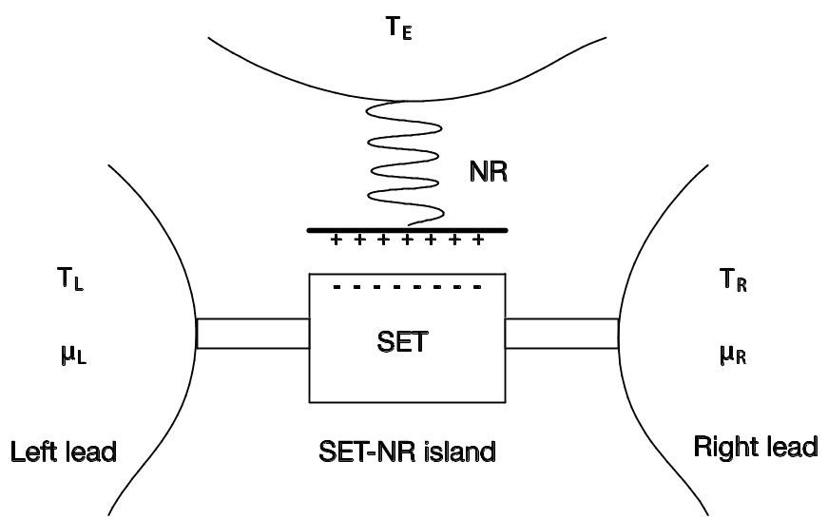
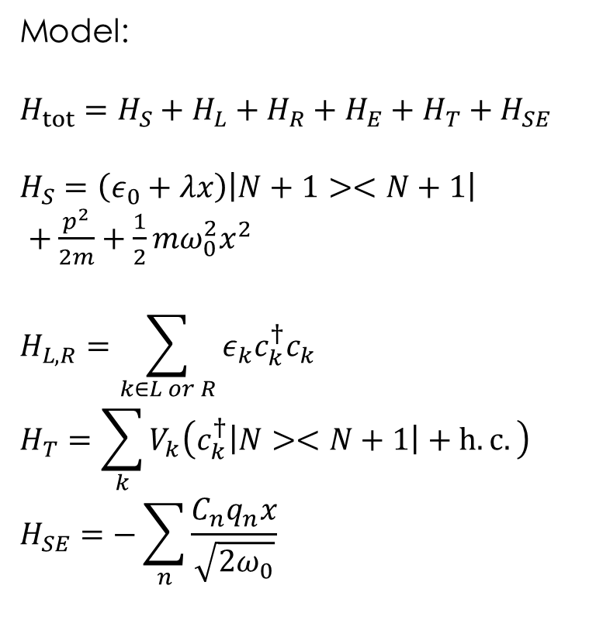
Quantum dot electron-phonon interaction
Model:
$$H_{tot}=H_{S}+H_{L}+H_{R}+H_{E}+H_{T}+H_{SE}$$
$$H_{S}=\left(ε_{0}+λx\right)\left|N+1><N+1\right|$$
$+\frac{p^{2}}{2m}+\frac{1}{2}mω_{0}^{2}x^{2}$
$$H_{L,R}=\sum_{k∈L or R}{ε_{k}c_{k}^{†}c_{k}}$$
$$H_{T}=\sum_{k}{V_{k}\left(c_{k}^{†}\left|N><N+1\right|+h.c.\right)}$$
$$H_{SE}=−\sum_{n}{\frac{C_{n}q_{n}x}{\sqrt{2ω_{0}}}}$$
Notes:
NR: nano-mechanical resonator, SET: single electron transistor.

Slide 6
Quantum Master equation approach
Advantage of NEGF: any strength of system-bath coupling V; disadvantage: difficult to deal with nonlinear systems.
QME: advantage - center can be any form of Hamiltonian, in particular, nonlinear systems; disadvantage: weak system-bath coupling, small system.
Can we improve?
Wang, et al, Front. Phys. 9, 673 (2014); Thingna, et al, J. Chem. Phys. (2014)

Slide 7
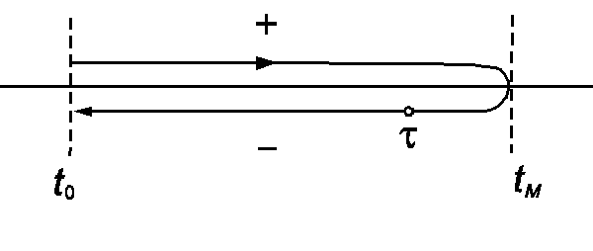
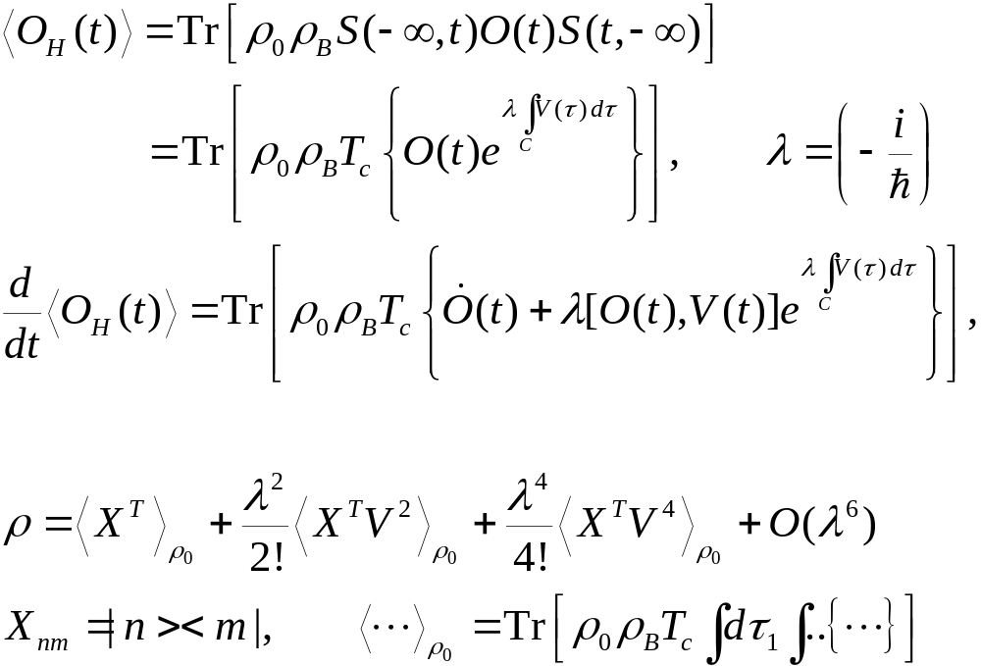
Dyson Expansions
Notes:
Some detail is in the last section of J.-S. Wang, B. K. Agarwalla, H. Li, and J. Thingna, “Nonequilibrium Green's function method for quantum thermal transport,” Front. Phys. (2013). rho_0 is in fact rho_0^I, i.e., interaction picture one.

Slide 8
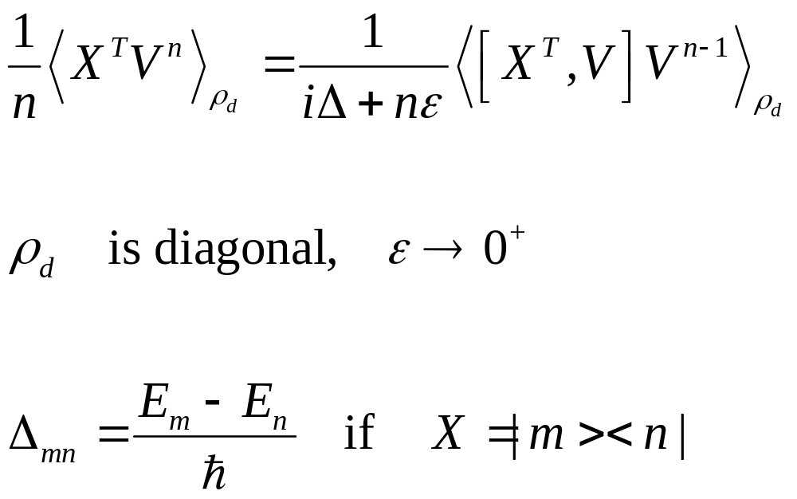
Divergence

Slide 9
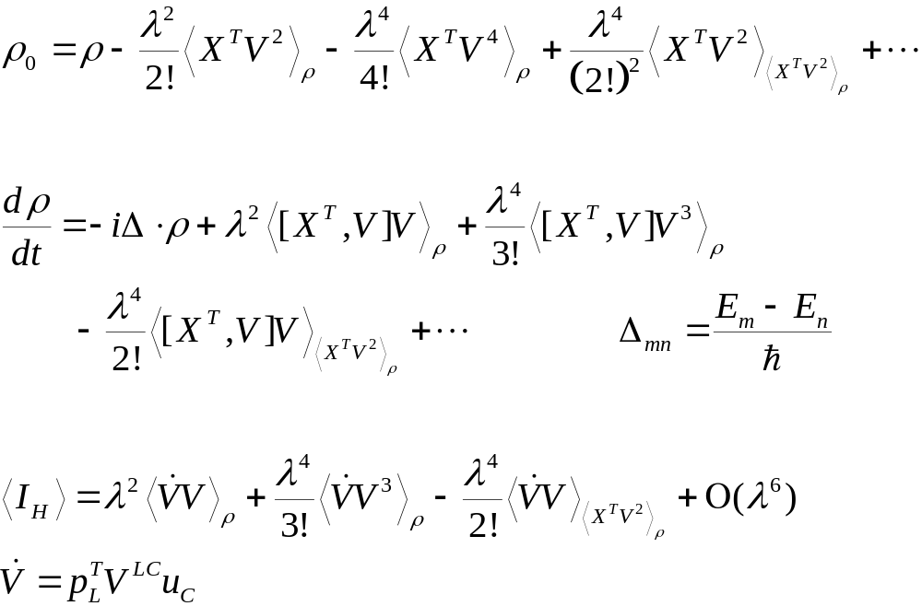
Unique one-to-one map, ρ₀↔ρ; ordered cumulants

Slide 10
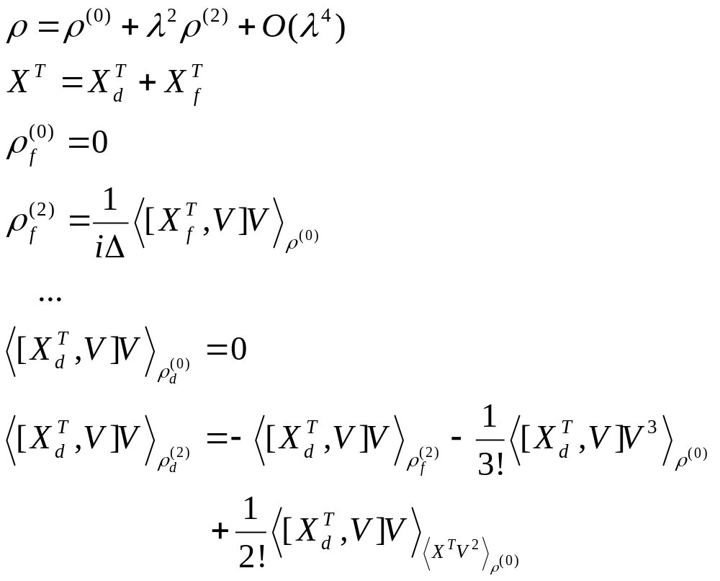
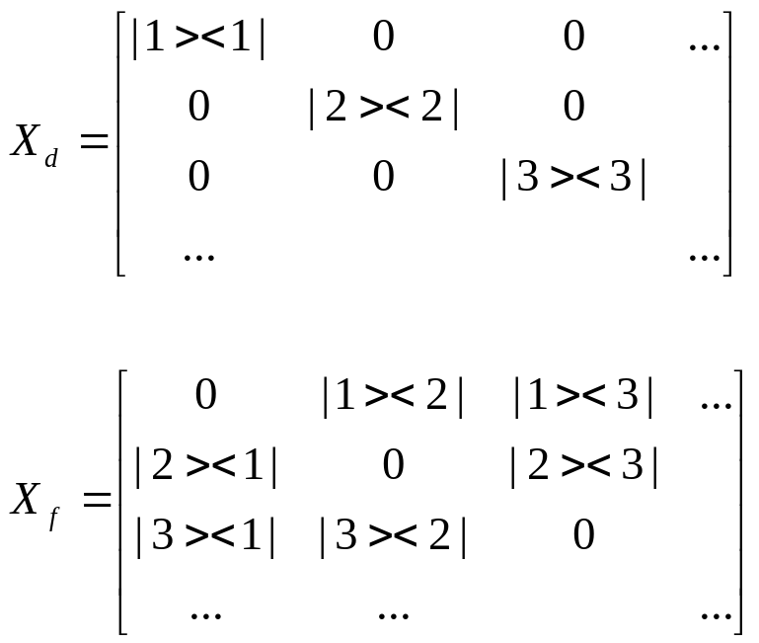
Order-by-Order Solution

Slide 11
Time-dependent driven
Nonequilibrium Green’s function (NEGF), we use Jauho, Wingreen, Meir (PRB 1994) theory
Master equation case - drive change the eigenvalues but not eigenvectors, easily generalize

Slide 12
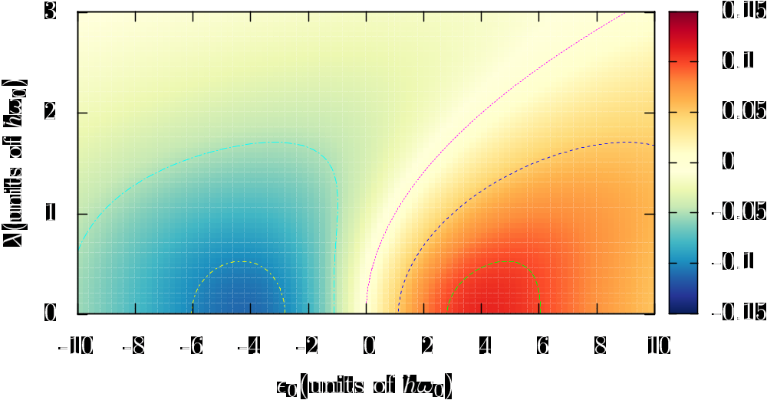
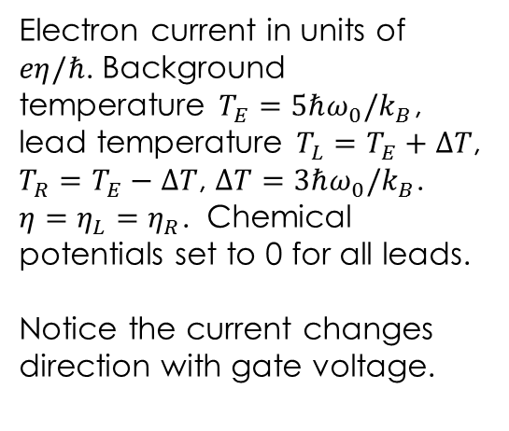
Electron current
Electron current in units of $eη/ℏ$. Background temperature $T_{E}=5ℏω_{0}/k_{B}$, lead temperature $T_{L}=T_{E}+ΔT$, $T_{R}=T_{E}−ΔT$, $ΔT=3ℏω_{0}/k_{B}$. $η=η_{L}=η_{R}$. Chemical potentials set to 0 for all leads.
Notice the current changes direction with gate voltage.
Zhou, et al, Phys Rev B 90, 045410 (2015).

Slide 13
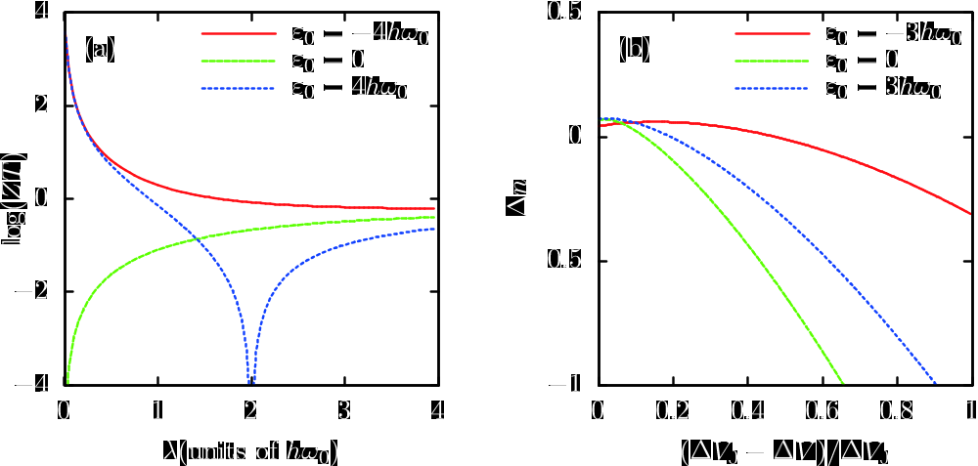
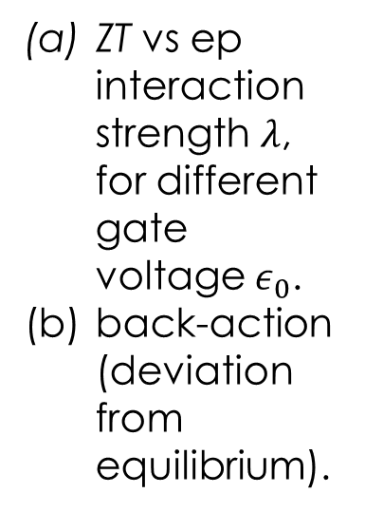
Reduction of ZT under electron-phonon interaction
ZT vs ep interaction strength $λ$, for different gate voltage $ε_{0}$.
back-action (deviation from equilibrium).

Slide 14
Why drive the system? can have higher efficiency
Far from thermal equilibrium
Break down of Onsager relation (due to break down of time translational invariance)

Slide 15
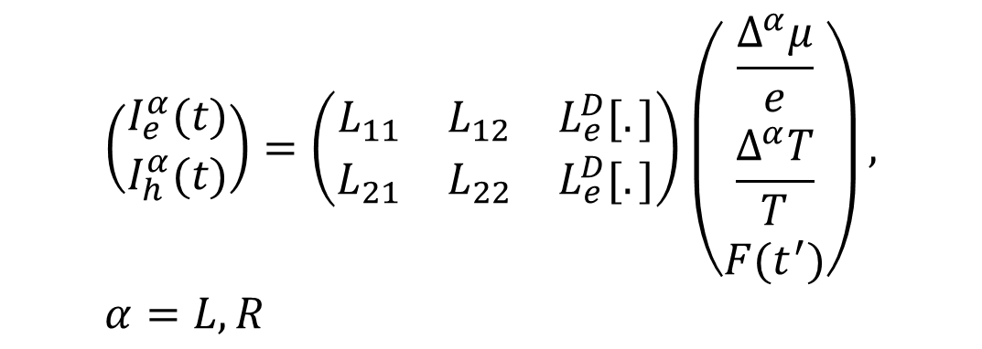
How to quantify efficiency in time-dependent situation?
Current I
$$\left(\begin{matrix}I_{e}^{α}(t) \\ I_{h}^{α}(t)\end{matrix}\right)=\left(\begin{matrix}L_{11} & L_{12} & L_{e}^{D}[.] \\ L_{21} & L_{22} & L_{e}^{D}[.]\end{matrix}\right)\left(\begin{matrix}\frac{Δ^{α}μ}{e} \\ \frac{Δ^{α}T}{T} \\ F(t^{′})\end{matrix}\right), α=L, R$$
Do this analysis for each fixed t.
ΔT or Δμ

Slide 16
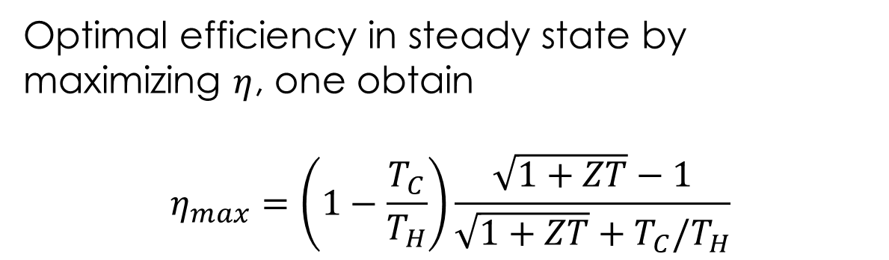

Measuring efficiency
Work done to load
$$η\left(t\right)=\frac{I_{e}^{2}R_{L}}{\frac{\det\left(L\right)R_{M}ΔT}{T}+L_{21}R_{M}I_{e}−\frac{I_{e}^{2}R_{M}}{2}}$$
Entropy flow
Peltier heat
Joule heat flow back
Optimal efficiency in steady state by maximizing $η$, one obtain
$$η_{max}=\left(1−\frac{T_{C}}{T_{H}}\right)\frac{\sqrt{1+ZT}−1}{\sqrt{1+ZT}+T_{C}/T_{H}}$$
See, eg., H J Goldsmid, “Intro to thermoelectricity.”

Slide 17
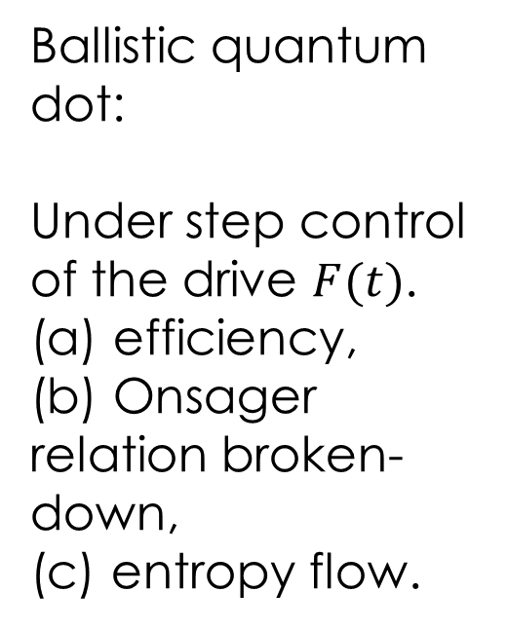
Efficiency enhancement by driven
Ballistic quantum dot:
Under step control of the drive $F(t)$. (a) efficiency,
(b) Onsager relation broken-down,
(c) entropy flow.
Zhou, et al, arXiv:1505.06132

Slide 18
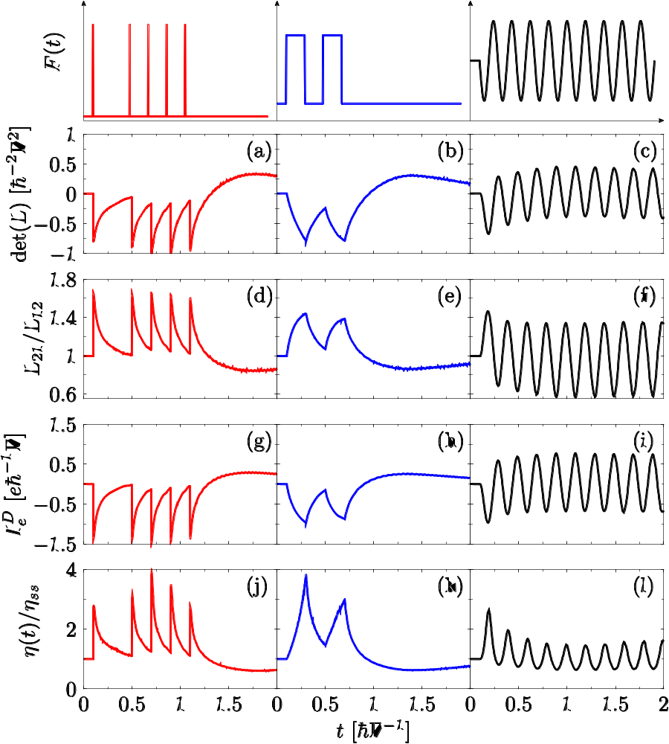
Wave form of drive.
Entropy transport
Breakdown of Onsager relation
Displacement current
Normalized efficiency
With ep interaction, arXiv:1505.06132

Slide 19
Summary
Structure change does bring in higher ZT, e.g., disorder, or go down to 0-dimension (quantum dot)
Electron-phonon interaction reduces ZT
Dynamic drive (forcing) improves ZT, up to a factor of 4

Slide 20
acknowledgements
Students: Hangbo Zhou, Juzar Thingna, Xiaoxi Ni
Collaborators: Peter Hänggi, Baowen Li, Albert Liang GC

Slide 21
Thank you

