Slide 1

Nonequilibrium Green’s Function Method: application to thermal transport and thermal expansion
Wang Jian-Sheng

Slide 2
Outline
An introduction to nonequilibrium Green’s function (NEGF) method
Heat transport, counting statistics
Problem of thermal expansion

Slide 3
NEGF
Our review: Wang, Wang, and Lü, Eur. Phys. J. B 62, 381 (2008); Wang, Agarwalla, Li, and Thingna, Front. Phys. (2013), DOI:10.1007/s11467-013-0340-x

Slide 4
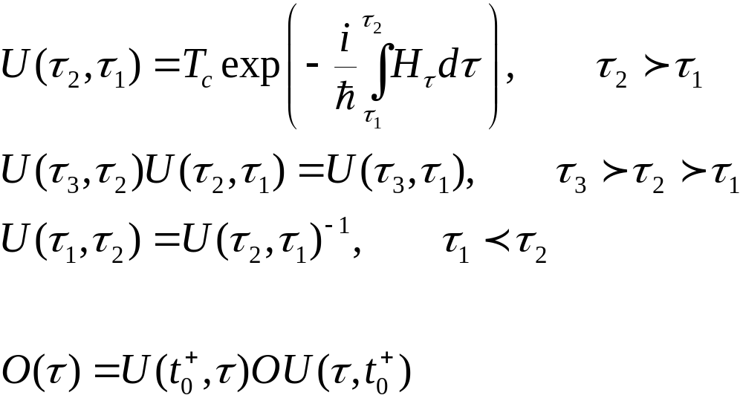
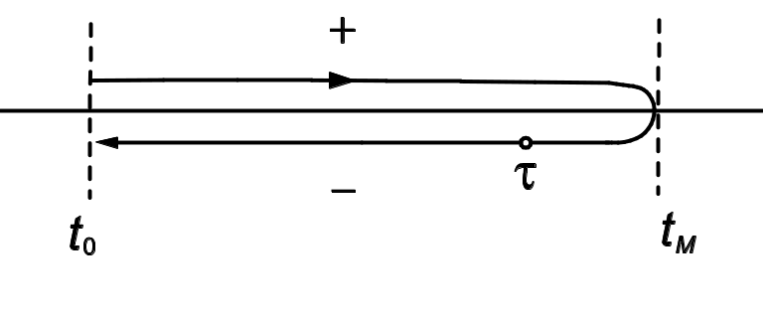
Evolution Operator on Contour

Slide 5
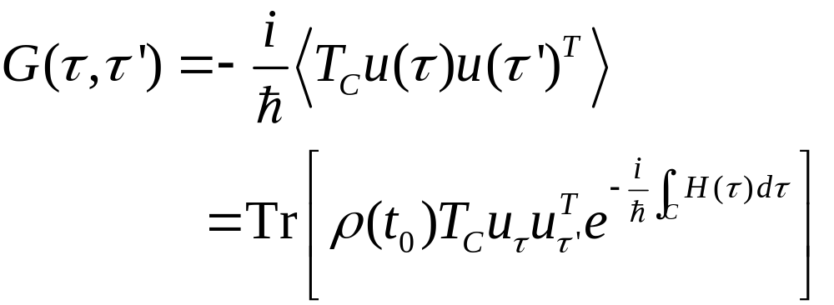
Contour-ordered Green’s function
Contour order: the operators earlier on the contour are to the right. See, e.g., H. Haug & A.-P. Jauho.
τ’
τ
t₀
Notes:
5

Slide 6
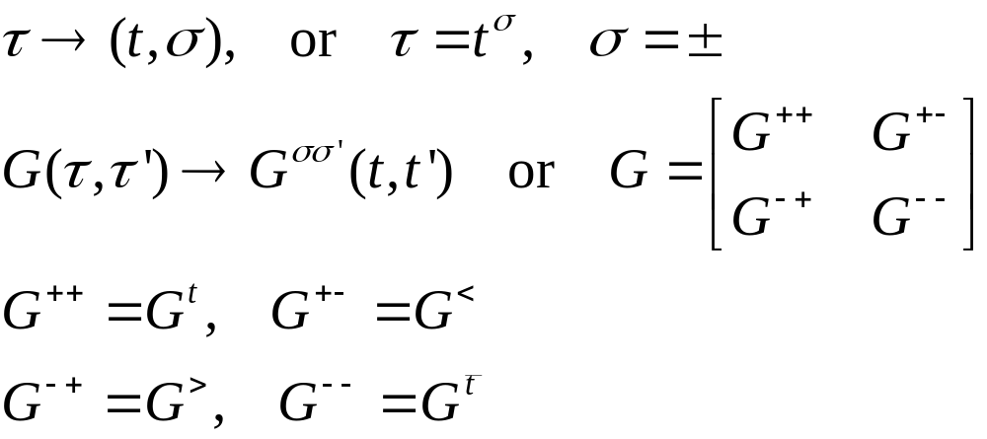
Relation to other Green’s functions
τ’
τ
t₀
Notes:
σ = + for the upper branch, and – for the returning lower branch.
6

Slide 7
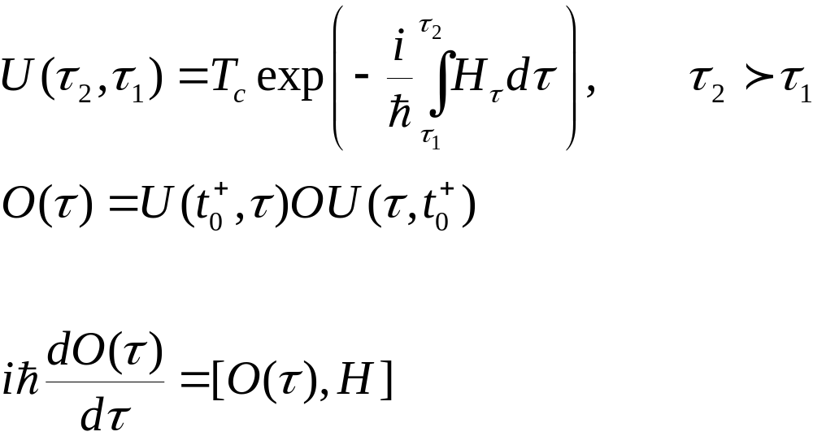
Heisenberg Equation on Contour
Notes:
The integral on the exponential is from a point tau_1 specified on the contour to tau_2 at a later point on the contour. The integral is along the contour.

Slide 8
Thermal conduction at a junction
Left Lead, T_{L}
Right Lead, T_{R}
semi-infinite
Junction Part

Slide 9
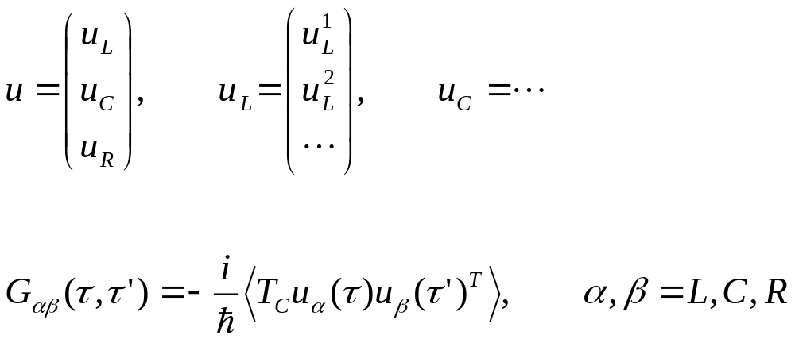
Three regions
9
Notes:
9

Slide 10
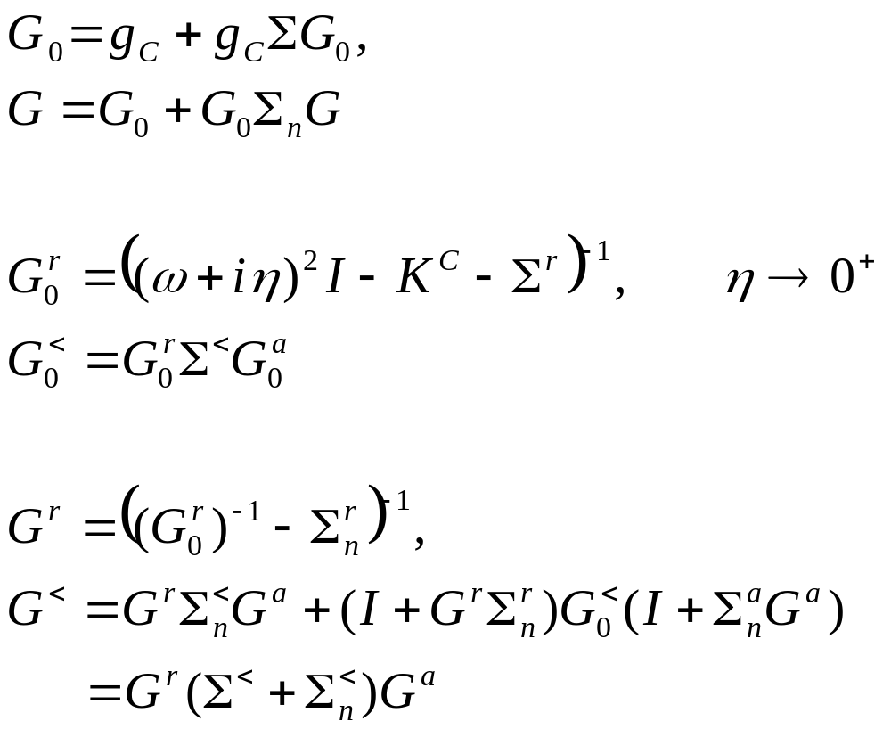
Dyson equations and solution
Notes:
In deriving the last line, we use the fact (g^{r})⁻¹ g< = 0.
10

Slide 11
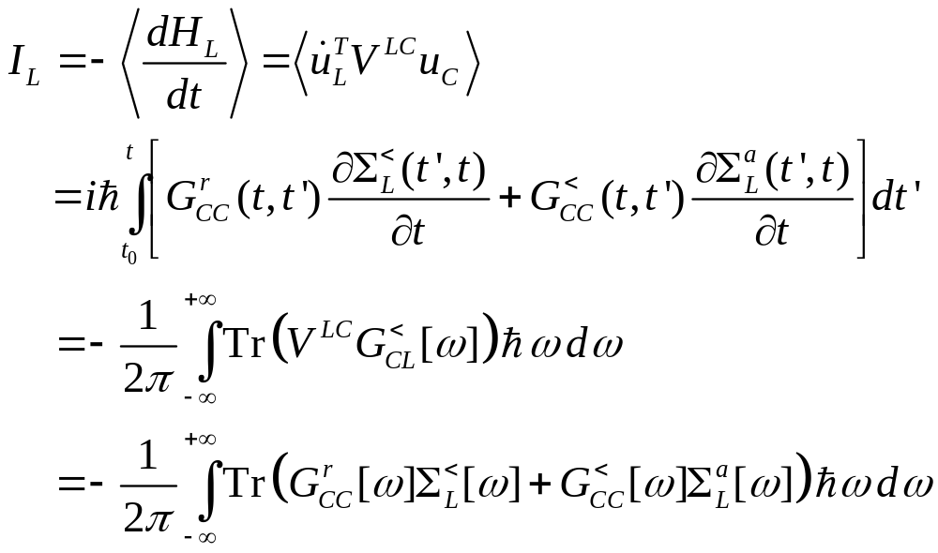
Energy current
Notes:
I_{L} is energy flowing out of the left lead into the center. This expression can be proving to be real, no need to take Re. Above equation works for general nonlinear case.
11

Slide 12
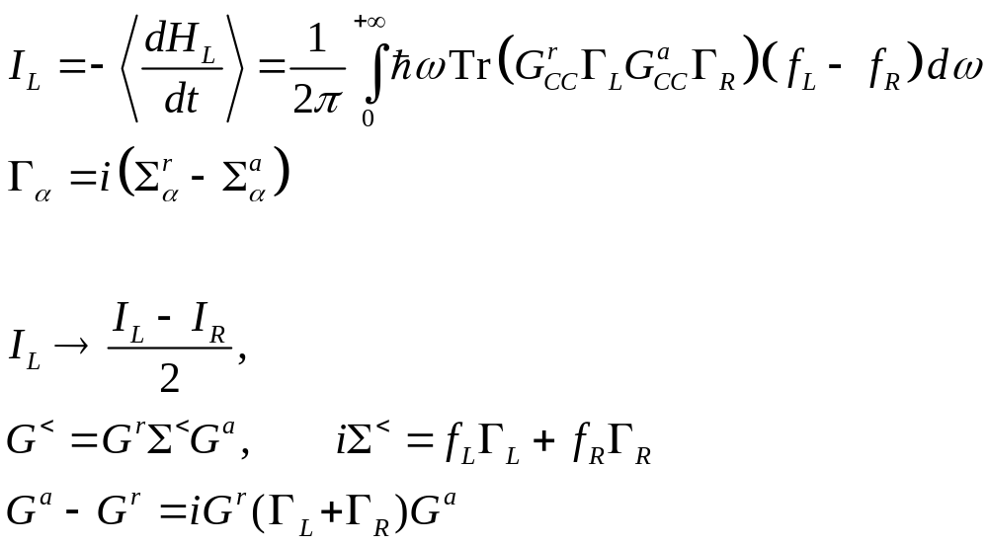
Landauer/Caroli formula
Notes:
The symmetrization appears necessary to get the Caroli formula. Caroli formula is valid only for ballistic case where H_{n} = 0.
12

Slide 13
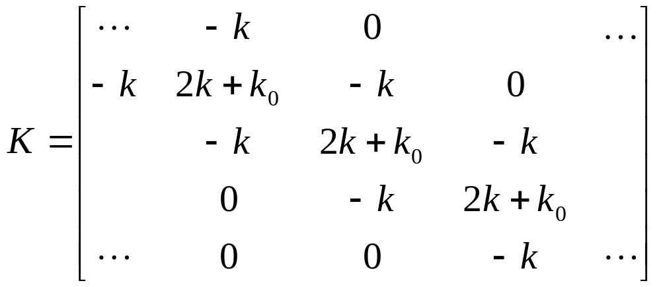
Ballistic transport in a 1D chain
Force constants
Equation of motion
Notes:
The matrix K is infinite in both directions.
13

Slide 14
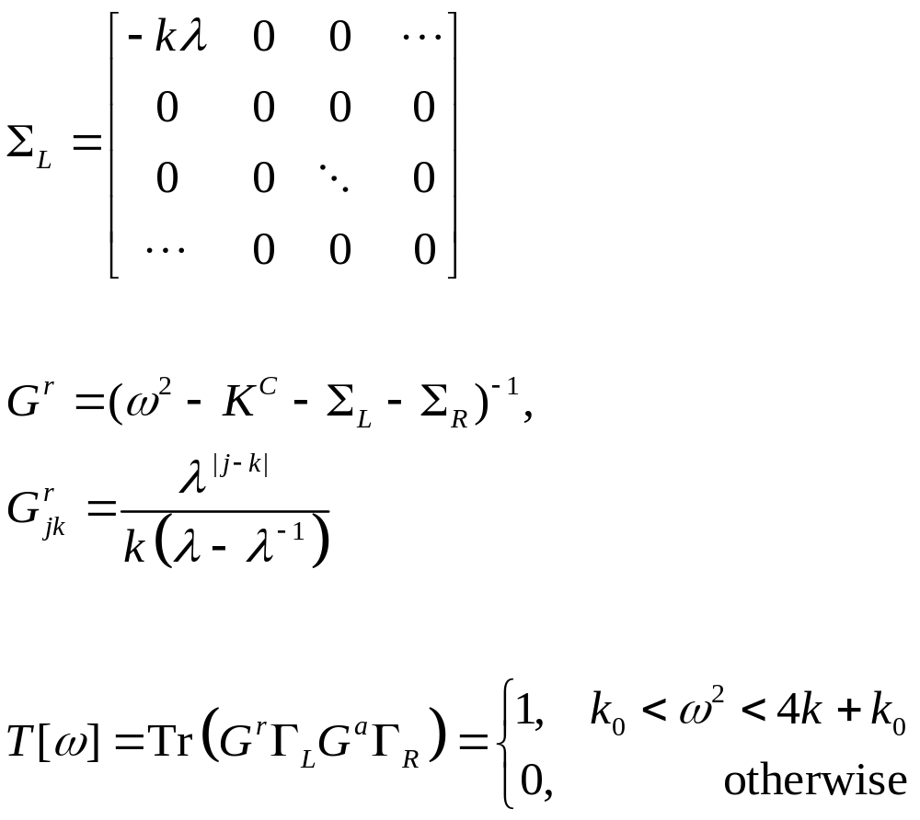
Lead self energy and transmission
T[ω]
1
ω
Notes:
Σ_{R} is nonzero only for the lower right corner.
14

Slide 15
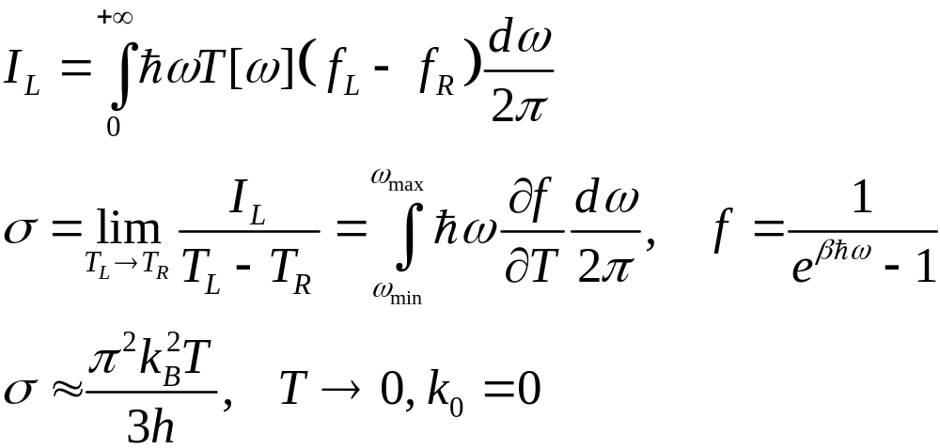
Heat current and conductance
Notes:
The last formula σ is called universal conductance.
15

Slide 16
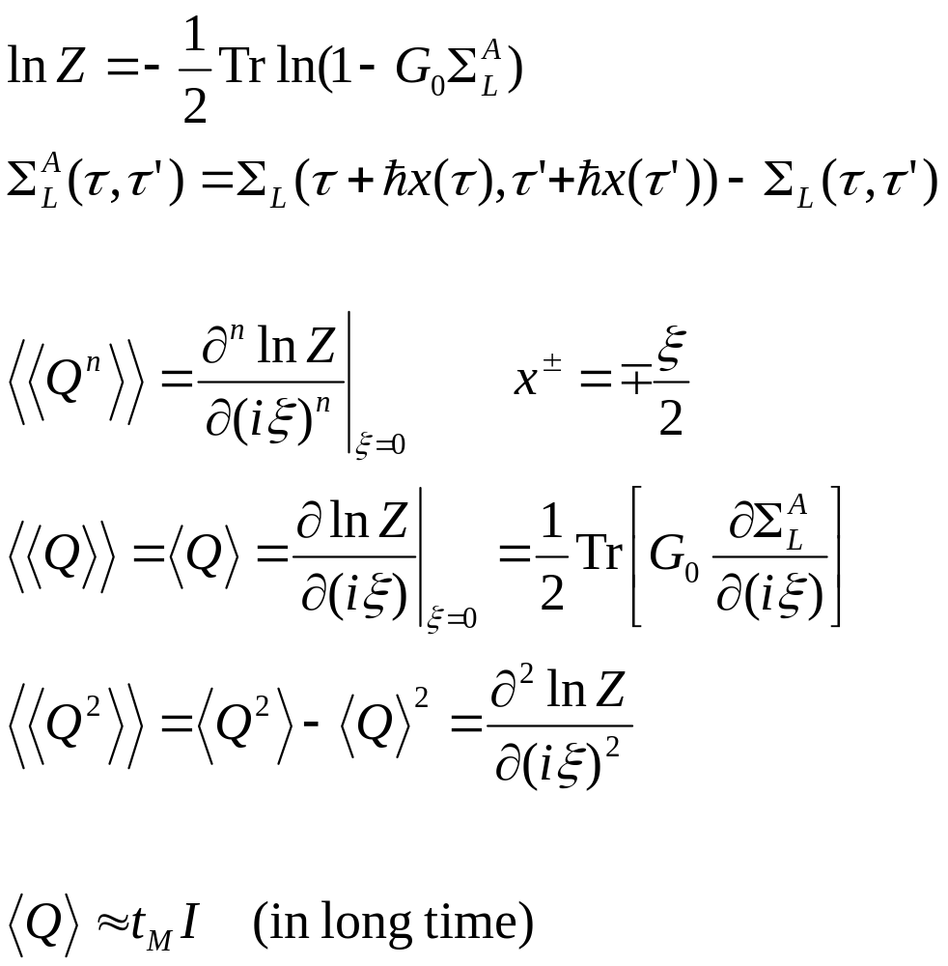
Arbitrary time, transient result
Notes:
16

Slide 17
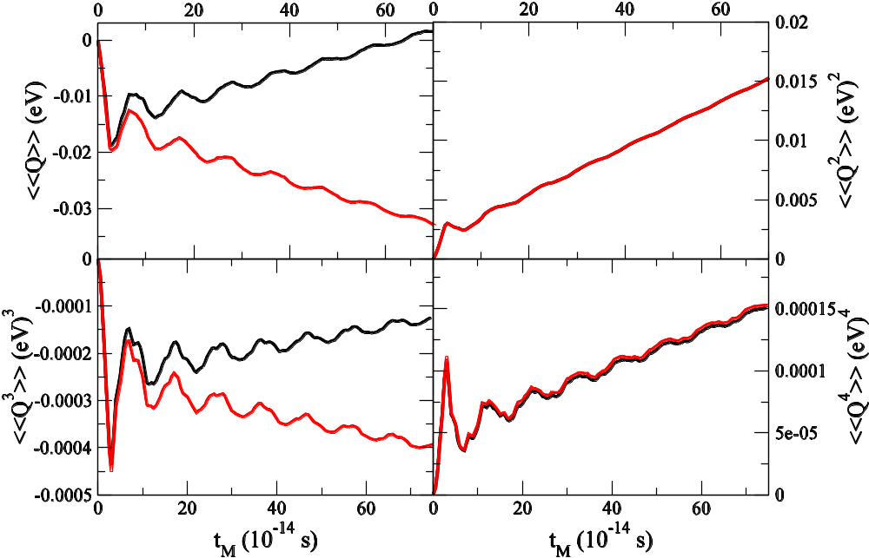
Numerical results, 1D chain
1D chain with a single site as the center.
k= 1eV/(uÅ²), k₀=0.1k,
T_{L}=310K, T_{C}=300K, T_{R}=290K. Red line right lead; black, left lead.
From Agarwalla, Li, and Wang, PRE 85, 051142, 2012.
Notes:
17

Slide 18
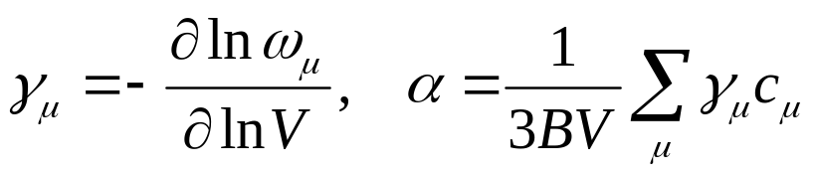
Thermal Expansion
Grüneisen theory
NEGF – compute the displacement of each atom <u_{j}>. It is obtained by the standard Feynman-diagrammatic expansion with respect to nonlinear interactions.

Slide 19
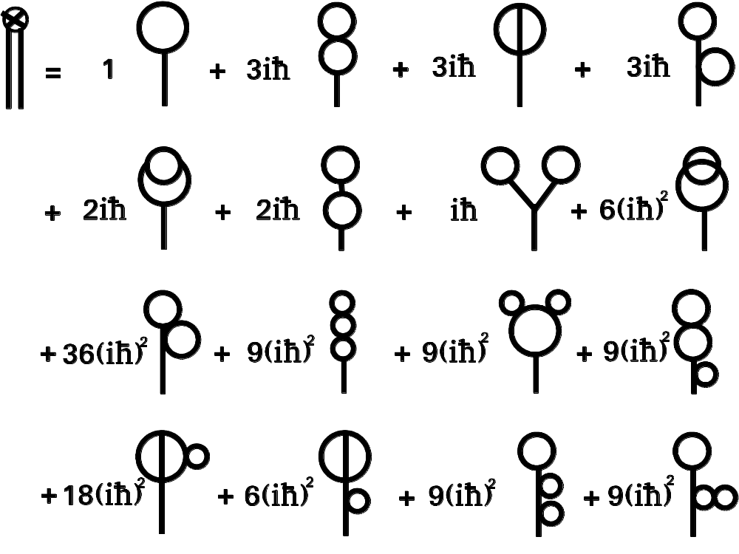
One-Point Green’s Function

Slide 20
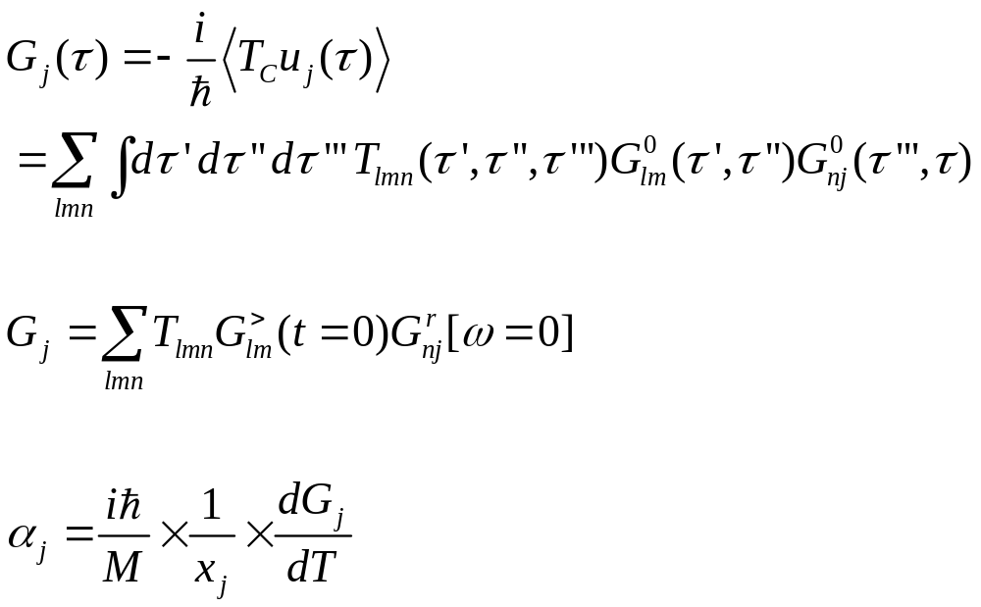
Average displacement, thermal expansion
One-point Green’s function
Notes:
The idea of calculating the thermal expansion coefficient this way due to Jiang Jinwu.
20

Slide 21
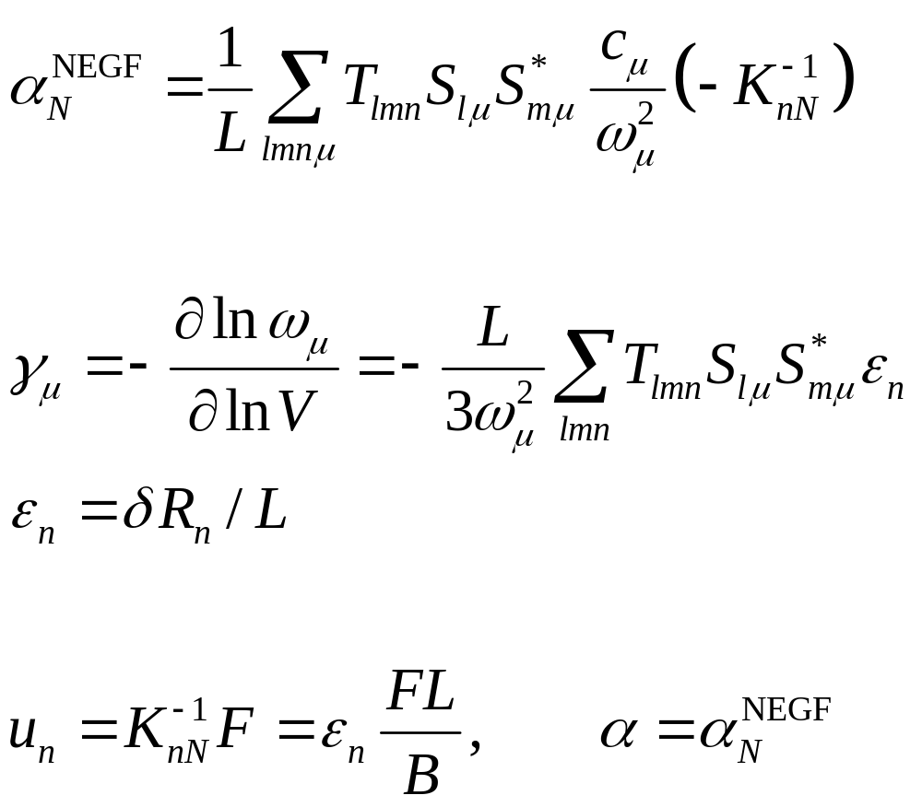
Connection, see Jiang, Wang, Wang, Park, arXiv:1408.1450.

Slide 22
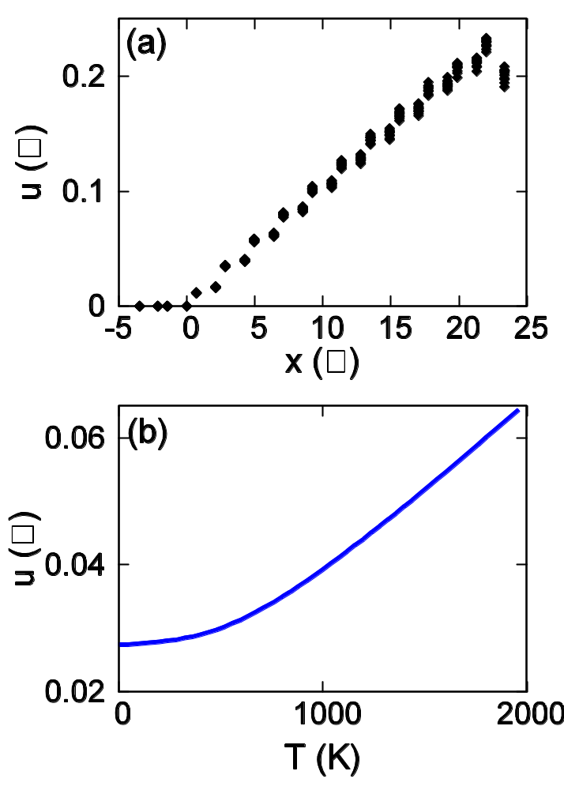
Thermal expansion
Displacement <u> as a function of position x.
as a function of temperature T. Brenner potential is used. From Jiang, Wang, and Li, Phys. Rev. B 80, 205429 (2009).
Left edge is fixed.
Notes:
22

Slide 23
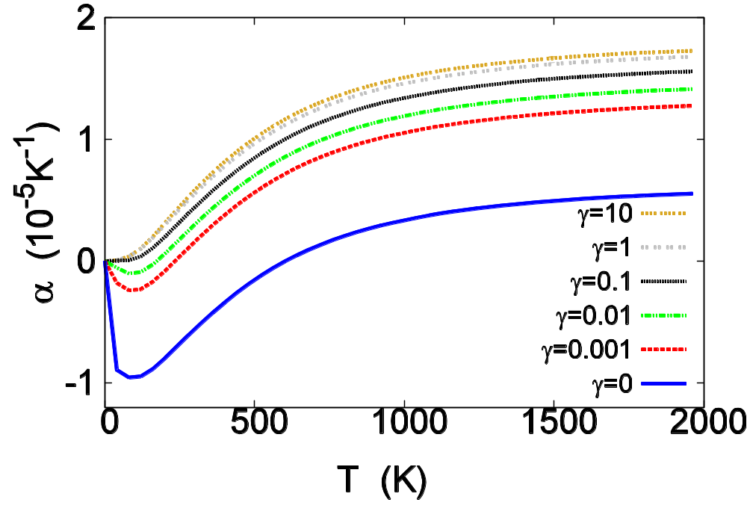
Graphene Thermal expansion coefficient
The coefficient of thermal expansion v.s. temperature for graphene sheet with periodic boundary condition in y direction and fixed boundary condition at the x=0 edge.  is onsite strength. From Jiang, Wang, and Li, Phys. Rev. B 80, 205429 (2009).
Notes:
23

Slide 24
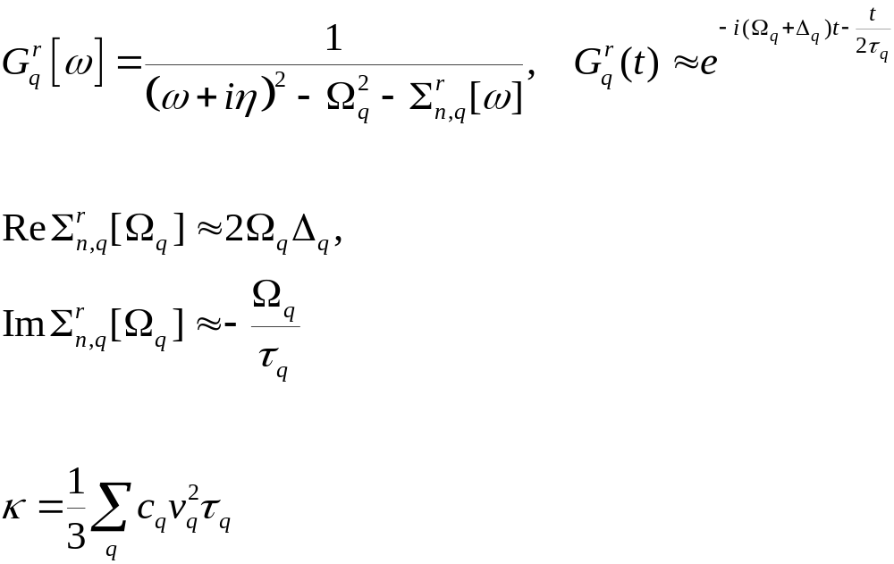
Phonon Life-Time
For calculations based on this, see, Xu, Wang, Duan, Gu, and Li, Phys. Rev. B 78, 224303 (2008).
Notes:
Xu Yong’s formula may have a factor 2 wrong.

Slide 25
Summary
NEGF: powerful tool for steady state and transient, best for ballistic system, difficult for interaction systems
Thermal expansion problem: NEGF does not need to assume uniform expansion, suited for any nanostructure or bulk

Slide 26
Acknowledgements
NEGF, transport: Wang Jian, Lü Jingtao, Eduardo C Cuansing, Zhang Lifa, Bijay Kumar Agarwalla, Li Huanan
Thermal expansion: Jiang Jinwu (now at Shanghai Univ)

