Slide 1

Nonequilibrium Green’s Function and Quantum Master Equation Approach to Transport
Wang Jian-Sheng

Slide 2
Outline
A quick introduction to nonequilibrium Green’s function (NEGF), applied to molecular dynamics with quantum baths
Formulation of quantum master equation to transport (energy, particle, or spin)
Dyson expansion and 4-th order results

Slide 3
NEGF
Our review:
1. Wang, Wang, and Lü, Eur. Phys. J. B 62, 381 (2008);
2. Wang, Agarwalla, Li, and Thingna, Front. Phys. (2013), DOI:10.1007/s11467-013-0340-x

Slide 4
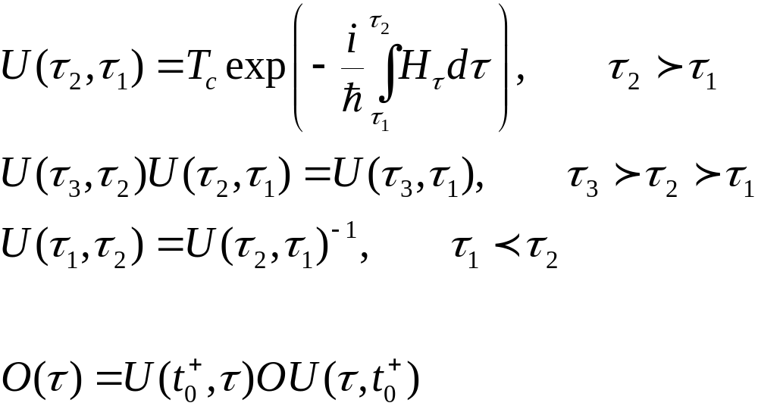
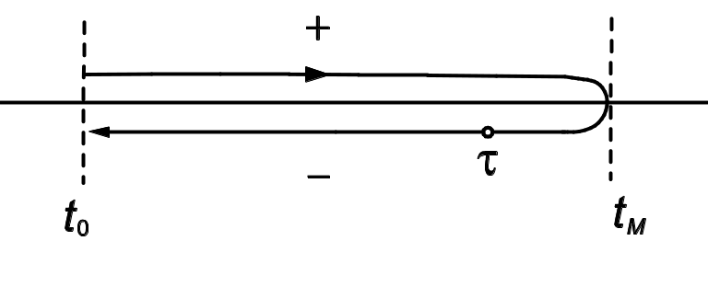
Evolution Operator on Contour

Slide 5
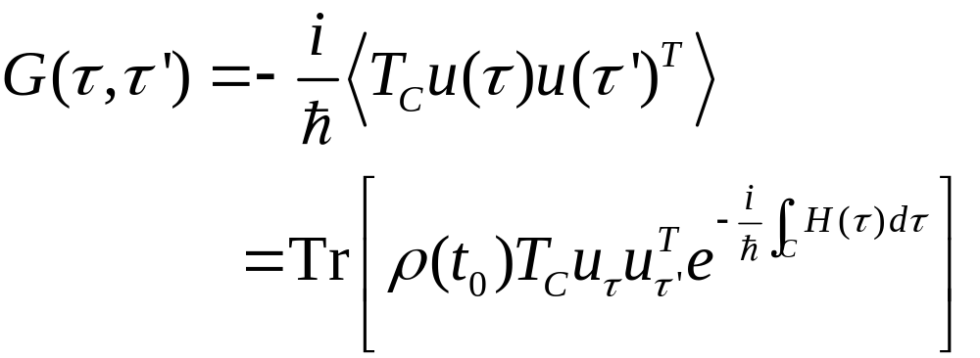
Contour-ordered Green’s function
Contour order: the operators earlier on the contour are to the right. See, e.g., H. Haug & A.-P. Jauho or J. Rammer.
τ’
τ
t₀
Notes:
J Rammer: “Quantum Field Theory of Non-equilibrium States,” Cambridge, (2007).
5

Slide 6
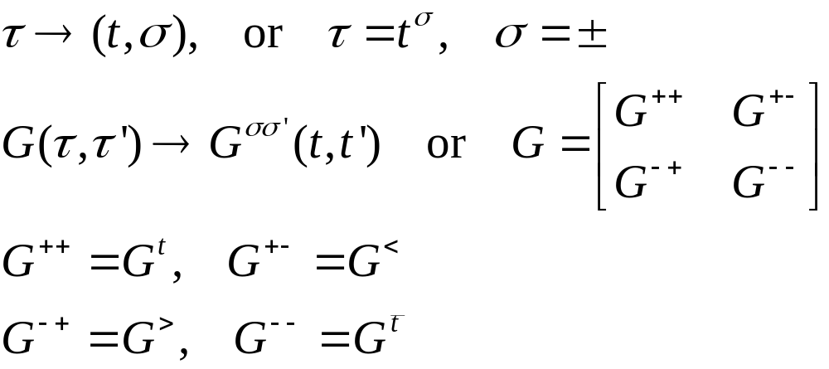
Relation to other Green’s functions
τ’
τ
t₀
Notes:
σ = + for the upper branch, and – for the returning lower branch.
6

Slide 7
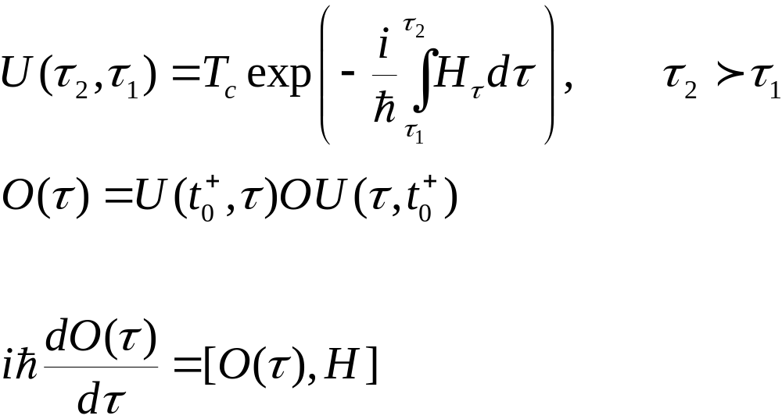
Heisenberg Equation on Contour
Notes:
The integral on the exponential is from a point tau_1 specified on the contour to tau_2 at a later point on the contour. The integral is along the contour.

Slide 8
Thermal conduction at a junction
Left Lead, T_{L}
Right Lead, T_{R}
semi-infinite
Junction Part

Slide 9
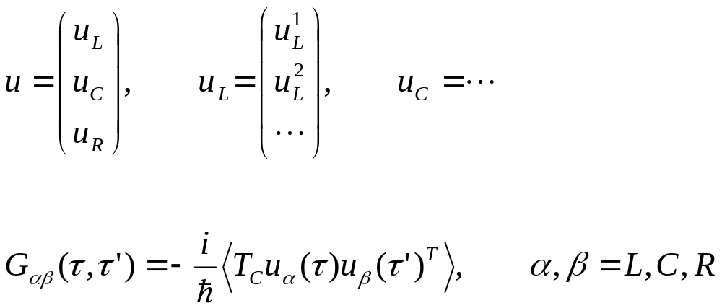
Three regions
9
Notes:
9

Slide 10
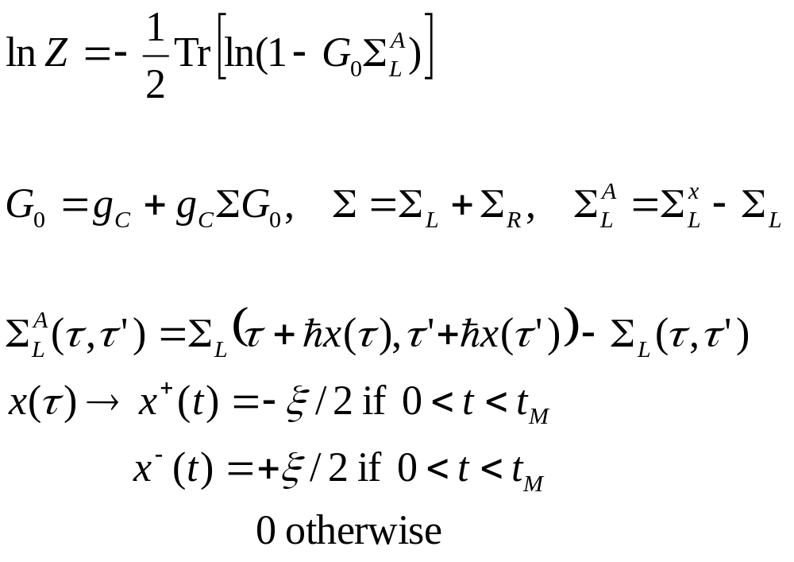
Important result
Notes:
10

Slide 11
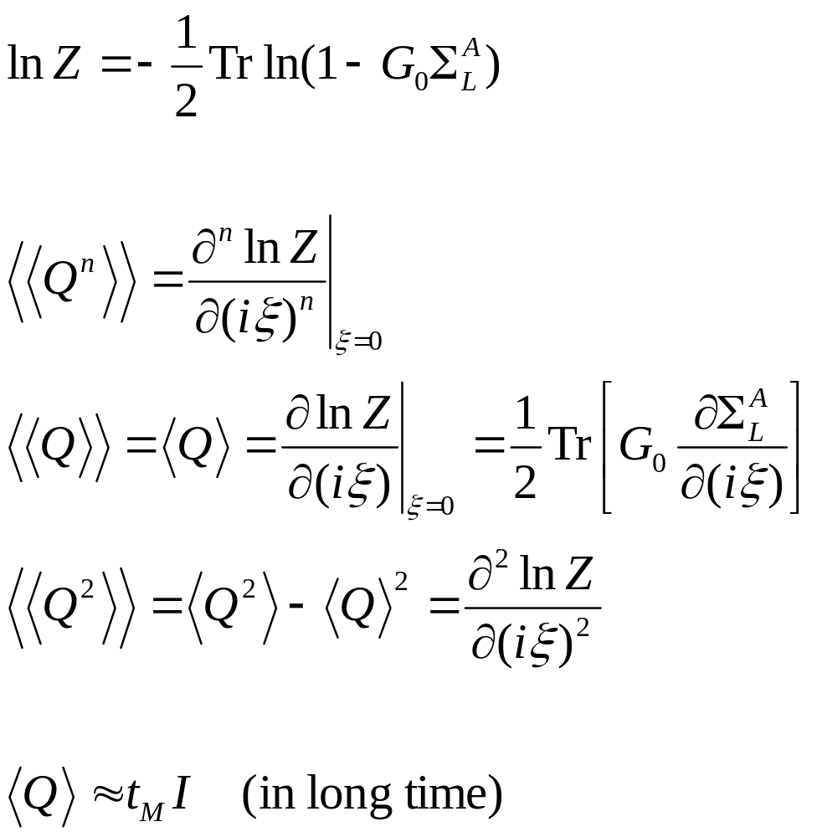
Arbitrary time, transient result
Notes:
11

Slide 12
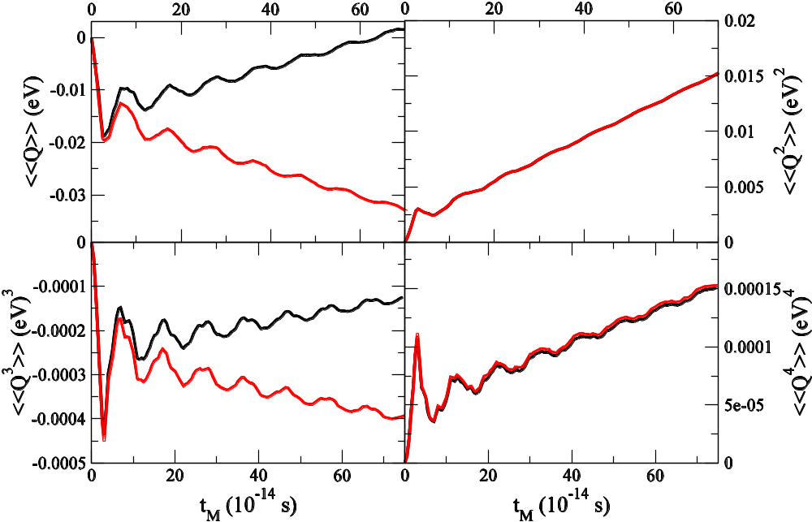
Numerical results, 1D chain
1D chain with a single site as the center.
k= 1eV/(uÅ²), k₀=0.1k,
T_{L}=310K, T_{C}=300K, T_{R}=290K. Red line right lead; black, left lead.
From Agarwalla, Li, and Wang, PRE 85, 051142, 2012.
Notes:
12

Slide 13
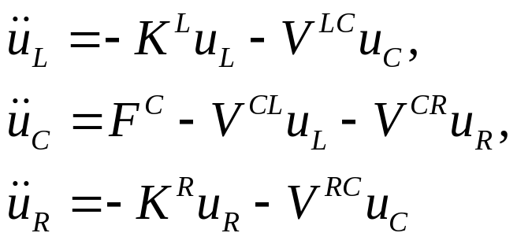
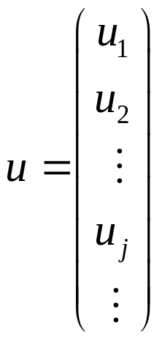
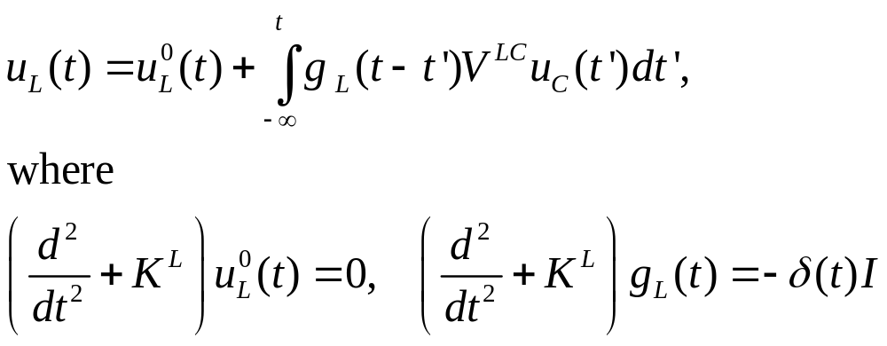
Quantum heat-bath & MD
Consider a junction system with left and right harmonic leads at equilibrium temperatures T_{L} & T_{R}, the Heisenberg equations of motion are
The equations for leads can be solved, given

Slide 14
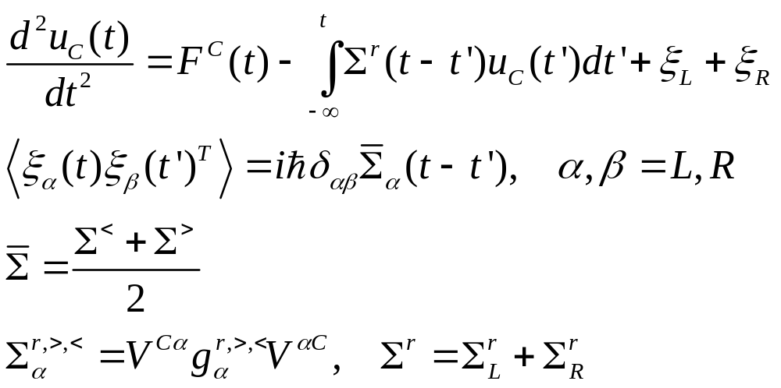
Molecular dynamics with quantum bath
See J.-S. Wang, et al, Phys. Rev. Lett. 99, 160601 (2007);
Phys. Rev. B 80, 224302 (2009).
Notes:
For more detail, see Phys. Rev. B 80, 224302 (2009). Any idea how to generalize this so that quantum mechanics is reproduced exactly?
14

Slide 15
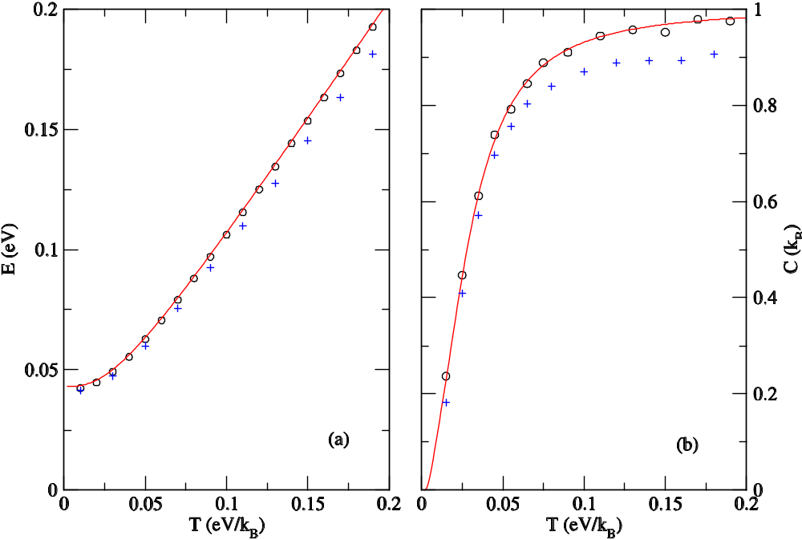
Equilibrium simulation
1D linear chain (red lines exact, open circles QMD) and nonlinear quartic onsite (crosses, QMD) of 128 atoms. From Eur. Phys. J. B, 62, 381 (2008).

Slide 16
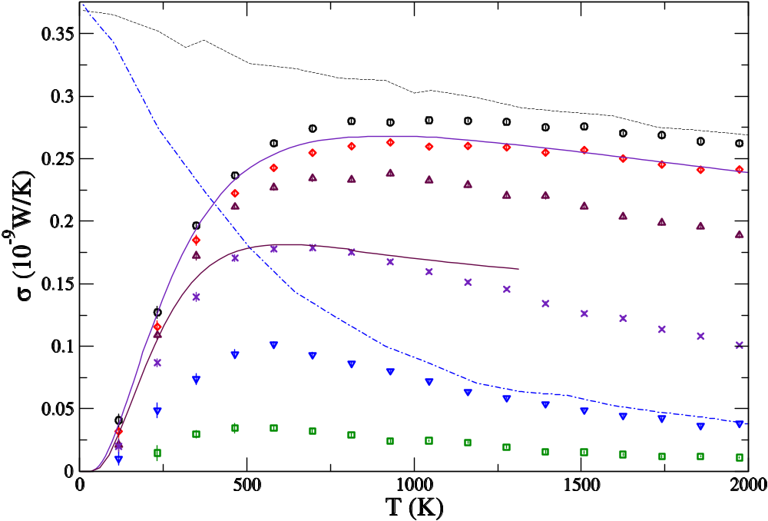
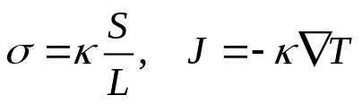
From ballistic to diffusive transport
1D chain with quartic onsite nonlinearity (Φ⁴ model). The numbers indicate the length of the chains. From JSW, PRL 99, 160601 (2007).
Classical, ħ → 0
4
16
NEGF, N=4 & 32
64
256
1024
4096

Slide 17
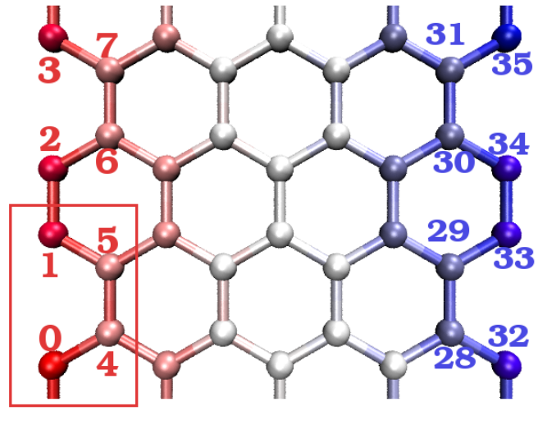
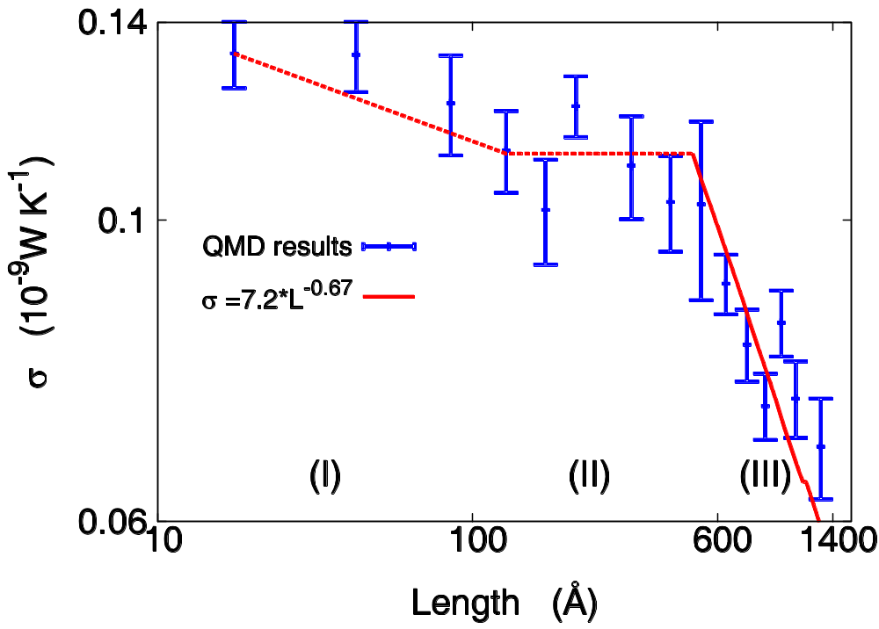
Conductance of graphene strips
Sites 0 to 7 are fixed left lead and sites 28 to 35 are fixed right lead. Heat bath is applied to sites 8 to 15 at temperature T_{L} and site 20 to 27 at T_{R}. JSW, Ni, & Jiang, PRB 2009.

Slide 18
Quantum Master Equation

Slide 19
Quantum Master Equation
Advantage of NEGF: any strength of system-bath coupling V; disadvantage: difficult to deal with nonlinear systems.
QME: advantage - center can be any form of Hamiltonian, in particular, nonlinear systems; disadvantage: weak system-bath coupling, small system.
Can we improve?

Slide 20
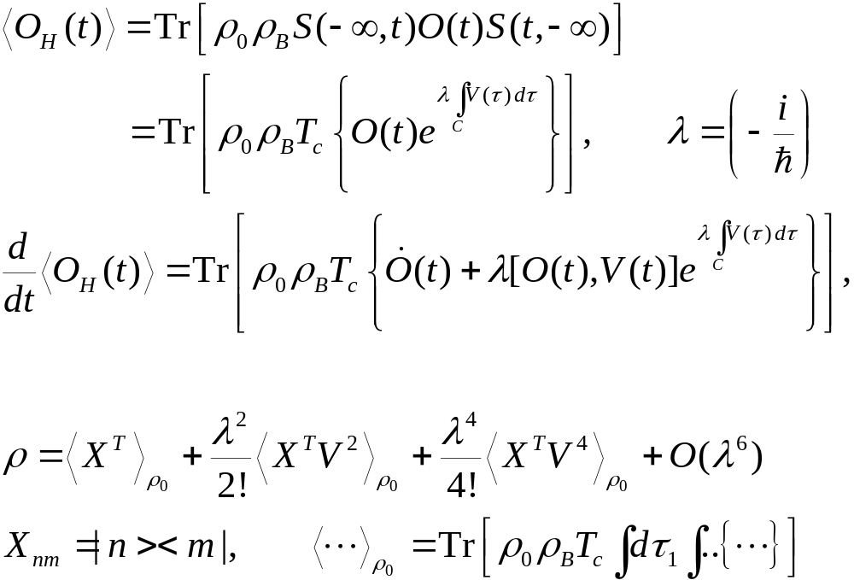
Dyson Expansions
Notes:
Some detail is in the last section of J.-S. Wang, B. K. Agarwalla, H. Li, and J. Thingna, “Nonequilibrium Green's function method for quantum thermal transport,” Front. Phys. (2013). rho_0 is in fact rho_0^I, i.e., interaction picture one.

Slide 21
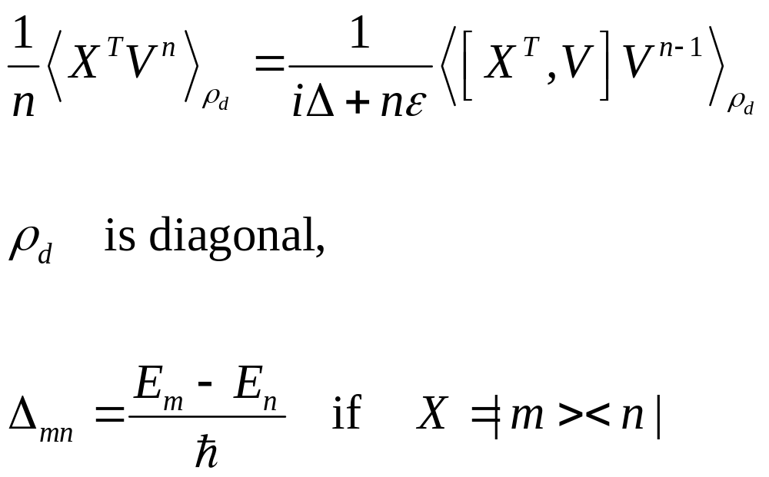
Divergence

Slide 22
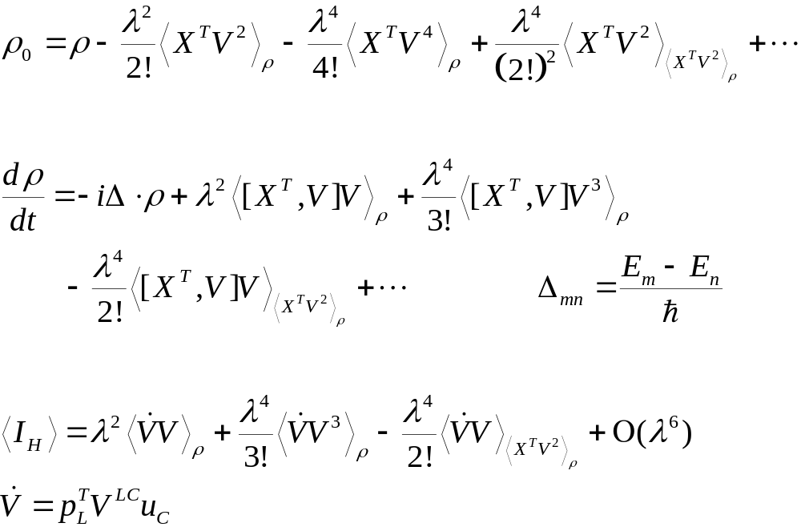
Unique one-to-one map, ρ₀↔ρ; ordered cumulants

Slide 23
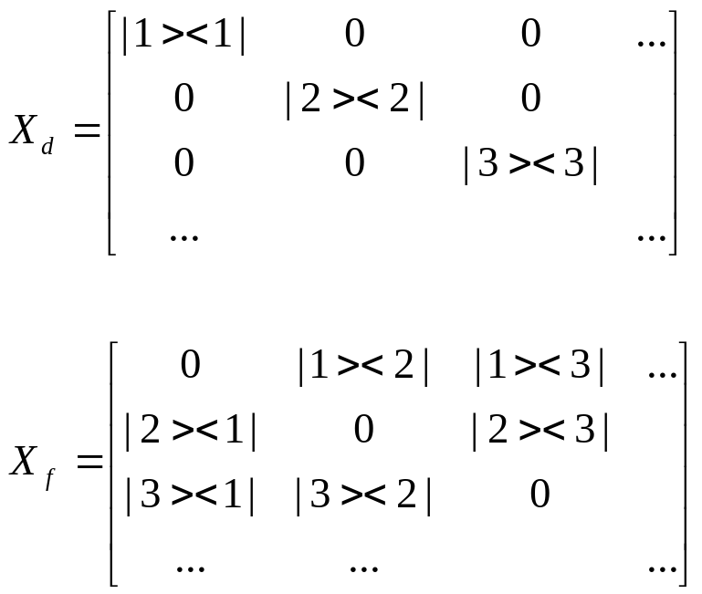
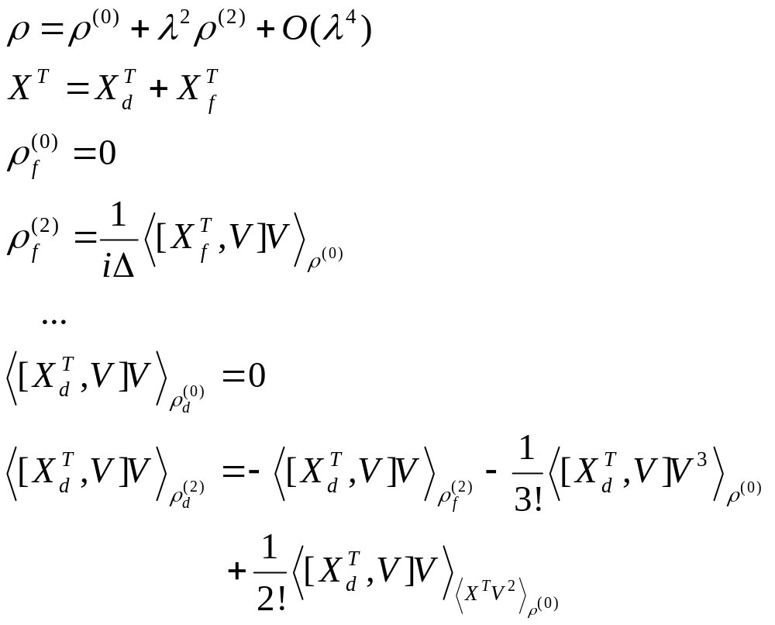
Order-by-Order Solution to ρ

Slide 24
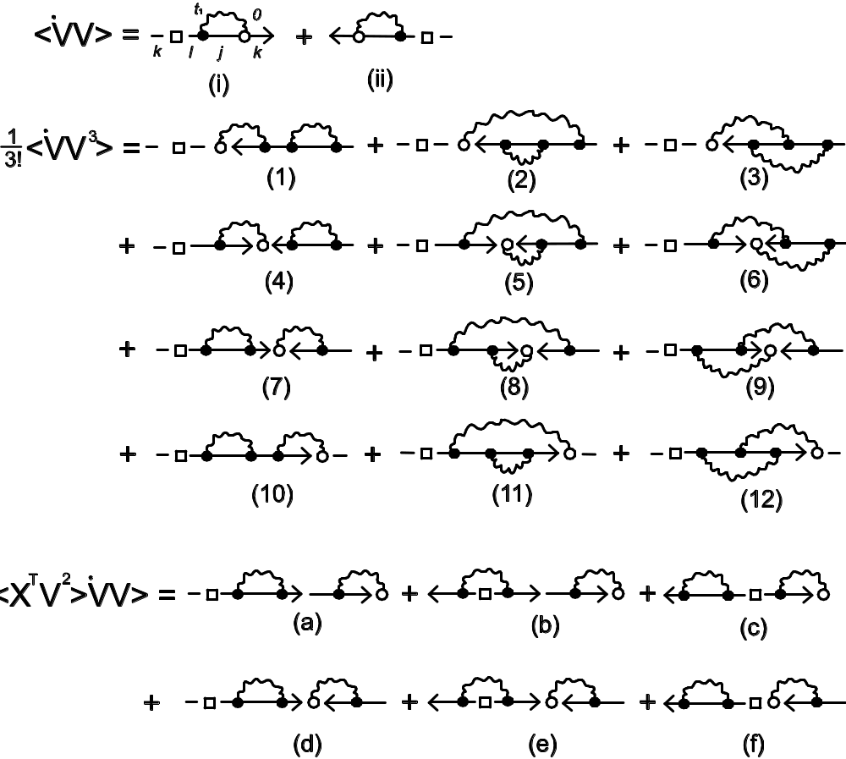
Diagrammatics
Diagrams representing the terms for current `V or [X ^{T},V]. Open circle has time t=0, solid dots have dummy times. Arrows indicate ordering and pointing from time -∞ to 0. Note that (4) is cancelled by (c); (7) by (d).
From Wang, Agarwalla, Li, and Thingna, Front. Phys. (2013), DOI: 10.1007/s11467-013-0340-x.

Slide 25
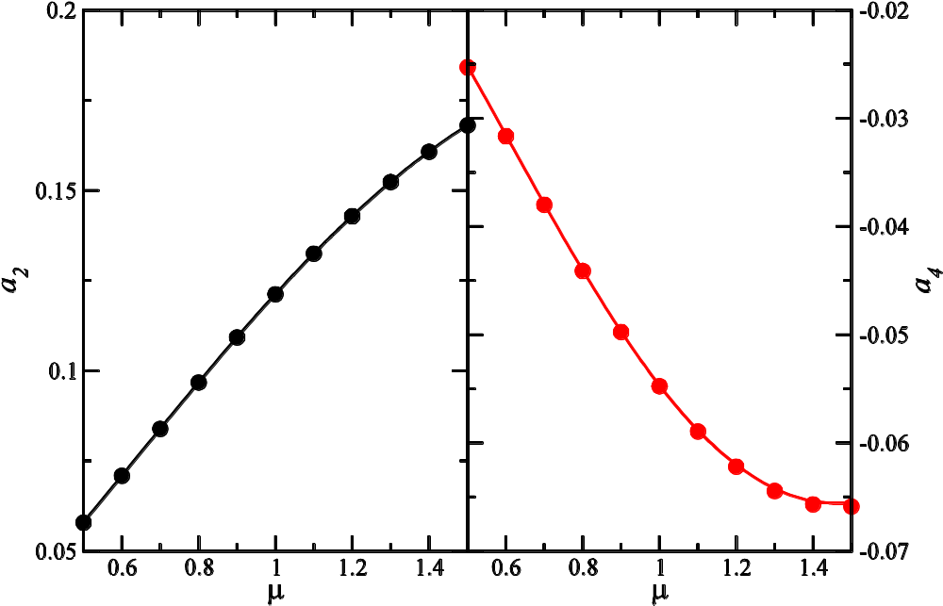
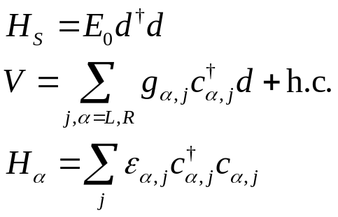
QD model to 4th order
The coefficients for the current I_{L} = a₂ η+a₄η², for the Lorentz-Drude bath spectrum J(ω) = ηħ/(1 + ω²/D²). 50% chemical potential bias, equal temperature. Curves from NEGF, dots from 4-th order master equation.
From Thingna, Zhou, and Wang, arxiv:1408.6996.

Slide 26
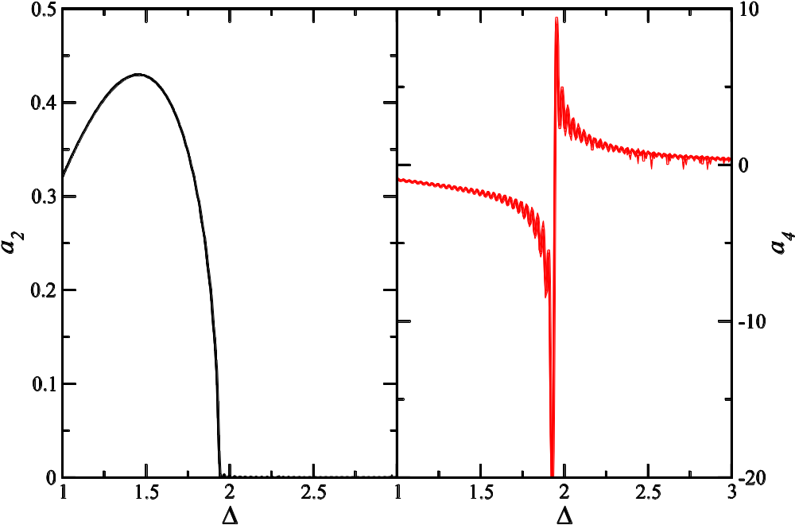
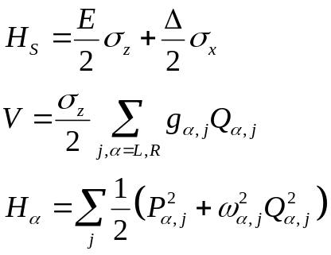
Spin-Boson Model
The coefficients for the current
I_{L} = a₂ η+a₄η²
For the spin-boson model with Rubin baths,
J(ω) = (1/2)ħηω (4-ω²)^{1/2}.
T_{L} = 1.5, T_{R}=0.5, E=0.5. We see co-tunneling featuers.
From Thingna, Zhou, and Wang, arxiv:1408.6996.

Slide 27
Summary
NEGF: powerful tool to study transport in nanostructures for steady state and transient
Application to molecular dynamics – quantum heat bath
Quantum master equation approach – arbitrary strong interaction in the system

