Slide 1

Nonequilibrium Green’s Function Method in Quantum Transport – Electrons, phonons, photons
CSRC Summer School on Quantum Non-equilibrium Phenomena: Methods and Applications
Wang Jian-Sheng
Notes:
This is a set of lectures for the CSRC summer school on transport, 17-21 June 2019. CSRC: Beijing Computational Science Research Center.

Slide 2
Outline
Lecture 0: Electron Green’s functions √
Lecture 1: Basics of transport theories
Lecture 2: NEGF – brief history, phonon/harmonic oscillator example √
Lecture 3: NEGF “technologies” – rules of calculus, equation of motion method, current formula √
Lecture 4: Feynman diagrammatics
Lecture 5: Photons √
Notes:
This set of lectures is on basic concepts and fundamental techniques. The formulas are well-known. However, as a (theoretical) physicist, one is not satisfied with a given formula and how to use it, but one want to know now it is derived, and what it’s limitations are. So that one can apply the technique to new situations. Many-body physics theories are fundamental to understand the lectures fully, such are discussed in books as such Fetter-Walecka, Mahan, etc. Although we mainly focus on thermal transport, my aim is on general non-equilibrium transport, not necessarily thermal.

Slide 3
References
J.-S. Wang, J. Wang, and J. T. Lü, “Quantum thermal transport in nanostructures,” Eur. Phys. J. B 62, 381 (2008).
J.-S. Wang, B. K. Agarwalla, H. Li, and J. Thingna, “Nonequilibrium Green’s function method for quantum thermal transport,” Front. Phys. 9, 673 (2014).
See also textbooks by Haug & Jauho, Rammer, Datta, Stefanucci & van Leeuwen, etc.
Notes:
See also https://www.physics.nus.edu.sg/~phywjs/NEGF/negf.html for the links to the arxiv version of the review papers. The reference books are:
H. Haug & A.-P. Jauho, “Quantum Kinetics in Transport and Optics of Semi-conductors,” Springer-Verlag 1996.
J. Rammer, “Quantum Field theory of non-equilibrium states”, Cambridge University Press, 2007.
S. Datta, “Electronic transport in mesoscopic systems,” Cambridge Univ Press, 1995.
G. Stefanucci and R van Leeuwen, “Nonequilibrium Many-Body Theory of Quantum Systems, a modern introduction,” Cambridge Univ Press, 2013.

Slide 4
Lecture Zero
Green’s function for free electrons
Notes:
Lecture zero on some preliminary concepts on Green’s functions of the electrons.

Slide 5
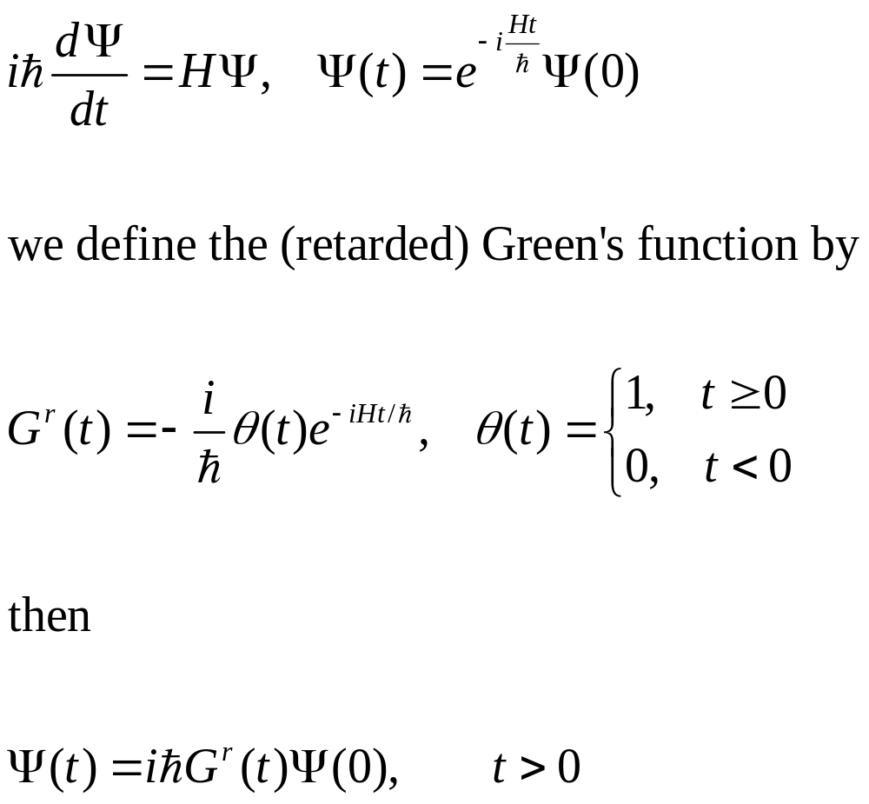
Single electron quantum mechanics
Notes:
In a particular representation, since H is 2x2 matrix, Psi a column vector, so the Green’s function G is also 2x2 matrix.

Slide 6
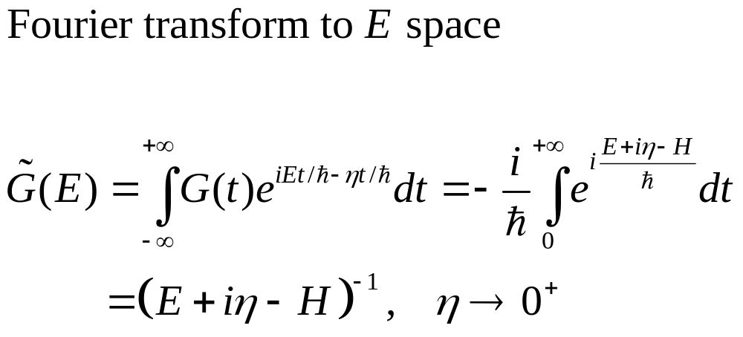
Green’s function in energy space
${\left(z−H\right)}^{−1}$ is called resolvent of the operator $H$.
Notes:
Here z or E or i*eta really means the constant type the identity matrix I. The small eta 1) makes the integral converge, 2) makes the inverse Fourier transform well defined (which produce the theta(t) in the retarded Green’s function).

Slide 7
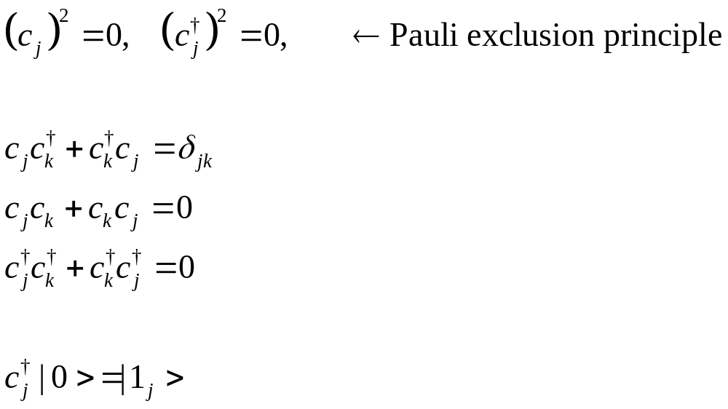
Annihilation/creation operators
defining property of fermion

Slide 8
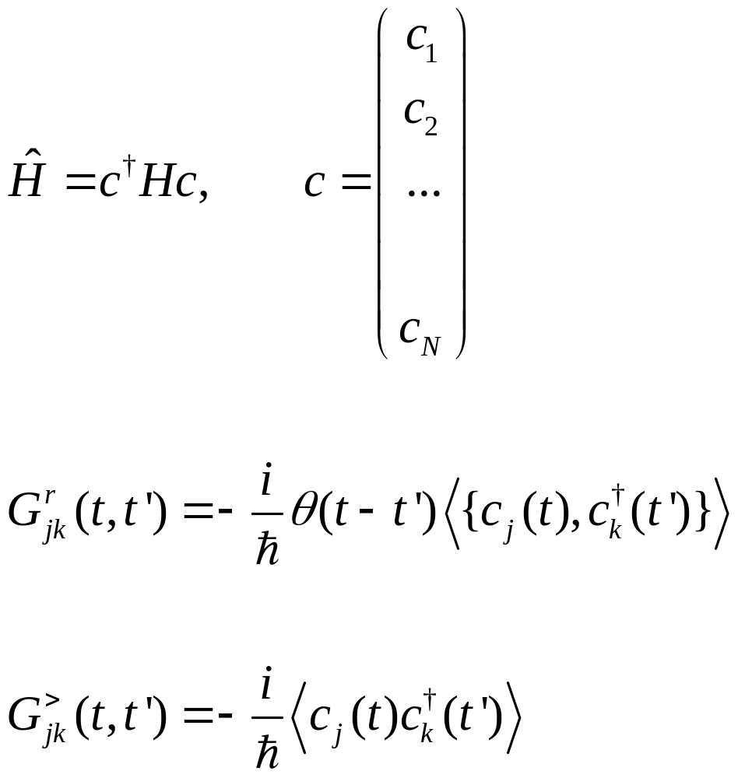
Many-electron Hamiltonian and Green’s functions
Annihilation operator c is a column vector, H is N by N matrix. {A, B} =AB+BA
Notes:
Various other Green’s functions (G<, G>, G^r, G^a, G^t, G^tbar) will be defined later for phonon. The form and relation among Greens are such so that phonon and electrons are the same. See slide 54, 55.

Slide 9
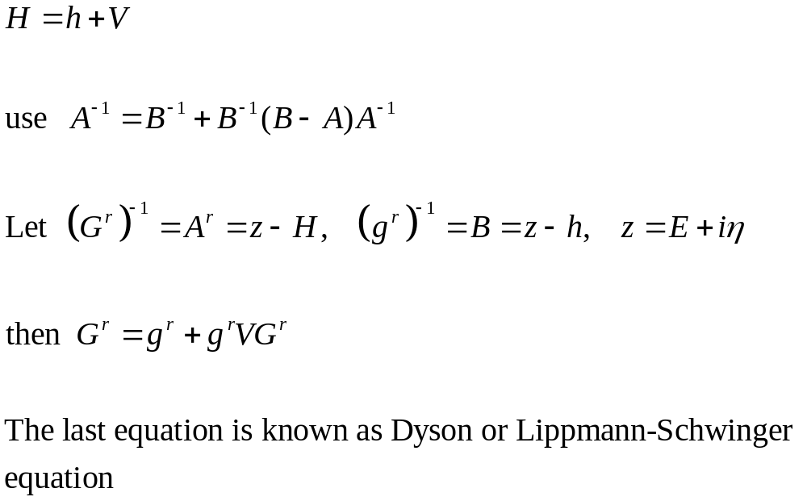
Perturbation theory, single electron

Slide 10
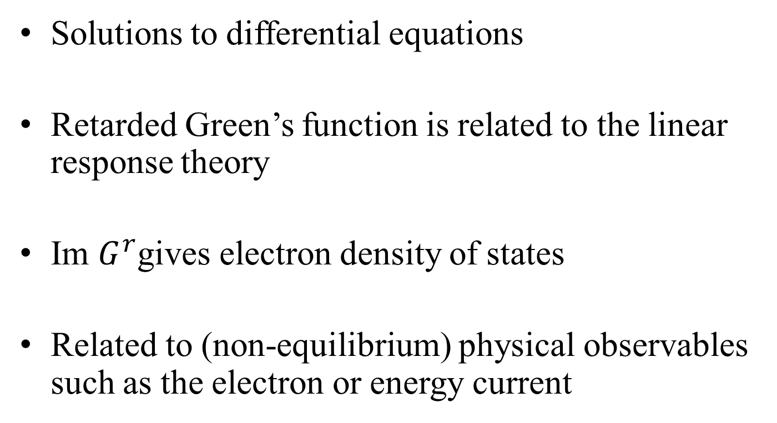
Why Green’s functions?
Solutions to differential equations
Retarded Green’s function is related to the linear response theory
Im $G^{r}$gives electron density of states
Related to (non-equilibrium) physical observables such as the electron or energy current

Slide 11
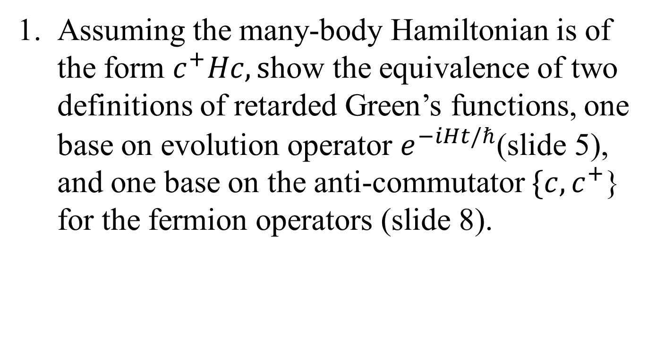
Problem for lecture zero
Assuming the many-body Hamiltonian is of the form $c^{+}Hc, s$how the equivalence of two definitions of retarded Green’s functions, one base on evolution operator $e^{−iHt/ℏ}$(slide 5), and one base on the anti-commutator $\{c,c^{+}$} for the fermion operators (slide 8).
Notes:
Hint: show they have the same equation of motion for G(t). Alternatively, show this in E space.

Slide 12
end of lecture zero

Slide 13
Lecture One
Basics of thermal transport or transport in general
Notes:
Lecture one is mostly phenomenological. Lecture two and two will start from ground up.

Slide 14
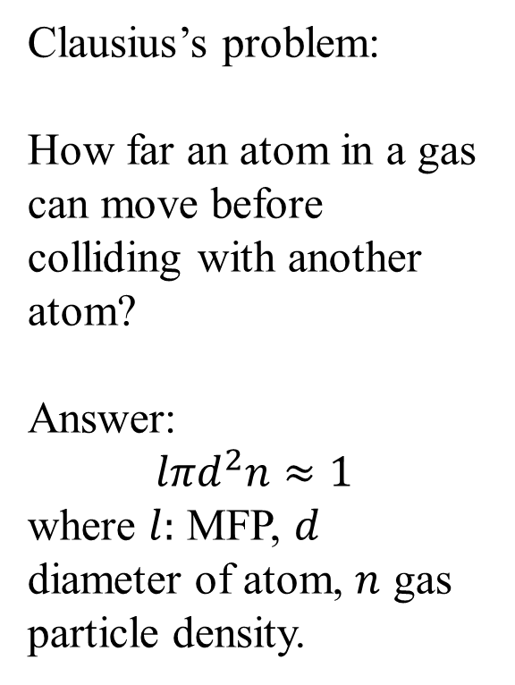
Mean free path (MFP)
Clausius’s problem:
How far an atom in a gas can move before colliding with another atom?
Answer:
$$lπd^{2}n≈1$$
where $l:$ MFP, $d$ diameter of atom, $n$ gas particle density.
diffusive vs ballistic regime
Notes:
MFP is a fundamental concept distinguish diffusive over ballistic transport. For a quantum dot with no size/length, we can hardly talk about diffusive transport.

Slide 15
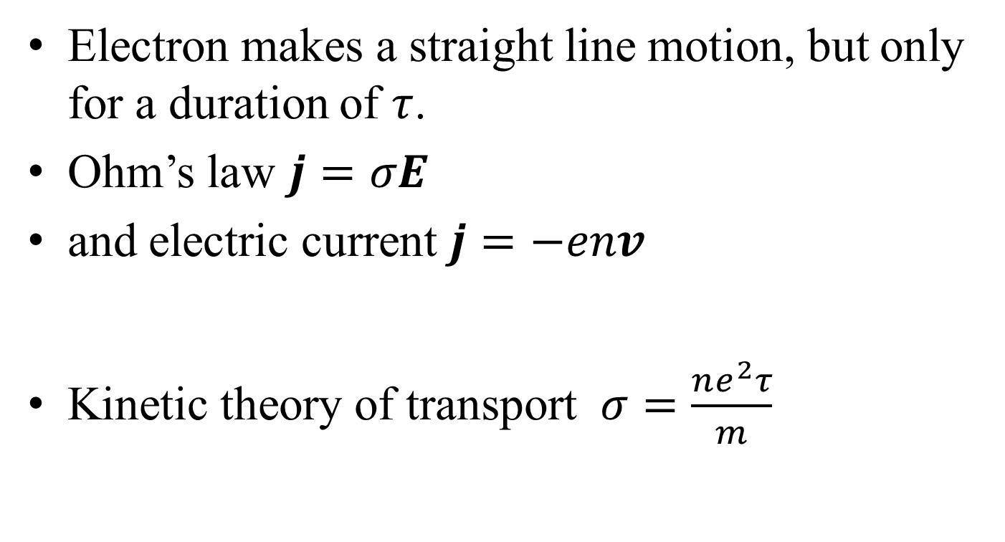
Relaxation time (electrons)
Electron makes a straight line motion, but only for a duration of $τ$.
Ohm’s law $j=σE$
and electric current $j=−env$
Kinetic theory of transport $σ=\frac{ne^{2}τ}{m}$
See: Ashcroft/Mermin, Solid State Physics.
Notes:
Electron has charge (-e). This is obviously in the diffusive transport regime. The basic idea above form the foundation of so-called Drude model for electron conduction.

Slide 16
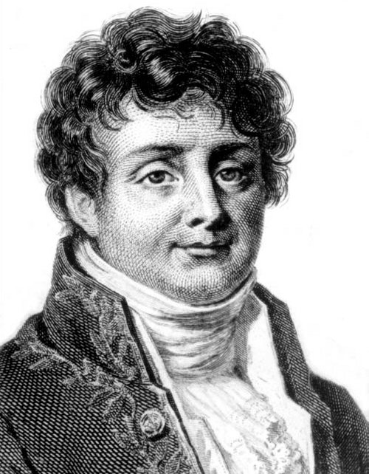
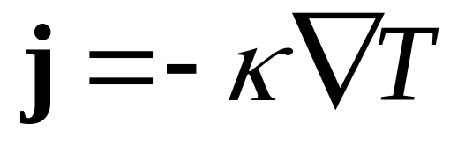
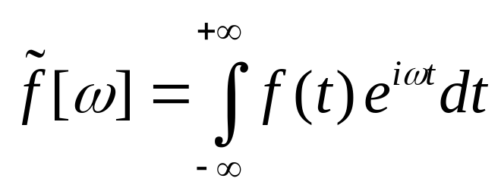
Fourier’s law for heat conduction
Fourier, Jean Baptiste Joseph, Baron (1768-1830)

Slide 17
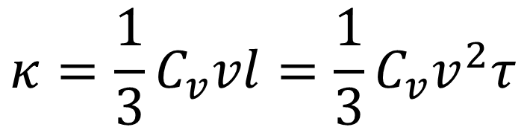
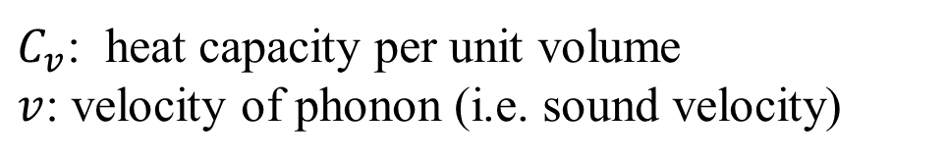
Kinetic theory formula for thermal conductivity
$$κ=\frac{1}{3}C_{v}vl=\frac{1}{3}C_{v}v^{2}τ$$
$C_{v}$: heat capacity per unit volume
$v$: velocity of phonon (i.e. sound velocity)
Notes:
MPF: l = vτ.

Slide 18
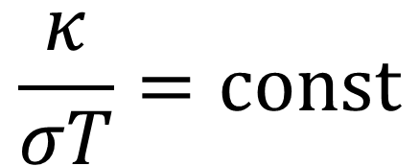
Wiedemann-Franz law (for electrons)
$$\frac{κ}{σT}=const$$

Slide 19
Some features of electron transport in metal

Slide 20
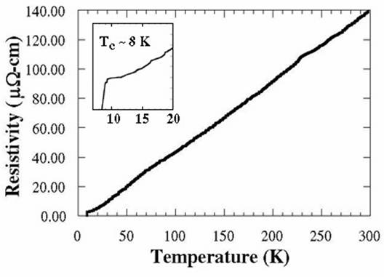
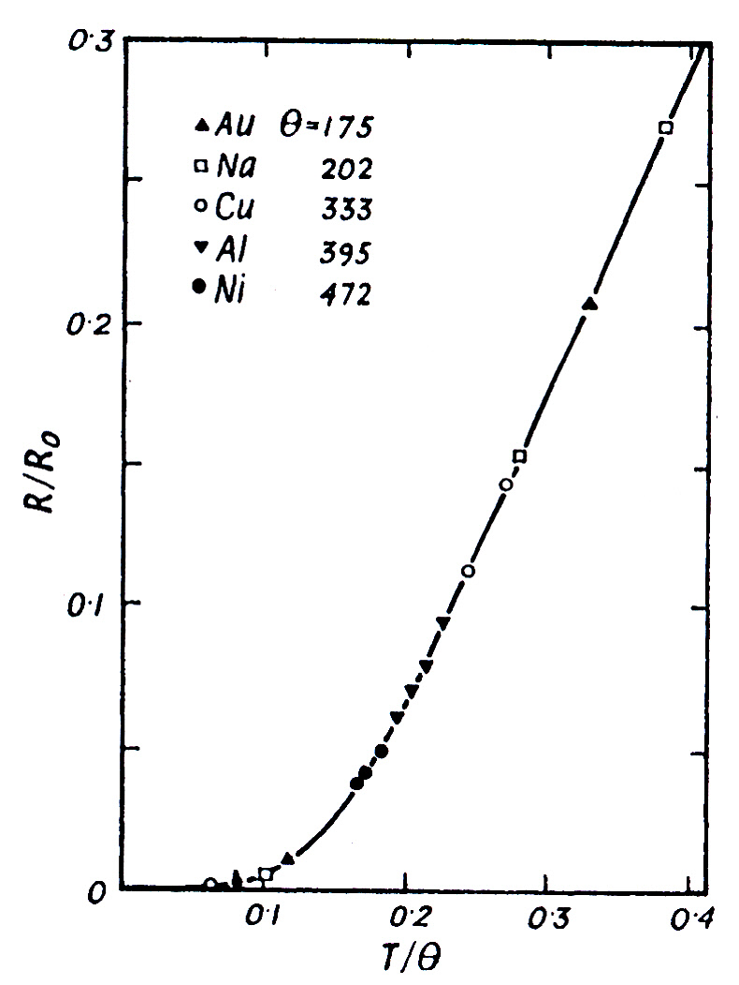
ρ ∝ T⁵ at low temperature
ρ vs T for lead (Pb), ρ ∝ T almost in the entire temperature range and becomes superconducting at T_{c} = 7.2 K.
Simple kinetic theory gives ρ = 1/σ = m/(ne²τ). Electron-phonon scattering can explain this linear dependence as self-energy (-Im Σ^{r} ∝1/τ) due to phonon is proportional to <uu> ∝ T in the classical limit. The best conductor near room temperature is Cu with resistivity around 1.6 μΩ·cm.
Fig. 115 of Ziman. Two-parameter fit to Grüneisen-Bloch theory to experimental data. The theory is based on Boltzmann transport equation and Debye model for phonons. The typical value of good metal resistivity is of the order of μΩ·cm (or 10 nΩ·m).
Notes:
Lead rho vs T is from http://www.bpc.edu/mathscience/faculty/jones/chapter_1_01.html
The Debye temperature of Pb is 88 K; this explains why the linear region is so large.

Slide 21
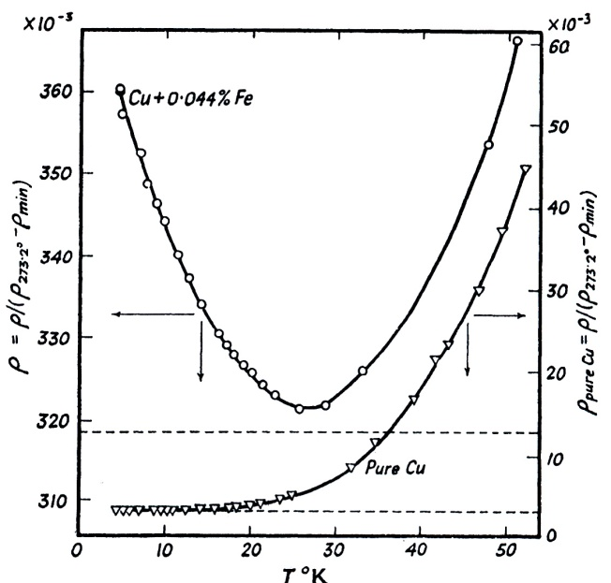
J. M. Ziman, “Electrons and Phonons,” Oxford Univ Press, 1960
Left top: Fig. 107. Due to impurity scattering, the resistance saturates to a constant. But with small amount of magnetic atoms, the resistance can go up, now known as Kondo effect.
Left bottom: Fig. 103. The disordered alloy follows Δρ ∝ (1-x) x. This is known as Nordheim’s rule (1931).
Top right, Fig. 109. bottom right, Fig. 129. Thermal power S (also known as Seebeck coefficient). The Boltzmann approach gives S = - π²k_{B}²T/(3e)· ∂ln σ(ε)/∂ε|_{ε=εF}.
-S
Notes:
Kondo problem has rich physics and is a big topic in traditional condensed matter physics.

Slide 22
Top left: Fig. 157. magneto-resistance of Mg. Bottom: Fig. 158. Δρ = ρ(H)-ρ(0), ρ₀ = ρ(0). The magneto-effect can be surprisingly large, e.g. Bi. The scale seems wrong, can the magneto-effect so large? Note they are all positive (i.e. magnetic field increases resistance). Top right: Fig. 159. Anisotropic effect with respect to crystalline direction.
Kohler’s rule (1938): Δρ/ρ₀=F(H/ρ₀). The data fall on the same curve independent of T (top left). This can be explained by Boltzmann equation under Lorentz force. Δρ ∝ H² is typical.
Notes:
Mg: Magnesium (Ne)3s², Mn: Manganese (Ar)3d⁵4s².
A. A. Abrikosov, Europhys. Lett. 49 789 (2000): this paper gives theory that magneto-resistance can be linear in H, not quadratic for some systems. Seems to be a hot topic related to topological insulator.

Slide 23
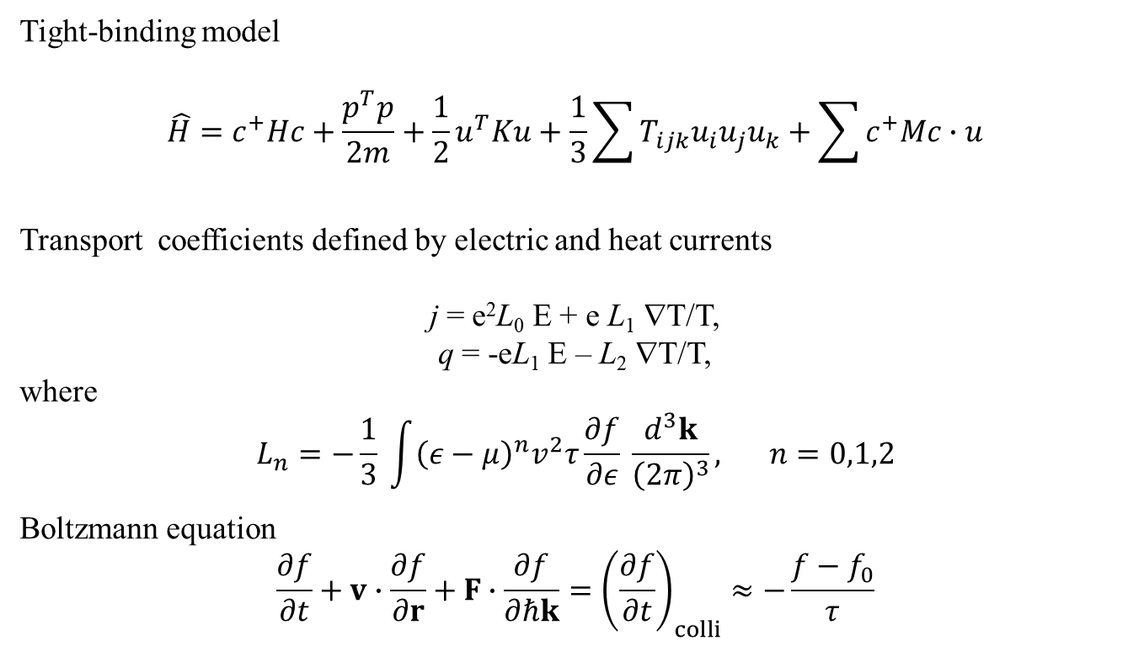
Boltzmann approach to transport
Tight-binding model
$$\hat{H}=c^{+}Hc+\frac{p^{T}p}{2m}+\frac{1}{2}u^{T}Ku+\frac{1}{3}\sum{T_{ijk}u_{i}u_{j}u_{k}}+\sum{c^{+}Mc∙u}$$
Transport coefficients defined by electric and heat currents
j = e²L₀ E + e L₁ ∇T/T,
q = -eL₁ E – L₂ ∇T/T,
where
$$L_{n}=−\frac{1}{3} \int{{\left(ε−μ\right)}^{n}v^{2}τ\frac{∂f}{∂ε} \frac{d^{3}k}{{\left(2π\right)}^{3}}, } n=0,1,2$$
Boltzmann equation
$$\frac{∂f}{∂t}+v∙\frac{∂f}{∂r}+F∙\frac{∂f}{∂ℏk}={\left(\frac{∂f}{∂t}\right)}_{colli}≈−\frac{f−f_{0}}{τ}$$
Notes:
The last term in the Boltzmann equation is known as single mode relation time approximation.

Slide 24
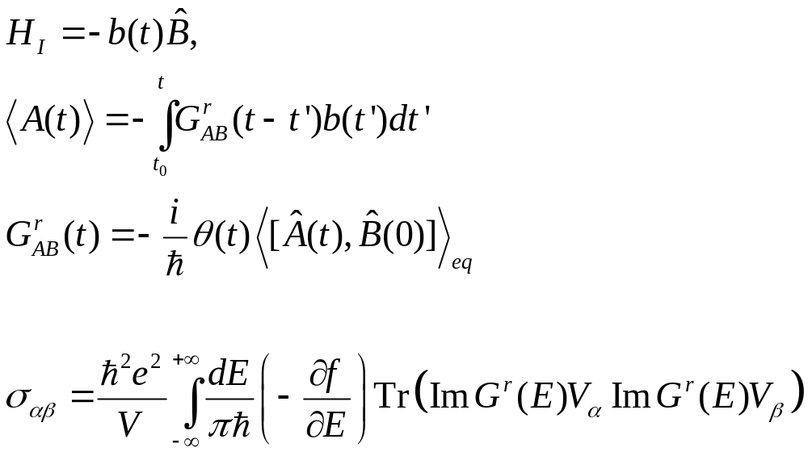
Green-Kubo & Kubo-Greenwood formulas
Notes:
Green-Kubo approach, see R. Kubo, M. Toda, N. Hashitsume, “Statistical Physics II.” See my own handwritten notes on the derivation of Kubo-Greenwood formula.s

Slide 25
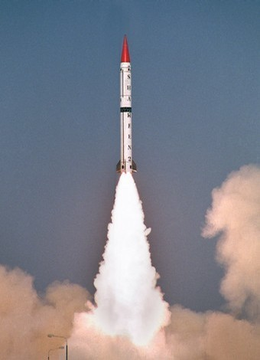
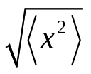


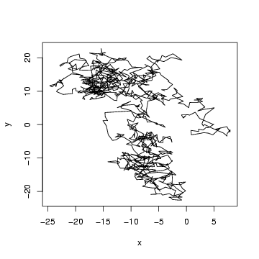
Diffusive transport vs ballistic transport
t
Notes:
We recall Brownian motion, Langevin equation and Fokker-Planck equations, Einstein formula, etc. See book by, e.g., N Pottier, “Nonequilibrium statistical physics.”

Slide 26
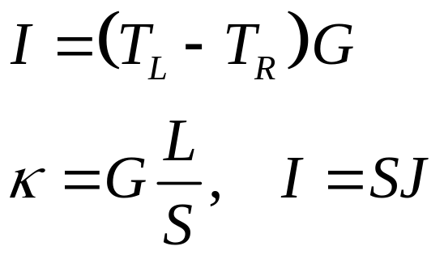
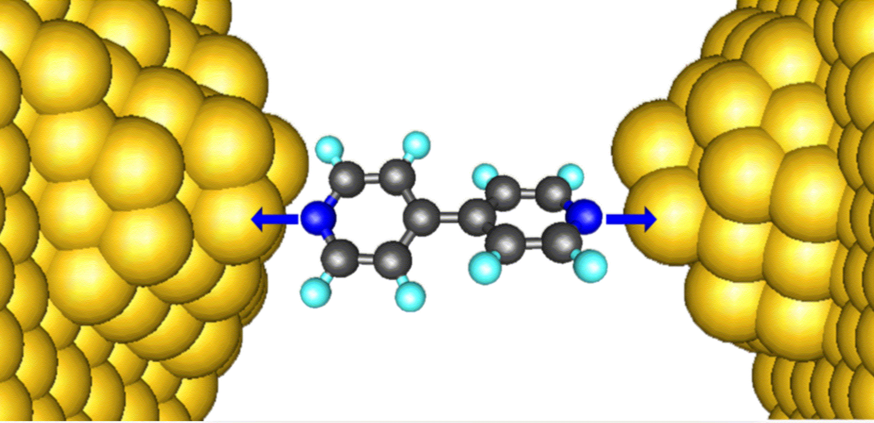
Thermal conductance
Notes:
For near zero-dimensional systems like this, we need a different perspective of physical quantities, like thermal conductance G.

Slide 27
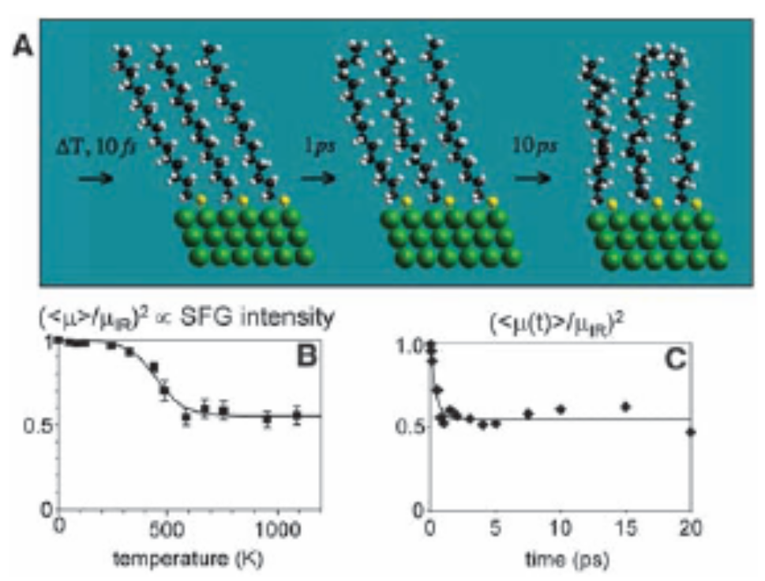
Experimental report of Z Wang et al (2007)
The experimentally measured thermal conductance is 50pW/K for alkane chains at 1000K, From Z Wang et al, Science 317, 787 (2007).

Slide 28
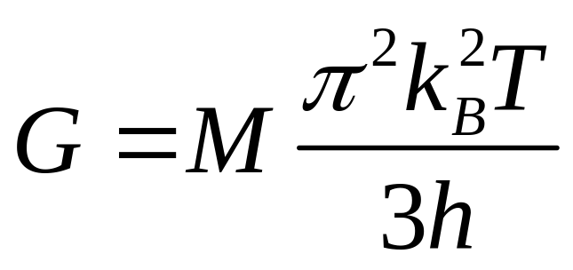
“Universal” thermal conductance
Rego & Kirczenow, PRL 81, 232 (1998).
M = 1

Slide 29
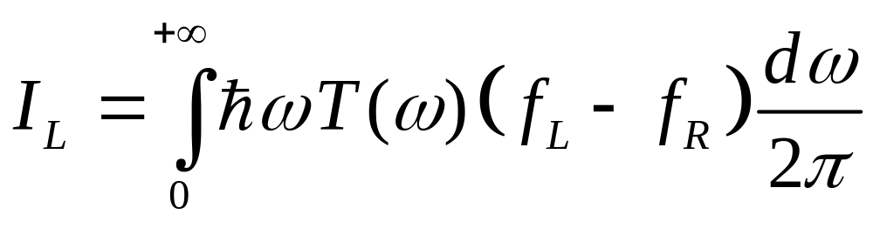
Landauer formula
Scatter center
Left lead/bath TL
Right lead/bath TR
See: S Datta, “Electronic transport in mesoscopic systems”
Notes:
By convention, I_L is the current out of the left bath. Why we need to divide by 2π, not pi or other factor? Since the temperature of the left and right can be any value in the Bose function f, this is a nonlinear response current. We give a derivation in late lectures from NEGF. Another approach is scattering picture approach, see my first review in EPJB.

Slide 30
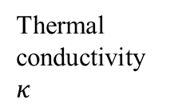

From ballistic to diffusive
Thermal conductivity $κ$
?
System linear dimension L
MFP $l$
Notes:
This is a research topic of current interests, see many of contributions from Prof. Li Baowen’s group.

Slide 31
Phonon Hall effect
B
Experiments by C Strohm et al, PRL (2005), also confirmed by AV Inyushkin et al, JETP Lett (2007). Effect is small |T₄ –T₃| ~ 10⁻⁴ kelvin in a strong magnetic field of few tesla, performed at low temperature of 5.45 K.
T₄
T₃
Tb₃Ga₅O₁₂
∇T
5 mm

Slide 32
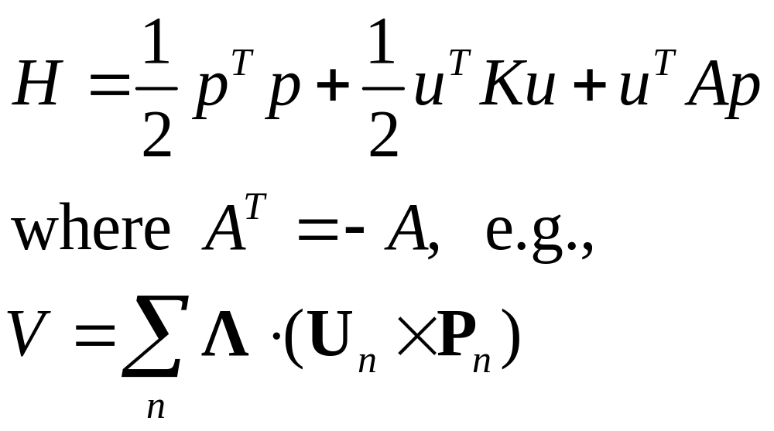
Ballistic model of phonon Hall effect
H is not positive-definite
Notes:
See Lifa Zhang’s papers, e.g., New J. Phys. 11, 113038 (2009).

Slide 33
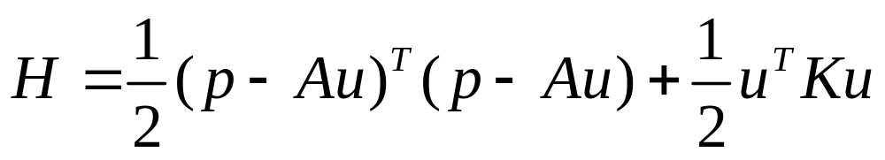
Revised positive-definite Hamiltonian
H is formally the same as ionic crystal in a magnetic field

Slide 34
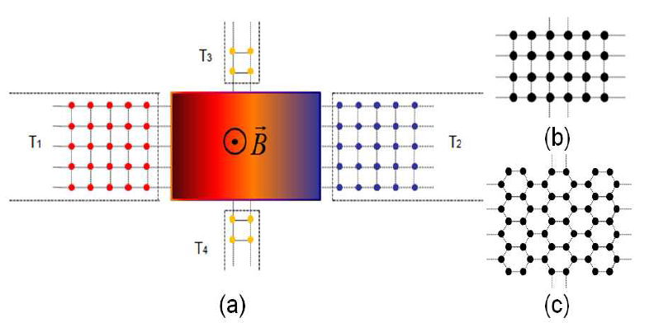
Four-terminal junction structure, NEGF
R=(T₃ -T₄)/(T₁ –T₂).

Slide 35
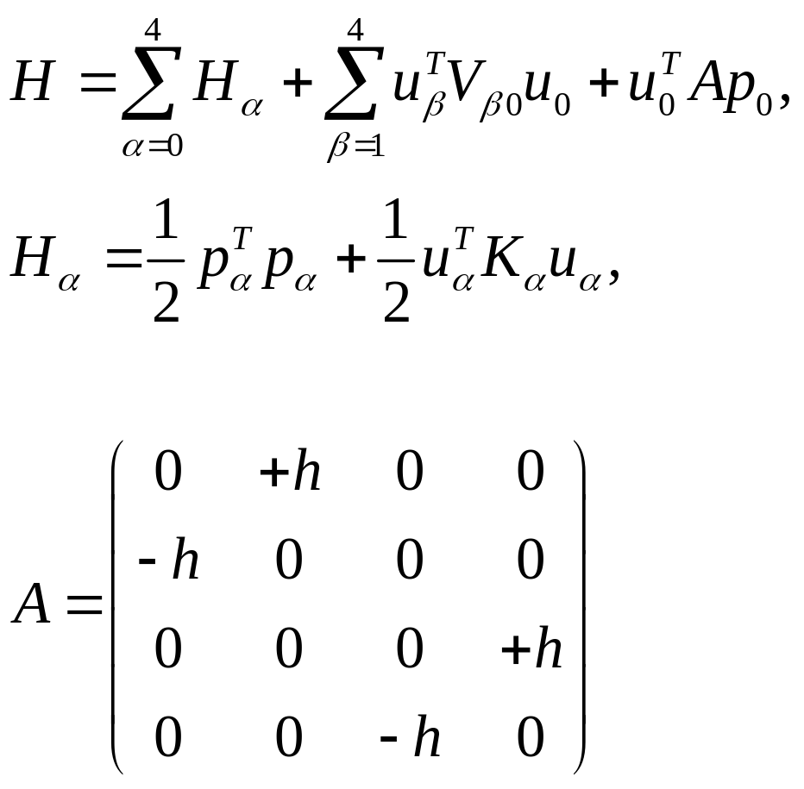
Hamiltonian for the four-terminal junction

Slide 36
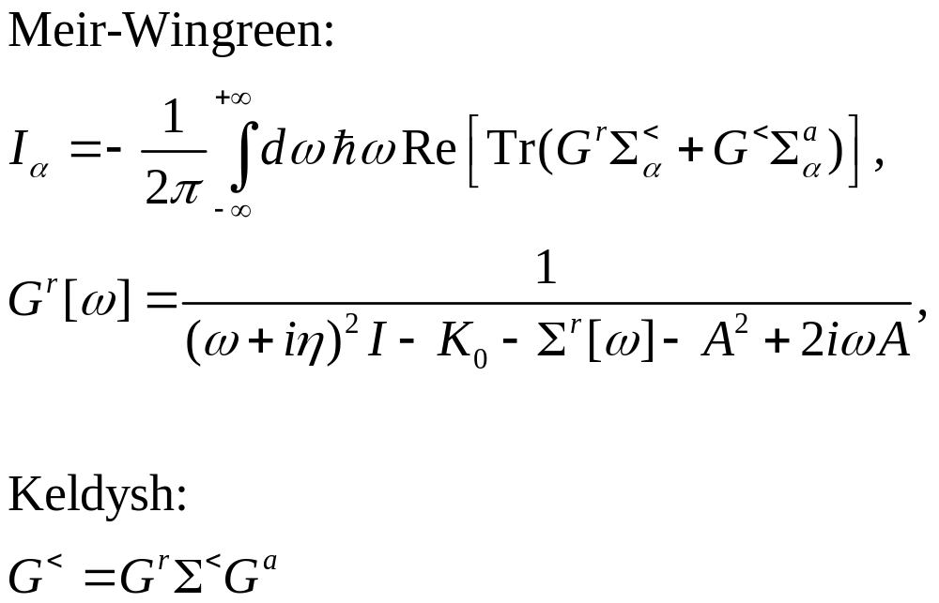
The energy current

Slide 37
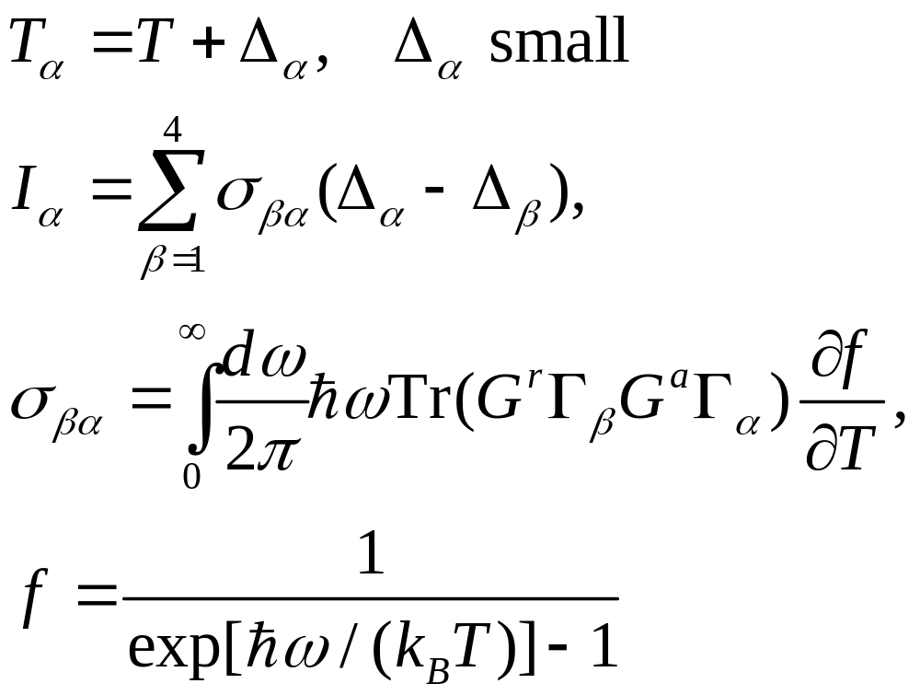
Linear response regime

Slide 38
Problems for lecture one
Derive the electron conductivity σ Drude formula (slide 15) following Ashcroft/Mermin.
Give a hand-waving derivation of the kinetic theory formula for the thermal conductivity κ (slide 17).
Give a derivation of the thermal conductivity (generalized to sum over the phonon modes) based on Boltzmann equation (slides 23) with a single mode relaxation approximation.
Notes:
These are more or less trivial.

Slide 39
Derive the “universal” conductance formula (slide 28) from the Landauer formula, assuming a unit transmission T [ω]=1.
Generalize Landauer formula so that it smoothly interpolates between ballistic regime and diffusive regime [hint: J Wang, J-S Wang APL (2006)].
Derive the Kubo-Greenwood formula (slide 24) .
Notes:
Answer to problem 6 is in my handwritten notes. It is long.

Slide 40
end of lecture one

Slide 41
Lecture Two
History, definitions, properties of NEGF

Slide 42
A Brief History of NEGF
Schwinger 1961
Kadanoff and Baym 1962
Keldysh 1965
Caroli, Combescot, Nozieres, and Saint-James 1971
Meir and Wingreen 1992
Notes:
Schwinger introduced earliest g<, g>, g^t, g^t_bar. Kadanoff and Baym had their famous book “quantum statistical mechanics”, Keldysh emphasized the contour order and its usefulness for diagrammatic expansion, Caroli perhaps first apply to transport, and we now have the Meir-Wingreen formula for current when the center is interactive.

Slide 43
Equilibrium Green’s functions using a harmonic oscillator as an example
Single mode harmonic oscillator is a very important example to illustrate the concept of Green’s functions as any phononic system (vibrational degrees of freedom in a collection of atoms) and photonic system at ballistic (linear) level can be thought of as a collection of independent oscillators in eigenmodes. Equilibrium means that system is distributed according to the Gibbs canonical distribution.

Slide 44
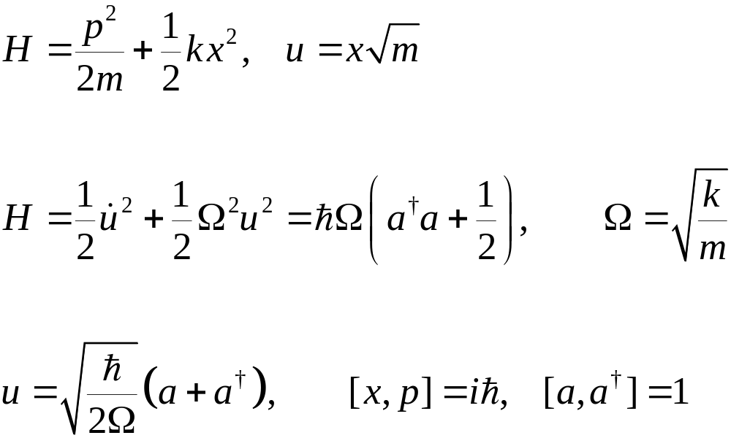
Harmonic Oscillator
k
m
Notes:
du/dt = sqrt(hbar/(2Omega)) ( - a + a\dagger) (i Omega). The harmonic oscillator is also fundamental in the quantum field of photon, e.g.

Slide 45
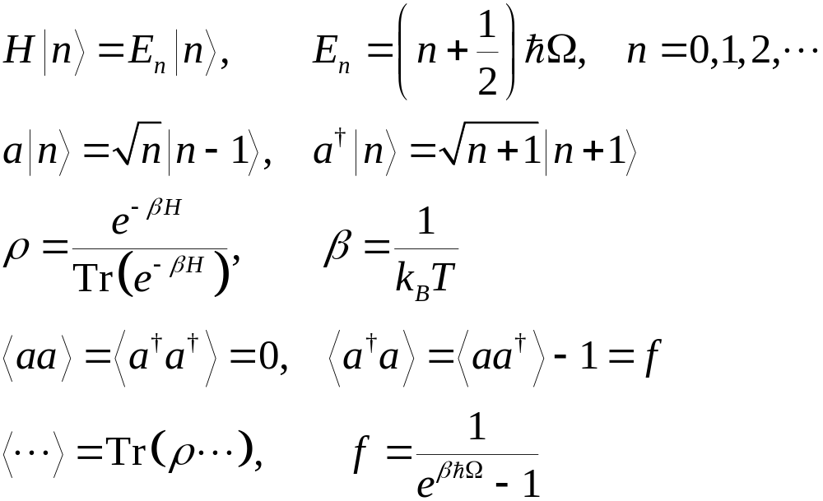
Eigenstates, Quantum Mech/Stat Mech

Slide 46
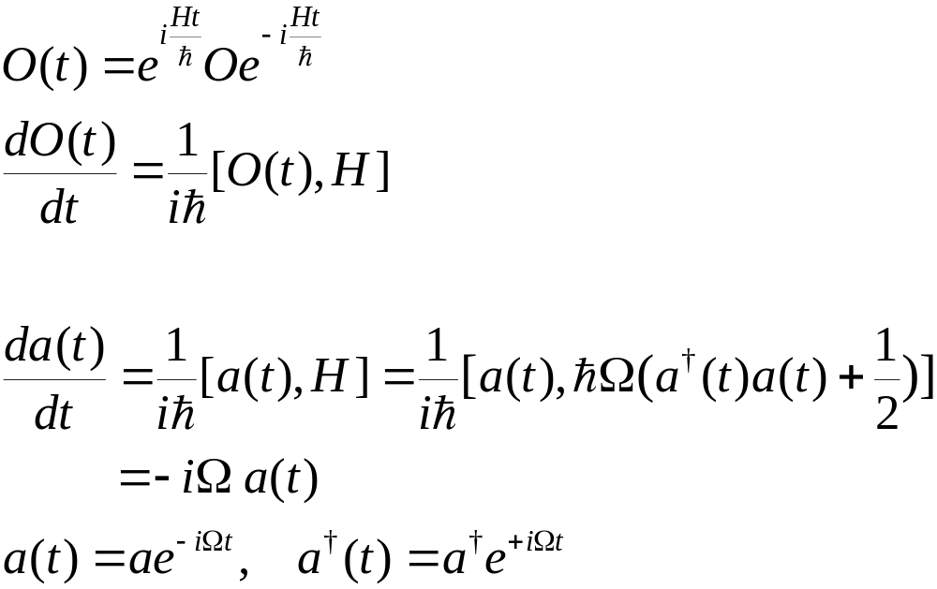
Heisenberg Operator/Equation
O: Schrödinger operator
O(t): Heisenberg operator

Slide 47

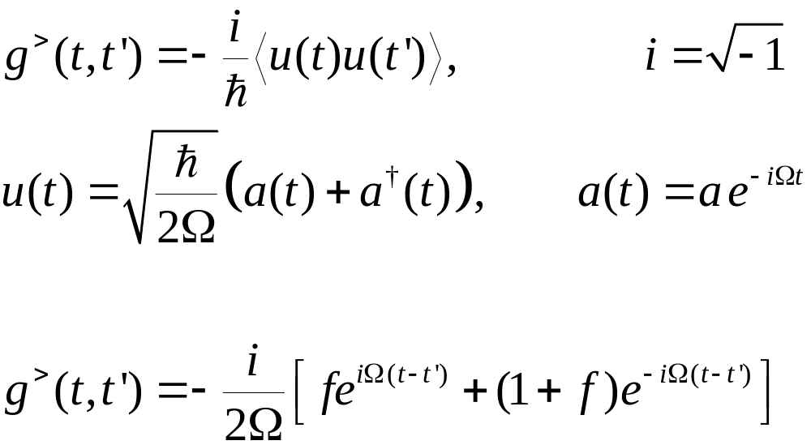
Defining >, <, t, Green’s Functions
Notes:
Derive the last equation from the top definition.

Slide 48
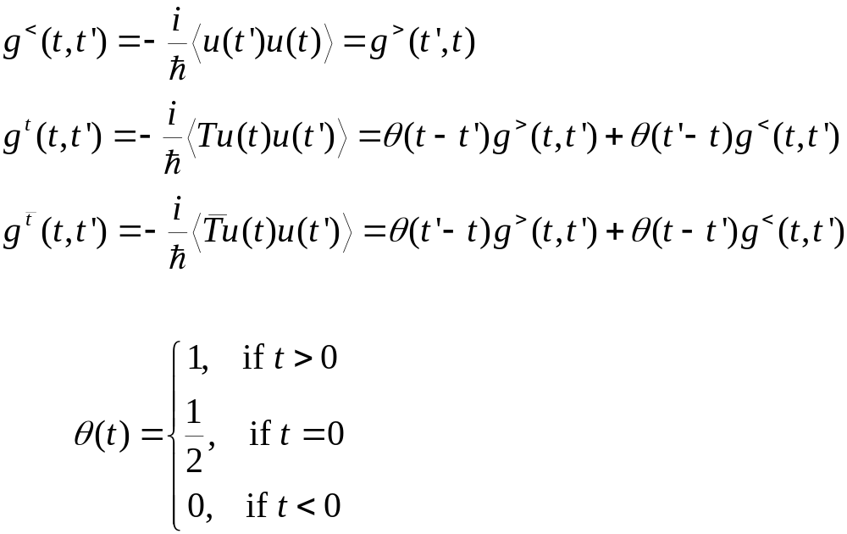
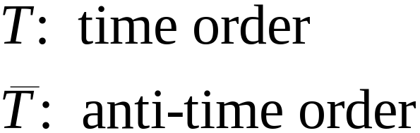
Notes:
T, Ť are called super-operator, as it act on the operator, not in the vector of Hilbert space. What to define for theta(0) is a bit arbitrary/controversy.

Slide 49
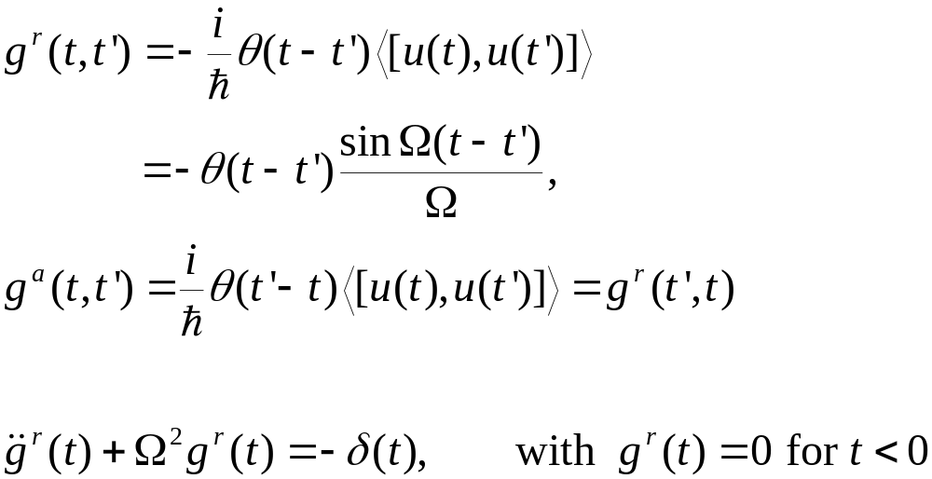
Retarded and Advanced Green’s functions

Slide 50
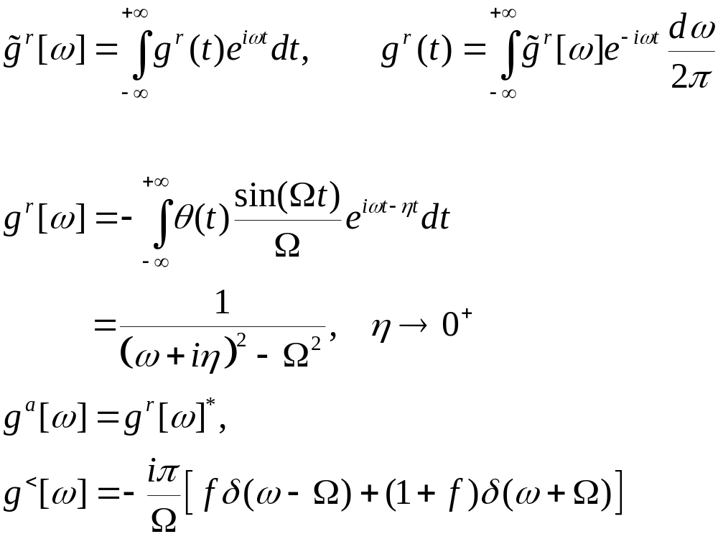
Fourier Transform
Notes:
We use the convention that planewave is exp(ik.r – i ωt).

Slide 51
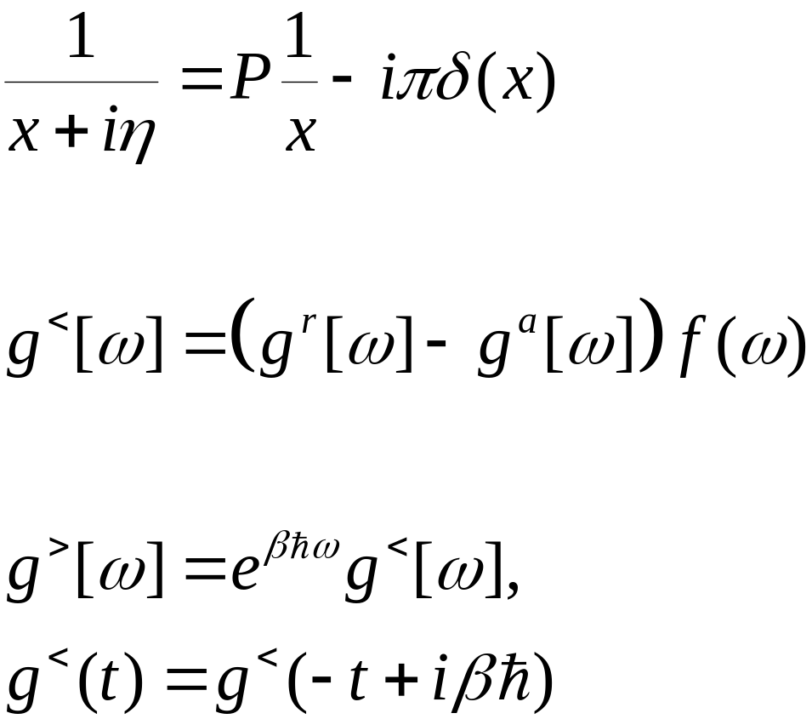
Plemelj formula, fluctuation-dissipation, Kubo-Martin-Schwinger condition
P for Cauchy principle value
Valid only in thermal equilibrium

Slide 52
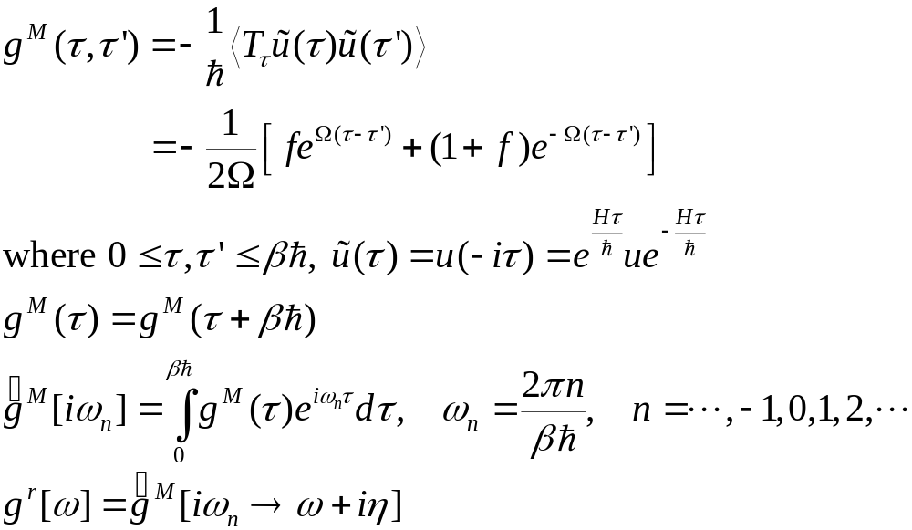
Matsubara Green’s Function
Notes:
What periodicity/boundary do we have for fermion?

Slide 53
Nonequilibrium Green’s Functions
By “nonequilibrium”, we mean, either the Hamiltonian is explicitly time-dependent after t₀, or the initial density matrix ρ is not a canonical distribution.
We’ll show how to build nonequilibrium Green’s function from the equilibrium ones through product initial state or through the Dyson equation.

Slide 54
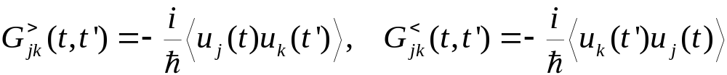
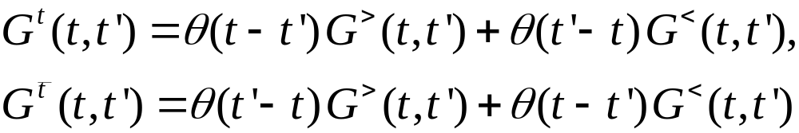
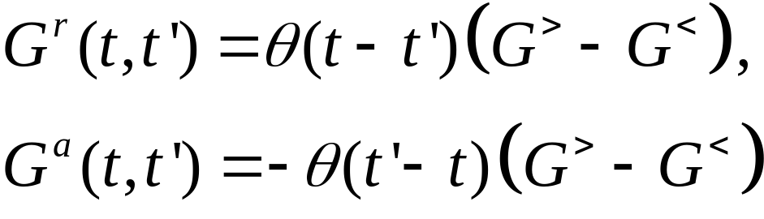
Definitions of General Green’s functions (phonon/displacement)
Notes:
Other types such as Matsubara Green’s function or canonical (Kubo) correlation are also used. i = sqrt(-1). The average < … > can be equilibrium or with respect to arbitrary density matrix. For classical systems, G< = G>.
54

Slide 55
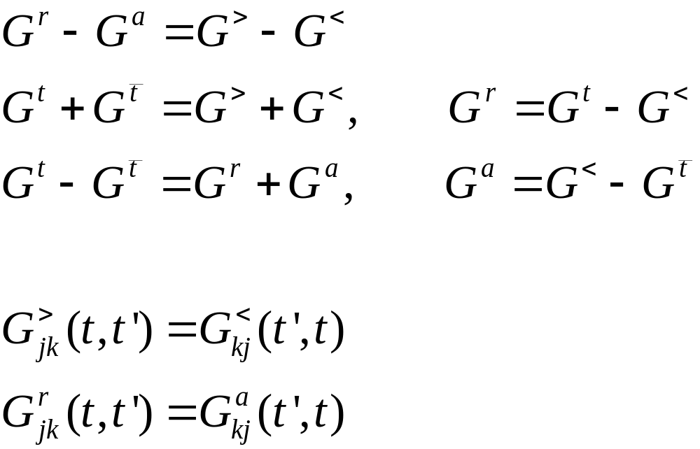
Relations among Green’s functions
Notes:
The relation implies two (three?) linearly independent ones, and one independent one only if nonlinear dependence is considered. Does self-energy has similar relations?
55

Slide 56
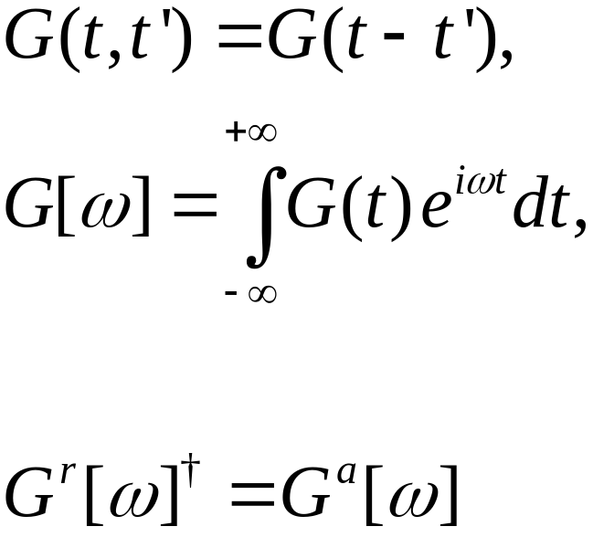
Steady state, Fourier transform
Notes:
The inverse Fourier transform has a factor of 2 . We use square brackets [ ] to denote Fourier transformed function. For more general relation of Gr and Ga, see my handwritten notes on NEGF for electrons.
56

Slide 57

Equilibrium Green’s Function, Lehmann Representation
Notes:
Lehmann representation is to expand everything in the eigenstates. Using the Lehmann representation, one can relate G> with G<, as well relate them to G^r-G^a.

Slide 58

Kramers-Kronig Relation
Notes:
G^a is when z -> w – I eta. P stands for principle value.

Slide 59

Eigen-mode Decomposition
Notes:
Only for finite system, in equilibrium? See a nice summary in appendix of Phys Rev B. 80 205429 (2009).

Slide 60

Pictures in Quantum Mechanics
Schrödinger picture: O, (t) =U(t,t₀)(t₀)
Heisenberg picture: O(t) = U(t₀,t)OU(t,t₀) , ρ₀, where the evolution operator U satisfies
See, e.g., Fetter & Walecka, “Quantum Theory of Many-Particle Systems.”
Notes:
< . > = Tr(ρ . ). T here denotes time order, assuming t > t’. Anti-time order if t < t’.
60

Slide 61

Calculating correlation
B
A
t₀
t’
t
Notes:
t₀ is the synchronization time where the Schrödinger picture and Heisenberg picture are the same.
61

Slide 62


Evolution Operator on Contour

Slide 63

Contour-ordered Green’s function
Contour order: the operators earlier on the contour are to the right. See, e.g., H. Haug & A.-P. Jauho.
τ’
τ
t₀
Notes:
63

Slide 64

Relation to other Green’s function
τ’
τ
t₀
Notes:
σ = + for the upper branch, and – for the returning lower branch.
64

Slide 65

An Interpretation
G is defined with respect to Hamiltonian H and density matrix ρ and assuming Wick’s theorem.
Notes:
This is originally due to Schwinger.

Slide 66
Problems for lecture two
Express the annihilation operator a and creation operator a⁺ by the position operator x and momentum operator p (slide 44). Why they have to be that form?
Compute the thermal average values <aa>, <a⁺a⁺>, <aa⁺>, and <a⁺a> for the simple harmonic oscillator (slide 45).
For the harmonic oscillator, work out the expressions for various Green’s functions defined in terms of a, a⁺, instead of u (slide 47 - 50). Discuss the advantage and disadvantage of both. [Hint: Piet Brower’s lecture notes, “Theory of many-particle systems”.]
Notes:
http://www.physics.udel.edu/~bnikolic/QTTG/shared/reviews/brouwer_notes.pdf

Slide 67

Verify the equations for g^{r} on slides 49 and 50.
For the harmonic oscillator, verify the claim that we can obtain g^{r} in frequency domain from the Matsubara function by the substitution iω_{n} → ω+iη (bottom of slide 52).
Prove the “fluctuation-dissipation” theorem for equilibrium systems, $G^{<}=\left(G^{r}−G^{a}\right)f$, using the Lehmann representation. Here $f$ is the Bose function $\frac{1}{e^{βℏω}−1}.$

Slide 68
Prove the Kramers-Kronig relation and state the condition needed for its validity (slide 58).
Explain the meaning of slide 63 from first line to the second line.
Derive the retarded Green’s function of photon for a free field (no interaction) and discuss how it differs from the time-ordered one (at zero temperature) [Hint. Mahan, “Many-particle physics”,3rd ed, Chap.2.10]

Slide 69
end of lecture two

Slide 70
Lecture three
Calculus on contour, equation of motion method, current, etc
Notes:
This lecture is the real meat of NEGF.

Slide 71


Calculus on the contour
Integration on (Keldysh) contour
Differentiation on contour
Notes:
dτ is σdt for integration, but just dt in differentiation. σ is either just the sign + or -, or +1, -1.
71

Slide 72


Theta function and delta function
Theta function
Delta function on contour
where θ(t) and δ(t) are the ordinary Heaviside theta and Dirac delta functions
Notes:
72

Slide 73

Transformation/Keldysh Rotation
Notes:
Also properly known as Larkin-Ovchinikov transform, JETP 41, 960 (1975).

Slide 74

Convolution, Langreth Rule
Notes:
The last two equations are known as Keldysh equations.

Slide 75
Equation of Motion Method
The advantage of equation of motion method is that we don’t need to know or pay attention to the distribution (density operator) ρ. The equations can be derived quickly.
The disadvantage is that we have a hard time justified the initial/boundary condition in solving the equations.

Slide 76

Heisenberg Equation on Contour
Notes:
The integral on the exponential is from a point tau_1 specified on the contour to tau_2 at a later point on the contour. The integral is along the contour.

Slide 77


Express contour order using theta function
Operator A(τ) is the same as A(t) as far as commutation relation or effect on wavefunction is concerned
Notes:
u u^{T} is a square matrix, and [u, v^{T}] is a matrix formed by (j,k) element [u_{j}, v_{k}].
77

Slide 78

Equation of motion for contour ordered Green’s function
Notes:
We use the equation of motion d²u/dt² = -Ku.
78

Slide 79

Equations for Green’s functions
Notes:
79

Slide 80

Solution for Green’s functions
c and d can be fixed by initial/boundary condition.
Notes:
Note that if ax = b, x = b/a, but not if a = 0, in that case, x = infinity, thus, the Dirac delta function.
80

Slide 81
Junction system, adiabatic switch-on
  g_{α} for isolated systems when leads and centre are decoupled
  G0 for ballistic system
  G for full nonlinear system
H_{L}+H_{C}+H_{R} +V +H_{n}
H_{L}+H_{C}+H_{R} +V
G
H_{L}+H_{C}+H_{R}
G₀
g_{α}
t = − ∞
Equilibrium at T_{α}
t = 0
Nonequilibrium steady state established
81
Notes:
Two adiabatic switch-on’s.
81

Slide 82
Sudden Switch-on
H_{L}+H_{C}+H_{R} +V +H_{n}
Green’s function G
H_{L}+H_{C}+H_{R}
g_{α}
t = − ∞
Equilibrium at T_{α}
t = ∞
t =t₀
Nonequilibrium steady state established
82
Notes:
Two adiabatic switch-on’s.
82

Slide 83

Three regions
83
Notes:
83

Slide 84

Heisenberg equations of motion in three regions
84
Notes:
84

Slide 85

Force Constant Matrix

Slide 86

Relation between g and G0
Equation of motion for GLC
Notes:
In obtaining G_{LC}, an arbitrary function satisfying (d/dtau^2 + K^{L}) f = 0 is omitted. Absence of this term is consistent with adiabatic switch-on from Feynman diagrammatic expansion.
86

Slide 87

Dyson equation for GCC
Notes:
In this derivation, we assume H_{n} = 0.
87

Slide 88

Equation of Motion Way (ballistic system)

Slide 89

The Langreth theorem
Notes:
Need to use the relation between G⁺⁺, G⁻ ⁻, G⁺⁻, and G⁺⁻ with G^{r} and G<. See Haug & Jauho, page 66.
89

Slide 90

Dyson equations and solution
Notes:
In deriving the last line, we use the fact (g^{r})⁻¹ g< = 0.
90

Slide 91

Energy current
Notes:
I_{L} is energy flowing out of the left lead into the center. This expression can be proving to be real, no need to take Re. Above equation works for general nonlinear case.
91

Slide 92

Meir-Wingreen formula, symmetric form
Notes:
What is the electronic current analogue of this equation?

Slide 93

Landauer/Caroli formula
Notes:
The symmetrization appears necessary to get the Caroli formula. Caroli formula is valid only for ballistic case where H_{n} = 0.
93

Slide 94
1D calculation
In the following we give a complete calculation for a simple 1D chain (the baths and the center are identical) with on-site coupling and nearest neighbor couplings. This example shows the steps needed for more general junction systems, such as the need to calculate the “surface” Green’s functions.

Slide 95

Ballistic transport in a 1D chain
Force constants
Equation of motion
Notes:
The matrix K is infinite in both directions.
95

Slide 96

Solution of g
Notes:
K^{R} is semi-finite, V is nonzero only at the corner.
96

Slide 97

Lead self energy and transmission
T[ω]
1
ω
Notes:
Σ_{R} is nonzero only for the lower right corner.
97

Slide 98

Heat current and conductance
Notes:
The last formula σ is called universal conductance.
98

Slide 99



General recursive algorithm for g
Notes:
The algorithm is due to Lopez Sancho et al (1985). Typically, 10 to 20 iterations should be already converged. For real fortran codes, see https://www.physics.nus.edu.sg/~phywjs/NEGF/balli.tar.gz
99

Slide 100
Problems for lecture three
Work out the detail of Keldysh rotation and Langreth rules (slide 73,74).
On slide 76, what is the meaning of t₀⁺? And why we need to define Heisenberg operator starting at the same point?
Derive the integral form of equation from the differential form for G_{LC} (slide 86) and state clearly the implicit assumption made for the validity of the integral form.

Slide 101
On slide 80, how to fix the constants c and d for the retarded, advanced, and time-ordered Green’s functions?
Derive the contour ordered Dyson equation, slides 86-88.
Derive the two different forms of Keldysh equations on bottom of slide 90.
Derive the Meir-Wingreen formula and the Caroli formula (slide 91 - 93).
Verify the results on slide 95-98 for 1D chain. In particular, show that the transmission function T[ω]=1.

Slide 102
end of lecture three

Slide 103
Lecture four
Feynman diagrammatic expansion, Hedin equations
Notes:
The last set of lecture slides are sketchy due to lack of preparation time.

Slide 104
Diagrammatic representation of expansion results, e.g., Meyer expansion for equation of states
Grand potential:
Ξ = 1 + x [ o ] + ½! x² [ o o + o---o] + 1/3! x³ [ …. ]
ln Ξ = x [ o ] + ½! x² [ o---o] + 1/3! x³ [ …. ]
Equation of state
o o---o
pV/(k_{B}T) = N – 1/2 [ o---o] – 1/3 [ o---o] – 1/8 [ 3 o---o + …]
Notes:
Grand partition function cap theta is sum over the particle number N and integration over phase space of the Boltzmann factor. See, e.g., K Huang, “Statistical Mechanics”.

Slide 105

Diagrammatics in higher order quantum master equations
Diagrams representing the terms for current `V or [X ^{T},V]. Open circle has time t=0, solid dots have dummy times. Arrows indicate ordering and pointing from time -∞ to 0. Note that (4) is cancelled by (c); (7) by (d).
From Wang, Agarwalla, Li, and Thingna, Front. Phys. (2013), DOI: 10.1007/s11467-013-0340-x.

Slide 106
Feynman diagrammatic method
The Wick theorem
Cluster decomposition theorem, factor theorem
Dyson equation
Vertex function
Vacuum diagrams and Green’s function
Notes:
What is the basis of the validity of Wick theorem? Bruus & Flensberg, “Many-body quantum theory in condensed matter physics – an introduction” is a good book on the topic.
Other more advanced books are Fetter and Walecka, AGD, etc.

Slide 107

Handling interaction
Transform to interaction picture, H = H₀ + H_{n}
Notes:
For the concept of pictures and relations among them, see A. L. Fetter and J. D. Walecka, “Quantum theory of many-body systems”, McGraw-Hill, 1971. The meaning of t₀ and t’ is quite different. t₀ is such that three pictures are equivalent, t’ is an arbitrary time. Note that ρ behaves like |><|.
107

Slide 108


Scattering operator S
Notes:
A(t) and B(t’) are in interaction picture (i.e. A_{I}(t) etc).
108

Slide 109


Contour-ordered Green’s function
τ’
τ
t₀
Notes:
Another possible representation of the result is using Feynman path integral formulation.
109

Slide 110

Perturbative expansion of contour ordered Green’s function
Notes:
Every operator is in interaction picture, dropped superscript I for simplicity. The Wick theorem is valid if the expectation < … > is with respect to a quadratic weight. For a proof, see Rammer.
110

Slide 111


General expansion rule
Single line
3-line vertex
n-double line vertex

Slide 112
Diagrammatic representation of the expansion
=
+ 2iħ
+ 2iħ
+ 2iħ
=
+
Notes:
Due to the last term, G should be read as connected part G_c only in the Dyson equation. The Dyson equation here is wrong – one need to subtract the disconnected part, which is not zero.
112

Slide 113

Self -energy expansion
Σ_{n} =
Notes:
The self-energy diagrams are obtained by including all doubly or more connected diagrams removing the two external legs from the Green’s function diagrams. For a more systematic exposition of the Feynman-diagrammatic expansion, see Fetter and Welecka. hbar was set to 1 in the diagrams.
113

Slide 114

Explicit expression for self-energy
Notes:
See also figure 3 in J.-S. Wang, X. Ni, and J.-W. Jiang, Phys. Rev. B 80, 224302 (2009).
114

Slide 115

One-Point Green’s Function
Notes:
From Jingwu Jiang’s PRB.

Slide 116

Average displacement, thermal expansion
One-point Green’s function
Notes:
The idea of calculating the thermal expansion coefficient this way due to Jiang Jinwu.
116

Slide 117

“Partition Function”

Slide 118

Diagrammatic Way
Feynman diagrams for the nonequilibrium transport problem with quartic nonlinearity. (a) Building blocks of the diagrams. The solid line is for g_{C}, wavy line for g_{L}, and dash line for g_{R}; (b) first few diagrams for ln Z; (c) Green’s function G⁰_{CC}; (d) Full Green’s function G_{CC}; and (e) re-sumed ln Z where the ballistic result is ln Z₀ = (1/2) Tr ln (1 –g_{C}Σ). The number in front of the diagrams represents extra combinatorial factor.

Slide 119

Electron phonon interaction
Free electrons + free phonons + ep interactions
G₀
Vertex M
D₀

Slide 120

Hedin equations (electron-phonon system)
Notes:
The idea of Hedin is that use functional derivatives, the complete diagrammatic expansion with infinite many different diagrams can be encapsulated with few lines of algebraic/integral equations, as if they are close set of equations. These functions involved the Green’s functions, self-energies, and vertex functions. The famous WG method the first term in the expansion for coulomb interaction. We need read Hedin’s original PRB paper and other newer papers to understand Hedin equations. For a derivation for the electron-phonon system, see my note Hdein-equations-EPI.pdf

Slide 121

Functional Derivative

Slide 122
Problems for lecture four
Give a proof of the expansion rule on slide 111, using the equation of motion method.
Work out the first few terms of Feynman-Dyson expansion for the (contour ordered) electron Green’s function G and phonon Green’s function D and identify the lowest order self-energies (the Hartree, Fock, and polarization diagrams). Give the explicit expressions in energy/frequency space.

Slide 123
Verify the “one-point” Green’s function result for the T_{ijk} interaction for phonons on slide 116.
Derive the Hedin equations for the electron-phonon system.
Notes:
I have not understood the derivation or have not spend time try. A smart student in the audience should try and give a presentation.

Slide 124
end of lecture four

Slide 125
Lecture Five
Green’s function for scalar and vector photons
Notes:
Lecture one is mostly phenomenological. Lecture two and two will start from ground up.

Slide 126

Scalar photon

Slide 127



Meir-Wingreen/Caroli formulas
Random phase approximation (RPA)
Assuming local equilibrium
Notes:
Now we changed notation, f is fermion function, N is bose function. G for electron Green’s function, D for photon Green’s function. v here is bare Coulomb interaction.

Slide 128


Two graphene sheets
1000 K
Ratio of heat flux to blackbody value for graphene as a function of distance d, J_{zBB} = 56244 W/m². From PRB 96, 155437 (2017), J.-H. Jiang and J.-S. Wang.
300 K

Slide 129




Metal surfaces and tip
: dot and surface.
: cubic lattice parallel plate geometry. From Z.-Q. Zhang, et al. Phys. Rev. B 97, 195450 (2018); Phys. Rev. E 98, 012118 (2018).

Slide 130

Current-carrying graphene sheets

Slide 131


Current-induced heat transfer
: T₁=T₂=300 K. (a) and (c) infinite system (fluctuational electrodynamics), (b) and (d) 4×4 cell finite system with four leads (NEGF).
: Double-layer graphene. T₁=300K, varying T₂ at distance d = 10 nm, chemical potential at 0.1 eV.
From Peng & Wang, arXiv:1805.09493.

Slide 132

Green’s function for vector photon
A: vector potential (component A^{α}),
V: volume,
e: polarization vector.
Notes:
Epsilon_0 is dielectric constant of the vacuum.

Slide 133


Electrons & electrodynamics
Notes:
D and Pi here are all 4x4 matrix in scalar/vector (relativistic) space.

Slide 134

Radiative energy current of a benzene molecule under voltage bias
Benzene molecule modeled as a 6-carbon ring with hopping parameter t = 2.54 eV, lead coupling Γ = 0.05 eV. Unpublished work by Zuquan Zhang.
Notes:
Under published work, computed by Zuquan Zhang

Slide 135
end of lecture five

Slide 136
The end of lectures
These powerpoint slides can be found at https://www.physics.nus.edu.sg/~phywjs
Under the heading of talks (CSRC-lectures-2019.pptx)

