Slide 1

Angular Momentum Radiation by a Benzene Molecule
Jian-Sheng Wang
Notes:
Talk at Guangzhou, China-Singapore 15th joint meeting

Slide 2
Outline
Experimental motivation
Electron-photon interaction and photon Green’s functions, NEGF “technologies”
Maxwell stress tensor, angular momentum flux
Application to a benzene ring

Slide 3
Experimental motivation

Slide 4
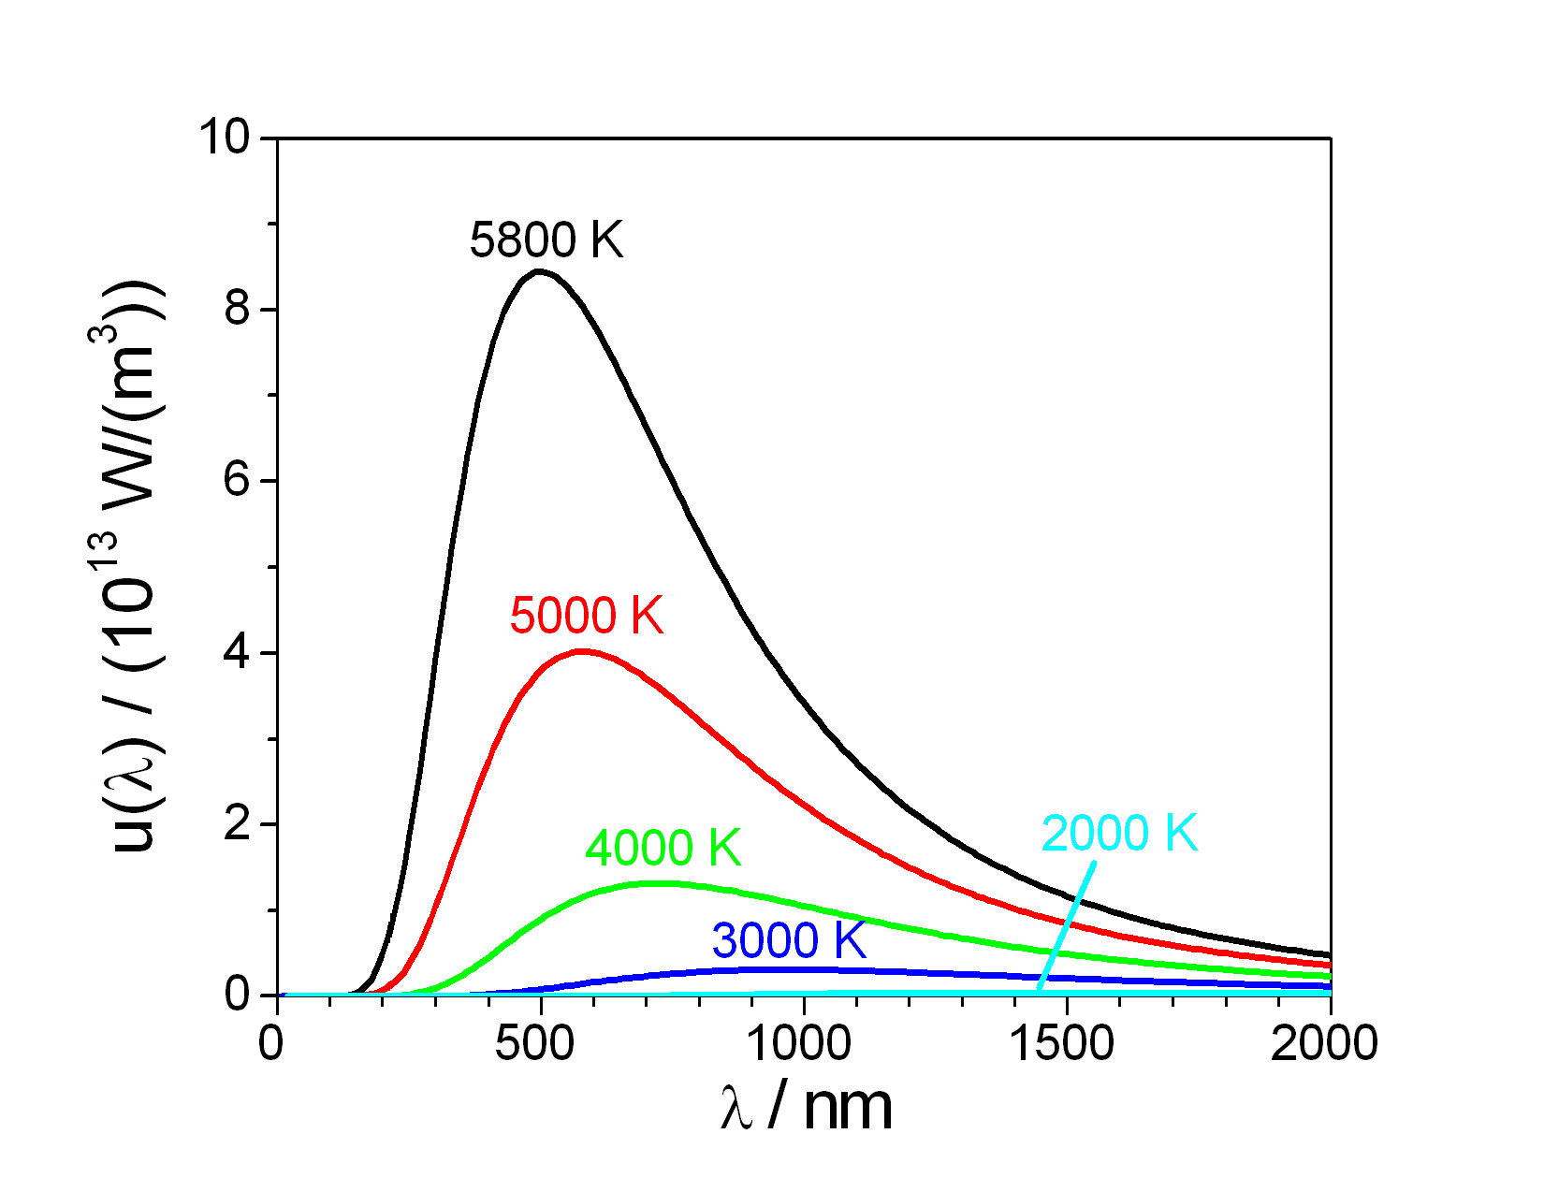
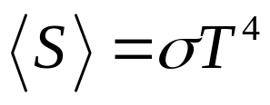
Radiation from thermal objects
Stefan-Boltzmann law:
Notes:
https://commons.wikimedia.org/wiki/File:Planck_law_radiation.PNG

Slide 5
Radiation by molecules
Fluorescence & vibration-assisted radiation. Qiu et al, Science 299, 542 (2003).
Luminescence, fano effect. Dong, et al, Nat. Commun. 8, 15225 (2017).
Exciton, Coulomb interaction. Galperin, et al, Nano. Lett. 19, 2803 (2019).

Slide 6
Angular momentum of E&M field
Circularly polarized light by chiral nanostructure – Konishi et al, PRL 106, 057402 (2011); by magneto-optical nanoparticles – Ott et al, PRB 97, 205414 (2018).
Twisted photon – circulating electron (classical E&M) – Katoh et al, PRL 118, 094801 (2017).
Torque/angular momentum from topological insulator – Maghrebi et al, PRL 123, 055901 (2019).

Slide 7
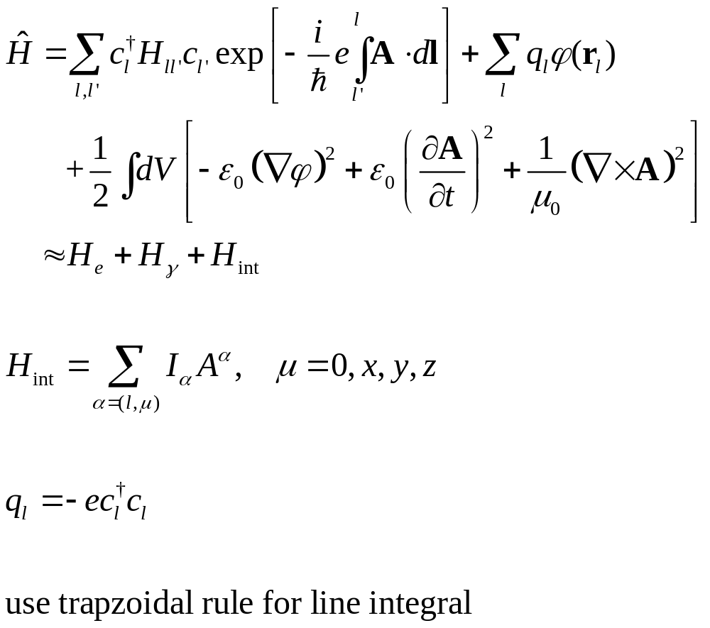
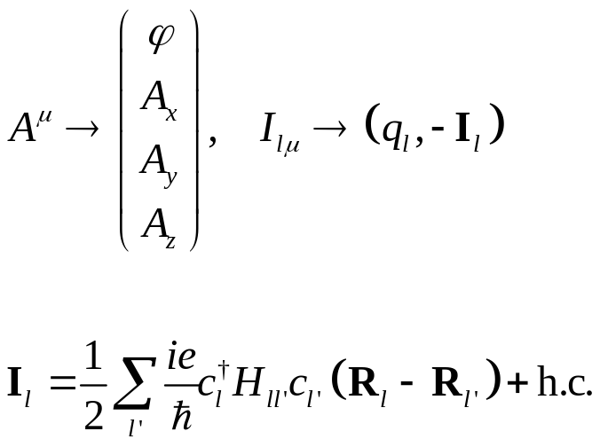
Electrons & electrodynamics
Notes:
D and Pi here are all 4x4 matrix in scalar/vector (relativistic) space.

Slide 8
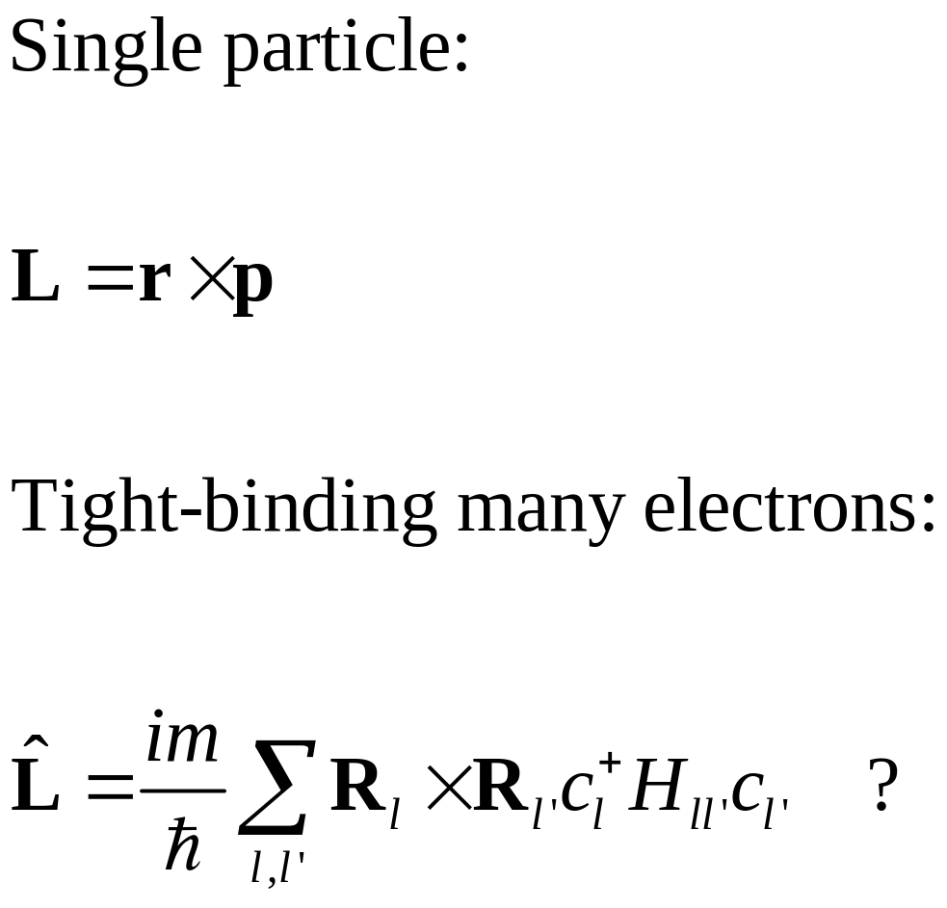
Angular momentum

Slide 9
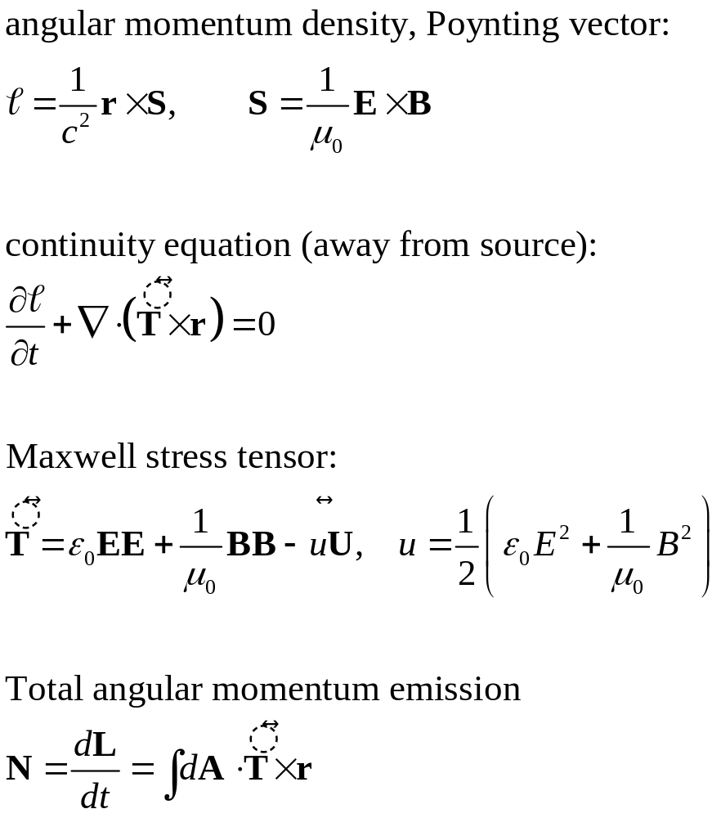
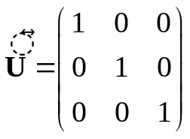
The angular momentum of the field

Slide 10
NEGF “technologies”

Slide 11
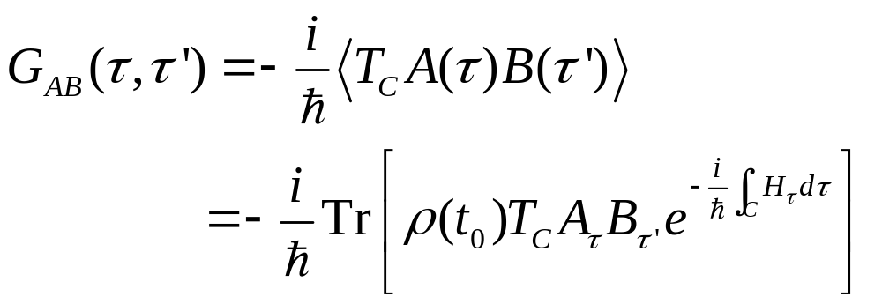
Contour-ordered Green’s function
Contour order: the operators earlier on the contour are to the right. See, e.g., H. Haug & A.-P. Jauho.
τ’
τ
t₀
Notes:
A B in the second line is in Schrodinger picture.
11

Slide 12
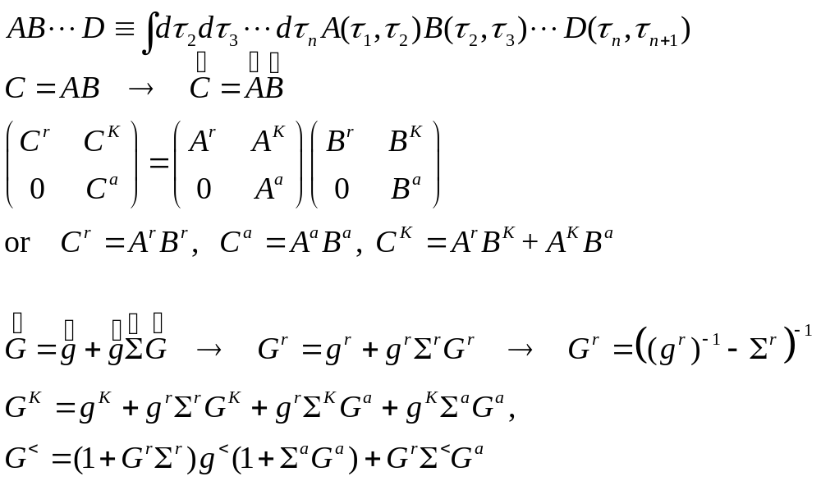
Convolution, Langreth rule
Notes:
The last two equations are known as Keldysh equations.

Slide 13
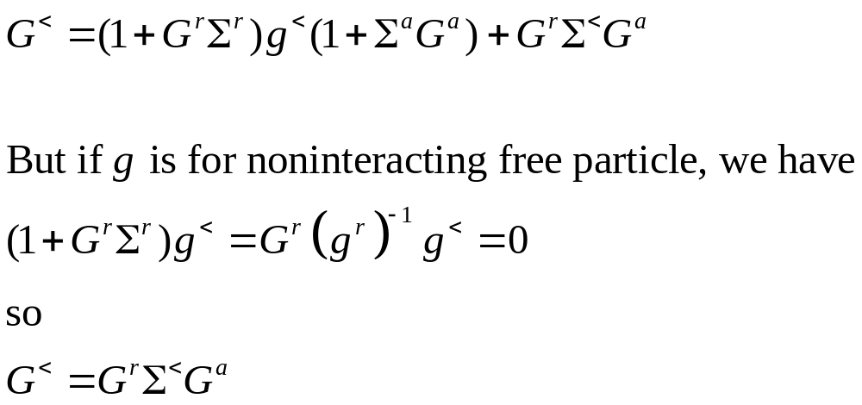
Keldysh equation

Slide 14
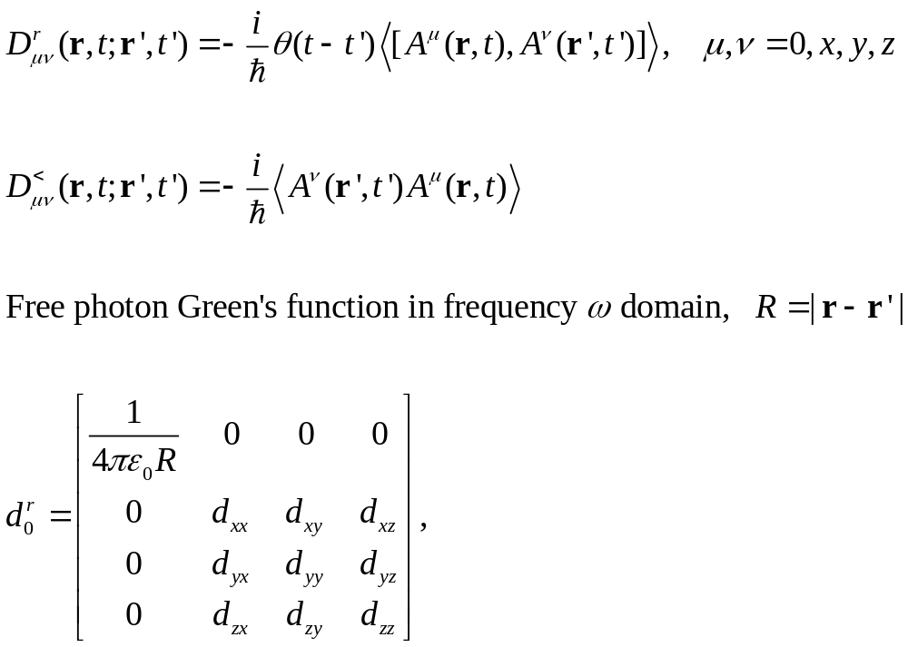
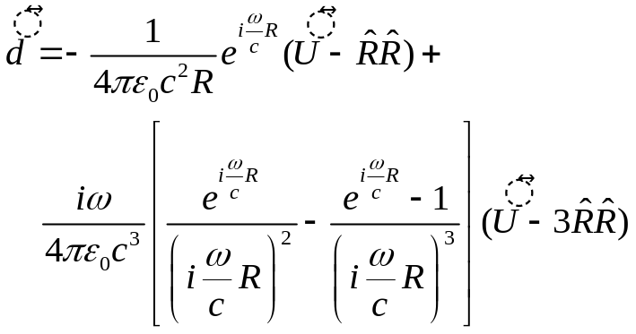
Photon Green’s function
[A, B]=AB-BA
Notes:
U is identity and \hat R is unit vector, dyadic [We can obtain d0 by equation of motion method without going over to second quantization, since it is the same as in classical EM theory]

Slide 15
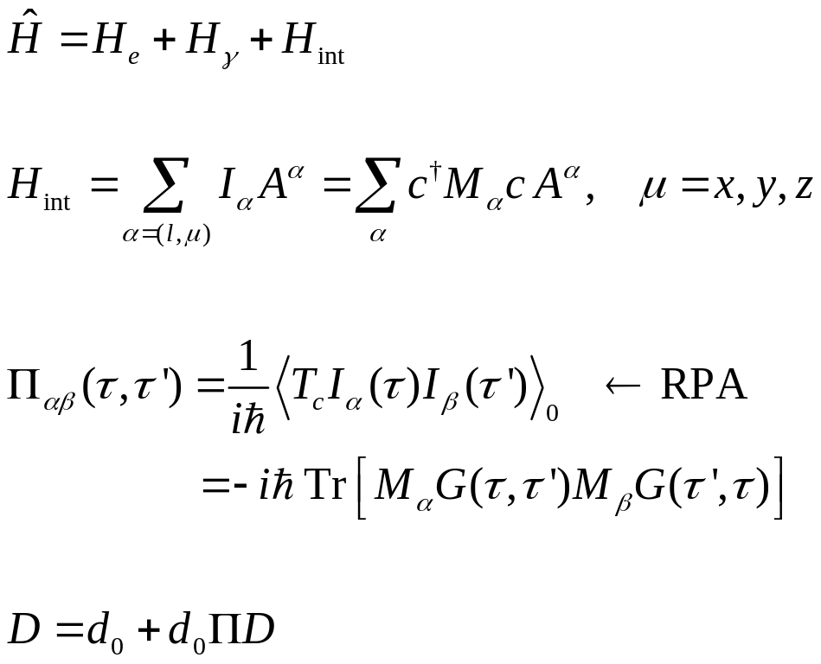
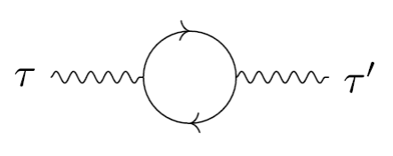
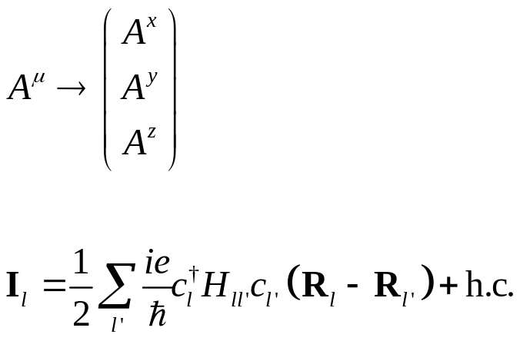
Random phase approximation
Notes:
D and Pi here are all 4x4 matrix in scalar/vector (relativistic) space.

Slide 16
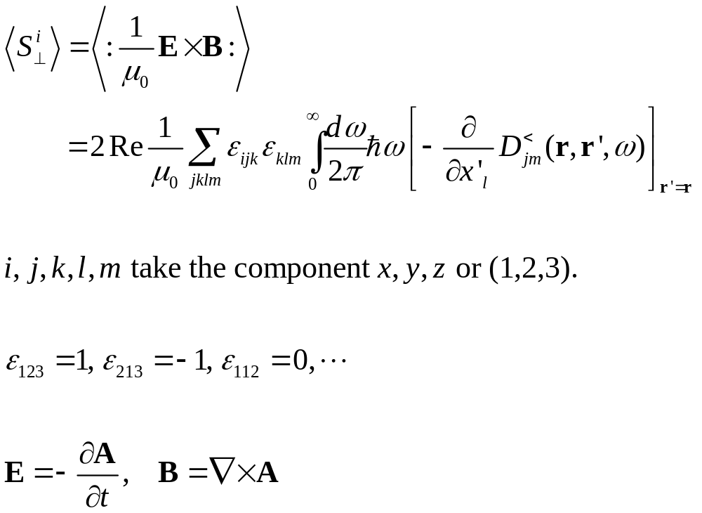
Poynting vector

Slide 17
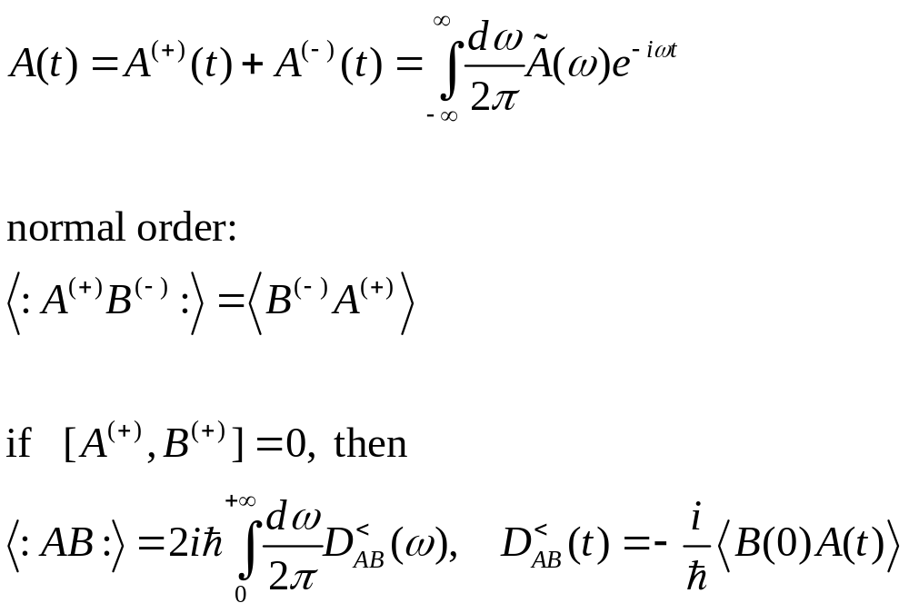
Normal order means positive frequency D lesser

Slide 18
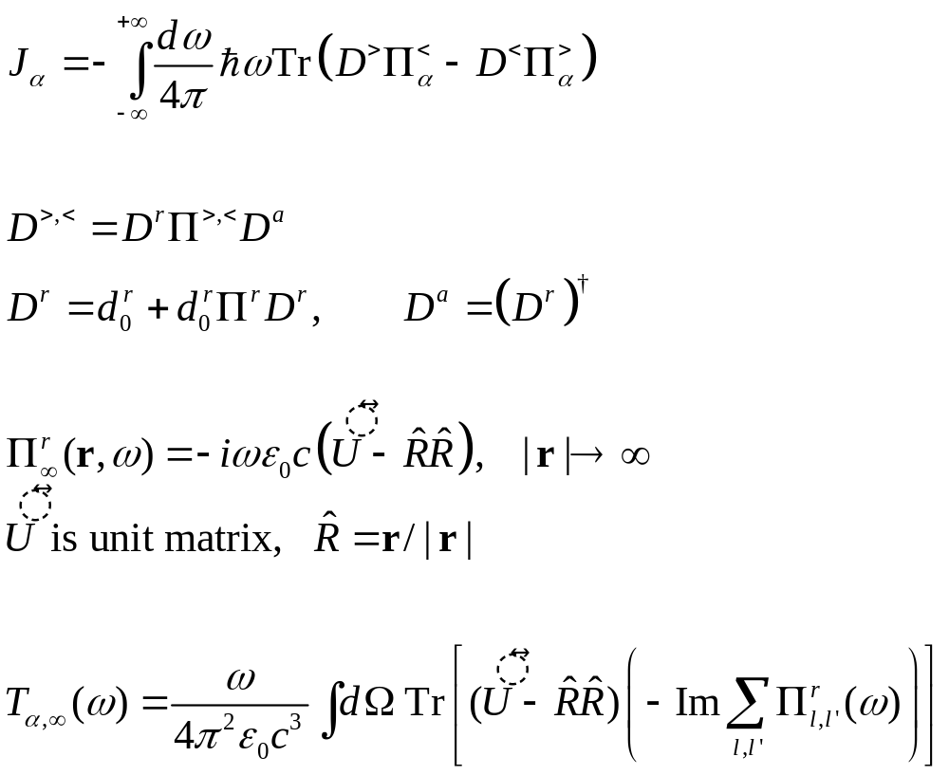
Energy radiation: Meir-Wingreen formula, photon bath at infinity
z
r
y
x

Slide 19
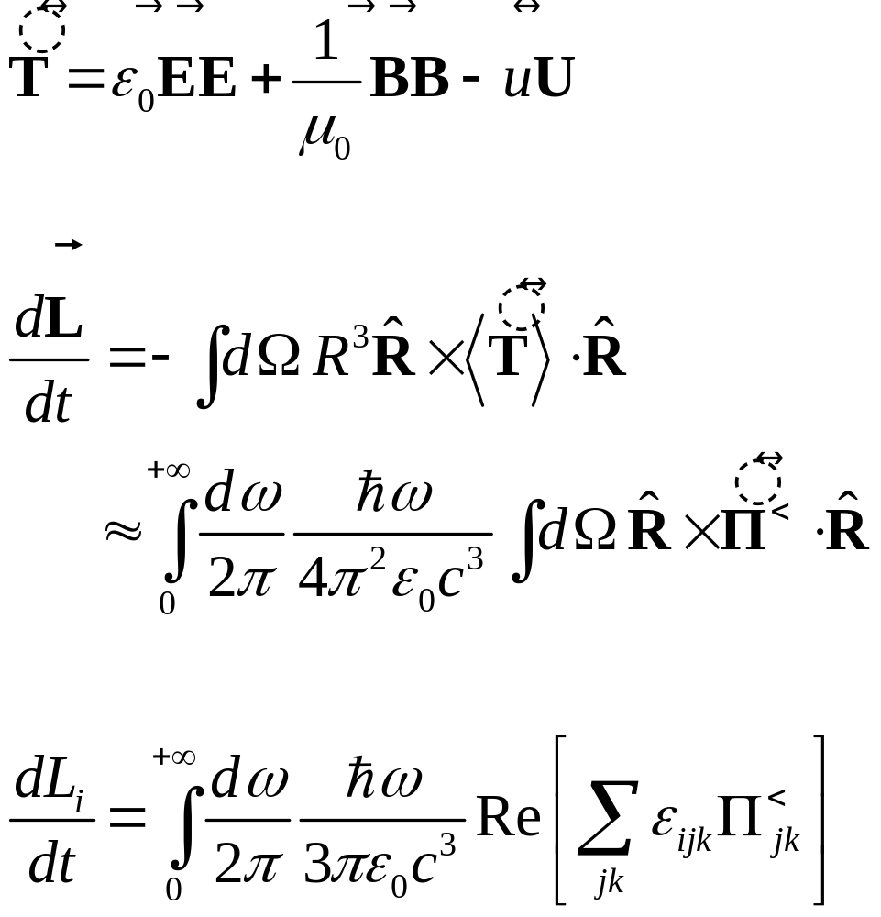
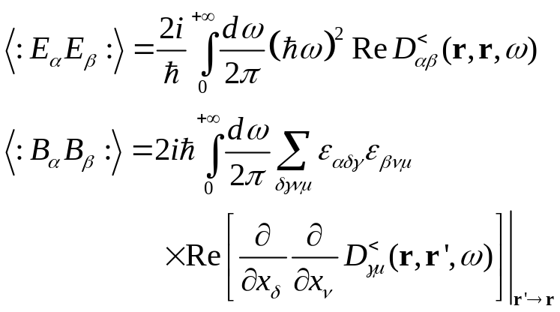
Maxwell stress tensor and angular momentum transfer

Slide 20
Application to benzene

Slide 21
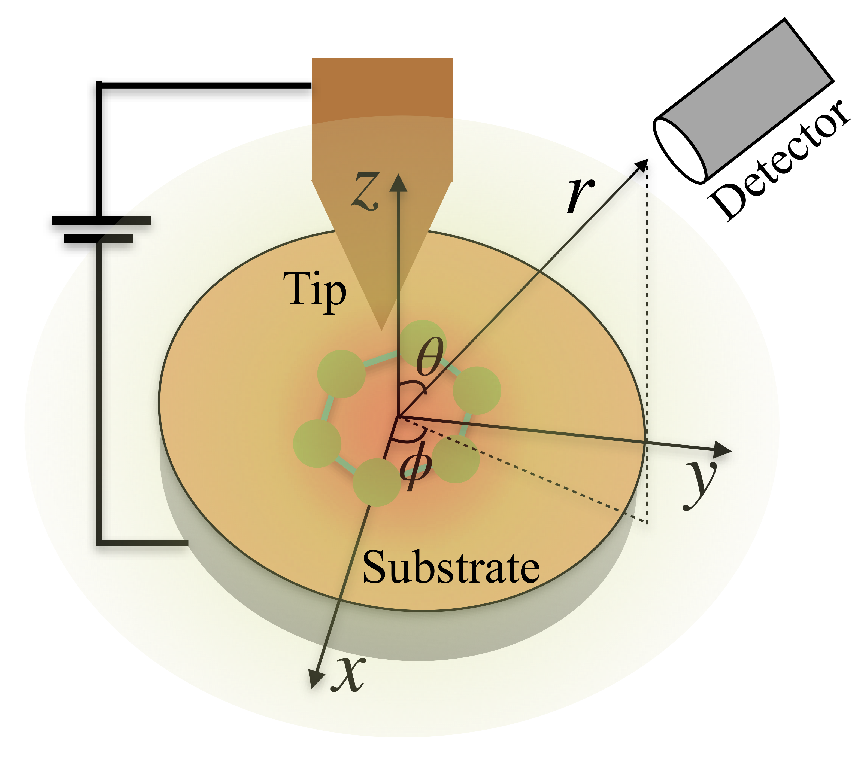
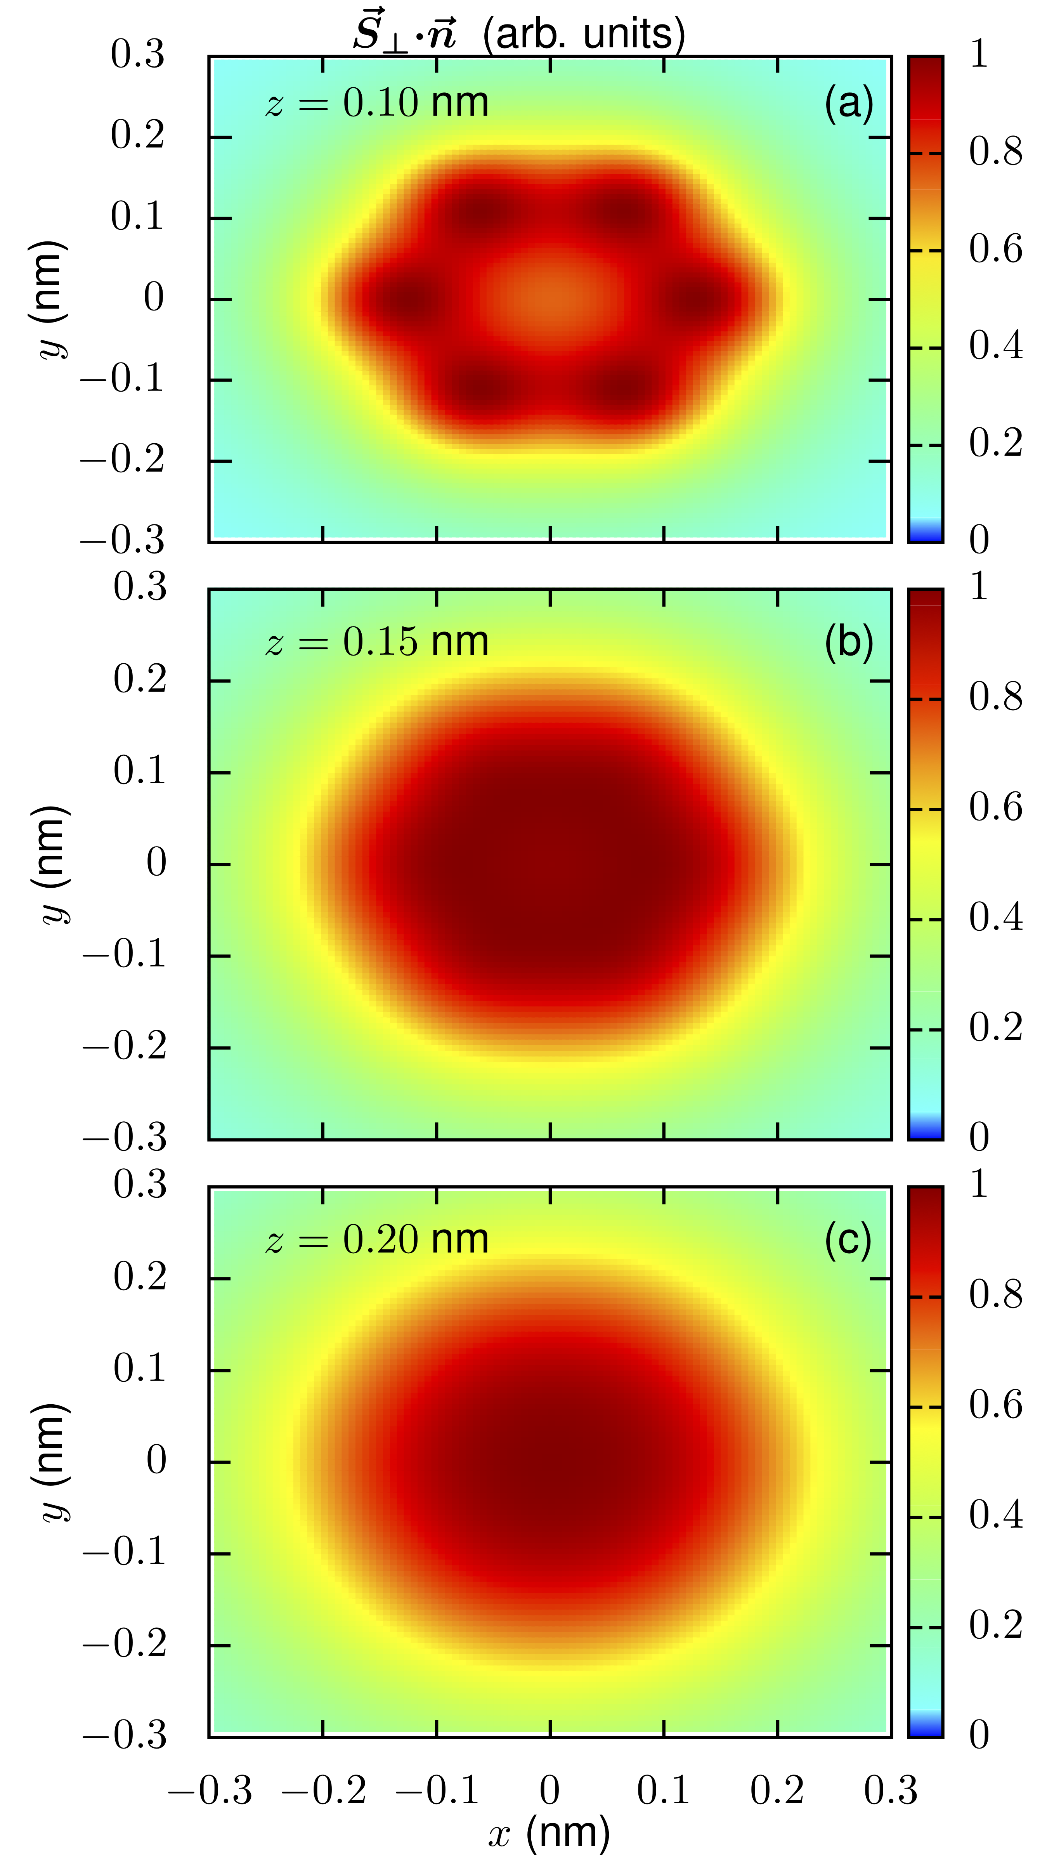
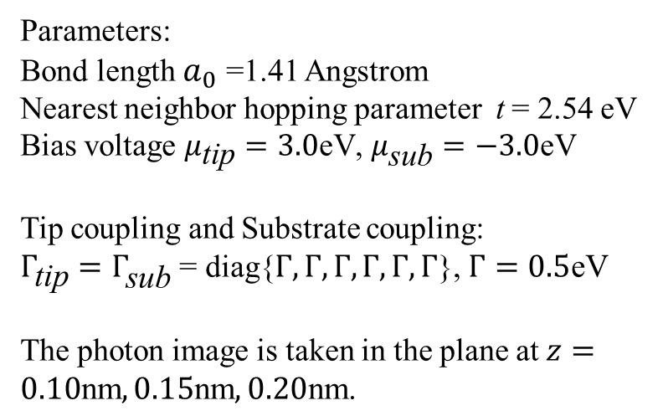
Light emission by a biased benzene molecule
Parameters:
Bond length $a_{0}$ =1.41 Angstrom
Nearest neighbor hopping parameter t = 2.54 eV
Bias voltage $μ_{\text{tip}}=3.0\text{eV}$, $μ_{\text{sub}}=−3.0\text{eV}$
Tip coupling and Substrate coupling:
$Γ_{\text{tip}}=Γ_{\text{sub}}$ = diag{$Γ,Γ,Γ,Γ,Γ,Γ$}, $Γ=0.5\text{eV}$
The photon image is taken in the plane at $z=0.10\text{nm},0.15\text{nm},0.20\text{nm}\text{.}$

Slide 22
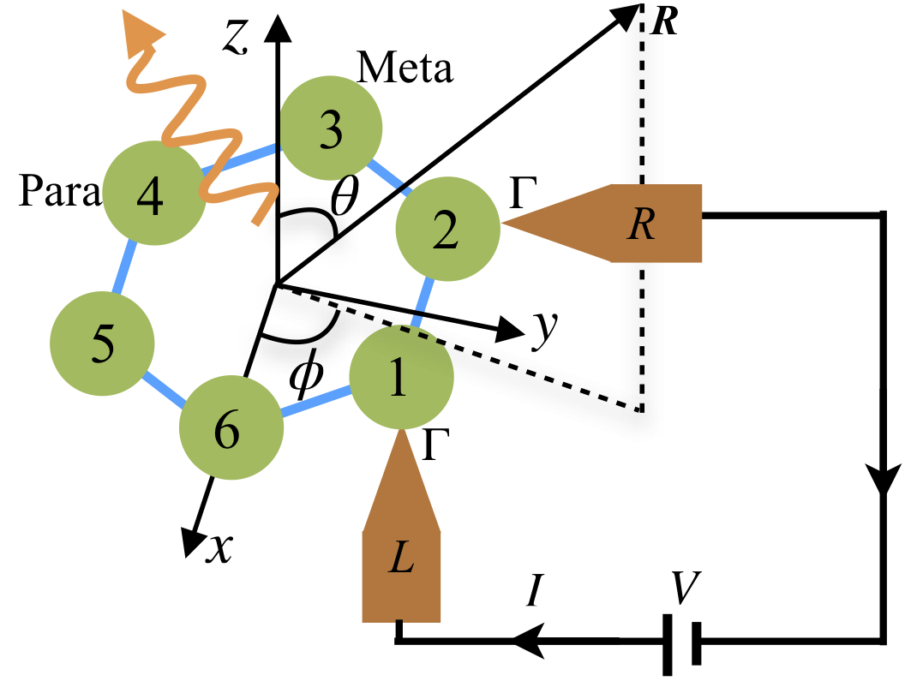
Angular momentum emission, setup
Zhang et al, PRB 101, 161406 (2020).

Slide 23
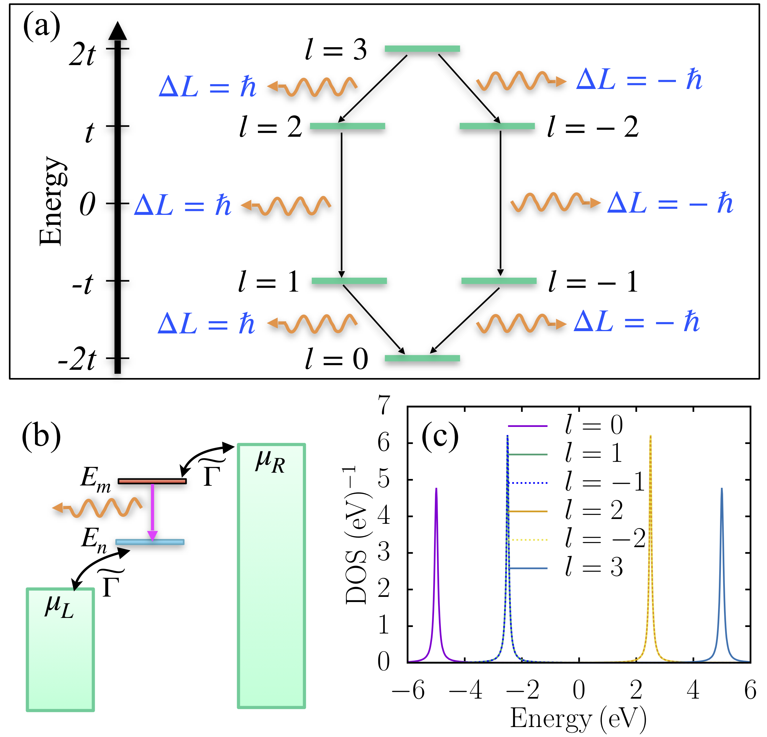
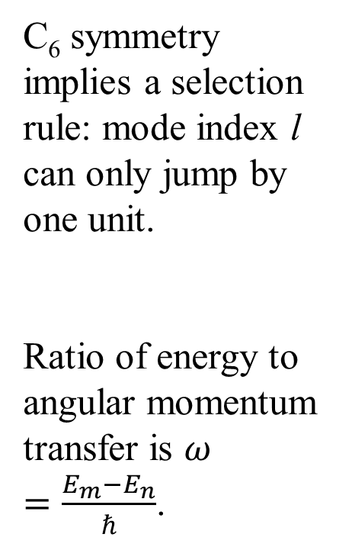
Selection rule - mode space emission
C₆ symmetry implies a selection rule: mode index l can only jump by one unit.
Ratio of energy to angular momentum transfer is $ω=\frac{E_{m}−E_{n}}{ℏ}$.

Slide 24
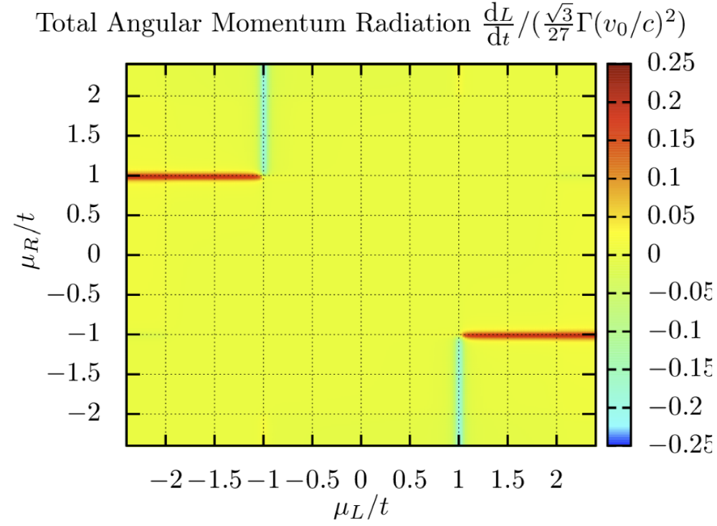
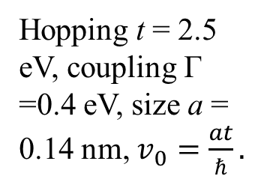
Angular momentum emission
ε
2t
t
2
-2
-t
-1
1
-2t
0
Hopping t = 2.5 eV, coupling Γ =0.4 eV, size a = 0.14 nm, $v_{0}=\frac{at}{ℏ}.$

Slide 25
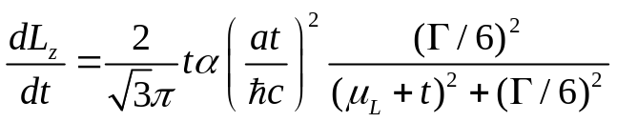
Resonance effect

Slide 26
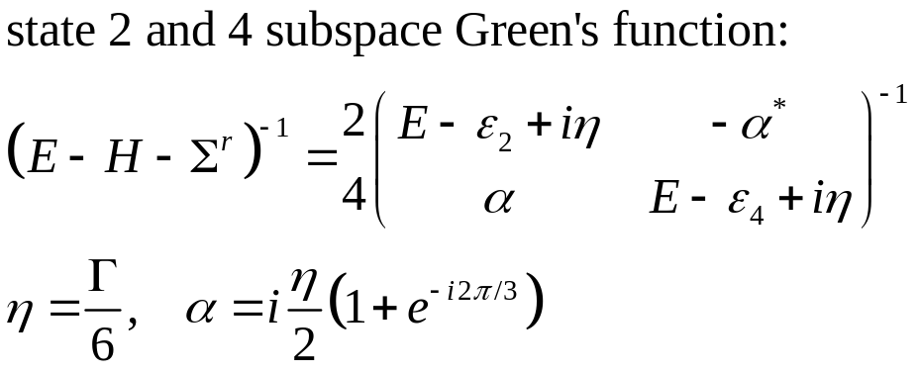
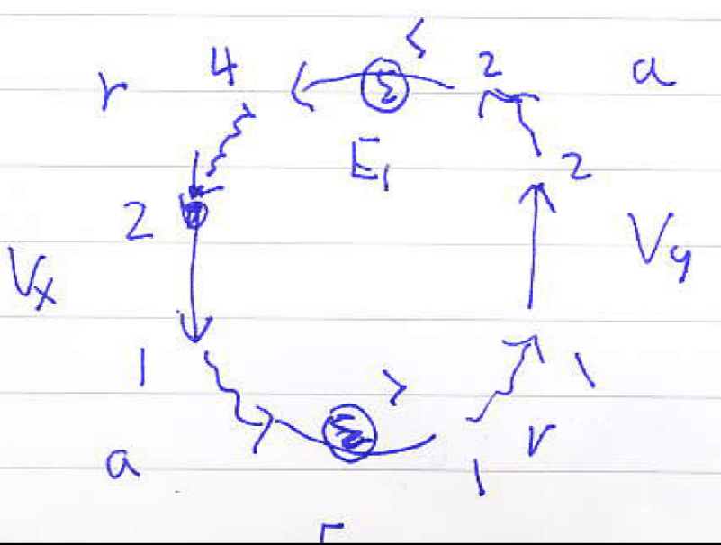
Tunneling between degenerate energy states
E
2t
4
t
2
-t
5
1
-2t
0

Slide 27
Summary
Fully quantum-mechanical, microscopic theory for energy and angular momentum radiation is proposed.
Angular momentum emission in a benzene ring is reported. Interesting resonant effect is discovered.

Slide 28
Acknowledgements
Postdoc: Zu-Quan Zhang
Collaborators, Prof. Jingtao Lü at Huazhong Univ Sci Tech.
Supported by MOE tier 2 and FRC grants

Slide 29
Near-field effect
Rytov fluctuational electrodynamics (1953)
Polder & van Hove (PvH) theory (1971)
Phonon tunneling/phonon polaritons (Mahan 2011, Xiong at al 2014, Chiloyan et al 2015, …)
Other mechanism?

Slide 30
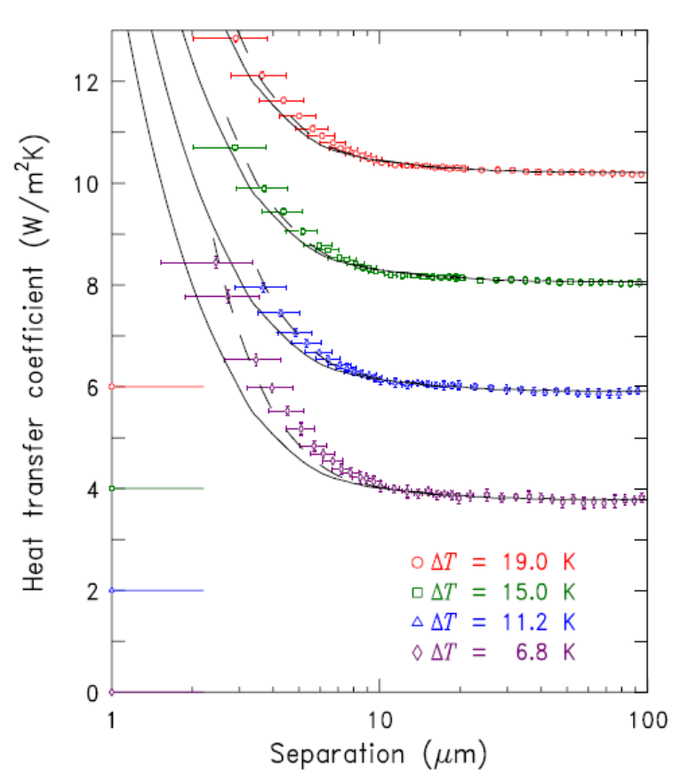
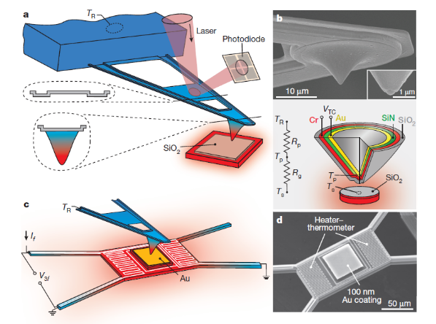
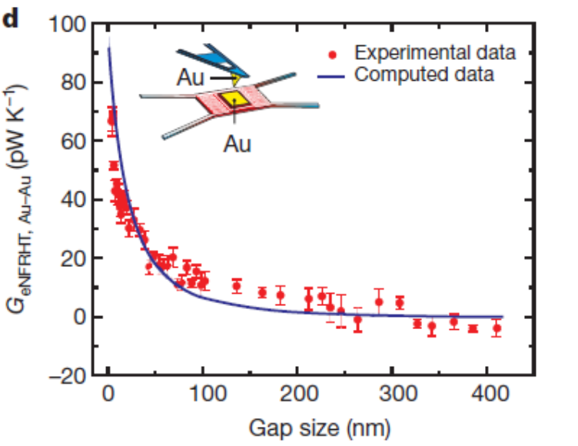
Experiments
Ottens, et al, PRL 107, 014301 (2011).
Kim, et al, Nature 528, 387 (2015).

Slide 31
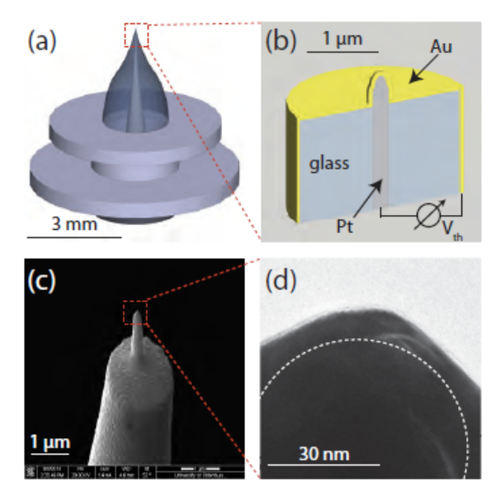
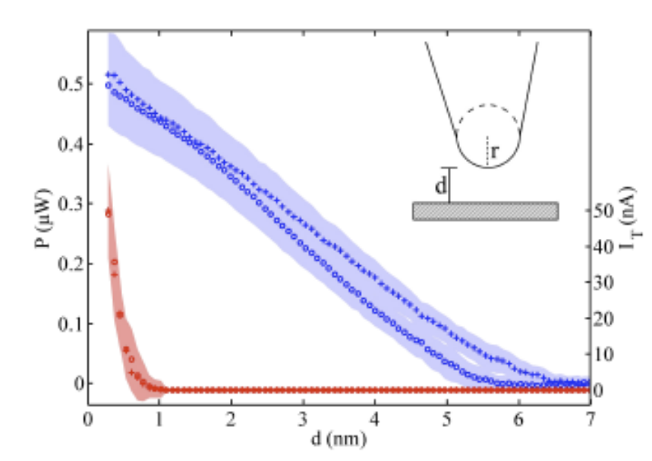
A recent experiment that does not agree with any theory
Heat transport between a Au tip and surface is measured, obtain much larger values than conventional theory predicts. Nature Comm 2017, Kloppstech, et al.

Slide 32
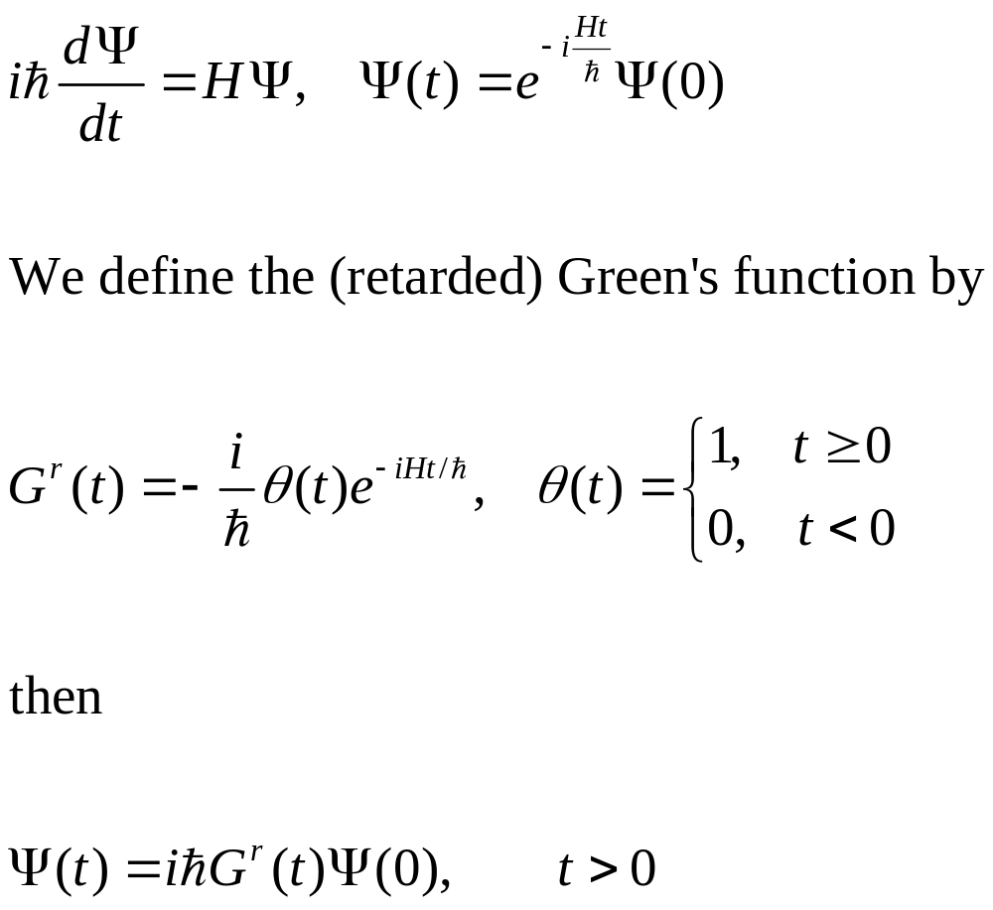
Single electron quantum mechanics
Notes:
In a particular representation, since H is 2x2 matrix, Psi a column vector, so the Green’s function G is also 2x2 matrix.

Slide 33
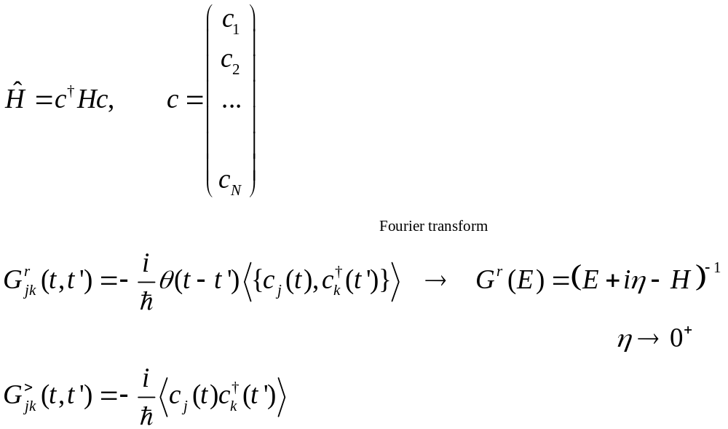
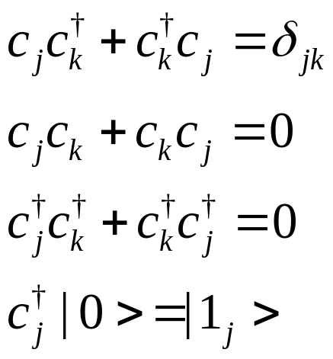
Many-electron Hamiltonian and Green’s functions
Annihilation operator c is a column vector, H is N by N matrix. {A, B} =AB+BA
Notes:
Various other Green’s functions (G<, G>, G^r, G^a, G^t, G^tbar) will be defined later for phonon. The form and relation among Greens are such so that phonon and electrons are the same. See slide 54, 55.

Slide 34
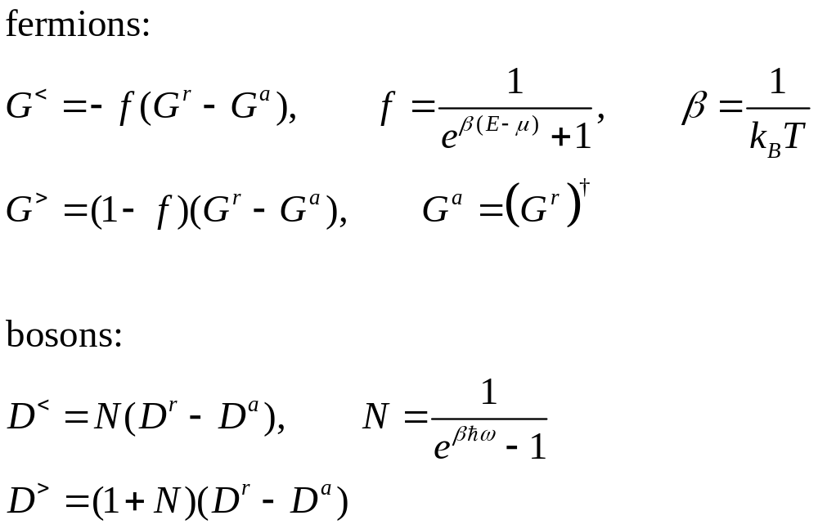
Equilibrium fluctuation-dissipation theorems

Slide 35
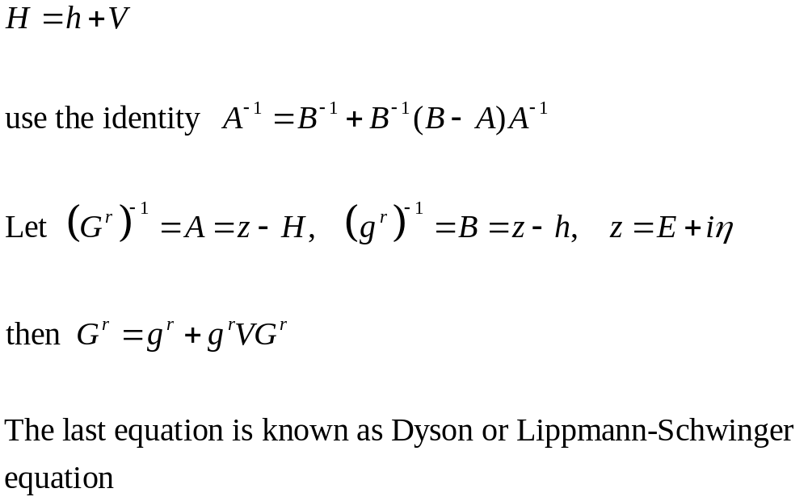
Perturbation theory, single electron

Slide 36
Electron-photon interaction and photon Green’s functions D

Slide 37
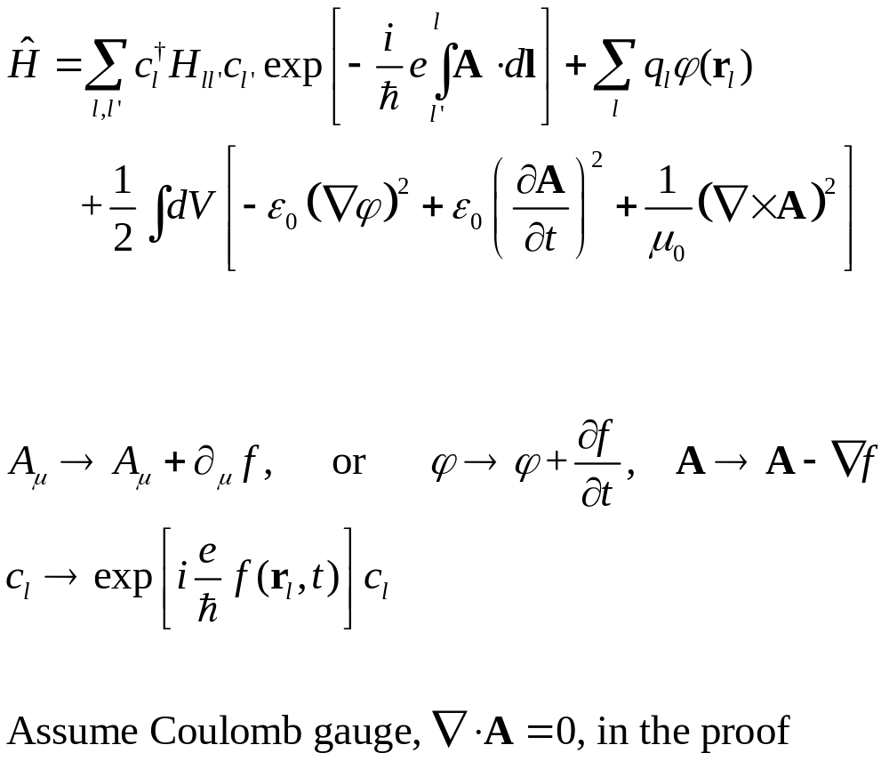
Gauge invariance
Notes:
D and Pi here are all 4x4 matrix in scalar/vector (relativistic) space.

Slide 38
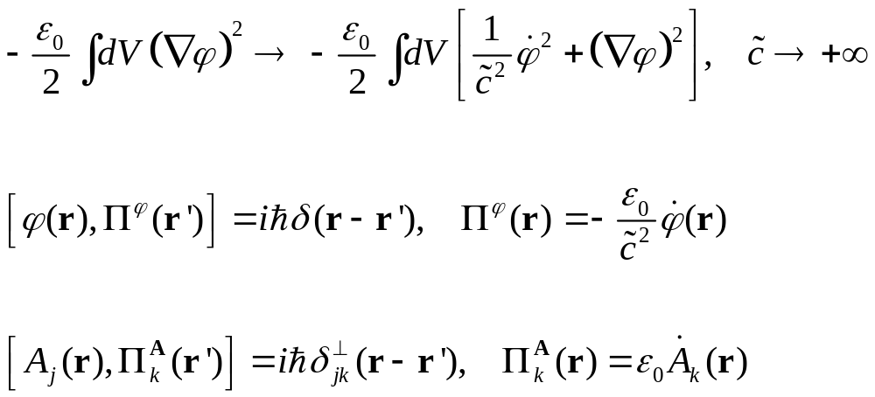
Commutation relation of the fields
Notes:
For the scalar field, note the minus sign.

Slide 39
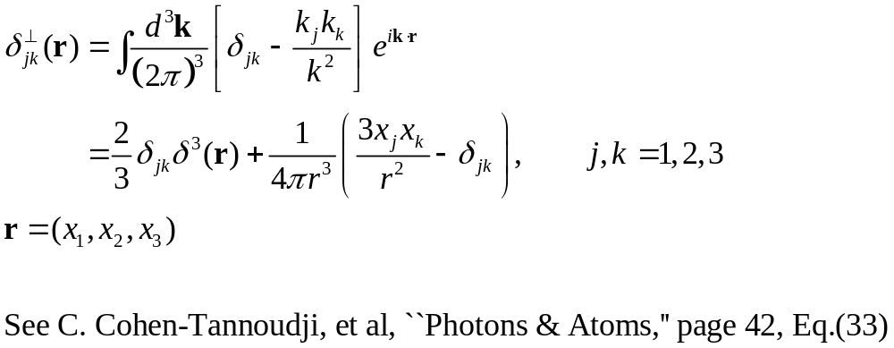
Transverse delta function

Slide 40
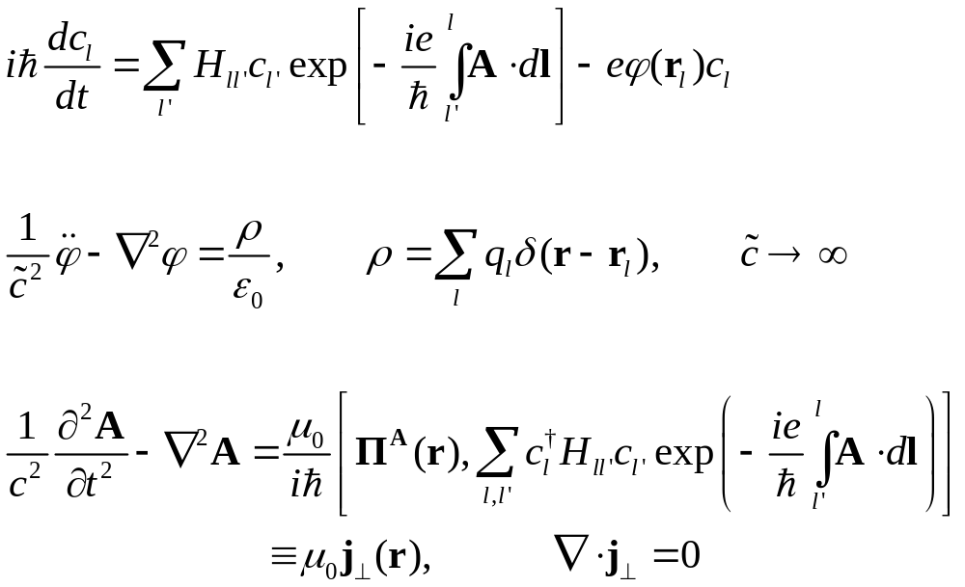
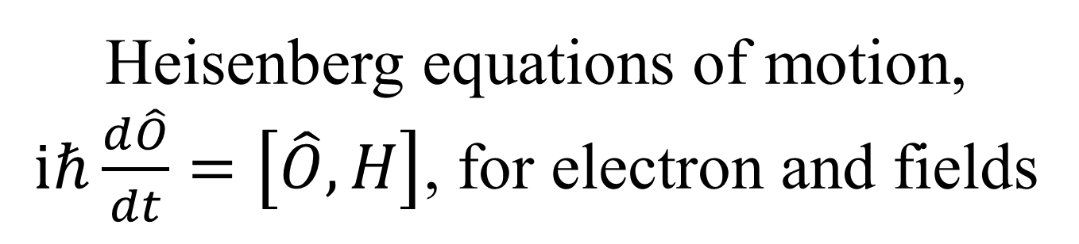
Heisenberg equations of motion, $iℏ\frac{d\hat{O}}{dt}=\left[\hat{O},H\right]$, for electron and fields

Slide 41
A brief history of NEGF
Schwinger 1961
Kadanoff and Baym 1962
Keldysh 1965
Caroli, Combescot, Nozieres, and Saint-James 1971
Meir and Wingreen 1992
Notes:
Schwinger introduced earliest g<, g>, g^t, g^t_bar. Kadanoff and Baym had their famous book “quantum statistical mechanics”, Keldysh emphasized the contour order and its usefulness for diagrammatic expansion, Caroli perhaps first apply to transport, and we now have the Meir-Wingreen formula for current when the center is interactive.

Slide 42
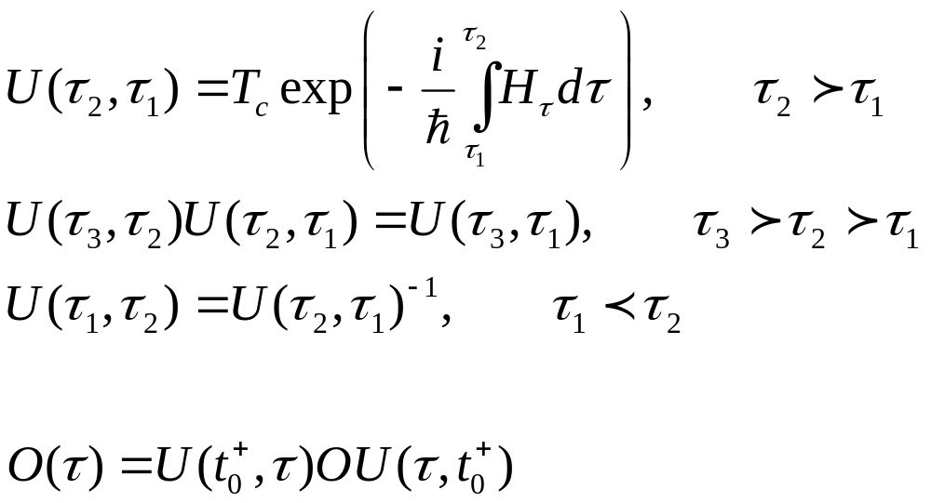
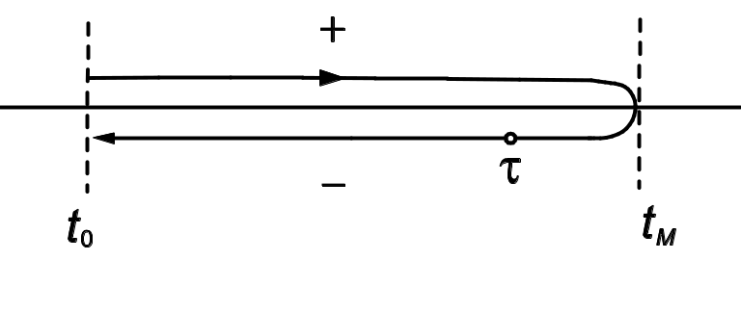
Evolution operator on contour

Slide 43
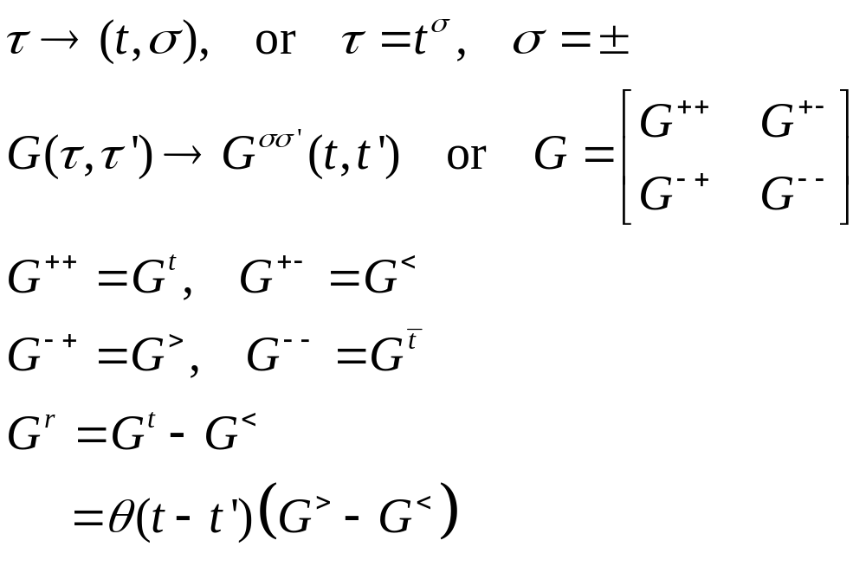
Relation to other Green’s functions
τ’
τ
t₀
Notes:
σ = + for the upper branch, and – for the returning lower branch.
43

Slide 44
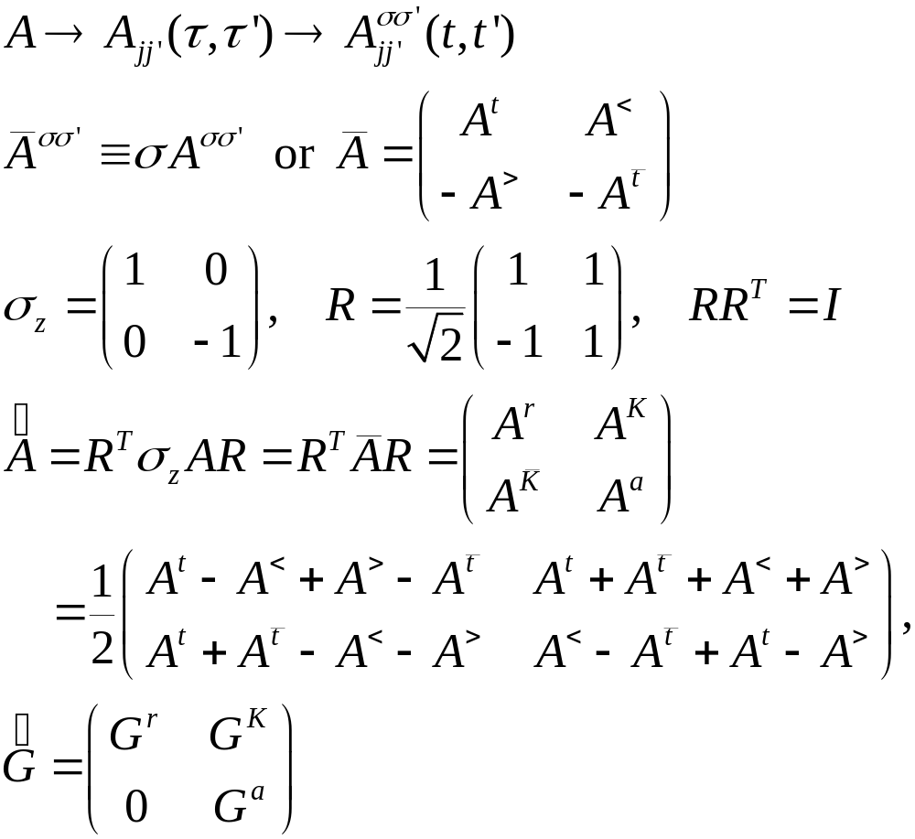
Transformation/Keldysh rotation
Notes:
Also properly known as Larkin-Ovchinikov transform, JETP 41, 960 (1975).

Slide 45


Analytic Result: heat transfer between ends of 1D chains

Slide 46



Analytic Result: far field total radiative power of a two-site model
t
T₁, μ₁
T₂, μ₂

Slide 47


Two graphene sheets
1000 K
Ratio of heat flux to blackbody value for graphene as a function of distance d, J_{zBB} = 56244 W/m². From J.-H. Jiang and J.-S. Wang, PRB 96, 155437 (2017).
300 K

Slide 48

Current-carrying graphene sheets

Slide 49


Current-induced heat transfer
: T₁=T₂=300 K. (a) and (c) infinite system (fluctuational electrodynamics), (b) and (d) 4×4 cell finite system with four leads (NEGF).
: Double-layer graphene. T₁=300K, varying T₂ at distance d = 10 nm, chemical potential at 0.1 eV.
From Peng & Wang, arXiv:1805.09493.

Slide 50


Carbon nanotubes
Heat transfer from 400K to 300K objects. (a), (b) zigzag carbon nanotubes. (c), (d) nano-triangles. d: gap distance, M: nanotube circumference, L: triangle length. ε: dielectric constant. From G. Tang, H.H. Yap, J. Ren, and J.-S. Wang, Phys. Rev. Appl. 11, 031004 (2019).

Slide 51

Pure scalar photon

Slide 52


Meir-Wingreen to Caroli formula
Random phase approximation (RPA)
Assuming local equilibrium
Notes:
Now we changed notation, f is fermion function, N is bose function. G for electron Green’s function, D for photon Green’s function. v here is bare Coulomb interaction.

Slide 53



Benzene radiation power & electric current under bias
Parameters:
Bond length $a_{0}$ =1.41 Angstrom
Nearest neighbor hopping parameter t = 2.54 eV
$μ_{\text{sub}}=0.0\text{eV}$, $μ_{\text{tip}}$ is set to be the voltage bias.
Tip coupling and Substrate coupling:
$Γ_{\text{tip}}=Γ_{\text{sub}}$ = diag{$Γ,Γ,Γ,Γ,Γ,Γ$}, $Γ=0.2 \text{eV}$
Sphere surface radius R = 0.1 mm
Unpublished work from Zuquan Zhang.
‑I_{e}
I_{e}

Slide 54












Angular momentum emission
(a)
(b)
$$z$$
R
$$z$$
3
3
4
$$Γ$$
4
$$θ$$
2
2
5
5
$$φ$$
$$y$$
$$y$$
1
1
6
6
$$Γ$$
$$x$$
$$x$$
$$I$$
$$V$$
$$V$$
$$I$$
Unsymmetric connection, have emission
Symmetric leads, no net angular momentum emission

Slide 55


Fluctuational electrodynamics
Rytov 1953: Polder & van Hove 1971:
random variables

Slide 56

Poynting vector
Notes:
The Poynting scalar concept first appear in arxiv:1703.07113 by Peng et al.

