Slide 1
Energy, momentum, and angular momentum transfers mediated by photons
Jian-Sheng Wang
Department of Physics,
National University of Singapore

Slide 2
Outline
Radiative (heat) transfer, experimental background
NEGF theory of energy, momentum, and angular momentum transfer
  N + 1 objects, bath at infinity
  Meir-Wingreen/Landauer formula
  Zero-point motion, when it contributes?
Applications
  Near-field heat transfer between graphene objects
  Angular momentum emission from current-driven benzene molecule
  Graphene edge effect

Slide 3
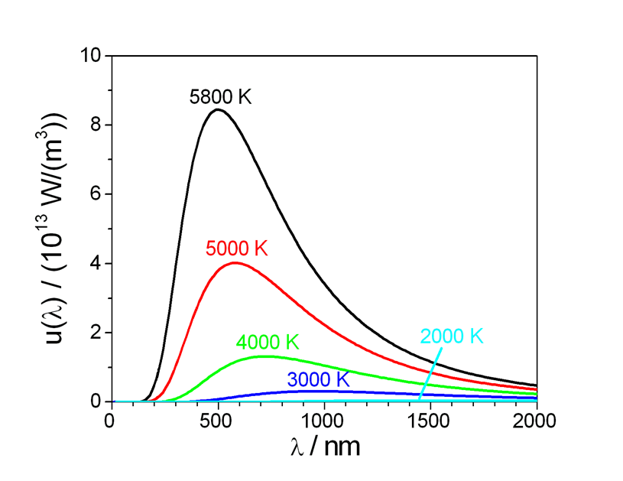
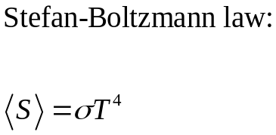
Experimental background, blackbody radiation
Notes:
u is S per unit wavelength.

Slide 4
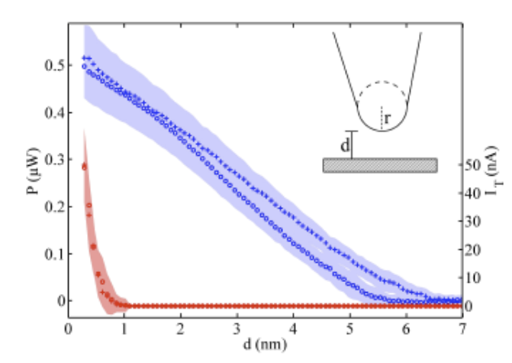
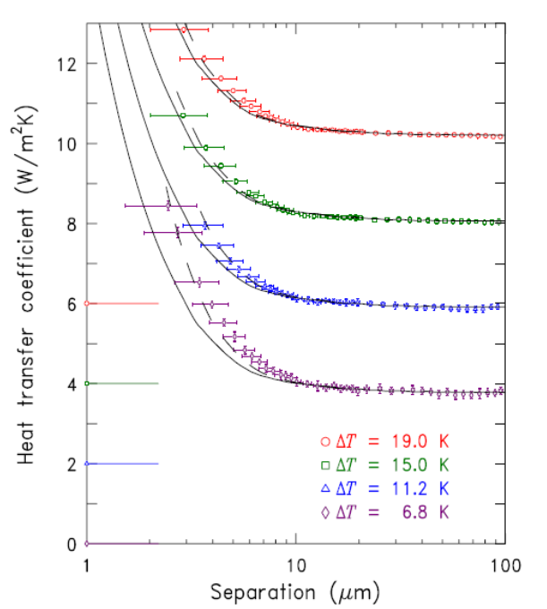
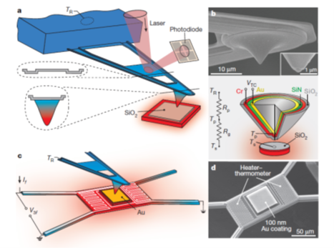
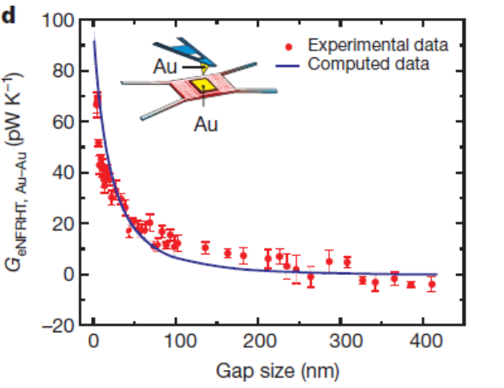
Near-field heat transfer
↑ Kloppstech, et al, Nature Comm (2017).
Ottens, et al PRL (2011).
→ Kim et al, Nature (2015).

Slide 5
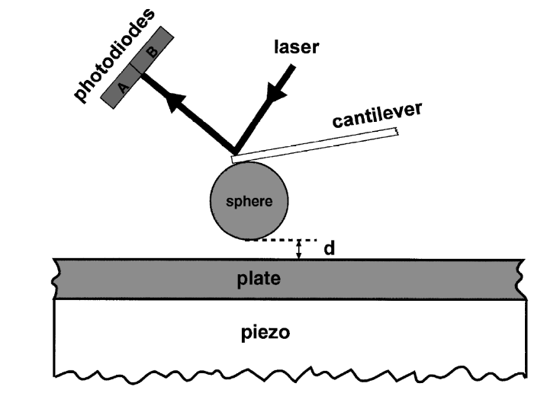
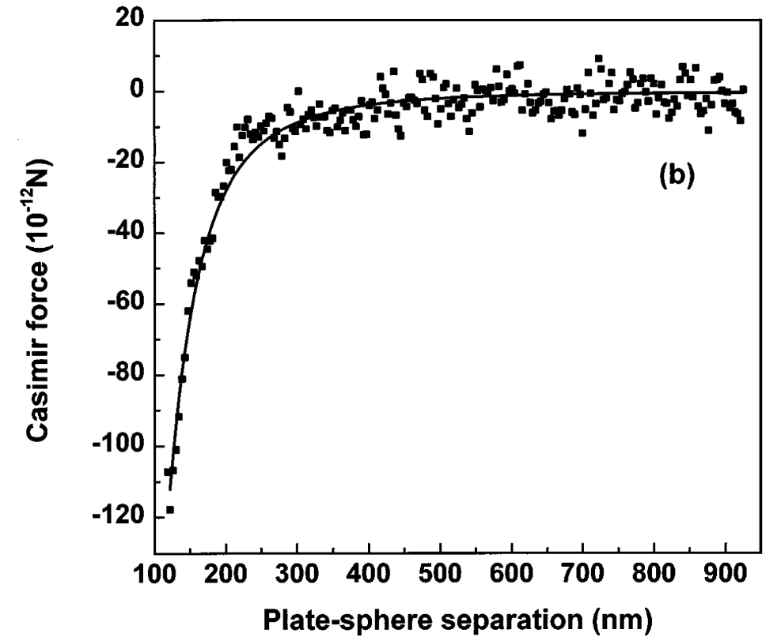
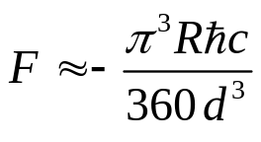
(Casimir) force
Casimir force in plate-sphere geometry, from Mohideen and Roy, PRL (1998).

Slide 6
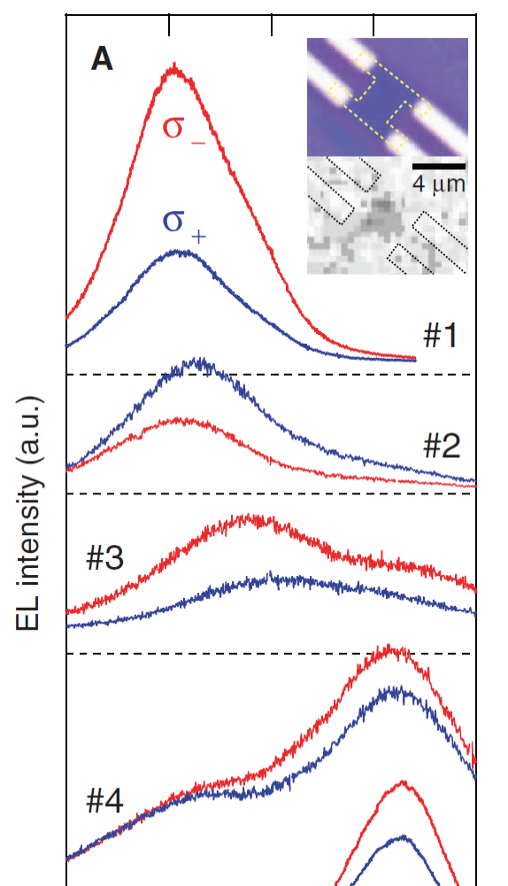
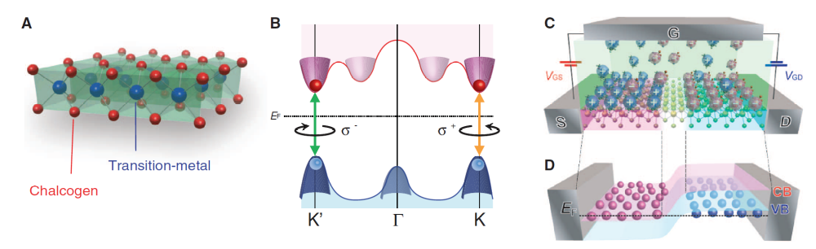
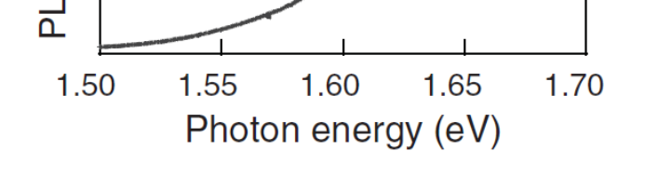
Angular momentum emission
2D semiconductor junction made of WSe₂ that can emit polarized light. From Y. J. Zhang, et al., Science 344, 725 (2014).
Notes:
W: Tungsten, Se: Sellenium. Chalcogen [kaekegen]

Slide 7
Nonequilibrium Green’s function (NEGF) theory

Slide 8
A brief history of NEGF
Schwinger 1961
Kadanoff and Baym 1962
Keldysh 1965
Caroli, Combescot, Nozieres, and Saint-James 1971
Meir and Wingreen 1992
…
J.-S. Wang, J. Wang, and J. T. Lü, “Quantum thermal transport in nanostructures,” Eur. Phys. J. B 62, 381 (2008); J.-S. Wang, B. K. Agarwalla, H. Li, and J. Thingna, “Nonequilibrium Green’s function method for quantum thermal transport,” Front. Phys. 9, 673 (2014).
Notes:
Schwinger introduced earliest g<, g>, g^t, g^t_bar. Kadanoff and Baym had their famous book “quantum statistical mechanics”, Keldysh emphasized the contour order and its usefulness for diagrammatic expansion, Caroli perhaps first apply to transport, and we now have the Meir-Wingreen formula for current when the center is interactive

Slide 9
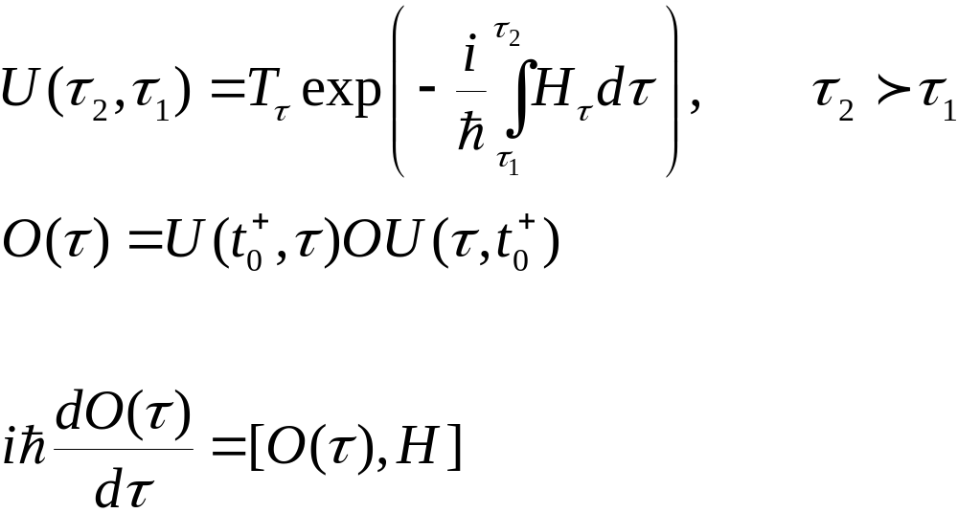


Evolution on Keldysh contour
$$−∞$$
$$t$$

Slide 10
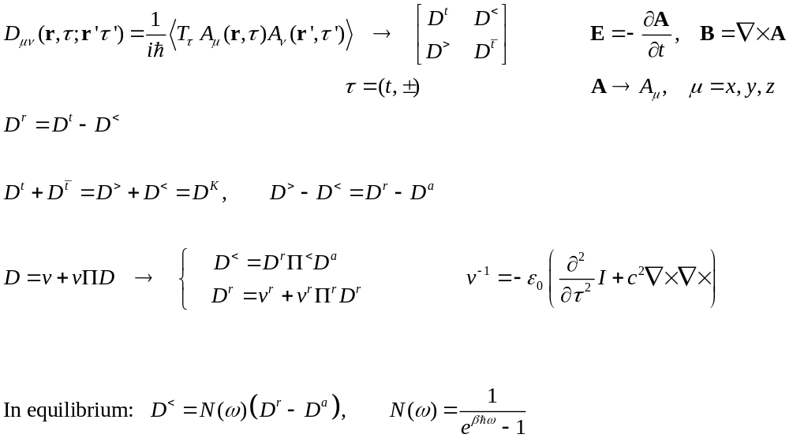

NEGF preliminaries
+
−
$$−∞$$
$$t$$

Slide 11
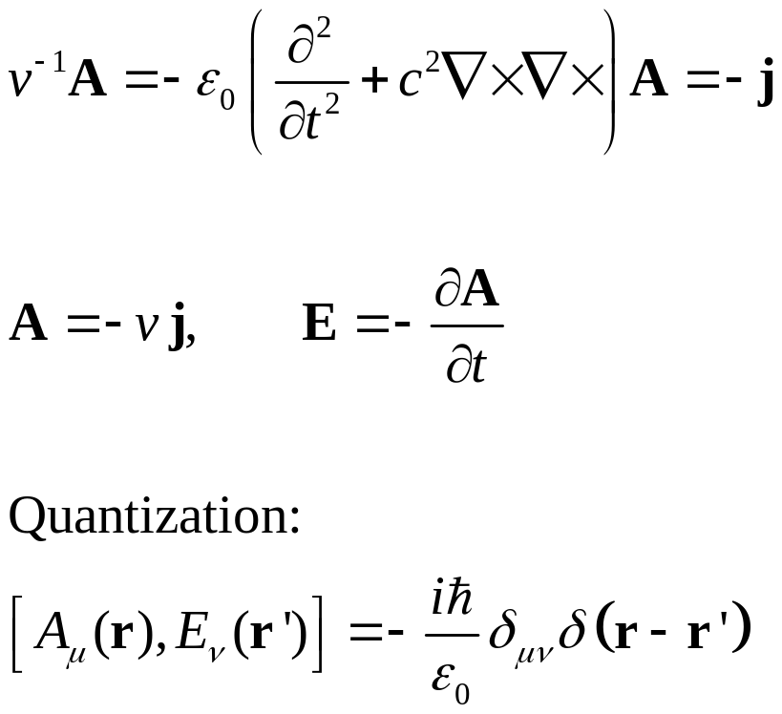
ϕ = 0 gauge, fundamental equation for vector potential A

Slide 12

System setup
N+1 or infinity
$$R→∞$$
…
1
Question: what is the energy emitted, force and torque applied to, for each of the object 1 to N+1.
N
2

Slide 13
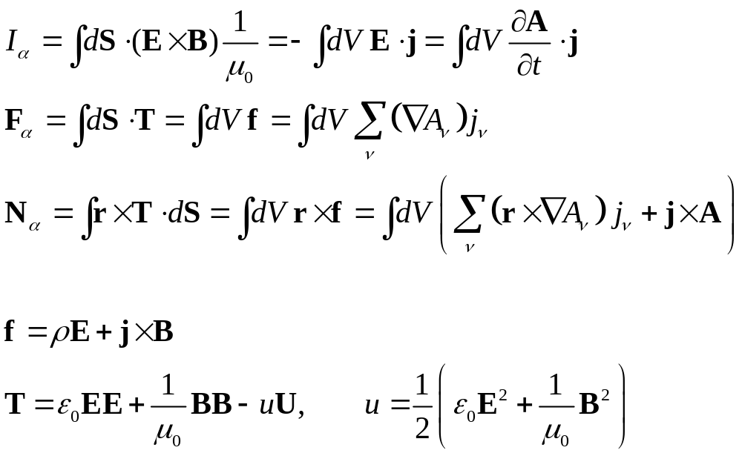
From surface integral to volume integral
α

Slide 14
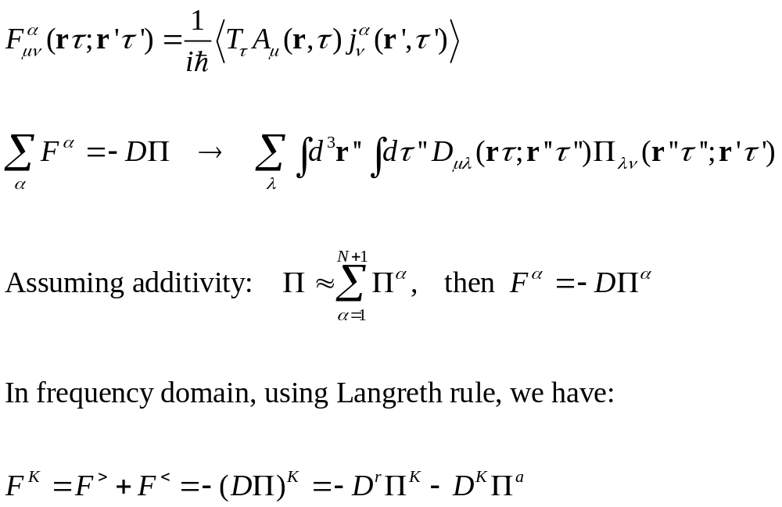
A-j correlation function

Slide 15
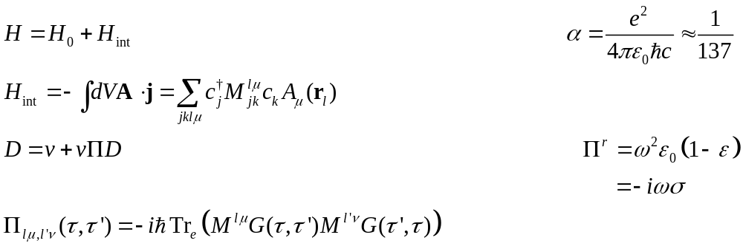

Self energy $Π$
RPA
Aslamazov-Larkin diagram

Slide 16
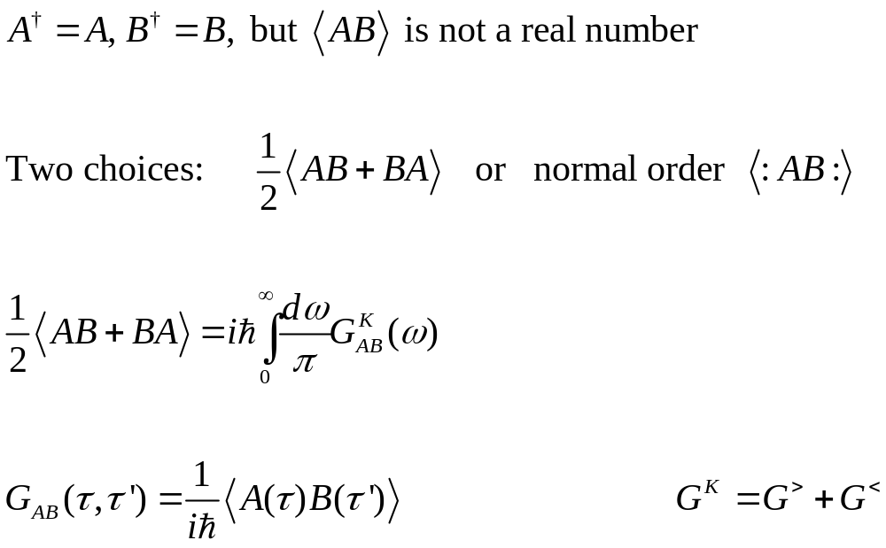
Operator order: normal or symmetric order?

Slide 17
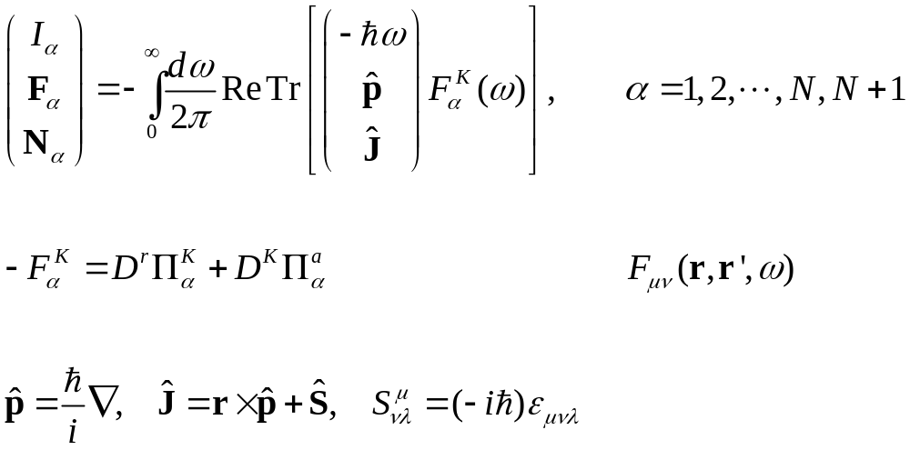
Meir-Wingreen formula
Notes:
Levi Civita symbol

Slide 18
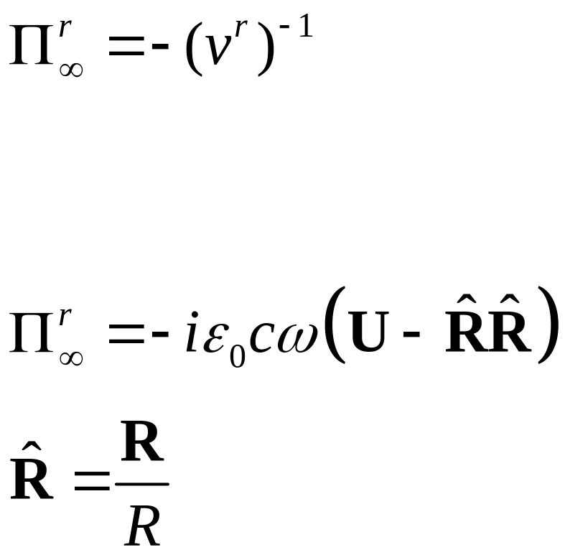
Bath at infinity
Eckhardt, PRA 29, 1991 (1984)
Krüger, et al, PRB 86, 115423 (2012)

Slide 19
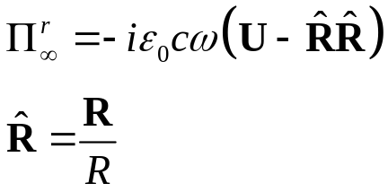
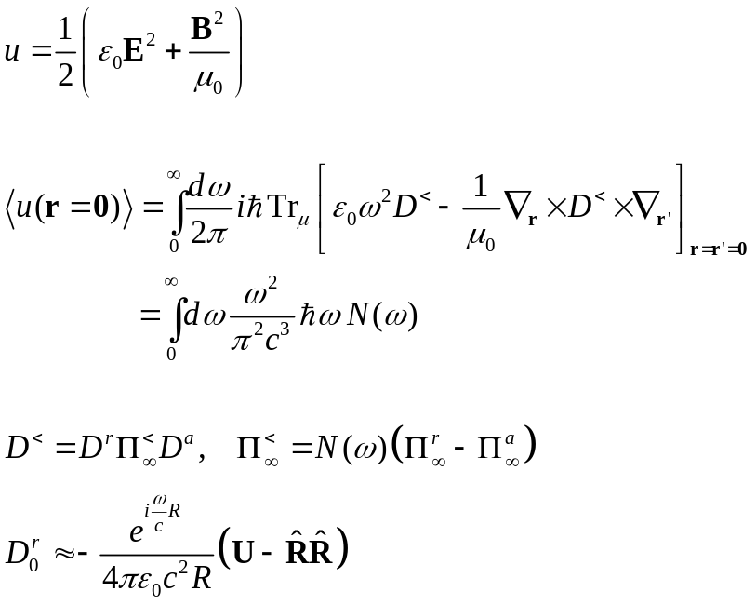
Recover blackbody Planck result
R
0

Slide 20
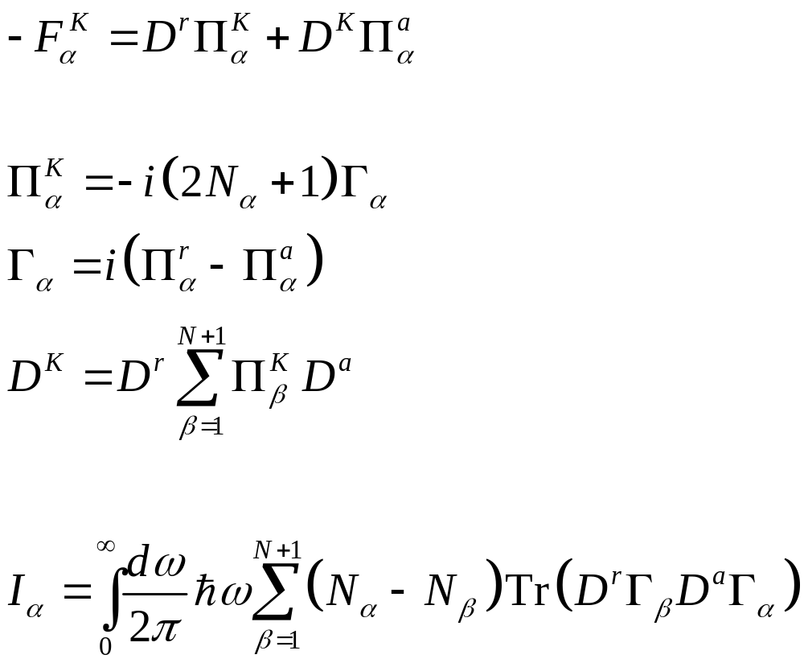
From Meir-Wingreen to Landauer: local equilibrium approximation
No Landauer form for force and torque!

Slide 21
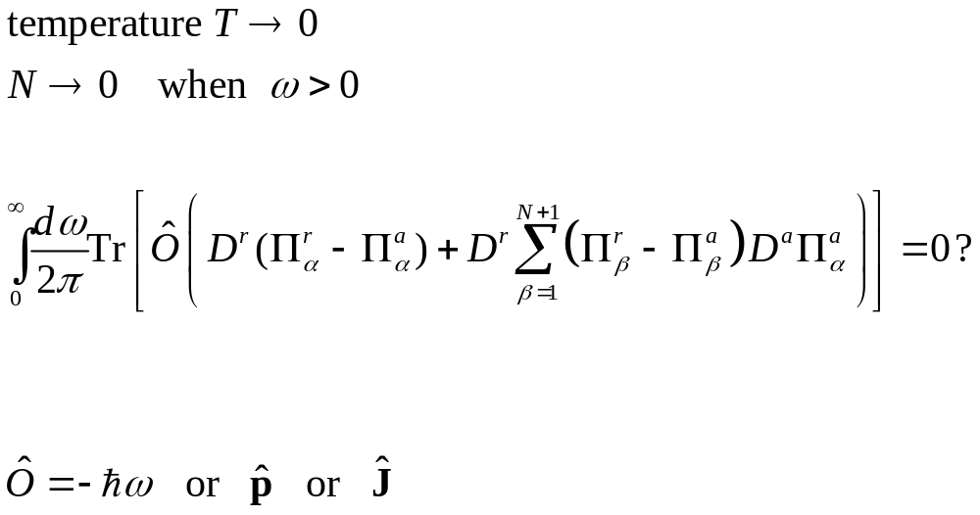
When zero-point-motion contribution is cancelled?

Slide 22
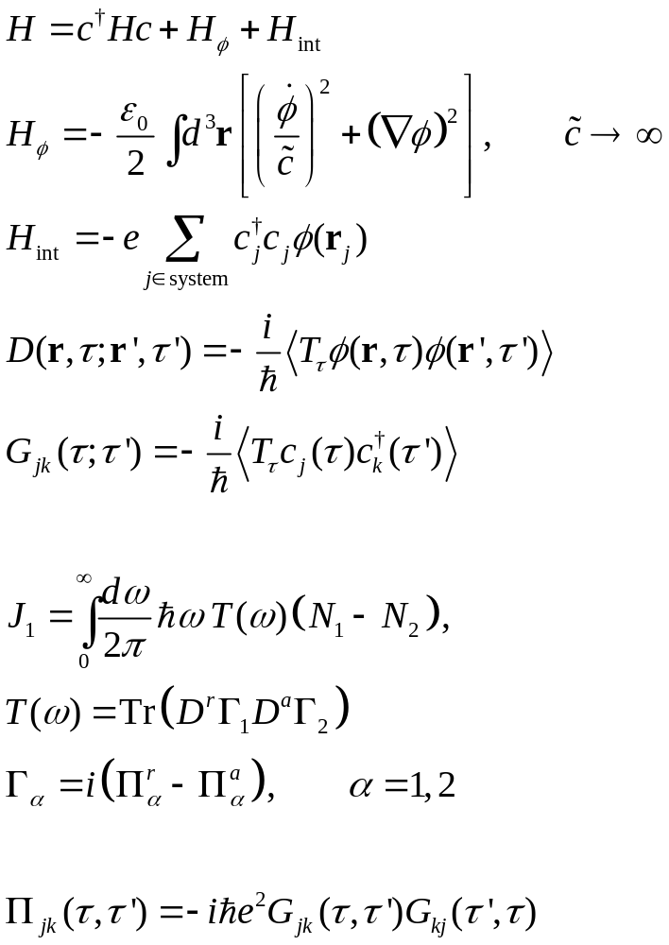
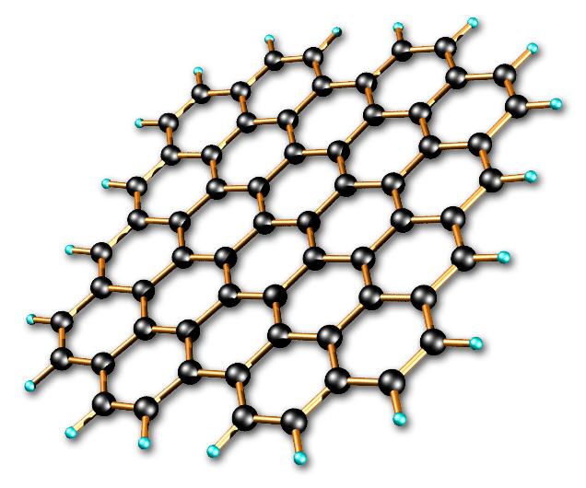
“scalar field” theory, non-retardation limit
1000 K
distance d
300 K

Slide 23
Applications

Slide 24
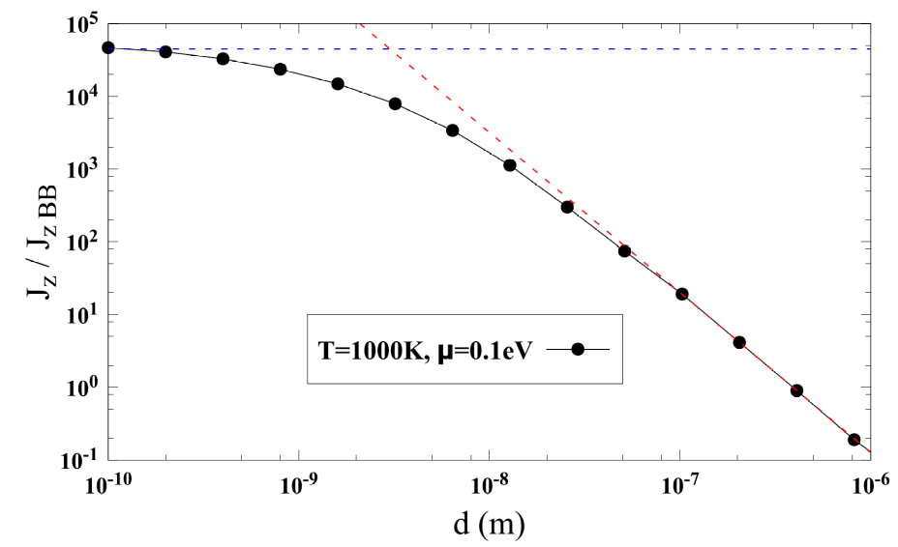
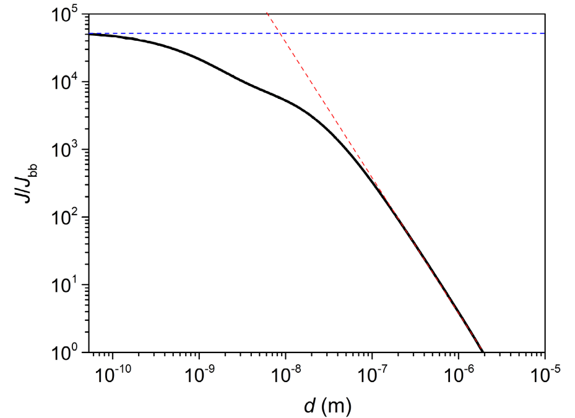
Heat transfer between two graphene sheets
↓ First principles QE/BerkeleyGW calculation for the ratio of energy transfer to blackbody value between two graphene sheets at temperatures 300 K and 1000 K, η = 0.05 eV, electron chemical potential at Dirac point. Zhu & Wang, arXiv:2105.02422.
↑ Heat transfer ratio based on electron tight-binding model with nearest neighbor hopping t = 2.8 eV, between 300 K and 1000 K sheets at chemical potential μ = 0.1 eV. Slope ≈ 2.2. Jiang & Wang, PRB 96, 155437 (2017).

Slide 25
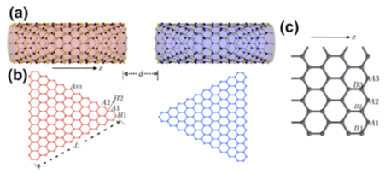
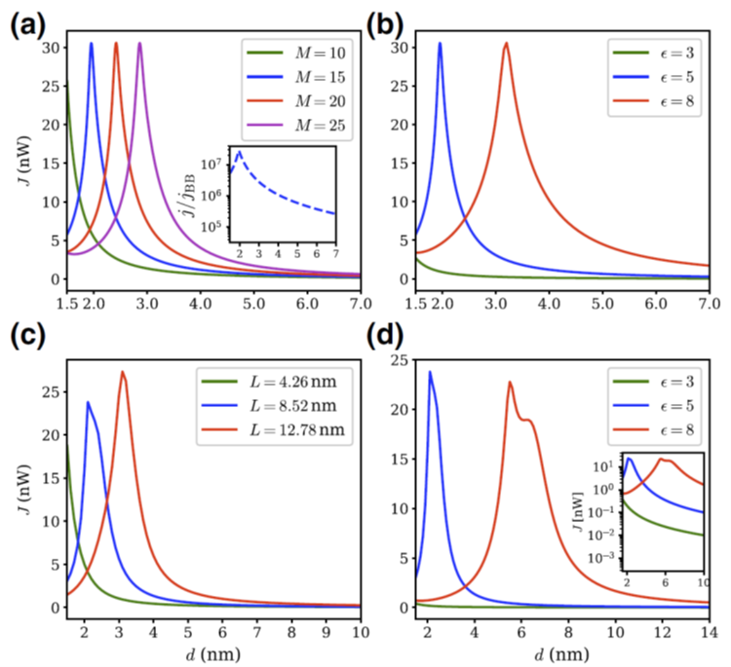
Heat transfer between zigzag nanotubes
Heat transfer from 400K to 300K objects. (a), (b) zigzag carbon nanotubes. (c), (d) nano-triangles. d: gap distance, M: nanotube circumference, L: triangle length. ε: dielectric constant. From Tang, Yap, Ren, and Wang, Phys. Rev. Appl. 11, 031004 (2019).

Slide 26
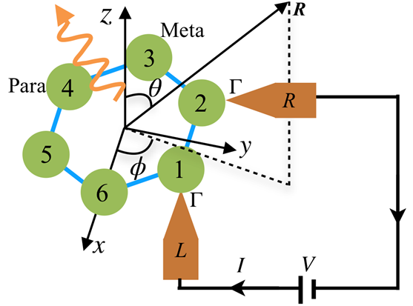
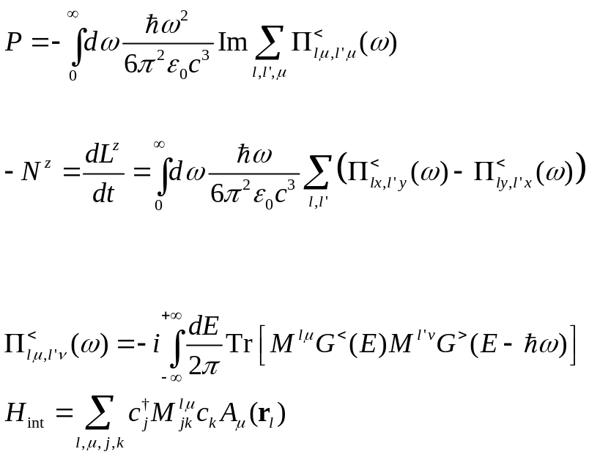
Angular momentum emission from a benzene molecule
Far field monopole approximation (all atoms are at the origin), ignore screening/multiple scatterings.

Slide 27
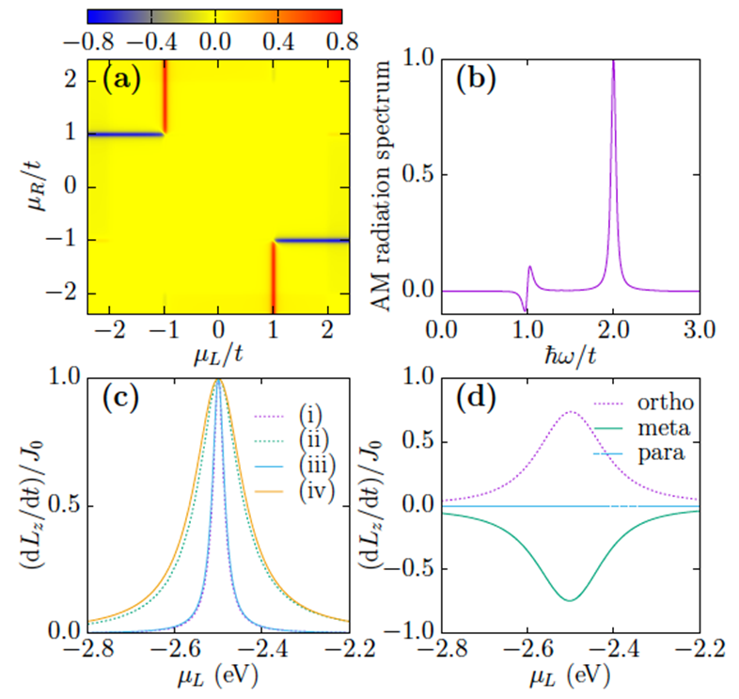


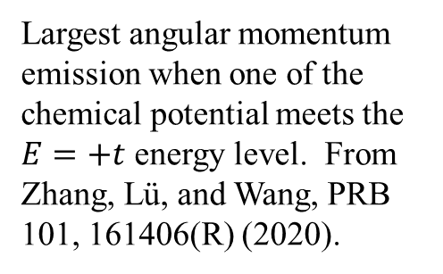
Angular momentum emission resonance effect
E
$E=t$, $\left|l\right|=2$
$$E=−2t, l=0$$
Largest angular momentum emission when one of the chemical potential meets the $E=+t$ energy level. From Zhang, Lü, and Wang, PRB 101, 161406(R) (2020).

Slide 28
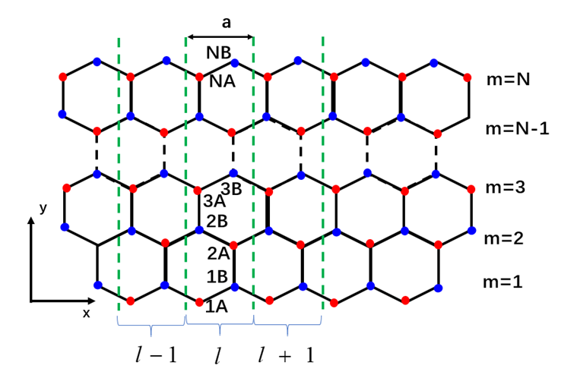
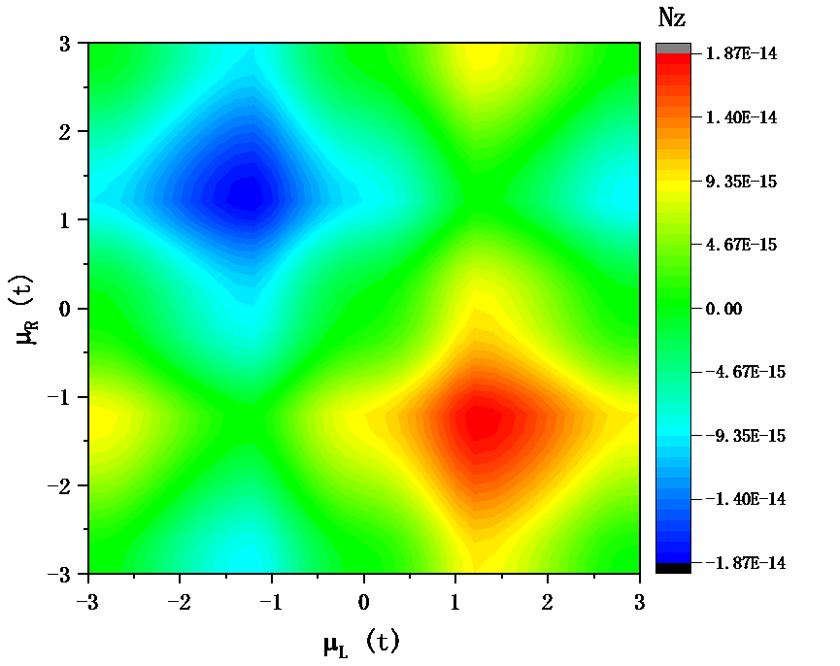
Angular momentum emission from graphene edge
Angular momentum emission intensity (atomic units), as chemical potential bias, at temperature of 300 K. Unpublished, Y.-M. Zhang, etc.

Slide 29
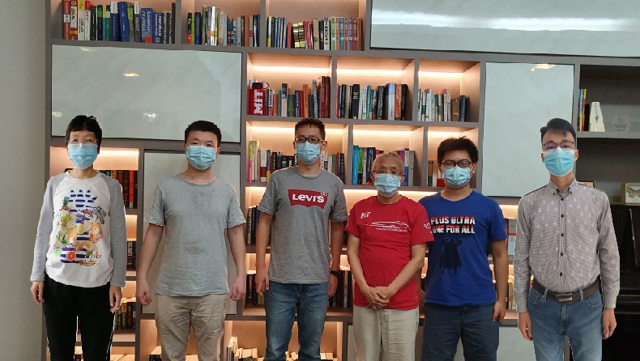
Acknowledgements
left to right: Dr. Zhang Yong-Mei, Dr. Zhu Tao, Dr. Gao Zhibin, Prof. Wang Jian-Sheng, Mr. Sun Kangtai, and Dr. Zhang Zuquan.

