Slide 1
Transient behavior and full counting statistics in thermal transport in nanojunctions
Jian-Sheng Wang
Dept Phys,NUS
Notes:
Slides for IMS workshop, Jian-Sheng Wang, a soft ppt copy is available under the page http://staff.science.nus.edu.sg/~phywjs/Talks/talks.html

Slide 2
Outline of the talk
Introduction
Method of nonequilibrium Green’s functions
Applications
    Thermal currents in1D chain and nanotubes
    Transient problem
    Full counting statistics
Notes:
2

Slide 3
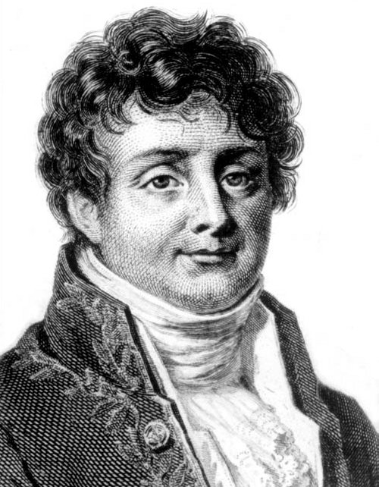
Fourier’s law for heat conduction
Fourier, Jean Baptiste Joseph, Baron (1768-1830)

Slide 4
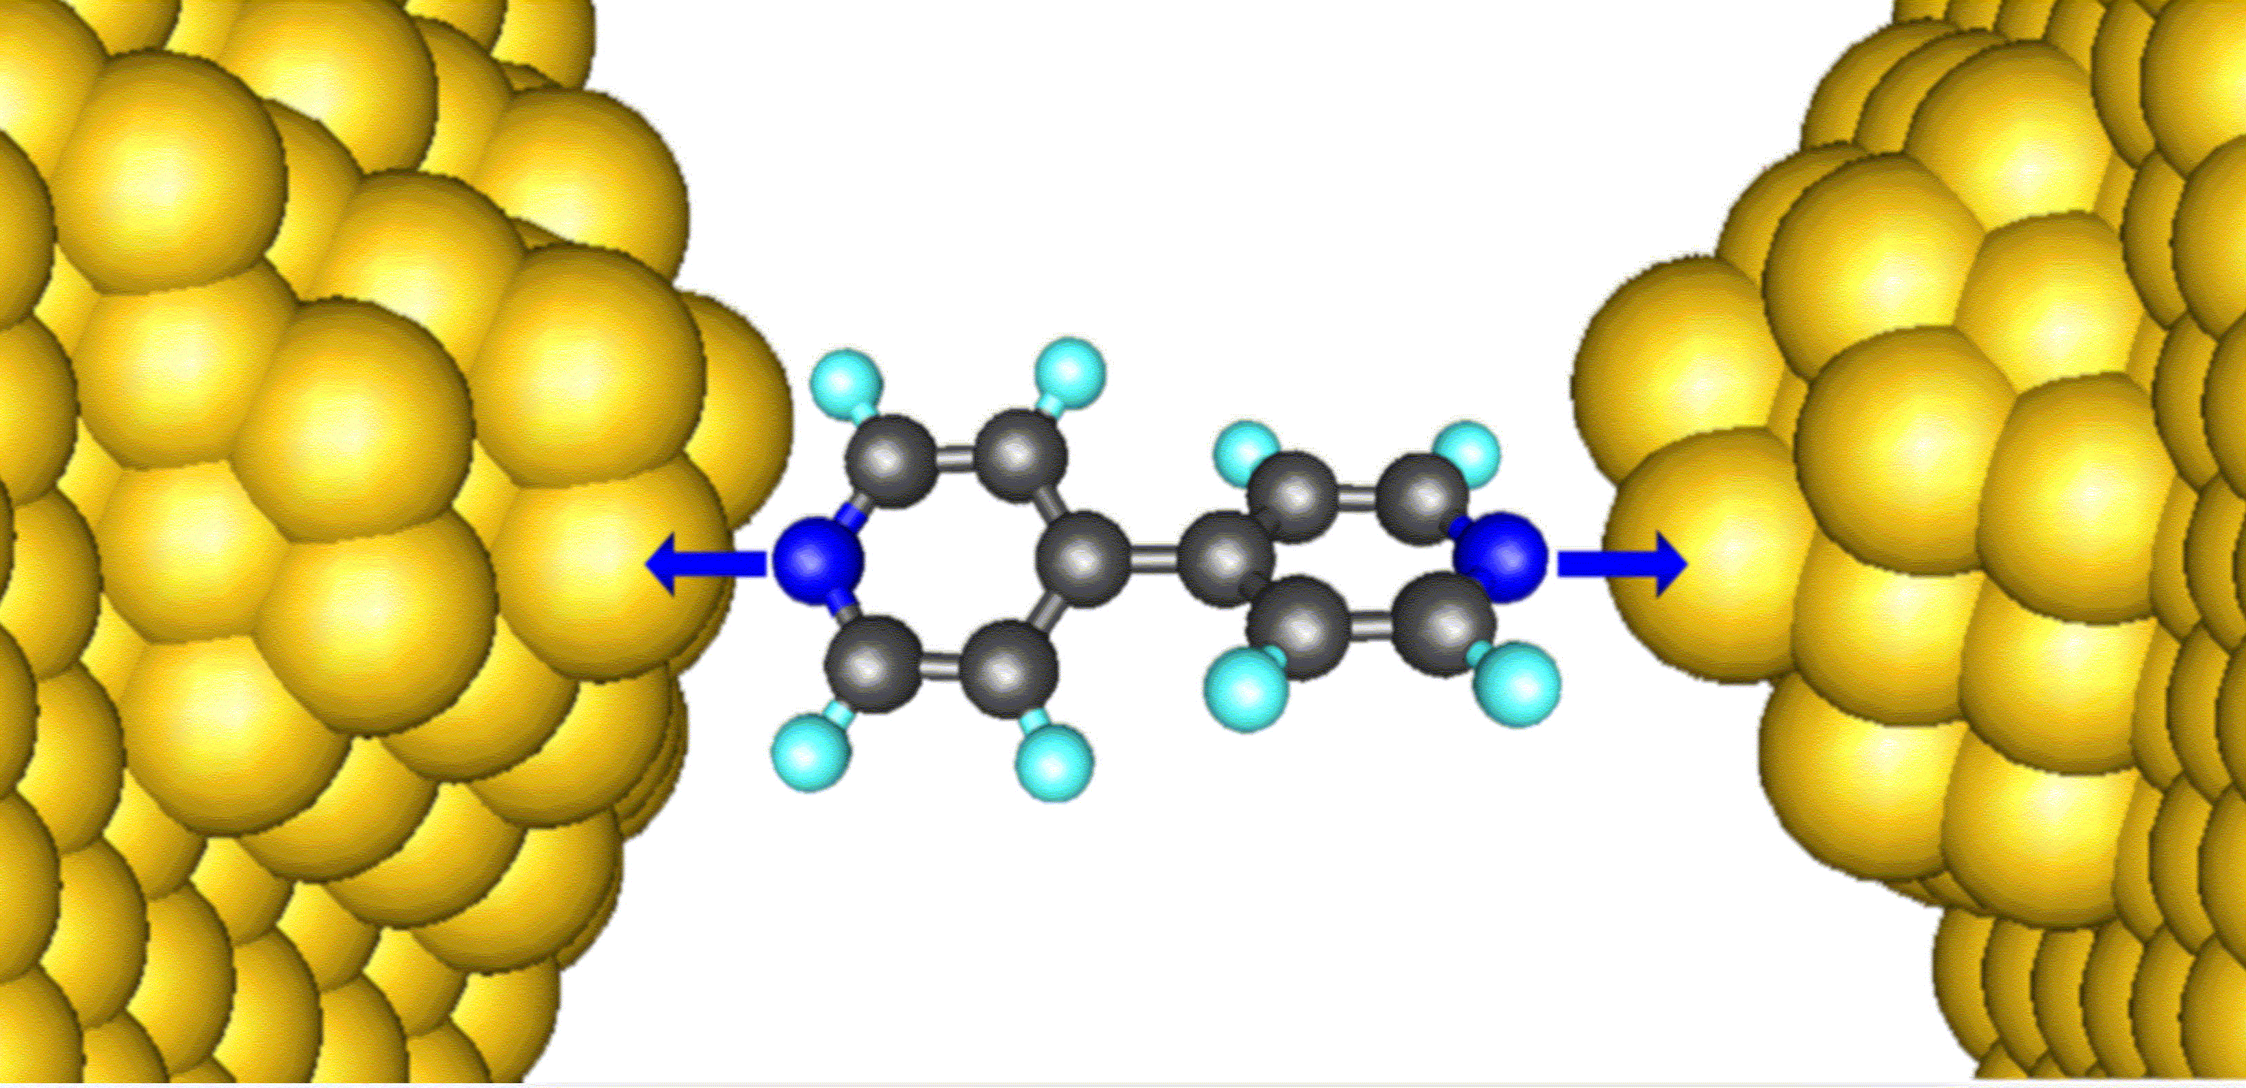
Thermal conductance

Slide 5
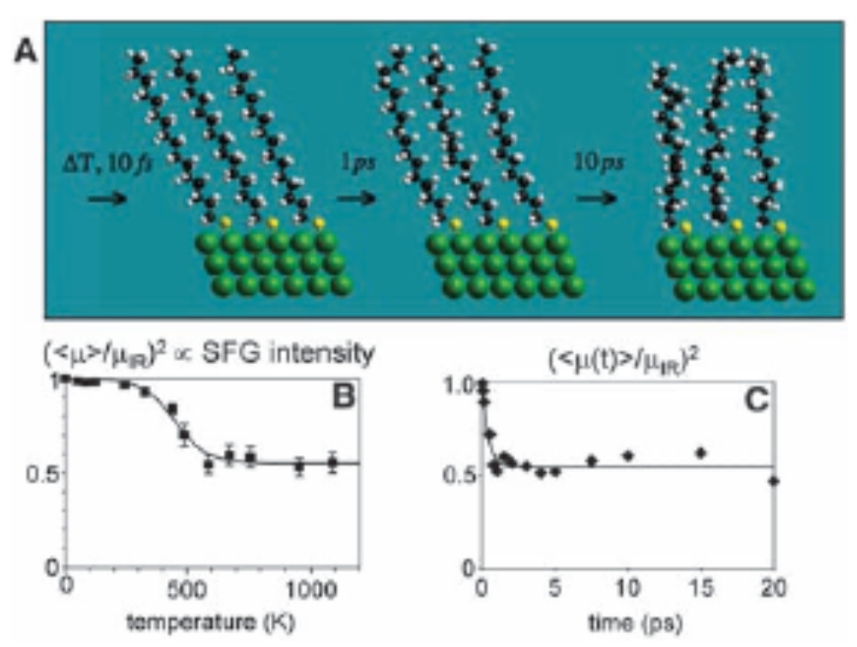
Experimental report of Z Wang et al (2007)
The experimentally measured thermal conductance is 50pW/K for alkane chains at 1000K. From Z Wang et al, Science 317, 787 (2007).

Slide 6
Thermal transport of a junction
Junction
Left Lead, T_{L}
Right Lead, T_{R}
semi-infinite
Notes:
The model in this form is fairly general. Note that x has the dimension of length. Superscript T is for matrix or column vector transpose.
6

Slide 7
Models
Junction
Left Lead, T_{L}
Right Lead, T_{R}
Notes:
The model in this form is fairly general. Note that x has the dimension of length. Superscript T is for matrix or column vector transpose.
7

Slide 8
Force constant matrix
K^{R}
Notes:
K is divided into three regions, left, center, right. The force constants K can be computed from a first principles package by taking the second derivatives of the total potential.
8

Slide 9
Definitions of Green’s functions
Greater/lesser Green’s function
Time-ordered/anti-time ordered Green’s function
Retarded/advanced Green’s function
Notes:
Other types such as Matsubara Green’s function or canonical (Kubo) correlation are also used. i = sqrt(-1). The average < … > can be equilibrium or with respect to arbitrary density matrix. For classical systems, G< = G>.
9

Slide 10
Contour-ordered Green’s function
Contour order: the operators earlier on the contour are to the right.
τ’
τ
t₀
Notes:
10

Slide 11
Relation to the real-time Green’s functions
τ’
τ
t₀
Notes:
σ = + for the upper branch, and – for the returning lower branch.
11

Slide 12
Equations for Green’s functions
Notes:
12

Slide 13
Solution for Green’s functions
c and d can be fixed by initial/boundary condition.
Notes:
Note that if ax = b, x = b/a, but not if a = 0, in that case, x = infinity, thus, the Dirac delta function.
13

Slide 14
Contour-ordered Green’s function
τ’
τ
t₀
Notes:
Another possible representation of the result is using Feynman path integral formulation.
14

Slide 15
Perturbative expansion of contour ordered Green’s function
Notes:
Every operator is in interaction picture, dropped superscript I for simplicity. The Wick theorem is valid if the expectation < … > is with respect to a quadratic weight. For a proof, see Rammer.
15

Slide 16
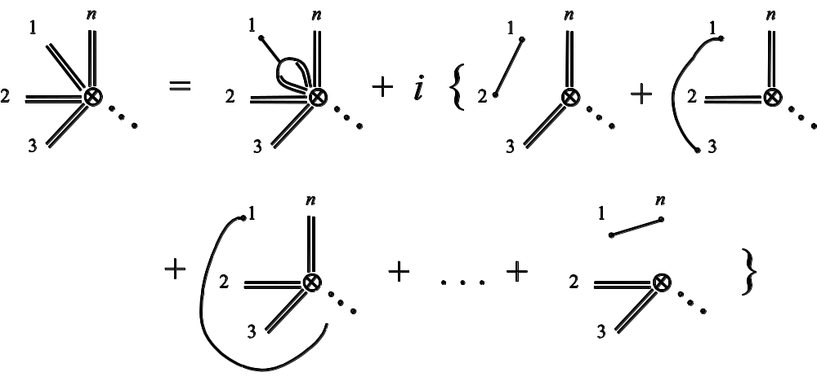
General expansion rule
Single line
3-line vertex
n-double line vertex
Notes:
See our review article or Rammer’s book.

Slide 17
Diagrammatic representation of the expansion
=
+ 2i
+ 2i
+ 2i
=
+
Notes:
17

Slide 18
Explicit expression for self-energy
Notes:
See also figure 3 in J.-S. Wang, X. Ni, and J.-W. Jiang, Phys. Rev. B 80, 224302 (2009).
18

Slide 19
Junction system
Three types of Green’s functions:
  g for isolated systems when leads and centre are decoupled
  G 0 for ballistic system
  G for full nonlinear system
Governing Hamiltonians
H_{L}+H_{C}+H_{R} +V +H_{n}
H_{L}+H_{C}+H_{R} +V
G
H_{L}+H_{C}+H_{R}
G₀
Green’s function
g_{α}
t = − ∞
Equilibrium at T_{α}
t = 0
Nonequilibrium steady state established
19
Notes:
Two adiabatic switch-on’s.
19

Slide 20
Three regions
20
Notes:
20

Slide 21
Dyson equations and solutions
Notes:
In deriving the last line, we use the fact (g^{r})⁻¹ g< = 0.
21

Slide 22
Energy current
Notes:
I_{L} is energy flowing out of the left lead into the center. This expression can be proving to be real, no need to take Re. Above equation works for general nonlinear case.
22

Slide 23
Caroli formula
Notes:
The symmetrization appears necessary to get the Caroli formula. Caroli formula is valid only for ballistic case where H_{n} = 0.
23

Slide 24
Ballistic transport in a 1D chain
Force constants
Equation of motion
Notes:
The matrix K is infinite in both directions.
24

Slide 25
Solution of g
Surface Green’s function
Notes:
K^{R} is semi-finite, V is nonzero only at the corner.
25

Slide 26
Lead self energy and transmission
T[ω]
1
ω
Notes:
Σ_{R} is nonzero only for the lower right corner.
26

Slide 27
Heat current and conductance, Landauer formula
Notes:
The last formula σ is called universal conductance.
27

Slide 28
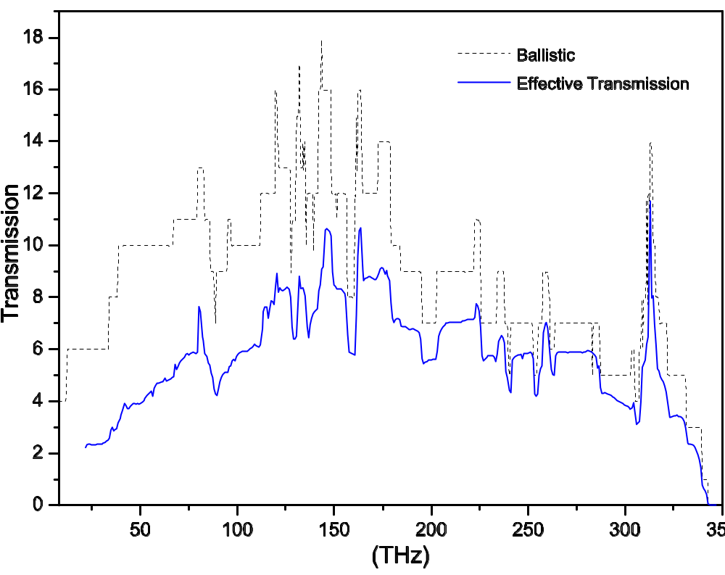
Carbon nanotube, nonlinear effect
The transmissions in a one-unit-cell carbon nanotube junction of (8,0) at 300K. From J-S Wang, J Wang, N Zeng, Phys. Rev. B 74, 033408 (2006).
Notes:
The nonlinear result may be not correct at the low frequency end.
28

Slide 29
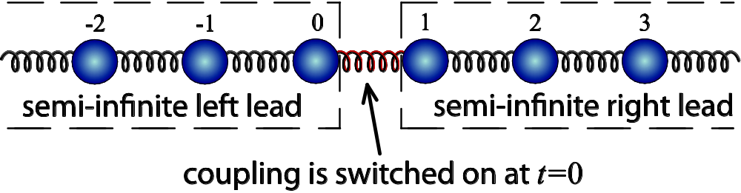
Transient problems
Notes:
The I_{L} is valid for 1D chain with spring constant k.
29

Slide 30
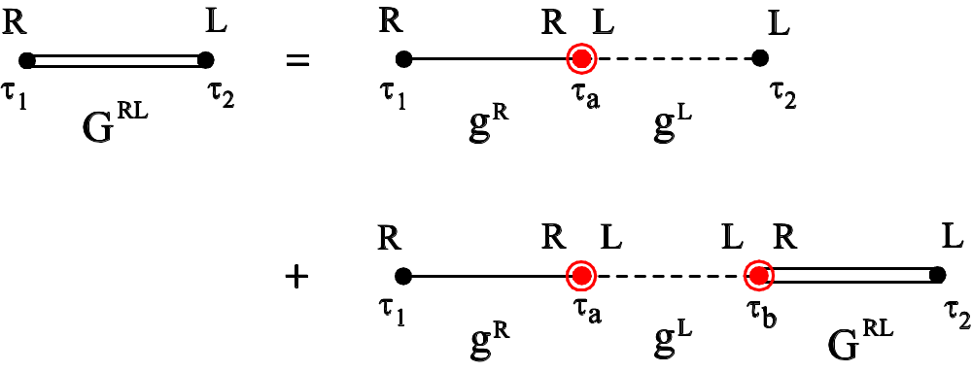
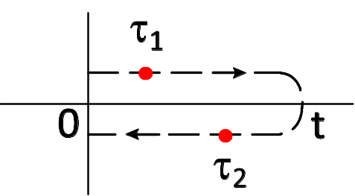
Dyson equation on contour from 0 to t
Contour C
Notes:
In steady state we use Keldysh contour which is from - to +. But here for transient study, the contour is a finite segment.
30

Slide 31
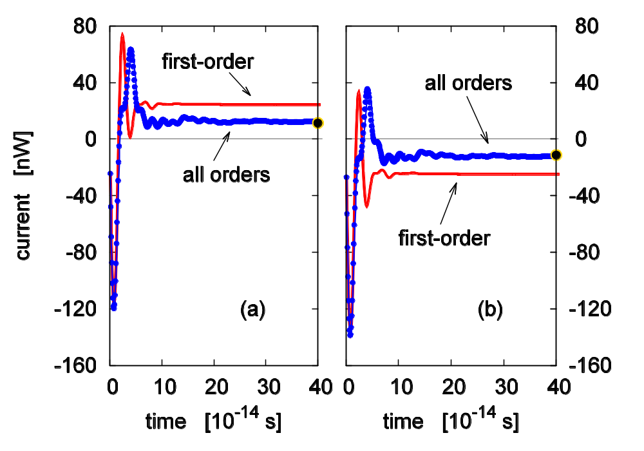
Transient thermal current
The time-dependent current when the missing spring is suddenly connected. (a) Current flow out of left lead, (b) out of right lead. Dots are what predicted from Landauer formula. T=300K, k =0.625 eV/(Å²u) with a small onsite k₀=0.1k. From E. C. Cuansing and J.-S. Wang, Phys. Rev. B 81, 052302 (2010). See also PRE 82, 021116 (2010).
31
Notes:
31

Slide 32
Full counting statistics
What is the amount of energy (heat) Q transferred in a given time t ?
This is not a fixed number but given by a probability distribution P(Q )
Generating function
All moments of Q can be computed from the derivatives of Z.
The objective of full counting statistics is to compute Z(ξ).
32
Notes:
32

Slide 33
A brief history on full counting statistics
L. S. Levitov and G. B. Lesovik proposed the concept for electrons in 1993; rederived for noninteracting electron problems by I. Klich, K. Schönhammer, and others
K. Saito and A. Dhar obtained the first result for phonon transport in 2007
J.-S. Wang, B. K. Agarwalla, and H. Li, PRB 2011; B. K. Agarwalla, B. Li, and J.-S. Wang, arXiv:1111.6182
Notes:
33

Slide 34
Definition of generating function based on two-time measurement
Notes:
34

Slide 35
Approaches to compute Z
Express Z as expectation value of some effective evolution operator over a contour
Evaluate the expression using
    Feynman path integral/influence functional
    Feynman diagrammatic expansion
Notes:
35

Slide 36
Product initial state
Notes:
36

Slide 37
Ux
Notes:
37

Slide 38
Schrödinger, Heisenberg, and interaction pictures
Schrödinger picture
Heisenberg picture
Interaction picture
Notes:
38

Slide 39
Compute Z in interaction picture
-ξ/2
+ξ/2
Notes:
39

Slide 40
Important result
Notes:
40

Slide 41
Long-time result, Levitov-Lesovik formula
Notes:
41

Slide 42
Arbitray time, transient result
Notes:
42

Slide 43
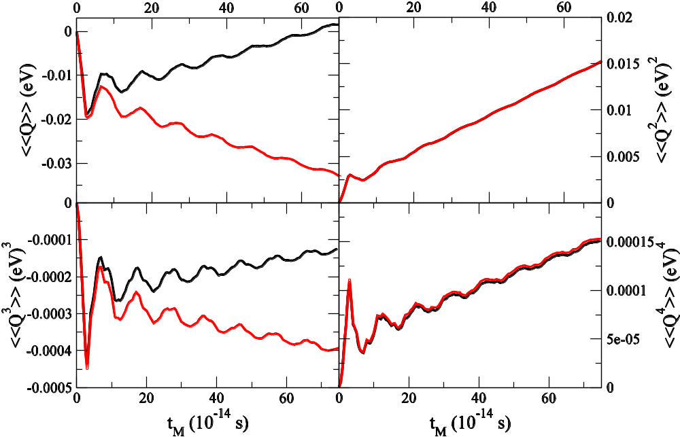
Numerical results, 1D chain
1D chain with a single site as the center.
k= 1eV/(uÅ²), k₀=0.1k,
T_{L}=310K, T_{C}=300K, T_{R}=290K. Red line right lead; black, left lead. B. K. Agarwalla, B. Li, and J.-S. Wang, arXiv:1111.6182.
Notes:
43

Slide 44
Other results
We can also compute the cumulants for the projected steady state ρ’
Entropy production
Fluctuation theorem, Z(ξ) = Z(-ξ +i(β_{R}-β_{L}))
The theory is applied equally well to electron number of electron energy transport
Notes:
44

Slide 45
Summary remarks
NEGF is a powerful tool to handle thermal transport problems in nanostructures
Steady state current is obtained from Landauer and Caroli formula
New results for transient and full counting statistics. A key quantity is the self-energy Σ_{L}^{A}
Notes:
45

Slide 46
Thank you
Notes:
I acknowledge my students/collaborators/group members over the years involved in this field: Wang Jian, Zeng Nan, Lü Jingtao, Eduardo Cuansing, Jiang Jinwu, Jose L. Garcia, Zhang Lifa, Ni Xiaoxi, Leek Meng Lee, Xu Yong, Pawel Keblinski, Baowen Li, Lan Jinghua, Gan Chee Kwan.
46

