Slide 1
Microscopic theory of energy, momentum, and angular momentum transfer mediated by photons
Jian-Sheng Wang
Department of Physics, NUS

Slide 2
Outline
Motivation
Tight-binding model for electrons
NEGF theory of energy, momentum, and angular momentum transfer, Meir-Wingreen formulas
Applications
  Angular momentum emission from graphene edges
  Van der Waals force between C₆₀
  Super-Planckian near-field radiation in 2D metals

Slide 3
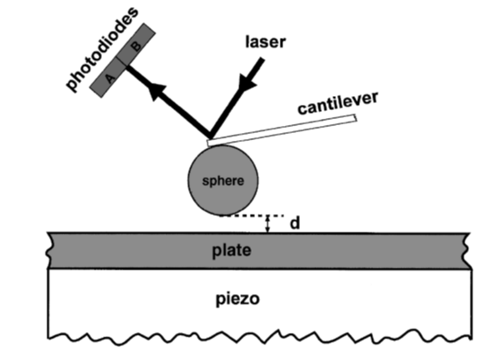
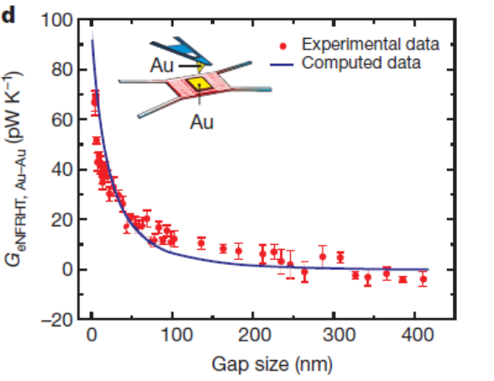
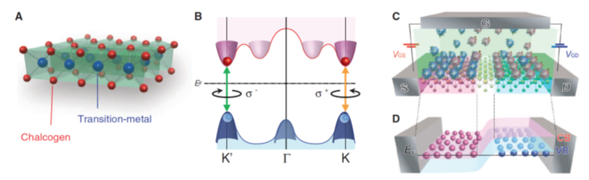
Photon mediated physics
Casimir force (Mohideen & Roy, PRL 1998)
Near field effect (Kim et al, Nature, 2015)
WSe₂, polarized light (Zhang et al, Science, 2014)

Slide 4
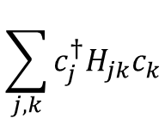
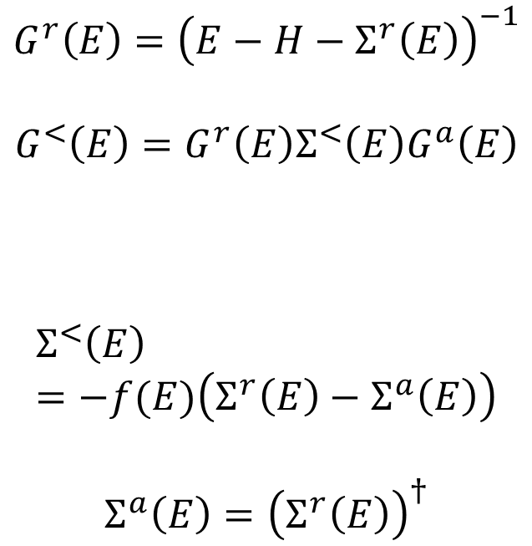
Electron tight-binding model with or without bath(s)
$$G^{r}\left(E\right)={\left(E−H−Σ^{r}\left(E\right)\right)}^{−1}$$
$$G^{<}\left(E\right)=G^{r}\left(E\right)Σ^{<}\left(E\right)G^{a}\left(E\right)$$
$$Σ^{<}\left(E\right)=−f(E)\left(Σ^{r}\left(E\right)−Σ^{a}\left(E\right)\right)$$
$$Σ^{a}\left(E\right)={\left(Σ^{r}\left(E\right)\right)}^{†}$$
system
bath
$$\sum_{j,k}{c_{j}^{†}H_{jk}c_{k}}$$

Slide 5
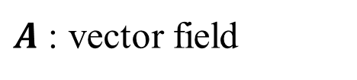
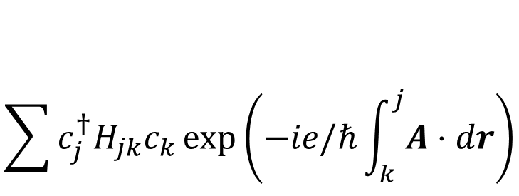
Electron-field interaction, Peierls substitution
system
$$\sum{c_{j}^{†}H_{jk}c_{k}\exp\left(−ie/ℏ\int_{k}^{j}{A⋅dr}\right)}$$
bath
$A$ : vector field

Slide 6
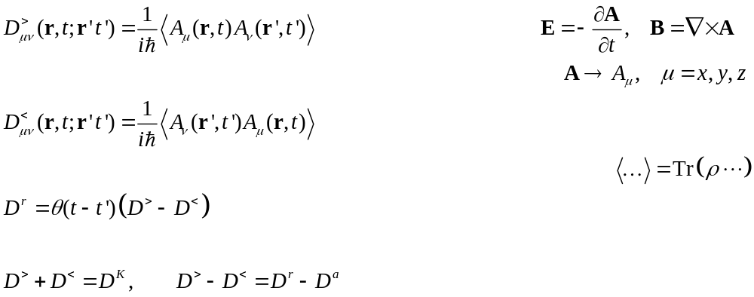
NEGF, definitions

Slide 7
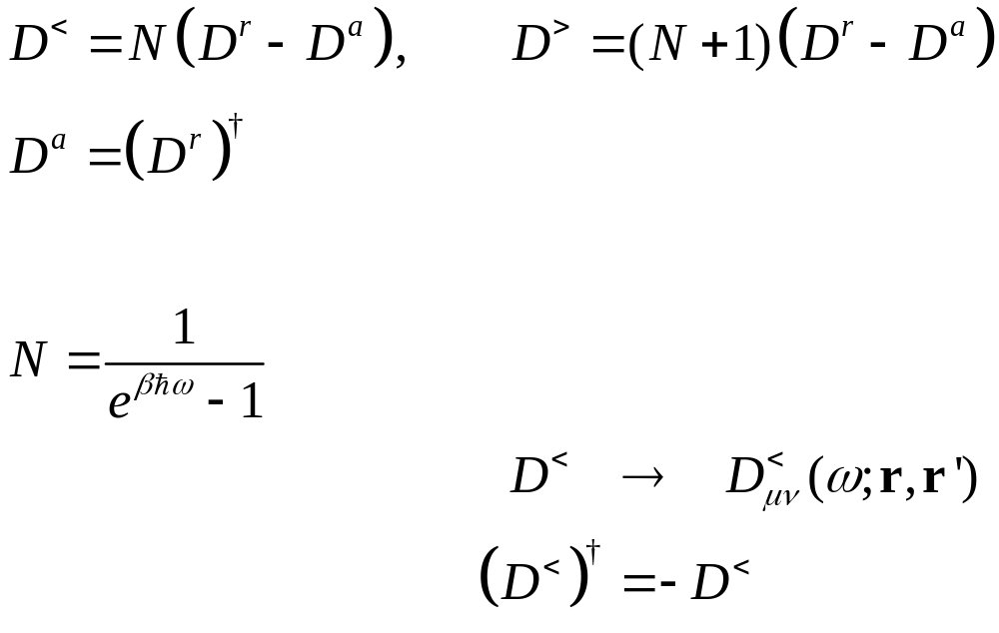
Fluctuation-dissipation theorem in thermal equilibrium
Callen and Welton 1951,
Eckhardt 1984

Slide 8
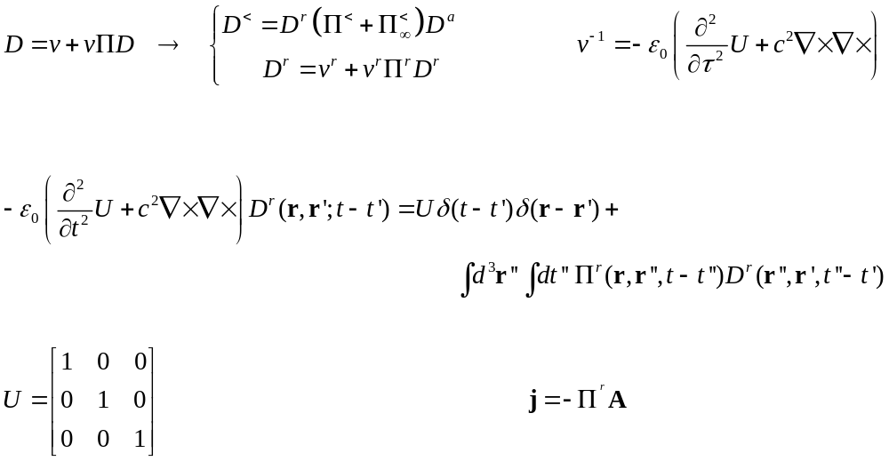
Dyson equations

Slide 9
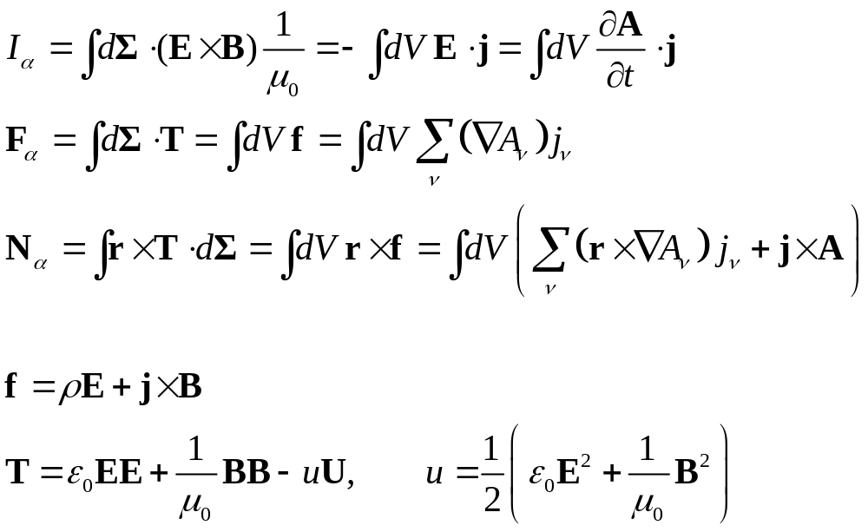
From surface integral to volume integral
α

Slide 10
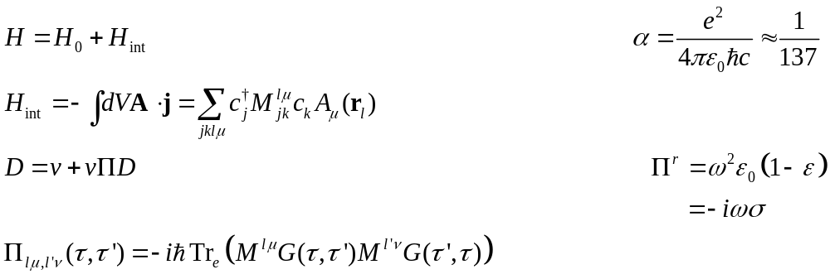

Self energy $Π$
diamagnetic
RPA

Slide 11
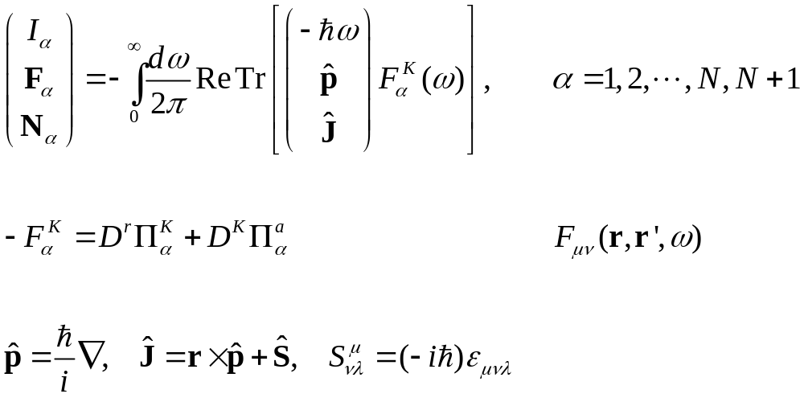
Meir-Wingreen formula
Krüger, et al (2012); Strekha, et al, PRA;
Wang, et al, Front. Phys. (2023).
Notes:
Levi Civita symbol

Slide 12
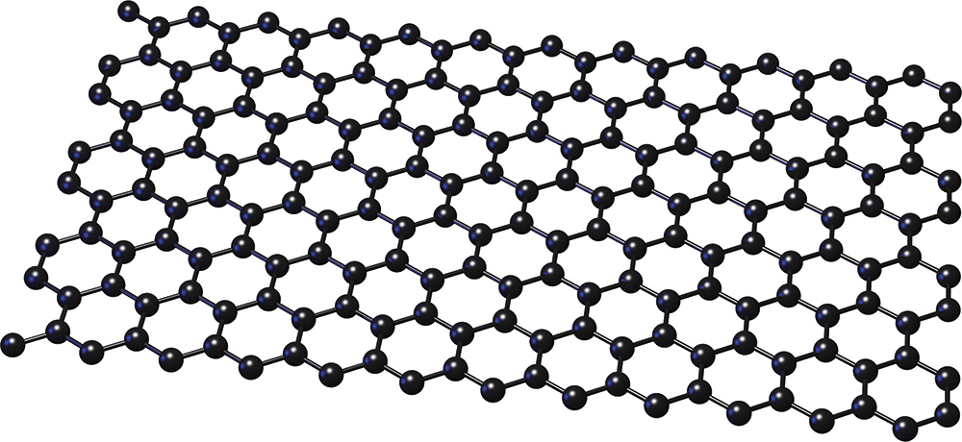
Force and torque from the nonequilibrium edge
$$J$$
$$p$$
$$μ_{L}$$
$$μ_{R}$$

Slide 13
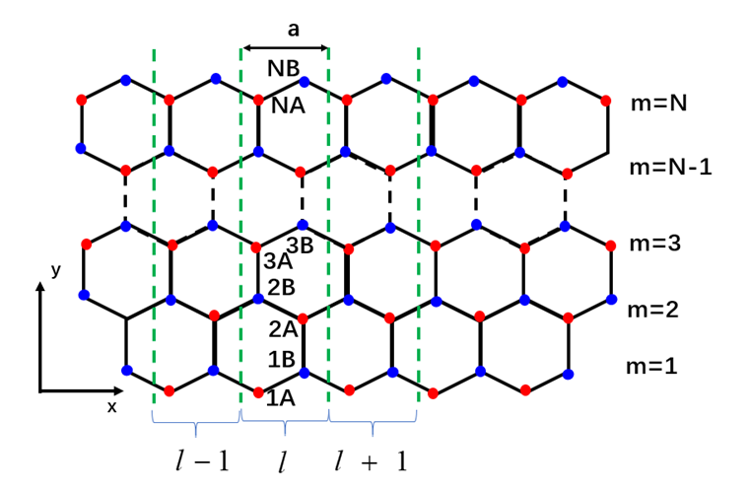
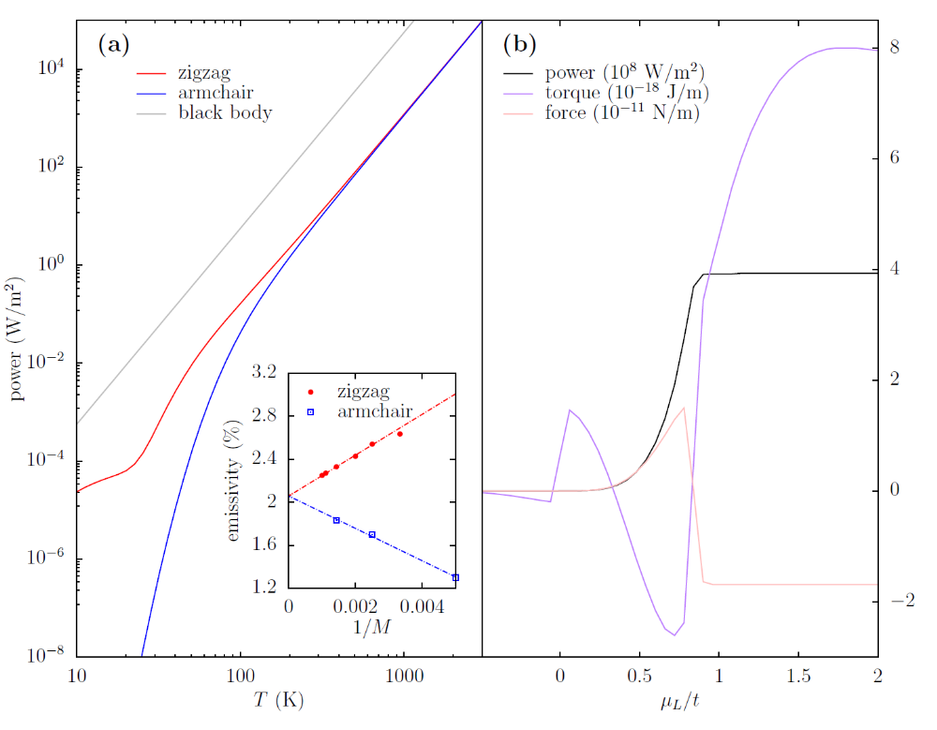
Emission from graphene edge
(a) Emission power as a function of temperature, (b) P, N, F as a function of $μ_{L}$ fixing $\frac{μ_{R}}{t}=−0.8$. Y.-M. Zhang, etc.

Slide 14
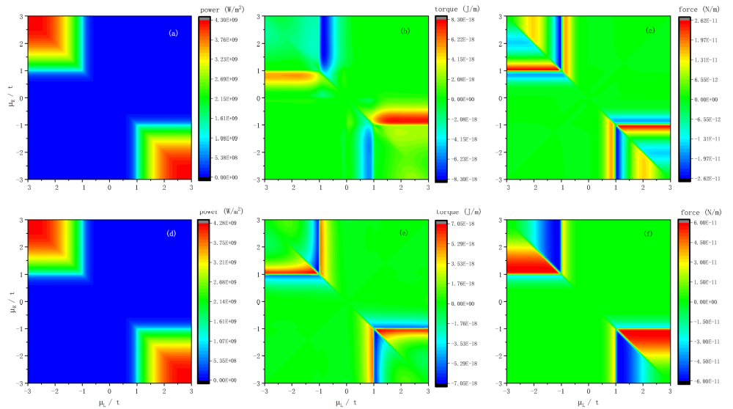
I, N, F scan $μ_{R}$vs $μ_{L}$. System size width 700 unit cells, k-point 401. From Zhang, et al, PRB 105, 205421 (2022).

Slide 15
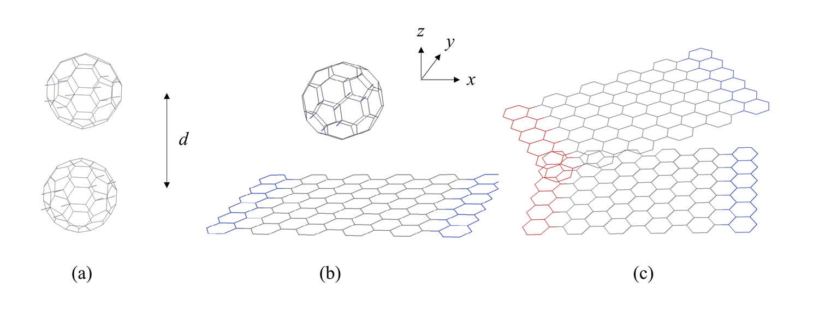
C₆₀ and graphene

Slide 16
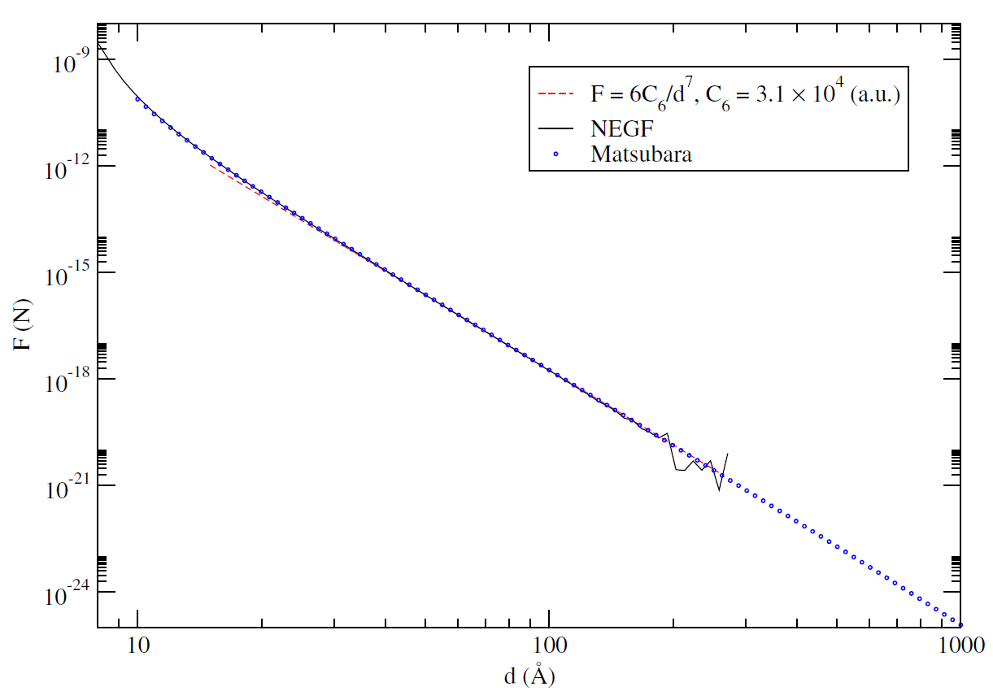
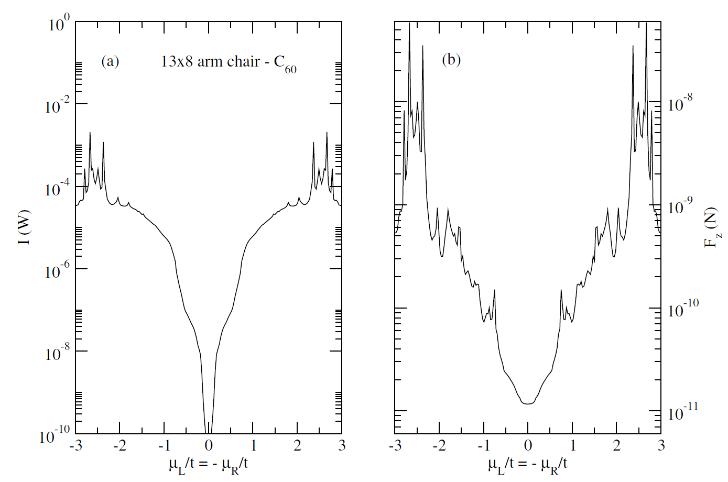
van der Waals force between two C₆₀ molecules as a function of distance d at 300 K.
From arXiv:2307.1136
Energy transport and force between 13×8 graphene strip and C₆₀ at a center distance of 1 nm, symmetrically biased with chemical potential at 300 K.

Slide 17
Heat transfer of 2D metals, super-Planckian problem
1000 K
300 K
y
x
z
d

Slide 18
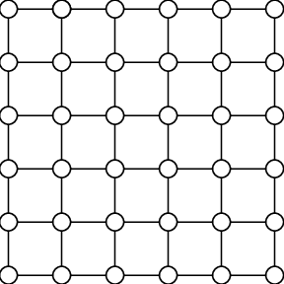
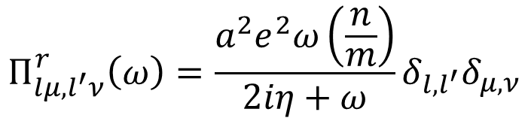
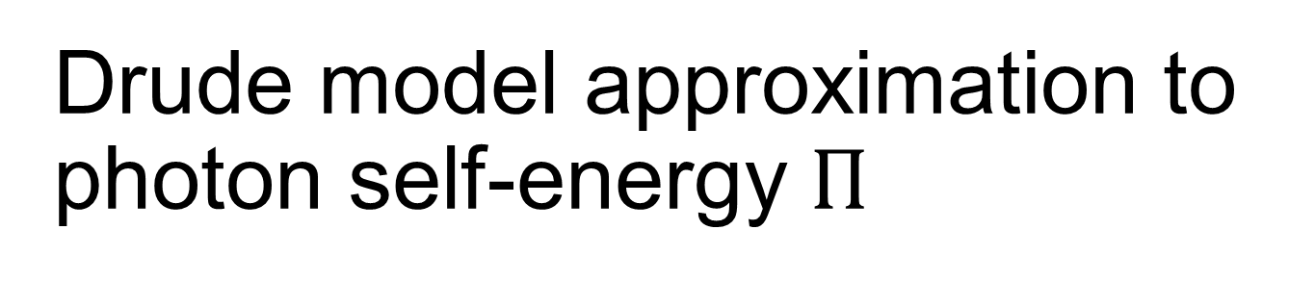
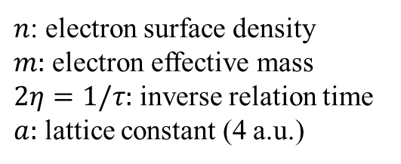
Drude model approximation to photon self-energy $Π$
$$Π_{lμ,l^{′}ν}^{r}\left(ω\right)=\frac{a^{2}e^{2}ω\left(\frac{n}{m}\right)}{2iη+ω}δ_{l,l^{′}}δ_{μ,ν}$$
$n$: electron surface density
$m:$ electron effective mass
$2η=1/τ:$ inverse relation time
$a:$ lattice constant (4 a.u.)
a

Slide 19
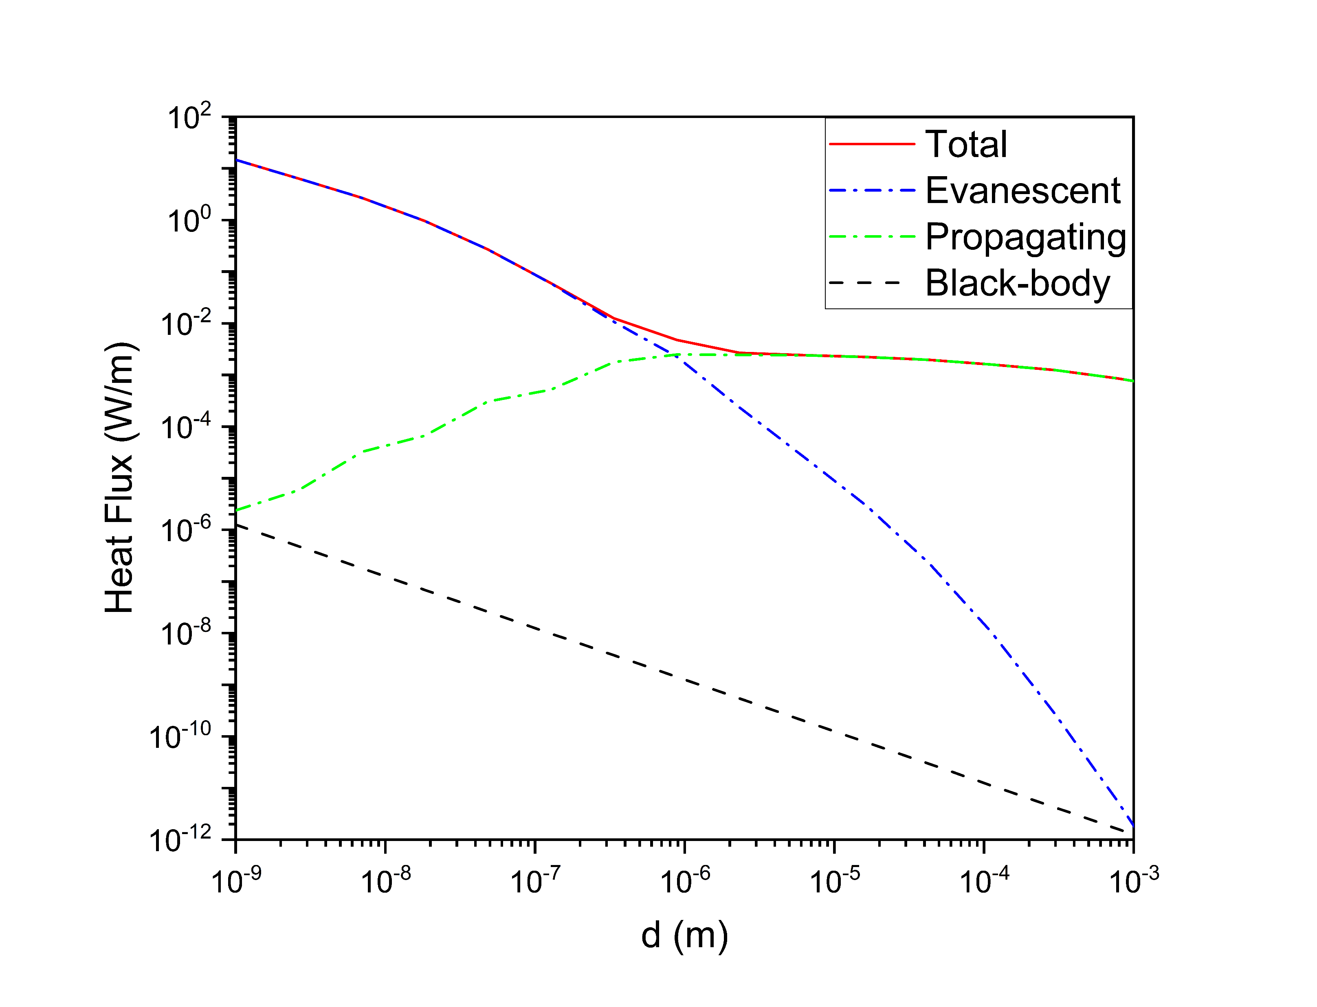
Fig. 1. Heat flux between coplanar 2D metals as a function of gap sizes. The materials properties are calculated by the Drude model. The red line is the total heat flux; the blue- and green-dotted lines are results from evanescent waves and propagating waves, respectively. The black-dashed line is the Black-body result given by the Stefan-Boltzmann law with a geometrical view factor F = a/2d, where a = 4 a.u. is the lattice constant and d is the gap size.
Some parameters:
Lx = 160, Lz = 640,
T1=1000 K, T2=300 K
w_max = 10*Kb*(T1+T2)
q_max = 5/d for total and evanescent q_max = w/c for propagating
W_n = 512
a_lat = 4 a.u.
Rcut = 1.6

Slide 20
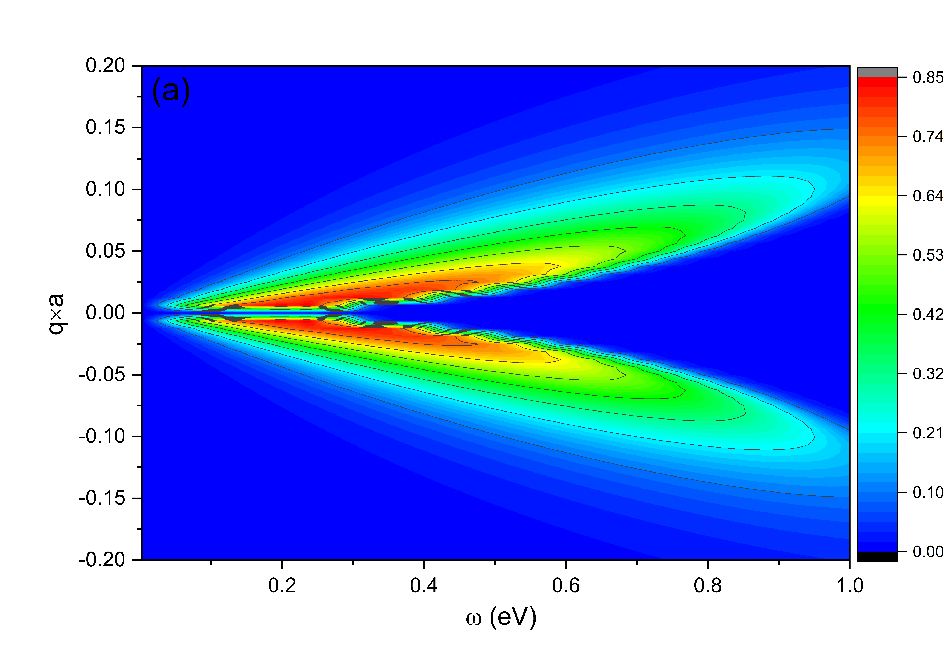
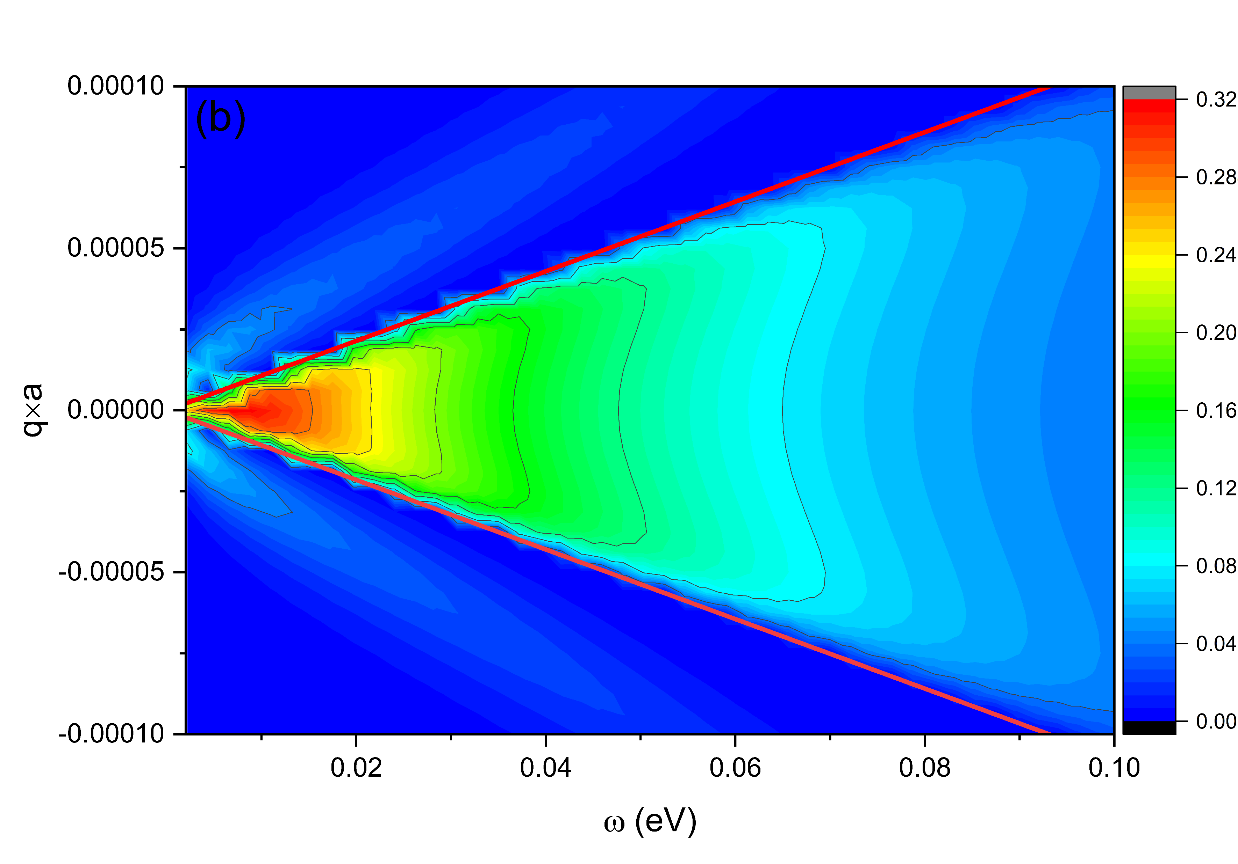
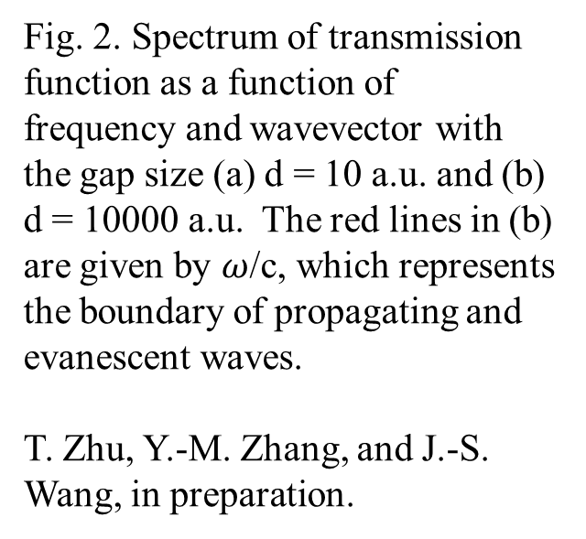
Fig. 2. Spectrum of transmission function as a function of frequency and wavevector with the gap size (a) d = 10 a.u. and (b) d = 10000 a.u. The red lines in (b) are given by $ω$/c, which represents the boundary of propagating and evanescent waves.
T. Zhu, Y.-M. Zhang, and J.-S. Wang, in preparation.

Slide 21
Conclusion
A NEGF formulation for photon transport between condensed matter objects at the nanoscale
Energy, momentum, and angular momentum transport in a unified framework with the Meir-Wingreen formula
Other applications

Slide 22

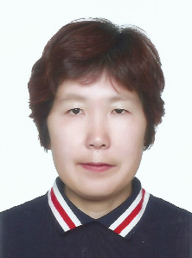

Acknowledgements
Tao Zhu, Tiangong University, Tianjin, China
Yong-Mei Zhang, Nanjing Univ of Aeronautics and Astronautics
Mauro Antezza, Univ Montpellier, CNRS
MOE FRC tier 1 support

