Slide 1
Quantum master equation approach to transport
Jian-Sheng Wang
Department of Physics, National University of Singapore

Slide 2
Outline
Dyson expansion, why divergent (in each term)?
Quantum master equation by eliminating initial state dependence
Second order reduced density matrix by analytic continuation (AC), when it is good?
Applications
  Self-consistent phonons
  Time-dependent thermoelectric effect
  Interface transport

Slide 3

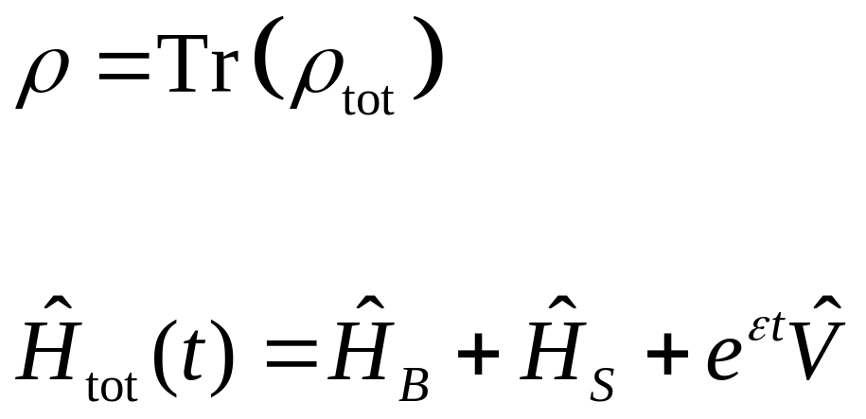
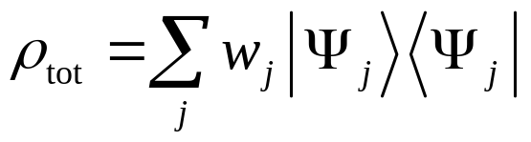
Open quantum system setup
bath
system

Slide 4
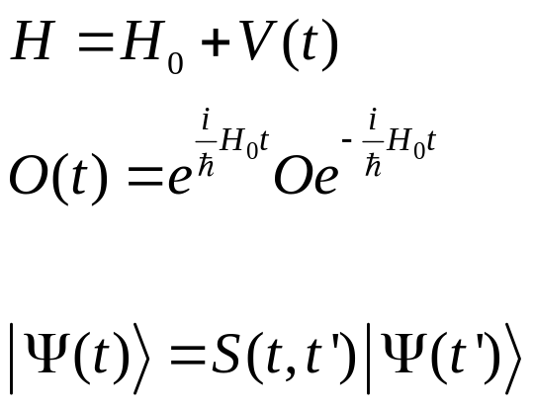
Three pictures
Schrödinger
Heisenberg
Interaction

Slide 5
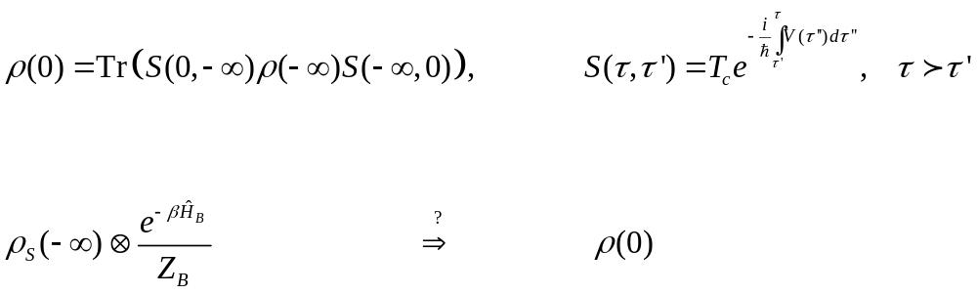
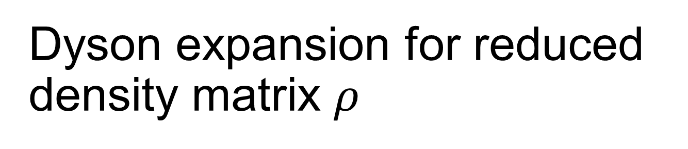
Dyson expansion for reduced density matrix $ρ$
$$−∞ t=0$$

Slide 6
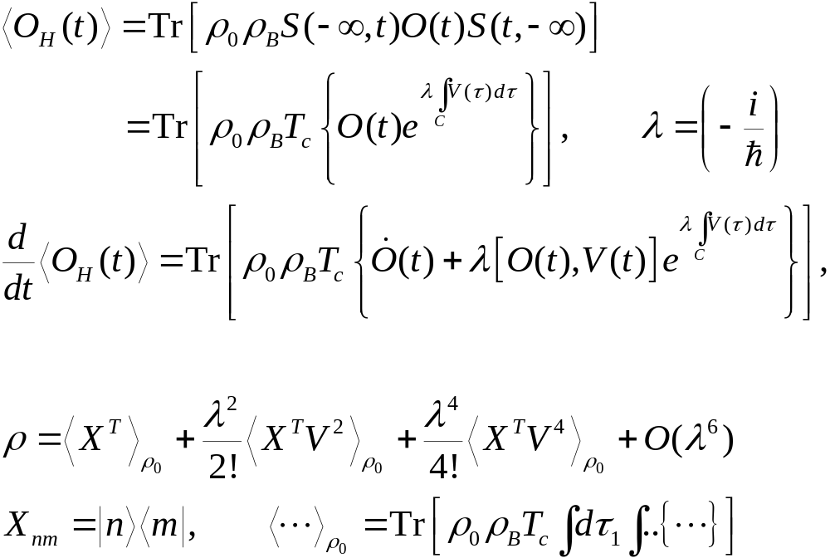
Dyson Expansions
Notes:
Some detail is in the last section of J.-S. Wang, B. K. Agarwalla, H. Li, and J. Thingna, “Nonequilibrium Green's function method for quantum thermal transport,” Front. Phys. (2013). rho_0 is in fact rho_0^I, i.e., interaction picture one.

Slide 7
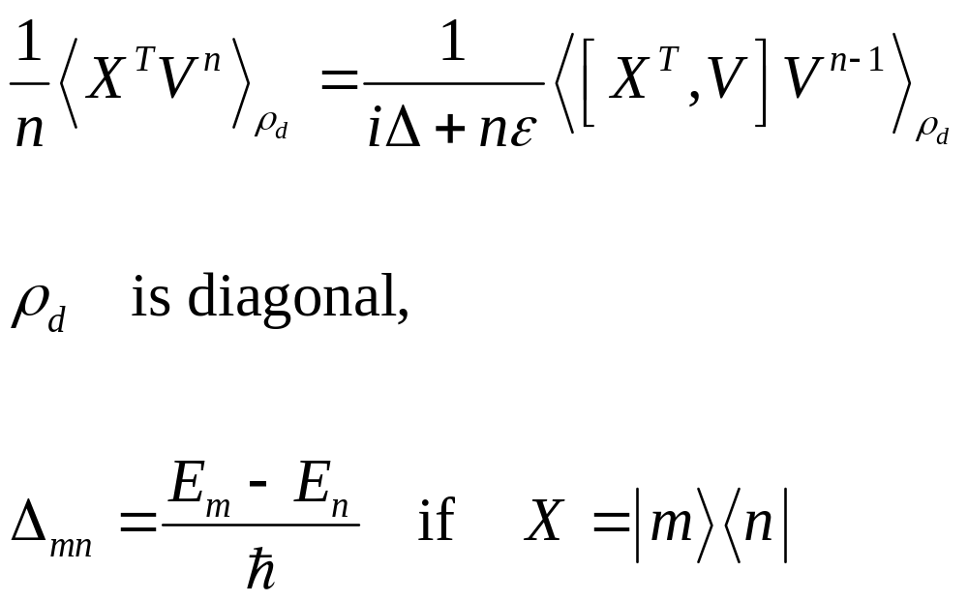
Divergence

Slide 8
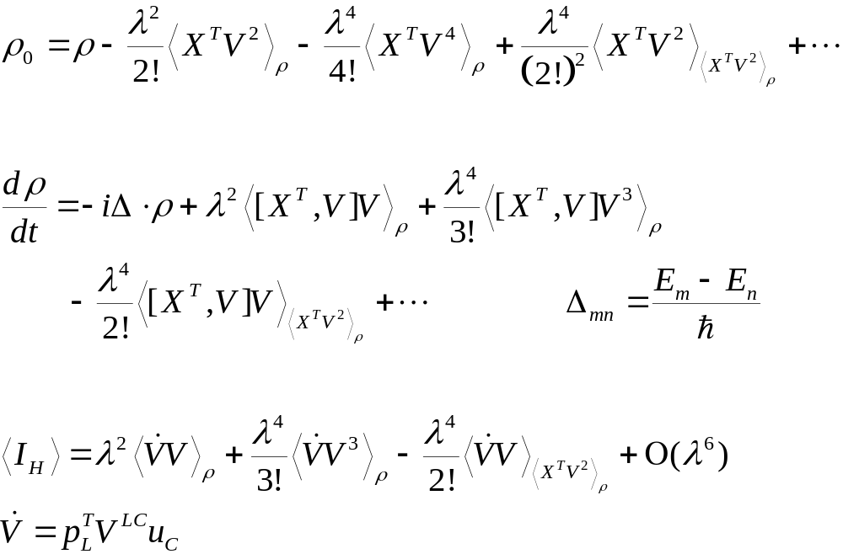
Unique one-to-one map, ρ₀↔ρ; ordered cumulants

Slide 9
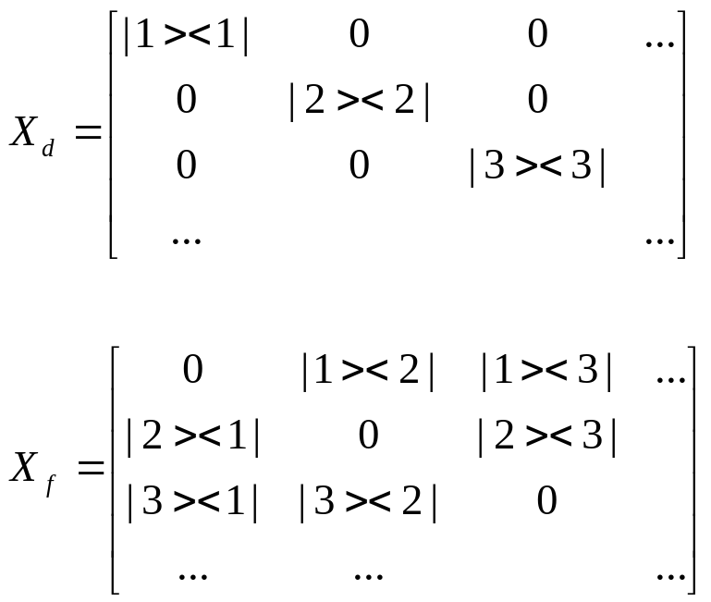
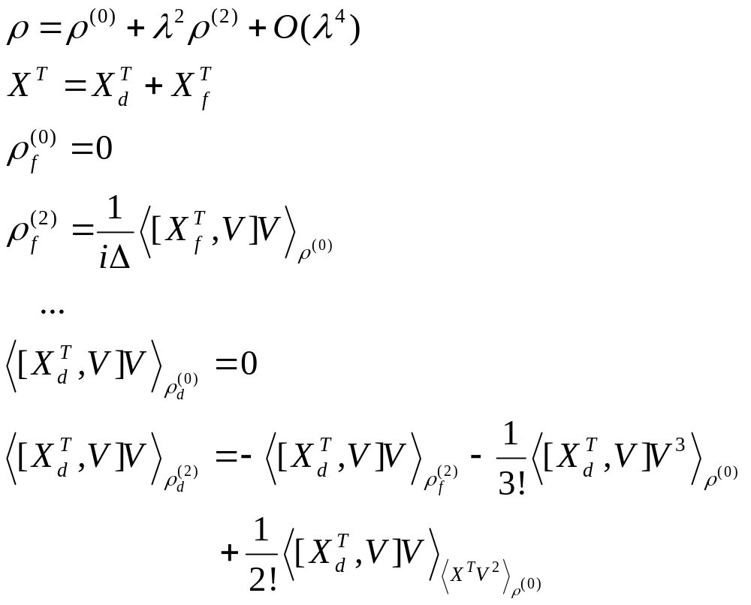
Order-by-Order Solution to ρ

Slide 10
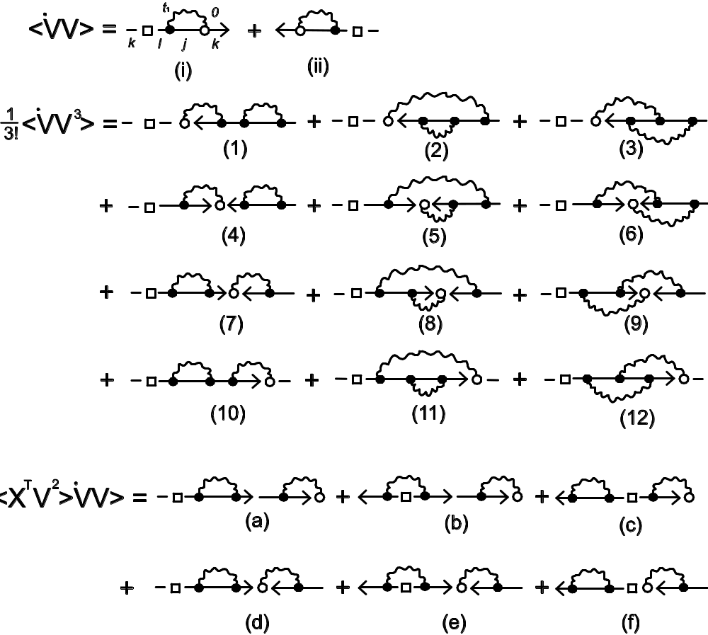
Diagrammatics for current
Diagrams representing the terms for current `V or [X ^{T},V]. Open circle has time t=0, solid dots have dummy times. Arrows indicate ordering and pointing from time -∞ to 0. Note that (4) is cancelled by (c); (7) by (d).
From Wang, Agarwalla, Li, and Thingna, Front. Phys. (2013), 9, 673 (2014).

Slide 11
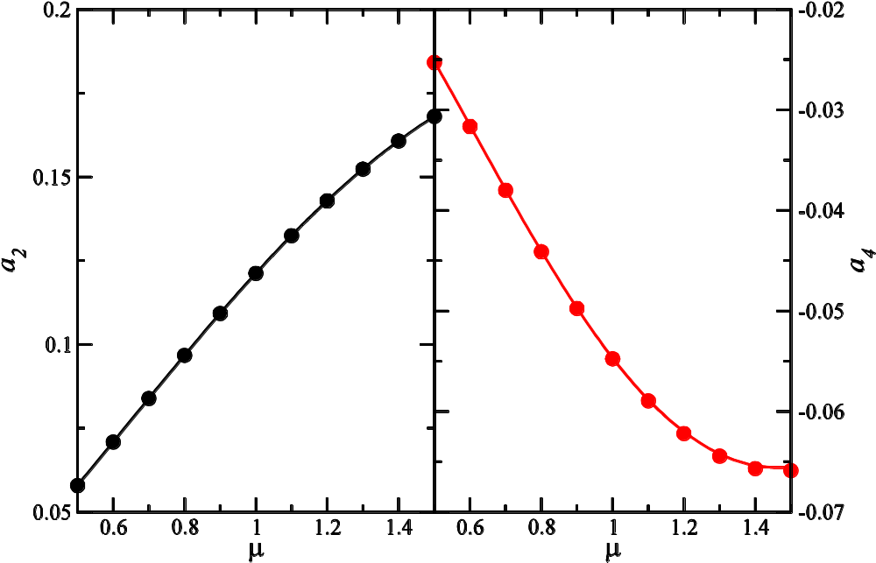
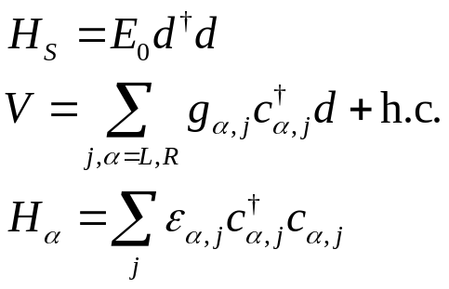
QD model to 4th order
The coefficients for the current I_{L} = a₂ η+a₄η², for the Lorentz-Drude bath spectrum Γ(E) = ηΓ/(1 + E²/D²). 50% chemical potential bias, equal temperature. Curves from NEGF, dots from 4-th order master equation.
From Thingna, Zhou, and Wang, J. Chem. Phys. 141, 194101 (2014).

Slide 12
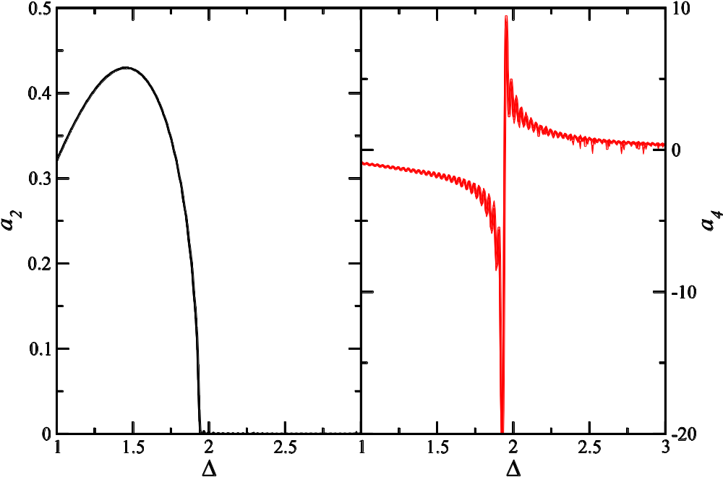
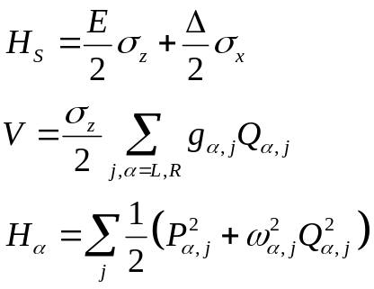
Spin-Boson Model
The coefficients for the current
I_{L} = a₂ η+a₄η²
For the spin-boson model with Rubin baths,
J(ω) = (1/2)ħηω (4 ̶ ω²)^{1/2}.
T_{L} = 1.5, T_{R}=0.5, E=0.5. We see co-tunneling features.
From Thingna, Zhou, and Wang, J. Chem. Phys. 141, 194101 (2014).

Slide 13
Second-order density matrix, analytic continuation (AC)

Slide 14
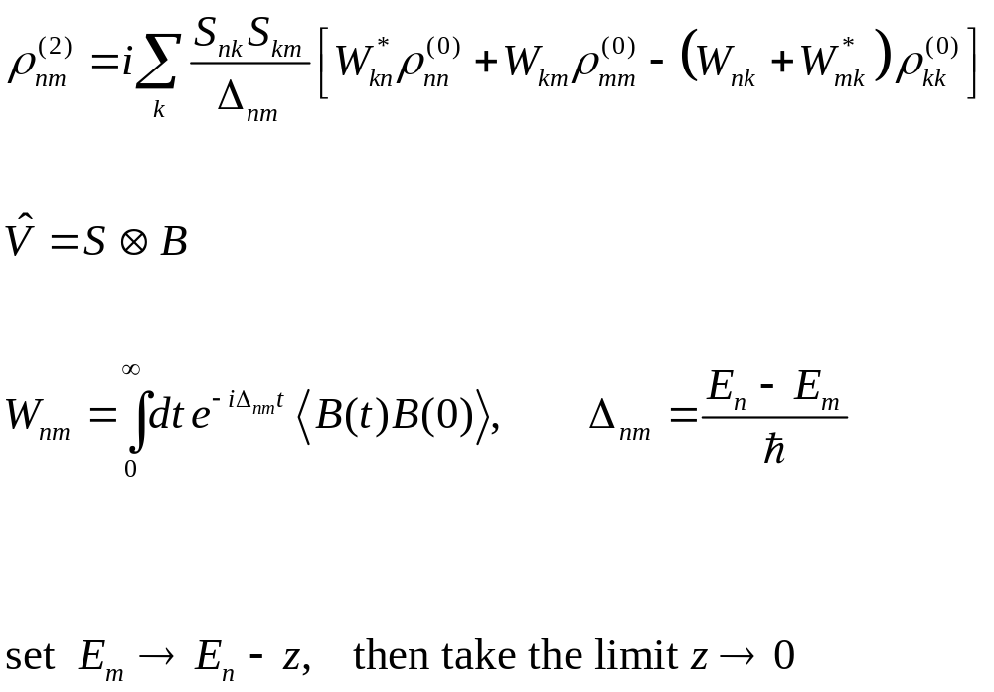
Treating the indices (n,m) as continuous variables and taking a limit n → m.

Slide 15
When AC works?
WORK FAIL TO WORK
One bath, any systems; two baths, harmonic oscillators, J. Chem. Phys. 136, 194110 (2012)
Two-bath, spin-Boson model; Two baths, single quantum dot, Thingna, Xu
Double quantum dots, Xu et al PRB 95, 035428 (2017)

Slide 16
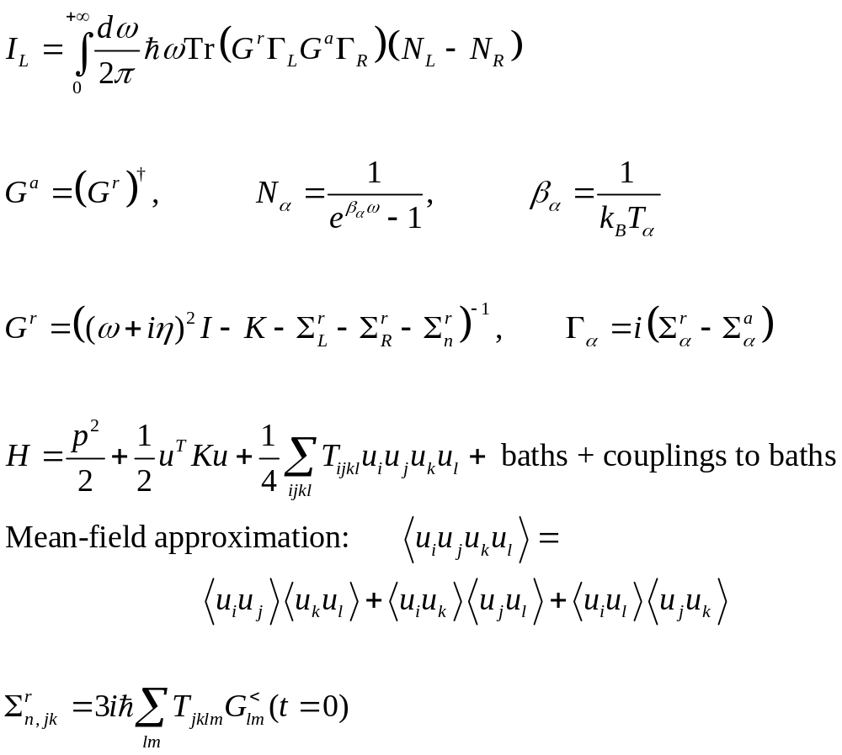
Self-consistent phonons

Slide 17
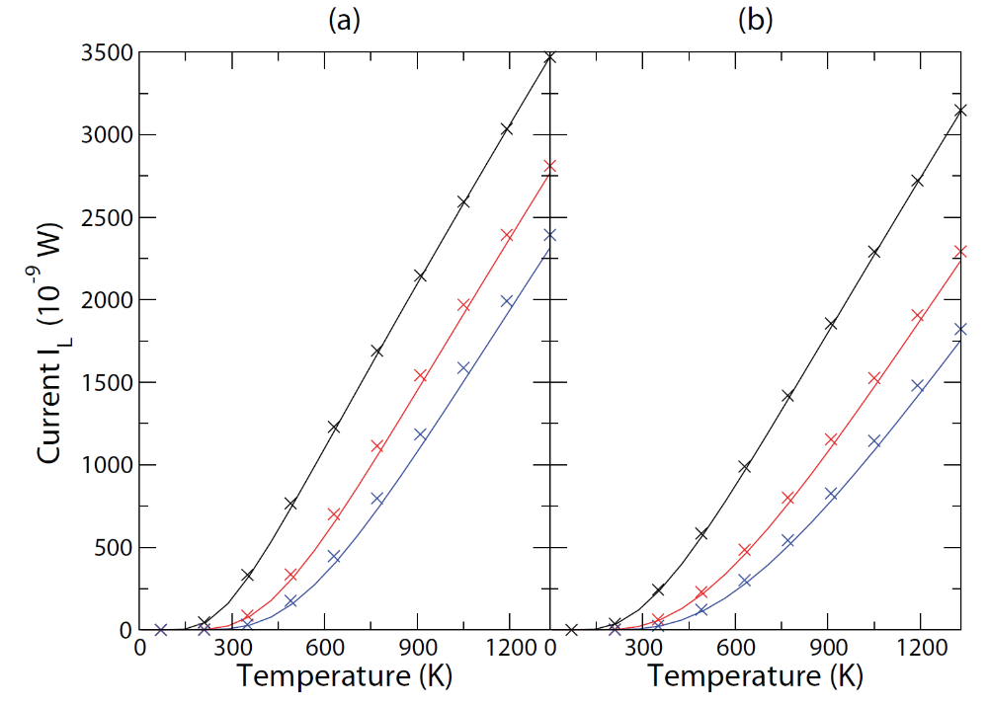
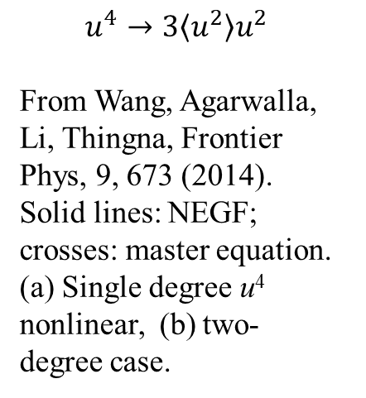
Self-consistent phonon
$$u^{4}→3\left\langle u^{2}\right\rangle u^{2}$$
From Wang, Agarwalla, Li, Thingna, Frontier Phys, 9, 673 (2014). Solid lines: NEGF; crosses: master equation. (a) Single degree u⁴ nonlinear, (b) two-degree case.

Slide 18
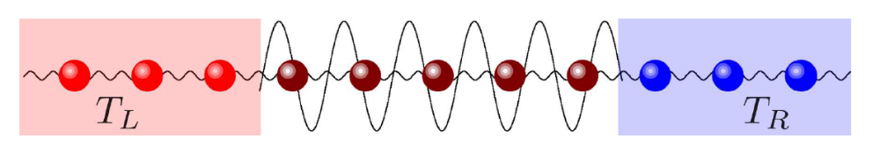
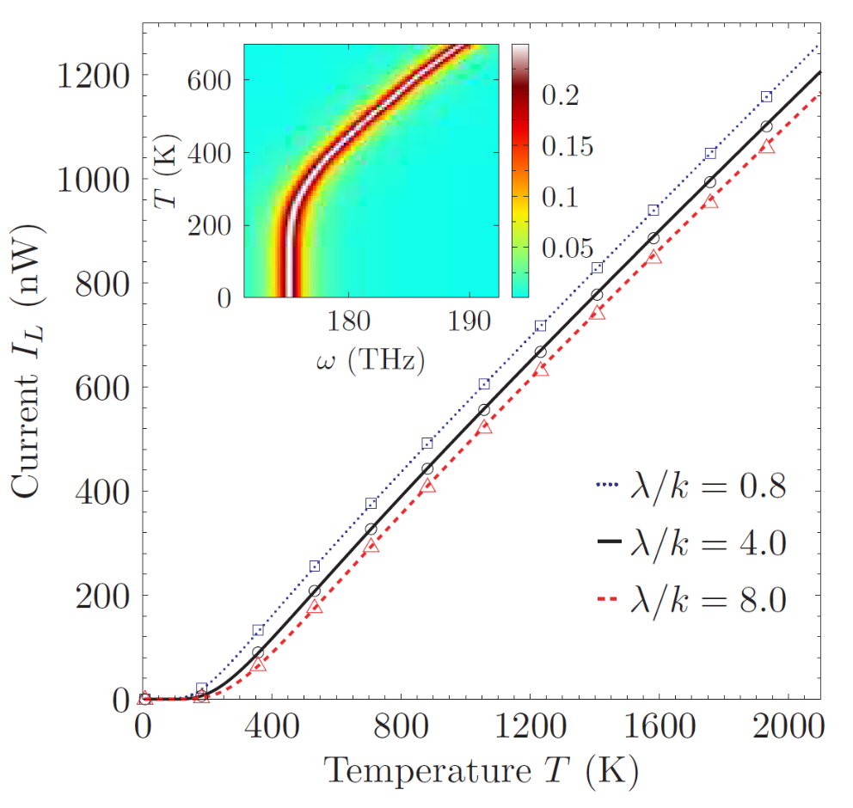
He, Thingna, Wang, Li, PRB 94, 155411 (2016). Lines: quantum self-consistent approach, symbols:
quantum master equation. Inset shows the temperature dependence of the transmission function for λ/k = 8. Lorentz-Drude baths. Common parameters are: m = 1u, k = 30.160 meV/(Å u), γ = 0.92THz, ω_{c} = 0.92PHz, and ∆ = 0.05. Bath temperature T_{L} = (1 + ∆)T, T_{R}=(1-∆)T.
Notes:
Gamma is system-bath coupling, Delta temperature bias, wc frequency in J(w) = gamma*w/(1 + (w/wc)^2).

Slide 19
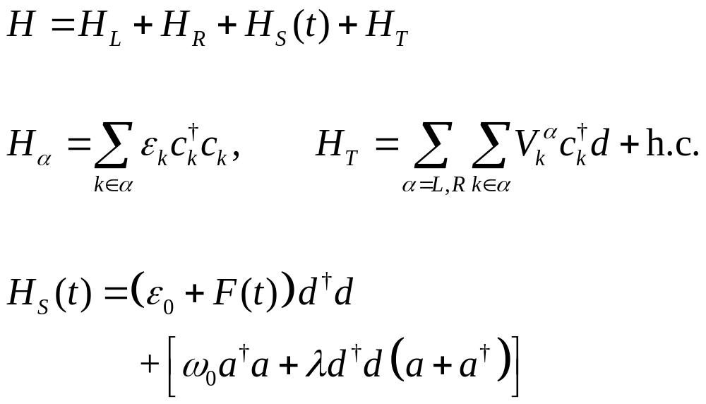
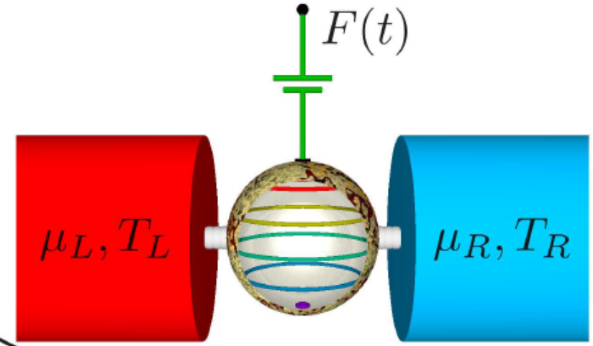
Time-dependent driven

Slide 20
Why drive the system? Can have higher efficiency
Far from thermal equilibrium
Break down of Onsager relation (due to break down of time translational invariance)

Slide 21
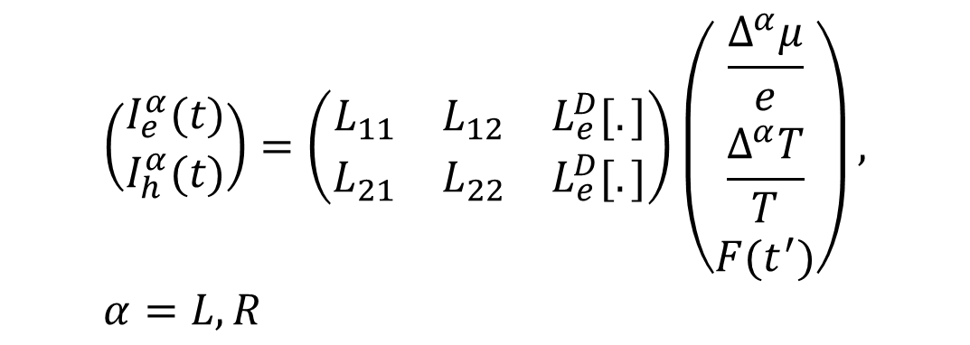
How to quantify efficiency in time-dependent situation?
Current I
$$\left(\begin{matrix}I_{e}^{α}(t) \\ I_{h}^{α}(t)\end{matrix}\right)=\left(\begin{matrix}L_{11} & L_{12} & L_{e}^{D}[.] \\ L_{21} & L_{22} & L_{e}^{D}[.]\end{matrix}\right)\left(\begin{matrix}\frac{Δ^{α}μ}{e} \\ \frac{Δ^{α}T}{T} \\ F(t^{′})\end{matrix}\right), α=L, R$$
Do this analysis for each fixed t.
ΔT or Δμ

Slide 22
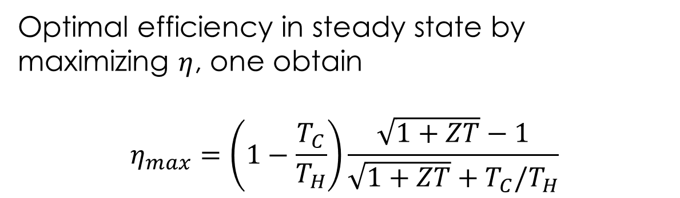

Measuring efficiency
Work done to load
$$η\left(t\right)=\frac{I_{e}^{2}R_{L}}{\frac{\det\left(L\right)R_{M}ΔT}{T}+L_{21}R_{M}I_{e}−\frac{I_{e}^{2}R_{M}}{2}}$$
Entropy flow
Joule heat flow back
Peltier heat
Optimal efficiency in steady state by maximizing $η$, one obtain
$$η_{max}=\left(1−\frac{T_{C}}{T_{H}}\right)\frac{\sqrt{1+ZT}−1}{\sqrt{1+ZT}+T_{C}/T_{H}}$$
See, eg., H J Goldsmid, “Intro to thermoelectricity.”

Slide 23
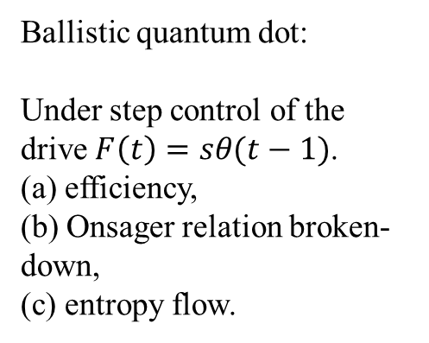
Efficiency enhancement by driven
Ballistic quantum dot:
Under step control of the drive $F\left(t\right)=sθ(t−1)$.
(a) efficiency,
(b) Onsager relation broken-down,
(c) entropy flow.
Zhou, et al, arXiv:1505.06132

Slide 24
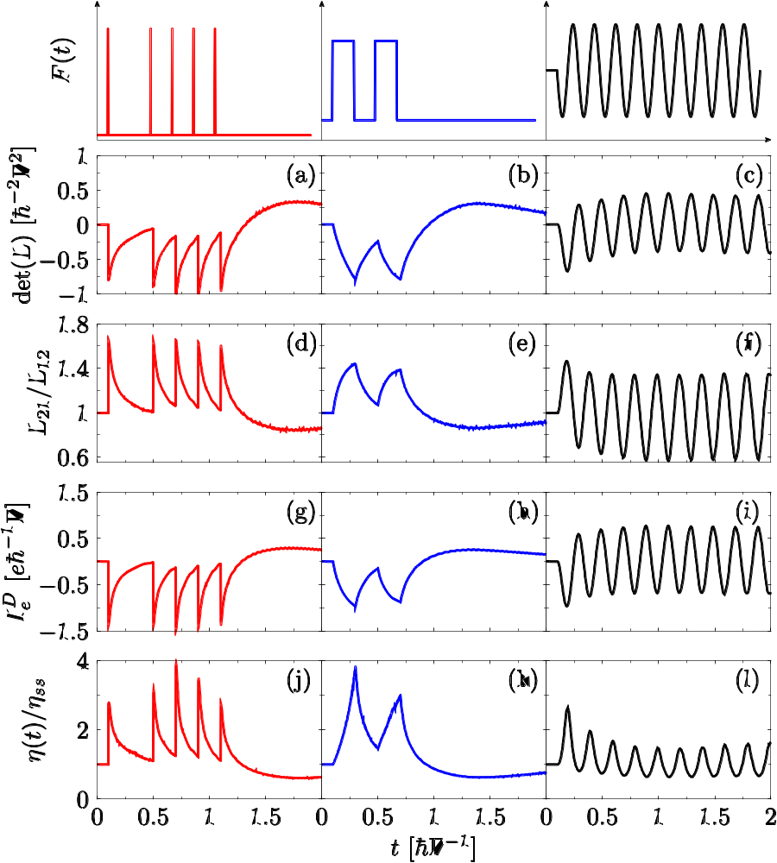
Wave form of drive.
Entropy transport
Breakdown of Onsager relation
Displacement current
Normalized efficiency
From Zhou, Thingna, Haangi, Wang, Li, Scientific Rep 5, 14870 (2015).

Slide 25
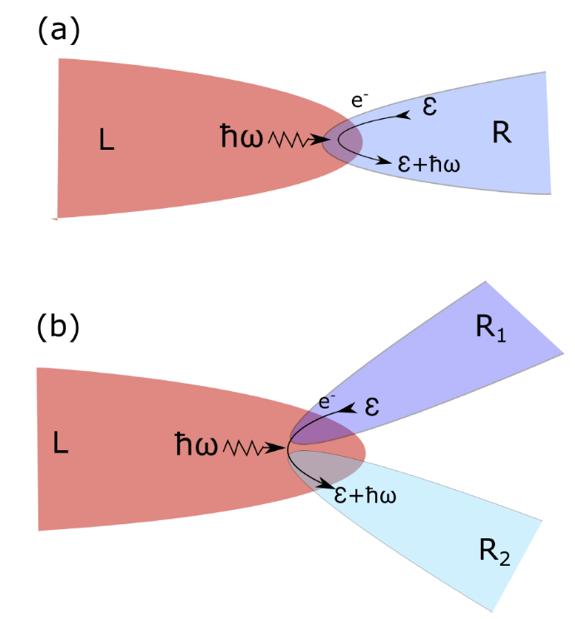
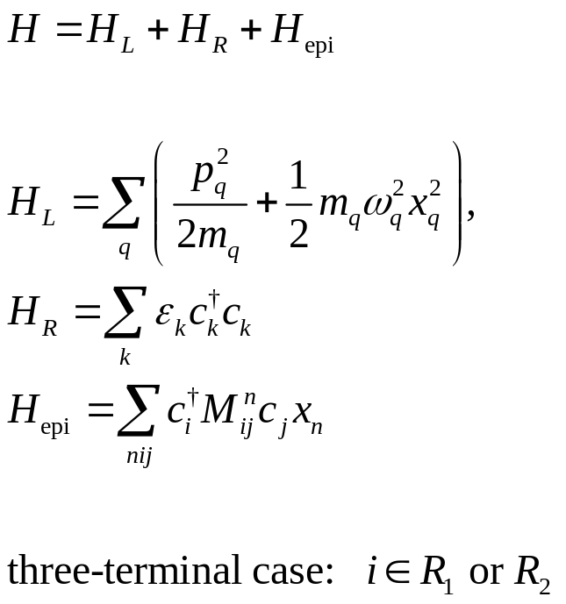
Three-terminal interface
(a) Insulator emits phonons to conductor. (b) Electron hop to the other conductor due to phonon absorption/emission in insulator.

Slide 26
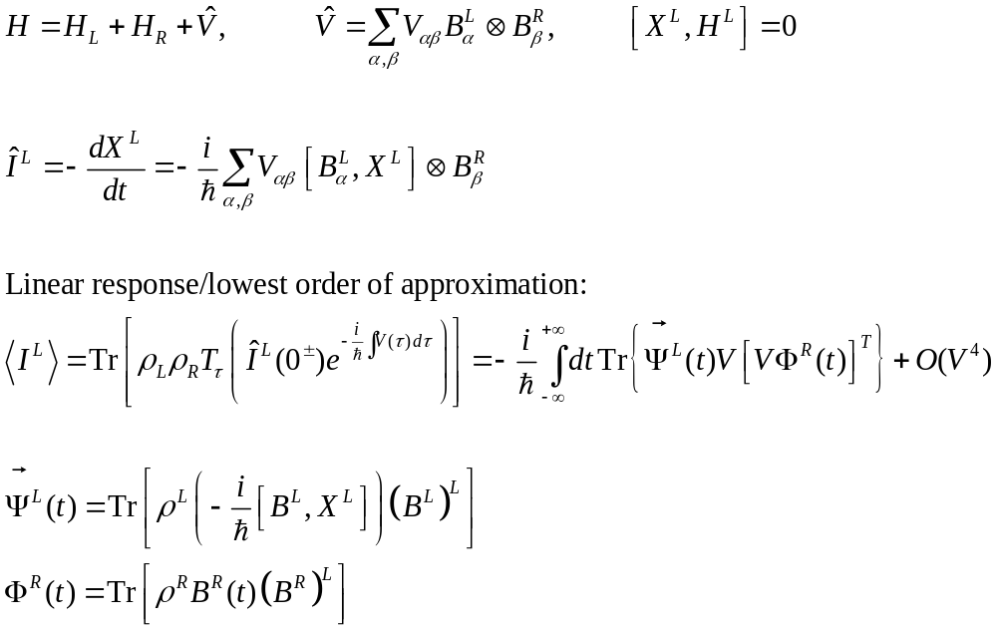
Two (or three) baths, no center

Slide 27
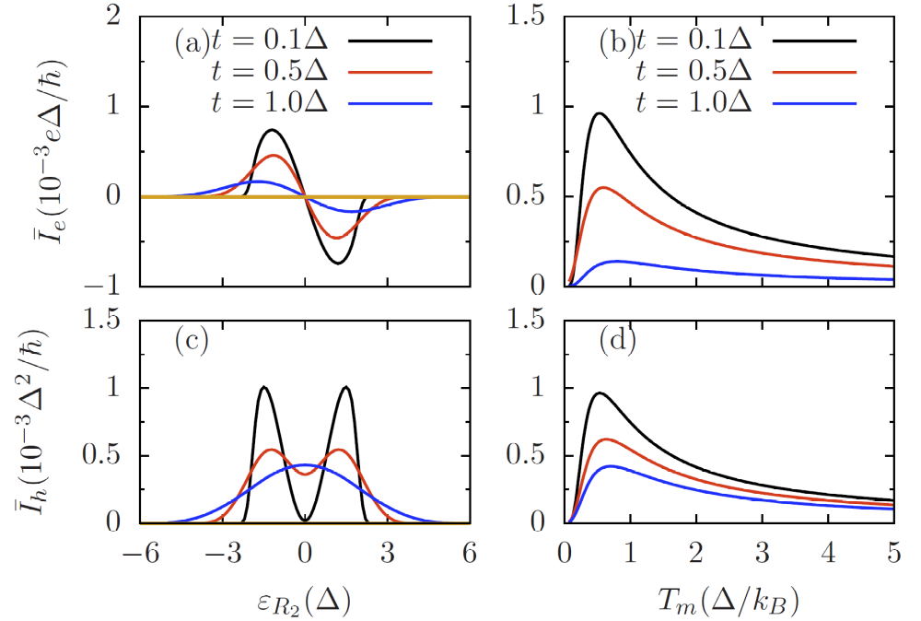
Current under no temperature bias
From Zhou, Zhang, Wang, Zhang, PRB 101, 235305 (2020). Electric current (a) and (b) when T_{R1}=T_{R2}=Δ, T_{L}=1.1 Δ, varying onsite potential ε_{R2} (ε_{R1}=0). (c) and (d) corresponding heat current. 1D Rubin bath for phonons and 1D chain tight-binding electrons.

Slide 28
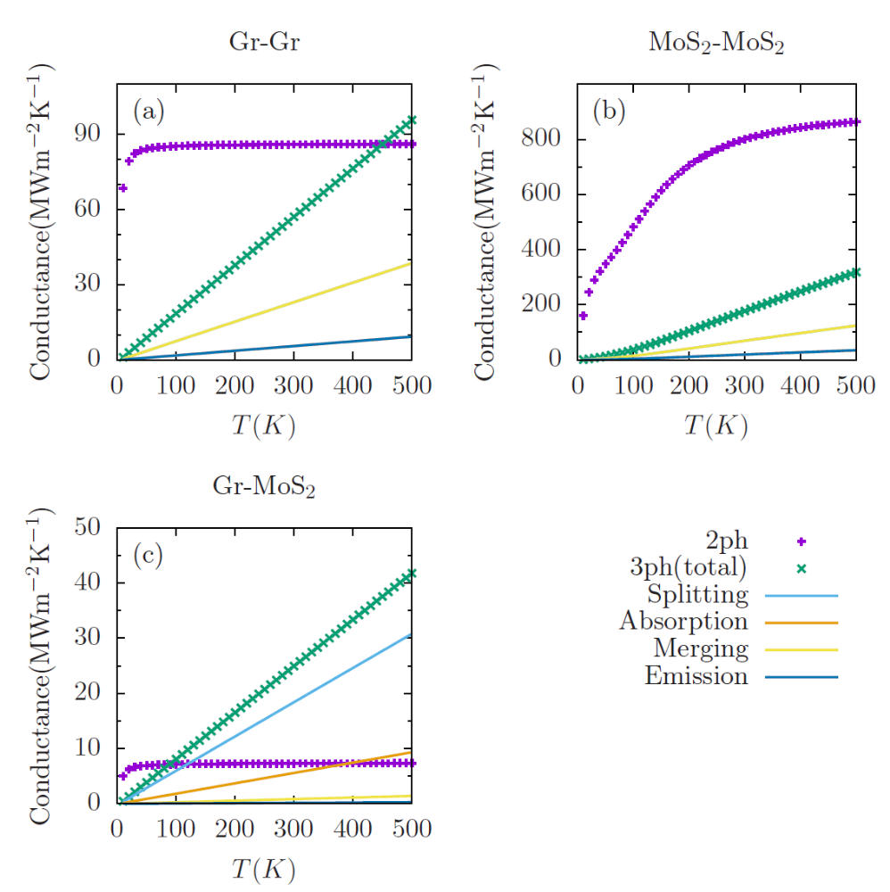
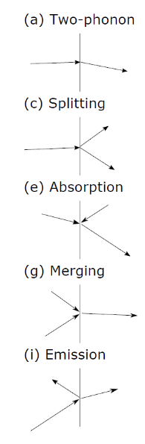
Three-phonon scattering at interface
From Zhou, et al (in preparation).
The energy current can be written in a Landauer form with temperature dependent transmission coefficient.

Slide 29
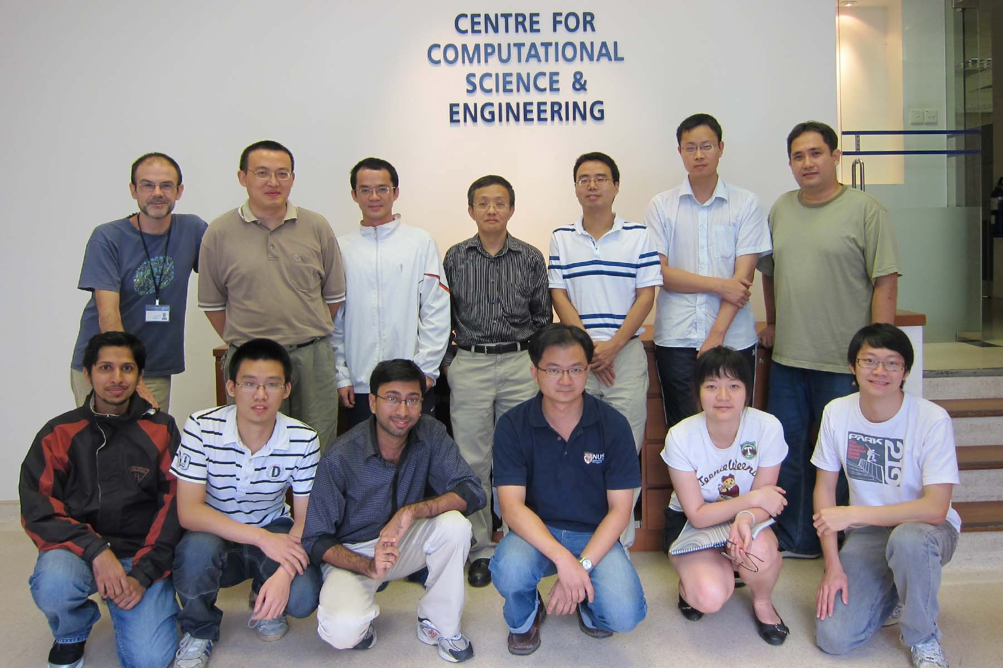
Acknowledgements
Jose Luis Garcia Palcios
Juzar YahyaThingna
Hangbo Zhou

