Slide 1

Nonequilibrium Green’s Functions – definition, fluctuation-dissipation theorem, Meir-Wingreen formula, etc
KITP, UC Santa Barbara - Emerging regimes and implications of quantum and thermal fluctuational electrodynamics
Wang Jian-Sheng
Notes:
This is a set of lectures first delivered for the CSRC summer school on transport, 17-21 June 2019. CSRC: Beijing Computational Science Research Center.

Slide 2
Outline
Lecture 0: Electron Green’s functions
Lecture 1: NEGF – brief history, phonons/harmonic oscillator example
Lecture 2: NEGF “technologies” – equation of motion method, Langreth rules, heat current formula (Meir-Wingreen, Landauer).
Notes:
This set of lectures is on basic concepts and fundamental techniques. The formulas are well-known. However, as a (theoretical) physicist, one is not satisfied with a given formula and how to use it, but one want to know now it is derived, and what it’s limitations are. So that one can apply the technique to new situations. Many-body physics theories are fundamental to understand the lectures fully, such are discussed in books as such Fetter-Walecka, Mahan, etc. Although we mainly focus on thermal transport, my aim is on general non-equilibrium transport, not necessarily thermal.

Slide 3
References
J.-S. Wang, J. Wang, and J. T. Lü, “Quantum thermal transport in nanostructures,” Eur. Phys. J. B 62, 381 (2008).
J.-S. Wang, B. K. Agarwalla, H. Li, and J. Thingna, “Nonequilibrium Green’s function method for quantum thermal transport,” Front. Phys. 9, 673 (2014).
J.-S. Wang, J. Peng, Z.-Q. Zhang, Y.-M. Zhang, and T. Zhu, “Transport in electron-photon systems”, manuscript in preparation.
Notes:
See also https://www.physics.nus.edu.sg/~phywjs/NEGF/negf.html for the links to the arxiv version of the review papers. The reference books are:
H. Haug & A.-P. Jauho, “Quantum Kinetics in Transport and Optics of Semi-conductors,” Springer-Verlag 1996.
J. Rammer, “Quantum Field theory of non-equilibrium states”, Cambridge University Press, 2007.
S. Datta, “Electronic transport in mesoscopic systems,” Cambridge Univ Press, 1995.
G. Stefanucci and R van Leeuwen, “Nonequilibrium Many-Body Theory of Quantum Systems, a modern introduction,” Cambridge Univ Press, 2013.

Slide 4
Lecture Zero
Green’s function for free electrons
Notes:
Lecture zero on some preliminary concepts on Green’s functions of the electrons.

Slide 5
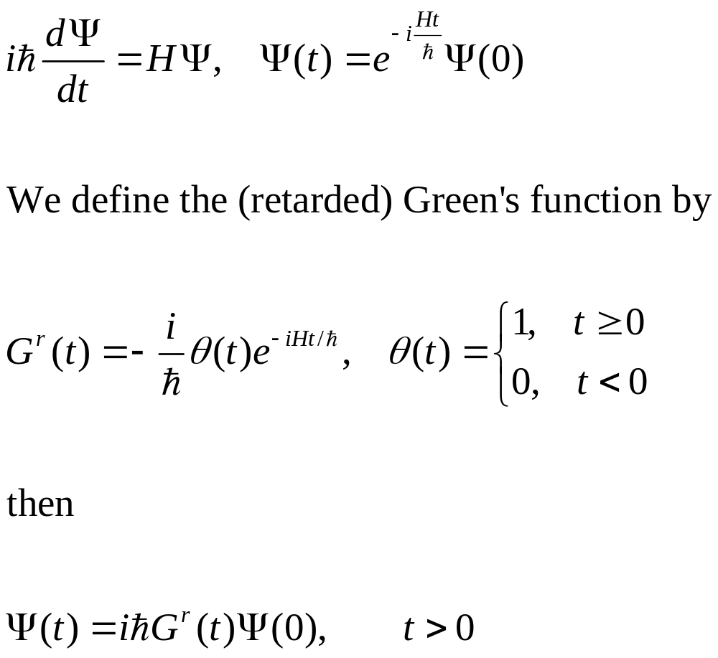
Single electron quantum mechanics
Notes:
In a particular representation, since H is 2x2 matrix, Psi a column vector, so the Green’s function G is also 2x2 matrix.

Slide 6
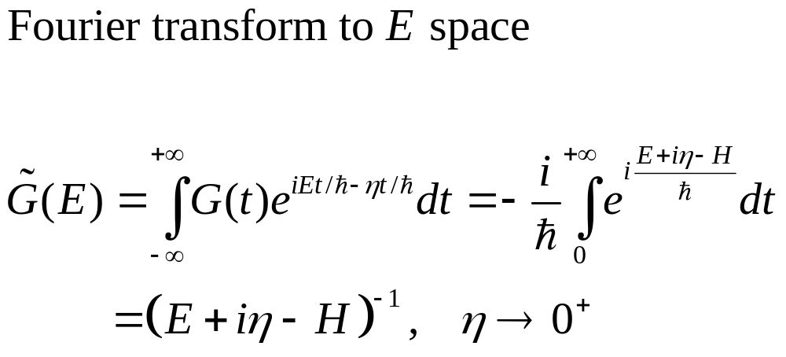
Green’s function in energy space
${\left(z−H\right)}^{−1}$ is called resolvent of the operator $H$.
Notes:
Here z or E or i*eta really means the constant type the identity matrix I. The small eta 1) makes the integral converge, 2) makes the inverse Fourier transform well defined (which produce the theta(t) in the retarded Green’s function).

Slide 7
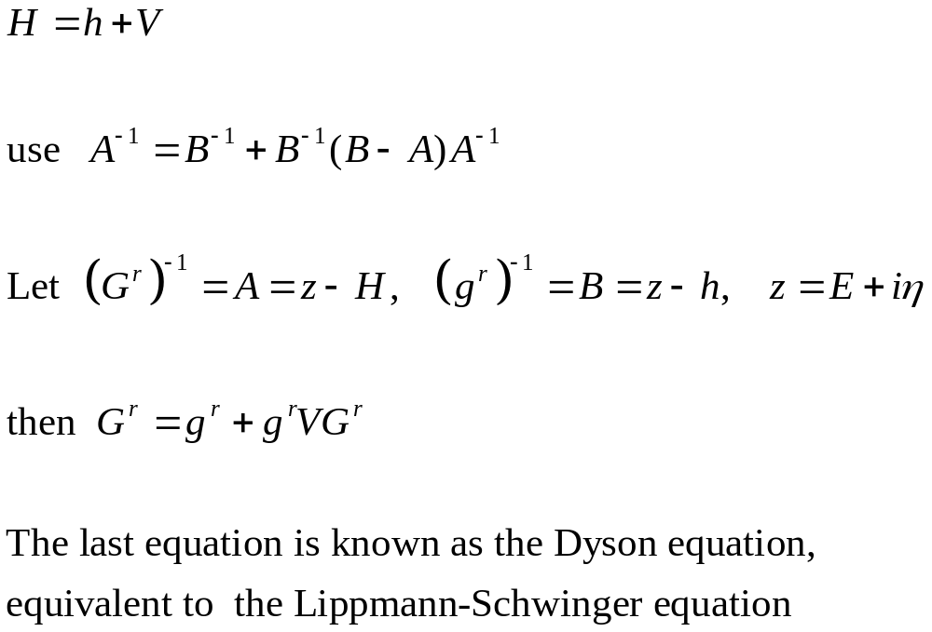
Perturbation theory, single electron

Slide 8
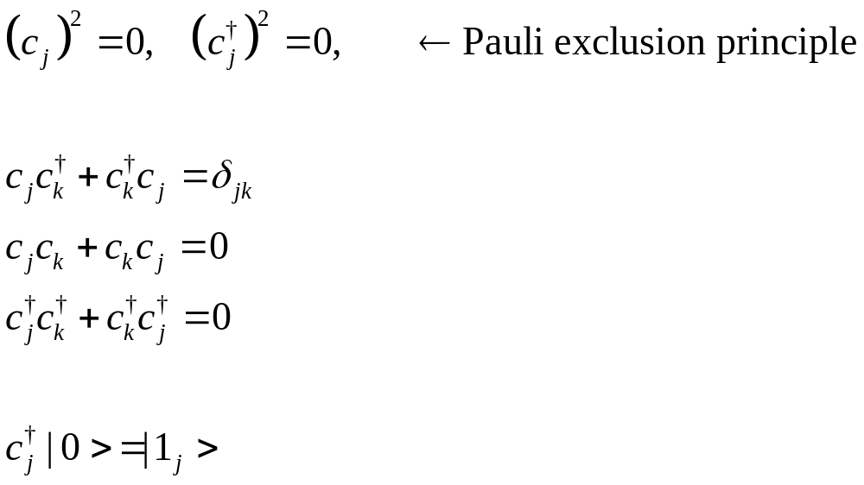
Annihilation/creation operators
defining property of fermion

Slide 9
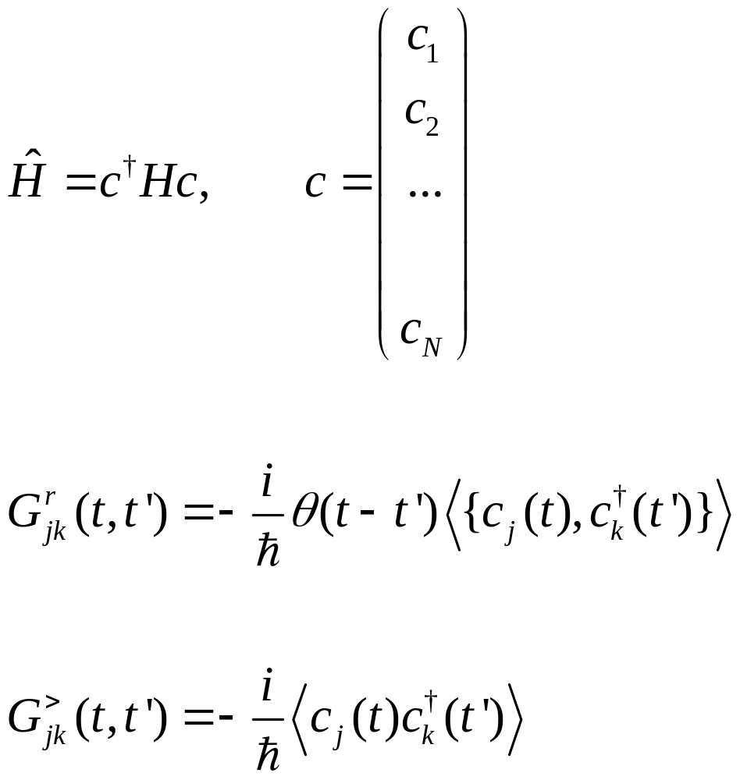
Many-electron Hamiltonian and Green’s functions
Annihilation operator c is a column vector, H is N by N matrix. {A, B} =AB+BA
Notes:
Various other Green’s functions (G<, G>, G^r, G^a, G^t, G^tbar) will be defined later for phonon. The form and relation among Greens are such so that phonon and electrons are the same. See slide 54, 55.

Slide 10
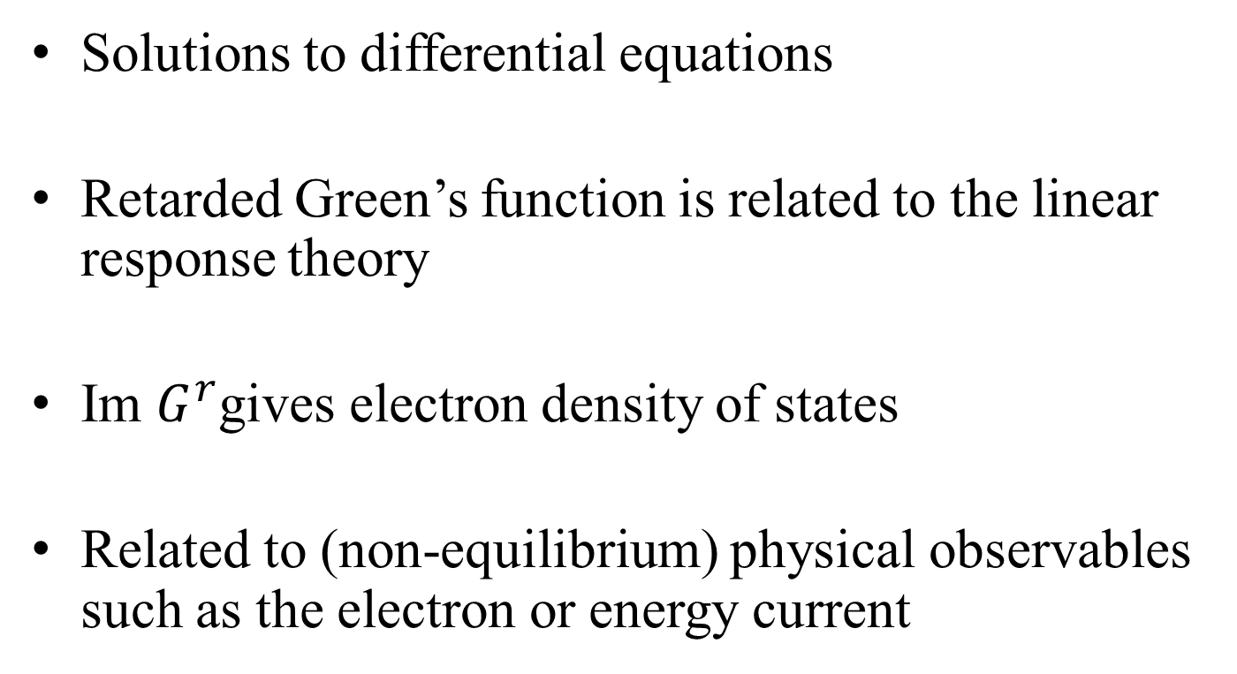
Why Green’s functions?
Solutions to differential equations
Retarded Green’s function is related to the linear response theory
Im $G^{r}$gives electron density of states
Related to (non-equilibrium) physical observables such as the electron or energy current

Slide 11
end of lecture zero

Slide 12
Lecture Two
History, definitions, properties of NEGF

Slide 13
A Brief History of NEGF
Schwinger 1961
Kadanoff and Baym 1962
Keldysh 1965
Caroli, Combescot, Nozieres, and Saint-James 1971
Meir and Wingreen 1992
Notes:
Schwinger introduced earliest g<, g>, g^t, g^t_bar. Kadanoff and Baym had their famous book “quantum statistical mechanics”, Keldysh emphasized the contour order and its usefulness for diagrammatic expansion, Caroli perhaps first apply to transport, and we now have the Meir-Wingreen formula for current when the center is interactive.

Slide 14
Equilibrium Green’s functions using a harmonic oscillator as an example
Single mode harmonic oscillator is a very important example to illustrate the concept of Green’s functions as any phononic system (vibrational degrees of freedom in a collection of atoms) and photonic system at ballistic (linear) level can be thought of as a collection of independent oscillators in eigenmodes. Equilibrium means that system is distributed according to the Gibbs canonical distribution.

Slide 15
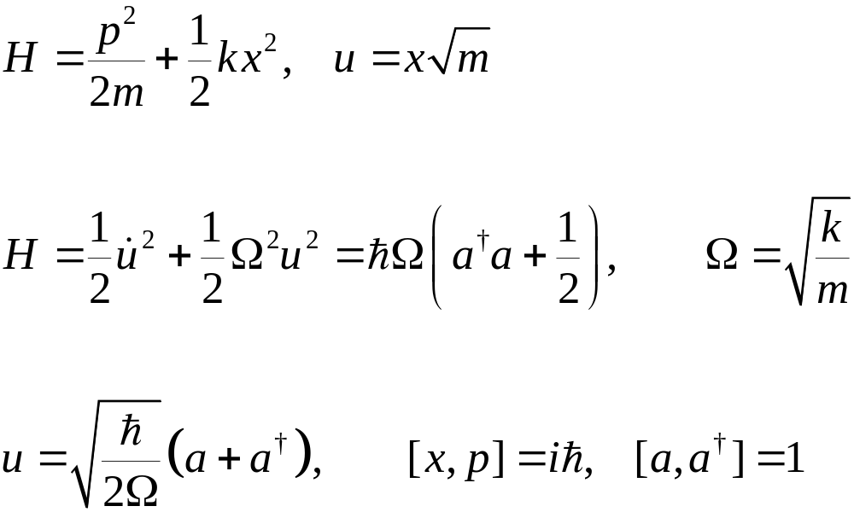
Harmonic Oscillator
k
m
Notes:
du/dt = sqrt(hbar/(2Omega)) ( - a + a\dagger) (i Omega). The harmonic oscillator is also fundamental in the quantum field of photon, e.g.

Slide 16
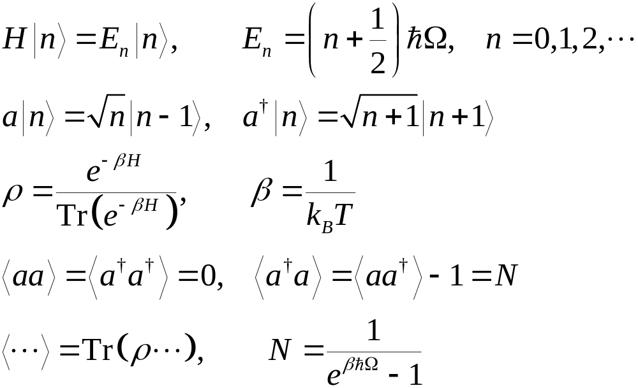
Eigenstates, Quantum Mech/Stat Mech

Slide 17
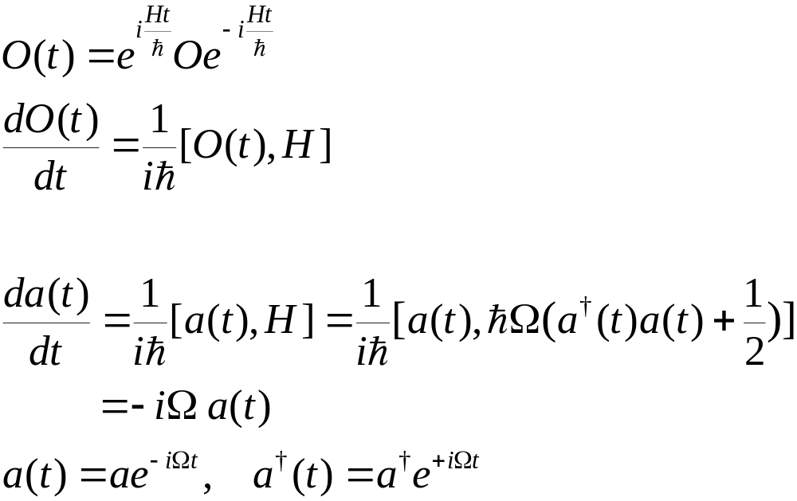
Heisenberg Operator/Equation
O: Schrödinger operator
O(t): Heisenberg operator

Slide 18

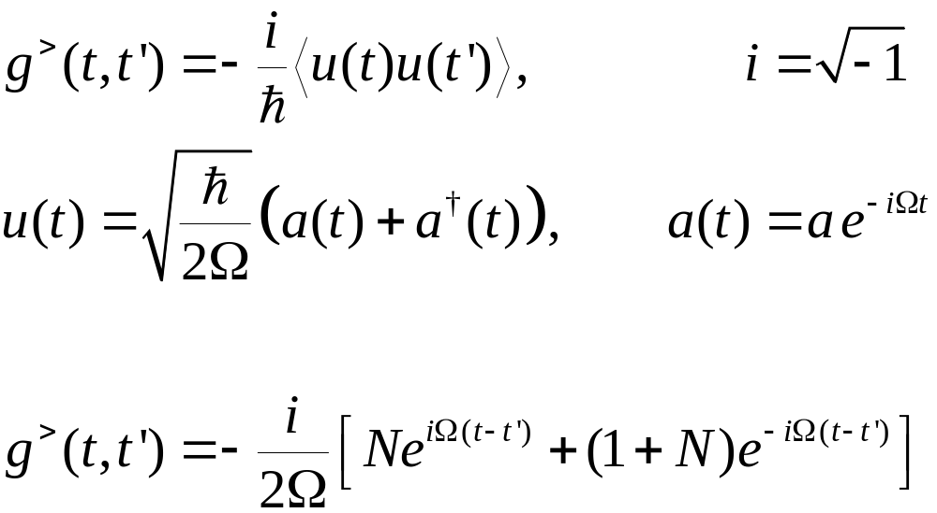
Defining >, <, t, Green’s Functions
Notes:
Derive the last equation from the top definition.

Slide 19
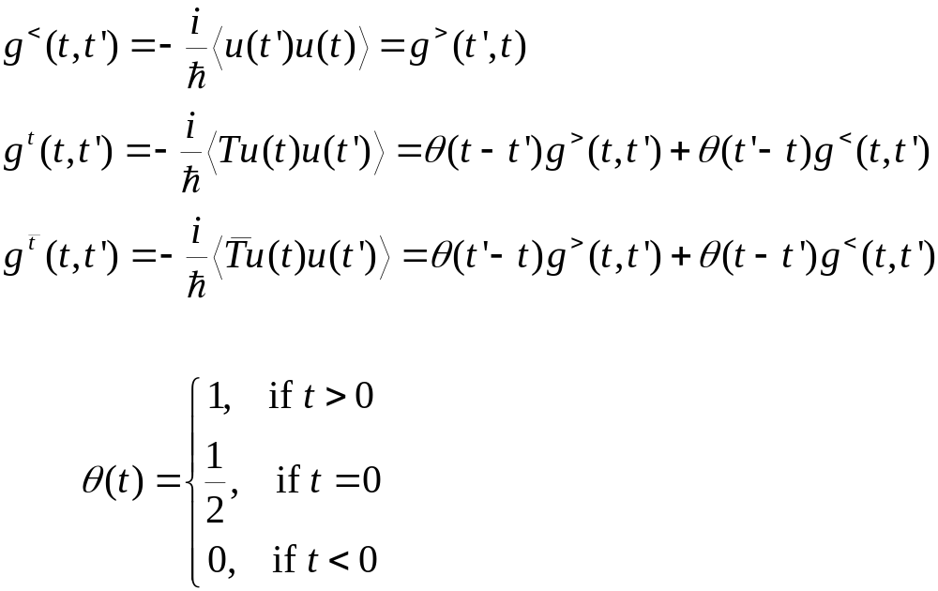
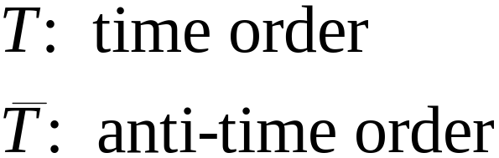
Notes:
T, Ť are called super-operator, as it act on the operator, not in the vector of Hilbert space. What to define for theta(0) is a bit arbitrary/controversy.

Slide 20
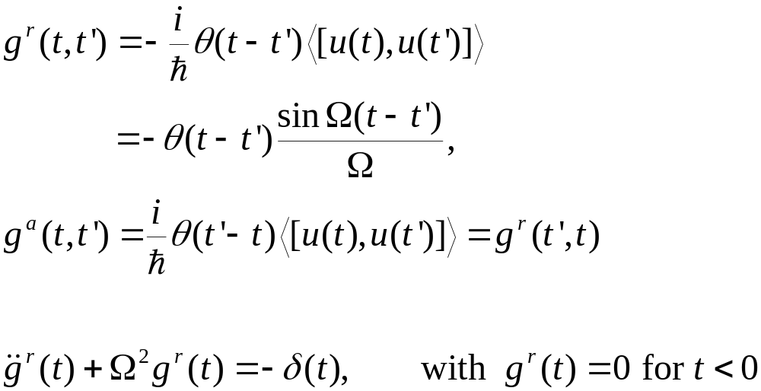
Retarded and Advanced Green’s functions

Slide 21
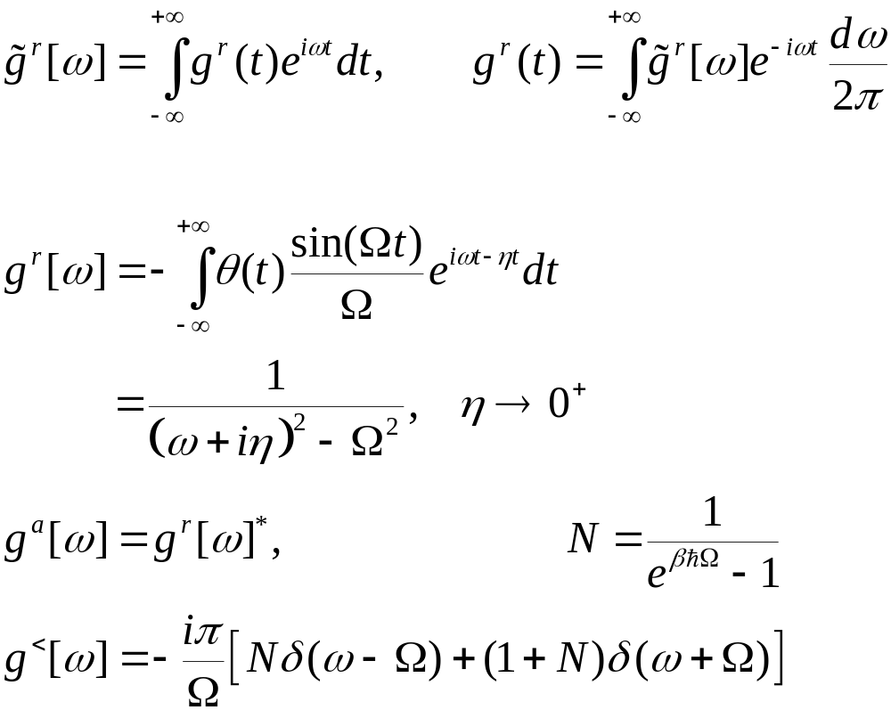
Fourier Transform
Notes:
We use the convention that planewave is exp(ik.r – i ωt).

Slide 22
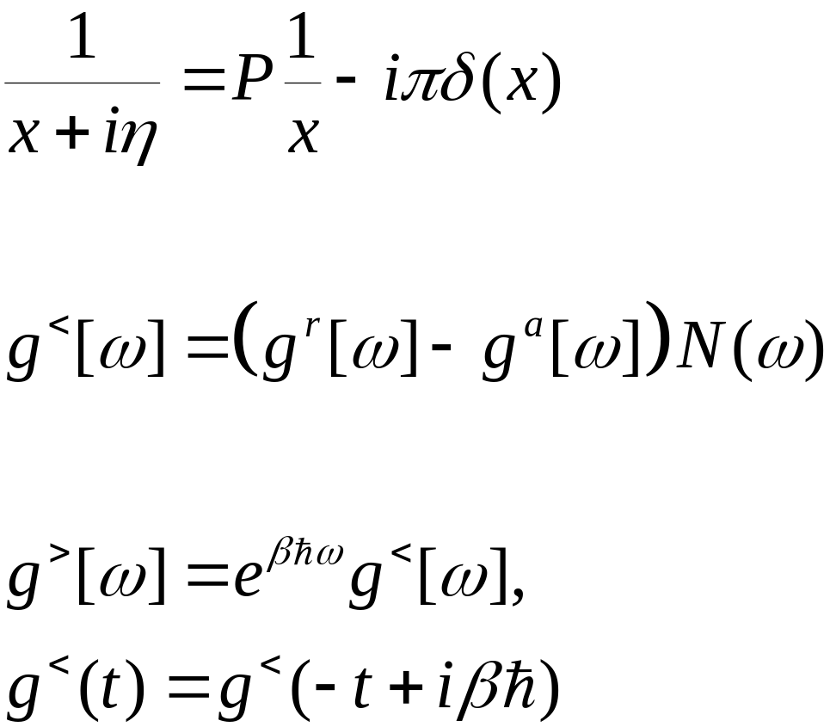
Plemelj formula, fluctuation-dissipation, Kubo-Martin-Schwinger condition
P for Cauchy principle value
Valid only in thermal equilibrium

Slide 23
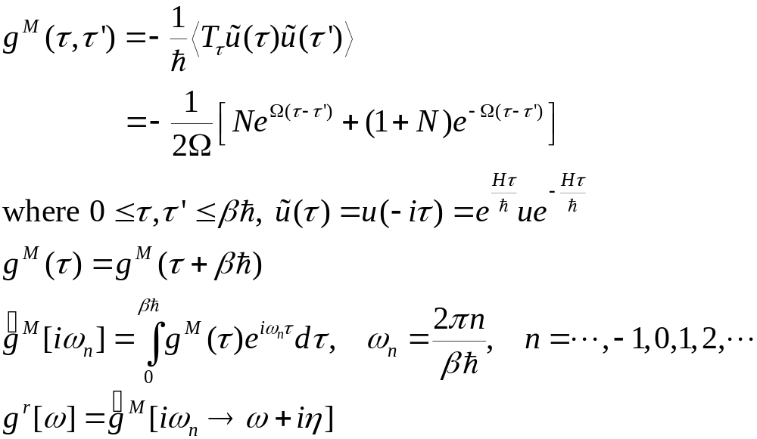
Matsubara Green’s Function
Notes:
What periodicity/boundary do we have for fermion?

Slide 24
Nonequilibrium Green’s Functions
By “nonequilibrium”, we mean, either the Hamiltonian is explicitly time-dependent after t₀, or the initial density matrix ρ is not a canonical distribution.
We’ll show how to build nonequilibrium Green’s function from the equilibrium ones through product initial state or through the Dyson equation.

Slide 25
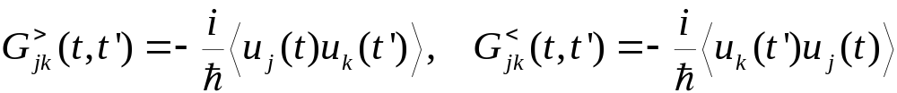
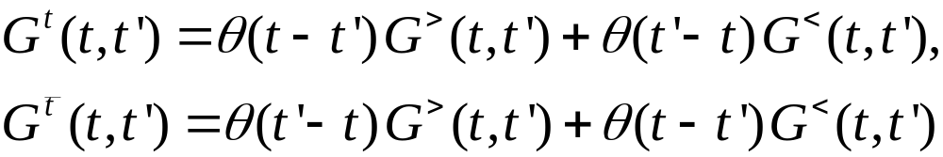
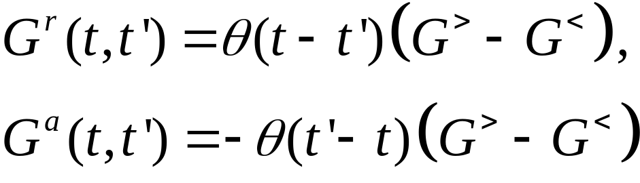
Definitions of General Green’s functions (phonon/displacement)
Notes:
Other types such as Matsubara Green’s function or canonical (Kubo) correlation are also used. i = sqrt(-1). The average < … > can be equilibrium or with respect to arbitrary density matrix. For classical systems, G< = G>.
25

Slide 26
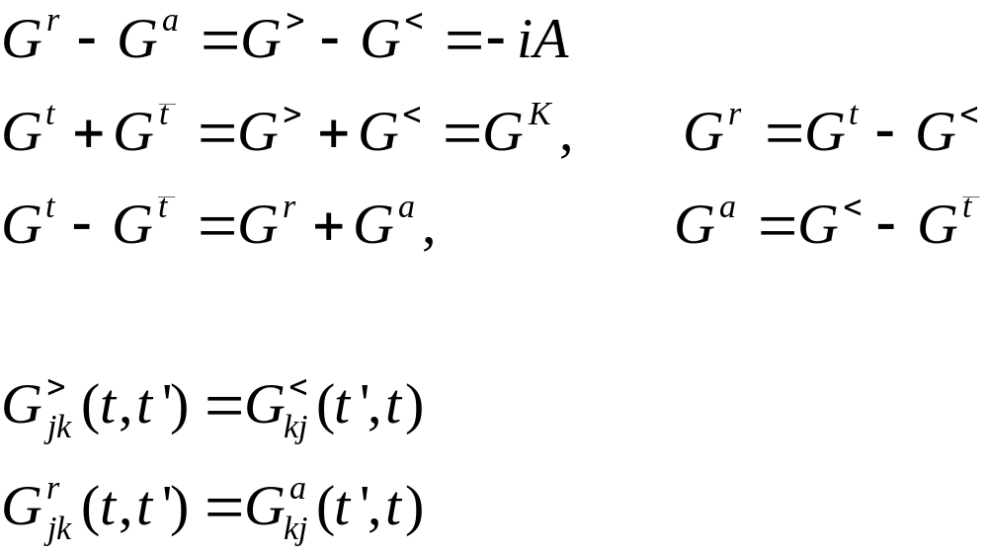
Relations among Green’s functions
Notes:
The relation implies two (three?) linearly independent ones, and one independent one only if nonlinear dependence is considered. Does self-energy has similar relations?
26

Slide 27
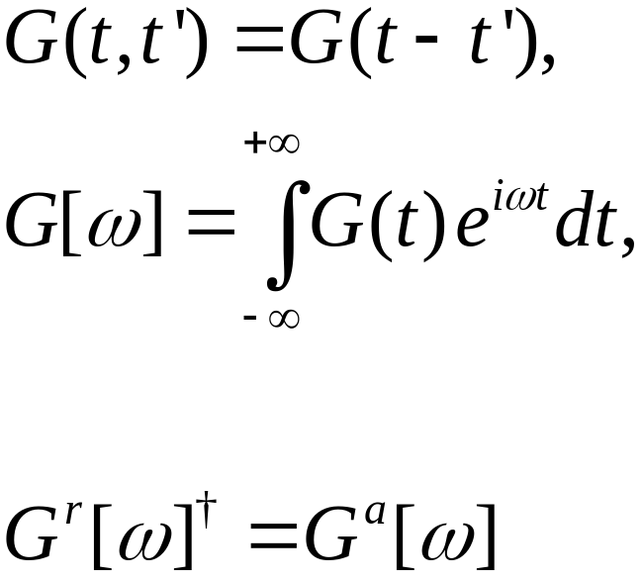
Steady state, Fourier transform
Notes:
The inverse Fourier transform has a factor of 2 . We use square brackets [ ] to denote Fourier transformed function. For more general relation of Gr and Ga, see my handwritten notes on NEGF for electrons.
27

Slide 28
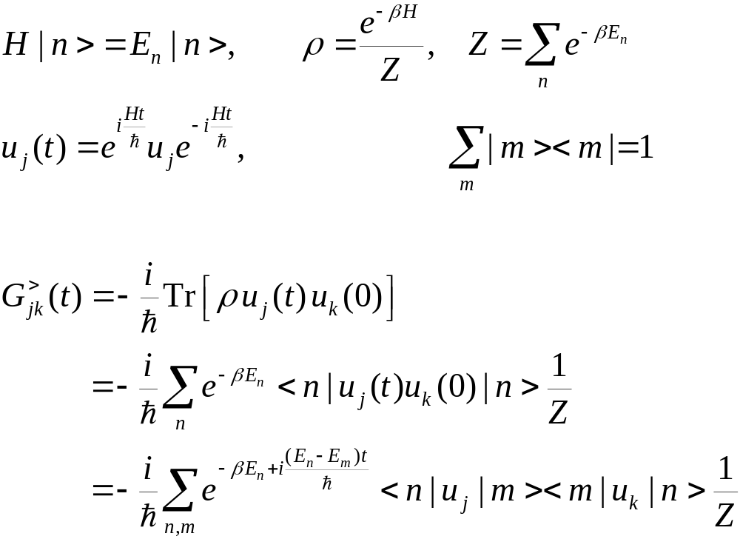
Equilibrium Green’s Function, Lehmann Representation
Notes:
Lehmann representation is to expand everything in the eigenstates. Using the Lehmann representation, one can relate G> with G<, as well relate them to G^r-G^a.

Slide 29
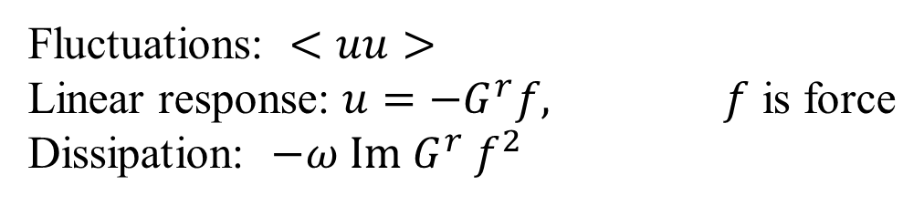
Fluctuation-Dissipation Theorem
(Callen-Welton 1951)
$G^{<}\left(ω\right)=N\left(ω\right)\left(G^{r}\left(ω\right)−G^{a}\left(ω\right)\right)$
$G^{>}\left(ω\right)=(1+N\left(ω\right))\left(G^{r}\left(ω\right)−G^{a}\left(ω\right)\right)$
Fluctuations: $<uu>$
Linear response: $u=−G^{r}f, f$ is force
Dissipation: $−ω Im G^{r} f^{2}$

Slide 30
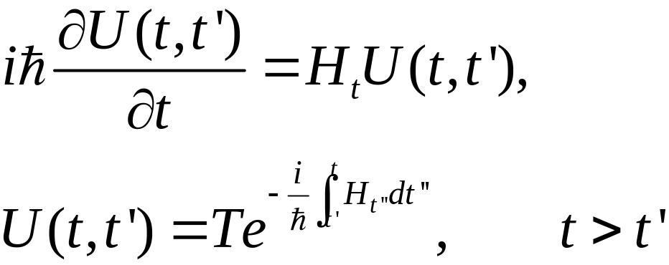
Pictures in Quantum Mechanics
Schrödinger picture: O, Ψ(t) =U(t,t₀)Ψ(t₀)
Heisenberg picture: O(t) = U(t₀,t)OU(t,t₀) , ρ₀, where the evolution operator U satisfies
See, e.g., Fetter & Walecka, “Quantum Theory of Many-Particle Systems.”
Notes:
< . > = Tr(ρ . ). T here denotes time order, assuming t > t’. Anti-time order if t < t’.
30

Slide 31
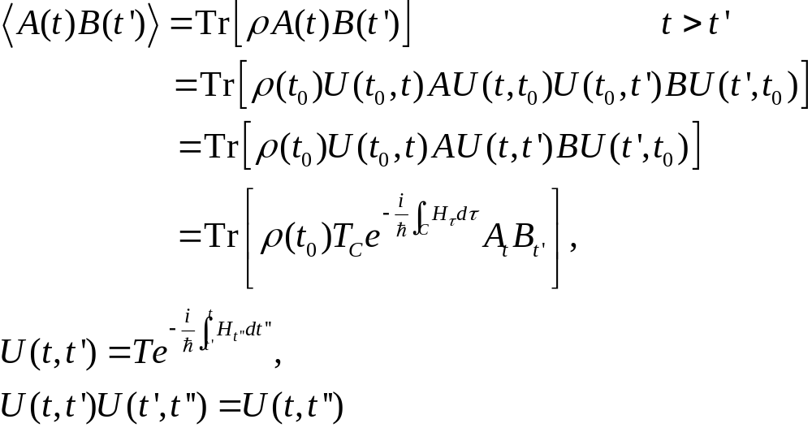
Calculating correlation
B
A
t₀
t’
t
Notes:
t₀ is the synchronization time where the Schrödinger picture and Heisenberg picture are the same.
31

Slide 32
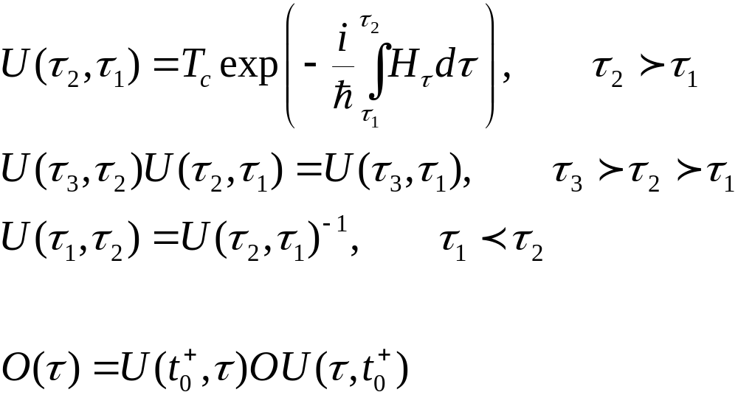
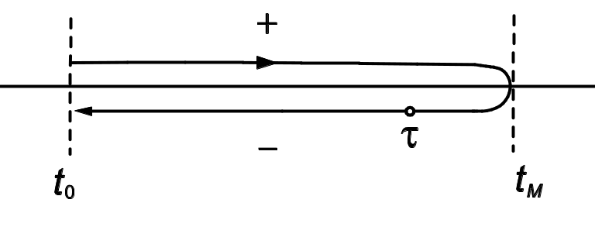
Evolution Operator on Contour
Keldysh contour

Slide 33
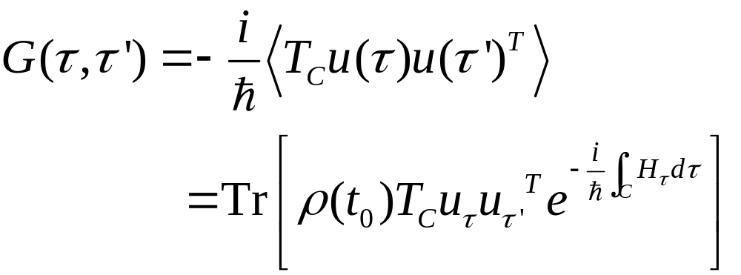
Contour-ordered Green’s function
Contour order: the operators earlier on the contour are to the right. See, e.g., H. Haug & A.-P. Jauho.
τ’
τ
t₀
Notes:
33

Slide 34
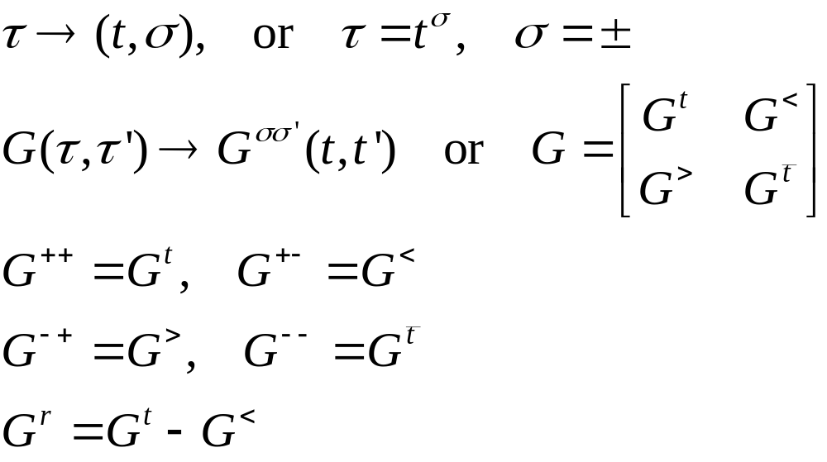
Relation to real-time Green’s functions
τ’
τ
t₀
Notes:
σ = + for the upper branch, and – for the returning lower branch.
34

Slide 35
end of lecture two

Slide 36
Lecture three
Calculus on contour, equation of motion method, current, etc
Notes:
This lecture is the real meat of NEGF.

Slide 37
Equation of Motion Method
The advantage of equation of motion method is that we don’t need to know or pay attention to the distribution (density operator) ρ. The equations can be derived quickly.
The disadvantage is that we have a hard time justified the initial/boundary condition in solving the equations.
Diagrammatic expansion (initial product states satisfy Wick’s theorem)

Slide 38
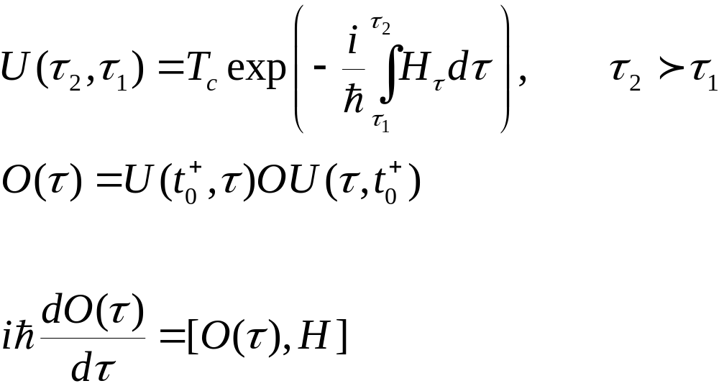
Heisenberg Equation on Contour
Notes:
The integral on the exponential is from a point tau_1 specified on the contour to tau_2 at a later point on the contour. The integral is along the contour.

Slide 39
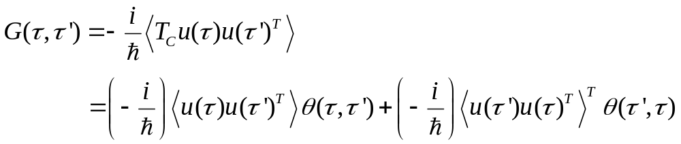
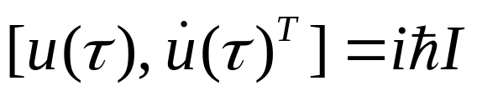
Express contour order using theta function
Operator A(τ) is the same as A(t) as far as commutation relation or effect on wavefunction is concerned
Notes:
u u^{T} is a square matrix, and [u, v^{T}] is a matrix formed by (j,k) element [u_{j}, v_{k}].
39

Slide 40
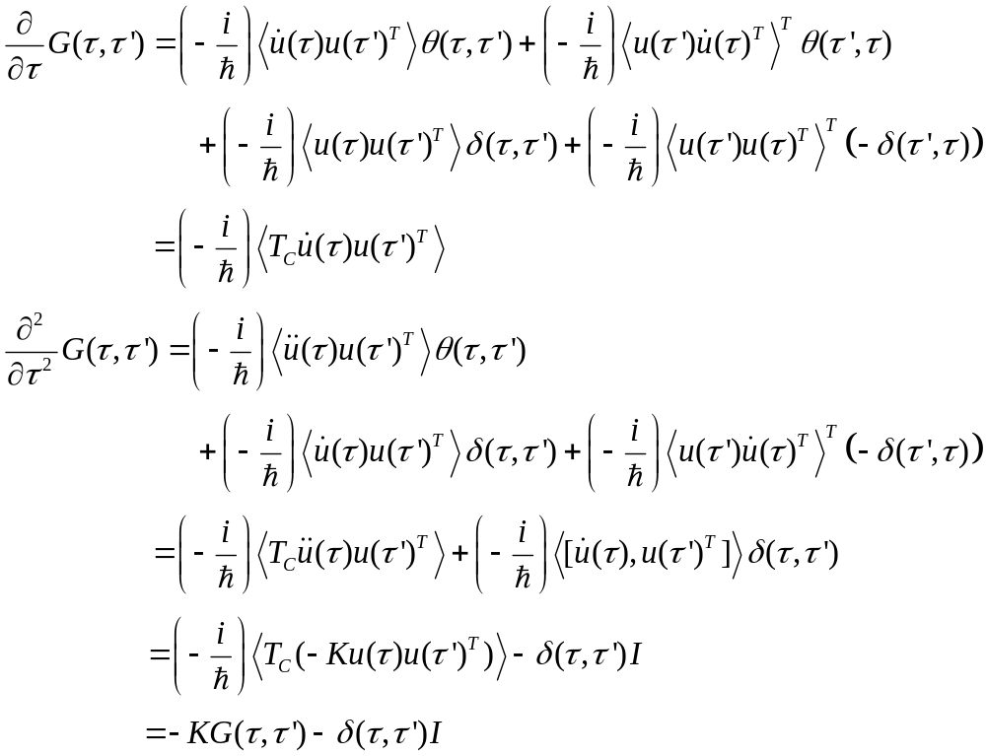
Equation of motion for contour ordered Green’s function
Notes:
We use the equation of motion d²u/dt² = -Ku.
40

Slide 41
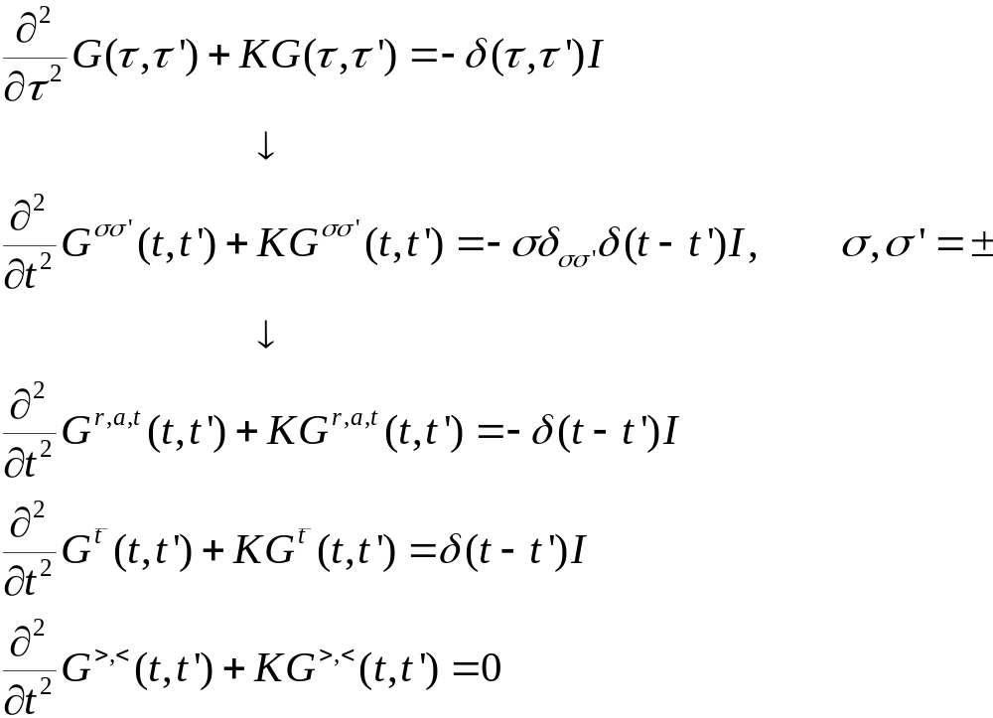
Equations for Green’s functions
Notes:
41

Slide 42
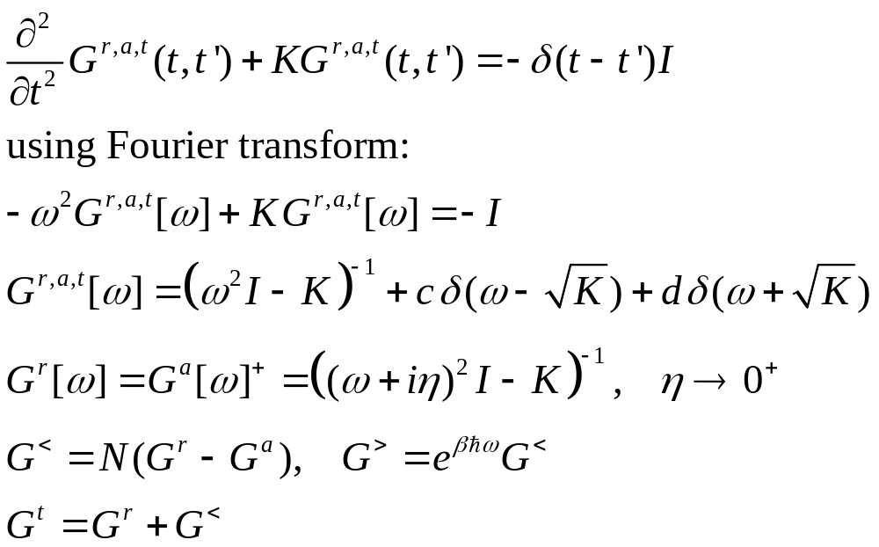
Solution for Green’s functions
c and d can be fixed by initial/boundary condition.
Notes:
Note that if ax = b, x = b/a, but not if a = 0, in that case, x = infinity, thus, the Dirac delta function.
42

Slide 43

Junction system
$$V$$
Hot Bath
Cool bath
System
Key point: reducing from an infinite size problem
to finite degrees of the center through self-energy.

Slide 44
Junction system, adiabatic switch-on
  g_{α} for isolated systems where leads and centre are decoupled
  G for coupled ballistic nonequilibrium system
H_{L}+H_{C}+H_{R} +V
G
H_{L}+H_{C}+H_{R}
g_{α}
t = − ∞
Equilibrium at T_{α}
t = 0
Nonequilibrium steady state established
44
Notes:
Two adiabatic switch-on’s.
44

Slide 45
Sudden Switch-on
H_{L}+H_{C}+H_{R} +V
Green’s function G
H_{L}+H_{C}+H_{R}
g_{α}
t = − ∞
Equilibrium at T_{α}
t = ∞
t =t₀
Nonequilibrium steady state established
45
Notes:
Two adiabatic switch-on’s.
45

Slide 46
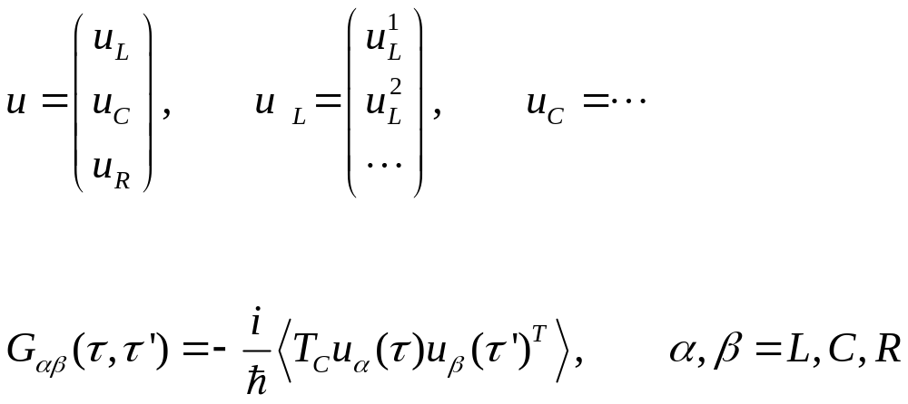
Three regions
46
Notes:
46

Slide 47
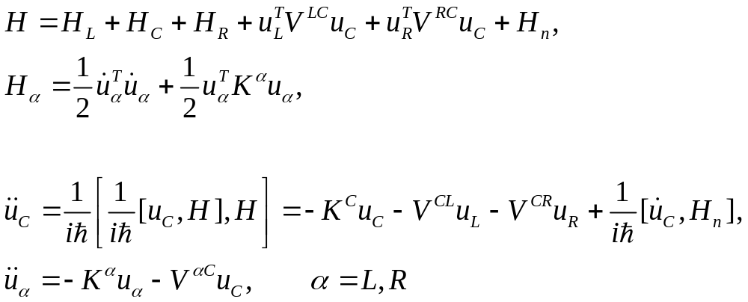
Heisenberg equations of motion in three regions
47
Notes:
47

Slide 48
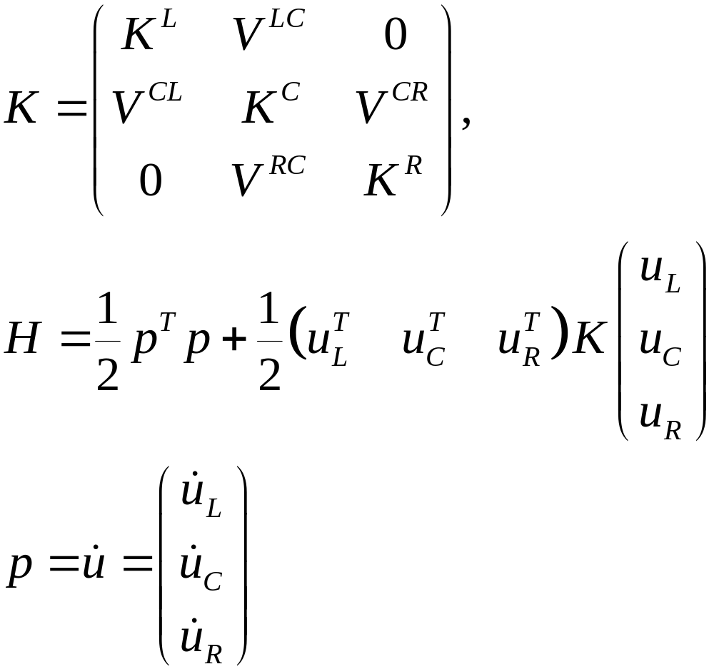
Force Constant Matrix

Slide 49
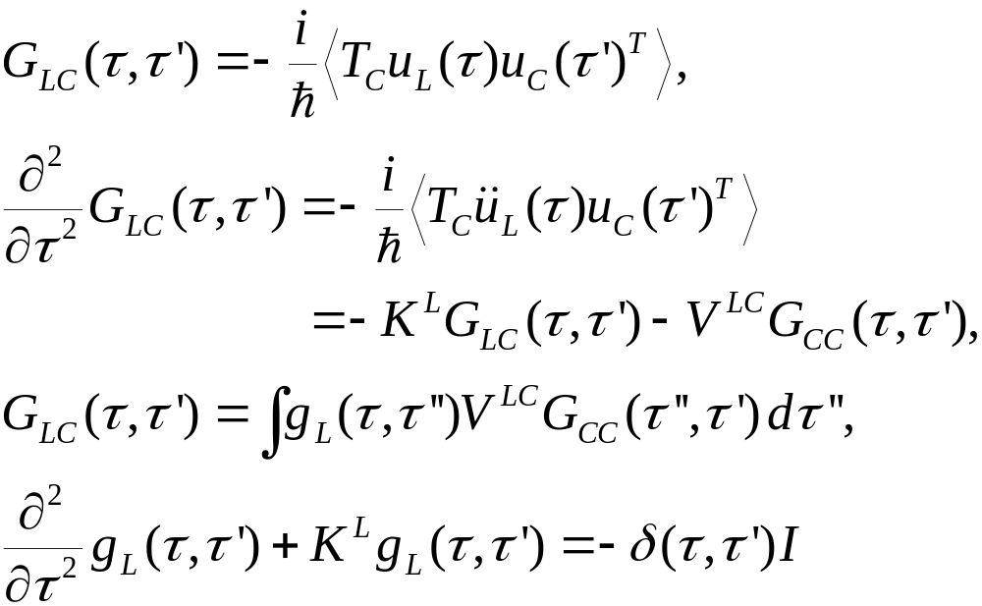
Relation between g and G
Equation of motion for GLC
Notes:
In obtaining G_{LC}, an arbitrary function satisfying (d/dtau^2 + K^{L}) f = 0 is omitted. Absence of this term is consistent with adiabatic switch-on from Feynman diagrammatic expansion.
49

Slide 50
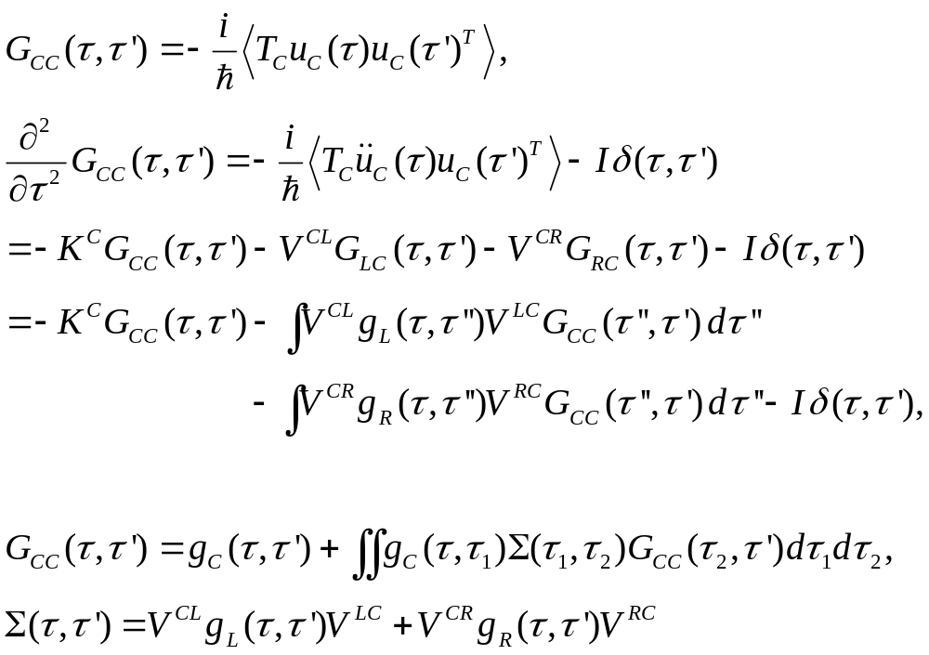
Dyson equation for GCC
Notes:
In this derivation, we assume H_{n} = 0.
50

Slide 51
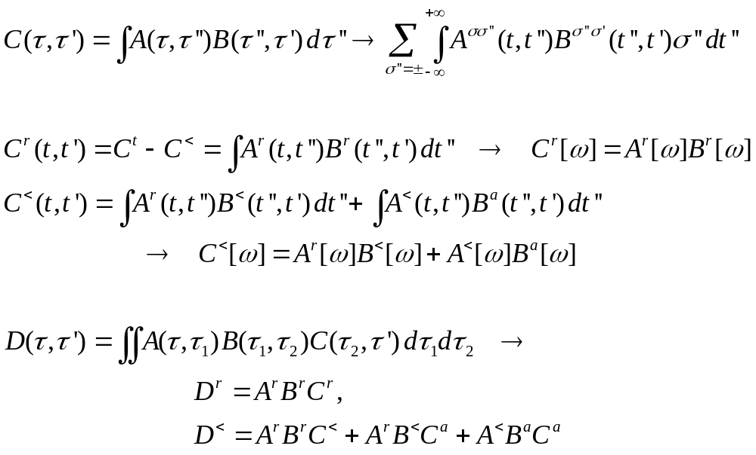
The Langreth theorem
Notes:
Need to use the relation between G⁺⁺, G⁻ ⁻, G⁺⁻, and G⁺⁻ with G^{r} and G<. See Haug & Jauho, page 66.
51

Slide 52
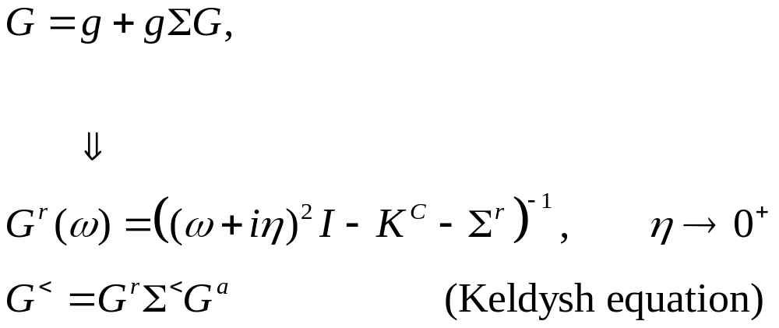
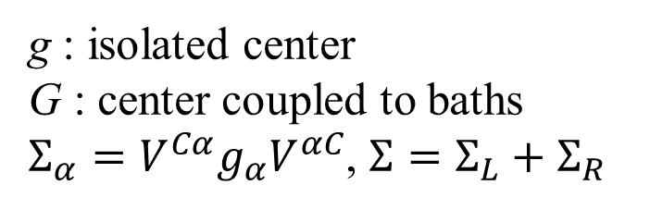
Dyson equations and solution
g : isolated center
G : center coupled to baths
$Σ_{α}=V^{Cα}g_{α}V^{αC}$, $Σ=Σ_{L}+Σ_{R}$
Notes:
In deriving the last line, we use the fact (g^{r})⁻¹ g< = 0.
52

Slide 53
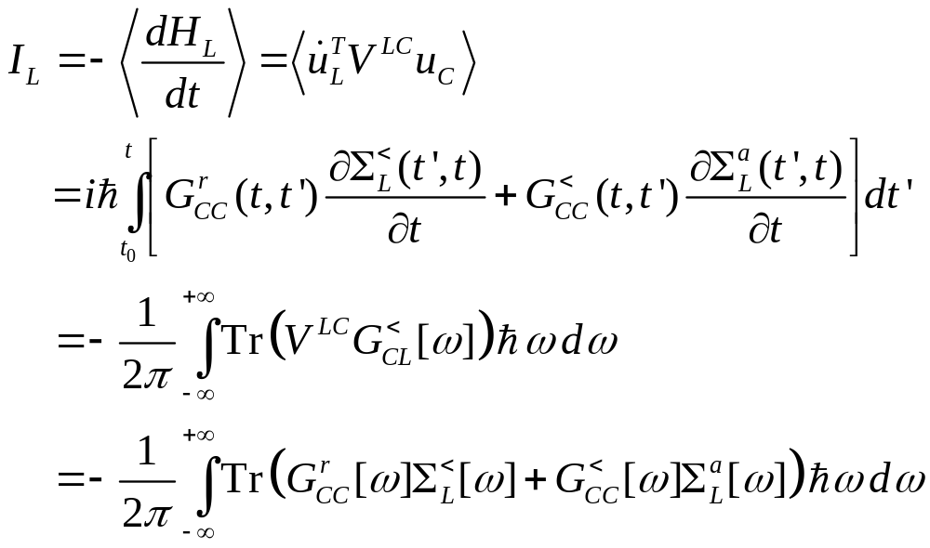
Energy current
Notes:
I_{L} is energy flowing out of the left lead into the center. This expression can be proving to be real, no need to take Re. Above equation works for general nonlinear case.
53

Slide 54
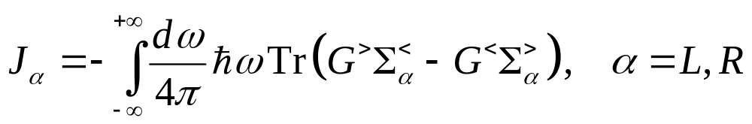
Meir-Wingreen formula, symmetric form
Notes:
What is the electronic current analogue of this equation?

Slide 55
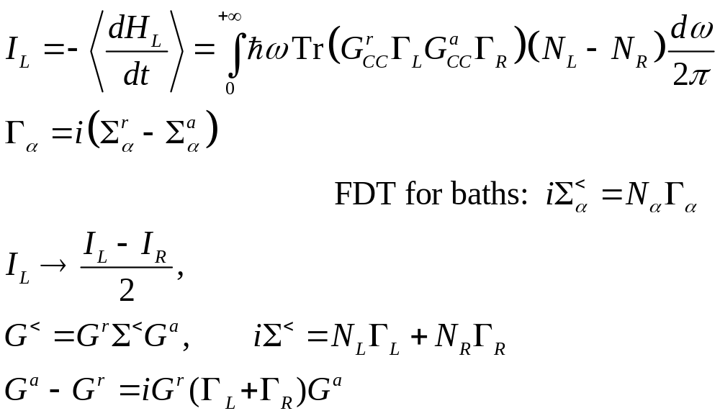
Landauer/Caroli formula
Notes:
The symmetrization appears necessary to get the Caroli formula. Caroli formula is valid only for ballistic case where H_{n} = 0.
55

Slide 56
1D calculation
In the following we give a complete calculation for a simple 1D chain (the baths and the center are identical) with on-site coupling and nearest neighbor couplings. This example shows the steps needed for more general junction systems, such as the need to calculate the “surface” Green’s functions.

Slide 57
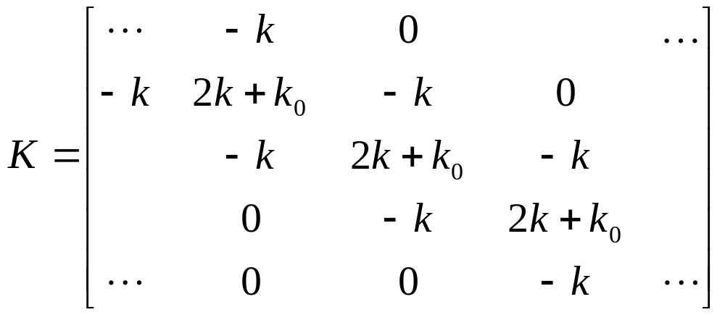
Ballistic transport in a 1D chain
Force constants
Equation of motion
Notes:
The matrix K is infinite in both directions.
57

Slide 58
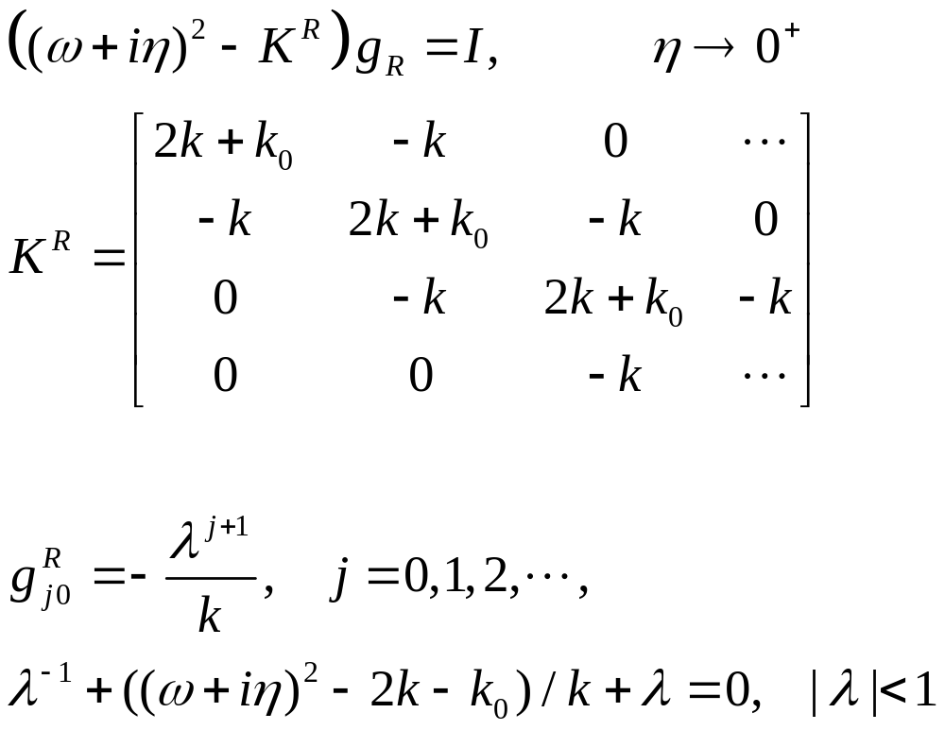
Solution of g
Notes:
K^{R} is semi-finite, V is nonzero only at the corner.
58

Slide 59
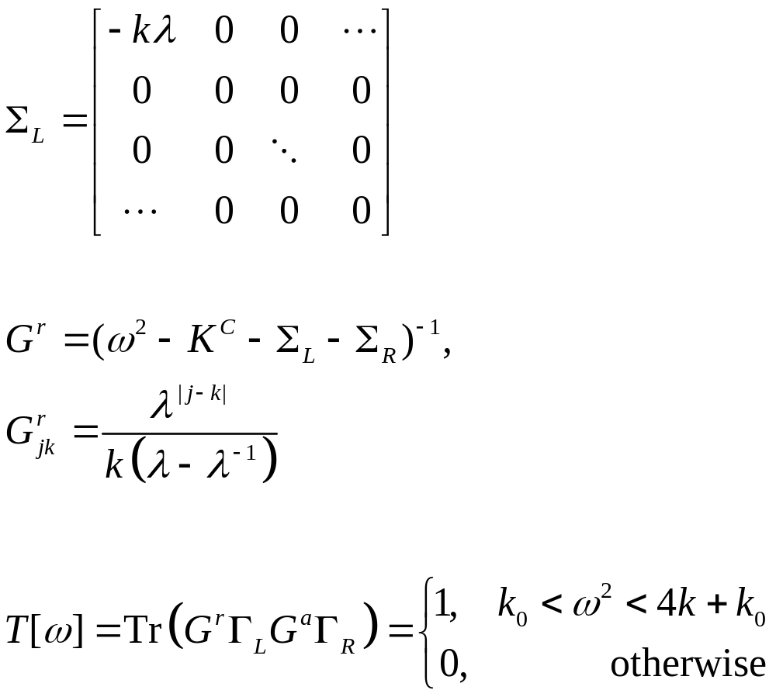
Lead self energy and transmission
T[ω]
1
ω
Notes:
Σ_{R} is nonzero only for the lower right corner.
59

Slide 60
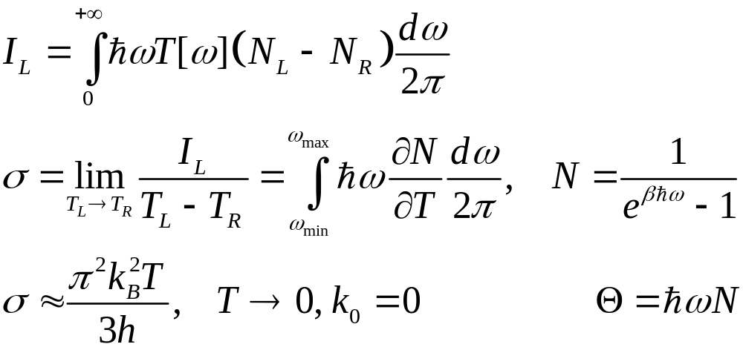
Heat current and conductance
K. Schwab, et al, Nature 404, 974 (2000)
Notes:
The last formula σ is called universal conductance.
60

Slide 61



General recursive algorithm for g
Notes:
The algorithm is due to Lopez Sancho et al (1985). Typically, 10 to 20 iterations should be already converged. For real fortran codes, see https://www.physics.nus.edu.sg/~phywjs/NEGF/balli.tar.gz
61

Slide 62

(8,0) carbon nanotube
J.-S. Wang, J. Wang, N. Zheng, PRB 74, 033408 (2006).
Main figure: center region one unit cell (0.43 nm). Inset: length dependence of thermal conductivity at 300K.

