Slide 1

Classical molecular dynamics of phonons and electrons with quantum baths
Jian-Sheng WANG

Slide 2
Outline
A quick introduction to molecular dynamics
Langevin equation
Generalized Langevin equation with quantum heat baths
Application examples
  Quantum heat transport in nanostructure
  Electron transport
  Electron-magnet coupled system

Slide 3
Molecular Dynamics

Slide 4
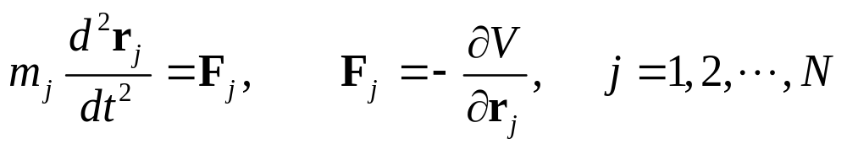
Basic Idea
Solve Newton’s equations of motion
Choose a force field (specified by a potential V) appropriate for the given system under study
Decide a statistical ensemble to use, choice of boundary conditions; collect statistics of observables

Slide 5
Commonly Use Force Fields
Lennard-Jones Potential
  For noble gas and generic fluids
Tersoff, Brenner, Stillinger-Weber, 3-, 4-body potentials
  For C, Si, Ge, …
AMBER, CHARMM, GROMOS, MM4, etc
  For biomolecules
GULP, DFT codes, etc
  For solids

Slide 6
Ensembles
Micro-canonical Ensemble
  Energy is fixed
Canonical ensemble
  Need to use “thermostat” to fix temperature
    Langevin dynamics
    Nosé-Hoover
    Generalized Langevin

Slide 7
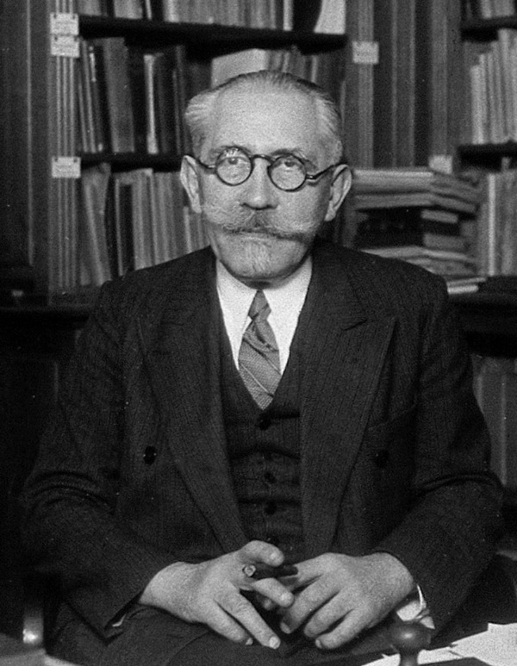
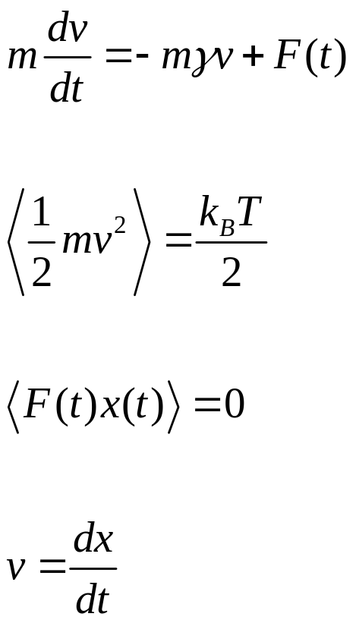
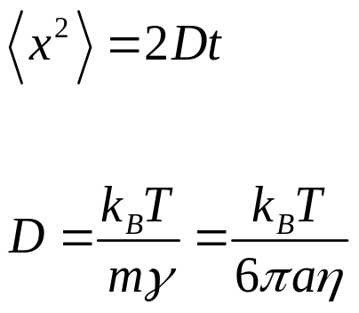
Langevin theory of Brownian motion (1908)
P. Langevin 1872-1946
Notes:
ξ is known as white noise because it is delta correlated.

Slide 8
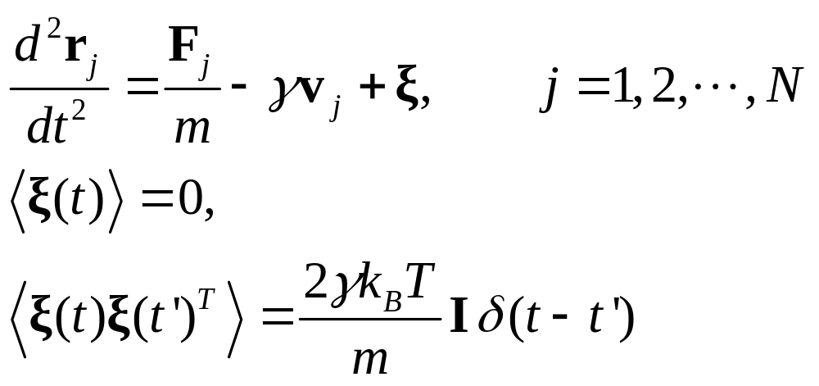
Langevin Dynamics
Notes:
ξ is known as white noise because it is delta correlated.

Slide 9
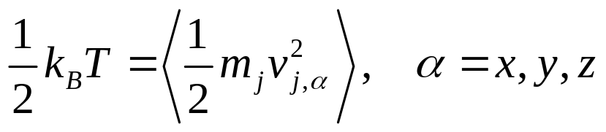
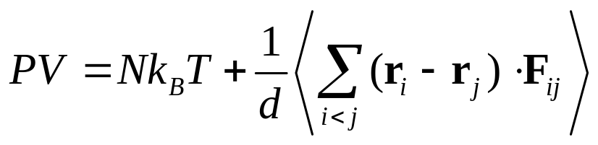
Observables, Statistics
Equilibrium temperature (in micro-canonical ensemble) by equipartition theorem.
Pressure of a fluid (for pair potential)
Where d is dimension, F_{ij} is the force acting on particle i from particle j.

Slide 10
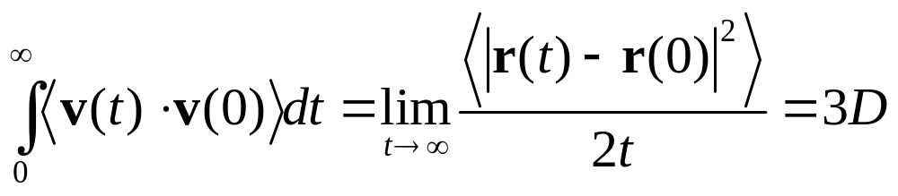
Transport Coefficients
The diffusion constant can be computed through velocity correlation function

Slide 11
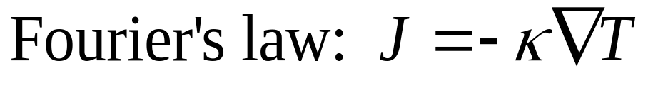
Transport Coefficients
Thermal conductivity can be computed through energy-current correlation using Green-Kubo formula; or nonequilibrium simulation by directly computing the energy current

Slide 12
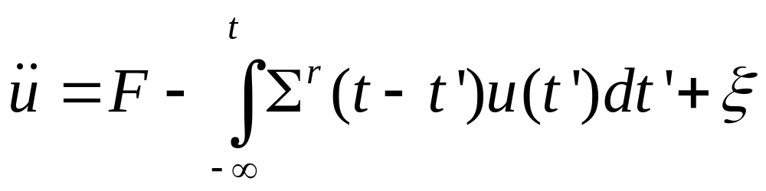
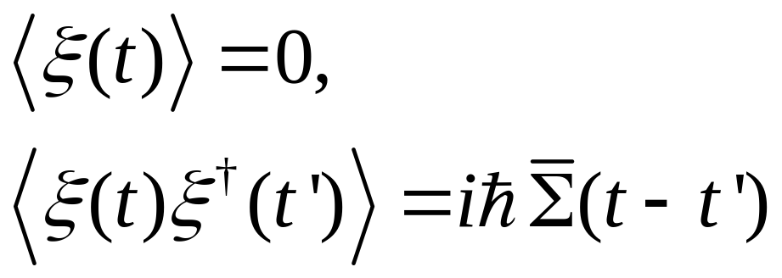
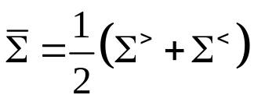
Generalized Langevin
Σ is known as self-energy
Notes:
Simga^r and Simga bar are related by the fluctuation-dissipation theorem.

Slide 13
Quantum noise with Langevin dynamics
For thermal transport, Dhar & Roy, J Stat Phys (2006); JSW, PRL 99, 160601 (2007).
Thermostat to solids, Ceriotti, Bussi, Parinello, PRL 103, 030603 (2009); Dammak, Chalopin, Laroche, Mayoun, Greffet, PRL 103, 190601 (2009).
Kantorovich, et al, PRB 78, 094303 (2008); 94, 184305 (2016).

Slide 14
Thermal conduction at a junction
Left Lead, T_{L}
Right Lead, T_{R}
semi-infinite
Junction Part

Slide 15
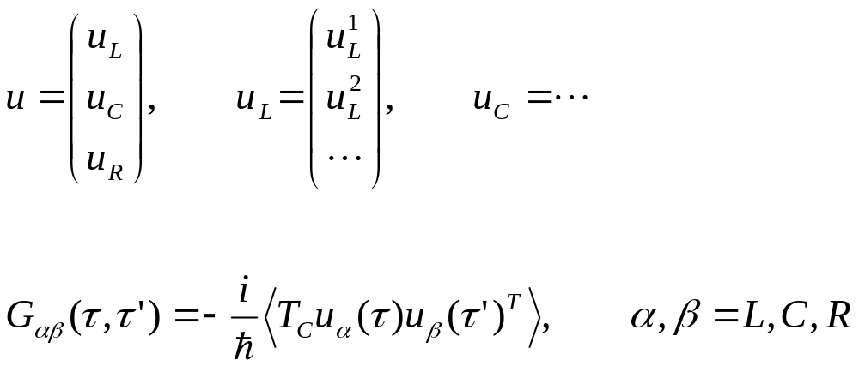

Three regions
T_{c} is contour order super-operator; u is
15
Notes:
15

Slide 16
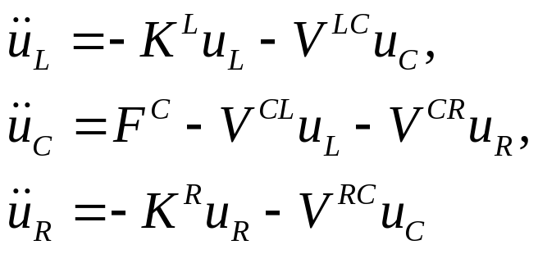
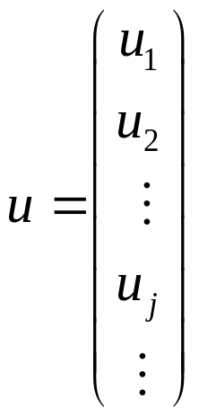
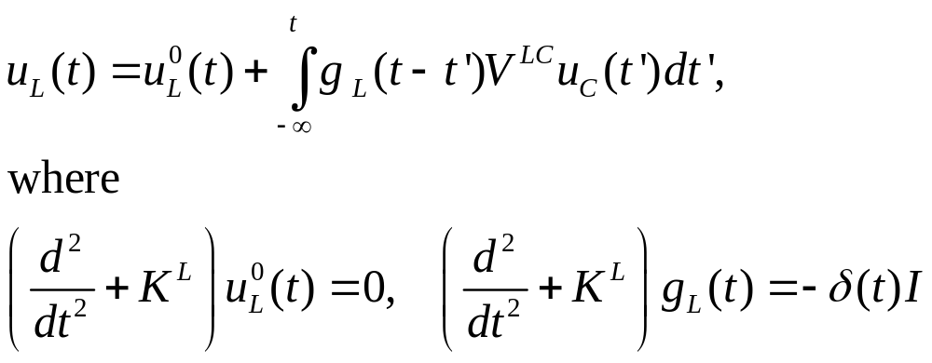
Quantum heat-bath & MD
Consider a junction system with left and right harmonic leads at equilibrium temperatures T_{L} & T_{R}, the Heisenberg equations of motion are
The equations for leads can be solved, given

Slide 17
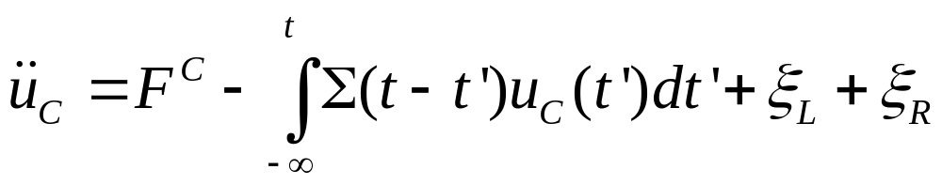
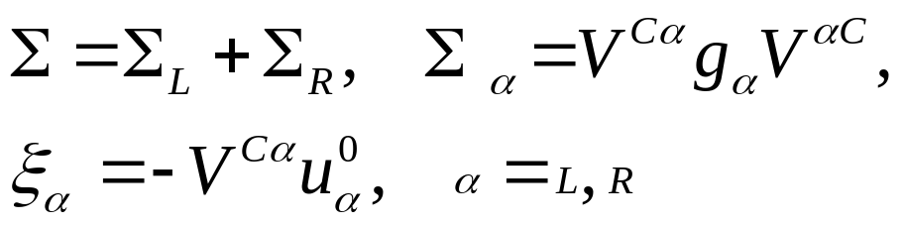
Quantum Langevin equation for center
Eliminating the lead variables, we get
where retarded self-energy and “random noise” terms are given as
See JSW, Phys. Rev. Lett. 99, 160601 (2007); JSW, et al,
Phys. Rev. B 80, 224302 (2009).
(such idea for classical ensemble appears as early as in 1976, Adelman & Doll, JCP. But see Kantorovich PRB 2008)

Slide 18
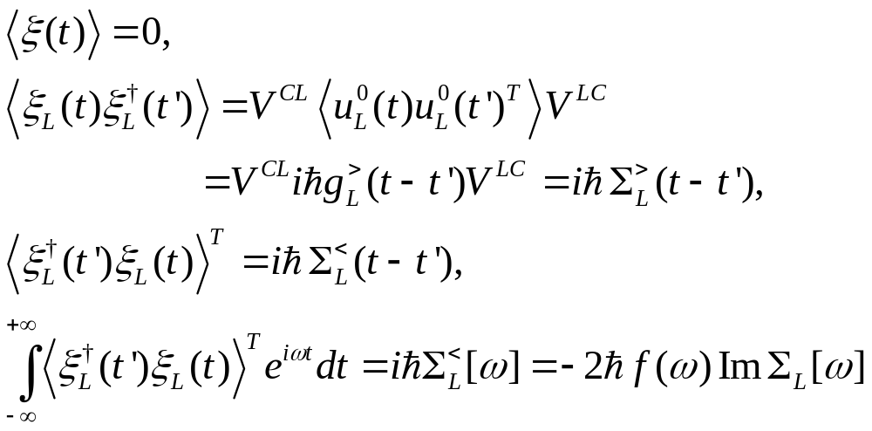
Properties of the quantum noise
For nonequilibrium Green’s function (NEGF) notations, see JSW, Wang, & Lü, Eur. Phys. J. B, 62, 381 (2008); or JSW, Agarwalla, Li, & hingna, Front. Phys. 9, 673 (2014).

Slide 19
Quasi-classical approximation (Schmid 1982)
Replace operators u_{C} & ξ by ordinary numbers
Using the symmetrized quantum correlation, iħ(∑> +∑<)/2 for the correlation matrix of ξ.
For linear systems, quasi-classical approximation turns out exact! See, e.g., Dhar & Roy, J. Stat. Phys. 125, 805 (2006).

Slide 20
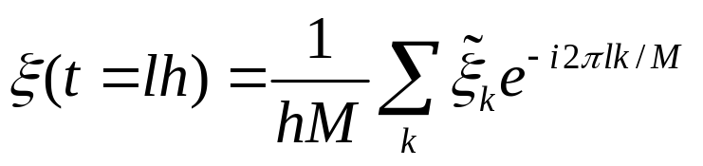
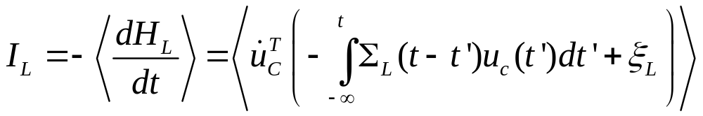
Implementation
Generate noise using fast Fourier transform
Solve the differential equation using velocity Verlet
Perform the kernel integration using a simple rectangular rule
Compute energy current by

Slide 21
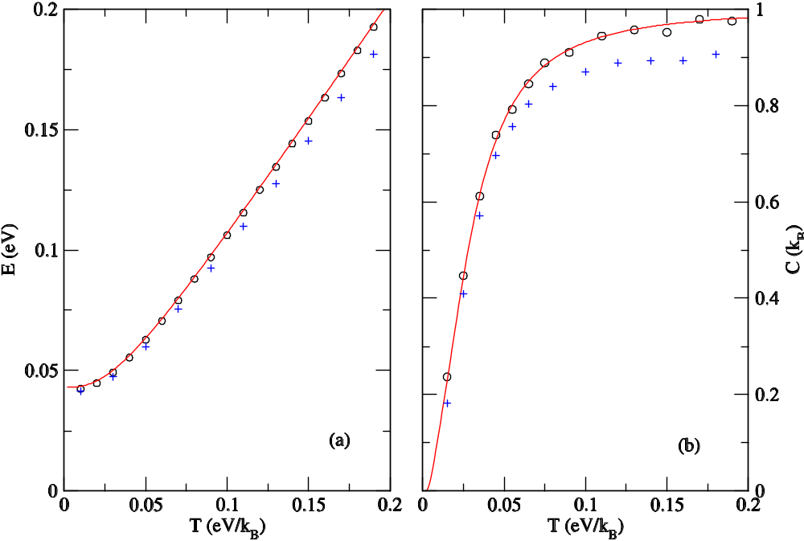
Equilibrium simulation
1D linear chain (red lines exact, open circles QMD) and nonlinear quartic onsite (crosses, QMD) of 128 atoms. From Eur. Phys. J. B, 62, 381 (2008).

Slide 22
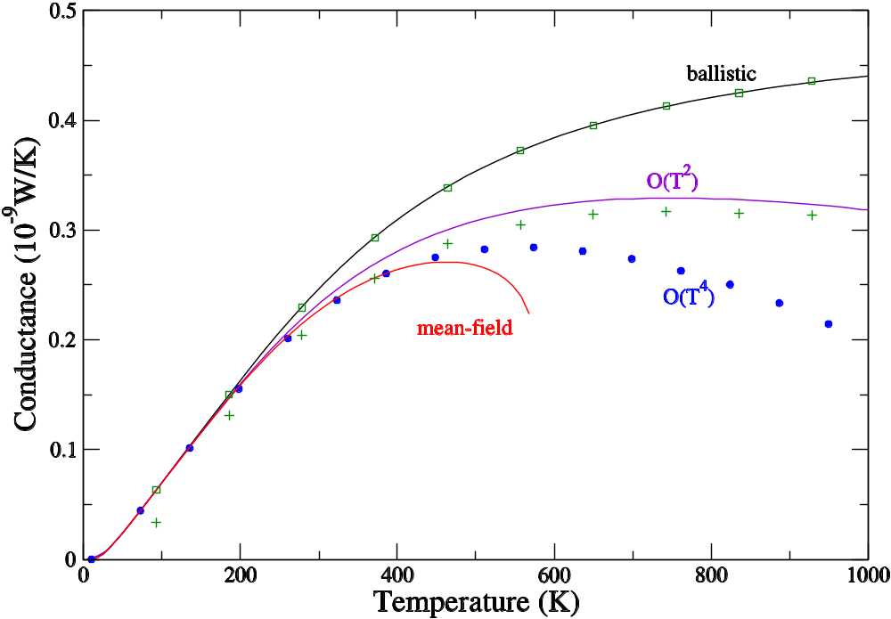
Comparison of QMD with NEGF
Three-atom junction with cubic nonlinearity (FPU-α). From JSW, Wang, Zeng, PRB 74, 033408 (2006) & JSW, Wang, Lü, Eur. Phys. J. B, 62, 381 (2008).
QMD ballistic
QMD nonlinear
k_{L}=1.56 k_{C}=1.38, t=1.8 k_{R}=1.44

Slide 23
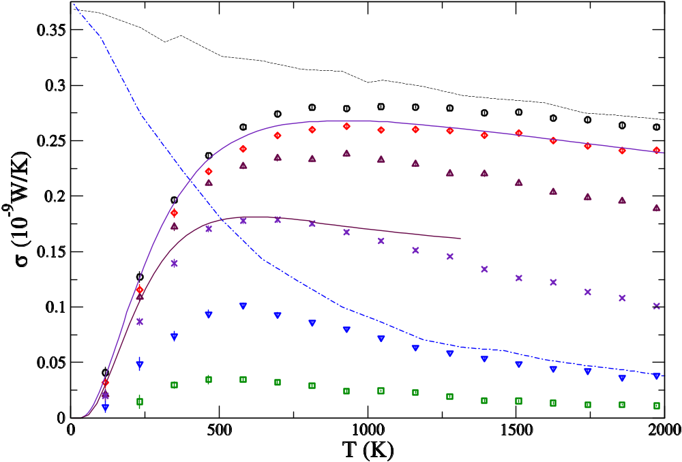
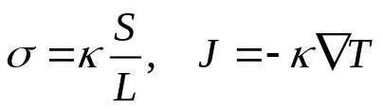
From ballistic to diffusive transport
1D chain with quartic onsite nonlinearity (Φ⁴ model). The numbers indicate the length of the chains. From JSW, PRL 99, 160601 (2007).
Classical, ħ → 0
4
16
NEGF, N=4 & 32
64
256
1024
4096

Slide 24
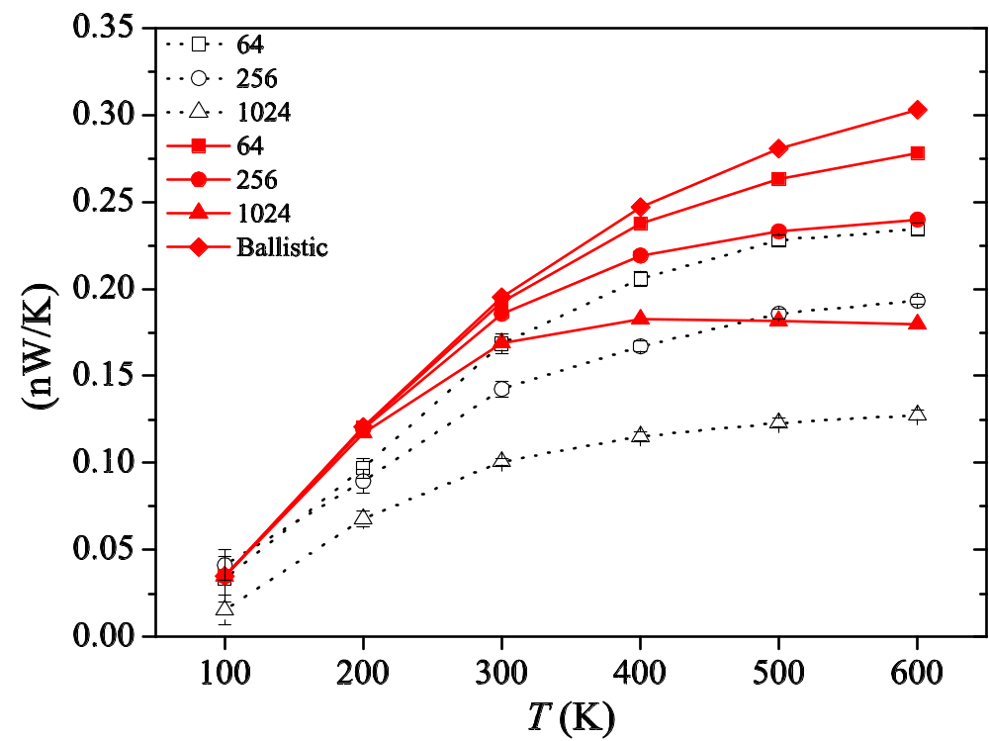
FPU-β model
It is not clear whether QMD over or under estimates the nonlinear effect. From Xu, JSW, Duan, Gu, & Li, PRB 78, 224303 (2008).
} relaxing rate NEGF

Slide 25
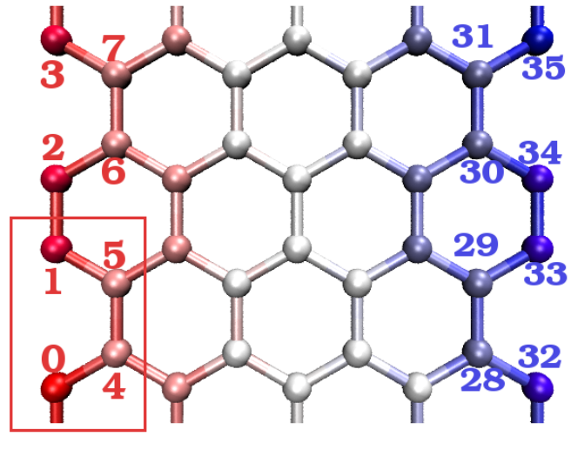
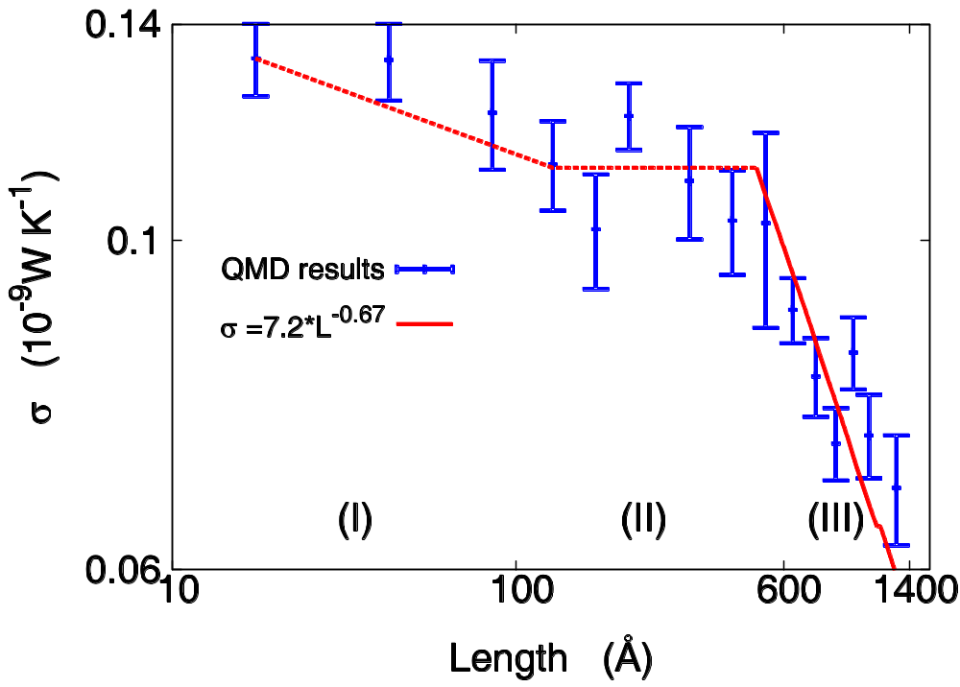
Conductance of graphene strips
Sites 0 to 7 are fixed left lead and sites 28 to 35 are fixed right lead. Heat bath is applied to sites 8 to 15 at temperature T_{L} and site 20 to 27 at T_{R}. JSW, Ni, & Jiang, PRB 2009.

Slide 26
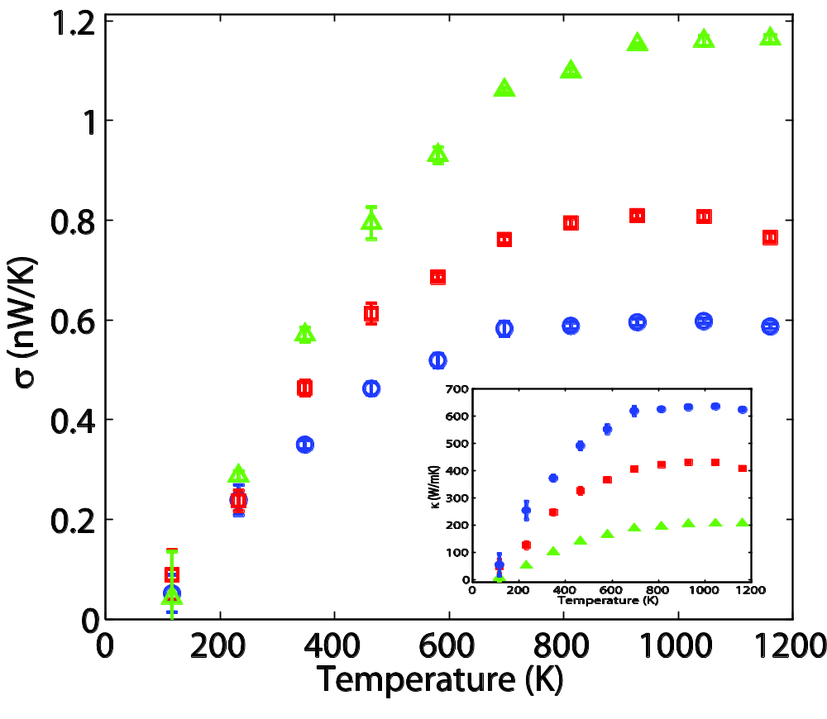
Zigzag (5,0) carbon nanotubes
Temperature dependence of the thermal conductance (and conductivity) for lengths 4.26 (green), 12.8 (red) and 25.6 (blue) nm, respectively. JSW, Ni and Jiang, PRB 2009.

Slide 27
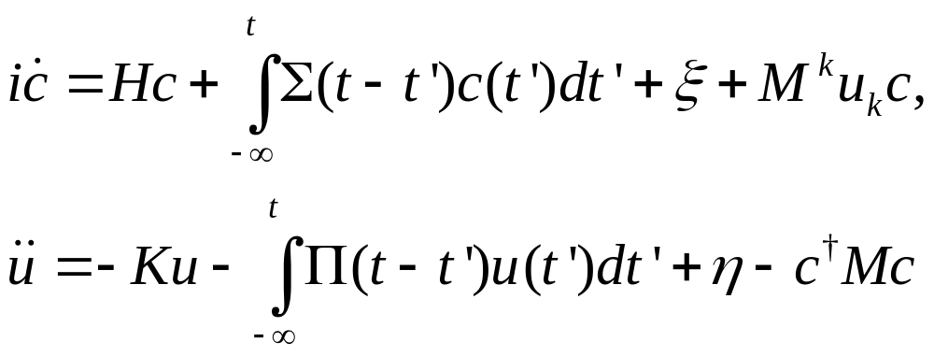
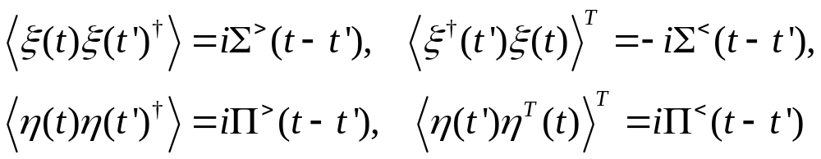
Electron transport & phonons
For electrons in the tight-binding form interacting with phonons, the quantum Langevin equations are (set ħ = 1)

Slide 28
Quasi-classical approximation & NEGF
D<
∑<_{n} = i
G<
G<
∑^{r}_{n} = i {
D<
D^{r}
D^{r}
}
+
−
G^{r}
G>
Χ
G<
To lowest order in coupling M, quasi-classical approximation is to replace all G> by −G<.
Π<_{n} = −i
Χ
G>
Π^{r}_{n} = −i {
G^{r}
G<
}
+
G<
Gª

Slide 29
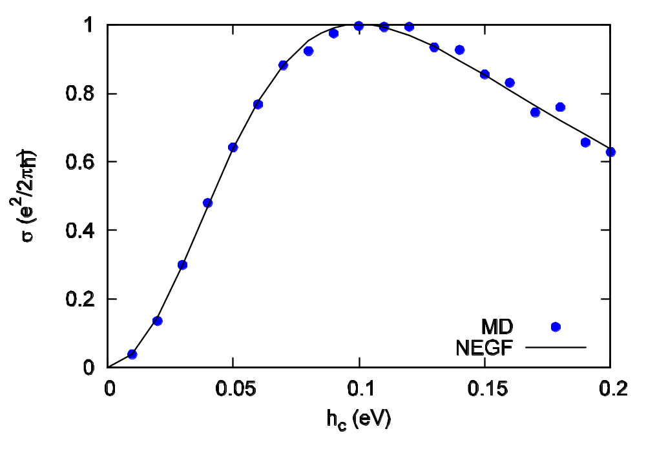
Ballistic electron transport, NEGF vs QMD
Nearest neighbor hopping model with two sites in the center, lead hopping -h_{l} = 0.1 eV, varying the center part hopping term. From Lü & JSW, J. Phys.:Condens. Matter 21, 025503 (2009). For NEGF method of electron-phonon interaction, see Lü & JSW, PRB 76, 165418 (2007).

Slide 30
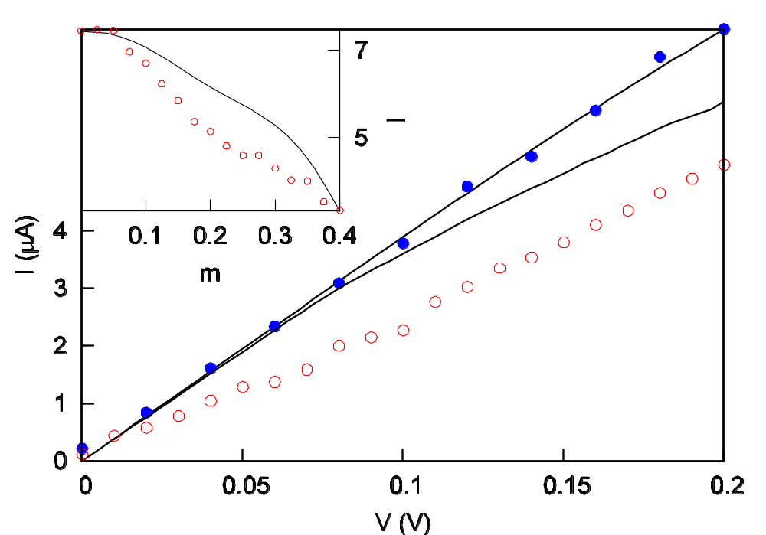
Strong electron-phonon interactions
Two-center-atom model with Su, Schrieffer & Heeger electron-phonon interaction. Lines are NEGF, dots are QMD. From Lü & JSW, J. Phys.: Condens. Matter, 21, 025503 (2009).
ballistic

Slide 31
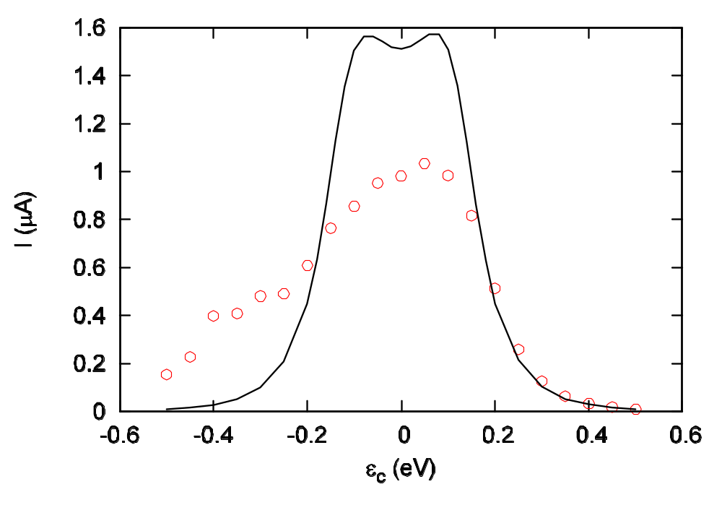
QMD is exact in low electron density limit
Self-consistent Born approximation NEGF
QMD
Low electron density

Slide 32
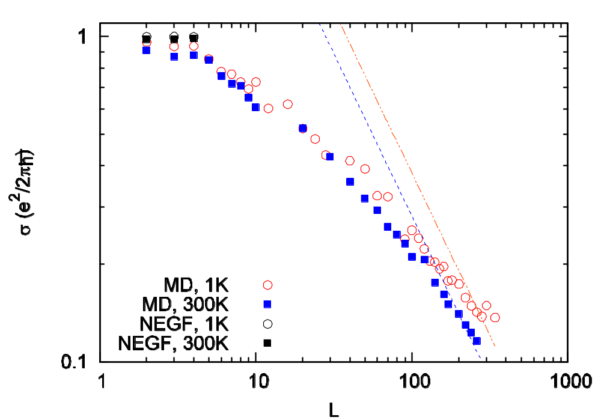
Ballistic to diffusive
Electronic conductance vs center junction size L. Electron-phonon interaction strength is m=0.1 eV. From Lü & JSW, J. Phys.: Condens. Matter, 21, 025503 (2009).

Slide 33
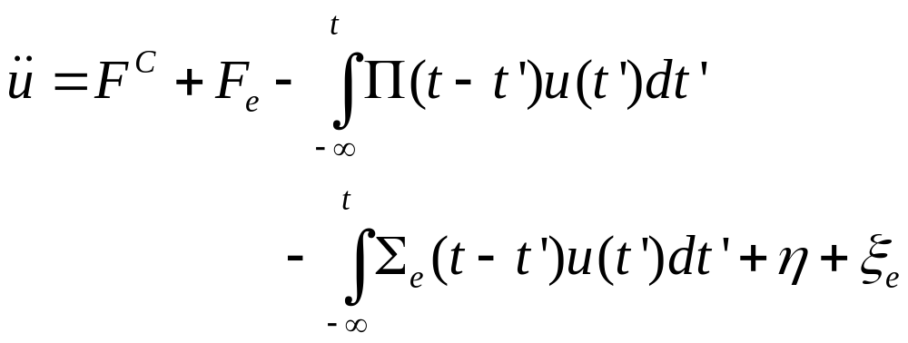
Electrons as a heat bath (Lü, Brandbyge, et al, based on path-integral formulism)

Slide 34
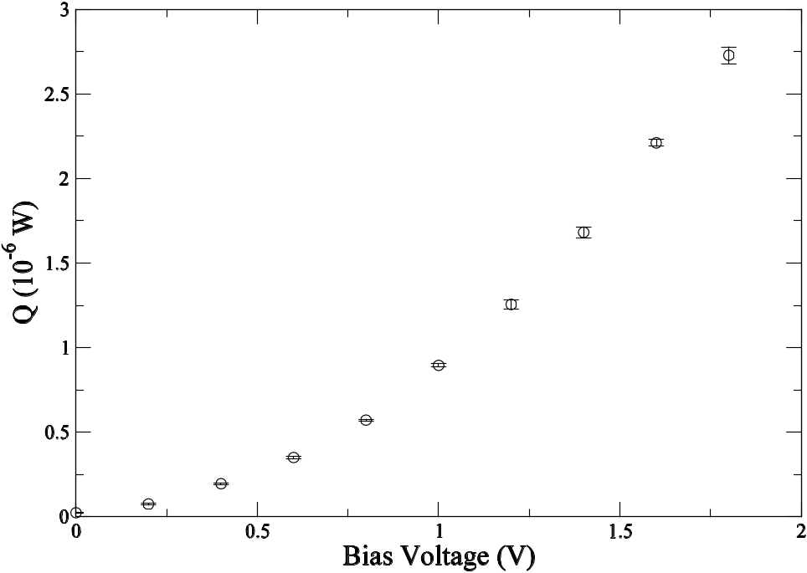
Joule heating from QMD
Heat per unit time generated due to electric current for a 4×2 graphene armchair configuration. From Lü, et al, AIP Advances, 5, 053204 (2015).

Slide 35
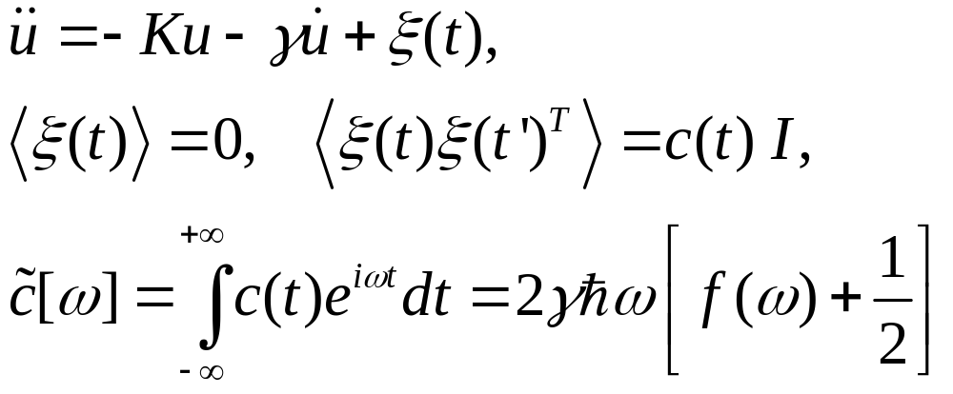
A simplified QMD?
Consider the following Langevin equation for lattice vibration [Keblinski & JSW, unpublished; see also Buyukdagli, et al, PRE 78, 066702 (2008); Ceriotti, et al, JCTC (2010) ]:
then in the limit of small damping (γ → 0), the energy of the vibrational modes is given exactly as that of the corresponding quantum system.

Slide 36
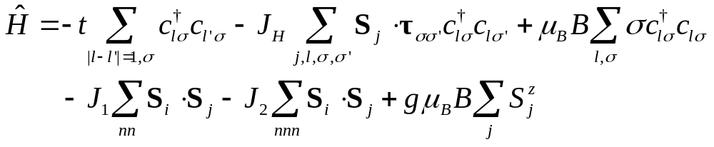


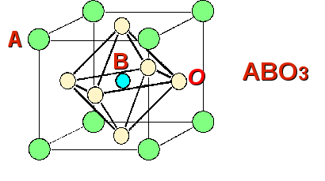
df coupling model
Spins sit on the corners of a cubic lattice, electron at the center of the lattice. Parameters: t ≈ 0.2 eV, J_{H} ≈ 0.1 eV or less, lattice constant a = 3.9 Å, J₁/k_{B} = - 0.037 K, J₂/k_{B} = 0.069 K, g = 2.
Approaches:
Boltzmann + RPA
Dynamic mean-field
Exact diagonalisation

Slide 37
Magnetic polaron physics?
A single electron within the background sea of Heisenberg spins.
We can only talk about the mobility, v=μE; then σ = enμ is correct at low carrier density, say n≈10⁻⁴ per unit cell.
Our approach: 1) Derive Heisenberg equations of motion for c_{lσ}, and S_{j} from the df coupling model. 2) replace S_{j} by a classical vector, replace c_{lσ} by complex number (i.e., single particle wavefunction). 3) Simulating a single electron diffuses on lattice under the influence of fluctuating magnetic moments. 4) Determine the diffusion constant D, and use Einstein relation to get μ = D/(k_{B}T).
Notes:
We can try this on computer, the only concern is the large time-scale difference (4 to 5 orders of magnitude) between the electrons and spins. Of course, this is a semi-classical approach, not full quantum mechanics.

Slide 38
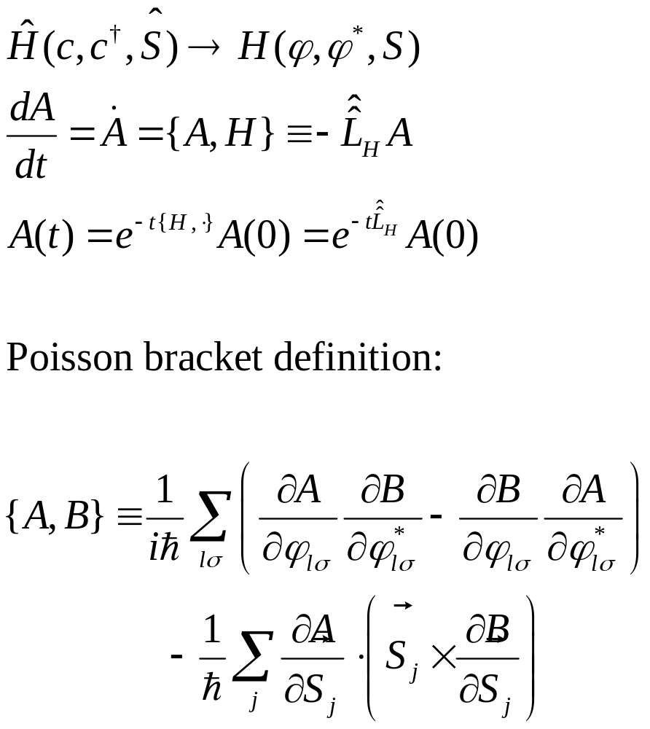
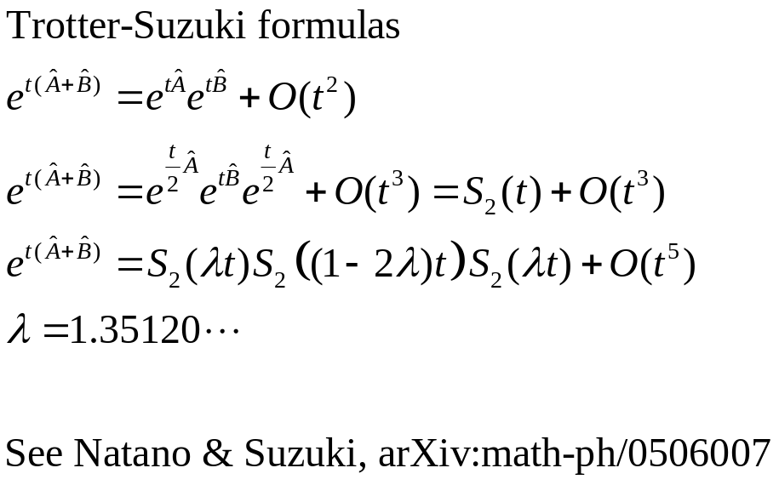
Operator-splitting method

Slide 39
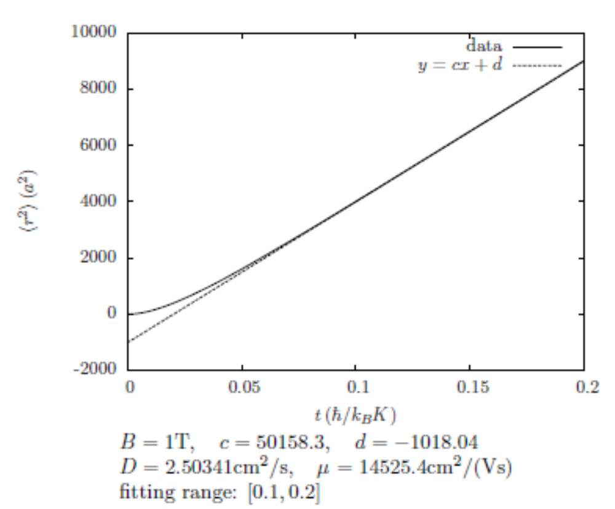
Electron diffusion
A typical MD run result of the mean-square displacement for a 2D version of the model. Temperature T=2K, J_{H}=0.005 eV, t=0.05 eV. Unpublished, from Ruofan Chen.

Slide 40
Conclusion & Outlook
QMD for phonon is correct in the ballistic limit and high-temperature classical limit
Produce correct physics for single electron
Much large systems can be simulated (comparing to NEGF)
Quantum corrections in dynamics?
  Solve a hierarchical set of Heisenberg equations (Prezhdo et al, JCP)
  Can we treat the noises ξ & η as operators (i.e. matrices) thus restore ∑> ≠∑<?

Slide 41
Collaborators/students
Baowen Li
Pawel Keblinski
Jian Wang
Jingtao Lü
Jin-Wu Jiang
Eduardo Cuansing
Nan Zeng
Lifa Zhang
Xiaoxi Ni
Saikong Chin
Chee Kwan Gan
Jinghua Lan
Yong Xu
Bijay Kumar Agarwalla
Thingna Juzar Yahya
Ruofan Chen

