Slide 1

Ultra-near-field radiative heat transfer
Jian-Sheng WANG

Slide 2
Outline
Brownian motion, Langevin equation, and generalized Langevin equation with quantum heat baths
Near field radiation problem as an open quantum system problem
Back to Langevin - turn Maxwell equations to stochastic differential equations
NEGF, Applications

Slide 3
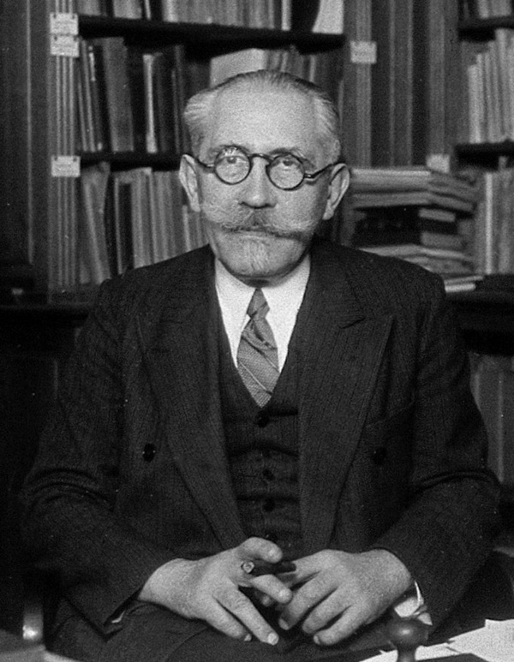
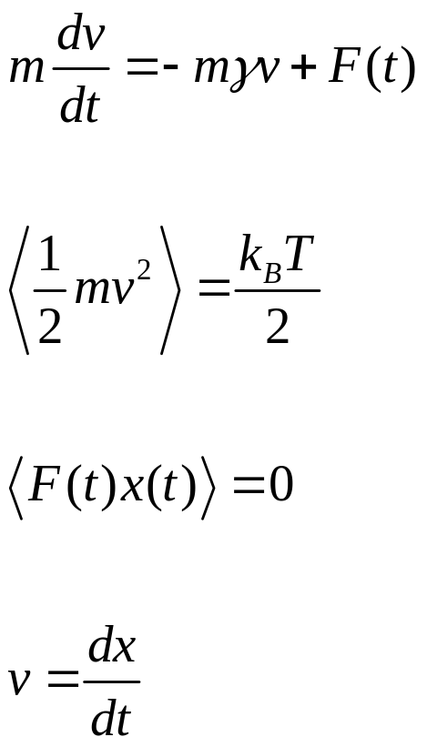
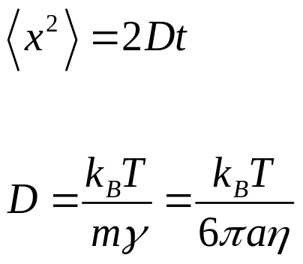
Langevin theory of Brownian motion (1908)
P. Langevin 1872-1946
Notes:
ξ is known as white noise because it is delta correlated.

Slide 4
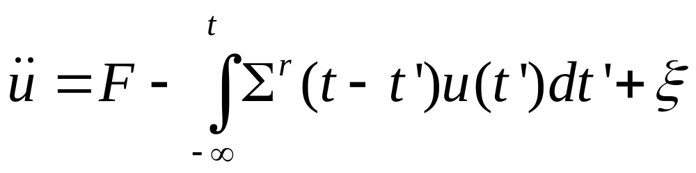
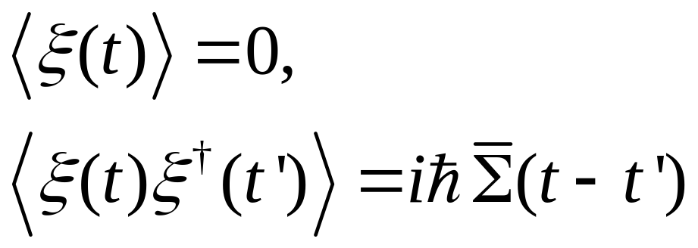
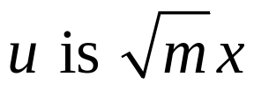
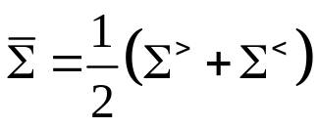
Generalized Langevin
Σ is known as self-energy
Notes:
Simga^r and Simga bar are related by the fluctuation-dissipation theorem.

Slide 5
Quantum noise with Langevin dynamics
For thermal transport, Dhar & Roy, J Stat Phys (2006); JSW, PRL 99, 160601 (2007).
Thermostat to solids, Ceriotti, Bussi, Parinello, PRL 103, 030603 (2009); Dammak, Chalopin, Laroche, Mayoun, Greffet, PRL 103, 190601 (2009).
Kantorovich, et al, PRB 78, 094303 (2008); 94, 184305 (2016).

Slide 6
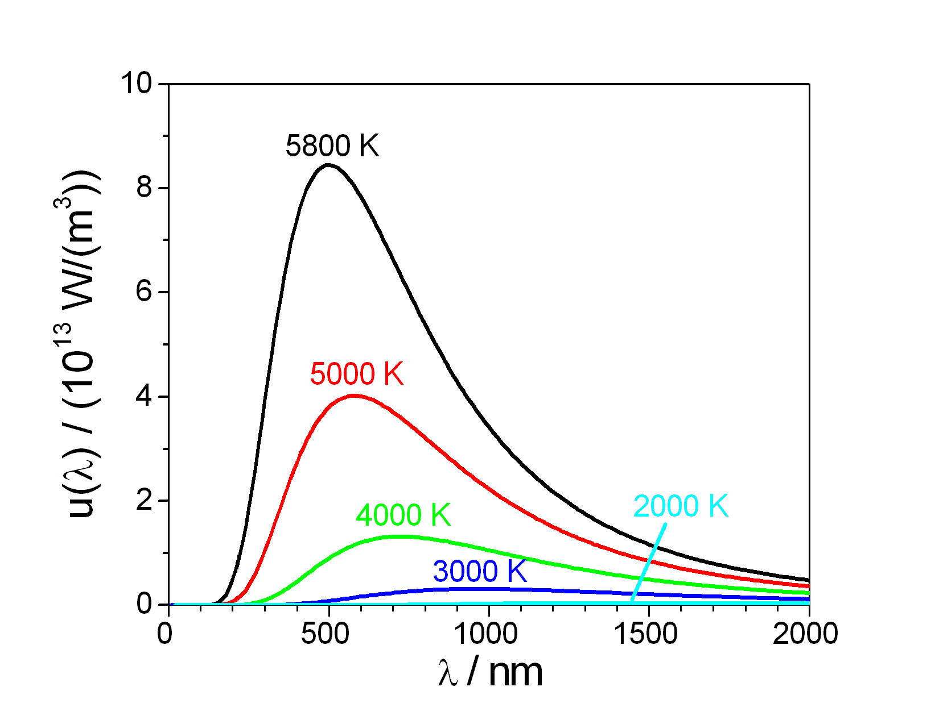
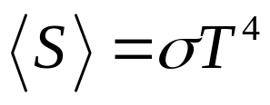
Black-body radiation and near-field effect
Stefan-Boltzmann law:
What if closer than wavelength λ?
Notes:
https://commons.wikimedia.org/wiki/File:Planck_law_radiation.PNG

Slide 7
Near-field effect
Rytov fluctuational electrodynamics (1953)
Polder & van Hove (PvH) theory (1971)
Phonon tunneling/phonon polaritons (Mahan 2011, Xiong at al 2014, Chiloyan et al 2015, …)
Other mechanism?

Slide 8
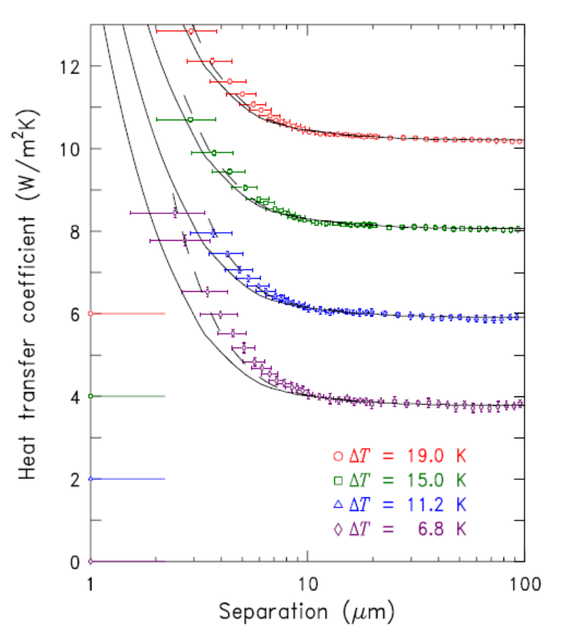
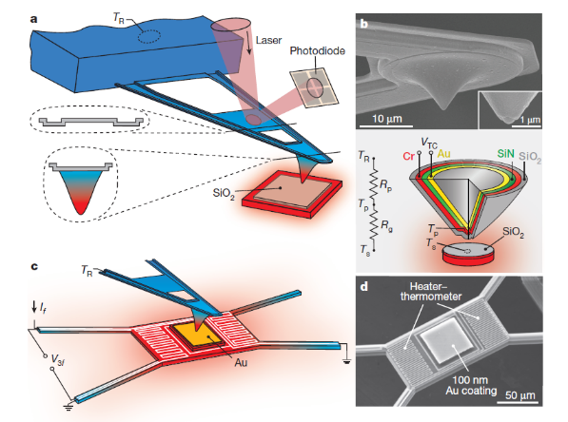
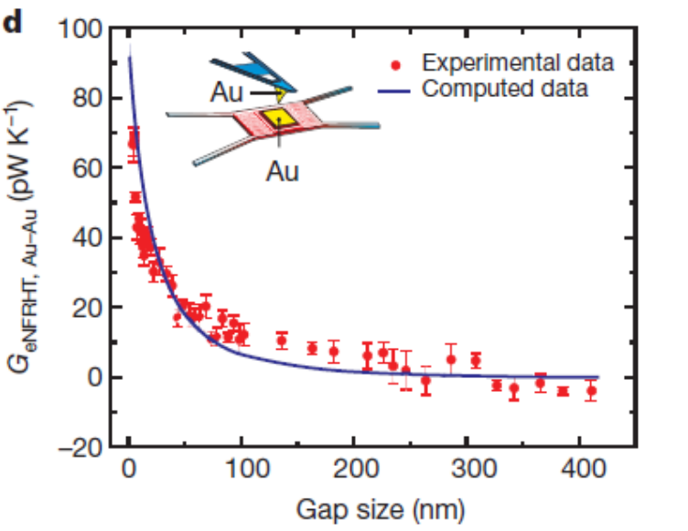
Experiments
Ottens, et al, PRL 107, 014301 (2011).
Kim, et al, Nature 528, 387 (2015).

Slide 9
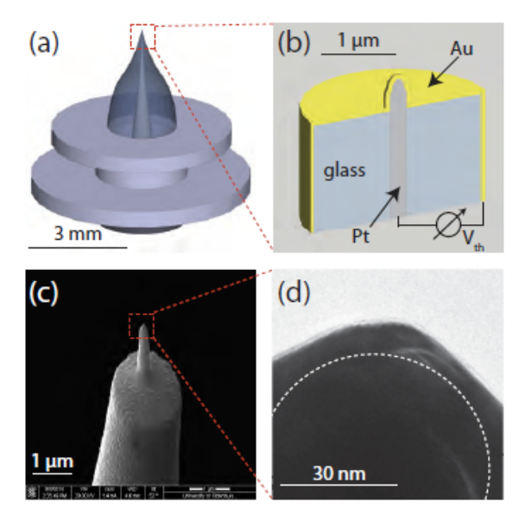
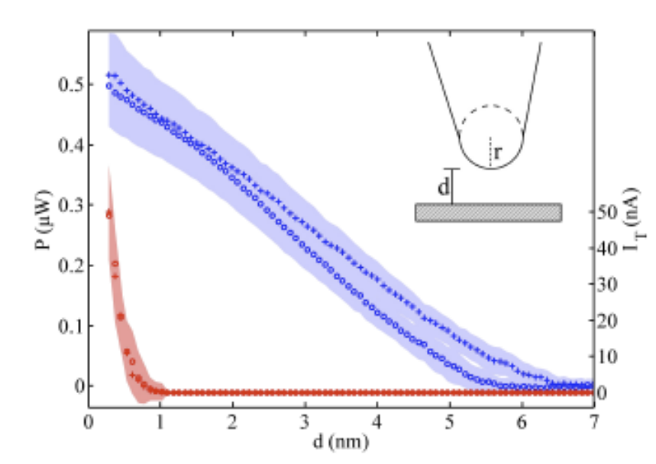
A recent experiment that does not agree with theory
Heat transport between a Au tip and surface is measured, obtain much larger values than conventional theory predicts. Nature Comm 2017, Kloppstech, et al.

Slide 10
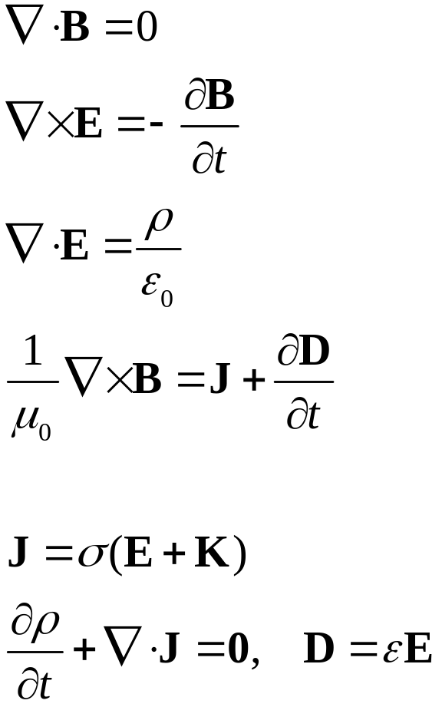
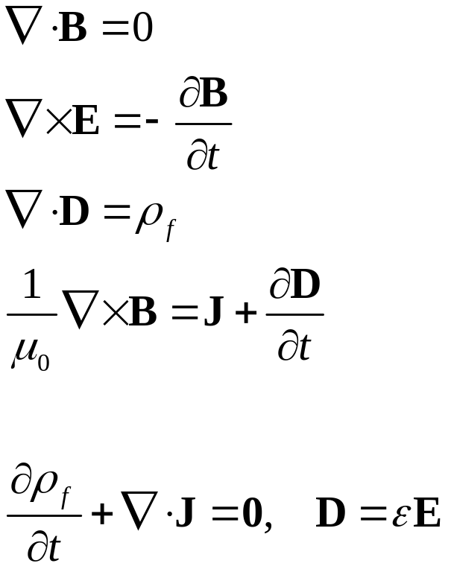
Fluctuational electrodynamics
Rytov 1953: Polder & van Hove 1971:
random variables

Slide 11
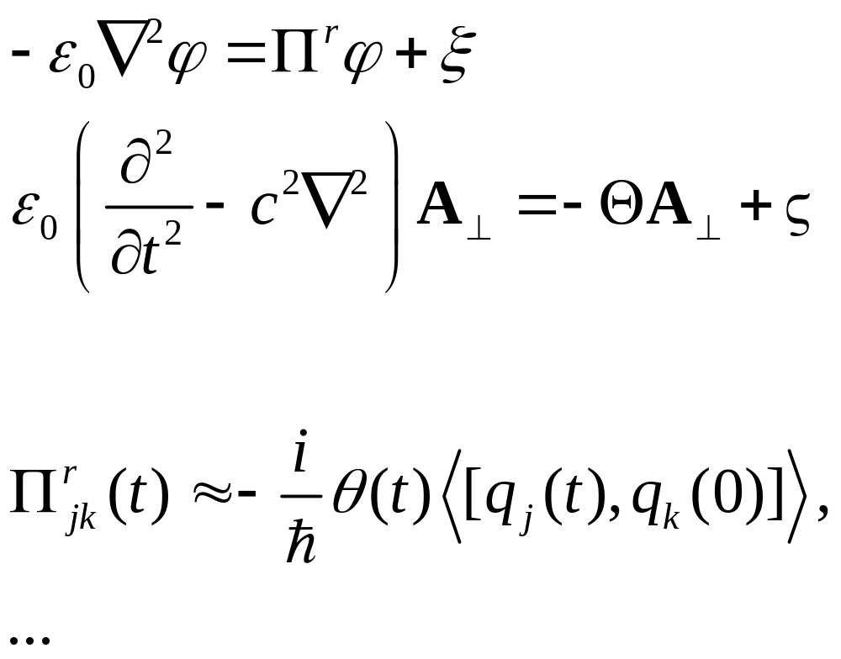
Rytov fluctuational electrodynamics revised, separating into longitudinal & transverse fields

Slide 12

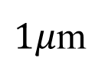
New length scale
Energy flux (W/m²)
E = Q²/(2C)? capacitor physics?
10¹¹
1/d²
10³
hc/k_{B}T
Distance d log scale
$$1 Å$$
10 nm
$1μ$m

Slide 13
Our approach, EPL 118, 24001 (2017), arXiv:1703.07113
Electrons → tight-binding model (discrete)
Field → continuum (continuous)
NEGF formulation → electron G and photon D and self energies Σ, Π.

Slide 14
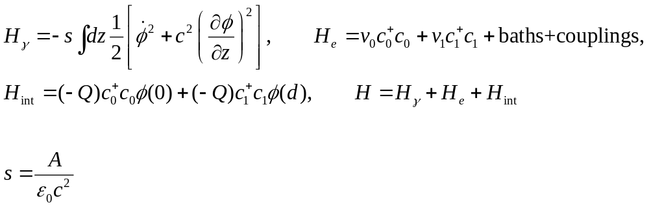
Two quantum-dot 1D model
electron baths
left photon bath
right photon bath
0 1
distance d
Dots or parallel plates?

Slide 15
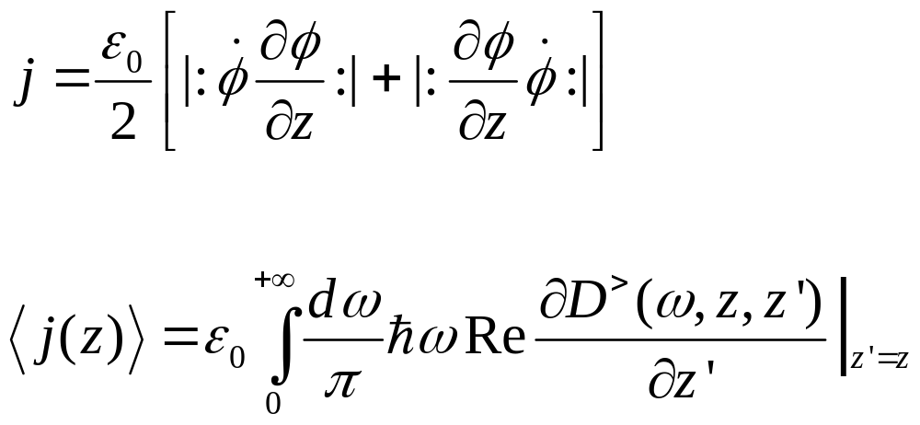
Anti-Normal ordered radiative heat current operator
We solve the electron-scalar photon coupled problem with self-consistent Born approximation (SCBA).

Slide 16
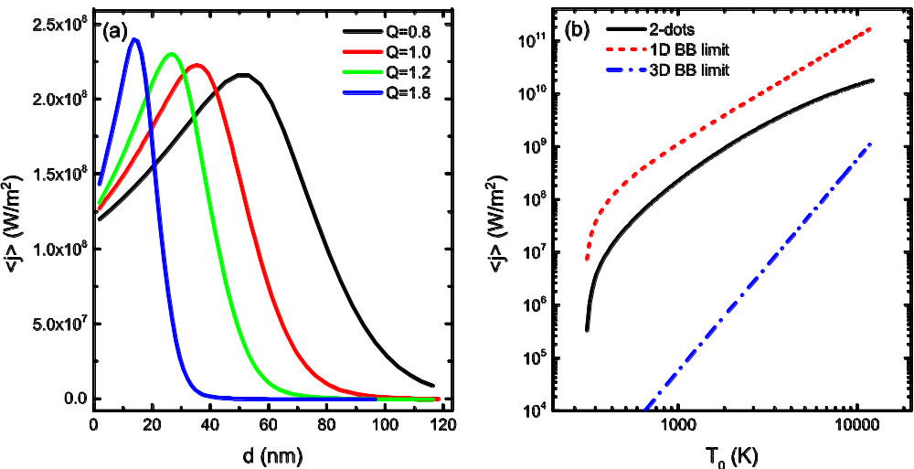
Radiative heat current (wrong!)
Temperatures T₀=1000 K, T₁=300 K, T_{L}=100 K, T_{R}=30 K, chemical potentials μ₀=0 eV, μ₁=0.02 eV, and onsite v₀=0, v₁=0.01eV. Area A=389.4 (nm)².
The temperature dependence of radiative heat current density. T₁=300 K and varying T₀. Wang and Peng, arxiv:1607.02840

Slide 17
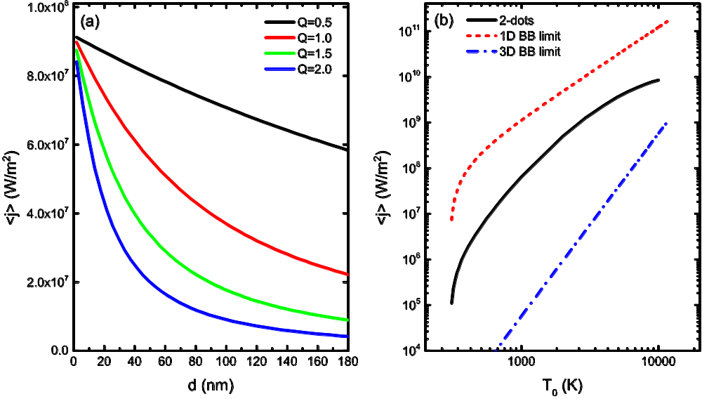
Near-field heat current
Temperatures T₀=1000 K, T₁=300 K, T_{L}=100 K, T_{R}=30 K, chemical potentials μ₀=0 eV, μ₁=0.02 eV, and onsite v₀=0, v₁=0.01eV. Area A=389.4 (nm)².
The temperature dependence of radiative heat current density. T₁=300 K and varying T₀. Wang and Peng, EPL 118, 24001 (2017).

Slide 18
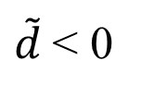
Negative definition vs positive definition Hamiltonian for the field φ
<j>
H_{γ}<0
H_{γ}>0
$\tilde{d}$< 0
0
Distance d

Slide 19
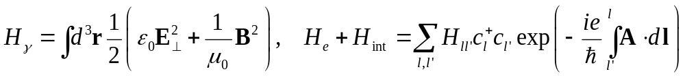
Cubic lattice model
hot
gap d
cold
Lattice constant a
Hopping t

Slide 20
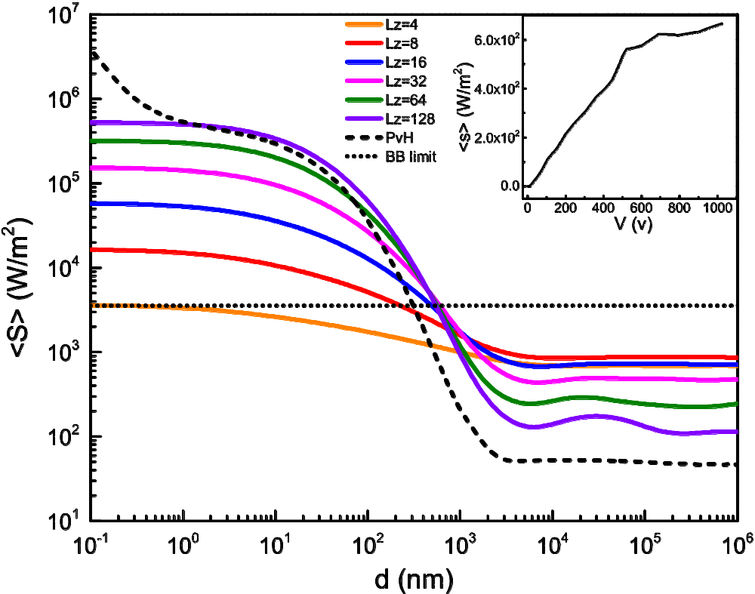
3D A┴ result
Average Poynting vector as a function of spacing d. T₀=500K, T₁=100K.
Model parameters close to Au. PvH result at carrier concentration
(1/6) a⁻³.
Wang and Peng, arxiv:1607.02840.

Slide 21
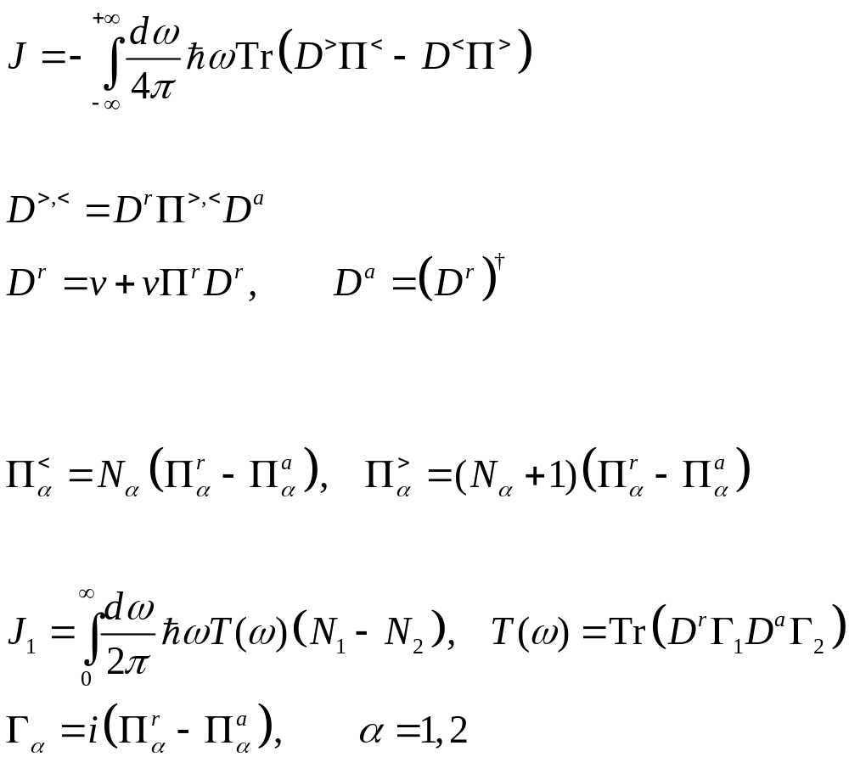

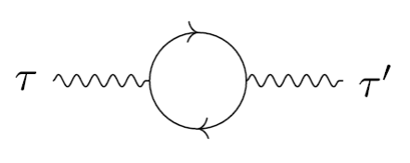
Meir-Wingreen/Caroli formulas
Random phase approximation (RPA)
Assuming local equilibrium

Slide 22
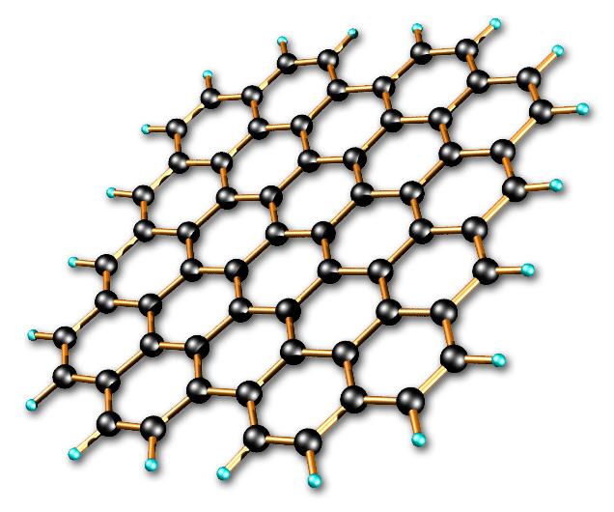
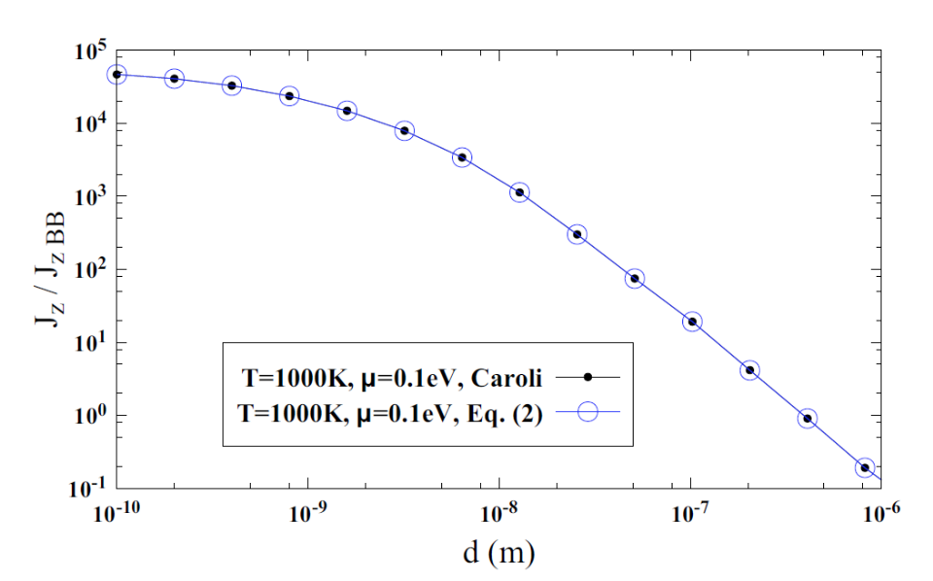
Two graphene sheets
1000 K
Ratio of heat flux to blackbody value for graphene as a function of distance d, J_{zBB} = 56244 W/m². From PRB 96, 155437 (2017), J.-H. Jiang and J.-S. Wang.
300 K

Slide 23
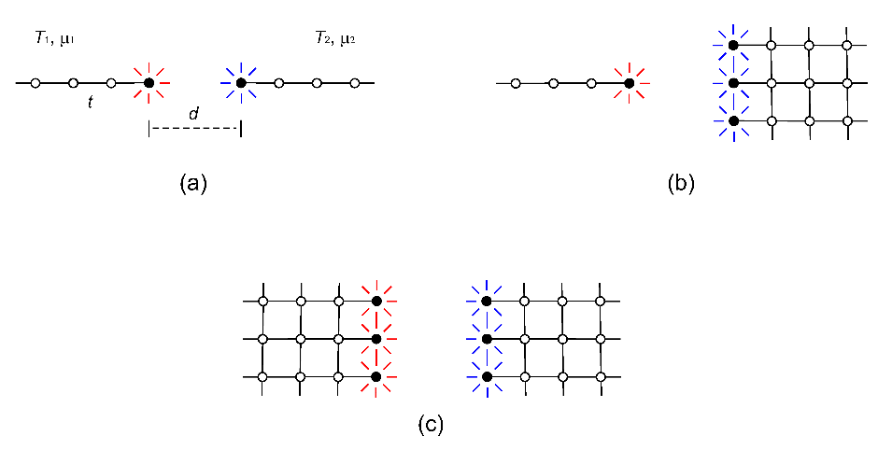
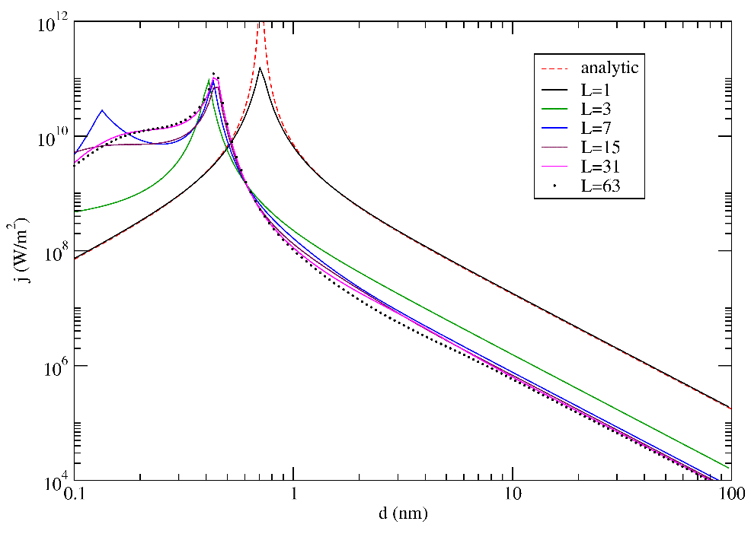
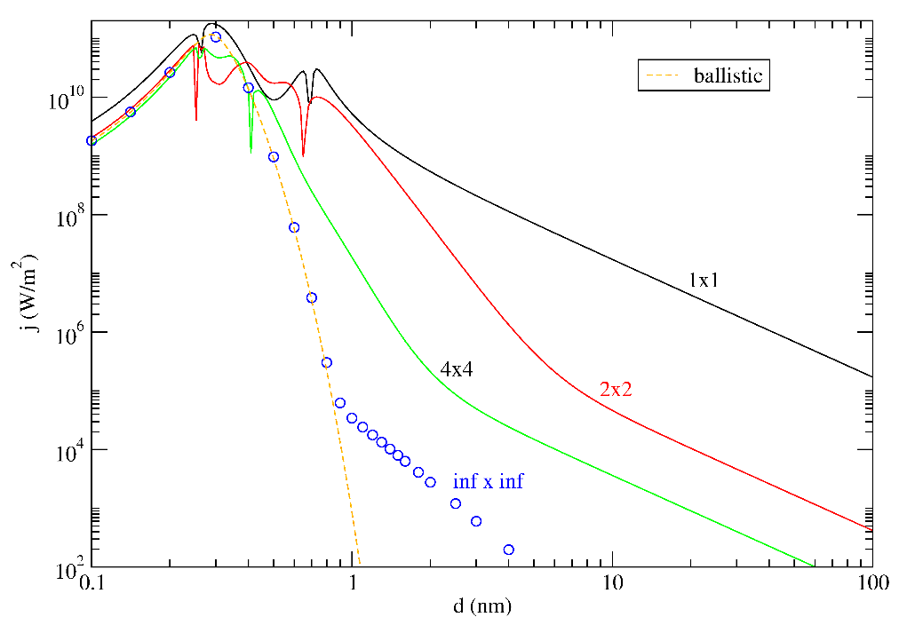
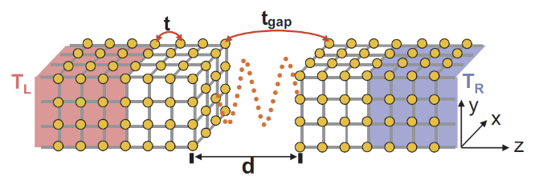
Metal surfaces and tip
: dot and surface.
: cubic lattice parallel plate geometry. From Z.-Q. Zhang, etc. arXiv:1801.07946 and 1803.01479.

Slide 24
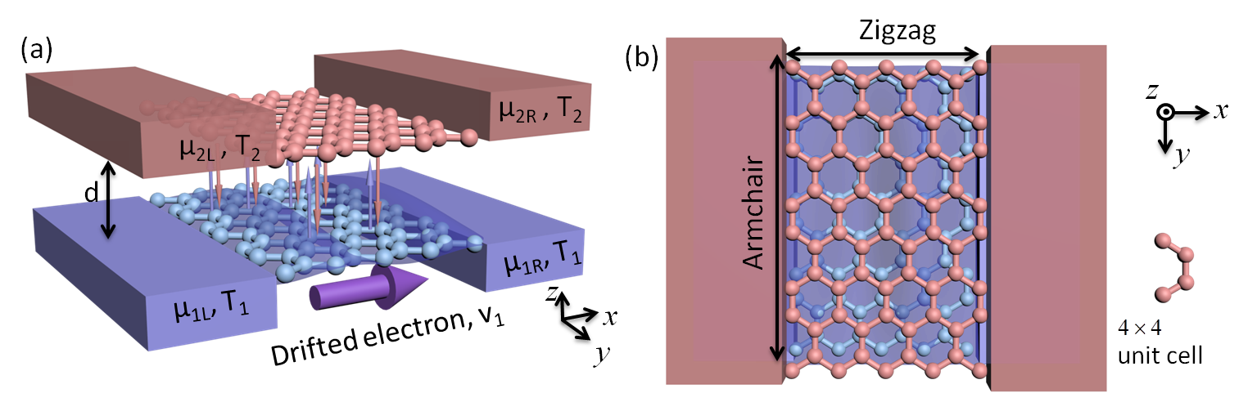
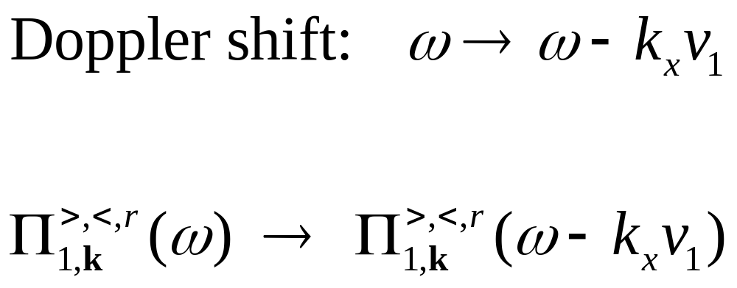
Current-carrying graphene sheets

Slide 25
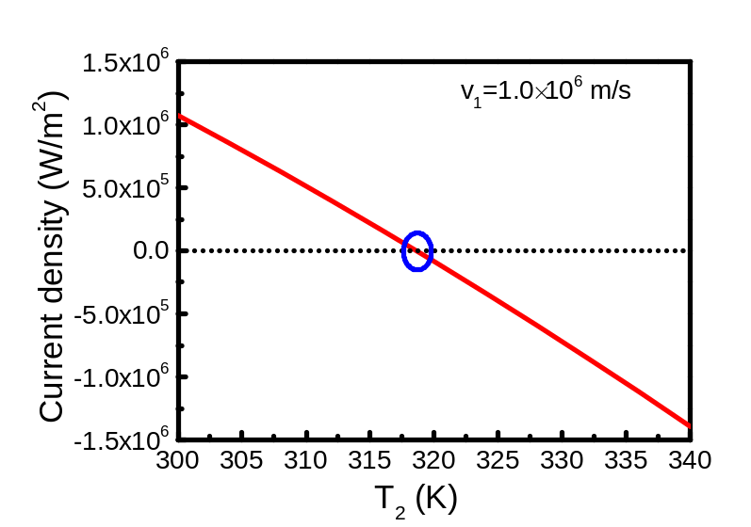
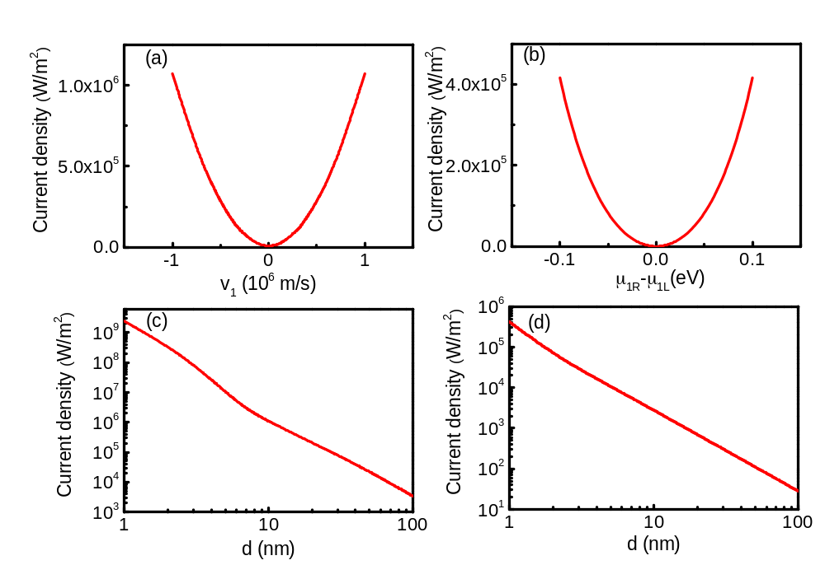
Current-induced heat transfer
: T₁=T₂=300 K. (a) and (c) infinite system (fluctuational electrodynamics), (b) and (d) 4×4 cell finite system with four leads (NEGF).
: Double-layer graphene. T₁=300K, varying T₂ at distance d = 10 nm, chemical potential at 0.1 eV.
From Peng & Wang, arXiv:1805.09493.

Slide 26
Summary
Open system, Brownian motion, Langevin equations, NEGF
A microscopic theory for near-field radiation is proposed.
1D two-dot model, 3D cubic results, and current-carrying graphene reported
Rytov’s theory need to be revised

Slide 27
Acknowledgements
Students: Jiebin, Han Hoe, Jia-Hui, Zuquan
Collaborators, Jingtao Lü, Gaomin Tang, …
MOE tier 2 and FRC grants

