Slide 1
From Monte Carlo to nonequilibrium Green’s functions
Jian-Sheng Wang
Department of Physics,
National University of Singapore

Slide 2
Outline
The earlier days of education
The Swendsen-Wang algorithm
NEGF
  phonons
  Near-field photon transport
  Floquet drive

Slide 3
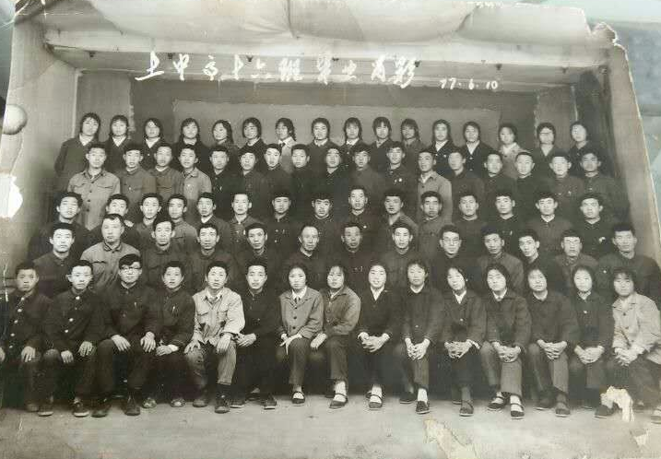
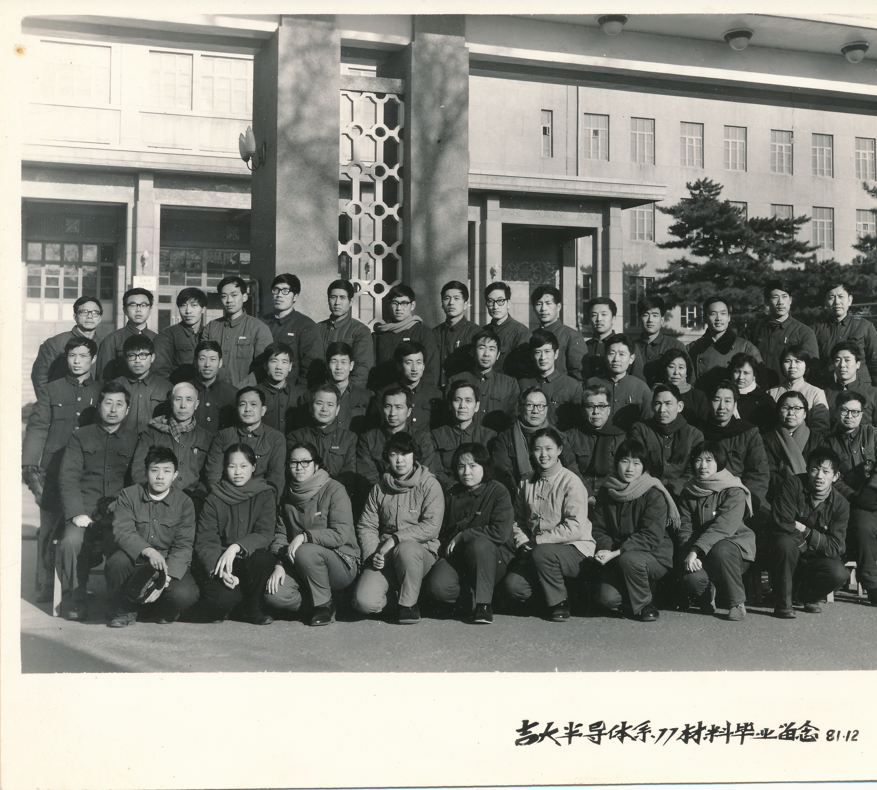
High school and Jilin University
↓ B. Sc. graduating in 1981 from the Department of Semiconductors, Jilin University
↑ High school graduation, summer 1977.

Slide 4
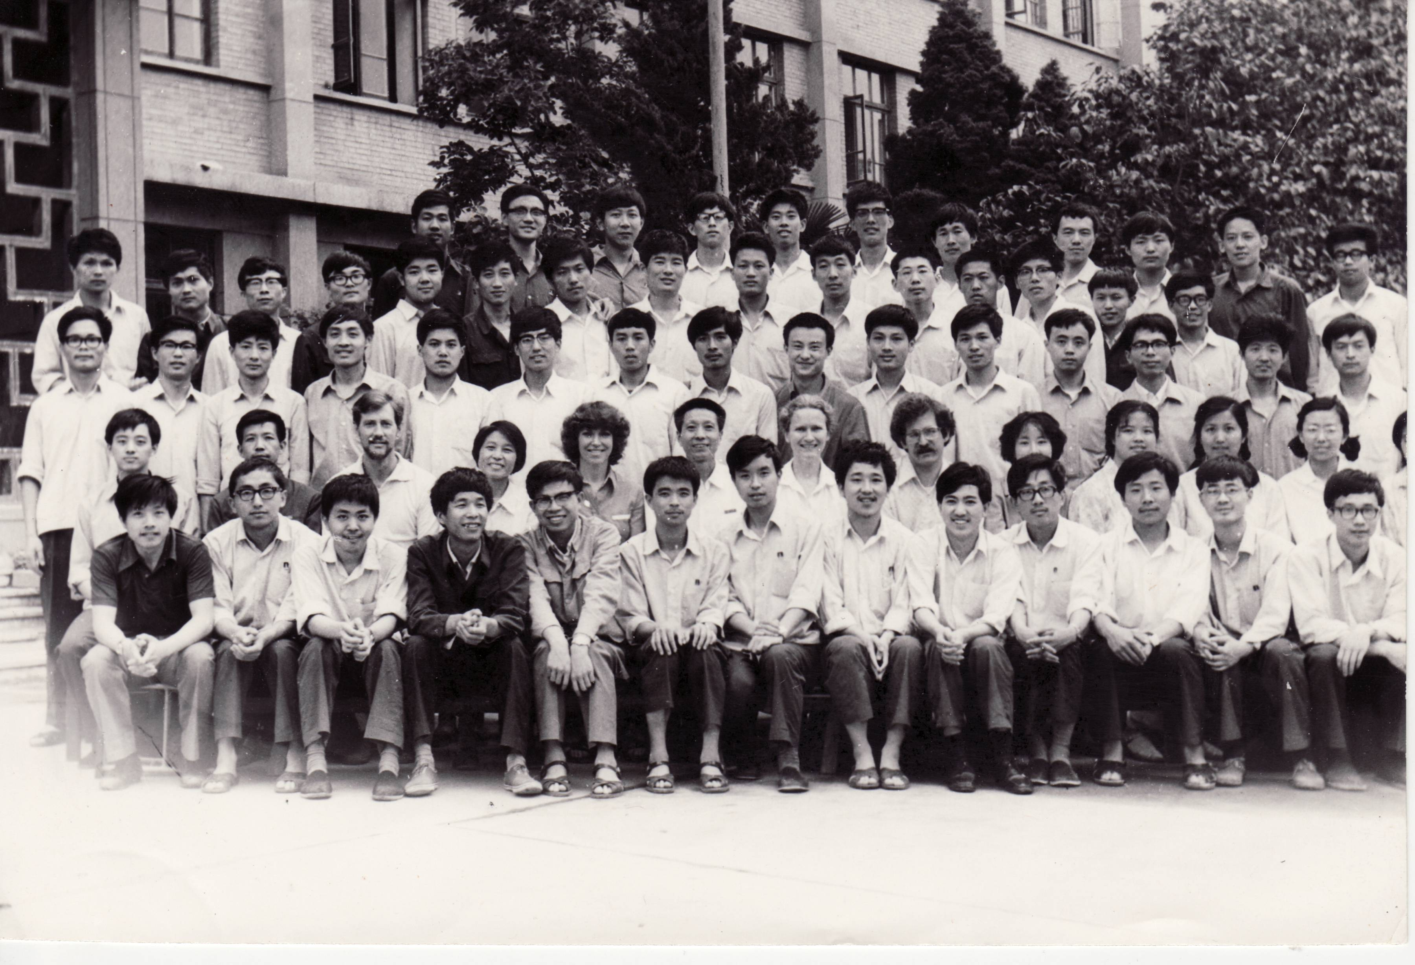
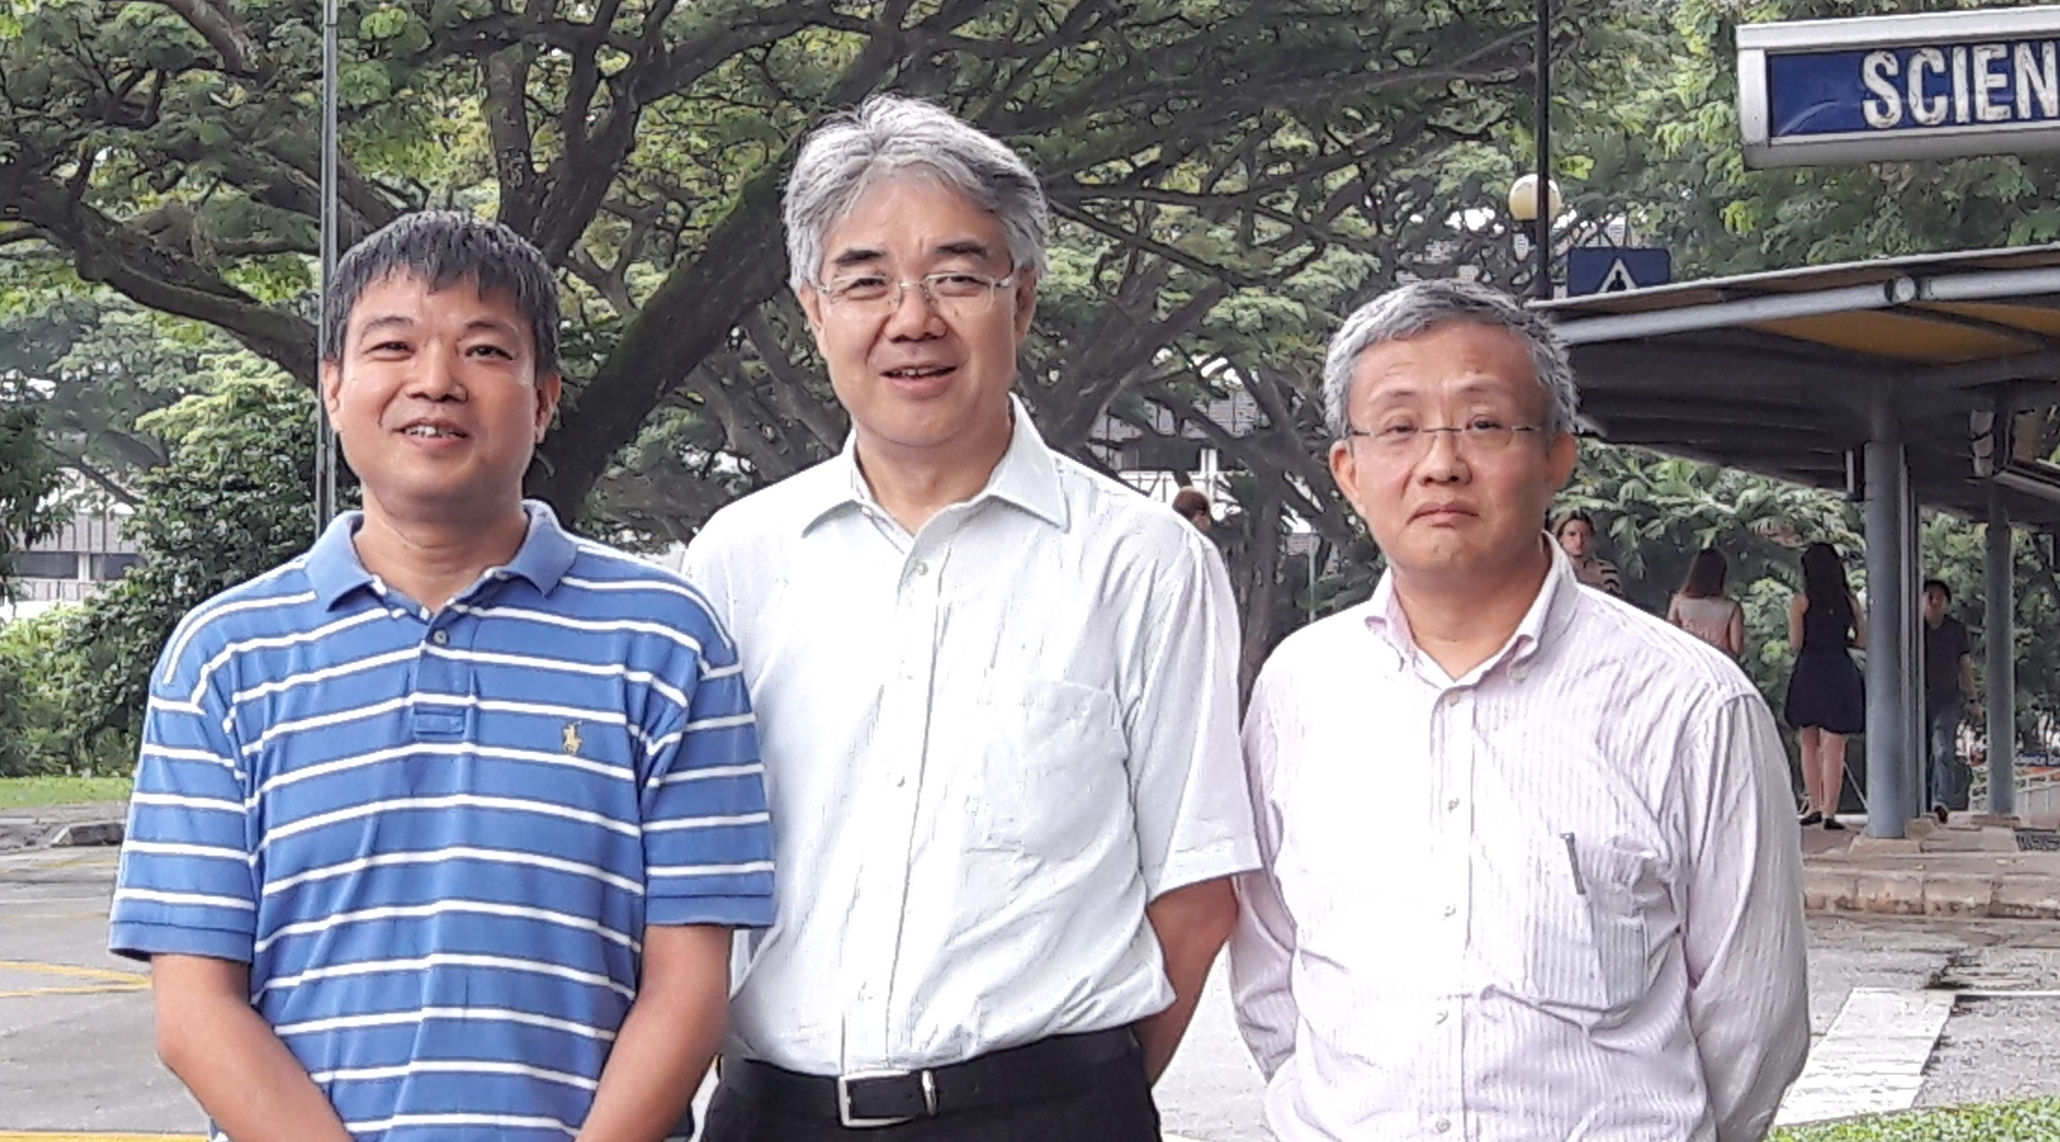
CUSPEA
ↆ NUS, 2016
↑ Xi’an, 1982

Slide 5
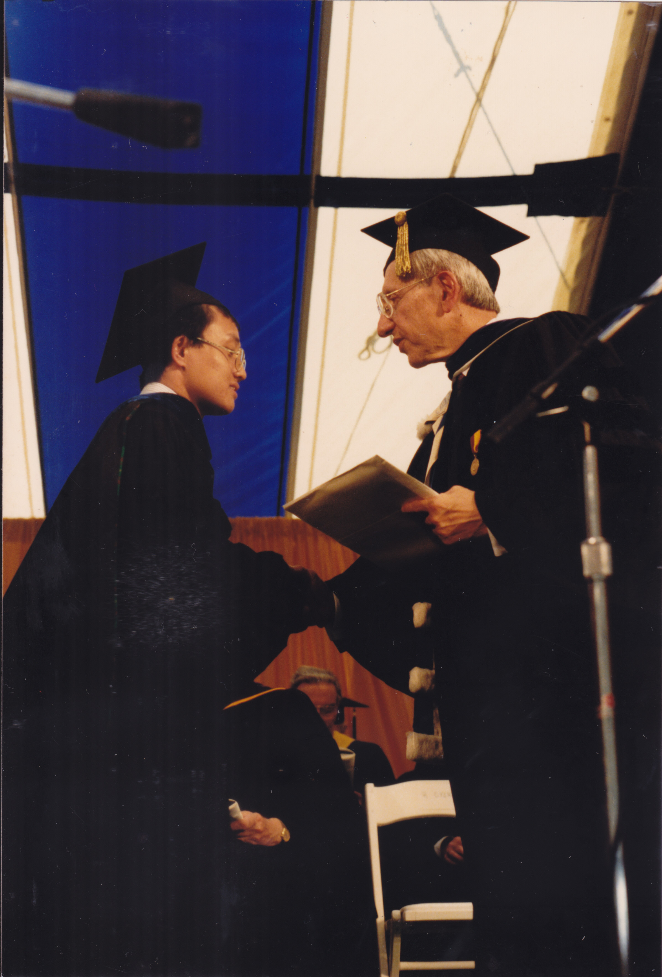
Carnegie Mellon University
PhD 1987
classical mechanics
quantum mechanics I, II, III, IV
experimental physics I, II
Intro to theoretical physics I,II
statistical mechanics I, II
electrodynamics
nuclear & particle physics
quantum field theory
solid state physics I, II
condensed matter I, II

Slide 6
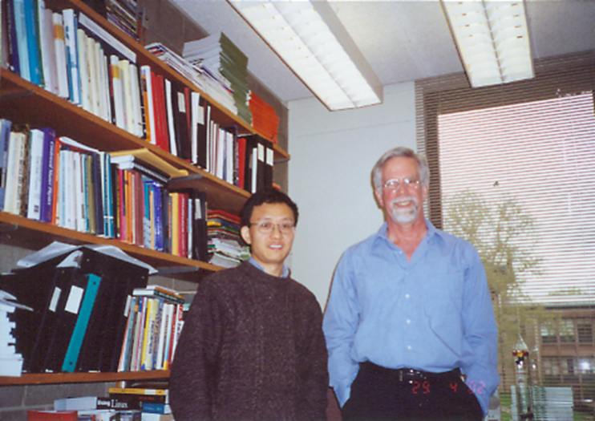
Monte Carlo method
Robert H. Swendsen in his office with Jian-Sheng Wang in 2002.

Slide 7
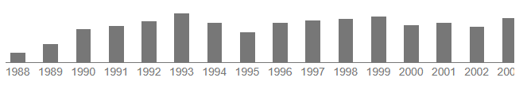
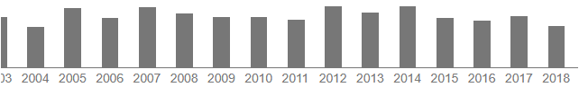
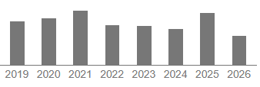
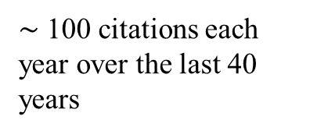
The Swendsen-Wang algorithm, PRL 1987
140
$∼$ 100 citations each year over the last 40 years

Slide 8
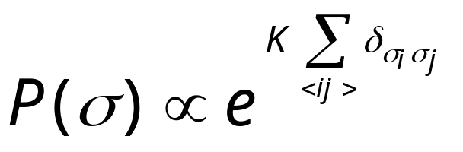
Swendsen-Wang Algorithm
+
-
-
+
-
+
-
-
-
-
-
An arbitrary Ising configuration according to
+
+
+
+
+
+
+
-
+
-
-
+
-
+
+
-
+
+
-
-
+
-
-
-
-
+
+
-
-
+
+
+
+
-
+
-
-
-
K = J/(k_{B}T)
Notes:
For a review, see R. H. Swendsen, J.-S. Wang and A. M. Ferrenberg, in “The Monte Carlo Method in Condensed Matter Physics”, K Binder, ed, Springer 1992. For a complete working program on Swenden-Wang, as well as Sweeny and Gliozzi, see the C program sw-oner-gg.c. The Fortran program sw2d.f was used mainly for timing computers.

Slide 9
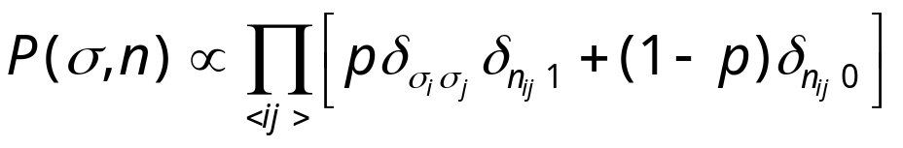
Swendsen-Wang Algorithm
+
-
-
+
-
+
-
-
-
-
-
Put a bond with probability p = 1-e^{-K}, if σ_{i} = σ_{j}
No bond if σ_{i} ≠ σ_{j}
+
+
+
+
+
+
+
-
+
-
-
+
-
+
+
-
+
+
-
-
+
-
-
-
-
+
+
-
-
+
+
+
+
-
+
-
-
-
Notes:
Note that there is a factor of 2 difference between Ising Hamiltonian –JΣσ_{i}σ_{j} and Potts Hamiltonian –JΣδ(σ_{i},σ_{j}). Thus p = 1 –exp(-2J/(kT)) in standard Ising model, but p = 1 – exp(-K) for Potts model.

Slide 10
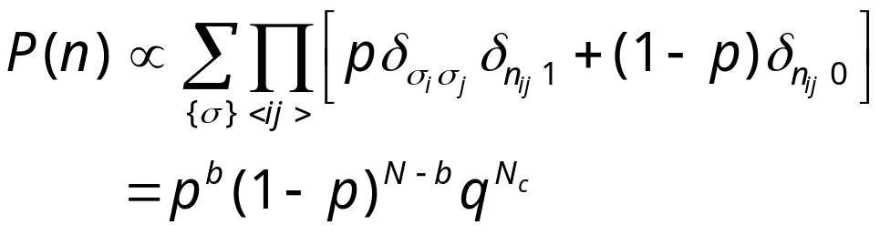
Swendsen-Wang Algorithm
Erase the spins
Fortuin-Kasteleyn 1972

Slide 11
Swendsen-Wang Algorithm
-
+
-
-
-
-
+
Assign new spin for each cluster at random. Isolated single site is considered a cluster.
-
+
-
-
+
+
+
+
-
-
+
-
-
+
+
+
-
+
+
-
+
+
-
-
-
+
-
-
-
+
+
-
+
-
-
+
+
-
+
+
-
-
Go back to P(σ,n) again.
Notes:
If a magnetic field is present, the probability of new spins will be based on the field energy.

Slide 12
Swendsen-Wang Algorithm
-
+
-
-
-
-
+
Erase bonds to finish one sweep.
-
+
-
-
+
+
+
+
-
-
+
-
-
+
+
+
-
+
+
-
+
+
-
-
-
+
-
-
-
+
+
-
+
-
-
+
+
-
+
+
-
-
Go back to P(σ) again.

Slide 13
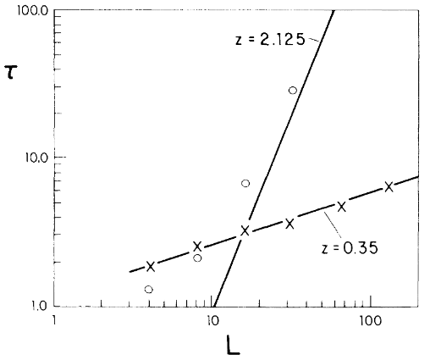
Much Reduced Critical Slowing Down
Comparison of correlation times of Swendsen-Wang with single-spin flip at T_{c} for 2D Ising model
From R H Swendsen and J S Wang, Phys Rev Lett 58 (1987) 86.

Slide 14
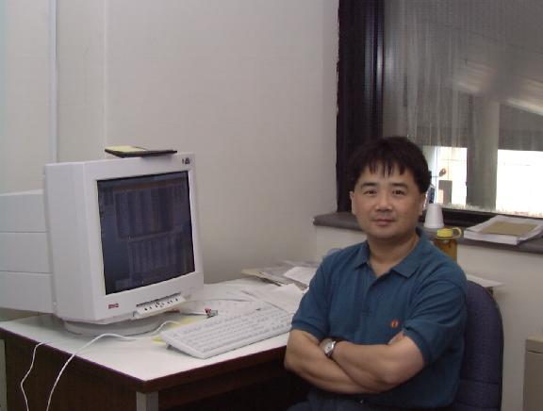

Transition to NEGF
$$Tr\left(G^{r}Γ_{L}G^{a}Γ_{R}\right)$$
Hong Guo from McGill University

Slide 15

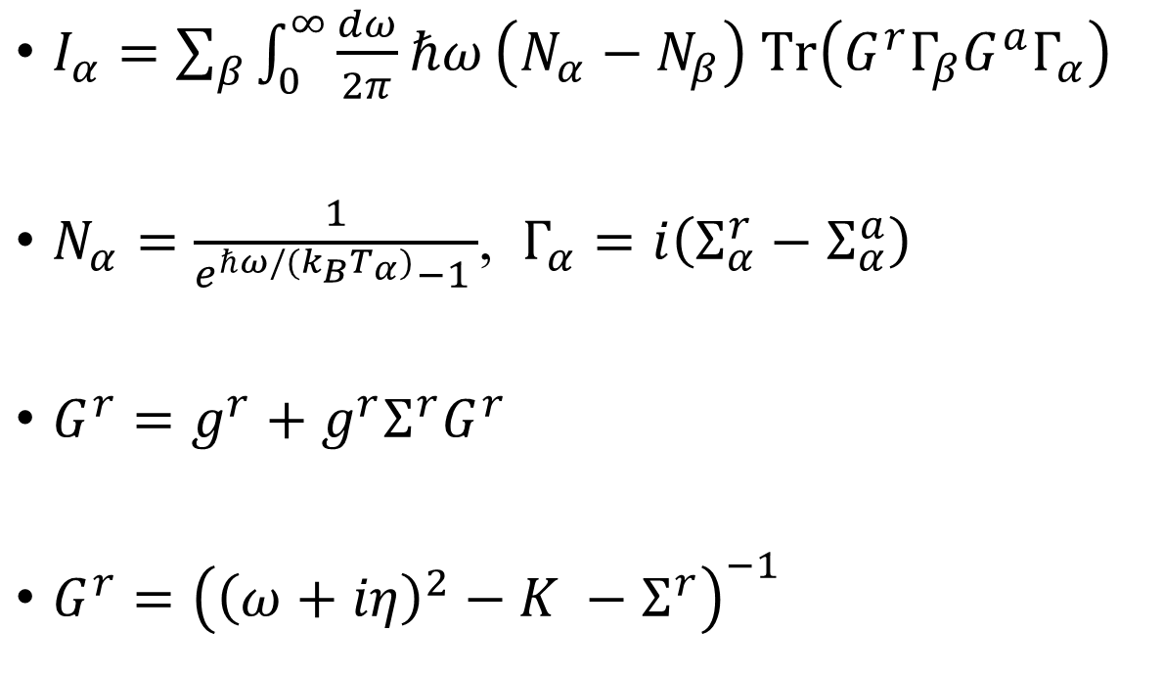


Caroli formula for phonons
Energy out of bath $α$
$I_{α}=\sum_{β}{\int_{0}^{∞}{\frac{dω}{2π}ℏω}\left(N_{α}−N_{β}\right) Tr\left(G^{r}Γ_{β}G^{a}Γ_{α}\right)}$
$N_{α}=\frac{1}{e^{ℏω/(k_{B}T_{α})}−1 }$, $Γ_{α}=i\left(Σ_{α}^{r}−Σ_{α}^{a}\right)$
$G^{r}=g^{r}+g^{r}Σ^{r}G^{r}$
$G^{r}={\left({\left(ω+iη\right)}^{2}−K −Σ^{r}\right)}^{−1}$
$$β$$
bath
$$α$$
center
bath
.
.
.
Yamamoto & Watanabe PRL 2006

Slide 16
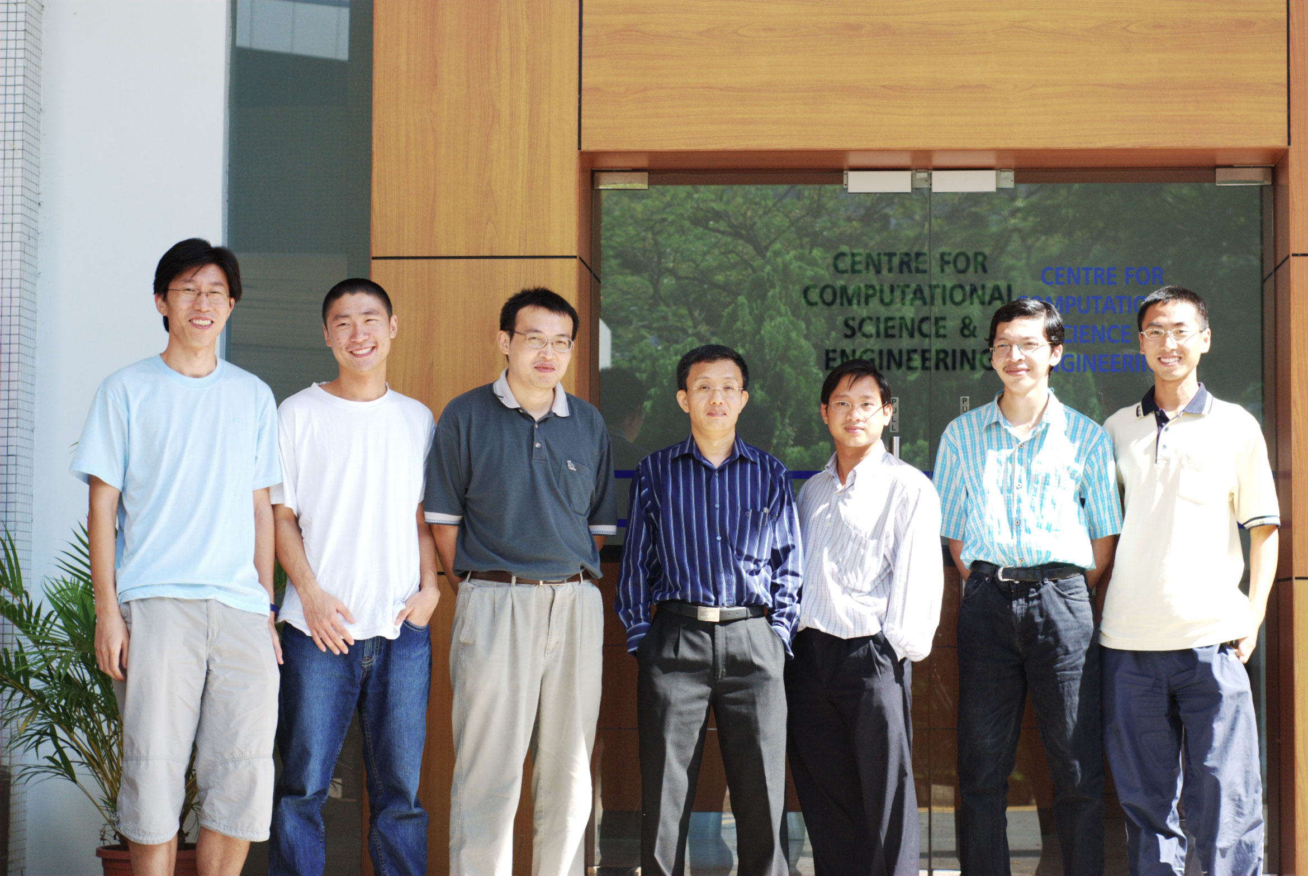
My group at NUS Physics around 2007

Slide 17
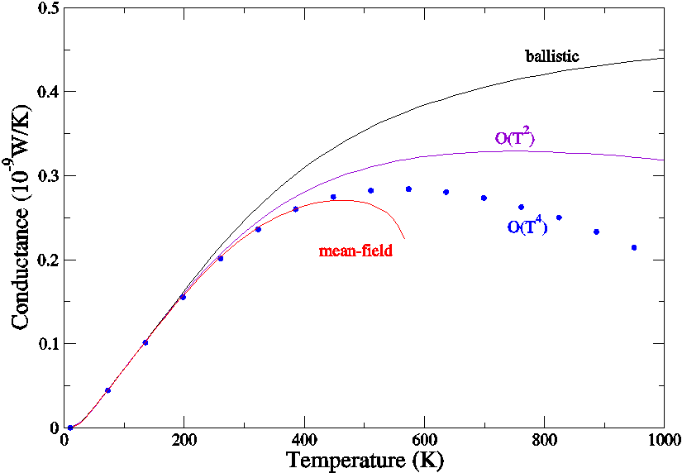
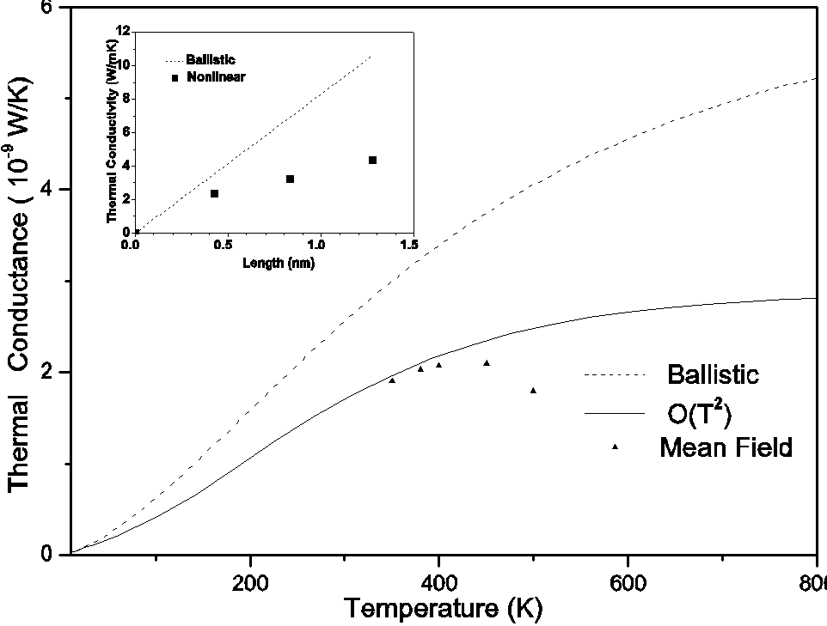
From ballistic to diffusive?
J-S Wang, J Wang, Zeng,
PRB (2006) cited 326 times
↑ 1D chain, → nanotube,
both with cubic linearity

Slide 18
Photon system setup
N+1 or infinity
$$R→∞$$
…
1
Question: what are the energy emitted, force and torque applied to, for each of the object 1 to N+1.
N
2

Slide 19
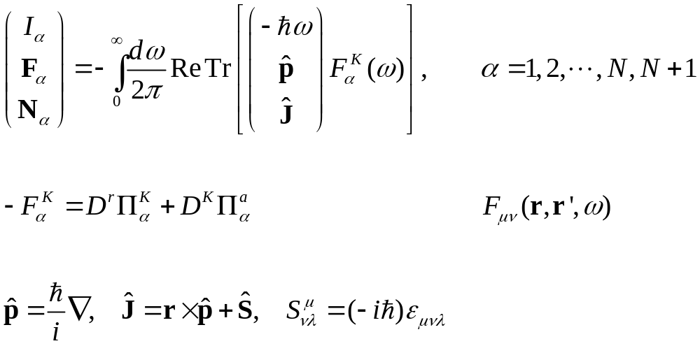
Meir-Wingreen formula for photon transport
Krüger, et al (2012); Strekha, et al, PRA;
Wang, et al, Front. Phys. (2023).

Slide 20
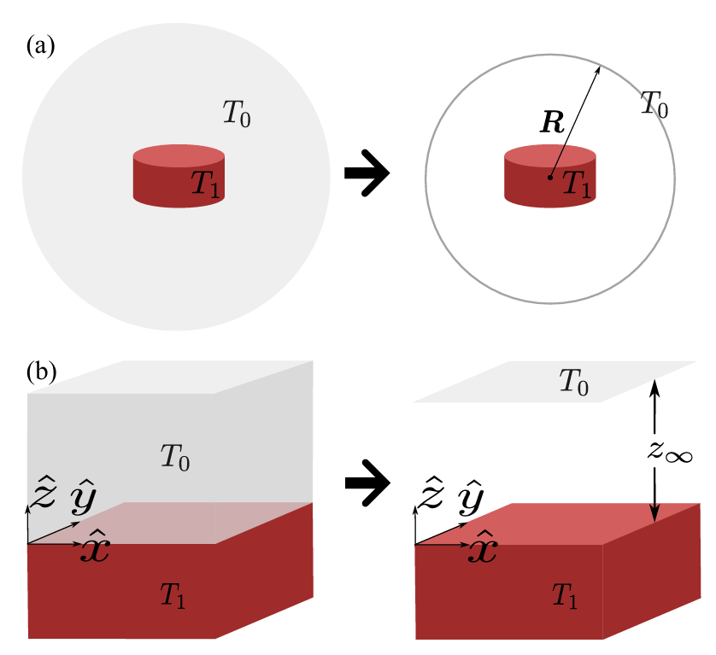

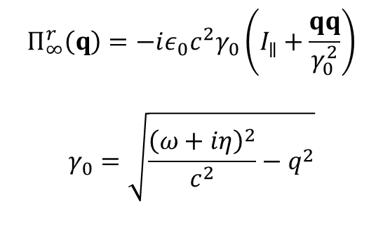
Bath at infinities
$$Π_{∞}^{r}\left(ω,R\right)=−iε_{0}cω(I−\hat{R}\hat{R})$$
$$Π_{∞}^{r}\left(q\right)=−iε_{0}c^{2}γ_{0}\left(I_{∥}+\frac{qq}{γ_{0}^{2}}\right)$$
$$γ_{0}=\sqrt{\frac{{\left(ω+iη\right)}^{2}}{c^{2}}−q^{2}}$$
From G. Tang, Y. Ren, and J.-S. Wang,
arXiv:2605.02265

Slide 21
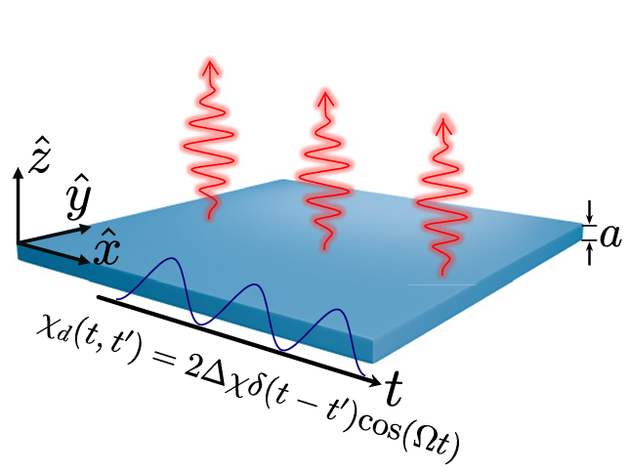
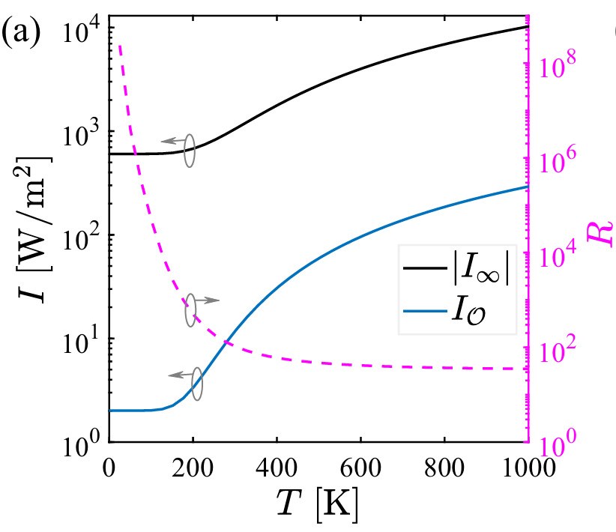
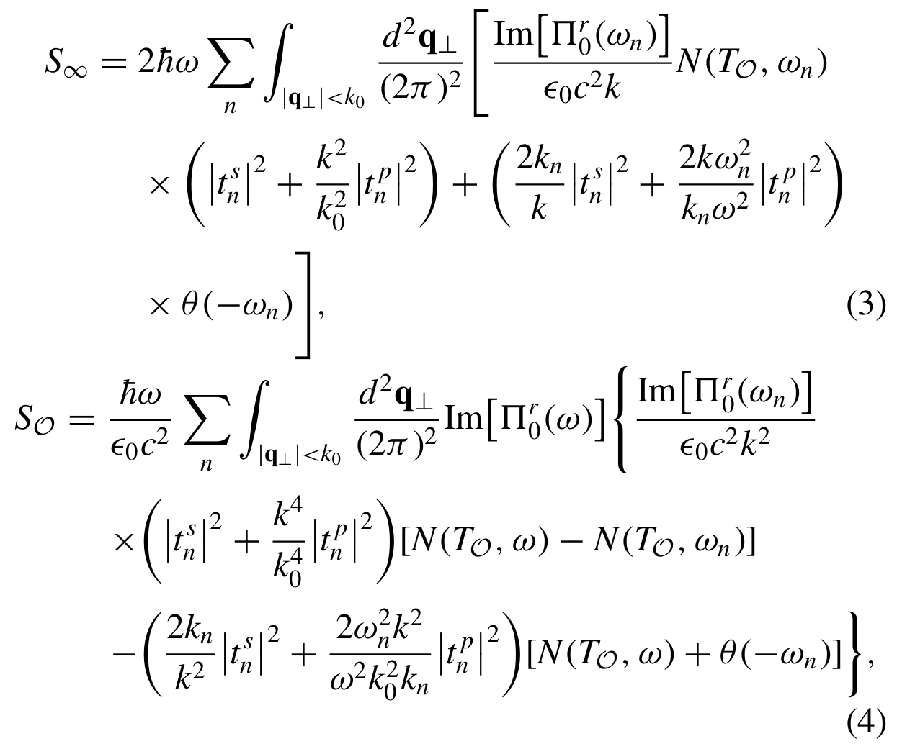


Floquet drive
SiC film $a=0.52 μ$m
Zhu, Pan, Tang, Zhang, J.-S. Wang, PRB 2026
$$R=I_{∞}(Δχ=2.5)/I_{∞}(0)$$

Slide 22
Acknowledgements
R Swendsen, J Lebowitz, K Binder, D Stauffer, MQ Zhang, D Chowdhury, V Privman, R Dickman, P Nielaba, W Selke, J Wang, N Zeng, G Pereira, R Pandey, C K Gan, K-t Leung, L W Lee, J Cai, Z Yao, L Yi, H Guo, GR Liu, B Li, Y Xu, JT Lü, J Lan, X Ni, G Liang, JW Jiang, L Zhang, J Ren, E C Cuansing, BK Agarwalla, J Thingna, H Li, S Liu, P Hänggi, R Mahendiran, H Zhou, X Xu, D He, JP Lv, R Chen, JC Ren, JH Jiang, JB Gong, HH Yap, J Peng, YM Zhang, ZQ Zhang, G Tang, T Deng, G Wu, SW Yang, K Sun, T Zhu, ZB Gao, H Pan, H Zhu, L. Feng, M Antezza, P Rodriguez-Lopez, Y. Ren, …

