Slide 1

Nonequilibrium Green’s Function Method in Thermal Transport
Wang Jian-Sheng

Slide 2
Lecture 1: NEGF basics – a brief history, definition of Green’s functions, properties, interpretation.
Lecture 2: Calculation machinery – equation of motion method, Feynman diagramatics, Dyson equations, Landauer/Caroli formula.
Lecture 3: Applications – transmission, transient problem, thermal expansion, phonon life-time, full counting statistics, reduced density matrices and connection to quantum master equation.

Slide 3
References
J.-S. Wang, J. Wang, and J. T. Lü, “Quantum thermal transport in nanostructures,” Eur. Phys. J. B 62, 381 (2008).
J.-S. Wang, B. K. Agarwalla, H. Li, and J. Thingna, “Nonequilibrium Green’s function method for quantum thermal transport,” Front. Phys. (2013).
See also http://staff.science.nus.edu.sg/~phywjs/NEGF/negf.html
Notes:
See also http://staff.science.nus.edu.sg/~phywjs/NEGF/negf.html

Slide 4
Lecture One
History, definitions, properties of NEGF

Slide 5
A Brief History of NEGF
Schwinger 1961
Kadanoff and Baym 1962
Keldysh 1965
Caroli, Combescot, Nozieres, and Saint-James 1971
Meir and Wingreen 1992

Slide 6
Equilibrium Green’s functions using a harmonic oscillator as an example
Single mode harmonic oscillator is a very important example to illustrate the concept of Green’s functions as any phononic system (vibrational degrees of freedom in a collection of atoms) at ballistic (linear) level can be thought of as a collection of independent oscillators in eigenmodes. Equilibrium means that system is distributed according to the Gibbs canonical distribution.

Slide 7
Harmonic Oscillator
k
m
Notes:
du/dt = sqrt(hbar/(2Omega)) ( - a + a\dagger) (i Omega)

Slide 8
Eigenstates, Quantum Mech/Stat Mech

Slide 9
Heisenberg Operator/Equation
O: Schrödinger operator
O(t): Heisenberg operator

Slide 10
Defining >, <, t, Green’s Functions

Slide 11
Notes:
T, Ť are called super-operator, as it act on the operator, not in the vector of Hilbert space.

Slide 12
Retarded and Advanced Green’s functions

Slide 13
Fourier Transform
Notes:
We use the convention that planewave is exp(ik.r – i wt).

Slide 14
Plemelj formula, Kubo-Martin-Schwinger condition
P for Cauchy principle value
Valid only in thermal equilibrium

Slide 15
Matsubara Green’s Function

Slide 16
Nonequilibrium Green’s Functions
By “nonequilibrium”, we mean, either the Hamiltonian is explicitly time-dependent after t₀, or the initial density matrix ρ is not a canonical distribution.
We’ll show how to build nonequilibrium Green’s function from the equilibrium ones through product initial state or through the Dyson equation.

Slide 17
Definitions of General Green’s functions
Notes:
Other types such as Matsubara Green’s function or canonical (Kubo) correlation are also used. i = sqrt(-1). The average < … > can be equilibrium or with respect to arbitrary density matrix. For classical systems, G< = G>.
17

Slide 18
Relations among Green’s functions
Notes:
The relation implies two (three?) linearly independent ones, and one independent one only if nonlinear dependence is considered.
18

Slide 19
Steady state, Fourier transform
Notes:
The inverse Fourier transform has a factor of 2 . We use square brackets [ ] to denote Fourier transformed function.
19

Slide 20
Equilibrium Green’s Function, Lehmann Representation
Notes:
Lehmann representation is to expand everything in the eigenstates.

Slide 21
Kramers-Kronig Relation
Notes:
G^a is when z -> w – I eta.

Slide 22
Eigen-mode Decomposition
Notes:
Only for finite system, in equilibrium? See a nice summaryin appendix of Phys Rev B. 80 205429 (2009).

Slide 23
Pictures in Quantum Mechanics
Schrödinger picture: O, (t) =U(t,t₀)(t₀)
Heisenberg picture: O(t) = U(t₀,t)OU(t,t₀) , ρ₀, where the evolution operator U satisfies
See, e.g., Fetter & Walecka, “Quantum Theory of Many-Particle Systems.”
Notes:
< . > = Tr(ρ . ). T here denotes time order, assuming t > t’. Anti-time order if t < t’.
23

Slide 24
Calculating correlation
B
A
t₀
t’
t
Notes:
t₀ is the synchronization time where the Schrödinger picture and Heisenberg picture are the same.
24

Slide 25
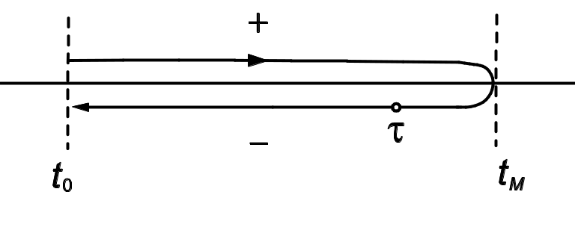
Evolution Operator on Contour

Slide 26
Contour-ordered Green’s function
Contour order: the operators earlier on the contour are to the right. See, e.g., H. Haug & A.-P. Jauho.
τ’
τ
t₀
Notes:
26

Slide 27
Relation to other Green’s function
τ’
τ
t₀
Notes:
σ = + for the upper branch, and – for the returning lower branch.
27

Slide 28
An Interpretation
G is defined with respect to Hamiltonian H and density matrix ρ and assuming Wick’s theorem.
Notes:
This is originally due to Schwinger.

Slide 29
Calculus on the contour
Integration on (Keldysh) contour
Differentiation on contour
Notes:
dτ is σdt for integration, but just dt in differentiation. σ is either just the sign + or -, or +1, -1.
29

Slide 30
Theta function and delta function
Theta function
Delta function on contour
where θ(t) and δ(t) are the ordinary theta and Dirac delta functions
Notes:
30

Slide 31
Transformation/Keldysh Rotation
Notes:
Also properly known as Larkin-Ovchinikov transform, JETP 41, 960 (1975).

Slide 32
Convolution, Langreth Rule
Notes:
The last two equations are known as Keldysh equations.

Slide 33
Lecture two
Equation of motion method, Feynman diagrams, etc

Slide 34
Equation of Motion Method
The advantage of equation of motion method is that we don’t need to know or pay attention to the distribution (density operator) ρ. The equations can be derived quickly.
The disadvantage is that we have a hard time justified the initial/boundary condition in solving the equations.

Slide 35
Heisenberg Equation on Contour
Notes:
The integral on the exponential is from a point tau_1 specified on the contour to tau_2 at a later point on the contour. The integral is along the contour.

Slide 36
Express contour order using theta function
Operator A(τ) is the same as A(t) as far as commutation relation or effect on wavefunction is concerned
Notes:
u u^{T} is a square matrix, and [u, v^{T}] is a matrix formed by (j,k) element [u_{j}, v_{k}].
36

Slide 37
Equation of motion for contour ordered Green’s function
Notes:
We use the equation of motion d²u/dt² = -Ku.
37

Slide 38
Equations for Green’s functions
Notes:
38

Slide 39
Solution for Green’s functions
c and d can be fixed by initial/boundary condition.
Notes:
Note that if ax = b, x = b/a, but not if a = 0, in that case, x = infinity, thus, the Dirac delta function.
39

Slide 40
Feynman diagrammatic method
The Wick theorem
Cluster decomposition theorem, factor theorem
Dyson equation
Vertex function
Vacuum diagrams and Green’s function

Slide 41
Handling interaction
Transform to interaction picture, H = H₀ + H_{n}
Notes:
For the concept of pictures and relations among them, see A. L. Fetter and J. D. Walecka, “Quantum theory of many-body systems”, McGraw-Hill, 1971. The meaning of t₀ and t’ is quite different. t₀ is such that three pictures are equivalent, t’ is an arbitrary time. Note that ρ behaves like |><|.
41

Slide 42
Scattering operator S
Notes:
A(t) and B(t’) are in interaction picture (i.e. A_{I}(t) etc).
42

Slide 43
Contour-ordered Green’s function
τ’
τ
t₀
Notes:
Another possible representation of the result is using Feynman path integral formulation.
43

Slide 44
Perturbative expansion of contour ordered Green’s function
Notes:
Every operator is in interaction picture, dropped superscript I for simplicity. The Wick theorem is valid if the expectation < … > is with respect to a quadratic weight. For a proof, see Rammer.
44

Slide 45
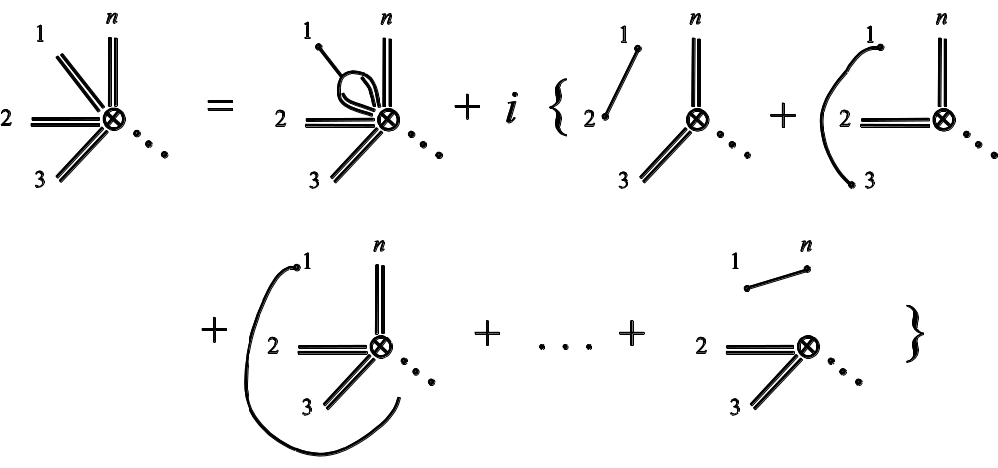
General expansion rule
Single line
3-line vertex
n-double line vertex
Notes:
See our review article or Rammer’s book.

Slide 46
Diagrammatic representation of the expansion
=
+ 2iħ
+ 2iħ
+ 2iħ
=
+
Notes:
Due to the last term, G should be read as connected part G_c only in the Dyson equation.
46

Slide 47
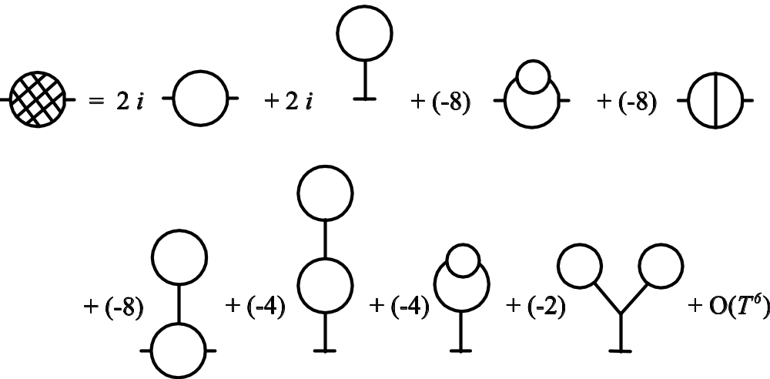
Self -energy expansion
Σ_{n} =
Notes:
The self-energy diagrams are obtained by including all doubly or more connected diagrams removing the two external legs from the Green’s function diagrams. For a more systematic exposition of the Feynman-diagrammatic expansion, see Fetter and Welecka. hbar was set to 1 in the diagrams.
47

Slide 48
Explicit expression for self-energy
Notes:
See also figure 3 in J.-S. Wang, X. Ni, and J.-W. Jiang, Phys. Rev. B 80, 224302 (2009).
48

Slide 49
Junction system, adiabatic switch-on
  g_{α} for isolated systems when leads and centre are decoupled
  G0 for ballistic system
  G for full nonlinear system
H_{L}+H_{C}+H_{R} +V +H_{n}
H_{L}+H_{C}+H_{R} +V
G
H_{L}+H_{C}+H_{R}
G₀
g_{α}
t = − ∞
Equilibrium at T_{α}
t = 0
Nonequilibrium steady state established
49
Notes:
Two adiabatic switch-on’s.
49

Slide 50
Sudden Switch-on
H_{L}+H_{C}+H_{R} +V +H_{n}
Green’s function G
H_{L}+H_{C}+H_{R}
g_{α}
t = − ∞
Equilibrium at T_{α}
t = ∞
t =t₀
Nonequilibrium steady state established
50
Notes:
Two adiabatic switch-on’s.
50

Slide 51
Three regions
51
Notes:
51

Slide 52
Heisenberg equations of motion in three regions
52
Notes:
52

Slide 53
Force Constant Matrix

Slide 54
Relation between g and G0
Equation of motion for GLC
Notes:
In obtaining G_{LC}, an arbitrary function satisfying (d/dtau^2 + K^{L}) f = 0 is omitted. Absence of this term is consistent with adiabatic switch-on from Feynman diagrammatic expansion.
54

Slide 55
Dyson equation for GCC
Notes:
In this derivation, we assume H_{n} = 0.
55

Slide 56
Equation of Motion Way (ballistic system)

Slide 57
“Partition Function”

Slide 58
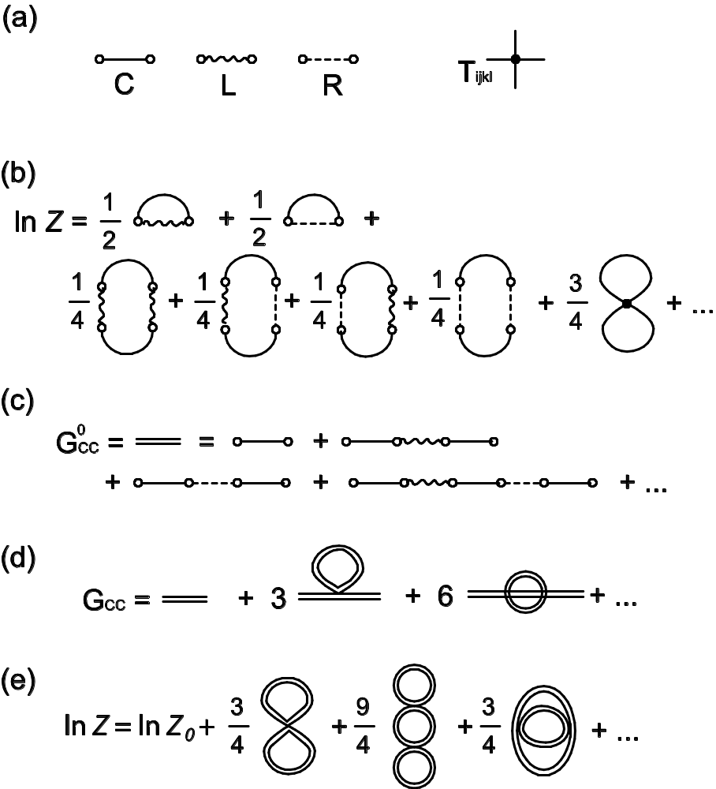
Diagrammatic Way
Feynman diagrams for the nonequilibrium transport problem with quartic nonlinearity. (a) Building blocks of the diagrams. The solid line is for g_{C}, wavy line for g_{L}, and dash line for g_{R}; (b) first few diagrams for ln Z; (c) Green’s function G⁰_{CC}; (d) Full Green’s function G_{CC}; and (e) re-sumed ln Z where the ballistic result is ln Z₀ = (1/2) Tr ln (1 –g_{C}Σ). The number in front of the diagrams represents extra combinatorial factor.

Slide 59
The Langreth theorem
Notes:
Need to use the relation between G⁺⁺, G⁻ ⁻, G⁺⁻, and G⁺⁻ with G^{r} and G<. See Haug & Jauho, page 66.
59

Slide 60
Dyson equations and solution
Notes:
In deriving the last line, we use the fact (g^{r})⁻¹ g< = 0.
60

Slide 61
Energy current
Notes:
I_{L} is energy flowing out of the left lead into the center. This expression can be proving to be real, no need to take Re. Above equation works for general nonlinear case.
61

Slide 62
Landauer/Caroli formula
Notes:
The symmetrization appears necessary to get the Caroli formula. Caroli formula is valid only for ballistic case where H_{n} = 0.
62

Slide 63
1D calculation
In the following we give a complete calculation for a simple 1D chain (the baths and the center are identical) with on-site coupling and nearest neighbor couplings. This example shows the general steps needed for more general junction systems, such as the need to calculate the “surface” Green’s functions.

Slide 64
Ballistic transport in a 1D chain
Force constants
Equation of motion
Notes:
The matrix K is infinite in both directions.
64

Slide 65
Solution of g
Notes:
K^{R} is semi-finite, V is nonzero only at the corner.
65

Slide 66
Lead self energy and transmission
T[ω]
1
ω
Notes:
Σ_{R} is nonzero only for the lower right corner.
66

Slide 67
Heat current and conductance
Notes:
The last formula σ is called universal conductance.
67

Slide 68
General recursive algorithm for g
Notes:
The algorithm is due to Lopez Sancho et al (1985). Typically, 10 to 20 iterations should be already converged.
68

Slide 69
Lecture Three
Applications

Slide 70
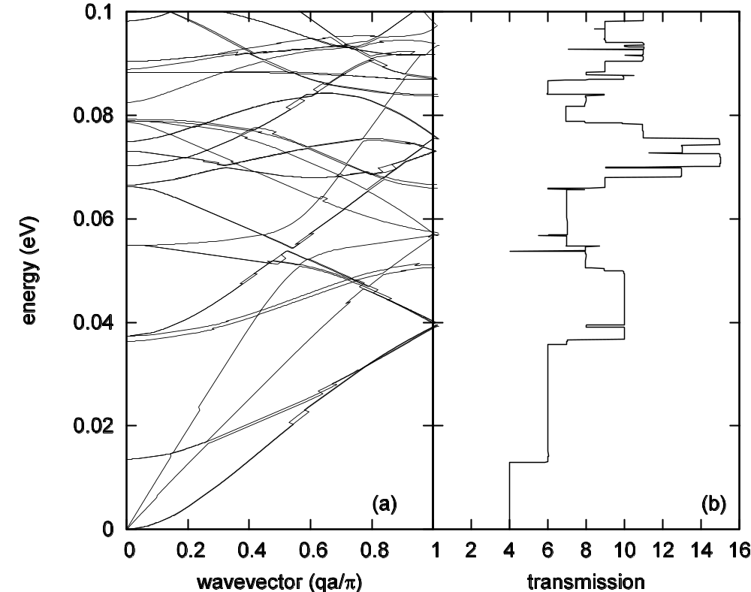
Carbon nanotube (6,0), force field from Gaussian
Dispersion relation
Transmission
Calculation was performed by J.-T. Lü.
Notes:
The force constants were symmetrized using the method of Mingo et al (2008). Calculation was performed by Lü Jingtao.
70

Slide 71
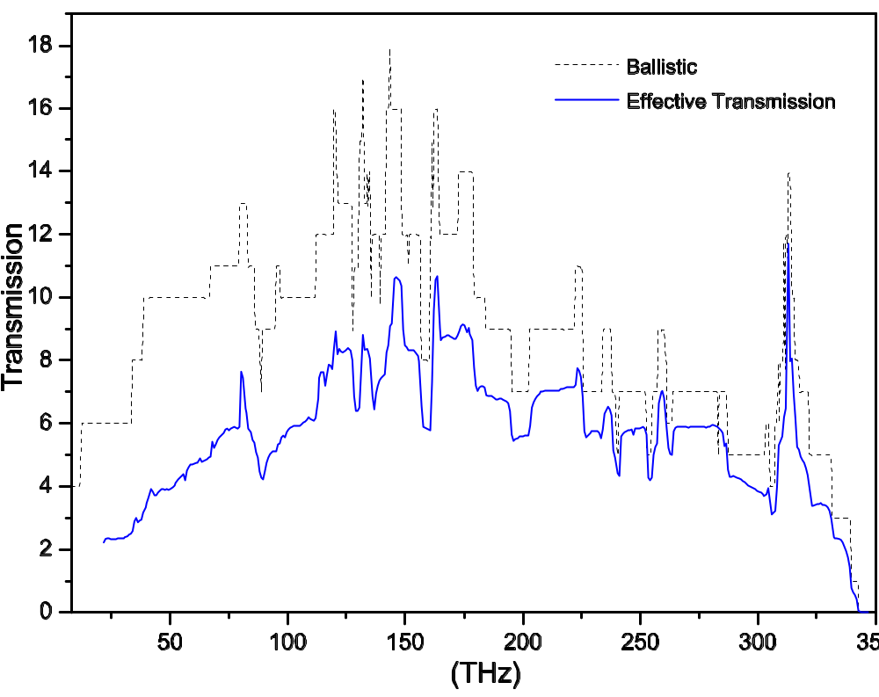
Carbon nanotube, nonlinear effect
The transmissions in a one-unit-cell carbon nanotube junction of (8,0) at 300K. From J-S Wang, J Wang, N Zeng, Phys. Rev. B 74, 033408 (2006).
Notes:
The nonlinear result may be not correct at the low frequency end.
71

Slide 72
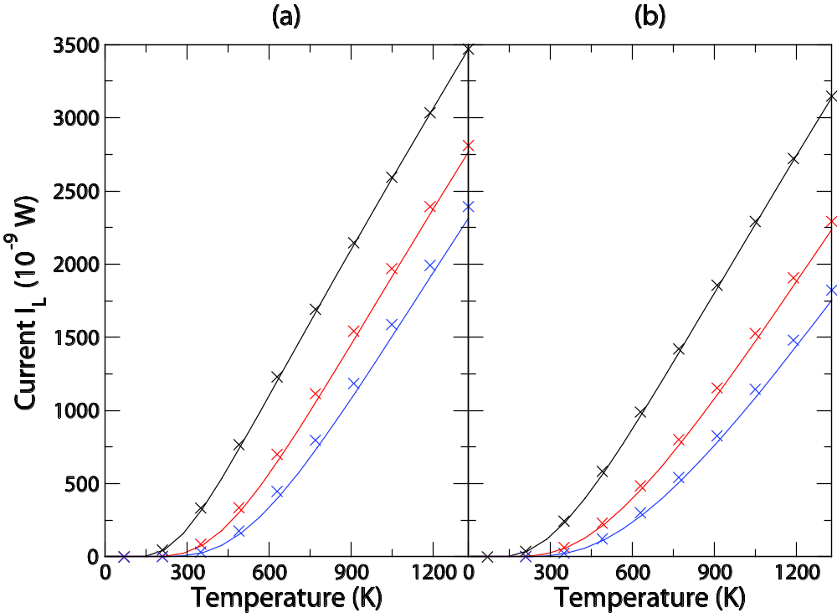
u⁴ Nonlinear model
One degree of freedom (a) and two degrees freedom (b) (1/4) Σ T_{ijkl} u_{i} u_{j} u_{k} u_{l} nonlinear model. Symbols from quantum master equation, lines from self-consistent NEGF. For parameters used, see Fig.4 caption in J.-S. Wang, et al, Front. Phys. Calculated by Juzar Thingna.
1
5
10

Slide 73
Molecular dynamics with quantum bath
See J.-S. Wang, et al, Phys. Rev. Lett. 99, 160601 (2007);
Phys. Rev. B 80, 224302 (2009).
Notes:
For more detail, see Phys. Rev. B 80, 224302 (2009). Any idea how to generalize this so that quantum mechanics is reproduced exactly?
73

Slide 74
Average displacement, thermal expansion
One-point Green’s function
Notes:
The idea of calculating the thermal expansion coefficient this way due to Jiang Jinwu.
74

Slide 75
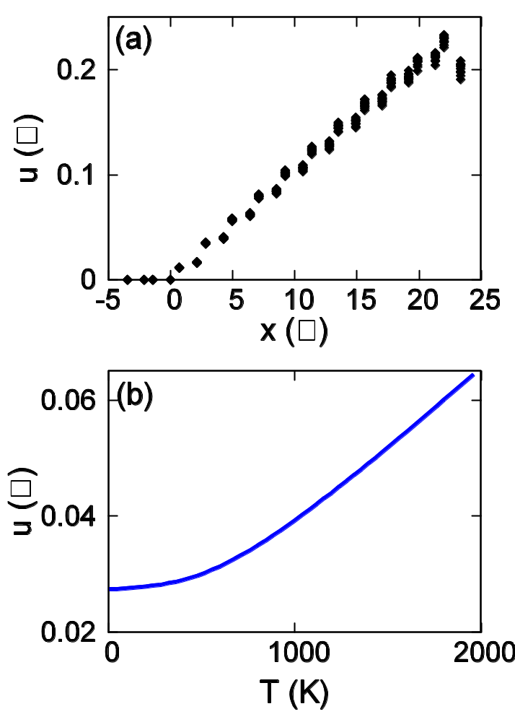
Thermal expansion
Displacement <u> as a function of position x.
as a function of temperature T. Brenner potential is used. From J.-W. Jiang, J.-S. Wang, and B. Li, Phys. Rev. B 80, 205429 (2009).
Left edge is fixed.
Notes:
75

Slide 76
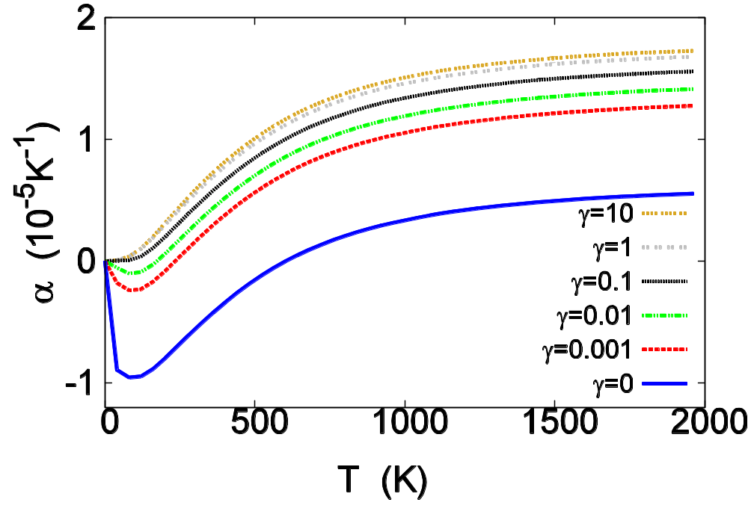
Graphene Thermal expansion coefficient
The coefficient of thermal expansion v.s. temperature for graphene sheet with periodic boundary condition in y direction and fixed boundary condition at the x=0 edge.  is onsite strength. From J.-W. Jiang, J.-S. Wang, and B. Li, Phys. Rev. B 80, 205429 (2009).
Notes:
76

Slide 77
Phonon Life-Time
For calculations based on this, see, Y. Xu, J.-S. Wang, W. Duan, B.-L. Gu, and B. Li, Phys. Rev. B 78, 224303 (2008).
Notes:
Xu Yong’s formula may have a factor 2 wrong.

Slide 78
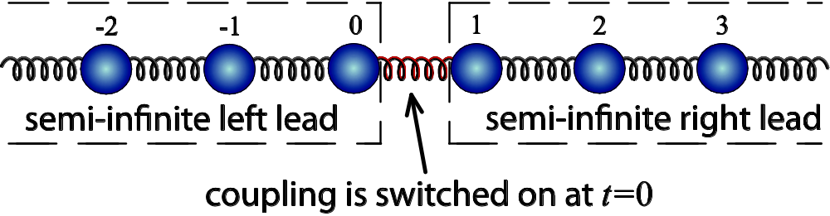
Transient problems
Notes:
The I_{L} is valid for 1D chain with spring constant k. Eduardo will present a talk on this topic Friday morning.
78

Slide 79
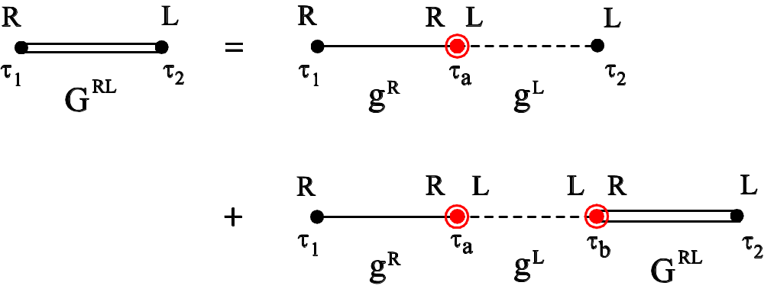
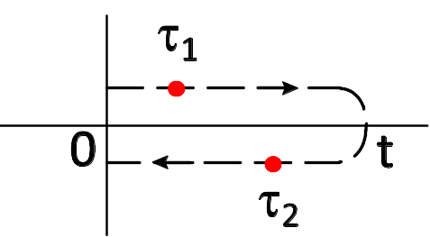
Dyson equation on contour from 0 to t
Contour C
Notes:
In steady state we use Keldysh contour which is from - to +. But here for transient study, the contour is a finite segment.
79

Slide 80
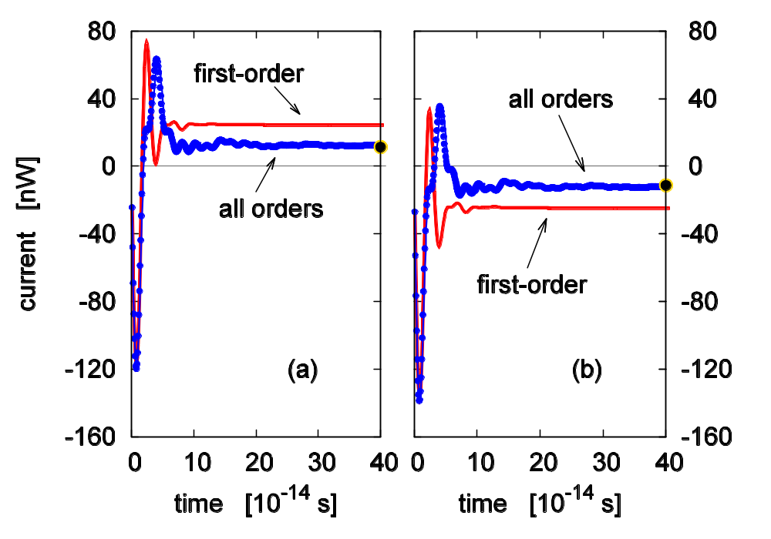
Transient thermal current
The time-dependent current when the missing spring is suddenly connected. (a) current flow out of left lead, (b) out of right lead. Dots are what predicted from Landauer formula. T=300K, k =0.625 eV/(Å²u) with a small onsite k₀=0.1k. From E. C. Cuansing and J.-S. Wang, Phys. Rev. B 81, 052302 (2010). See also arXiv:1005.5014.
80
Notes:
80

Slide 81
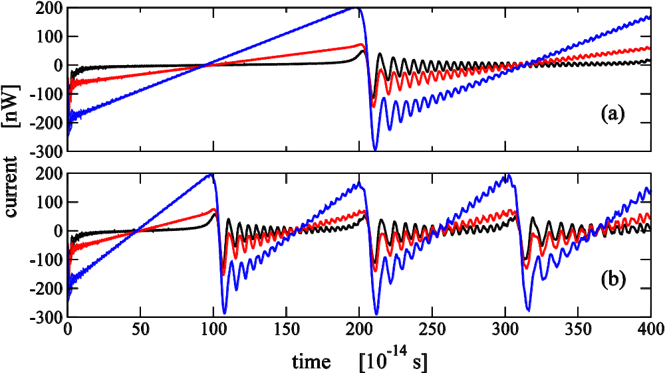
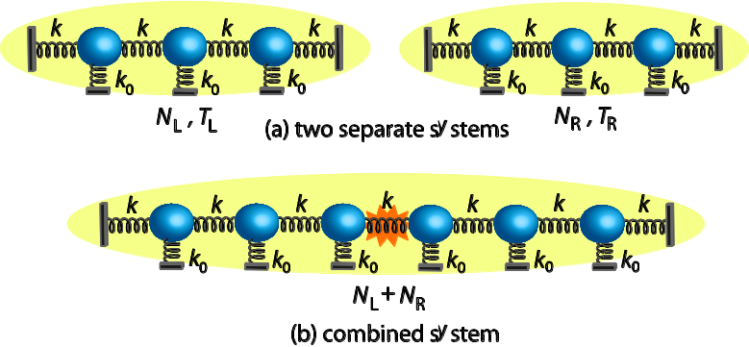
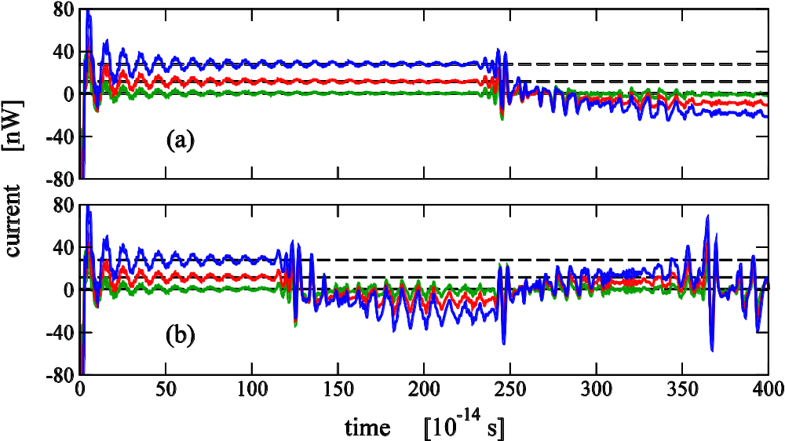
Finite lead problem
Top ↥: no onsite (k₀=0), (a) N_{L} = N_{R} = 100, (b) N_{L}=N_{R}=50, temperature T=10, 100, 300 K (black, red, blue). T_{L}=1.1T, T_{R} = 0.9T.
Right ↦: with onsite k₀=0.1k and similarly for other parameters. From E. C. Cuansing, H. Li, and J.-S. Wang, Phys. Rev. E 86, 031132 (2012).
81
Notes:
81

Slide 82
Full counting statistics (FCS)
What is the amount of energy (heat) Q transferred in a given time t ?
This is not a fixed number but given by a probability distribution P(Q)
Generating function
All moments of Q can be computed from the derivatives of Z.
The objective of full counting statistics is to compute Z(ξ).
82
Notes:
82

Slide 83
A brief history on full counting statistics
L. S. Levitov and G. B. Lesovik proposed the concept for electrons in 1993; rederived for noninteracting electron problems by I. Klich, K. Schönhammer, and others
K. Saito and A. Dhar obtained the first result for phonon transport in 2007
J.-S. Wang, B. K. Agarwalla, and H. Li, PRB 2011; B. K. Agarwalla, B. Li, and J.-S. Wang, PRE 2012.
Notes:
83

Slide 84
Definition of generating function based on two-time measurement
Consistent history quantum mechanics (R. Griffiths).
Notes:
84

Slide 85
Product initial state
Notes:
85

Slide 86
Notes:
For electron number measurement, the effect to phase a phase, see B. K. Agarwalla, B. Li, and J.-S. Wang, “Full-counting statistics of heat transport in harmonic junctions: transient, steady states, and fluctuation theorems,” Phys. Rev. E 85, 051142 (2012).
86

Slide 87
Schrödinger/Heisenberg/interaction pictures
Schrödinger picture
Heisenberg picture
Interaction picture
Notes:
87

Slide 88
Compute Z in interaction picture
-ξ/2
+ξ/2
Notes:
88

Slide 89
Important result
Notes:
89

Slide 90
Long-time result, Levitov-Lesovik formula
Notes:
90

Slide 91
Arbitrary time, transient result
Notes:
91

Slide 92
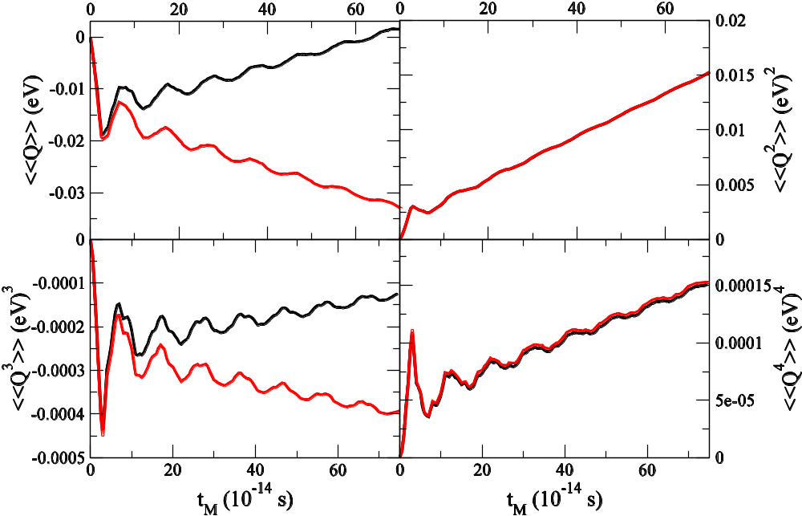
Numerical results, 1D chain
1D chain with a single site as the center.
k= 1eV/(uÅ²), k₀=0.1k,
T_{L}=310K, T_{C}=300K, T_{R}=290K. Red line right lead; black, left lead. B. K. Agarwalla, B. Li, and J.-S. Wang, PRE 85, 051142, 2012.
Notes:
92

Slide 93
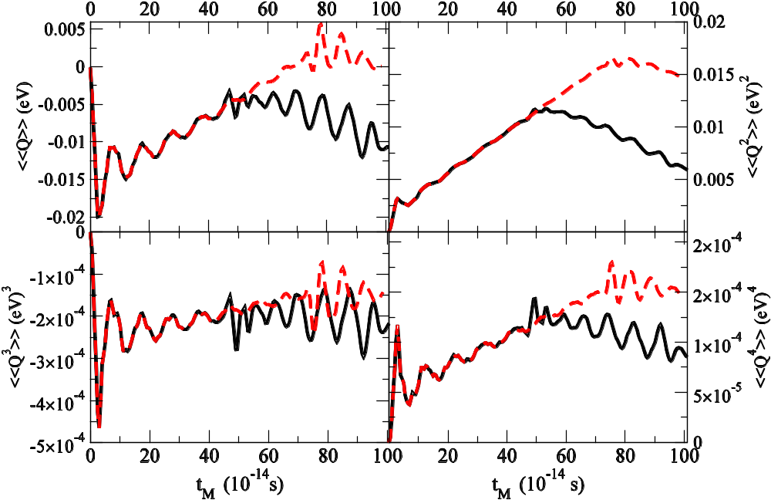
Cumulants in Finite System
Plot of the culumants of heat <<Q^{n}>> for n=1,2,3, and 4 for one-atom center connected with two finite lead (one-dimensional chain) as a function of measurement time t_{M}. The black and red line correspond to N_{L} =N_{R} =20 and 30, respectively. The initial temperatures of the left, center, right parts are 310K, 360K, and 290K, respective. We choose k=1 eV/(uÅ²) and k₀=0.1 eV/(uÅ²) for all particles. From J.-S. Wang, et al, Front. Phys. 2013.

Slide 94
FCS for coupled leads
From H. Li, B. K. Agarwalla, and J.-S. Wang, Phys. Rev. E 86, 011141 (2012); H. Li, B. K. Agarwalla, and J.-S. Wang, Phys. Rev. B 86, 165425 (2012). For multiple leads, see B. K. Agarwalla, et al, arXiv:1308.1604
Notes:
94

Slide 95
FCS in nonlinear systems
Can we do nonlinear?
Yes we can. Formal expression generalizes Meir-Wingreen
Interaction picture defined on contour
Some example calculations
Notes:
95

Slide 96
Vacuum diagrams, Dyson equation, interaction picture transformation on contour
Notes:
96

Slide 97
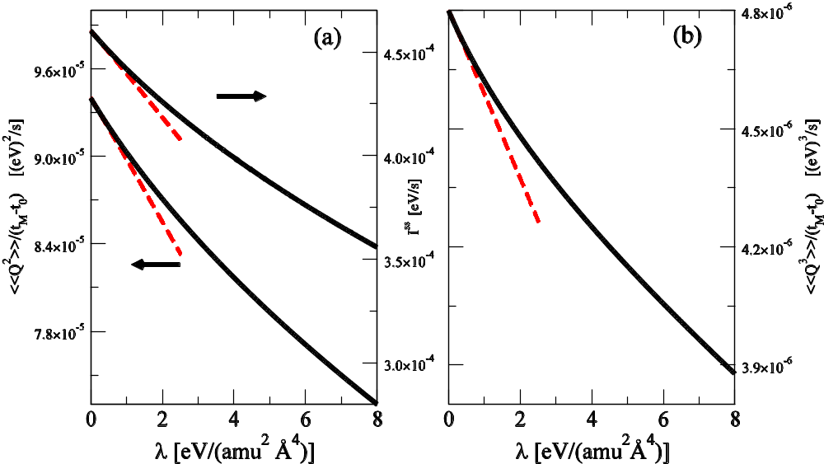
Nonlinear system self-consistent results
Single-site (1/4)λu⁴ model cumulants.
k=1 eV/(uÅ²), k₀=0.1k, K_{c}=1.1k, V ^{LC}_{-1,0}=V ^{CR}_{0,1}=-0.25k, T_{L}=660 K, T_{R}=410K.
From H. Li, B. K. Agarwalla, B. Li, and J.-S. Wang, arxiv::1210.2798
Notes:
97

Slide 98
Quantum Master Equations
When we tried to calculation the reduced density matrix from Dyson expansion, we found that the 2nd order (of the system-bath coupling) diagonal terms do not agree with master equation results, and there are also divergences in higher orders. Similarly, the currents also diverge at higher order. We were quite puzzled. The following is our effort to solve this puzzle and found an expression of the high order current which is finite.

Slide 99
Quantum Master Equations
Notes:
Some detail is in the last section of J.-S. Wang, B. K. Agarwalla, H. Li, and J. Thingna, “Nonequilibrium Green's function method for quantum thermal transport,” Front. Phys. (2013). rho_0 is in fact rho_0^I, i.e., interaction picture one.

Slide 100
Unique one-to-one map ρ ↔ ρ₀

Slide 101
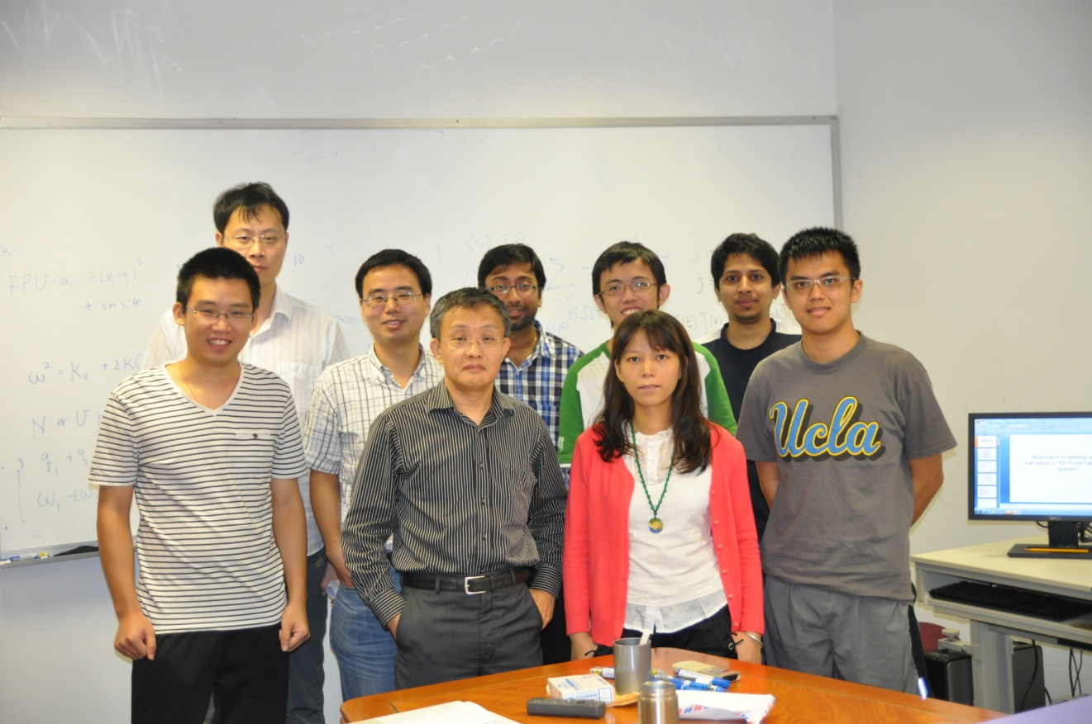
Group & Acknowledgements
Group members: front (left to right) Mr. Zhou Hangbo, Prof. Wang Jian-Sheng, Dr./Ms Lan Jinghua, Mr. Wong Songhan; Back: Mr. Li Huanan, Dr. Zhang Lifa, Dr. Bijay Kumar Agarwalla, Mr. Kwong Chang Jian, Dr. Thingna Juzar Yahya. Picture taking 17 April 2012. Others not in the picture: Qiu Hongfei. Thanks also go to Jian Wang, Jingtao Lü, Jin-Wu Jiang, Edardo Cuansing, Meng Lee Leek, Ni Xiaoxi, Baowen Li, Peter Hänggi, Pawel Keblinski.
http://staff.science.nus.edu.sg/~phywjs/

