Slide 1

Quantum Master Equation Approach to Transport
Wang Jian-Sheng

Slide 2
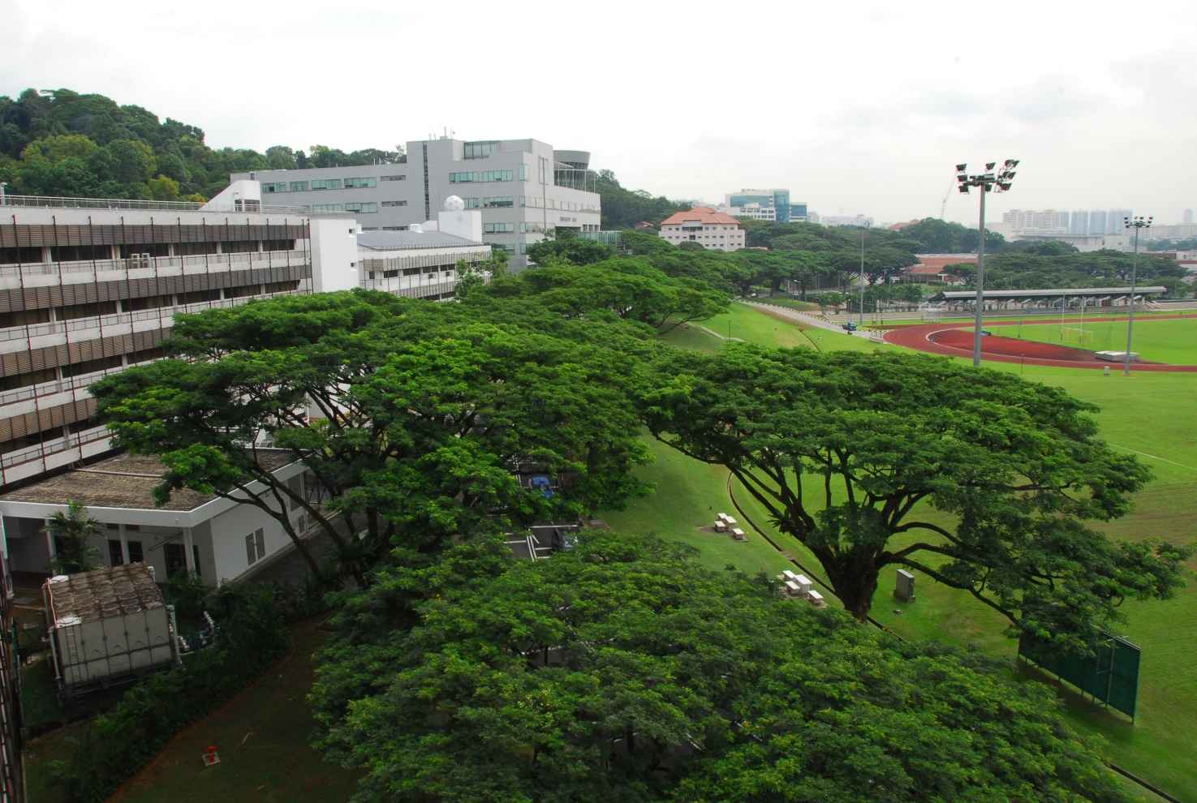
NUS, number one in Asia
This year’s QS university ranking has rated NUS a topmost in Asia.
Department of Physics at NUS is top 32 (QS 2013) world-wide, with renounced research centers such as Graphene Research Center and CQT.
Notes:
QS: British Quacquarelli Symonds

Slide 3
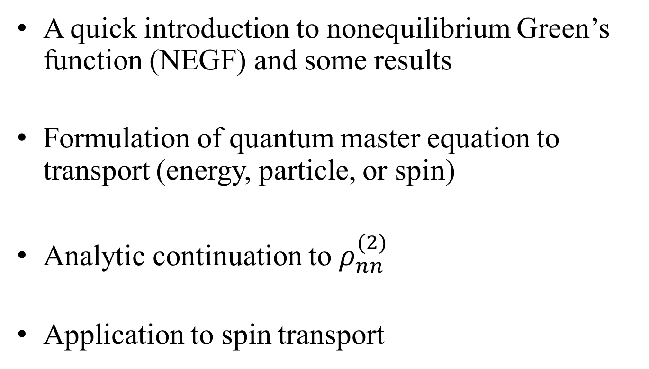
Outline
A quick introduction to nonequilibrium Green’s function (NEGF) and some results
Formulation of quantum master equation to transport (energy, particle, or spin)
Analytic continuation to $ρ_{nn}^{(2)}$
Application to spin transport

Slide 4
NEGF
Our review: Wang, Wang, and Lü, Eur. Phys. J. B 62, 381 (2008); Wang, Agarwalla, Li, and Thingna, Front. Phys. (2013), DOI:10.1007/s11467-013-0340-x

Slide 5
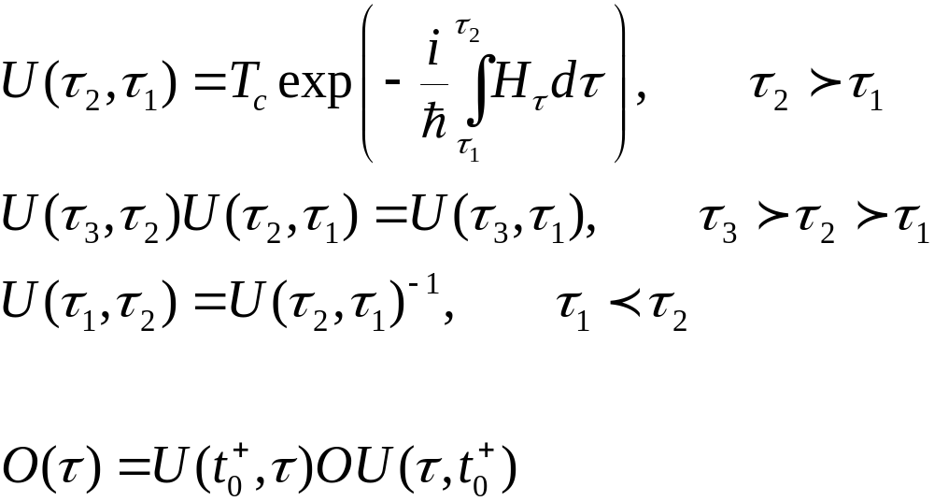
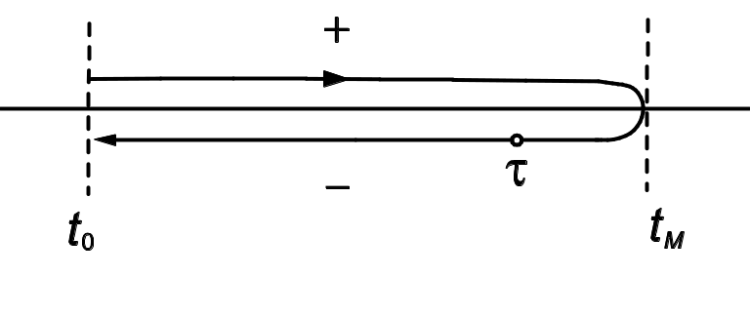
Evolution Operator on Contour

Slide 6
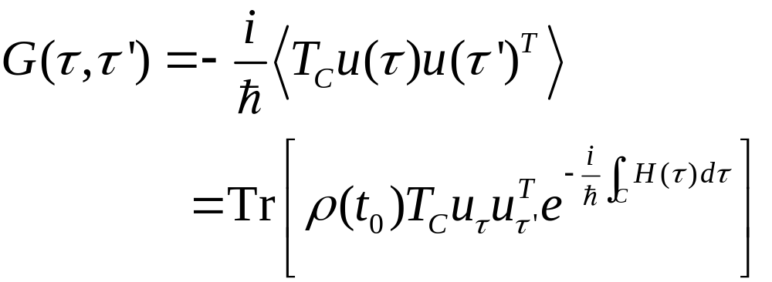
Contour-ordered Green’s function
Contour order: the operators earlier on the contour are to the right. See, e.g., H. Haug & A.-P. Jauho.
τ’
τ
t₀
Notes:
6

Slide 7
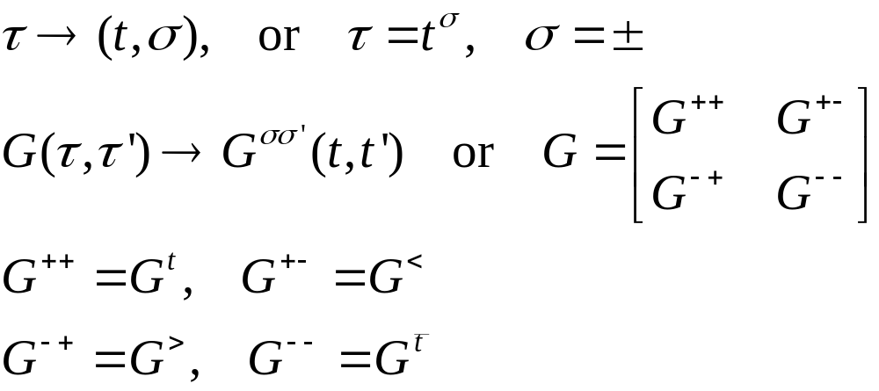
Relation to other Green’s functions
τ’
τ
t₀
Notes:
σ = + for the upper branch, and – for the returning lower branch.
7

Slide 8
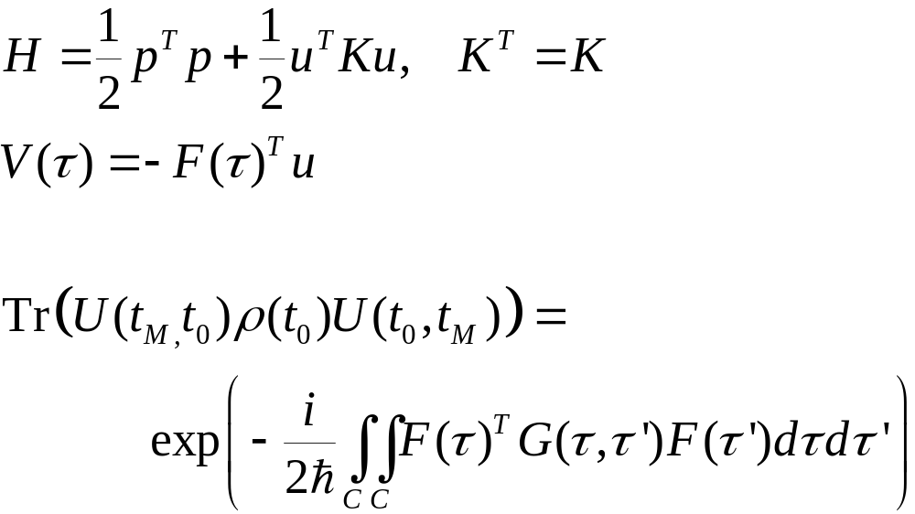
An Interpretation due to Schwinger
G is defined with respect to Hamiltonian H and density matrix ρ(t₀), and assuming validity of Wick’s theorem.
Notes:
This is originally due to Schwinger 1961.

Slide 9
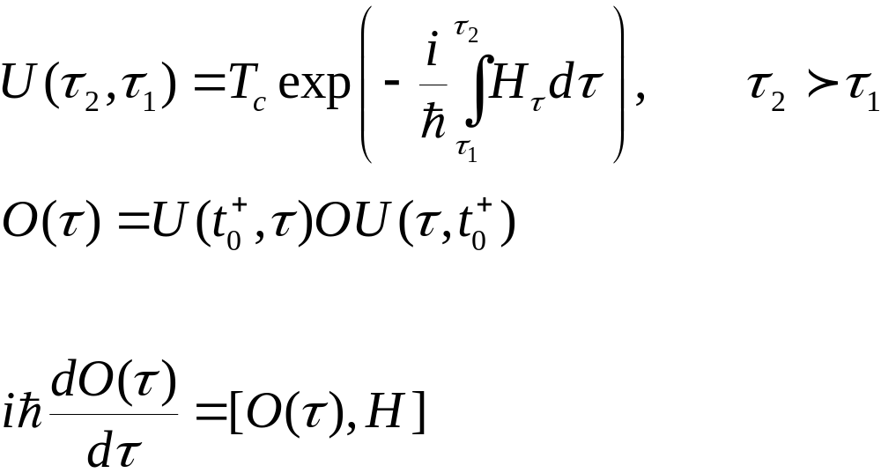
Heisenberg Equation on Contour
Notes:
The integral on the exponential is from a point tau_1 specified on the contour to tau_2 at a later point on the contour. The integral is along the contour.

Slide 10
Thermal conduction at a junction
Left Lead, T_{L}
Right Lead, T_{R}
semi-infinite
Junction Part

Slide 11
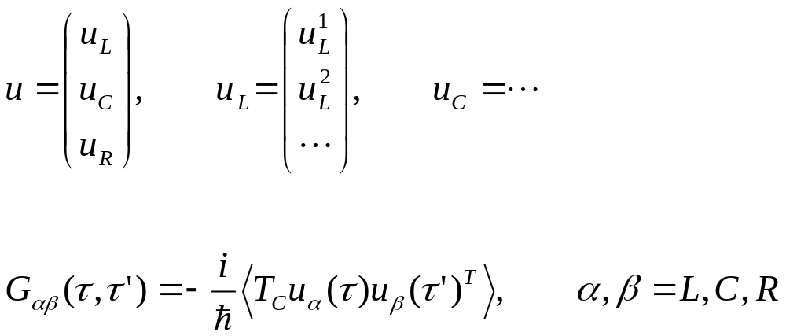
Three regions
11
Notes:
11

Slide 12
Junction system, adiabatic switch-on
  g_{α} for isolated systems when leads and centre are decoupled
  G0 for ballistic system
  G for full nonlinear system
H_{L}+H_{C}+H_{R} +V +H_{n}
H_{L}+H_{C}+H_{R} +V
G
H_{L}+H_{C}+H_{R}
G₀
g_{α}
t = − ∞
Equilibrium at T_{α}
t = 0
Nonequilibrium steady state established
12
Notes:
Two adiabatic switch-on’s.
12

Slide 13
Sudden Switch-on
H_{L}+H_{C}+H_{R} +V +H_{n}
Green’s function G
H_{L}+H_{C}+H_{R}
g_{α}
t = − ∞
Equilibrium at T_{α}
t = ∞
t =t₀
Nonequilibrium steady state established
13
Notes:
Two adiabatic switch-on’s.
13

Slide 14
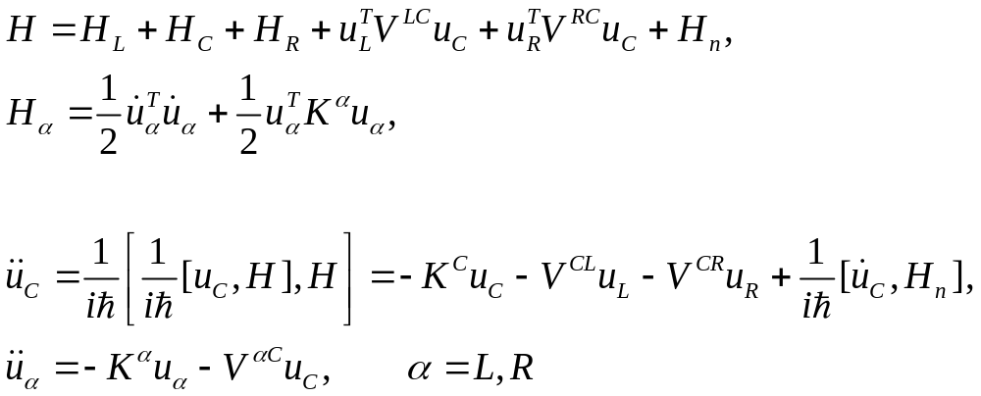
Heisenberg equations of motion in three regions
14
Notes:
14

Slide 15
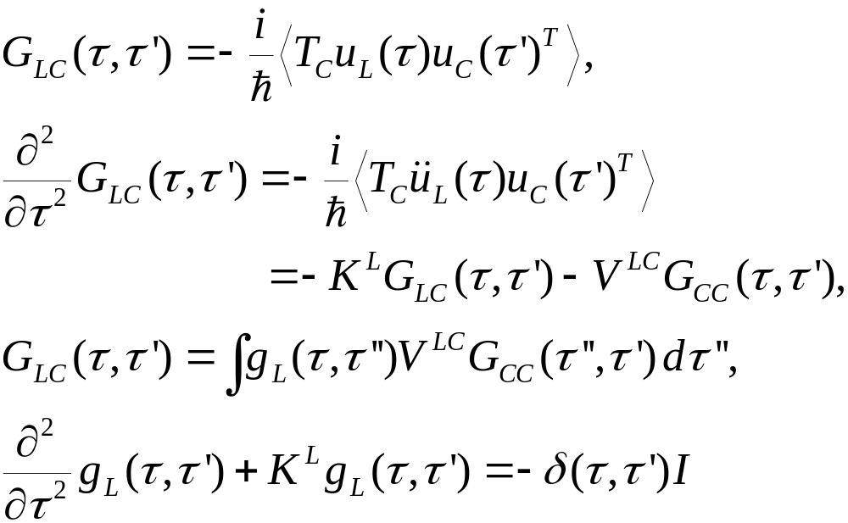
Relation between g and G0
Equation of motion for GLC
Notes:
In obtaining G_{LC}, an arbitrary function satisfying (d/dtau^2 + K^{L}) f = 0 is omitted. Absence of this term is consistent with adiabatic switch-on from Feynman diagrammatic expansion.
15

Slide 16
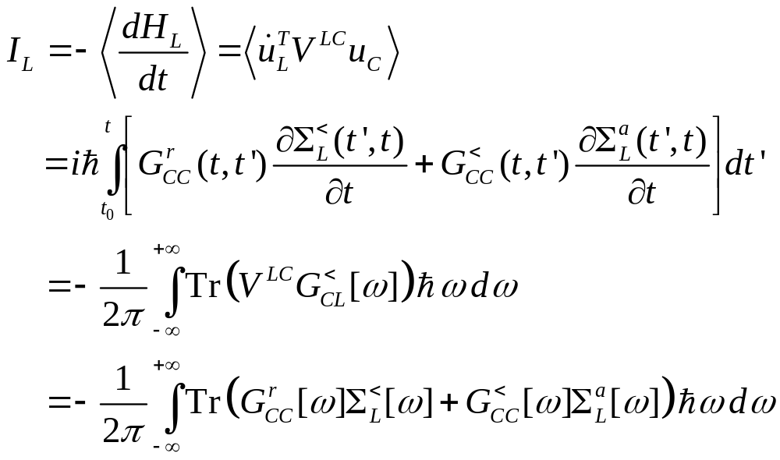
Energy current
Notes:
I_{L} is energy flowing out of the left lead into the center. This expression can be proving to be real, no need to take Re. Above equation works for general nonlinear case.
16

Slide 17
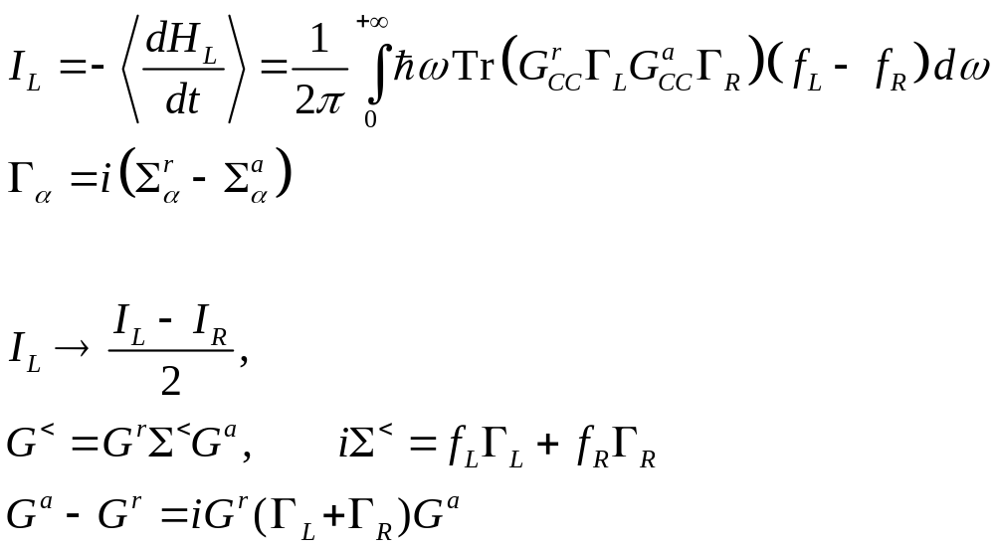
Landauer/Caroli formula
Notes:
The symmetrization appears necessary to get the Caroli formula. Caroli formula is valid only for ballistic case where H_{n} = 0.
17

Slide 18
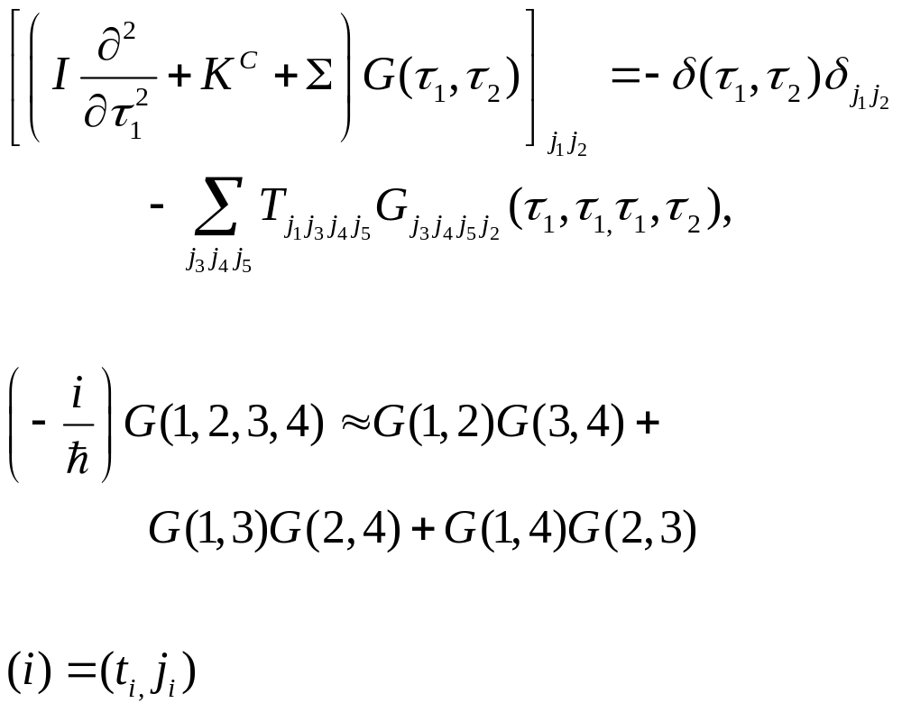
Self-consistent mean-field NEGF
T_{ijkl} nonlinear model

Slide 19
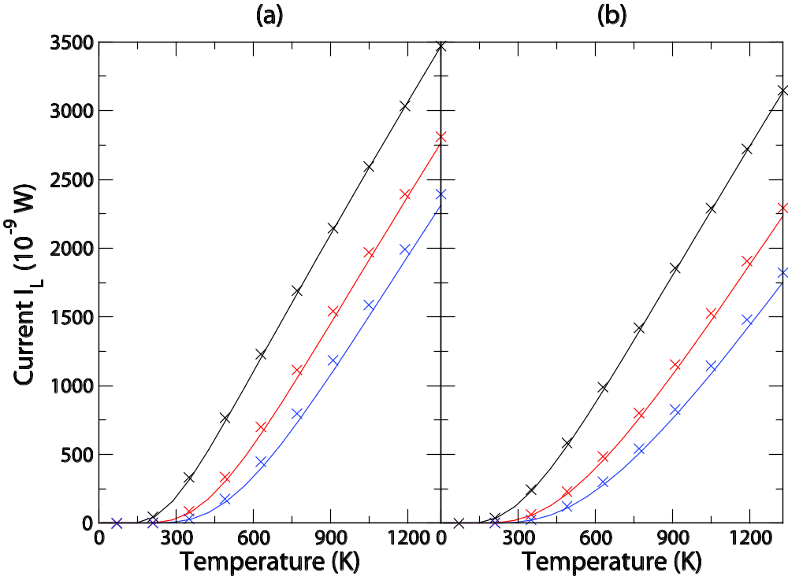
u⁴ Nonlinear model
One degree of freedom (a) and two degrees freedom (b) (1/4) Σ T_{iiii} u_{i}⁴ nonlinear model. Symbols are from quantum master equation, lines from self-consistent NEGF. For parameters used, see Fig.4 caption in Wang, et al, Front. Phys 2013.
Calculated by Juzar Thingna.
1
5
10

Slide 20
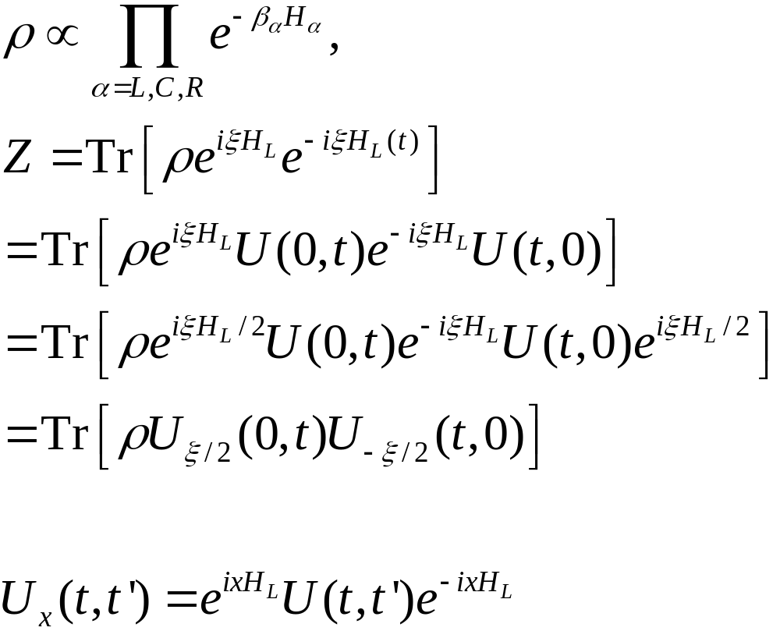
Full Counting Statistics, two-time measurement
Levitov & Lesovik, 1993
Notes:
20

Slide 21
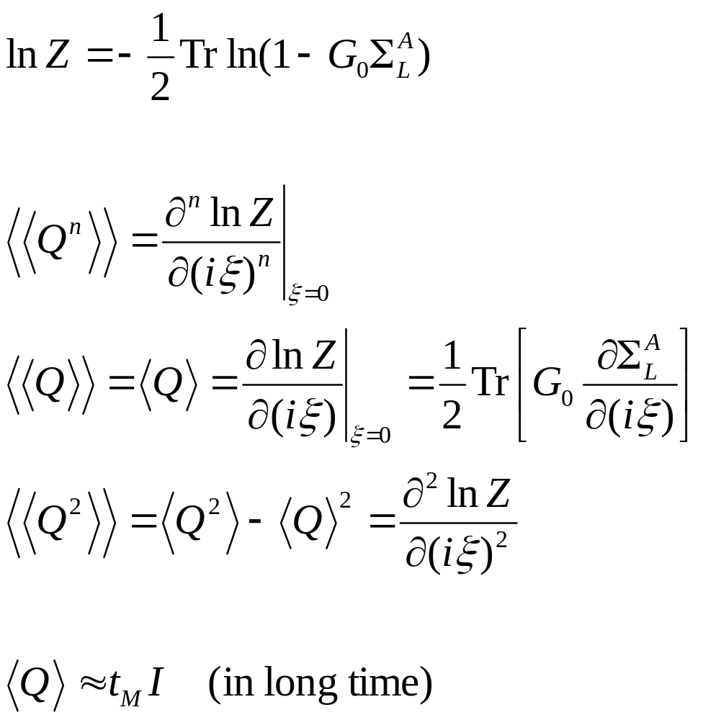
Arbitrary time, transient result
Notes:
21

Slide 22
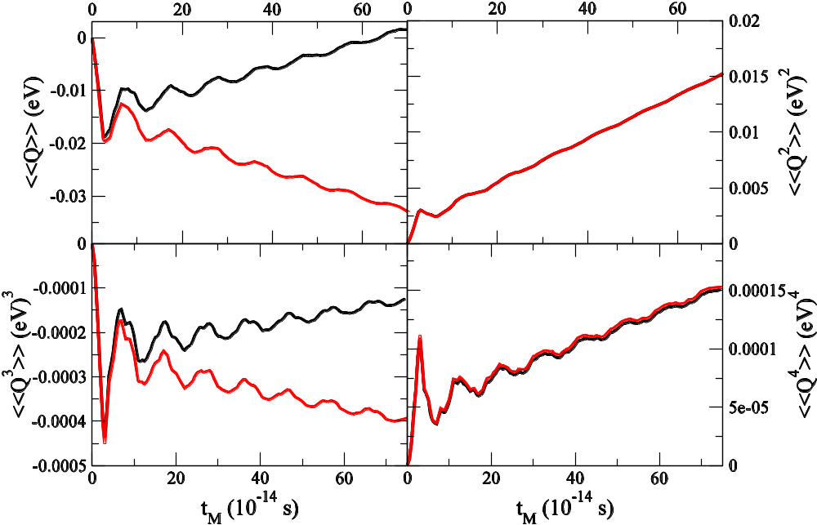
Numerical results, 1D chain
1D chain with a single site as the center.
k= 1eV/(uÅ²), k₀=0.1k,
T_{L}=310K, T_{C}=300K, T_{R}=290K. Red line right lead; black, left lead.
From Agarwalla, Li, and Wang, PRE 85, 051142, 2012.
Notes:
22

Slide 23
Quantum Master Equation

Slide 24
Quantum Master Equation
Advantage of NEGF: any strength of system-bath coupling V; disadvantage: difficult to deal with nonlinear systems.
QME: advantage - center can be any form of Hamiltonian, in particular, nonlinear systems; disadvantage: weak system-bath coupling, small system.
Can we improve?

Slide 25
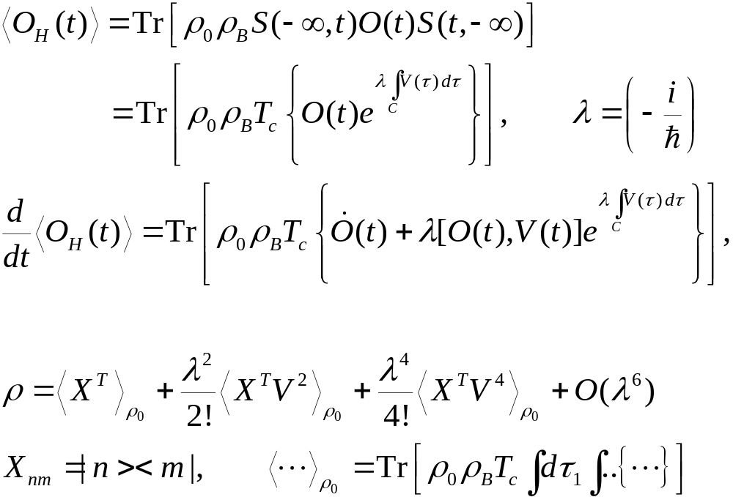
Dyson Expansion, Divergence
Notes:
Some detail is in the last section of J.-S. Wang, B. K. Agarwalla, H. Li, and J. Thingna, “Nonequilibrium Green's function method for quantum thermal transport,” Front. Phys. (2013). rho_0 is in fact rho_0^I, i.e., interaction picture one.

Slide 26
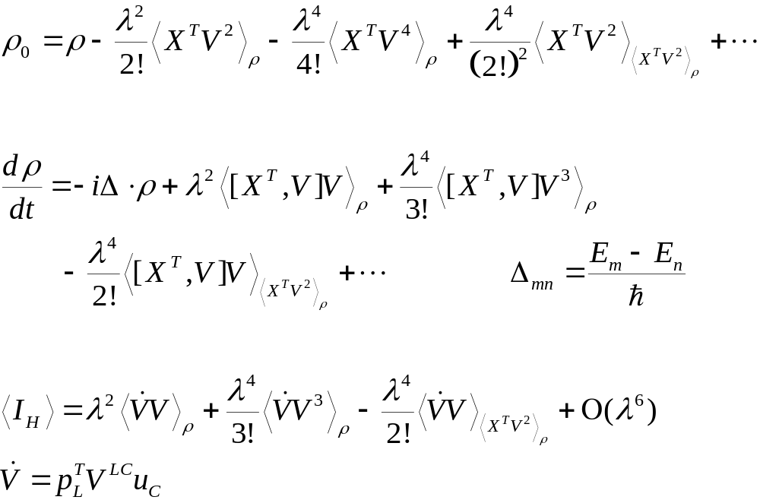
Unique one-to-one map ρ ↔ ρ₀

Slide 27
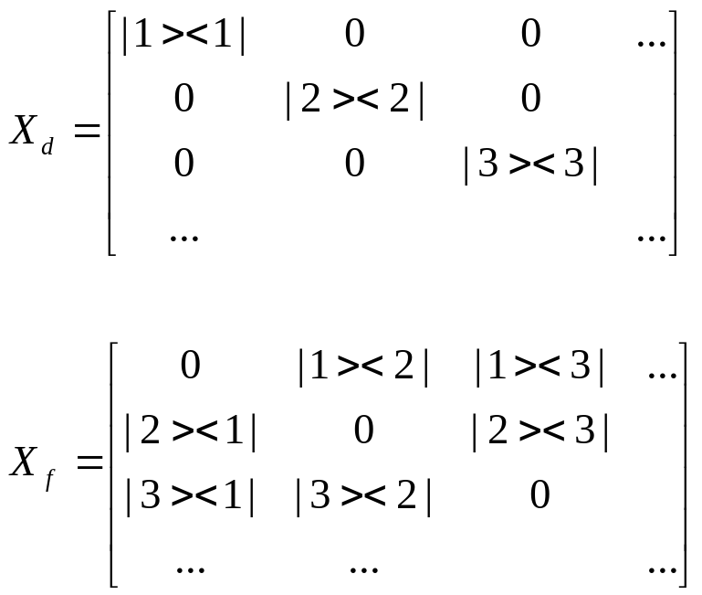
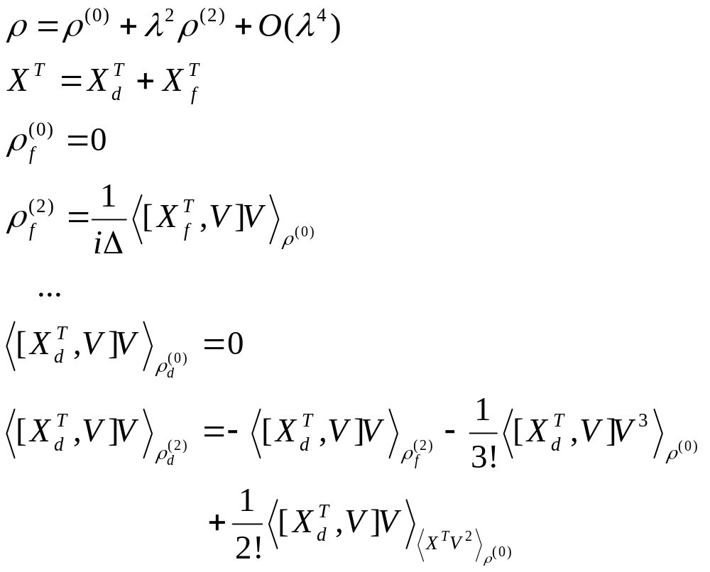
Order-by-Order Solution to ρ

Slide 28
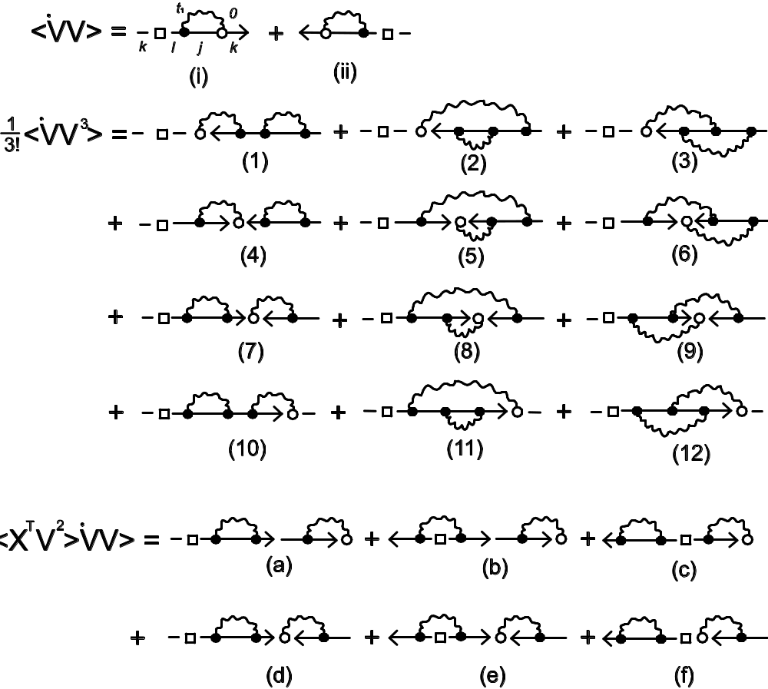
Diagrammatics
Diagrams representing the terms for current `V or [X ^{T},V]. Open circle has time t=0, solid dots have dummy times. Arrows indicate ordering and pointing from time -∞ to 0. Note that (4) is cancelled by (c); (7) by (d).
From Wang, Agarwalla, Li, and Thingna, Front. Phys. (2013), DOI: 10.1007/s11467-013-0340-x.

Slide 29
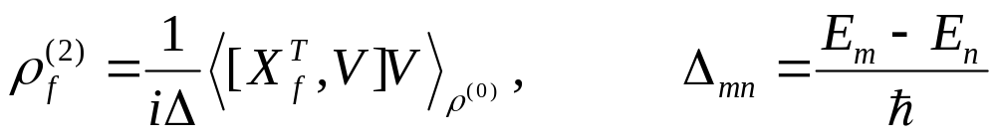
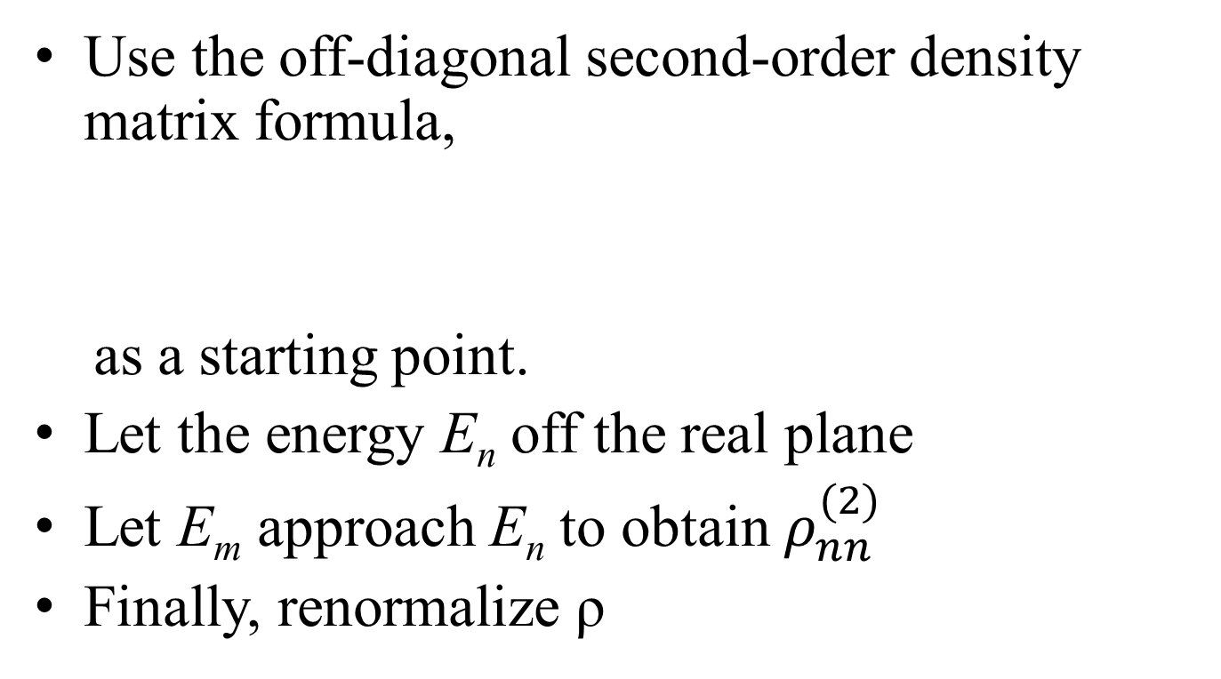
Analytic Continuation (AC)
Use the off-diagonal second-order density matrix formula,
as a starting point.
Let the energy E_{n} off the real plane
Let E_{m} approach E_{n} to obtain $ρ_{nn}^{(2)}$
Finally, renormalize ρ

Slide 30
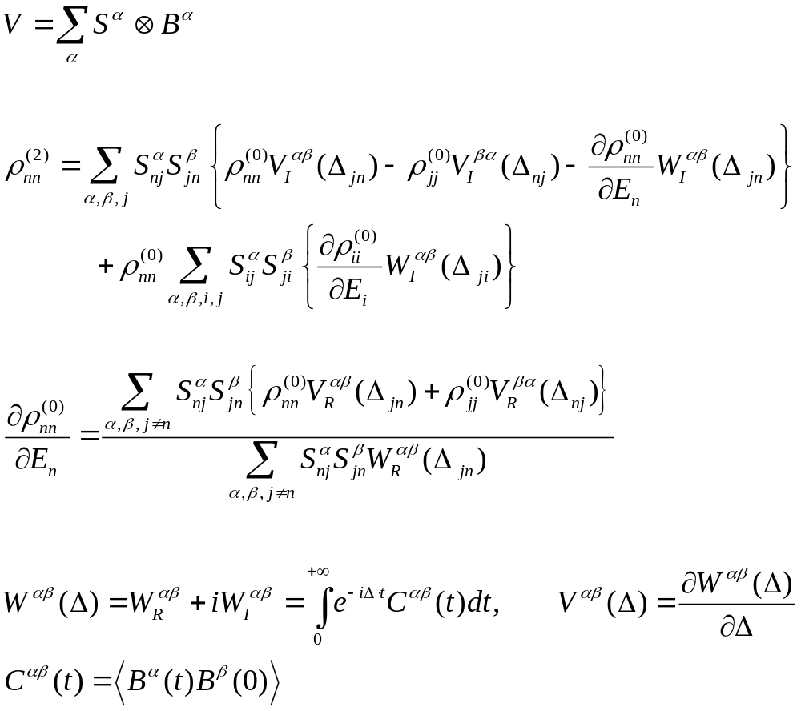
AC Formula
Notes:
I think this formula works only for fermionic system. For phononic system, alpha, beta indices are different?

Slide 31
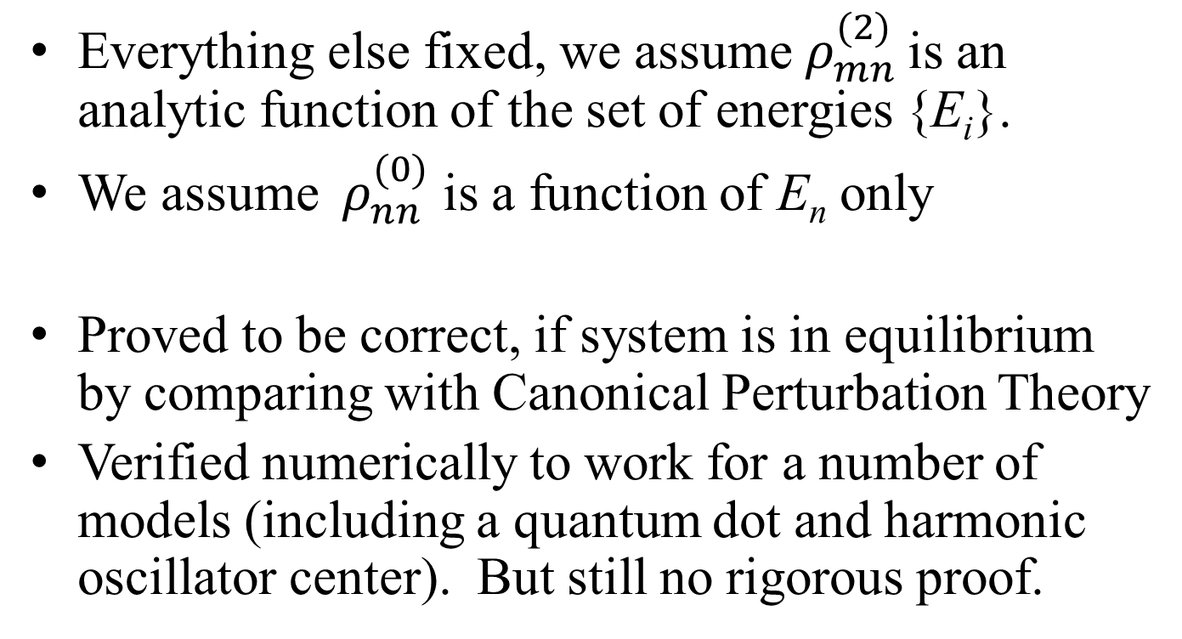
AC: assumptions, and why works?
Everything else fixed, we assume${ ρ}_{mn}^{(2)}$ is an analytic function of the set of energies {E_{i}}.
We assume ${ ρ}_{nn}^{(0)}$ is a function of E_{n} only
Proved to be correct, if system is in equilibrium by comparing with Canonical Perturbation Theory
Verified numerically to work for a number of models (including a quantum dot and harmonic oscillator center). But still no rigorous proof.

Slide 32
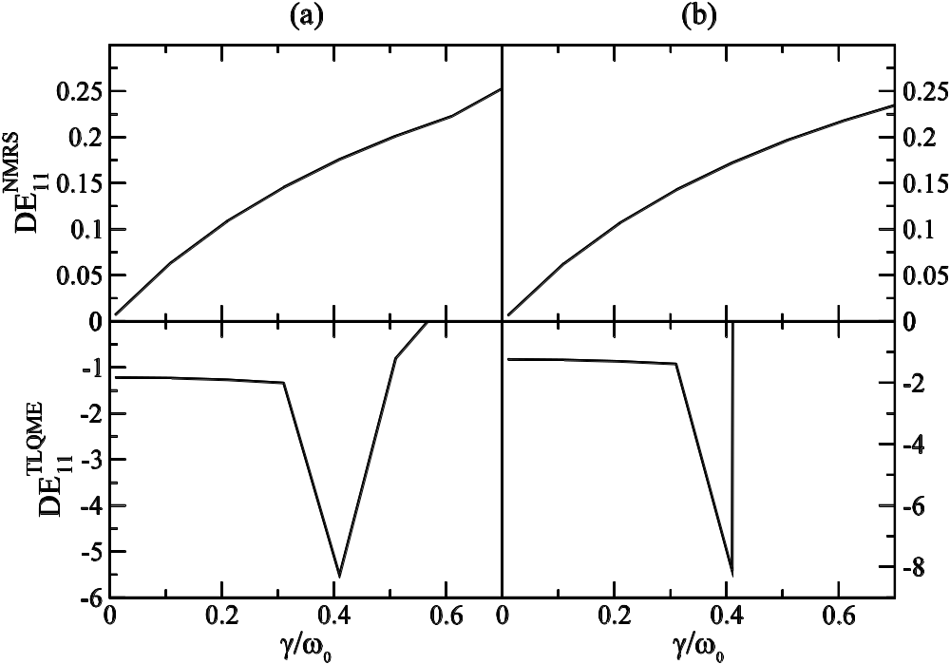
Comparing AC with DSH
DE: discrepancy error for ρ₁₁. Top |AC-DSH|, bottom, difference with a 2nd order time-local Redfield-like quantum master equation solution.
(a) & (b) different temperature bias. See Thingna, Wang, Hänggi, Phys. Rev. E 88, 052127 (2013) for details.
Notes:
DSH: Dhar, Saito, Hanggi: PRE 85, 011126 (2012).

Slide 33
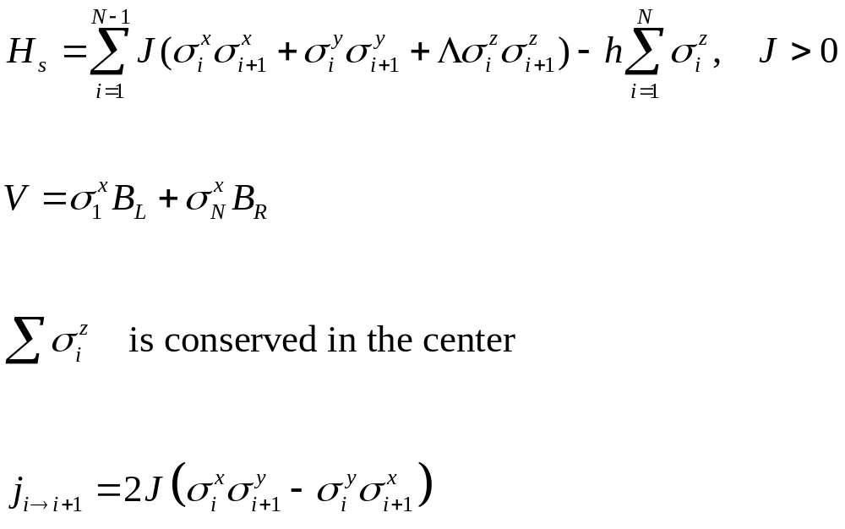
XXZ spin chain, spin transport

Slide 34
Current & spin chain
The usual definition j = - dM_{L}/dt does not work, as there is no magnetic baths, only thermal baths.
Tr(ρ⁽⁰⁾j) = 0 exactly so we need to know ρ⁽²⁾; we use AC.

Slide 35
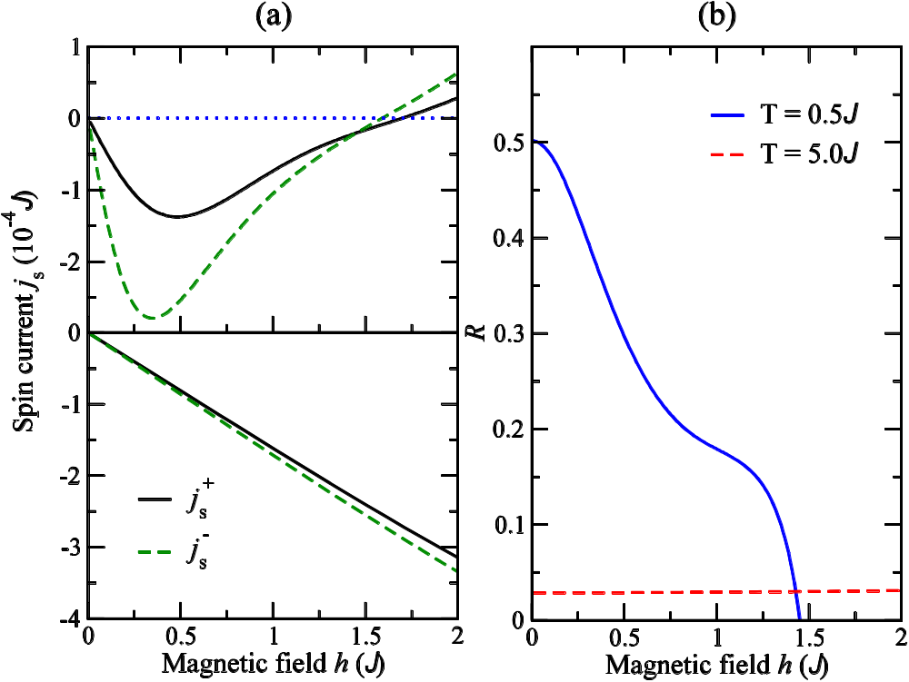
Spin current and rectification
(a) Black forward j⁺, green backward j⁻ currents. Top low temperature (0.5 J), bottom high temperature (5J).
(b) R = |j⁺ - j⁻|/|j⁺ + j⁻|.
From Thingna and Wang, EPL, 104, 37006 (2013).
Notes:
Coupled the first and last spin to sigma^x.

Slide 36



Acknowledgements
Dr. Jose Luis García Palacios
Dr. Juzar Yahya Thingna, University of Augsburg
Prof. Peter Hänggi, University of Augsburg

