Slide 1

Radiative energy transport of electron systems by scalar and vector photons
Jian-Sheng Wang
Notes:
Tongji Univ talk, 30 July 10:00-11:00.

Slide 2
Outline
Experimental motivations
Electron Green’s functions G
Electron-photon interaction and photon Green’s functions D
NEGF “technologies”
Application examples

Slide 3
Experimental motivations

Slide 4
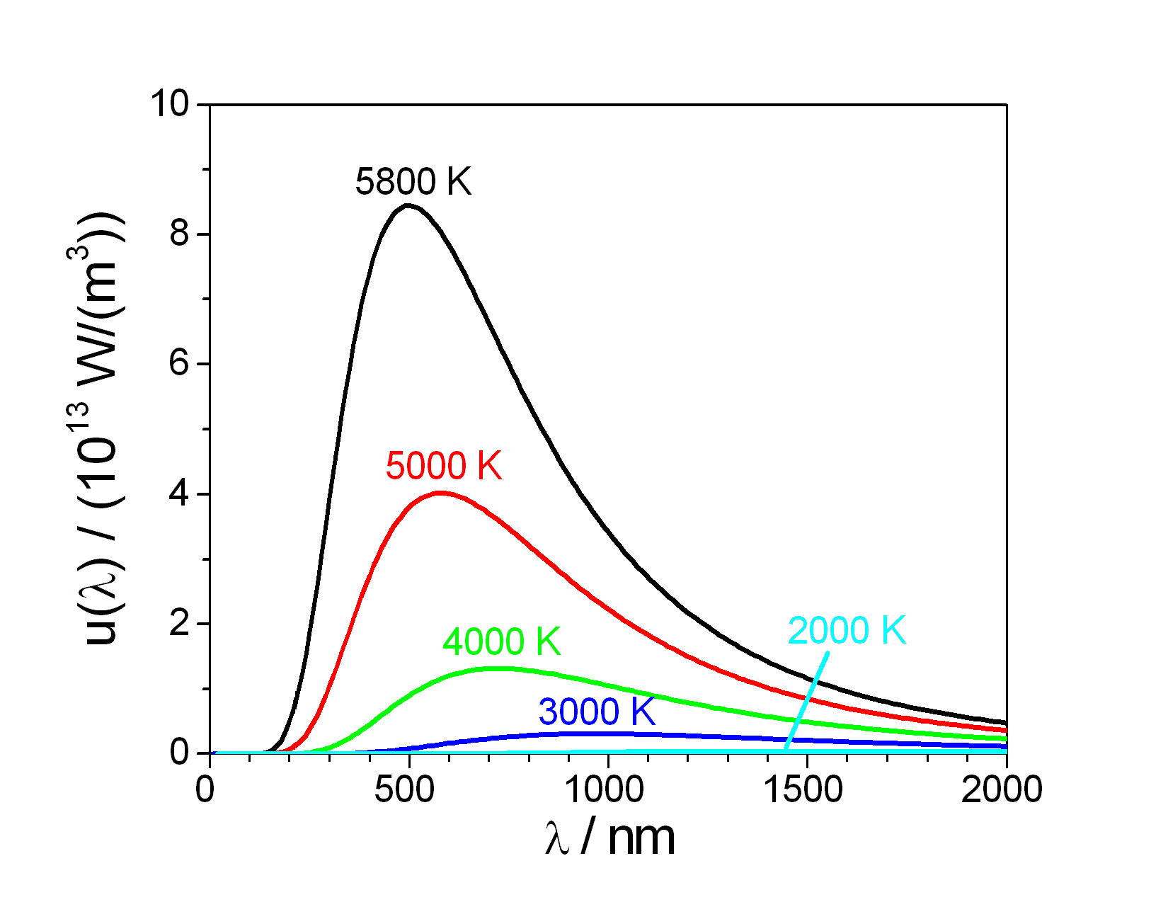
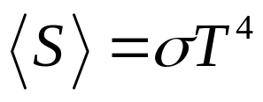
Radiation from thermal objects, far-field effect
Stefan-Boltzmann law:
What if closer than wavelength λ?
Notes:
https://commons.wikimedia.org/wiki/File:Planck_law_radiation.PNG

Slide 5
Near-field effect
Rytov fluctuational electrodynamics (1953)
Polder & van Hove (PvH) theory (1971)
Phonon tunneling/phonon polaritons (Mahan 2011, Xiong at al 2014, Chiloyan et al 2015, …)
Other mechanism?

Slide 6
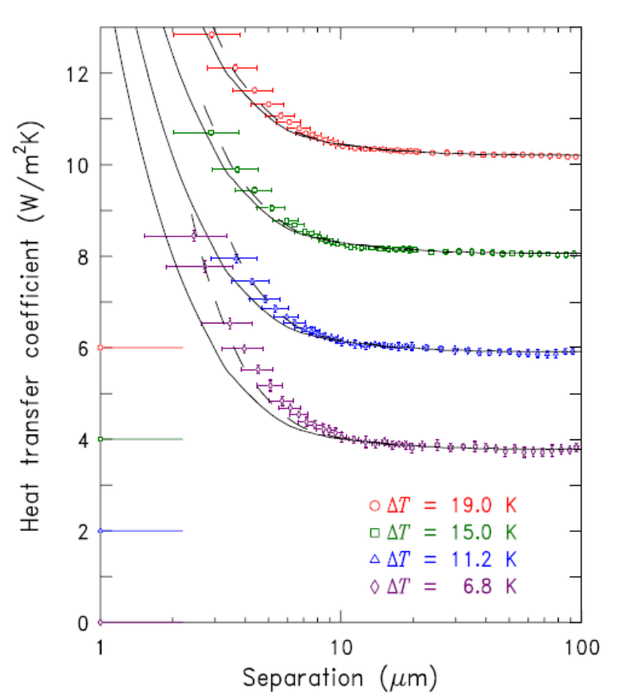
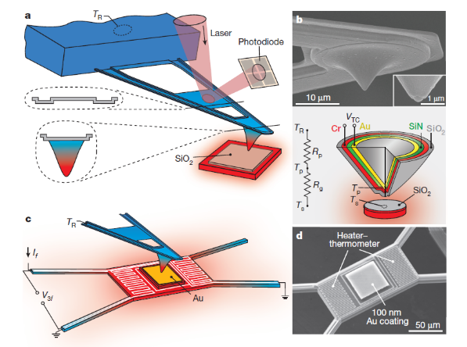
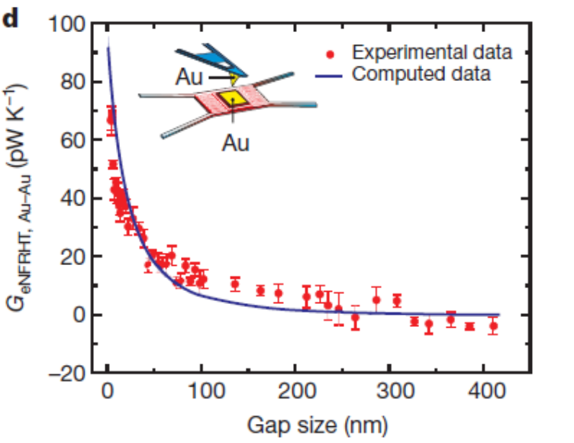
Experiments
Ottens, et al, PRL 107, 014301 (2011).
Kim, et al, Nature 528, 387 (2015).

Slide 7
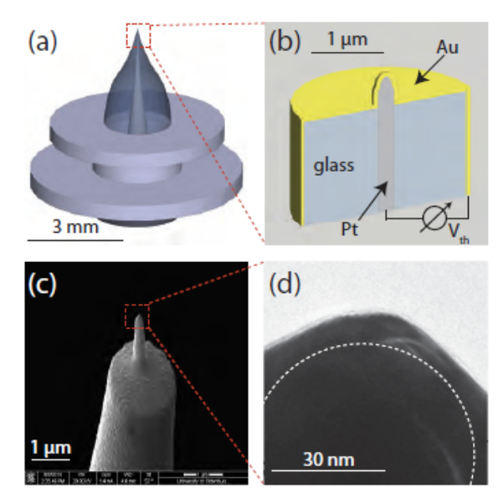
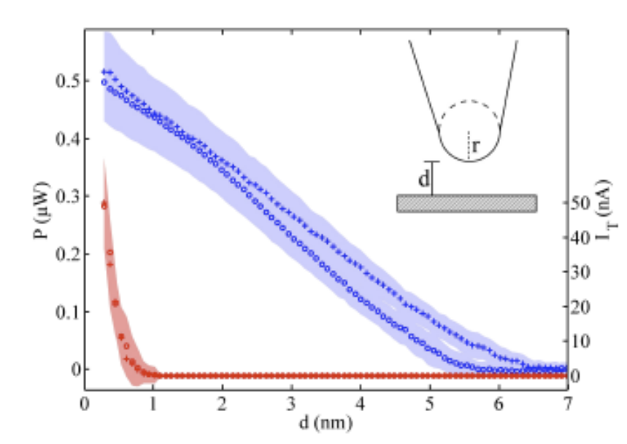
A recent experiment that does not agree with any theory
Heat transport between a Au tip and surface is measured, obtain much larger values than conventional theory predicts. Nature Comm 2017, Kloppstech, et al.

Slide 8
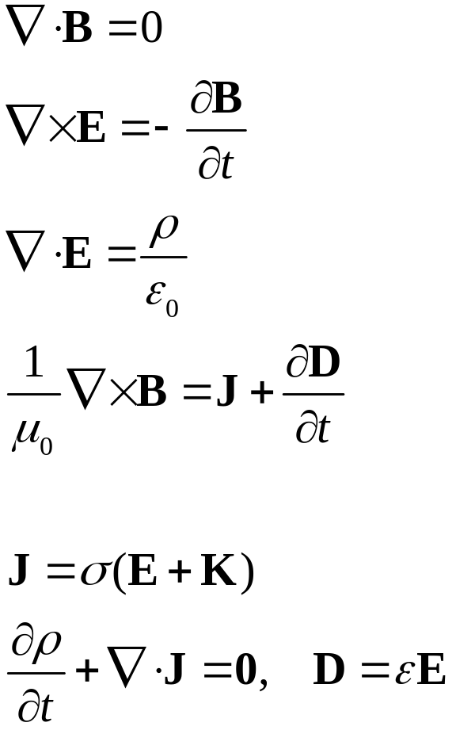
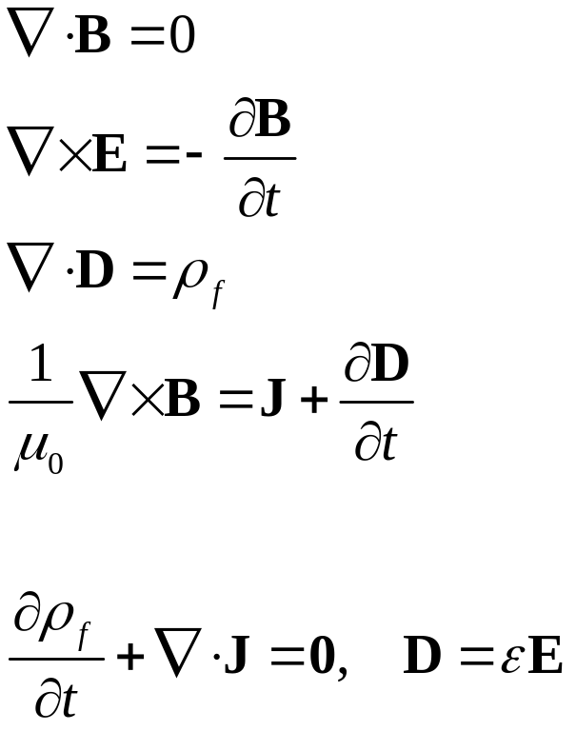
Fluctuational electrodynamics
Rytov 1953: Polder & van Hove 1971:
random variables

Slide 9
Electron Green’s functions G

Slide 10
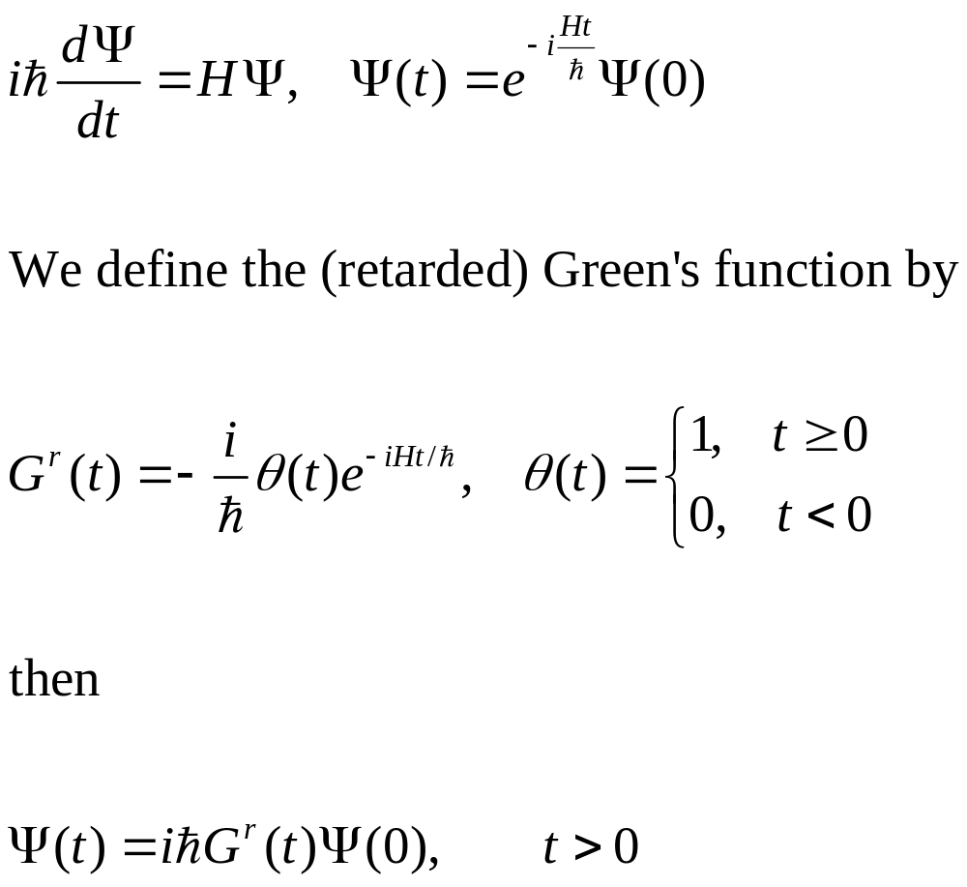
Single electron quantum mechanics
Notes:
In a particular representation, since H is 2x2 matrix, Psi a column vector, so the Green’s function G is also 2x2 matrix.

Slide 11
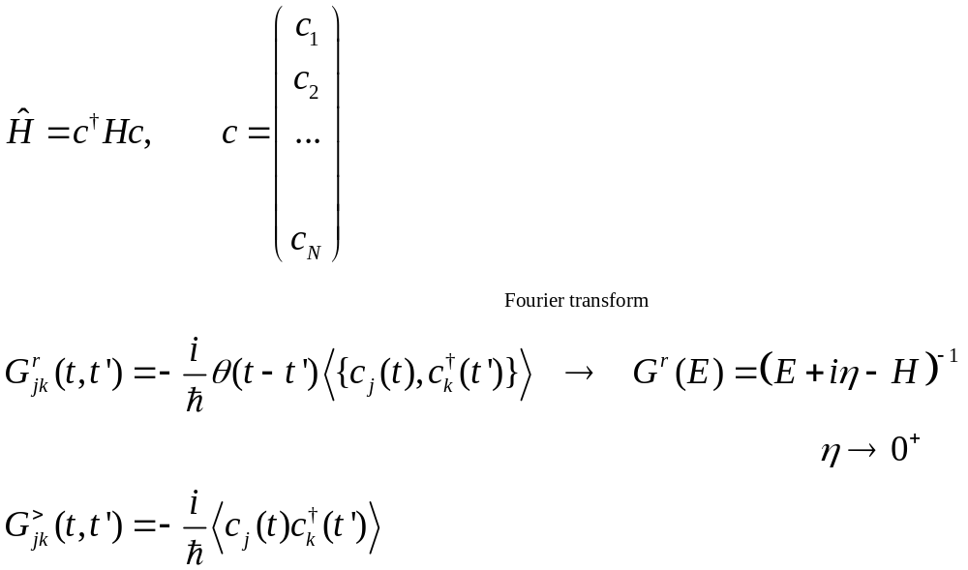
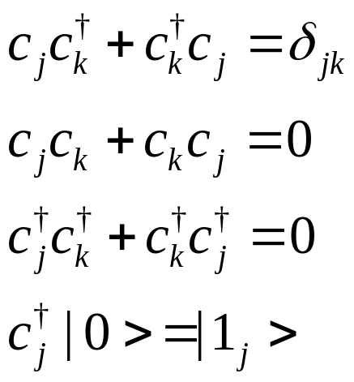
Many-electron Hamiltonian and Green’s functions
Annihilation operator c is a column vector, H is N by N matrix. {A, B} =AB+BA
Notes:
Various other Green’s functions (G<, G>, G^r, G^a, G^t, G^tbar) will be defined later for phonon. The form and relation among Greens are such so that phonon and electrons are the same. See slide 54, 55.

Slide 12
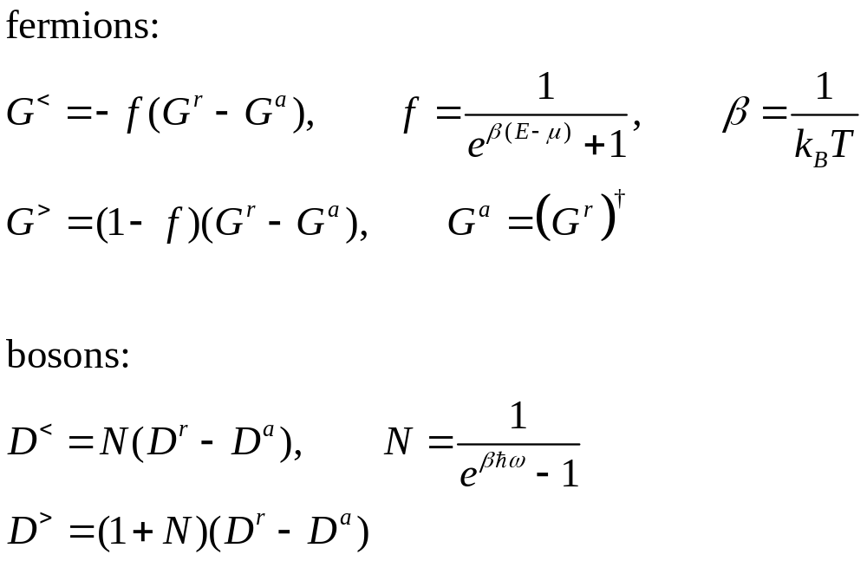
Equilibrium fluctuation-dissipation theorems

Slide 13
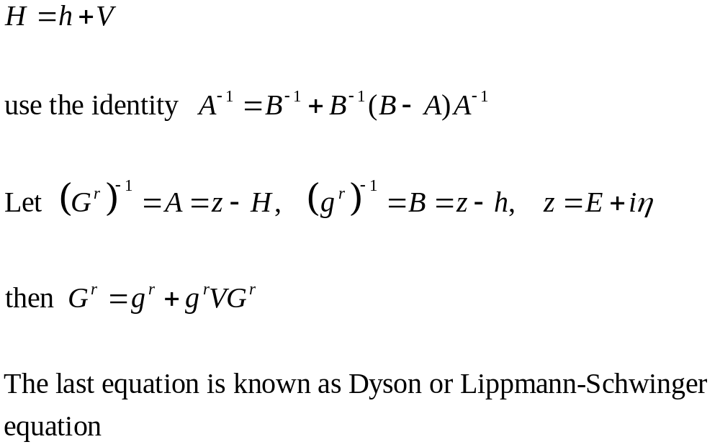
Perturbation theory, single electron

Slide 14
Electron-photon interaction and photon Green’s functions D

Slide 15
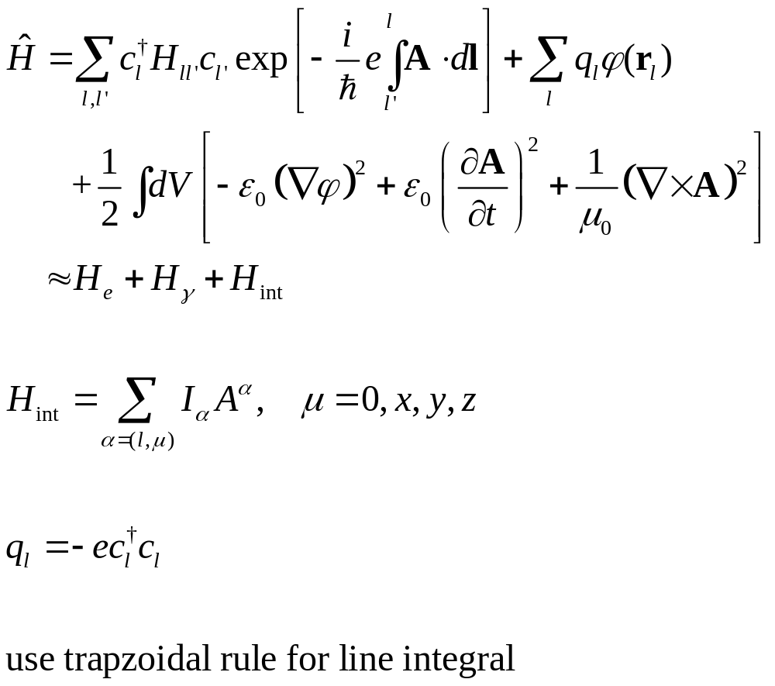
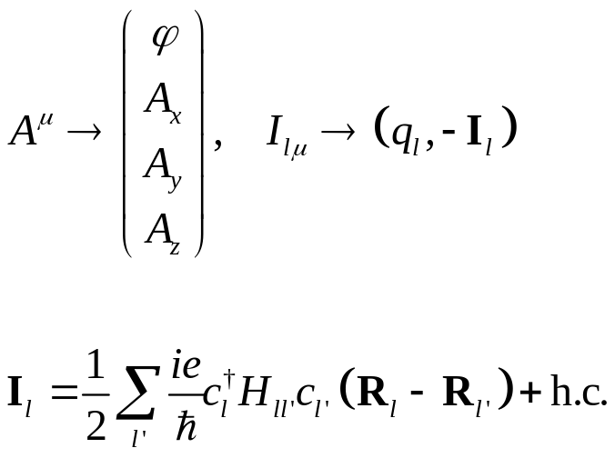
Electrons & electrodynamics
Notes:
D and Pi here are all 4x4 matrix in scalar/vector (relativistic) space.

Slide 16
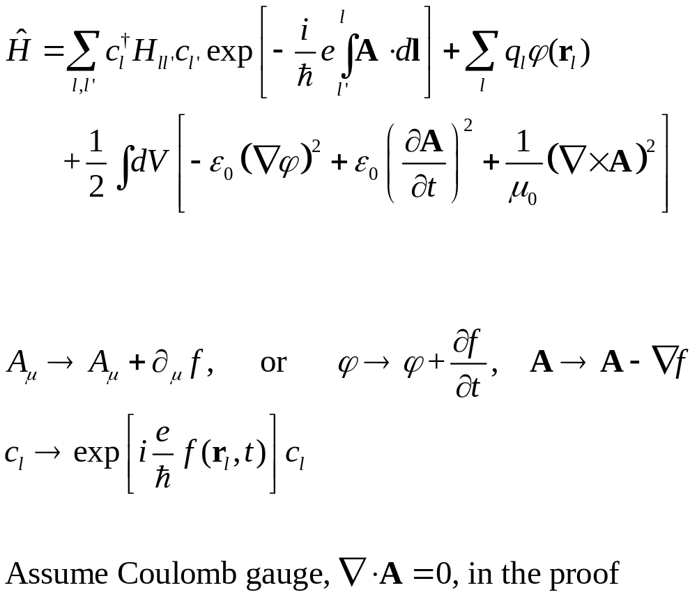
Gauge invariance
Notes:
D and Pi here are all 4x4 matrix in scalar/vector (relativistic) space.

Slide 17
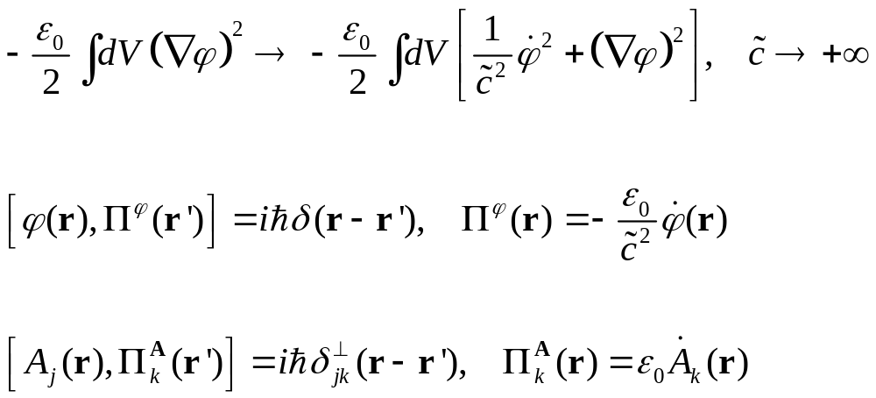
Commutation relation of the fields
Notes:
For the scalar field, note the minus sign.

Slide 18
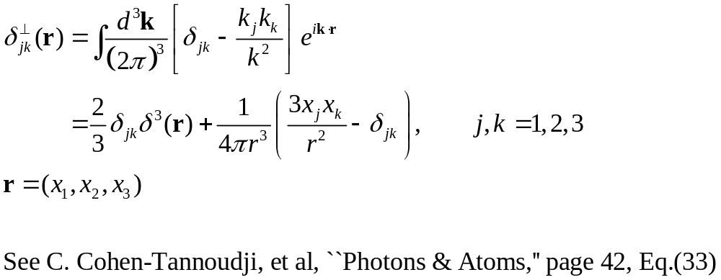
Transverse delta function

Slide 19
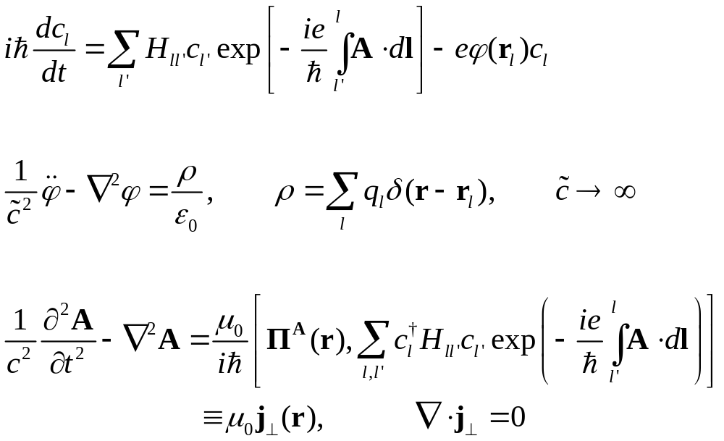
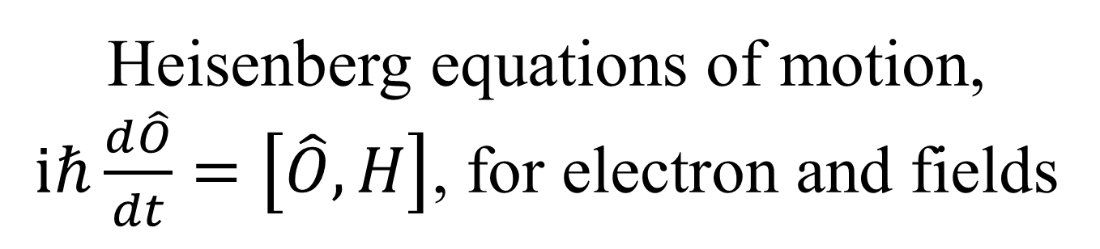
Heisenberg equations of motion, $iℏ\frac{d\hat{O}}{dt}=\left[\hat{O},H\right]$, for electron and fields

Slide 20
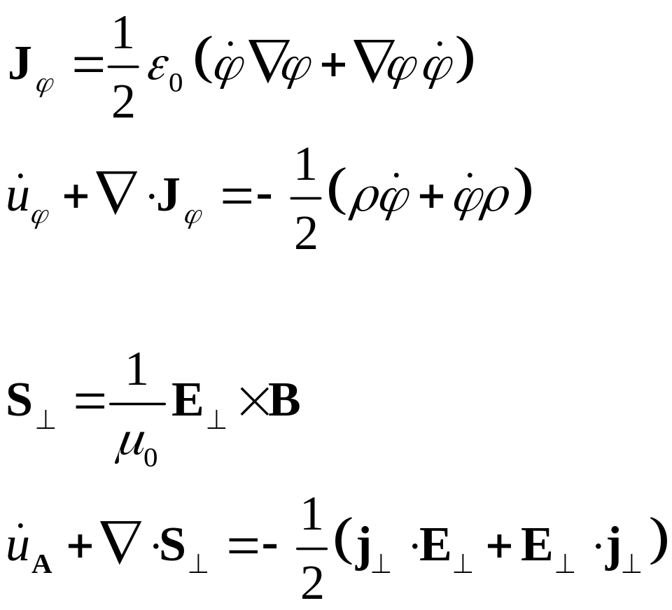
Poynting scalar/vector
Notes:
The Poynting scalar concept first appear in arxiv:1703.07113 by Peng et al.

Slide 21
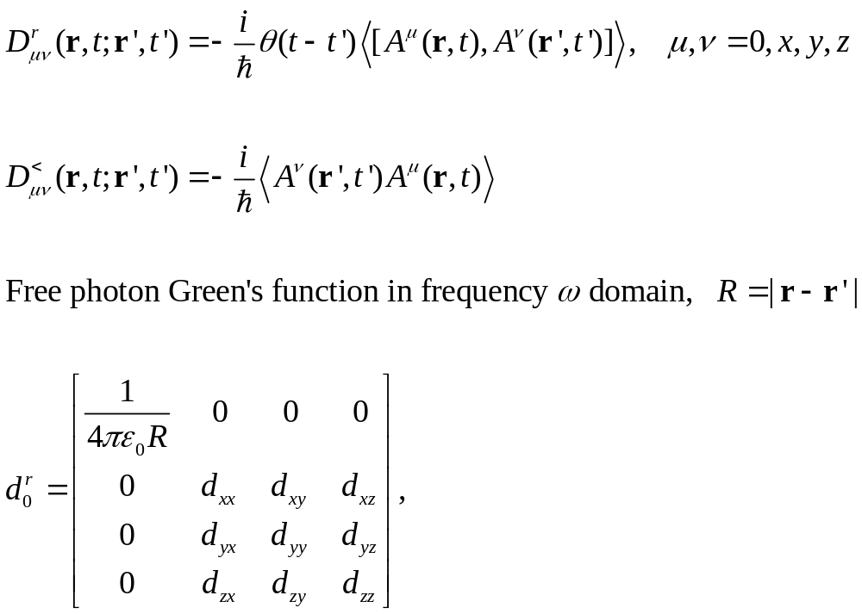
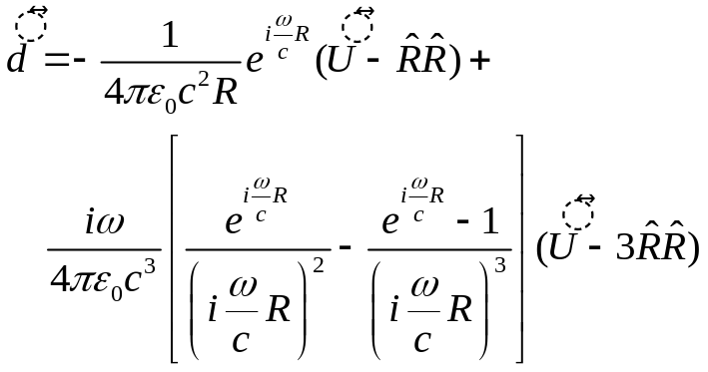
Photon Green’s function
[A, B]=AB-BA
Notes:
U is identity and \hat R is unit vector, dyadic [We can obtain d0 by equation of motion method without going over to second quantization, since it is the same as in classical EM theory]

Slide 22
NEGF “technologies”

Slide 23
A brief history of NEGF
Schwinger 1961
Kadanoff and Baym 1962
Keldysh 1965
Caroli, Combescot, Nozieres, and Saint-James 1971
Meir and Wingreen 1992
Notes:
Schwinger introduced earliest g<, g>, g^t, g^t_bar. Kadanoff and Baym had their famous book “quantum statistical mechanics”, Keldysh emphasized the contour order and its usefulness for diagrammatic expansion, Caroli perhaps first apply to transport, and we now have the Meir-Wingreen formula for current when the center is interactive.

Slide 24
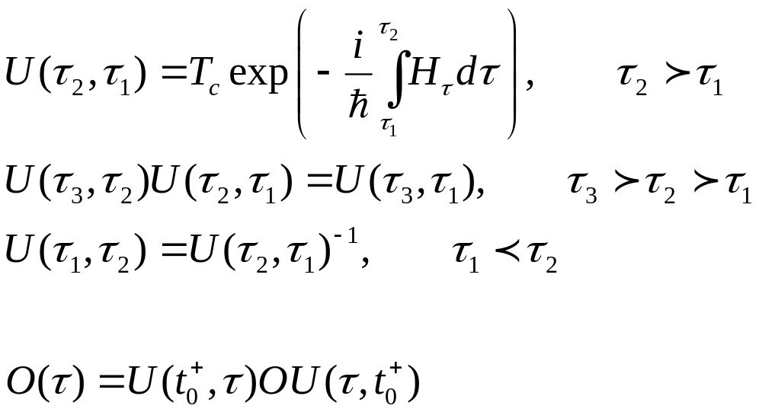
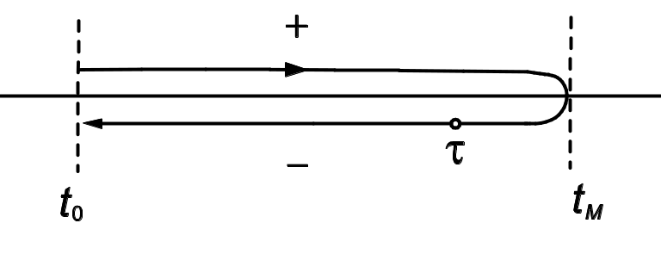
Evolution operator on contour

Slide 25
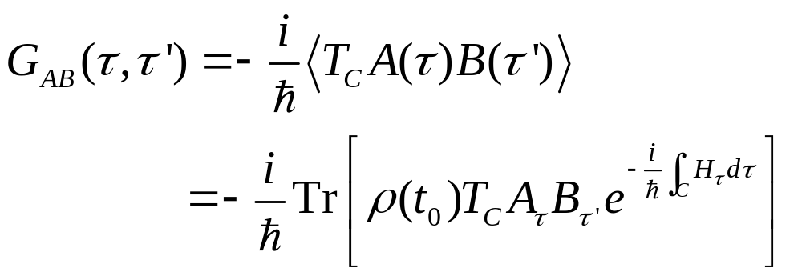
Contour-ordered Green’s function
Contour order: the operators earlier on the contour are to the right. See, e.g., H. Haug & A.-P. Jauho.
τ’
τ
t₀
Notes:
A B in the second line is in Schrodinger picture.
25

Slide 26
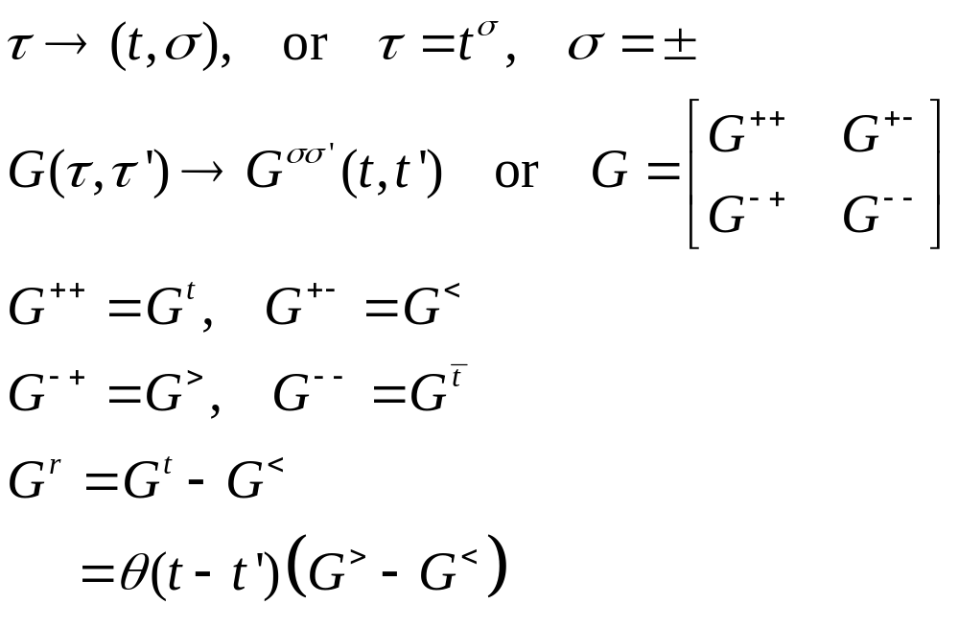
Relation to other Green’s functions
τ’
τ
t₀
Notes:
σ = + for the upper branch, and – for the returning lower branch.
26

Slide 27
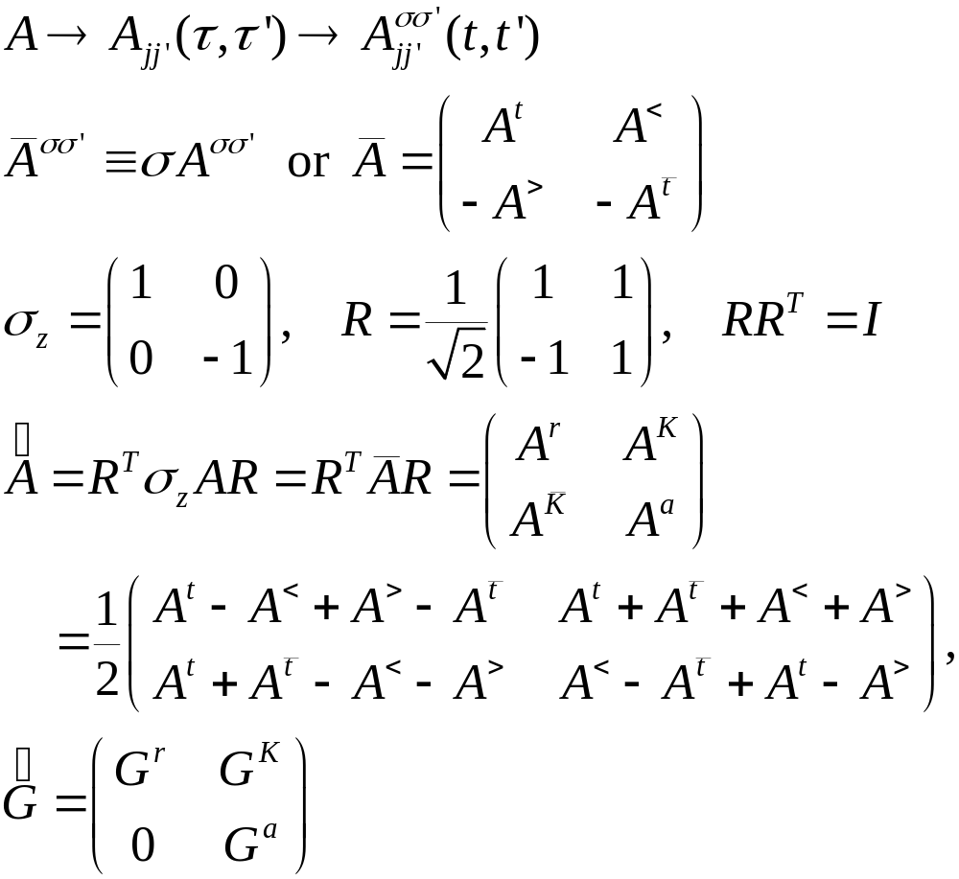
Transformation/Keldysh rotation
Notes:
Also properly known as Larkin-Ovchinikov transform, JETP 41, 960 (1975).

Slide 28
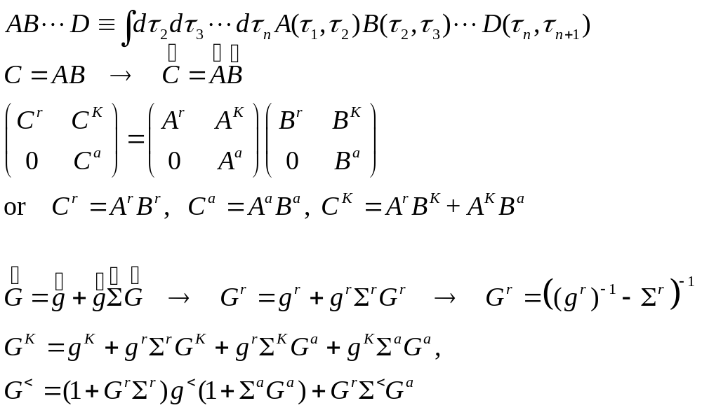
Convolution, Langreth rule
Notes:
The last two equations are known as Keldysh equations.

Slide 29
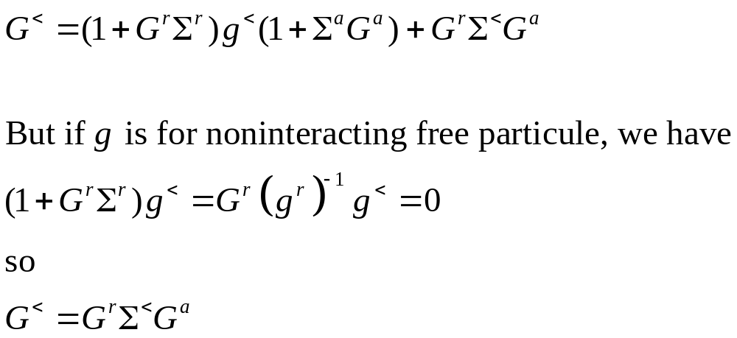
Keldysh equation

Slide 30
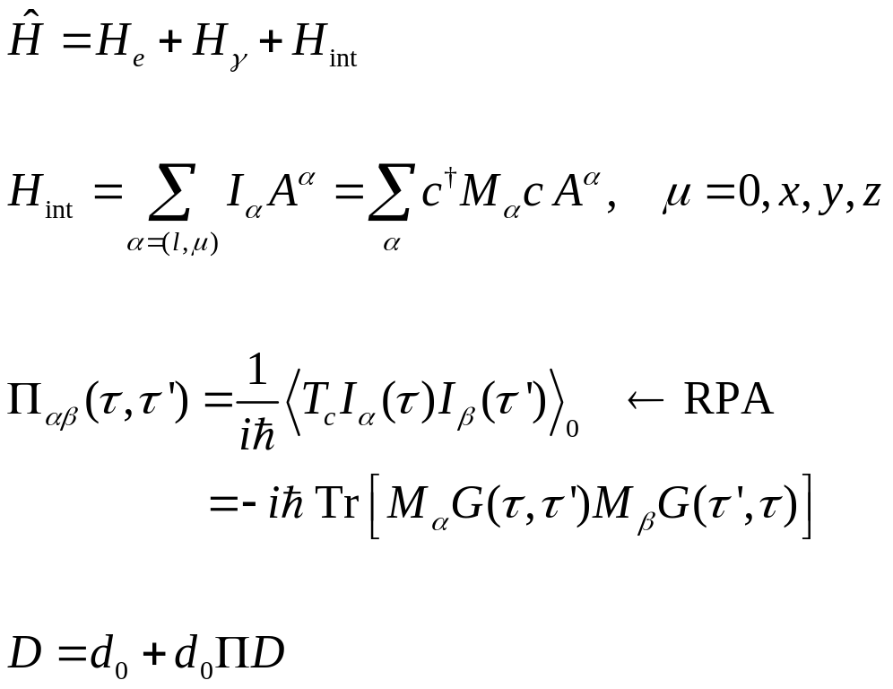
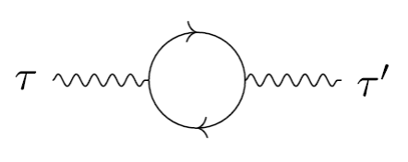
Random phase approximation
Notes:
D and Pi here are all 4x4 matrix in scalar/vector (relativistic) space.

Slide 31
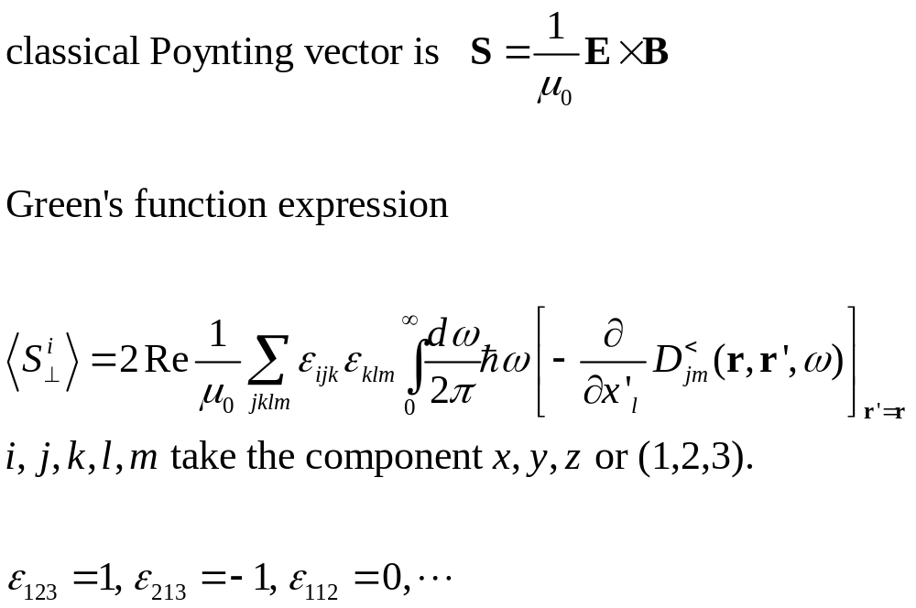
Poynting vector

Slide 32
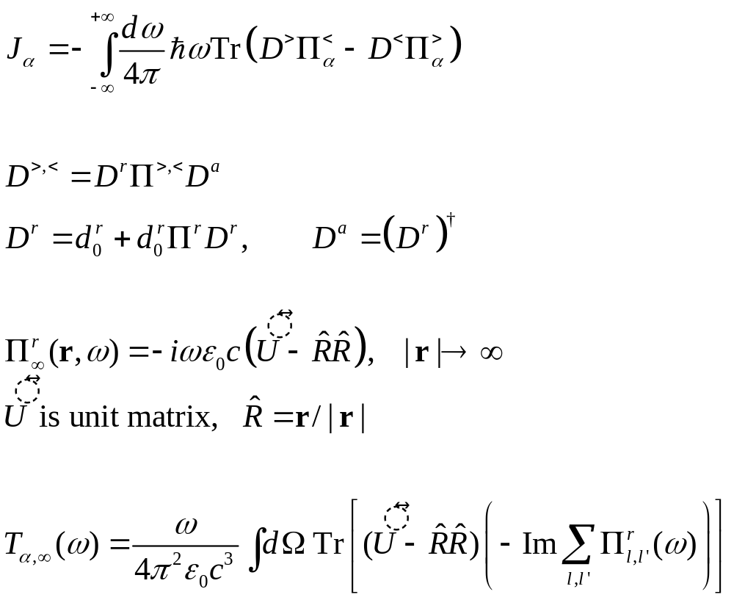
Meir-Wingreen formula, photon bath at infinity
z
r
y
x

Slide 33
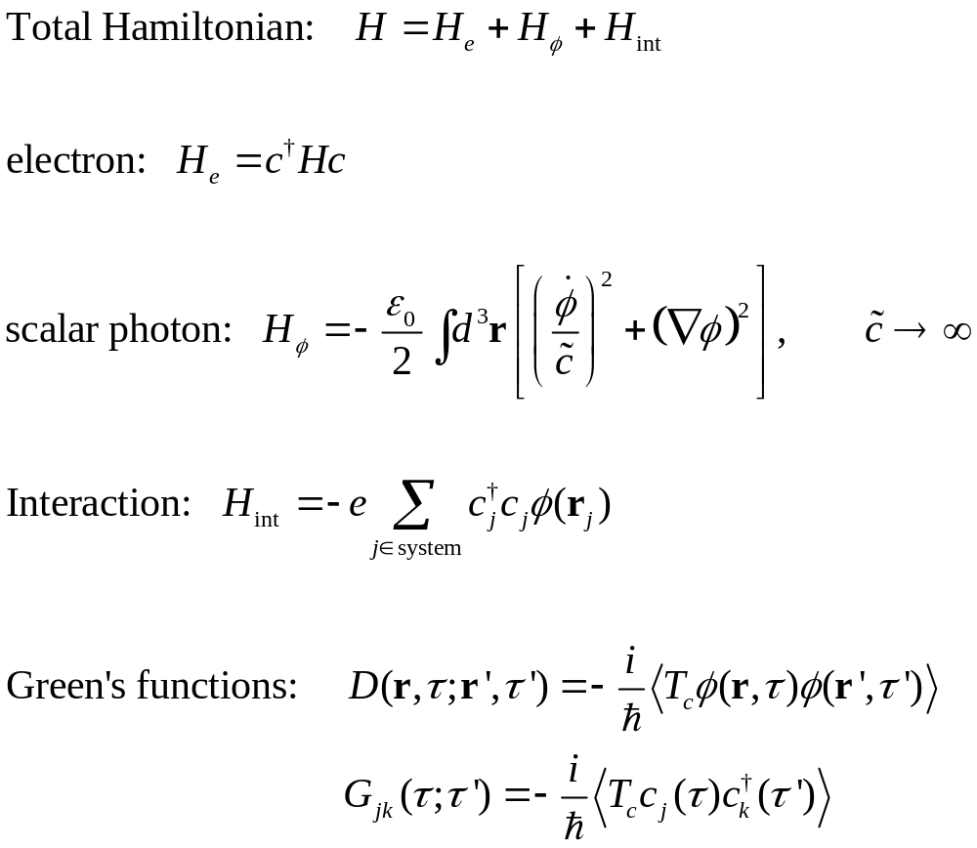
Pure scalar photon

Slide 34
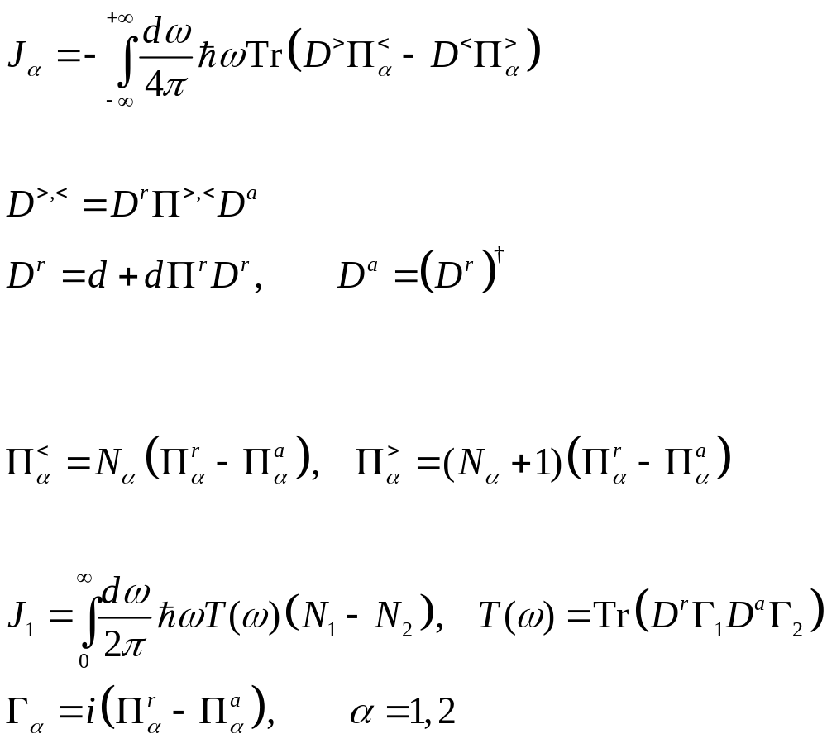

Meir-Wingreen to Caroli formula
Random phase approximation (RPA)
Assuming local equilibrium
Notes:
Now we changed notation, f is fermion function, N is bose function. G for electron Green’s function, D for photon Green’s function. v here is bare Coulomb interaction.

Slide 35
Application examples

Slide 36
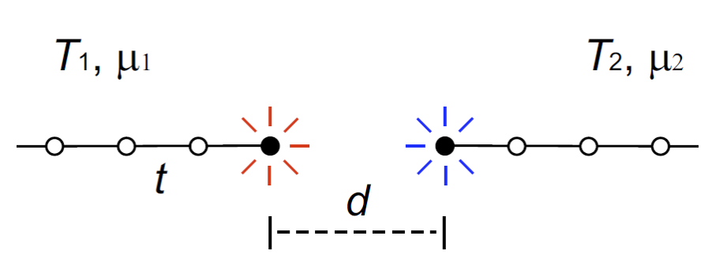
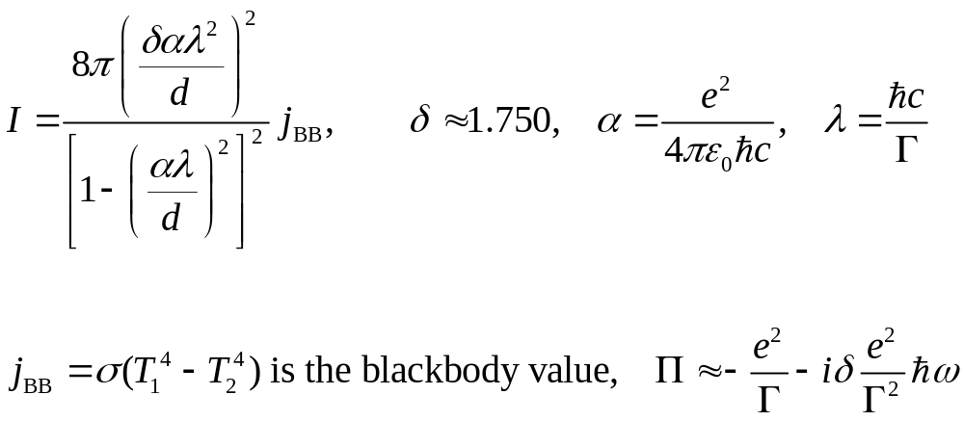
Analytic Result: heat transfer between ends of 1D chains

Slide 37

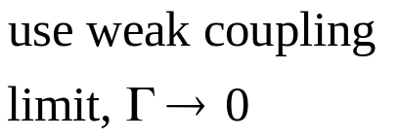
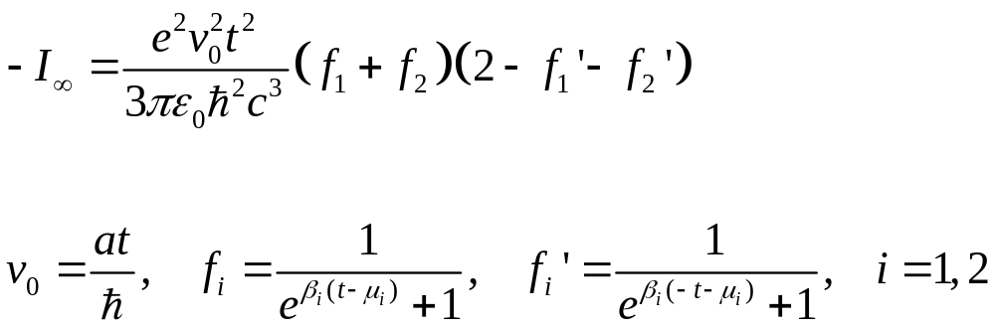
Analytic Result: far field total radiative power of a two-site model
t
T₁, μ₁
T₂, μ₂

Slide 38
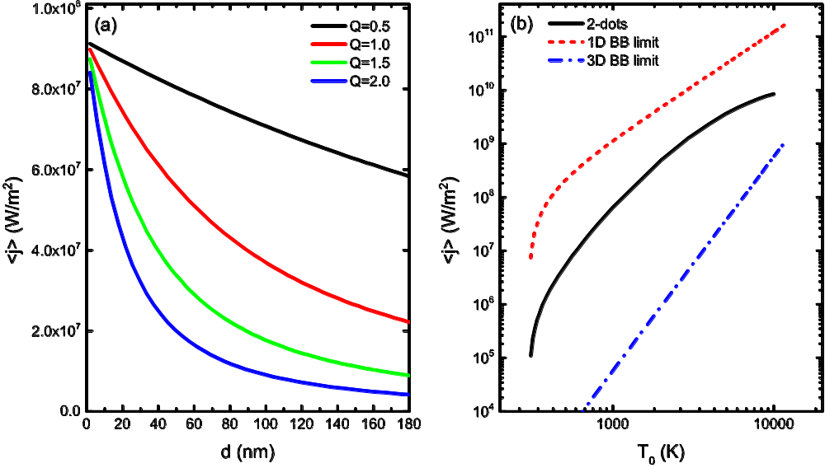
Heat current in a capacitor model
Temperatures T₀=1000 K, T₁=300 K, T_{L}=100 K, T_{R}=30 K, chemical potentials μ₀=0 eV, μ₁=0.02 eV, and onsite v₀=0, v₁=0.01eV. Area A=389.4 (nm)².
The temperature dependence of radiative heat current density. T₁=300 K and varying T₀. Wang and Peng, EPL 118, 24001 (2017).

Slide 39
Negative definition vs positive definition Hamiltonian for the field φ
<j>
H_{γ}<0
H_{γ}>0
$\tilde{d}$< 0
0
distance d

Slide 40
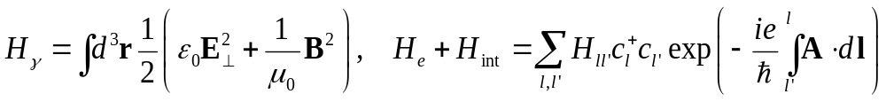
Cubic lattice model
hot
gap d
cold
lattice constant a
hopping t

Slide 41
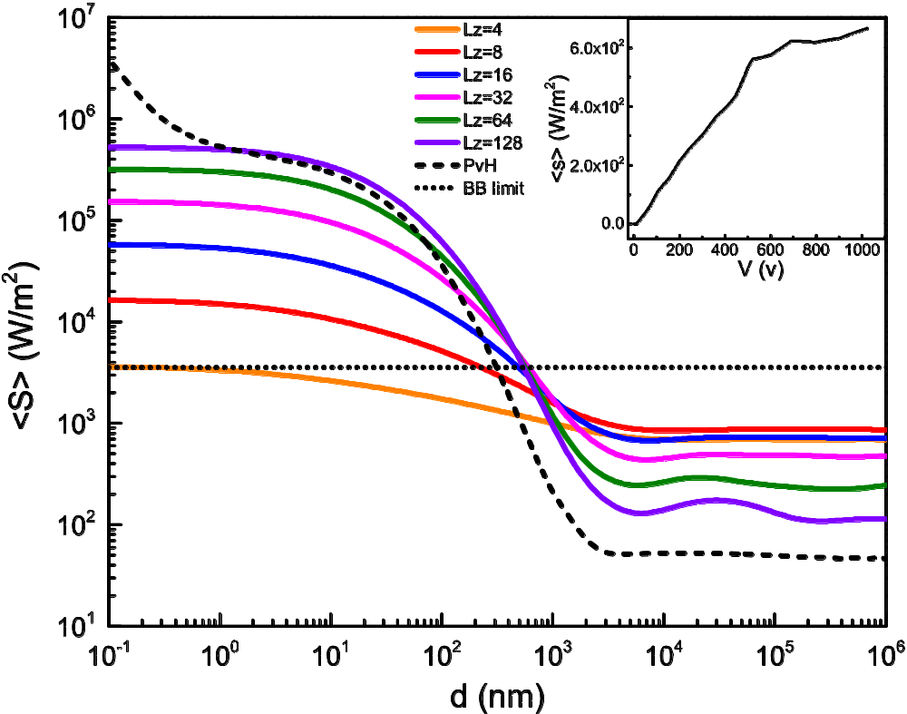
3D A┴ result
Average Poynting vector as a function of spacing d. T₀=500K, T₁=100K.
Model parameters close to Au. PvH result at carrier concentration
(1/6) a⁻³.
Wang and Peng, arxiv:1607.02840.

Slide 42
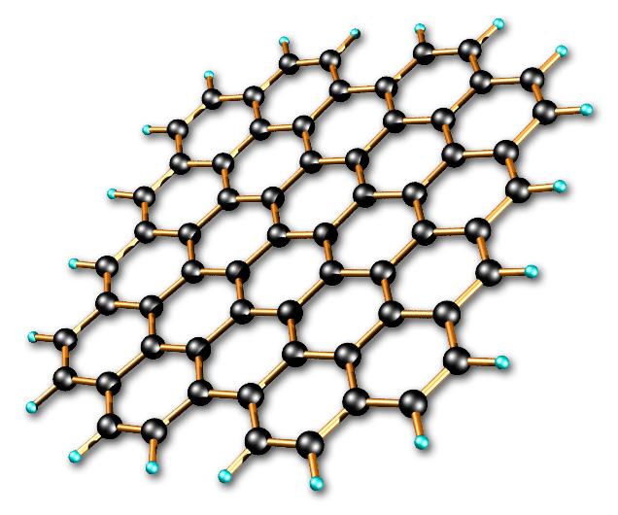
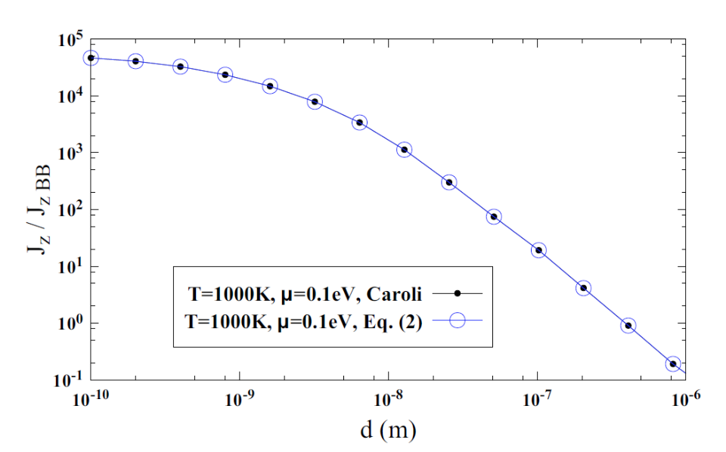
Two graphene sheets
1000 K
Ratio of heat flux to blackbody value for graphene as a function of distance d, J_{zBB} = 56244 W/m². From J.-H. Jiang and J.-S. Wang, PRB 96, 155437 (2017).
300 K

Slide 43
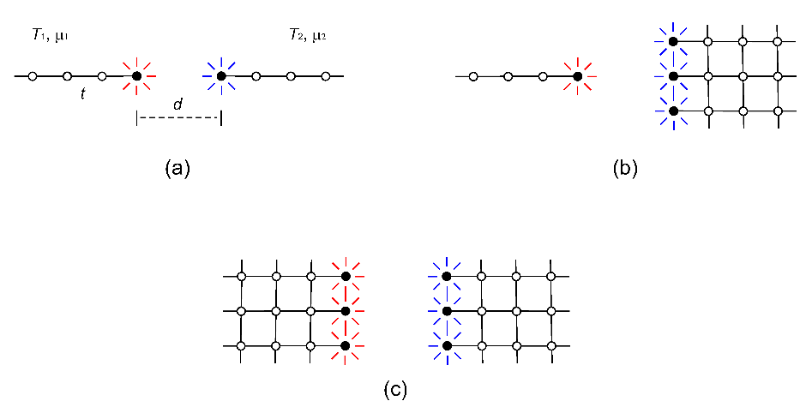
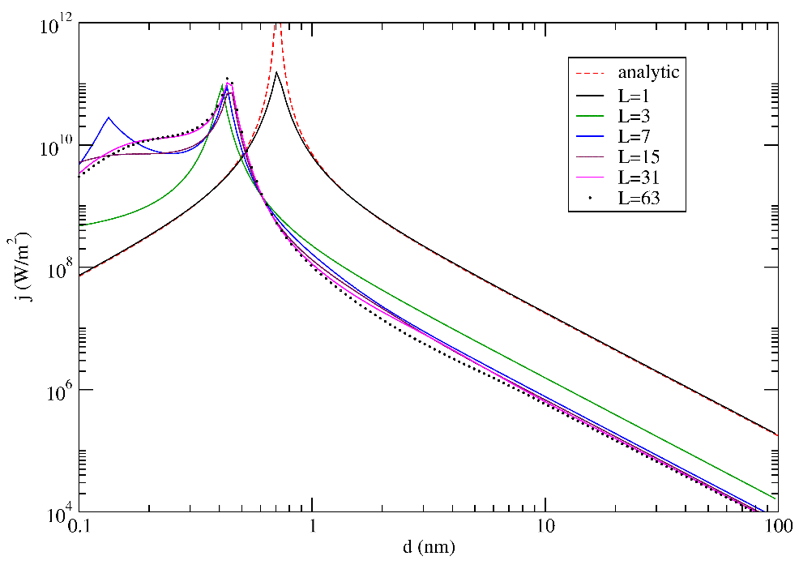
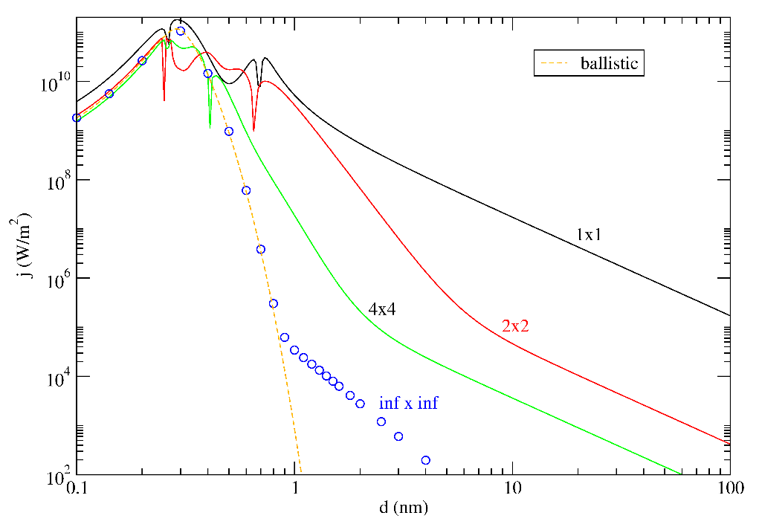
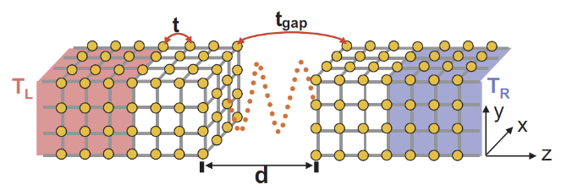
Metal surfaces and tip
: dot and surface.
: cubic lattice parallel plate geometry. From Z.-Q. Zhang, et al. Phys. Rev. B 97, 195450 (2018); Phys. Rev. E 98, 012118 (2018).

Slide 44

Current-carrying graphene sheets

Slide 45


Current-induced heat transfer
: T₁=T₂=300 K. (a) and (c) infinite system (fluctuational electrodynamics), (b) and (d) 4×4 cell finite system with four leads (NEGF).
: Double-layer graphene. T₁=300K, varying T₂ at distance d = 10 nm, chemical potential at 0.1 eV.
From Peng & Wang, arXiv:1805.09493.

Slide 46


Carbon nanotubes
Heat transfer from 400K to 300K objects. (a), (b) zigzag carbon nanotubes. (c), (d) nano-triangles. d: gap distance, M: nanotube circumference, L: triangle length. ε: dielectric constant. From G. Tang, H.H. Yap, J. Ren, and J.-S. Wang, Phys. Rev. Appl. 11, 031004 (2019).

Slide 47

Radiative energy current of a benzene molecule under voltage bias
Benzene molecule modeled as a 6-carbon ring with hopping parameter t = 2.54 eV, lead coupling Γ = 0.05 eV. Unpublished work by Zuquan Zhang.
Notes:
Under published work, computed by Zuquan Zhang

Slide 48



Light emission by a biased benzene molecule
Parameters:
Bond length $a_{0}$ =1.41 Angstrom
Nearest neighbor hopping parameter t = 2.54 eV
Bias voltage $μ_{\text{tip}}=3.0\text{eV}$, $μ_{\text{sub}}=−3.0\text{eV}$
Tip coupling and Substrate coupling:
$Γ_{\text{tip}}=Γ_{\text{sub}}$ = diag{$Γ,Γ,Γ,Γ,Γ,Γ$}, $Γ=0.5\text{eV}$
The photon image is taken in the plane at $z=0.10\text{nm},0.15\text{nm},0.20\text{nm}\text{.}$

Slide 49



Benzene radiation power & electric current under bias
Parameters:
Bond length $a_{0}$ =1.41 Angstrom
Nearest neighbor hopping parameter t = 2.54 eV
$μ_{\text{sub}}=0.0\text{eV}$, $μ_{\text{tip}}$ is set to be the voltage bias.
Tip coupling and Substrate coupling:
$Γ_{\text{tip}}=Γ_{\text{sub}}$ = diag{$Γ,Γ,Γ,Γ,Γ,Γ$}, $Γ=0.2 \text{eV}$
Sphere surface radius R = 0.1 mm
Unpublished work from Zuquan Zhang.
‑I_{e}
I_{e}

Slide 50
Summary
Fully quantum-mechanical, microscopic theory for near-field and far field radiation is proposed.
1D two-dot model, 3D cubic results, and current-carrying graphene, etc, are reported
Rytov’s theory need to be revised

Slide 51
Acknowledgements
Students: Jiebin, Han Hoe, Jia-Hui, Zuquan
Collaborators, Jingtao Lü, Gaomin Tang, Jie Ren, …
MOE tier 2 and FRC grants

