Slide 1
Isn’t there a negative absolute temperature?
Jian-Sheng Wang
Department of Physics,
National University of Singapore

Slide 2
Abstract
In 1956, Ramsey, based on experimental evidence of nuclear spin, developed a theory of negative temperature. The concept is challenged recently by Dunkel and Hilbert [Nature Physics 10, 67 (2014)] and others. In this talk, we review what thermodynamics is and present our support that negative temperature is a valid concept in thermodynamics and statistical mechanics.

Slide 3
References
J. Dunkel and S. Hilbert, Nature Physics 10, 67 (2014); S. Hilbert, P. Hänggi, and J. Dunkel, Phys. Rev. E 90, 062116 (2014); M. Campisi, Phys. Rev. E 91, 052147 (2015); P. Hänggi, S. Hilbert, and J. Dunkel, arXiv:1507.05713.
R.H. Swendsen and J.-S. Wang, Phys. Rev. E 92, 020103(R) (2015); arXiv:1410.4619; J.-S. Wang, arXiv:1507.02022.
S. Braun, et al, Science 339, 52 (2013); J.M.G. Vilar and J.M. Rubi, J. Chem. Phys. 140, 201101 (2014); D. Frenkel and P.B. Warren, Am. J. Phys. 83, 163 (2015); P. Buonsante, et al, arXiv:1506.01933.

Slide 4
Outline
Empirical temperatures and the Kelvin absolute temperature scale
Negative T ?
Thermodynamics
  Classic: Traditional
  Modern: Callen formulation
  Post-modern: Lieb and Yngvason axiomatic foundations
Volume or ‘Gibbs’ entropy – evidence of violations of thermodynamic laws
Conclusion

Slide 5
thermometers
Ideal gas equation of state
pV = Nk_{B}T
p: pressure, e.g., fixed at 1 atm
V: volume, V = length × cross section area
N: number of molecules
k_{B}: Boltzmann constant
T: absolute temperature
length

Slide 6
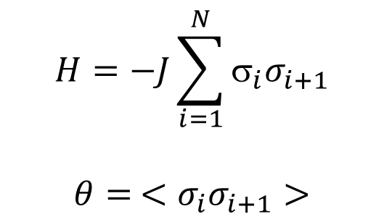
“Ising thermometer”, empirical temperature θ
$$H=−J\sum_{i=1}^{N}{σ_{i}σ_{i+1}}$$
$$θ= <σ_{i}σ_{i+1}>$$
Spin up, σ = +1
Spin down, σ = -1

Slide 7
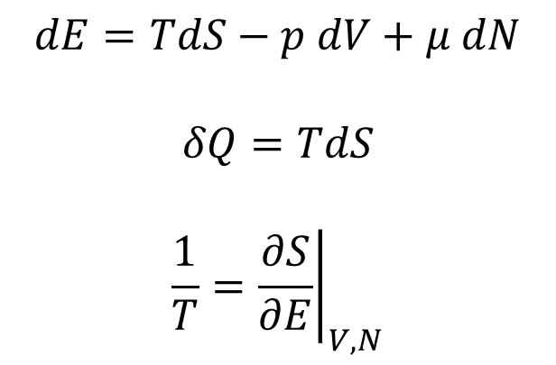
Fundamental thermodynamic equation
Entropy S
S_{G}: Gibbs volume
$$dE=TdS−p dV+μ dN$$
$$δQ=TdS$$
$$\frac{1}{T}={\left.\frac{∂S}{∂E}\right|}_{V,N}$$
S_{B}: Boltzmann
Energy E
E: (internal) energy, Q: heat, T: temperature
μ: chemical potential

Slide 8
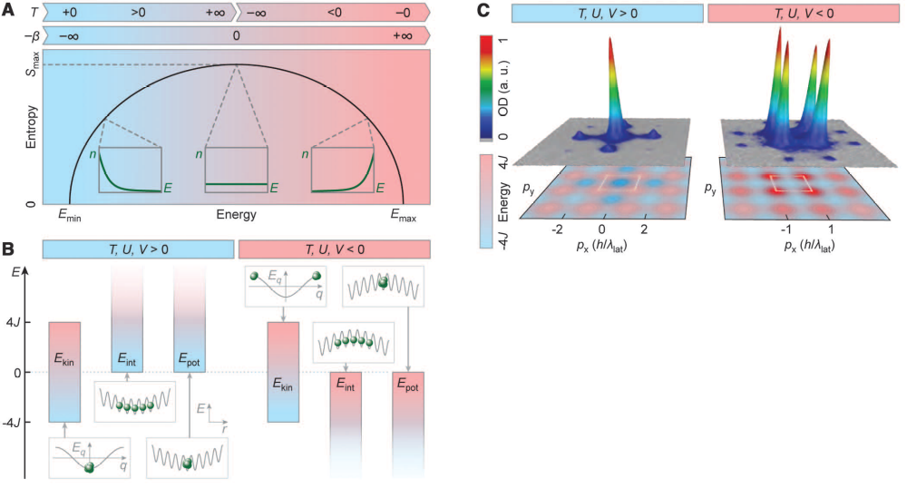
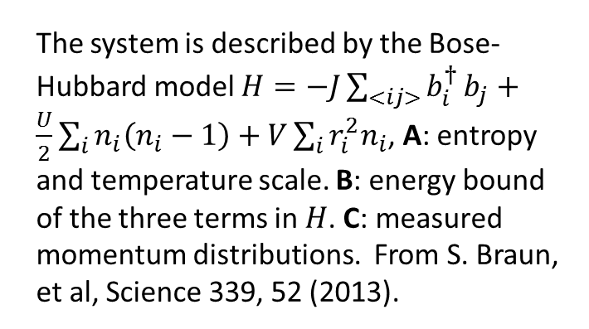
S. Braun et al ³⁹K atoms on optical lattice experiment
The system is described by the Bose-Hubbard model $H=−J\sum_{<ij>}{b_{i}^{†}}b_{j}+\frac{U}{2}\sum_{i}{n_{i}\left(n_{i}−1\right)}+V\sum_{i}{r_{i}^{2}n_{i}}$, A: entropy and temperature scale. B: energy bound of the three terms in $H$. C: measured momentum distributions. From S. Braun, et al, Science 339, 52 (2013).

Slide 9
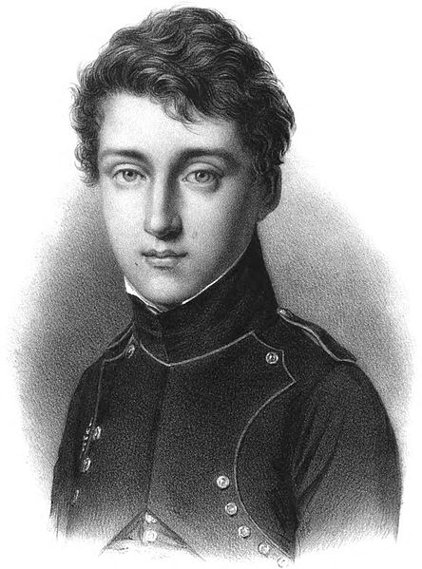
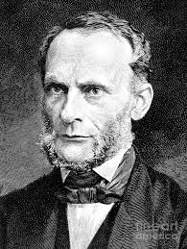
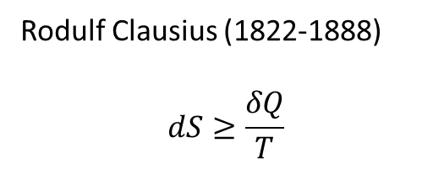
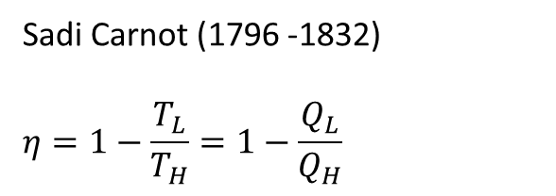
Thermodynamics: traditional
Sadi Carnot (1796 -1832)
$$η=1−\frac{T_{L}}{T_{H}}=1−\frac{Q_{L}}{Q_{H}}$$
Rodulf Clausius (1822-1888)
$$dS≥\frac{δQ}{T}$$

Slide 10
The idea (see, e.g., A. B. Pippard, “the elements of …”)
Define empirical thermometer, based on 0th law of thermodynamics
Build Carnot cycle with two isothermal curves and two adiabatic curves
Compute the efficiency of cycle and find the relation of empirical temperature and the Kelvin scale
Define entropy according to Clausius

Slide 11
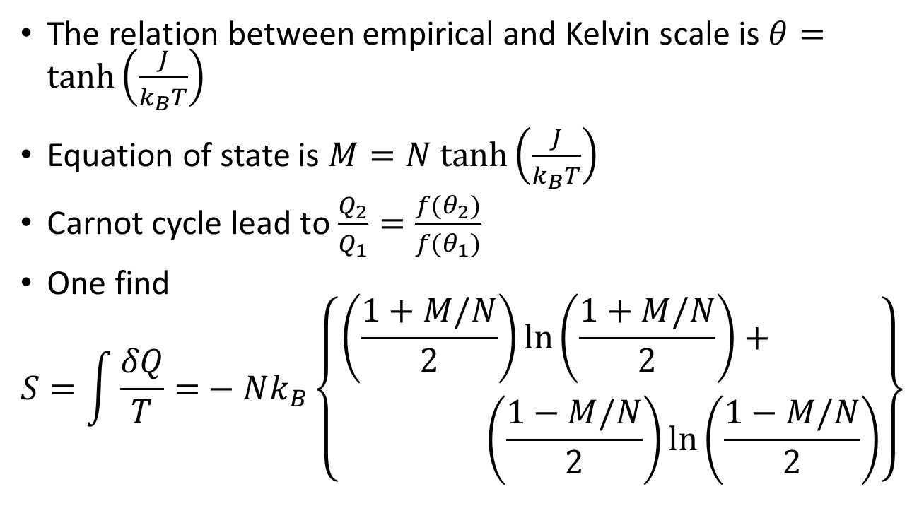
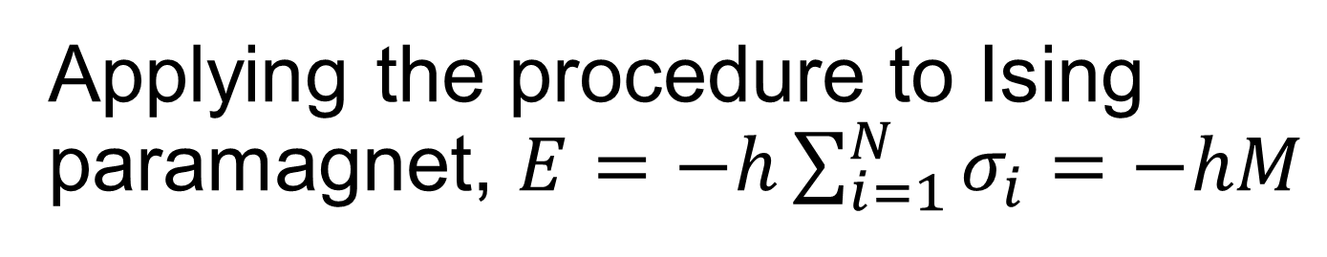
Applying the procedure to Ising paramagnet, $E=−h\sum_{i=1}^{N}{σ_{i}=−hM}$
The relation between empirical and Kelvin scale is $θ=tanh\left(\frac{J}{k_{B}T}\right)$
Equation of state is ${M=N tanh\left(\frac{J}{k_{B}T}\right)}^{}$
Carnot cycle lead to $\frac{Q_{2}}{Q_{1}}=\frac{f(θ_{2})}{f(θ_{1})}$
One find
$$S=\int{\frac{δQ}{T}=}−Nk_{B}\left\{\begin{aligned}\left(\frac{1+M/N}{2}\right)ln\left(\frac{1+M/N}{2}\right)+ \\ \left(\frac{1−M/N}{2}\right)ln\left(\frac{1−M/N}{2}\right)\end{aligned}\right\}$$

Slide 12

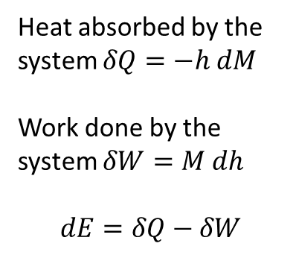

Carnot cycle in the paramagnet
Magnetization M
Heat absorbed by the system $δQ=−h dM$
Work done by the system $δW=M dh$
$$dE=δQ−δW$$
$$θ_{L}$$
$$θ_{H}$$
Magnetic field h

Slide 13
Zeroth Law of thermodynamics
Max Planck: “If a body A is in thermal equilibrium with two other bodies B and C, then B and C are in thermal equilibrium with one another.”
Two bodies in thermal equilibrium means: if the two bodies are to be brought into thermal contact, there would be no net flow of energy between them.
Basis for thermometer and definition of isotherms

Slide 14
Callen postulates (see also R H Swendsen, “introduction to ..”)
Existence of state functions. (Equilibrium) States are characterized by a small number of macroscopically measurable quantities. For simple system it is energy E, volume V, and particle number N.

Slide 15
Callen postulate II
There exists a state function called “entropy”, for which
the values assumed by the extensive parameters of an isolated composite system in the absence of an internal constraint are those that maximize the entropy over the set of all constrained macroscopic states.
The above statement is a form of Second Law of thermodynamics.

Slide 16
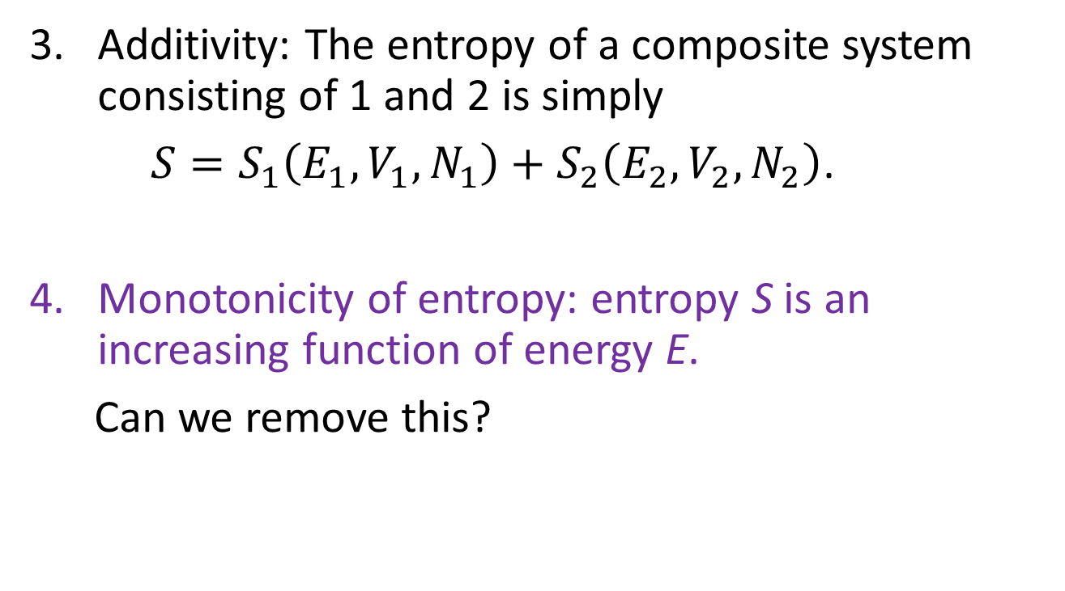
Callen postulates
Additivity: The entropy of a composite system consisting of 1 and 2 is simply
$S=S_{1}\left(E_{1},V_{1},N_{1}\right)+S_{2}\left(E_{2},V_{2},N_{2}\right)$.
Monotonicity of entropy: entropy S is an increasing function of energy E.
Can we remove this?

Slide 17




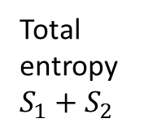
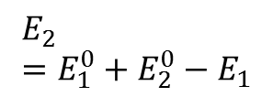

Second law according to Callen
Total entropy $S_{1}+S_{2}$
$$E_{2}^{0}$$
$$E_{1}^{0}$$
Combined and allow to exchange energy
$$E_{2}=E_{1}^{0}+E_{2}^{0}−E_{1}$$
$$E_{1}^{max}$$
$E_{1}^{}$?
$$E_{1}$$

Slide 18

Second law according to Callen
Total entropy $S_{1}+S_{2}$
$$E_{2}^{0}$$
$$E_{1}^{0}$$
Combined and allow to exchange energy
$$E_{2}=E_{1}^{0}+E_{2}^{0}−E_{1}$$
$$E_{1}^{max}$$
$E_{1}^{}$=${ E}_{1}^{max}$
$$E_{1}$$

Slide 19
E.H. Lieb & J. Yngvason, Phys Rep 310, 1 (1999)
Build the foundation of thermodynamics and the second law on the concept of “adiabatic accessibility.”
Starting with a set of more elementary axioms and proving the Callen postulates as theorems.
See also R. Giles, “Mathematical Foundations of Thermodynamics,” Pergamon (1964).

Slide 20
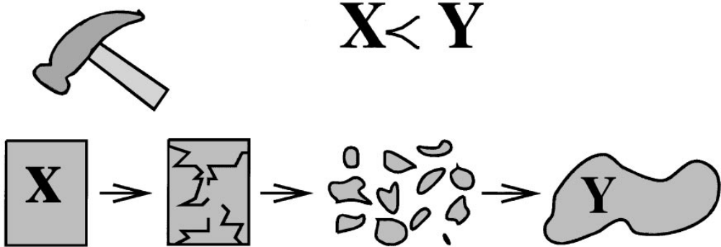
Adiabatic Accessibility, X ≺ Y
“A State Y is adiabatically accessible from a state X, in symbols X ≺ Y, if it is possible to change the state from X to Y by means of an interaction with some device and a weight, in such a way that the device returns to its initial state at the end of the process whereas the weight may have changed its position in a gravitational field.”

Slide 21
Order relation ≺
Reflexivity, X ≺ X
Transitivity, X ≺ Y & Y ≺ Z implies X ≺ Z
Consistency, X≺X’ & Y≺Y’ implies (X,Y) ≺ (X’,Y’)
Scaling invariance, if X ≺ Y, then t X ≺ t Y for all t > 0
Splitting and recombination, for all 0 < t < 1, X ≺ (tX, (1-t)X), and (tX, (1-t)X) ≺ X
Stability, (X, εZ₀) ≺ (Y, εZ₁) (for any small enough ε > 0) implies X ≺ Y

Slide 22
Comparison Hypothesis (CH)
Definition: We say the comparison hypothesis holds for a state space if any two states X and Y in the space are comparable, i.e., X ≺ Y or Y ≺ X.
Compare to Carathéodory: In the neighborhood of any equilibrium state of a system there are states which are inaccessible by an adiabatic process.

Slide 23
Entropy Principle
There is a real-valued function S on all states of all systems (including compound systems), called “entropy” such that
  Monotonicity: When X and Y are comparable then X ≺ Y if and only if S(X) ≤ S(Y)
  Additivity: S((X,Y)) = S(X) + S(Y)
  Extensivity: for t > 0, S(tX) = t S(X)
The above is proved with axiom 1-6 and CH, i.e. 1-6 plus CH and entropy principle are equivalent. Callen’s maxima entropy postulate is proved as a theorem 4.3 on page 57.

Slide 24
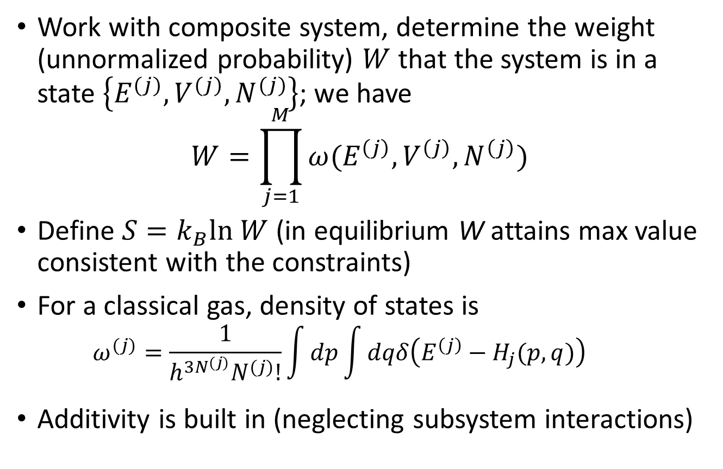
Our definition of entropy
Work with composite system, determine the weight (unnormalized probability) $W$ that the system is in a state $\left\{E^{(j)},V^{(j)},N^{(j)}\right\}$; we have
$$W=\prod_{j=1}^{M}{ω(E^{\left(j\right)},V^{\left(j\right)},N^{\left(j\right)})}$$
Define $S=k_{B}ln W$ (in equilibrium W attains max value consistent with the constraints)
For a classical gas, density of states is
  $$ω^{(j)}=\frac{1}{h^{3N^{(j)}}N^{(j)}!}\int{dp}\int{dqδ\left(E^{\left(j\right)}−H_{j}(p,q)\right)}$$
Additivity is built in (neglecting subsystem interactions)

Slide 25
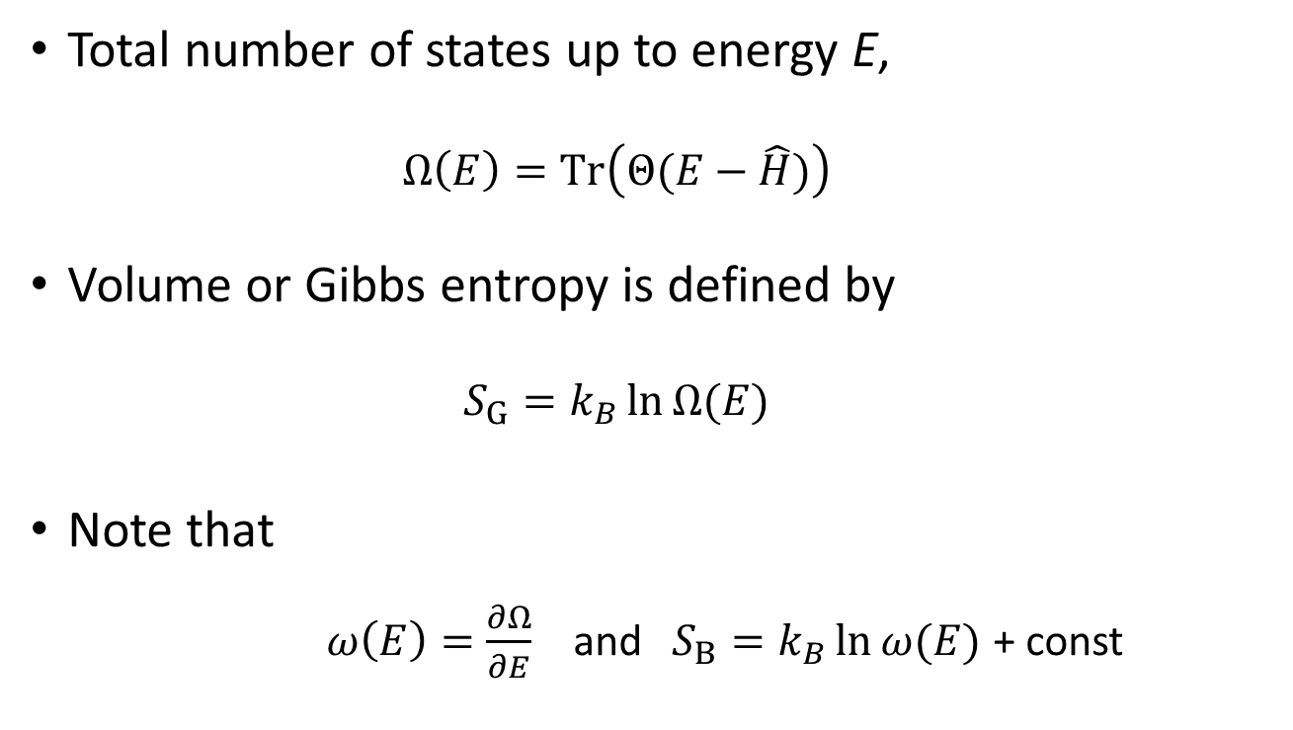
Gibbs ‘volume’ entropy S_{G}
Total number of states up to energy E,
  $$Ω\left(E\right)=Tr\left(Θ(E−\hat{H})\right)$$
Volume or Gibbs entropy is defined by
  $$S_{G}=k_{B}\ln{Ω(E)}$$
Note that
  $ω\left(E\right)=\frac{∂Ω}{∂E}$ and $S_{B}=k_{B}\ln{ω(E)}$ + const

Slide 26
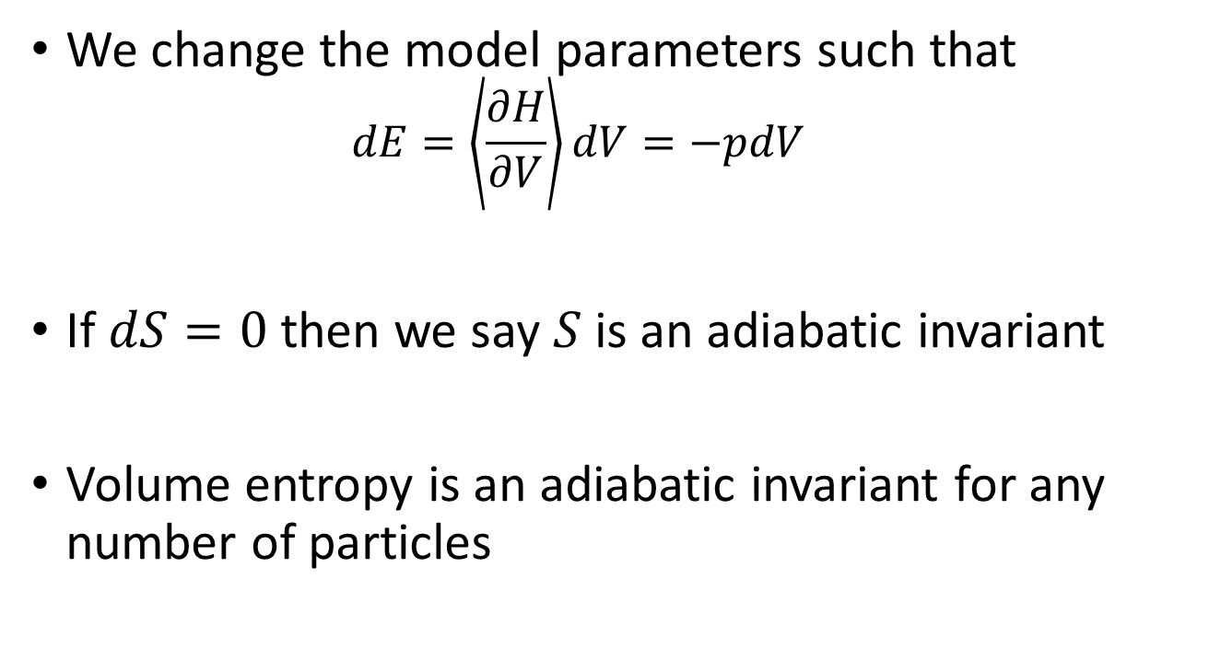
Adiabatic invariance, see, e.g. S.-K. Ma, Chap.23
We change the model parameters such that
  $$dE=\left\langle \frac{∂H}{∂V}\right\rangle dV=−pdV$$
If $dS=0$ then we say $S$ is an adiabatic invariant
Volume entropy is an adiabatic invariant for any number of particles

Slide 27
Why volume entropy is wrong
It violates Zeroth Law
It violates Second Law
[for systems with bounded energies]
It violates Third Law (when applied to a simple quantum oscillator, given a constant heat capacity)

Slide 28
Temperatures of three bodies according to T_{G}
Starting with three systems 1, 2, 3, such that there is no energy transfer when making contact, then according to S_{G}, all seven cases will have different temperatures of T_{G}.
1
2
3
T₁
T₂
T₃
1
2
2
3
1
3
T₁₂
T₂₃
T₁₃
1
2
3
T₁₂₃

Slide 29
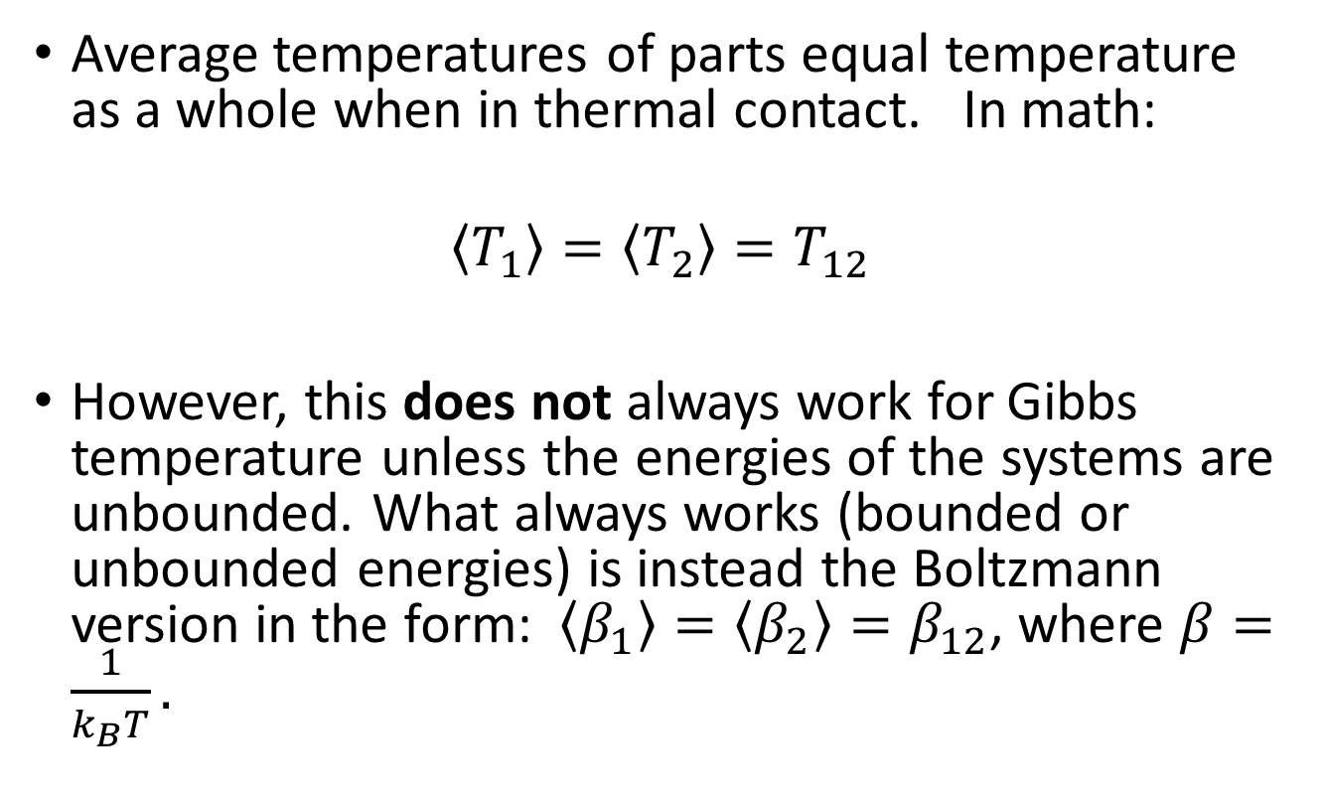
HHD formulation of 0th law
Average temperatures of parts equal temperature as a whole when in thermal contact. In math:
$$\left\langle T_{1}\right\rangle =\left\langle T_{2}\right\rangle =T_{12}$$
However, this does not always work for Gibbs temperature unless the energies of the systems are unbounded. What always works (bounded or unbounded energies) is instead the Boltzmann version in the form: $\left\langle β_{1}\right\rangle =\left\langle β_{2}\right\rangle =β_{12}$, where $β=\frac{1}{k_{B}T}.$

Slide 30
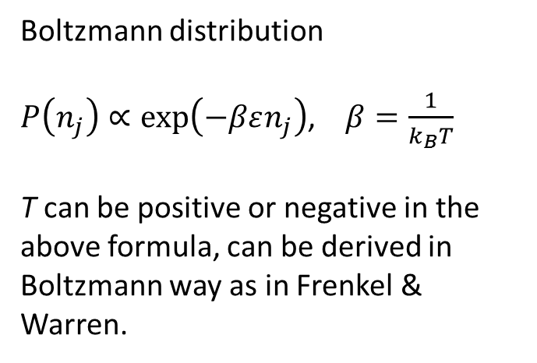
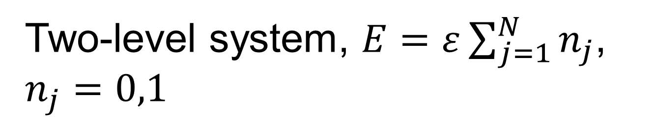
Two-level system, $E=ε\sum_{j=1}^{N}{n_{j}}$, $n_{j}=0,1$
ε
0
Boltzmann distribution
$P\left(n_{j}\right)∝\exp\left(−βεn_{j}\right)$, $β=\frac{1}{k_{B}T}$
T can be positive or negative in the above formula, can be derived in Boltzmann way as in Frenkel & Warren.

Slide 31
Temperature T_{G} increases if you combine two loafs of bread into one
ε
0
ε
0
T_{1,G} = 2⁵
T_{2,G} = 2⁸
ε
0
T_{1+2,G} = T_{1,G}T_{2,G}=2¹³

Slide 32
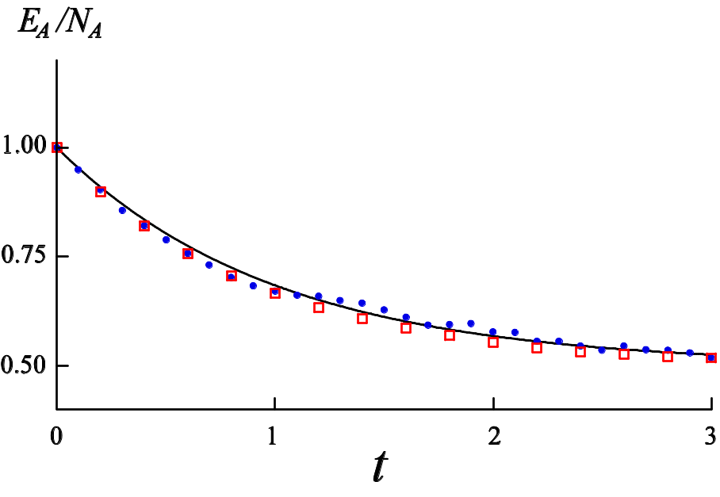
Heat flows from cold to hot according to T_{G}
ε
0
Two-level system
ħ ω = ε
Energy of the two-level system vs time. Squares: N_{A} = 5, N_{B}=1, temperature of the oscillator T = 64. Dots: N_{A} = 1000, N_{B}=1000, T = ∞.
Quantum harmonic oscillator energy level

Slide 33

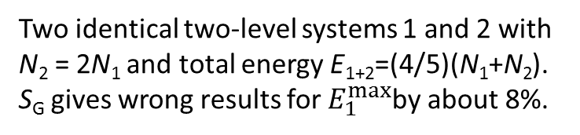
Violation of Callen’s second postulate
Total entropy $S_{1}+S_{2}$
N₁ | E₁^{max} for S_{B} | E₁^{max} for S_{G}
5 | 4 | 4
10 | 8 | 9
50 | 40 | 43
100 | 80 | 87
500 | 400 | 433
1000 | 800 | 867
Two identical two-level systems 1 and 2 with N₂ = 2N₁ and total energy E₁₊₂=(4/5)(N₁+N₂). S_{G} gives wrong results for $E_{1}^{max}$by about 8%.
$$E_{1}^{max}$$
$$E_{1}^{eq}$$
$$E_{1}$$

Slide 34
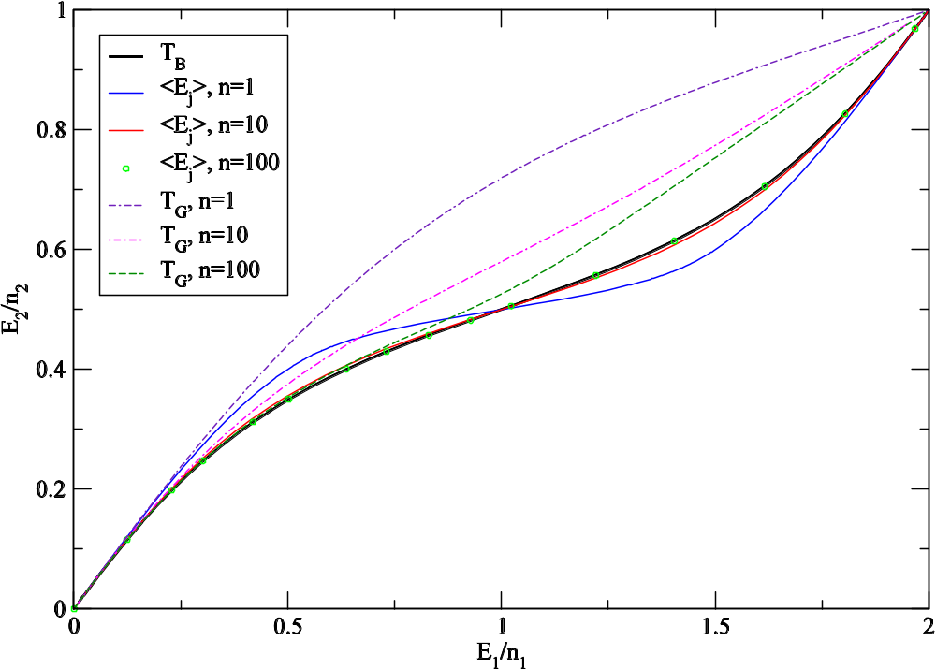
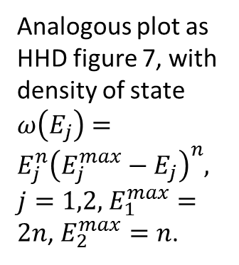
Boltzmann temperature determines the direction of heat flow
Analogous plot as HHD figure 7, with density of state $ω\left(E_{j}\right)=E_{j}^{n}{\left(E_{j}^{max}−E_{j}\right)}^{n},$
$j=1,2,$ $E_{1}^{max}=2n$, $E_{2}^{max}=n$.

Slide 35
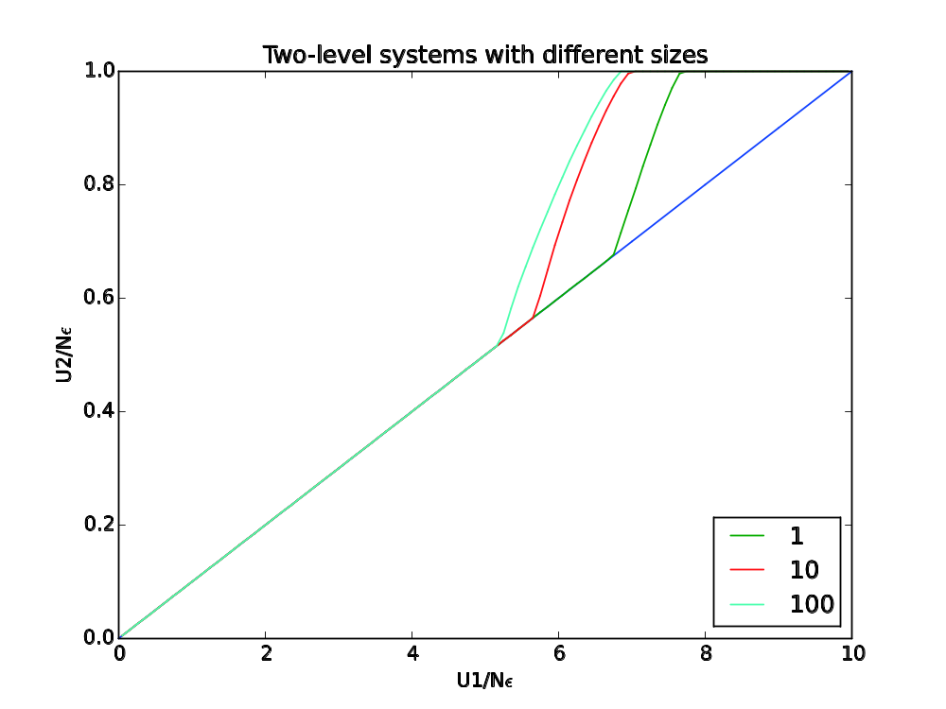
Boltzmann T_{B} determines the direction of heat flow, T_{G} does not
Energies of two identical two-level systems, system 1 is 10 times larger than system 2, predicted by ‘no heat transfer’ as well as equality of T_{B} (max of total Boltzmann entropy) is given by the blue straight line.
Other curves are predictions of T_{G} for different sizes of N₂.
From Swendsen, arxiv:1508.01323.

Slide 36
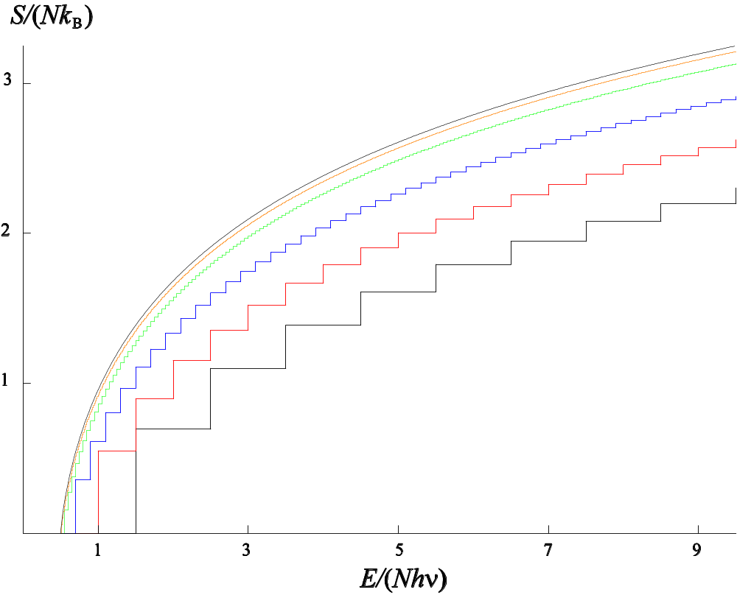
Entropy and thermodynamic limit
Entropy of (distinguishable) quantum harmonic oscillators computed according to S_{G} for the number of oscillators N = 1, 2, 5, 20, 80, and ∞ (from bottom to top) or S_{B} with one particle larger, i.e., N = 2, 3, 6, etc.
Temperature for N=1 cannot be properly defined.

Slide 37
Opposing view
Ensembles are not equivalent, especially so for the case when energy distributions are inverted
Thermodynamics applies to any number of particles, N = 1, 2, 3, …
Heat flows from hot to cold is “naïve”; T is not a state function
Ising models are bad benchmarks

Slide 38
Conclusion
The volume entropy S_{G} fails to satisfy the postulates of thermodynamics – the zeroth law and the second law. It lacks additivity, essential for the validity of thermodynamics
For classical Hamiltonian systems, S_{G} satisfies an exact adiabatic invariance (due to Hertz) while Boltzmann entropy does not. However, the violations are of order 1/N and go away for large systems
Thermodynamics is a macroscopic theory which applies to large systems only

