Slide 1
Phonon Hall Effect
Jian-Sheng Wang
Department of Physics, National University of Singapore
Notes:
Also posted at http://phyweb.physics.nus.edu.sg/~phywjs/Talks/talks.html

Slide 2
Outline
Electron Hall effect
Phonon Hall effect, experimental background
Phonon Hall models
Kubo linear response and the correction term
Definitions of Berry curvature
Hall effect from a driven current
Conclusion

Slide 3
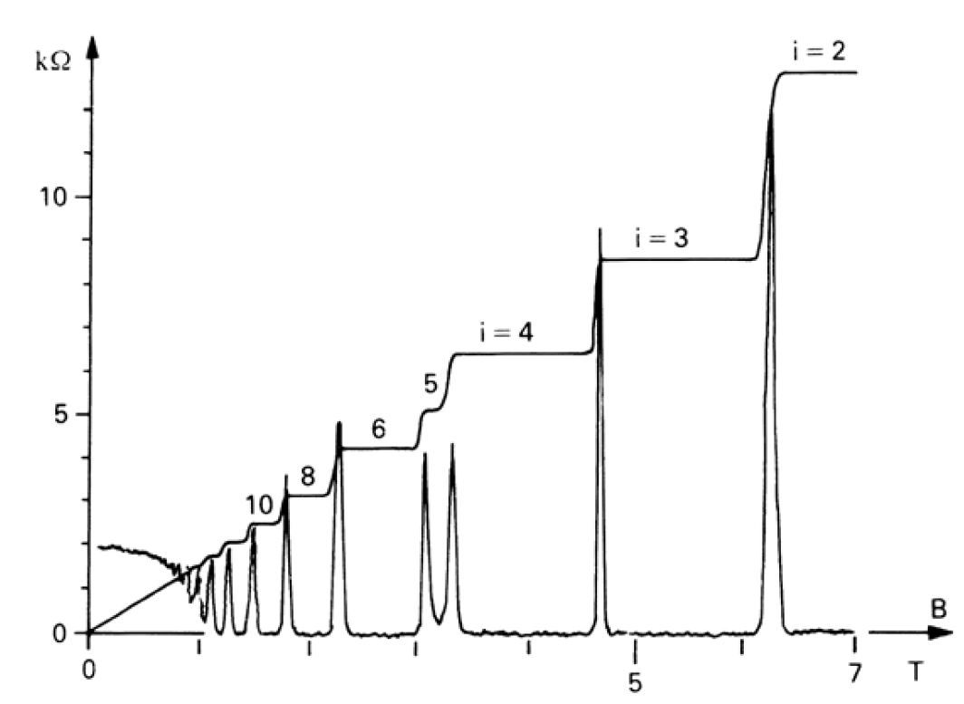
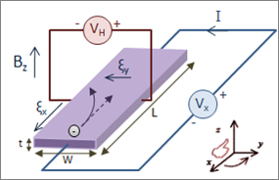
Hall effect
Notes:
Hall geometry figure from https://en.wikipedia.org/wiki/Hall_effect

Slide 4
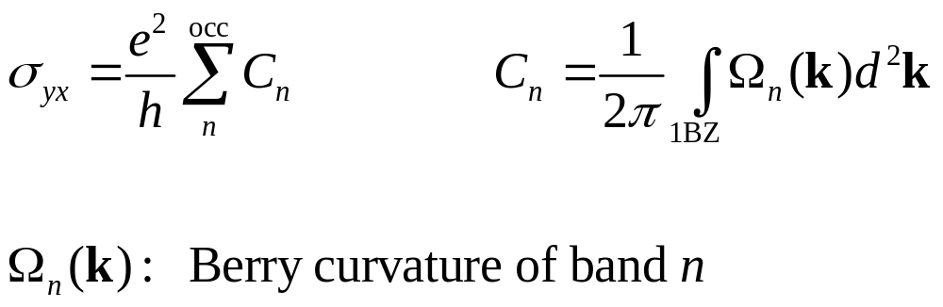
Quantum Hall effect, TKNN formula
Thouless, Kohmoto, Nightingale, den Nijs (1982)

Slide 5
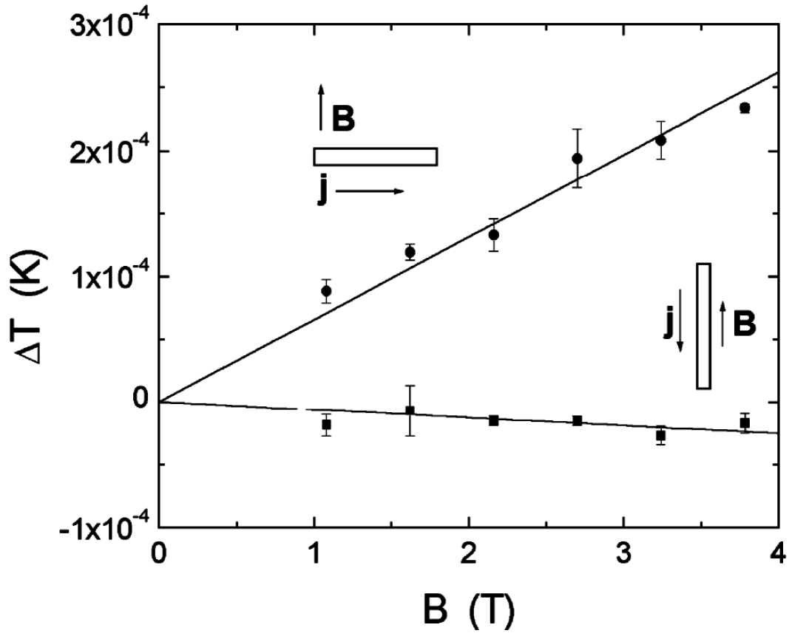
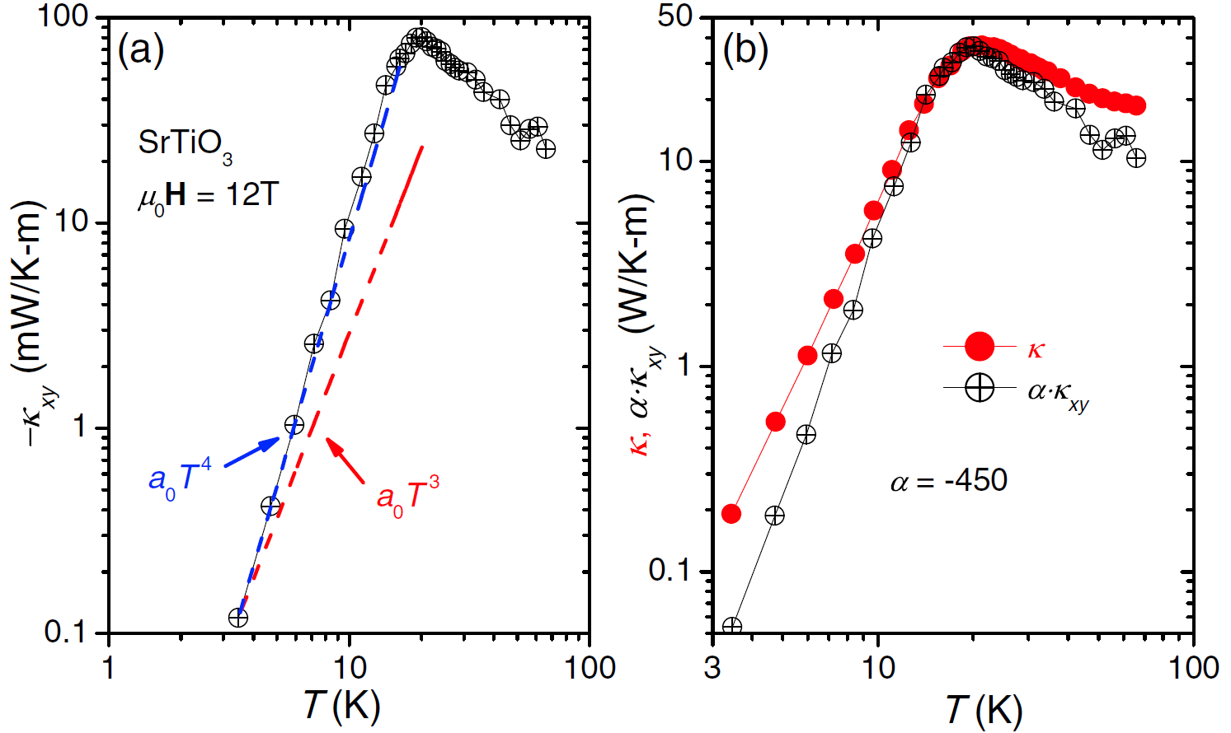
Phonon Hall effect
First phonon Hall experiment on Tb₃Ga₅O₁₂ at T=5.45 K, with k_{xy} estimated to be 0.45 (mW/K-m) at B = 10 T. C. Strohm, G.L.J.A. Rikken, and P. Wyder, PRL 95, 155901 (2005).
SrTiO₃ Hall experimental result, X. Li, B. Fauqué, Z. Zhu, and K. Behnia, PRL 124, 105901 (2020).

Slide 6
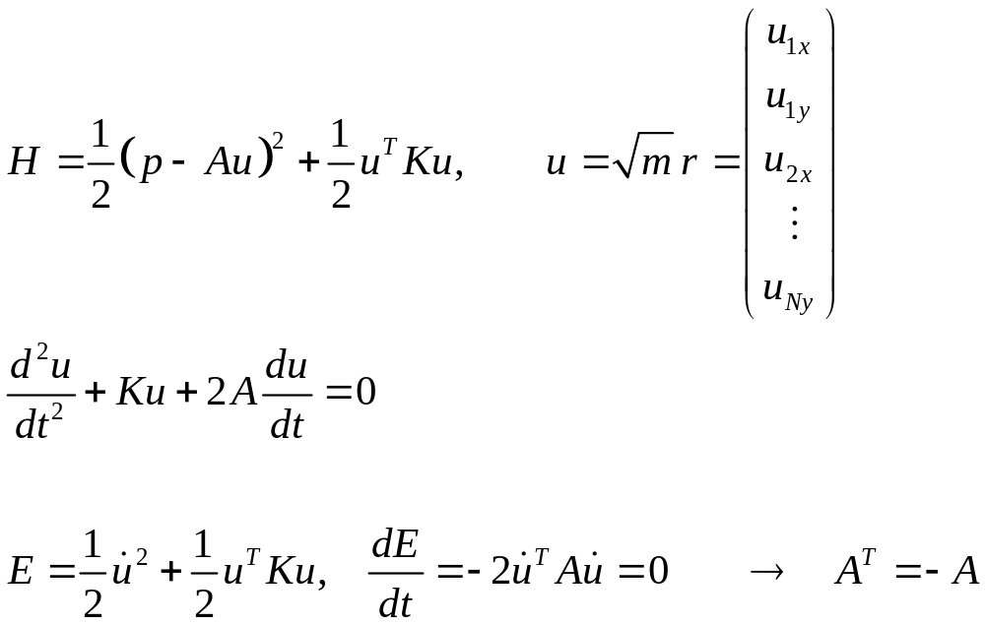
Phonon model
Positive definite
Velocity dependent force
but non-dissipative
What is the physical original of A?
Notes:
A Hamiltonian system cannot be dissipative – equation of motion need only A^T - A, here what I mean is that if the equation of motion contains A du/dt, non-dissipative mean A must be antisymmetric.

Slide 7
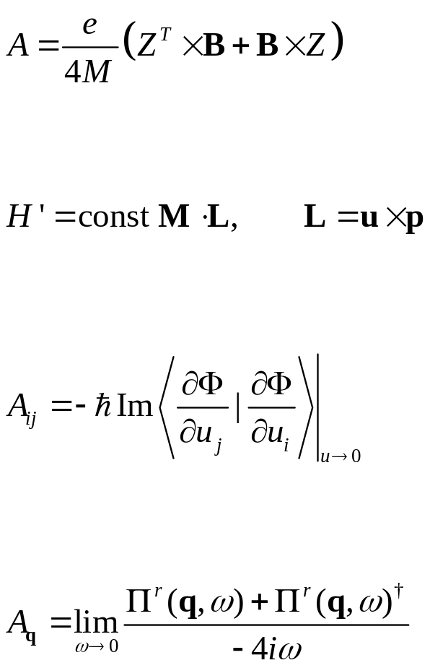
Form of A
Charged particles with Lorentz force
Spin-orbital Rahman type
Electron Berry phase (Mead & Truhlar 1979)
Effective force due to electron-phonon interaction in nonequilibrium
Notes:
Z is Born effective charge 3x3 matrix.

Slide 8
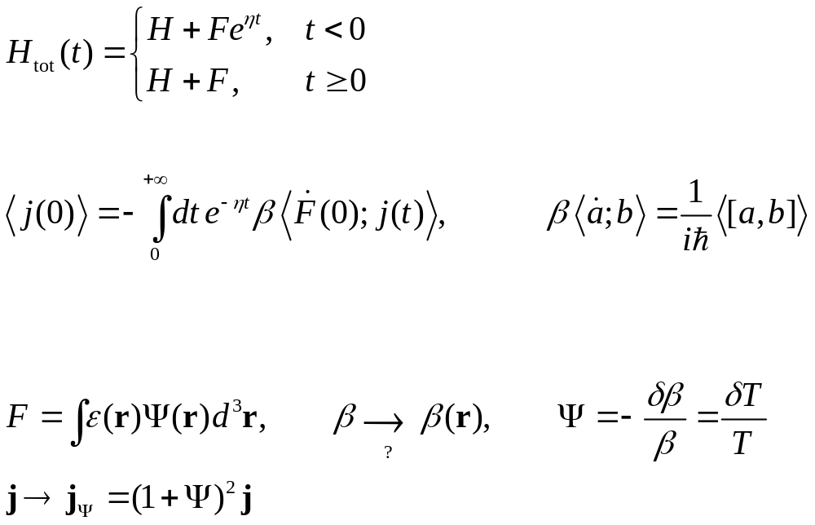
Kubo linear response theory
Notes:
We solve the von Neumann equation for the density matrix perturbatively to 1st order in F. <A; B> =<B; A> means Kubo correlation.

Slide 9
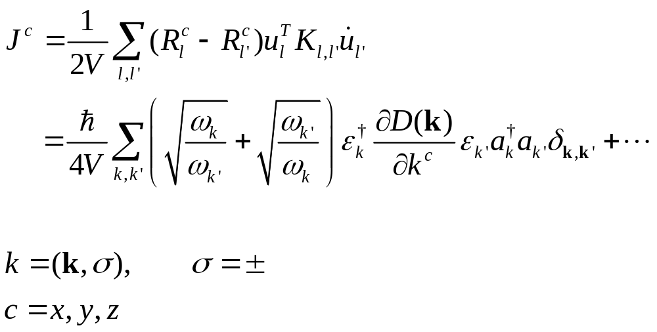
Current density vector (Hardy 1963)
It turns out that aa and a⁺a⁺ terms also contribute

Slide 10
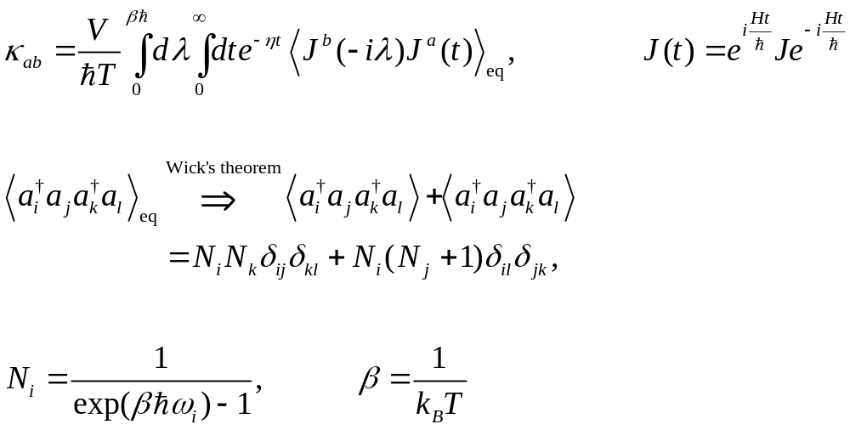
Green-Kubo formula

Slide 11
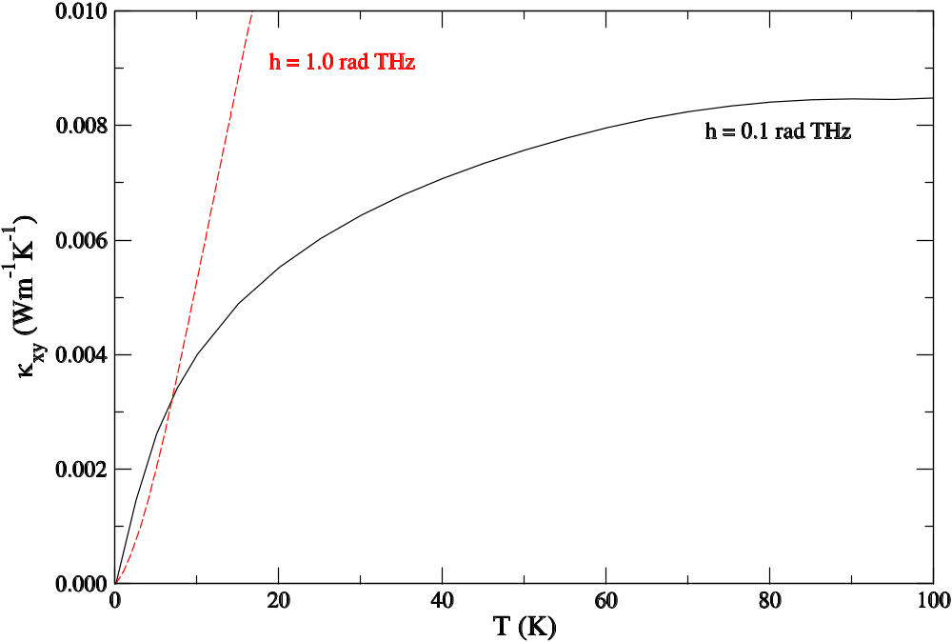
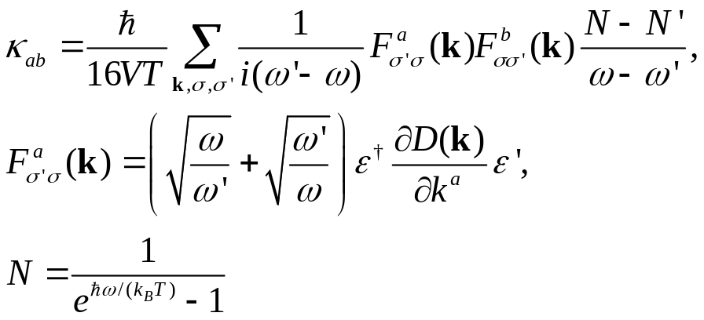
Thermal Hall conductivity, Green-Kubo formula
J S Wang and L Zhang, PRB 80, 012301 (2009).

Slide 12
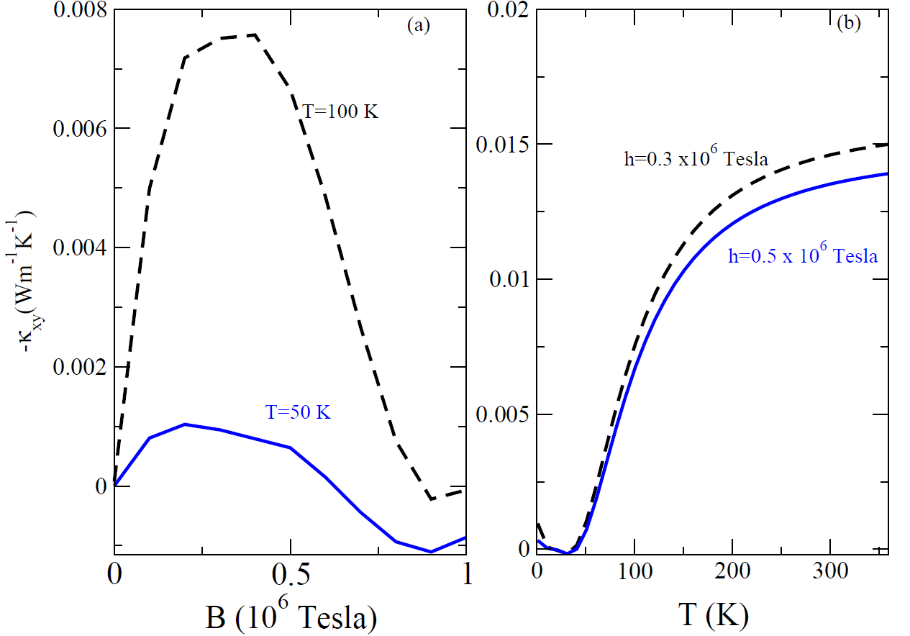
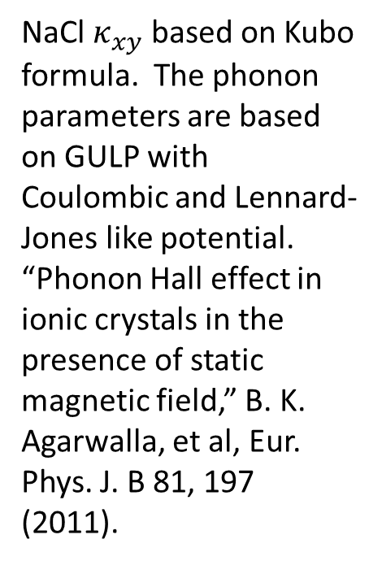
NaCl result
NaCl $κ_{xy}$ based on Kubo formula. The phonon parameters are based on GULP with Coulombic and Lennard-Jones like potential. “Phonon Hall effect in ionic crystals in the presence of static magnetic field,” B. K. Agarwalla, et al, Eur. Phys. J. B 81, 197 (2011).

Slide 13
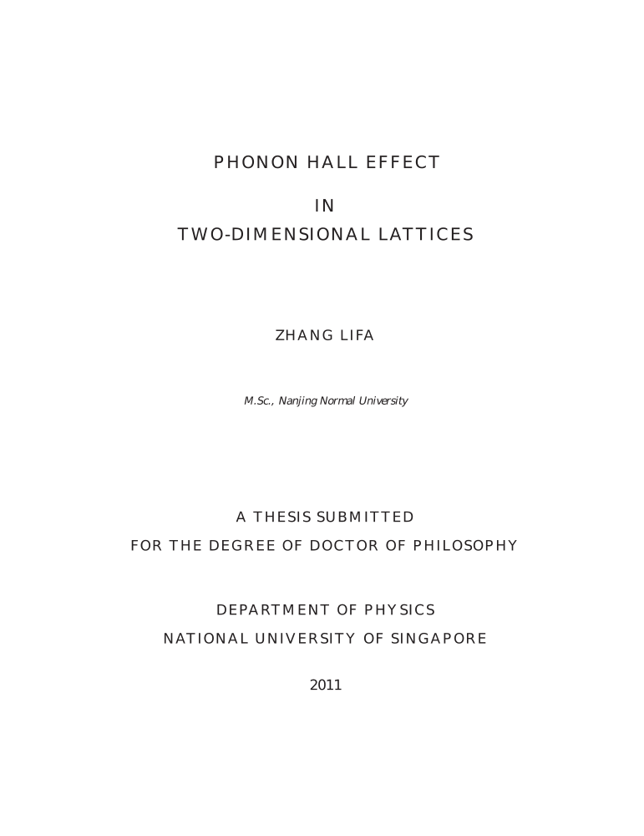
Berry Phase/Berry Curvature
Important observation: We cannot use only positive frequency ω and polarization e to define Berry phase/curvature.
We need positive and negative frequencies, and u and p (or du/dt) to define Berry curvature Ω.

Slide 14
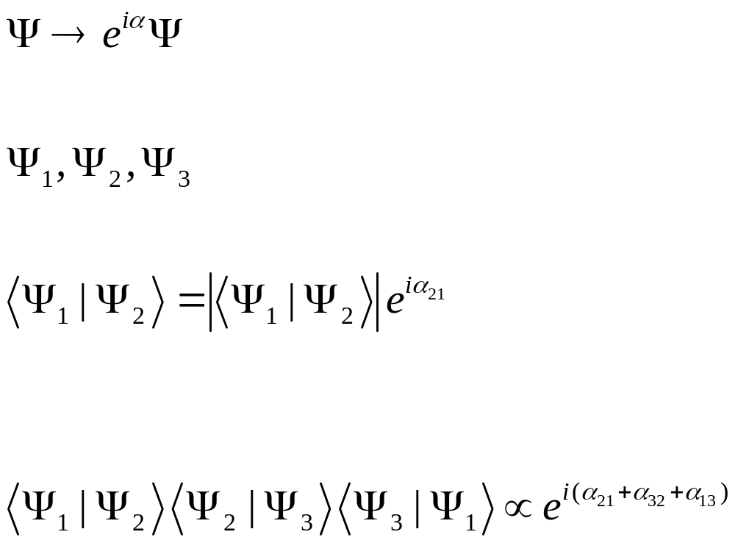



Berry phases
$${|Ψ}_{2}>$$
$${|Ψ}_{1}>$$
$${|Ψ}_{3}>$$
The relative phase in a loop is invariant and has physical consequences.
Notes:
See “Berry phases in electronic structure theory”, David Vanderbilt, Cambridge (2018).

Slide 15
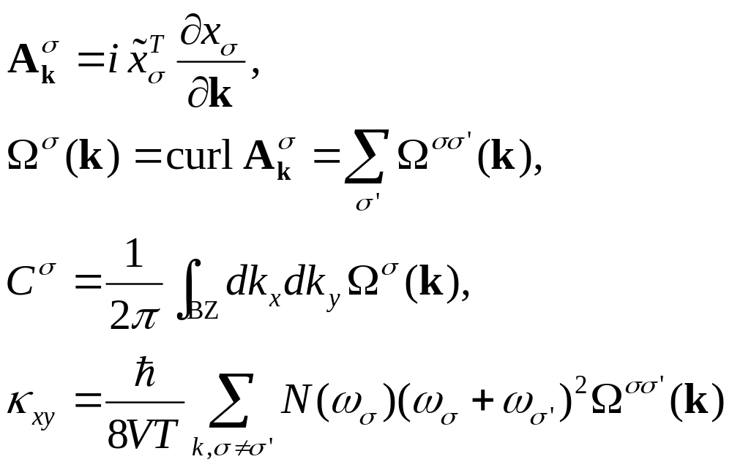
Berry curvature
WRONG
Notes:
x is the right eigenvector (column), tilde{x}^T is the left eigenvector (row).

Slide 16
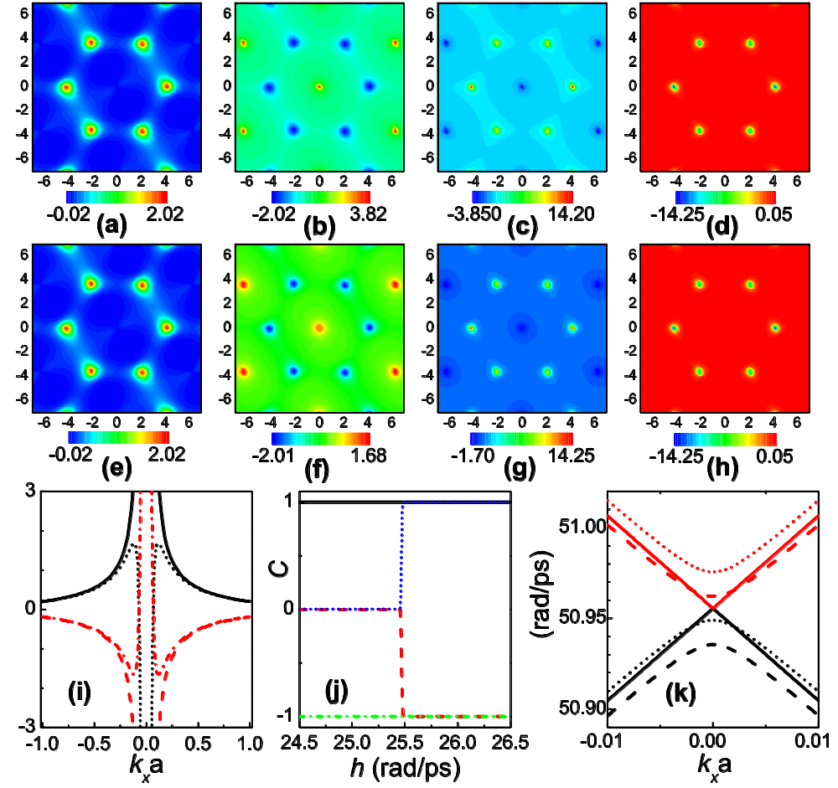
Berry phase effect
Nearest neighbor phonon honeycomb lattice. (a)-(d) density plots of Berry curvature just before Chern number change, see (j), (e)-(h) after the jump at critical magnetic field h_{c}. (i) Berry curvature near Gamma point, (k) and associated phonon dispersion.
From “Topological nature of the phonon Hall effect,” L. Zhang, et al, PRL 105, 225901 (2010).

Slide 17
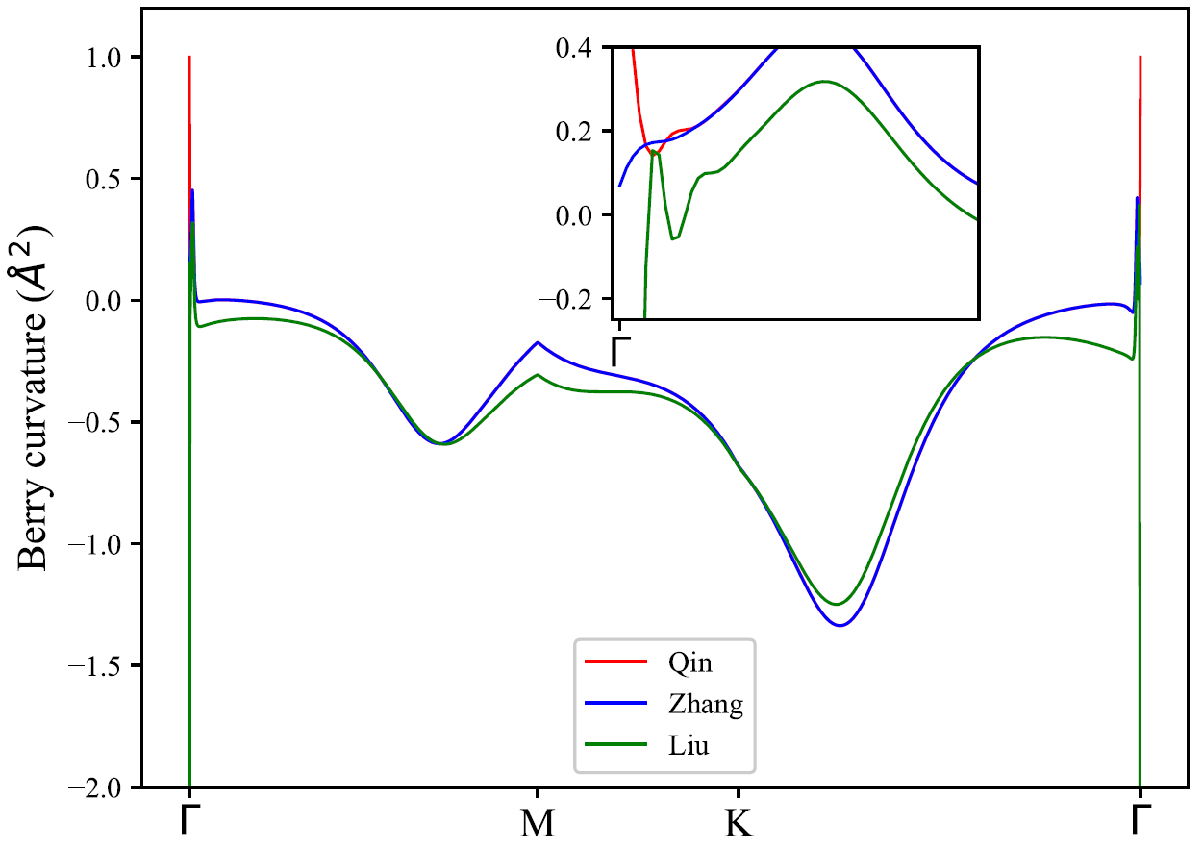
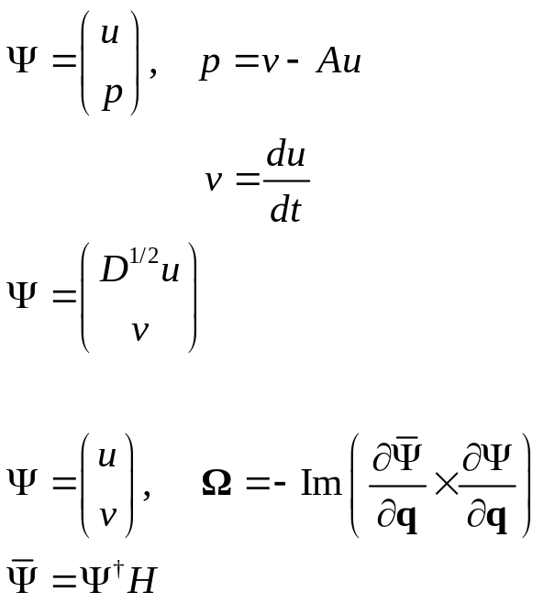
Berry curvature – three definitions
Lifa Zhang’s
Yong Xu’s
Tao Qin’s

Slide 18
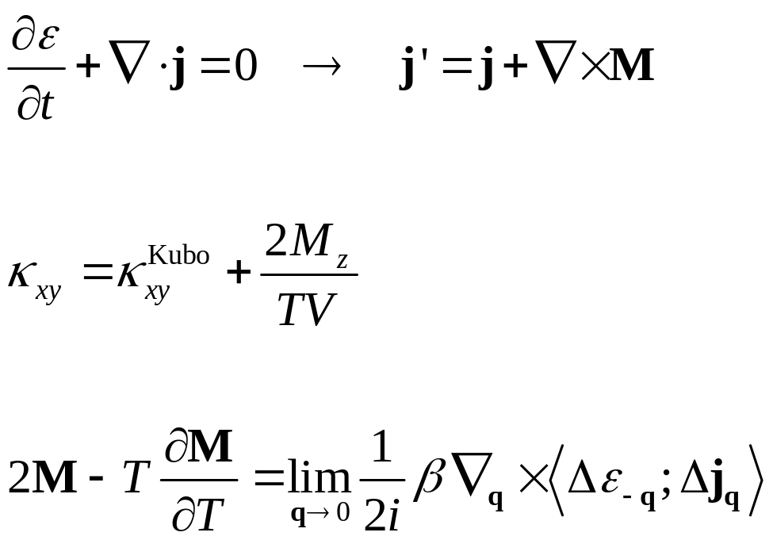
Correction to Kubo formula
Conservation of energy cannot determine the current uniquely, they can differ by a curl of a vector field.
The energy magnetization, M, if it is not zero causes a correction to Kubo formula.
[Luttinger 1964, Cooper et al 1997, Qin et al PRL, PRB 2011]

Slide 19
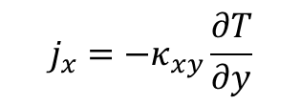

Microscopic circular energy current, edge current, Hall effect
$$j_{x}=−κ_{xy}\frac{∂T}{∂y}$$
$$∂_{y}T$$
y
x

Slide 20
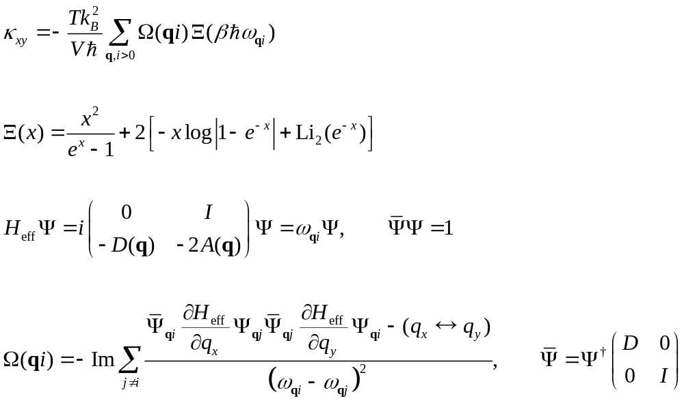

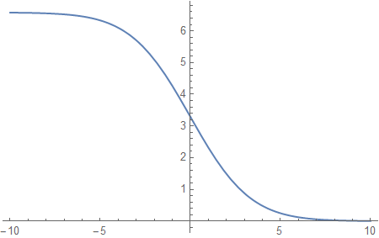

T. Qin et al formula

Slide 21
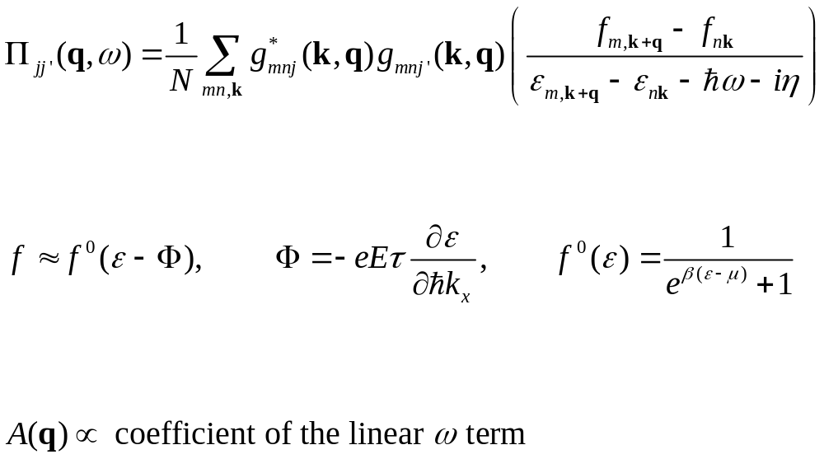
Compute Π and thus A

Slide 22
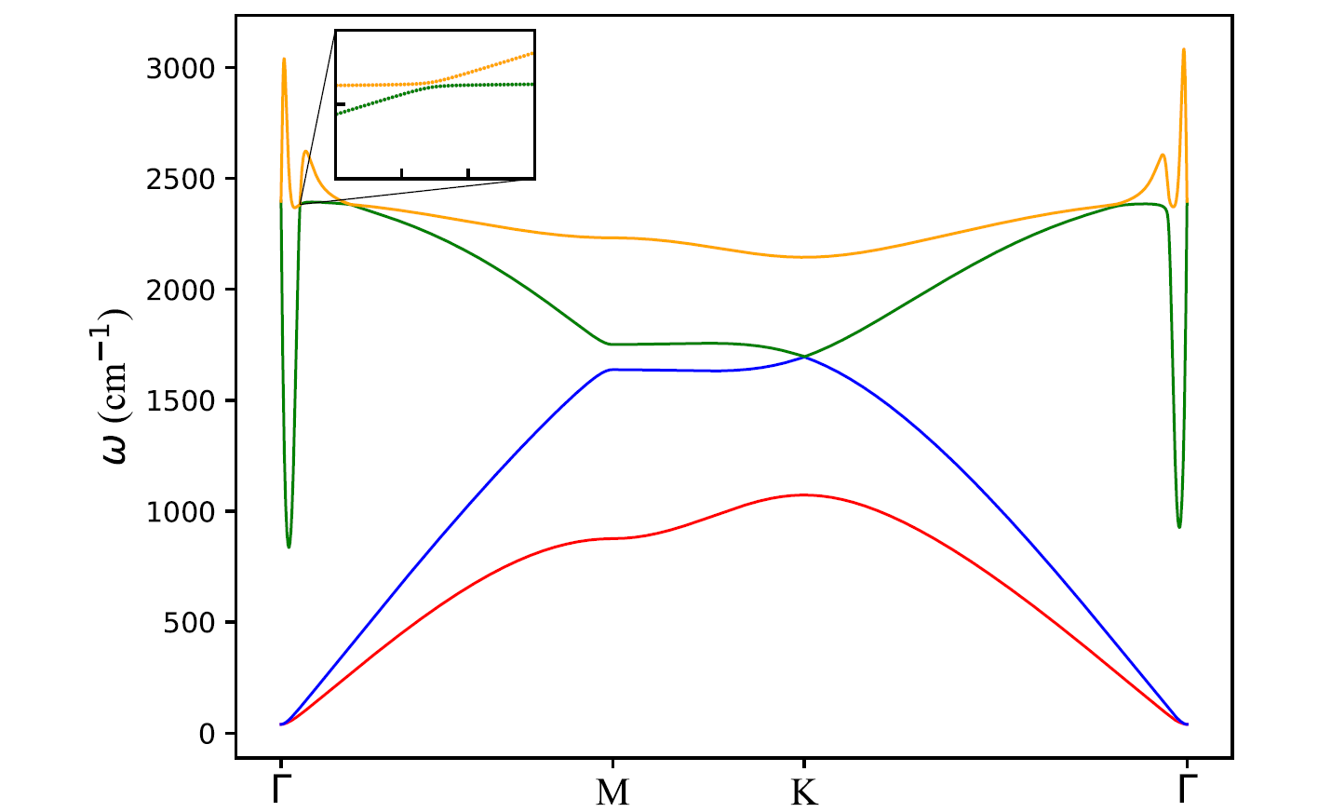
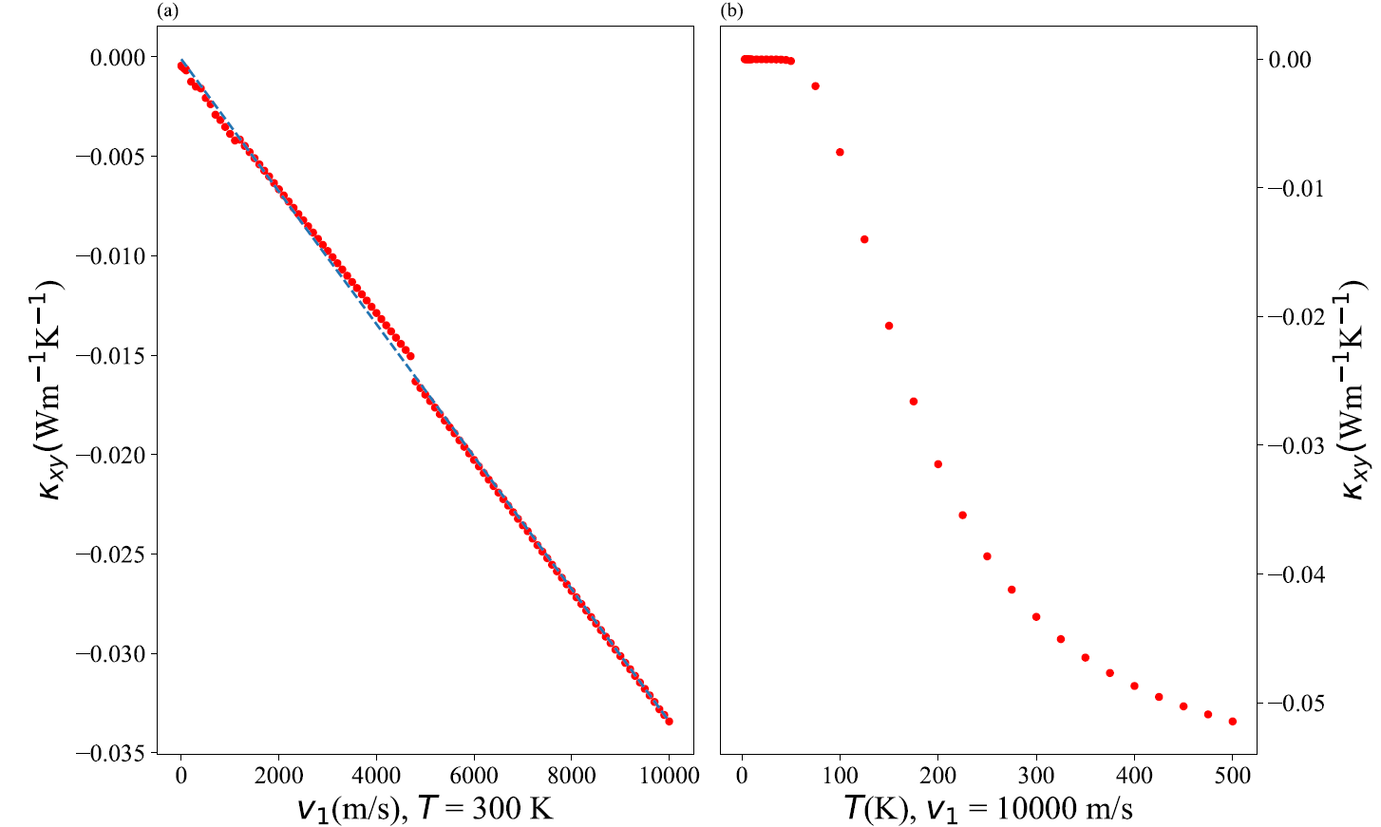
Honeycomb lattice under current drive
Honeycomb lattice with phonon nearest neighbor coupling K_{L}=0.144 eV(u Å²), K_{T}=K_{L}/4, electron hopping t = 2.8 eV, SSH-like electron-phonon interaction of J₁=-6 eV/ Å. Sun et al PRB 102, 134311 (2020).

Slide 23
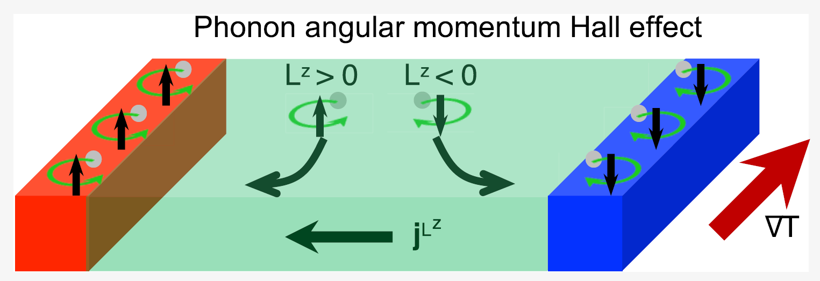
How does phonon know which way to go?
S. Park and B.-J. Yang, Nano Lett, 20, 7694 (2020). Angular momentum current is generated perpendicular to the temperature gradient, square or cubic lattice, no gauge field A.

Slide 24
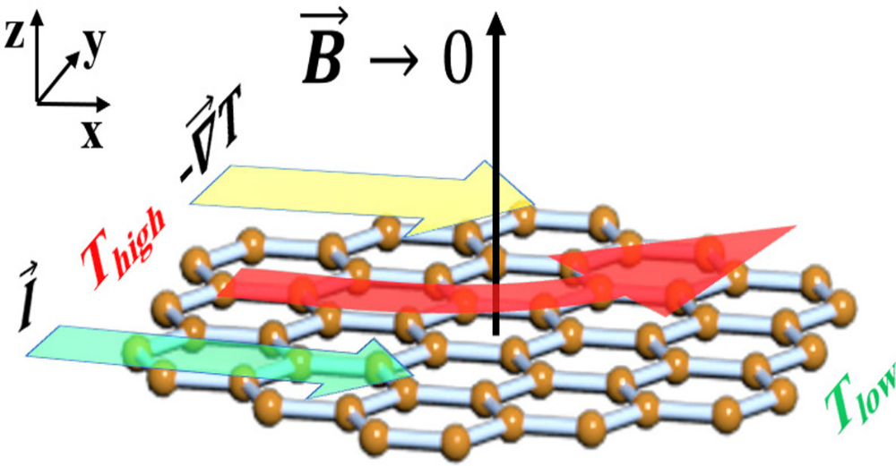
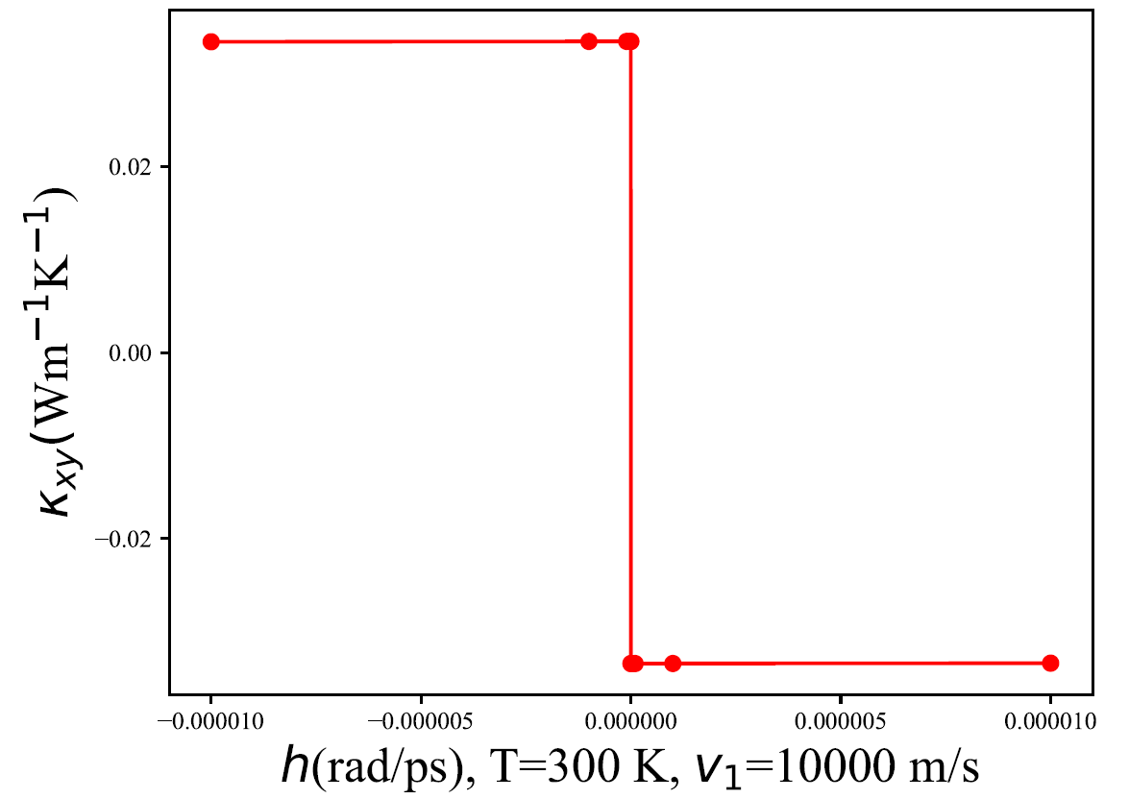
How does phonon know which way to go?

Slide 25
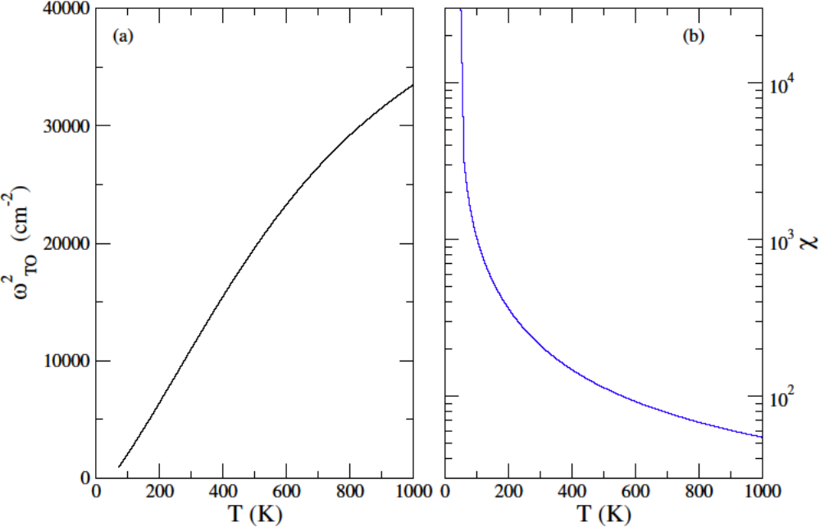
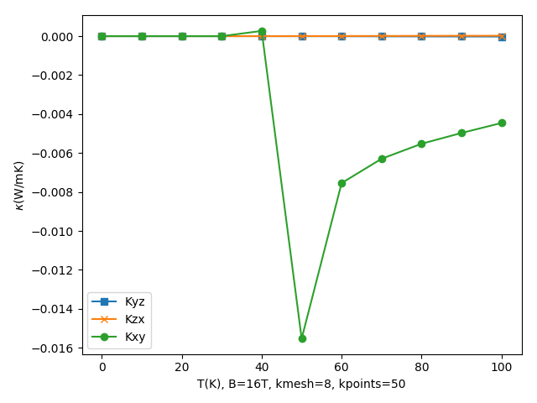

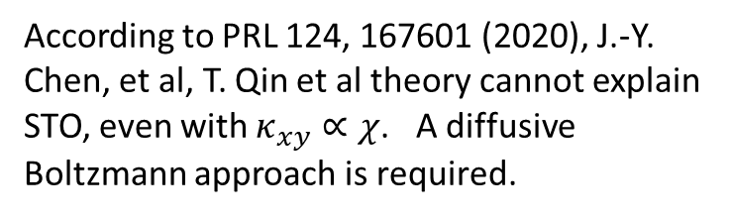
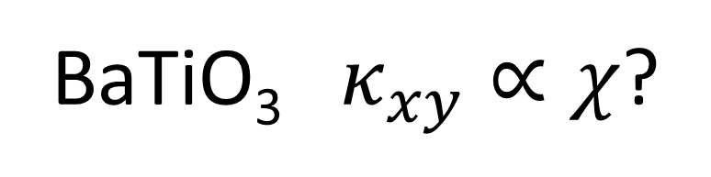
BaTiO₃ $κ_{xy}∝χ$?
$$ε=ε_{∞}+χ$$
According to PRL 124, 167601 (2020), J.-Y. Chen, et al, T. Qin et al theory cannot explain STO, even with $κ_{xy}∝χ$. A diffusive Boltzmann approach is required.
Notes:
By the way, recently I tried several numerical tests on your BTO system. What I did is to find a suitable way to ‘fake’ a split in between lowest two optical modes. Currently I choose to lift up one of them by hand to open a small gap (0.01 times its original value) near the Gamma point only (I choose the range when w < 100 cm^-1), then I found that the kappa can increase to ~0.01 W/mK, and the trend is consistent with STO experiment. Moreover, there are two kinds lifting, one is to lift the mode with higher index, the other one is to lift the lower branch which may cause band-crossing; they result in opposite sign of kappa, and the latter one is negative. Therefore I think splitting the degeneracy may be important in this system, and try to find some other ingredients to introduce the split, but I did not find a way to do it yet. Furthermore, since the temperature is not so high, I did not apply temperature-dependence of the phonon lifetime into this calculation, but still let eta = 0.1 cm^-1.

Slide 26
Conclusion
After more than 10 years of research on phonon Hall effect, issues still exist
Surprising transverse current (under temperature gradient or electric current driven), still no complete understanding?
NEGF on finite samples?

Slide 27



Acknowledgements
Mr. Kangtai Sun
Prof. Bijay Kumar Agarwalla
Supported by MOE tier 2 grant and FRC tier 1 grant.
Prof. Lifa Zhang

