Slide 1
Nonequilibrium Green’s function method for energy, momentum, and angular momentum transfers mediated by photons
Jian-Sheng Wang
Department of Physics,
National University of Singapore

Slide 2
Outline
Near-field heat transfer by Coulomb force of electrons, Meir-Wingreen formulas
NEGF theory of energy, momentum, and angular momentum transfer
  N + 1 objects, bath at infinity
  Meir-Wingreen/Landauer formula
Applications
  Angular momentum emission from current-driven benzene molecule
  Nonreciprocity, graphene edge effect

Slide 3
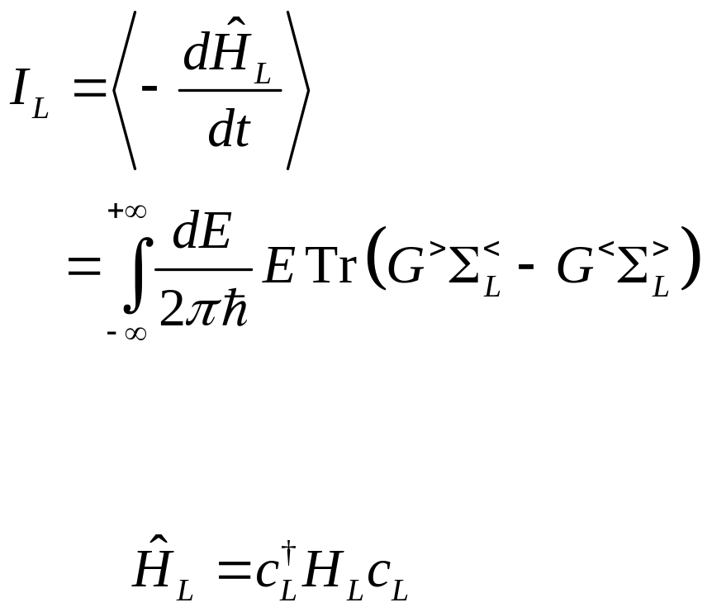
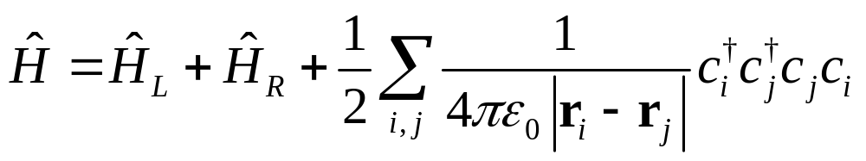
Coulomb problem, Meir-Wingreen formula

Slide 4
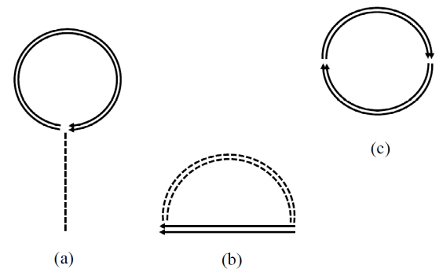
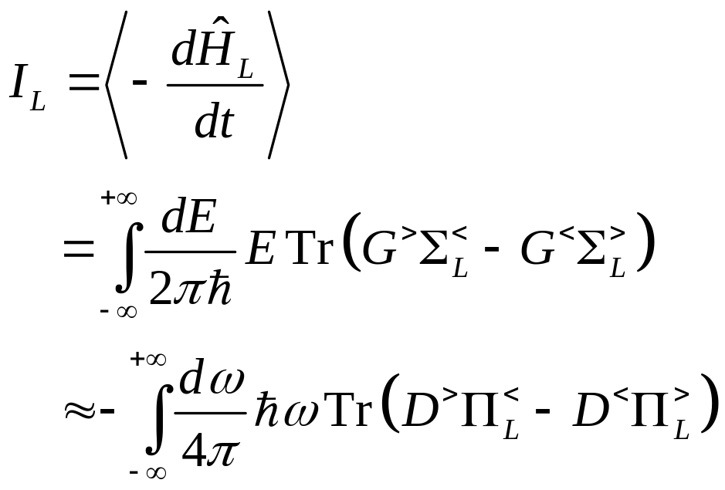
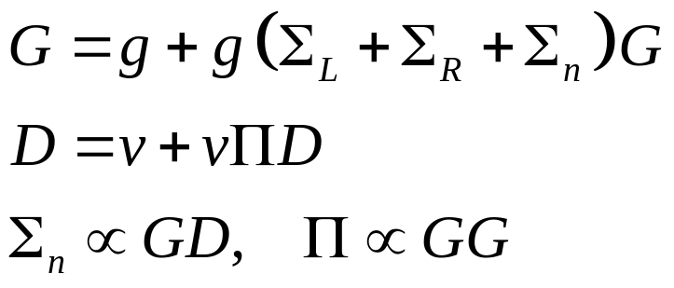
From electrons to photons

Slide 5
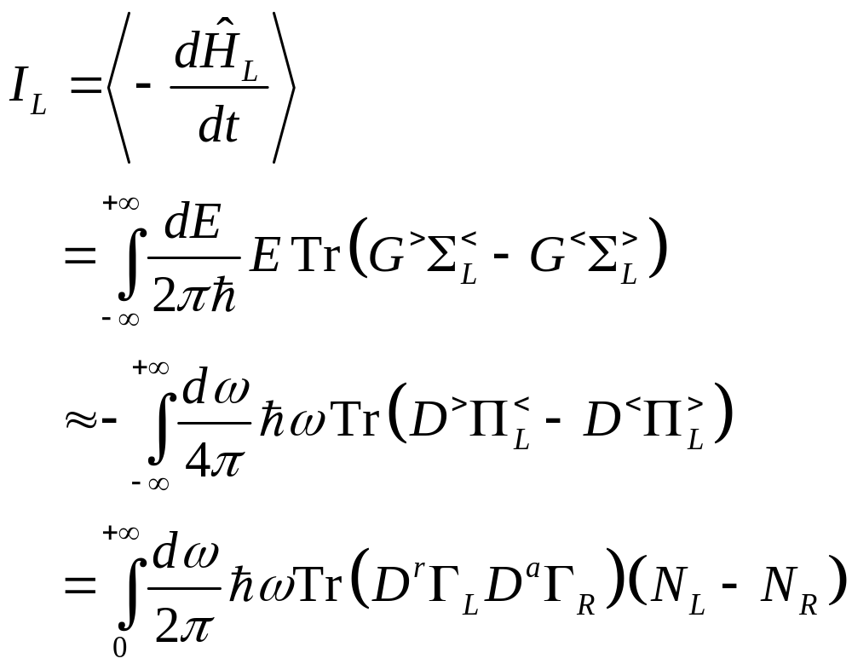
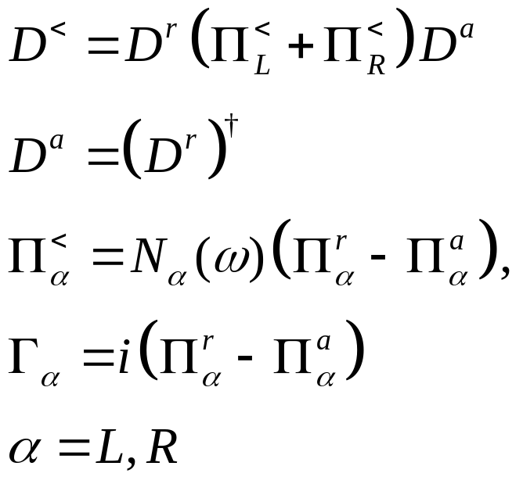
Assuming local equilibrium

Slide 6
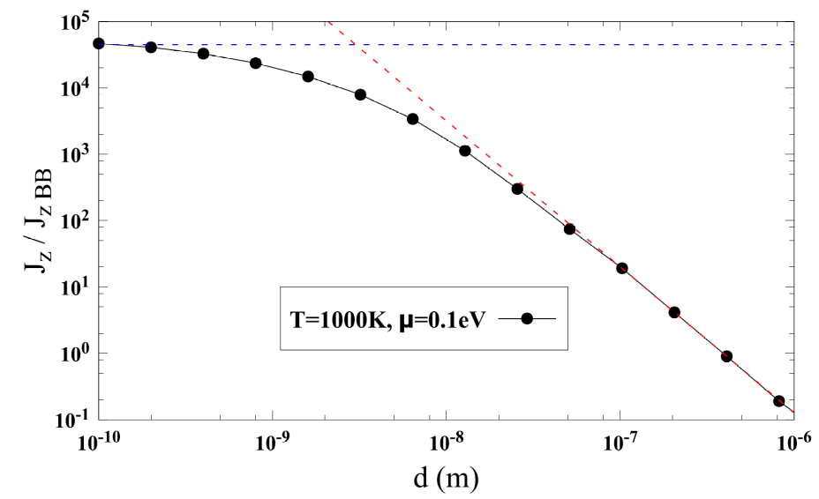
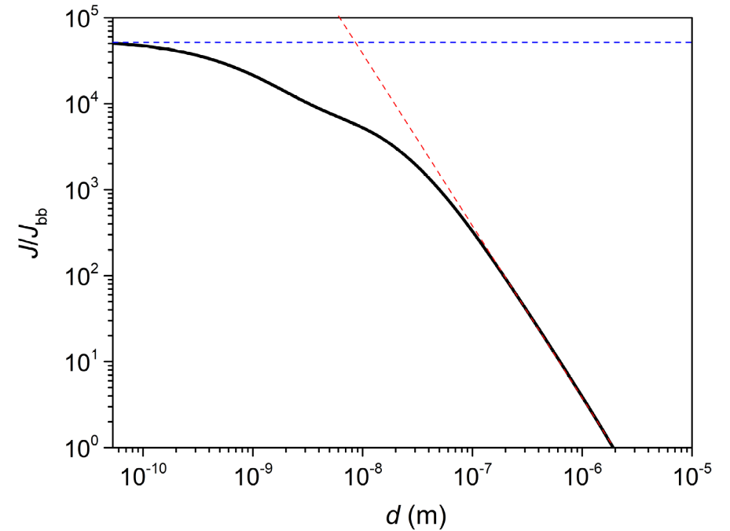
Heat transfer between two graphene sheets
↓ First principles QE/BerkeleyGW calculation for the ratio of energy transfer to blackbody value between two graphene sheets at temperatures 300 K and 1000 K, η = 0.05 eV, electron chemical potential at Dirac point. Zhu & Wang, PRB 104, L121409 (2021).
↑ Heat transfer ratio based on electron tight-binding model with nearest neighbor hopping t = 2.8 eV, between 300 K and 1000 K sheets at chemical potential μ = 0.1 eV. Slope ≈ 2.2. Jiang & Wang, PRB 96, 155437 (2017).

Slide 7
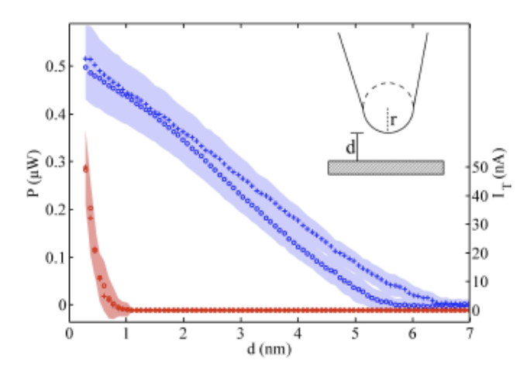
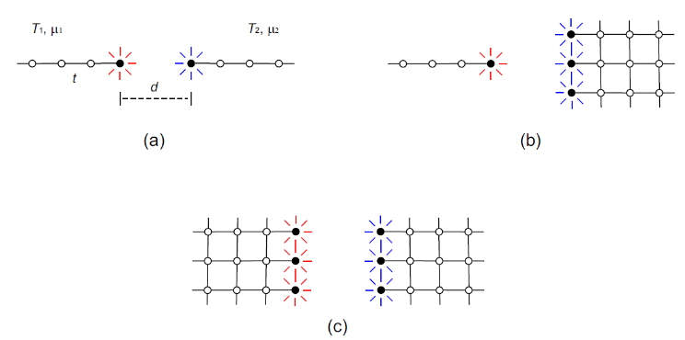
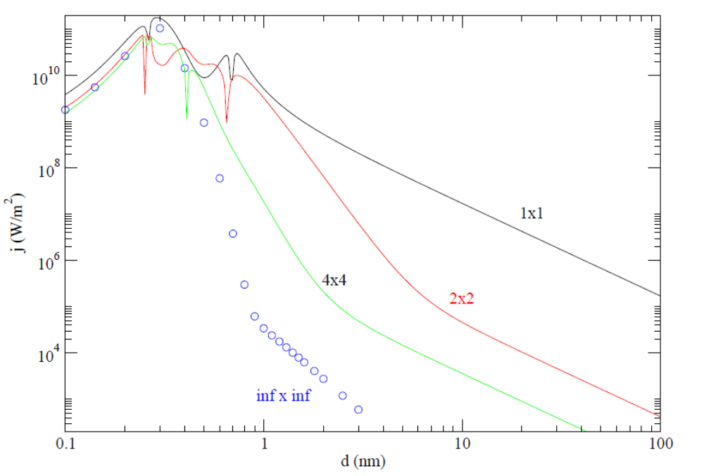
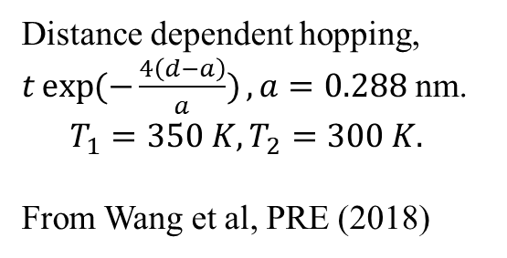
Geometry effects
Kloppstech, et al, Nature Comm (2017)
Distance dependent hopping,
$t\exp{(−\frac{4\left(d−a\right)}{a})}, a=0.288$ nm.
$$T_{1}=350 K, T_{2}=300 K.$$
From Wang et al, PRE (2018)

Slide 8
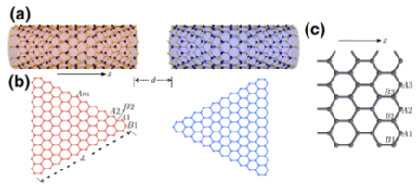
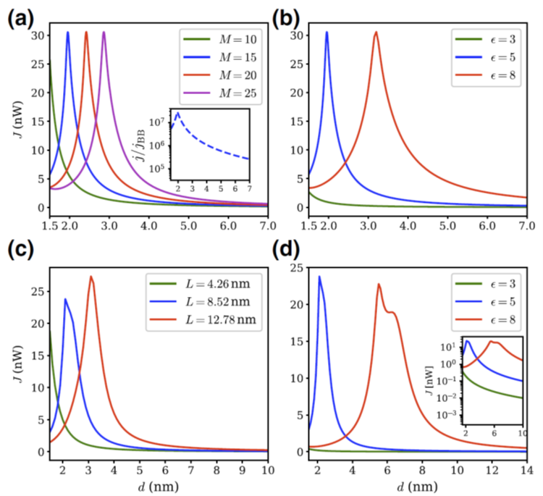
Heat transfer between zigzag nanotubes or triangles
Heat transfer from 400K to 300K objects. (a), (b) zigzag carbon nanotubes. (c), (d) nano-triangles. d: gap distance, M: nanotube circumference, L: triangle length. ε: dielectric constant. From Tang, Yap, Ren, and Wang, Phys. Rev. Appl. 11, 031004 (2019).

Slide 9
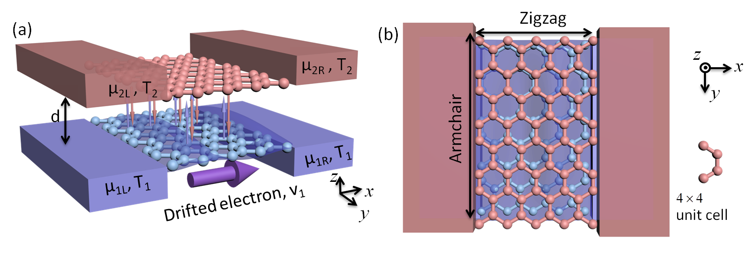
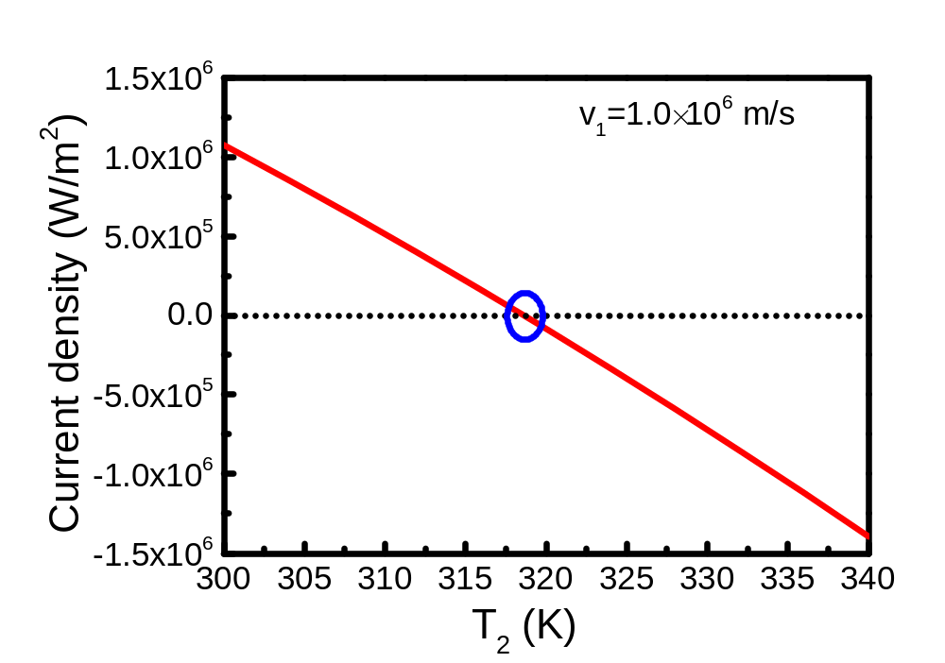
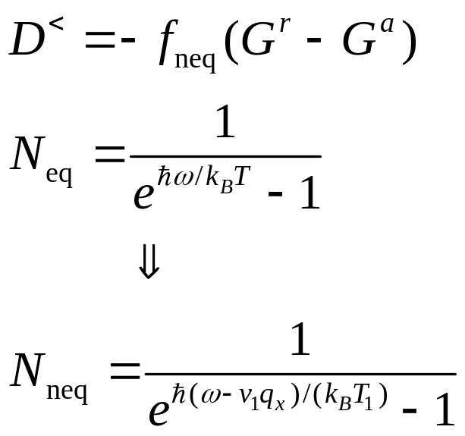
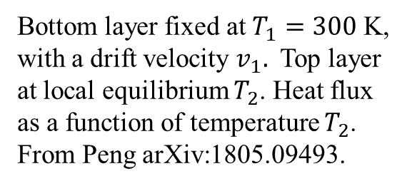
Heat transfer driven by current
Bottom layer fixed at $T_{1}=300$ K, with a drift velocity $v_{1}.$ Top layer at local equilibrium $T_{2}$. Heat flux as a function of temperature $T_{2}$. From Peng arXiv:1805.09493.

Slide 10
Nonequilibrium Green’s function, general theory
https://phyweb.physics.nus.edu.sg/~phywjs/NEGF/review-2022.pdf

Slide 11

System setup
N+1 or infinity
$$R→∞$$
…
1
Question: what are the energy emitted, force and torque applied to, for each of the object 1 to N+1.
N
2

Slide 12
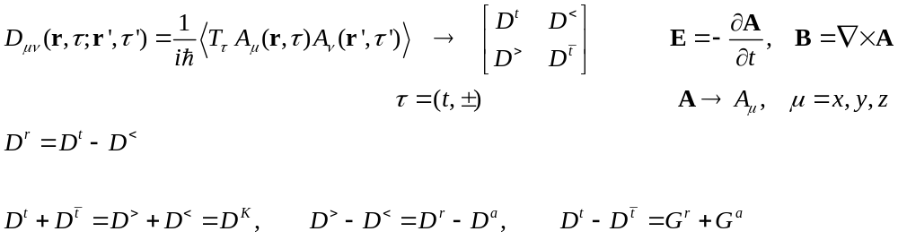
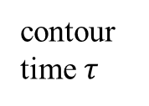


NEGF preliminaries
contour time $τ$
+
−
$$−∞$$
$$t$$
Keldysh 1965, Haug & Jauho 2008

Slide 13
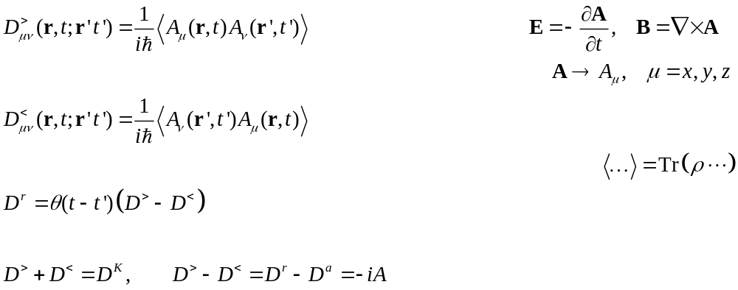
NEGF definitions

Slide 14
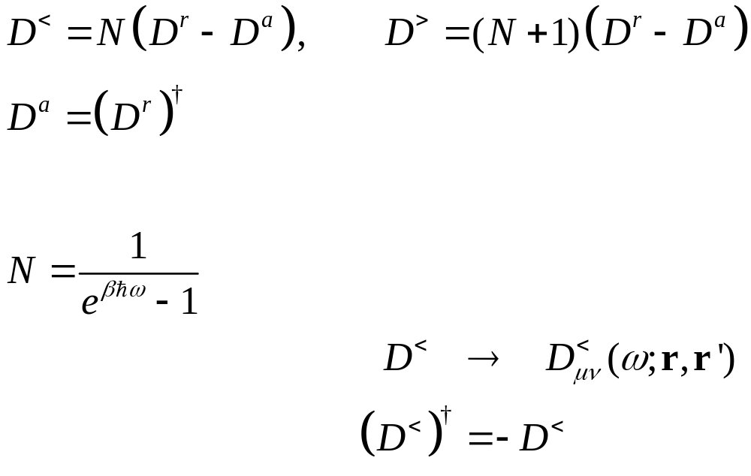
Fluctuation-dissipation theorem in thermal equilibrium
Callen and Welton 1951,
Eckhardt 1984

Slide 15
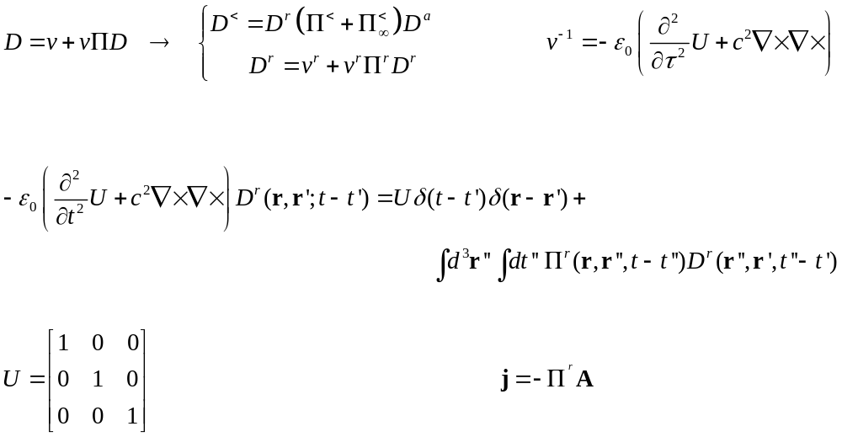
Dyson equations

Slide 16
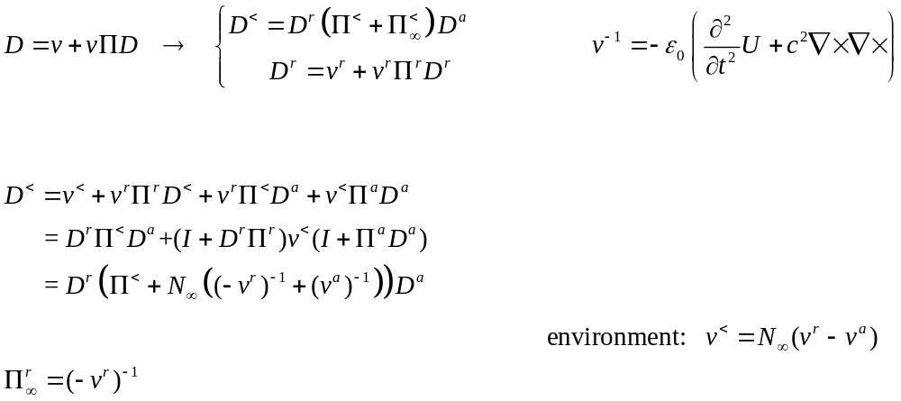
Keldysh equation

Slide 17
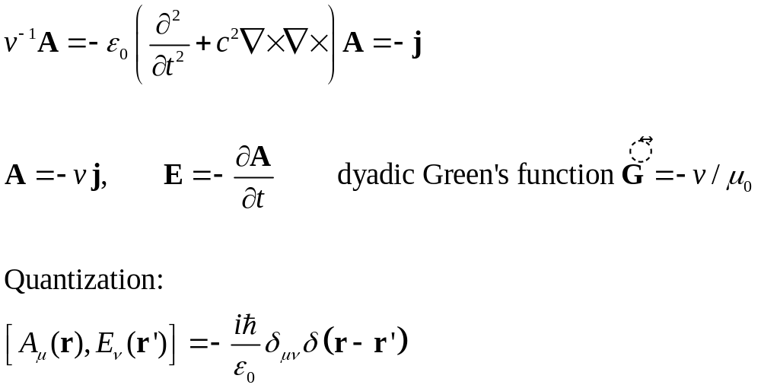
ϕ = 0 gauge, fundamental equation for vector potential A

Slide 18
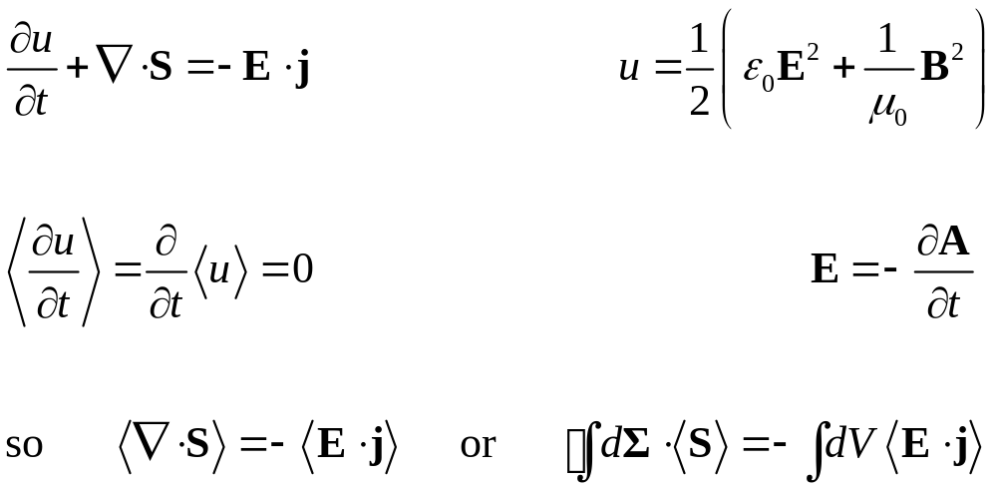
Poynting theorem, steady state average

Slide 19
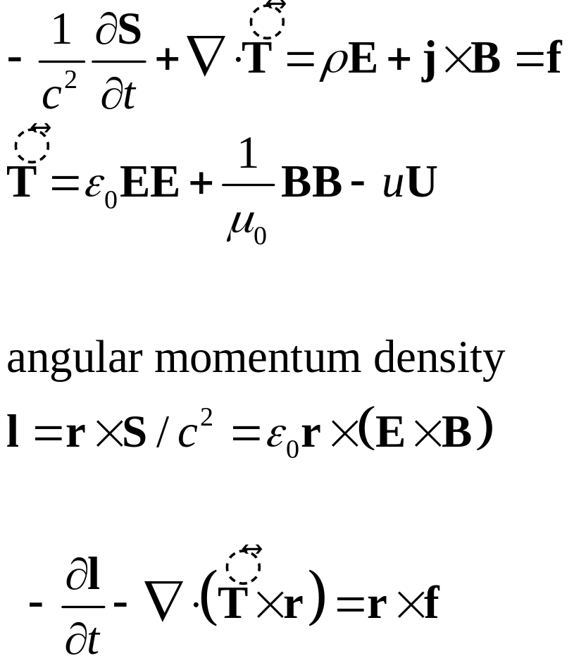
Momentum and angular momentum conservation

Slide 20
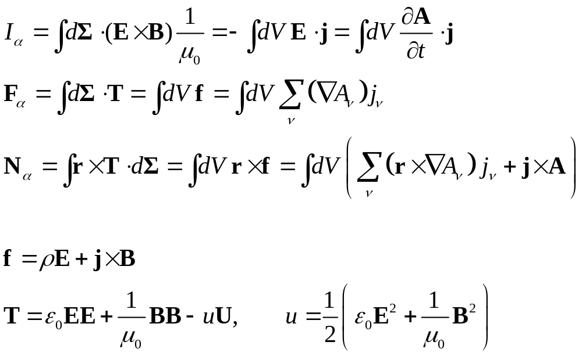
From surface integral to volume integral
α

Slide 21
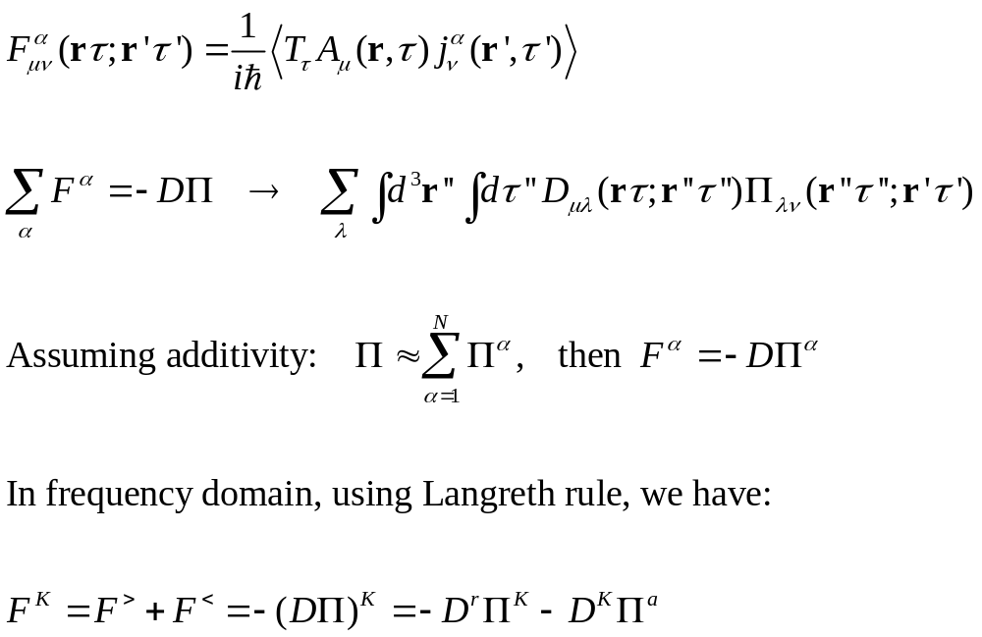
A-j correlation function

Slide 22
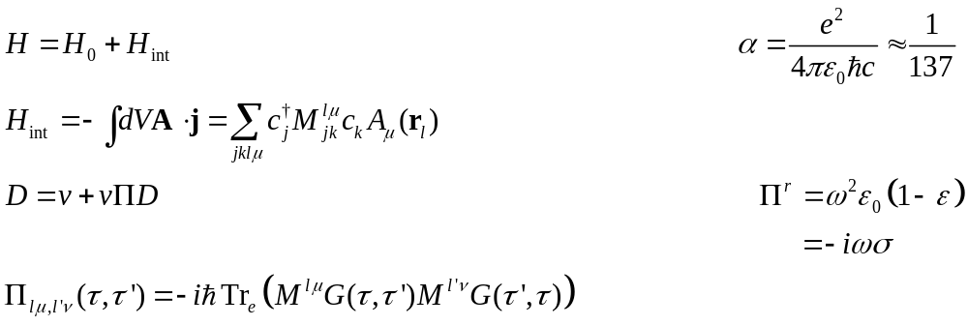
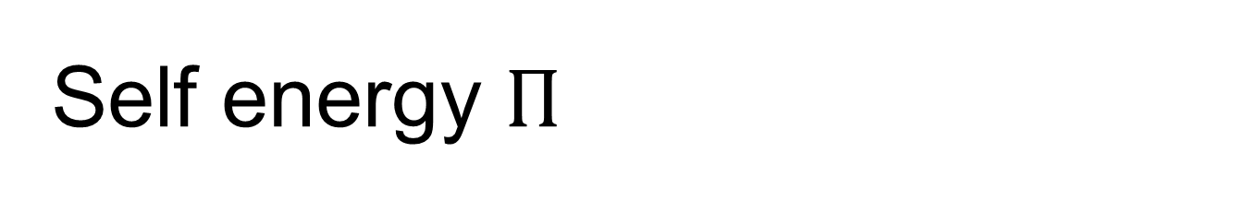
Self energy $Π$
RPA
Aslamazov-Larkin diagram (superconductivity, Coulomb drag)

Slide 23
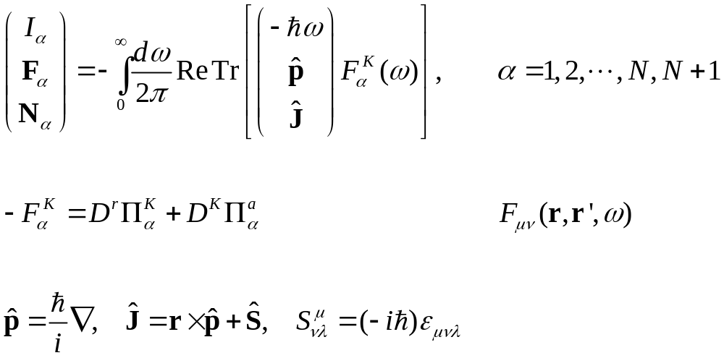
Meir-Wingreen formula
Krüger, et al (2012); Strekha, et al, poster
Notes:
Levi Civita symbol

Slide 24
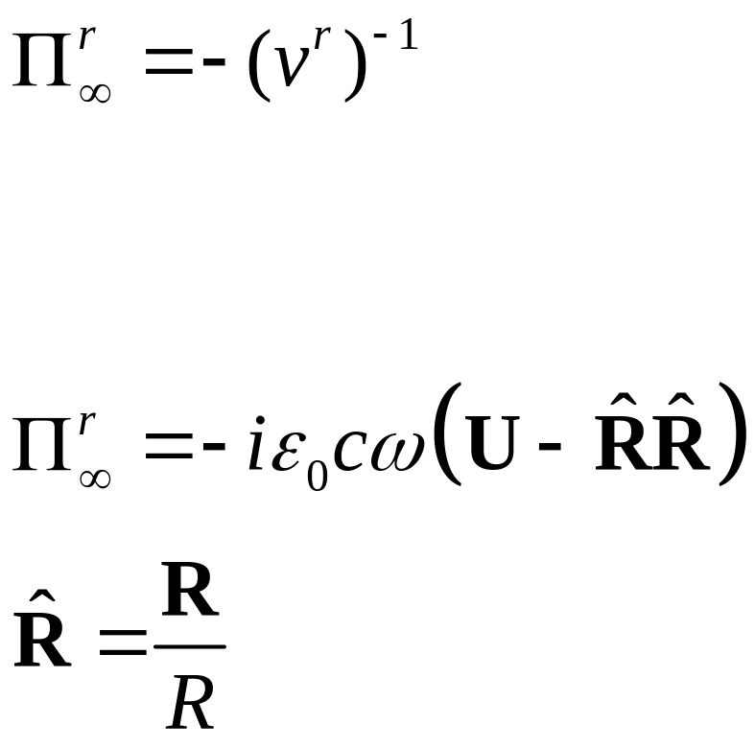
Bath at infinity
Eckhardt, PRA 29, 1991 (1984)
Krüger, et al, PRB 86, 115423 (2012)

Slide 25
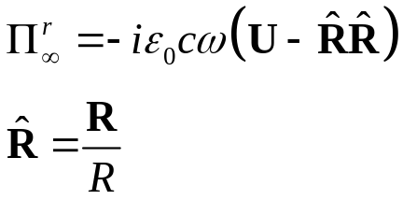
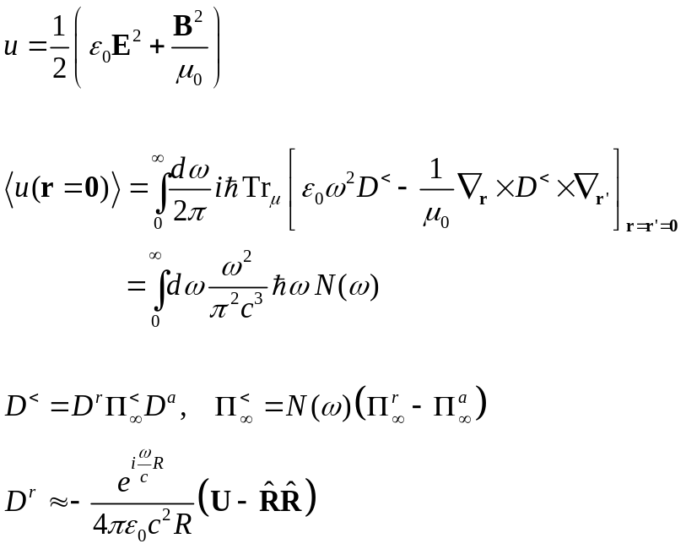
Recover blackbody Planck result
R
0

Slide 26
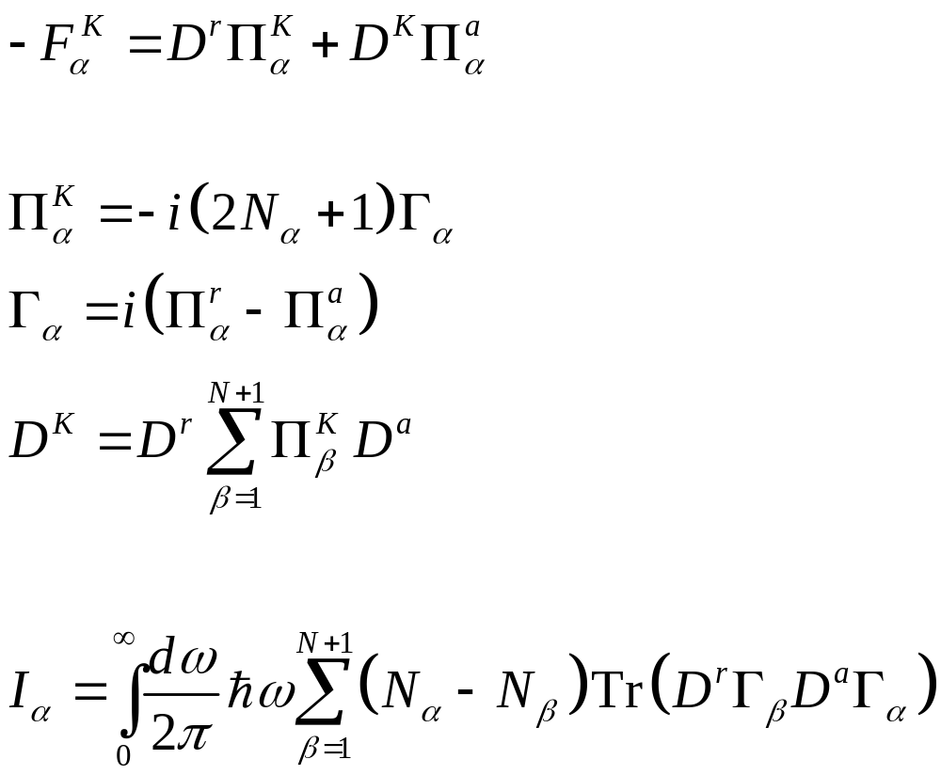
From Meir-Wingreen to Landauer: local equilibrium approximation
No Landauer form for force and torque!

Slide 27
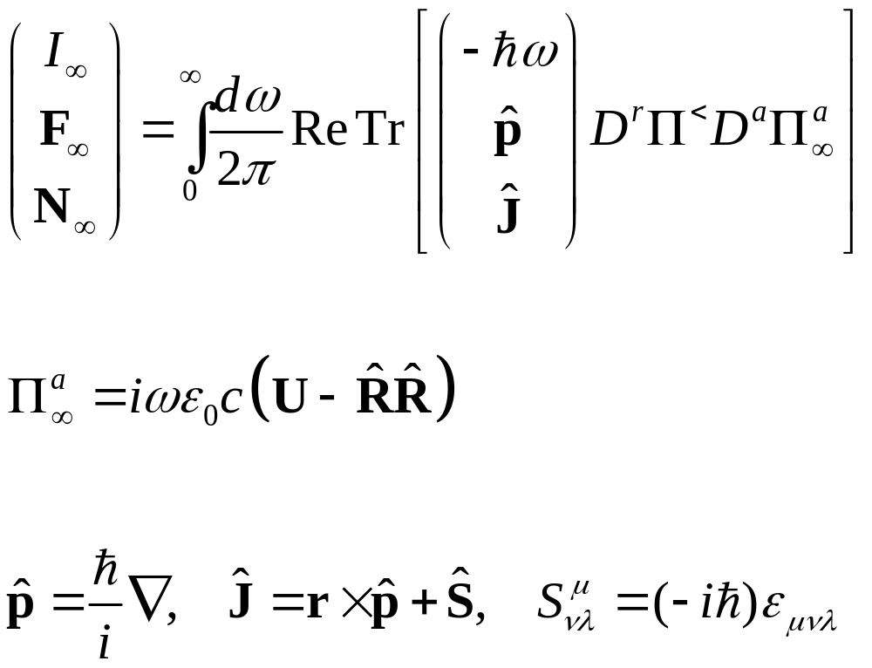
Emission to infinity

Slide 28
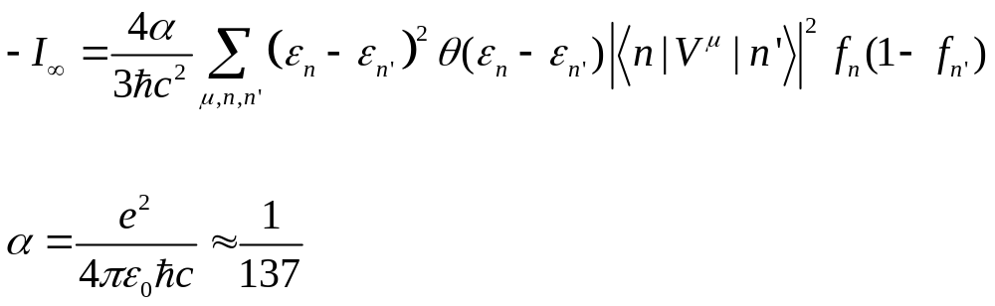
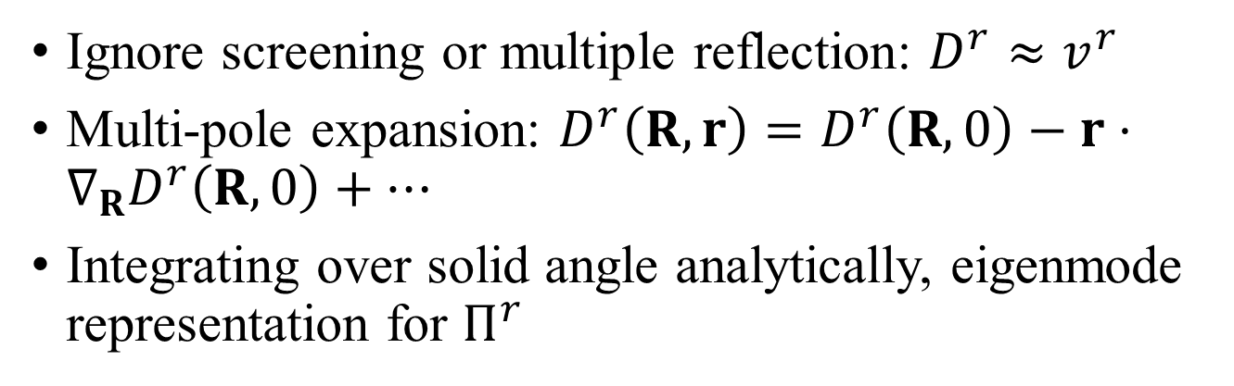
Far field approximations
Ignore screening or multiple reflection: $D^{r}≈v^{r}$
Multi-pole expansion: $D^{r}\left(R,r\right)=D^{r}\left(R,0\right)−r⋅∇_{R}D^{r}\left(R,0\right)+⋯$
Integrating over solid angle analytically, eigenmode representation for $Π^{r}$
Fermi golden rule

Slide 29
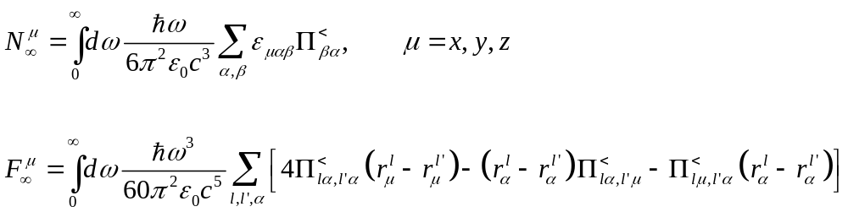
Torque and force on object
Force is zero if system is reciprocal, i.e., if ${\left(Π^{<}\right)}^{T}=Π^{<}$

Slide 30
Applications

Slide 31
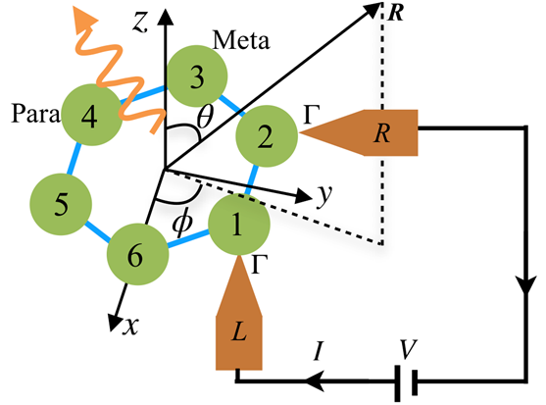
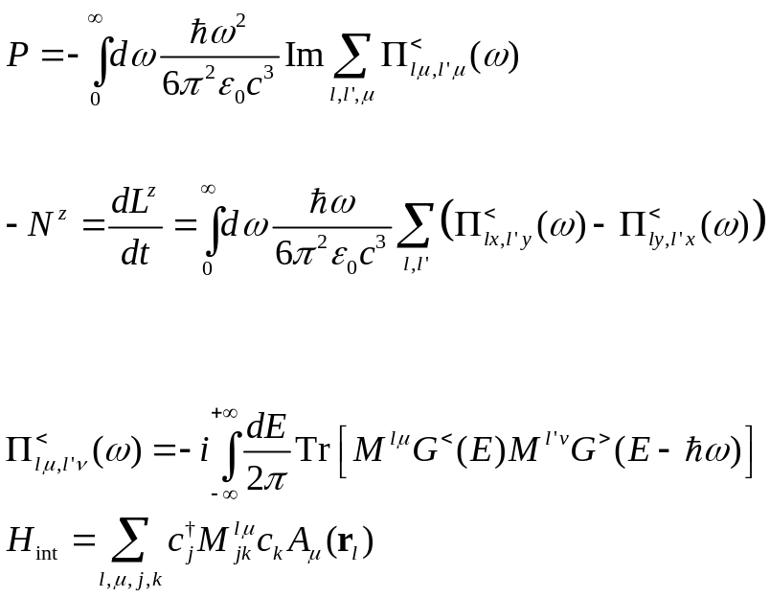
Angular momentum emission from a benzene molecule
Far field monopole approximation (all atoms are at the origin), ignore screening/multiple scatterings.

Slide 32
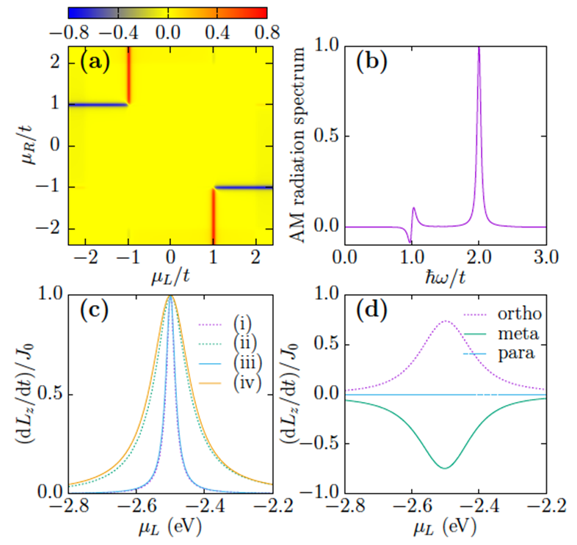


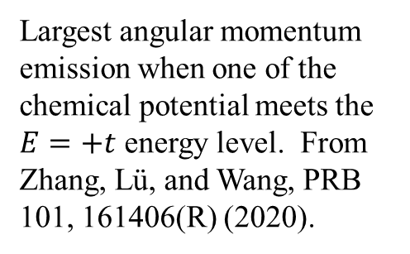
Angular momentum emission resonance effect
E
$E=t$, $\left|l\right|=2$
$$E=−2t, l=0$$
Largest angular momentum emission when one of the chemical potential meets the $E=+t$ energy level. From Zhang, Lü, and Wang, PRB 101, 161406(R) (2020).

Slide 33
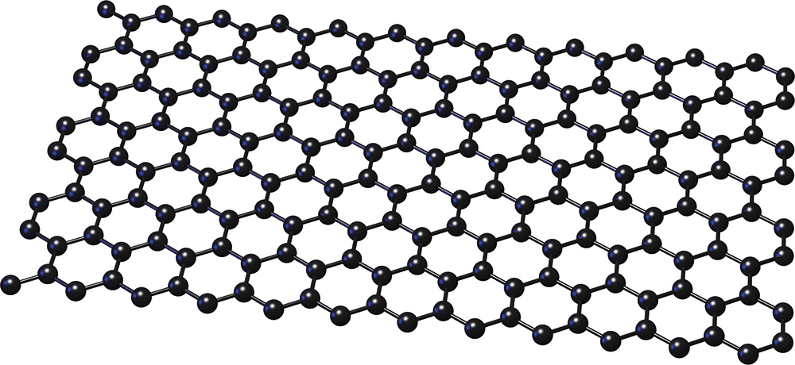





Force and torque from the nonequilibrium edge
$$J$$
$$p$$
$$μ_{L}$$
$$μ_{R}$$

Slide 34
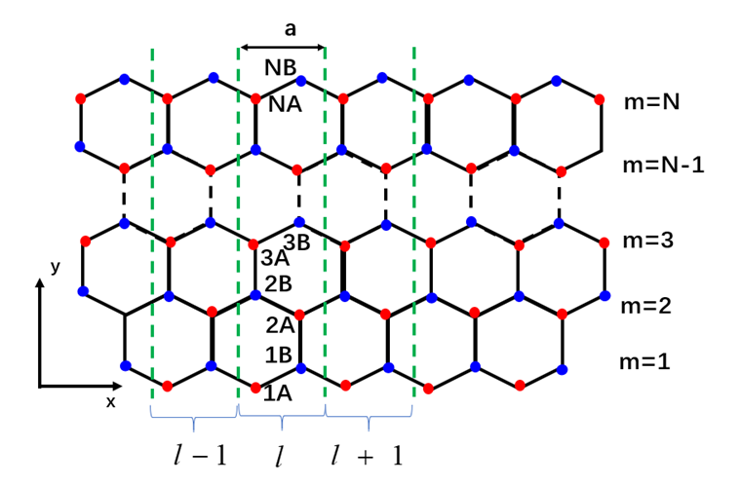
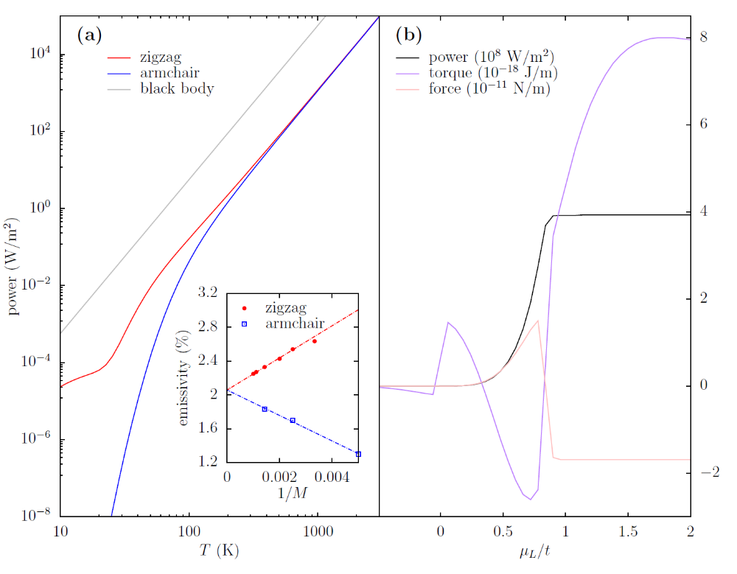
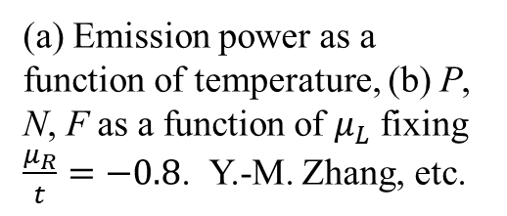
Emission from graphene edge
(a) Emission power as a function of temperature, (b) P, N, F as a function of $μ_{L}$ fixing $\frac{μ_{R}}{t}=−0.8$. Y.-M. Zhang, etc.

Slide 35
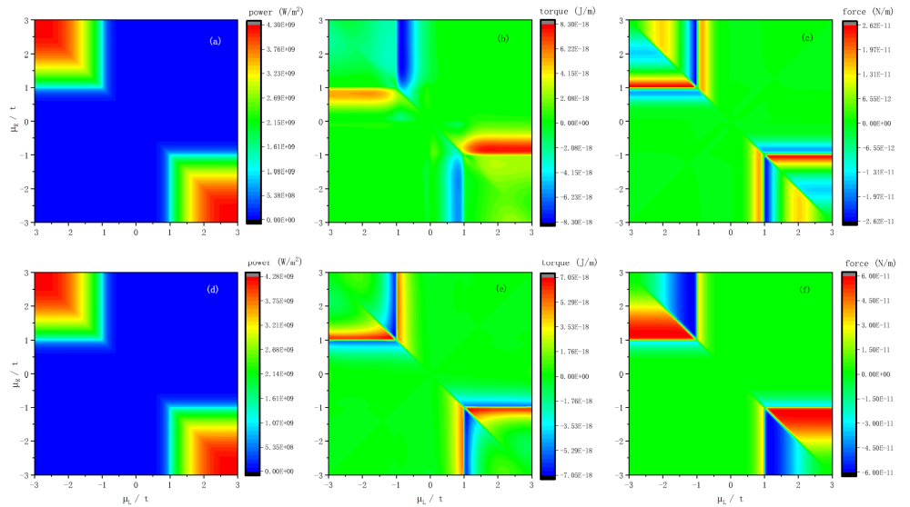
I, N, F scan $μ_{R}$vs $μ_{L}$. System size width 700 unit cells, k-point 401. From Zhang, et al, PRB 105, 205421 (2022).

Slide 36

NEGF advantage
Fully quantum-mechanical
Local equilibrium or not, reciprocal or not, the theory is the same
Strong coupling regime? E.g., cavity QED (different free Green’s function $v$), or need self-consistent $Π_{L}(G_{L}, G_{R})$?
First-principle based materials properties, i.e., $Π$.
Challenges: Large system sizes? Moving objects?

Slide 37

Acknowledgements
left to right: Dr. Zhang Yong-Mei, Dr. Zhu Tao, Dr. Gao Zhibin, Prof. Wang Jian-Sheng, Mr. Sun Kangtai, and Dr. Zhang Zuquan.

